Slide 1
Biophysics Working Group
The African Biophysics Landscape
Tjaart P. J. Krüger, S. G. Nana Engo, Lawrence Norris, B. Trevor Sewell

Slide 2
What is a Biophysicist?
Scientists in in Africa who study topics in Biophysics self identify in many different categories
Biophysicist
Structural Biologist
Chemical Biologist
Biological Physicist
Microscopist
Enzymologist
Biotechnologist
Immunologist
Biochemist
Physical/ Computational Chemist
This increases the difficulty in accurately defining the landscape: We have decided to be inclusive provided their study involves Biophysics or the application thereof

Slide 3
Even though physics is often central to the studies being undertaken – those undertaking the studies often have little physics background.
This issue is not unique to Africa and is being addressed by the international Biophysics community by encapsulating the Physics in software and through the increasing use of artificial intelligence. This enables “Physics näive” scientists to get started on complex problems and learn the Physics as they go along.
The international effort in biophysics is currently dominated by the desire to understand living systems at atomic or molecular detail – thus Structural Biology is more often than not, the starting point for Biophysical studies.

Slide 4
Why biophysics?
This unique interdisciplinary field brings our understanding of biological processes to an unprecedented level of detail.
Only when we understand nature’s processes at a sufficiently deep level can we make reliable predictions and obtain sustainable technological solutions.
An integral component of scientific discovery in biophysics involves technological development. Innovative experimental and computational methods pave the way for new scientific discoveries and provide practical solutions across the broad domain of biological sciences.

Slide 5
Biophysics and the UN SDGs
SDG 2: Zero Hunger
Understanding the complex process of photosynthesis to engineer crops with enhanced yield
Developing innovative biosensing technologies to detect and prevent plant diseases
Exploring alternative, less toxic treatments for plant pests and diseases to ensure sustainable agriculture.
SDG 3: Good Health and Wellbeing
Structural biology to understand disease mechanisms and guide the rational design of new drugs and vaccines
Biosensing and quantum biology for sensitive disease diagnostics
Biophotonics for light-based therapies and diagnostics
Computational approaches to complement experimental work and deepen our understanding of diseases.
SDG 4: Quality Education
SDG 9: Industry, Innovation and Infrastructure
Biophysics research is essential for building a strong bioeconomy and developing new technologies.

Slide 6
Equipment and Facilities:
Biophysics research requires state-of-the-art equipment and facilities. However, most African countries lack the necessary infrastructure and resources to support biophysics research. This includes basic and advanced experimental equipment, as well as high-performance computers for theoretical investigations.
Maintenance and Sustainability:
Even if equipment is acquired, it is crucial to ensure that it is properly maintained and sustained. This requires a steady supply of funds and technical expertise, which is often lacking in Africa.
Financial Model:
Once the capital investment for major equipment is made it is expected, at least in South Africa, that users will fund operator staff, consumables and maintenance. This is unrealistic and is not the model applied in many successful centres e.g. ESRF, DLS, eBIC, EMBL etc
Retention of skilled Personnel:
Once people have been properly trained – either as Biophysicists or as instrument service engineers, they are in high demand and can get excellent jobs abroad

Slide 7
Very Low Critical Mass
Limited Educational, Training, and Mentorship Opportunities in Africa
Few African universities offer biophysics courses, and none
offer biophysics degrees. In addition, general and specialised biophysics schools and workshops in Africa are organised too infrequently
Awareness and Funding
Very few students and research scientists in Africa venture into biophysics. One major reason is a lack of awareness of the importance of this field of research. This leads to limited funding opportunities supporting biophysics research and development, which, in turn, discourages scientific work in this area.
Exodus of Skilled Scientists
Most Africans interested in biophysics study abroad and do not return to Africa, while most of those who returned to their home countries have not remained in biophysics. The primary reason for this is the
severe shortage of infrastructure and resources for biophysics research.

Slide 8
High Priority Needs: Capacity Building
Education and Training: Establish biophysics curricula and degrees at African universities. Host general and specialised biophysics schools, workshops, seminars, and expert lectures to educate and train aspiring biophysicists.
Mentorship: Provide mentorship opportunities for aspiring and established biophysicists. This includes pairing experienced biophysicists with younger researchers and encouraging collaboration between African and international biophysicists.
Public Awareness: Organise public awareness activities such as popular-science literature, news reports, science festivals, roadshows, and school visits and demonstrations to elevate the profile of biophysicists and the importance of biophysics research.

Slide 9
High Priority Needs: Investment in Infrastructure and Equipment
Procurement of modern equipment
Maintenance costs
Supporting infrastructure – technical staff
Funding for projects that will use the equipment
Funding for postgraduate and post-doctoral staff
Indeed, the placement of major equipment requires an entire ecosystem to be in place
Appropriate building to house equipment
Electricity availability
High speed Internet availability
Transparent and efficient Customs processes
Transparent and efficient Immigration processes
Data storage and processing
Sample preparation, shipping and handling
International support
Competent and committed suppliers

Slide 10
Low-Cost Innovations to Address Local Needs
Affordable Solutions: Develop inexpensive technologies for the vast majority of Africans who cannot afford expensive solutions. This includes dedicated technologies for specific applications and innovative thinking to find a↵ordable solutions.
Artificial Intelligence: Utilise artificial intelligence such as machine learning and techniques to optimize and enhance biophysics research and applications.

Slide 11
Synergies With Neighbouring Fields and Multinational Research Programmes
Interdisciplinary Approaches: Encourage interdisciplinary approaches by collaborating with other fields of physics and related scientific disciplines.
Professional Societies: Cooperate with professional societies for various disciplines to leverage synergies and cross-pollination of ideas.
Establish Initiatives: Establish multinational research programmes and consortia to share expensive equipment and expertise.
Training Events: Organize training events and workshops to enhance research quality and opportunities.

Slide 12
What is next for our report?
Register
Web based survey to identify more Biophysicists in Africa
List of high end equipment and centres in Africa
Protein capable X-ray diffractometers
Bioscience configured FEGTEMS
Bioscience configured FEGSEMS and dual-beam instruments
High end mass spectrometers
≥600 Mhz NMR
High end light microscopes
Various smaller apparatus of specific interest to Biophysics
Ongoing workshops and activities
Biostruct Africa
CZI cryoEM
CZI light microscopy (AMI)
Monthly “Biophysics in Africa” Zoom Colloquia
Ad hoc workshops and visits by prominent biophysicists
https:/biophysicsworkshop.co.za

Slide 13
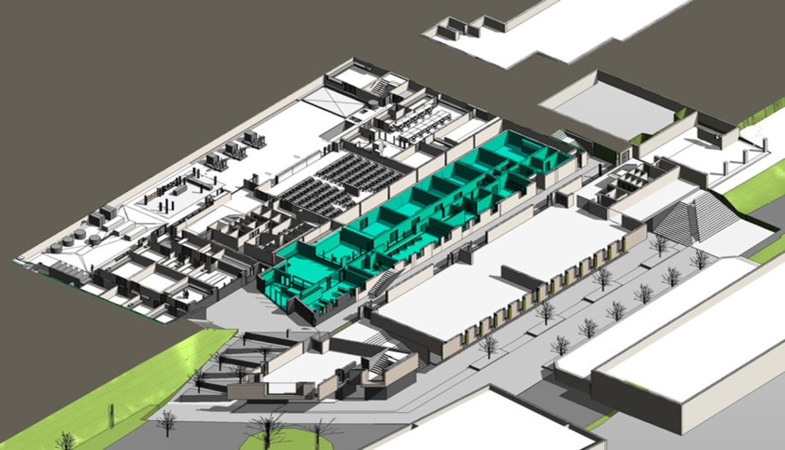
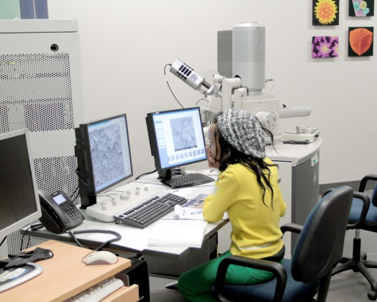
An example
Aaron Klug Centre for Imaging and Analysis
Purpose: To provide the instrumental resources and expertise for structural analysis in all disciplines including structural biology
Staff: Half-time Director, 4 scientific officers, 2 technical officers employed by UCT. Scientist and two technical officers on secondment from Centre for Minerals Processing
Data professional on loan from eResearch

Slide 14
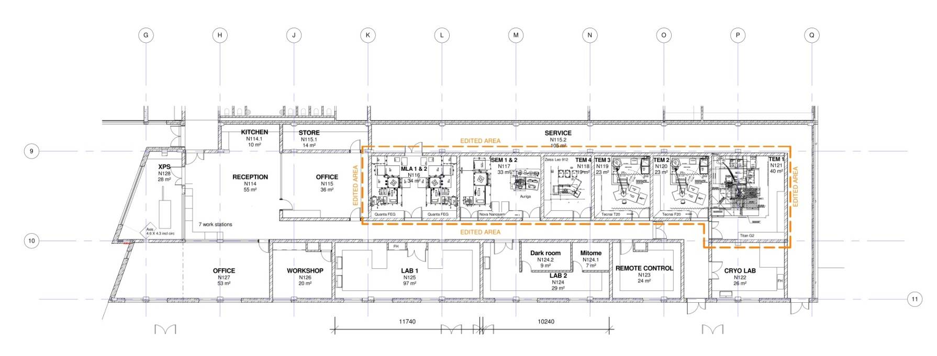

Space: 660m^{2,}, vibration free, magnetic field compensated, temperature controlled, humidity controlled
Equipment: 3 TEMs, 4 SEMs, Protein Diffractometer, Preparative equipment, computer infrastructure
Applications for a high-end TEM (e.g. TITAN Krios) pending
Automated acquisition systems
Web-based image processing interfaces
Integration with UCT HPC

Slide 15
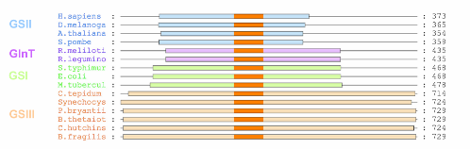
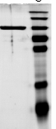
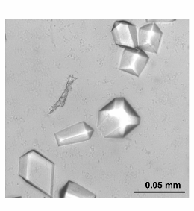
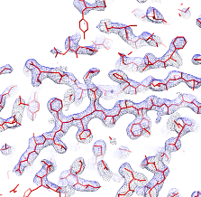
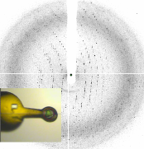
Structural biology workflow
1. Sample selection
2. Soluble expression
3. Purification
4. (Crystallization)
5. Data collection
6. Data processing
7. Interpretation
8. Publication
Notes:
It’s also very important to note that Biophysics is only one aspect, often the celebrated for the visual insights it brings, but no more important that the other stages of the experiment.
Often more than half the battle is in preparing sample and a considerable portion of our efforts in growing capacity have centred around equipping world class protein production facilities and growing the skills to execute this critical part of all aspects of the pipeline.
We have not been alone in this pursuit and the developments in our collaborators labs have been essential for them accessing our resources.
Entering at different points in the pipeline e.g. collaborations with partners providing excellent protein samples skip ahead in the experiment. Or collaborations with overseas partners have allowed us to access resources we don’t posses in the country.

Slide 16
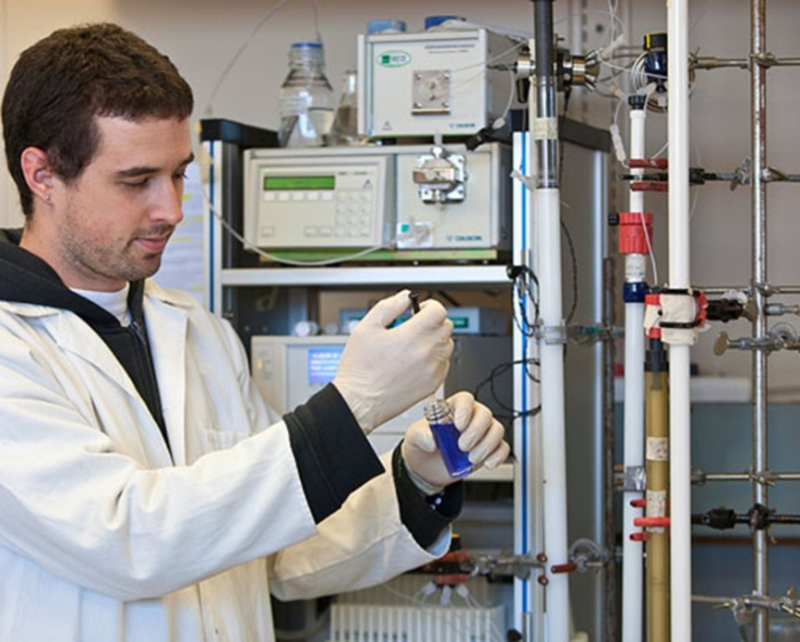
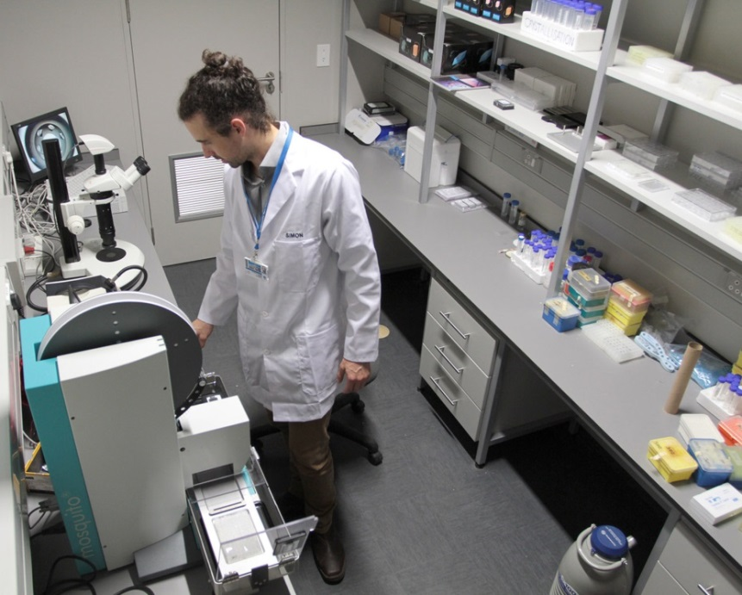
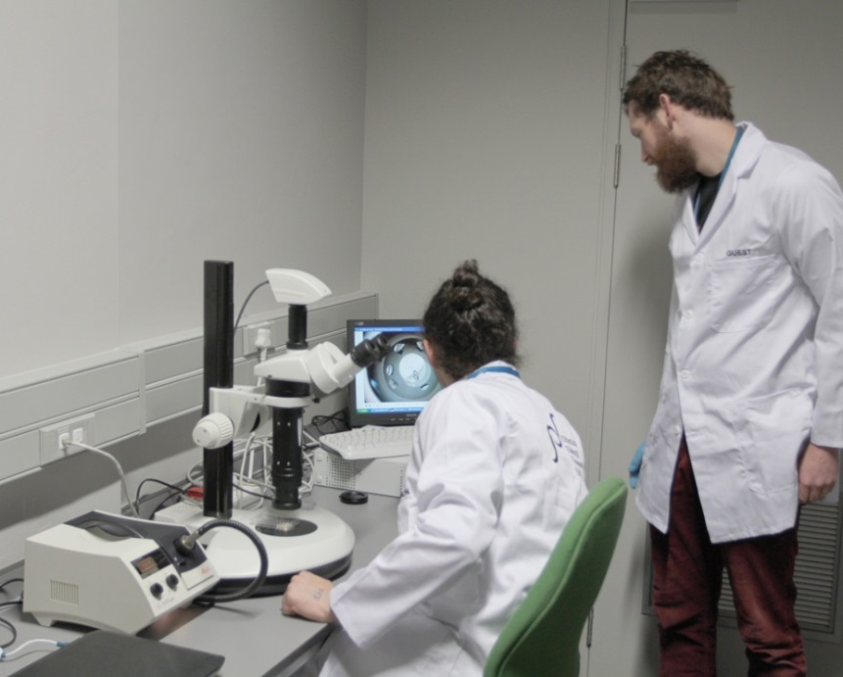
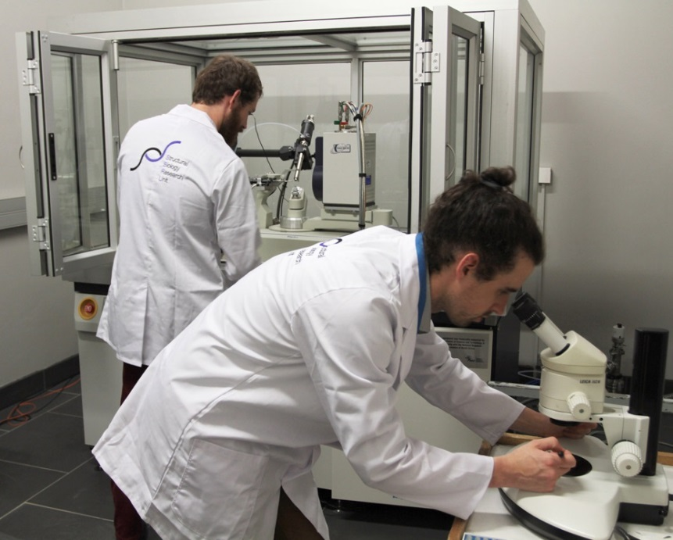
Resources: 80m² lab space, molecular biology, cell culture, chromatography and biochemical assay facilities. Computers.
Chromatography
Crystal trials
Crystals
Data collection

Slide 17
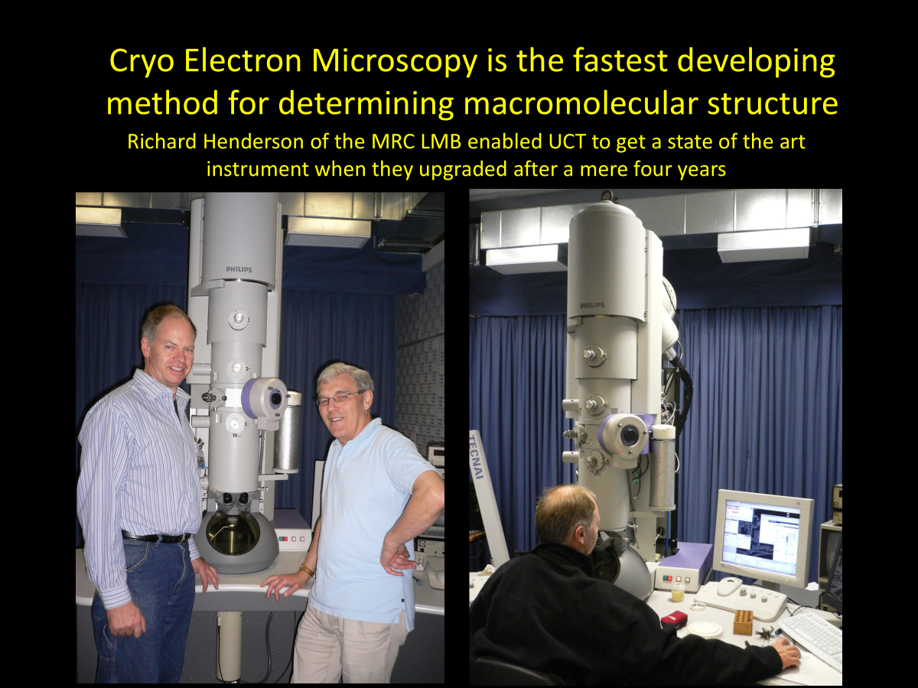

Slide 18
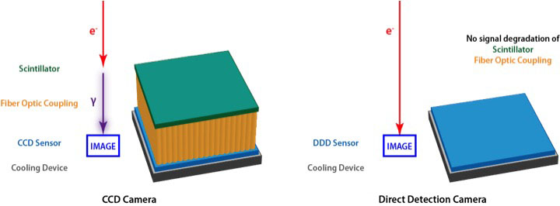
Fig. CCD vs Direct Detection Camera (http://www.directelectron.com/products/de-series)
Traditional TEM digital cameras use a scintillator to convert primary electrons in the microscope to photons before being detected by the imaging sensor.
In contrast, the DDD directly detects image-forming electrons in the microscope without the use of a scintillator.
The result is dramatically better resolution, signal-to-noise ratio, and sensitivity.

Slide 19
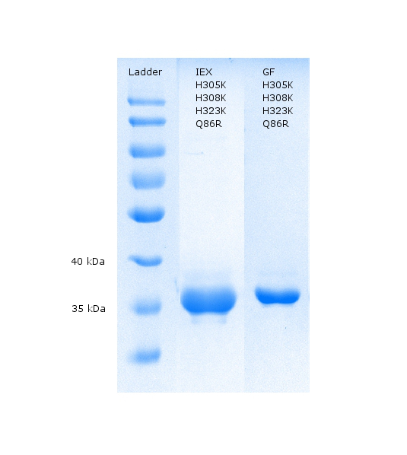
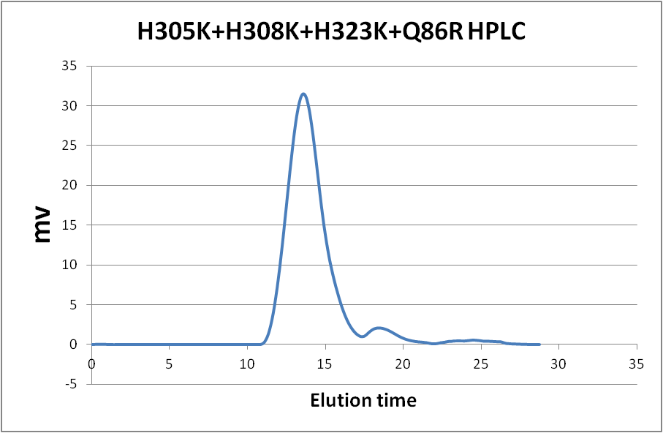
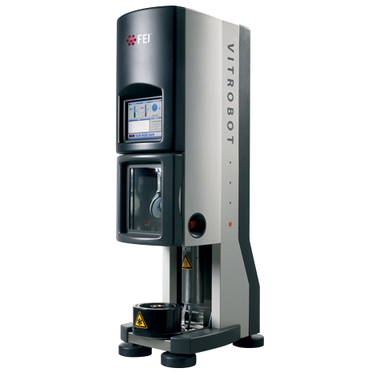
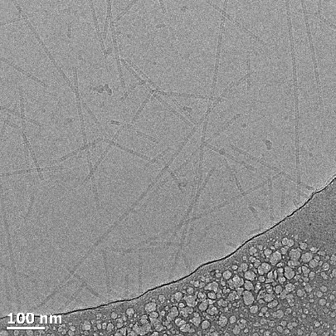
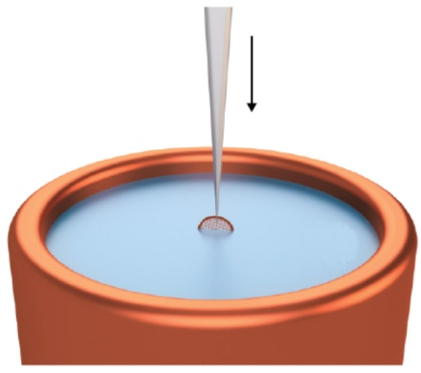
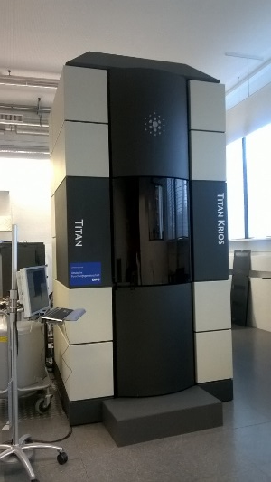
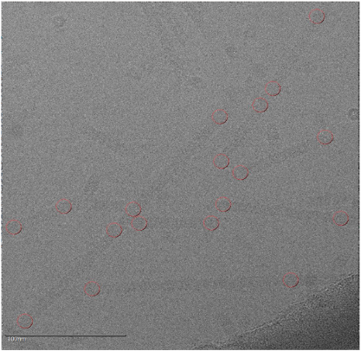
Gel filtration chromatography
SDS PAGE gel
Protein Purification
Liquid ethane
-188 °C
Vitrobot
Cryo grids preparation
Images collected at a magnification of 165 000 X
Thermo Fisher Titan Krios microscope
Data collection

Slide 20
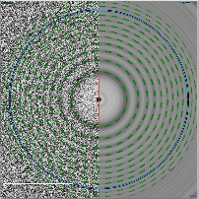
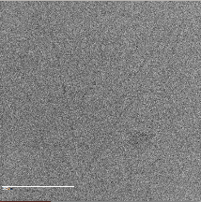
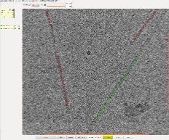
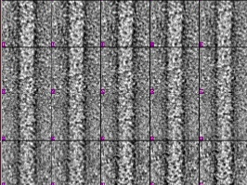
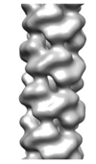
Image Processing Outline
Micrograph alignment and averaging
MOTIONCORR
CTF correction
CTFFIND3/ACE2
Particle picking
Integrated Manual picker
Segmentation and stack creation
(160²/448² pixel helical segments)
Sort good images
Junksort function from XMIPP
Centred segments by applying x shifts
SPIDER
Classification by particle diameter
SPIDER
MOTIONCORR
APPION
Iterative helical real space reconstruction
IHRSR ++
SPIDER

Slide 21
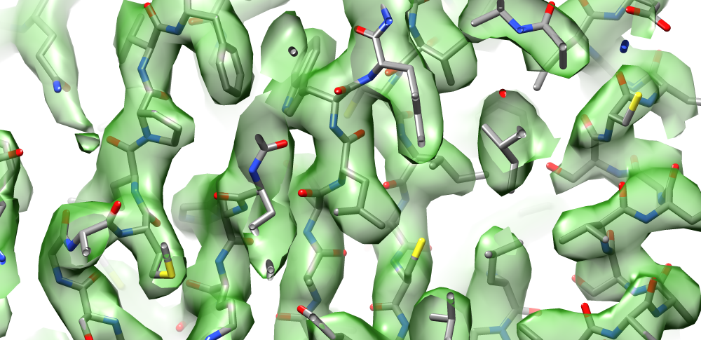
The process delivers a three-dimensional charge density map (a part of which is displayed as the green surface contour below) . This can be interpreted using a combination of AI and molecular dynamics. The community insists that all maps and models are deposited in an internationally accessible database.

Slide 22
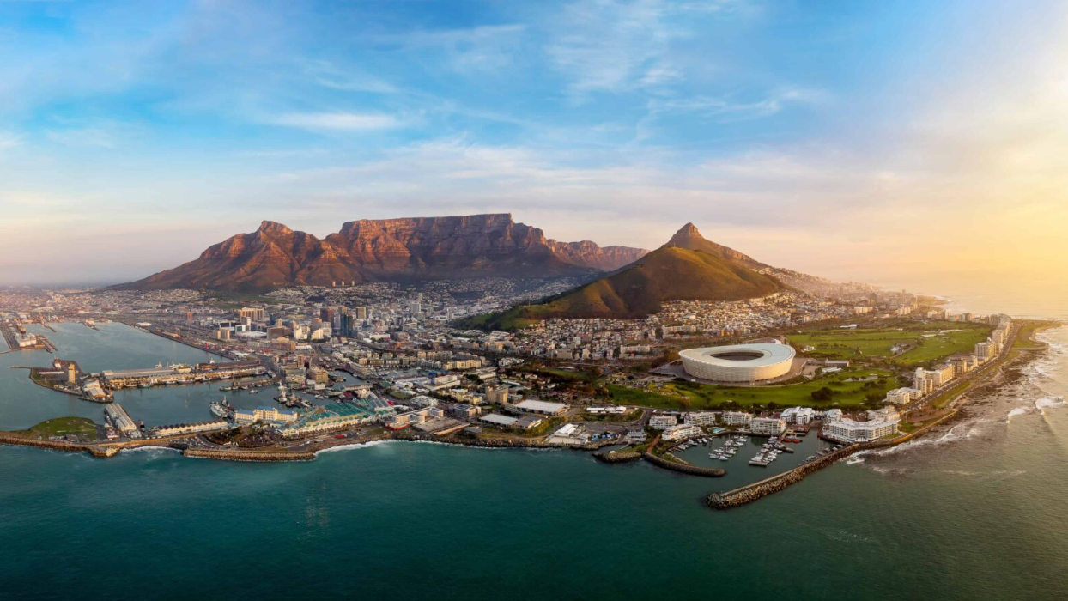
IUBMB FASBMB SASBMB IUPAB
CONGRESS 2027
19 – 23 SEPTEMBER 2027
www.iubmbcongress2027.co.za

Slide 23
So what is the Strategy?
Build a community
Organize activities e.g. Ad hoc workshops and lectures, attract major conferences
Membership of local and international Societies: e.g SAIP, ASBMB,MSSA,AIC, AfBS, BPS, IUPAB
Appointment of Biophysicists to university teaching positions
Introduction of courses at undergraduate level
Supervise students at Masters, Doctoral and post-Doctoral level
Apply for research grants to local and international funding organizations
Establish centres to provide major facilities locally e.g. Aaron Klug Centre
Utilitise the facilities of European Centres: ESRF, DLS, eBIC, Instruct
Purchase appropriate equipment in cognate university deparments
Deposit data in international databases
Publish in internationally recognized Journals
Publish commentaries advertising Biophysics in local and international media, including social media

