Slide 1
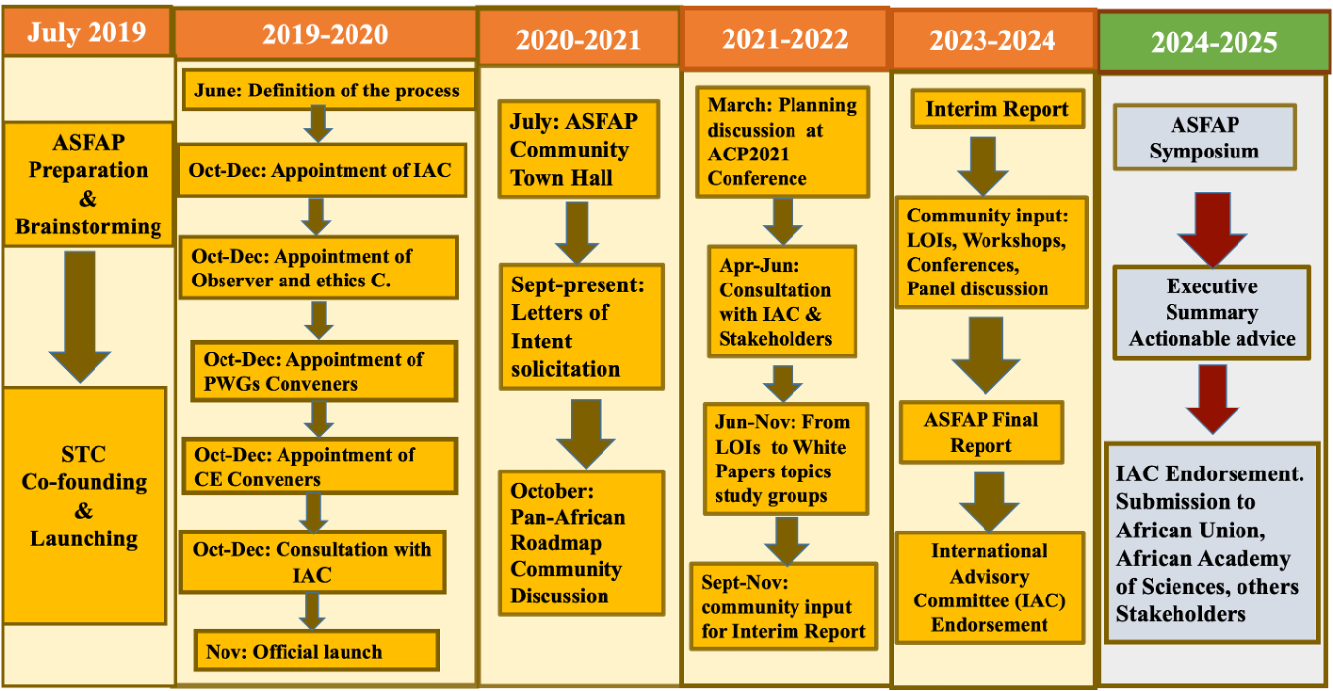
ASFAP Timeline
ASFAP Community Planning Meeting, March 7-11, 2022
ASFAP Working Meeting towards Final Report
Dec 15-17, 2024
ASFAP Town Hall
Delay: final report & symposium on 09/22-25/2025

Slide 2
Final Report Synthesis
  Accelerators
  Astrophysics and cosmology
  Atomic and molecular physics
  Biophysics
  Complex systems
  Computing
  Condensed matter and materials physics
  Earth science
  Energy
  Fluid and plasma physics
  Instrumentation and detectors
  Light sources
  Medical physics
  Nuclear physics
  Optics and photonics / Laser physics
  Particle physics
  Ethics in physics
  Observers feedback
  Physics Education
  Women in physics
  Community Engagements
  Young Physics Forum
We may still drop more chapters if conveners do not respond timely in addressing comments

Slide 3
Acknowledgements & Thanks
UNESCO
  Air ticket coverages and travel arrangements for many participants
  Help with visa application
APS
  Air ticket and hotel coverages for some participants
Prof. Young-Kee Kim
  Hotel, airport transfer and meal coverages for many participants
INFN, BNL, University of Grenoble, Penn Medicine
  Full travel coverage for their staff
Prof. Shaaban Khalil and our hosts
  The logistical support and their diligent efforts
The in-person participants
  For making the efforts to show up
Online participants
  For their participation

