Slide 1
Dynamic Aperture Updates

Slide 2
Topics
Updates on dynamic aperture with beam-beam and errors
  Update from previous talk
General points on dynamic aperture

Slide 3
Recap
Previously shown beam-beam has very low impact on DA with
  Single multipole lens in between two IPs
  Identical multipole lenses between all IPs
  Lattice with misalignment and orbit + tune correction (Yi Wu)
  IP waist and beta modified
Dynamic aperture evaluated using largest ellipse

Slide 4


Dynamic Aperture: Largest Ellipse
Define dynamic aperture as largest possible ellipse (in X,Y plane) that only contains stable particles. Developed with A. Piveteau
Allows get quantifiable dynamic aperture to scan parameters
$$b$$
$$a$$

Slide 5
Simulation Set-up
Load FCC-ee tt lattice without perturbations from MADX
Perturb lattice in MADX and import to Xsuite
Taper lattice
Compute 6D Twiss in Xsuite
Install (WS) beam-beam elements in Xsuite
  B2 same/mirrored parameters as B1
Compute DA metric – Largest Ellipse
Repeat without beam-beam

Slide 6
Alignment Errors
Test impact of alignment errors on dynamic aperture
  Focus on vertical alignment errors of:
    Sextupoles - introduction of coupling and optics beating
    Quadrupoles – same as sextupoles + introduction of orbit + dispersion effects
Random errors with increasing standard deviation
  Applied to quadrupoles or sextupoles
  20 identical errors seeds with and without beam-beam
  Compute average and standard deviation of dynamic aperture for each error size
  Compare individual seeds too

Slide 7
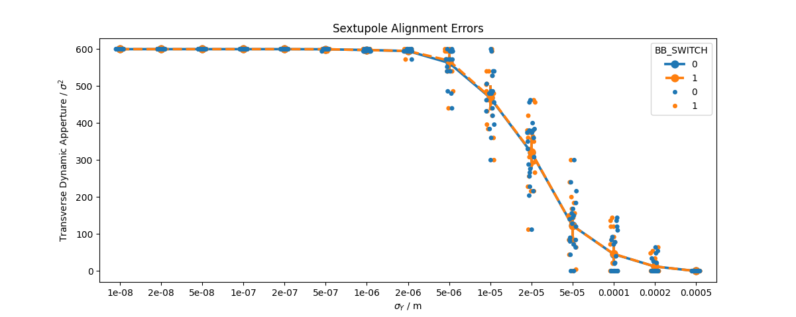
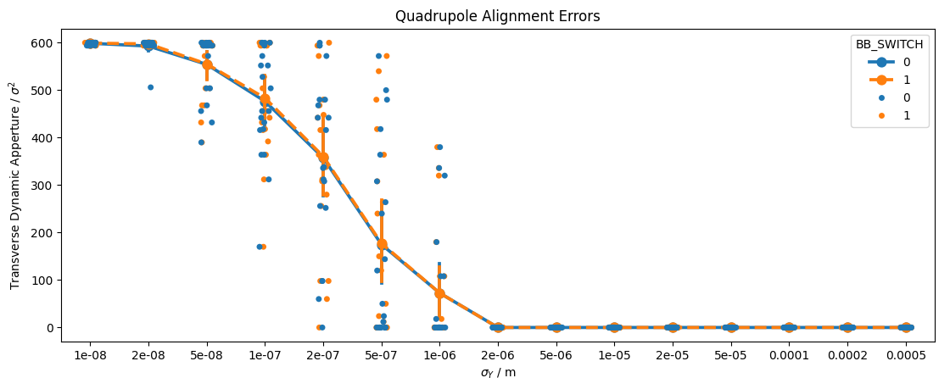
Results

Slide 8
Results
Very small impact of beam-beam element on average dynamic aperture
Most error seeds have very similar dynamic aperture in both cases
  Shown next to each other in plot
  Few cases with differences
    Interesting to study these behaviour of these seeds
    Need to understand how beam-beam interacts with these errors

Slide 9
Topics
Updates on dynamic aperture with beam-beam and errors
  Update from previous talk
General points on dynamic aperture

Slide 10
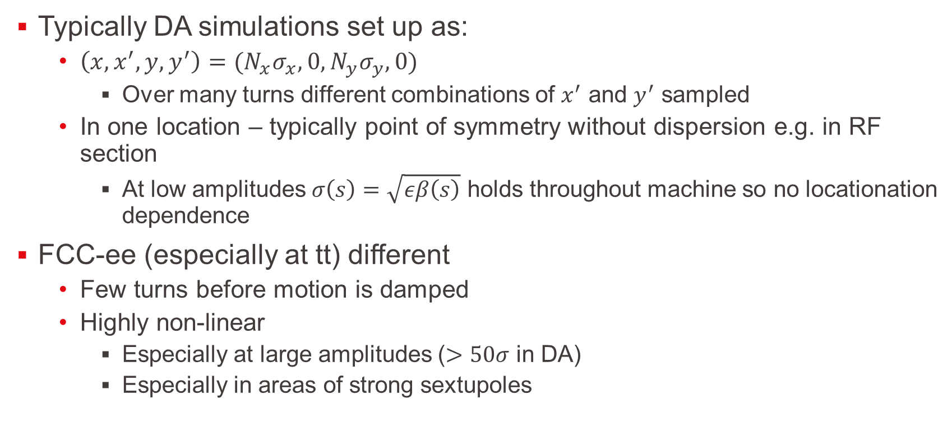
Position and Angle Dependence of DA
Typically DA simulations set up as:
  $\left(x,x^{′},y,y^{′}\right)=(N_{x}σ_{x},0,N_{y}σ_{y},0)$
    Over many turns different combinations of $x^{′}$ and $y^{′}$ sampled
  In one location – typically point of symmetry without dispersion e.g. in RF section
    At low amplitudes $σ\left(s\right)=\sqrt{εβ\left(s\right)}$ holds throughout machine so no locationation dependence
FCC-ee (especially at tt) different
  Few turns before motion is damped
  Highly non-linear
    Especially at large amplitudes ($>50σ$ in DA)
    Especially in areas of strong sextupoles

Slide 11
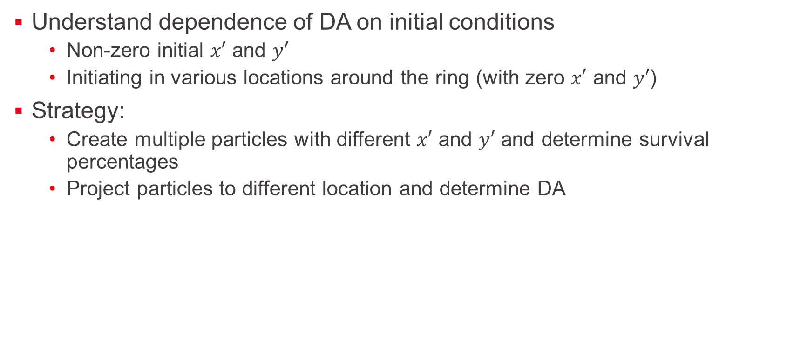
Investigation
Understand dependence of DA on initial conditions
  Non-zero initial $x′$ and $y′$
  Initiating in various locations around the ring (with zero $x′$ and $y′$)
Strategy:
  Create multiple particles with different $x′$ and $y′$ and determine survival percentages
  Project particles to different location and determine DA

Slide 12


Angle Scan
$$N_{y}σ_{y}$$
$$N_{x}σ_{x}$$

Slide 13



Angle Scan
$$x_{N}′$$
$$x_{N}$$
$$N_{x}ε_{x}$$
$$N_{y}σ_{y}$$
$$N_{x}σ_{x}$$

Slide 14



Angle Scan
$$x_{N}′$$
$$x_{N}$$
$$N_{x}ε_{x}$$
$$N_{y}σ_{y}$$
$$y_{N}′$$
$$N_{y}ε_{y}$$
$$N_{x}σ_{x}$$
$$y_{N}$$

Slide 15
Angle Scan
$$x_{N}′$$
$$x_{N}$$
$$N_{x}ε_{x}$$
$$N_{y}σ_{y}$$
$$y_{N}′$$
$$N_{y}ε_{y}$$
$$N_{x}σ_{x}$$
$$y_{N}$$

Slide 16


Angle Scan
$$x_{N}′$$
$$x_{N}$$
$$N_{x}ε_{x}$$
$$N_{y}σ_{y}$$
$$N_{y}σ_{y}$$
$$y_{N}′$$
$$N_{y}ε_{y}$$
$$N_{x}σ_{x}$$
$$N_{x}σ_{x}$$
$$y_{N}$$

Slide 17
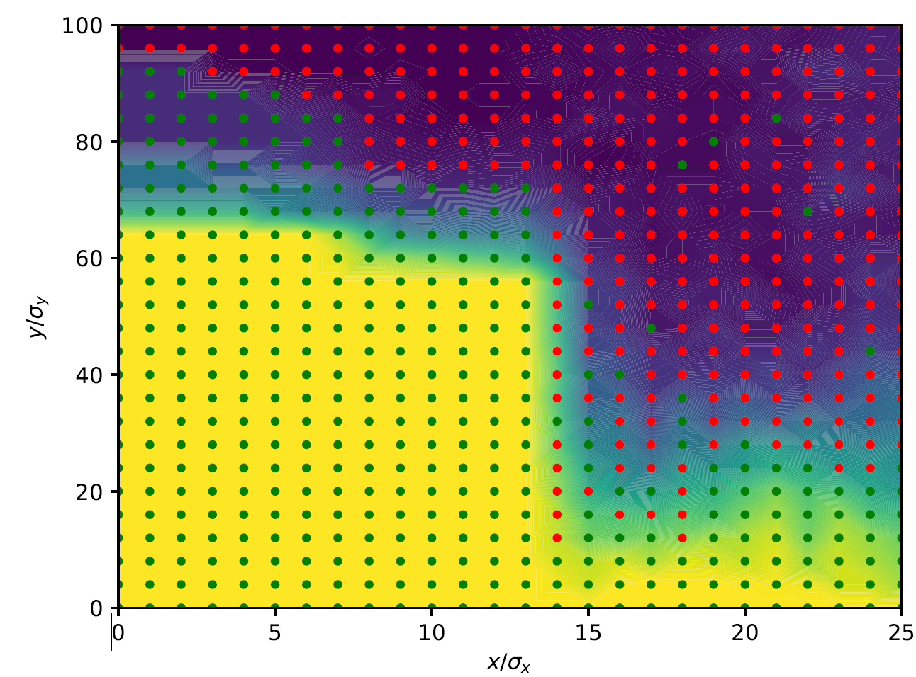
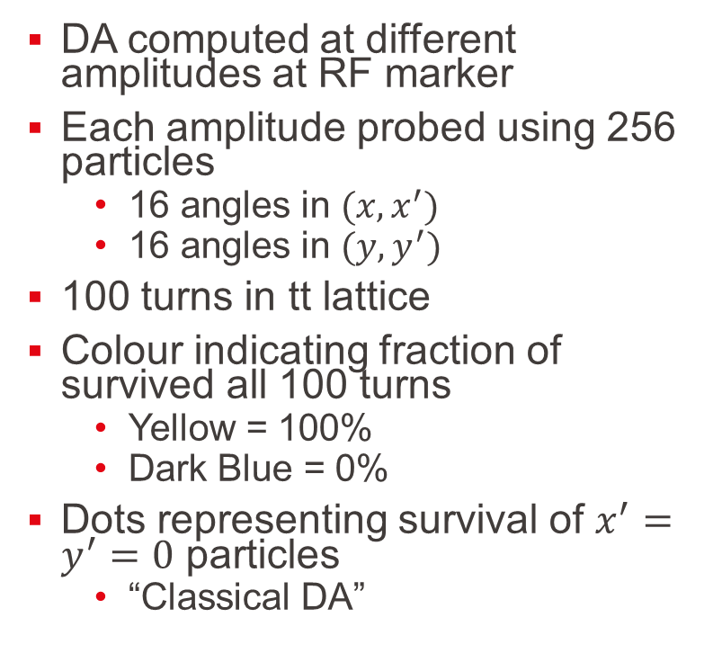
DA Angle Scan
No Radiation
DA computed at different amplitudes at RF marker
Each amplitude probed using 256 particles
  16 angles in $(x,x^{′})$
  16 angles in $(y,y^{′})$
100 turns in tt lattice
Colour indicating fraction of survived all 100 turns
  Yellow = 100%
  Dark Blue = 0%
Dots representing survival of $x^{′}=y^{′}=0$ particles
  “Classical DA”

Slide 18
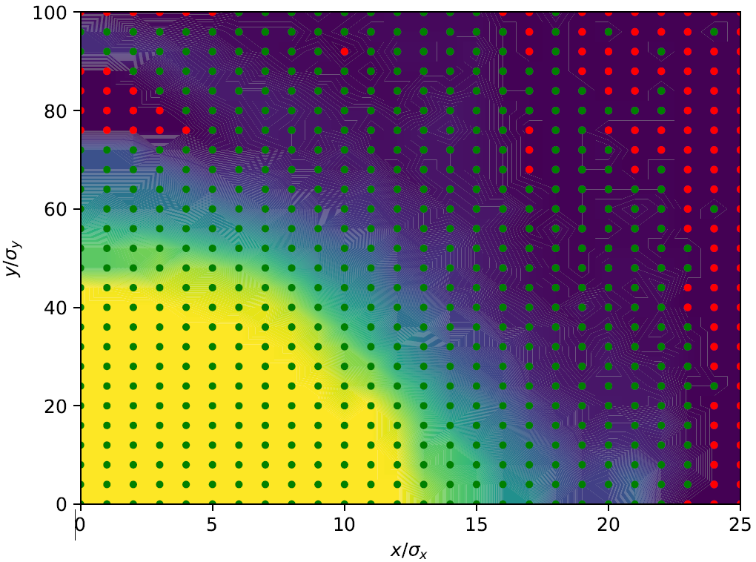
DA Angle Scan
Radiation
DA computed at different amplitudes at RF marker
Each amplitude probed using 256 particles
  16 angles in $(x,x^{′})$
  16 angles in $(y,y^{′})$
100 turns in tt lattice
Colour indicating fraction of survived all 100 turns
  Yellow = 100%
  Dark Blue = 0%
Dots representing survival of $x^{′}=y^{′}=0$ particles
  “Classical DA”

Slide 19
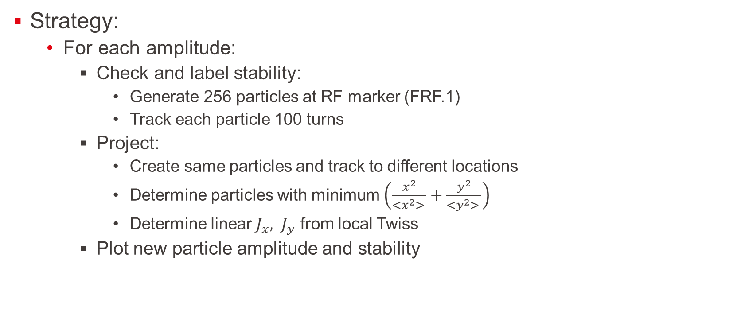
DA Location Projection
Strategy:
  For each amplitude:
    Check and label stability:
      Generate 256 particles at RF marker (FRF.1)
      Track each particle 100 turns
    Project:
      Create same particles and track to different locations
      Determine particles with minimum $\left(\frac{x^{2}}{<x^{2}> }+\frac{y^{2}}{<y^{2}> }\right)$
      Determine linear $J_{x}{, J}_{y}$ from local Twiss
    Plot new particle amplitude and stability

Slide 20




Projection of DA
$$s_{0}$$
$$x_{N}′$$
Track
$$x_{N}$$
$$N_{x}ε_{x}$$

Slide 21




Projection of DA
$$s_{0}$$
$$s_{1}$$
$$x_{N}′$$
$$x_{N}′$$
Track
$$x_{N}$$
$$x_{N}$$
$$N_{x}ε_{x}$$
$$N_{x}ε_{x}$$

Slide 22




Projection of DA
$$s_{0}$$
$$s_{1}$$
$$s_{1}$$
$$x_{N}′$$
$$x_{N}′$$
$$x′$$
Track
$$x_{N}$$
$$x_{N}$$
$$x$$
$$N_{x}ε_{x}$$
$$N_{x}ε_{x}$$
$$N_{x}ε_{x}$$

Slide 23
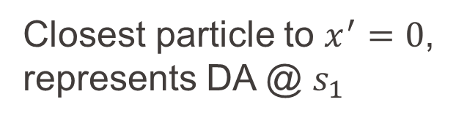
Projection of DA
$$s_{0}$$
$$s_{1}$$
$$s_{1}$$
$$x_{N}′$$
$$x_{N}′$$
$$x′$$
Track
$$x_{N}$$
$$x_{N}$$
$$x$$
$$N_{x}ε_{x}$$
$$N_{x}ε_{x}$$
$$N_{x}ε_{x}$$
Closest particle to $x^{′}=0$, represents DA @ $s_{1}$

Slide 24
Projection of DA
$$s_{0}$$
$$s_{1}$$
$$s_{1}$$
$$x_{N}′$$
$$x_{N}′$$
$$x′$$
Track
$$x_{N}$$
$$x_{N}$$
$$x$$
$$N_{x}ε_{x}$$
$$N_{x}ε_{x}$$
Closest particle to $x^{′}=0$, represents DA @ $s_{1}$

Slide 25

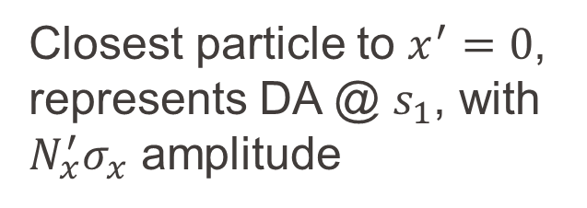
Projection of DA
$$s_{0}$$
$$s_{1}$$
$$s_{1}$$
$$x_{N}′$$
$$x_{N}′$$
$$x′$$
Track
$$x_{N}$$
$$x_{N}$$
$$x$$
$$N_{x}ε_{x}$$
$$N_{x}ε_{x}$$
$${N′}_{x}ε_{x}$$
Closest particle to $x^{′}=0$, represents DA @ $s_{1}$, with $N_{x}^{′}σ_{x}$ amplitude

Slide 26
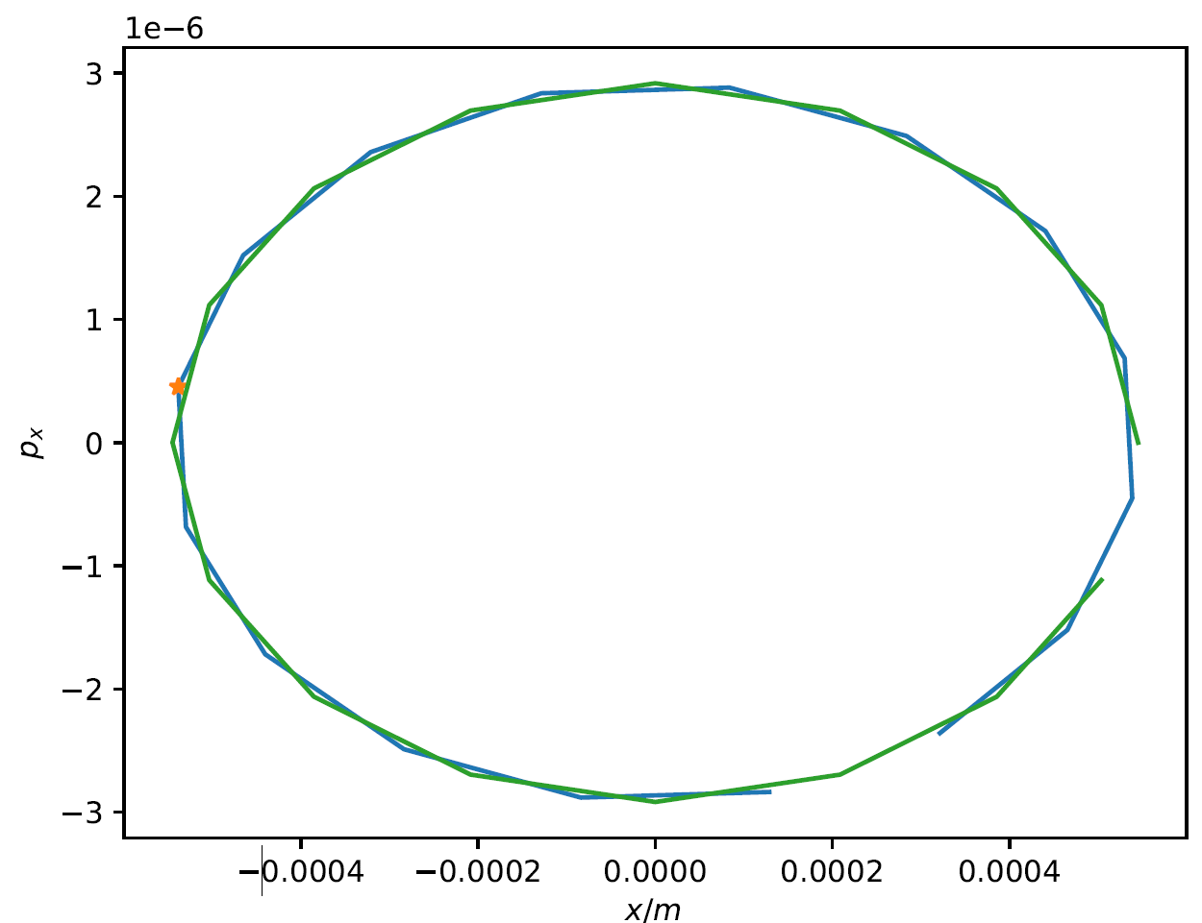
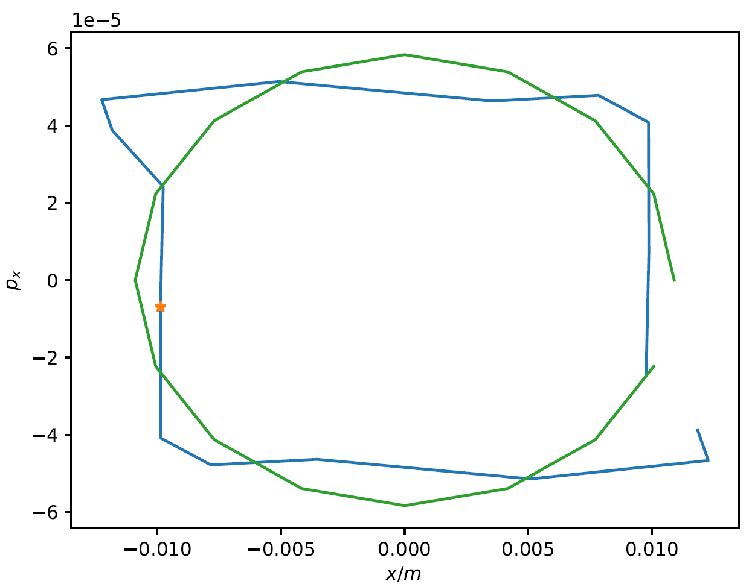
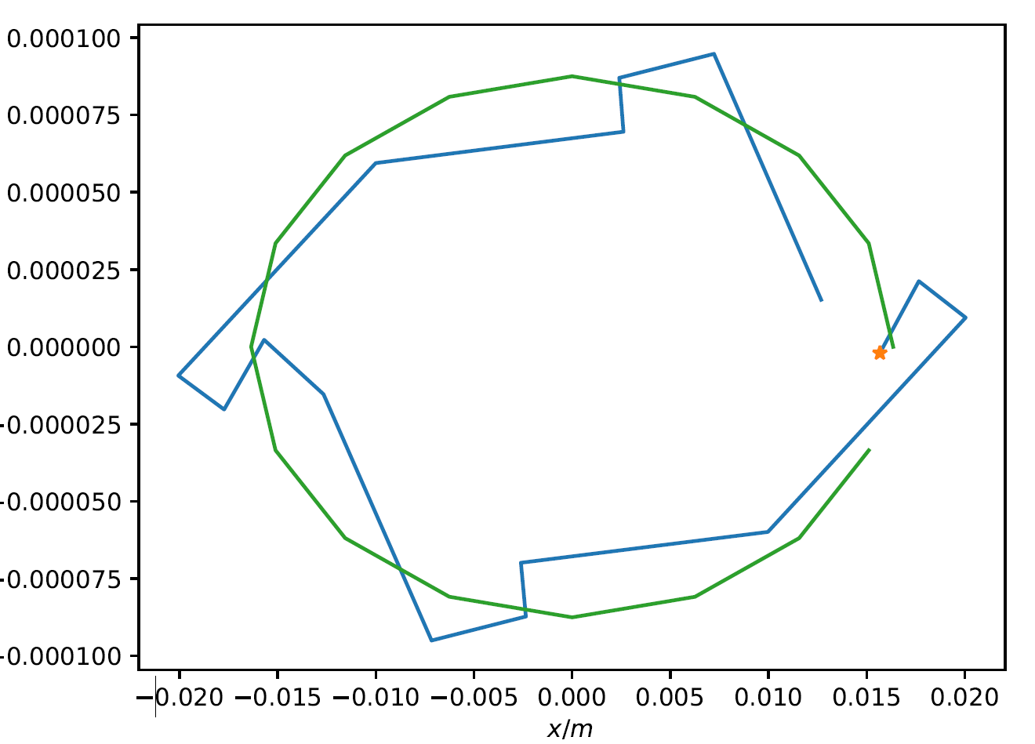



Particle projection – Drift Downstream
Green = particles initiated at RF marker
Blue = Particles downstream
Orange = Closest particle to x’ = 0
$$1σ_{x}$$
$$20σ_{x}$$
$$25σ_{x}$$

Slide 27
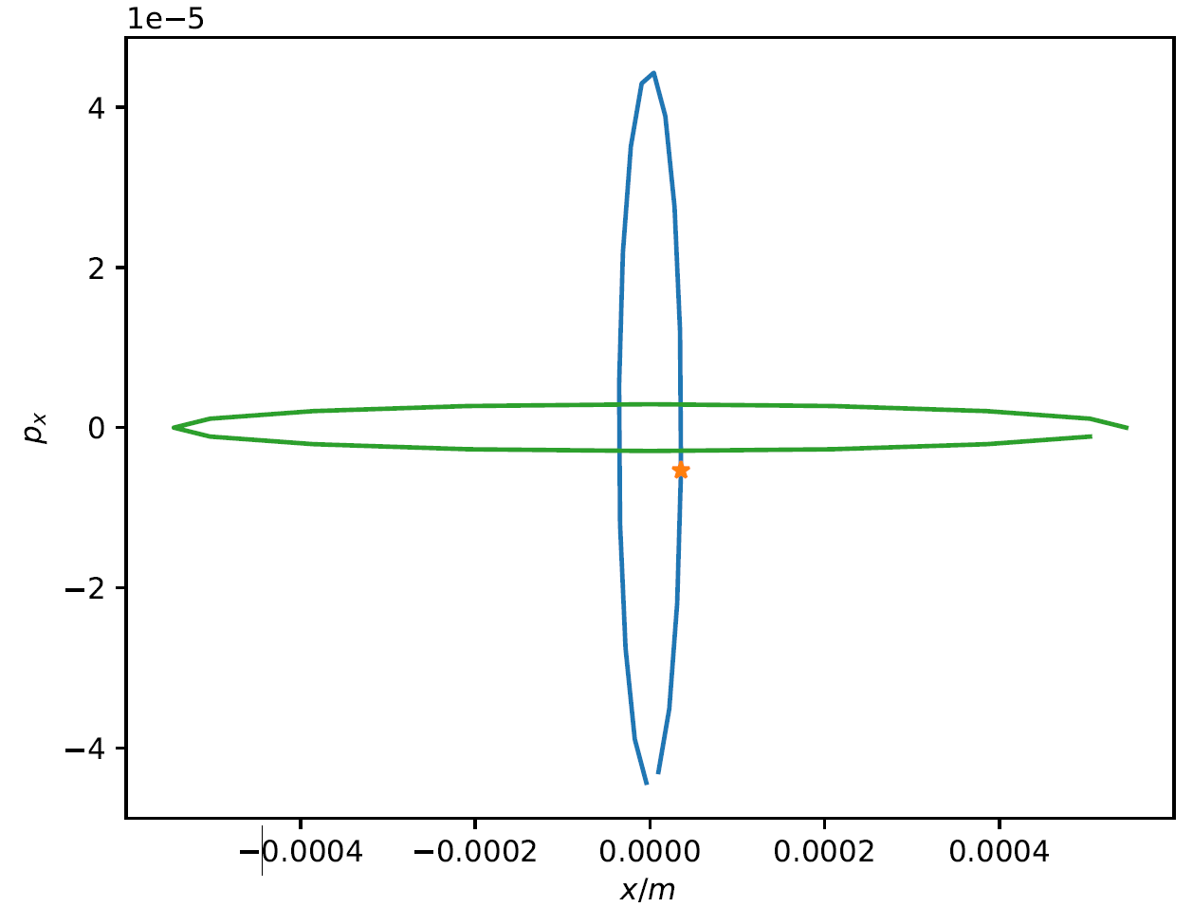
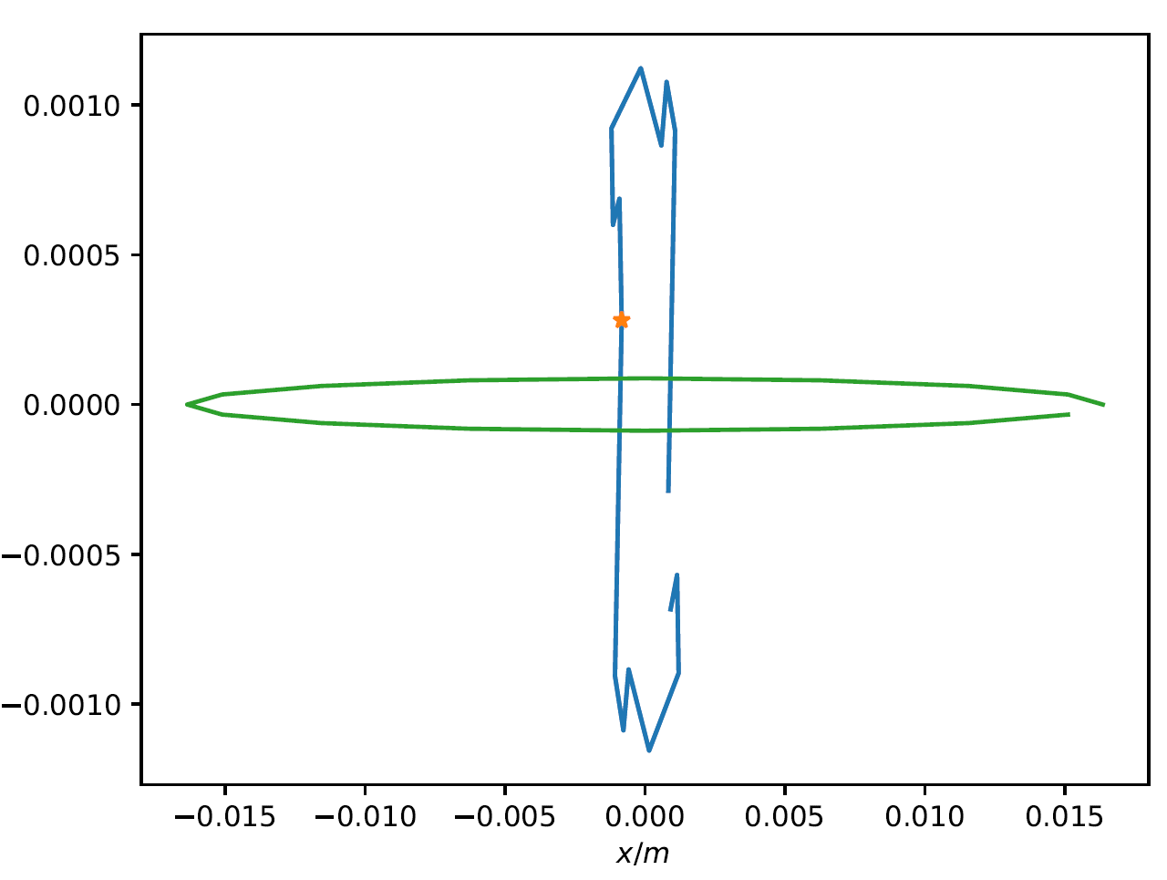


Particle projection – IP
Green = particles initiated at RF marker
Blue = Particles downstream
Orange = Closest particle to x’ = 0
$$1σ_{x}$$
$$20σ_{x}$$

Slide 28
DA Location Projection
Strategy:
  For each amplitude:
    Check and label stability:
      Generate 256 particles at RF marker (FRF.1)
      Track each particle 100 turns
    Project:
      Create same particles and track to different locations
      Determine particles with minimum $\left(\frac{x^{2}}{<x^{2}> }+\frac{y^{2}}{<y^{2}> }\right)$
      Determine linear $J_{x}{, J}_{y}$ from local Twiss
    Plot new particle amplitude and stability

Slide 29
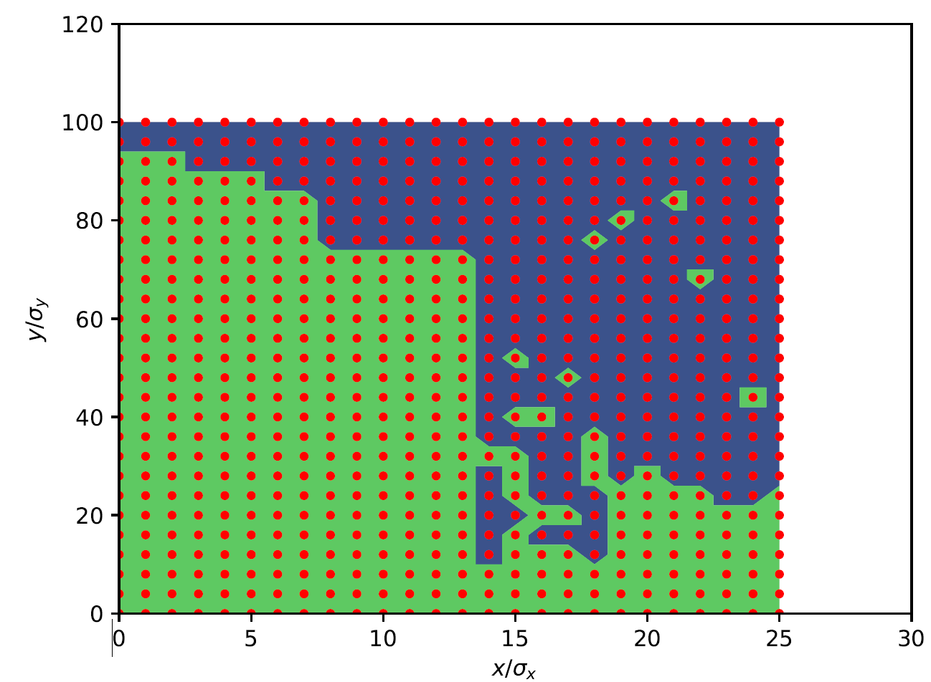
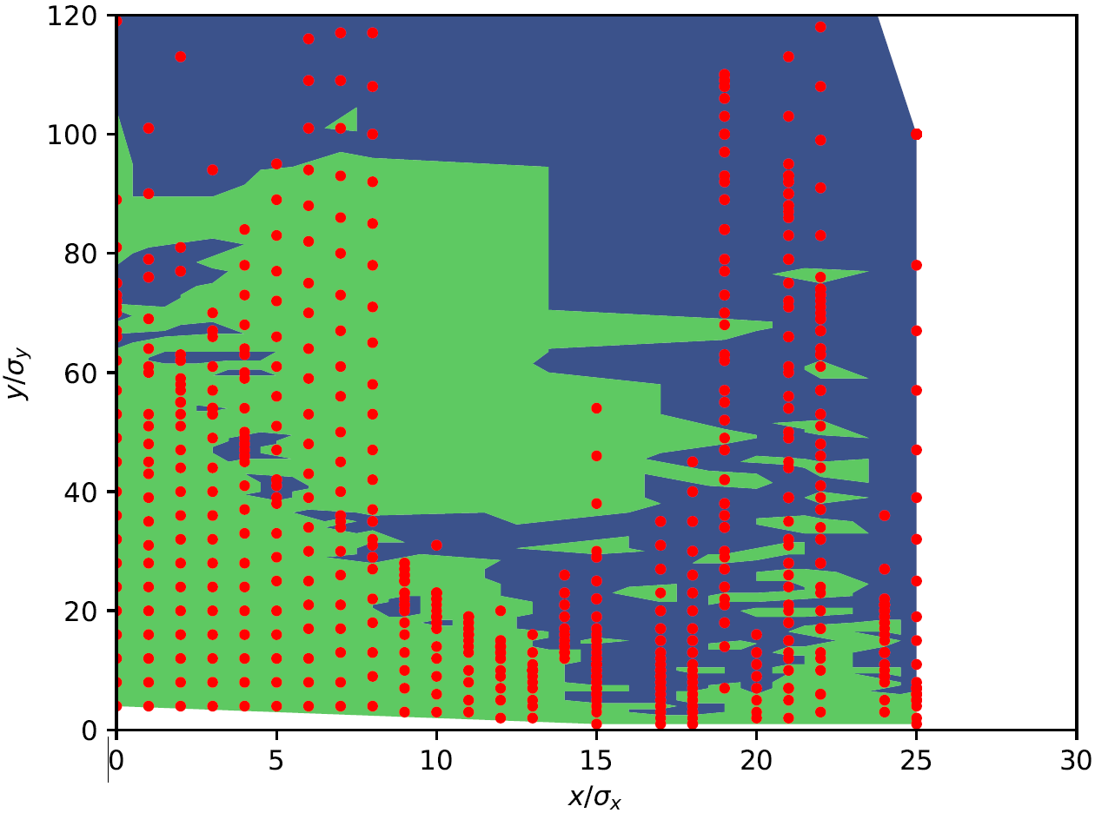
IP.1

Slide 30
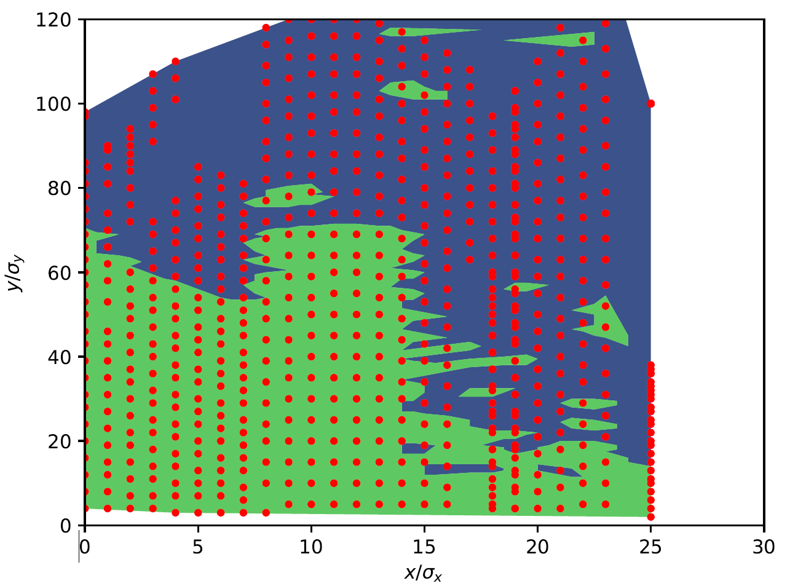
IP.4

Slide 31
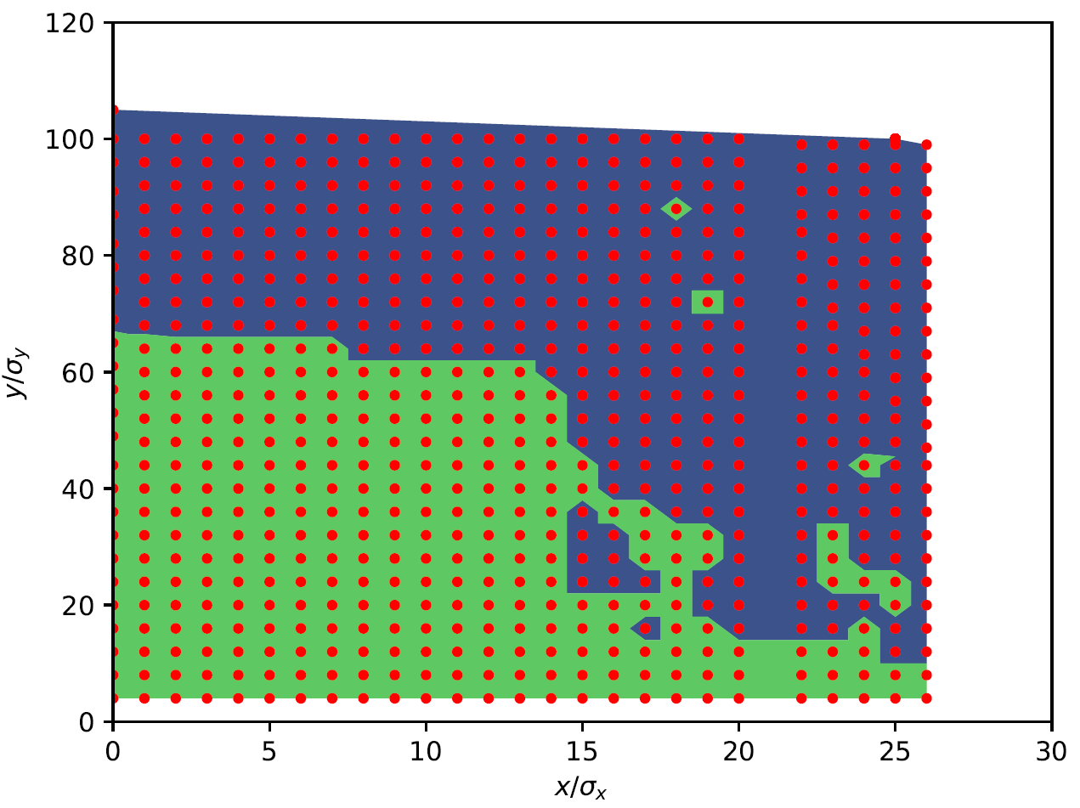
IR Quad outside Crab Sextupoles

Slide 32
IR Quad outside Crab Sextupoles

Slide 33
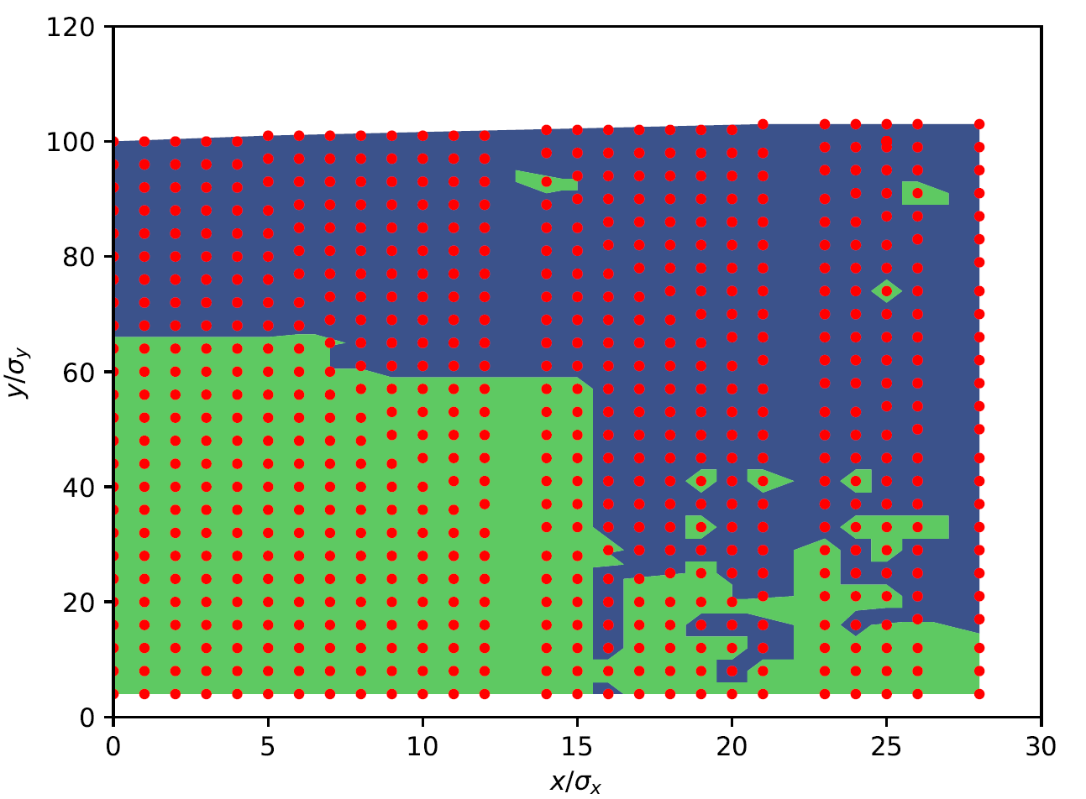
Arc Quadrupole

Slide 34
Arc Quadrupole

Slide 35
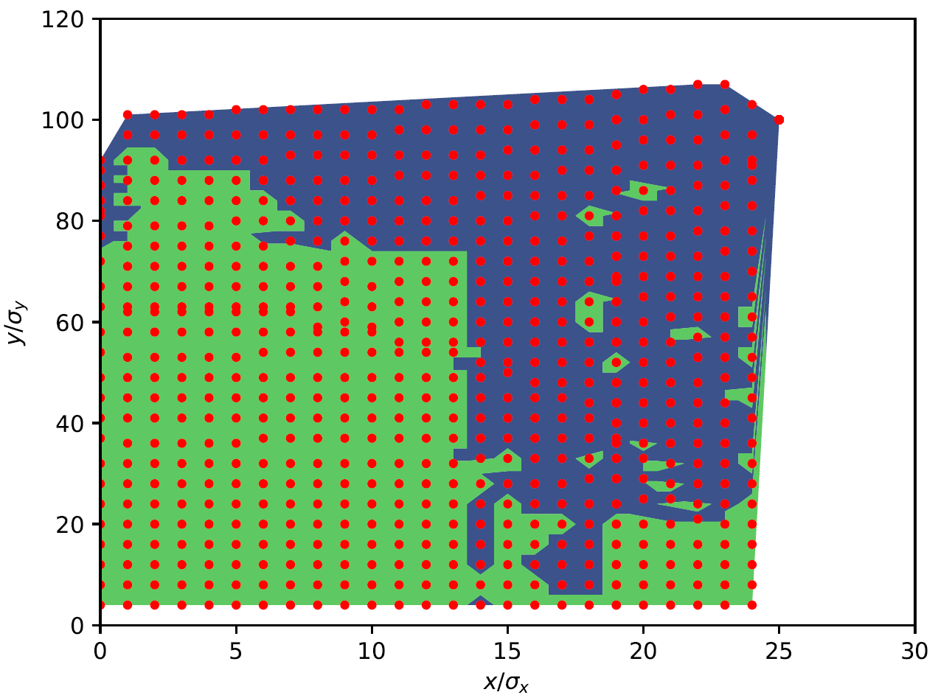
Same marker ½ turn later (FRF.2)

Slide 36
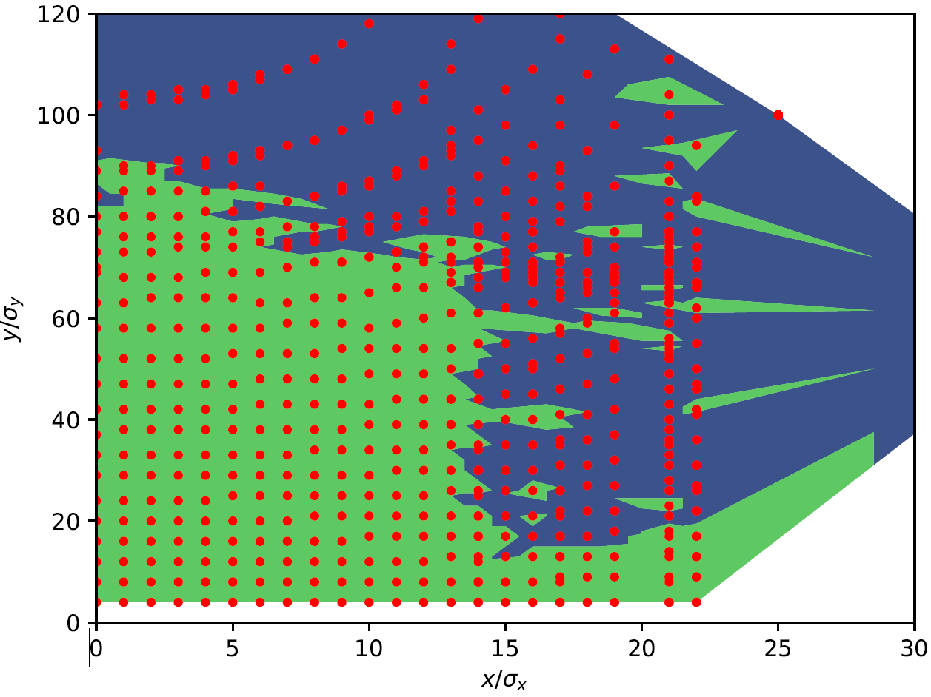
Same location 1 turn later…

Slide 37
Conclusions and Next Steps
DA highly dependent on initial conditions
  Need to be careful when evaluating DA
    Intrinsic property when simulating with radiation
  Especially important when optimising DA
    Might just lead to weakening of sextupoles at certain phase advances from initiation point
  Solution – evaluate DA at multiple angles in phase space
    Number of angles to be determined – convergence or analytical considerations
Next steps
  Repeat with LCC lattice – maybe less extreme non-lienearities
  Explore with multipole errors and beam-beam distorting linearity at lower amplitudes

