Slide 2
Status of the
PSB 2 GeV Upgrade and the RCS Study
SGUI Meeting
B. Mikulec, 07 July 2011

Slide 3
Context
As a follow-up of the Chamonix 2010 workshop, a study of an Energy Upgrade of the PSB was initiated.
Feasibility report released in September 2010.
Also at Chamonix 2010, the idea of a Rapid Cycling Synchrotron (RCS) was already presented by C. Carli, but it was only after the 2011 Chamonix workshop that a feasibility study was requested by the management.
A first draft of this study was circulated internally 1 week ago for first comments.
An RCS would replace the PSB.

Slide 4
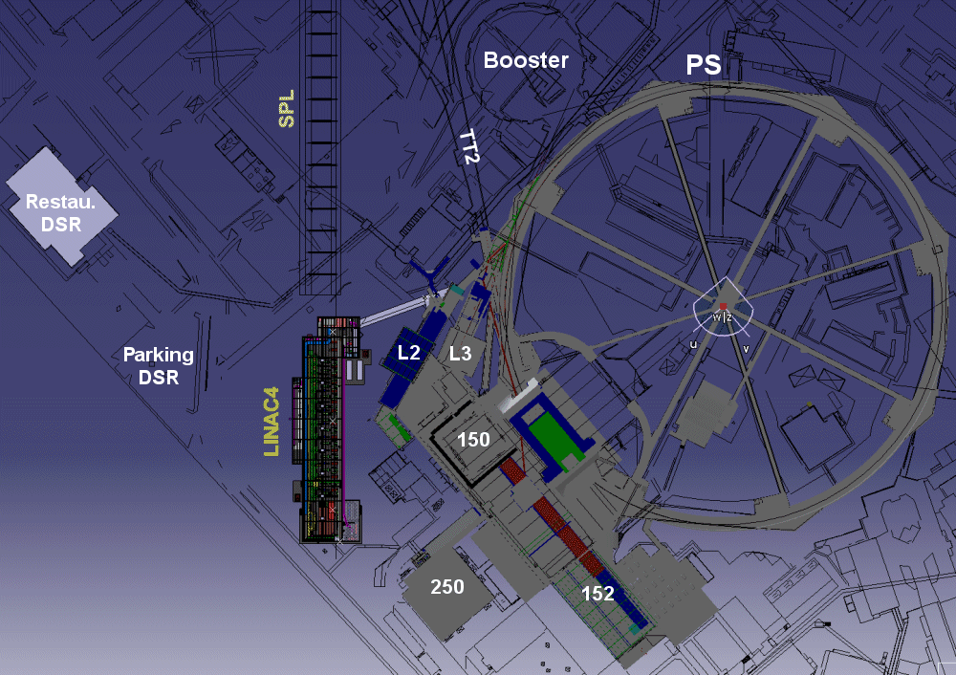
PSB Energy Upgrade
https://twiki.cern.ch/twiki/bin/view/PSBUpgrade/PSBUpgradeMainWebEnergyUpgrade
Goals of the 2 GeV Upgrade:
Reduce space charge effects
at PS injection (bottleneck
for ultimate LHC beams)
Use consolidation effort for
performance increase
Pre-requisite: Linac4 injection
towards ISOLDE…

Slide 5
PSB Energy Upgrade – Main Parameters
PSB Energy Upgrade – main characteristics
Injection Energy | 160 MeV
Extraction Energy | 1/1.4 GeV (ISOLDE) / 2 GeV (other beams)
Revolution Frequency | ~1 – 1.81 MHz
Basic Cycle Length | 1.2s
Harmonics | 1, 2, 1+2
Max. intensity / ring | 1.4E13 p (or maybe more)

Slide 6
PSB @ 2 GeV: Main Modifications
In order of cost (for LIU or consolidation)…
New MPS (POPS-type like in PS): cost driver, ~15 MCHF
  Includes civil engineering (new building to house the MPS)
RF consolidation is mandatory (main limit: C04 system)
  Idea: replacement of C02/C04 cavities with Finemet wide-band cavities
Exchange of certain power converters
  Mainly in transfer line and for PS injection
Beam transfer
  Kickers/septa at extraction/recombination PS injection
Cooling and ventilation
  Replacement of cooling station and piping, upgrade ventilation
Magnets
  Upgrade cooling system+shimming of main magnets, replacement of transfer line magnets and PS injection+low-energy correction magnets
Electrical systems
Intercepting devices, transport, beam instrumentation, vacuum etc.
Notes:
Alloy of Finemet together with high-permeability materials; frequency range 1-10 MHz

Slide 7
PSB Energy Upgrade Study – Status
Feasibility report published
  Detailed study of required modifications
  Timelines and budget estimate
Study currently frozen
Waiting for management/council decision for PSB Upgrade or RCS, something else or no upgrade
If accepted end of this year, could be done in LS2

Slide 8
Potential Linac4 Connection to PSB in LS1
Recommended by the LIU Project Management only in case LS1 starts in May 2013 (not December 2012); LS1 duration: 20 months.

Slide 9
RCS
https://twiki.cern.ch/twiki/bin/view/PSBUpgrade/PSBUpgradeMainWebEnergyUpgrade
RCS underlying design constraints:
Match the performance of one PSB ring at 2 GeV for LHC with Linac4 as injector
Keep the cost within limits…
Advantages on first sight:
New machine
Faster cycling, therefore potential gain for certain beams/users
But: there are also certain disadvantages
Initial cost estimate suggests at least twice that of the PSB 2 GeV Upgrade + consolidation
Operational and beam dynamics issues in PSB and PS
Scheduling

Slide 10
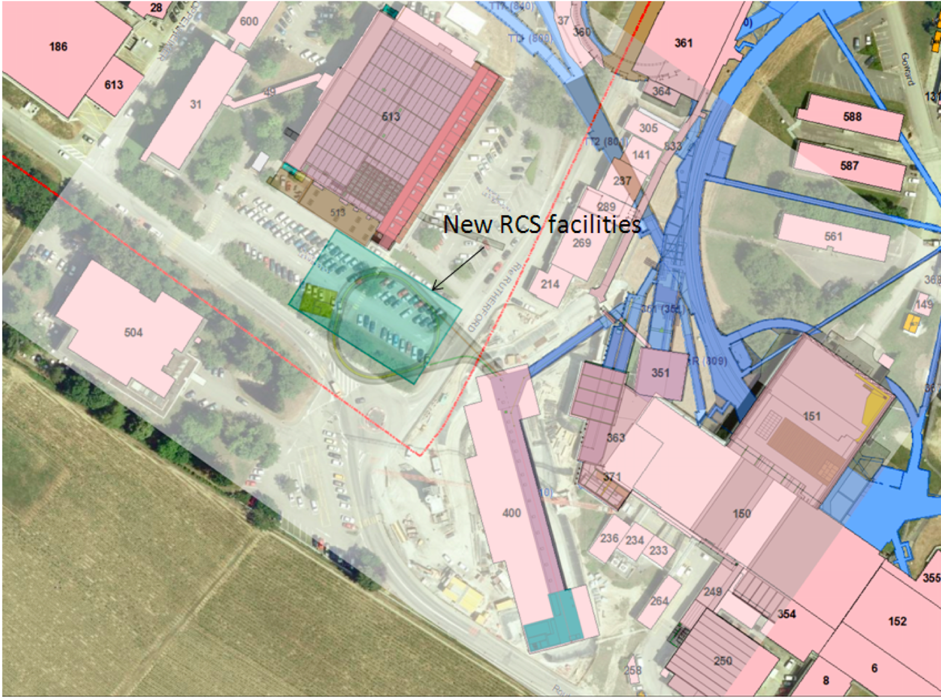
RCS – Civil Engineering Proposal
Original proposal for location inside PS ring not practicable
Implantation planned under the car park beside the computer center ~13 m below ground plus surface building with access shaft

Slide 11
RCS – Main Parameters
RCS – main characteristics
Circumference | 119.68 m (4/21 of PS circumference)
Injection Energy | 160 MeV
Extraction Energy | 2 GeV (all beams); ISOLDE?
Revolution Frequency | 1.3 – 2.4 MHz
Cycling Rate | 10 Hz
Harmonics | 1, 2, 2+1, 2+4, 4(?)
Max. intensity / pulse | 1E13 p

Slide 12
RCS – Preliminary Design
3-fold structure: 1 straight section for injection, 1 for RF and 1 for extraction
Linac4 H⁻ charge-exchange injection, transverse and longitudinal painting
Whole acceleration cycle within 50 ms
Leaves very little time for beam manipulation (transverse and in particular longitudinal blow-up)
Magnet aperture is a problem with required high magnetic fields; magnet design is challenging
Lattice design proposed, but far from being frozen
Extraction to measurement/dump line or to long transfer line towards PS and ISOLDE (using already existing tunnels and passing through PSB zone)

Slide 13
RCS – Remarks and Challenges
Upgrade of Linac4 for faster cycling (10 Hz instead of 1.11 Hz)
Injection and Extraction: very tight space
  Chicane bump, H⁻ stripping and painting bump (3x4 magnets)
  For extraction need kicker rise-time of 40 ns (for potential h=4 operation)
Lattice: current baseline 21 cells (5 per arc and 2 per straight section)
  FODO with space for additional equipment (steerers, beam instrumentation etc.) only between QFs and bends (~55 cm)
  γ- transition: 3.6, max. β_x: 8.73 m, max. β_y: 12.06 m, max. dispersion 3.73 m
  ISOLDE beams most challenging for aperture considerations
RF: Wide-band Finemet cavities at 60 kV total rf voltage
Magnets: field of up to 1.3 T (bends) to be achieved with thin lamination of grain orientated high silicon content steel
MPS: POPS-type for max. flexibility and ppm operation (including ‘off’ cycles)
Transfer lines to PS and ISOLDE: full upgrade needed for 2 GeV@10 Hz plus additional shielding at certain locations
Notes:
Linac4 upgrade ~9 MCHF (ion source, EM quads, rf pulse length and cooling, power converters and transfer line
Integrated field for bends: 1.946 Tm, current at peak field 6.1 kA, gap height 71 mm.
Cooling loads of magnets: 1.5 MW + 300 kW for power converters

Slide 14
ISOLDE Beam Production with the RCS
Injection at h=1+2 on a ramp with transverse and longitudinal painting to minimize space charge effects at injection
Extract 1 bunch at max. 1E13 p
Can receive several subsequent shots every 100 ms (depending on need and supercycle)
  Better beam power distribution over time
  In average increased proton delivery for HIE-ISOLDE
Potential issue for HIE-ISOLDE:
In case HIE-ISOLDE would request also 1.4 GeV extraction energy, increase of transfer line cost by several MCHF for ppm operation – who would cover the cost?

Slide 15
RCS Study – Status
First draft of feasibility report under discussion
  Preliminary RCS layout
  Feasible, but need to still work out many details (lattice, magnets, rf, operational parameters, transfer lines etc.)
  Rough timelines and budget estimate
Waiting for management/council decision for PSB Upgrade or RCS
If accepted in principle, the study will have to be refined
Not clear if the RCS connection could be done during LS2 (with current planning beam not available before end of 2018)

Slide 16
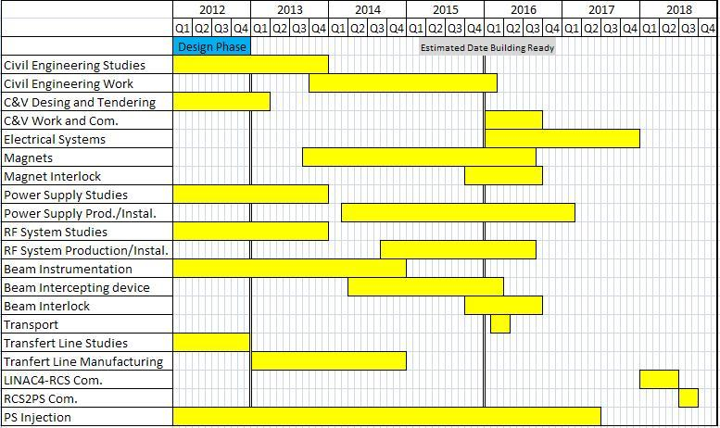
RCS – Draft Planning
Potentially first beam end of 2018…

Slide 17
Summary
2 GeV PS injector upgrade is required for LHC ultimate beams
Detailed study of PSB 2 GeV Upgrade available; can be achieved during LS2
Draft feasibility study for RCS end of July; if all goes well, might just be possible to commission end of LS2
HIE-ISOLDE would profit both from PSB 2 GeV Upgrade + Linac4 and from an RCS (main gain of 2 GeV for unstable isotope beams after T. Stora; additional gain through increased intensity or repetition rate)
Management decision hopefully this autumn
Further studies awaited from HIE-ISOLDE:
Conclusion on advantages/disadvantages for targets in both scenarios
In case of the RCS: could HIE-ISOLDE drop the 1.4 GeV beams?
Upgrade of BTY line for 2 GeV – what needs to be changed? (including shielding)
Notes:
PSB total upgrade cost: 37MCHF + 18 MCHF (consolidation) = ~55 MCHF
RCS cost estimate: ~145 MCHF + PSB dismantling
~factor 2.6

