Slide 1
RILIS operation
Presented to
Standing group for the upgrade of the ISOLDE facility
July 7, 2011
By V. Fedosseev

Slide 2
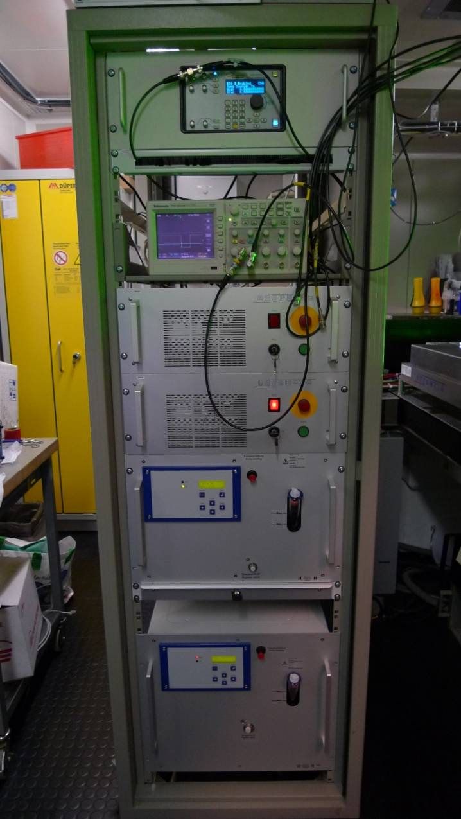
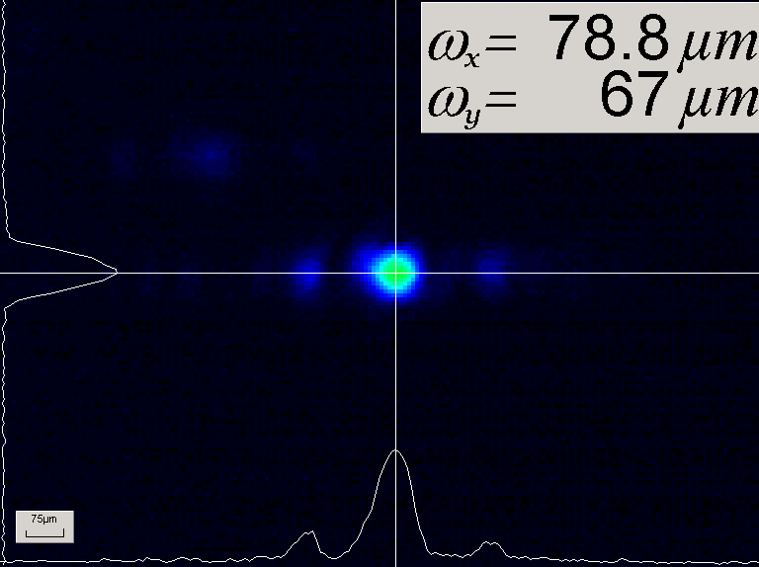
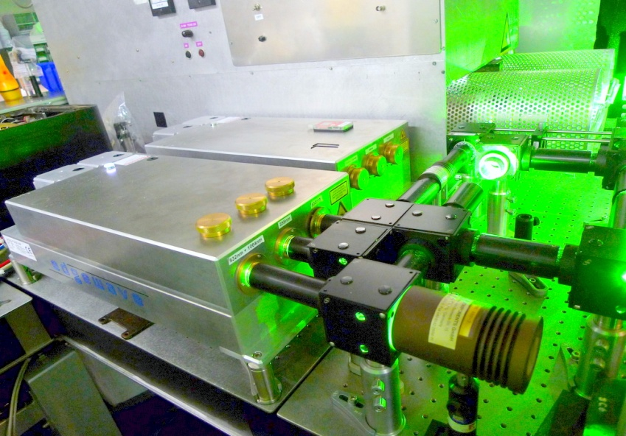
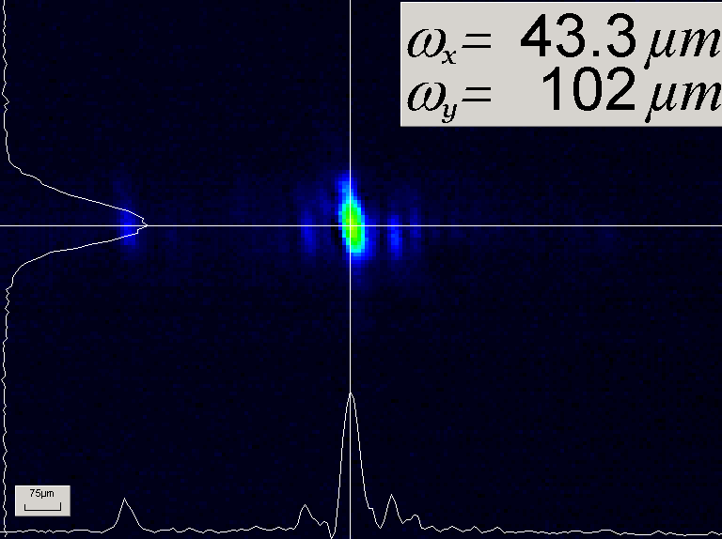
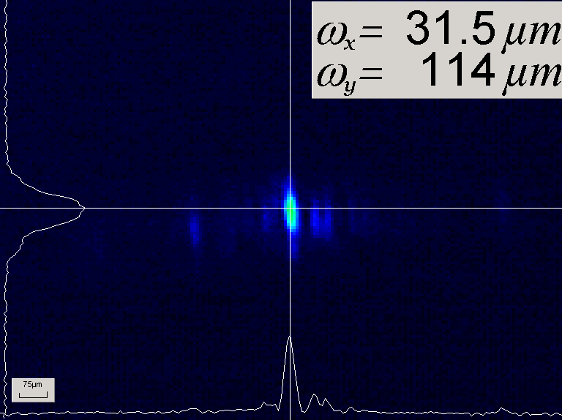
2008: First step of RILIS upgrade
Copper Vapor Lasers are replaced by Diode Pumped Solid State Nd:YAG Lasers
Two lasers are available:
one in use, second as a backup
Main green
beam
Residual green
beam
UV beam
Laser generates 3 beams at 10 kHz:
Main green beam – 532nm, 70-80 W, 8 ns
Residual green beam – 532 nm, 12-28 W, 9 ns
UV beam - 355 nm, 18-20 W, 11 ns

Slide 3
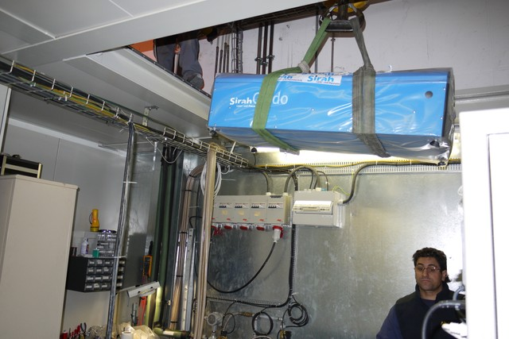
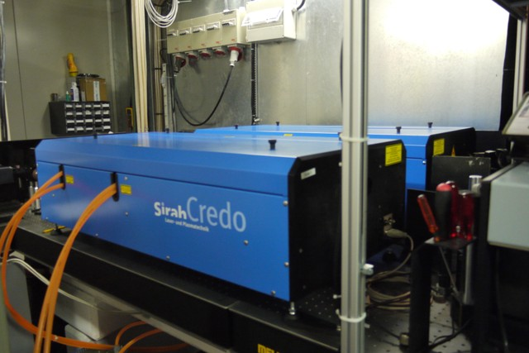
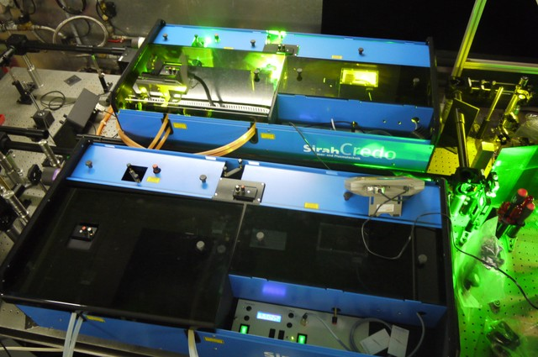
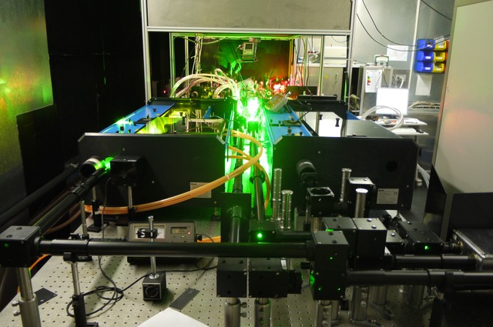
2009-2010: Second step of RILIS upgrade
New Dye Lasers installed
Benefits:
Greater efficiency and stability.
Higher UV power and better beam quality.
Enable UV pumping to provide beams in the 380 – 540 nm range.
Wavelength control via LabVIEW

Slide 4
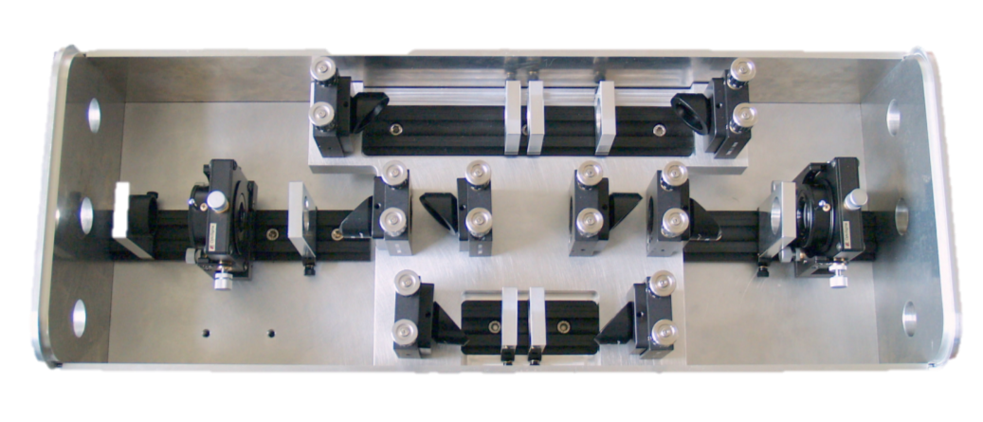
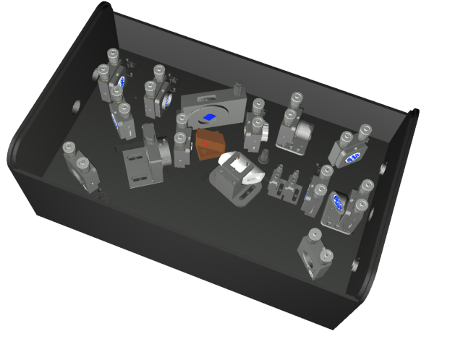
Ti:Sapphire lasers constructed and installed
2010-2011: Third step of RILIS upgrade
Ti:Sa design
Frequency conversion unit
designed by S. Rothe
Sirah 2
Ti:Sa
3ω, 4ω
Ti:Sa
3ω, 4ω
Sirah 1
Ti:Sa
NB-DL
NB-DL
Photonics
Photonics
Sirah 1
Sirah 2
Edgewave
Edgewave
Power
+ chiller
Edgewave

Slide 5
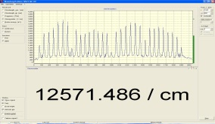
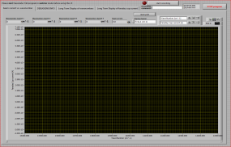
The 3 RILIS laser upgrade steps are now completed
1) Pump laser replacement
2) Dye laser replacement
3) Ti:Sa laser installation
RILIS Dye Laser System
λ – meter
Nd:YAG
Dye 2
SHG
Dye 1
THG
Master clock
Dye 3
SHG
GPS/HRS
Delay Generator
RILIS Ti:Sa Laser System
Target &
Ion Source
Nd:YAG
Ti:Sa 1
Ti:Sa 2
FHG
Faraday cup
SHG
λ – meter
pA – meter

Slide 6
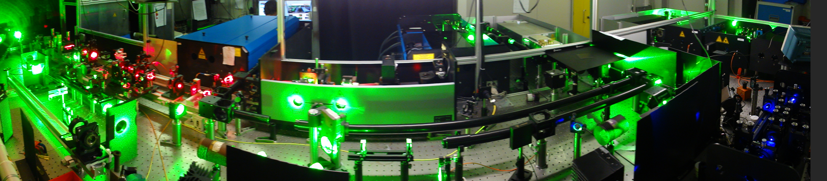
The complete RILIS Dye + Ti:Sa system
Improved HRS laser beam launch system with a 4th laser beam path for laser transport to ISCOOL
Sirah dye lasers with 2nd harmonic generation and UV pumping option
Edgewave Nd:YAG laser for dye pumping or non resonant ionization
Narrow band dye laser with computer controlled grating and etalon for high resolution spectroscopy or isomer selectivity
3 Ti:Sa lasers from Mainz university
Photonics Industries Nd:YAG pump laser for the Ti:Sa lasers
Harmonic generation unit for Ti:Sa system
Dye laser 3rd harmonic generator
RILIS cabin layout has been redesigned to accommodate the new lasers
Dye and Ti:Sa synchronization and compatibility for mixed ionization schemes has been verified online during the At run
Ti:Sa system is operating in testing/backup mode during 2011. It has so far been used for ionization of At and for Pr ionization scheme development
Optical pumping in ISCOOL should be tested during 2011 shutdown

Slide 7
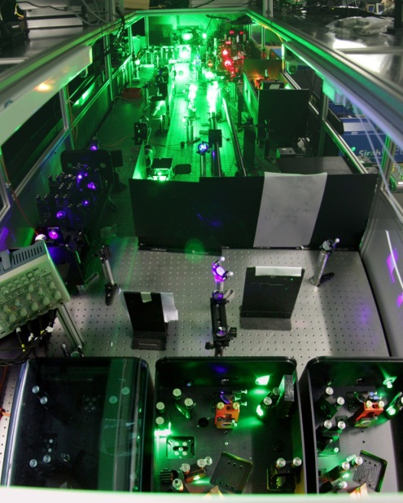
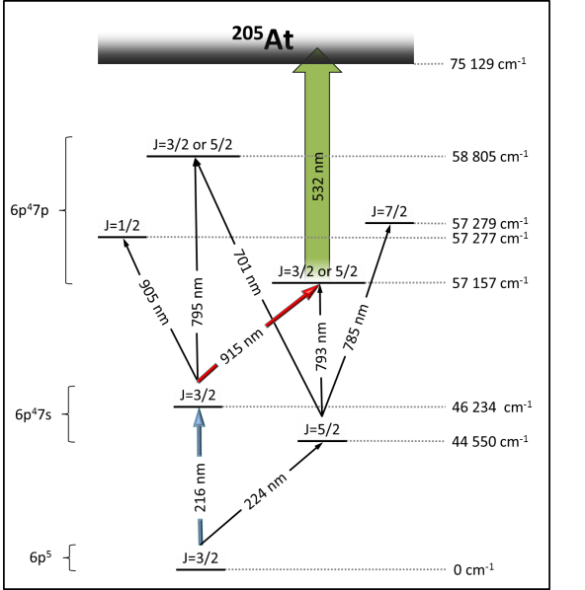
The new solid state Ti:sapphire laser system is operational
Successfully used for Beam development of astatine and first physics results (βDF)
Prerequisite for geared operation: Temporal synchronization of the two laser systems
Powerful dye pump laser can provide non-resonant step for Ti:Sa schemes
Mixed schemes are now possible: Blue -VIS step from Dye and NIR step from Ti:Sa
Laser beams produced by dye and Ti:Sa are exchangeable
New schemes possible
Backup solution
Unique for laser ion sources world-wide
Keep one dye set up for future, use Ti:Sa instead
Highest efficiencies
New elements
Reduction in down time
Outlook:
RILIS scheme development could become partly parasitic (e.g. astatine)
Wavelength stabilization under construction -> less maintenance
Pointing stabilization will be implemented
In Ti:Sa-only mode, RILIS could be on-call soon

Slide 8
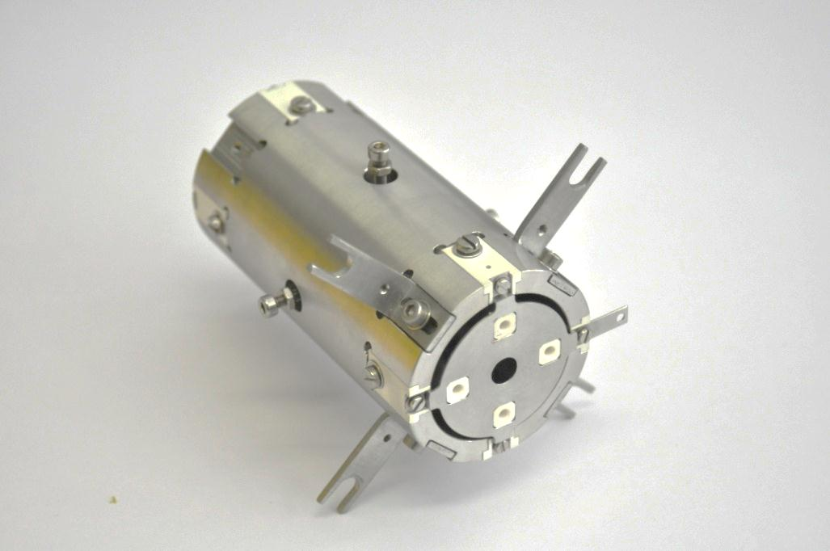
First On-Line Test of Laser Ion Source and Trap at ISOLDE
First on-line test of performance of the Laser Ion Source and Trap (LIST) at ISOLDE from 11/05/2011 untill 13/05/2011
LIST was implemented successfully at ISOLDE
LIST worked well over 2 days of proton taking
Measurement of
    suppression of isobaric contaminants
    Mg ionization efficiency
    yields of different isotopes etc.
1 cm
Preliminary Results:
Maximum Surface Ion Suppression of ≈ 3000
No significant change of performance after two days with protons
Different time of flight structures for different LIST settings

Slide 9
RILIS ion beams
Ion beams of 31 elements are produced at ISOLDE with RILIS
Recent new beams: Sm, At

Slide 10
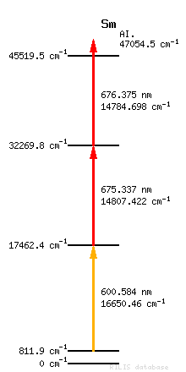
First RILIS Sm beam at ISOLDE
First RILIS run of 2011 with the refurbished RILIS room and new laser layout.
Attempted in 2010 with a GdB₆ low work function cavity
Re-tested in April 2011 with a standard Ta ionizer
Laser power before transmission to source:
No Sm was seen using the 2010 scheme but we discovered a discrepancy between two published values for the 1st step wavenumber. An alternative value was tested and determined to be the correct one.
5 W
1st step wave-number:
2010 test:
16654.21 cm⁻¹
2011 correct value:
16650.46 cm⁻¹
Efficiency measurement
ξ_{laser+surf} = 16 %
3.5 W
Ion current, A
1.5 W
All 3 transitions were saturated
Time, s

Slide 11
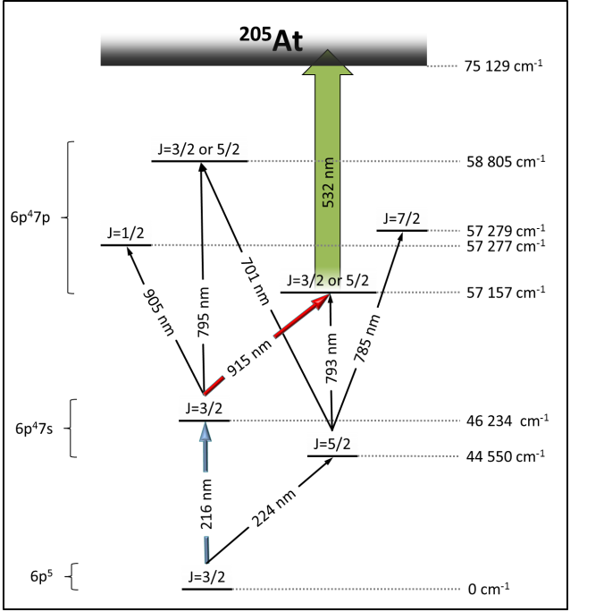
Astatine beam development
November 2010: I-086, Stage 1 completed
Confirmation of the two first excited states
first measurement of the ionization potential of At
May 2011: I-086, Stage 2a, Part 1 (NIR region) completed
energy levels found in Dec.2010 at TRIUMF confirmed
one new level observed, starting from 224 nm first step
6 ionization schemes were compared
up to 150 pA of ²⁰⁵At was obtained
224 nm
¹⁹⁹At
199
At
Scan
310
…
335 nm
216 nm
¹⁹⁹At
216 nm
224 nm

Slide 12
Dye + Ti:Sa range
24 ion beams can be produced either with dye or Ti:Sa lasers
Si, Ti, Fe, Ge, Pd, Hf, Pr are available
Ti:Sa ionization schemes for
Si, Ti, Fe, Ge, Pd, Hf, Pr are available
Dye scheme tested
Ti:Sa and Dye schemes tested
Released
from ISOLDE target
Ti:Sa scheme tested
Feasible
Not released

Slide 13
RILIS operation in 1994-2011
Laser ON time
in 2011:
~ 2500 h – expected
-> 52% of the Total running time of ISOLDE facility
870 h by today
Laser time per beam for the operation year 2011
Beam | Sm | Ga | Mg | At | Pb | Dy | Nd | Pr | Ag | Tl | Cd | Mn | Ni | Zn | Mg
Planned | 80 | 104 | 64 | 160 | 184 | 64 | 136 | 0 | 112 | 208 | 288 | 120 | 272 | 376 | 192
Real | 89 | 165 | 64 | 154 | 221 | 35 | 110 | 4

Slide 14
RILIS operators:
  2 CERN stuff members: Bruce Marsh, Valentin Fedosseev
  1 CERN fellow: Marica Sjodin (contract ends on 31.08 2011)
  2 PhD students: Sebastian Rothe, Daniel Fink
  ISOLDE Users (2 in average): Maxim Seliverstov, Dmitry Fedorov, Pavel Molkanov, ...
At present RILIS operation is organized in 8-hours shifts:
4 persons on shifts + 1 person on-call
Regular breaks in laser operation are needed for rest:
Not more than 3 weeks of work without free days.

Slide 15
RILIS remote monitoring / protection
Requirements for safe and reliable shift free RILIS operation fall into 3 categories:
Machine protection / safety
Performance monitoring
Automation
To avoid risk of equipment
damage or danger to personnel.
This must be a ROBUST system
(PC independent).
Remote monitoring of key
parameters with an alert system
to request operator intervention.
To maintain RILIS performance
therefore reducing the frequency
of operator interventions.
NON ESSENTIAL
ESSENTIAL
MACHINE PROTECTION/SAFETY
Laser stop
Laser shutter
STATUS
EMAIL
PERFORMANCE MONITORING
SMS
Mirror control
AUTOMATION
Laser control

Slide 16
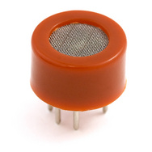
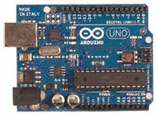
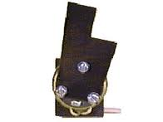
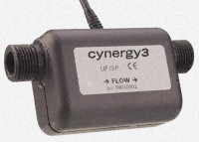
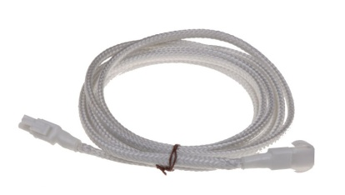
Machine protection/saftey
Dye Leak: Fire hazard; laser damage risk
Up to 6 dye circulators each containing up to 3 L of ethanol flowing at 7 L/min.
Action required: Stop pump laser, alert the laser operator.
Organic solvent
detector
(breathalyzer)
Pump laser control by
Hyper-terminal commands
and access to laser operator
alert system (LABVIEW based)
+
Micro-controller
and data logger
+
Dye flow interruption: Fire hazard; laser damage risk
Up to 40 W pump beam focused on dye cell. Almost immediate dye cell damage if dye flow stops.
Action required: Block pump beam to dye laser, alert the laser operator.
Solution to be tested:
Non invasive
dye flow sensor
(ULTRASONIC)
Laser beam shutter
Flip mirror/ beam
dump assembly
with controller
+
Micro-controller
and data logger
+
Water leak: Equipment damage risk; electrical safety hazard
Water cooling for Ti:Sa crystals. Water cooling network for each dye circulator.
Action required: Stop pump lasers, alert the laser operator.
Install water leak sensor cables on laser table and RILIS cabin floor
Include sensor data logger in RILIS monitoring system
By Bruce Marsh

Slide 17
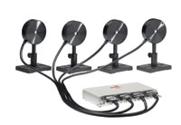
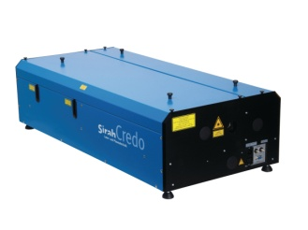
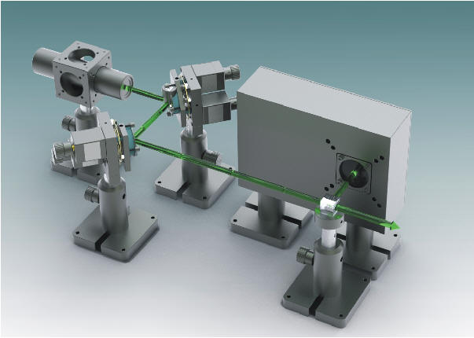
Performance Monitoring / Automation
Dye ageing, harmonic crystal damage Symptom: loss of laser power and ionization efficiency
Dyes have a finite lifetime (some hrs – 3/4 days depending on pump power)
Harmonic generation crystals can be damaged due to UV light absorption, particularly at <225nm
Power measurement at reference point or light leakage through optics
→
STATUS
RILIS status monitoring PC
configured to provide SMS
and email status alerts
Wavelength drifts Symptom: reduced ionization efficiency
Temperature fluctuations and mechanical instability can cause wavelength drifts. Even a small drift (<0.3 cm⁻¹) can significantly reduce the ionization efficiency.
STATUS
Laser control
software and
RILIS monitoring
system
Simultaneous measurement of all
wavelengths
→
→
Grating/etalon control
Beam pointing stability: Symptom: reduced ionization efficiency
Currently regular (~hourly) beam position adjustments are necessary. The biggest cause of a
beam position drift is the intermittent switching of the RILIS A/C unit. An improvement in the
air conditioning performance could be beneficial.
A commercial beam position stabilization device has been purchased. It should be able to stabilize short and long term beam position fluctuations for up to 3 laser beams.

