Slide 1

Welcome to the 4th I.FAST Annual Meeting
Last regular meeting before the final one in October at CERN.
It’s a pleasure to be in Krakow, and we warmly thank the local organisers, Dorota and Dariusz, and Valérie who has remotely prepared the event.
Programme highlights:
iFAST/EAJADE Workshop on Sustainability before the event, Tuesday 8 April 2025 all day.
Session on Innovation and Start-ups, Thursday 10/04 at 15:30.
Poster Session, Thursday 10/04 at 17:45-18:30 (please hang your posters already in the morning).
Presentation and discussion (Q&A) on the next accelerator R&D proposal, Friday 11/04 at 9:00.
+ Governing Board Meeting, Friday 11/04, 11:00.

Slide 2
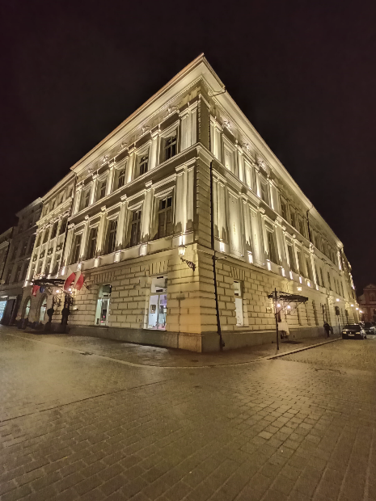

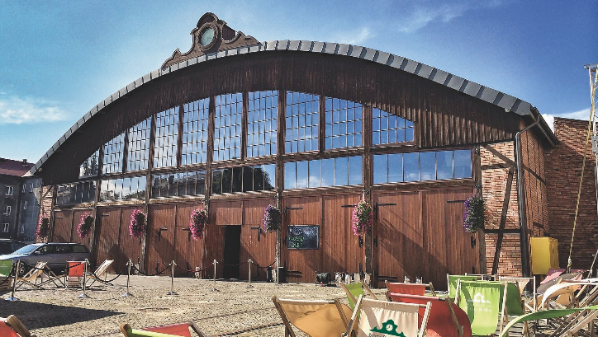
Social events
Welcome drink, Wednesday 9 April 2024, at the Grand Hotel.
Buffet lunch, Thursday 10 April, Polish Academy of Arts and Science.
Banquet dinner, Thursday 10 April, Stara Zajezdnia (Old Tram Depot) – reachable by tram.

Slide 3
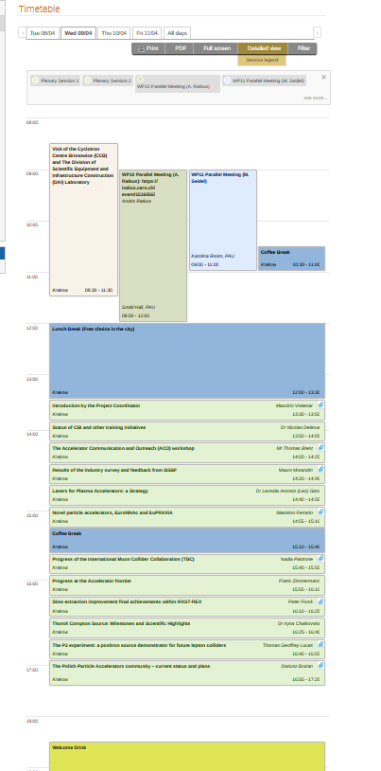
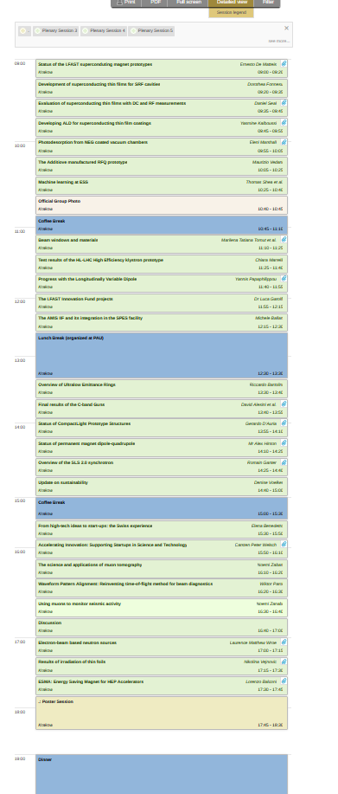
A rich agenda
Usual combination of reports on I.FAST activities and highlight talks.
Some basic recommendations to the speakers:
Always leave 5 minutes for questions at the end (included in your allocated time!).
Present the achievements but concentrate on the impact of your work (what will follow up): impact on science, society, or future projects.
When relevant, address the recommendations given by the SAC in their 2024 report.
Report on the status of the missing deliverables.
And:
Keep in mind to provide interesting stories to our new Communication Officer, Thomas Bent, for Accelerating News and other media.

Slide 4
Coordinator Report for the
4th I.FAST Annual Meeting
M. Vretenar, CERN, Project Coordinator
Krakow, 9 April 2025

Slide 5
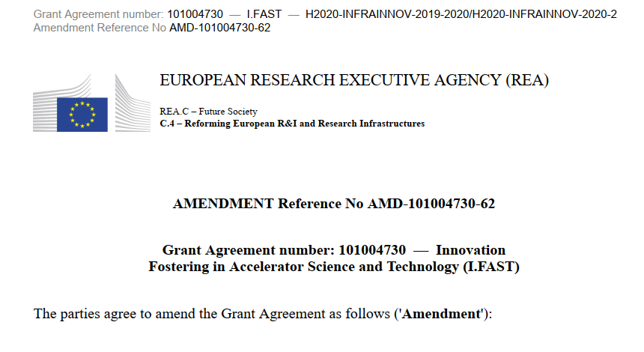
I.FAST since April 2024
Periodic Report 2 (October 2022 – April 2024) submitted on 30 June 2024.
Project review by the EC on 15 July. Periodic report approved; interim payment received on 15 October.
The status of our late deliverables was not improving in Autumn.
Letter asking for an extension of the project by 6 months for “force majeure” events (Covid, increase of material costs and delays, loss of key personnel) sent on 25 October, with rescheduling of major deliverables. Formal Amendment request started soon afterwards, incorporating many small updates.
Amendment (with extension) approved on 12 December.
Many thanks to the I.FAST WP and Task Leaders for the support during the administrative negotiation with the Project Officer, and in particular to Cloé for the efficient follow-up of all issues.

Slide 6
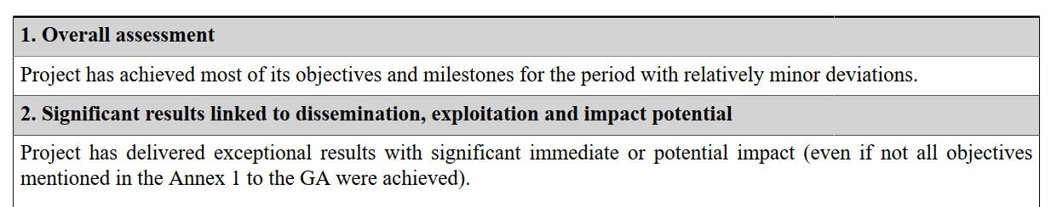
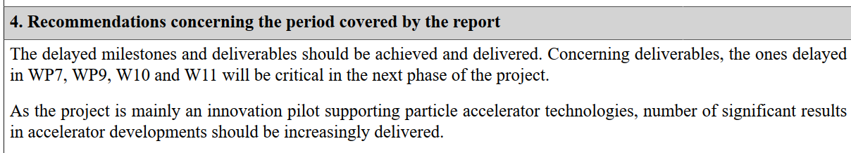
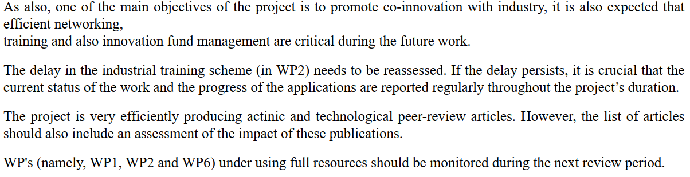
2nd Periodic Review – project assessment

Slide 7
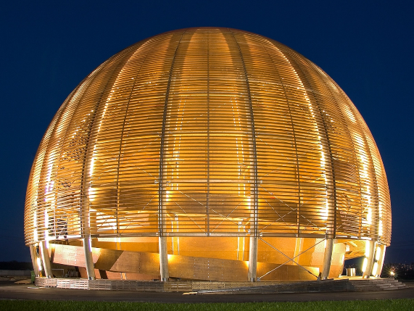

Profiting of the extension for a soft landing
End of Project 31 October 2025.
Final Report to be delivered by 31 December 2025.
Final I.FAST meeting Tuesday 21 – Wednesday 22 October at the CERN Globe.
Final Governing Board Meeting in March 2026.
Last payment (final instalment) around June 2026.
Procedure for Final Report (period 01.05.2024 – 31.10.2025)
September 2025: Task Leaders receive a template to be filled in.
End of October 2025: deadline for sending the contributions to Valérie, who assembles the WP Sections and sends them to WP Coordinators for validation.
15 November 2025: deadline for WP Coordinators to send WP chapters to Valérie.
End of November: complete document sent to WP Coordinators for approval.
15 December: Report ready for submission.

Slide 8
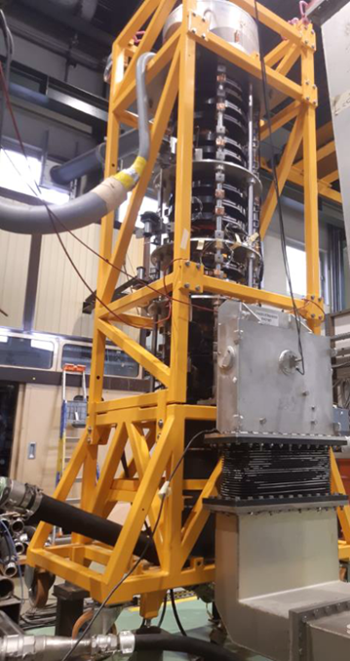
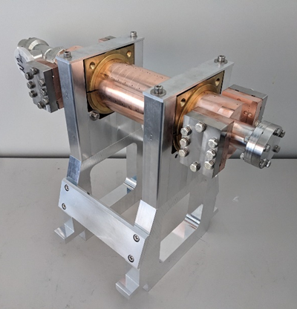
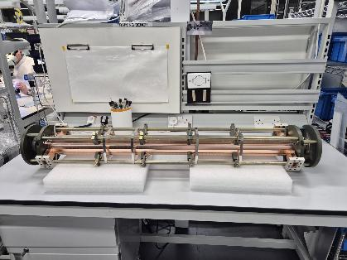
Scientific highlights 2024/25
A selection of key deliverables in 2025/24:
Beam windows prototypes (D4.3)
Machine learning at ESS (D10.5)
Thin films roadmap (D9.1)
Klystron prototype (D11.2)
Test of 2 RF guns (D7.4)
Roadmap for future accelerators (D5.2)
Sustainable accelerators report (D11.1)
Ripple mitigation for slow extraction (D5.3)
+ brazing of the first X-band structure

Slide 9
12 Deliverables to the end…
 |  |  | Resp. | M old | M new | Due | Status
1 | D7.5 | Construction of the XLS accelerating structure pre-prototype | ELETTRA | 24 | 44 | 31/12/24 | End March
2 | D5.1 | International collaboration plans towards a multi-TeV muon collider | INFN | 46 | 46 | 28/02/25 | in work
3 | D9.3 | First 6 GHz cavity coated and characterised | UKRI | 36 | 50 | 30/06/25 | Delayed M50
4 | D9.5 | 1.3 GHz Nb-coated cavity irradiated by laser in argon atmosphere and RF tested | RTU | 45 | 46 | 28/02/25 | waiting for cavity
5 | D11.3 | Prototype adjustable PM quadrupole and combined function magnets | UKRI | 28 | 46 | 28/02/25 | waiting for magnet
6 | D7.1 | Final report on the development of high brightness electron beams for light sources | DESY | 48 | 48 | 30/04/25
7 | D9.2 | RF test on coated resonant cavity | INFN | 46 | 50 | 30/06/25
8 | D7.6 | Construction of the XLS accelerating structure full prototype | ELETTRA | 36 | 50 | 30/06/25
9 | D8.4 | Construction of combined CCT demonstrator | INFN | 42 | 50 | 30/06/25
10 | D7.3 | Longitudinally variable bend prototype fabrication | CERN | 40 | 51 | 31/07/25
11 | D2.3 | Industrial training scheme | UU | 24 | 52 | 31/08/25
12 | D8.5 | Construction of HTS CCT demonstrator | INFN | 38 | 54 | 31/10/25
Please report during the presentations on the status of these deliverables,
In particular the 4 that are already late (Elettra, INFN, RTU, UKRI)

Slide 10
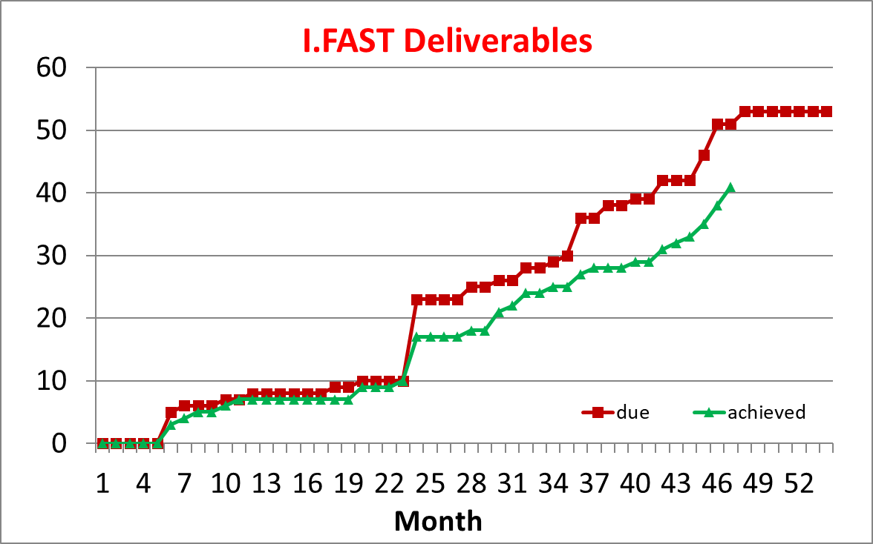
Status of Deliverables
On the positive side: good progress in the last months.
On the negative side: quality of some deliverables is going down (e.g., lacking references)

Slide 11
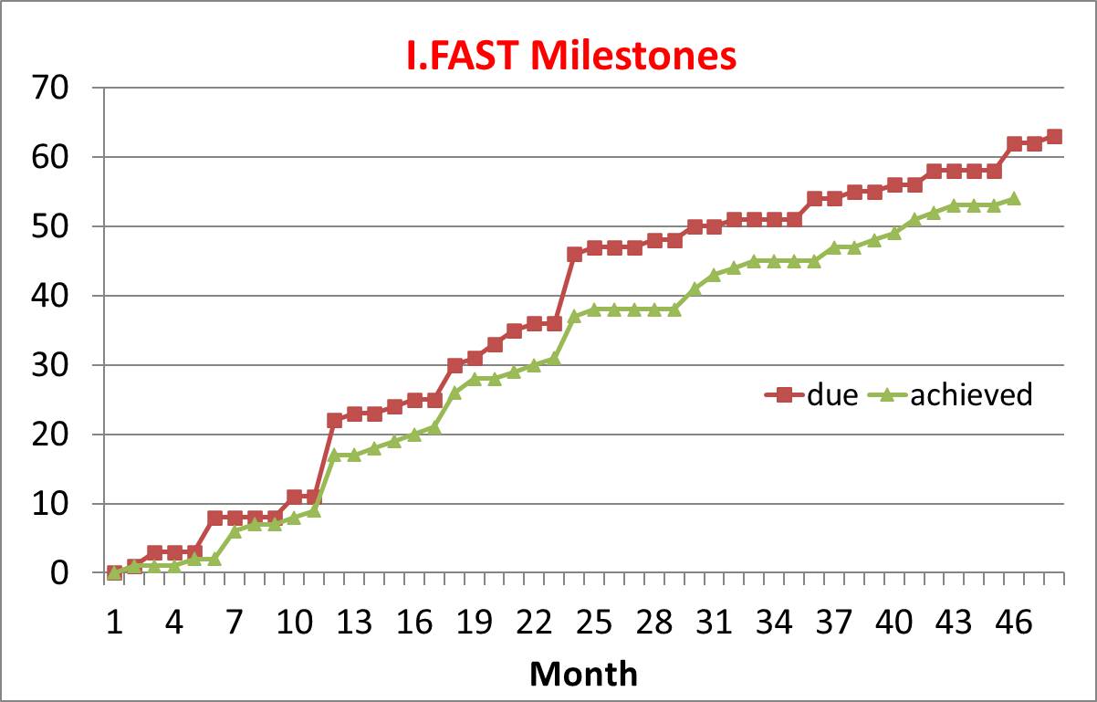
Missing Milestones and status
 |  |  |  |  |  | Month | Due | Status
1 | MS5 | ACO workshop | 2.2 | 18 | 31/10/22 | 24 |  | Workshop in March
2 | MS34 | Construction of the combined formers for CCT winding | 8.4 | 32 | 31/12/23 | 32 |  | Come in March
3 | MS16 | International workshop to define R&D plans | 5.1 | 36 | 30/04/24 | 36 | 30/04/24 | 90% ready
4 | MS56 | Magnets constructed and tested | 11.3 | 25 | 31/05/23 | 38 | 30/06/24 | With deliverable
5 | MS12 | IIF Projects final progress | 4.2 | 46 | 28/02/25 | 46 | 28/02/25 | In progress
6 | MS27 | Prototype acceptance tests | 7.3 | 46 | 28/02/25 | 46 | 28/02/25 | With deliverable
7 | MS29 | High-power test stand setup and final results of the high-power tests | 7.4 | 46 | 28/02/25 | 46 | 28/02/25 | 2 months delay
8 | MS19 | Ultimate hadron-beam brightness | 5.2 | 48 | 30/04/25 | 48 | 30/04/25 | In progress
9 | MS30 | Construction and RF tests of CompactLight accelerating structure prototype | 7.5 | 21 | 31/01/23 | 48 | 30/04/25 | With deliverable
(MS5 just received)
Still 8 missing.

Slide 12
Instructions to presenters at this meeting
Always leave 5 minutes for questions at the end (included in your allocated time!).
Present the achievements, but concentrate on the impact of your work (what will follow up): impact on science, society, or future projects.
Address the recommendations given by the SAC in their 2024 report (next slide).
Report on the status of the missing deliverables.
And:
Keep in mind to provide interesting stories to our new Communication Officer, Thomas Bent, for Accelerating News and other media.

Slide 13
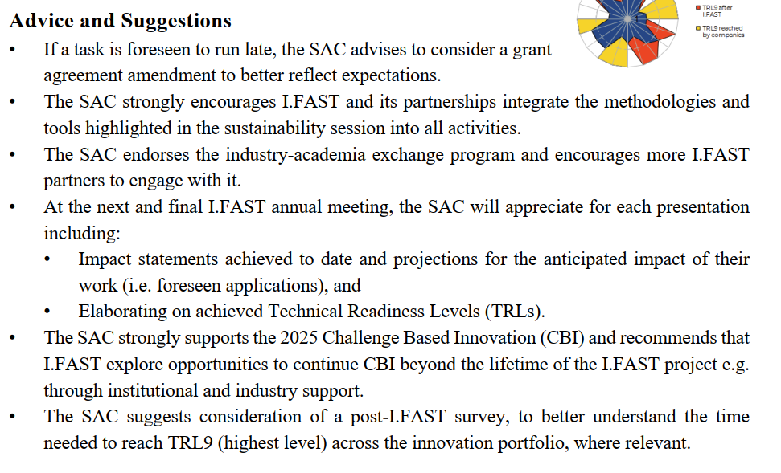
SAC 2024 Recommendations
Two SAC members are with us in Krakow: M. Minty and C. Welsch. A. Yamamoto excused himself, attending another meeting.
Done
Ongoing
Done
Communicated
Done
For final report

Slide 14
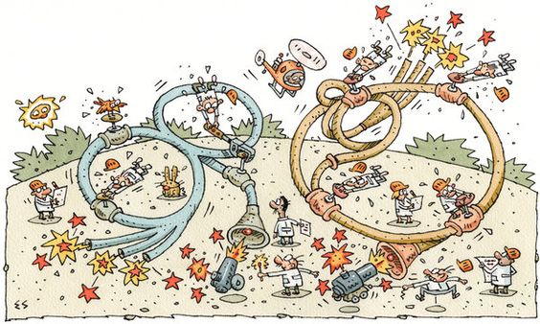

Thank you for your attention
Image credit: Elwood Smith, NYT
And please do not forget to acknowledge the I.FAST Contribution in all your publications!
This project has received funding from the European Union’s Horizon 2020 Research and Innovation programme under GA No 101004730.

