Slide 1
Accelerator communication & outreach workshop
Thomas Brent, CERN, 2.2 Task Leader – I.FAST

Slide 2
Mission – Milestone MS05. Task 2.2
“Engage the network of communication officers from the major institutes of the European accelerator community in knowledge-sharing and in developing closer collaborative ties”

Slide 3

The workshop
March 2025: www.indico.cern.ch/event/1474373

Slide 4











Slide 5
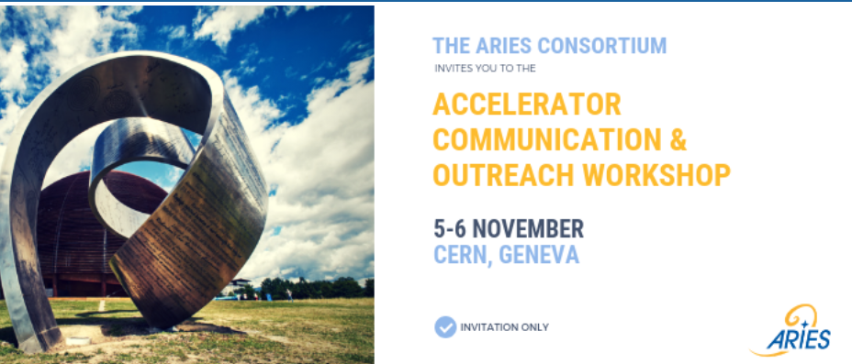
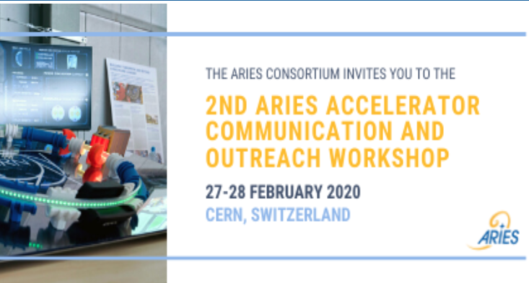
Previous workshops
November 2018: https://indico.cern.ch/event/760778/
February 2020: https://indico.cern.ch/event/877001/

Slide 6
Competitiveness

Slide 7
What is competitiveness?
Is it:
Having the top researchers?
Having more start-ups and/or unicorns?
Having bigger businesses?
Having IP in key technologies?
Having the most cutting-edge research facilities?
Turning the most profit from the tech sector?

Slide 8





Slide 9

What should communicators at accelerator facilities do about this?

Slide 10
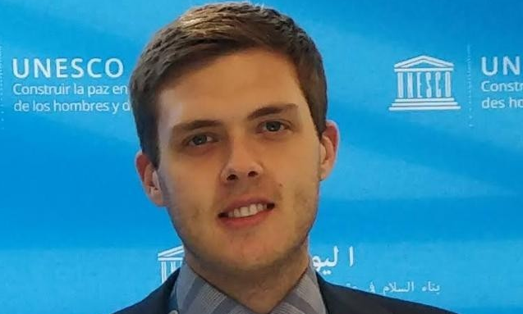
The speakers
Alexander Blūms, Latvia’s science attaché in Brussels
Why scientific competitiveness is a growing priority in Europe
Summary of recent policy trends in research and innovation

Slide 11
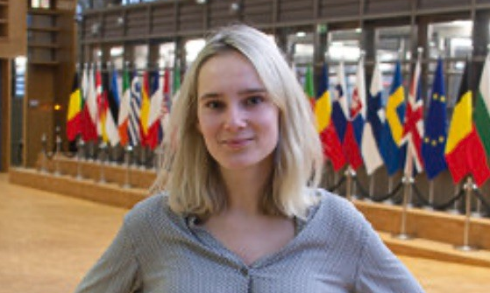
The speakers
Goda Naujokaitytė, journalist and editor at Science|Business
Building networks with journalists to communicate about competitiveness
Which stories attract media attention?

Slide 12
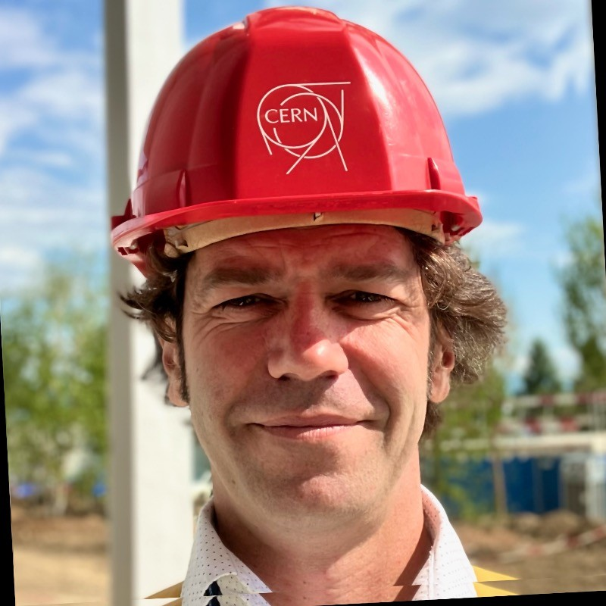
The speakers
Arnaud Marsollier, head of Education, Communication & Outreach at CERN
Experience of communicating accelerator facilities
The importance of inter-institutional networks

Slide 13
Outcomes
An excellent opportunity to speak openly with peers from other accelerator facilities – we share similar challenges!
We now have a private LinkedIn page to keep in touch and grow the network of comms officers
We will have an article about the workshop in Accelerating News in June, and a short snippet in the CERN Courier.
We are planning future events and exchanges to keep up the networking

Slide 14
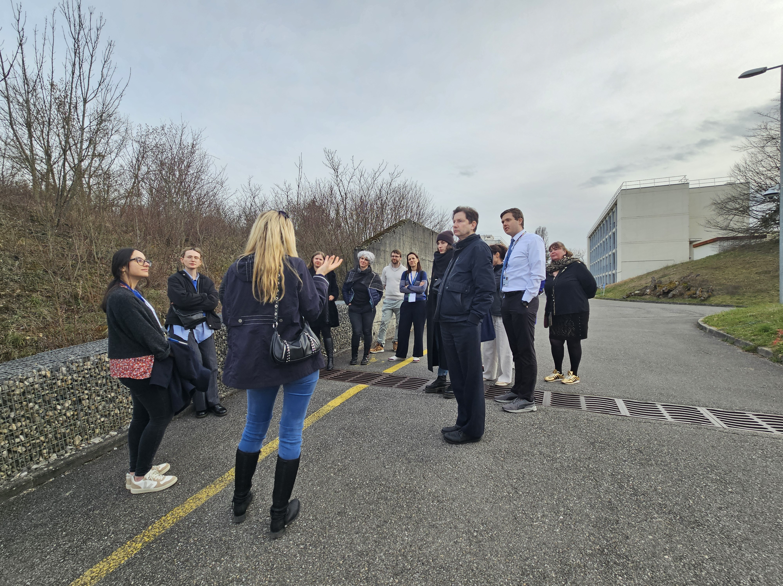
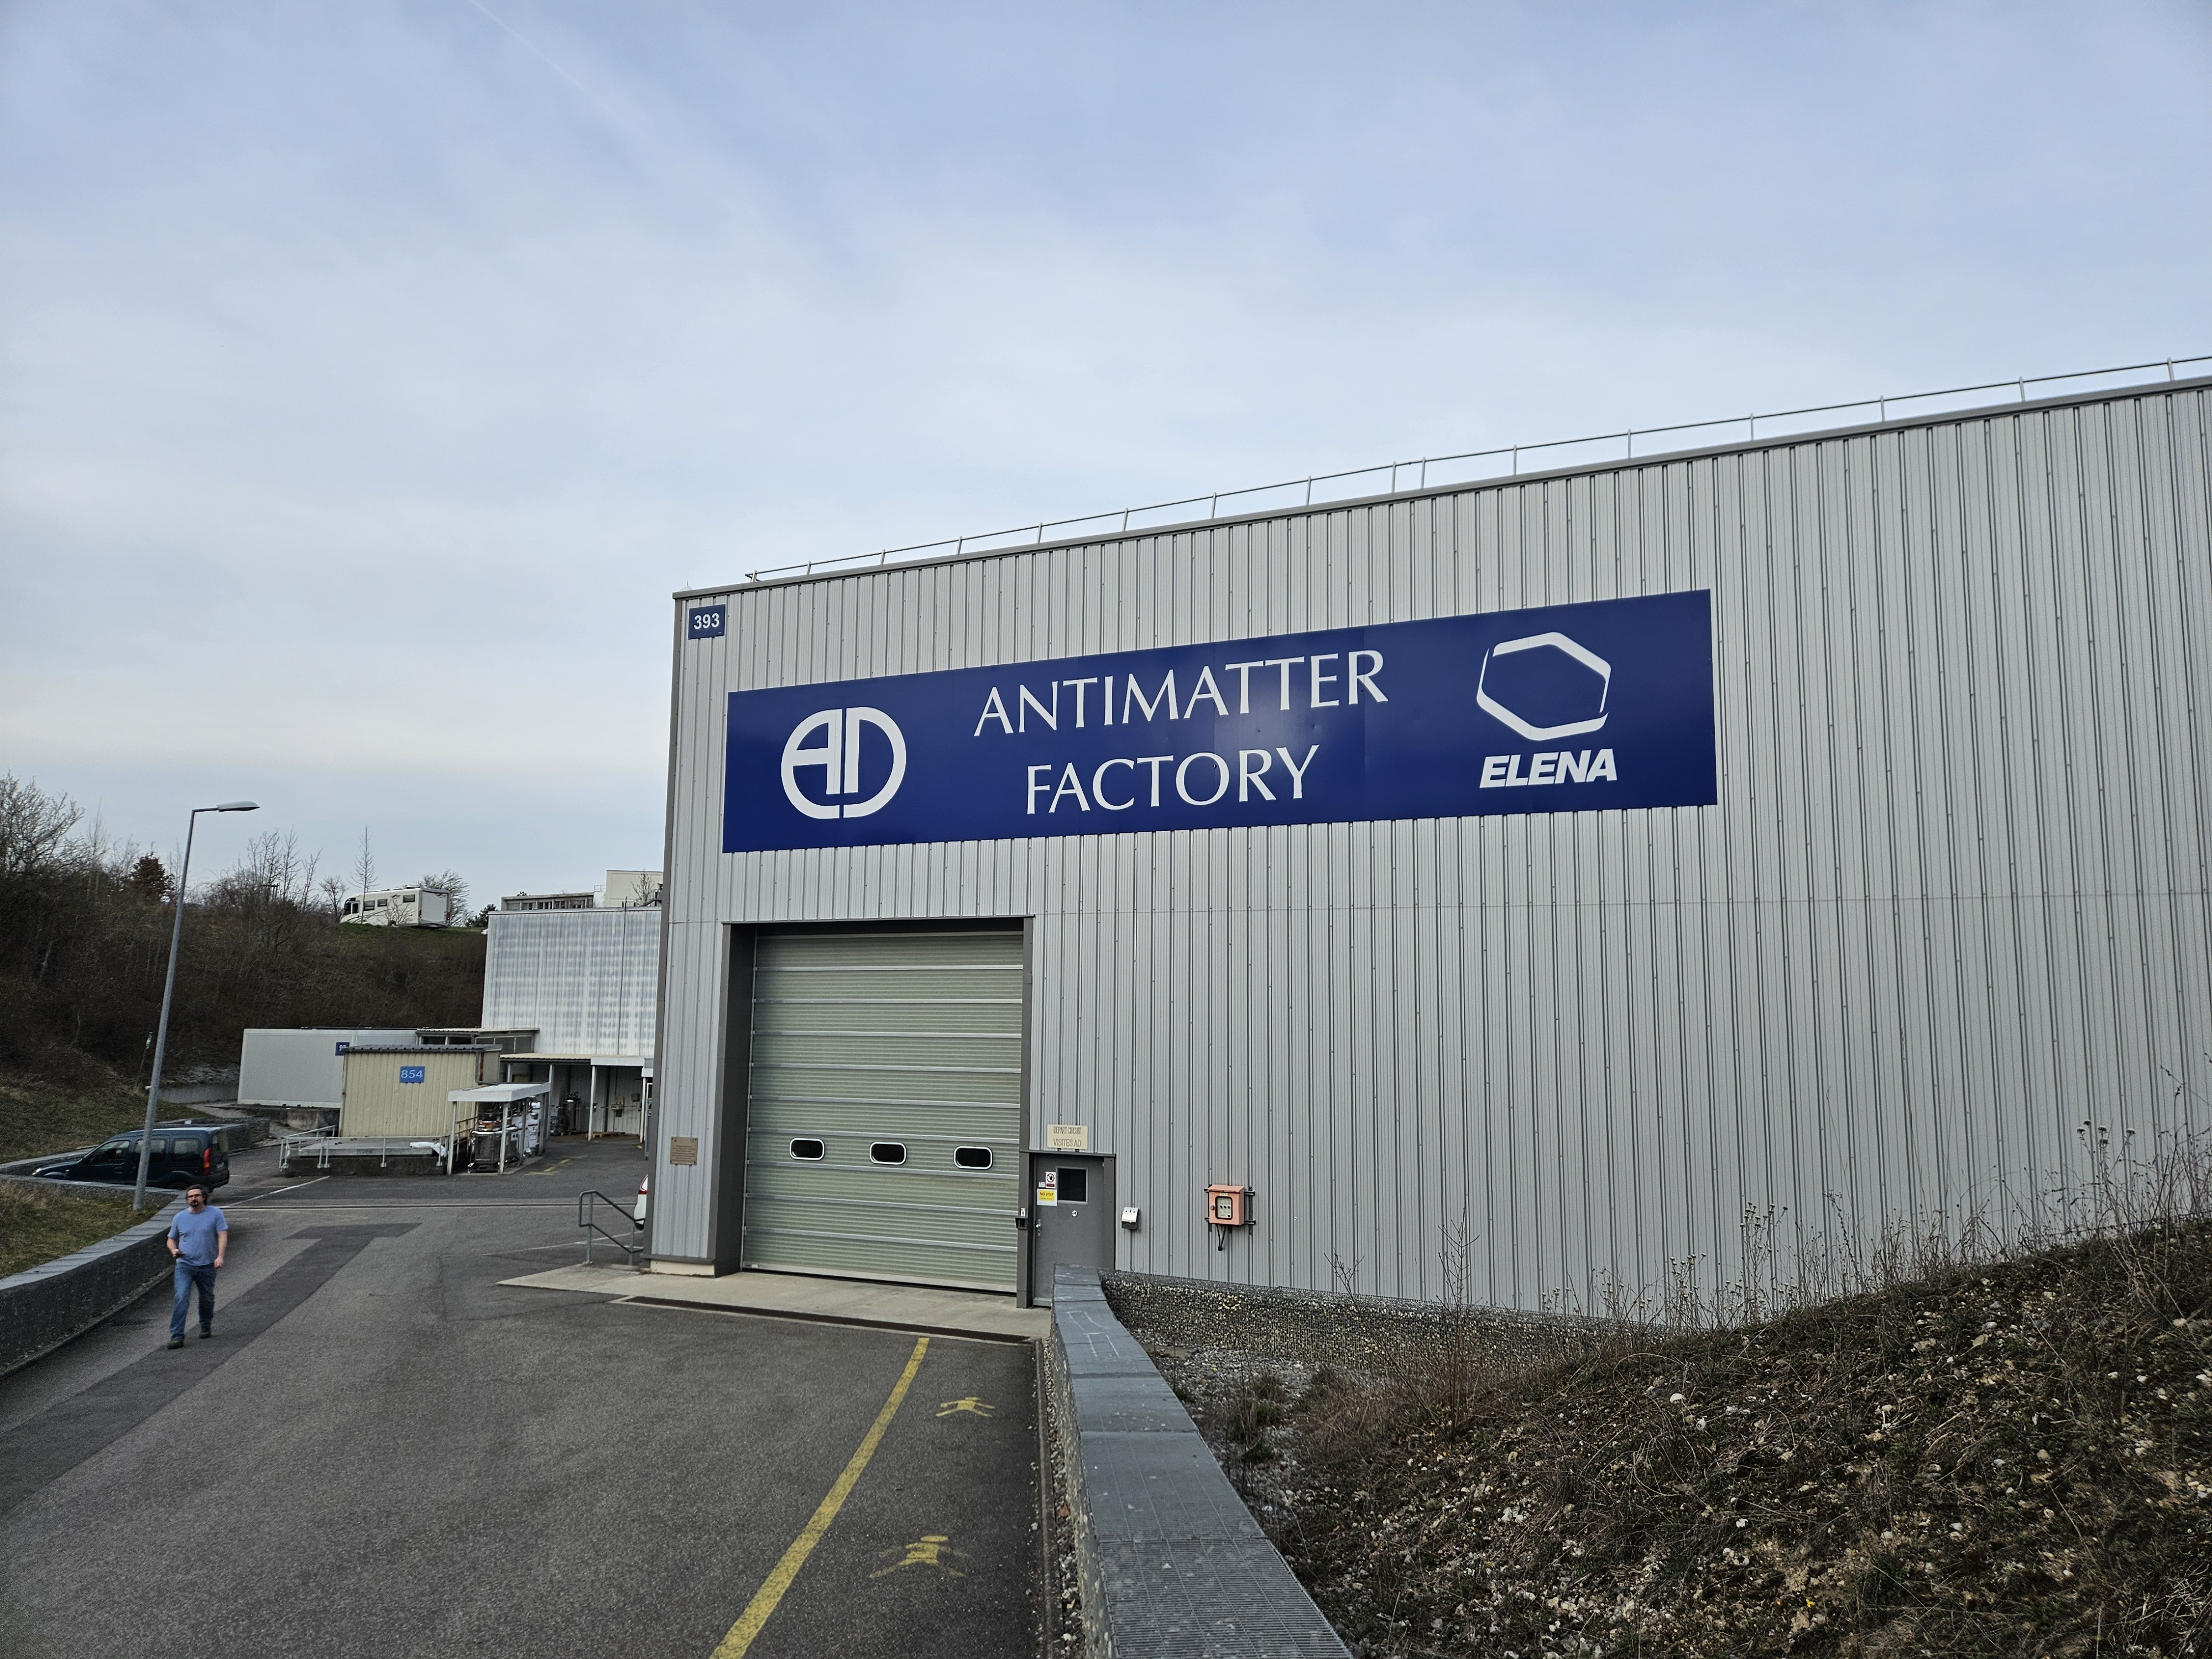

Slide 15
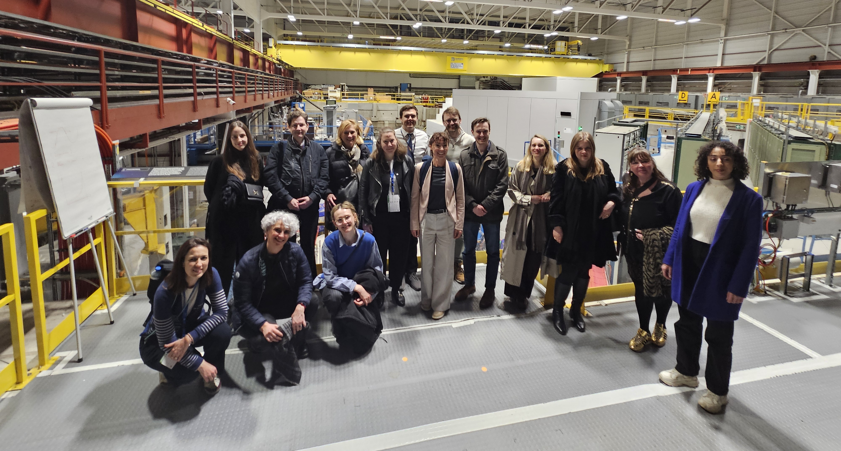

Slide 16
Questions?

