Slide 1





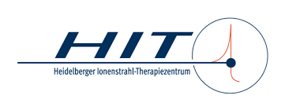



IFAST Prototyping Activity
REX Resonant EXtraction Improvements:
Final Achievements
Work Package 5 Task 3
4th Annual Meeting / 9th April 2025
Peter Forck & Rahul Singh (GSI) on behalf of the consortium

Slide 2
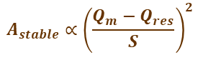
Challenge for slow Extraction from Synchrotrons
Slow extraction: Gentle beam excitation at 3rd order resonance
Beam physics: Extraction as ‘slow losses’ for 1 … 10 s
Particle crosses stability boarder sequentially
Exponential amplitude growth during ‘transit time’
≈ 50 … 1000 turns to reach septum for extraction
Schematics for knock-out extraction:
Stored beam horizontal phase space at electrostatic septum
x’
Knock-out extraction:
Transverse excitation
diffusion of core to separatrix
Signal-induced fluctuations
separatrix
ele.-stat. septum
Problem: Sensitivity to any unintended resonance condition, e.g.:
Change of tune: unintended quadrupole current ripple
Stochastic amplitude excitation of ‘knock-out’ extraction
thickness
$$A_{stable}∝{\left(\frac{Q_{m}−Q_{res}}{S}\right)}^{2}$$
extr.
channel
x
Mitigation research within IFAST-REX with two directions:
Improved technical devices
• Improved power supply measurement for magnets
→ TRL 7 reached
• Novel transverse excitation for knock-out extraction
→ TRL 7 reached
Beam stabilization simulation & experimental validation:
• Simulation and experimental validation
• Tailored beam-based tests
Unintended quadrupole current ripple
⇒ tune ripple
⇒ bursts extracted
transit time T_{transit}
last spiral step x_{step}
after 3 turns
Sextupoles: non-linear fields
Ion’s amplitude growth per turn
⇔ T_{transit} & x_{step}
Phase-
space
X’
Approaching
3rd order
resonance
X’
X
X

Slide 3
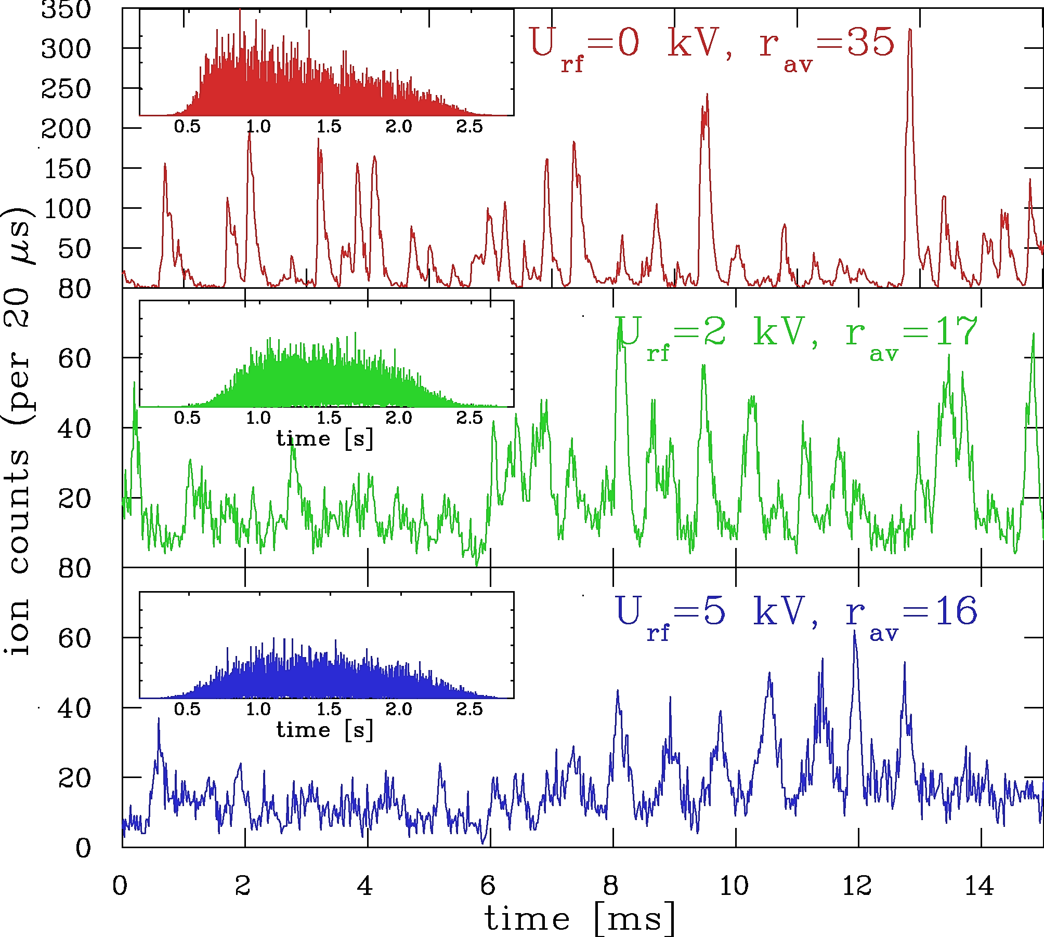
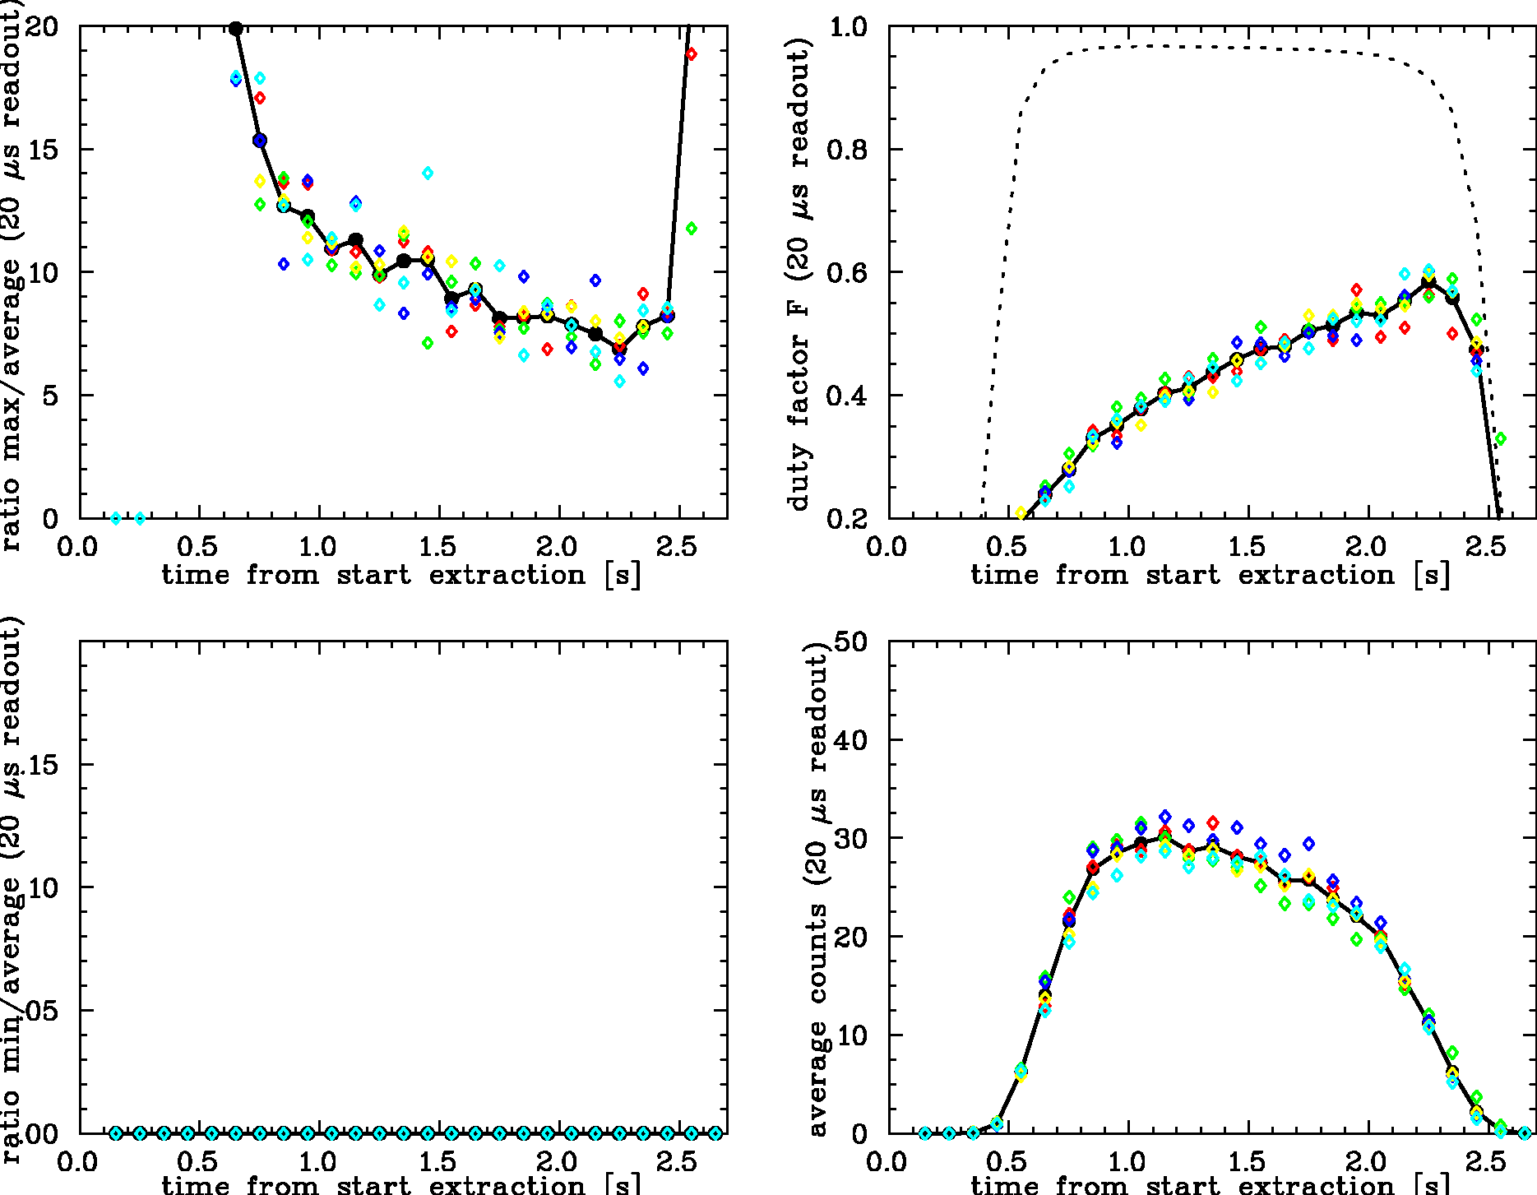
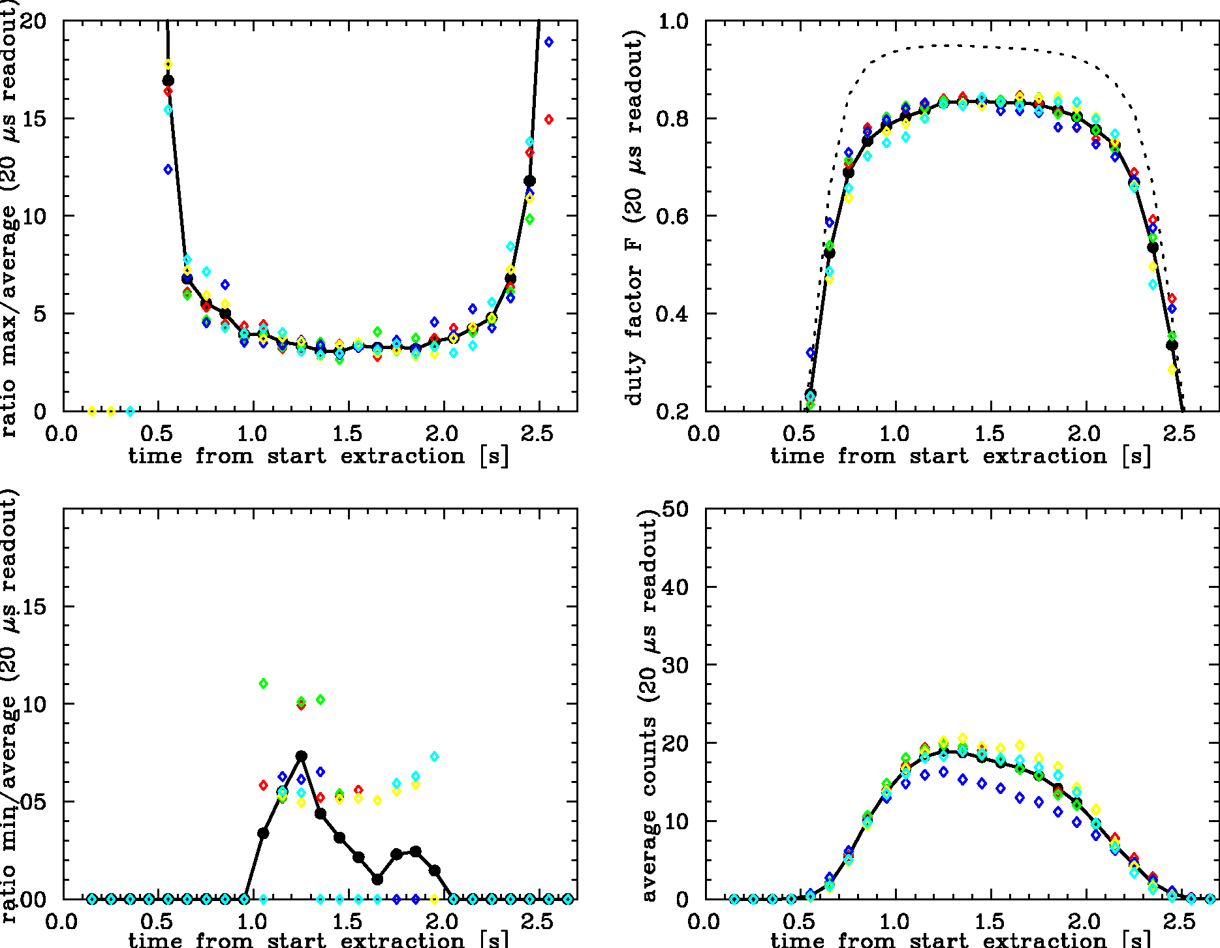
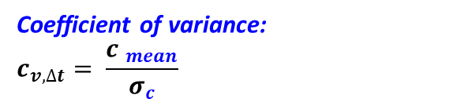
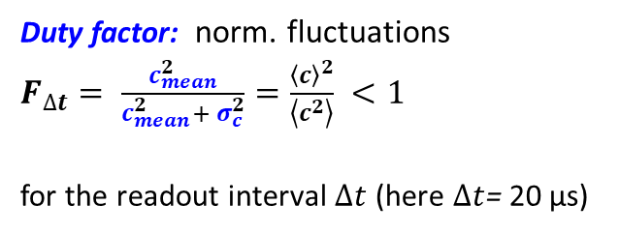
General: Beam Fluctuations for slow Extraction
Slow extraction: Gentle beam excitation at third order resonance
Problem: Fluctuations of the extracted beam (before systematic optimization)
Example: C⁶⁺ at 300 MeV/u at GSI, quadrupole scan, 2.5 s extraction called ‘spill’; coasting & bunched beam
Time domain:
Small fluctuation ⇔ ‘good’ spill
coasting beam
20 µs readout interval
Poisson limit
Duty factor: norm. fluctuations
$F_{∆t}= \frac{c_{mean}^{2}}{c_{mean}^{2}+ σ_{c}^{2}}=\frac{{\left\langle c\right\rangle }^{2}}{\left\langle c^{2}\right\rangle } <1$
for the readout interval $∆t$ (here $∆t$= 20 µs)
c_{mean}=35
Large fluctuation
⇔ ‘bad’ spill
bunched beam
Coefficient of variance:
$$c_{v,∆t}= \frac{{c }_{mean}}{σ_{c}}$$
Poisson
limit
Improvement by bunching:
Medical facility: Readout time typ. 100 µs used since years; however, improvement required
GSI & CERN: Not acceptable for nuclear & particle physics as related to detector deadtime

Slide 4
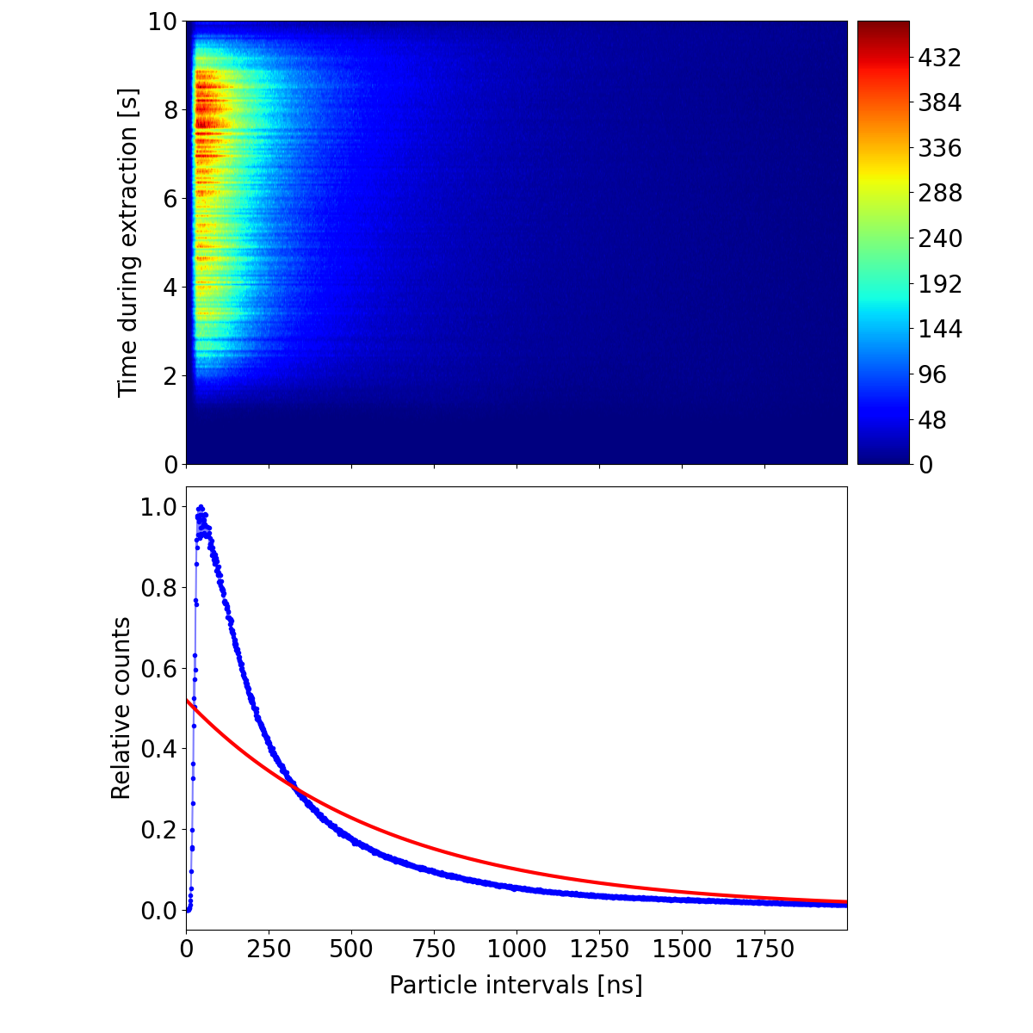
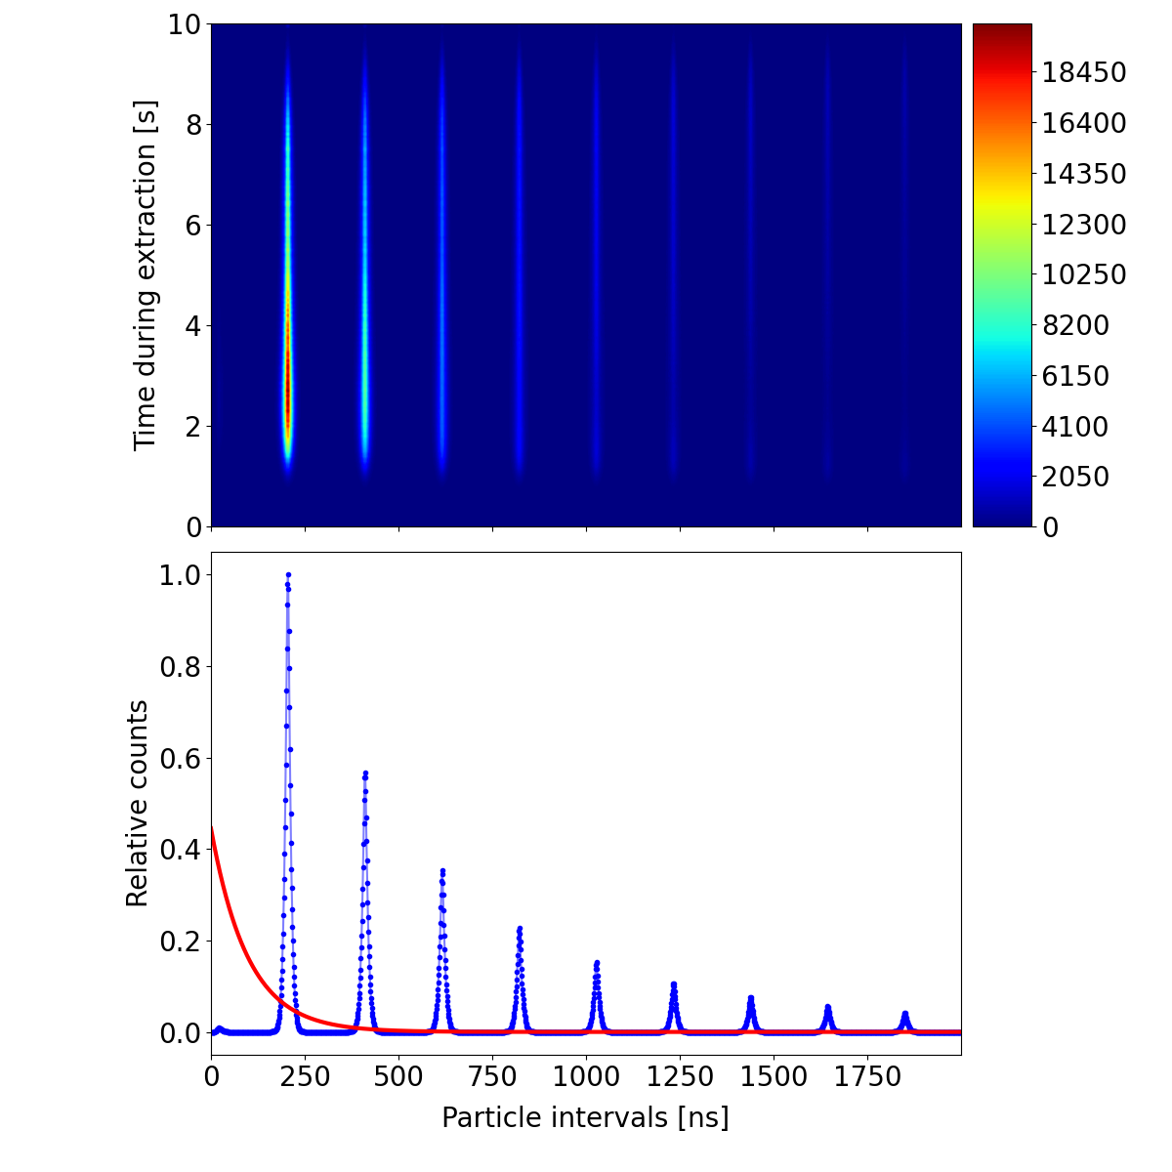
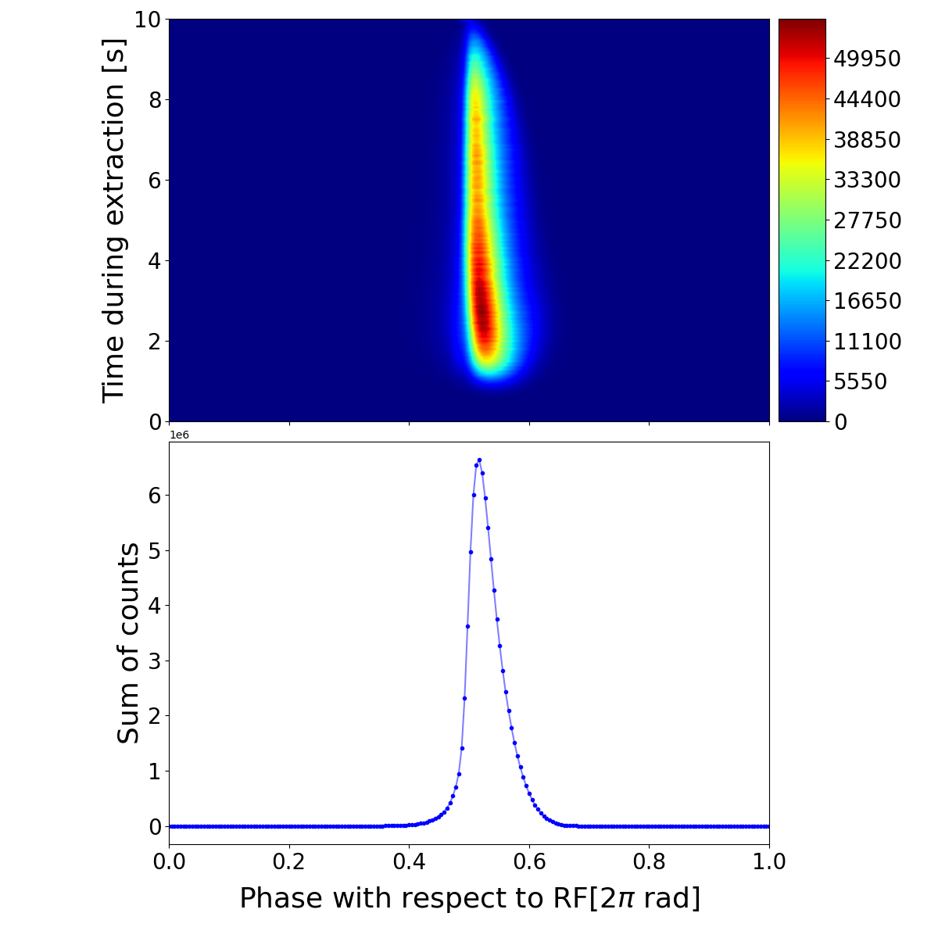
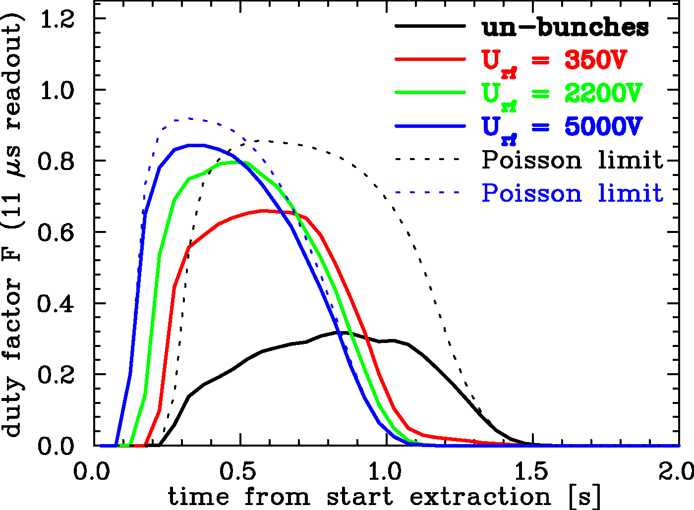
Spill Detector Development Measurement Example : Arrival Time with TDC
Bunched beam extraction U_{rf} = 3.1 kV
Topic: Bunched beam extraction
GSI measurement
Coasting beam extraction
time rel.
to rf
Results:
Measurement of ion arrival versus rf & ion time interval:
Costing beam: Quite ‘non-Poisson’
extraction 10 s
Bunched beam: wider interval distrib. ⇔ better duty factor
Bunched beam: Short ‘bunches’, ≈ 1/3 of stored bunch
→ acceptable for med. facilities,
→ but not at GSI & CERN fix target exp.
measure
measure
mean interval = 1/r_{mean}
mean interval = 1/r_{mean}
Small fluctuation ⇔ ‘good’ spill
coasting
Poisson
Poisson
time 2 µs
time 2 µs
time 200 ns
Beam: f_{rf} = 4.96 MHz
Large fluctuation
⇔ ‘bad’ spill
Beam: Bi⁶⁸⁺ 300 MeV/u
f_{rf} = 3.62 MHz
Remark: Possible mitigation by bunching at ≈ 80 MHz
T. Milosic et al., IBIC’21
J. Yang et al., IBIC’22

Slide 5
Experiment: Investigation of Extraction Signal Type
Topic: Spill micro-structure dependence on signal type for knock-out extraction
by GSI with contributions by HIT, CERN and MedAustron for coasting beam
Multi-band excitation types and comparison to traditional single band: Tests at COSY (FZ-Jülich)
Noise at baseband
Noise at 3 bands
Noise at baseband plus
sine at two harmonics
Large fluctuation,
⇔ ‘bad’ spill
small fluctuation,
⇔ ‘good’ spill
However: Different rf excitation power required
Noise++ is good compromise
Large power from rf-amplifier (typ. 2x400 W), see below
Such systematic comparison performed for the first time!
P. Niedermayer, R. Singh.,
Scientific reports, 14, 10310 (2024)

Slide 6
Simulation: Investigation of Extraction Signal Type
Topic: Spill micro-structure dependence on signal type for knock-out extraction
by GSI with contributions by HIT, CERN and MedAustron
Normalized horizontal phase space:
Particle density shortly before extraction
Simulations by Xsuite and explanation
Simulation: Single particle tracking (COSY parameters)
Beam dynamics: Non-linear Hamiltonian
as representation of particle transverse energy
(Kabayashi Hamiltonian description)
Normalization to separatix value H_{sep}
Distance to separatix and dynamic evolution
Results:
Prior to extraction, distance from separatrix varies
Crossing separatrix depends on excitation type
Large distance and fast crossing preferred
Less sensitive to separatrix variation
Less sensitive power supply ripple
Better spill micro-structure achieved
Normalized Hamiltonian 5 ms prior to extraction:
power supply
ripple
P. Niedermayer, R. Singh.,
Scientific reports, 14, 10310 (2024)

Slide 7
Experiment: Investigation of high Harmonics Excitation
Topic: Spill micro-structure dependence on harmonics of betatron-frequency
by GSI and HIT; measurement at HIT with coasting beam C⁶⁺ 251 MeV/u, excitation by phase-shift keying RBPSK
Systematics for harmonics $h$ of betatron frequency $f_{ex}=(h±{q_{x})f}_{rev}$ excitation:
⇒ higher harmonics preferred
⇒ multi-band preferred
Fluctuations for dual harmonics excitation:
Fluctuations for single harmonics excitation:
Large fluctuation
⇔ ‘bad’ spill
Blue: upper side-band
Orange: lower side-band
Red: upper & lower side-band
Blue: upper side-band
Small fluctuation ⇔ ‘good’ spill
Orange: lower side-band
Hardware: Software Defined Radio & new high-bandwidth rf-amplifier from Barthel HF Technik
Such systematic comparison performed for the first time!
P. Niedermayer et al. (GSI & HIT)
In preparation for Phys. Rev. Accel. Beams
& arXiv:2503: 11285v1

Slide 8
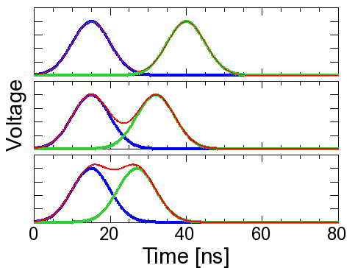
Experiment: Investigation of high Harmonics Excitation
Topic: Spill micro-structure dependence on harmonics of betatron-frequency
by GSI and HIT; measurement at HIT with coasting beam C⁶⁺ 251 MeV/u, excitation by phase-shift keying RBPSK
Capability for counting experiments: characterization by particle’s delay
⇒ High harmonics lead more uniform distribution
Integral distribution of particle interval:
Pile-ups as a function of harmonics:
Pile-ups scheme:
7th harm.
Many pile-ups
trigger level
1st
pulse
2nd
pulse
→ separated
Base-band
signal
almost overlap
Few pile-ups
Pile-up
Hardware: Software Defined Radio & new high-bandwidth rf-amplifier from Barthel HF Technik
Such systematic comparison performed for the first time!
P. Niedermayer et al. (GSI & HIT)
In preparation for Phys. Rev. Accel. Beams
& arXiv:2503: 11285v1

Slide 9

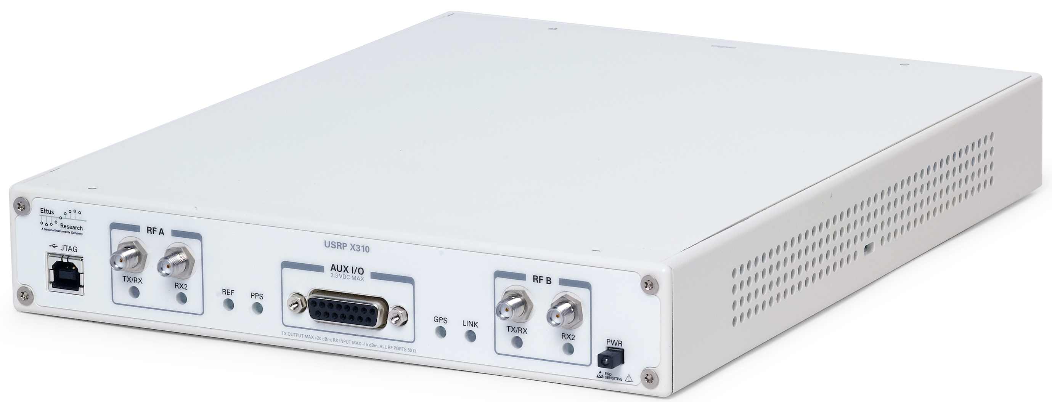

Technology: Control of Knock-out Excitation
Topic: Technical realization for ko extraction control
by GSI and HIT, with contributions by MedAustron
PC
DSP with GNU Radio
Signal chain
beam
control
Control hardware: Universal Software Defined Radio USRP:
Low-cost commercial hardware
High performance ADC & DAC
Highly customizable due to large FPGA
Software:
Flow-graph design by as Open Software
Very complex signals generation exp. tests with reasonable effort
Shift of several application to FPGA
⇒ Latency after trigger significantly improved
⇒ Contribution to GNU-based software by GSI
stripline
kicker
data
rev. freq.
USRP
ADC/DAC with FPGA
180°
excitation
signals
trigger
180⁰ spitter
ampl.
Signal generation (GSI,MedA,HIT)
Collaboration efforts at GSI and MedAustron, for test at HIT (due to legal issues) ⇒ Operational at GSI (& HIT), tests at MedAustron
TRL 7 reached (only TRL 6 promised)
Universal software defined radio
USDR Ettus X310
DAC: 16 bit, 200 MS/s
Analog bandwidth: > 100 MHz
Max. output voltage 1.8 V
FPGA: 400k cells, clock rate 200 MHz
P. Niedermayer and R. Singh, IBIC’22 & ‘23

Slide 10
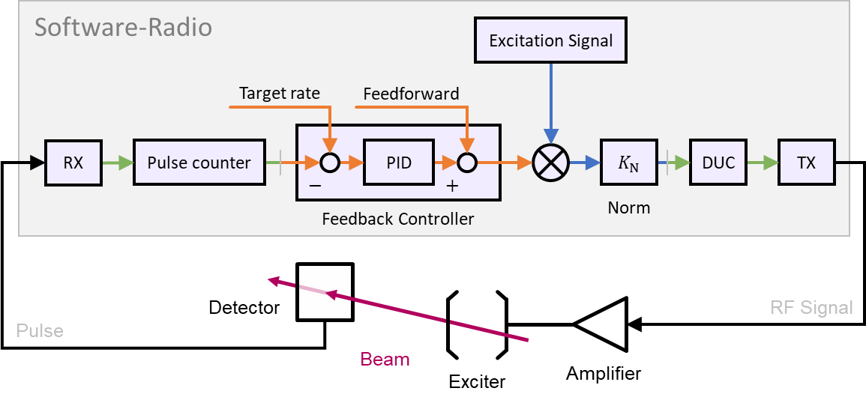
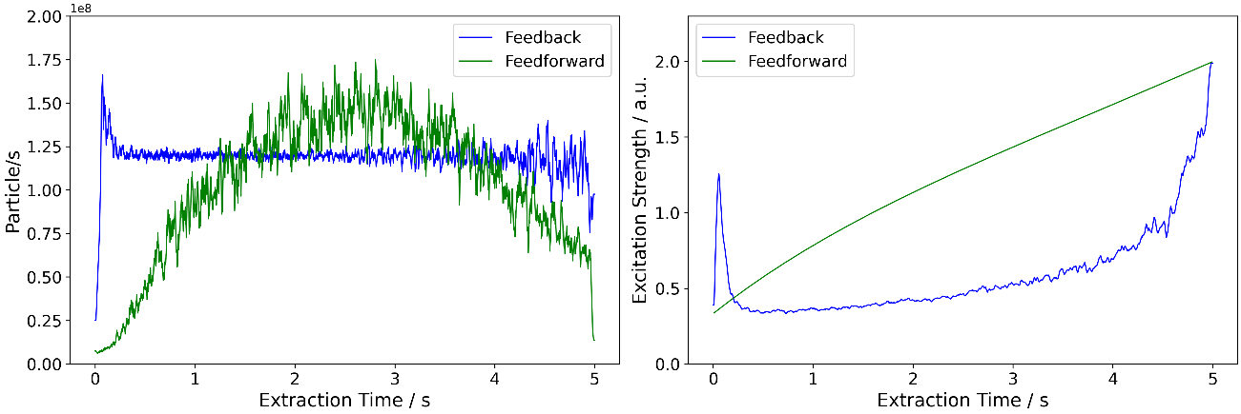
Application: Extension for Control of Knock-out Excitation
Topic: Feedback for macro-spill improvement
by GSI with contributions by HIT
Technology used additionally for feedback on 1 ms range
Control hardware & software: Feedback loop on USRP:
Shift of several application into FPGA
Latency significantly improved to 30 µs
300 Hz overall bandwidth achieved
⇒ Contribution to GNU-based software by GSI
2
Improved macro- & micro-structure
rf-power evolution
⇒ large rf-power required
1.5
Particle rate [10⁸/s]
only feedforward
feedforward and
feedback
1
only feedforward
feedforward and feedback
0.5
0
0
1
3
2
4
5
0
1
2
3
4
5
Extraction time [s]
Extraction time [s]
P. Niedermayer et al., IPAC’25 (in preparation)

Slide 11
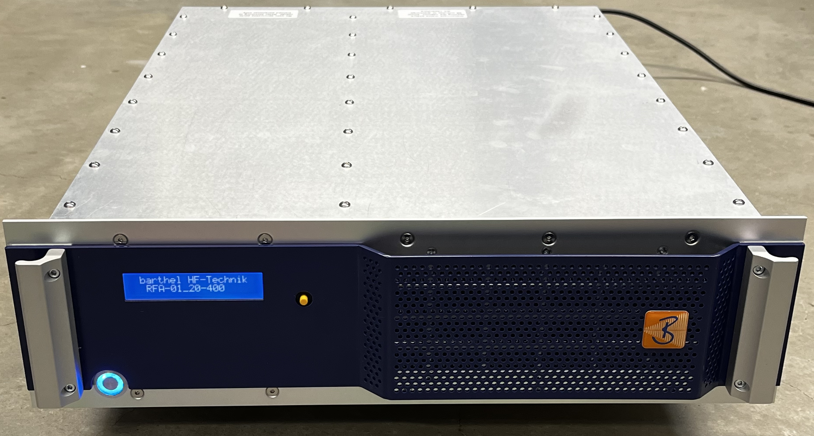
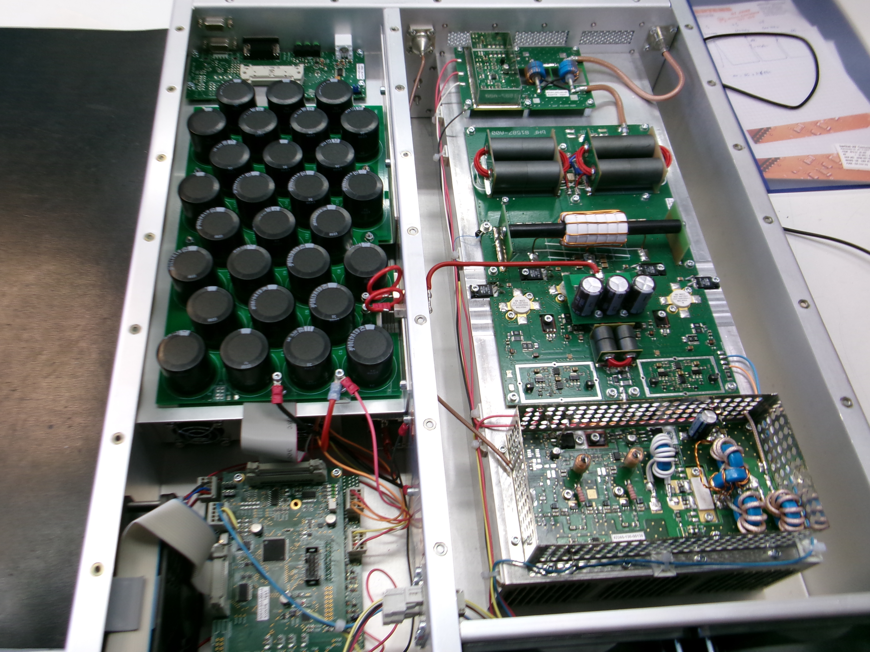
Technology: RF Power Amplifier Achievements
Technical development by company Barthel HF Technik plus GSI & HIT
Topic: Technical realization for knock-out amplifier:
High power required (due to broadband exc. & feedback)
Higher voltage by pure capacity load (instead 50 Ω)
Immunity against reflection from capacitive load (!)
PC
DSP with GNU Radio
Signal chain
beam
control
data
stripline
kicker
Achieved parameters | Value | Remark
Frequency range | 0.1 … 20 MHz | Broadband !
Output power | 500 W | Lager power
Gain | 56 … 58 dB | Flatness 2 dB !
Input impedance | 50 Ω
2nd harmonics distortion | -35 … -15 dBc
Output impedance | 50 Ω | Can be operated with any load impedance!
Output reflection VSWR | < 3:1
Electrode capacitive load | 50 pF typ. | Total power reflection
Output reflection VSWR | < 3:1
Mechanics, cooling | 19" rack, air
rev. freq.
USRP
ADC/DAC with FPGA
180°
excitation
signals
trigger
180⁰ spitter
ampl.

Slide 12
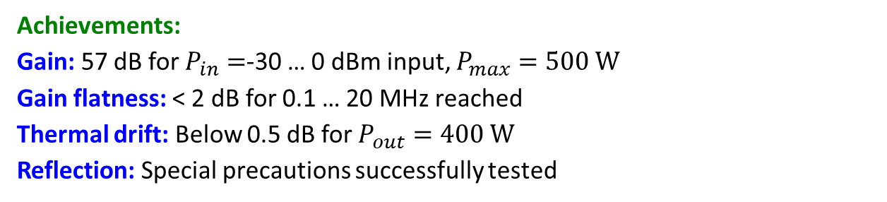

Technology: RF Power Amplifier Achievements
Technical development by company Barthel HF Technik plus GSI & HIT
Topic: Technical realization for knock-out amplifier
PC
DSP with GNU Radio
Signal chain
beam
Achievements:
Gain: 57 dB for $P_{in}=$-30 … 0 dBm input, $P_{max}=500 W$
Gain flatness: < 2 dB for 0.1 … 20 MHz reached
Thermal drift: Below 0.5 dB for $P_{out}=400 W$
Reflection: Special precautions successfully tested
control
data
stripline
kicker
rev. freq.
USRP
ADC/DAC with FPGA
180°
excitation
signals
Status:
Two amplifier produced
Characterized by company Barthel and at HIT
Enabled innovative beam measurement for high harmonics
TRL 7 reached (only TRL 6 promised)
⇒ Final milestone D5.3 for month 46 reached
trigger
180⁰ spitter
ampl.
Gain flatness: $\frac{P_{out}}{P_{in}}$ versus $P_{in}$ for 0.1 … 20 MHz
frequency
[MHz]
2dB
30 dB

Slide 13
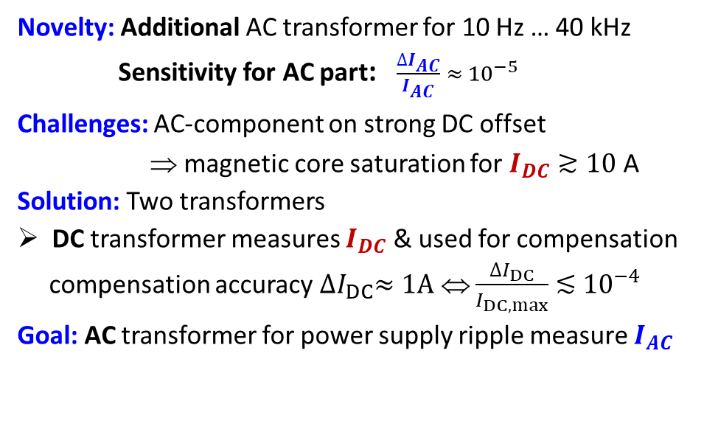
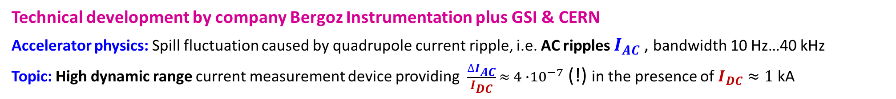
Technology: Transformer for Power Supply Ripple Determination
Technical development by company Bergoz Instrumentation plus GSI & CERN
Accelerator physics: Spill fluctuation caused by quadrupole current ripple, i.e. AC ripples $I_{AC}$, bandwidth 10 Hz…40 kHz
Topic: High dynamic range current measurement device providing $\frac{∆I_{AC}}{I_{DC}} ≈{ 4 ∙10}^{−7}$ (!) in the presence of $I_{DC}≈1$ kA
Methodology: Production of large dynamic range AC current measurement device by company Bergoz
Novelty: Additional AC transformer for 10 Hz … 40 kHz
Sensitivity for AC part: $\frac{∆I_{AC}}{I_{AC}} ≈{ 10}^{−5}$
Challenges: AC-component on strong DC offset
⇒ magnetic core saturation for $I_{DC}≳10$A
Solution: Two transformers
DC transformer measures $I_{DC}$ & used for compensation
compensation accuracy ${∆I}_{DC}≈1A$ ⇔ $\frac{{∆I}_{DC}}{I_{DC,max}}$ $≲$ ${10}^{−4}$
Goal: AC transformer for power supply ripple measure $I_{AC}$
IFAST-REX deliverable
split-core
DC transformer
additional
AC transformer
magnet current
(= DC & AC ripple)
ACCT
electronics
-
A
+
D
Compensation
winding for DC
DC meas.
digital
output
magnet
power supply
digital control

Slide 14
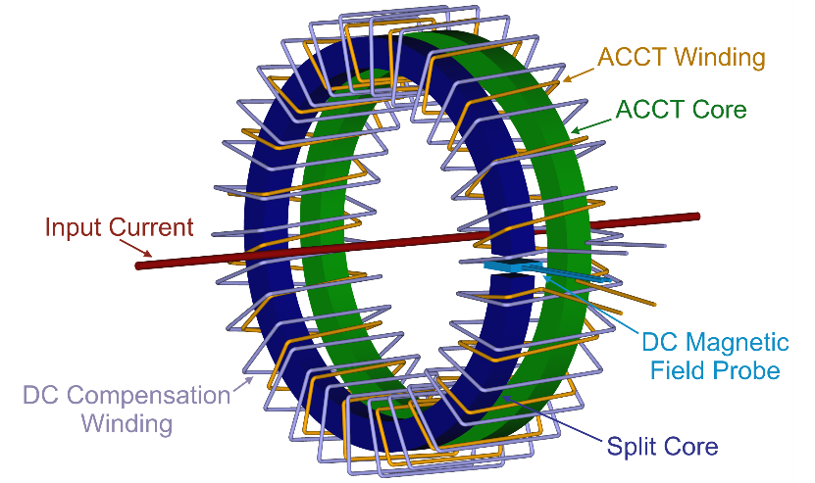
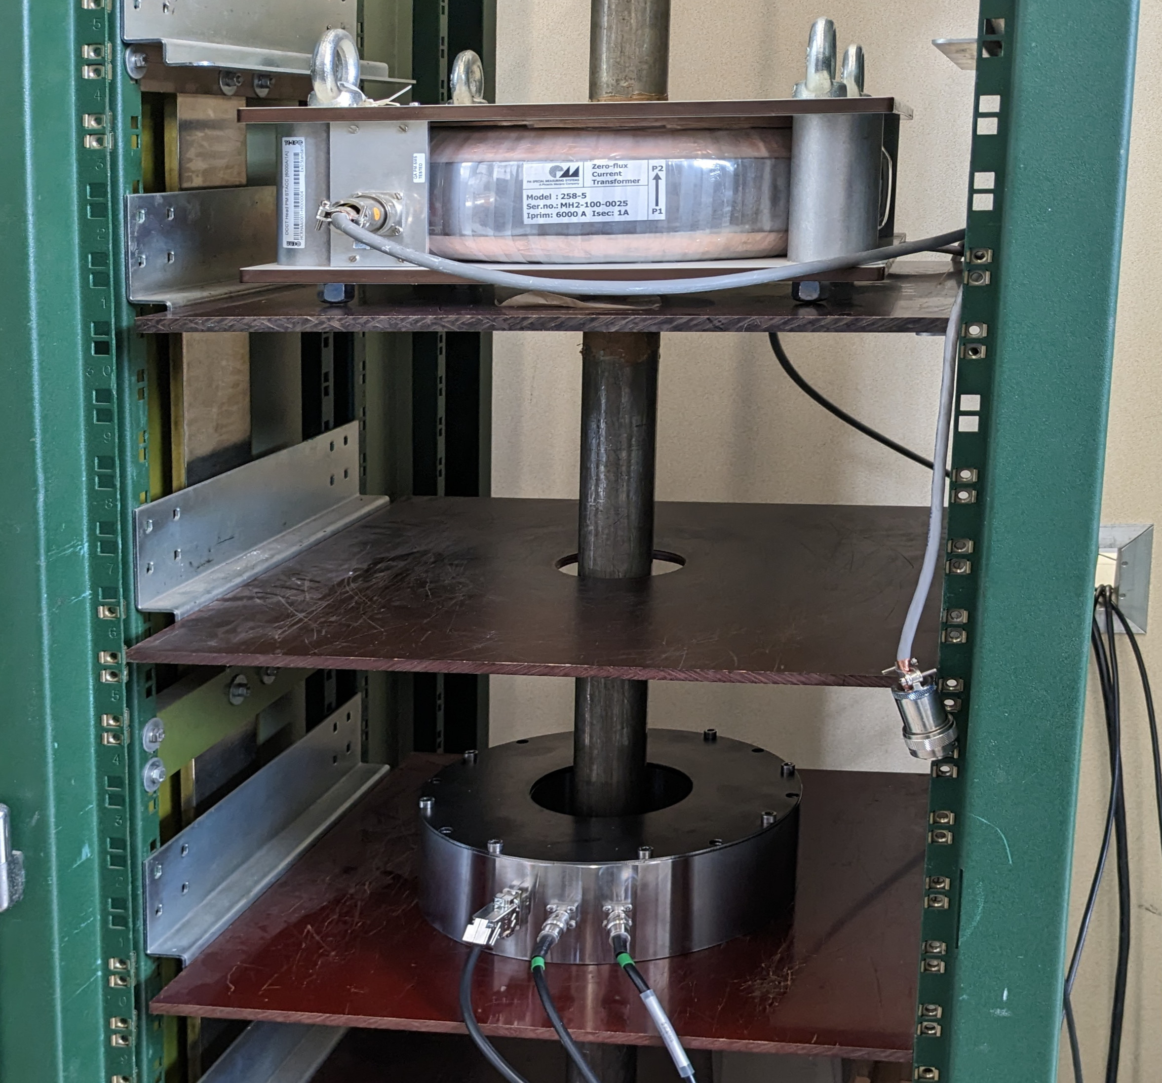
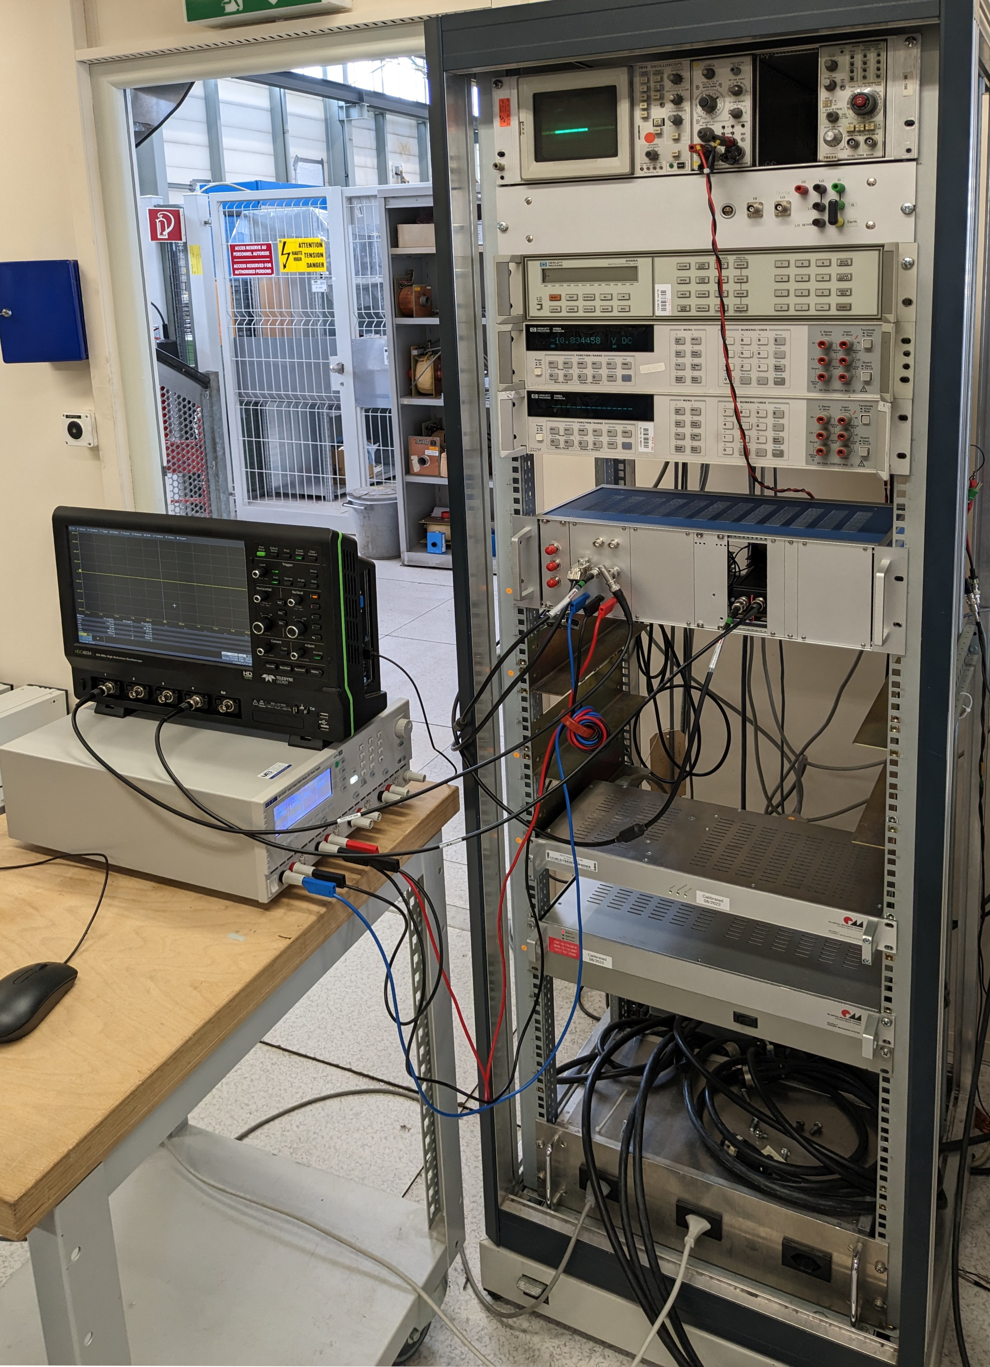
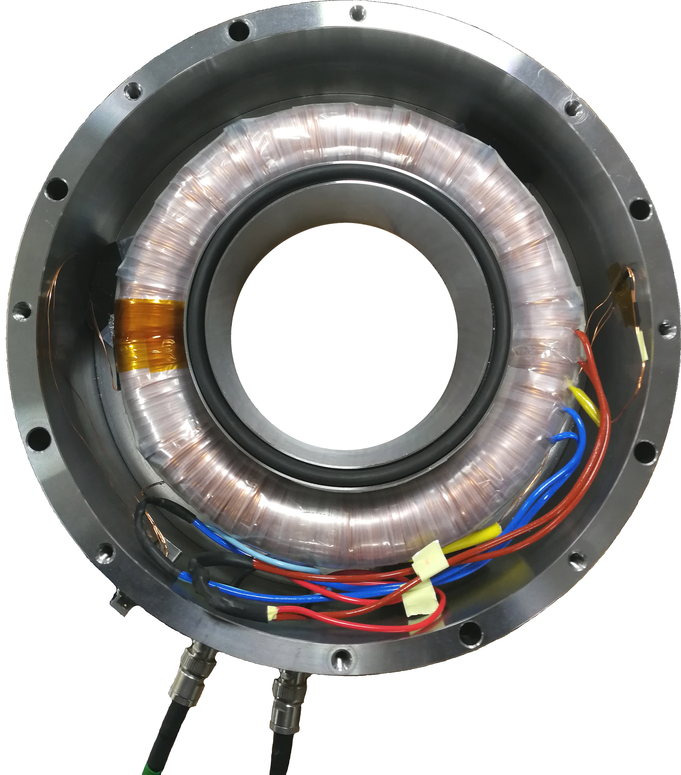
Technology: Realization of the Transformer
Technical development by company Bergoz Instru. plus GSI & CERN
Development: Prototype by Bergoz as novel device
DC part: For AC transformer mag. saturation compensation
Split core of 1500 windings
Standard Hall probe Honeywell SS495A1
AC part: Core with 1500 windings
Analogue part comparable to beam current ACCT
260 mm
Detailed tests:
At Bergoz: up to 400 A_{DC}
plus ~10⁻³ power supply ripple
At CERN in 2023-25:
up to 5 kA_{DC} with
typical power supplier
110 mm
Precision voltmeters
Reference fluxgate DCCT
Prototype sensor
Prototype electronics
Windings:
1500 turns
Reference fluxgate DCCT electronics

Slide 15
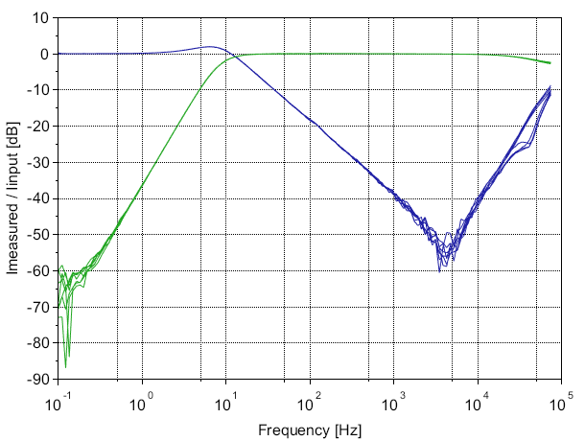
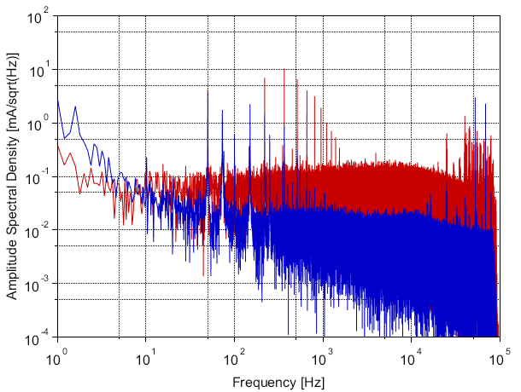
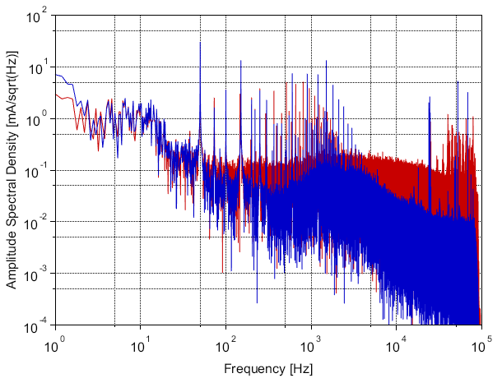


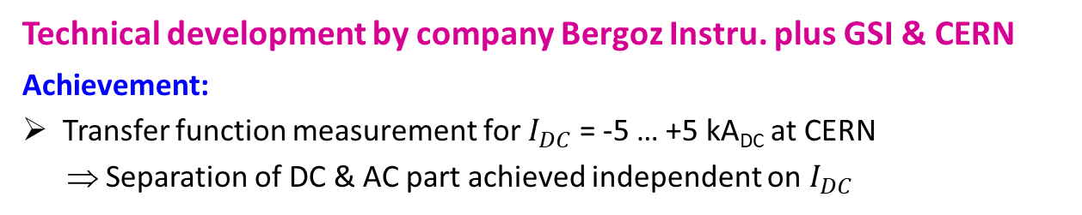
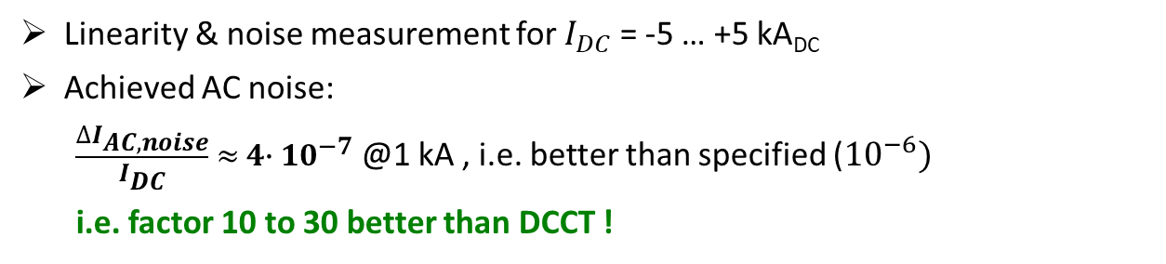



Technology: Achievements for the Transformer
Improvement with respect to 1st prototype
+10
$I_{DC}$ = -5 … +5 kA_{DC}
Technical development by company Bergoz Instru. plus GSI & CERN
Achievement:
Transfer function measurement for $I_{DC}$ = -5 … +5 kA_{DC} at CERN
⇒ Separation of DC & AC part achieved independent on $I_{DC}$
0
DC feedback
-20
AC response
Transfer function I_{meas} / I_{prim} [dB]
-40
Linearity & noise measurement for $I_{DC}$ = -5 … +5 kA_{DC}
Achieved AC noise:
$\frac{∆I_{AC,noise}}{I_{DC}} ≈{ 4∙ 10}^{−7}$ @1 kA , i.e. better than specified (${10}^{−6})$
i.e. factor 10 to 30 better than DCCT !
-60
-80
Desired working range: 8 Hz … 40 kHz
10⁻¹
10⁰
10¹
10²
10³
10⁴
10⁵
Frequency [Hz]
10²
Zero dc-current $I_{DC}$ = 0 kA_{DC}
Maximal dc-current I_{DC} = 5 kA_{DC}
10²
Significant improvement
compared to 1st prototype in year 2023!
⇔ TRL 7 reached via tests at CERN
(TRL 6 promised)
⇔ Final deliverable reached !
10¹
reference DCCT
reference DCCT
10¹
novel sensor
novel sensor
10⁰
10⁰
Amplitude spec. density [$mA/\sqrt{Hz}$]
10⁻¹
Amplitude spec. density [$mA/\sqrt{Hz}$]
10⁻¹
10⁻²
10⁻²
10⁻³
10⁻³
10⁻⁴
Remark: $n ×50$Hz lines from network
$n ×73$Hz lines from DCCT
10⁻⁴
10⁰
10¹
10²
10³
10⁴
10⁵
10⁰
10¹
10²
10³
10⁴
10⁵
Frequency [Hz]
Frequency [Hz]

Slide 16







Dissemination of Results 2024-25
Refereed publications including IFAST-REX Acknowledgement 2024-25:
P. Niedermayer, R. Singh (GSI), ‘Excitation Signal Optimization for Minimizing Fluctuations in Knock Out Slow Extraction’,
Scientific Reports, 14, 10310 (2024)
Philipp Niedermayer, Rahul Singh (GSI), ‘Excitation of nonlinear second order betatron sidebands for Knock Out slow extraction at the 1/3 resonance’,
Rev. Accel. Beams 27, 082801 (2024)
E.C. Cortes Garcia, P. Niedermayer, R. Singh, R. Taylor, E. Benedetto, E. Feldmeier, M. Hun, T. Haberer (HIT, GSI, CERN, SEEIIST),
‘Interpretation of the horizontal beam response near the third integer resonance’, Phys. Rev. Accel. Beams 27, 124001 (2024)
P. Niedermayer, R. Singh and E. Feldmeier (GSI, HIT), Knock-out slow extraction using betatron sidebands at high harmonics,
in preparation for Phys. Rev. Applied (2025)
Earlier publications: See talk Annual Meeting 2024
Six theses by IFAST-REX consortium members:
Pablo A. Arrutia Sota, ‘Advanced RF techniques for CERN's future slow-extracted beams’, PhD Thesis Keble College, University of Oxford, 2024
Thomas Bass, ‘A Comparative Analysis of Simulations and Experimental Outcomes: Slow Extraction Driven by RF Transverse Excitation at the CERN Proton Synchrotron’, Master Thesis Royal Holloway, University of London
Florian Kühteubl, ‘Slow Extraction Optimization for the MedAustron Synchrotron’, PhD Thesis Technical University Vienna, 2024
Philipp Niedermayer, ‘Transverse excitation for beam diagnostics and slow extraction from synchrotrons’, PhD Thesis Goethe University Frankfurt
Rebecca Taylor, ‘Slow Extraction: Upgrades for Next Ion Medical Machines at FLASH timescales’, PhD Thesis Imperial College London, Physics Department, 2024
Jiangyan Yang, ‘Exploration of slow extraction beam quality and improvements at SIS18’, PhD Thesis Goethe University Frankfurt am Main, 2025

Slide 17
Summary for IFAST-REX
Experiments, simulation, and interpretation:
Beam dynamics simulation: Deep insight to non-linear process of slow extraction
Ground-breaking experiments performed with dedicated excitation and feedback & broad to operational usage
Network with intensive discussion between participants (in particular for Xsuite simulations)
Knock-out extraction control and amplifier:
Control by versatile capability of SDR implemented, contributions to GNU-based software
Rf-amplifier manufactured; speciality: broadband gain-flatness & immunity against reflections suited for capacitive load
Novel transformer:
Prototype successfully commissioned, can be very useful for further applications
Next step following IFAST: Stabilization of quadrupole power supply or tune correction (e.g. with air-coil quadrupole)
Further work for slow extraction micro-structure:
Experiments performed at several facilities, significant improvements demonstrated and operational
e.g. CERN & MedAustron: Empty bucket channelling, COSE, rf-knock-out, ML methods; CERN & GSI: Improved diagnostics
SAC recommendations:
Transverse emittance studies: Not performed systematically; will be done in future. However, users don’t complain presently
Further applications of novel transformer possible!
Deliverable report D5.3 submitted in March 2025 as foreseen ⇔ mission accomplished
IFAST-REX contributes significant to technical developments and networking !

Slide 18
The valuable work of all collaborators are warmly acknowledged
Main contributors:
Barthel: M. Barthel
Bergoz: L. Dupuy, F. Stulle
CERN: P. Arrutia Sota, M. Basto, M. Fraser, M. Pari, F. Velotti
CNAO: A. Mereghetti, M. Pullia
GSI: P. Forck, P. Niedermayer, R. Singh, S. Sorge, A. Stafiniak, J. Yang
HIT: C. Cortes, E. Feldmeier, A. Peters
MedAustron: F. Kühteubl, D. Prokopovich, C. Schnitzer
SEEIST & Tera-Care: E. Benedetto, R. Taylor
Thank you for your attention

Slide 19
Backup slides

Slide 20
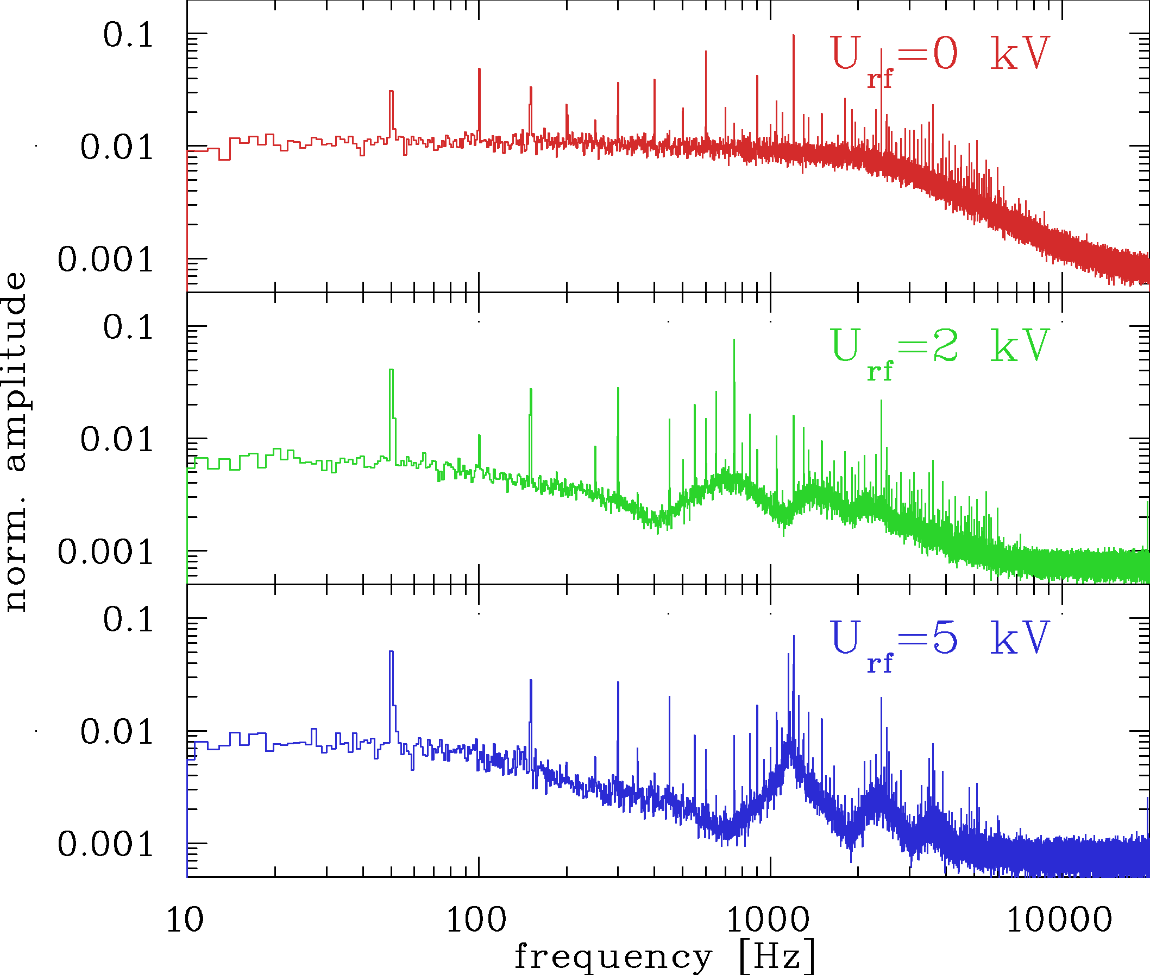
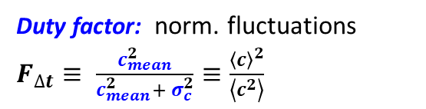

General: Beam Fluctuations for slow Extraction
Slow extraction: Gentle beam excitation at third order resonance
Problem: Fluctuations of the extracted beam (before systematic optimization)
Example: C⁶⁺ at 300 MeV/u at GSI, quadrupole scan, 2.5 s extraction called ‘spill’; coasting & bunched beam
Time domain:
Frequency domain:
Duty factor: norm. fluctuations
$F_{∆t}≡ \frac{c_{mean}^{2}}{c_{mean}^{2}+ σ_{c}^{2}}≡\frac{{\left\langle c\right\rangle }^{2}}{\left\langle c^{2}\right\rangle }$
20 µs time resolution
coasting beam
c_{mean}=35
50 Hz &
harmonics
small fluctuation ⇔ ‘good’ spill
f_{cut}
coasting beam
bunched beam
Poisson limit
Large fluctuation
⇔ ‘bad’ spill
synchrotron freq.
& harmonics
bunched beam
Poisson
limit
Coefficient of variance:$c_{v,∆t}= \frac{c_{mean}}{σ_{c}}$
Improvement by bunching:
Medical facility: Readout time typ. 100 µs used since years; however, improvement required
GSI & CERN: Not acceptable for nuclear & particle physics as related to detector deadtime

Slide 21
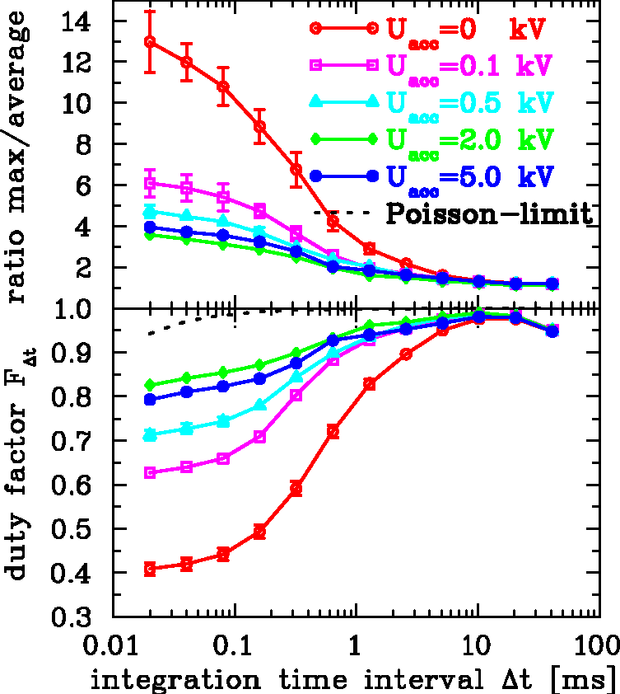

Coasting Beam Extraction versus bunched Beam Extraction
Experiment: C⁶⁺, 300 MeV/u: Measured by particle counting scintillator, readout period 20 µs
50 Hz & harmonics
coasting beam
coasting beam
f_{cut}
(decrease by factor 2)
bunched beam
bunched beam
small fluct. ⇔ good spill
synchrotron freq.
& harmonics
Results:
Bunching improves the micro-spill significantly,
here bunching frequency f_{acc} ≈ 4 MHz
Lower value concerning the cut-off frequency in the Fourier-Trans.
Value of maximum-to-average depends on readout period ( = sampling freqeuncy)
However:
Also ‘bunches’ are extracted (see below). Some users do not want to have this!
Large fluct.
⇔ bad spill
$P. Forck et al.,$ EPAC‘2000

Slide 22
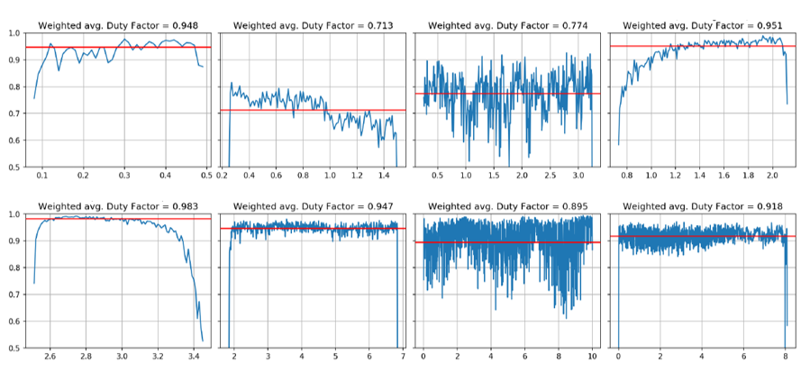
Typical Duty Factor for different Facilities for operational Parameters
Performed by Florian Kühteubl et al. (MedAustron) for same sample period of $∆t=10$ms (but different extr. duration)
Duty factor $F_{∆t}≡ \frac{c_{mean}^{2}}{c_{mean}^{2}+ σ_{c}^{2}}≡\frac{{\left\langle c\right\rangle }^{2}}{\left\langle c^{2}\right\rangle }$ describes normalized fluctuations ⇒ the larger the duty factor the better the beam
Facility | Ex. meth. | Beam | Improvement | Duty fac. F_{Δt}
A | Tune scan | coasting | Rf-chan. | 0.948
B | Trans. ko | Bunched | Air-core quad | 0.713
 | Betatron, | Coasting | Rf-chan | 0.774
C | Tune scan | Coasting | Tune wobble | 0.951
 | Tune scan | Bunched | - | 0.983
D | Trans. ko | Bunched | - | 0.947
E | Trans. ko | Bunched | Rf-chan. | 0.895
F | Trans. ko | Bunched | Air-core quad. | 0.918
Duty factor
Facility A
tune scan, channelling
Facility B
trans. ko, bunched
Facility B
Facility C
tune scan, coasting
betatron (longi), coasting
Time [s]
Time [s]
Time [s]
Time [s]
Duty factor
Facility C
tune scan, bunched
Facility D
trans. ko, bunched
Facility E
trans. ko, bunched
Facility F
trans. ko, bunched
Time [s]
Time [s]
Time [s]
Time [s]
Result: - Different beam quality caused by power supplier quality
- Various active beam stabilizations in operation and under test

Slide 23
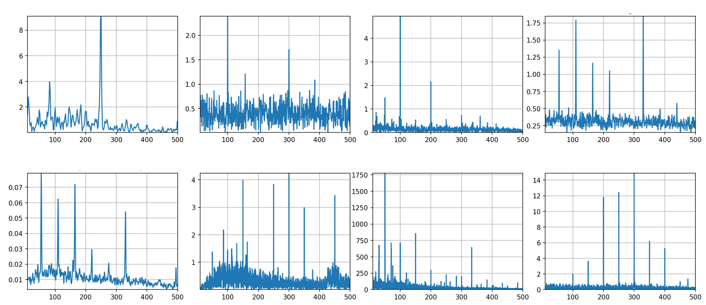
Typ. Frequency Spectrum for different Facilities for operational Parameters
Performed by Florian Kühteubl et al. (MedAustron) for same sample period of 10 ms
Comparison different facilities with same sample rate: Frequency spectrum 0…500 Hz
→ Characterization of power supplier quality and beam reaction for typical ( = user-defined) conditions
Facility A
tune scan, channelling
Facility B
trans. ko, bunched
Facility B
Facility C
tune scan, coasting
Results:
50 Hz related lines; depends strongly on power supplier type
Different beam reaction (broadband)
Differences (expected)
coasting ↔ bunched beam
⇒ Beam characterization for simulation
⇒ Requirements & methods of
counteraction
betatron , coasting
Amplitude
Frequency [Hz]
Frequency [Hz]
Frequency [Hz]
Frequency [Hz]
Facility C
tune scan, bunched
Facility D
trans. ko, bunched
Facility E
trans. ko, bunched
Facility F
trans. ko, bunched
Amplitude
Frequency [Hz]
Frequency [Hz]
Frequency [Hz]
Frequency [Hz]

Slide 24
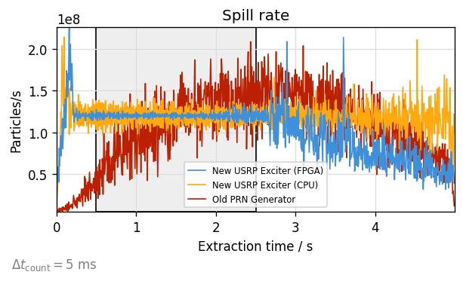
Experiment: Extension for Control of Knock-out Excitation
Topic: Feedback for macro-spill improvement
by GSI with contributions by HIT
GSI: Feedback plus improved Noise++:
Significant improvement for micro- & macro spill achieved
Automated parameter optimization successfully tested
In first operational stage at GSI now
HIT: Feedback plus improved Phase Shift Keying BPSK:
Comparable system at HIT in operation
However, less performant due medical device requirements
Technology can be further used for feedback on 1 ms range
Control hardware & software: Feedback loop on USRP:
Shift of several application to FPGA
Latency significantly improved to 30 µs
300 Hz overall bandwidth achieved
⇒ Contribution to GNU-based software by GSI
Milestone & deliverable for rf-control exceed
2
Automated optimization
using PyBOBYQA algorithm
Particle rate [10⁸/s]
coeff. of variance c_{v} @5ms
1
0
0
1
2
3
4
5
Steps (= required extraction cycles)
Extraction time [s]

Slide 25


Experiment: Knock-out Extraction Signal Spectrum Dependence
Topic: Spill micro-structure dependence on multi-band signals for knock-out extraction
by HIT & GSI with contributions by CERN and MedAustron
Excitation spectrum influences:
Separatrix crossing
Diffusion from the beam towards core
Horizontal tune at HIT Q_{x}= 1.6789 at end of acceleration
Excitation close to tune & harmonics f_{ex,i} = Q_{ex,i} x f_{rev}
Signal | Q_{ex,1} | Q_{ex,2} | Q_{ex,3} | ΔQ_{ex}
1 | -- | 0.327 | - | 0.009
3 | 0.321 | 0.327 | 1.327 | 0.001
$$q_{x}=\frac{1}{3}$$
$$q_{x}=\frac{1}{3}$$
Result: Strong dependence on excitation spectra
Optimization performed in 2023 (HIT, GSI, MedA)
Versatile signal generation
Large power and bandwidth from amplifier
Improvement by multi-band excitation !
E.C. Cortes Garcia et al. IPAC’22 &
E.C. Cortes Garcia et al. NIM A 167137, 2022
P. Niedermayer el. al. IPAC’23

Slide 26
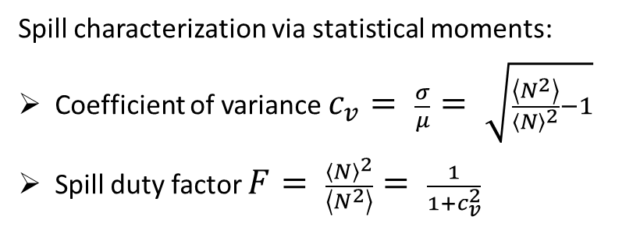
Experiment: Investigation of Extraction Signal Type
Topic: Spill micro-structure dependence on signal type for knock-out extraction
by GSI with contributions by HIT, CERN and MedAustron
Systematic for excitation types: Tests at COSY (FZ-Jülich) ⇒ Significant influence systematically investigated
Noise at baseband
Noise at 3 bands
Noise at baseband plus sine at two harmonics
Spill characterization via statistical moments:
Coefficient of variance $c_{v}= \frac{σ}{μ}= \sqrt{\frac{\left\langle N^{2}\right\rangle }{{\left\langle N\right\rangle }^{2}}−1}$
Spill duty factor $F= \frac{{\left\langle N\right\rangle }^{2}}{\left\langle N^{2}\right\rangle }= \frac{1}{1+c_{v}^{2}}$
Large fluctuation
⇔ ‘bad’ spill
small fluctuation,
⇔ ‘good’ spill
Such systematic comparison performed for the first time!
P. Niedermayer, R. Singh.,
Scientific reports, 14, 10310 (2024)

Slide 27
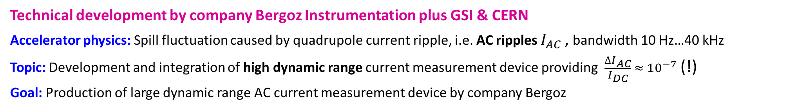
Transformer for Power Supplier (WG1): Specification
Technical development by company Bergoz Instrumentation plus GSI & CERN
Accelerator physics: Spill fluctuation caused by quadrupole current ripple, i.e. AC ripples $I_{AC}$, bandwidth 10 Hz…40 kHz
Topic: Development and integration of high dynamic range current measurement device providing $\frac{∆I_{AC}}{I_{DC}} ≈{ 10}^{−7}$ (!)
Goal: Production of large dynamic range AC current measurement device by company Bergoz
Methodology: Test device produced by Bergoz
Parameter for additional control | Main Quad SIS100
Magnet current specification
DC current min. I_{DC,min} & max. I_{DC,max} | 1 kA & 10 kA
DC current ramp gradient r_{I} | 6000 A/s
Ramp time Δt | 0.1 … 1 s
AC modulation rel. min. I_{AC,min}/I_{DC} & max. I_{AC,max}/I_{DC} | 10⁻⁴ & 10⁻²
AC modulation absolute min. I_{AC,min} max. I_{AC,max} | 0.1 & 100 A
Measurement requirements
Measurement duration t_{tot} | 20 s
Bandwidth f_{min} … f_{max} | 10 Hz … 40 kHz
Total dynamic range l | >120 dB
Measurement resolution flat-top relative ΔI_{AC}/I_{DC} | 10⁻⁷
Measurement uncertainty U_{I} | 0.1% - 1 %

Slide 28
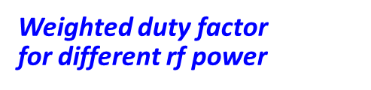

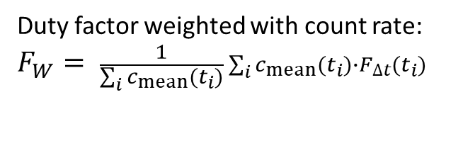
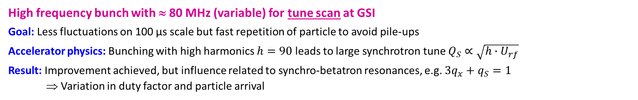
Micro-Spill Improvements by high Frequency Bunching
High frequency bunch with ≈ 80 MHz (variable) for tune scan at GSI
Goal: Less fluctuations on 100 µs scale but fast repetition of particle to avoid pile-ups
Accelerator physics: Bunching with high harmonics $h=90$ leads to large synchrotron tune $Q_{S}∝\sqrt{h∙U_{rf}}$
Result: Improvement achieved, but influence related to synchro-betatron resonances, e.g. $3q_{x}+q_{S}=1$
⇒ Variation in duty factor and particle arrival
Duty factor of one spill
Weighted duty factor
for different rf power
Small fluctuation ⇔ ‘good’ spill
Large fluctuation
⇔ ‘bad’ spill
Duty factor weighted with count rate:
$$F_{W}= \frac{1}{\sum_{i}{c_{mean}(t_{i})}}\sum_{i}{c_{mean}(t_{i})}∙F_{∆t}(t_{i})$$

Slide 29
Micro-Spill Improvements by high Frequency Bunching
High frequency bunch with ≈ 80 MHz (variable) for tune scan at GSI
Goal: Less fluctuations on 100 µs scale but fast repetition of particle to avoid pile-ups
Accelerator physics: Bunching with high harmonics $h=90$ leads to large synchrotron tune $Q_{S}∝\sqrt{h∙U_{rf}}$
Result: Improvement achieved, but influence related to synchro-betatron resonances, e.g. $3q_{x}+q_{S}=1$
⇒ Variation in duty factor and particle arrival
Particle arrival relative to rf
Quantitative confirmation by simulations
⇒ Usage depends user’s requirement

Slide 30
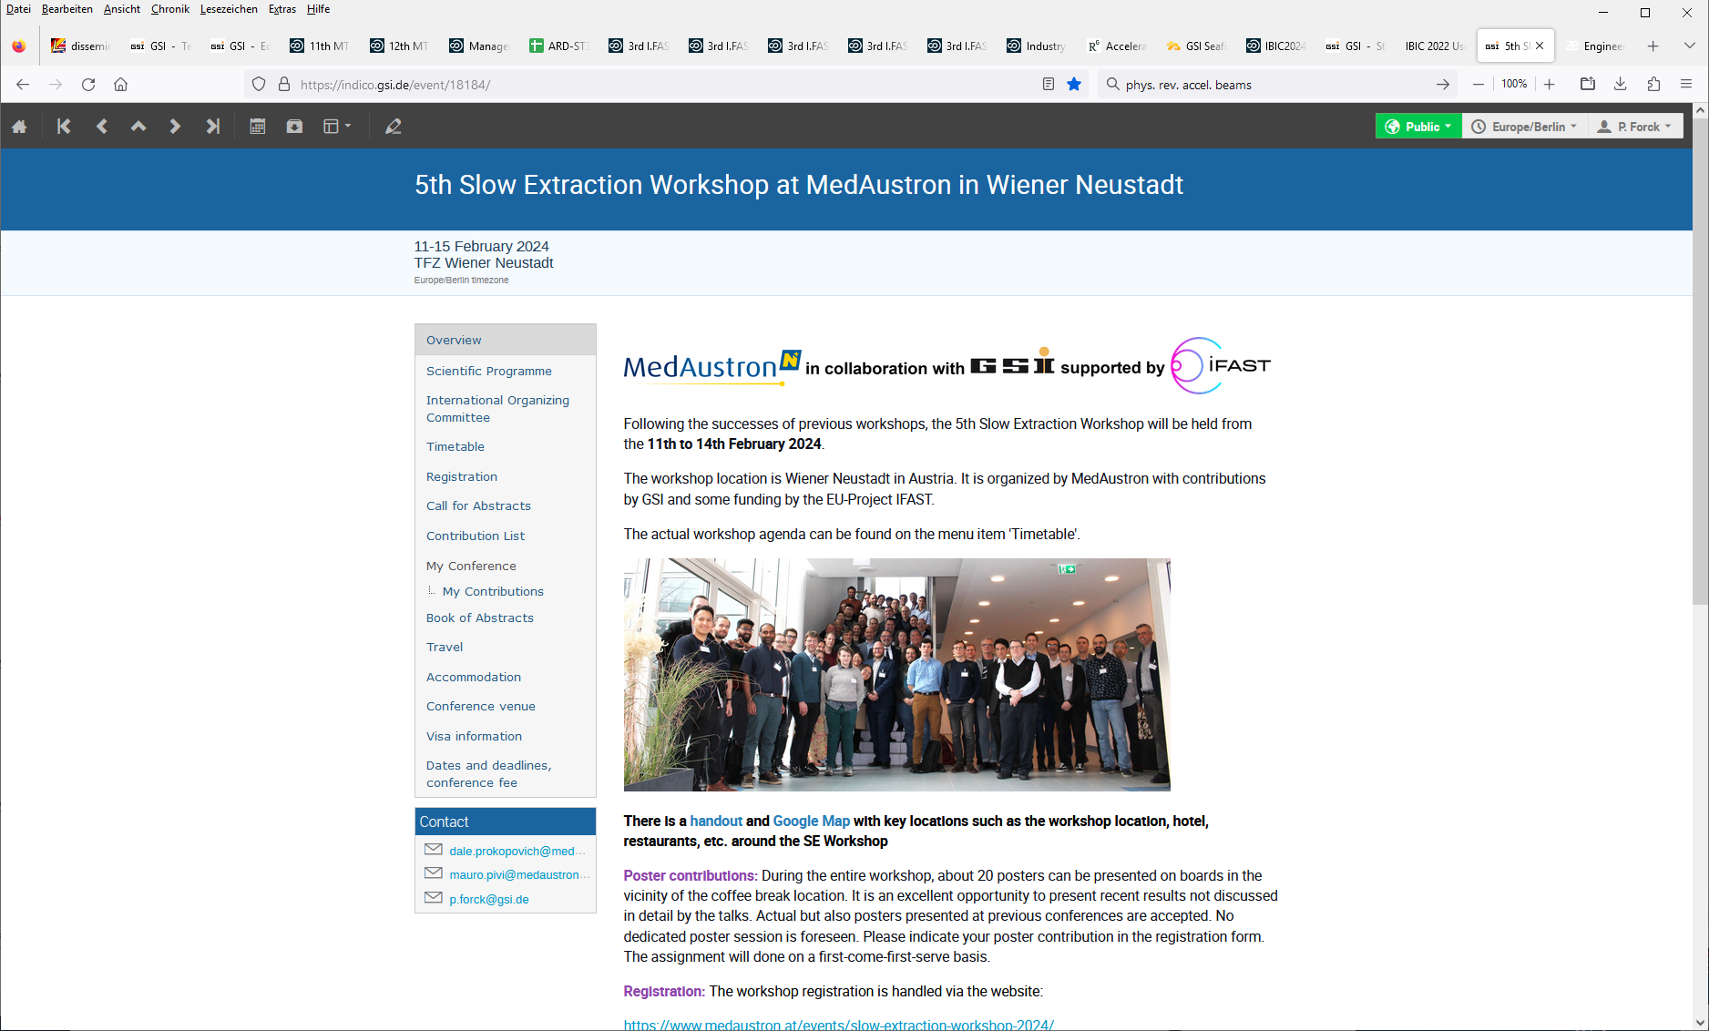
Slow Extraction Workshop 2024
Organized by MedAustron & GSI, sponsored by IFAST
Goal: Expert meeting for all aspects of slow extraction
Frame: International workshop started 2016 at GSI
Date: 11th to 15th Feb. 2024 in Wiener Neustadt, Austria
Subjects: Facility Overview, Spill Ripples & Beam Quality,
Hardware and Machine Protection,
Managing Extraction Efficiency, Septa Development,
Optimization & Machine Learning, MedAustron tour
Program: 60 talks, 7 discussions, 1 tutorial, 10 posters
Participants: 63 from Europe, US, Japan, China
https://indico.gsi.de/event/18184/
Result:
All major experts participated
Very intense discussion and knowledge transfer
Recognition of IFAST-REX contribution
Follow-up workshop at BNL mid 2025

