Slide 1

P3
PSI Positron Production
Positron source demonstrator for FCC
Thomas Lucas on behalf of Riccardo Zennaro and the P-cubed Team
IFAST Annual Meeting April 2025

Slide 2
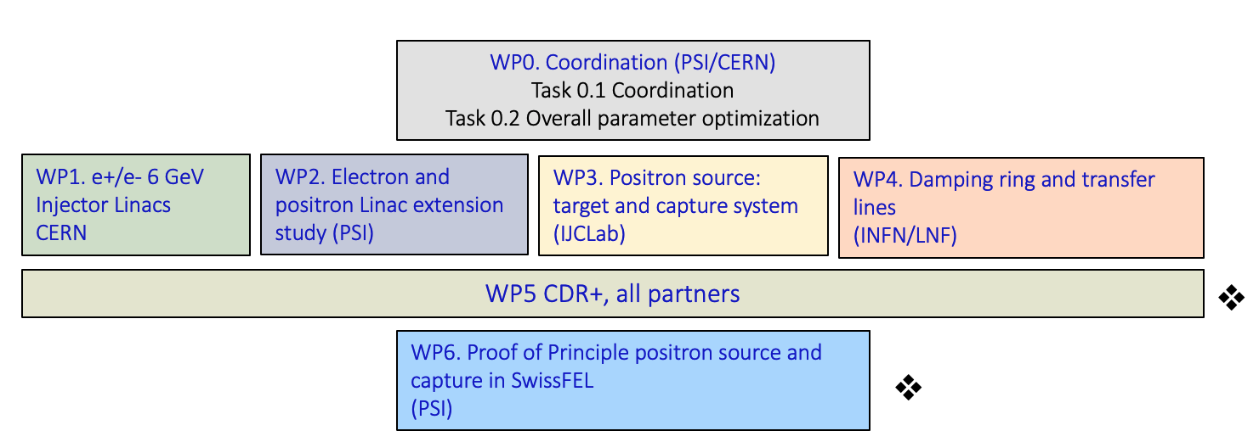
FCC-ee injector study collaboration
Work Breakdown Structure:

Slide 3
Chart contribution
P3 is strongly supported by CHART both for hardware and personnel cost
More @ https://chart.ch/

Slide 4
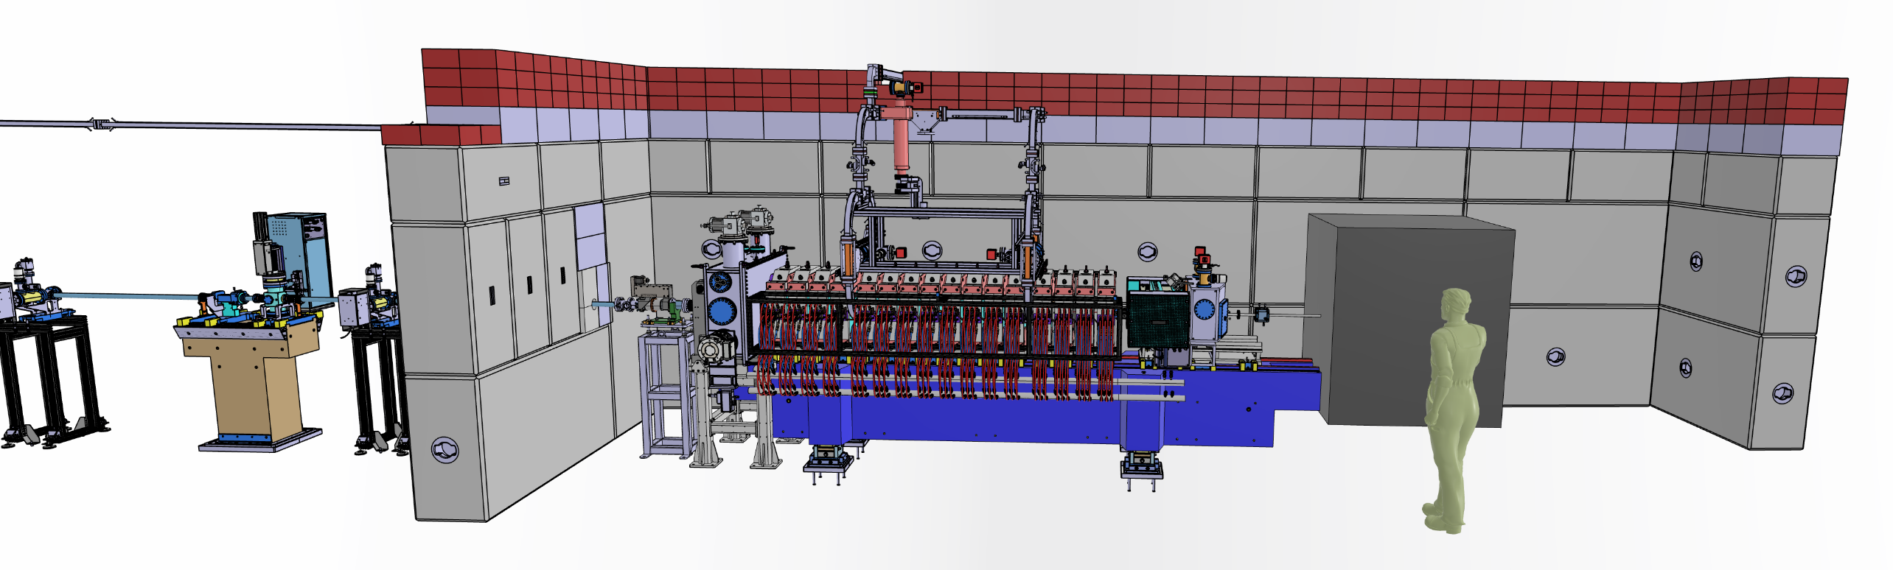
Introduction
P³ (P-cubed) is a Proof-of-principle study of a positron (e+) source and capture system that can substantially enhance the state-of-the-art e+ yield.
Based on the conventional principles of pair-production-based positron sources but will use novel technology (e.g. HTS solenoids) to achieve this enhances positron yield.
Integrated in FCC-ee Injector study as the FCC-ee e+ source test facility.
Design complete and currently in construction at SwissFEL at PSI.
Operation is foreseen in 2026.

Slide 5
P³ as demonstrator for FCC
 | FCC-ee | P³ (SwissFEL)
Energy [GeV] | 2.86 (new) | 0-6
Yield | 2.2(*) | 6
Target Length [mm] | 5 | 5-7.5
e- bunch charge [nC] | ≤4.34 (**) | 0.2
Rep. Rate [Hz] | 100 | 1
Bunches/pulse | 4 | 1
Beam power at target [W] | 7000 (*) | 1.2
Deposited power at target [W] | 1600 (*) | ~0
P³ will be installed in SwissFEL tunnel.
The available electron beam is adjustable in energy up to 6 GeV with a bunch charge of 200 pC and the repetition rate up to 100 Hz.
    Goal: P³ allows to develop the required technology for FCC-ee positron source and to demonstrate the yield
    Limits: Because of radioprotection resons the rep. rate must be limited to 1 Hz, as consequence the average beam power will be a factor ~7800 less than in FCC-ee (Z mode).
(*) Iryna’s talk at FCC week 2024
(**)FCCee injectors parameters - Google Sheets

Slide 6
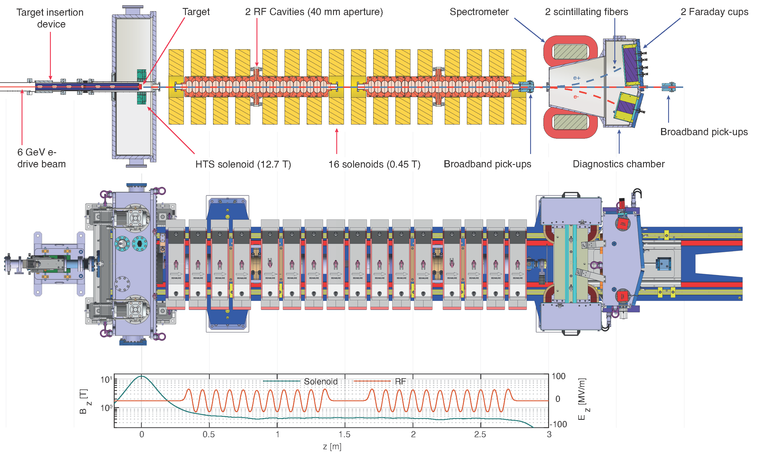
Technology of the P-cubed Experiment

Slide 7
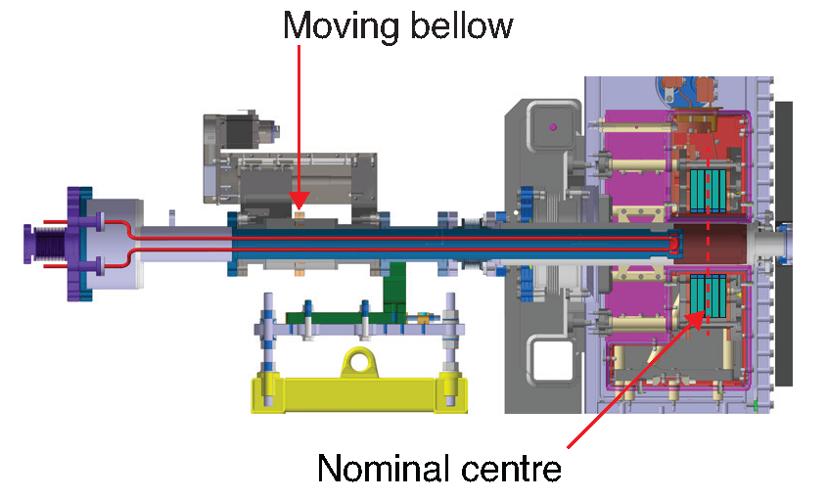
Technology of the P-cubed Experiment
Target System
P-cubed will test different different targets (baseline 17.5 mm tungsten cylinder).
The longitudinal position of target has an impact on the positron yield.
CERN and PSI have developed a system that allows for:
  Easily replacing the targets.
  Remotely adjusting the longitudinal location of the target with a stroke of +/50 mm with respect to the optimal point.
Thanks to R. Mena Andrade, J.L. Grenard, K. Guergar and A. Perillo Marcone

Slide 8
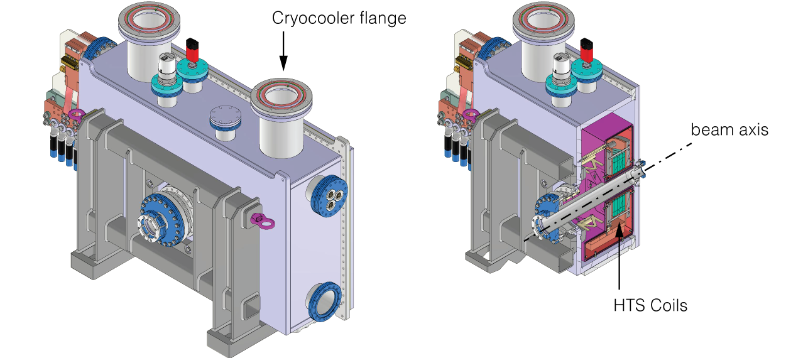
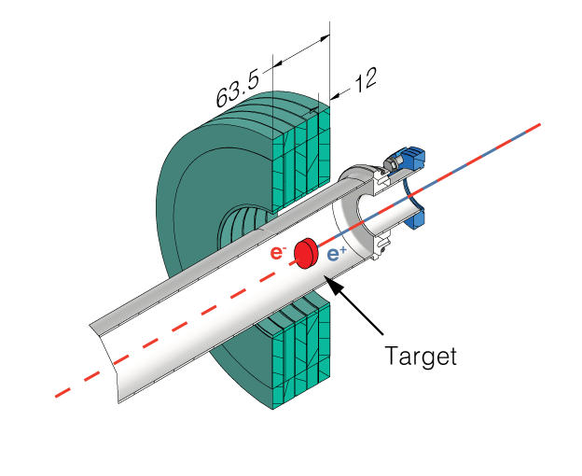
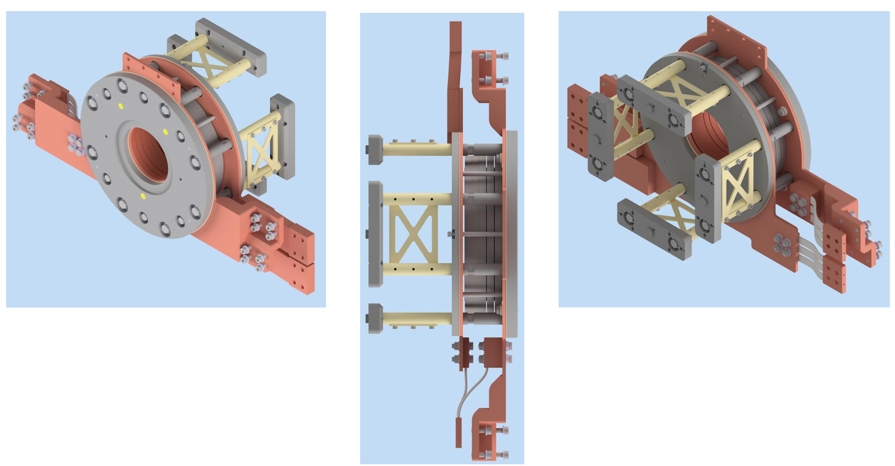
Technology of the P-cubed Experiment
HTS Solenoid
12.7 T peak field goal achieved thanks to “cryogen-free” operation at 15 K.
Made of 5 non-insulated ReBCO ( rare-earth barium copper oxide) tape coils.
Prototype has been successfully wound, soldered, and stacked at PSI.
In-house tests have demonstrated “cryogen-free” operation at 15 K and 2 kA, measuring peak magnetic fields of 18 T on-axis.
Thanks to J. Kosse, M. Duda, H. Garcia-Rodrigues, B. Auchmann, and colleagues

Slide 9
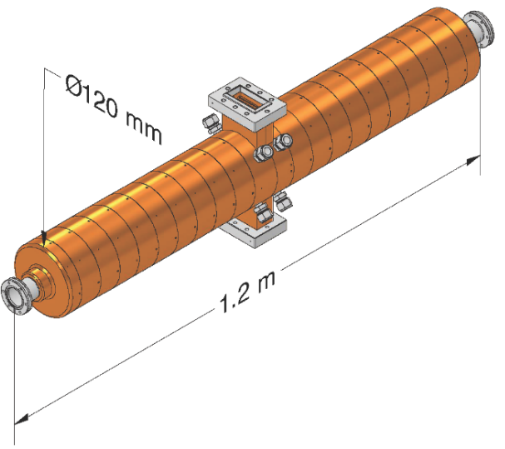

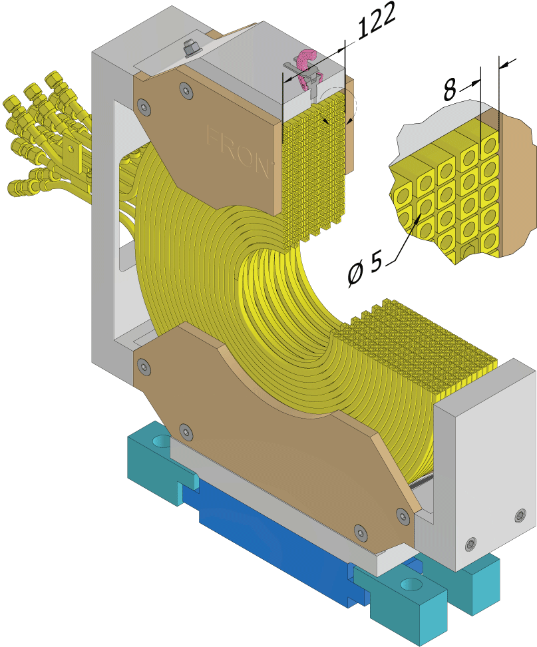
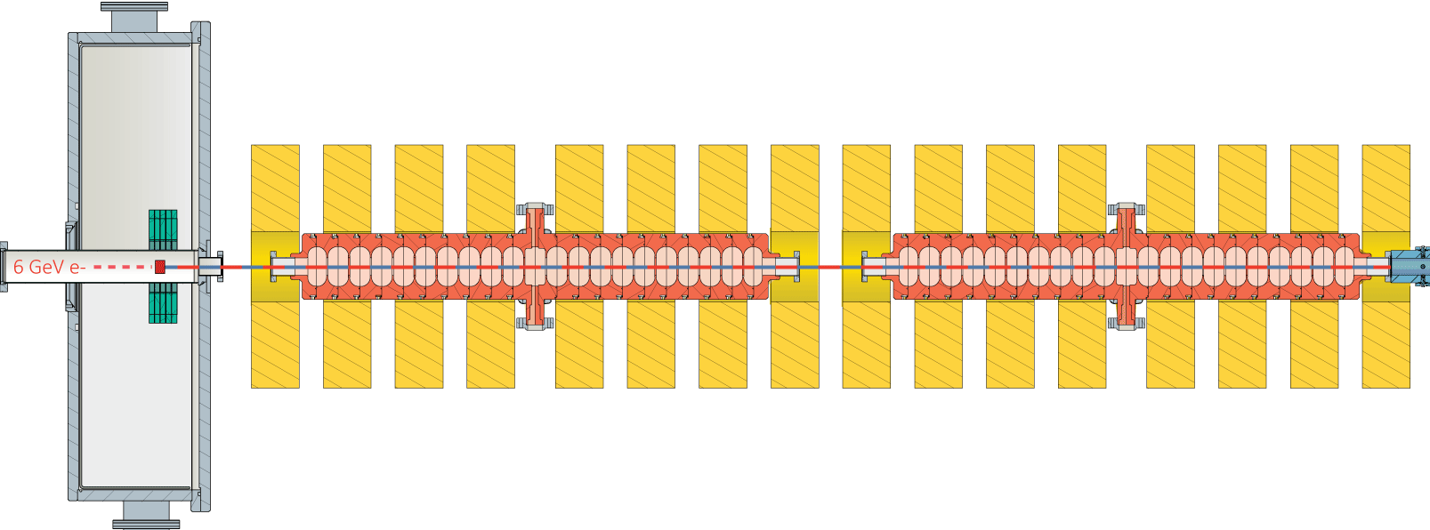
Technology of the P-cubed Experiment
RF Linac (2 RF Structures + 16 NC Solenoids)
RF structures in S-band are based on a standing-wave design that provides a large transverse aperture (40 mm).
S-band choice determined by the availability of commercial components.
16 NC Solenoids will create a 0.45 T magnetic channel. Each solenoid has a strength of 0.213 T.
Cavity length | 1.2 | m
Cavity frequency | 2.9988 | GHz
Operational gradient | 18 | MV/m
Number of cells | 21
Quality factor | 21600
Shunt impedance | 13.9 | MOhm/m
Coupling factor | 2
Filling time | 3 | μs
Mode separation | 5.3 | MHz
Max. repetition rate | 100 | Hz

Slide 10
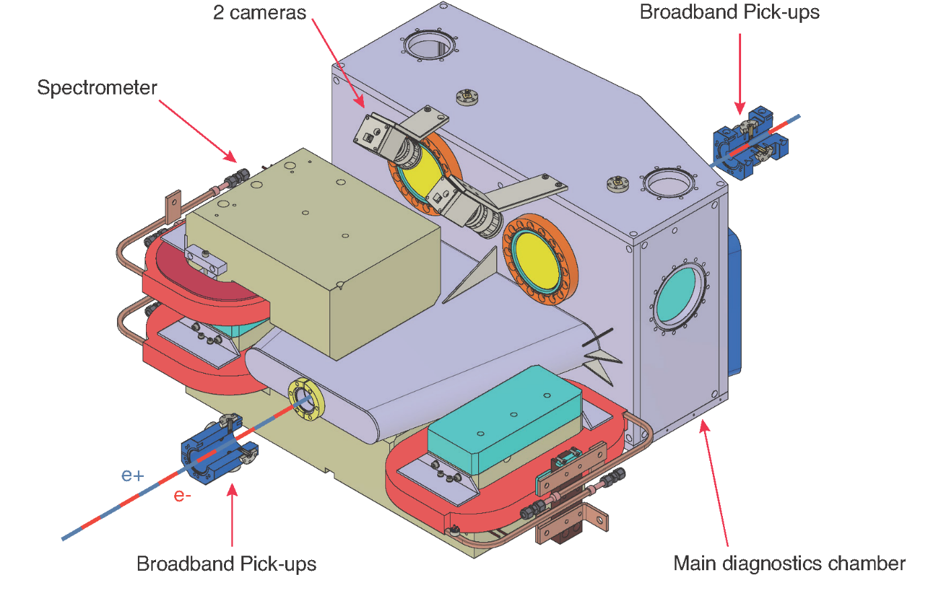

Technology of the P-cubed Experiment
Diagnostic chamber
The diagnostics will help researchers optimize the operation of the positron source and provide a proof-of-principle demonstration of the positron yield.
The setup will measure the charge and longitudinal profile of the positron and electron
Thanks to R. Zennaro, M. Zykova, E. Ismaili, R. Ischebeck, P. Juranic, F. Marcellini, G.L. Orlandi and N. Strohmaier

Slide 11
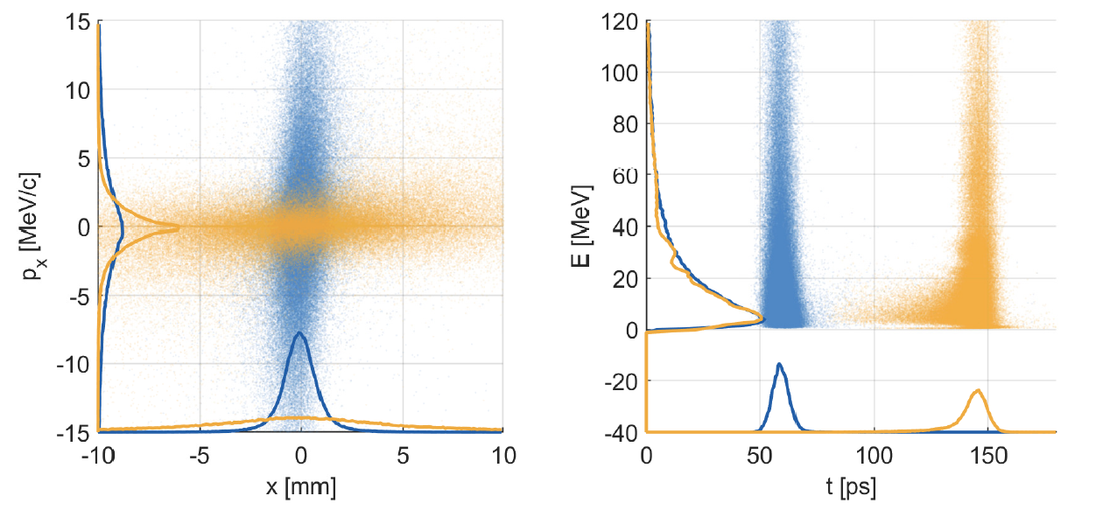
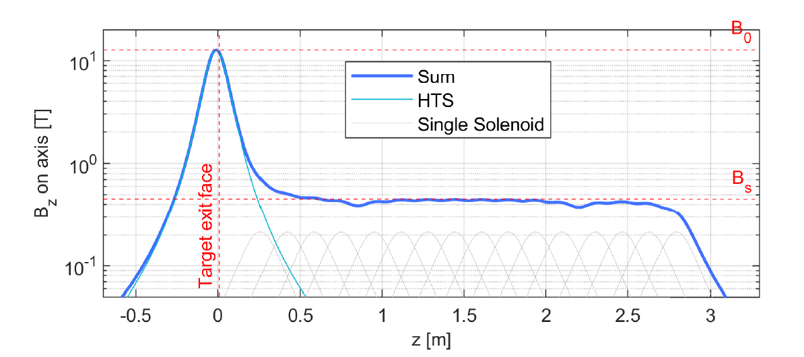
Transverse Beam Dynamics
Transverse
 | @ target exit | @ 1st cavity
Charge e+ | 2754 | 2334 | pC
σ_{x}, σ_{y} | 1.1 | 6.2 (<20) | mm
σ_{px}, σ_{py} | 7.1 | 2.7 | MeV/c
ε_{x,norm}, ε_{x,norm} | 11676 | 12016 | π mm mrad
σ_{t} | 5.7 | 11.3 | s
σ_{E} | 122.8 | 122.8 | MeV
Longitudinal
1st cavity
Courtesy of N. Vallis

Slide 12
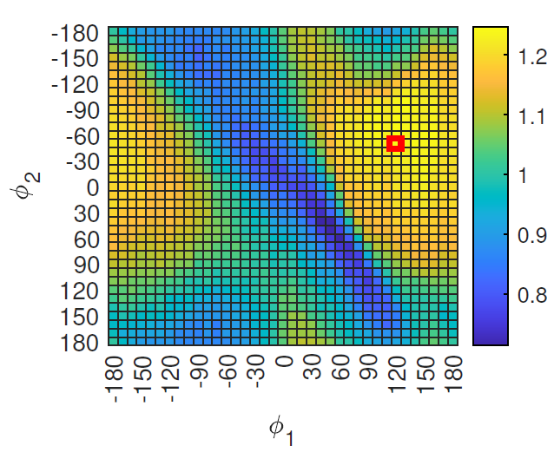
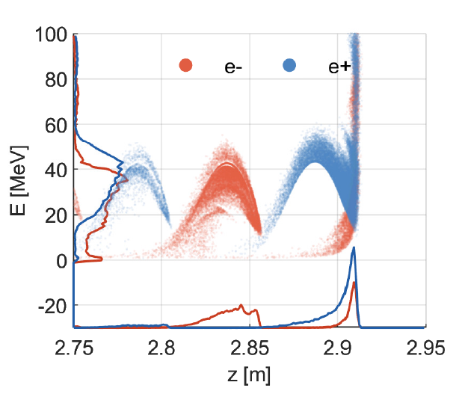
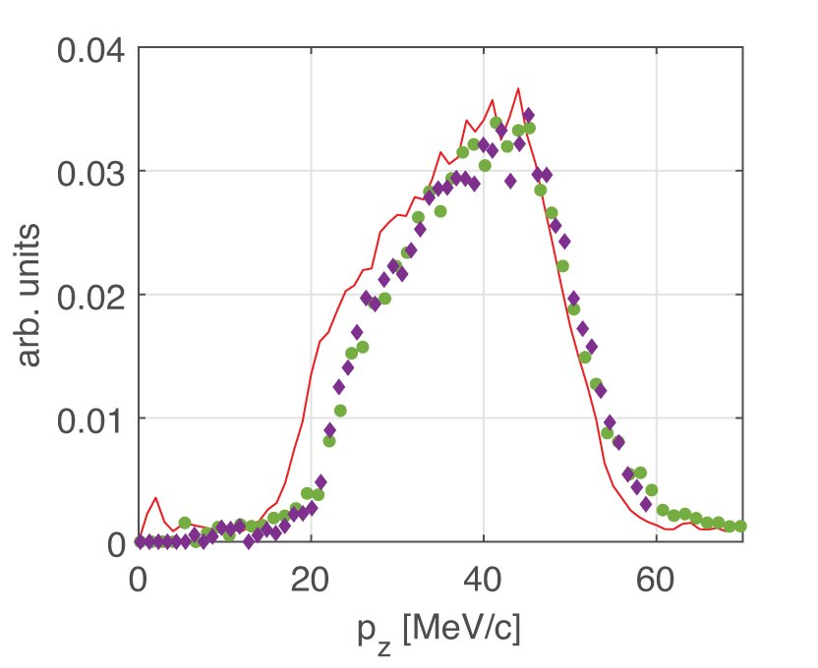
Longitudinal beam dynamics and RF phasing
Total positron output at 2nd RF structure.
It is a measurable charge that can be detected by the Faraday cups.
Max. 1246 pC (or 6.23 e+ per primary e-) at at φ = (120, -70).
expected
X=-190 mm
X=150 mm
e+ output [nC]
Charge distribution in time for the point of interest (POI)
Energy profile POI
Courtesy of N. Vallis

Slide 13
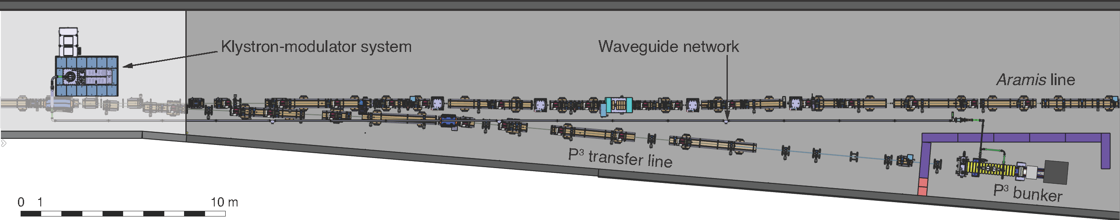
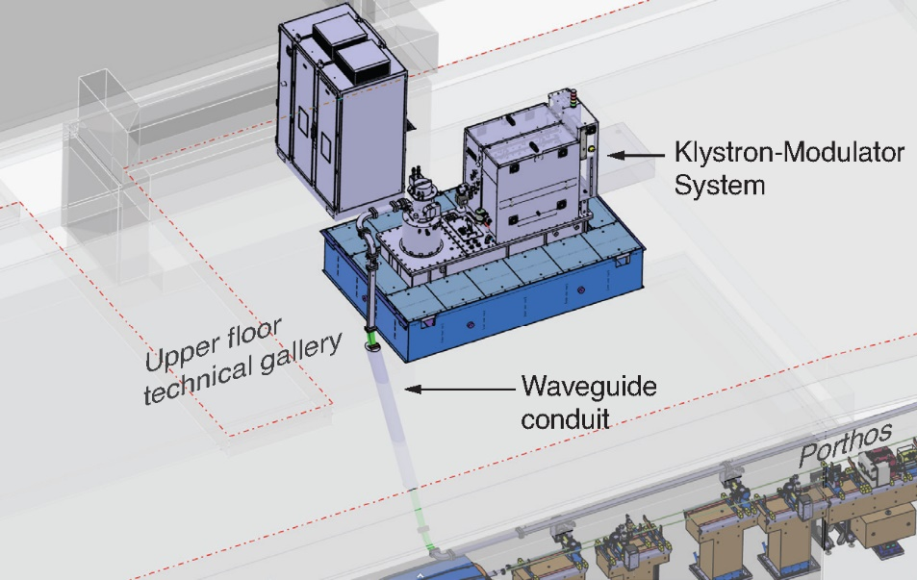
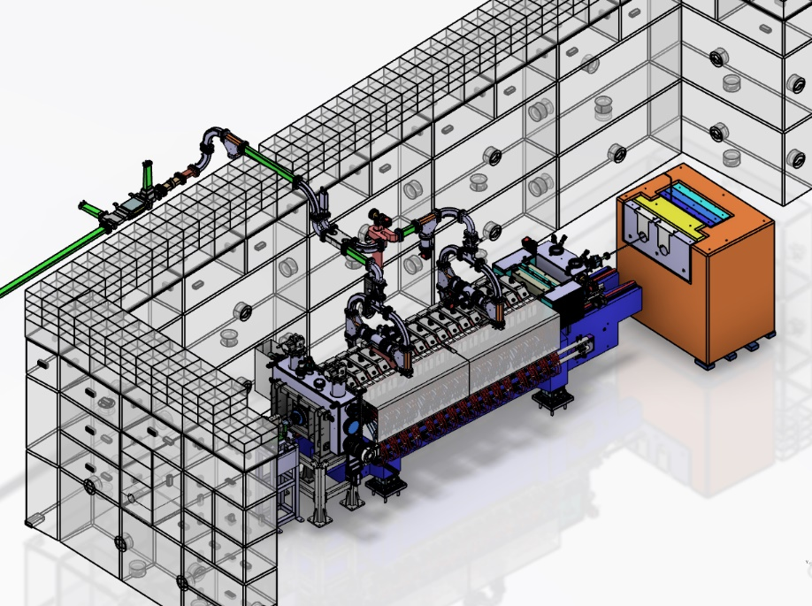
Status installation in SwissFEL
New
Existing
50 m installed
Dump
Switchyard and beam line installation ~completed
target
Modulator Racks installed
Modulator being assembled in WLHA
Girder assembly ongoing in WMHA
To be installed in August
Front wall assembled
Thanks to M. Schär, D. Hauenstein and M. Zykova

Slide 14
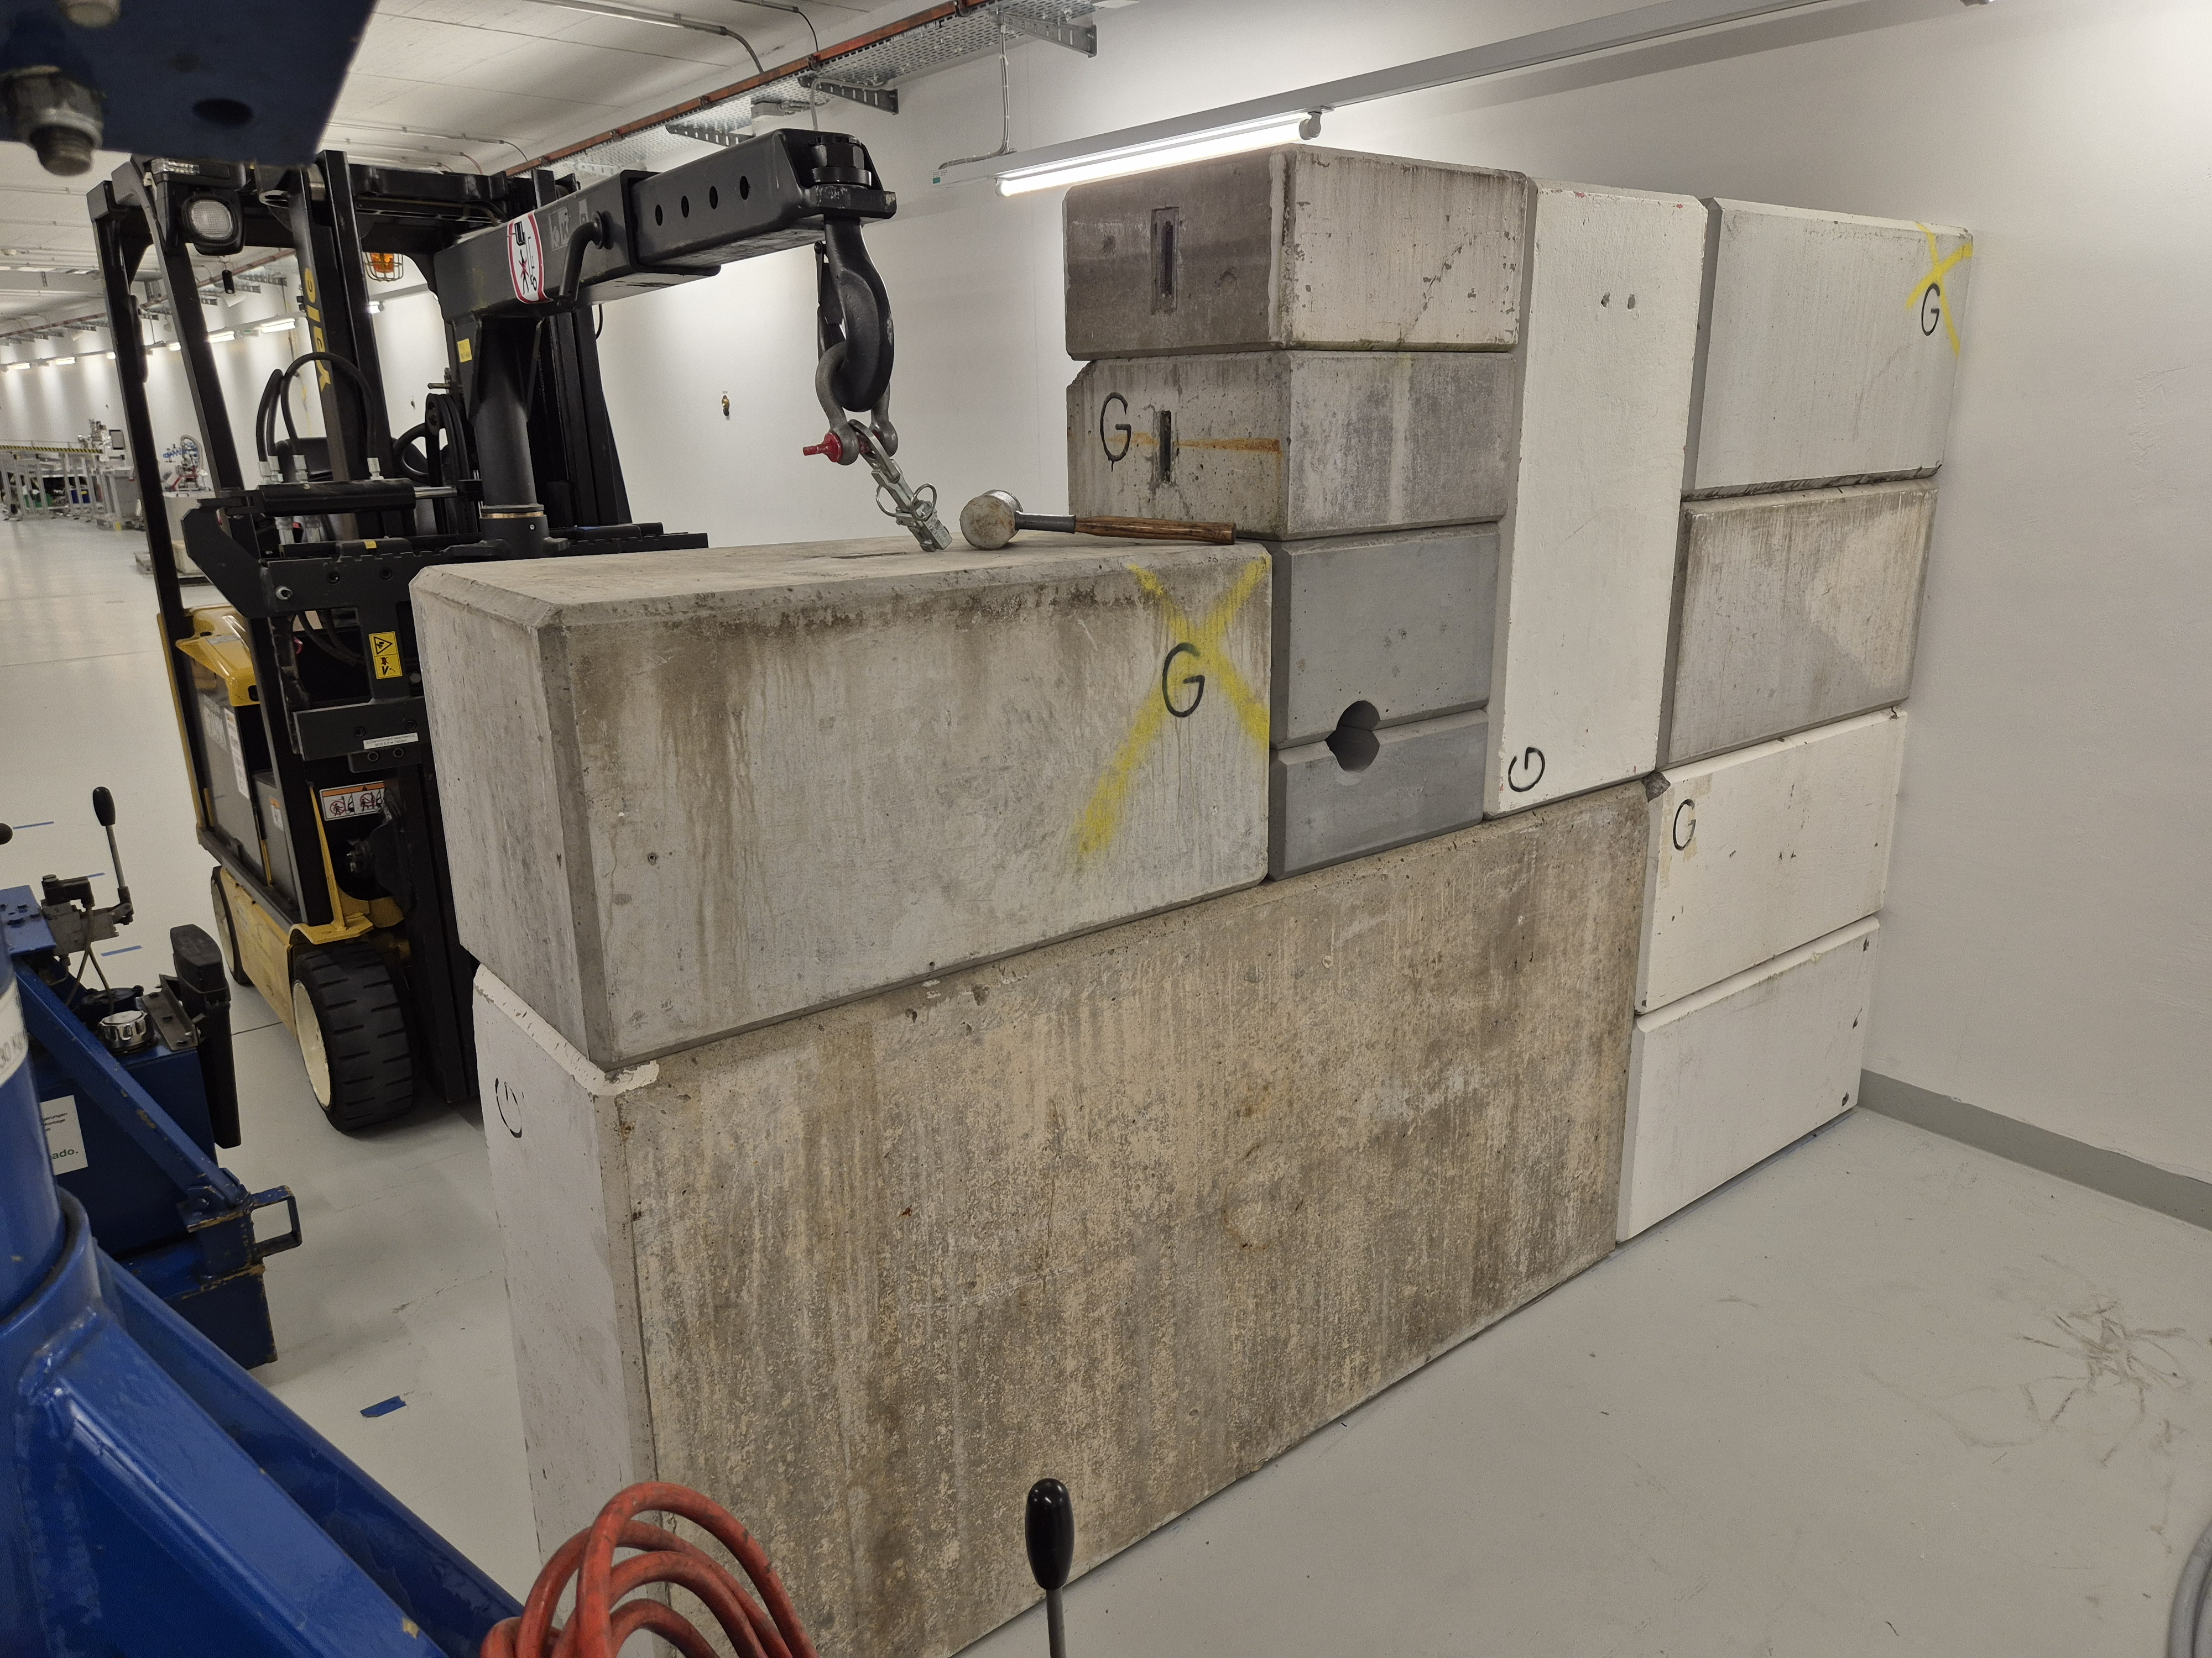
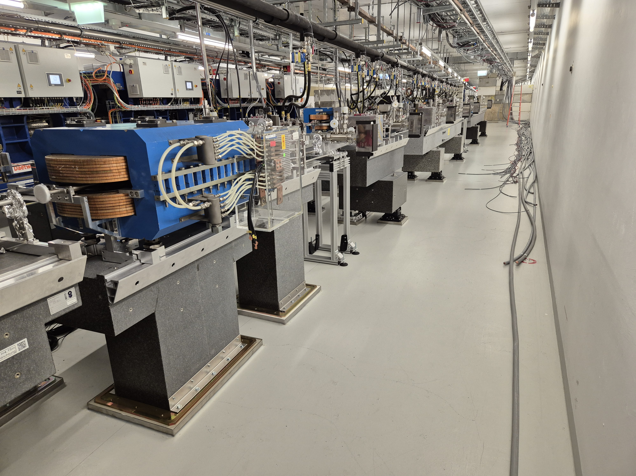
Installation in SwissFEL
beam
beam
Front wall and beam dump installed
Beam line installed up to the last screen

Slide 15
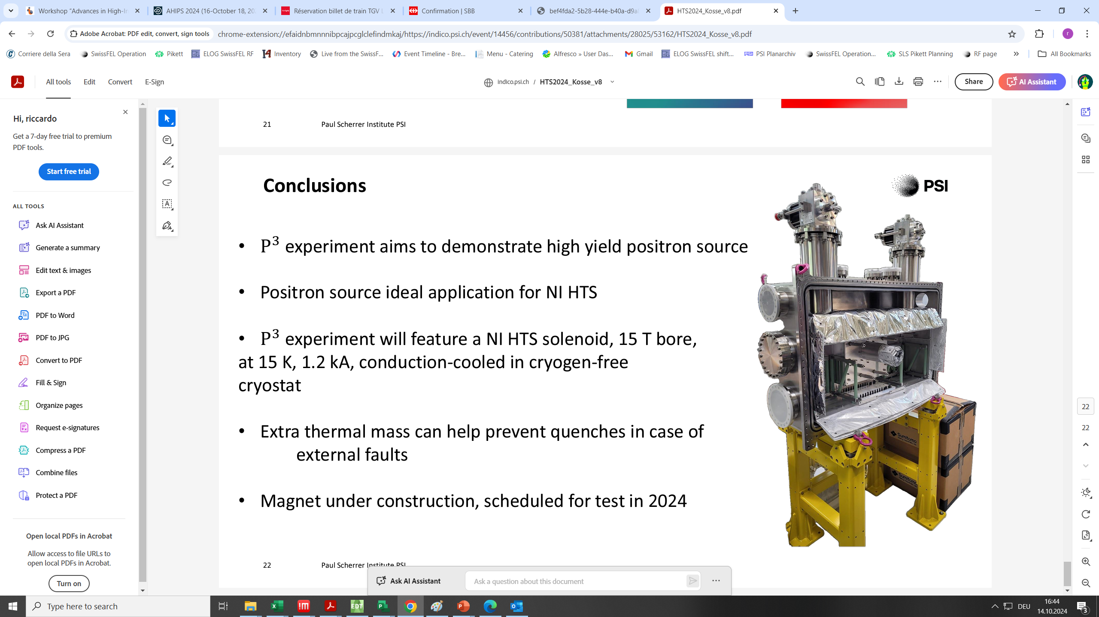
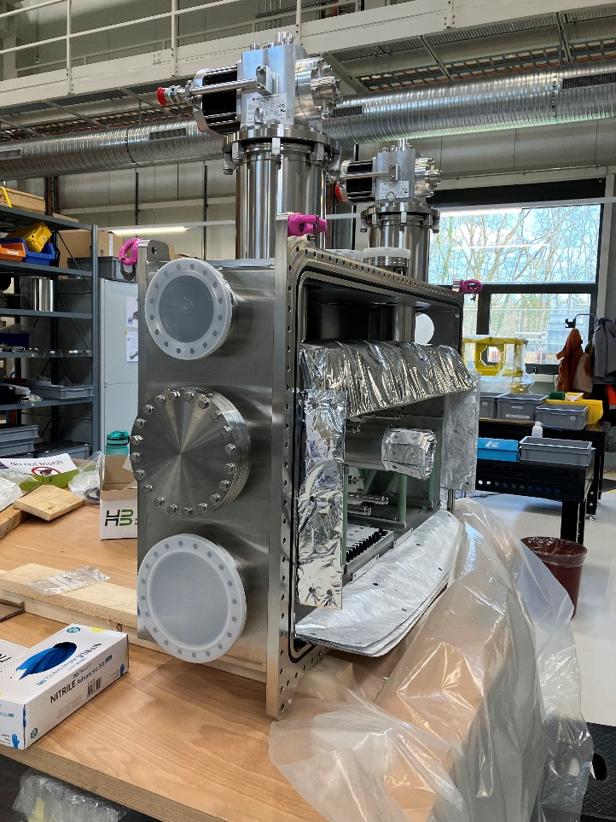
HTS solenoid
All 5 coils successfully tested
Installation of the cryostat in the bunker in summer shutdown
Cryostat ready

Slide 16
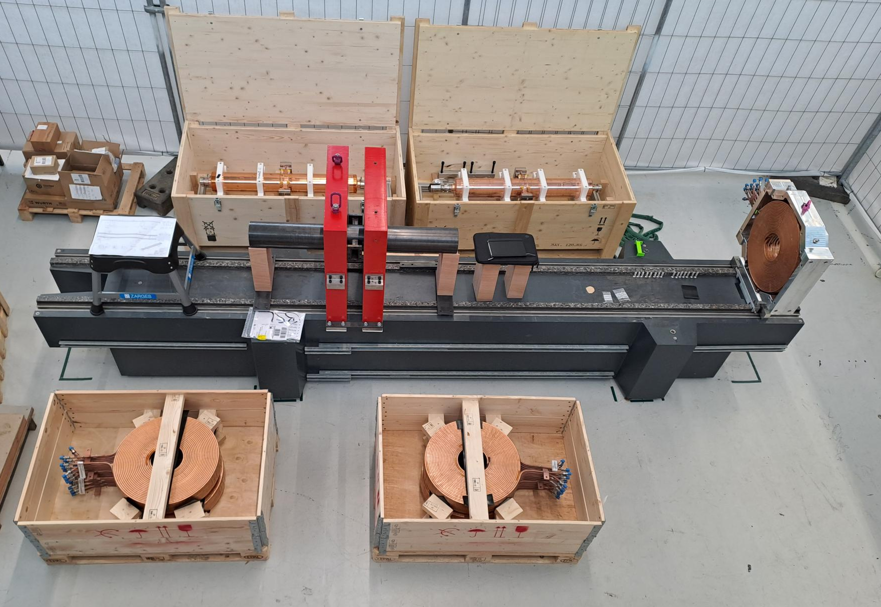
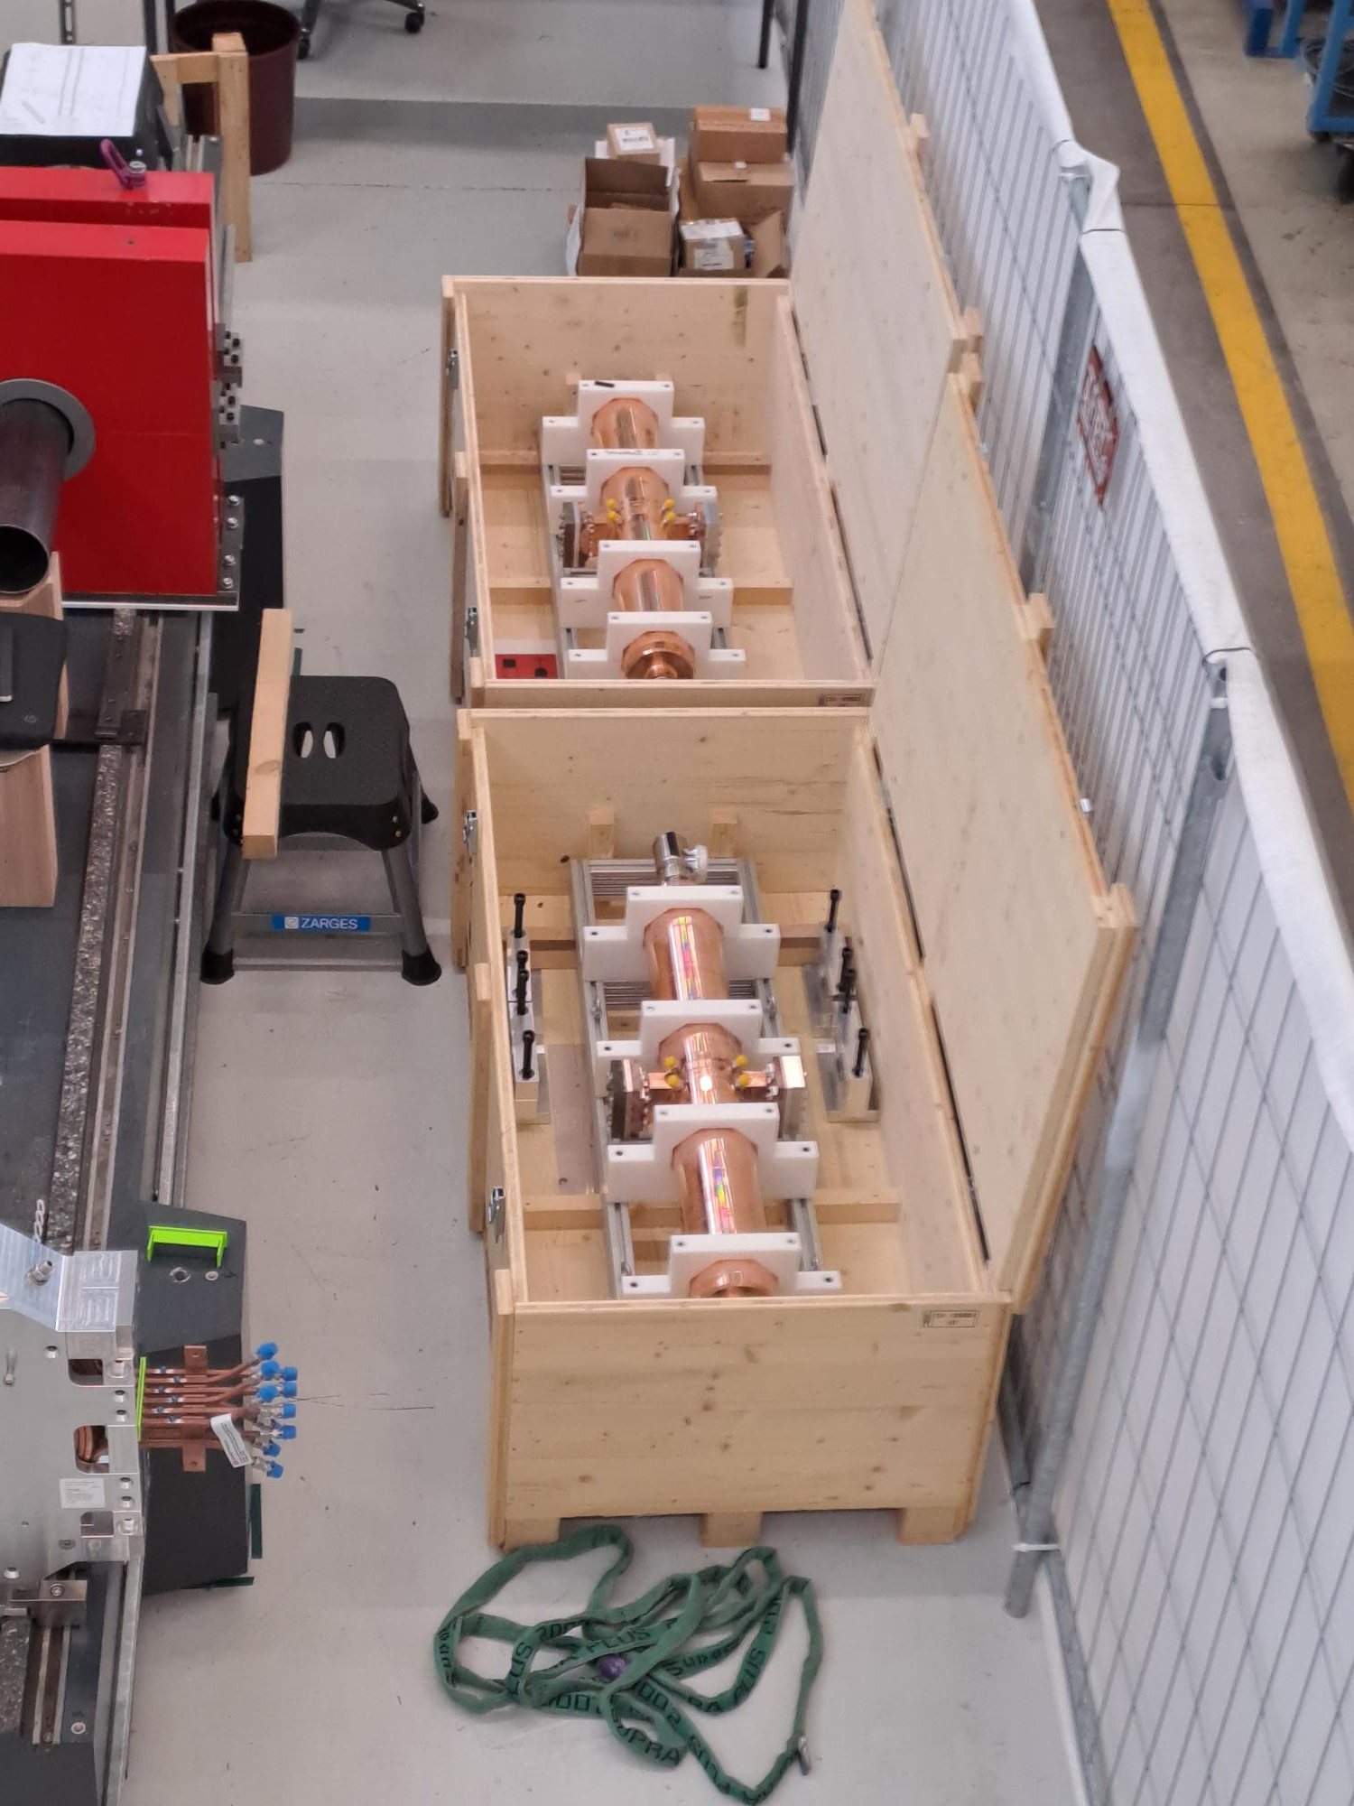
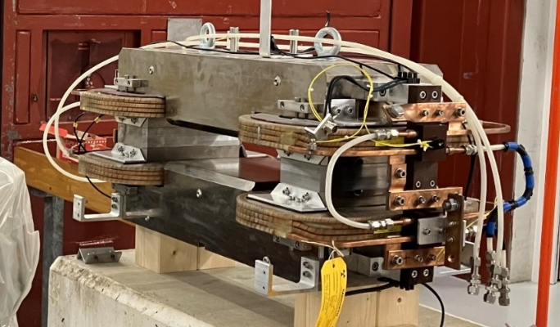
Experiment parts

Slide 17

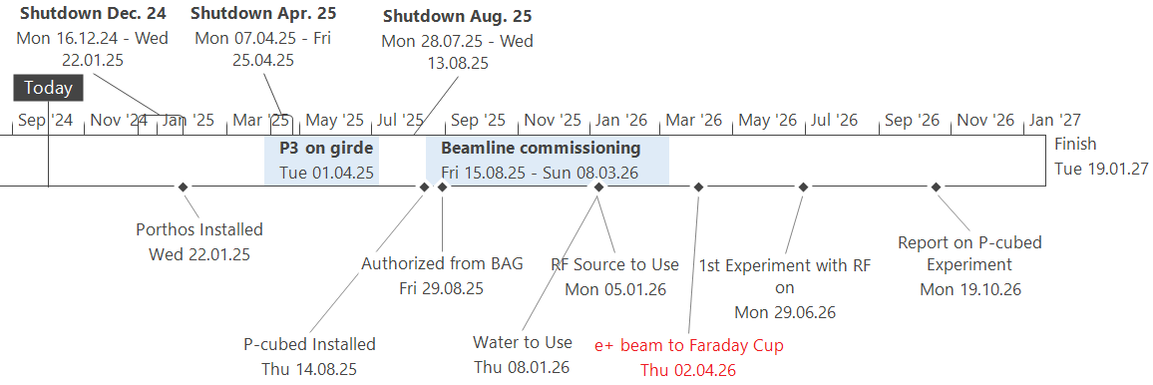
Timeplan

