Slide 1
I.FAST Task 10.6:
Machine Learning at ESS
Annual Meeting, Krakow, 2025-04-10
Tom Shea, Irena Dolenc Kittelmann
for the I.FAST Task 10.6 Team
(ESS, RTU, with WUT and Cosylab)

Slide 2
Introduction and Motivation
High-power hadron facilities provide the context
Performance limited by beam loss that is challenging to simulate, measure and control
Susceptible to errant beam that causes activation and even catastrophic damage and downtime
Objectives of Task 10.6
Explore the potential of machine learning (ML) techniques to identify errant beam conditions
Define a platform that can aggregate sensor data and execute ML algorithms with low latency; potentially capable of asserting intelligent triggers to acquire relevant data, and removing beam permit to suppress errant beam.
Ultimate impact: improve the performance and availability of ESS and other high-power hadron accelerators.

Slide 3
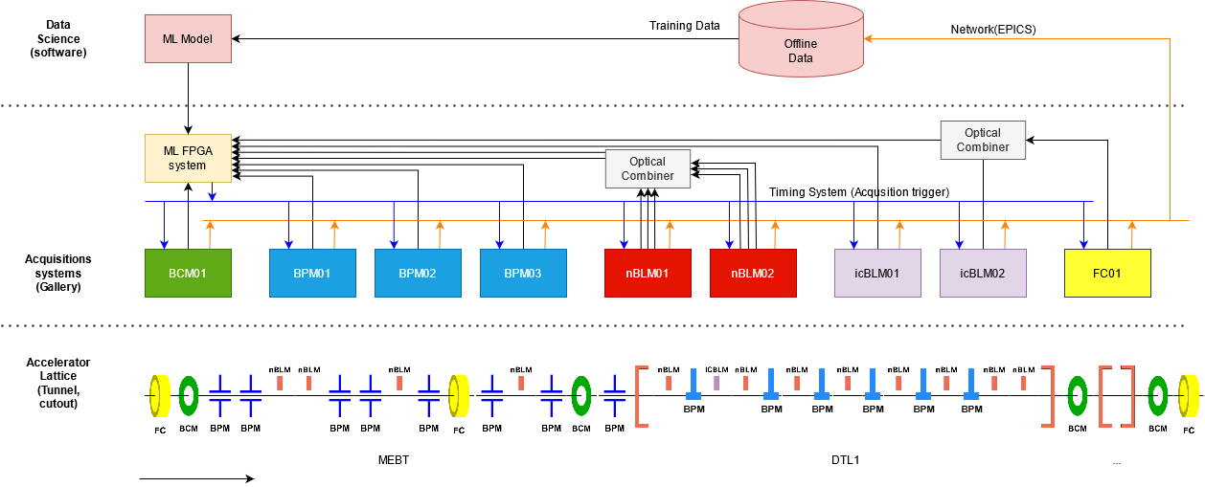
ESS Accelerator Layout
Full performance
5 MW on target
14 Hz
2.86 ms pulse length
62.5 mA peak
2 GeV protons
I.FAST Task 10.6 data
from DTL commissioning
in 2023
1 Hz
<50 µs pulse length
up to 62.5 mA
74 MeV

Slide 4
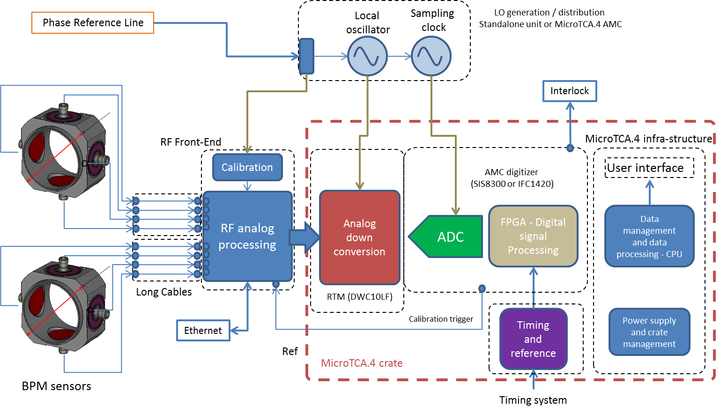
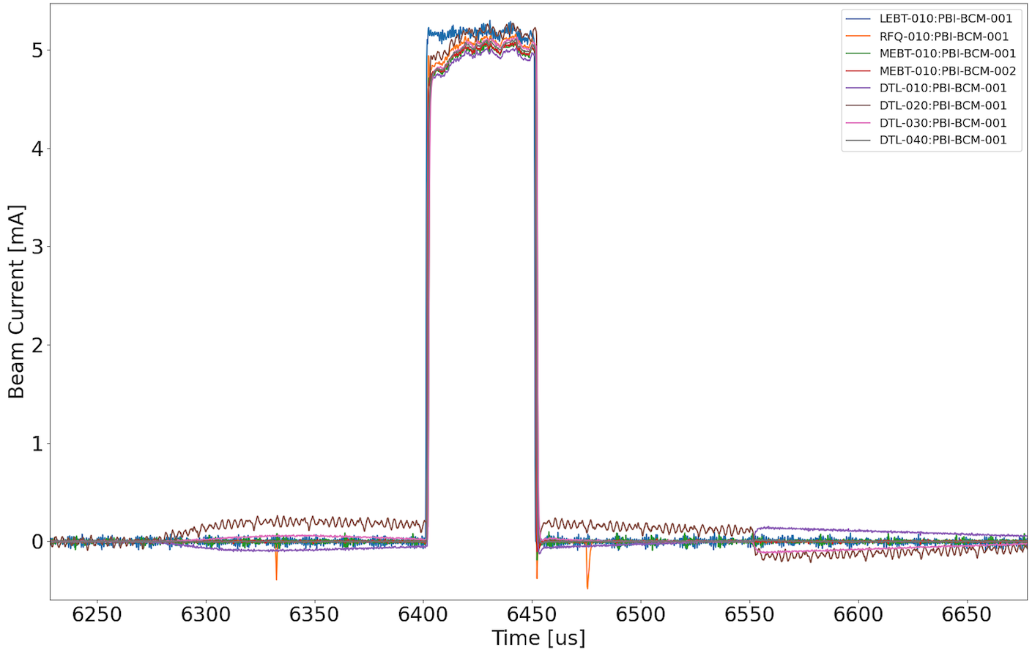
Beam Instrumentation
Typical system block diagram (BPM shown)
Data for analysis acquired though EPICS control system
All systems support future connection to low latency link
Typical waveforms for each pulse
(beam current shown)

Slide 5
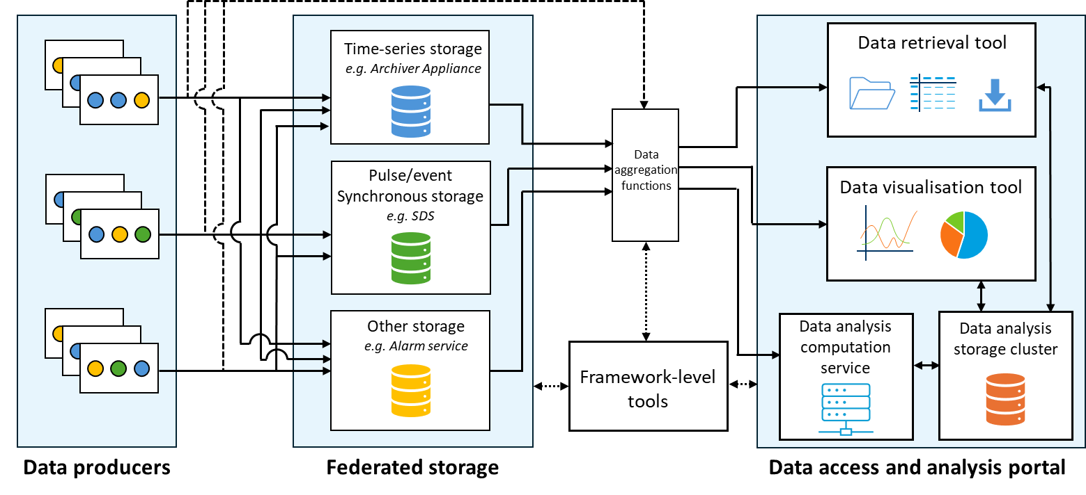
Data Workflow
Task 10.6 motivated improvements to data acquisition and analysis tools
Existing and new components are now being structured into a framework that will better support AI applications at ESS
x
Used in I.FAST data workflow
Prototype now deployed

Slide 6
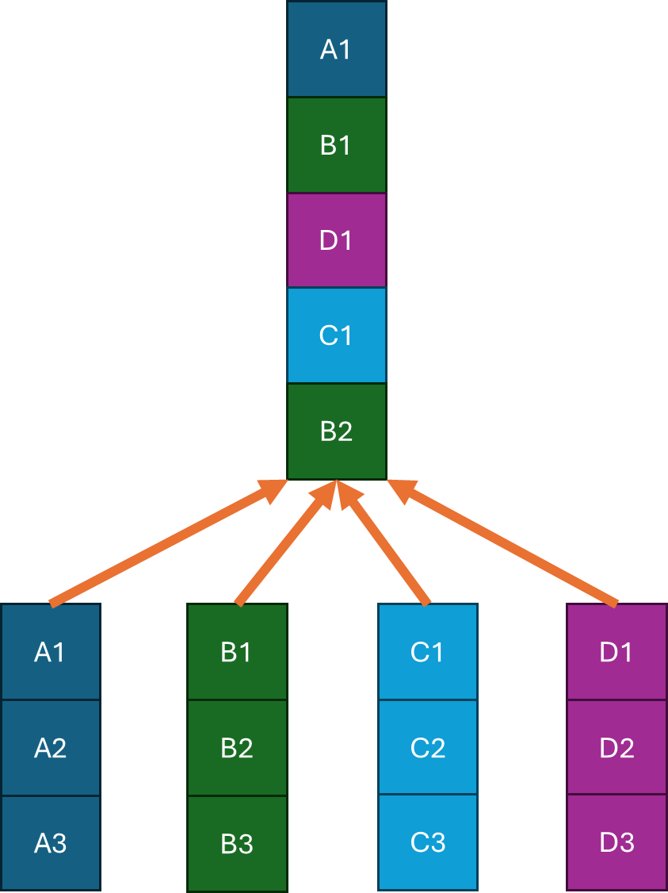
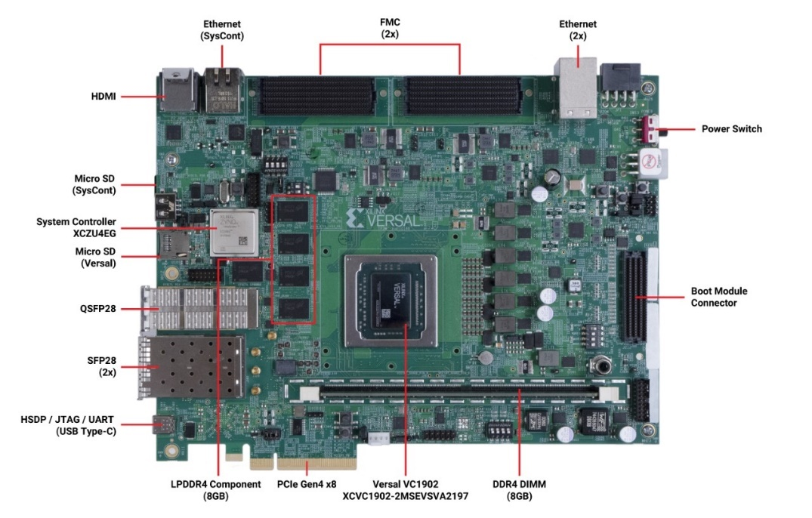
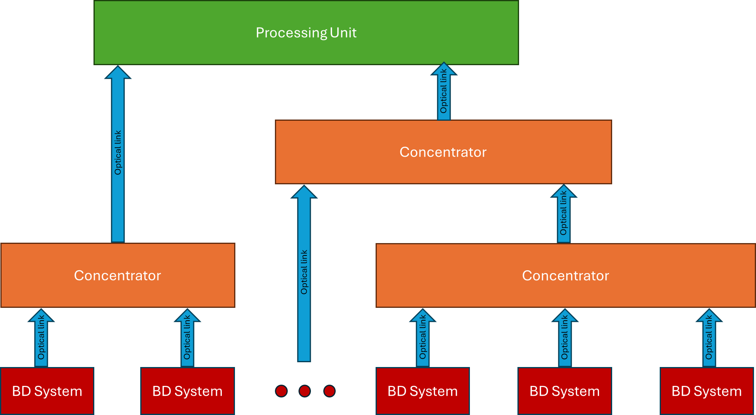
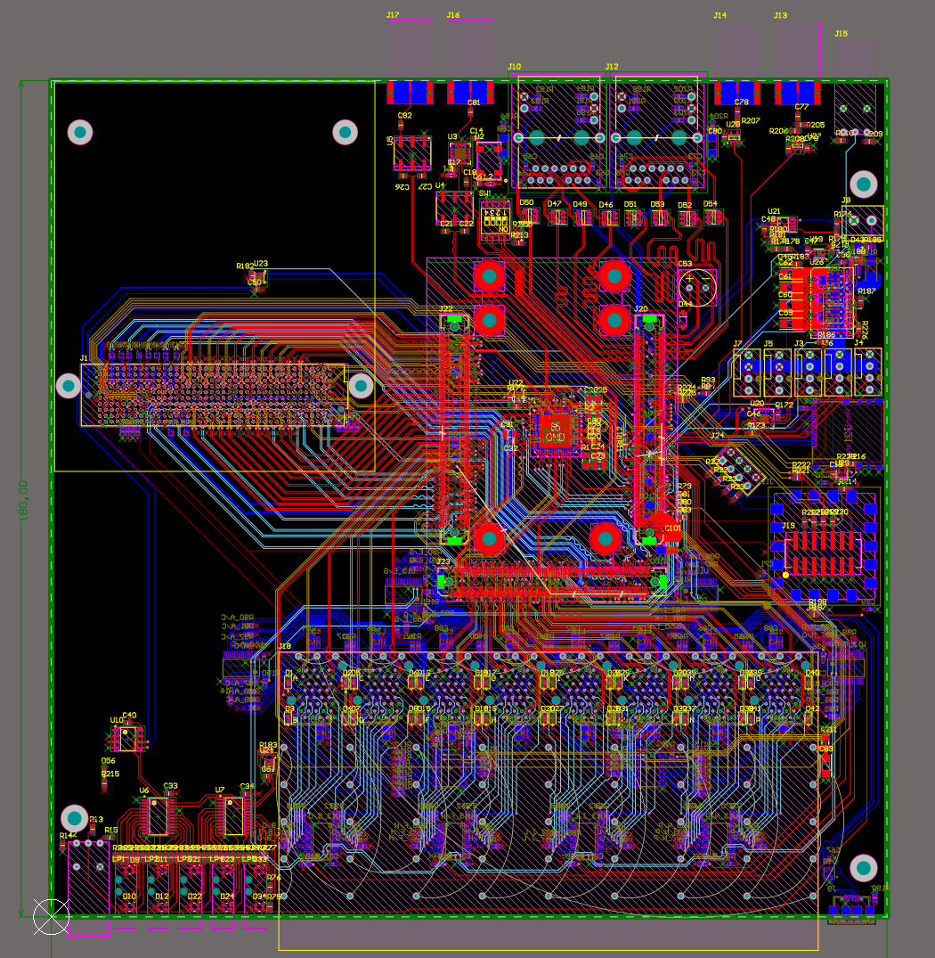
Low Latency Platform
Objective: Data delivery scaled to entire ESS accelerator (~0.3 Terabits/s, <10 µs latency)
Modal project (WUT): First article produced, test at ESS this Spring
I.FAST supported development of requirements and concept

Slide 7
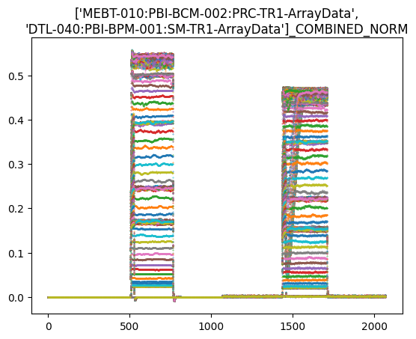
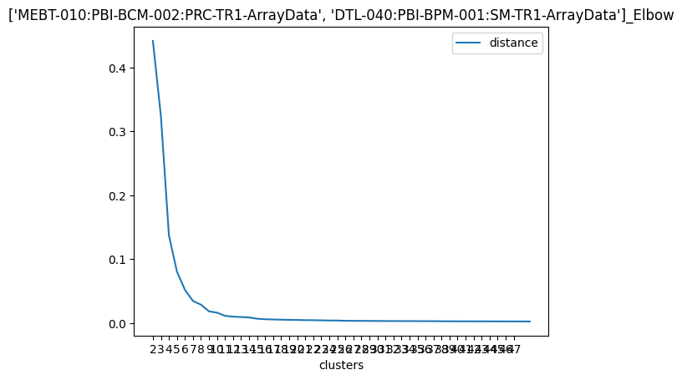
Analysis of ESS commissioning data
Extraction from Archiver Appliance
  Initial dataset: 400 GB representing about 13 hours of “stable” operation
  Then 2 weeks of data, filtered to pulses preceding interlocks
Data trimming of each timeseries
Combining and scaling of timeseries pairs
For this time-series data with varying pulse lengths, applied k-shape clustering algorithm with dynamic time warping; then cluster count determination
Waveforms from 2 instruments, cleaned, scaled and combined
Shoulder method to restrict cluster count

Slide 8
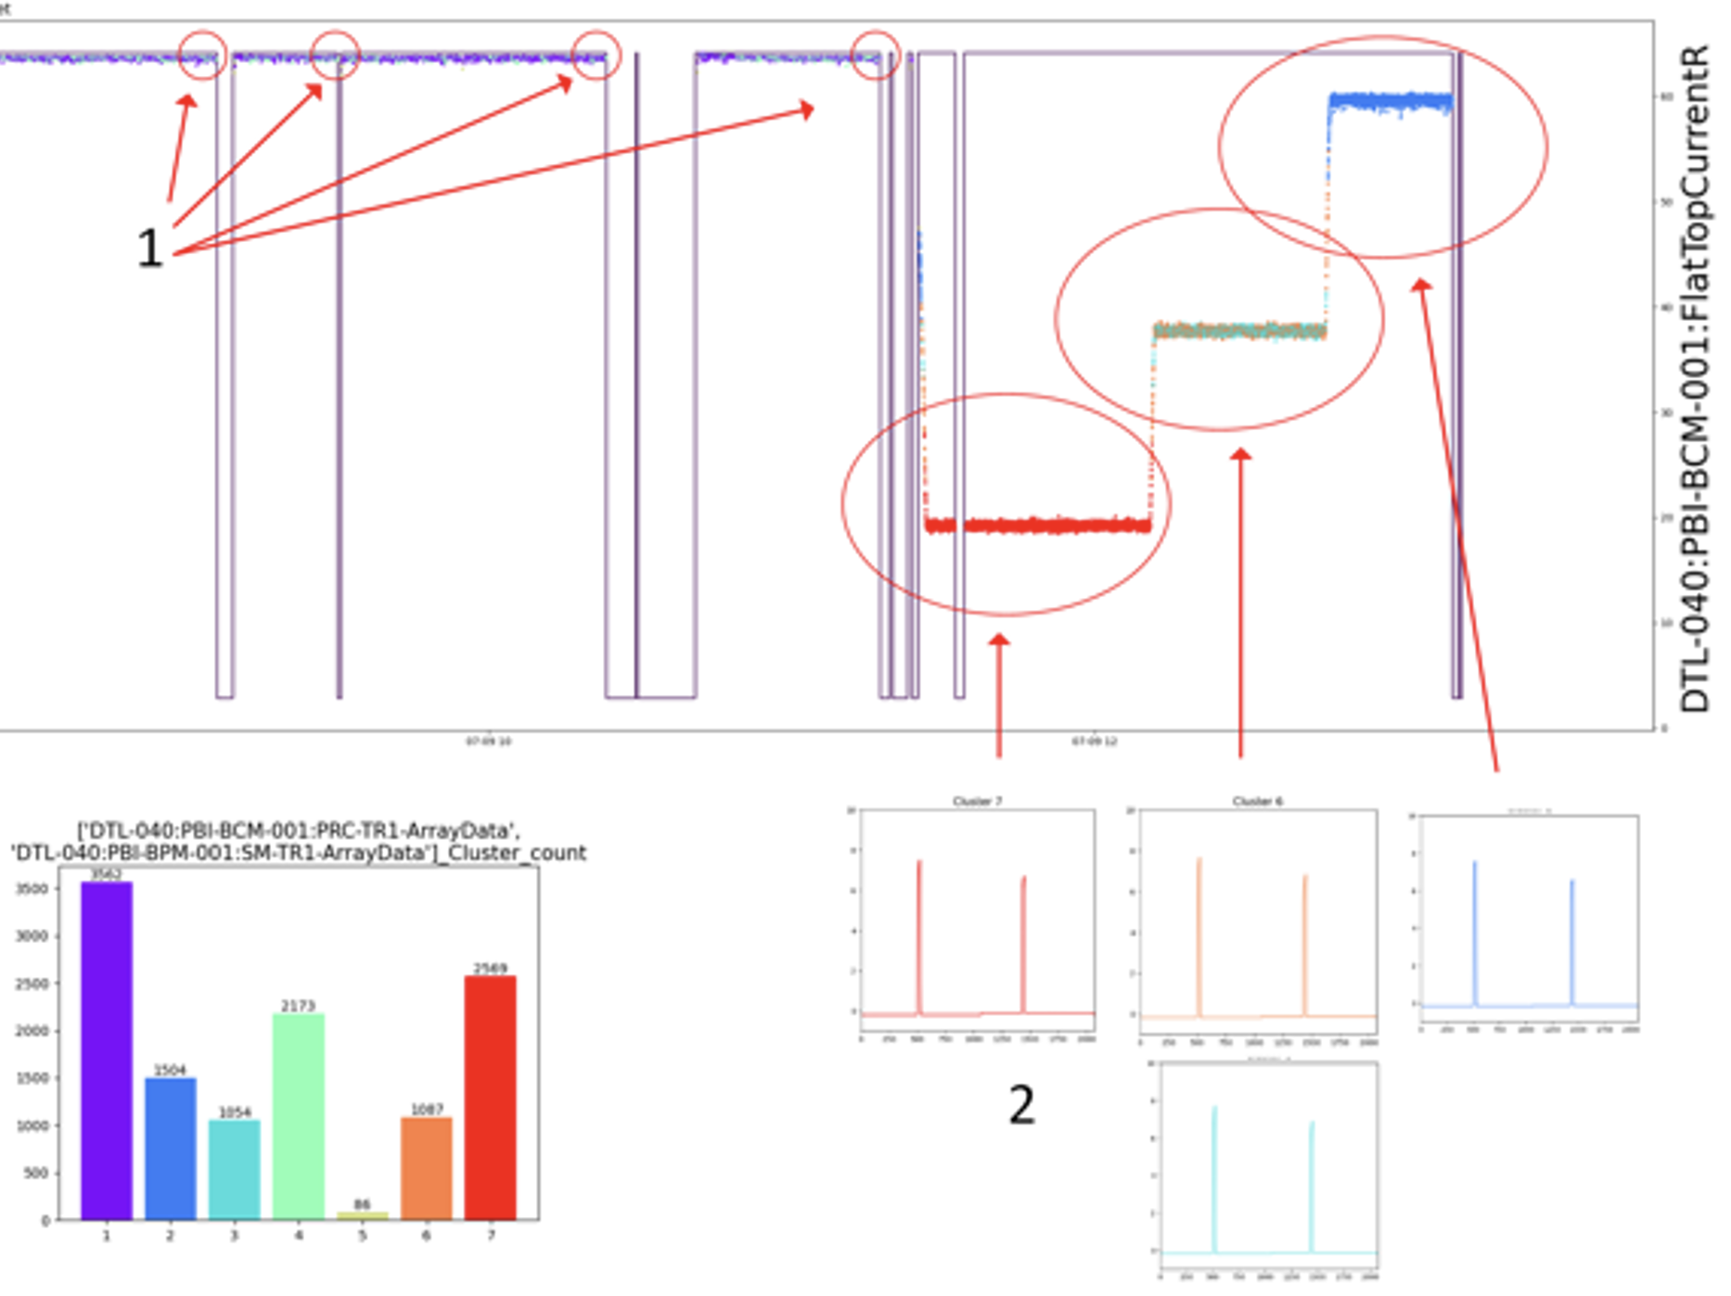
Example Results from the Analysis
K-shape clustering exhibited clear ability to discriminate based on pulse shape
Unlike the positive results from steady SNS operations, precursors to beam permit interlocks were not found in the ESS commissioning data
Consistent with experience at other facilities, data ages quickly as machine parameters change
Cluster frequency

Slide 9
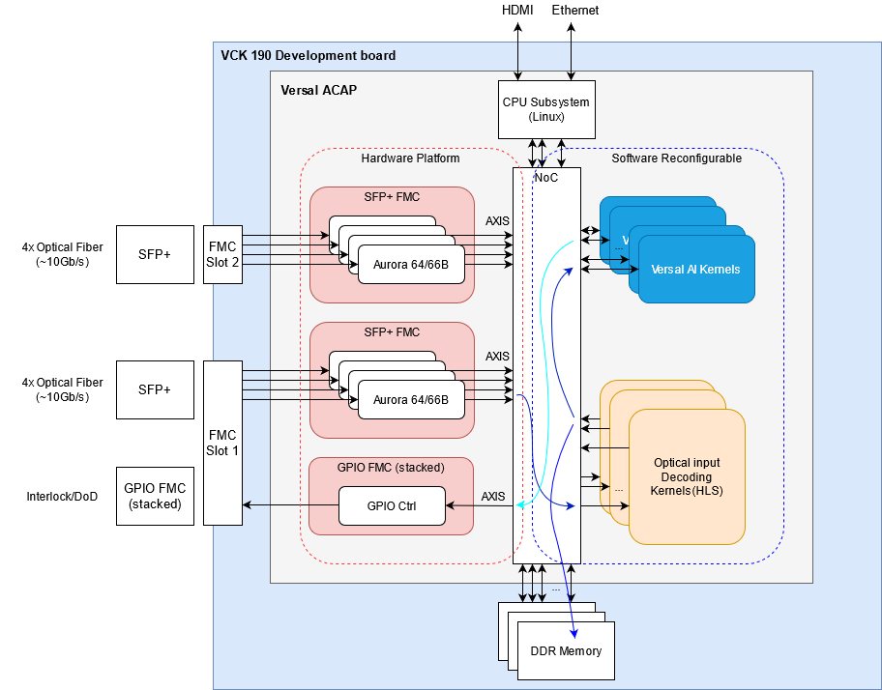
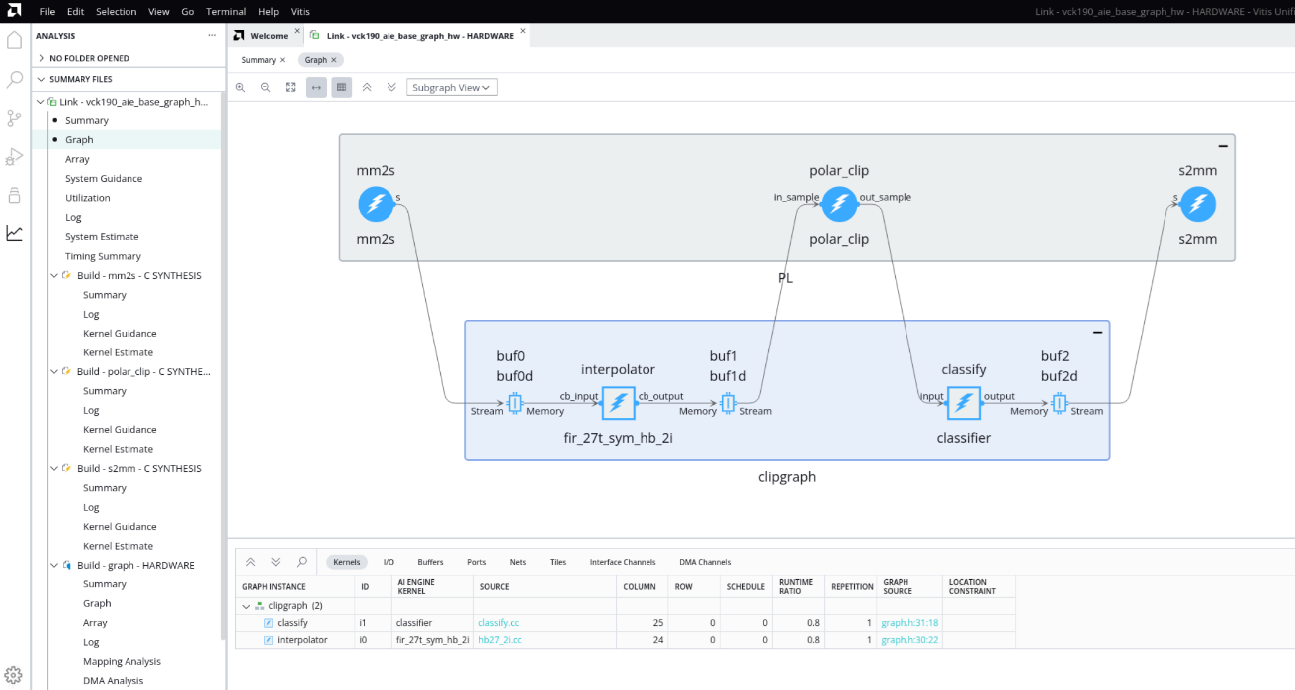
ML on the Low Latency Platform
x
x
Processing graph
One of the final activities of Task 10.6: Cosylab is applying the FPGA toolchain and will document the experience of deploying relevant algorithms on the AMD Versal platform

Slide 10
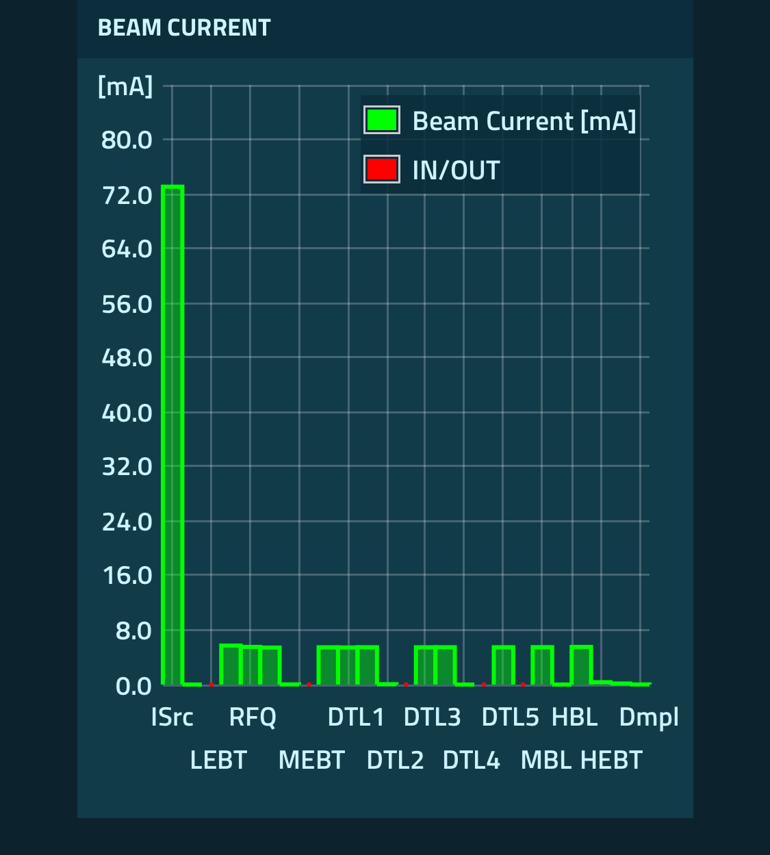
Summary and Outlook
Machine Learning for Hadron Linacs
  Clustering algorithms were applied to beam pulse data
  Shape discrimination shows promise for intelligent trigger
  At ESS, trained classifiers and prediction of errant pulses will require data from more stable machine operation.
  More information in report: https://zenodo.org/records/14979872
Support for Deployment at Scale:
  Polish Ministry of Science and ESS are now backing development of full-scale low-latency platform
  ESS developing operations data framework
  Large datasets via MOU with SNS in the US
We are Looking for Collaborators!
  Data workflows and metadata standards
  Data and algorithm sharing between facilities
  AI’s abstraction of machine specificities
  Communication between AI experts and accelerator experts
Yesterday:
First beam through entire ESS linac

Slide 11
Participants in I.FAST 10.6
T. J. Shea, I. Dolenc Kittelmann, K. Berkolds*, K. Rosengren,
R. Baron, S. Brewer, D. Cvenkel***, E. Donegani, T. Friedrich,
M. Grzegrzółka**, H. Hassanzedagen, J. Martins, R. Tarkeshian
ESS, *RTU, **WUT, ***Cosylab

