Slide 1
WP4 Managing Innovation:
Beam Windows and Composite Materials
I.FAST 4th Annual Meeting
10th April 2025
Krakow, Poland
M. Tomut, F. Carra

Slide 2
Outline
WP4.3 – Innovative beam windows for high-power accelerator applications
  Status of milestones and deliverables
  Outcome of beam tests of beam windows
WP4.4 – Carbide-Carbon Materials for Multipurpose Applications
SAC recommendations and Technology Readiness Levels (TRL)
Conclusions

Slide 3

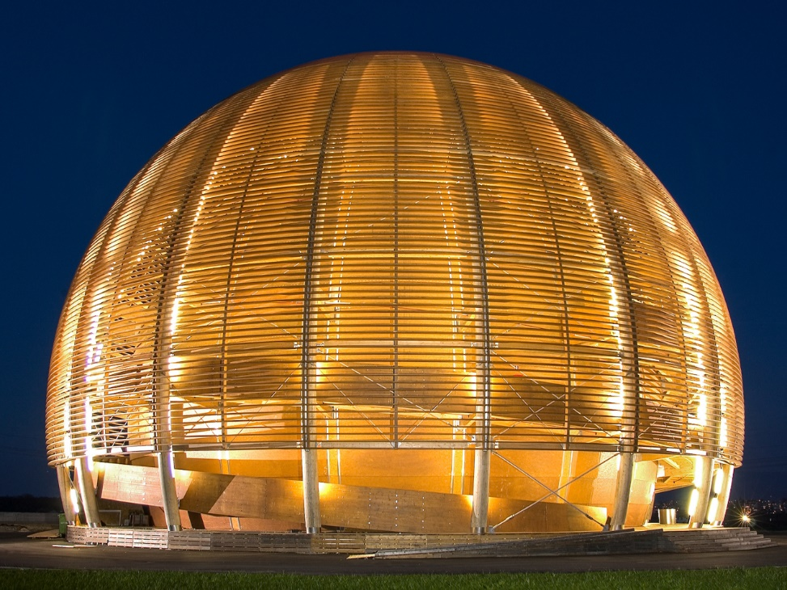





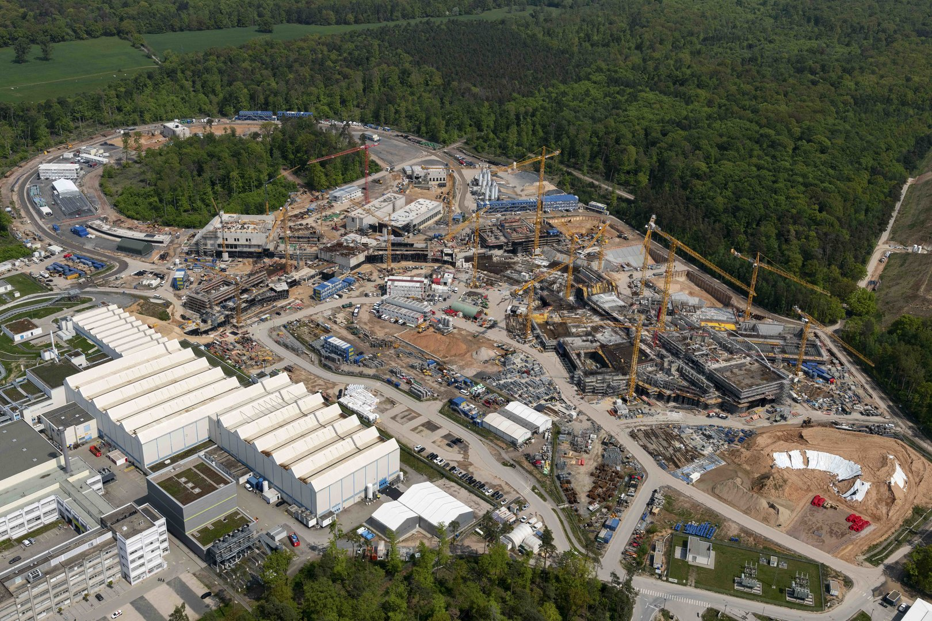
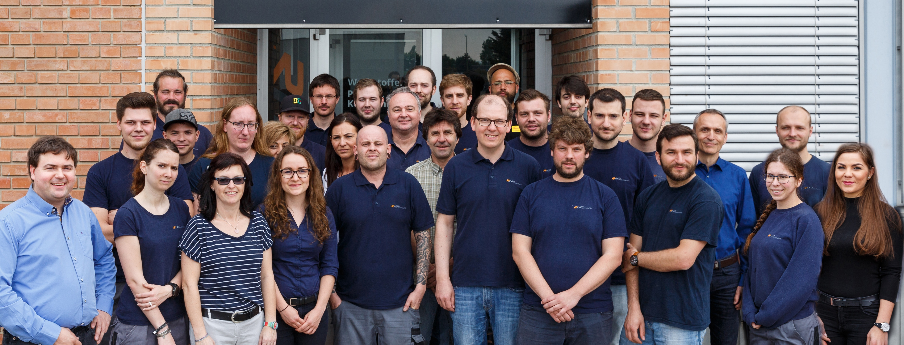
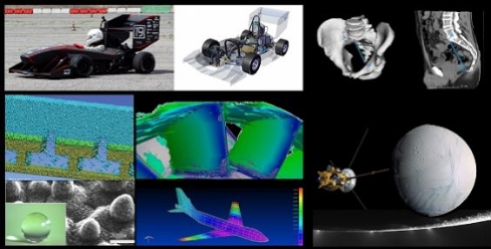
WP4.3 – Innovative beam windows for high-power accelerator applications
Beam window: separating environment at different pressures (vacuum/atmosphere or differential vacuum levels)
Two technical solutions investigated within WP4.3
  Metallic windows (tantalum, T91 steel, aluminium alloys)
  Graphenic windows (thin graphene membranes)
Task participants: GSI (DE), RHP (AT), CERN and Uni Münster
+ collaboration with La Sapienza University - DIMA (IT)

Slide 4
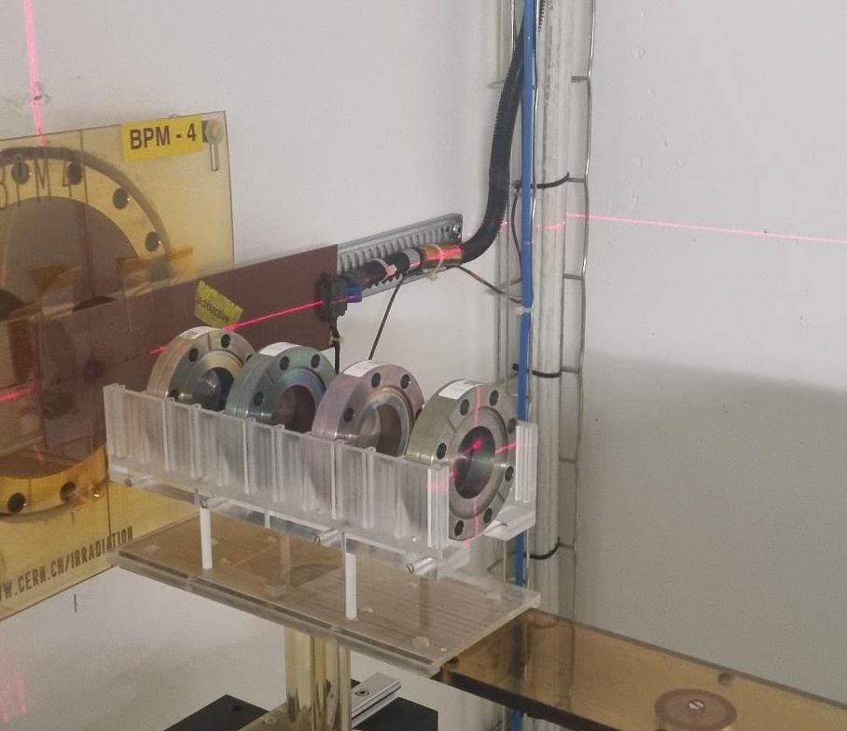
WP4.3 – Innovative beam windows for high-power accelerator applications
Milestone/Deliverable Number | Title | Lead beneficiary | Type | Dissemination level | Due Date (in months)
MS13 | First characterisation of beam windows materials under thermomechanical load and extended radiation damage | GSI | Report | Public | 18
D4.3 | Manufacturing and testing of two beam-windows prototypes | CERN | Demonstrator | Public | 32
Milestone MS13 achieved in 2022
Well documented at 2nd IFAST Annual Meeting
Deliverable D4.3 achieved in 2024
Irradiation of 4 beam windows prototypes at CERN IRRAD in Sep-Oct ’23
Samples cooldown until March ’24 → followed by thermomechanical characterization
Deliverable completed and submitted in June ‘24 → more in N. Vejnovic’s talk this afternoon

Slide 5
WP4.3 – Innovative beam windows for high-power accelerator applications
Graphenic Carbon windows – Finding the right material !
Previous beam tests on carbon foils mounted on frames
b)
Beam spot
STEM (a) and SEM (b) images of pre-existing microcracks in pristine carbon membranes
Failure of a graphene platelet-based membrane irradiated with 4.8 MeV/u 5 ×10¹³ U ions/cm²

Slide 6

WP4.3 – Innovative beam windows for high-power accelerator applications
Graphenic Carbon membranes – Material produced by
CVD deposition of GC on Si substrate
Laminar structure of GC
GC membrane on Si ring for beam window application
Strong bonding on Si ring
2-step etch process of Si substrate

Slide 7
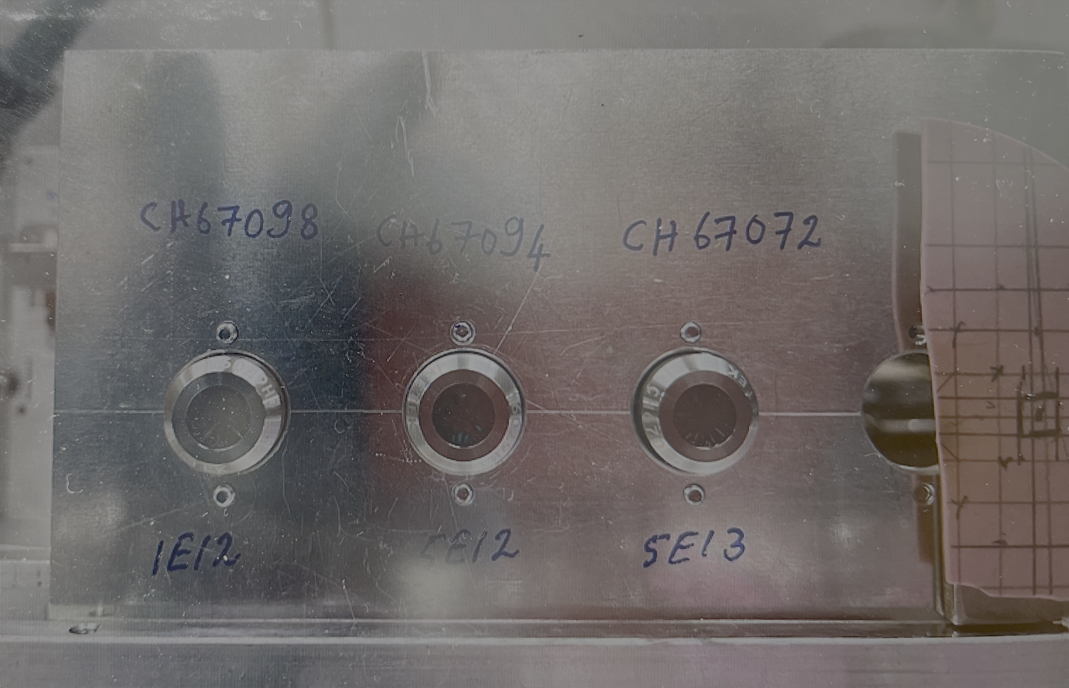
WP4.3 – Innovative beam windows for high-power accelerator applications
Graphenic Carbon membranes – Beam tests at GSI
IR thermography
monitoring
Peak temperatures in carbon membranes
exposed to 4.8 MeV/u heavy ions, as a function of beam intensity and duty cycle

Slide 8
WP4.3 – Innovative beam windows for high-power accelerator applications
Graphenic Carbon – Irradiated membranes
Pristine
4.8 MeV/u Au
1x 10¹³ ions/cm²
flux of 2x10⁹ i/cm²s
4.8 MeV/u Au
5x 10¹³ ions/cm²
flux of 2x10⁹ i/cm²s
5 MeV/u Ne
6.9x10¹⁶ ions/cm²
flux of 6x10¹² i/cm²s
Heavy ion beam irradiation- increase of the areal density - compaction
K. Botsiou, Master thesis

Slide 9
WP4.3 – Innovative beam windows for high-power accelerator applications
Irradiated Graphenic Carbon – understanding structural changes
Pristine
Phase transformation and compaction
GSI
GSI
RIKEN
RIKEN
Pristine
Raman spectra of pristine and irradiated foils
Increased size of in plane graphitic platelets
Disordering of lattice structure at nanoscale

Slide 10
WP4.3 – Innovative beam windows for high-power accelerator applications
Application of graphenic beam windows as gas targets windows – tests at GSI
1 bar gas pressure
GC window
GC window
Test with Pb beam
up to 280 MeV/u
Filled gases:
Nitrogen
Propene
Argon
Tested at the FRS beamline at SIS-18, GSI, Darmstadt

Slide 11

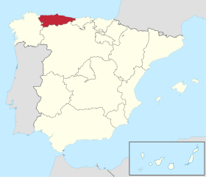
WP4.4 – Carbide-Carbon Materials for Multipurpose Applications
Large scale Carbide-Carbon Materials for multipurpose applications (M1 – M48)
  Promote the use of carbide-carbon materials (CCM) in future particle physics facilities and open up the market to commercial applications (thermal transfer, aerospace light components, fusion, etc.)
  Thermal conductivity 2-3 times higher than Cu! Stronger, low density
3x larger volume per sintering cycle
1.5x lower sintering temperature material
2x Cost Reduction
Higher efficiency
Who?
How?
Notes:
How?
Increasing by 3x the maximum achievable volume of CCM components (currently 500 cm³)
Decreasing the production temperature by 1.5x
Decreasing by 2x the final production costs (currently 16÷20 €/cm³)

Slide 12
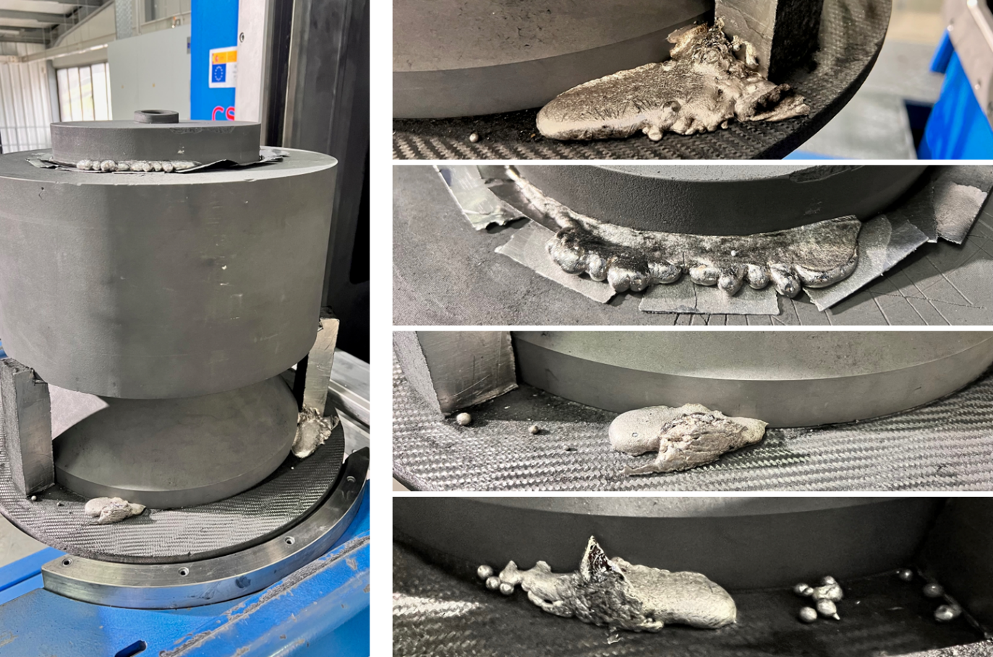
WP4.4 – Carbide-Carbon Materials for Multipurpose Applications
Milestone/Deliverable Number | Title | Lead beneficiary | Type | Dissemination level | Due Date (in months)
MS14 | Evaluation of a CCM alternative to Molybdenum- Graphite | CERN | Report | Public | 16
D4.4 | Production of large-size CCM plates | CERN | Demonstrator | Public | 24
Milestone MS14 achieved in 2022 (link)
Chromium-Graphite (CrGr) proposed (and produced) as a valid alternative to MoGr
Presented at the 1st IFAST Annual Meeting (see here)
D4.4 achieved in 2023 (link)
Two big (Ø230 mm) Chromium-Graphite disks produced in a single machine cycle (doubling of disk cross-section, decreasing of the sintering temperature wrt MoGr)
Presented at the 2nd IFAST Annual Meeting (see here)

Slide 13
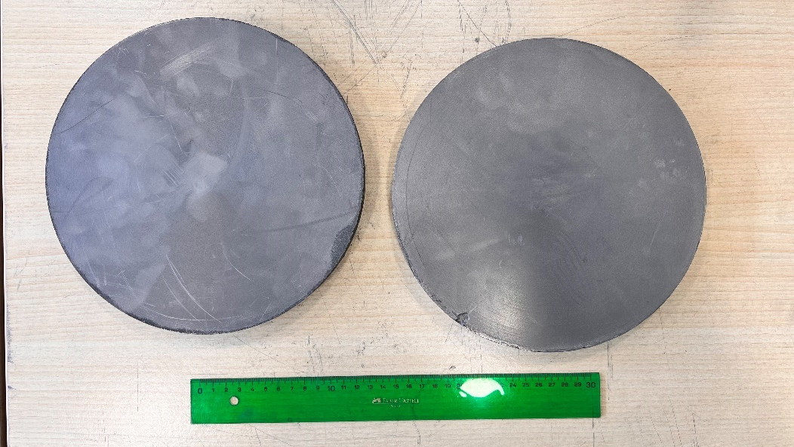
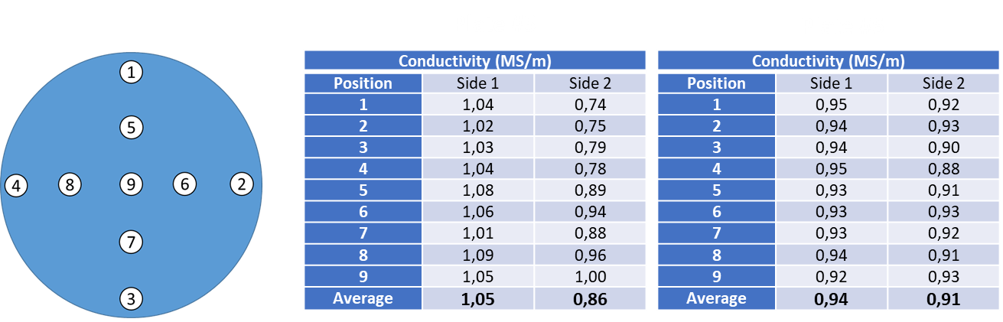
WP4.4 – Carbide-Carbon Materials for Multipurpose Applications
Ongoing additional activities (thanks to Nanoker for the commitment!)
2024: in-lab characterization at CERN of the full thermomechanical properties in temperature of the CrGr big disks (thanks to Nanoker for cutting > 100 samples!) → issue found: wrong orientation in the cutting direction of several specimens
2025: decided to repeat the full cutting + characterization campaign on a fresh new set of specimens, correcting the orientation issue → results expected by June this year
D4.4 2xØ230 mm CrGr plates

Slide 14
SAC recommendations and TRL
SAC recommendations for the final I.FAST annual meeting
  Impact statements achieved to date and projections for the anticipated impact of their work (i.e. foreseen applications)
  Elaborating on achieved Technical Readiness Levels (TRLs)
Technology | TRL | TRL definition | Time until market readiness* | Foreseen applications | Comments
Ta, T91 and graphenic carbon beam windows | 6 | Technology demonstrated in relevant environment (industrially relevant environment in the case of key enabling technologies) | 2 years | Additive-manufactured beam windows Graphenic beam windows for gas and water calibration targets for research and particle therapy | Assembly (window + flange bonding) requires optimization for the metallic foils→ possible proposal for IFAST-2 (additive manufacturing- multimaterials)
Molybenum-Graphite | 9 | Actual system proven in operational environment (competitive manufacturing in the case of key enabling technologies; or in space) | – | High-Power targetry and beam intercepting devices | Installed in 12 HL-LHC collimators, currently under operation!
Chromium-Graphite | 4 | Technology validated in lab | 2 years | High-Power targetry and beam intercepting devices | Based on the experience with MoGr, need to ensure repeatability through pre-series production of final-shape components → possibly part of a proposal for IFAST-2
*assuming budget available to go up to TRL=9 (validation through series production)

Slide 15
Conclusions
All WP4 milestones and deliverables completed in 2024
For metallic beam windows, two solutions of the assembly window flange were tested with beam
Graphenic carbon membranes are ideal for applications where minimal energy loss of the beam passing through the window are requested- gaseous and liquid calibration target- tests performed with beam at 1 bar
Chromium-Graphite composite produced as a sustainable alternative to MoGr- radiation hardness tests needed
Several additional optimization and scientific impact activities being performed, thanks to the strong engagement and motivation of WP4 research and industrial partners
Extensive scientific contribution through master theses and papers already produced and some more is coming!

Slide 16
Scientific Contributions
L. Notari, “Dynamic radiation effects induced by short-pulsed U-ion beams in metallic targets”, Master Thesis, 10.5281/zenodo.7484054
K. Botsiou, “Alpha particle energy loss measurements in carbon for improved stopping power values and areal density determination of graphenic carbon foils”, Master Thesis, 2024
L. Notari, M. Pasquali, F. Carra, M. Losasso, M. Tomut, “Materials adopted for particle beam windows in relevant experimental facilities”, Phys. Rev. Accel. Beams 27, 12 February 2024, 024801, https://zenodo.org/uploads/10964349
L. Notari, M. Pasquali, F. Carra, M. Losasso, J. Guardia-Valenzuela, M. Tomut, “Dynamic response to short-pulsed U-ion beams of material candidates for vacuum beam windows manufacturing”, Helyon, Volume 10, Issue 24, 30 December 2024, e40707 https://doi.org/10.1016/j.heliyon.2024.e40707
F. Carra, “Newly developed thermal conducting material holds promise for use in future accelerators and industry”, Accelerating News Issue 49, December 2024, https://acceleratingnews.eu/news/issue-49/ifast-ifa/newly-developed-thermal-conducting-material-holds-promise-use-future

Slide 17
Thank you for your attention!
From: F. Carra, C. Belei, M. Kitzmantel, M. Pasquali, M. Tomut, N. Vejnovic, J. Swieszek, S. Rivera, C. Gutierrez, L. Notari, K. Botsiou, J.H. Rockstedt, S. Purushotaman, S. Marin, F. Salvat Pujol, F. Ravotti, G. Pezzullo, I. Aviles, S. Hoell, J. Guardia Valenzuela, C. Accettura, O. Sacristan, L. Puddu, M. Losasso,
and I’m probably forgetting someone…

