Slide 1
Task 7.3: VAriable Dipole for the Elettra Ring (VADER)
I.FAST - General Meeting 2025 – 10/04/2025
Y. Papaphilippou for the Task 7.3 collaborators

Slide 2




VAriable Dipole for the Elettra Ring - VADER
Task 7.3 within I.FAST WP7: High Brightness Accelerators for Light Sources
Partners and collaborators:
Y. Papaphilippou
(A. Poyet)
M. Dominguez
F. Toral
E. Karantzoulis
D. Castronovo
R. Geometrante

Slide 3
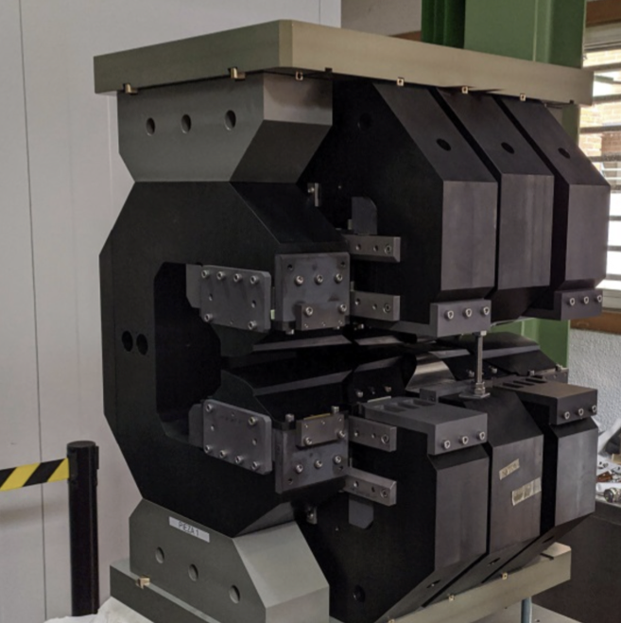
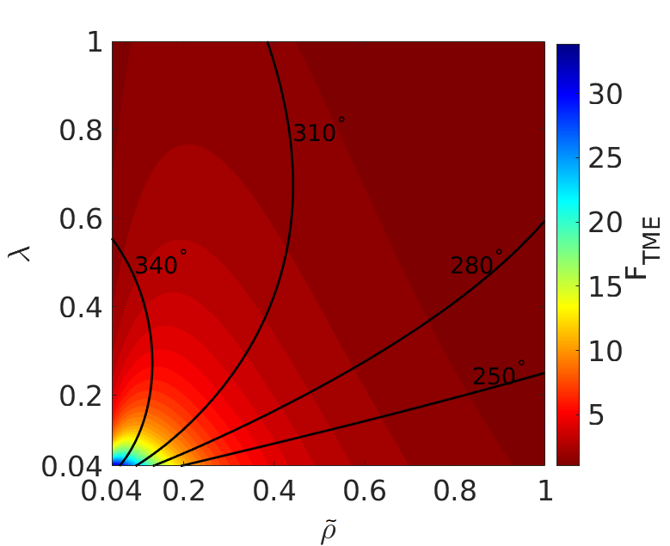
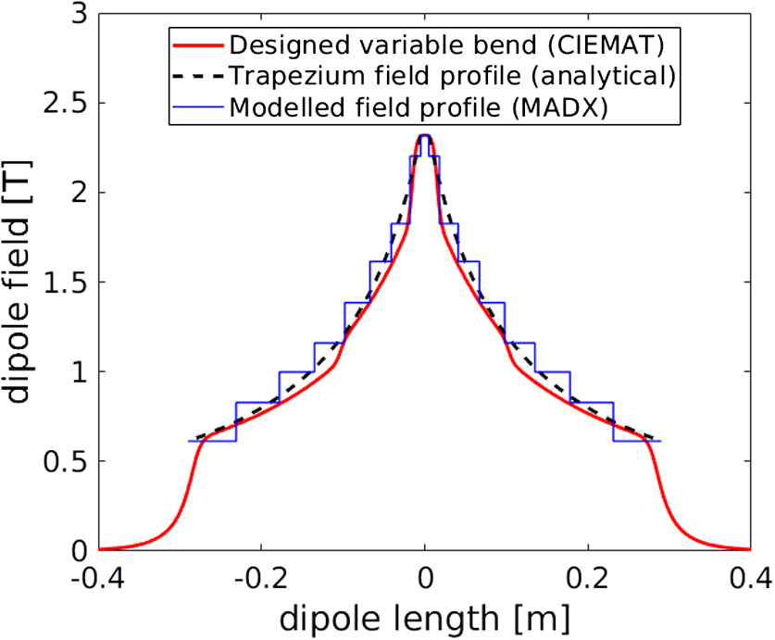
VADER objectives
Fabricate an innovative dipole magnet prototype with longitudinal varying dipole field, including a transverse gradient for the ELETTRA upgrade
Permanent magnet concept with trapezoidal bending radius, 2.3 T peak field and ~10 T/m gradient, already established (CERN/CIEMAT)
Proved the horizontal emittance reduction to ultra-low levels of i.e. ~60 pm @ 2.86 GeV, for the CLIC DR (M. A. Domínguez Martinez et al., IEEE Trans. Appl. Supercond. 28, 1, 2018; S. Papadopoulou et al, PRAB 22, 091601, 2019)
First demonstrator constructed/qualified by CIEMAT

Slide 4
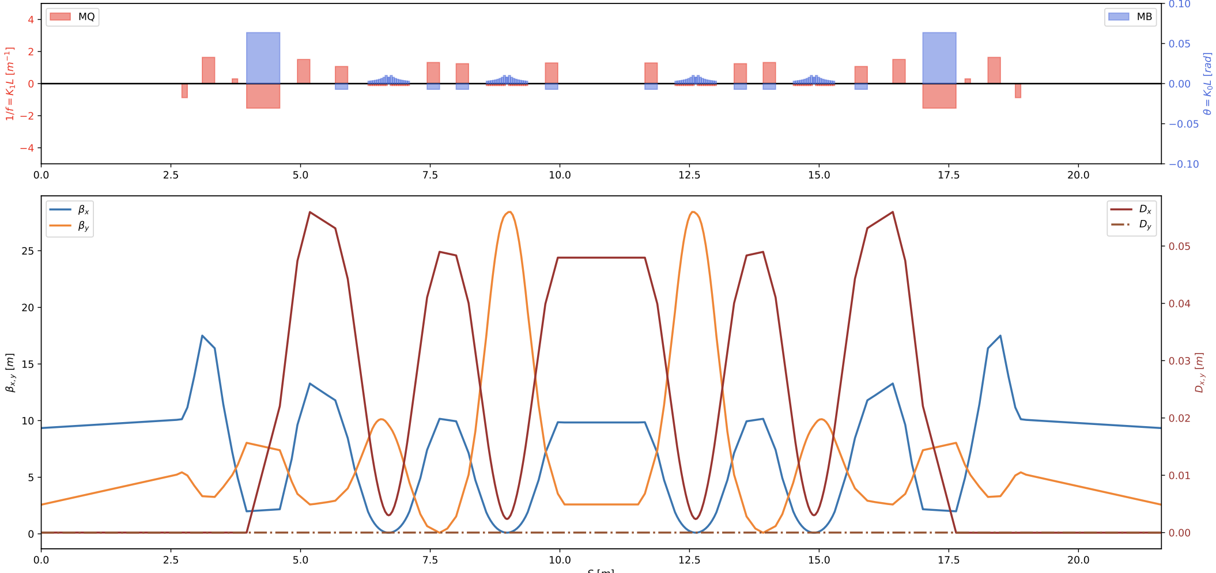
Lattice and optics design
A. Poyet
Optics constraints at the ID are matched
Horizontal emittance reduction from 212 to 100 pm (more than factor of 2!)
Tunes: 34.706 / 22.852
Chromaticities: -157/-125
Non-linear optimization: already good on-momentum DA

Slide 5
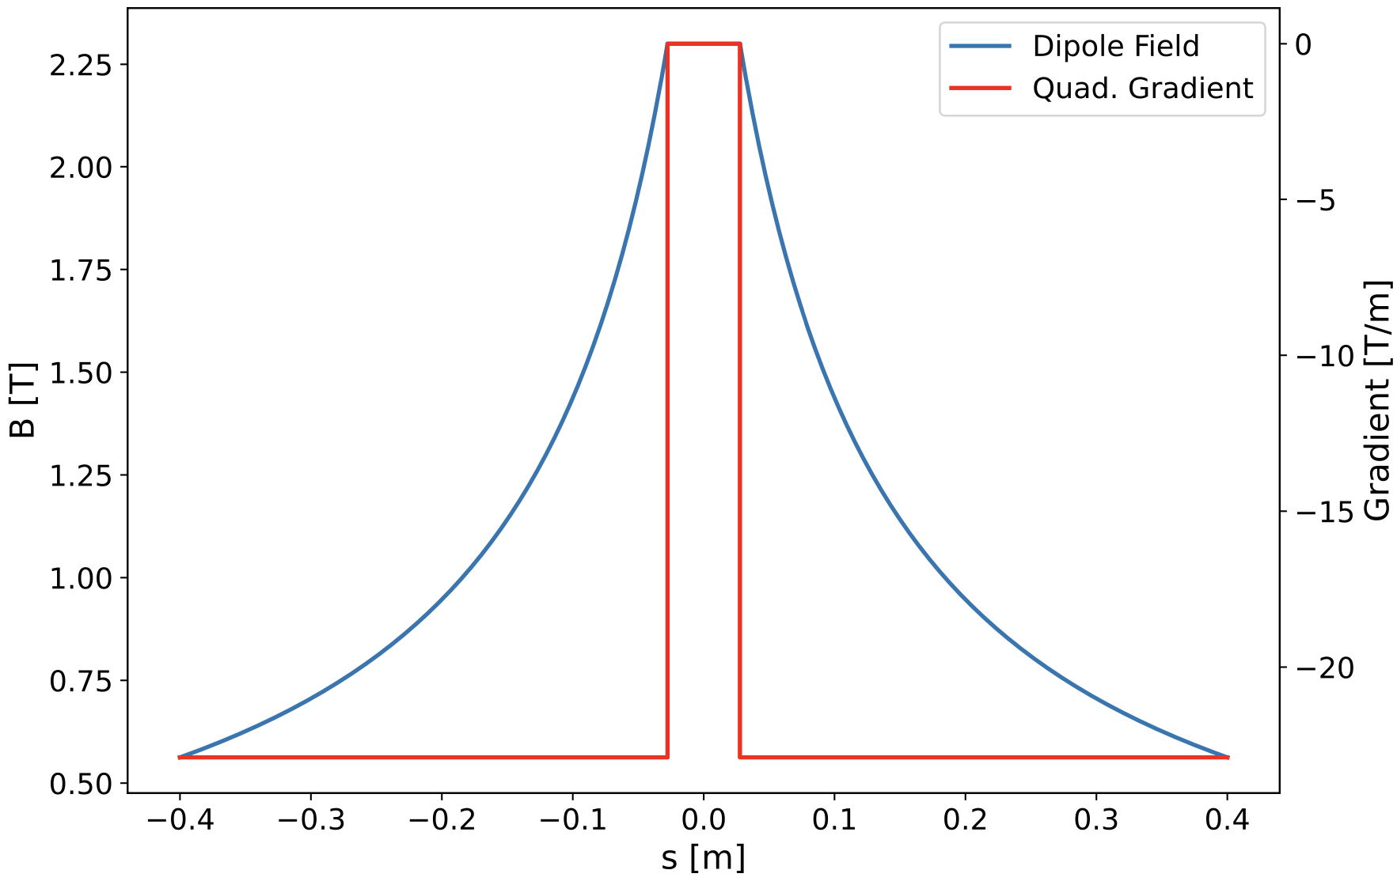
Profile Design and Magnet Specifications
Finalised in December 2022 (8 months delay, hiring issue during COVID)
Similar parameters as CLIC DR but…
  Higher transverse gradient (> factor of 2)
  Higher magnetic gap (~40%)
  Longer magnet (~40%)
Specifications | CLIC DR | VADER
Magnet Gap (mm) | 13 | 18
Max Field (T) | 2.3 | 2.3
Transverse G (T/m) | 11 | 23
Field Quality (Units 1E-4) | ≈ 1 | ≈ 1
Magnet Length (cm) | 56 | 80

Slide 6
Magnetic design challenges
Needed to satisfy field requirements for curved trajectory.
Combined with higher gap and low multipole content for iron dominated magnet that works under saturation, extremely difficult objective
Sagitta much higher than expected
Impossible to perform required calculations with Opera software for curved trajectory
This forced to manually develop in-house code (CIEMAT) to analyse field quality in both Opera & Matlab

Slide 7
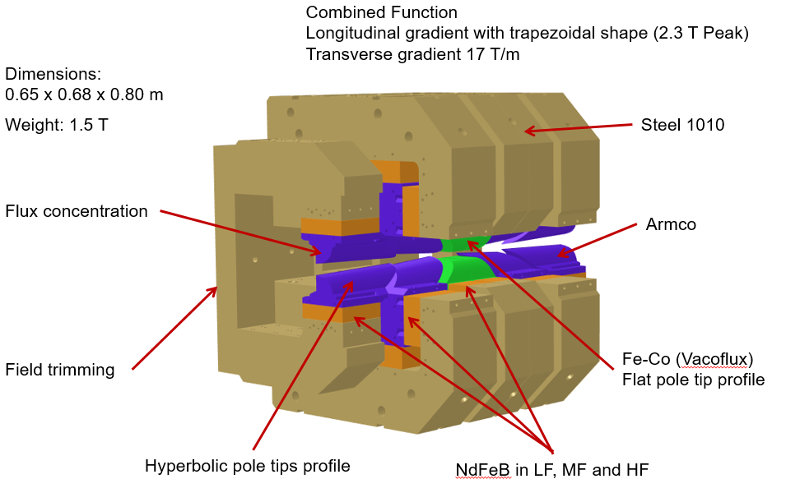
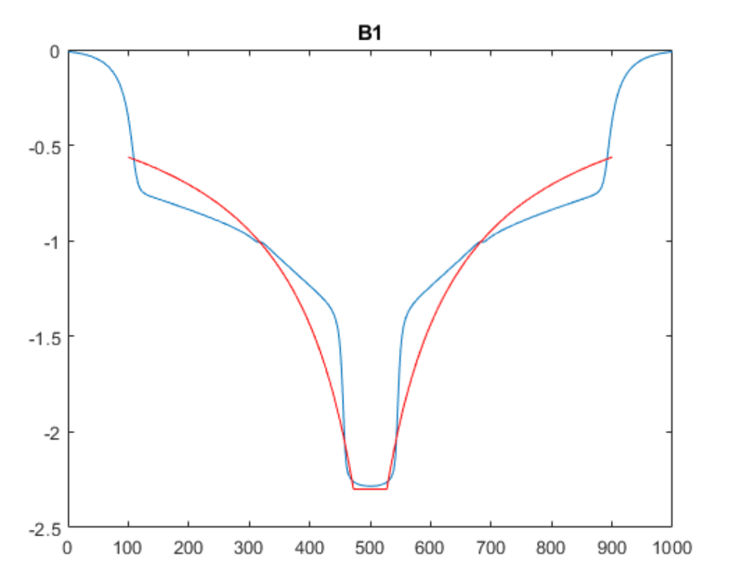
Magnetic Design @ CIEMAT
M. Dominguez,
F. Toral
Longitudinal gradient profile achieved
Integrated transverse gradient slightly below specs but ok for optics
Field quality looks reasonable
Mechanical design done
Fabrication drawings communicated to KYMA
B1 | B2 | B3 | B4 | B5 | B6 | B7 | B8 | B9 | B10
10000 | -807.79 | 4.65 | 6.74 | -1.09 | 0.21 | -0.07 | 2.55E-05 | -0.01 | -0.03

Slide 8
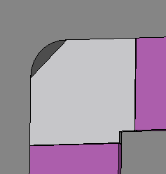
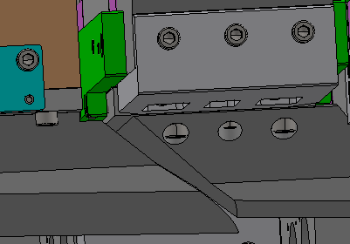
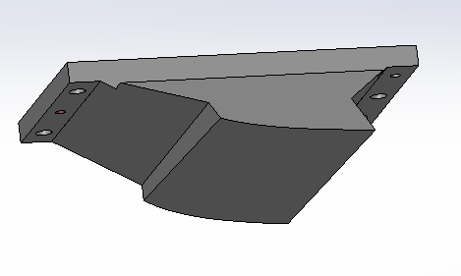
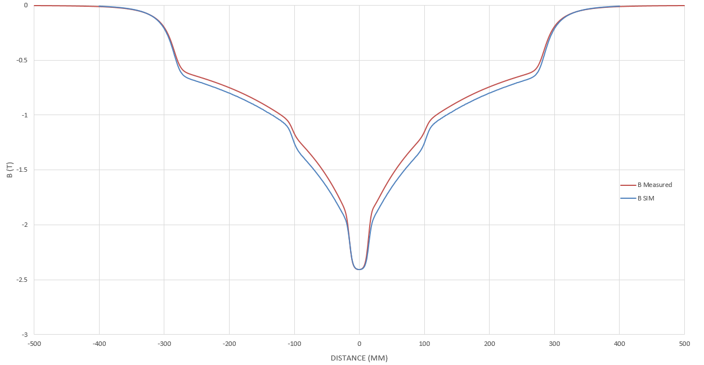

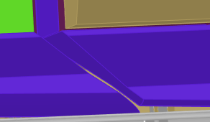

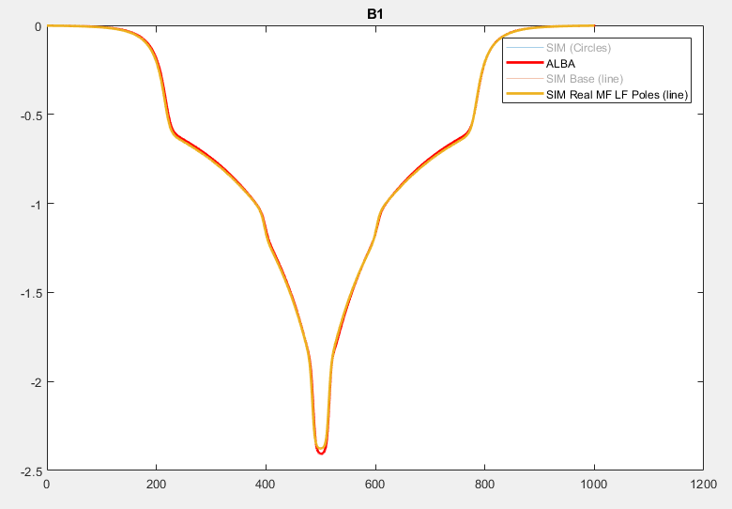
Resolving CLIC prototype issues for VADER
LF pole extrusion
6 mm HF & MF pole base expansion
MF pole extrusion
Discrepancy in CLIC prototype between simulations vs magnetic measurements: 4% lower integrated dipolar field
Various investigations: missing Armco heat treatment, misalignment, hysteresis, simulation error, etc.
Traced back to 3D mechanical model details not reflected in Opera simulation model due to simplifications
Their inclusion allowed model matching perfectly magnetic measurements: 0.641T simulated vs 0.638T measured

Slide 9
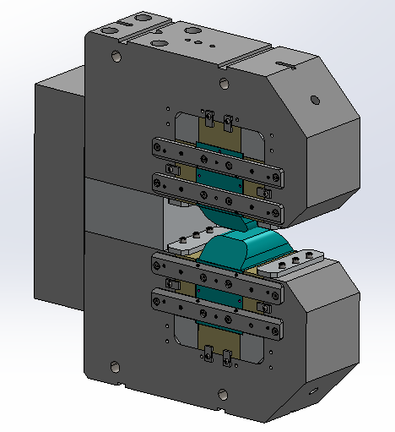
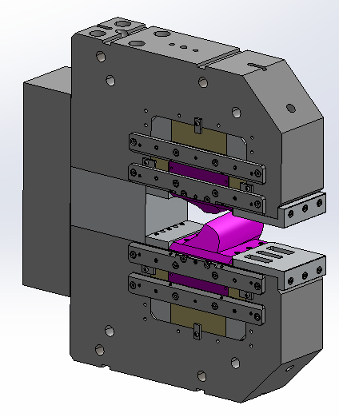
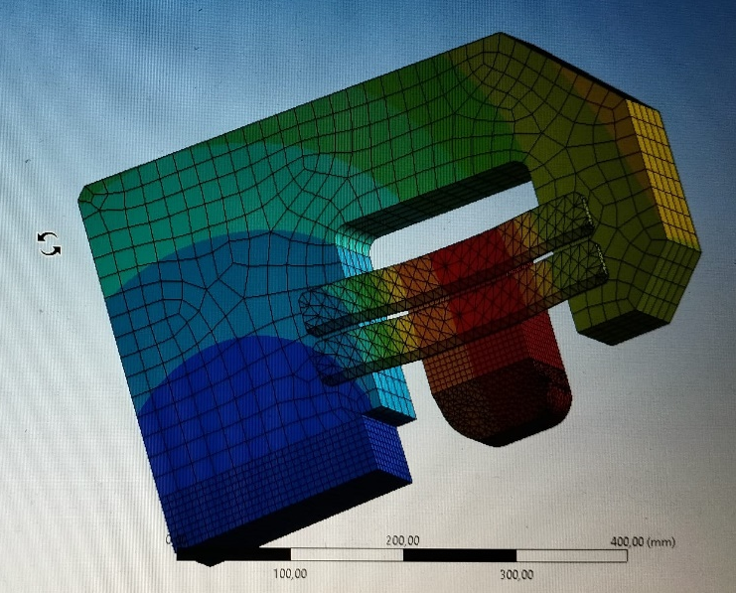
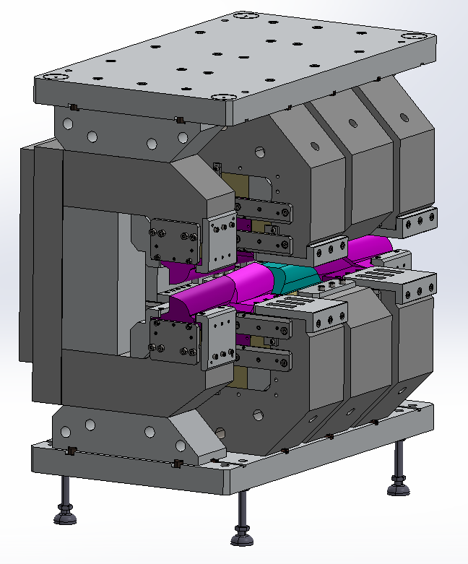
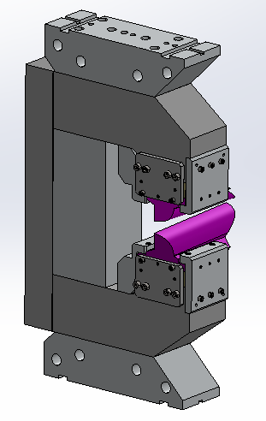
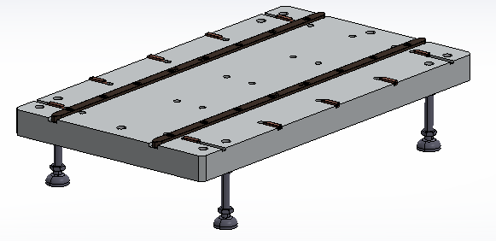
VADER: Final Mechanical Design
HF Module
MF Module
Deformations in the HF module
Base with guides
Final assembly
LF Module

Slide 10
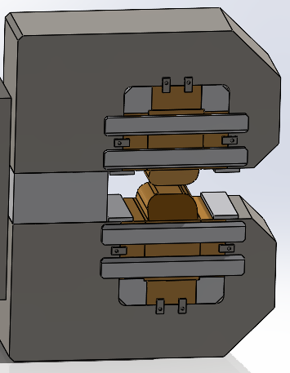
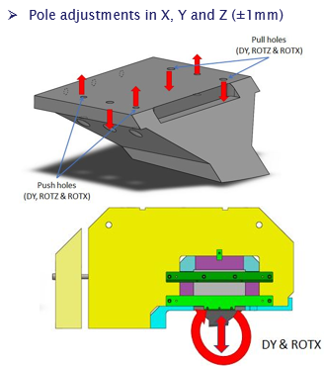
VADER vs CLIC Prototype: Main differences
Iron yokes formed by 3 main pieces instead of one, screwed from iron to iron across aluminium support block (before first assembly step)
In VADER, same pole adjustments in MF and LF modules present in CLIC except DY (vertical adjustment)

Slide 11
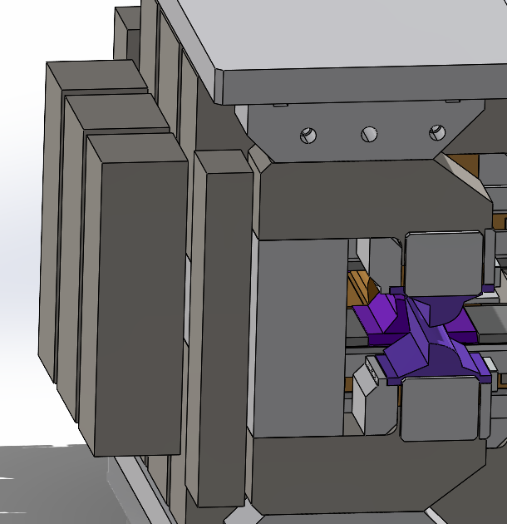
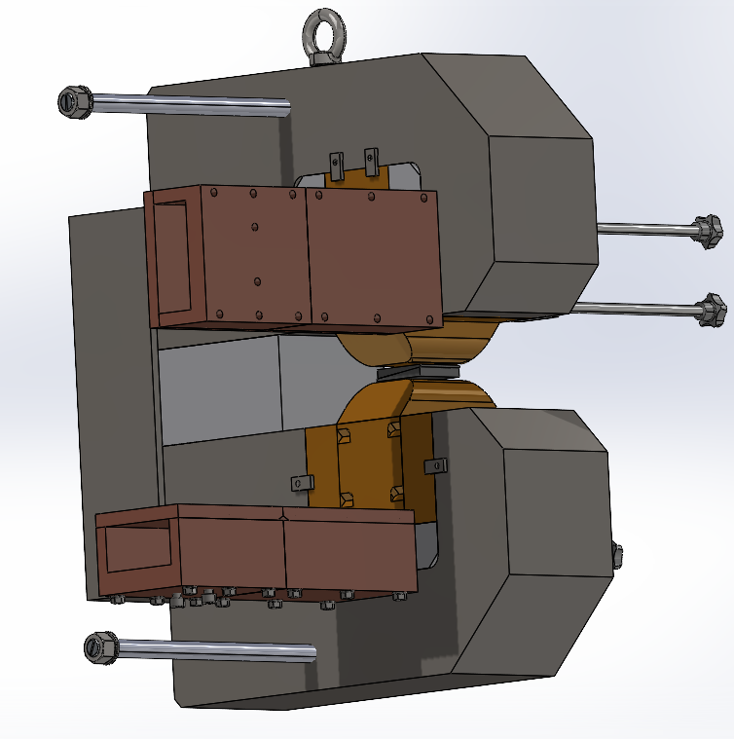
VADER vs CLIC Prototype: Main differences
PM blocks bigger, meaning higher forces. POM boxes redesigned (longer) and second one to carry block added
Moving parts of field regulation under much higher forces, guides reinforced and regulating screws include bronze ending to avoid fluency with time (instead of plastic in CLIC)

Slide 12
VADER: Timeline
Final manufacturing drawings - finalised during February 2025
Iterations for magnetic material selections during March 2025
From mid-April 2025, Kyma proceeds with procurement of all components (receiving quotes)
Initial estimates indicate that materials ready and delivered by July 2025
Assembly process estimated as follows:
  1 week for mechanical assembly of the modules.
  2 weeks for final assembly.
  1 week contingency.
Estimated date for fabrication of prototype August 2025 (9 months delay on deliverable D7.3)
Measurements in Elettra for acceptance tests (bench procured) by September 2025 (5 months delay on Milestone 27)

Slide 13
VADER: Achievements
Specified longitudinally varying dipole with gradient for reducing horizontal emittance of Elettra upgrade SR by factor of 2
Designed advanced permanent magnet dipole with variable field and gradient including mechanical field trimming reaching all specs (sustainability!)
Adress various challenges/limitations with present/previous design
Magnet is in the procurement/fabrication face in KYMA (industrial partner) reaching TRL6 (Technology demonstrated in industrially relevant environment).
Discussion with KIT for further testing magnet with beam (beyond IFAST), for reaching higher TRL R. Ruprecht, A. Mochihashi
Ready for series production and industrialization
Technology to be used in future low-emittance rings (light source SRs, damping rings for colliders such as FCCee, etc…)
Elaborating proposals on PM technology (combined function PMs, PM wigglers) for IFAST2 (STFC, KYMA, CIEMAT, DESY, KIT, CERN)

Slide 14

Thank you for your attention!

Slide 15
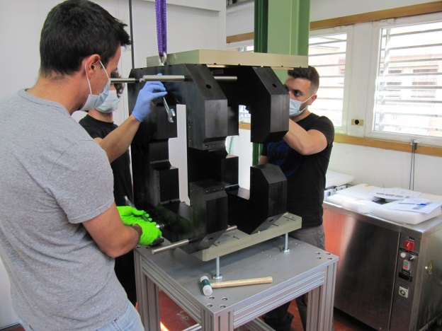
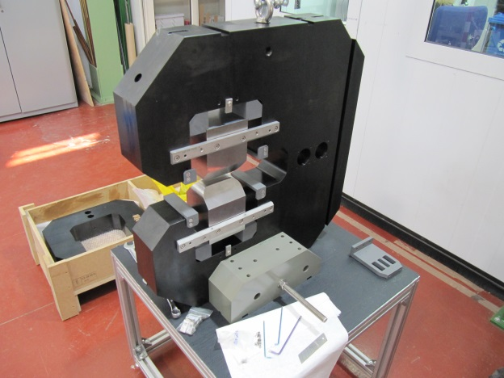
CLIC: Preliminary Assembly
Preliminary assembly without permanent magnets (PM) should be done to ensure the correct manufacturing and adjustment of all parts.
Testing the modules’ approach system
Each module is mounted separately, with all the parts except the PM

Slide 16
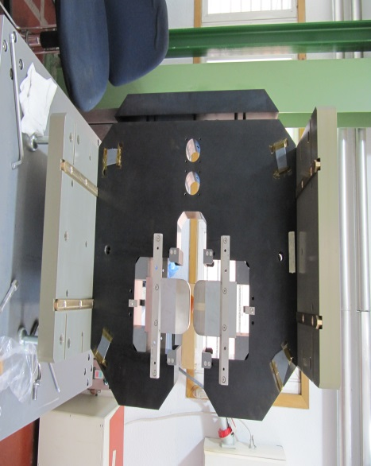
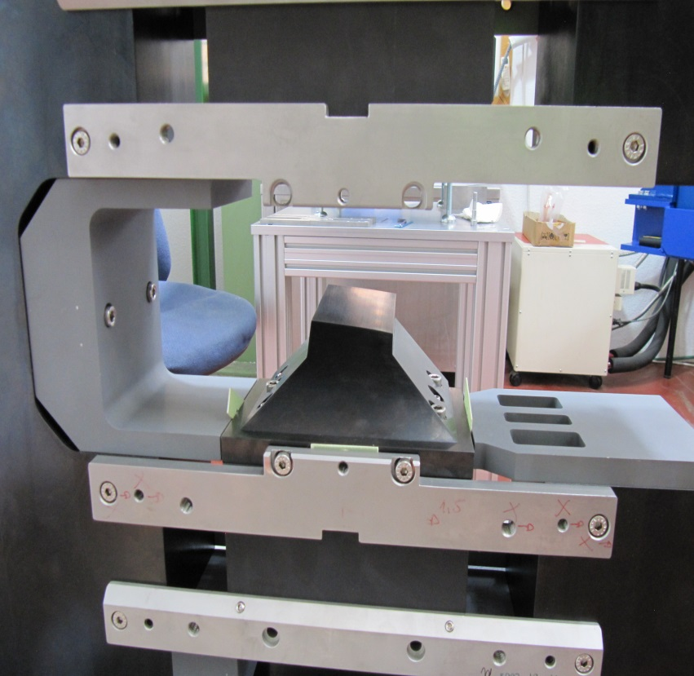
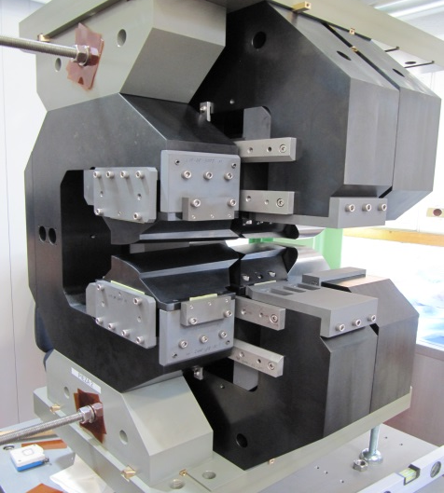
CLIC: Preliminary Assembly
HF module is mounted first, with the top and bottom aluminium plates
Then each module is introduced following the bronze guides fixed to the plates
Detail of one pole and how they are fixed in their nominal position using fibre gauges
Full assembly without PM

Slide 17
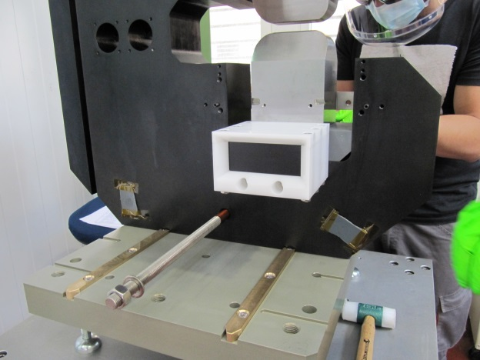
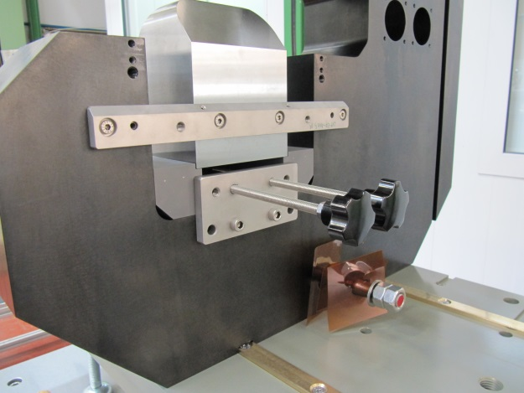
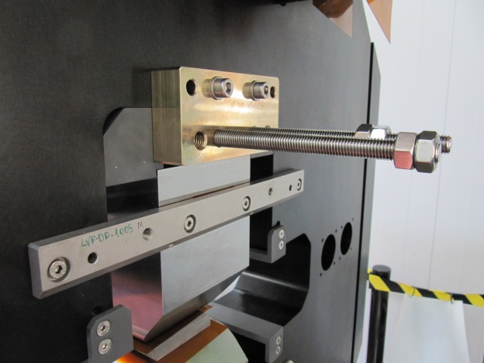
CLIC: Assembly with PM
The PM blocks are introduced using a POM box attached to the yoke
The insertion was controlled using these rods and plate…
…that have to be redesigned due to the huge forces involved
This is already implemented for VADER

Slide 18
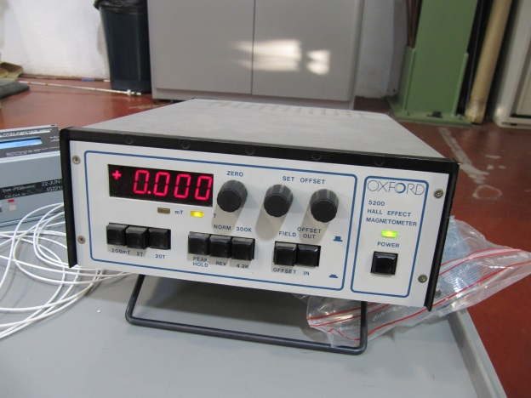
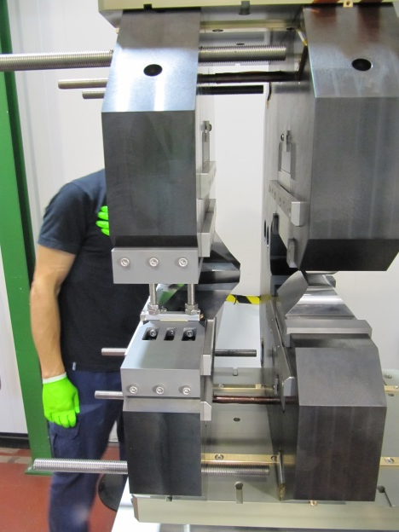
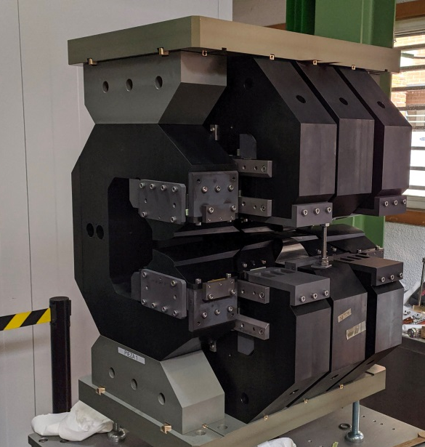
CLIC: Assembly with PM
Magnetic measurements are done after each PM is inserted.
Low precision but necessary to ensure correct PM assembly
Once each module has all magnets included, controlled approach of parts starts
Process repeated with each module until assembly is completed

