Slide 1




Final results of the C-band Guns
(Task 7.4)
David Alesini (INFN, Frascati, Italy)
Thomas Geoffrey Lucas (PSI, Villigen, Switzerland)
On behalf of the INFN-PSI Very High Gradient C band gun group

Slide 2
OUTLINE
Recap. on Goals and Responsibilities
SW GUN Final Results
TW GUN Final Results

Slide 3
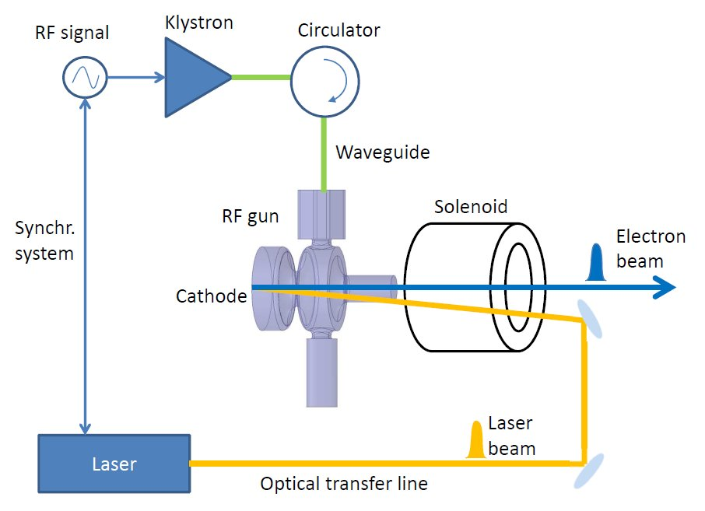


Task 7.4 structure and objectives
Design, realization and high power test of two different C-band (5.712 GHz) RF electron photo-guns operating at very high gradient cathode peak field (>160 MV/m):
  Standing Wave (SW) gun (INFN (IT), COMEB (IT))
  Travelling Wave (TW) gun (PSI (SW); VLD (NE))
Comparison of the performances, beam dynamics simulations to exploit the device potentialities
Research Institutions involved: INFN (IT), PSI (SW);
Private Companies involved: VLD (NE), COMEB (IT)
Coordination
Design and low power test of the SW Gun
Solenoid design and procurement
RF circulator procurement
design, brazing and low power characterization of the TW Gun
hosting and setting up the facility to perform the high-power test
mechanical construction of the TW gun components
mechanical construction and assembly of the SW gun
SW GUN
TW GUN

Slide 4


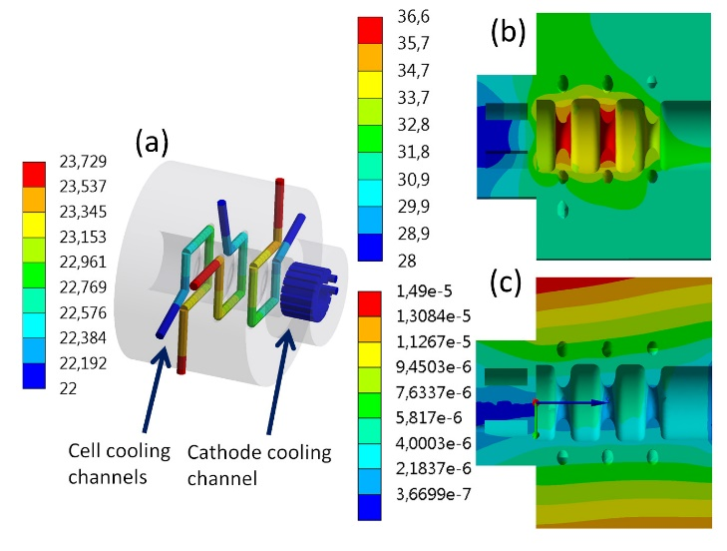
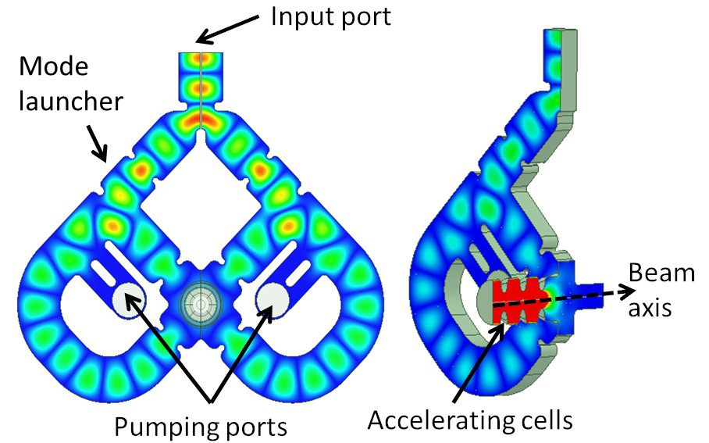
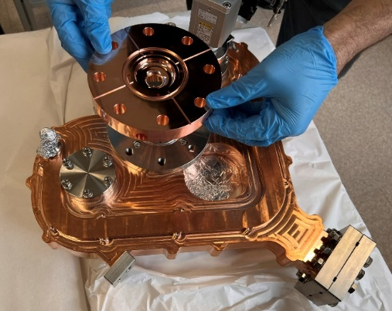
C BAND RF PHOTO-GUN: DESIGN
The new C-Band RF gun is a 2.5 cell standing wave cavity with:
four-port mode launcher for electric field coupling (low pulsed heating) and no multipole components induced by the coupler
coupling factor β=3 to operate with short rf pulses (300 ns)
Elliptical shape of the irises to reduce the surface electric field and modified Poynting vector
Large irises apertures to increase the pumping speed and increase the mode separation
A dedicate cooling system in each cell (possible with the on axis coupler) that allow to operate at high rep. rate (up to 1 kHz)
Parameter | Value
Resonant frequency | 5.712 (5.712)
E_{cath}/√P_{diss} [MV/(m⋅MW^{0.5})] | 51.4
rf input power [MW] | 18(19)
Cathode peak field [MV/m] | 160
Rep. rate [Hz] | 100-400
Quality factor | 11900 (11900)
Filling time [ns] | 166 (147)
Coupling coefficient | 3 (3.5)
rf pulse length [ns] | 300
Mode sep. π-π/2 [MHz] | 47 (48.3)
E_{surf}/E_{cath} | 0.96
Mod. Poy. vector [W/μm²] | 2.5
Pulsed heating [ºC] | 16
Average diss. Power [W] | 250-1000
D. Alesini et al., MOPOMS021, IPAC2022, Bangkok, Thailand, p. 679, 2022
D. Alesini et al., TUPA009, IPAC2023, Venezia, Italy, p. 1356, 2023
F. Cardelli et al., MOPOMS020, IPAC2022, Bangkok, Thailand, p. 675, 2022
A. Giribono et al., PRAB 26, 083402, 2023
G Castorina et al 2018 J. Phys.: Conf. Ser. 1067 082025

Slide 5
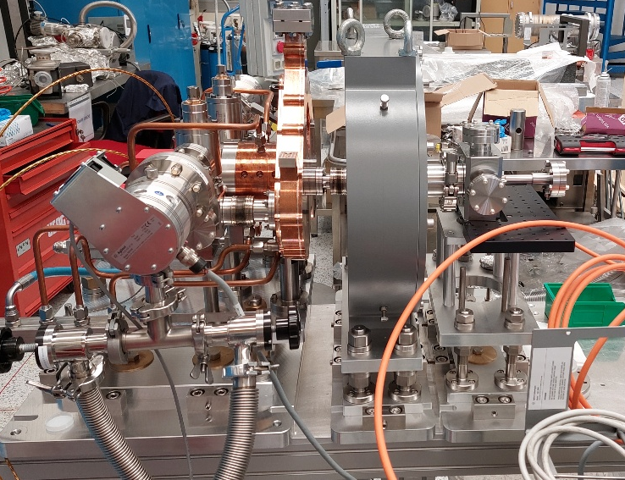
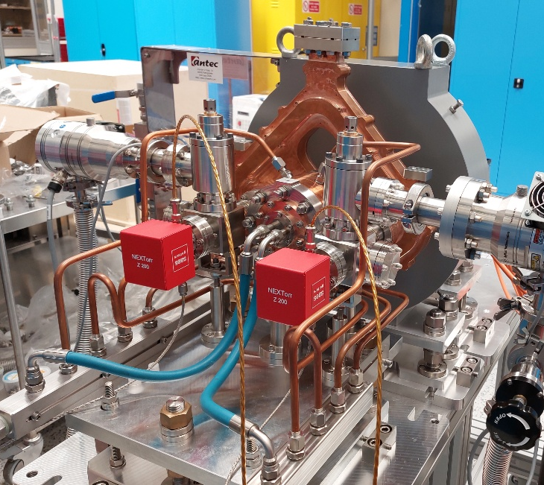
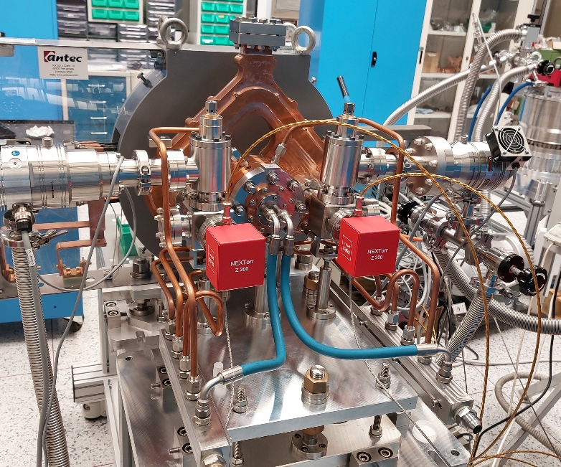
C-band Gun FINAL Assembly
The gun, after the final assembly and vacuum test has been assembled in its final configuration with the solenoid and vacuum chambers
Laser injection chamber
gun
solenoid
Pumping system

Slide 6
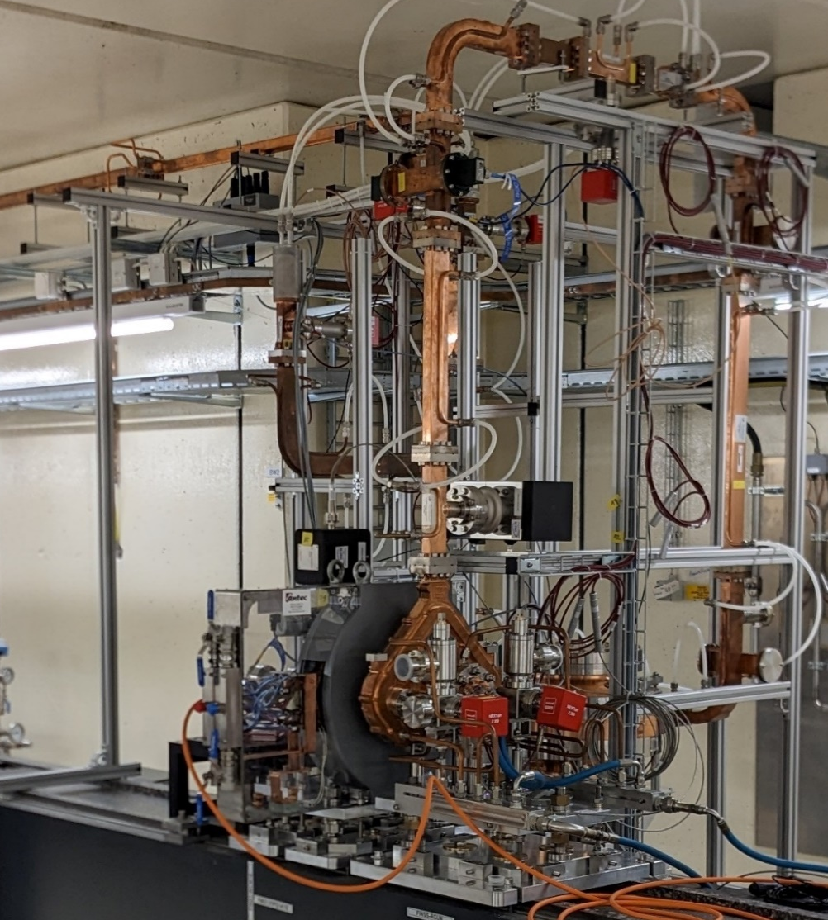
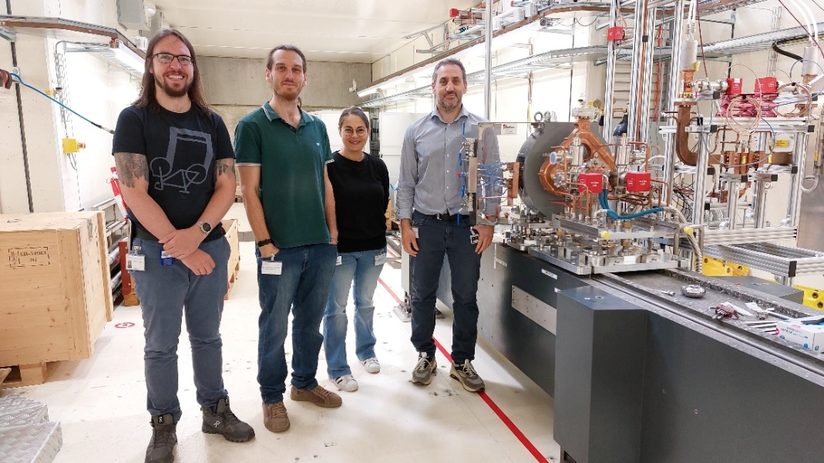
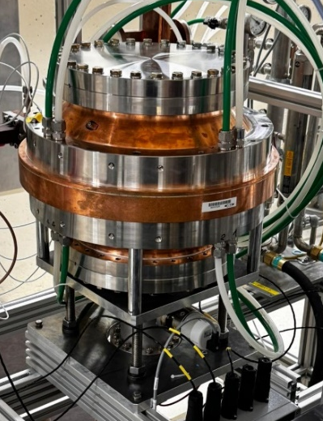
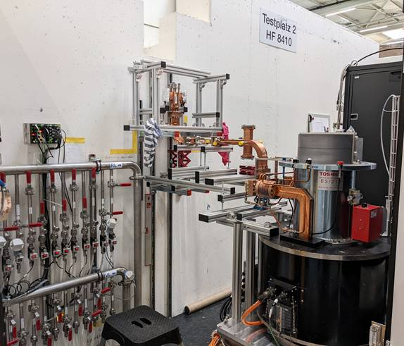
INSTALLATION AT PSI FOR HIGH POWER TEST
The whole system has then been transported to PSI and installed in the High Power Test Stand [T. Lucas, IPAC 24, WEPC69]. The original gun feeding scheme foresaw the use of a new in-vacuum isolator that experienced some delays due to the difficulties that have been encountered during its realization. For this reason we have developed an alternative scheme using power dividers and a BOC-type pulse compressor
From klystron
Solenoid
RF Power Source
Pulse compressor (BOC)
Gun

Slide 7

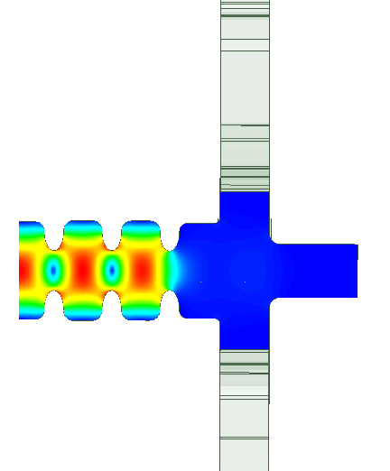
HIGH POWER TEST SCHEMATIC LAYOUT
In the setup there are eight NEG-ion pumps and four directional couplers. The vacuum is also monitored through four vacuum gauges; one in the laser injection chamber, two near the BOC and one near the klystron window. These have been used to monitor the local vacuum in the regions expected to suffer the most from high power operation.
DC 1
Bunker
Concrete wall
RF Load 1
50 MW
C-band Klystron
DC 3
DC 4
Waveguide line
From klystron
Klystron gallery
Laser Injection chamber
RF Load 2
9:1 Power divider
Faraday cup
Solenoid
BOC
Pulse compressor
Solenoid
NEG/ion pumps
DC 2
Gun
Pulse compressor (BOC)
ion pumps
Vacuum Gauge
GUN

Slide 8
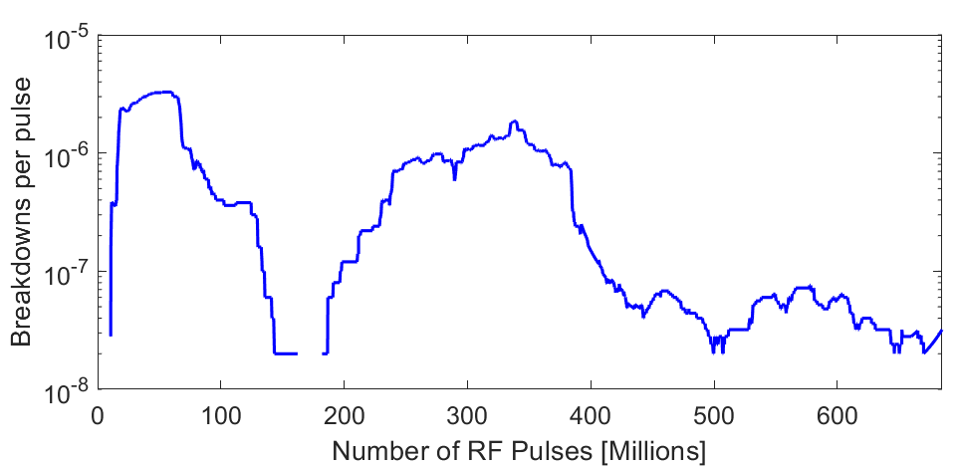
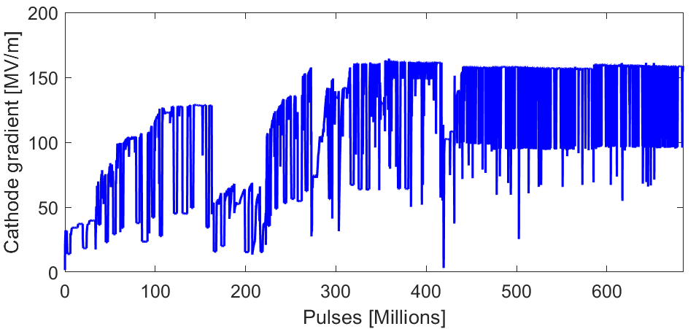
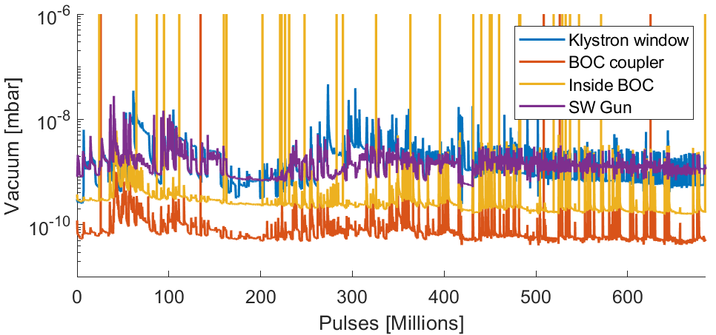
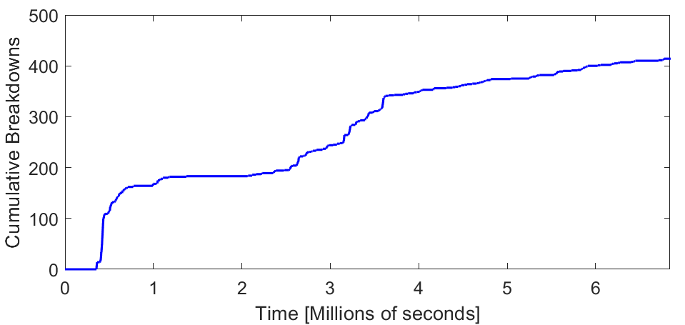

HIGH POWER TEST RESULTS
RF conditioning began in February 2024. The conditioning was done in a semi-automatic way, monitoring the vacuum at the different vacuum pumps and the reflected power to the klystron and progressively increasing the power from the klystron and pulse length keeping the repetition rate at 100 Hz
Conditioning dominated by the vacuum activity in the waveguide
final maximum input power limited by a vacuum activity in the ceramic of the klystron probably due to the reflected power
we reached so far a cathode peak field is 160 MV/m
no limitation due to the gun.
BOC detuned
BOC tuned
BOC detuned
BOC tuned
Oral IPAC 24

Slide 9
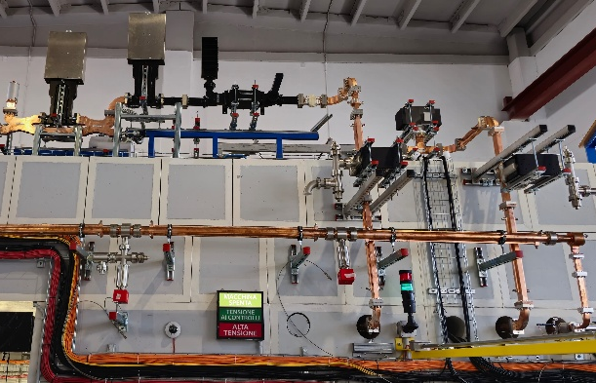
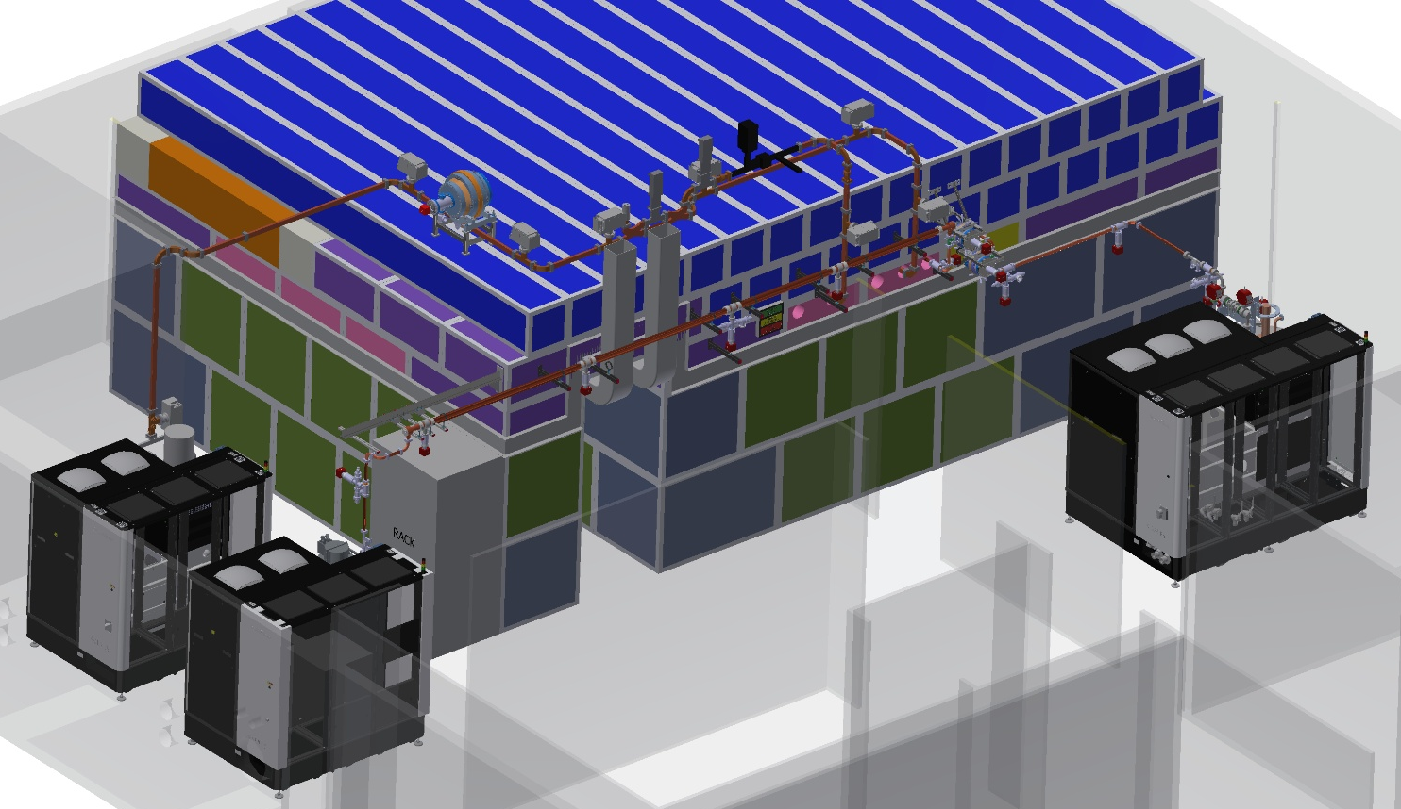
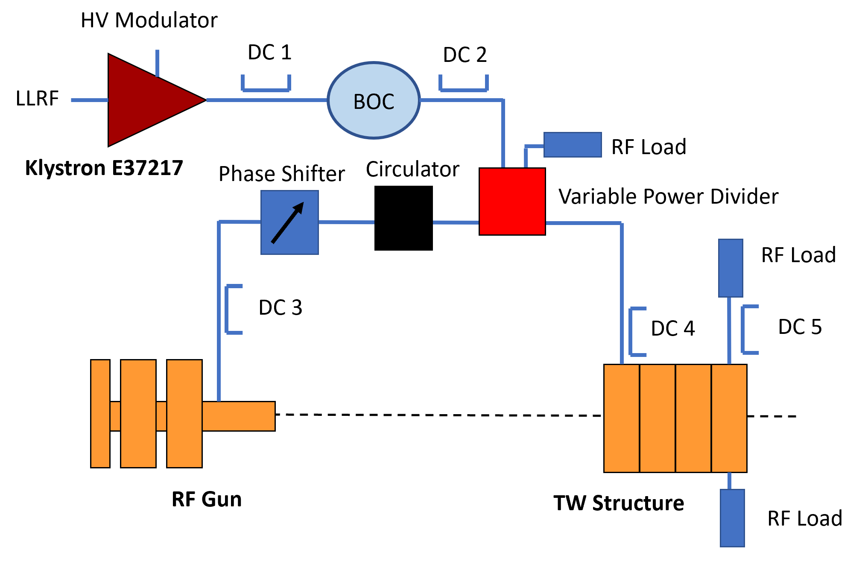
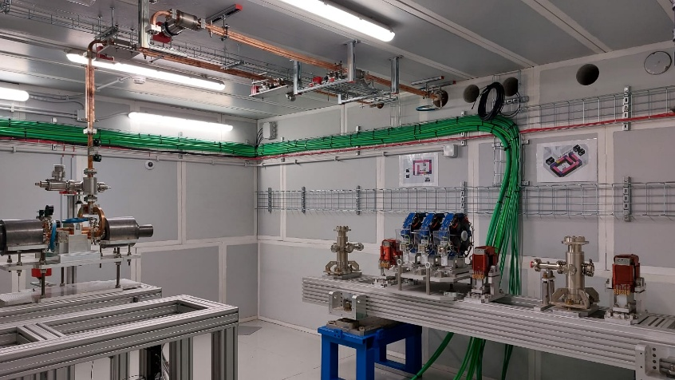
THE FUTURE@INFN TEX FACILITY
C band waveguide power line
The C band gun will be installed in the TEX facility, presently used for the test of the X band structures of the EUPRAXIA@SPARC_LAB linac.
The TEX facility is being equipped with three new RF sources: two X band and C band at high repetition rate (400 Hz).
The C band gun will be installed and used for high beam quality generation and experiments.
The possibility of a full C band injector for EUPRAXIA@SPARC_LAB is also being considered for the possibility to operate at 400 Hz.
Bunker
X-band source: K400+CPI VKX8311
New C-band Source: K300+ Canon E37217
X-band new source: K300+Canon E37119
EuPRAXIA@SPARC_LAB
X band structure

Slide 10
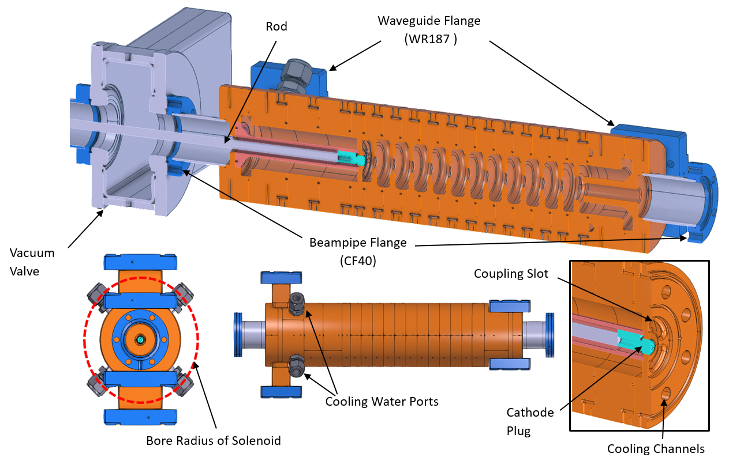
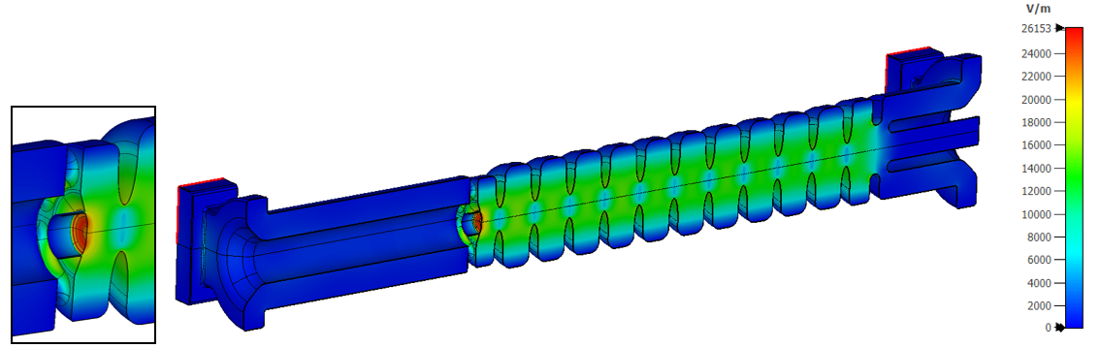
Mechanical Design
Gun fabricated using SwissFEL-style fabrication process which include UP machining of individual cells and then brazing.
New compact coupler style to allow solenoid to fit over gun.
TW has removeable cathode and the tuning-free brazing process greatly assisted in realising this device.
RF Design
T.G. Lucas, Toward a high brightness upgrade of SwissFEL
David Alesini and Thomas Geoffrey Lucas– Final results of the C-band Guns – I.FAST 4th Annual Meeting 8-11 April 2025

Slide 11
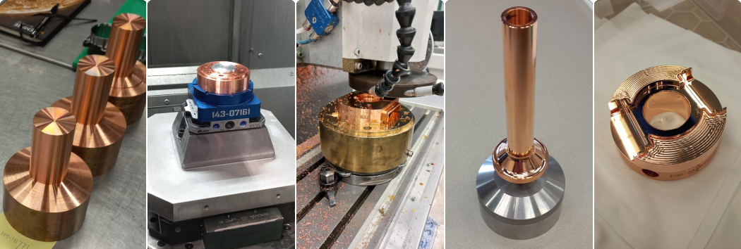
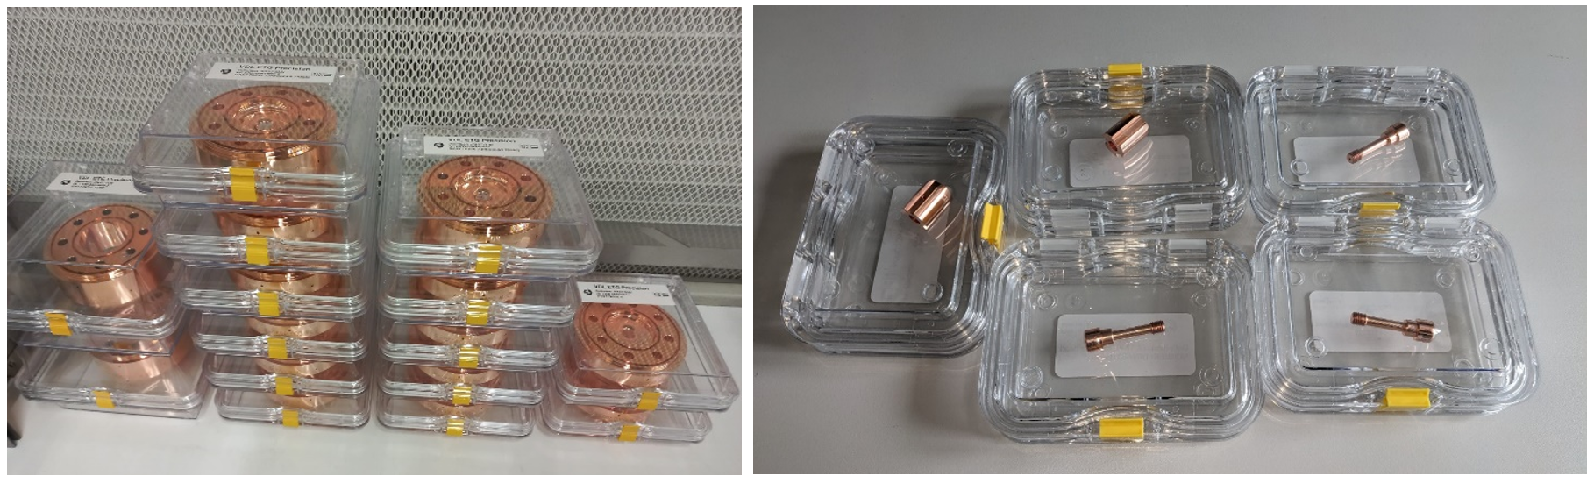
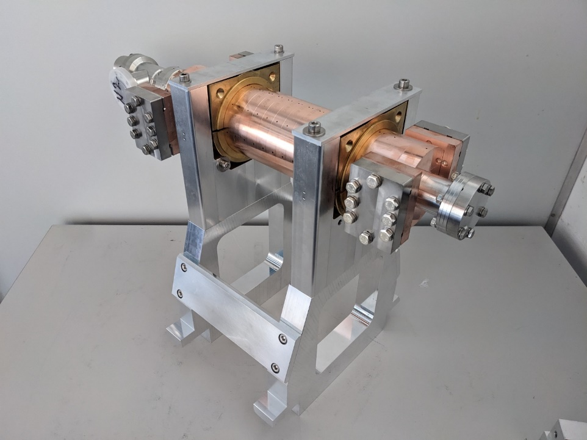
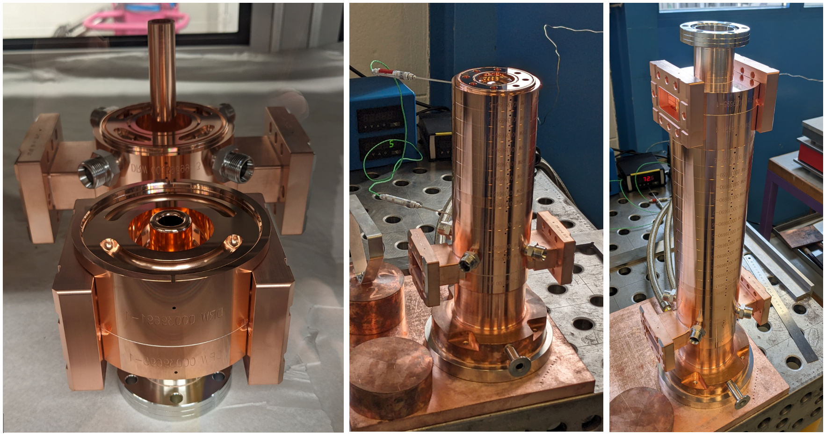
Realisation of a Travelling-Wave RF Photogun
Machining by VDL
David Alesini and Thomas Geoffrey Lucas– Final results of the C-band Guns – I.FAST 4th Annual Meeting 8-11 April 2025

Slide 12
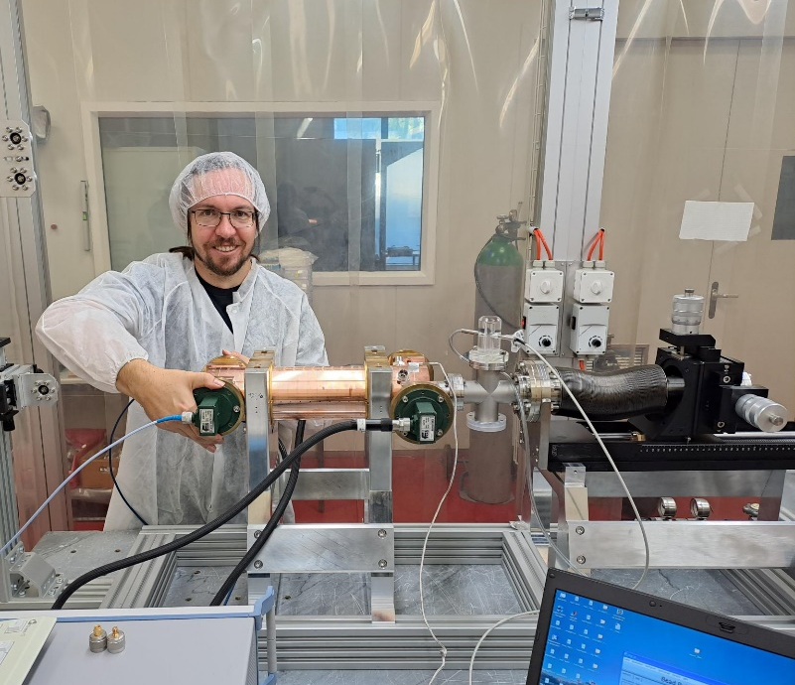
Low Power Measurements of TW Gun
Gun transferred to clean room for low power measurements.
Measurements include beadpull and S-parameter measurements.
Illustrated high level of field flatness.
Unknown curvature in phase, cause is still under investigation.
David Alesini and Thomas Geoffrey Lucas– Final results of the C-band Guns – I.FAST 4th Annual Meeting 8-11 April 2025

Slide 13
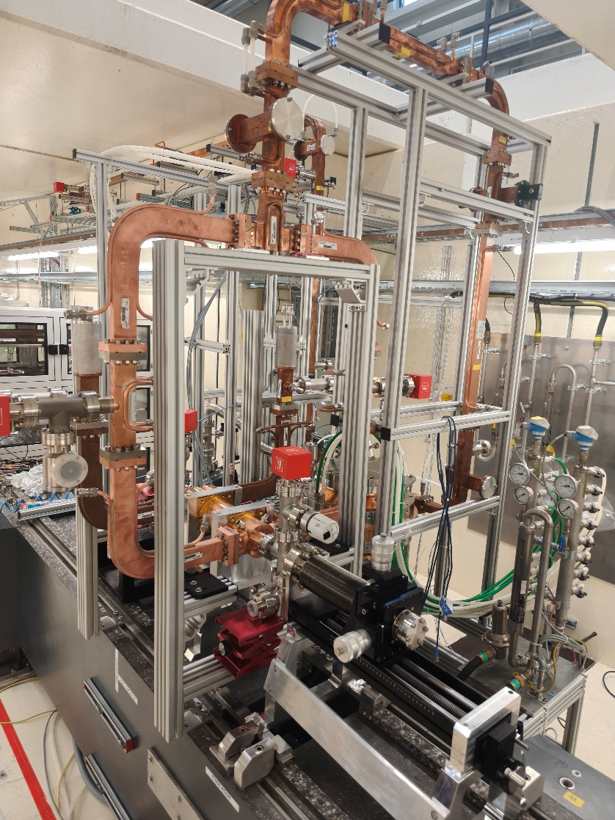
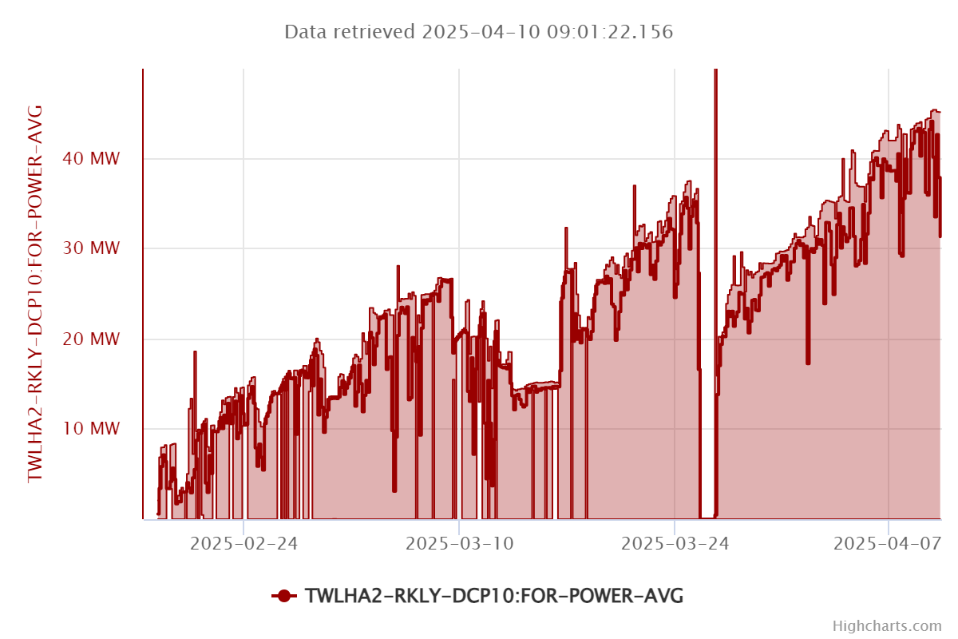
High Gradient Testing of C-band TW Gun
Today we reached 45 MW = 148 MV/m
and climbing!
David Alesini and Thomas Geoffrey Lucas– Final results of the C-band Guns – I.FAST 4th Annual Meeting 8-11 April 2025

Slide 14

LEDS workshop (partially funded by IFAST)
Second annual workshop on Longitudinal Electron beam Dynamics for coherent Light Sources (LEDS’24)
IFAST helped to sponsor this event held in Bern, Switzerland.
Focus on beam dynamics that limit the next generation of particle accelerators.
We had 34 participants from 17 institutes.
Presentations of developments in:
  Intrabeam scattering and Microbunching instability modelling
  Methods to measure sliced energy spread.
  Steady-State Microbunching in Rings.
Hope to have an announcement of the next LEDS soon!

Slide 15

CONCLUSIONS
We have developed new C band RF photo-guns, SW and TW, that represents the frontiers of rf photo-gun electron sources.
The SW one has been fabricated with the brazing free technology and has been tested at PSI reaching >160 MV/m cathode peak field w/o limitations due to the gun. It will be installed in the INFN TEX Facility (Frascati) for a full C band injector source.
The TW one has been fabricated and is now under test at PSI showing extremely good performances: so far, it has achieved a cathode peak field of 144 MV/m, with continuous improvements.
ACKNOWLEDGEMENTS
F. Cardelli, G. Di Raddo, R. Di Raddo, A. Vannozzi, A. Giribono, L. Faillace, A. Gallo, L. Pellegrino, S. Lauciani, L. Ficcadenti, G. Pedrocchi, G. Castorina, S. Bini, A. Liedl, V. Lollo, L. Piersanti, S. Pioli, R. Pompili, C. Vaccarezza, M. Ferrario, L. Spallino, P. Chimenti, G. Latini (INFN)
C. Beard, L.J.F. Hol, P. Craievich, M. Pedrozzi, J-Y. Raguin, F. Marcellini, R. Zennaro, H. Braun, M. Seidel (PSI)
THANK YOU FOR YOUR ATTENTION!
This project has received funding from the European Union’s Horizon 2020 Research and Innovation programme under GA No101004730
and by INFN Commission n. V

Slide 16
BACKUP SLIDES

Slide 17


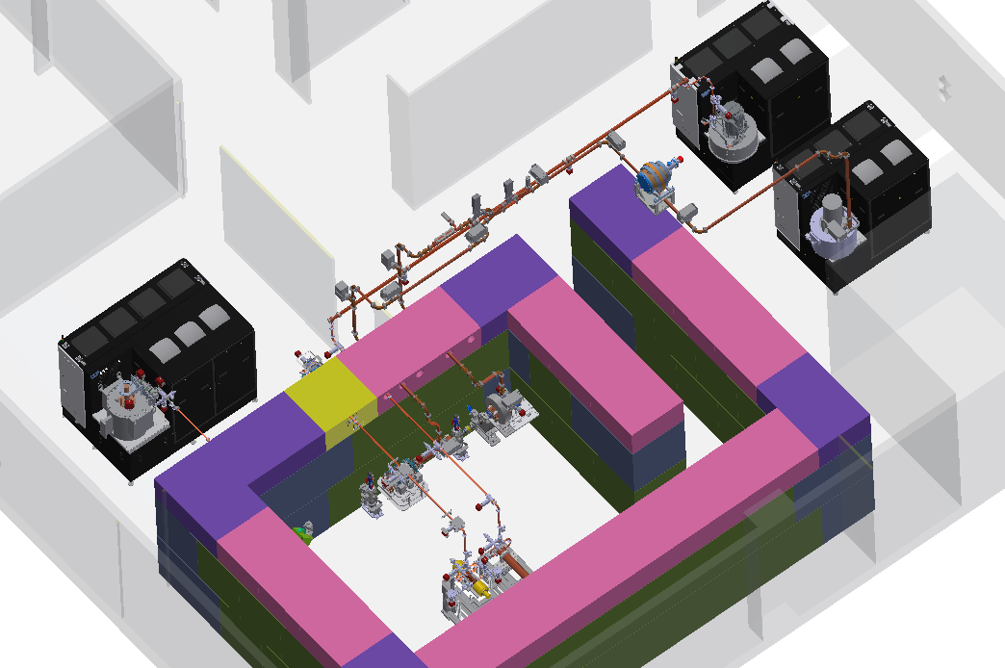
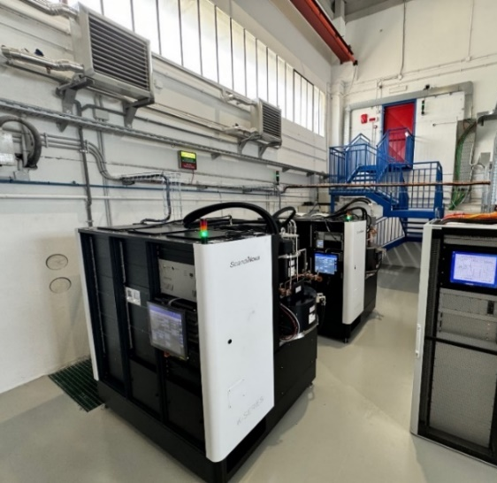
TEX Upgrade with new Power Sources
Currently, the test stand TEX is based on CPI VKX8311A Klystron on loan from CERN already commissioned and in operation.
Three other klystrons are being installed at TEX:
CANON X Band 25 MW, 400 Hz E37119
  Status:
    FAT of the klystron done @ CANON on a PFN modulator 11/2023, 25 MW, 10 Hz, t=1.5us
    FAT of the RF source @Scandinova 05/2024, full power in diode mode
    Modulator and klystron positioned at TEX
  CANON C Band E37217
  Status:
    FAT of the klystron done @ CANON on a PFN modulator 11/2023, 20 MW, 10 Hz, t=2.5us
    FAT of the RF source @Scandinova 05/2024, full power in diode mode
    Modulator and klystron positioned at TEX
CPI X Band 50 MW, 100 Hz High efficiency VKX8311HE
  Status:
  Tender has been done, realization phase (expected delivery from CPI Sept 2025)
Parameter | Unit | Canon E37119 | CPI VKX8311HE | CPI VKX8311 | Canon E37217
Frequency | MHz | 11994 |  |  | 5712
Vk beam voltage | kV | 312 | 415 | 420 | 280
Ik cathode current | A | 199 | 201 | 320 | 240
Peak RF output Power | MW | 25 | 50 | 50 | 20
Average RF output power | kW | 15 | 7,5 | 7,5 | 21
Modulator Average power | kW | 80 | 25 | 48 | 80
RF pulse length | μs | 1,5 |  |  | 2.5
Repetition Rate | Hz | 400 | 100 | 100 | 400
Gain | dB | 47 | 50 | 47 | 50
Efficiency | % | 40 | 55 | 38 | 40
Perveance | μp | 1.16 | 0.75 | 1.15 | 1
The commissioning of these sources and the waveguide networks is scheduled for May 2025, after the installation of the cooling and power systems that will serve these sources.
50MW, 50 Hz X-band Source
25 MW, 400 Hz X-band Source
20 MW, 400 Hz C-band Source

