Slide 1
Status of CompactLight Prototype Accelerating Structures
4th I.FAST Annual Meeting – Kracow 10/04/25
G. D’Auria Elettra – Sincrotrone Trieste

Slide 2






CompactLight Prototype Accelerating Structures
Objective:
Build and test two prototypes of the X-band (12 GHz) accelerating structure designed for the CompactLight (XLS) project, a new class of linac-driven FEL facility.
Deliverables:
D7.5: Construction and tests of the pre-prototype.
Development of production process and RF tests of the pre-prototype, Dic. 2023
D7.6: Construction and tests of the full prototype.
Production process analysis and validation, RF tests of the full prototype, Apr. 2025
Task 7.5 partners:

Slide 3
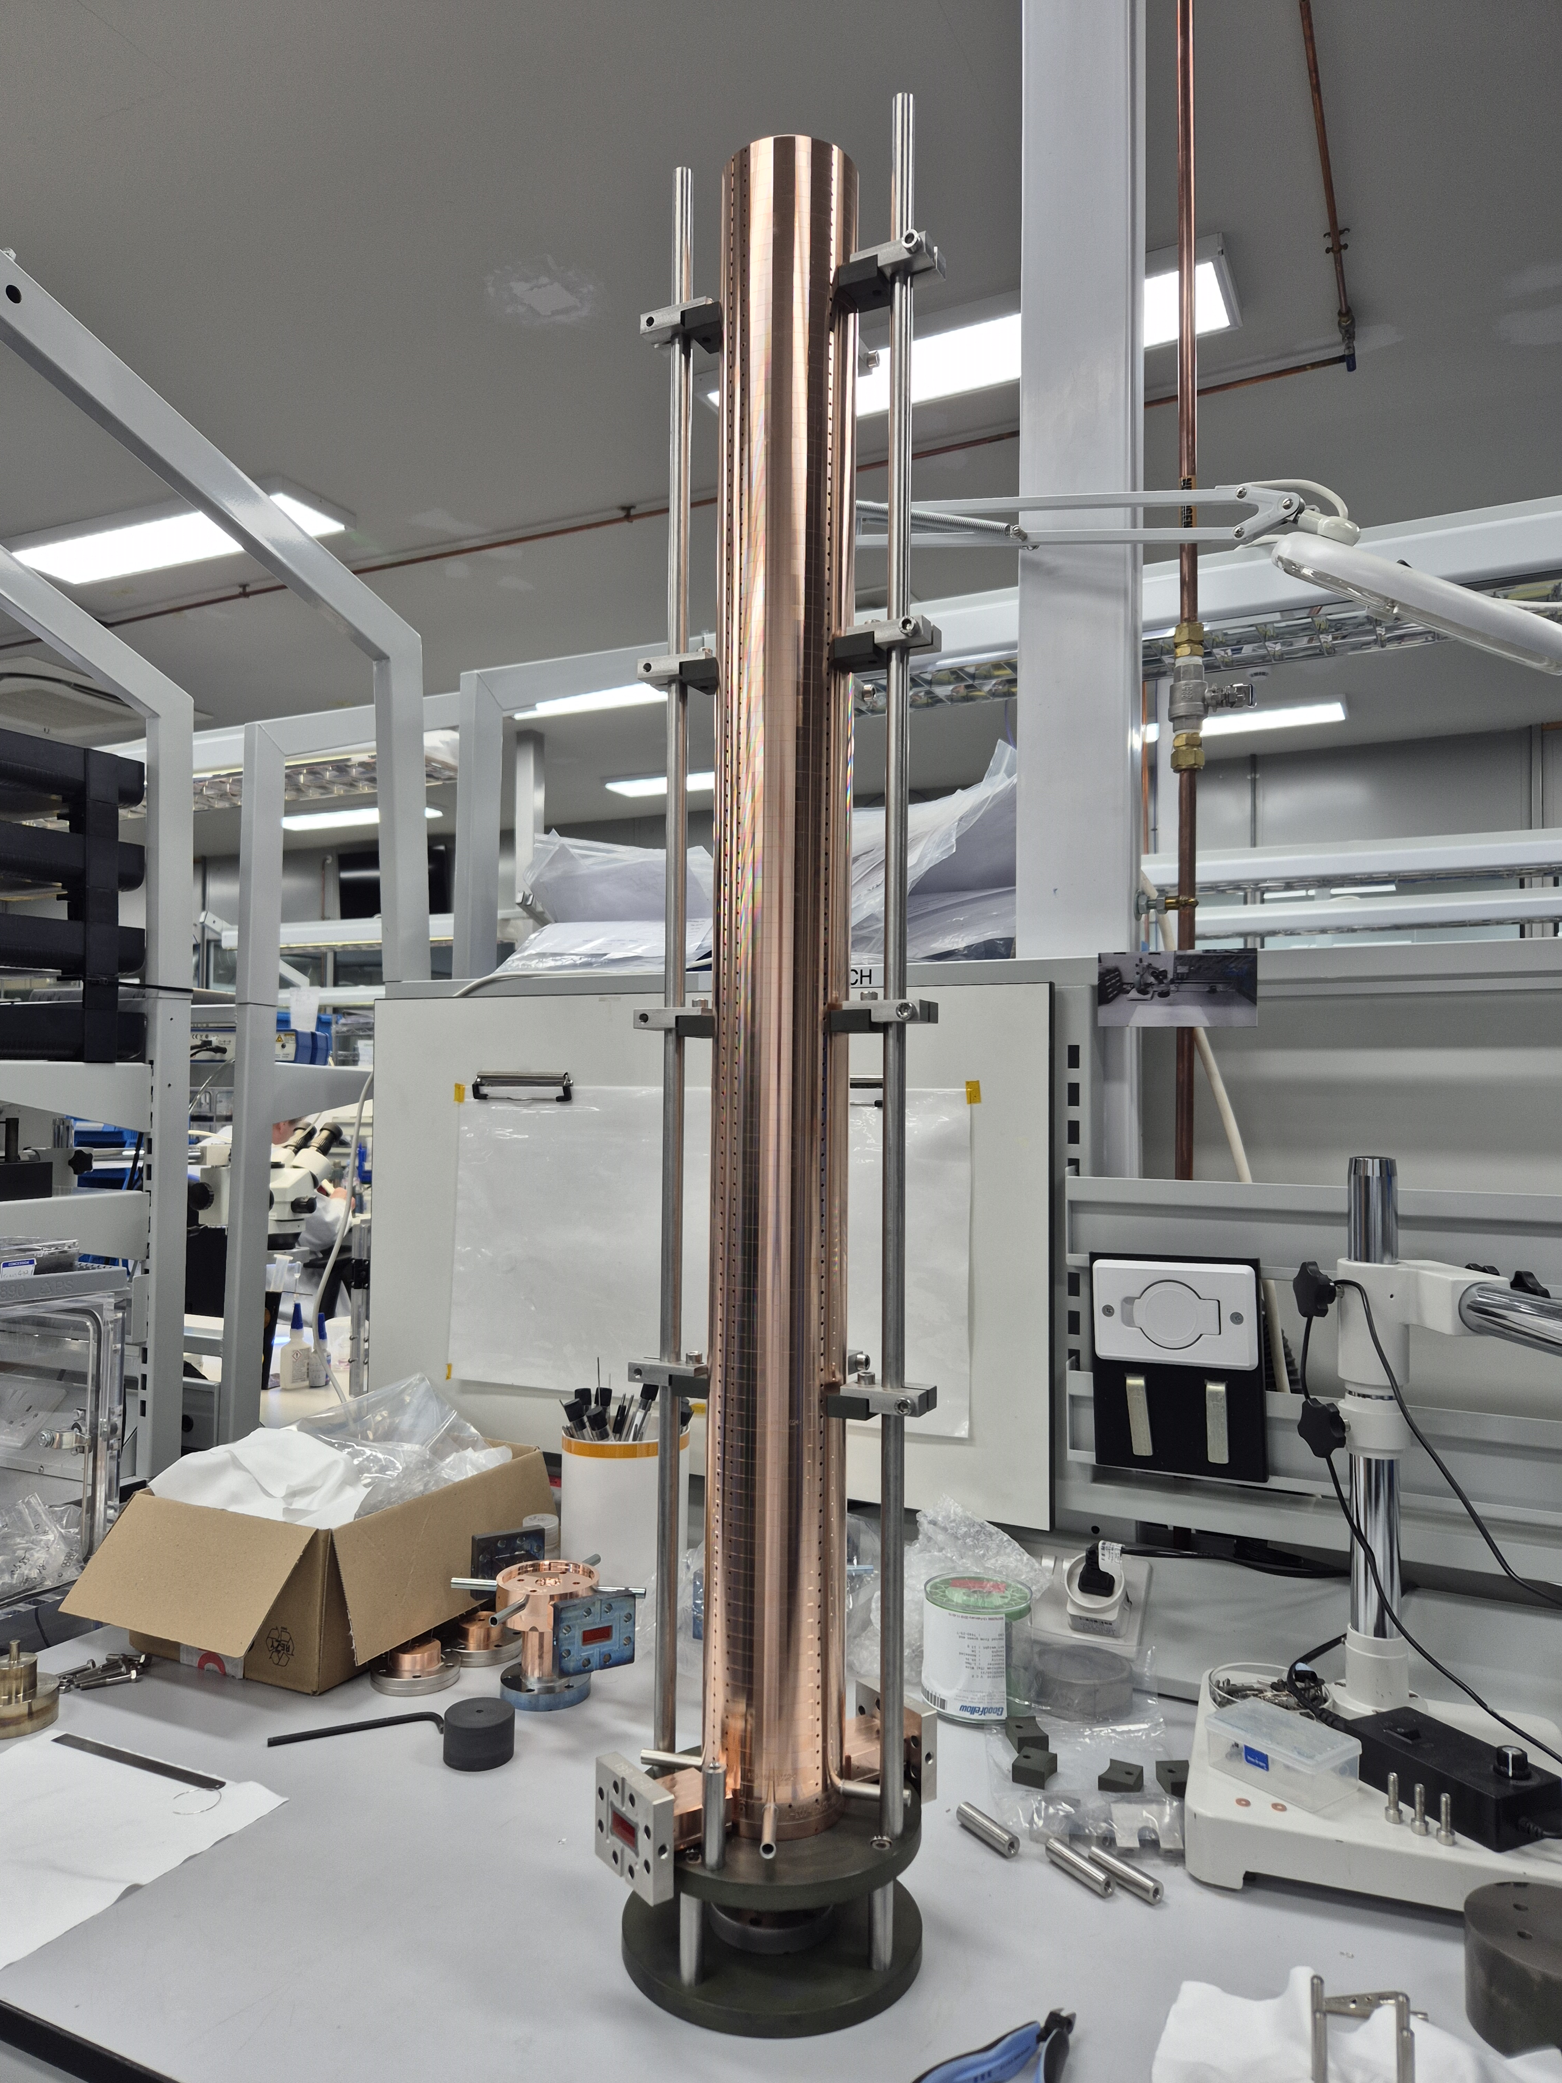
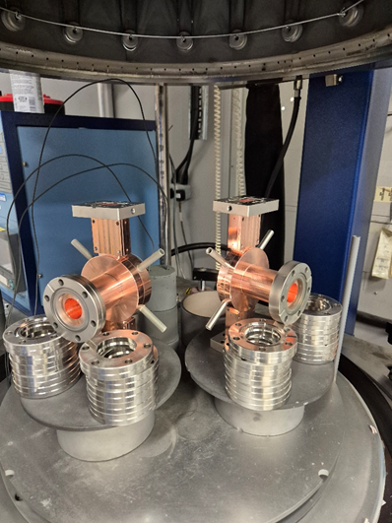
Pre-prototype
As already reported at the 3rd Annual Meeting and at the Steering Committee Meeting in October 2024, we had several problems with the brazing of the end stacks and the cooling pipes of the pre-prototype.
For this reason we were forced to revise the RF coupler design and brazing methods. We were also obliged to launch the manufacture of new RF couplers.
Two new couplers have been manufactured by VDL, tested by CERN Metrology and successfully brazed at TMD end of November 2024.
The stacking of the entire structure (108 disks) was completed mid of Jan 2025.

Slide 4
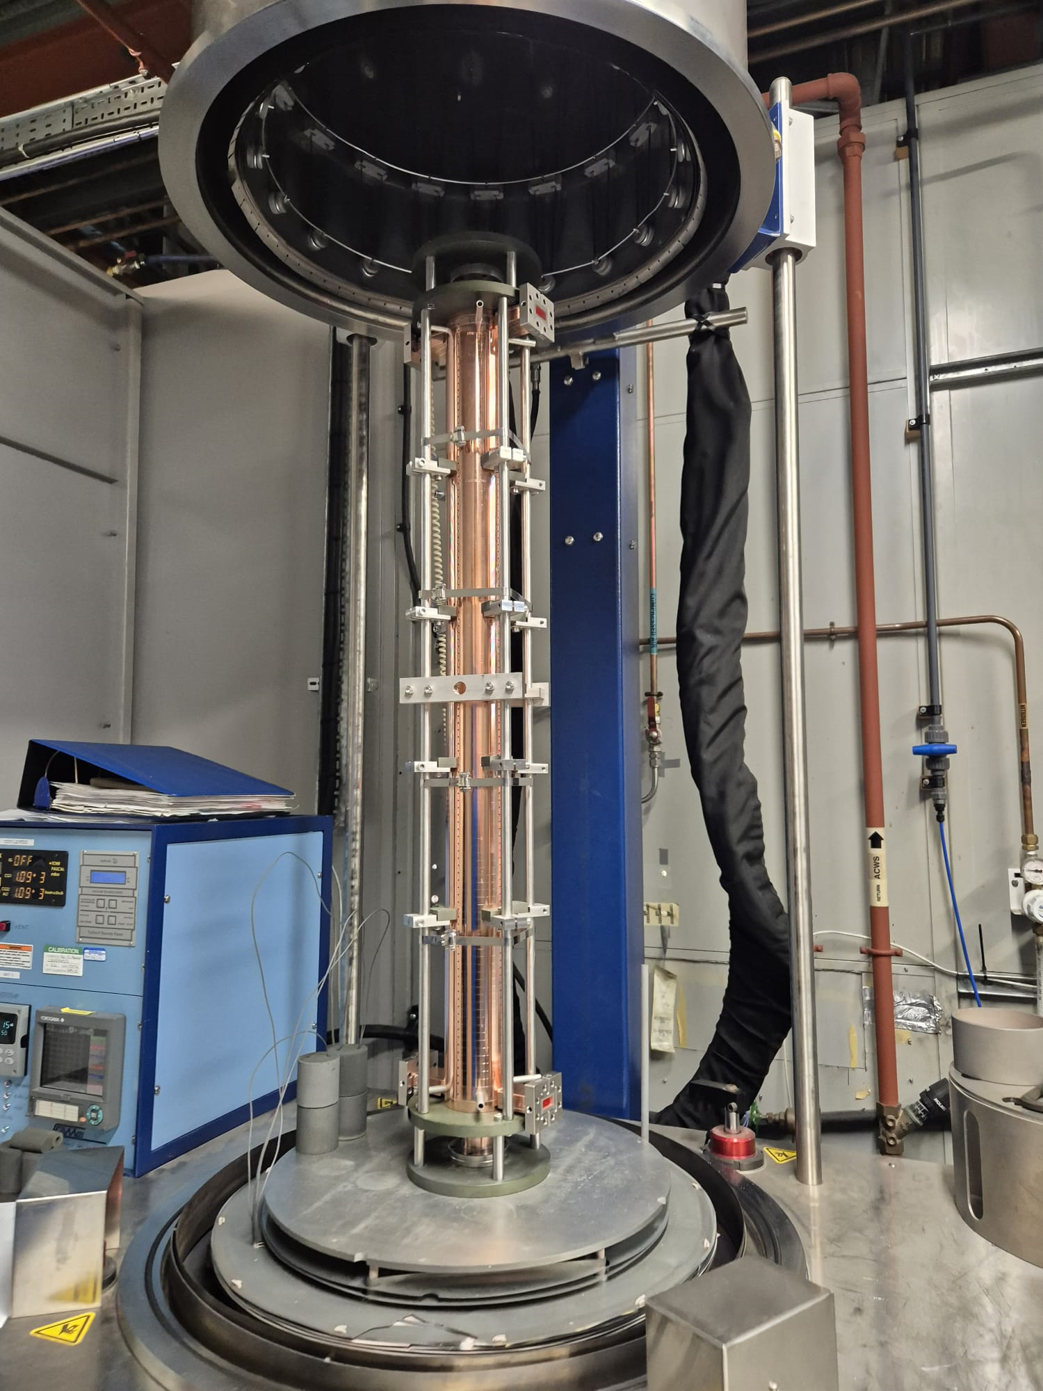
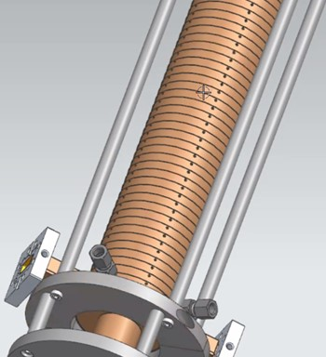
Pre-prototype brazing
The whole structure, with the two new end disk assemblies, was brazed mid of February 2025.
Prior to running this braze, a test furnace run was performed to ensure that the braze profile chosen would reach the desired brazing temperature.
A thermocouple was attached to the centre of the test mass and the results showed that the braze profile was adequate.
In addition a thermocouple was placed into the centre of the stack through one of the brazing vent holes to measure the temperature during the braze run.

Slide 5
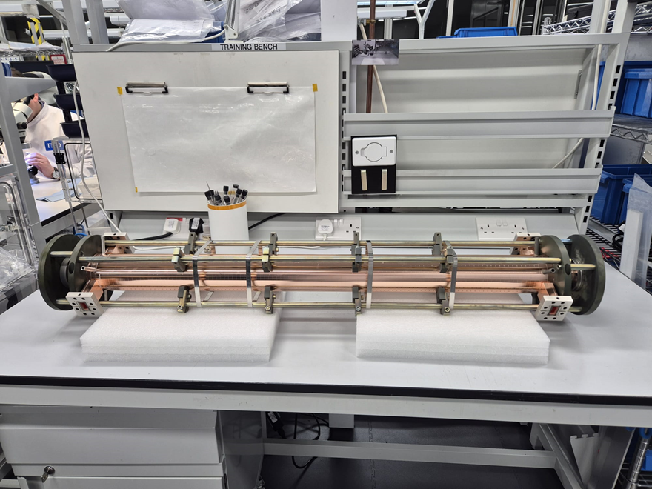
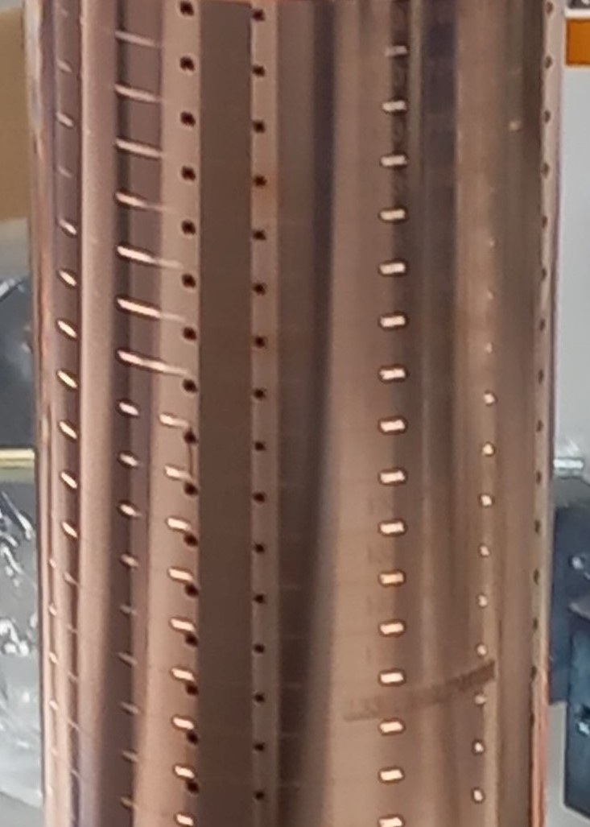
Vacuum tests
Following the braze run, the structure was removed from the furnace and placed into CPI TMD’s cleanroom for vacuum leak testing. The structure was tested using ultra-high vacuum leak checking equipment and was unfortunately shown to have a gross leak!!!
CPI TMD attempted to pinpoint the source of the leak, but it appeared to be leaking from several sources, and the size of the leak was too large to be able to accurately identify the sources.
It is suspected that the leaks may be coming from some of the braze channel vent holes, to test this CPI TMD purchased rubber bungs to plug every vent hole in every disk (216 holes in total), however this was not sufficient in reducing the leak to a level where the source could be identified.

Slide 6
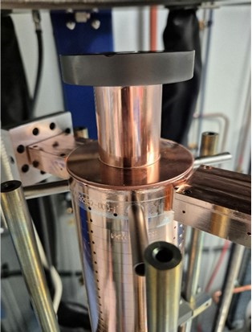
Mechanical damage
The braze run reached the desired braze temperature, but it became clear that there had been an issue with the structure thermally expanding into its braze jig, causing visible damage to the outside of the structure. The damage to the structure can be seen in the image.
Prior to furnacing, CPI TMD had put the brazing jig through a wet hydrogen greening process, which forms a green oxide layer on the stainless steel. This green oxide layer is applied to prevent the brazing parts from sticking to the braze jig. In addition to this, the braze jig was loosened once the structure was positioned in the furnace, to allow room for thermal expansion of the copper structure.
Copper has a close coefficient of thermal expansion to stainless steel (24.8 µm/m-°C and 18.7 µm/m-°C respectively), and so it was believed this would be sufficient to account for the difference in thermal expansion.
Despite this, this copper did stick to the stainless steel braze jig and expanded into it, causing damage to at least the outside of the stack.

Slide 7
Next steps
Following preliminary tests at CPI TMD, at the end of March the structure has been sent to CERN for low level RF measurements, mechanical tests (to assess any damage on the RF couplers) and for further evaluation to identify the cause of the vacuum leaks.
In particular:
CERN Metrology will check the alignment of the structure and, using an endoscope, will also check the brazing alloy penetration on the beam axis of the structure.
In addition, in order to identify the sources of vacuum leaks, the vent holes of the brazing channel need to be sealed.
Finally, if necessary, to fully understand the cause of the vacuum leaks, the section will be cut and the brazed areas are analysed.
All of the above activities
will be fundamental in reducing the brazing risks of the second structure!!!

Slide 8
Status of Deliverable D7.5
Introduction
RF design of the CompactLight accelerating structure
Mechanical design and thermal stabilization
  Cooling geometry and thermal stability
  Manufacturing process
Prototype fabrication
  Prototype cell fabrication
  Prototype cells metrology
Brazing procedures
  Prototype stack assembly procedure
  RF couplers brazing tests
  Problems experienced in brazing tests
  Production of new couplers
  Brazing tests on new RF couplers
First accelerating structure stack assembly
  Brazing of the first prototype
  Metrology and vacuum tests
  Low level RF measurement and RF characterization
Conclusions
Completed
Still to be completed:
D7.5 expected by end of May 2025

Slide 9
Second Prototype
After an accurate evaluation of the problems encountered on the first structure, and a careful analysis of the improvements required,
we estimate that the second prototype can be ready for brazing by the end of June 2025.
All the mechanical parts of the second structure (RF cells, couplers, WG components) are ready to be brazed.
Vacuum, mechanical and radio frequency testing will follow in July-August 2025.
The second deliverable, D7.6, can be released at the end of September 2025.

Slide 10
Expected time plan

Slide 11
Thank you!

