Slide 1
Status of permanent magnet dipole-quadrupole
Krakow, 10 April 2025, 4th iFAST Annual Meeting
Alex Hinton, WP11.3, STFC Daresbury Laboratory

Slide 2
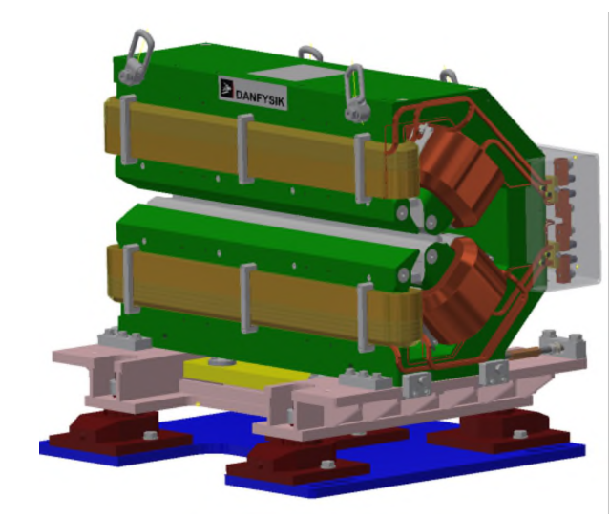
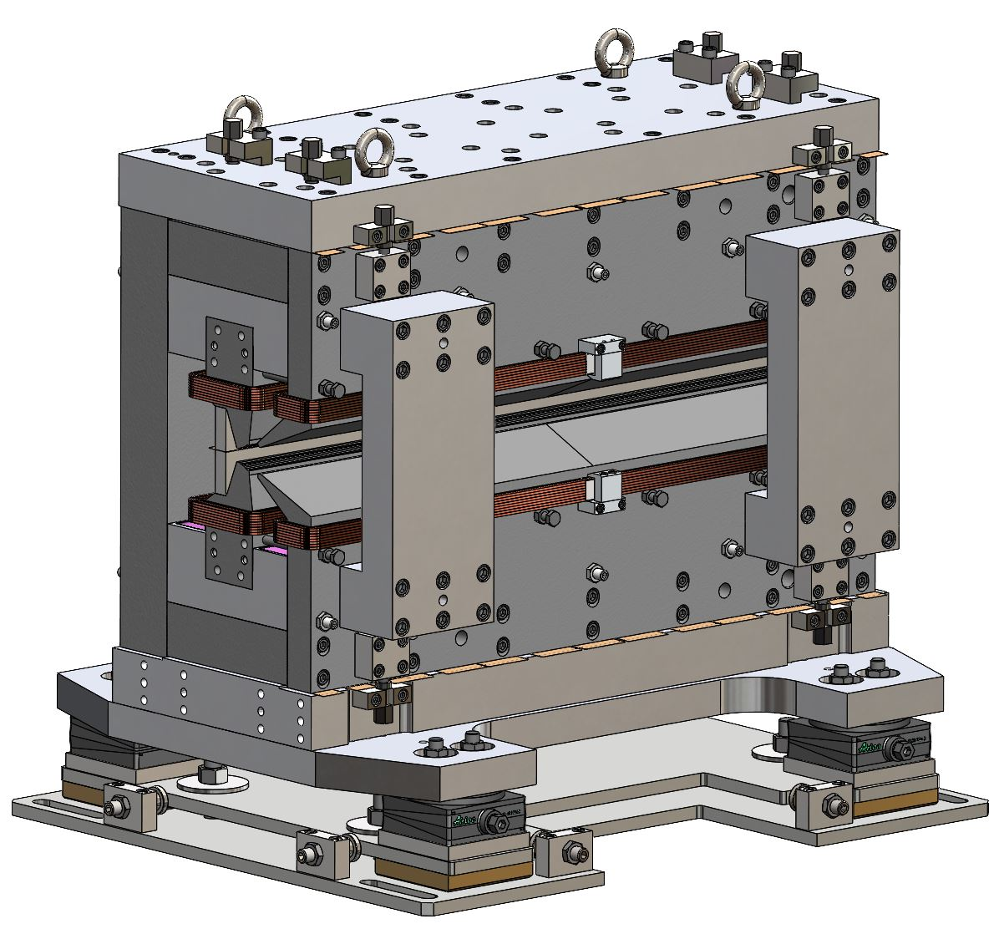
Introduction
WP11.3 - Permanent Magnet (PM) Combined Function Magnets for Ultra Low-Emittance Rings.
Development of prototype dipole-quadrupole (DQ) with equivalent parameters as existing electromagnet designed for Diamond-II lattice upgrade to save operating power.
Notes:
Aim is to go from electromagnet with big, power-hungry water cooled coil to energy-saving permanent magnet that does the same job.
Prototype aimed at DQs required as part of emittance reduction in Diamond-II upgrade.

Slide 3
Current Status
MS56 – Magnets Constructed and Tested
Estimated completion June 2025.
Delays due to several difficulties:
  Re-design to incorporate re-purposed undulator PM blocks.
  Difficulties acquiring low-carbon steel.
  Difficulties acquiring thermal shunt material.
  Time required to cut and de-burr thermal shunts.
  Staff availability.
Construction is now nearing completion.

Slide 4

Magnet Design
Re-purposed undulator blocks.
Hybrid Electromagnet-Permanent Magnet Tuneable Optics (HEPTO).
Dipole = 0.7 T, Gradient = 33 T/m.
Effective length = 0.870 m.
Main source of field = NdFeB permanent magnet blocks
Dipole and gradient fields require independent tuning of ±2.5% for commissioning purposes.
Field tuning achieved by air-cooled trim coils.
Yoke and poles made from low-carbon steel.
Main coil peak power = 31 W
Auxiliary coil peak power = 16 W
Spare thermal shunt material.
EM DQ nominal power = 2.3 kW + water
Notes:
Design is for improved sustainability – replace Ems with PMs to reduce power consumption.
Design of this prototype is sustainable – recycled/re-used PM and thermal shunt material – no need to produce new material / buy in large volume.
Some tuning is necessary, over small range. Achieved through air-cooled coils, > 2kW power saved compared to EM.

Slide 5
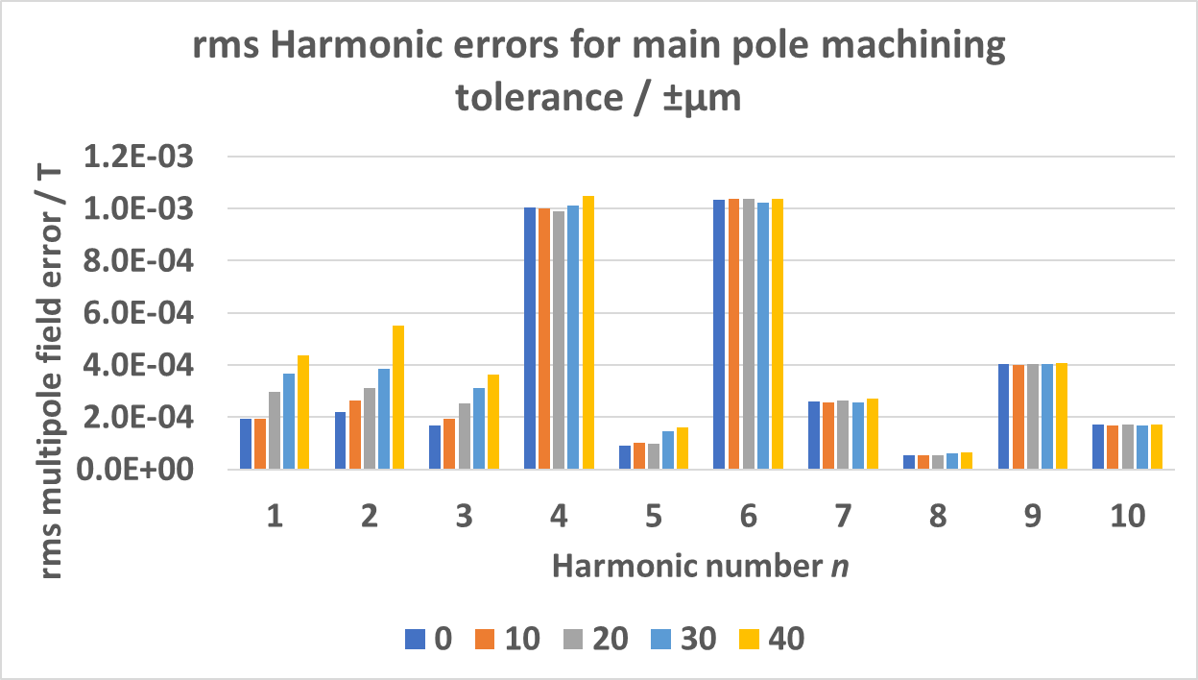
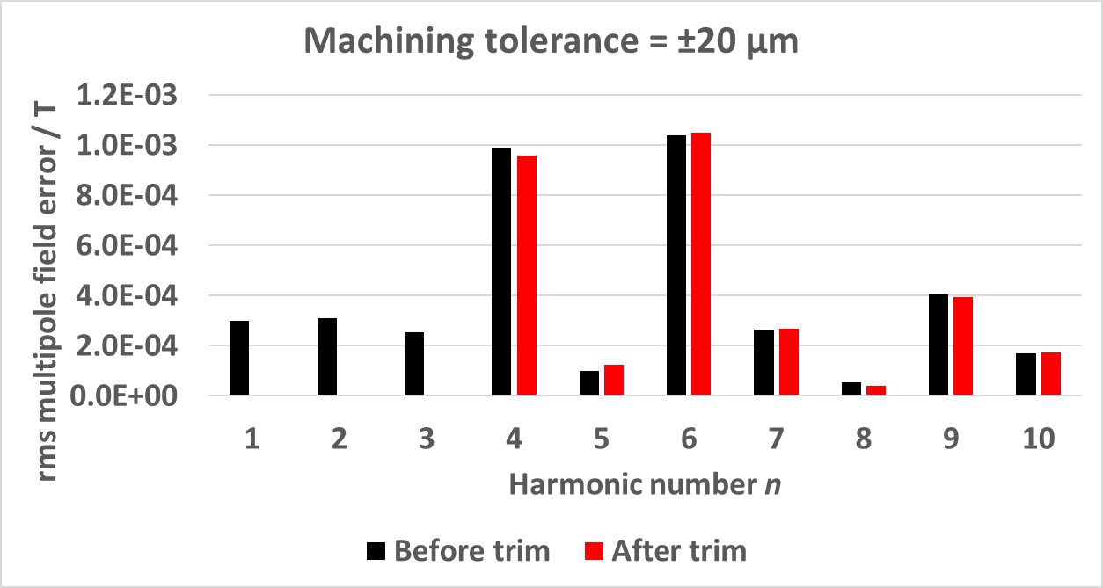
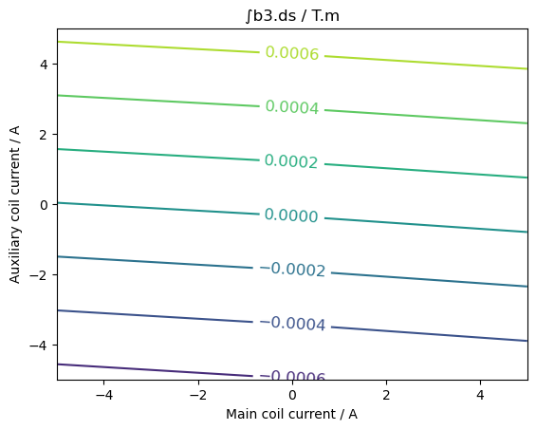
Machining Tolerances
Machining tolerances impact cost.
3-step shimming process using trim coils to optimise dipole, quadrupole, sextupole fields:
  Auxiliary coil set to minimise sextupole.
  Main coil set to achieve gradient.
  Re-fiducialisation to set magnet centre/dipole.
Machining tolerances and trimming have little impact on higher-order multipoles.
Notes:
Need to model machining tolerances – want to reduce cost whilst maintaining specified homogeneity.
Looser machining tolerances on poles = larger dipole, quadrupole, sextupole errors (but higher order harmonics less effected)
Sextupole near independent of main coil -> can use 3-step process to tune coil currents and physical offset to minimise dipole, quad, sextupole errors.
BUT….

Slide 6
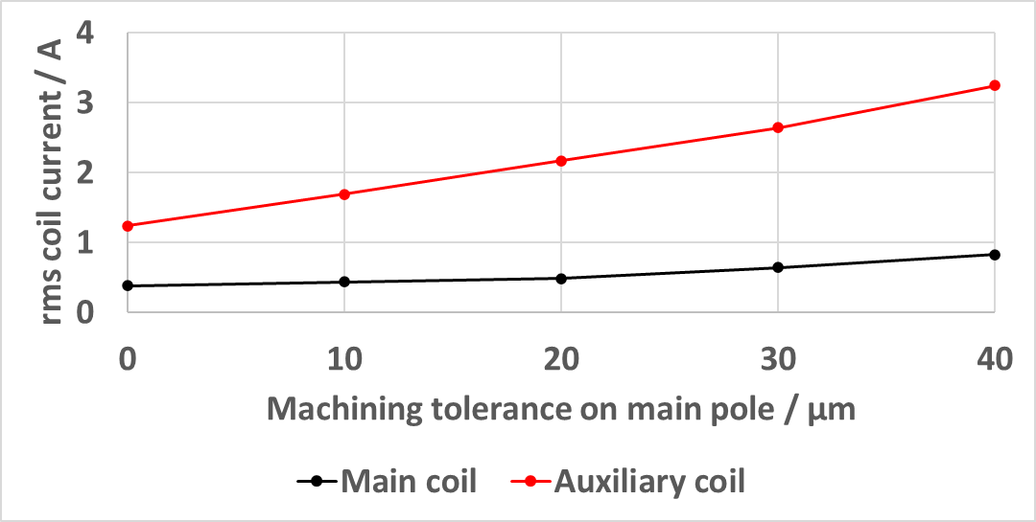
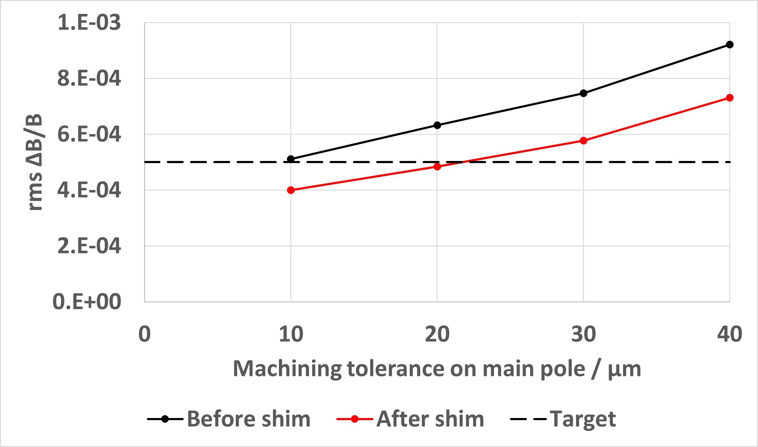
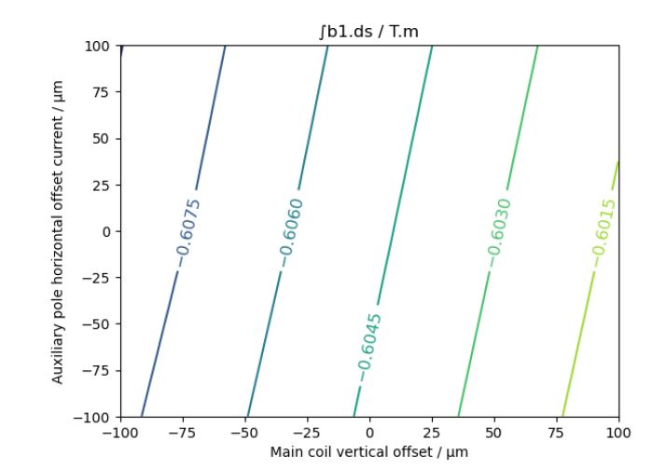
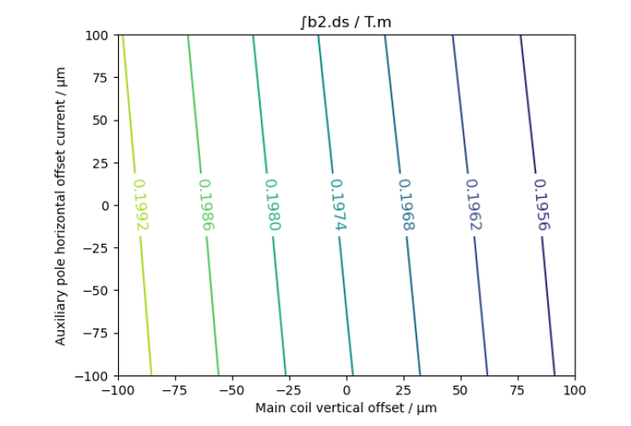
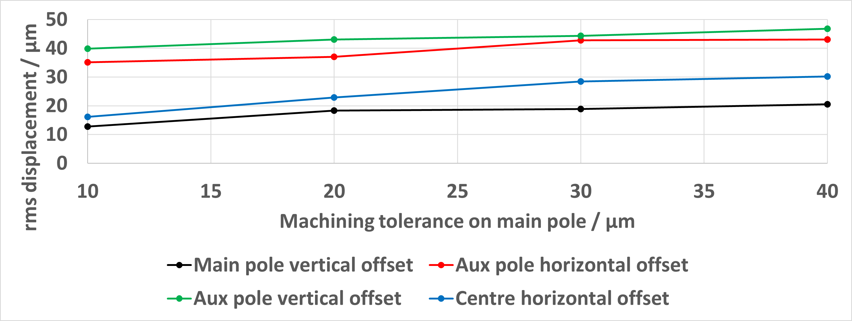
Mechanical Shimming
Larger machining tolerances will require larger currents for trimming.
  Higher nominal power.
  Heat load on magnets during normal operation.
  Reduced available tuning range.
Can mechanically shim to nominal field values.
Machining tolerances to achieve target ΔB/B < 5x10-4:
  ±20 µm on main pole.
  ±40 µm on auxiliary pole.
Mechanical design will allow relative adjustment of horizontal and vertical pole offsets in range ±50 µm.
Notes:
Using trim coil for shimming increases nominal power, reduces tuning range.
Can shimming be done mechanically? Physical movement of main and auxiliary poles has similar effect as changing coil currents.
With mechanical shimming, modelling shows can achieve target homogeneity with 20 um tolerances on main pole – challenging but better than < 10 um
Need shimming range ~ +/- 50 um

Slide 7
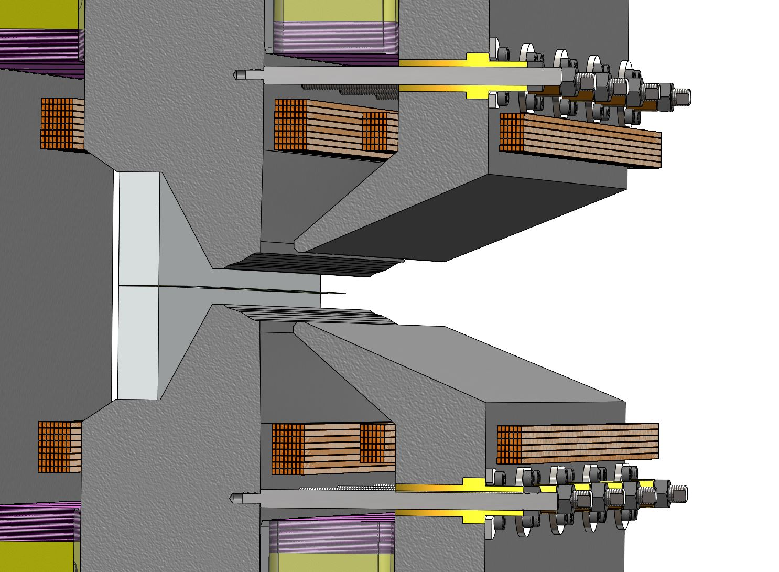
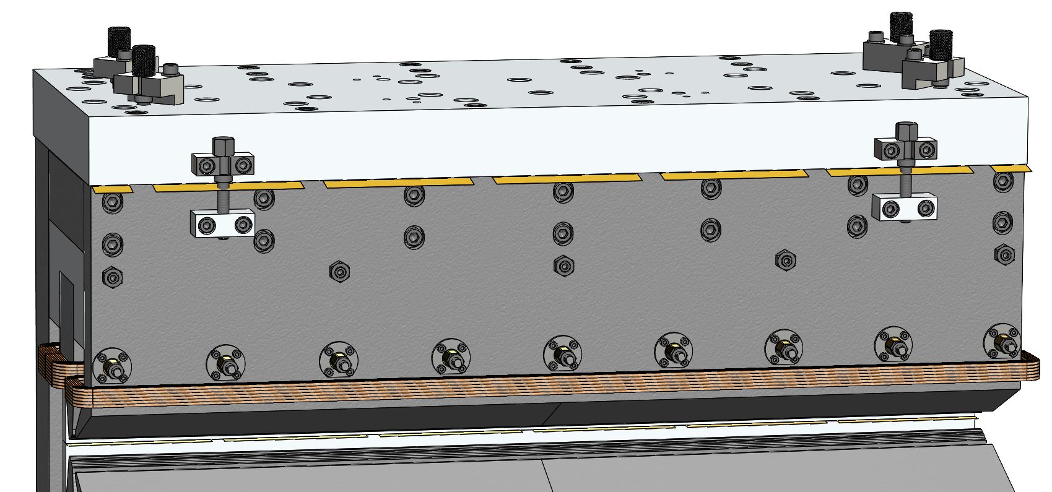
Mechanical Shimming
2. Two screws for opening gap between auxiliary pole and aluminium plate. Brass shims can be added/removed to adjust vertical position of auxiliary pole.
Gap is pre-shimmed with 300 µm thickness.
Shim thicknesses in range 10-50 µm.
1. Threaded rods used to deform auxiliary poles for horizontal adjustment of auxiliary pole tips.
Notes:
Mechanical design completed with mechanical shimming in mind
Threaded rods for horizontal adjustment of auxiliary pole
Vertical adjustment through brass shims – pre shimmed to allow gap to be increased/decreased

Slide 8
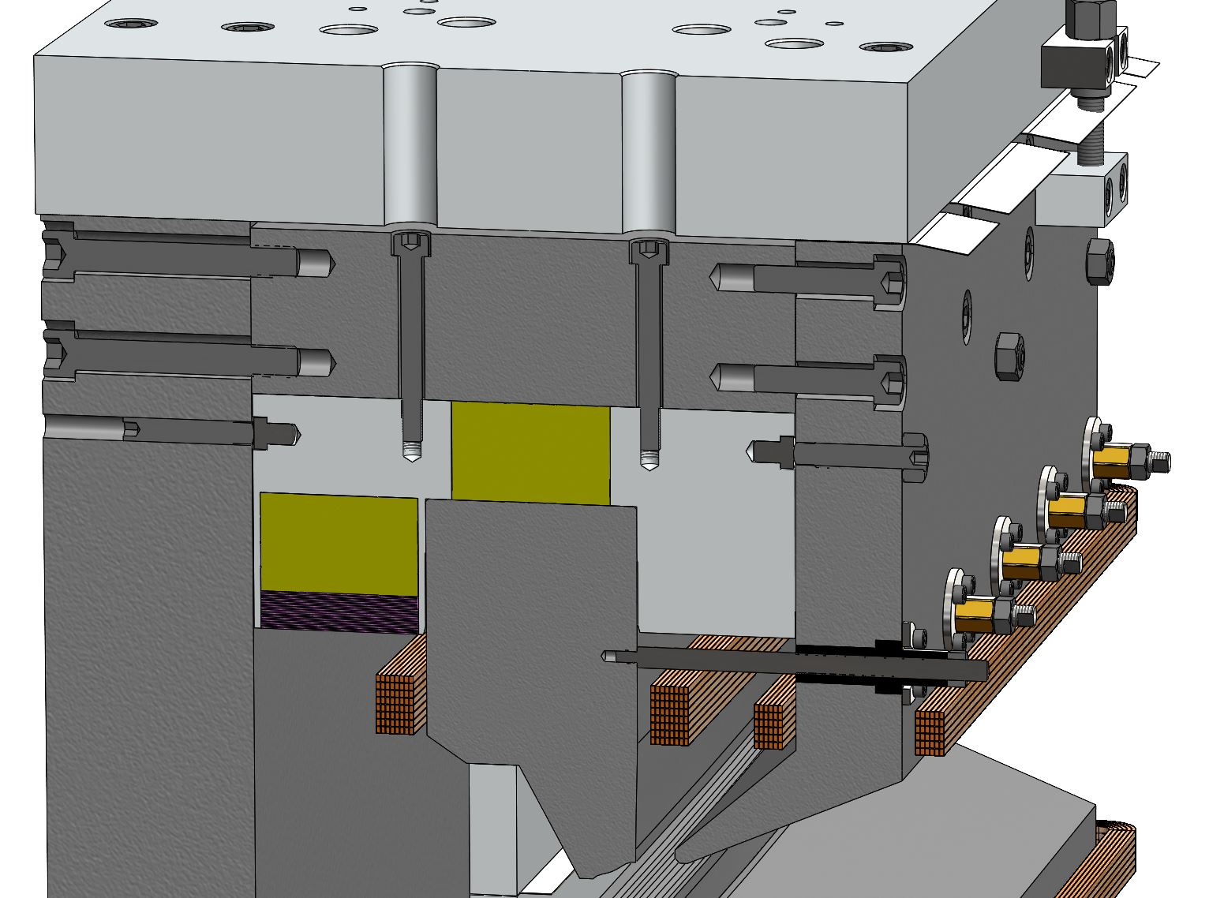
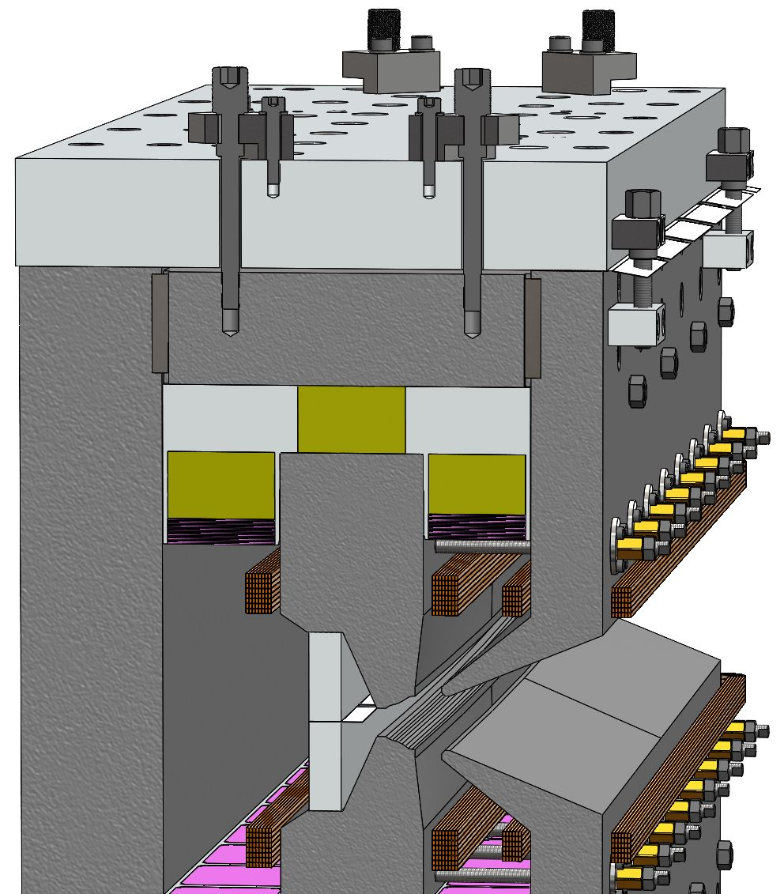
Mechanical Shimming
3. Two set screws used to move aluminium plate which holds the magnets and the top main pole horizontally. Bottom main pole will serve as a reference so will have no adjustment.
4. Screws for vertical adjustment of top main pole by moving top yoke arm vertically between the yoke backleg and the top auxiliary pole. These screws are used to open up the gap between main pole spacers to add/remove brass shims for vertical adjustment.
Notes:
Horizontal and vertical adjustment of top pole with respect to bottom pole
Bottom pole fixed as a reference

Slide 9
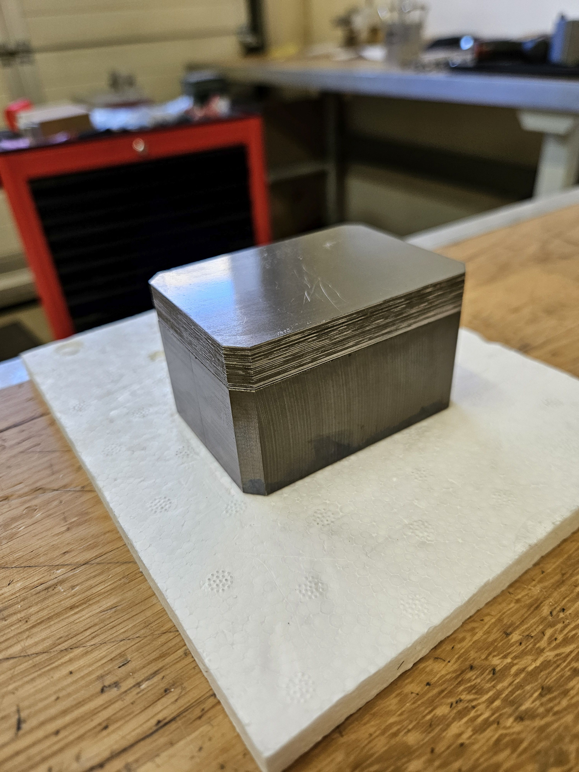
Assembly
Thermal shunt sheets glued to magnet blocks.
Notes:
Assembly is ongoing.
First step is to glue thermal shunts to PM blocks.
26 shunt sheets per side PM block x42 blocks – very slow process!

Slide 10
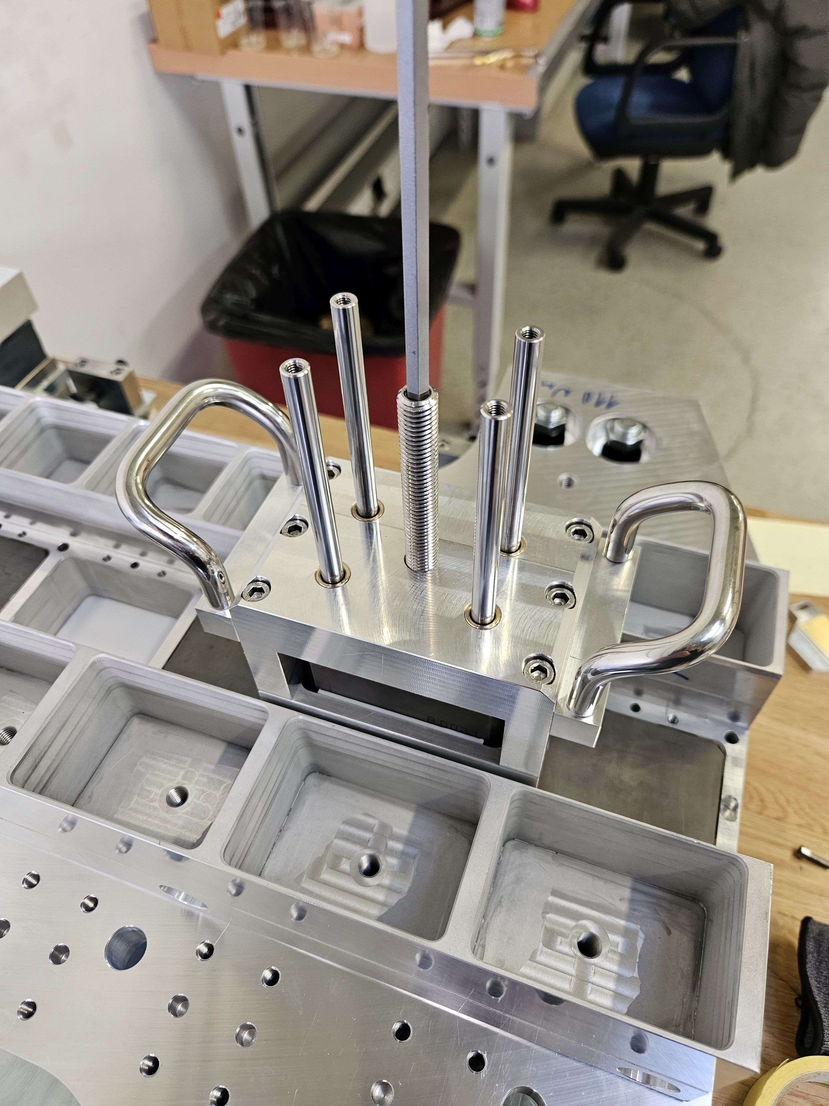
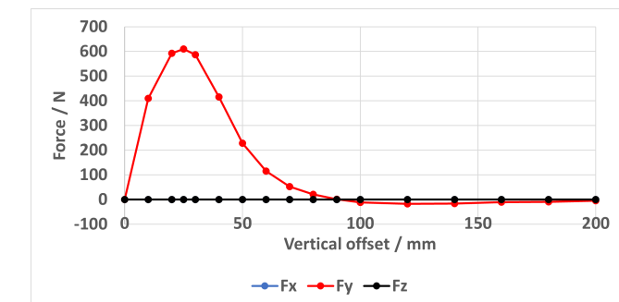
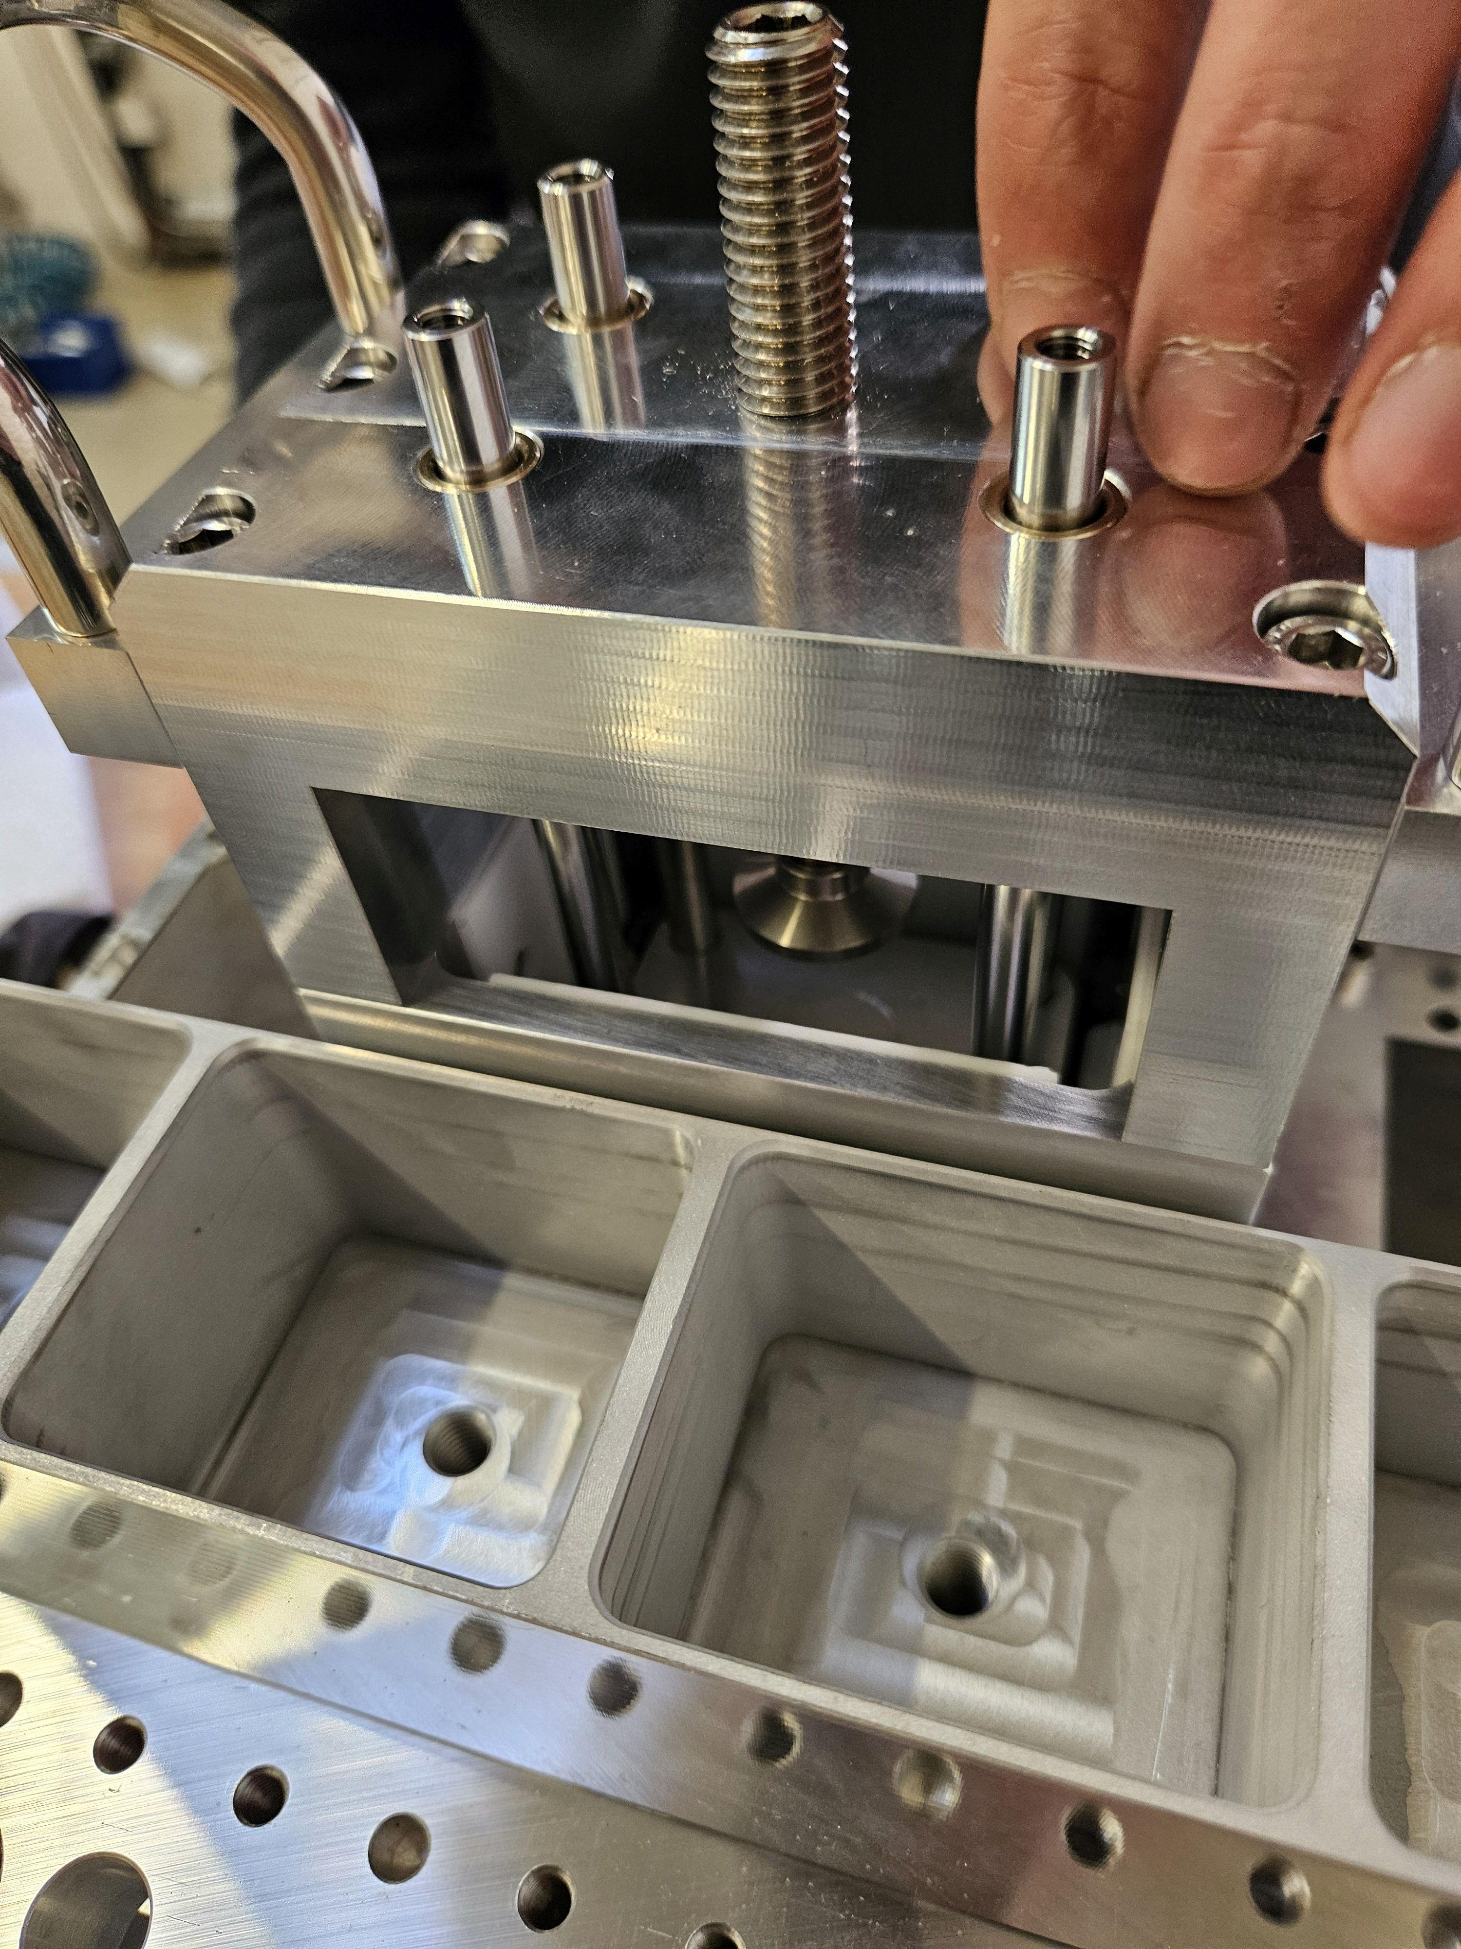
Assembly
Thermal shunt sheets glued to magnet blocks.
Middle magnets glued into tray.
Notes:
Middle magnets glued into non-magnetic tray.
Custom assembly tooling designed and built in-house at Kyma.
Tool slide along and use threaded rods to push magnets into slots.
Required because of large forces on magnets during assembly! Repulsive forces need to be overcome to push middle magnet in between two neighbours. Up to ~60 kg force to be overcome.

Slide 11
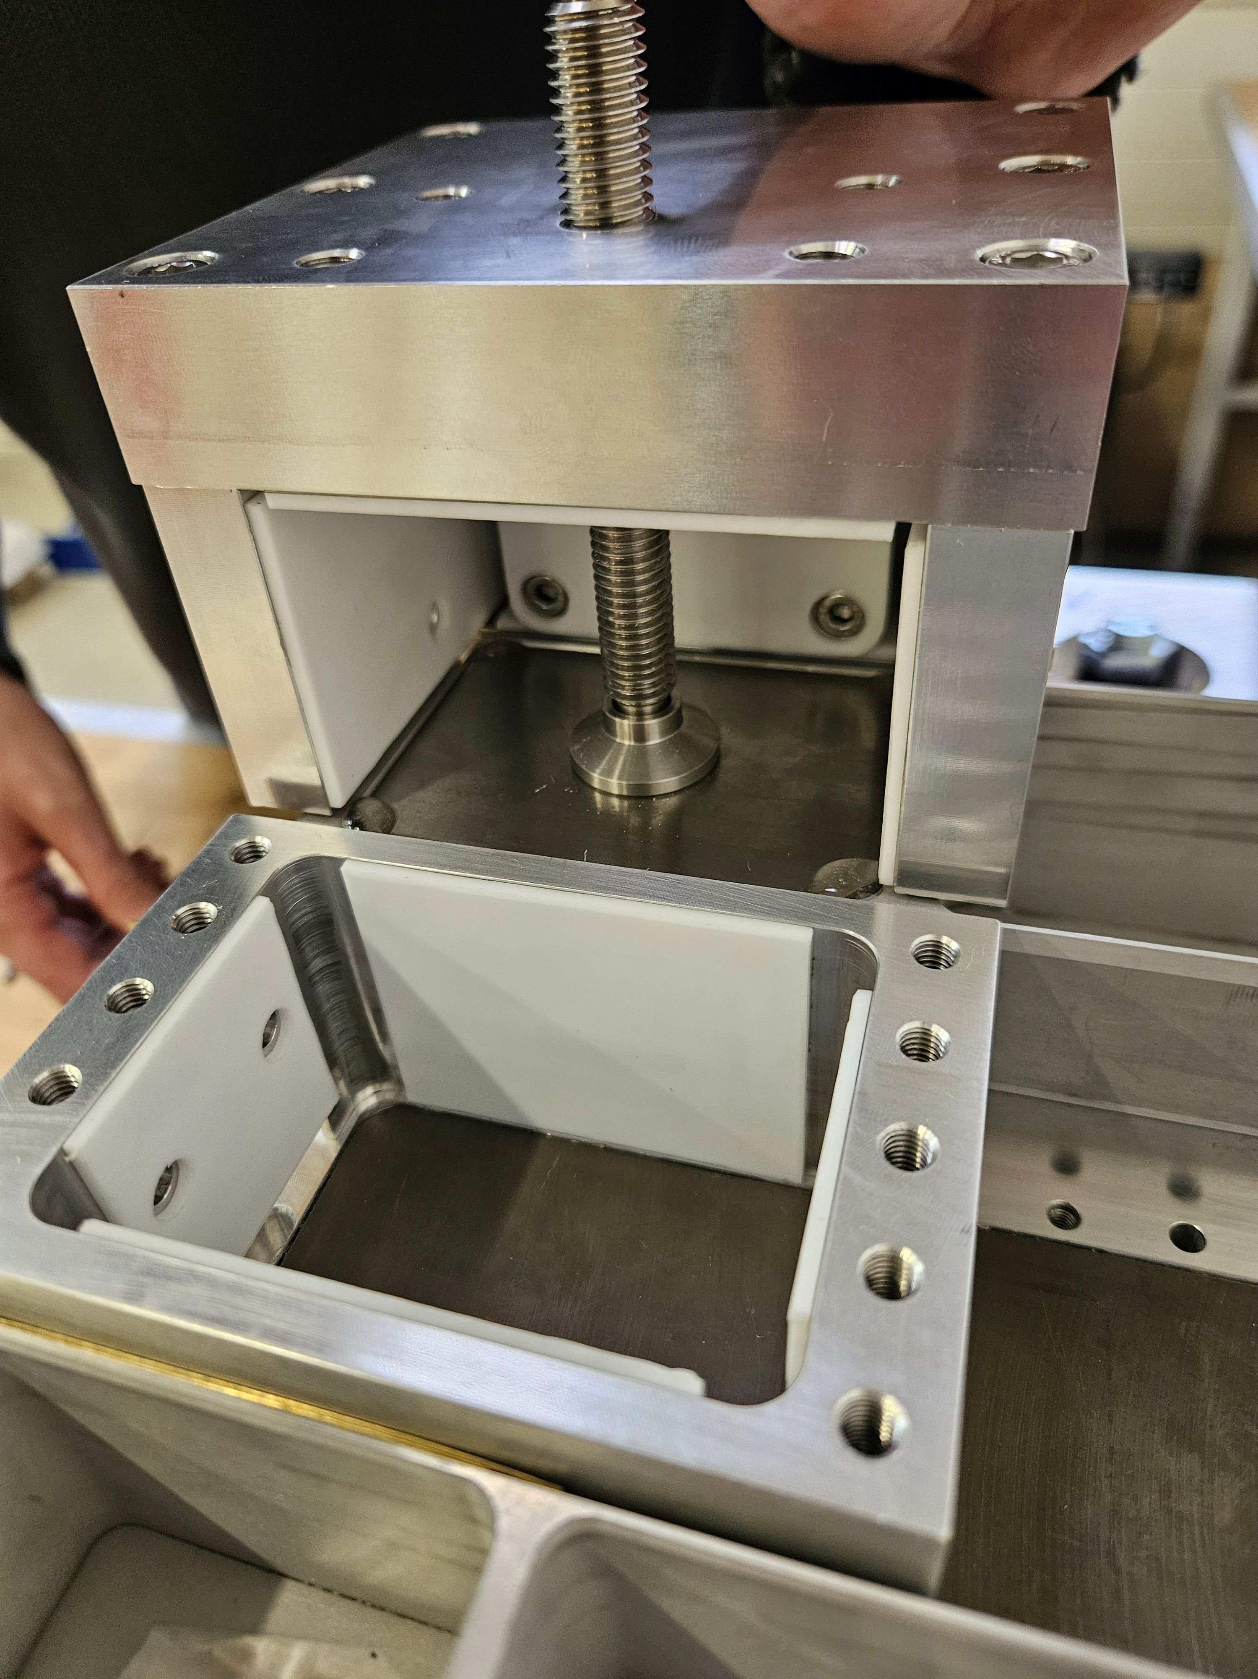
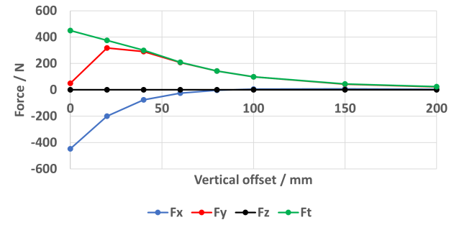
Assembly
Thermal shunt sheets glued to magnet blocks.
Middle magnets glued into tray.
Side magnets glued into tray.
Notes:
Next side magnets inserted.
Assembly tooling again used to overcome forces
Forces more complicated for side magnets – including horizontal forces to be overcome
Different tooling needed for different magnets due to different shapes. In a series production all magnets would be bespoke and same dimensions to simplify tooling.

Slide 12
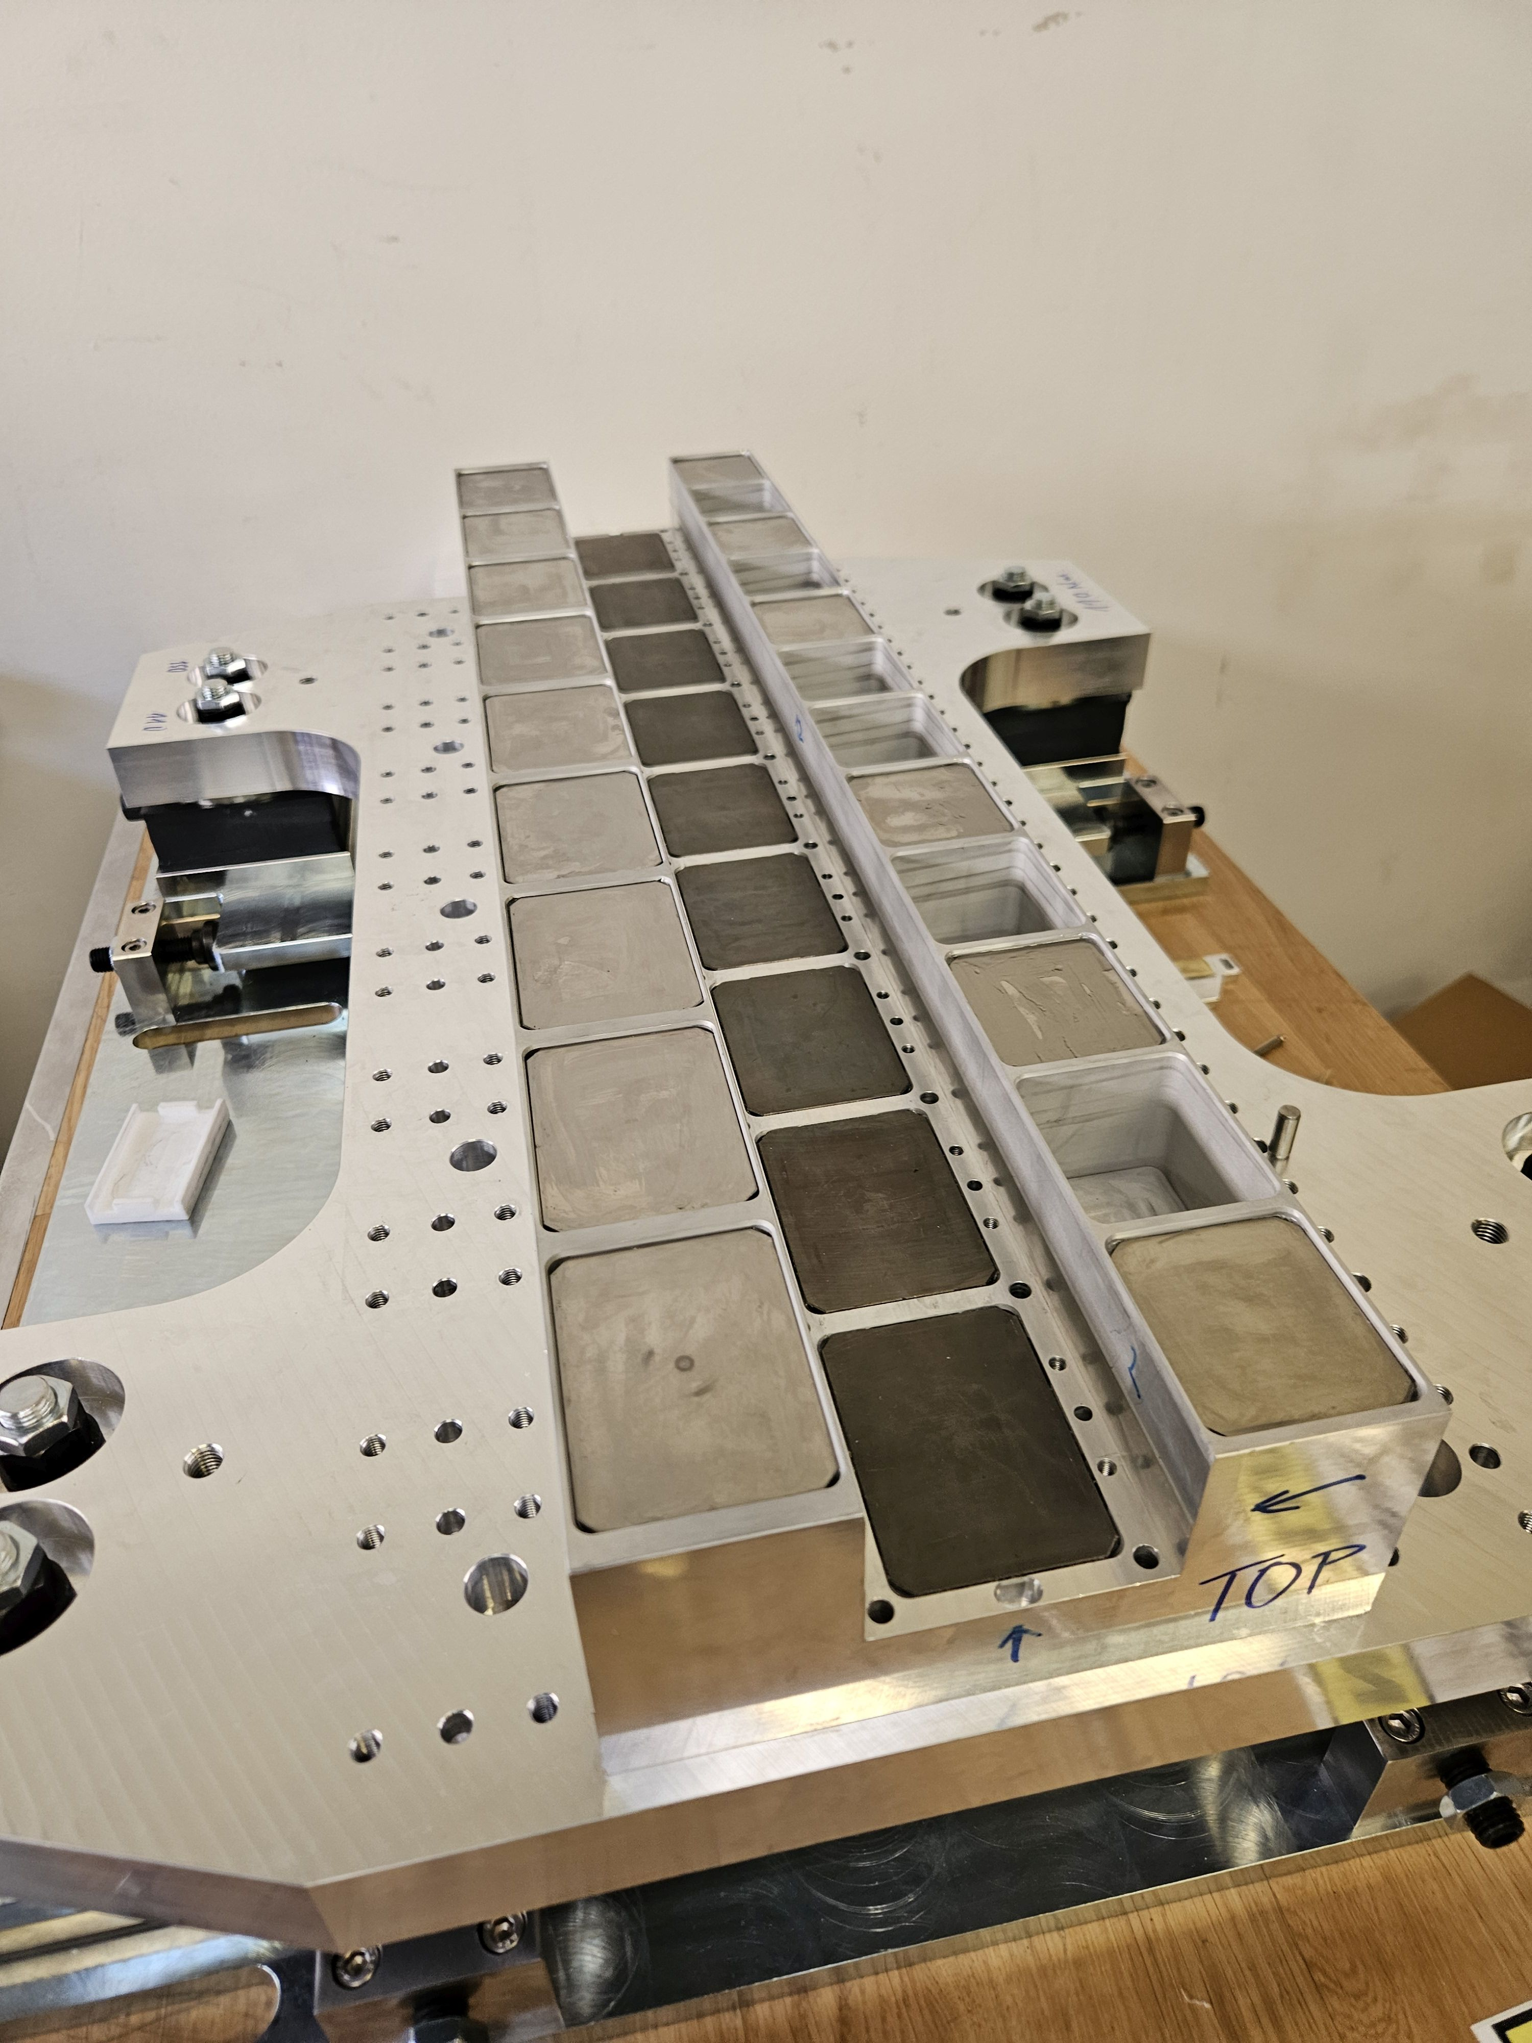
Assembly
Thermal shunt sheets glued to magnet blocks.
Middle magnets glued into tray.
Side magnets glued into tray.
Notes:
Magnets installed in set order to minimise forces on them

Slide 13
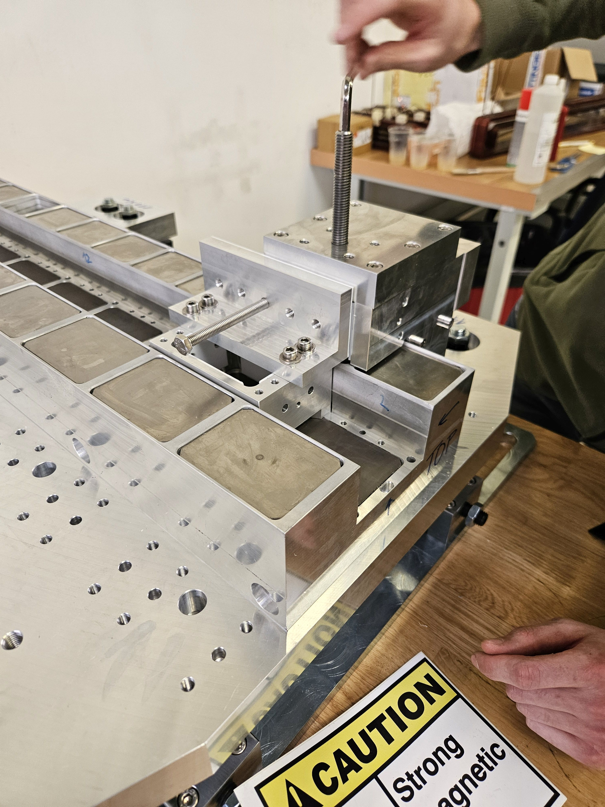
Assembly
Thermal shunt sheets glued to magnet blocks.
Middle magnets glued into tray.
Side magnets glued into tray.
Notes:
Final magnet being inserted

Slide 14
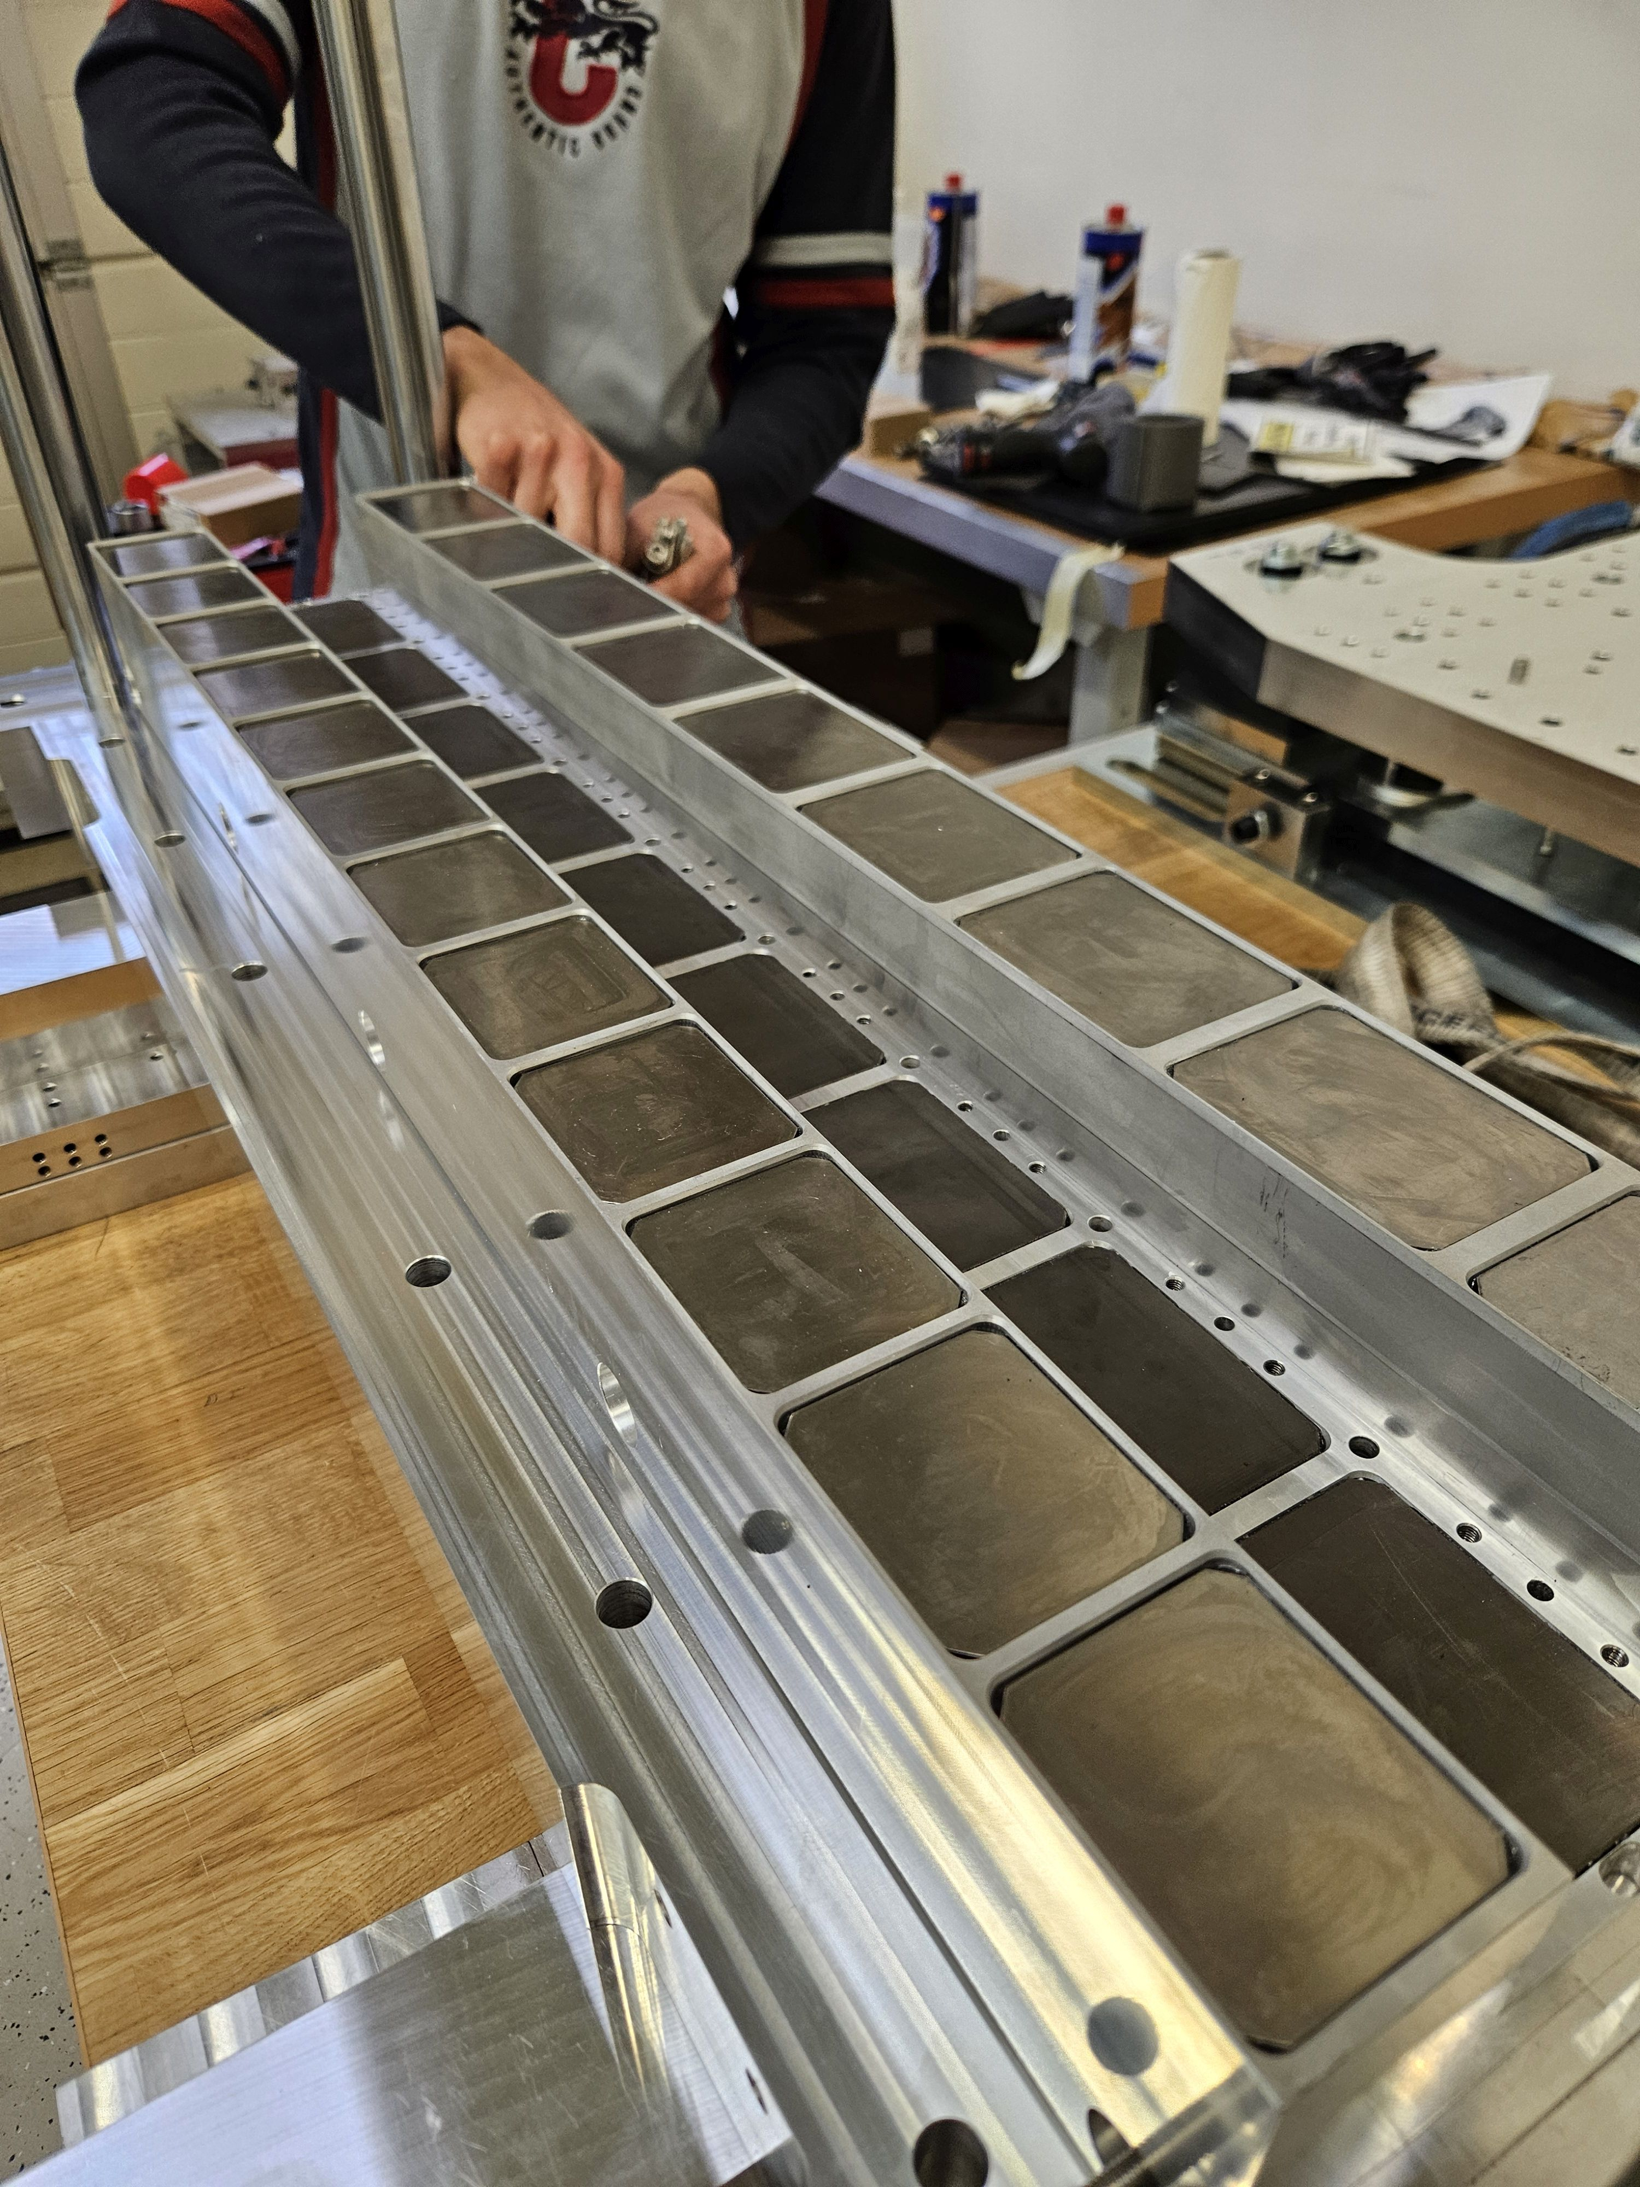
Assembly
Thermal shunt sheets glued to magnet blocks.
Middle magnets glued into tray.
Side magnets glued into tray.
Notes:
Fully filled PM carriage

Slide 15
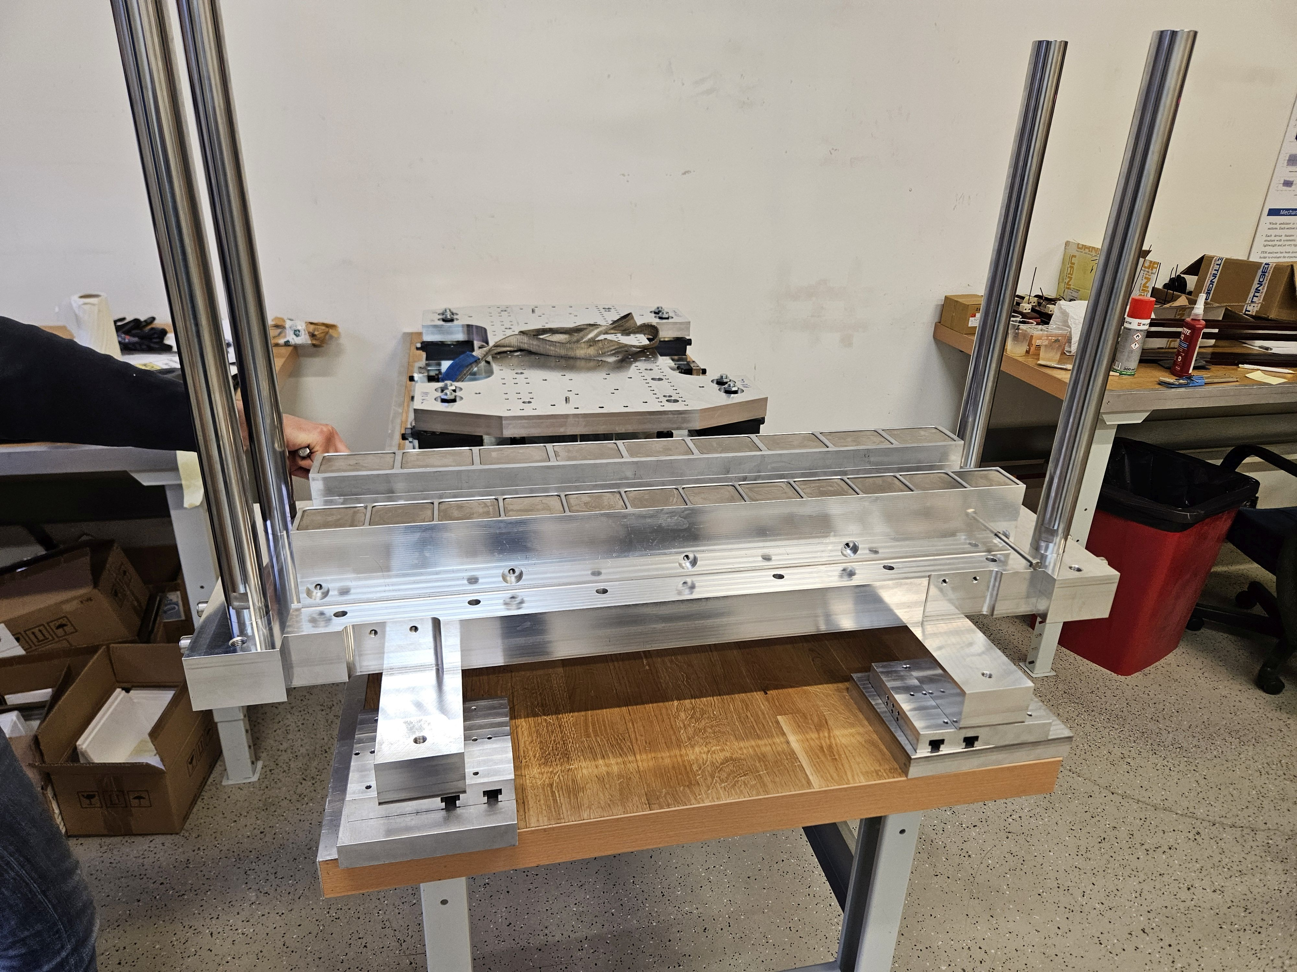
Assembly
Thermal shunt sheets glued to magnet blocks.
Middle magnets glued into tray.
Side magnets glued into tray.
Main pole inserted.
Notes:
Next the main pole is inserted into the magnet carriage.
4 poles act to guide the pole and manage movement in a controlled and safe way

Slide 16
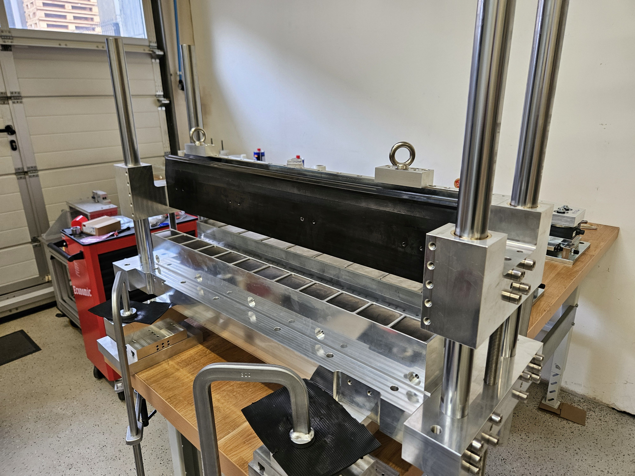
Assembly
Thermal shunt sheets glued to magnet blocks.
Middle magnets glued into tray.
Side magnets glued into tray.
Main pole inserted.
Notes:
Image of pole inserted in magnet carriage

Slide 17
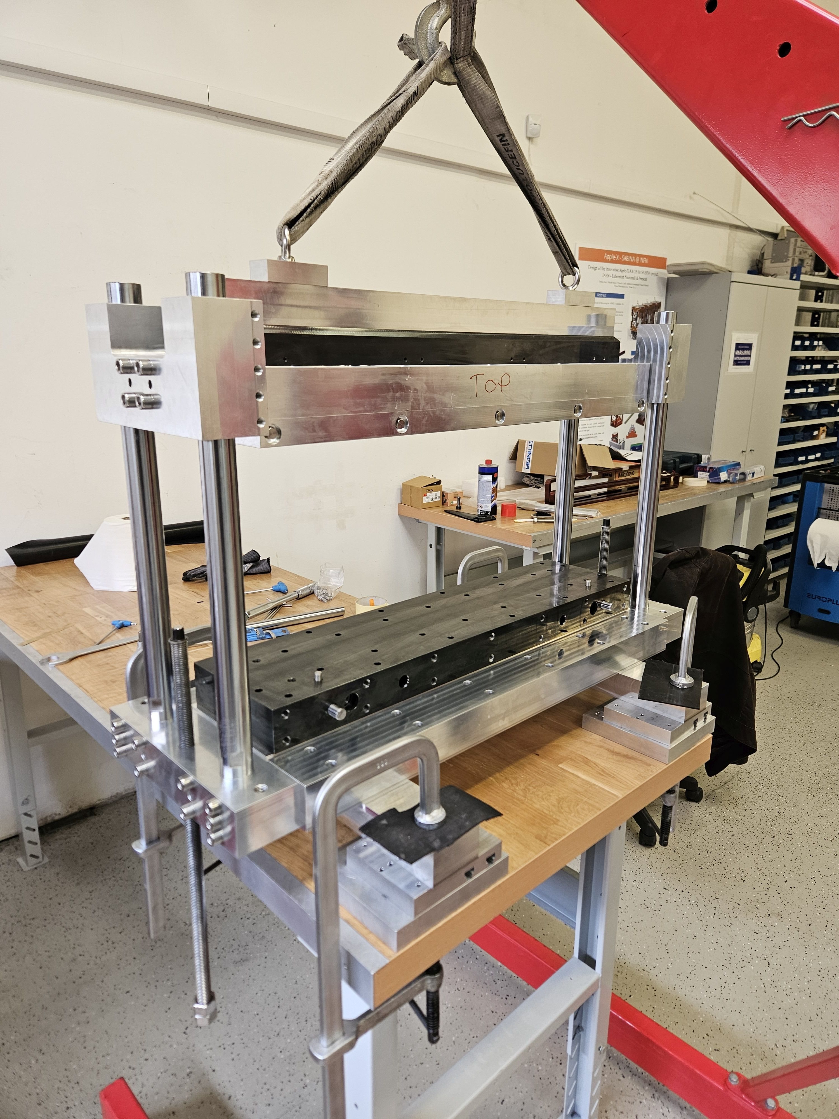
Assembly
Thermal shunt sheets glued to magnet blocks.
Middle magnets glued into tray.
Side magnets glued into tray.
Main pole inserted.
Main pole and magnet carriage bolted to top plate.
Notes:
Assembly of main pole and carriage is lowered using same frame onto the top plate.
Poles guide movement, crane used to lower carriage

Slide 18
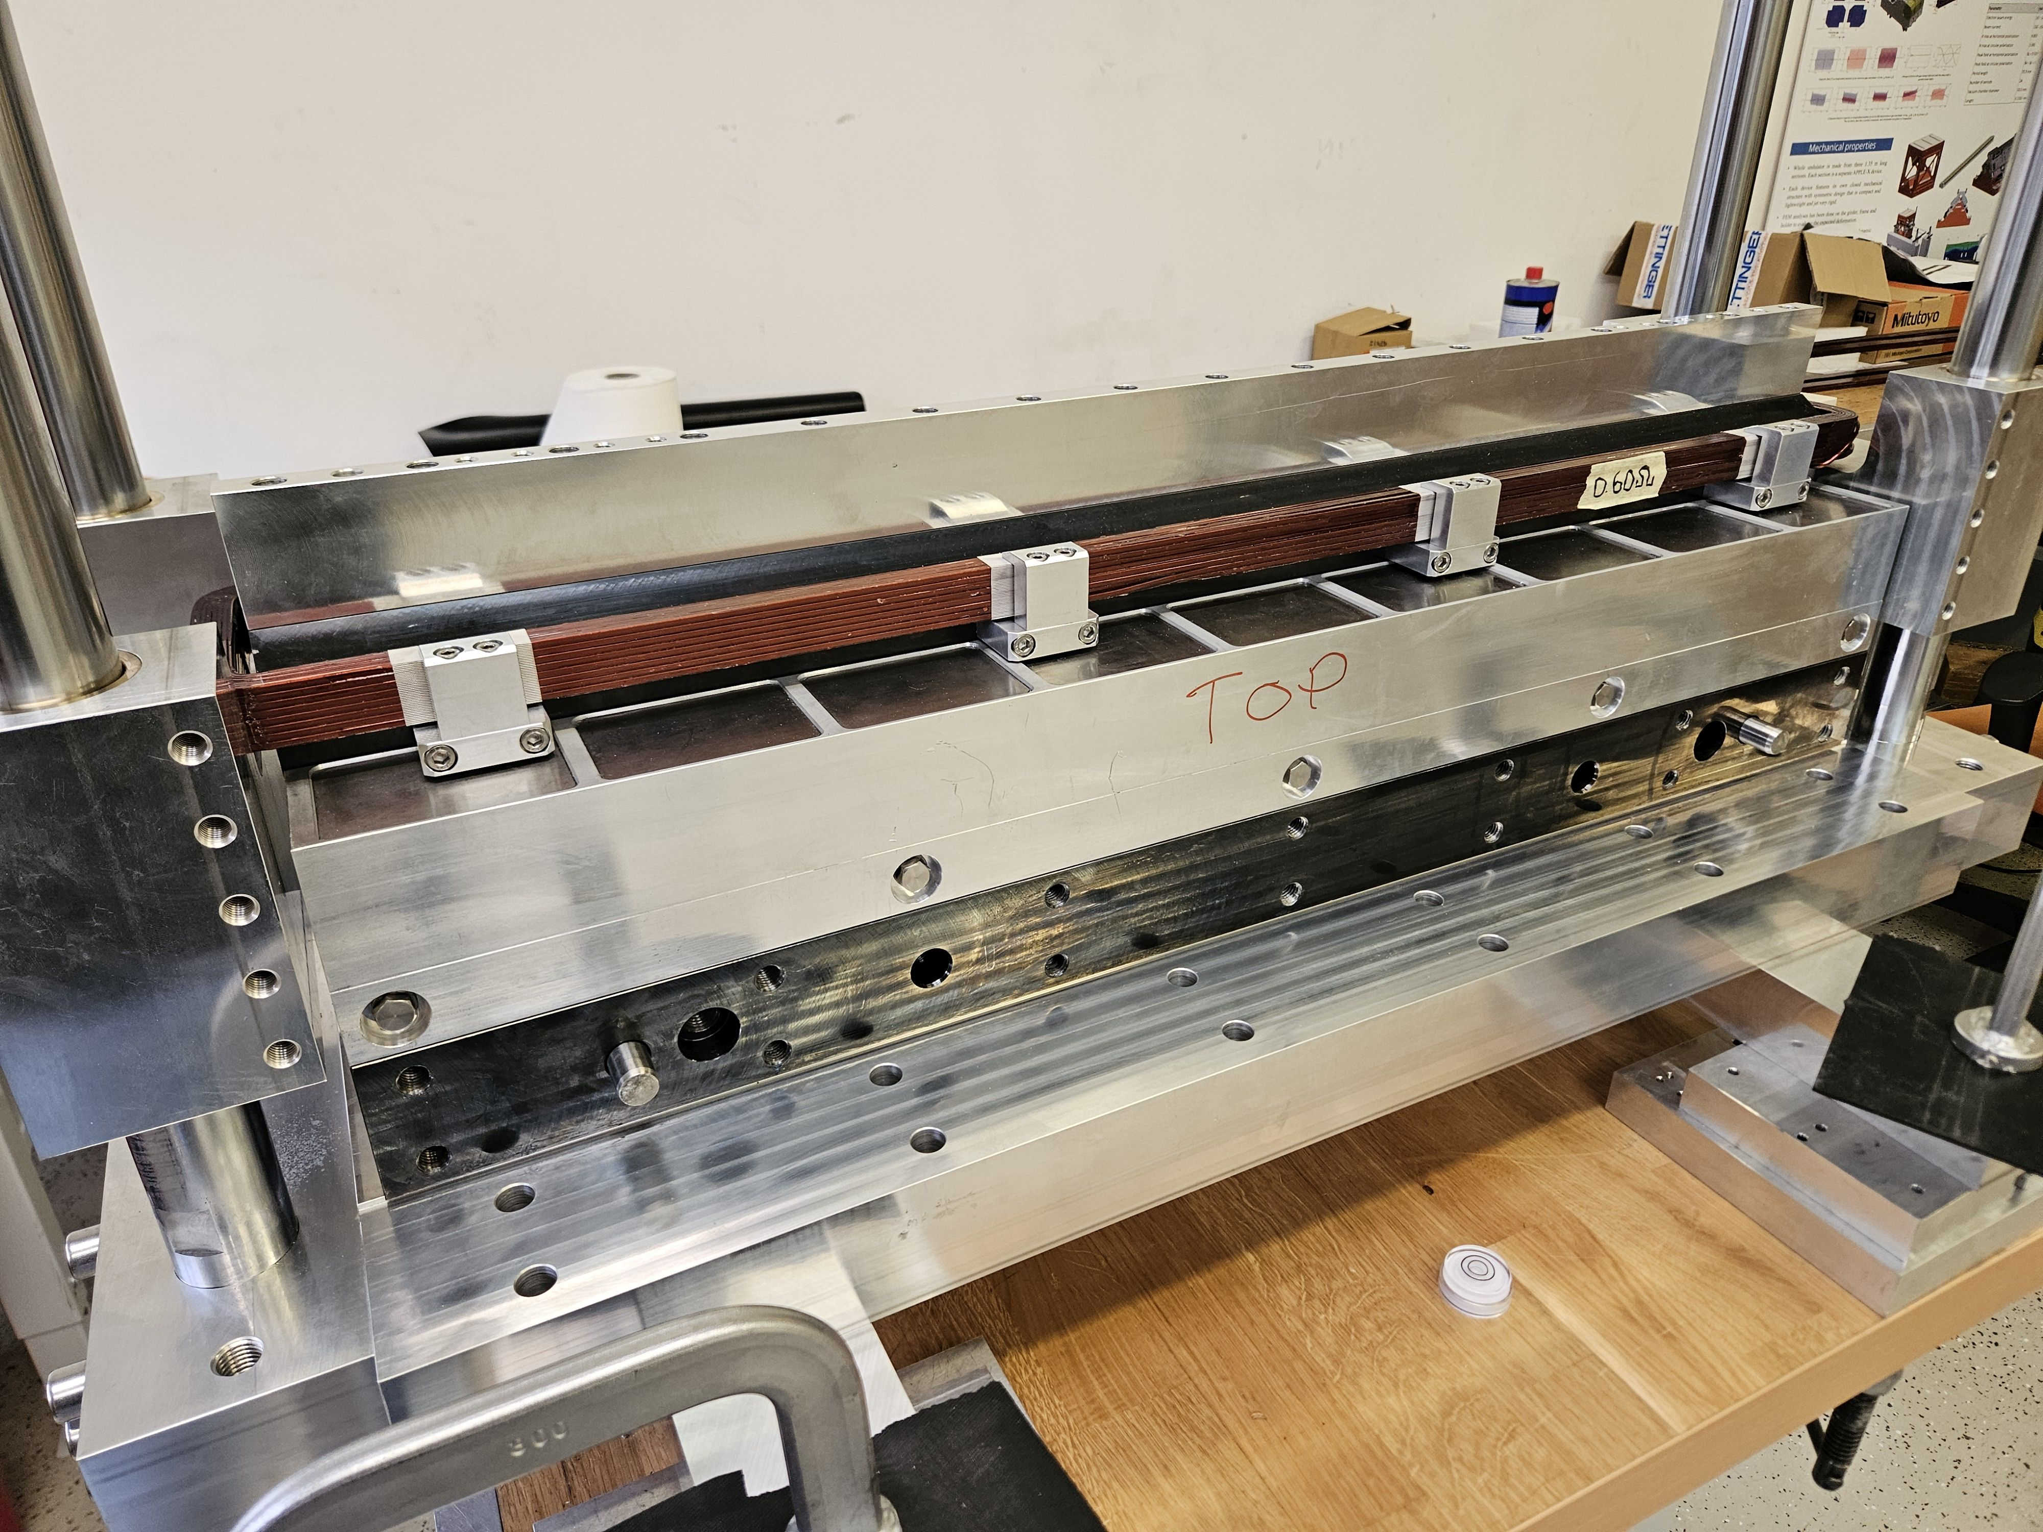
Assembly
Thermal shunt sheets glued to magnet blocks.
Middle magnets glued into tray.
Side magnets glued into tray.
Main pole inserted.
Main pole and magnet carriage bolted to top plate.
Mount trim coil on main pole.
Repeat for second girder.
Mount both girders to backplate.
Mount auxiliary poles.
Notes:
Finally, the coil is mounted around the main pole.
That’s one girder completed, have to do the same for the other girder!
Both girders have now been built.
Next steps are to mount the girders to the backplate, then mount the auxiliary coils.

Slide 19
Assembly
Thermal shunt sheets glued to magnet blocks.
Middle magnets glued into tray.
Side magnets glued into tray.
Main pole inserted.
Main pole and magnet carriage bolted to top plate.
Mount trim coil on main pole.
Repeat for second girder.
Mount both girders to backplate.
Mount auxiliary poles.
Final magnet assembled and ready for magnetic measurements.
Notes:
Final assembled magnet will look like this – ready for testing.

Slide 20
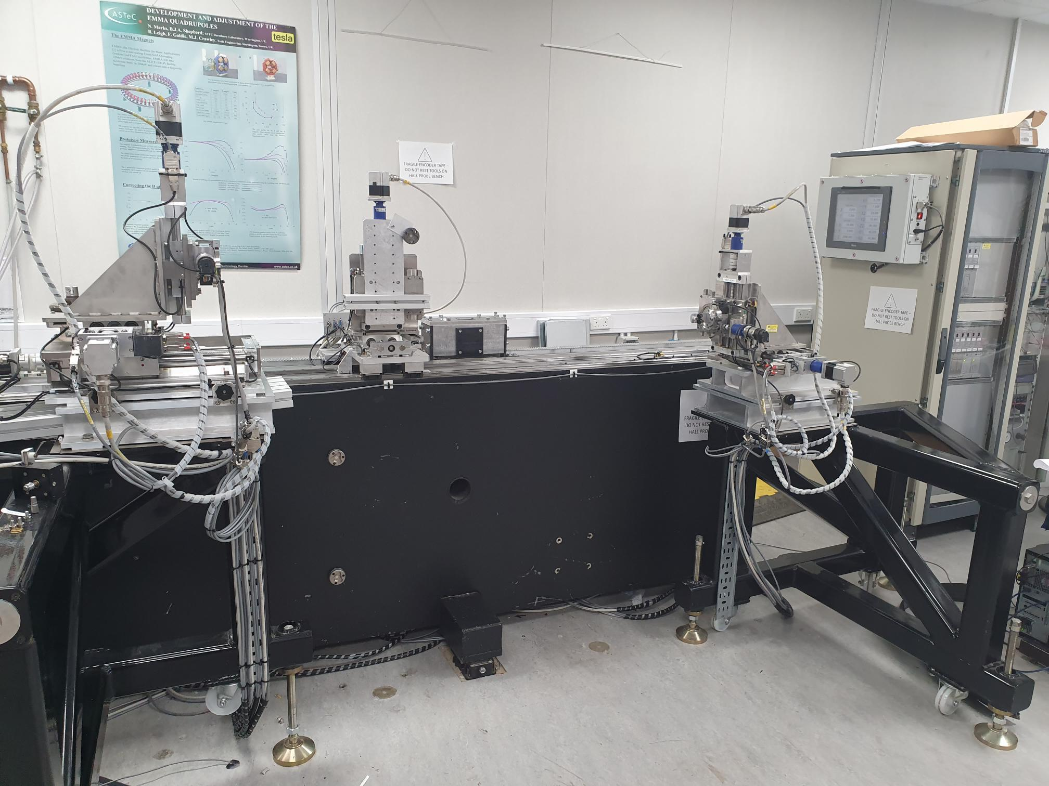
Magnetic Measurements
Hall probe mapping
Stretched wire integral fields
Prototype magnet will be shipped to Daresbury Laboratory for magnetic measurements and to verify performance with respect to equivalent EM:
Strength and homogeneity of field.
Trimming of field homogeneity using novel mechanical shimming methods.
Tuning range afforded by low-power trim coils.
Thermal stability with thermal shunts.
Notes:
Magnet will be shipped to DL for magnetic measurements.
Purpose of measurements is to verify the magnetic performance is equivalent to the EM and demonstrate unique features.
Show effectiveness of mechanical shimming – measure homogeneity, shim, re-measure iteratively
Will demonstrate tuning range achievable with low-power coils
Can measure stability of field with small fluctuations in temperature
Capabilities in lab – mapping with Hall probe (including BEM), stretched wire for integrated field measurements

Slide 21
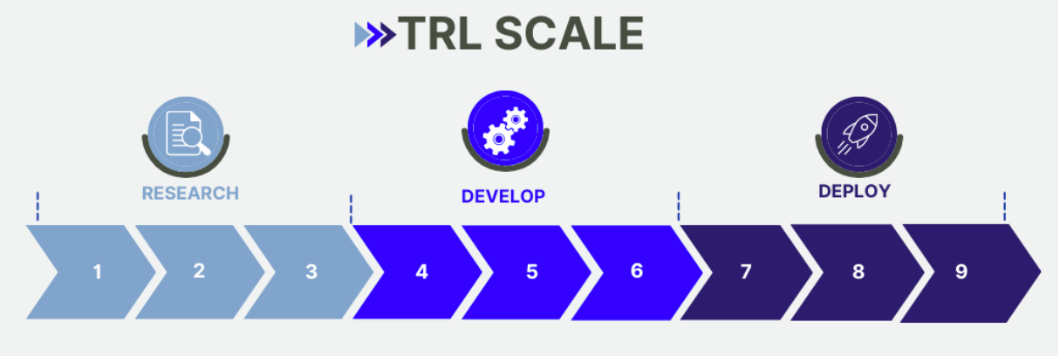
Outlook
Work ongoing to build and test prototype permanent magnet dipole-quadrupole with parameters aimed at Diamond-II.
Device designed to provide same bending and focussing strengths with 47 W maximum power – reduction from 21 kW nominal power.
Mechanical shimming in-built for correction of field homogeneity.
Verification of performance from magnetic measurements required.
Future work required to develop technology readiness level.
Potential future work / applications:
  Prototype built based off lessons learned?
  Testing of prototype on Diamond?
  Further development of PM technology – focus on manufacturing and shimming of tolerances?
  Series production for replacing all EM DQs on a future light source?
Notes:
Work is ongoing to build prototype PM designed as energy saving alternative to Ems
Milestone is not complete until magnetic measurements are done.
TRL around 4 – working on building prototype in lab.
What is future of technology – develop on success(?) of his project.
Build a second prototype if needed? Testing of prototype online on an accelerator (like ZEPTO-Diamond)? Series production of HEPTO magnets to replace all EMS on a machine?
Not going to happen for Diamond II, but somewhere else?

Slide 22
Thank you
Acknowledgements:
Ben Shepherd (STFC)
Dušan Topalović, Jure Počkar, Tadej Milharcic and Mirko Kokole (Kyma)
Alfie Shahveh (Diamond Light Source)

