Slide 1
Ultra-low emittance rings
WP7 - Task 7.2
Riccardo Bartolini, DESY
I.FAST 4th Annual Meeting, Krakow, 10.04.2025

Slide 2
Outline
Scope of WP7 and Task 7.2
Ultra-low emittance rings network
latest developments
summary of IFAST activities in Task 7.2
Conclusions and future work

Slide 3
WP7: high brightness accelerators for light sources
Scope: WP7 pursues the R&D on new technical solutions for the design and construction of accelerator-based light sources, exceeding the performance of present machines. The research embraces both storage ring based synchrotron light sources and free electron laser driven by Linacs.
Supporting
R&D and prototypes on cutting edge technological aspects,
Magnets (7.3 Y. Papaphilippou)
C-band Guns (7.4 D. Alesini) 3 dedicated talks
X-band RF cavities (7.5 G. D’Auria)
networking activities on ultra-low emittance rings (7.2 A. Mochihashi)

Slide 4
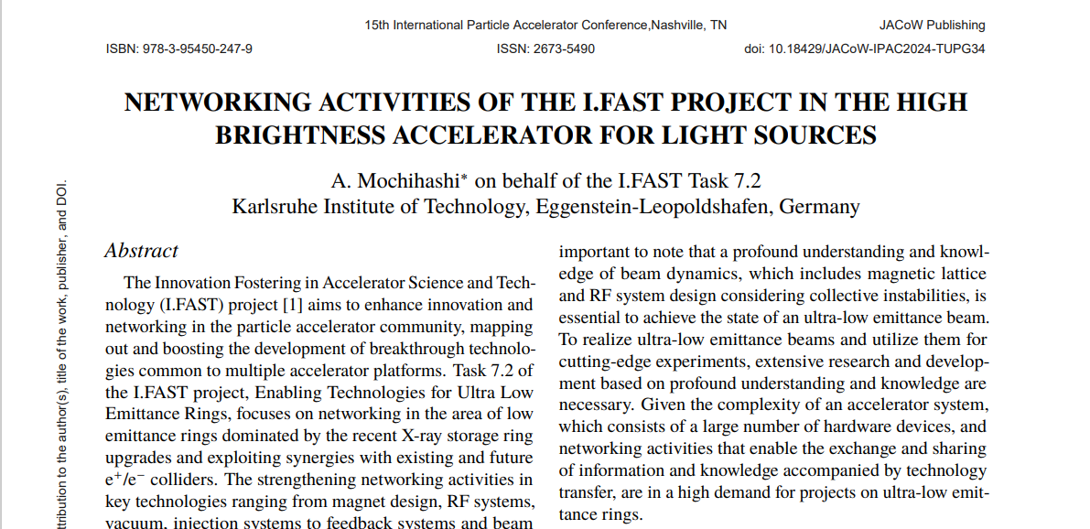
Networking in the ultra low emittance rings community
The WP7 in Task 7.2 will continue to foster and disseminate the latest development in accelerator technology of ultra low emittance rings serving a large and ever growing community in EU and worldwide: workshops + visits and beam tests + reports

Slide 5
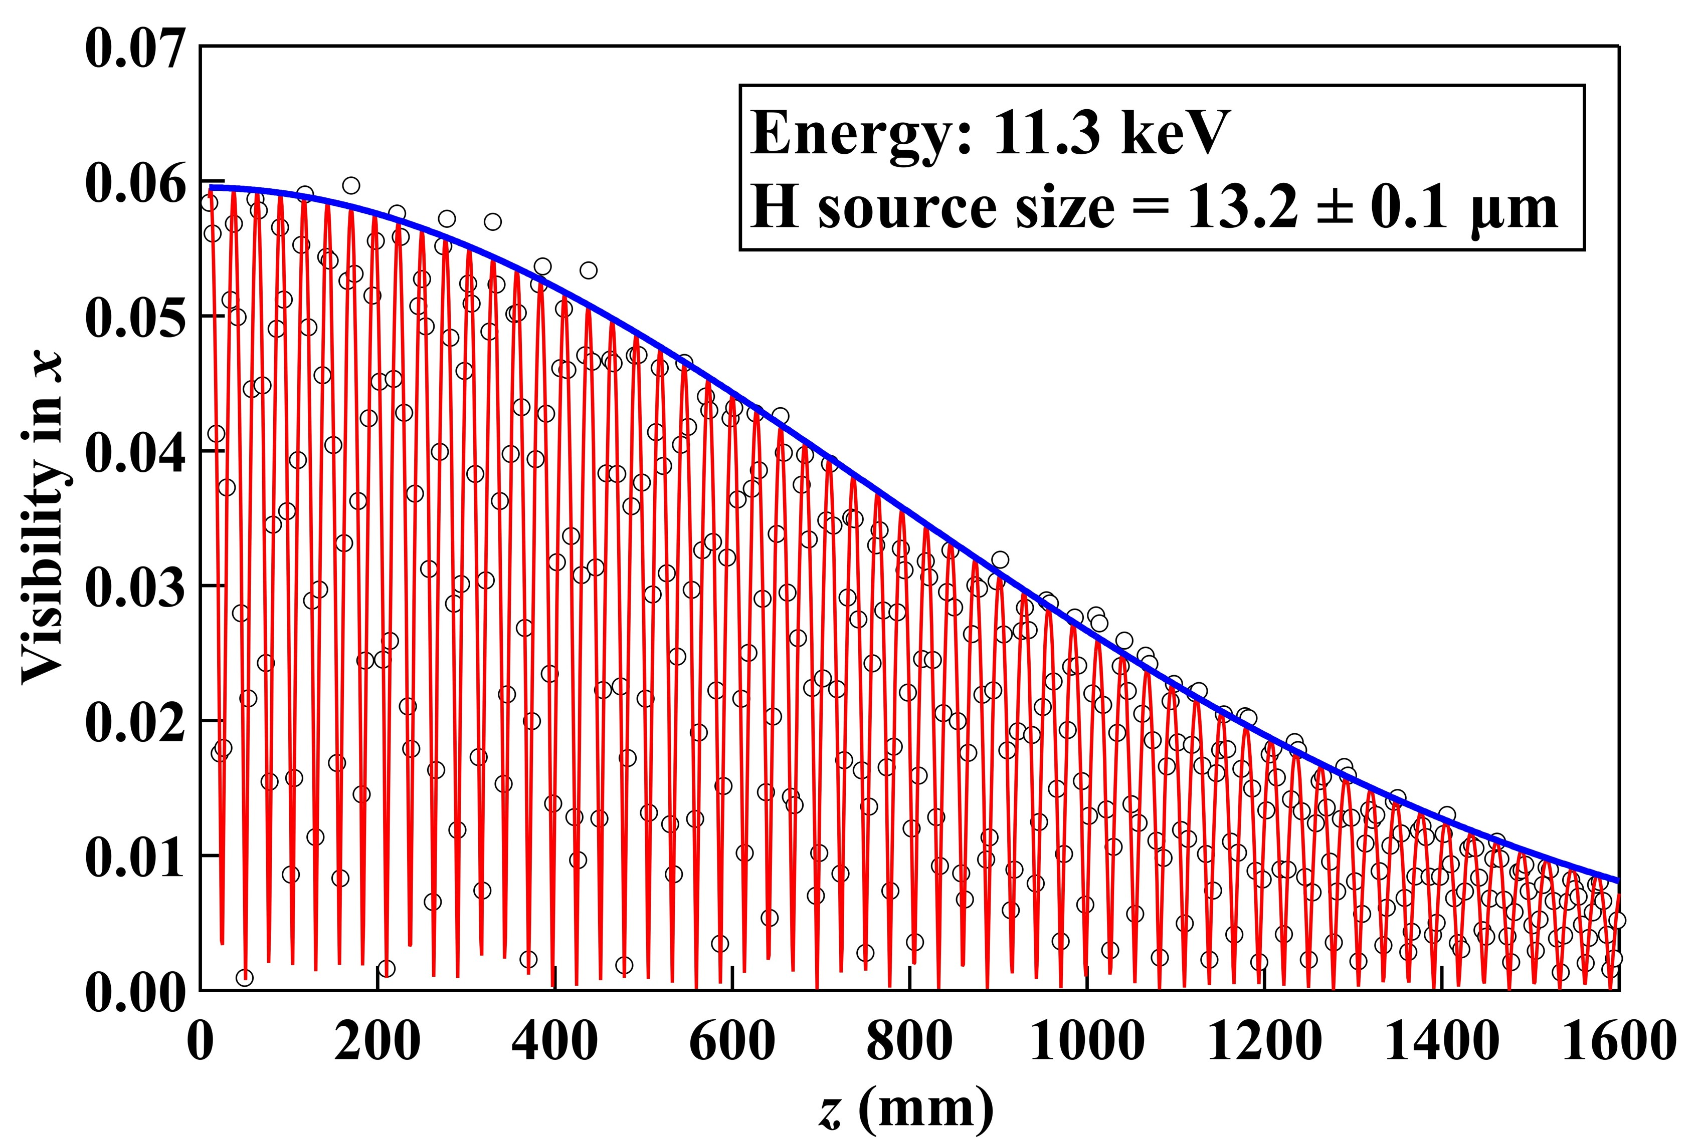
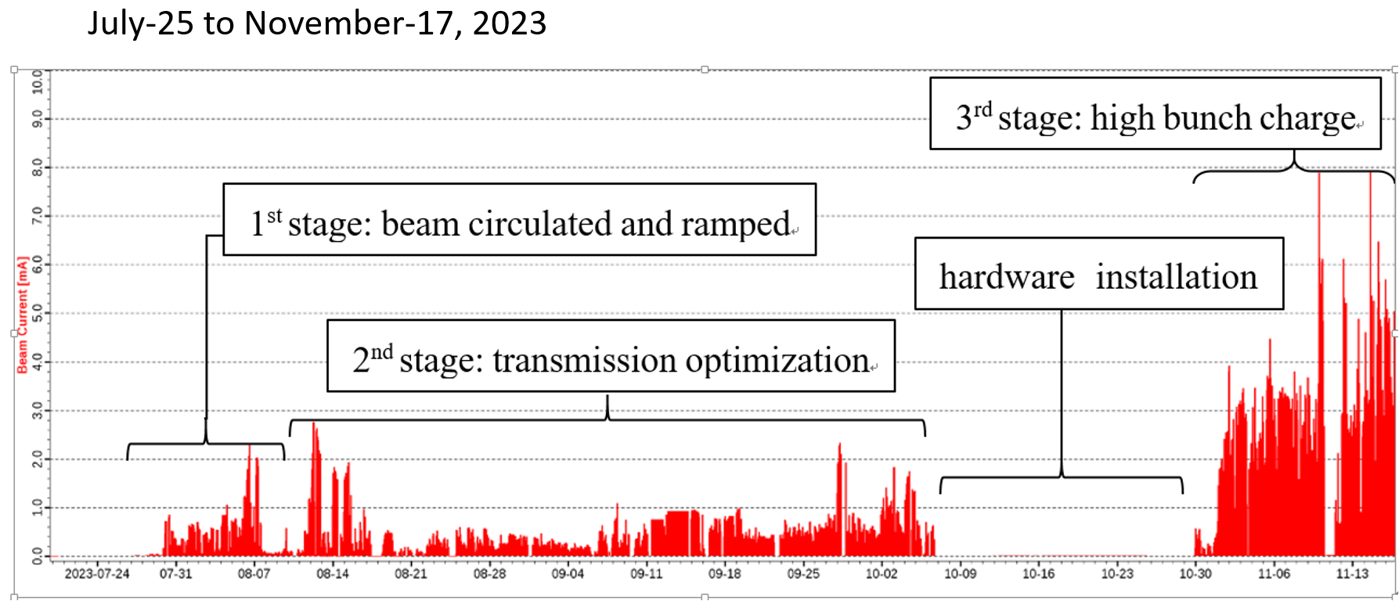
Harvesting successes with the projects launched in the last years
APS-U (Argonne, USA)
First stored beam April 2024
Nominal optics August 2024 (42 pm)
Nominal current 200 mA February 2025
working to reach specs in timing mode
HEPS (Beijing, China)
First turn August 2024
emittance larger than expected 75 pm vs 35 pm
40 mA in December 2024
current limited by RF system installed

Slide 6
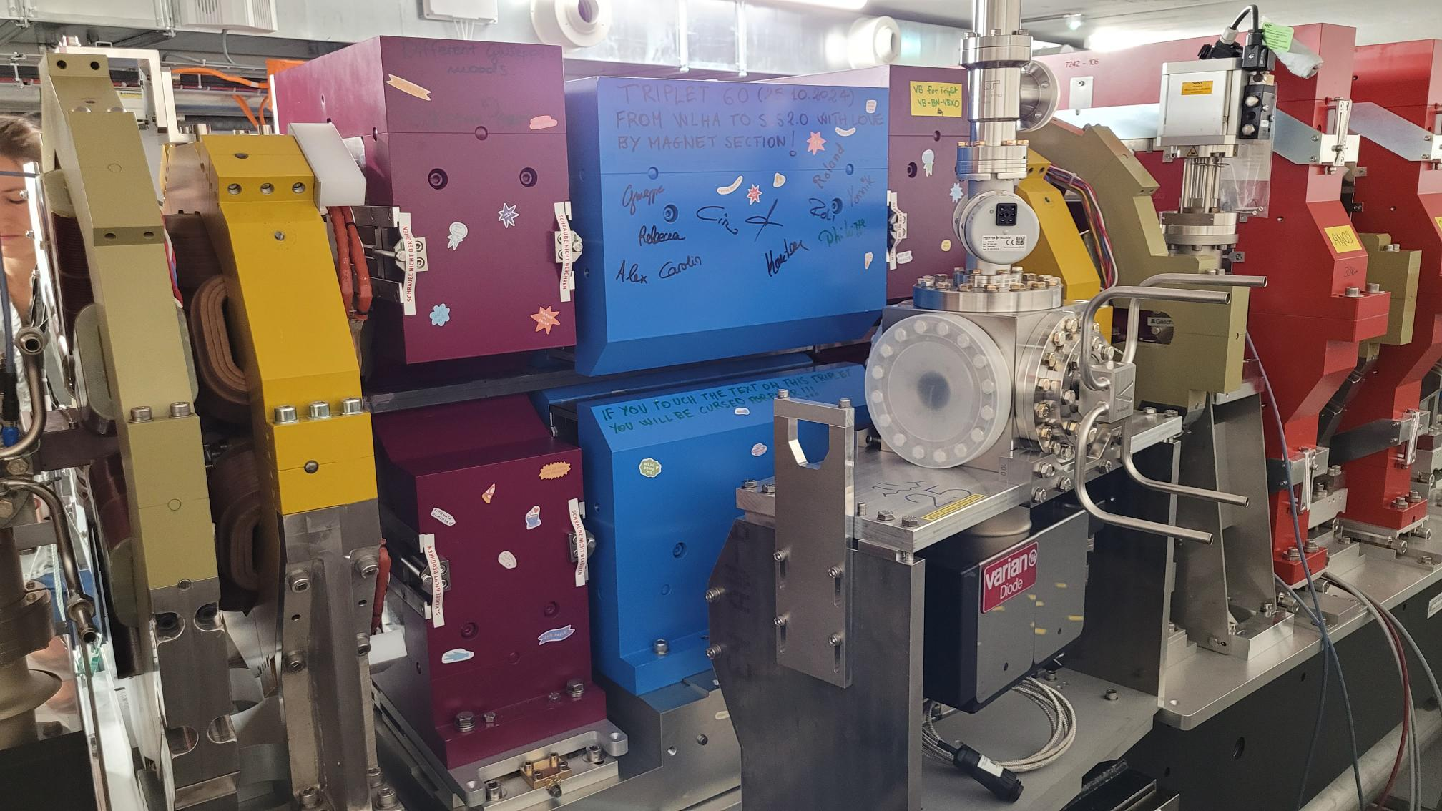
Harvesting successes with the projects launched in the last years
SLS-II (PSI, Switzerland) see R. Ganter talk
first stored beam January 2025
optics corrected (130 pm)
full current 400 mA April 2025
extensive use of permanent magnets (also for quadrupoles)
reduction of the energy consumption despite increase in operation energy
(from 24 GWh/year to 17 GWh/year from 2.4 GeV to 2.7 GeV)
Several other upgrades under construction
Elettra 2.0 in shutdown July 2025
Diamond II in shutdown December 2027
SPRing8-II (50 pm, 6GeV), SOLEIL-II (83 pm, 2.75 GeV), Korea-4GSR (58 pm, 4 GeV) funded
PETRA-IV funding expected 2026, ALBA in prototype phase – both in shutdown in 2030

Slide 7
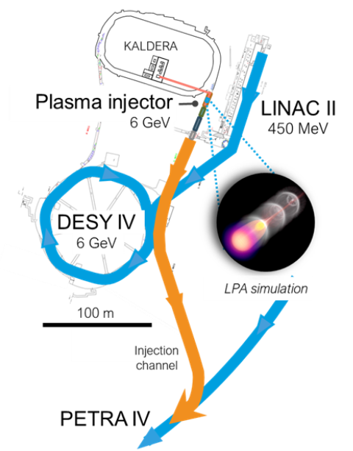
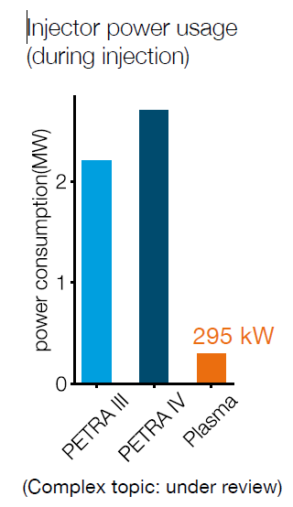
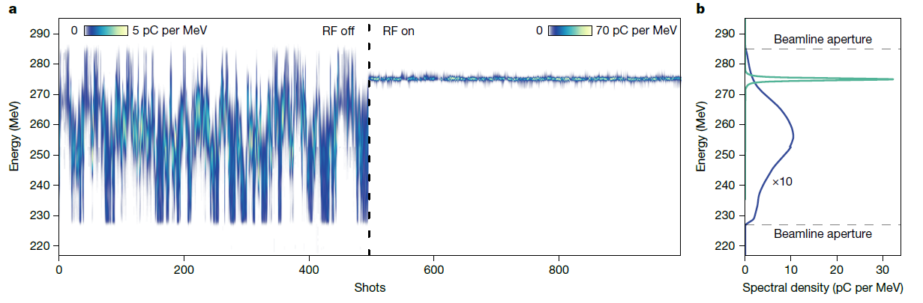
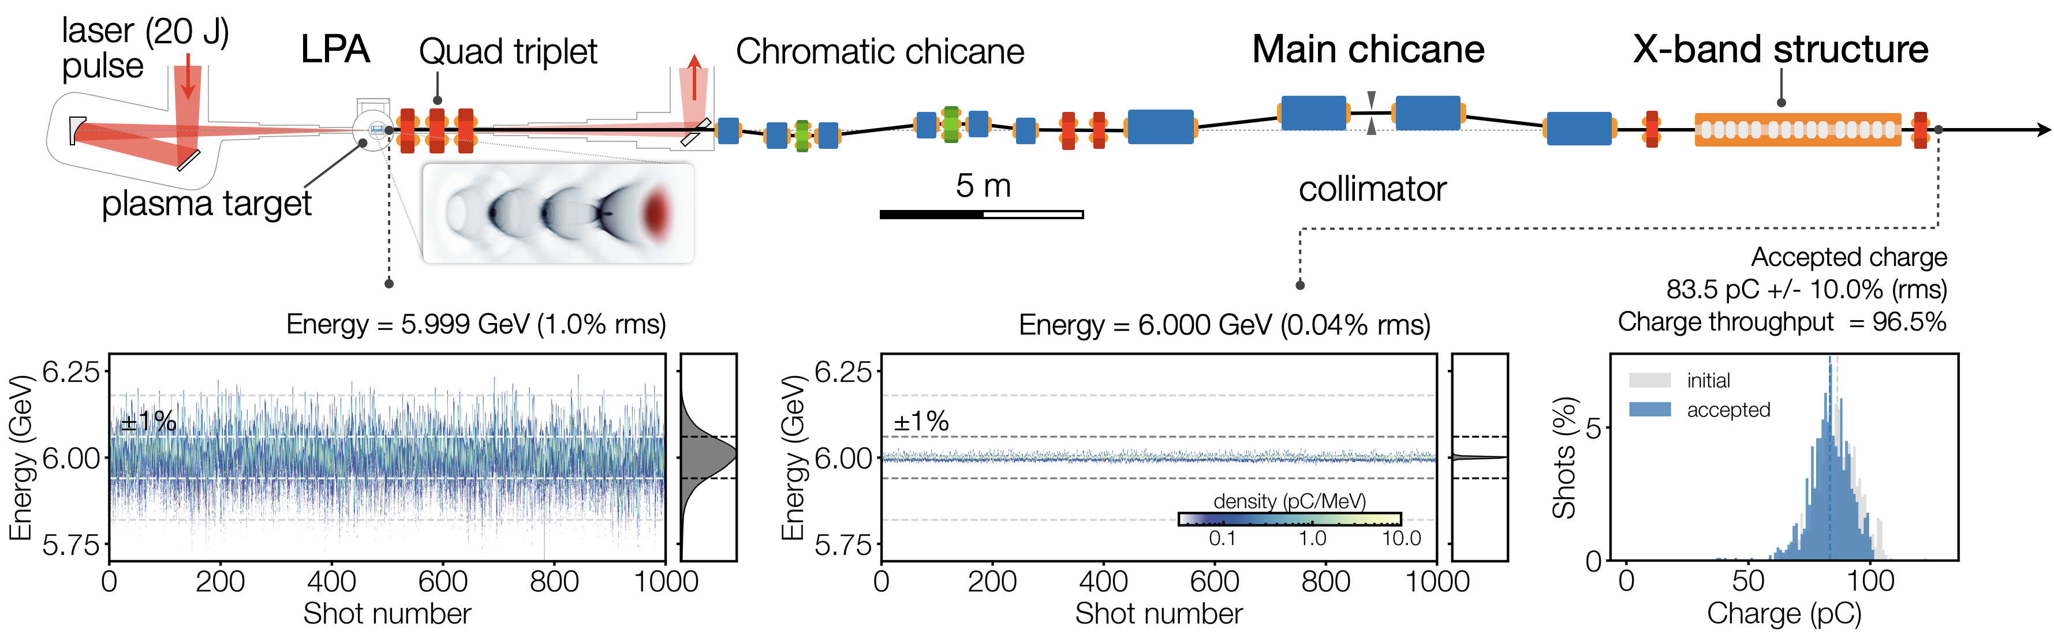
  Alternative options for the pre-accelerator: LPA injector
Building on the strong R&D for the development of LPA at DESY, we propose to build a 6 GeV LPA injector for PETRA IV.
The next 3 years will be focused to the demonstration of high quality beam suitable for high efficiency injection in PIV AND high reliability of the injector
Challenges addressed with the RF dechirper experiment at LUX DESY and 450 MeV injection in DESY II by mid 2026
published on Nature yesterday
Simulations courtesy
A. de la Ossa, S. Antipov

Slide 8
Latest activities in Task 7.2
Activities organized/supported in fourth year:
17th-20th September 2024 (PSI, Bern): topical workshop on Longitudinal Electron beam Dynamics for Coherent Light Sources (LEDS 2024). https://indico.psi.ch/event/15973/
17th-19th March 2024 (KIT, Karlsruhe): topical workshop on Stability of Storage Ring based Light Sources https://indico.scc.kit.edu/event/4809/
20th-20st March 2024 (KIT, Karlsruhe): beam measurements campaign at KARA to test procedure for Beam-Based Alignment and beam based stability data.
In preparation
August 2025, (TBC), 10th Low Emittance Ring General Workshop
Regular meetings scheduled for Task. 7.2 chaired by A. Mochihashi (KIT)

Slide 9
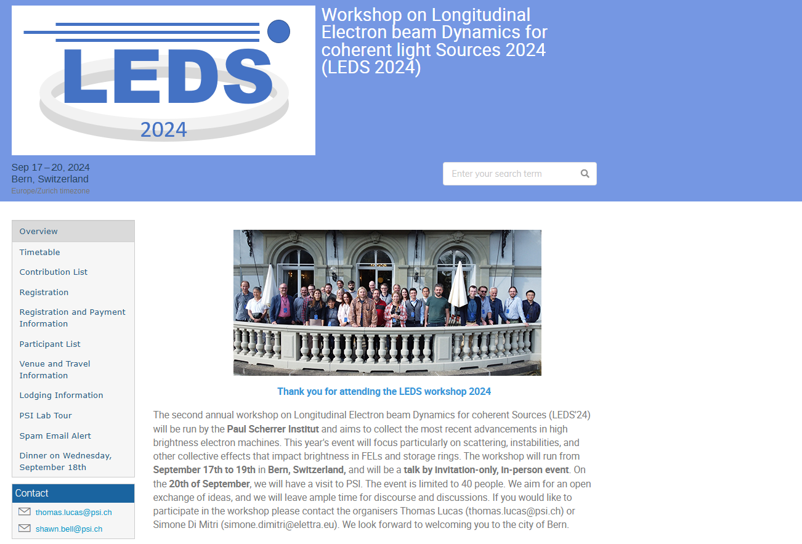
Workshop on Longitudinal Electron Beam Dynamics for Coherent Light Sources
Covering instabilities in high brightness electron beams
both in storage rings and in LINAC/FELS:
IBS, CSR
Steady state microbunching
36 participants
https://indico.psi.ch/event/15973/

Slide 10
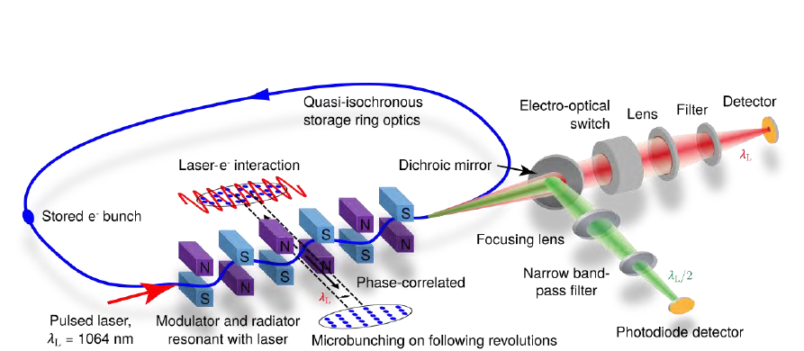
Steady State MicroBunching (SSMB) as a new operating mode for storage rings
Generate coherent radiation from microbunches in storage rings
- longitudinal focusing at optical wavelengths
- Enhance radiation emission in the <10 nm wavelengths
- Ultra small phase slippage required
Proposed so far with pulsed lasers.
Can theoretically be extended to CW operation.

Slide 11
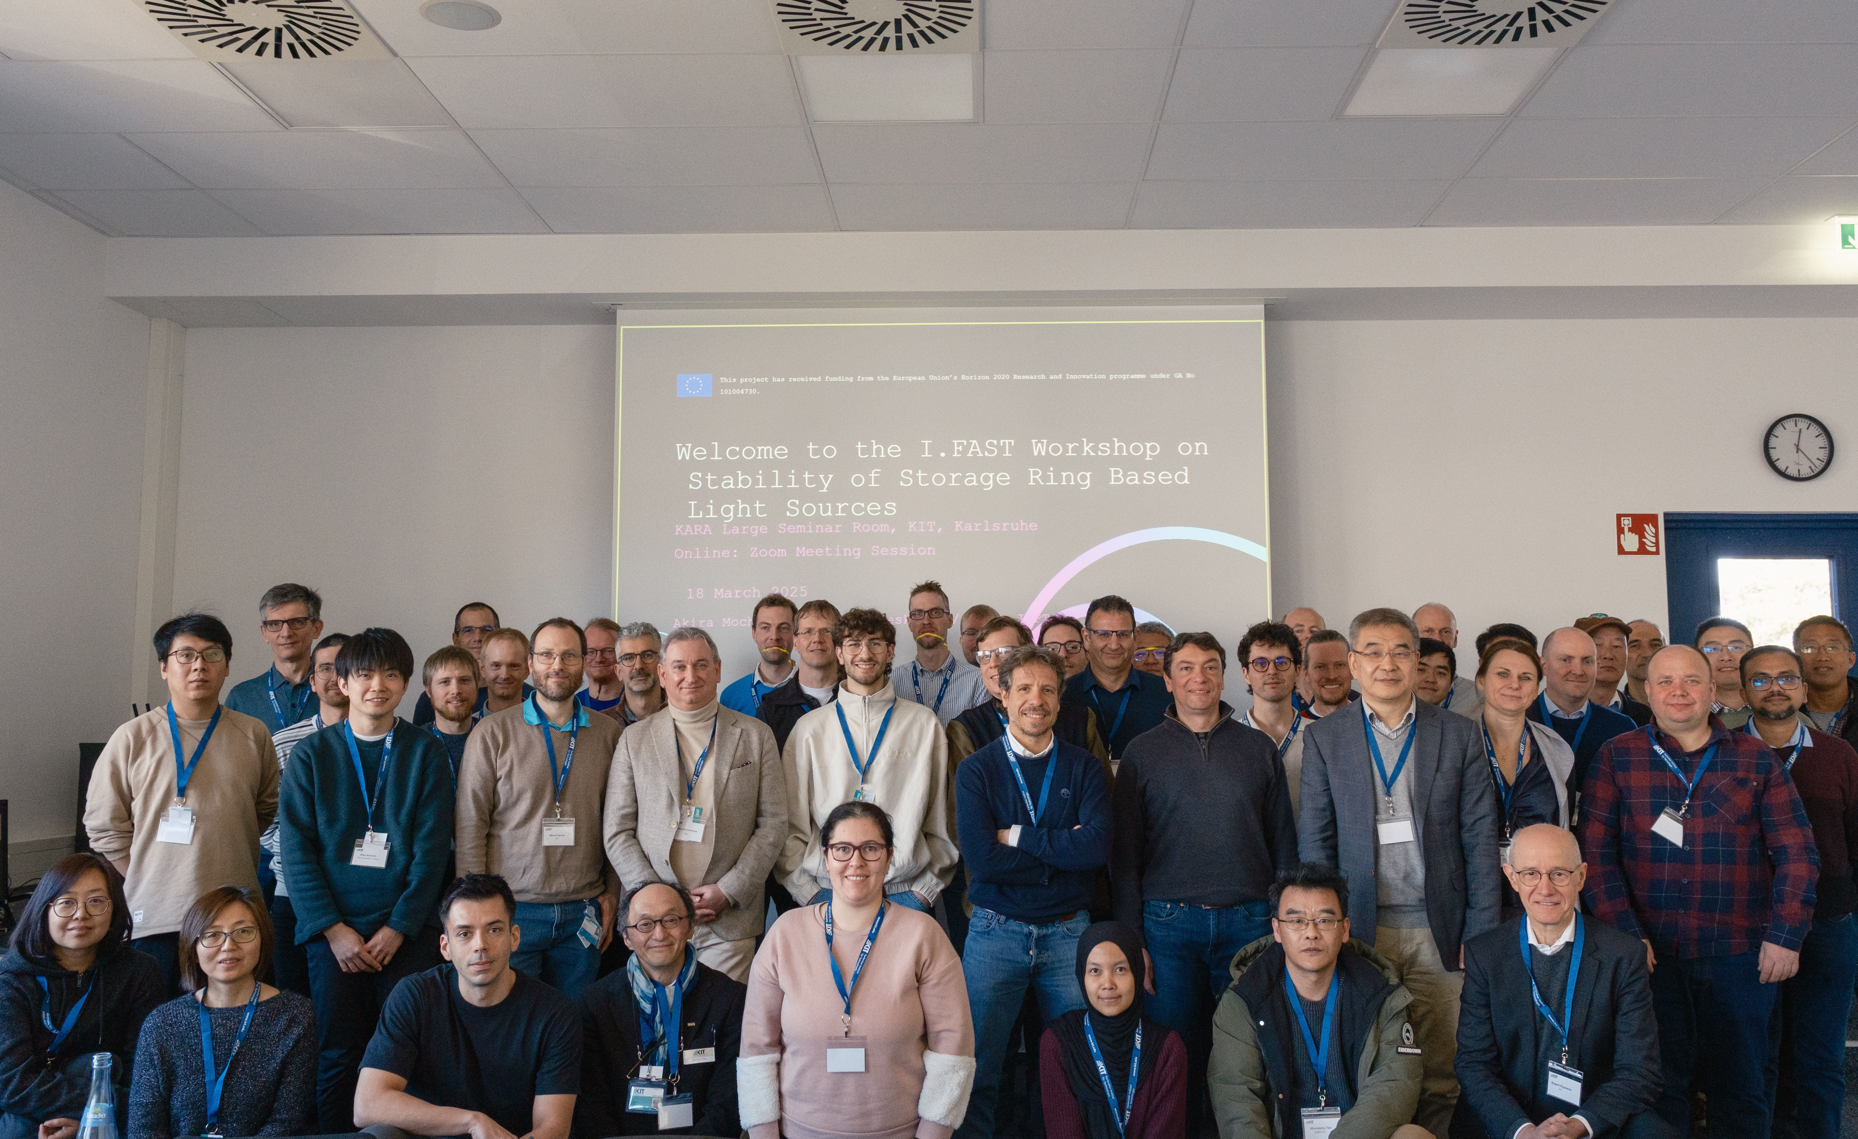
Workshop on Stability of Storage Ring Based Light Sources at KIT
17-19 March 2025: Workshop
20-21 March 2025: Joint Experiment
Joint organization with SOLEIL and KIT
Venue: KIT Campus North
Session blocks:
  Source position stability feedbacks
  Diagnostics (e-BPM and X-BPM)
  Infrastructure for stability
  Challenging issues
Participants:
  Onsite 52 + Online 34 = 86
  Research and industrial areas
  From Europe, Asia Pacific, America
Number of talks: 26
https://indico.scc.kit.edu/event/4809/

Slide 12
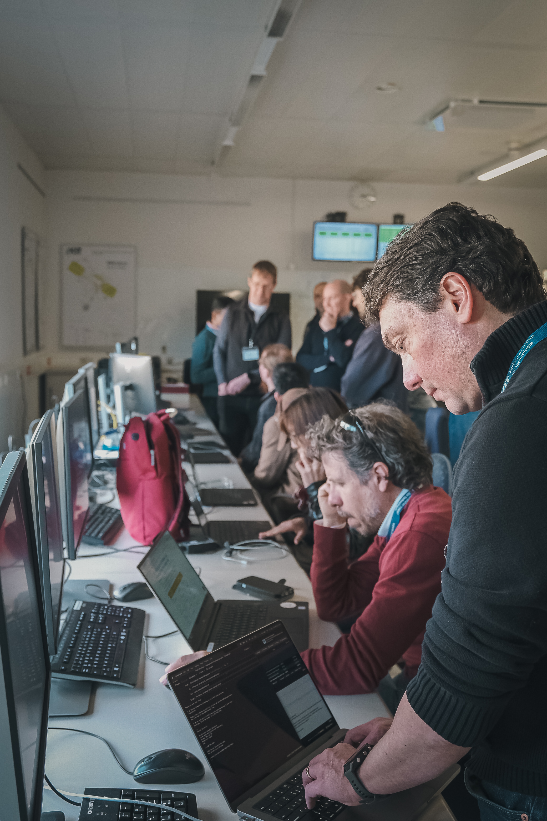
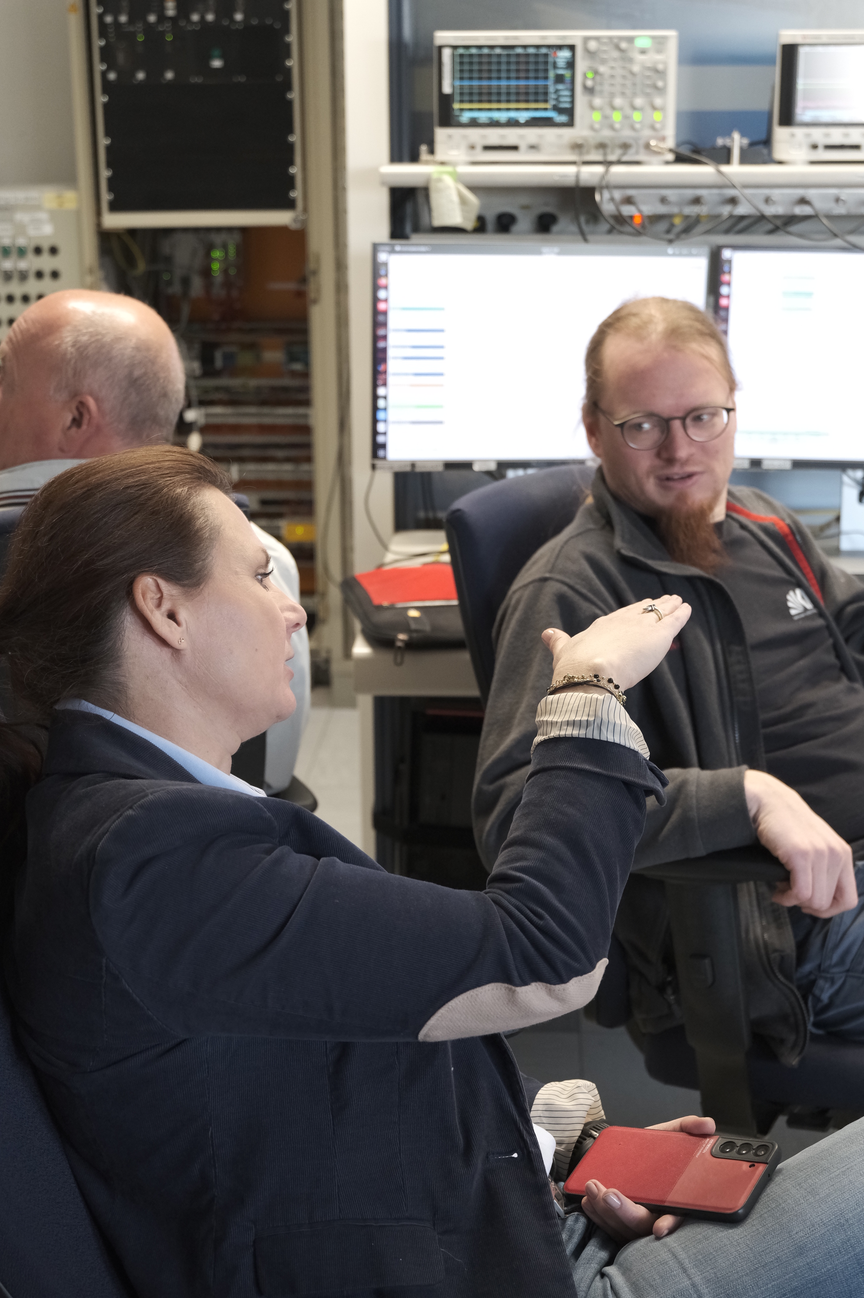
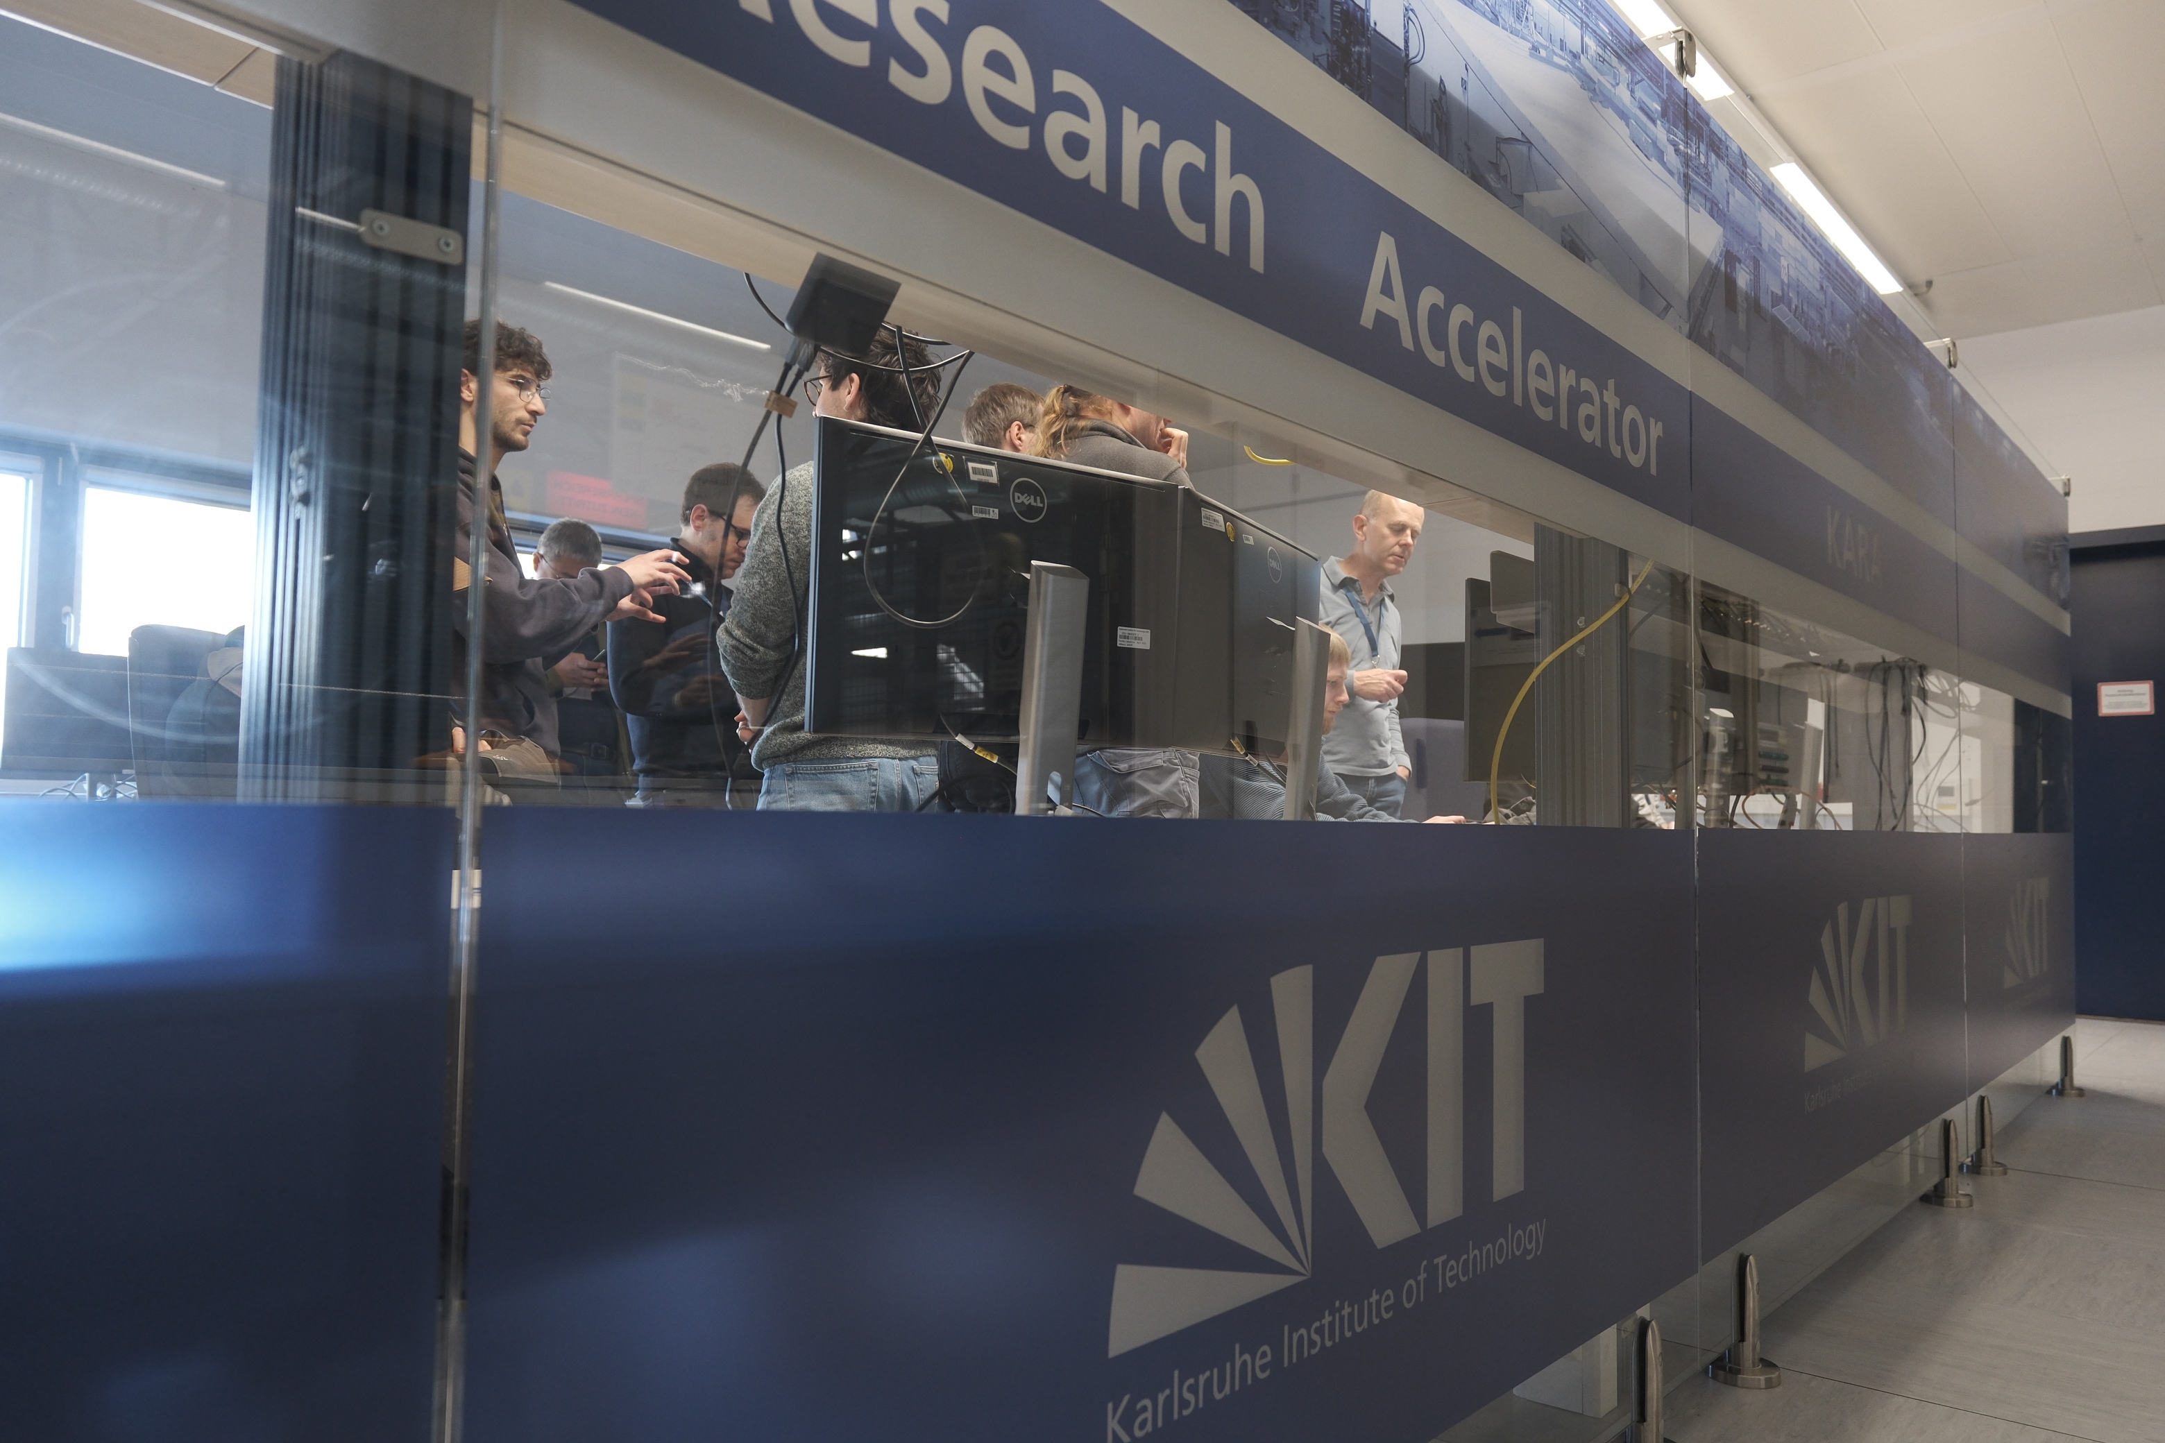
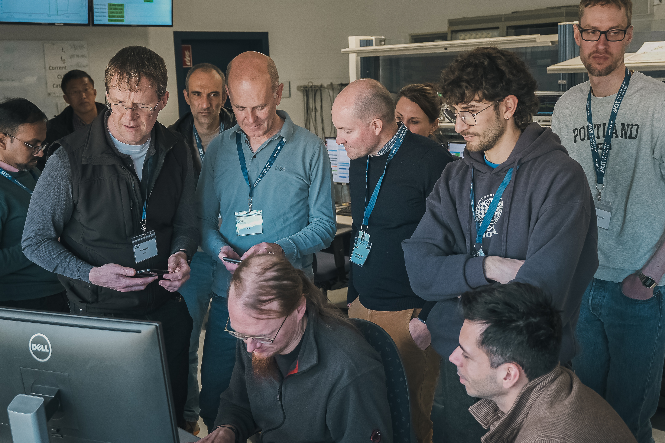
Joint Experiment at KARA
20-21 March: Joint experiment (1.5 days) as a EURO-LABS project activity
  Study on source position stability (beam-based alignment techniques)
  Stability due to changing thermal load
  Workshop participants and I.FASF-WP7 members joined the experiment
  Systematic measurements … the data analysis is ongoing, and the data are being shared with the participants

Slide 13
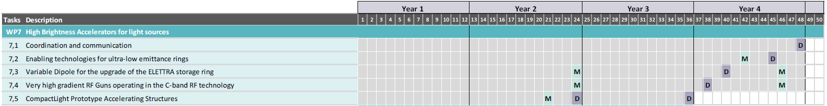
WP7 Task 7.1 and 7.2: milestones and deliverables
MS25 done, D7.2 done; D7.1 in preparation (April 2025)
Other tasks covered in next talks by Y. Papaphilippou, D. Alesini, and G. D’Auria

Slide 14
Conclusions and perspectives
Ultra low emittance ring community is very active with several projects
being commissioned (APS-U, HEPS, SLS II)
funded (ELETTRA 2.0, Diamond II, KOREA-4GSR)
in TDR/CDR phase (PETRA IV, SOLEIL-II, ALBA-II, ..)
WP7 Task 7.2 has supported and fostered interactions in the community of ultralow emittance rings in the last 4 years, with about 15 workshops and experimental sessions
Aim to conclude the series of workshops with the:
10Th general low emittance ring workshop (location TBD)
before the end of the I-FAST project.

Slide 15
Thanks A. Mochihaschi (KIT) and Y. Papaphilippou (CERN)
Thank you for your attention!

