Slide 1
From high-tech ideas to start-ups, an experience from Switzerland
Elena Benedetto
Fondation Tera-Care
AND also at (*)
University of Geneva
PlanetS Technology & Innovation Platform - Executive Officer
(*) for the next 20 min, I won’t talk about medical accelerators!

Slide 2














NCCR PlanetS the🇨🇭consortium of exo-planetary scientists
"PlanetS – Origin, Evolution and Characterisation of Planets"

Slide 3
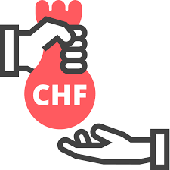


NCCR PlanetS the🇨🇭consortium of exo-planetary scientists
"PlanetS – Origin, Evolution and Characterisation of Planets"
12 y of Science
Impact: Development of Knowledge & Technology

Slide 4
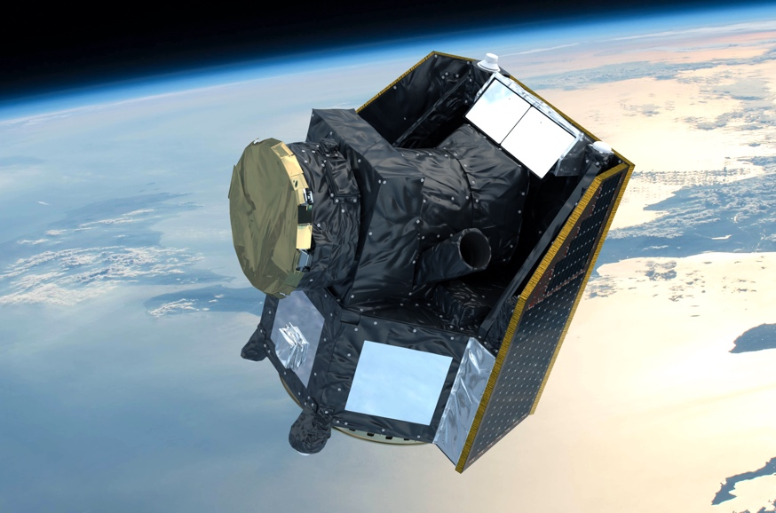

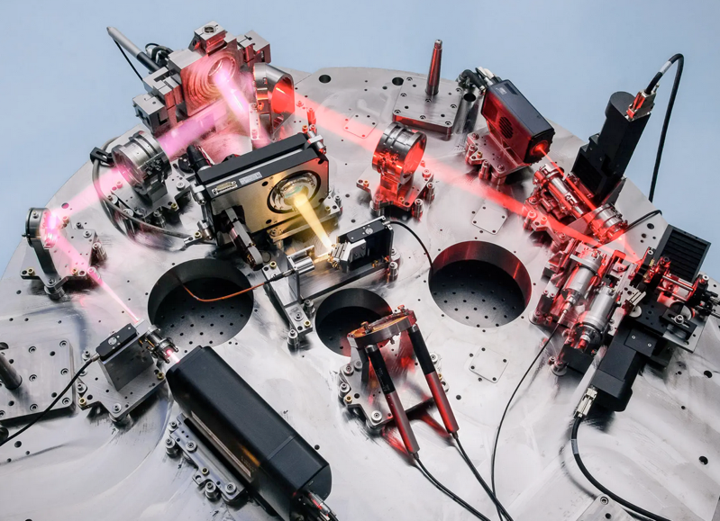

NCCR PlanetS the🇨🇭consortium of exo-planetary scientists
"PlanetS – Origin, Evolution and Characterisation of Planets"

Slide 5

The Technology & Innovation Platform connects Academia w. Industry
Seed-Funding
Transferring Knowledge
Industry engagement:
Events / Alumni / Booth @ conferences / Swiss-ILO support/…
Exploring startups
Businnes training / Events/Success stories
Innovation Fund
Academia – Industry Exchange

Slide 6
Networks
Join forces with other NCCRs (tech, life science, pharma…) to offer to the Swiss researchers
1 week hands-on workshop
on Startup creation
complementary to other initiatives (Innosuisse)

Slide 7

The bench2biz workshop
Target:
Scientists, engineers with an ~idea (product, tech., research result.…)
Goal:
determine if the idea has enough commercial potential to deserve additional effort: go/ no-go.
and learn how to take the next steps.
Format:
Organized in CH for the last 12 years: in-person, on-line, hybrid.
24 hours over ~1week hybrid (but 2.5days retreat also successful)
7-minute™ lectures + 53 minutes of work in a team: time limit!
Pre-Seed Workshop

Slide 8
Workshop: What happens?
Multiple idea-teams are formed, ahead of the workshop
Each team has an «idea champion», a coach, and a set of experts to help develop & assess the idea.

Slide 9
Generic Agenda Layout
Welcome
Team & tech intros
The Road...
Meet your team
Determine workflow and workflow roles
Break out sessions
Technology, IP, the product, the “pain”, value proposition
7min lecture, 1h work
Break out sessions
Business model, timeline, revenues, competitors, …
Kick-off Event
Homework assigned
Day One
Critical validation
Day Two
Asynchronous teamwork
Thicken topics from break-outs
Supplemental content (optional)
© 2006-2024 Neworks, LLC
Break out sessions
Big Picture
Team presentations
Asynchronous teamwork
15 slides based upon break-outs
Expert & peer feedback
Entrepreneurial traits
Are you an entrepreneur?
Who is in your team?
Finalize critical thinking
Prepare to present
Where do you go
from here?
Day Three
Day Four

Slide 10

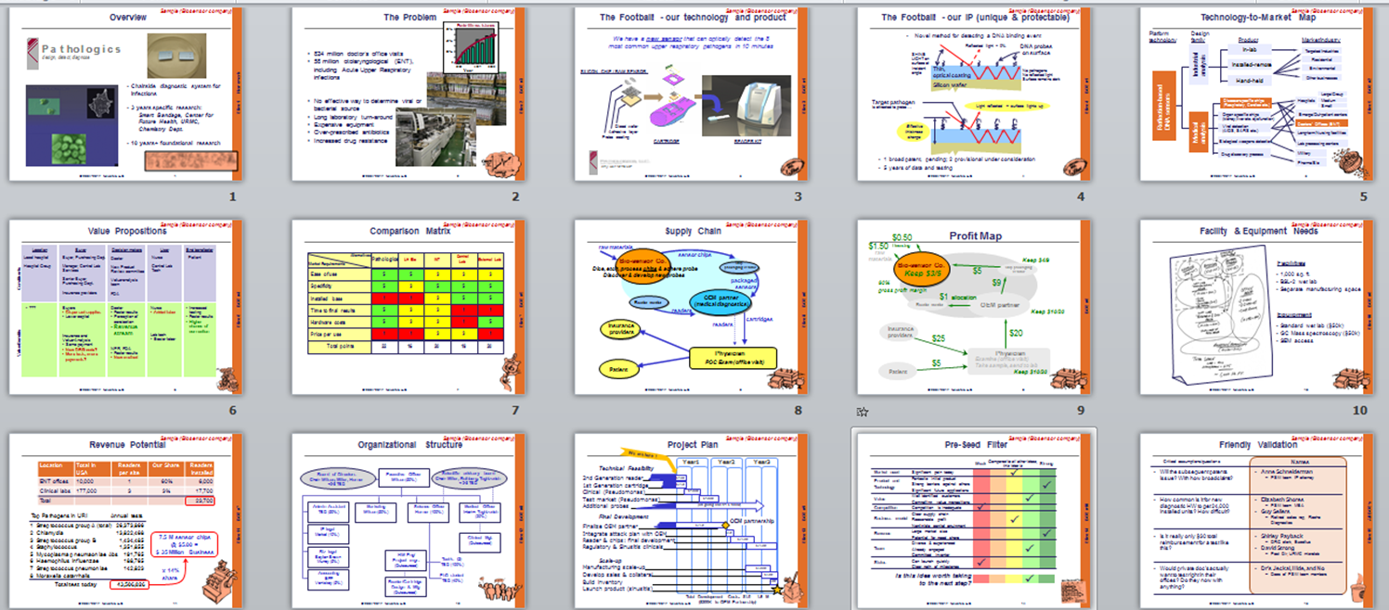

This is Critical Analysis:
  Not “Sales Pitch” !
Break-Out Session conclusions become a 20 minutes presentation on Day Four
Yes, it’s rough. Perhaps “wrong”. Perhaps “Stop!”
Certainly will change going forward.
But now the Idea Champions know critical business questions and how to tackle them!
© 2006-2024 Neworks, LLC
The Workshop
Early-stage ideas
A thin commercialization plan
© 2004 Neworks, LLC

Slide 11
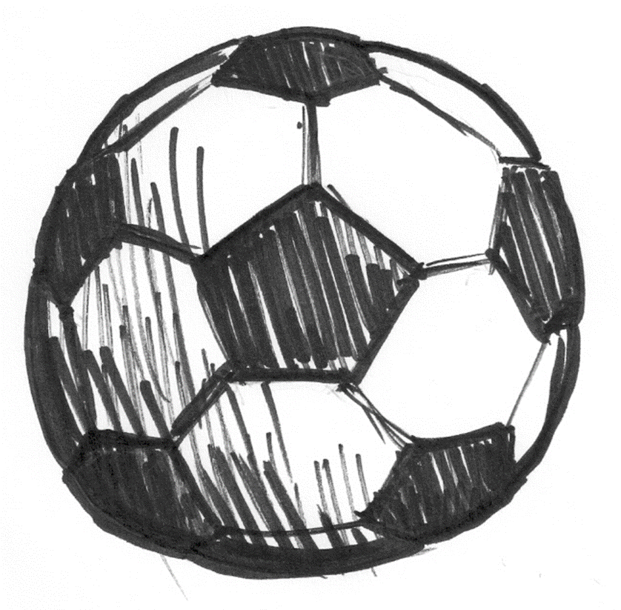
What is YOUR core technology?
BOS#1
Think dinner party!
3-4 bullets
1 or 2 sentences
Less than 30 words
Describe the basis of your technology
“We have an homogenization process
that makes drugs dissolve better:
We crush powders smaller and
our coatings keep them smaller!
“We make filters for cell phones that match today’s quality specification …
...but are only 1/1,000th the size.”
© 2006-2024 Neworks, LLC
“We have a new biosensor that can detect the 8 most common upper respiratory pathogens in 10 minutes.”
Notes:
First, you need to describe your technology in simple terms.
Think about a family celebration. You’ve got a whole bunch of people around that you haven’t seen for a while. Your sitting next to one of them who happens to be an artist, very well known for watercolor painting. Knows absolutely nothing about your really cool technology; or any kind of technology for that matter.
That’s the perfect person to test your description!
They might help you more than anyone else early on, because they are going to force you to explain the basics of your technology in very simple snippets that orient us to the kind of technology that’s behind your idea.

Slide 12

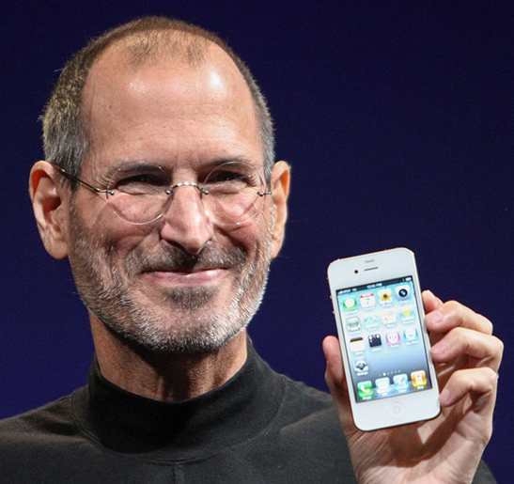
What is YOUR product?
BOS#1
If you can’t draw it, you can’t sell it!
Gotta’ think: NOUN
    What do we actually give to our customers?!
You can describe it, but...
      You need a PICTURE of your product
© 2006-2024 Neworks, LLC
“THIS is my product.”
Notes:
Second, you need to draw a picture of your product.
And I mean, we literally want to see a rough hand sketch; or a photo-shopped picture of a similar product, or a clunky graphic.
If you can’t show a picture of your product, you will not get other people to understand your dream.
Your product will probably change over the course of this workshop.
In fact, most technology companies do not end up launching the product they originally thought they would launch first.
But at any given time you need to be able to show a clear picture of the product you think you will be selling.
Ideally, you can actually show your product (or a mock-up) physically, just like the guy here

Slide 13
…Considerations on start-up creation programs (in IFAST-2 ?)
Learn a different perspective
explain technology to non-experts/ non-tech, …communicate impact
let go of assumptions (and your dream biz) …confront with reality
take ~rapid decisions, from ~incomplete information, on topics you don’t necessarily master…
Power of Network:
(bench2biz) experts from regional ecosystem join ‘’pro-bono’’: to spot promising start-up, collaborations, promote their services, have fun.
idea champions gains a supportive network they can leverage after the workshop
Leverage collective intelligence:
each of the team experts brings her own expertise + common sense
everybody learns A LOT, everybody teaches A LOT

Slide 15
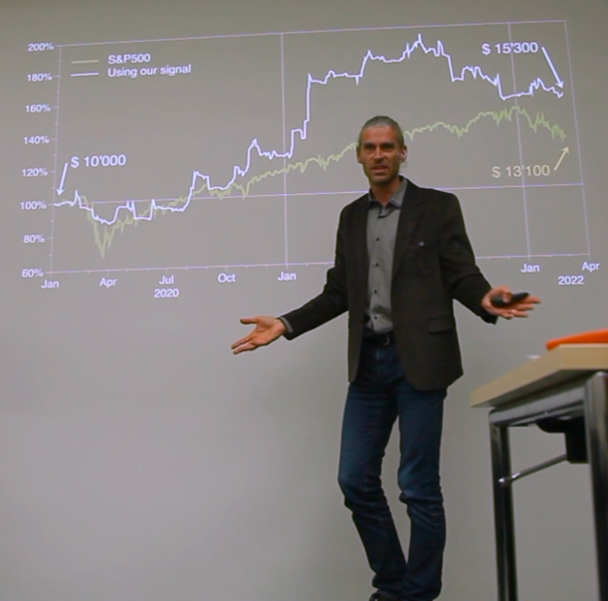

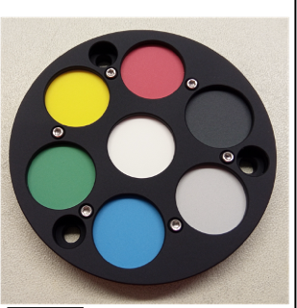
Externships for knowledge transfer
Opportunity
for postDoc to explore opportunities outside academia
for Industry to understand what researchers can bring
Build a Fintech startup
Complications in luxury watches
Proget manager at Micro-Cameras & Space Exploration (MCSE), NE
Notes:
Export
Positive Impact of PlanetS

Slide 16
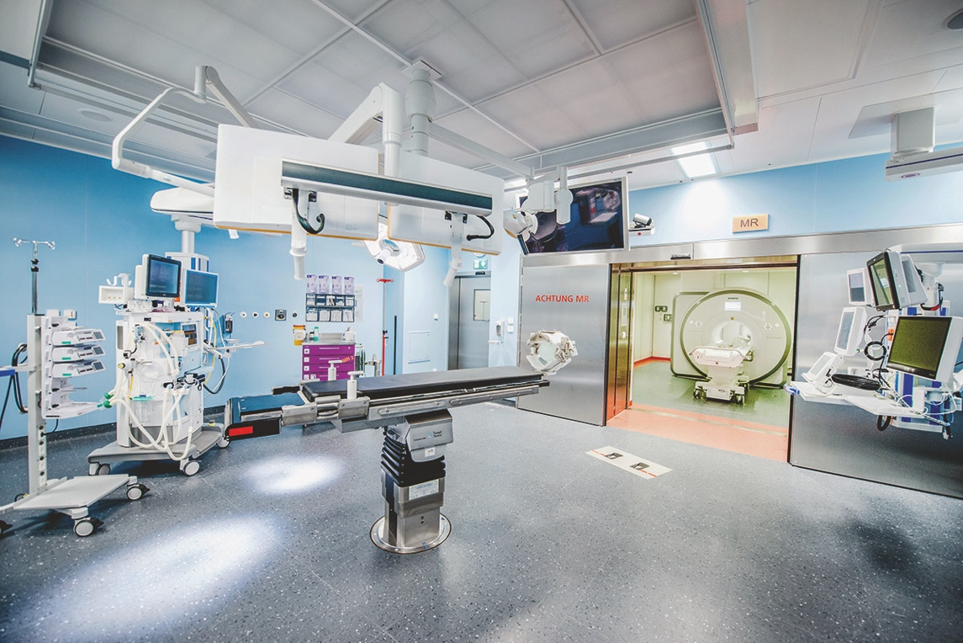
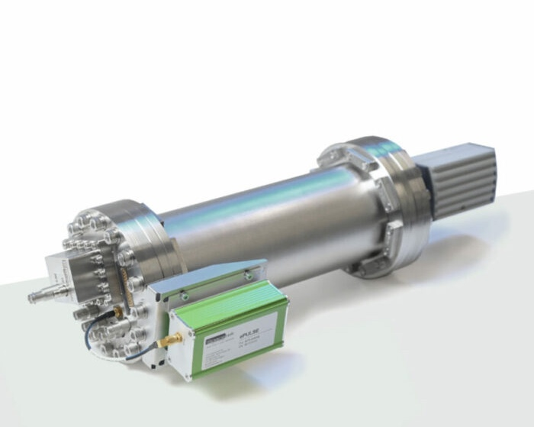

Seed Funding for knowledge transfer and innovation
Photo © Inselspital Bern
Polarization of light (search for signs of life) to detect tumoral cells
Spin-off UniBE: Noble gas spectro-analizer for a moon mission to quality measurement in semiconducting, coating industries
A transfer of knowledge or technology to/from industry
A market opportunity, patent, product
An innovative idea /R&D (high-risk high-gain)
Notes:
Export
Positive Impact of PlanetS

Slide 17
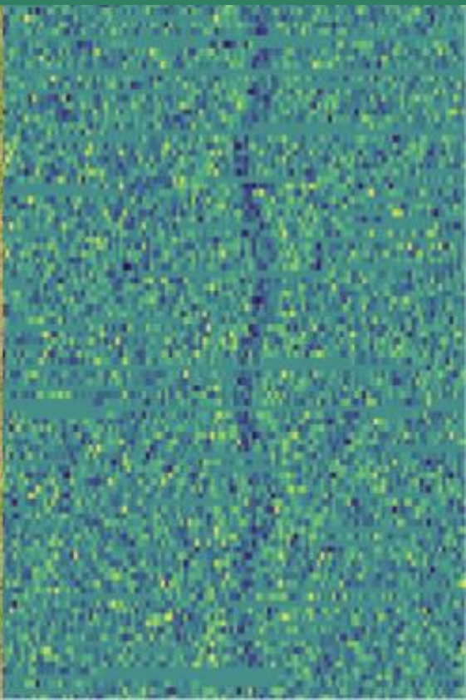
Seed Funding example:
Leleu et al., UniGE

Slide 18
Seed Funding example: ML/AI for exo-planet detection
A planet transiting in front of its star (eclipse)

Slide 19
Seed Funding example: ML/AI for exo-planet detection
A planet transiting in front of its star (eclipse)

Slide 20
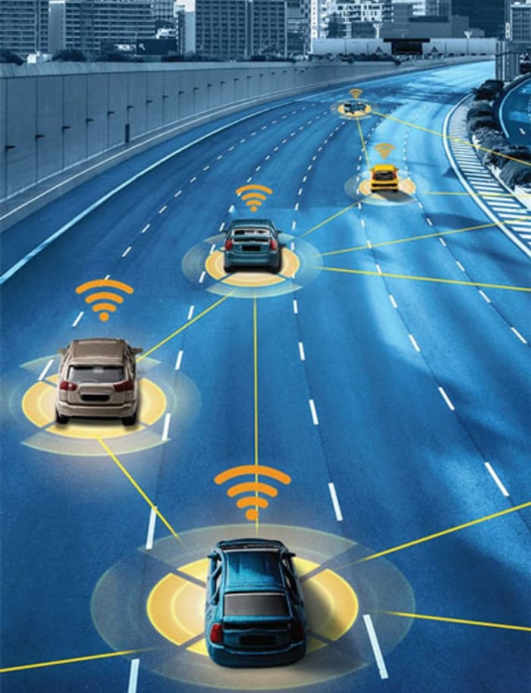
Seed Funding example: ML/AI for exo-planet detection

Slide 21
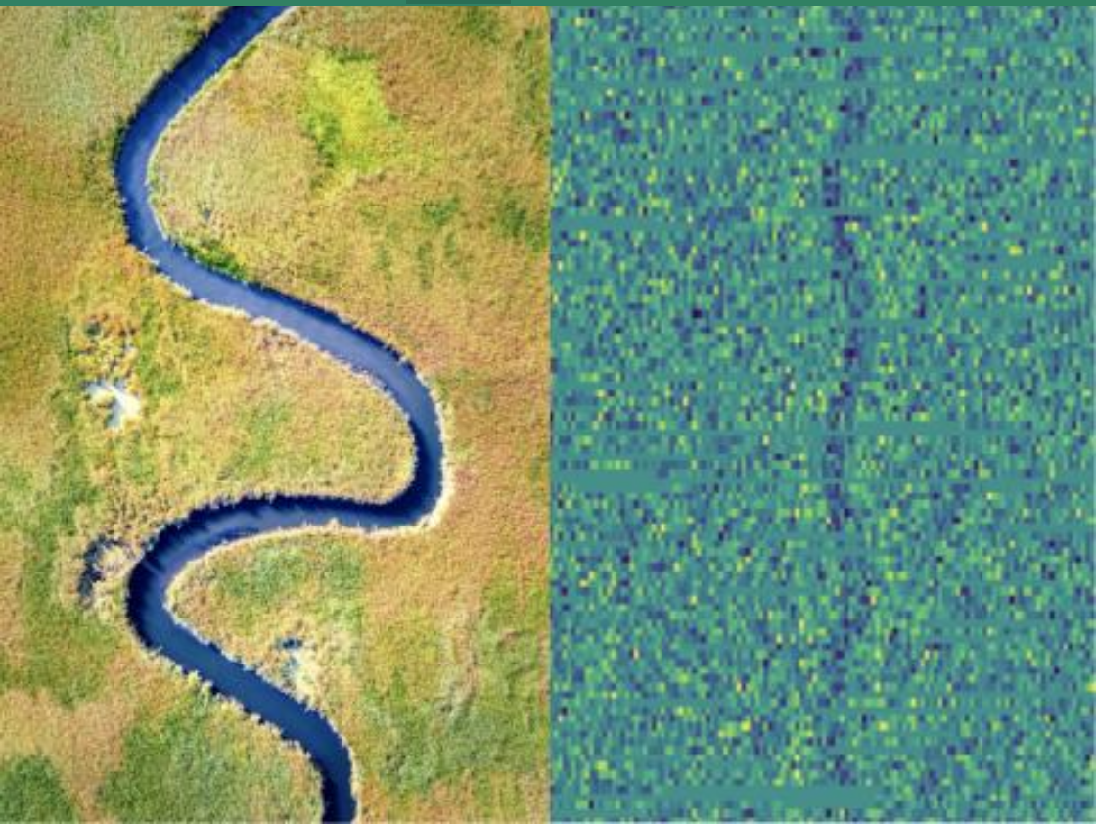
Seed Funding example: ML/AI for exo-planet detection

Slide 22
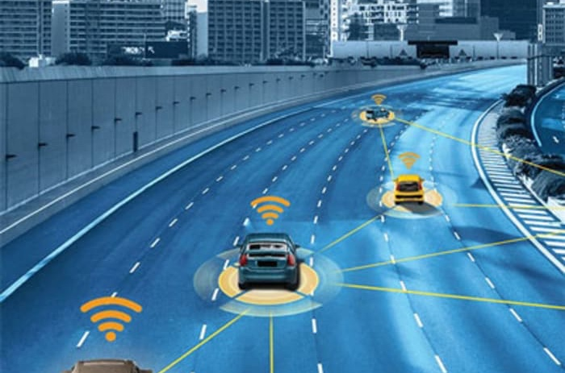
Seed Funding example: ML/AI for exo-planet detection

