Slide 1
Irradiation Campaign of Thin Foils
I.FAST 4th Annual Meeting
10th April 2025
Krakow, Poland
Nikolina Vejnovic (CERN)
With contributions from WP4.3, CERN IRRAD and FLUKA teams

Slide 2
Outline
Innovative beam windows for high-power accelerator applications
D4.3: Deliverable Report
Irradiation Campaign
Irradiation Parameters: Dose and Fluence
Characterisation of unirradiated and irradiated samples
Conclusions

Slide 3
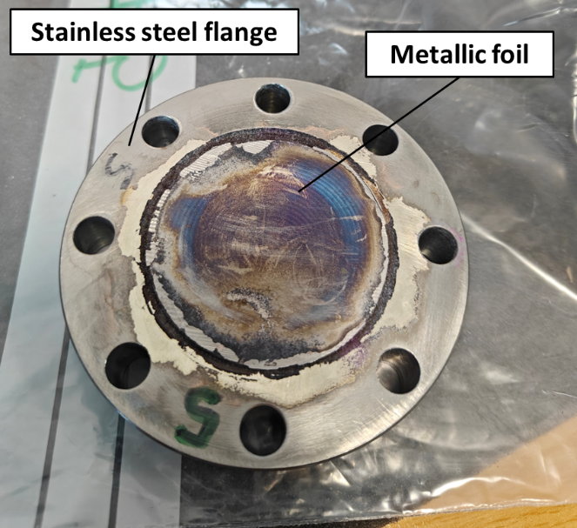
Innovative beam windows for accelerator applications
Beam window: thin interface separating environment at different pressures (vacuum/atmosphere or differential vacuum levels)
Application not limited to particle accelerators but other field of nuclear science and high-power hadron beam applications
Two technical solutions investigated within WP4.3:
  Metallic windows (tantalum, T91 steel)
  Graphenic windows (thin graphene membranes)
Task participants: RHP (AT) and CERN

Slide 4

D4.3 Deliverable Report
Objective of the campaign: Evaluation of the possible radiation damage for promising material
Thermomechanical behavior of the windows will degrade over time due to radiation damage from exposure to the beam
It is important to estimate the radiation damage to assess the suitability of promising materials
Date of submission : 31st of May 2024
https://zenodo.org/records/11502668

Slide 5
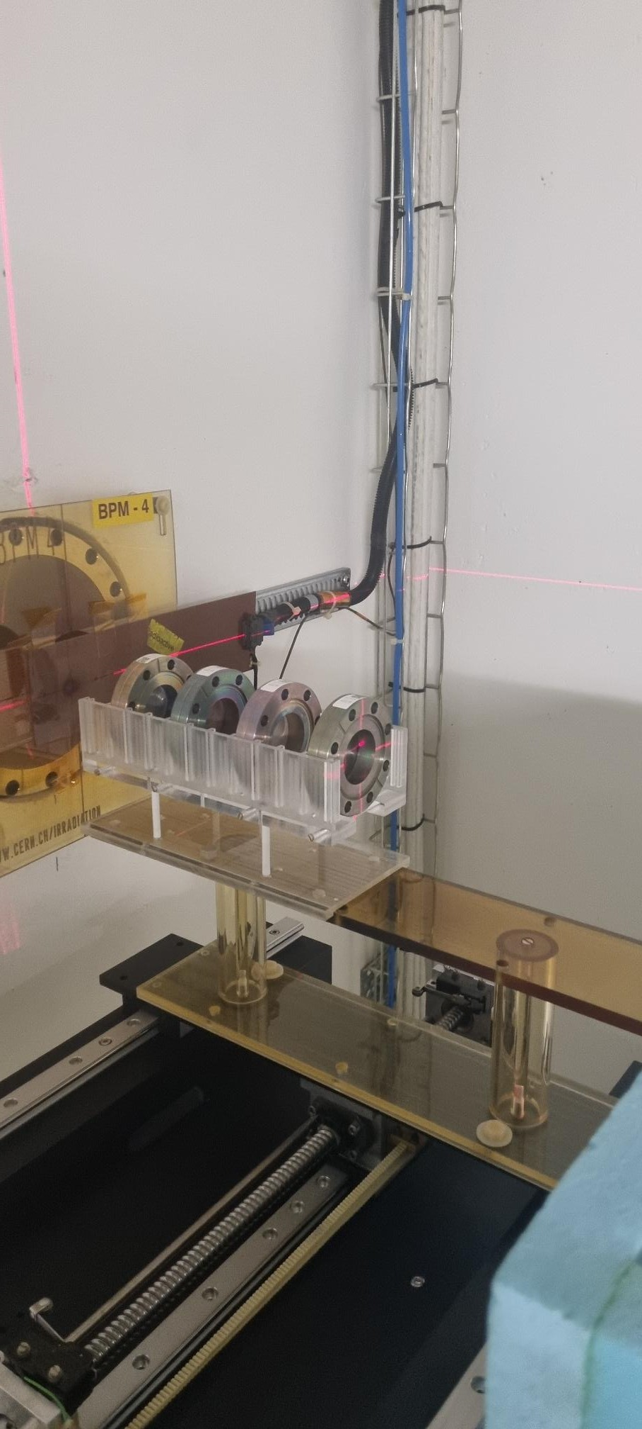
Irradiation Campaign
Facility: IRRAD (PS proton beam, T8 beam-line at the CERN PS East Hall building 157) www.cern.ch/ps-irrad
Beam: protons @24 GeV/c
Samples: thin foils brazed to metallic flange produced by RHP
Irradiation period 6th September-11th October 2023
Fluence up to 1.96e16 p/cm² over 10x10mm
Average dose - 4.56 MGy (Tantalum)
Sample Holder 1
Courtesy of G. Pezzullo, F. Ravotti (CERN)
    Sample holder 1
    Sample #7 → Tantalum, diameter 50mm, thickness 0.3mm
    Sample #15 → Tantalum, diameter 50mm, thickness 0.4mm
    Sample #13 → T91, diameter 50mm, thickness 0.4mm
    Sample #10 → T91, diameter 50mm, thickness 0.6mm

Slide 6
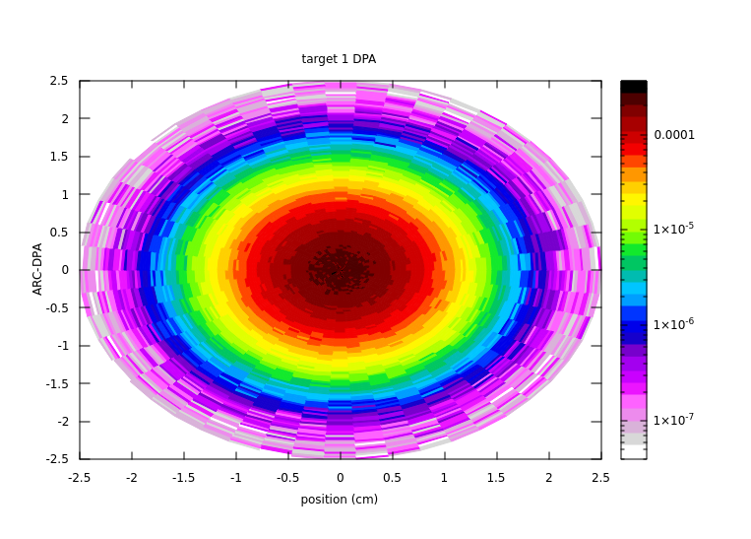
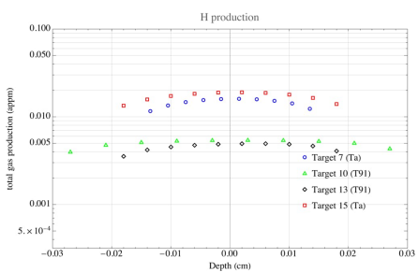
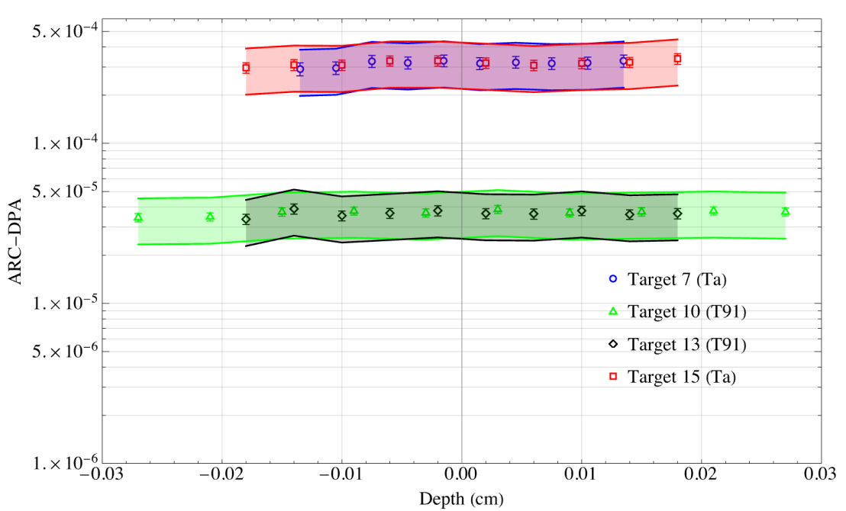
Irradiation parameters: Dose and Fluence
Change in the thermomechanical properties will be correlated to the estimated displacement-per-atom (DPA) and gas production (big thanks to the FLUKA team at CERN SY-STI!)
FLUKA simulations also allow to estimate the temperature during irradiation (looks to be close to T_{room})
Highest level of DPA in Sample Holder 1 ~3e-4 DPA
Courtesy of S. Marin, F. Salvat Pujol (CERN)

Slide 7
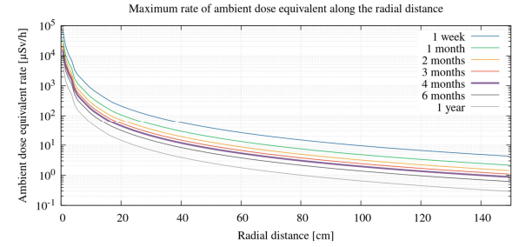
Characterisation of irradiated and unirradiated samples
Two identical sets are tested, unirradiated and irradiated samples.
The characterization was performed after 6-month of cooldown.
Irradiation campaign include various tests: dye penetrant, computed tomography, optical microscopy, SEM, electrical conductivity and thermal conductivity.
Thermal conductivity is very important, any potential change in this property after irradiation needs to be measured.

Slide 8
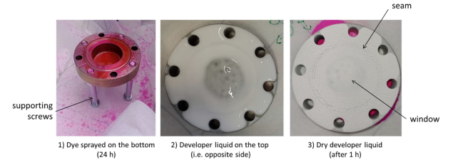
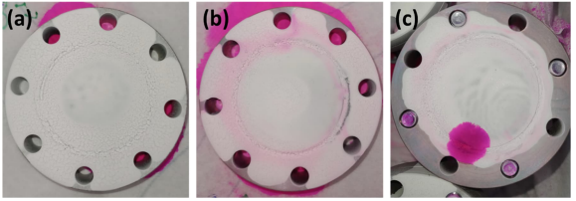
Dye penetrant
Test was performed at RHP (only on unirradiated one)
Objective: to evaluate leak tightness of the brazing
After brazing due to accelerated creep and differential CTE – the windows are taking concave and convex shapes
3 assemblies out of 10 presented micro leaks (due to the high stresses)
Brazing process must be improved in the future

Slide 9
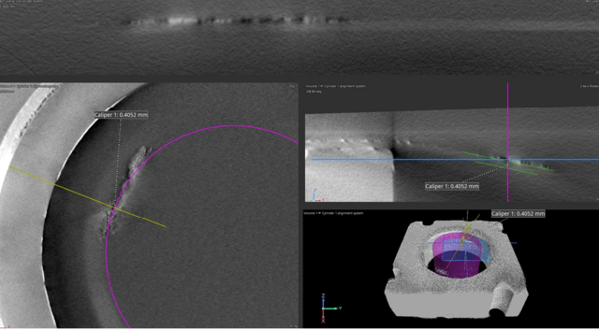
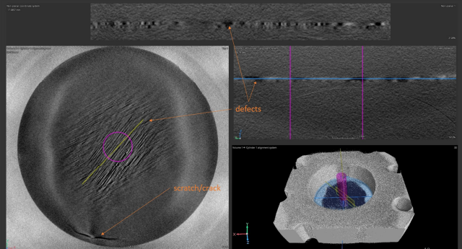
Computed Micro-Tomography (CT)
Analyses showed defects due to brazing-already highlighted in the previous test
Irradiated T91 samples – no observable effects
Irradiated Tantalum samples have some traces in the irradiated region - potential radiation-induced effect.
T91 unirradiated
Ta, irradiated

Slide 10
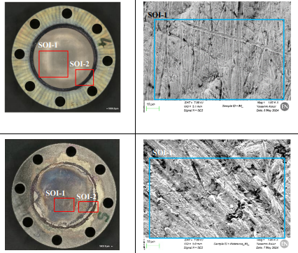
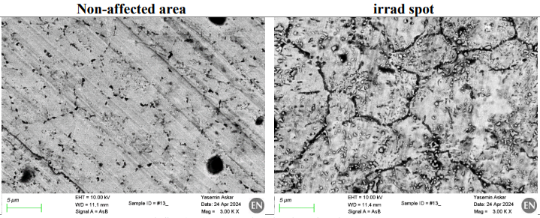
Optical Microscopy and SEM
Ta (top), T91 (bottom)
OM and SEM observations reveal a rough surface with visible machining marks
Superficial features visible with relative chemical contract suggest local contamination/oxidation
No significant oxidation differences between irradiated and unirradiated samples
Grain boundaries are more defined on irradiated locations than in unirradiated affected areas.

Slide 11
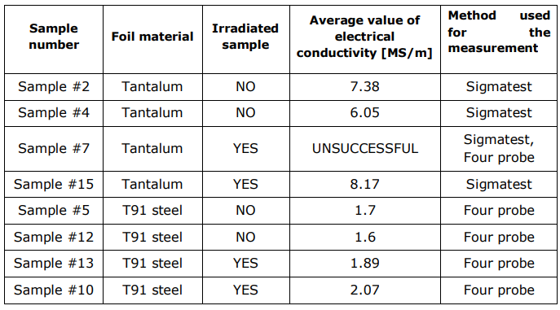
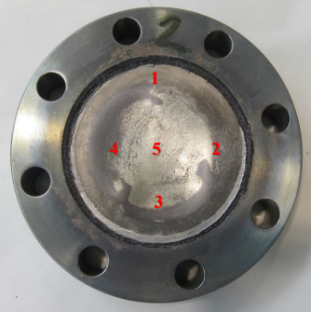
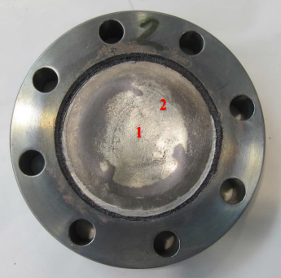
Electrical Conductivity
Useful for indirectly measuring thermal conductivity via the Wiedemann-Franz law
Two methods were used: SIGMATEST for non-ferrous materials and four-probe method for T91.
With four probe method some measurements are failed due to strong curvature
Sigmatest measurement
4-probe measurement
Electrical conductivity appeared to increase after irradiation but this results is likely within the measurement variance.

Slide 12
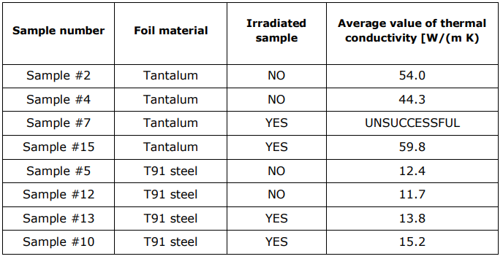
Thermal Conductivity
The Wiedemann-Franz law relates thermal conductivity (k) to electrical conductivity (σ) at a given temperature, expressed as
k=σ⋅L⋅T
Theoretical value of the thermal conductivity of both samples:
      T91 – 25 W/mK
      Ta – 57 W/mK

Slide 13
Conclusion
Brazing Issues: Defects and vacuum leaks were present in 30% of unirradiated samples.
Concavity/Convexity: Induced curvature from brazing is not necessarily negative, but it must be controlled.
Microscopic Evidence of Irradiation: Traces of irradiation were observed in both tomography and microscopy results.
Thermal and Electrical Conductivity: No significant change in the properties after irradiation, slight increases observed, potentially within sample-to-sample variance.

Slide 14
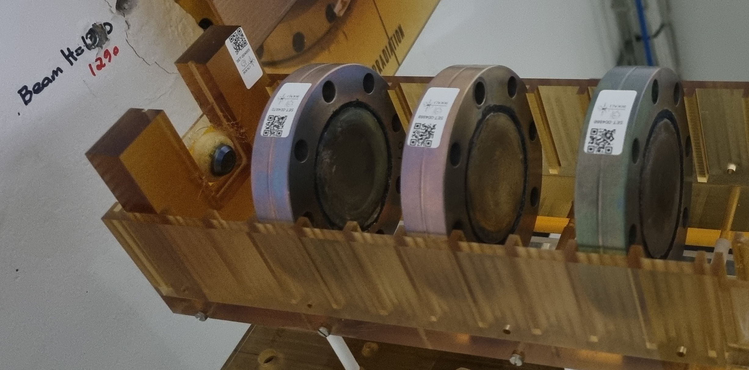
Second Irradiation Campaign
Facility: IRRAD (CERN), www.cern.ch/ps-irrad
Beam: protons @24 GeV/c
Irradiation period March-June 2024
Fluence up to 2.39e17 p/cm2 over 10x10mm
Average dose
      43.9 MGy (Tantalum)
  ~3e-3 DPA
Cooling Down Stage
Future plans: To perform the same characterization campaign with 10 times higher DPA to make the results much more relevant; plan for the publication.
Sample Holder 2
Courtesy of G. Pezzullo, F. Ravotti (CERN)
    Sample #8 → Tantalum, diameter 50mm, thickness 0.6mm
    Sample #9 → T91, diameter 50mm, thickness 0.4mm
    Sample #11 → T91, diameter 50mm, thickness 0.6mm
    Sample #10 → Graphene, 10x10 mm, thickness 1 um

Slide 15
Thank you for your attention!

