Slide 1
The new proposal for accelerator R&D
M. Vretenar, 2025 I.FAST Meeting
Krakow, 11 April 2023

Slide 2


A new instrument in the last call of Horizon Europe
No more “Innovation Pilot” but “Implementing research infrastructure technology roadmaps” – but the new call incorporates many aspects and results of I.FAST.
Name still to be defined, for the moment “I.FAST2”
The next flagship of our accelerator R&D projects!

Slide 3
21 years already - now heading for the 2030’s
Research Infrastructure programmes have evolved:
From support to communities to support to innovation.
From support to innovation to support of technology clusters based on a technology roadmap.
CARE 01/2004 – 12/2008
5 years, 15.2 M€ EC contribution
FP6
EuCARD 04/2009 – 03/2013
4 years, 10.0 M€ EC contribution
FP7
Integrating Activities
EuCARD-2 05/2013 – 04/2017
4 years, 8.0 M€ EC contribution
Along these projects, we keep our focus on cross-boundary technology subjects, not directly followed by large laboratories, with added value from collaboration and sharing of resources, to which has been now added the co-innovation with industry.
ARIES 05/2017 – 04/2022
4 years, 10.0 M€ EC contribution
H2020
Innovation Pilot
I.FAST 05/2021 – 10/2025
4 years, 10.0 M€ EC contribution
Preparing for FP10 that might be very different from what we have seen so far.
HE
(I.FAST2) 06/2026 – 05/2030 ???
4 years, x M€ EU contribution
INFRA-TECH

Slide 4
FP10
Position of ESFRI chair on Research Infrastructures: should not be limited to Pillar 1 (excellent science) as they are now, should have a transversal impact on environment, climate, security, etc.
The Commission is considering a scheme of FP10 combining several funds (ERC, EIC) into a mega-fund for competitiveness.
EU ministers and EU Council have expressed their position in favour of a stand-alone FP10 programme like now (March 2025).
Even though UK and CH are back into the Horizon programme, the budget for FP10 is expected to decrease in comparison to previous FP’s – because of other EU priorities.

Slide 5
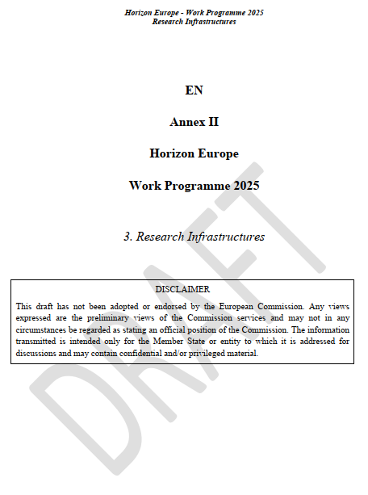
The 2025 RI Work Programme
Draft completed in October 2024, expected to be published in November 2024, is not yet out. Negotiations required for the budgets.
The draft has been circulating for months (and is even available on some national contact web sites) but it is not official yet.
Recent news are that the Work Programme is now finalised and being approved by the Committee – should be published in April (or rumors for early May).
We are preparing a proposal based on specifications that are not final.

Slide 6
The HORIZON-INFRA-2025-01-TECH-02 call
Implementing research infrastructure technology roadmaps
Expected EU contribution: 10 M€ - was originally 15 M€
Total budget for the call: 45 MEUR (to be confirmed): 4.5 projects can be funded.
Deadline for submission: 18 September 2025 (to be confirmed).
For infrastructure and technology communities with already developed research infrastructure technology roadmaps: accelerators, light sources, astronomy, etc.
Projects should implement significant parts of, or entire research infrastructure technology roadmaps through co-creation with industrial partners from the earliest possible stage. The technology roadmaps should be the result of a community or cross-community effort already undertaken. The technological solutions developed should respond to the needs of several research infrastructures, and in some cases the needs of different types of research infrastructures.
Project must include at least 2 Research Infrastructures (ESFRI, ERIC, or International European org.).

Slide 7
Requirements, from draft call description
All R&D topics included in the portfolio must:
implement significant parts of a research infrastructure technology roadmap (ESPP, LEAPS, others) or develop new advanced applications.
address prototyping of high-performance systems needed to upgrade the involved research infrastructures or construct their next generation.
Include co-creation with industrial partners from the earliest possible stage (as beneficiaries, subcontractors, PCP partners, or with letters of engagement) .
respond to the needs of several research infrastructures, possibly of different types.
possibly build on results from previous projects and avoid overlaps with ongoing projects.
consider resource efficiency (e.g. raw material and energy consumption) and environmental (including climate-related) impacts.

Slide 8
TIARA guidelines for the proposal
Different from previous projects, the new project should have:
A mixture of top-down and bottom-up topics: explore recognised critical R&D topics with appropriate funding, while keeping the creativity and innovation dimension of a bottom-up call to the community.
Less partners than in I.FAST, avoid beneficiaries with less that 100k EC funding. Ideal team one or 2 academic, one industry (limit is 50k for industry).
Rate of matching funds (now 50% for academia, 30% for industry) reduced to 1/3 (33%) for research institutions, 20% for industry.
Less space for Networks, possibly only in the frame of defining Technology Roadmaps – and more space to prototyping with industry.

Slide 9

Structure of the proposal
From I.FAST experience and discussions with EC,
Project based on 4 pillars (groups of Work Packages):
 | Pillar | Content | EC contribution per activity (guideline)
1 | Instruments | General WP’s covering all activities
2 | Enabling technologies | 6 key technologies, selected top-down, higher TRL | 0.5-1 M€
3 | Emerging technologies | About 10 selected technologies after bottom-up call, lower TRL | 200-400 k€
4 | Innovation Fund | Internal call after project start | 100-200 k€
Note: EC contribution as total cost, including the 25% overheads

Slide 10
Total budget repartition
 | Pillar | Maximum: 15M |  | Minimum: 10M | Number of activities
1 | Instruments | 2.5 M€ |  | 2.0 M€
2 | Enabling technologies | 6.0 M€ |  | 5.0 M€ | 5 - 6
3 | Emerging technologies | 4.0 M€ |  | 2.5-3.0 M€ | 10 – 12
4 | Innovation Fund | 2.5 M€ |  | 0-0.5 M€ | 0 - 10
 | Totals | 15 M€ |  | 10 M€

Slide 11
Teaming for proposal preparation
TIARA is taking ownership for proposal preparation. The TIARA Assembly selects topics for top-down, approves procedure for bottom-up selection, nominates conveners for the WP’s.
A TIARA “executive committee” takes care of defining the detailed structure of the proposal: negotiations for the top-down part, definition of the “instrument” pillar: J.M. Perez, A. Lucotte, M. Vretenar, T. Torims.
An Evaluation Committee nominated by TIARA (one representative per TIARA member) will select the proposals for emerging technologies.
A local Project Team at CERN will oversee the financial preparation and support the assembly of the proposal document.
A “Reading Committee” (TIARA + experts) will read and comment on the final document.

Slide 12
Status of preparation
TIARA meeting on January 10th enlarged to the accelerator user communities (with and without roadmaps) has identified topics for enabling technologies. Selected 7 “enabling technologies”, conveners identified, preliminary proposals submitted, under scrutiny.
Documentation and web site for “emerging technologies” call prepared, call for proposals for emerging technologies opened on 18 March, with deadline for submission of proposals 30 April.
An evaluation committee set up by TIARA will select the activities during the month of May (one member per TIARA participant + 2 from industry). The results of the selection will be announced at early June. All information available on https://ifast-project.eu/proposal-infra-tech-02
Revised submissions for Enabling Technologies requested for 31 March, will be analysed in April, decisions expected in May.

Slide 13
1. Coordination
Present structure of the proposal
CERN will continue ensuring the coordination of the project (with some changes expected in the CERN EU office).
Toms Torims has been recruited by CERN on April 1st and charged by TIARA with the role of co-convener of the proposal, together with MV.
Toms is expected to coordinate the project if it is approved by the EC.

Slide 14
2. Enabling Technologies Pillar
WP |  | Convener | Institute | Country | Status
1 | SC thin films for RF cavities | O. Malyshev / C. Antoine | UKRI/CEA | UK/FR | Submitted 5.03
2 | HTS magnets | E. De Matteis | INFN | IT | Submitted 31.03, in discussion
3 | Additive manufacturing | T. Torims / A. Ratkus | RTU | LV | Preliminary submitted 4.03
4 | SCRF Surface treatments | D. Longuevergne | CNRS | FR | Submitted 7.04
5 | Permanent magnets for accelerators | R. Geometrante | KYMA | IT/ind. | Preliminary submitted 5.03
6 | Laser driven acceleration | A. Maier | DESY | D | Preliminary 4.03, no more news
7 | High brightness electron injectors |  | PSI | CH | Under discussion
Maximum budget for the pillar: 5.5 M€, meaning 0.5-1.0 M€ /WP

Slide 15
3. Instruments Pillar
WP | Task | Title | Content
1 | 1 | Management, coordination
 | 2 | Dissemination
 | 3 | Risk Management
2 | 1 | Training | Support to schools
 | 2 | Communication, outreach | CBI, Acc. News, Social media
3 | 1 | Industry | Support to AIPF
 | 2 | Technology transfer | Support start-ups
 | 3 | Societal applications | Medical and industrial
4 | 1 | Far future accelerators | Exploratory work
 | 2 | Sustainability | Methodologies (LCA)
 | 3 | Roadmap follow-up | Contact with communities.
4 Work Packages, supporting all other activities

Slide 16
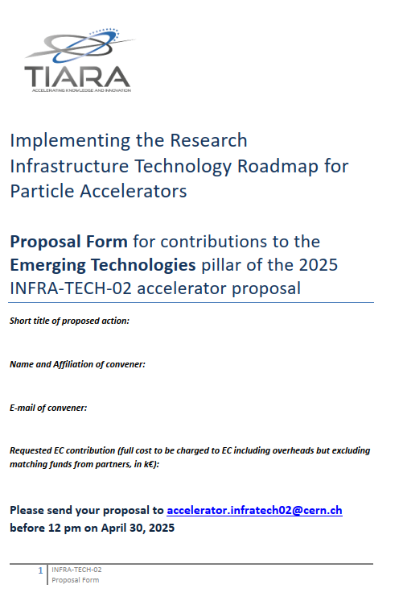
4. Emerging technologies pillar
Submission form available on the web site.
a 10-page document with all information needed by the Evaluation Committee

Slide 17
Evaluation criteria for emerging technologies
 | Criterion | Points
1 | Scientific and technological excellence, innovation content | 10
2 | Coherence with the roadmaps of accelerator communities and continuity with previous EC projects | 5
3 | Impact on Research Infrastructures, their users and/or society | 5
4 | Methodology and planning | 5
5 | Transnationality and integration of partners | 5
6 | Capacity to attract additional matching funds | 5
7 | Correspondence between cost and objectives | 5
8 | Extent and quality of industry involvement | 5
9 | Improve use of resources and reduce environmental impact | 5
 | TOTAL | 50
In preparation an evaluation guide to explain the criteria and to help obtaining harmonized scores.

Slide 18
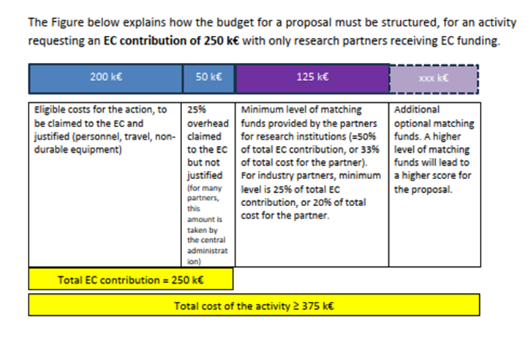
Guidelines - financial
EC contribution for emerging technologies between 200k and 400k, may go up to 500k in justified exceptional cases.
For all proposals:
Minimum EC contribution per partner 100 k€ (can be cumulated over different activities), 50 k€ for industry.
Minimum matching funds: 50% of the EC contribution for research partners, 25% for industrial partners. These limits correspond to a minimum co-funding rate (ratio between matching funds and total cost of the activity) of 33% for research and 20% for industry.

Slide 19
Timeline for the new proposal
Timeline: Enabling technologies
January 2025: define common roadmap with other accelerator communities, with priority topics and guidelines for internal call.
Early February nominate Conveners for enabling technologies and invite to set up collaborations.
March deadline for presenting WP’s to TIARA, first reactions.
30 April content and budget approved by TIARA.
May start writing.
Timeline: Emerging technologies call.
Early March 2025 send letter and submission form to all institutes having participated in previous programmes.
30 April submission deadline, nominate selection committee.
15 May pre-analysis and classification of submissions completed.
31 May selection of projects completed, start writing.
First draft of proposal ready by end of June
Revised draft and budget frozen end of July
Complete proposal for final revision end of August

Slide 20
Thank you for your attention!

