Slide 1
SAC Feedback
4th I.FAST Meeting, Warsaw, Poland
C P Welsch , M Minty, and A Yamamoto

Slide 2
Overview
Executive summary
Highlights from plenary sessions
SAC comments and suggestions for the future

Slide 3
Executive Summary

Slide 4
Executive Summary
The SAC congratulates I.FAST WP Leaders, Task Leaders, and Management on the successful delivery of Periodic Report 2 and subsequent approval by the EC on 15 Jul 2024. The EC report’s project assessment, that “... the project so far has achieved its objectives and milestones with minor deviations” is consistent with last year’s SAC report.
I.FAST was extended to 31 Oct 2025 to mitigate “force majeure” events via a successful amendment approved on 12 Dec 2024. The schedule was updated to indicate sub-project and overall project deliverable and report due dates.

Slide 5
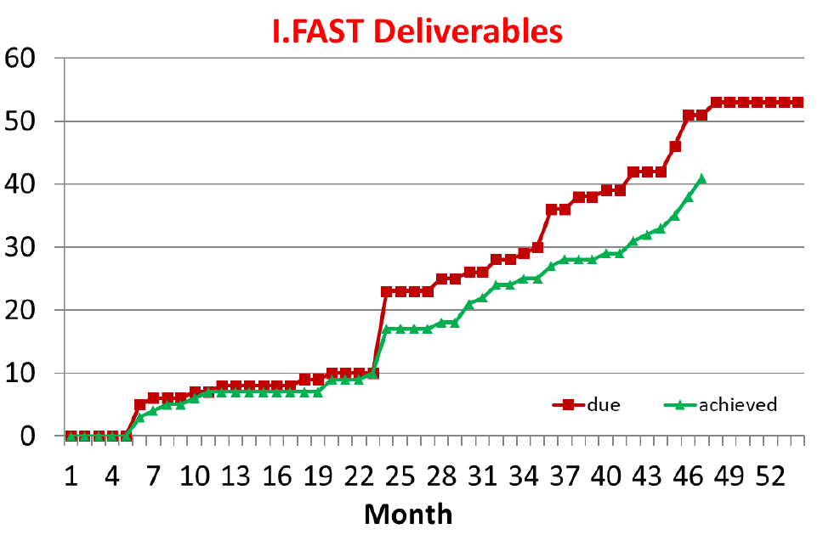
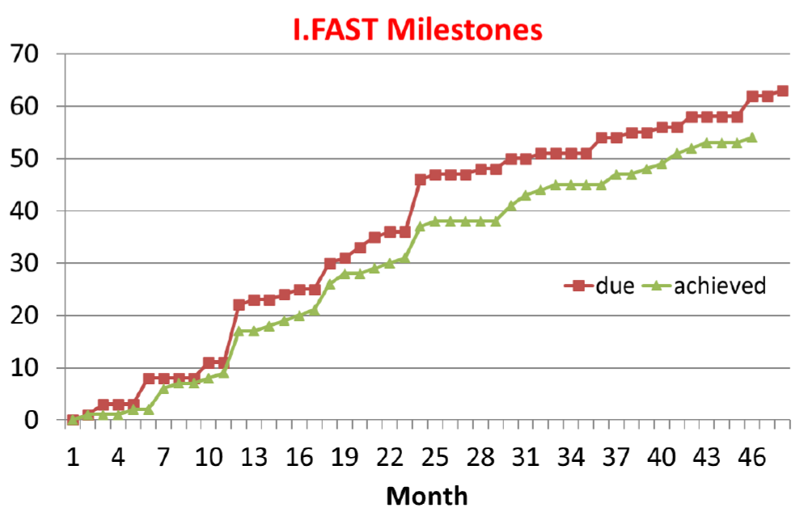
Executive Summary, continued
The project experienced an up-tick last year in the rate of achieving Work Packages deliverables and milestones: as of this meeting 41 of 54 deliverables and 54 of 63 milestones have been demonstrated.
In the past year, great progress has been made with outstanding results including, e.g.
fabrication - klystron and beam window prototypes
component testing - RF guns
developments with particle beams - advances in slow beam extraction and machine learning for beam control
roadmap developments - for future accelerators and thin film development
future directives incl sustainable accelerators report.

Slide 6
Executive Summary, continued
In response to last year’s SAC recommendation, project proponents mostly included explicit mention of the impacts of their work in terms of scientific achievements and in terms of fostering innovative research in Accelerator S&T.
For the final review we suggest metrics be developed to allow for improved consistency in reporting.
Many WPs mentioned explicitly new publications: Journal articles, documentation in ZENODO and other media such as Accelerating News. However, this was not consistently addressed across all presentations.

Slide 7
Executive Summary, continued
The SAC recognizes that many if not all developments in I.FAST S&T could only have been realized by collaborations developed through I.FAST between institutions and industry.
The effectiveness of I.FAST coordination with industry was quantitatively analyzed (WP3) via a survey of participants with results confirming by-enlarge the synergy between I.FAST and industry including in transitioning to manufacturing and marketing.
SAC strongly supports ongoing planning for the next program, “I.FAST2”.

Slide 8
Highlights from Plenary Sessions

Slide 9
Session 1 - Communication & Training
Training and Communication activities have shown clear, commendable progress since the SAC's initial reviews, especially in student training, interdisciplinary diversity, and industry-academia engagement.
However, some challenges remain, including external visibility, post-event continuity, and partner engagement. These should be addressed (at least partially) in the final months of the project and inform practice in any successor projects.

Slide 10
Session 1 - Highlights
The Challenge-Based Innovation (CBI) Programme has matured into a flagship initiative, showing strong appeal with >170 applicants in 2024 and well-balanced gender and geographical diversity.
SAC is delighted to note that its prior recommendations to formalize participation, diversify disciplines, and sustain the program have been acted upon.
There is evidence of ongoing engagement beyond the program, aligning well with SAC’s emphasis on long-term continuity.

Slide 11
Session 1 - Highlights
Within the Industry-Academia Exchange Programme multiple traineeships have been successfully executed. This reflects earlier SAC recommendations to refine the programme for maximum bi-directional benefit.
The Accelerator Communication & Outreach Workshop in March 2025 has effectively addressed SAC’s previous call for a pan-European network of communication professionals.
Networking: The establishment of a LinkedIn Communication Officer group and planned follow-up events demonstrate sustainable networking and shared learning and are commendable, responding to SAC’s recommendation from 2023.

Slide 12
Session 1 - Lowlights
There remains too little output on the I.FAST website and Zenodo, as repeatedly noted by SAC​. There were only five news published on the website since the last annual meeting - concerning for a project of I.FAST’s scale.
SAC has repeatedly emphasized the need to leverage institutional communication channels of all partners, but this appears only partially implemented. All WPs should more systematically work with local PR teams to amplify outcomes.
Efforts to attract industrial sponsorship to CBI were unsuccessful, despite the creation of sponsor packages. This remains an area that could benefit from an improved industry engagement strategy.
Communication still struggles to consistently connect with broader WP objectives. There seems room to better tie outreach and training to the overarching narrative and milestones of I.FAST.

Slide 13
Session 1 - Recommendations
Expand Communication Output and Compliance
Set minimum annual publication quotas for each WP on the I.FAST website and Zenodo.
Assign dedicated communication contact in each WP to ensure regular contributions and alignment with project milestones.

Slide 14
Session 1 - Recommendations
Enhance dissemination
Organize science communication training for WP leaders and others in I.FAST interested in science communication.
Include short public-facing summaries in all WP summaries.
Secure post-project sustainability
Create a structured alumni programme for CBI and training participants; track impact and encourage continuity.
Explore spin-off funding or mentoring schemes for post-CBI projects with high potential.
Broaden audiences
Extend efforts to schools, policymakers, and non-traditional stakeholders to maximize impact. Develop central communication materials for these identified target audiences.
Integrate communication into strategic planning
Ask WP leaders to identify clear communication milestones and track these centrally.

Slide 15
Session 2 - New Concepts
The session combined scientific ambition, increasing technical maturity, and international convening power.
With strong coordination and clear post-project pathways, and enhanced visibility, the impact of the developments can extend well beyond I.FAST’s end date.
The 2025 meeting showed a real evolution from earlier SAC concerns about fragmentation and speculative overreach. There is now clearer technical development, international coordination, and in some areas, much more mature hardware deliverables.

Slide 16
Session 2 - Highlights
REX is a good example of how new concepts can evolve into mature, deployable technologies:
Three hardware innovations all achieved TRL 7, fulfilling and exceeding original goals.
Demonstrated direct operational relevance with user-focused spill quality improvements.
Strong publication record and academic output, a model for research impact and training synergy.
SAC’s past calls for deliverable maturity, experimental validation, and ripple mitigation have all been robustly addressed here.

Slide 17
Session 2 - Highlights
MUST now operates with the structure and clarity expected of a flagship global design effort. It is linked to relevant roadmaps and strategic processes, and has delivered a technology roadmap with TRL targets, cost scenarios, and demonstrator plans.
There is also meaningful prioritization, e.g. distinguishing near-term (3 TeV) and long-term (10+ TeV) feasibility with realistic R&D staging.
SAC’s is pleased that its consistent urging for cross-border, mission-driven exploration of future colliders is realized here.
SAC would like to commend the maturity of the planning.

Slide 18
Session 2 - Highlights
WP5.2 has successfully incubated a pan-European community exploring novel accelerator physics and unconventional applications:
Several workshop series have catalyzed multidisciplinary exchanges on topics such as nano-structured accelerators, quantum computing in storage rings, and Cherenkov-like radiation from quasi-particles.
Ideas previously considered fringe are now linked to real testbeds or conceptual hardware studies
This reflects SAC’s encouragement to stretch the conceptual envelope and invest in foundational work where long-term payoff could be transformative.

Slide 19
Session 2 - Work-in-progress
While REX and MUST exemplify structured development, other topics remain (too?) loosely defined in terms of:
Technical feasibility
Experimental validation
Transition to TRL 3+
SAC has repeatedly asked for impact statements and development pathways, but several concepts still present vision without engineering, which could limit their post-I.FAST viability.

Slide 20
Session 2 - Lowlights
There is no clear hand-off strategy for sustaining and advancing the most promising ideas. This puts good concepts at risk of stalling unless embedded in future design studies, ERC proposals, or international programs.
SAC has emphasized that exploratory work must be linked to continuity strategies and this remains a gap.
Several ideas overlap with other I.FAST WPs, e.g. in sustainability, AI or instrumentation. However, these links remain underexploited, and internal cross-pollination appears ad hoc.

Slide 21
Session 2 - Recommendations
“New Concepts legacy report”, containing 1–2 pages per concept, detailing:
Concept summary
Maturity/TRL
Use case or facility
Suggested next steps
…to help funders, collaborators, and students find viable entry points.
Prioritize 3–5 ideas and align them with:
Known future funding calls (e.g. INFRA-TECH, COST, ERC Synergy)
Host facility roadmaps (CERN, GSI, PSI, etc.)
Use the final I.FAST meeting to match outputs with the needs in other WPs

Slide 22
Session 3 - Accelerator Technologies
SAC commends the I.FAST consortium for a number of remarkable progresses in advanced accelerator technologies including applied superconductivity (magnet and RF), high-efficiency RF, beam windows and additive manufacturing.
Developments should be further extended to reach real-world applications in the extended I.FAST program, in particular for high-field superconducting magnet with HTS and superconducting RF with A15 (Nb3SN and other ) superconductors. Long-term and ongoing efforts in this area will be critically important.

Slide 23
Session 3 - Highlights
The following three areas are highlighted as particularly successful:
Innovative beam windows for high-power accelerator applications
  Graphene Carbon windows - identifying optimum materials
  Promotion of carbide-carbon materials (CCM) for future particle physics facilities; opening up for commercial applications.
(Test results of) High efficiency klystrons for HL-LHC
  CSM (Core Stabilization Method) interaction structure
  Manufacturing started in 2022 after validation of CERN design at Thales,
  Measured efficiency 70% (calorimetric) with 365 kW output power at 57.7 kV, 9 A, Klystron behaviour perfectly reproduced by simulations
Variable (permanent) dipole for the Elettra ring (VADER)
  Fabrication of an innovative dipole magnet prototype with longitudinal varying dipole field, featuring a transverse gradient
  Permanent magnet concept with trapezoidal bending radius, 2.3 T peak field and ~10 T/m gradient, already established.
These are excellent examples of I.FAST activities realized in academia-industry cooperation.

Slide 24
Session 3 - Work-in-progress
The superconducting magnet and RF technologies are long-term efforts and need to be extended to reach practical applications:
CCT with HTS technology remains a significant challenge.
Development of SC thin films for SRF cavities
  Prototype R&D (A15 - Nb3SN on Cu) is in progress,
Both developments have demonstrated significant progress over the course of I.FAST but faced challenges from market difficulties.
SAC strongly recommends that these programs be continued.

Slide 25
Session 3 - Lowlights
There is no clear hands-off strategy for sustaining and advancing the most promising ideas. This puts good concepts at risk of stalling unless embedded in future design studies, ERC proposals, or international programs.
SAC would like to stress that R&D must continue to be linked to continuity strategies - this remains a gap.

Slide 26
Session 3 - Recommendations
SAC strongly recommends to extend the advanced accelerator technology development into the next phase of the I.FAST program.
This includes in particular high-field superconducting magnets with HTS and superconducting RF with A15 (Nb3SN and other ) superconductors.
Long-term and ongoing efforts will critically important.

Slide 27
Session 5 - Light Sources and Sustainability
SAC commends I.FAST for a maturing and increasingly coherent effort to align high-performance accelerator development with long-term sustainability goals.
The integration of sustainability into system design, the emergence of international collaborations, and facility upgrades such as SLS 2.0 position I.FAST as a driver of transformative change in this area.
However, to secure a lasting legacy, I.FAST should consolidate its achievements into actionable frameworks, impact pathways, and industrial partnerships, and make sure they are seen and used beyond the core consortium.

Slide 28
Session 5 - Light Sources and Sustainability
Substantial scientific and technical progress across several interconnected activities was presented, ranging from advanced light source infrastructure to novel hardware prototyping. Congratulations!
Viewed as a whole, the session reflected an increasingly mature, multidisciplinary effort to tackle performance enhancement and environmental responsibility, a welcome shift that is well-aligned with past SAC expectations.
Whereas early SAC reviews critiqued fragmented impact statements, unclear TRL articulation, and weak industry engagement, the session demonstrated a noticeable shift towards integrated, deliverable-focused, and sustainability-aware R&D.
However, despite this encouraging trajectory, some strategic blind spots and implementation inconsistencies remain, particularly around lifecycle assessments and follow-through beyond prototypes.

Slide 29
Session 5 - Highlights
SAC was pleased to see that energy efficiency is no longer an add-on but increasingly integrated into accelerator design choices, evident in SLS 2.0 and Diamond-II. These advances respond directly to prior SAC concerns that “green technologies” were too decoupled from core accelerator objectives.
WP11’s consistent framing of sustainability as part of system design thinking, not just reporting compliance, represents a transformative evolution in approach.
Across several talks teams were candid about fabrication failures, misalignments, or procurement delays, and equally transparent about diagnostics, redesigns, and timelines for recovery. This reflects a healthy learning culture and is in line with previous SAC advice to treat prototype failure as a source of insight rather than a project liability.
SAC found task 7.2's role in sustaining a pan-European network on ultra-low emittance rings exemplary. The workshops, along with test campaigns and dissemination through multiple channels, create enduring infrastructure for cross-institutional learning and reuse of technical solutions. This addresses longstanding SAC calls for deeper coordination and legacy-building across the community.

Slide 30
Session 5 - Work-in-progress
The WP11 overview acknowledged critical trade-offs such as rare earth sourcing, thermal stability, and potential GHG impacts of permanent magnets. However, no systematic life cycle inventory or cross-WP standardisation has emerged. While the ambition is visible, SAC’s 2023 call for shared metrics and reporting methods remains only partially fulfilled.
While multiple hardware developments (C-band guns, quadrupoles, CompactLight structures) are nearing completion, few have clear pathways to system-level deployment or sustained industrial engagement.
Many developments remain at prototype or lab-test phase, with limited clarity on:
Industry co-development
Manufacturing scalability
Performance under operational loads
This gap reflects prior SAC concerns about the “valley of death” between promising hardware and market-readiness.

Slide 31
Session 5 - Lowlights
A number of activities lacked strong industrial traction or joint development schemes. SAC has consistently flagged this as a shortcoming, especially given the maturity of some of these technologies and SAC would like to stress that this remains an issue.
For many deliverables, the TRL status was not explicitly stated, and the timelines for industrial uptake or facility deployment remained mostly vague.
SAC would like to highlight in particular that a systematic roadmap across the session is missing. SAC's 2024 recommendation to require "impact statements and TRL tags" for each hardware project has yet to be adopted uniformly.

Slide 32
Session 5 - Recommendations
SAC recommends that WP11’s sustainability assessment approach be published as a reusable I.FAST framework and promoted across future EU RIs.
SAC would recommend that for each major hardware outcome, a short TRL status update, intended use case, and estimated industrial/operational maturity by 2026–2028 be presented at the final I.FAST meeting.
SAC suggests a cross-WP “lessons learned” report capturing best practices to support future consortia and EU calls.

Slide 33
Summary and overall recommendations
Considering the excellent results, SAC welcomes the additional final project meeting as an opportunity to showcase project outcomes. This could include demos, roadmaps, and also partner matchmaking to raise wider awareness of I.FAST results.
SAC recommends a consistent use of terminology and metrics across all areas of activities to allow evaluation of achievements in the final I.FAST meeting.
The suggestions made in the Thursday afternoon session on knowledge valorisation and start -up support should be carefully considered for I.FAST2 and other related initiatives.
More time (well,...) should be foreseen in the event program for SAC to have discussions and summarize its findings!

Slide 34
Acknowledgement and thanks
SAC would like to thank all presenters for their very clear, focused and informative talks.
The reference to past SAC recommendations in some presentations is acknowledge and excellent practice.
Many thanks to Maurizio, Valerie and the local organizers for this very productive event!

Slide 36
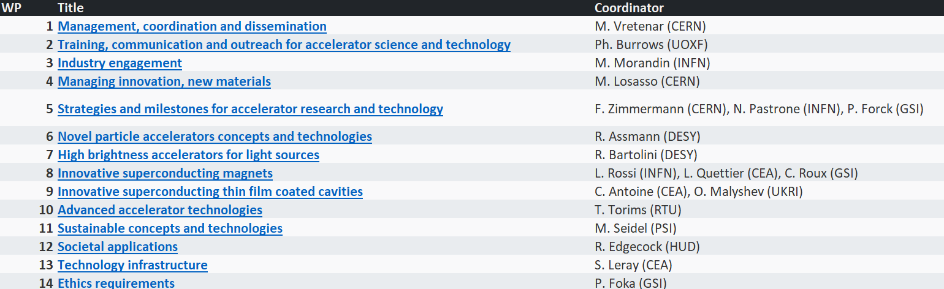
Reminder: I.FAST Work Packages

Slide 37
Housekeeping
Centrally provided templates (e.g. slides) should be used consistently by all speakers.
Number of slides should be better adjusted to allocated time slot.
Previous SAC recommendations (if available) to be included in all presentations to facilitate dialogue and longitudinal tracking.
A dedicated time slot should be foreseen in the program to allow SAC to discuss their findings and write their report.

Slide 38
