Slide 1



Electron-beam based neutron sources
Laurence Wroe (CERN, ATS-DO)
laurence.wroe@cern.ch
Javier Olivares-Herrador, Andrea Latina,
Steinar Stapnes, Walter Wuensch
4th iFAST Annual Meeting, Krakow, Wednesday 9th April 2025

Slide 2
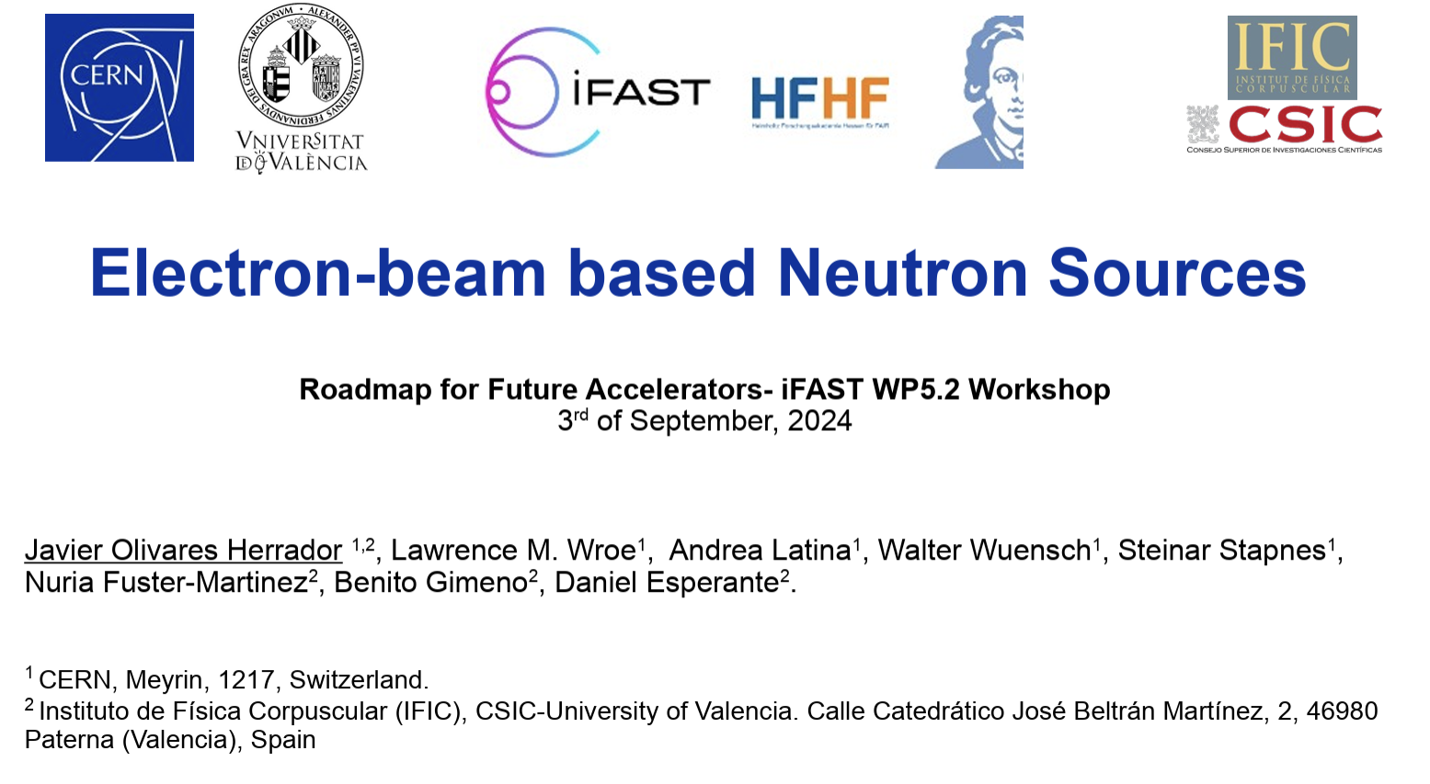

Introduction
Aim: Outline the considerations and performance of electron-beam based neutron sources at both compact and larger scales.
Contents:
  Neutrons: Applications; Supply and Demand; Production
  Electron-beam based neutron sources: Compact & Beyond
Additional resources:
  https://indico.gsi.de/event/19422/contributions/81834/
  https://indico.cern.ch/event/1459602/
  Publication in review – watch this space

Slide 3
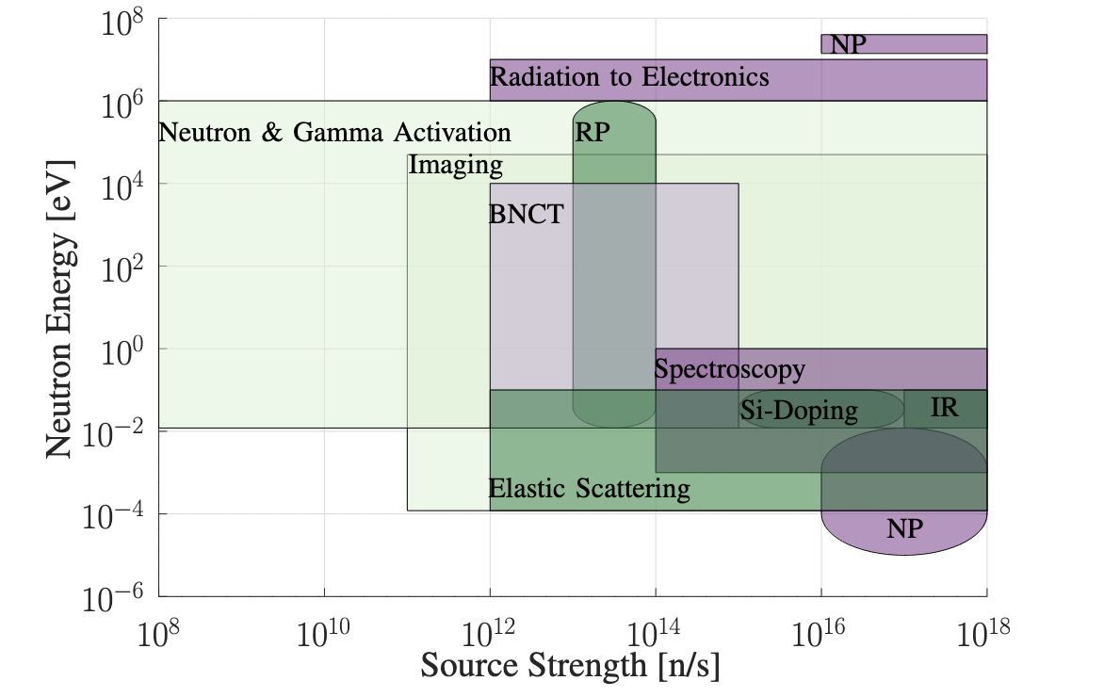
Neutron Applications
Wide-range of applications
  Scientific
  Industrial
  Medical
BNCT = Boron Neutron Capture Therapy
NP = Nuclear Physics Research
RP = Radioisotope Production
IR = Irradiation experiments
Data from [1], [2]

Slide 4
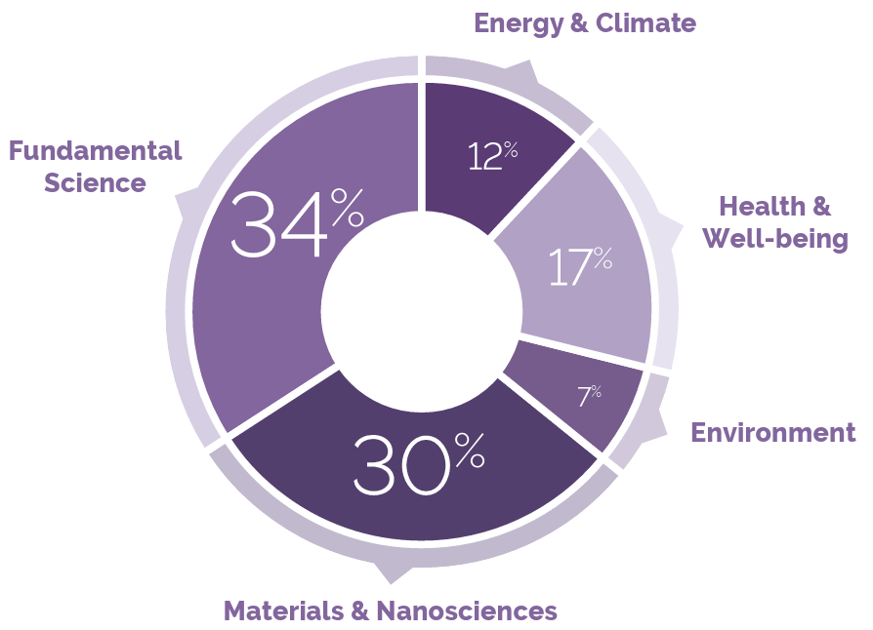
Demand for Neutrons
Scientific [3]:
  Over 4,000 peer-reviewed neutron scattering publications each year
Industrial / societal [4]:
  Energy storage – in-operando testing for next generation batteries
  Materials – measurements of stresses for material advancement
  Environment – in-operando testing of next generation solar-cells
  Security – analysis of single-event effects
Medical:
  Drug discovery – non-destructive and deep probing of biological samples (e.g. proteins)
  BCNT – 33 facilities worldwide [5]
Neutron beam-time usage averaged over ILL, ISIS, and LLB
Taken from [4]
  Oversubscription rate to neutron beamtime of between 2 and 5 times.
  Acknowledged underexploitedness and underservedness of industry.

Slide 5
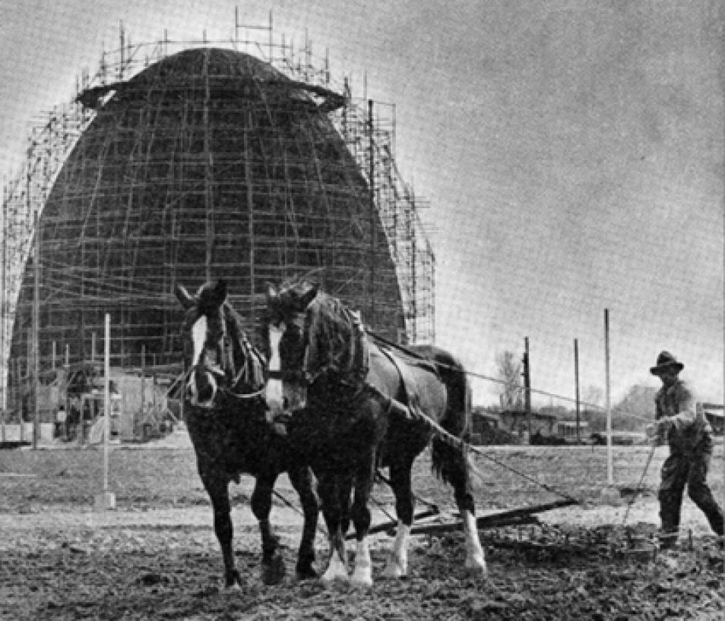
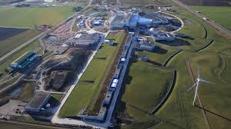
High Neutron Flux
Nuclear Research Reactors
(stats for power > 1 MW [6])
  91 in operation
  17 planned / under construction
  But 182 shutdown / decommissioned
Spallation Sources
  11 in operation
FRM I nuclear reactor, Munich, 1957
ESS, Lund
“…the neutron community therefore faces the very real prospect of having very few operational neutron sources in Europe by 2030.” [4]

Slide 6
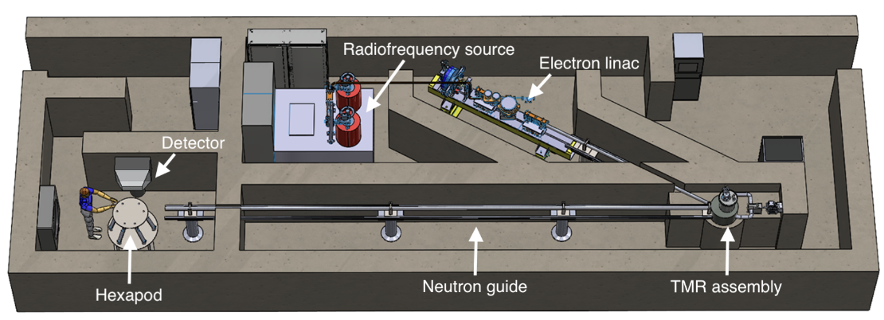
Medium Neutron Flux
Compact Accelerator Neutron Sources (CANS) can offer a solution for a medium flux scale
  More scalable because of a lower cost, complexity, infrastructure
  Tailored to specific application to compensate for a lower-flux
Example of a conceptual design of VULCAN
(Versatile ULtra Compact Accelerator-based Neutron source)

Slide 7
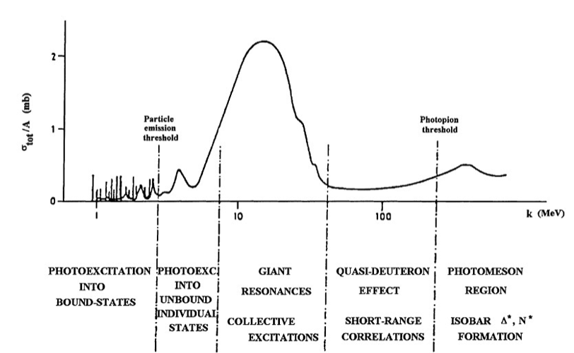

Accelerators – Hadron vs Electron
Hadron accelerators generate neutrons directly through:
  Spallation (> 100 MeV, 1-2 GeV more optimal)
  1-stage nuclear reaction (< 100 MeV)
    e.g.
Electron accelerators predominantly generate neutrons through:
  A primary Bremsstrahlung reaction
  Then a secondary photoreaction
Let’s compare the technologies!
Photonuclear cross-section W(g,n)
Taken from [7]

Slide 8



VULCAN – An Electron-based CANS
Turnkey solution for generating cold / thermal neutrons (λ ~ Å; v ~ 1 km/s)
  optimised for stress measurements in an industrial setting
  also suitable for neutron powder diffraction measurements within a university campus
Danish Technology Institute
DAES SA
Xnovo

Slide 9
VULCAN – Technology Choice
Why electron-driven?
  Neutron yield per kW of beam power is comparable between a
  35 MeV electron beam and a < 10 MeV proton beam
  Electron acceleration to 35 MeV is relatively simple and cheap
  High-gradient accelerating technology can be utilised for a compact accelerator design
  High-gradient accelerating technology is compatible with the desirability of a pulsed particle beam for time-of-flight neutron measurement

Slide 10

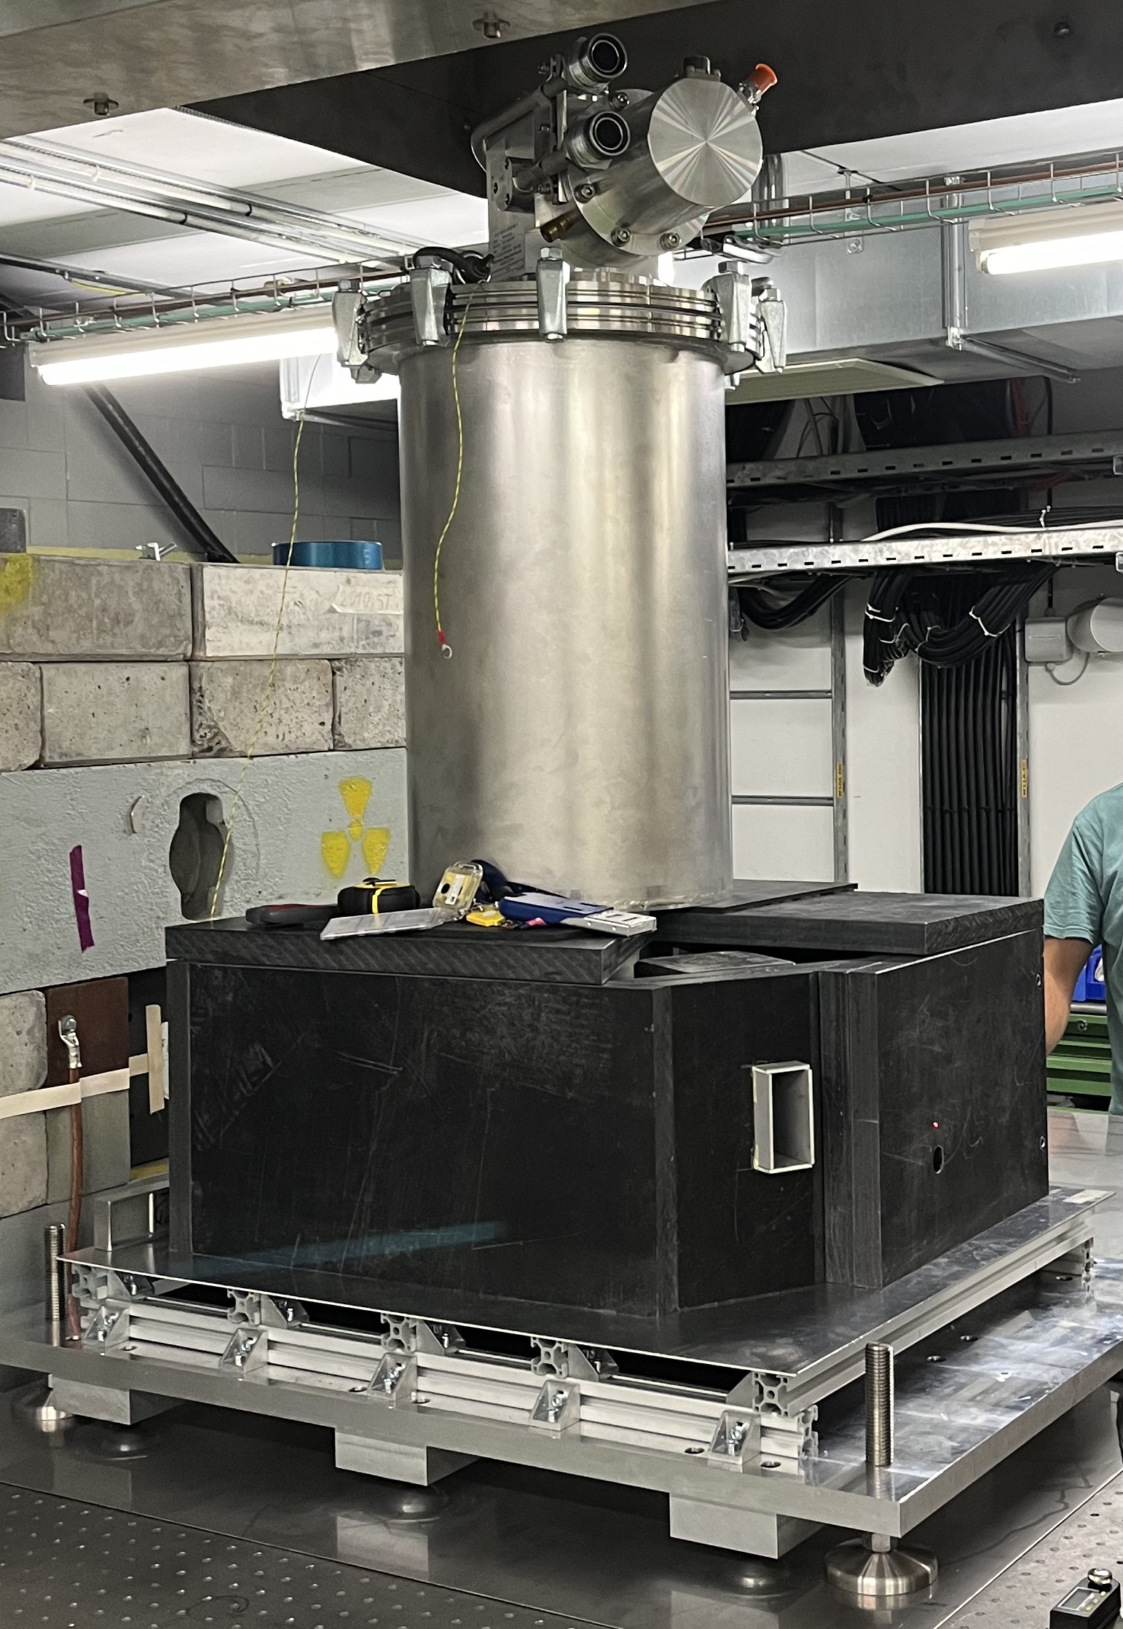
Project VULCAN – Status
CERN-DAES collaboration
(2023-2025) delivering:
  Conceptual design of the electron accelerator
  Proof of concept of DAES’ target-moderator-reflector assembly in CERN’s CLEAR accelerator
DAES are seeking funding for the fabrication of a first machine
The VULCAN prototype TMR

Slide 11
Electron-Beam Based Neutron Sources
“Is a high-gradient electron linac a suitable driver for neutron production?”
Studies undertaken that:
  Determine the electron beam specification achievable with:
      Accelerators based on high-gradient S-band technology
      Accelerators based on high-gradient X-band technology
  Model neutron production with calculated electron specification
  Characterise the unmoderated neutron spectrum
  Compare with state-of-the-art neutron facilities

Slide 12
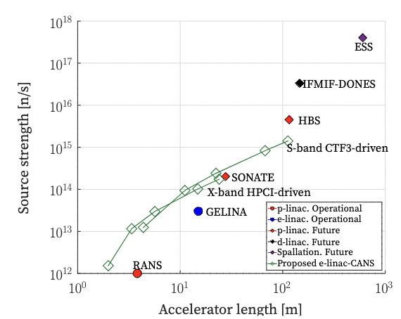
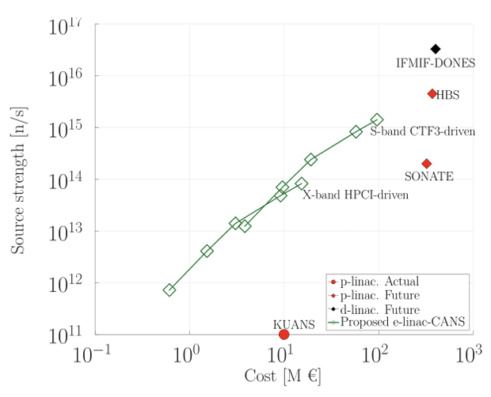
Example Findings
Neutron production is a trade-off between beam power, cost, and length
High-energy, high-intensity electron linacs can provide bright neutron beams to a specification comparable to proton-linac and spallation sources

Slide 13
Conclusions
Aim: Outline the considerations and performance of electron-beam based neutron sources at both compact and larger scales.
There is an ever-increasing need for neutron sources, yet the supply is predicted to diminish as facilities shut down
Electron-based neutron sources can be suitable for generating medium-fluxes as small-scale CANS and higher-fluxes as much larger machines
Thank you for listening!
Please do not hesitate to ask me questions now or later

Slide 14
Bonus Slides

Slide 15
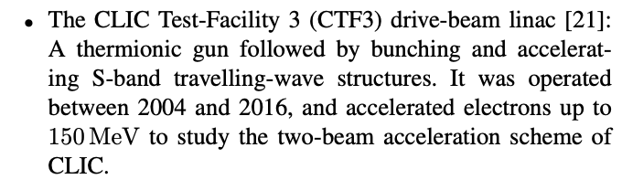
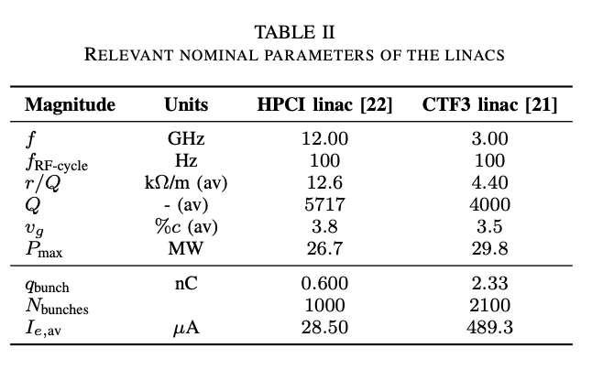
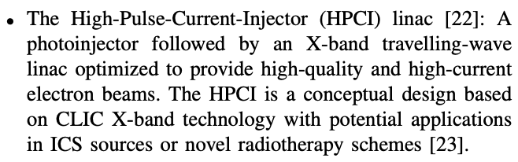
Bonus Slides

Slide 16
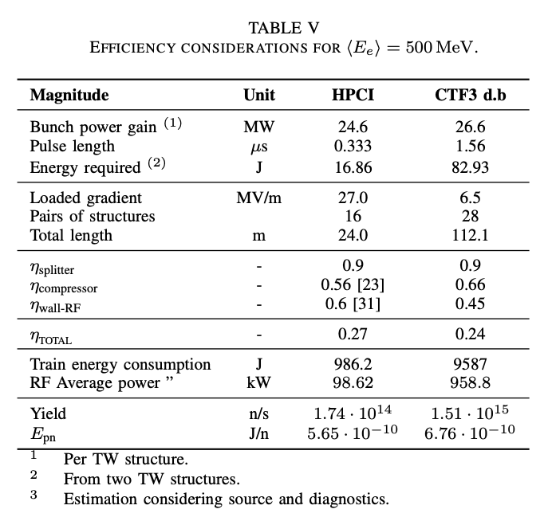
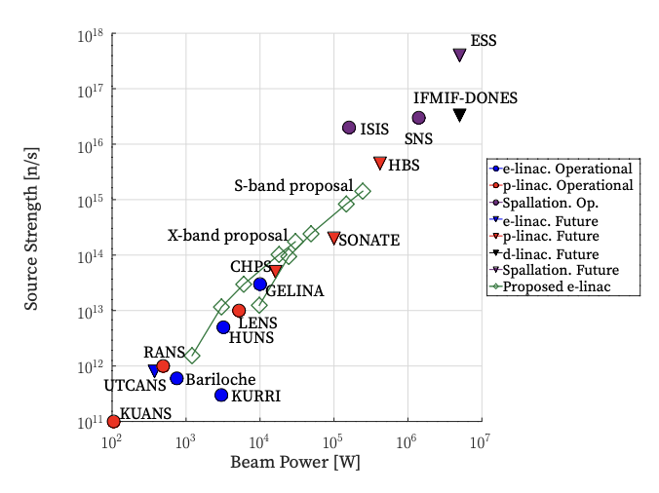
Bonus Slides

