Slide 1



SUSTAMAG
HORIZON-INFRA-2025-01-TECH-01:
New technologies and solutions for reducing the environmental and climate footprint of research infrastructures
Lucio Rossi , INFN & Univ. of Milan
On behalf of preparation group:
O. Meyer (CEA), L. Tabarez (CIEMAT), S. Sanfilippo (PSI), P. Spiller (GSI), B. Prause (Bruker EAS gmbh)

Slide 2
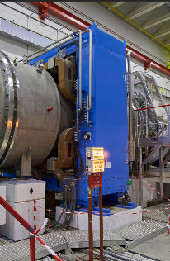
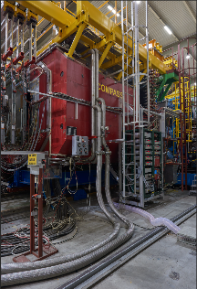
The issue
Magnets and related systems are among the largest source of consumption in Large Accelerator Infrastructure (especially for hadrons)
Magnets are among the bulkiest and heaviest equipment and requires maintenance and consolidation and dismissal.
Cooling of resistive magnets requires a technical infrastructure that is not negligible in consumption and complexity.
MNP33-2016:
7560 MWh
378 kCHF/year
SM2-2016:
6953 MWh
348 kCHF /year
Courtesy: Philip Schwarz, CERN

Slide 3
Sustainability Challenges in Research Infrastructures
• Magnets contribute significantly to energy and cooling demand: true for Normal Conducting but also for large cryo-plant for SCM
• Traditional cryogenic systems depend heavily on helium — limited supply and high energy costs
• Infrastructure consolidation and efficient systems are essential to meet climate targets
• Environmental cost of materials and end-of-life waste management often neglected

Slide 4
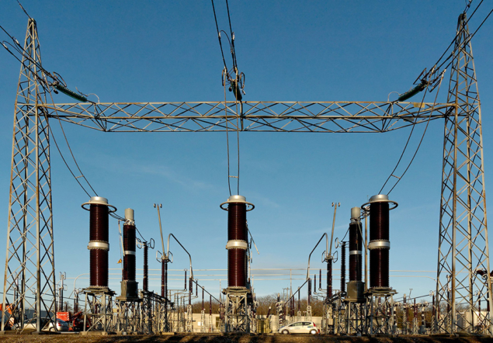
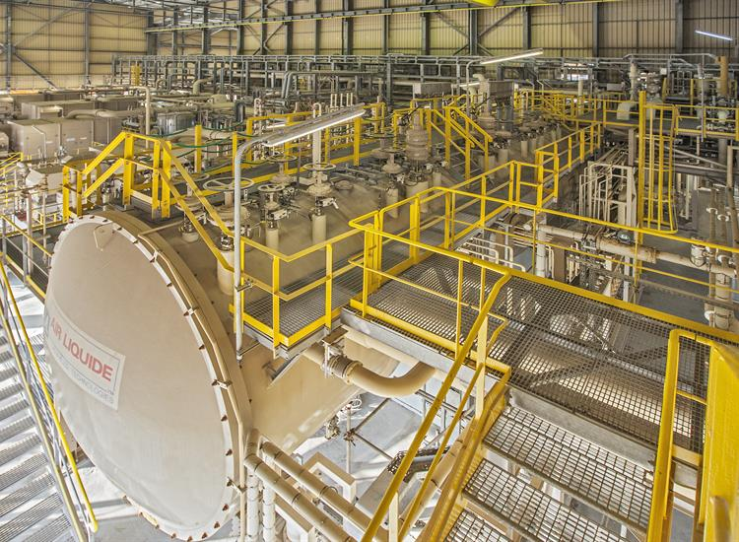
HTS : not a mitigation measure, rather a disruptive opportunity
• Higher critical fields and operating temperatures than LTS → reduced cooling needs
• Compact coils enable smaller infrastructure, reduced footprint
• Potential to operate at >20 K using He gas, cryocooler or sub-cooled nitrogen (mixture of Ne/He may also be investigated for certain case)
• Up to 10× lower energy usage demonstrated in concrete example study (e.g., ESABLIM, see later)
Innovative technologies: HTS at > 20 K; SC power links; PM (permanent magnets) can help to:
  Substantially reduce the energy consumption
  Reduce the electrical infrastructure (less power, less amperage, less water-cooling station) of present accelerator complex.
  Reduce use of pollutant like polymeric resins and other insulations
  Increase radiation hardness → less maintenance in high radioactive areas
  For future large SC accelerators: FCC, MC, …: reduce the dependence on He molecules (He is a byproduct of hydrocarbons)
CERN electric distribution line
Qatar LNG production plant

Slide 5
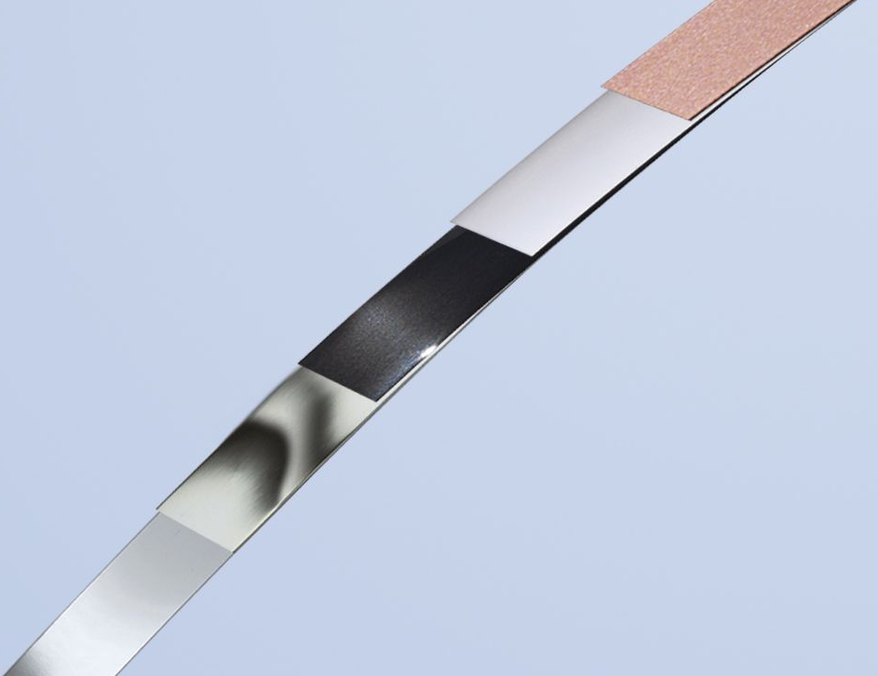
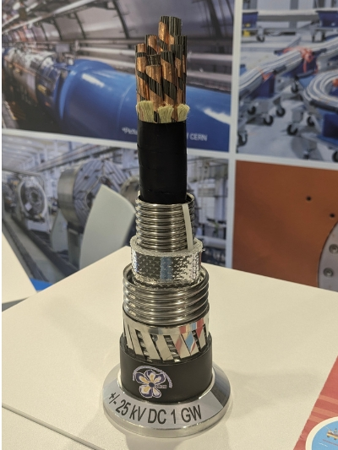
HTS for Sustainability:
A Full Life-Cycle Approach
• Begin with raw material sourcing (e.g. rare earth elements in REBCO tapes)
• Evaluate the carbon footprint of HTS magnet production (extraction, refinement, fabrication)
• Study energy use and cooling efficiency during operation (20–65 K cryogenics)
• Minimize resource use and environmental impact via compact design, low power consumption.
Look for best radhard insulation (or NON-Insulated, possible for HTS!).
HTS would allow also for “shielding the coil from direct irradiation”.
• Plan for end-of-life dismantling, recycling, and safe waste disposal.
• Develop tools for life-cycle analysis (LCA) across research infrastructures
REBCO tape (Bruker & CERN, FP7-Eucard2 project)
SC green line for 1GW in MgB2 (IRIS project, INFN-Milano-LASA and ASG )

Slide 6
However: energy saving is key but not all
Comparison among all systems
Assessing (for 1st time) total carbon footprint from mining to final product).
  SCM (SuperConducting Magnets)
    HTS
    LTS
  NCM (Normal Conducting Magnets)
  PMs
Operation
  Energy saving by use SCM(or PM) wrt to NCM
  Reduction of Infrastructure by use of SCM (for power & cooling, and heat rejection with water)
Dismissal of the facility at end of life
  Opportunity of recycling
  Storage of radioactivated waste
  Dangerous waste

Slide 7
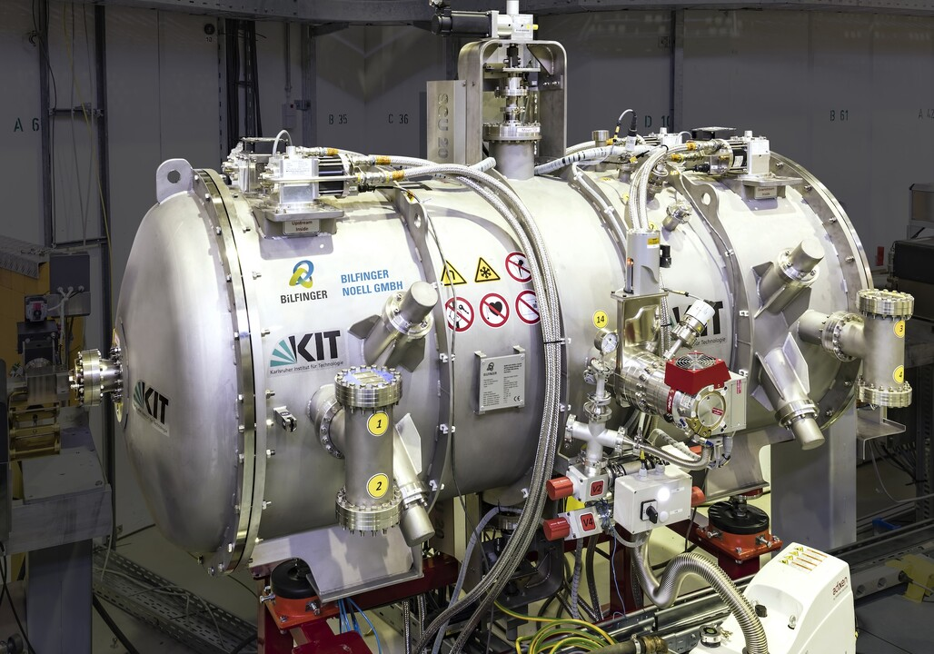
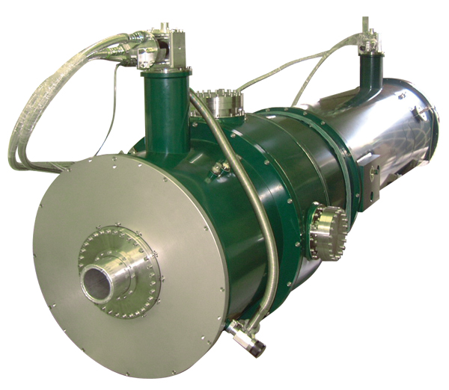
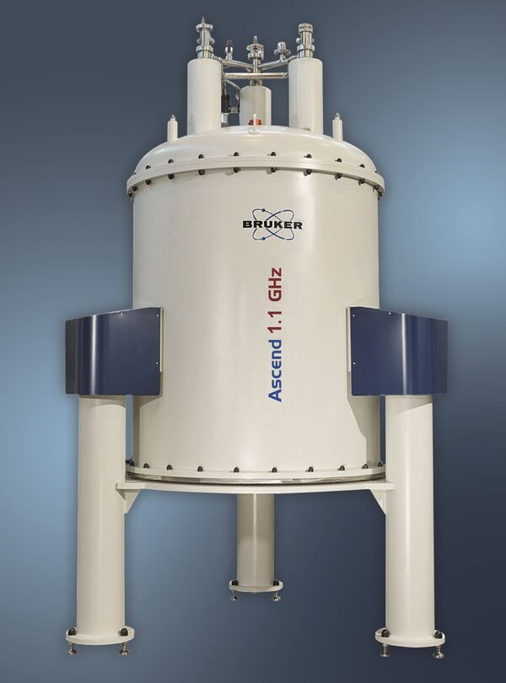
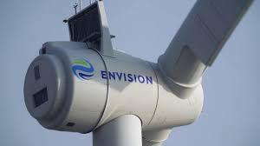
These themes are not only for HEP & NP
Also are in common with:
LS (Light Synchrotron) and FEL applications
Neutron scattering applications
High field science and NMR
Medical applications, including therapy and MRI
Power generation, including fusion
Transportation and mobility
SC undulator magnet (courtesy of Bilfinger (Wurzburg, De)
SC HTS wind generator, Denmark
SC LTS+HTS NMR magnet – 28 T, by BRUKER (De)
Cryogenic Limited (London) Sc system for neutron scattering

Slide 8
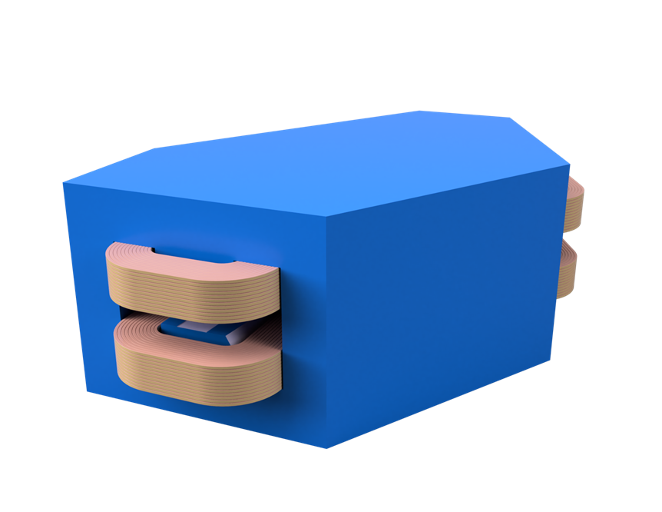

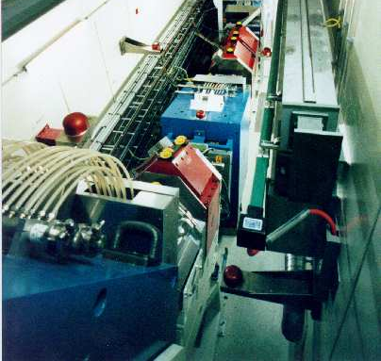
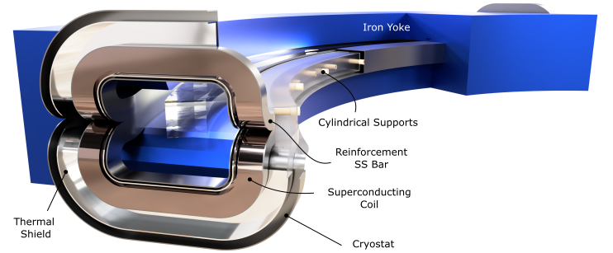
Possible Real prototypes – 1 INFN/UMIL
ESABLIM (Energy Saving Accelerators and Beam Lines Magnes
  Prototype of short magnet for AHO dipole (PSI) or CNAO main bend revamped with HTS conductor coils
Reduction with HTS: by 10-50
Now 260 → 500/700 MWh/year
715 MWh/year

Slide 9
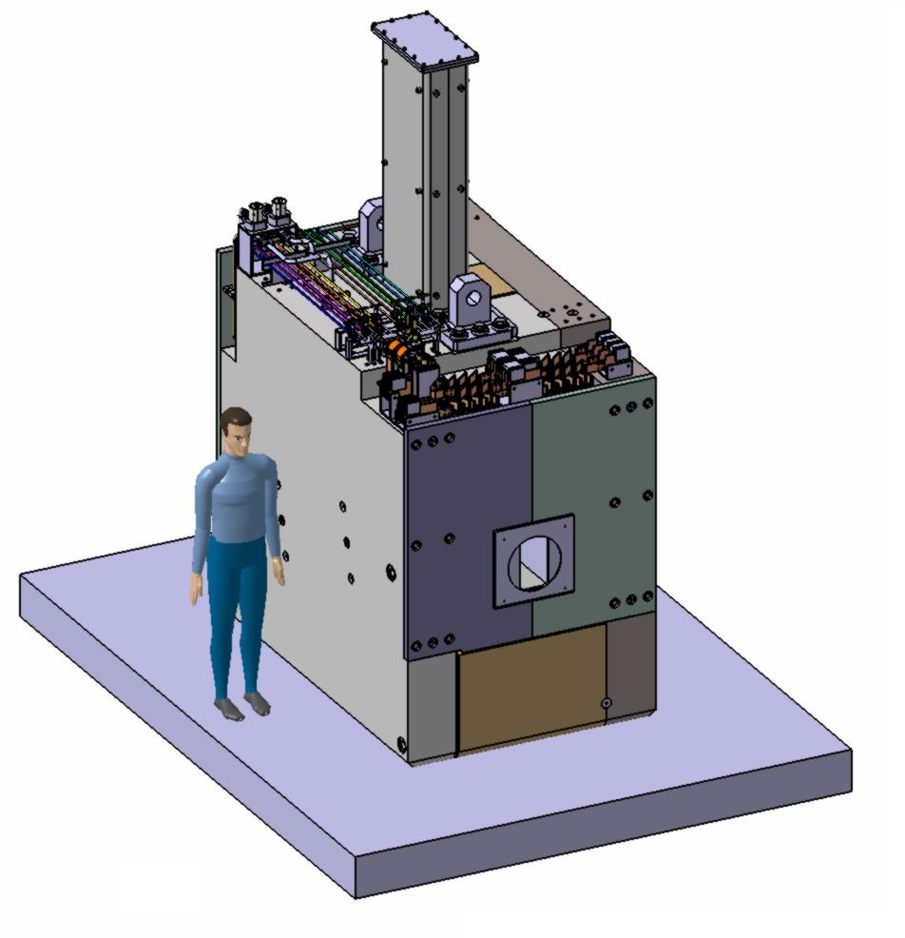
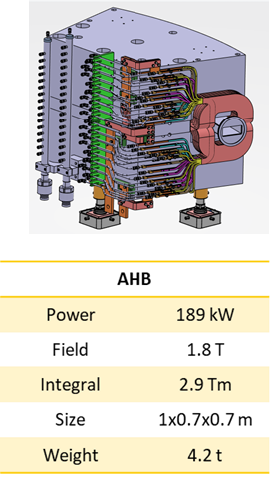
Possible Real prototypes – 2 PSI
SMILE project
PSI HIBM solenoids Prototype , with HTS coils
AHL
Power | 61 kW
Field | 1.12 T
Integral | 2.5 Tm
Size | 2.3x2.3x1.5 m
Weight | 48 t

Slide 10

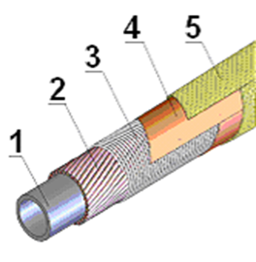
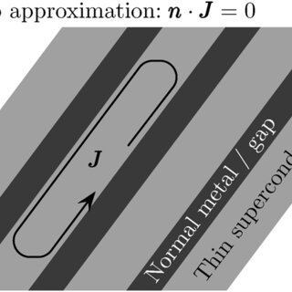
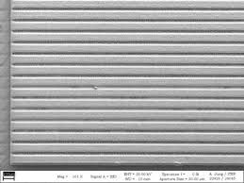
Possible Real prototypes – 3 GSI/FAIR
For low loss fast (> 1 1T/s) ramped magnets
PoP in IFAST of low loss striated tape in cable
→ PoP of subsize real HTS magnet : final focus quadrupole for HEP/NP and also for inertial fusion

Slide 11
Partners & Issues
Beneficiaries
  CEA
  CERN, needed as Int. Org.
  CIEMAT
  GSI/FAIR needed as ESFRI landmark
  INFN & UMIL
  PSI (Project Coordinator) : DECIDED!
  University specialist in these issues: KIT ?
  (Desy will pursue a different path – A. Klumpp, D. Volker. However, we can reconnect…)
Industry (as beneficiary)
  Bruker EAS gmbh (Hanau, De)
  Company expert of carbon footprint evaluation (also recycling)

Slide 12
Budget rough guess
Coordination & Communication: 0.5 M€
Studies & Assessment:1 M€
Prototypes (1 or 2 ? to be decided) : 2 M€
  Cherry on the cake: at least one at 50-60 K
  (> 65 K use of LN and/or powerful, low dissipation, cryocoolers)
Industrial package to study life cycle of CC materials and participate to thermal study and prototyping): 1.5 M€
Goal for prototypes:
1) move TRL from 3–4 to 5–6, prepare market-ready systems
2) also elucidate magnet design criteria that can become standard

Slide 13
Conclusions
Europe must catch up in HTS conductor production and integration
Strong global competition: US, Japan, Korea, China are moving fast
The time is now:
  From scientific carbon footprint computation and LCA
  To validated prototypes, strategic roadmap and industrial readiness
We propose a bold, EU-led transition to sustainable magnet technologies
The baton goes now to Stephane Sanfilippo PSI for coordinating the application

