Slide 1


IFAST – 4th Annual Meeting
6 GHz cavities:
Closed and Open geometries
WP9 Meeting – STFC update

Slide 2
Deposition of the 6 GHz closed cavities: NbTiN

Slide 3
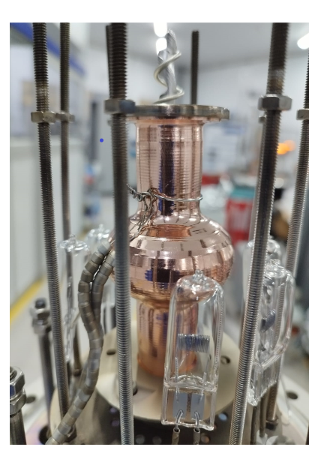
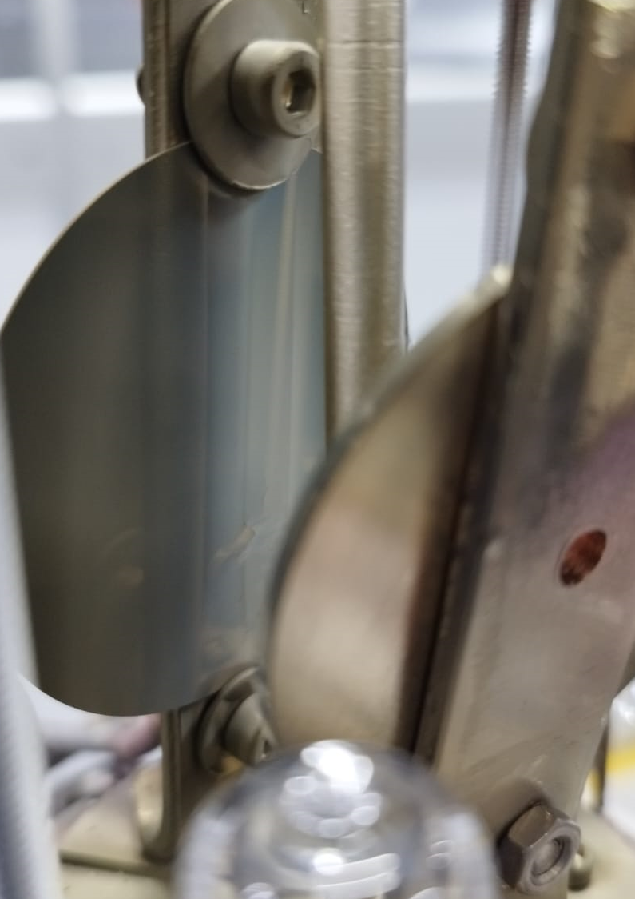
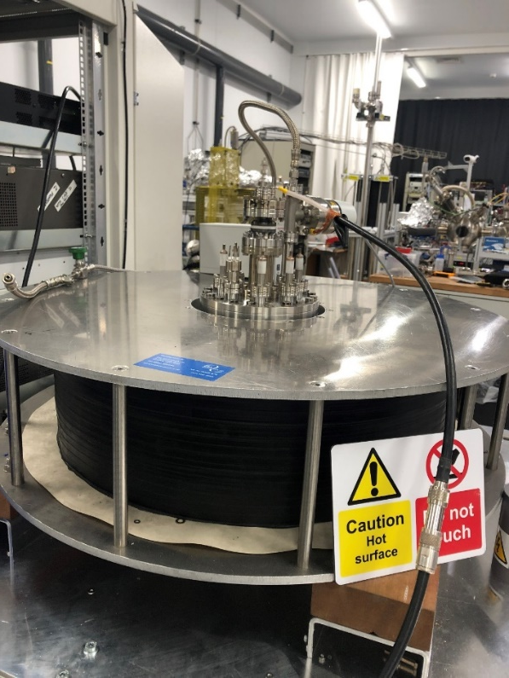
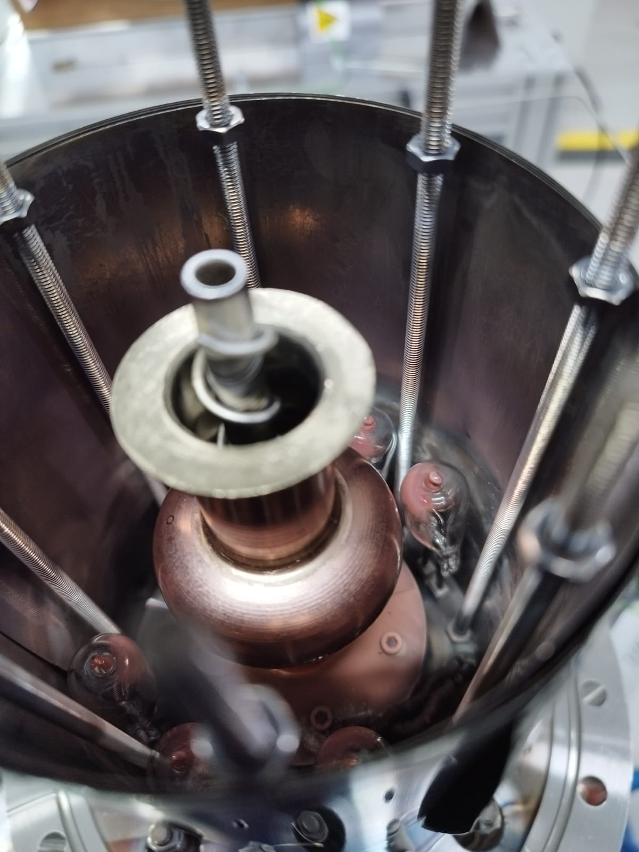
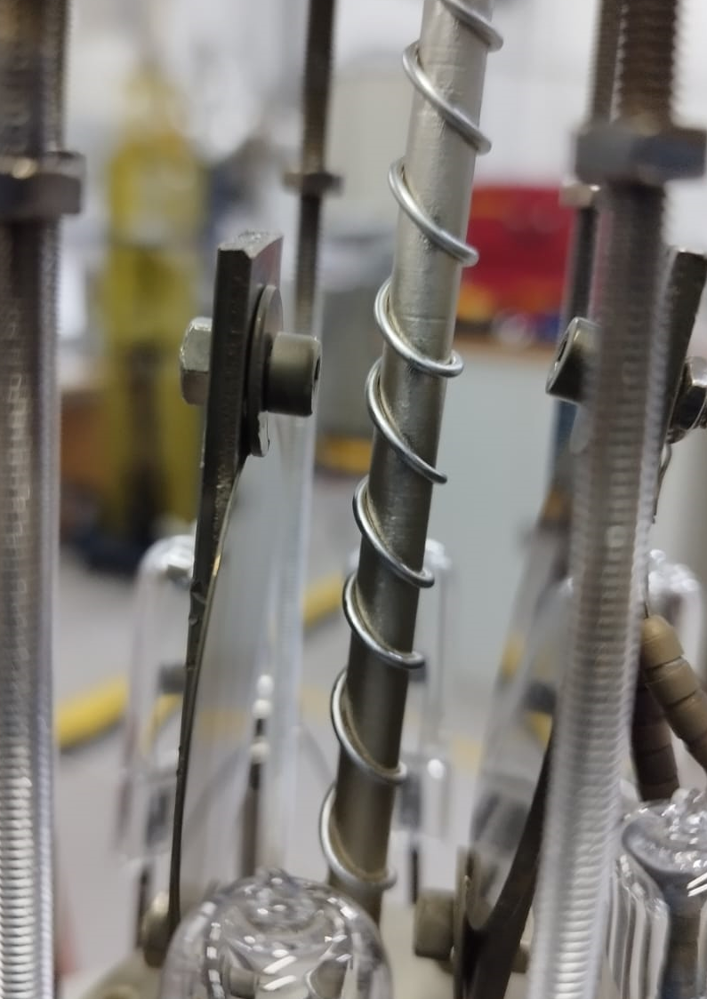
6 GHz Cavity deposition facility
Central target material in the form of a rod.
The sample can be 50 mm Cu/wafer or 6 GHz cavity.
Heating stage consists of six 240 W halogen bulbs for substrate heating up to 700 ºC.
An external coil capable of producing magnetic field of up 800 gauss, provides the magnetic field for the magnetron assembly.

Slide 4
Target material choice for 6 GHz deposition
Niobium/Titanium stoichiometry for NbTiN films were adjusted by target material.
  Target 1: Nb rod with Ti wire.
  Target 2: Nb₃₇Ti₆₃ alloy tube.
  Target 3: Nb₃₇Ti₆₃ alloy tube with Nb wire.

Slide 5
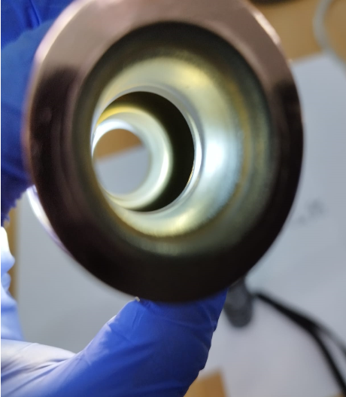
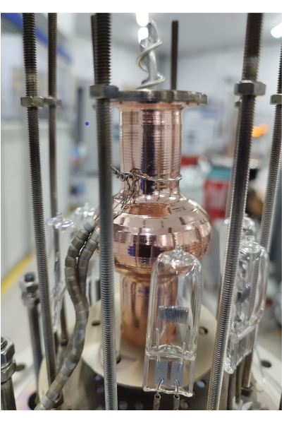
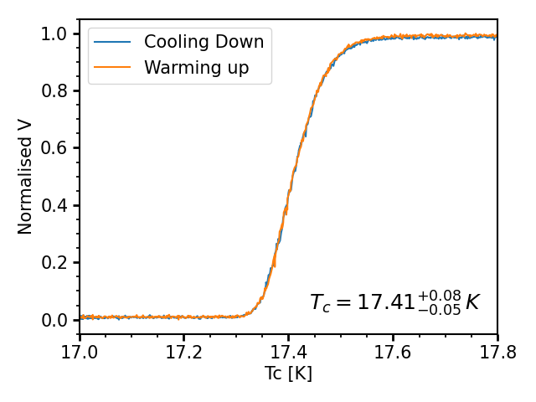
NbTiN from Nb rod with Ti wire
Deposition parameters:
Pulsed DC Magnetron Sputtering
- 200 W Power
- 350 kHz Repetition rate
- 1.1 µs Duty Cycle
- 600 ºC Substrate temperature
- Kr to N₂ (2:1 ratio)
- 5x10⁻² mbar pressure
Test sample using the Nb rod with Ti wire.
Four point probe measurement (FPP) on sapphire test sample shows high T_{c} close to theoretical (~18 K).
SEM showed crystal grains on the order of 10s nm in size.
Positive results suggested a potential deposition method for SRF thin film and therefore a 6 GHz copper cavity was coated.
1 mA

Slide 6
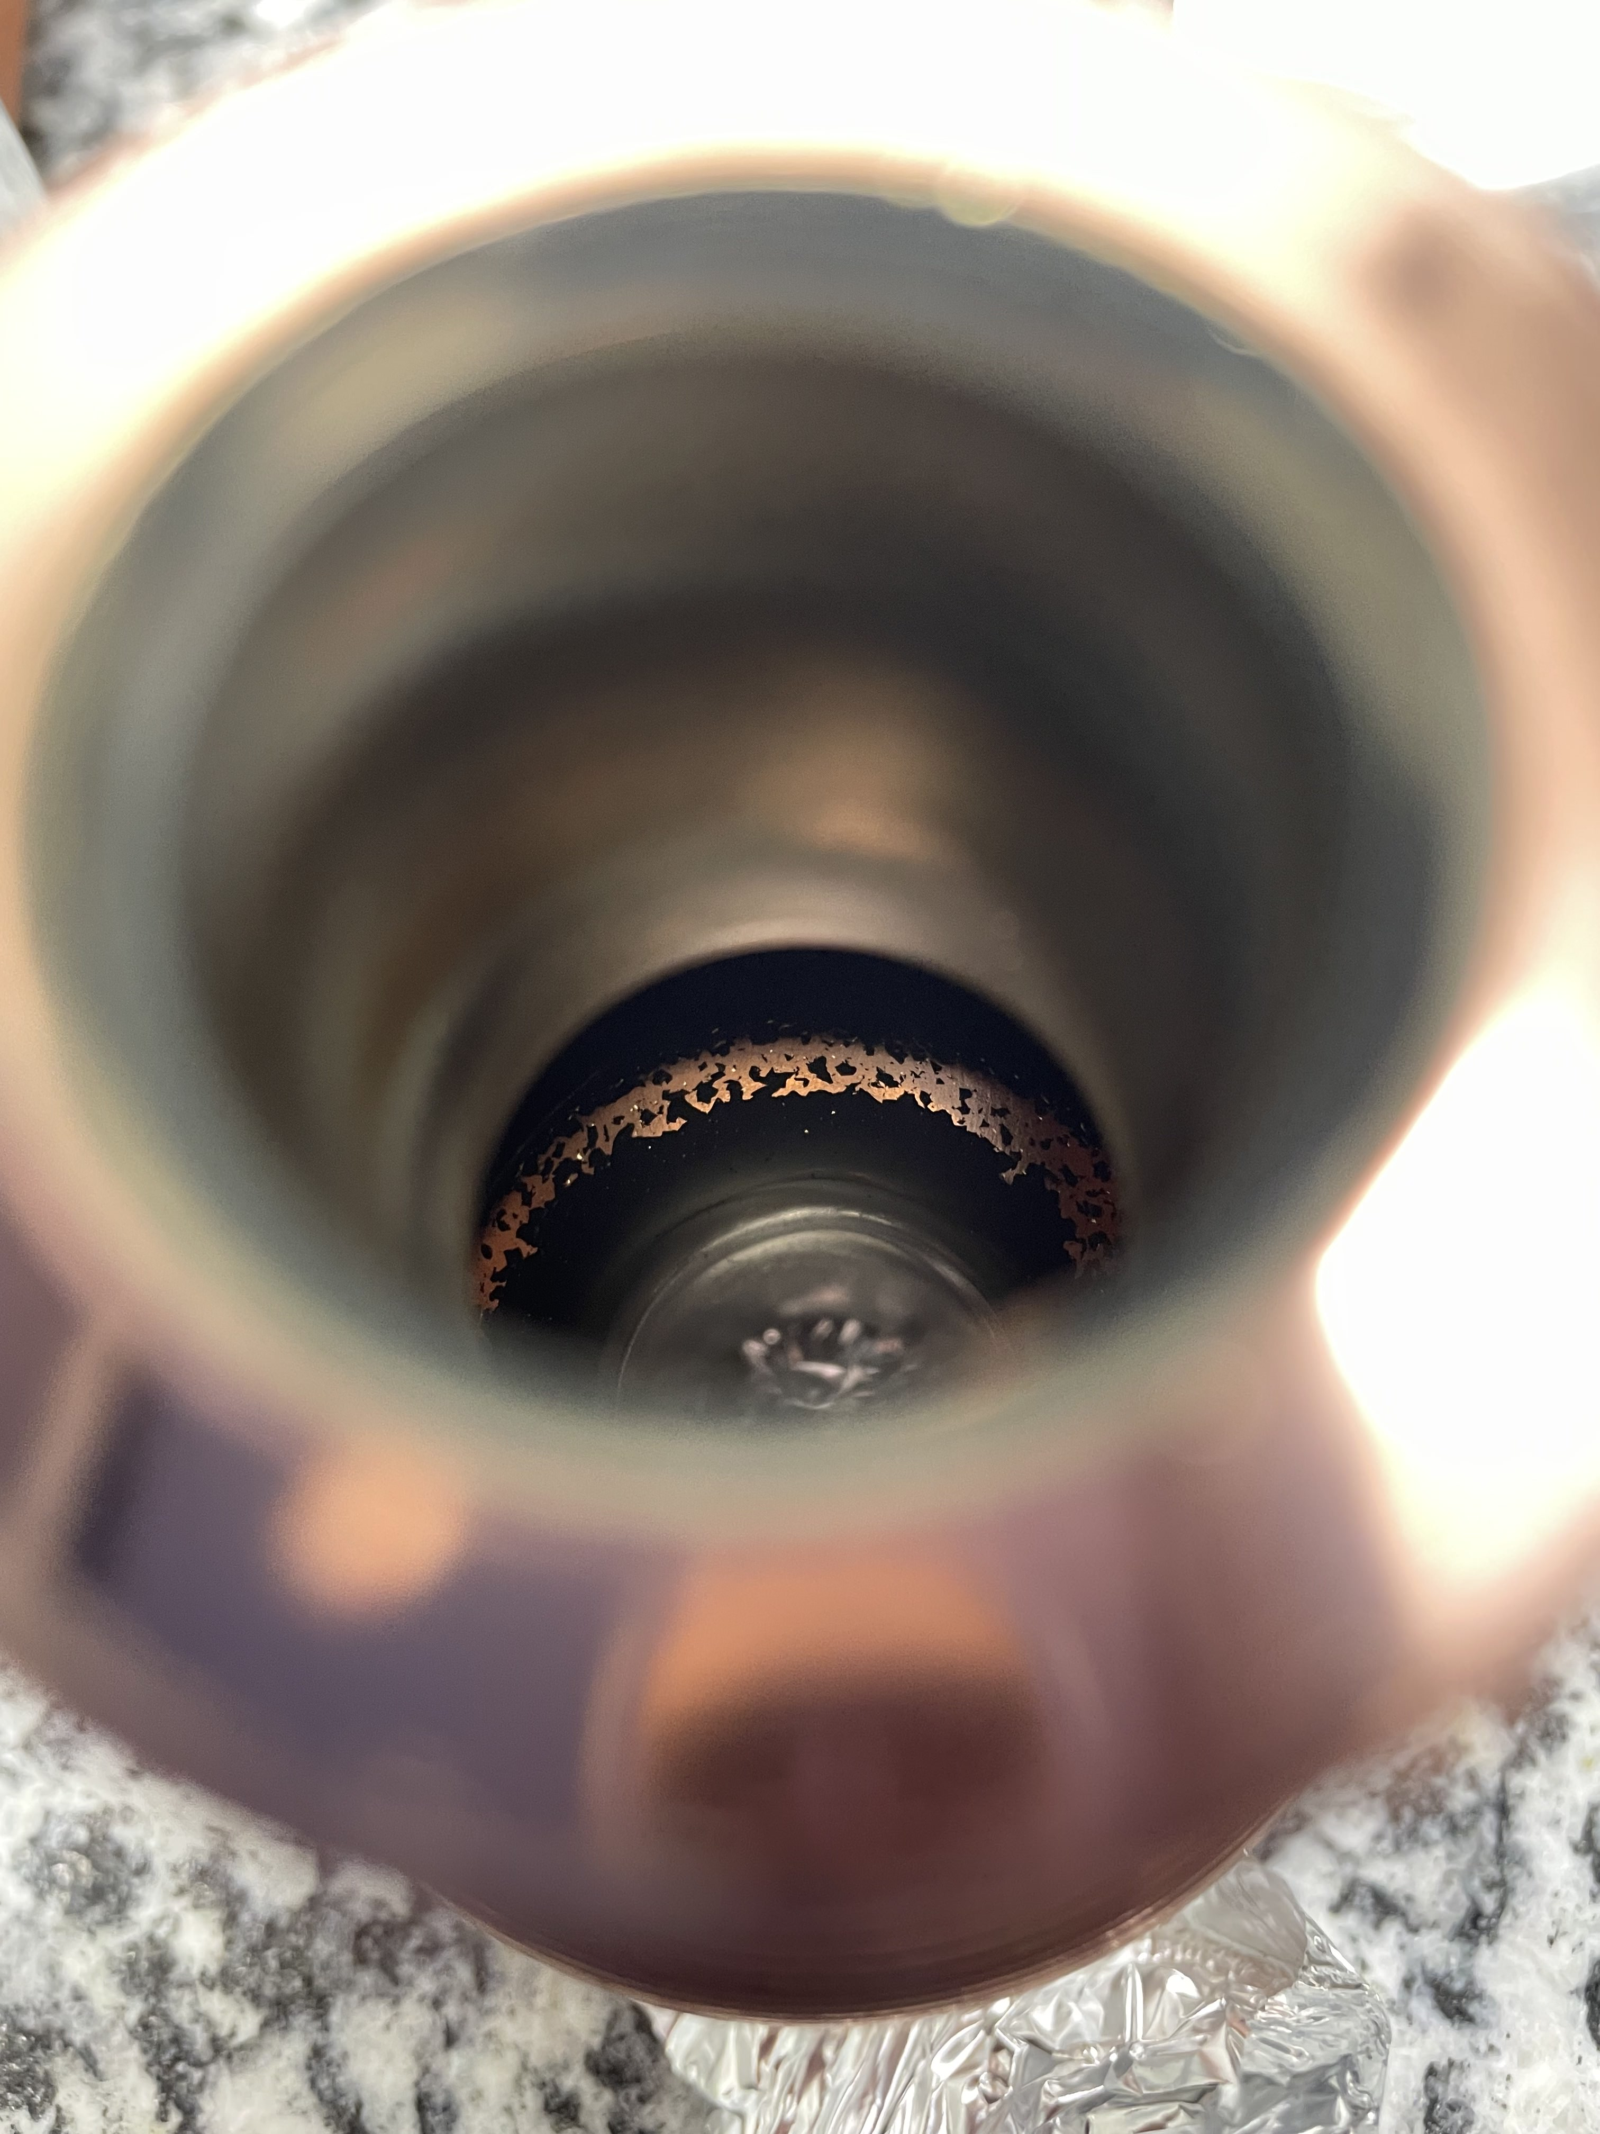
NbTiN from Nb rod with Ti wire
Unfortunately, the cavity delaminated when inspected at INFN
Courtesy of D. Ford

Slide 7
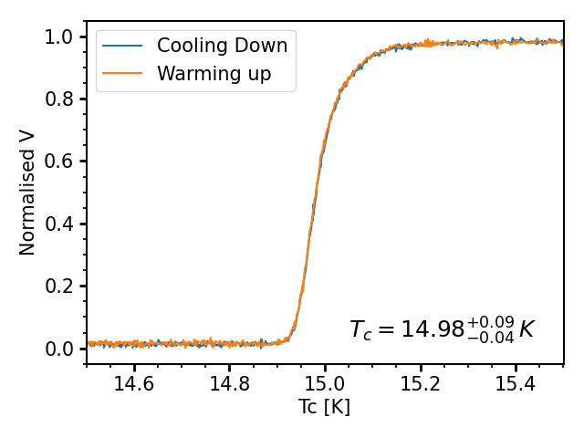
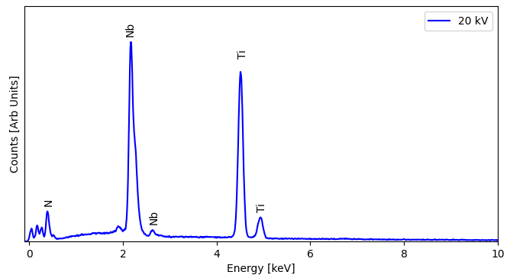
NbTiN from NbTi rod
Test sample using the NbTi alloy rod.
SEM and EDS show a dense structure with uniform stoichiometry.
FPP measured a lower T_{c} of 14.98 K, most likely due to the high Ti content.
Adjustment to increase Nb content before cavity deposition.
Deposition parameters:
Pulsed DC Magnetron Sputtering
- 200 W Power
- 350 kHz Repetition rate
- 1.1 µs Duty Cycle
- 600 ºC Substrate temperature
- Kr to N₂ (2:1 ratio)
- 5x10⁻² mbar pressure
1 mA
Element | Atomic (%)
Ti | 65
Nb | 35
Cu substrate
Sapphire Substrate

Slide 8
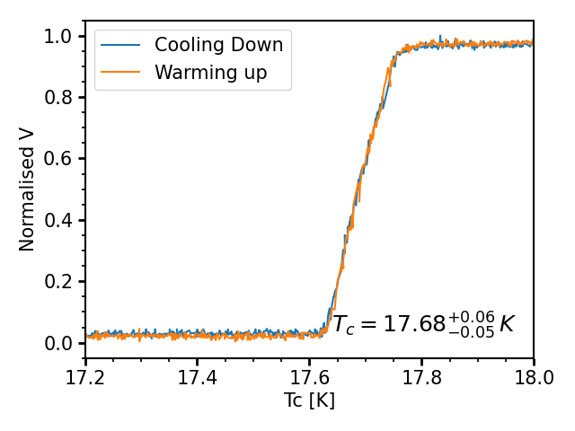
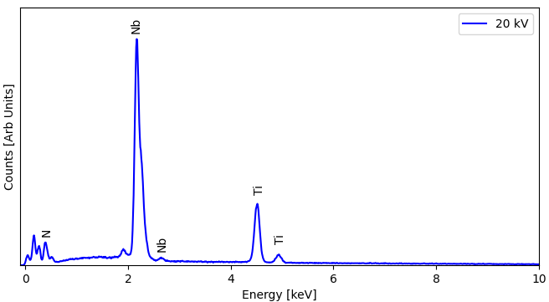
NbTiN from NbTi rod with Nb wire
The NbTi alloy rod was wrapped in Nb wire to adjust Nb:Ti composition.
SEM and EDS continues to show a dense structure with a Nb:Ti ratio (62:38)
FPP on sapphire measured T_{c} of 17.68 K.
After these results a 6 GHz copper cavity was coated.
Deposition parameters:
Pulsed DC Magnetron Sputtering
- 200 W Power
- 350 kHz Repetition rate
- 1.1 µs Duty Cycle
- 600 ºC Substrate temperature
- Kr to N₂ (2:1 ratio)
- 5x10⁻² mbar pressure
1 mA
Cu substrate
Sapphire substrate
Element | Atomic (%)
Ti | 38
Nb | 62

Slide 9
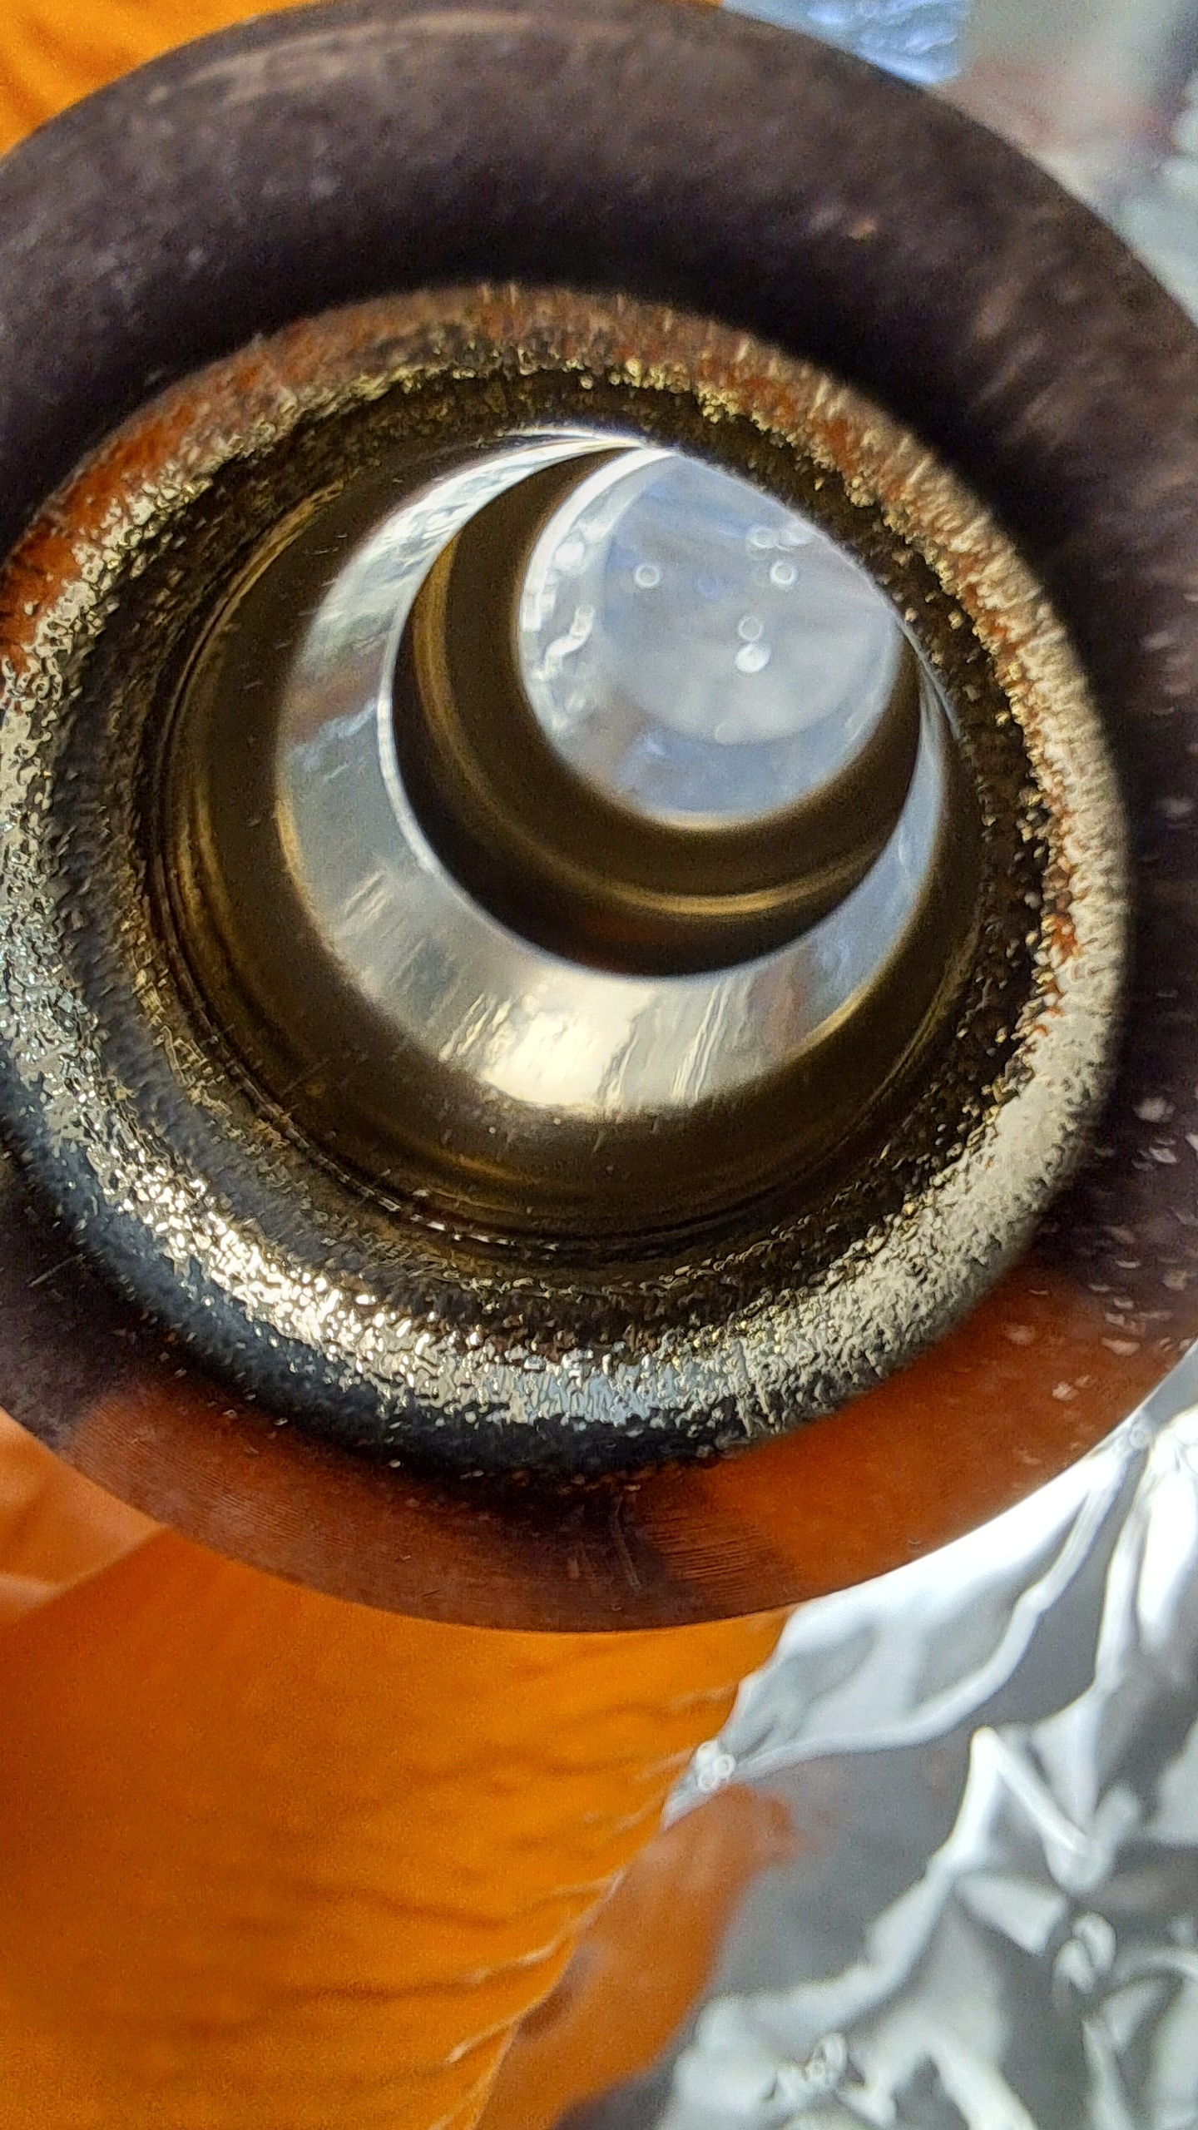
NbTiN from NbTi rod with Nb wire
The NbTi alloy rod was wrapped in Nb wire to adjust Nb:Ti composition.
SEM and EDS continues to show a dense structure with a Nb:Ti ratio (62:38)
FPP on sapphire measured T_{c} of 17.68 K.
After these results a 6 GHz copper cavity was coated.
Deposition parameters:
Pulsed DC Magnetron Sputtering
- 200 W Power
- 350 kHz Repetition rate
- 1.1 µs Duty Cycle
- 600 ºC Substrate temperature
- Kr to N₂ (2:1 ratio)
- 5x10⁻² mbar pressure
Cu substrate
Sapphire substrate

Slide 10
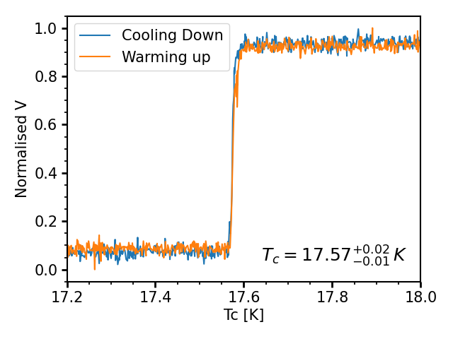
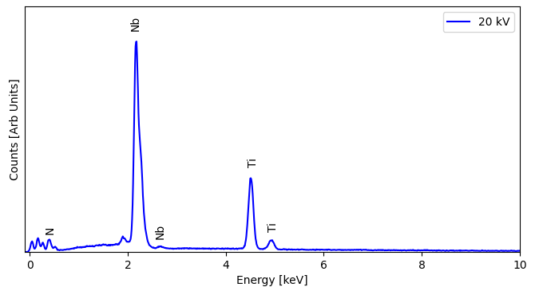
NbTiN from NbTi rod with Nb wire (He)
The NbTi rod & Nb wire deposition was repeated with He as the process gas to adjust the sputtering dynamics.
SEM shows a different structure formation in the film and a lower Nb content by a few %.
FPP on sapphire measured T_{c} of 17.57 K with very sharp transition.
A 6 GHz copper cavity was coated.
Deposition parameters:
Pulsed DC Magnetron Sputtering
- 200 W Power
- 350 kHz Repetition rate
- 1.1 µs Duty Cycle
- 600 ºC Substrate temperature
- He to N₂ (2:1 ratio)
- 5x10⁻² mbar pressure
1 mA
Cu substrate
Sapphire substrate
Element | Atomic (%)
Ti | 42
Nb | 58

Slide 11

Deposition of the 6 GHz split cavity

Slide 12
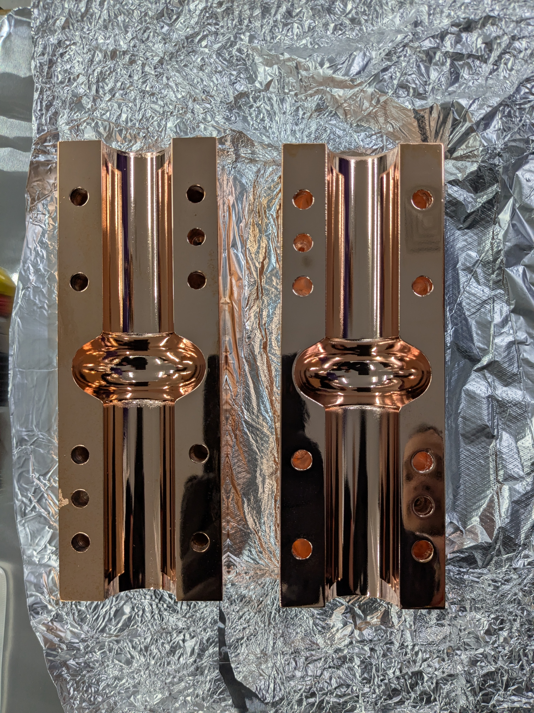
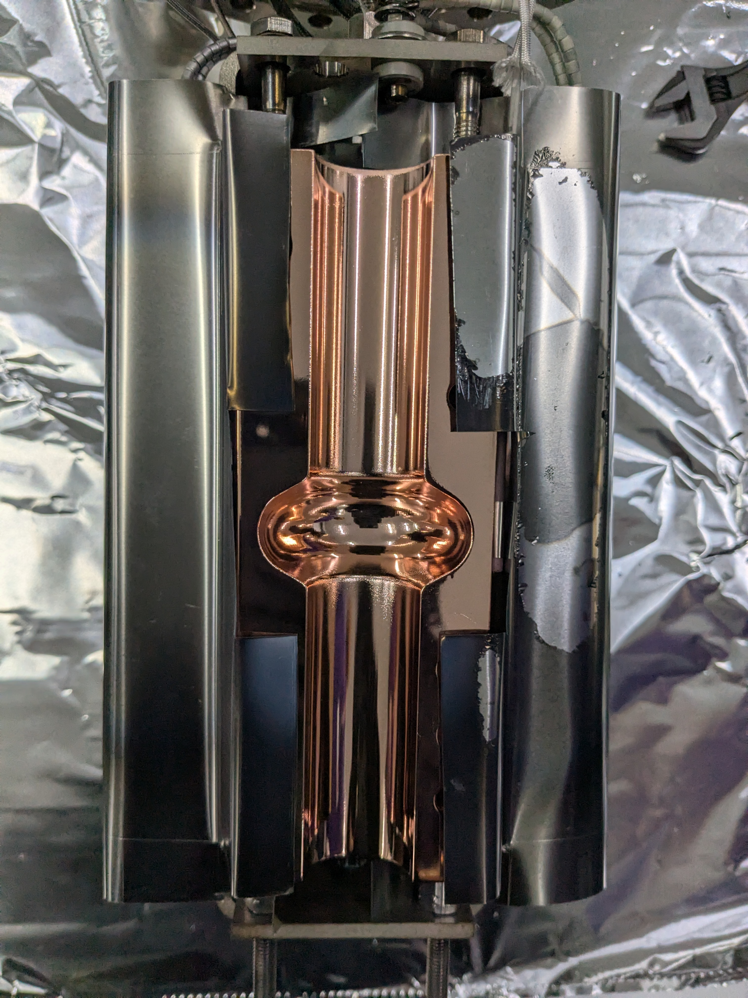
6 GHz Split Cavity
Progress on deposition on the split cavity has resumed as the cryogenic testing facility has been recommissioned - now reaching 2.8 K.
Latest tests have been conducted on cavity A: Which was electropolished by INFN.
Research plan:
Deposit Nb to be tested.
Deposit Nb₃Sn thin film on top of Nb layer.
Cavity A:
as received
Before installation in deposition system

Slide 13
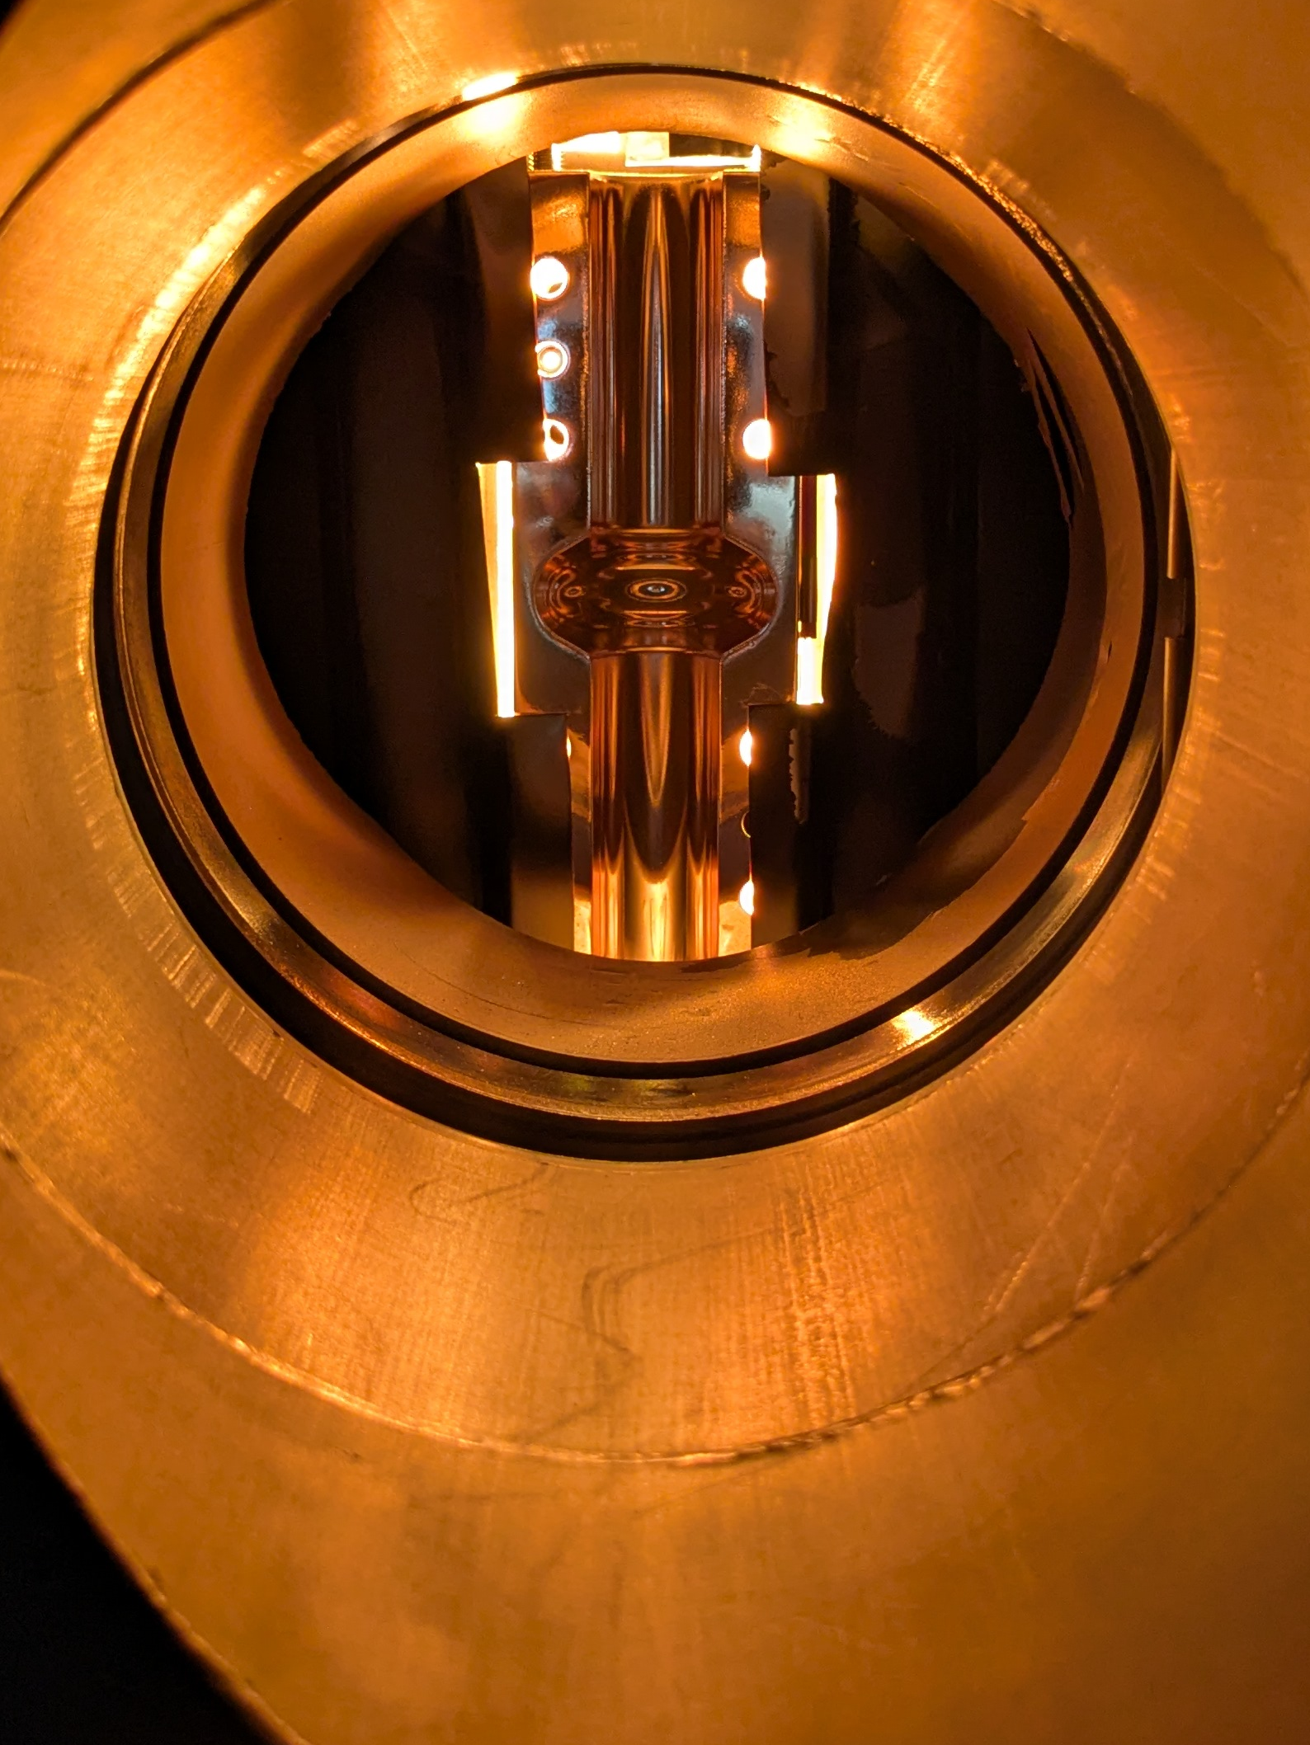
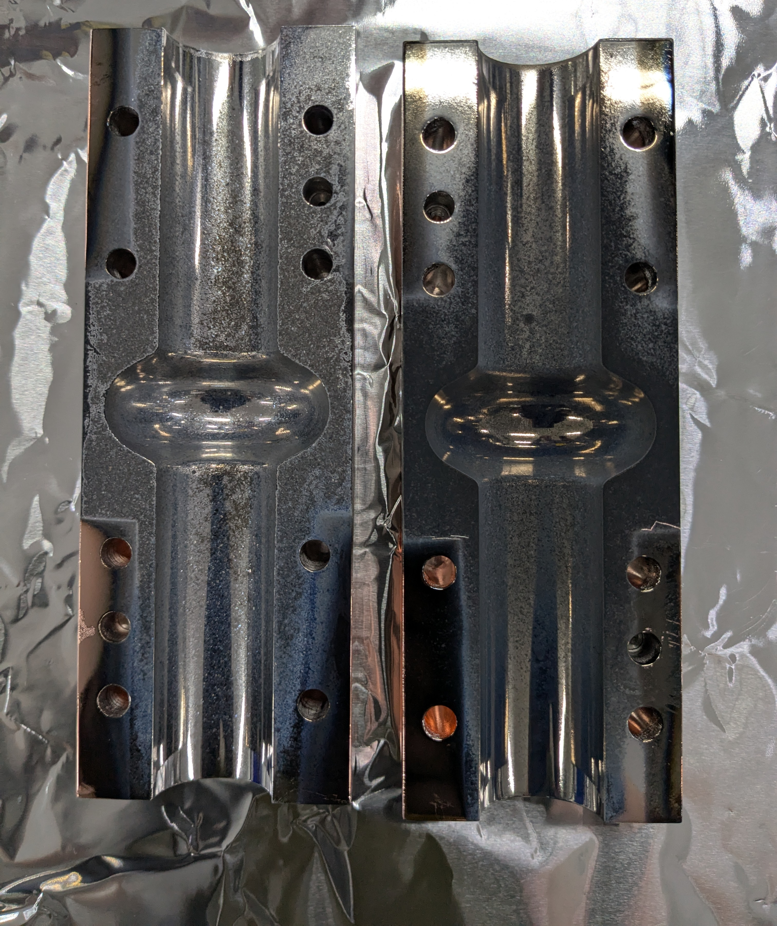
6 GHz Split Cavity: Latest Nb deposition
Deposition parameters:
HIPIMS
- 300 W Power
- 1000 Hz Repetition rate
- 100µs Duty Cycle
- 520 ºC Substrate temperature
- Kr process gas
- 5x10⁻³ mbar Deposition pressure
Face 1
Face 2
Heater stage uses 6 halogen bulbs to heat each face of the split cavity 520 ºC.
Each face was deposited sequentially, 8 hours for each face.
Cavity A:
Heated to 500ºC
Cavity A:
Nb layer deposited

Slide 14
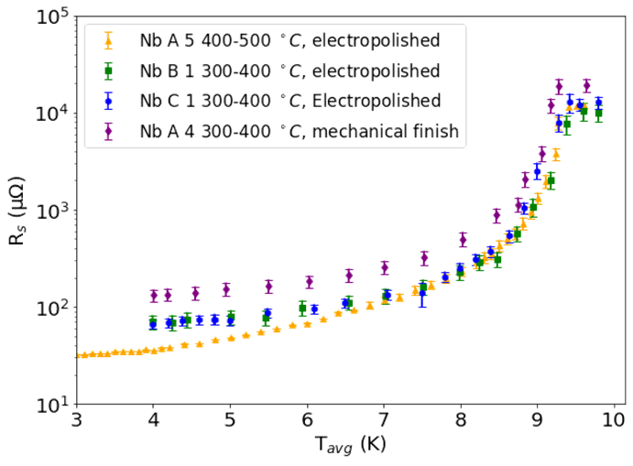
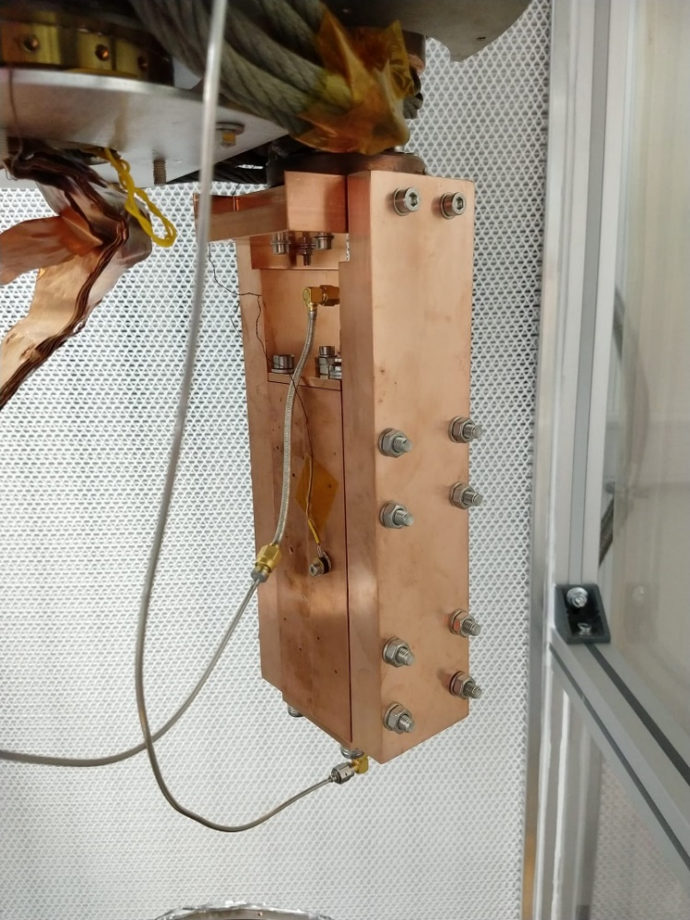
6 GHz Split Cavity Tests
Latest result 38.3 μΩ a factor of two lower than previously deposited electropolished cavities.
Compared to previous the substrate temperature was increased by 100 ºC.
Residual resistance is still an order of magnitude higher than expected.
Investigation into the cause of high residual resistance in the split cavities in ongoing.
 | R_{s, 4.2 K} (μΩ)
Nb A 5 | 38.3
Nb B 1 | 70
Nb C 1 | 70
Nb A 1 | 131
Courtesy of D. Seal &
N. Leicester

Slide 15
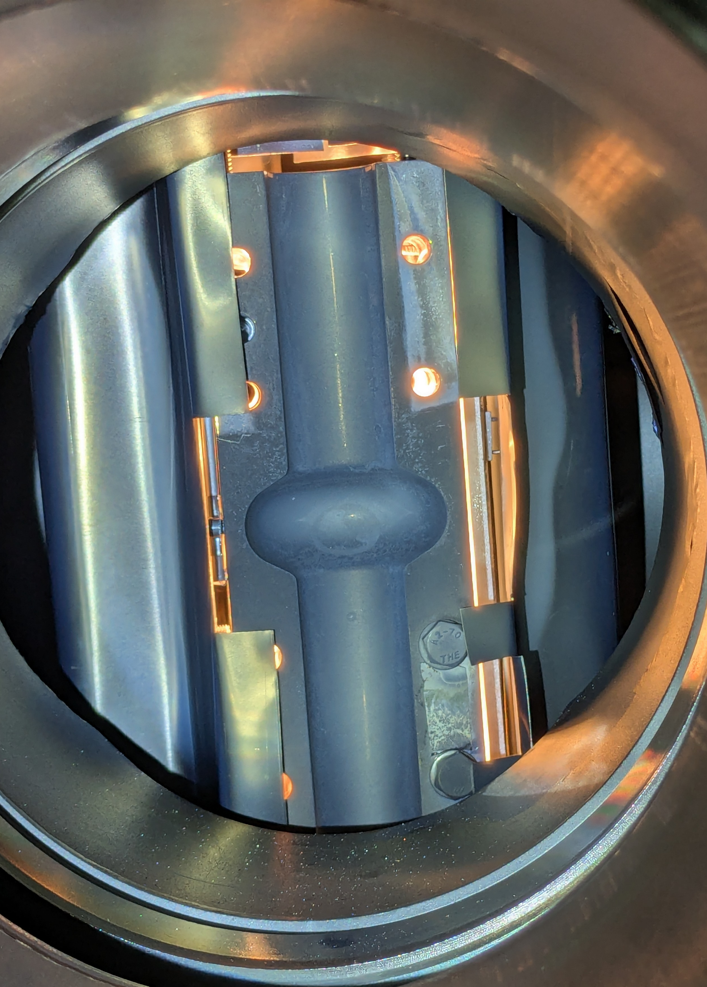
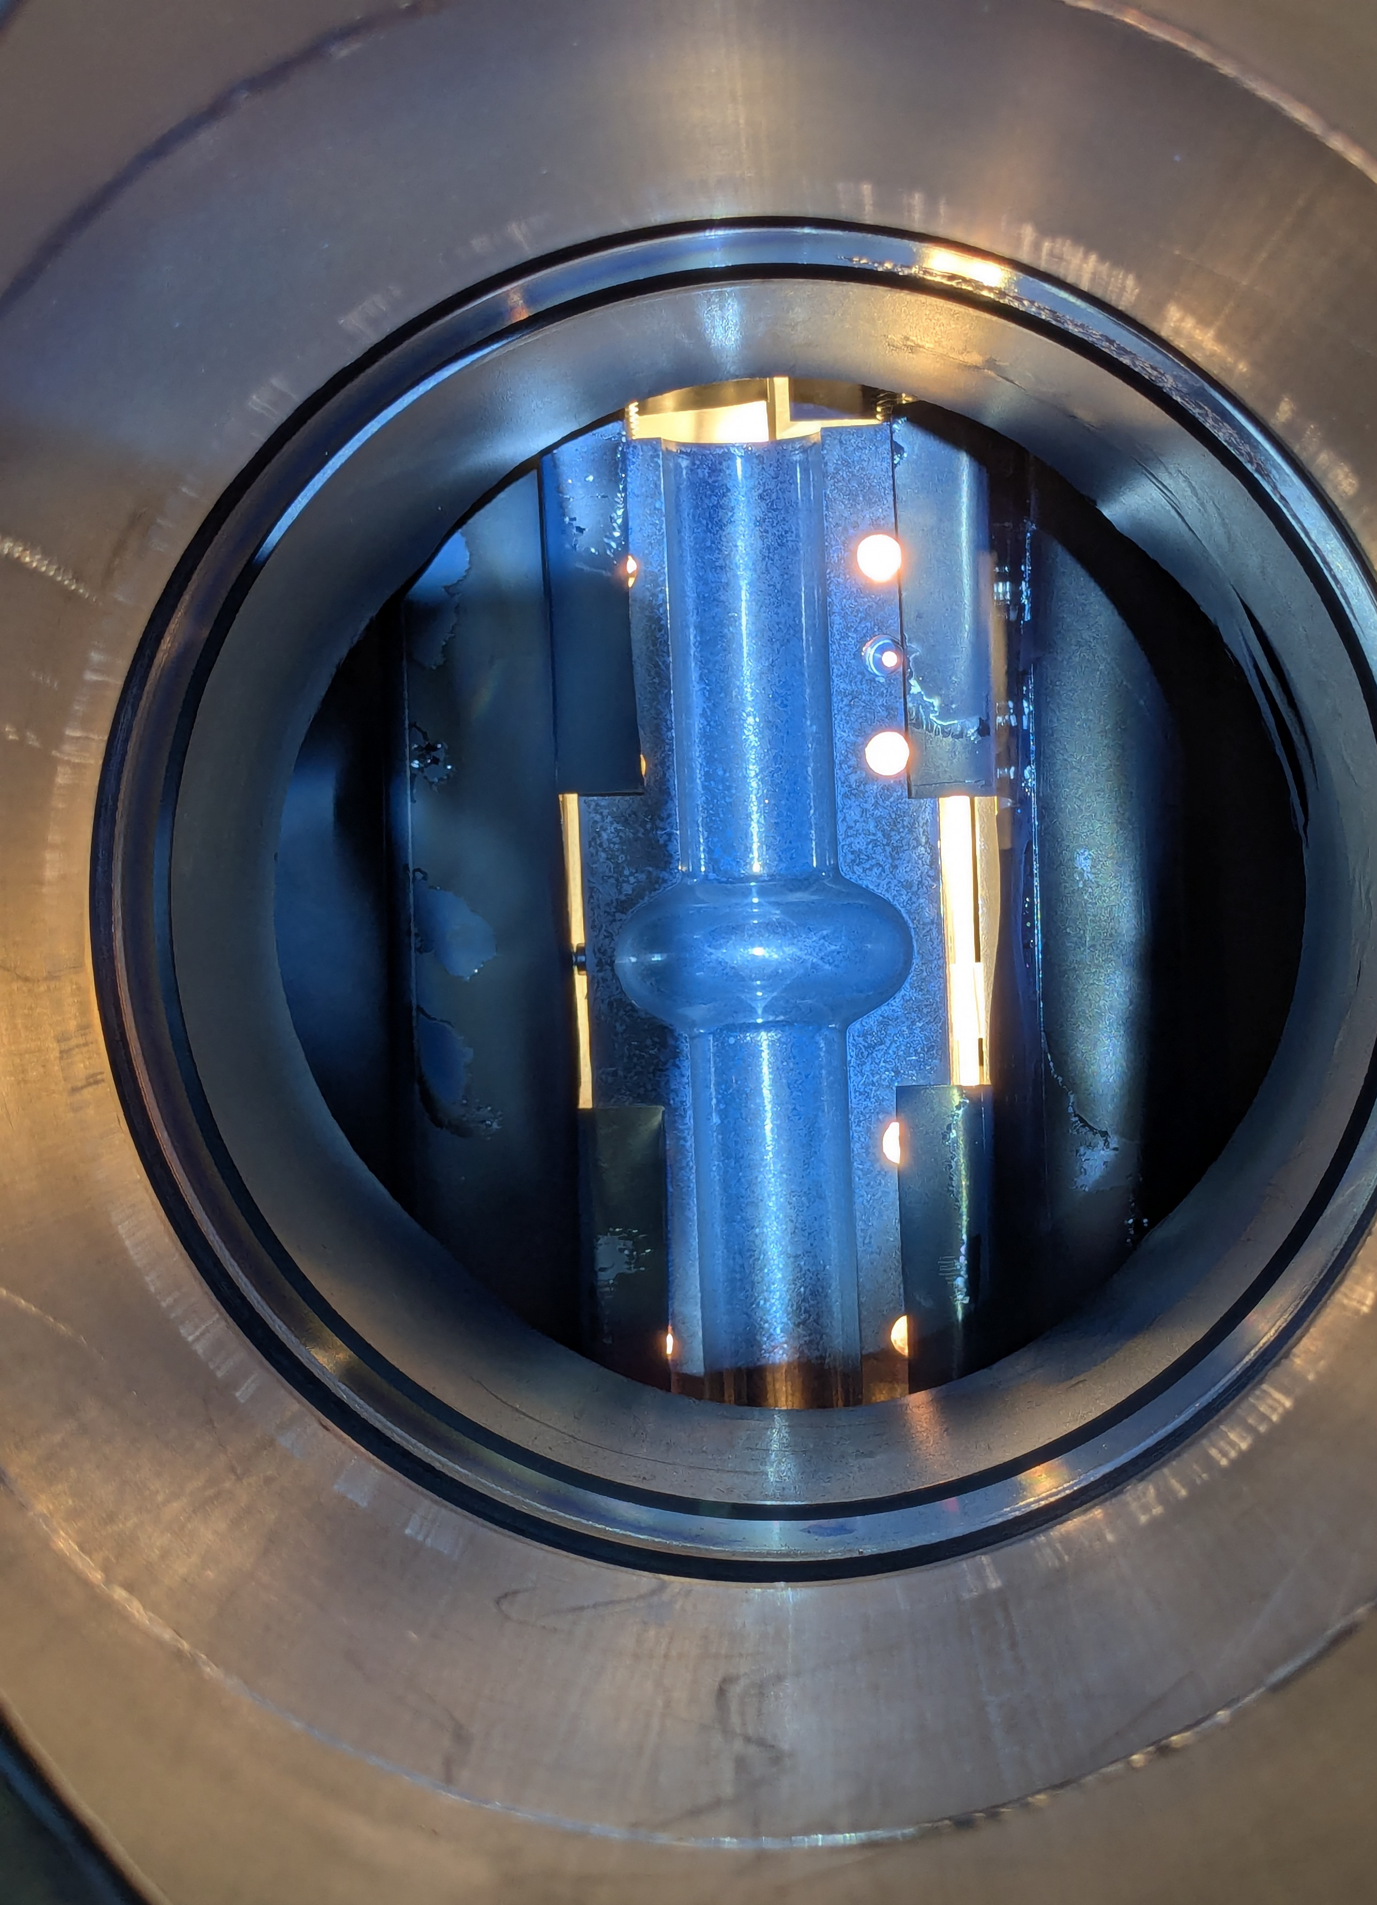
6 GHz Open Cavity: Nb₃Sn deposition
Deposition parameters:
DC magnetron sputtering
- 50 W Power
- 520 ºC Substrate temperature
- Kr process gas
- 5x10⁻³ mbar Deposition pressure
Unfortunately, during the first Nb₃Sn deposition the heating failed after 20 hour.
The sample was vented, heater stage was fixed and both split cavity faces were redeposited on.
Each face was deposited sequentially, 24 hours for each face.
Cavity A:
Nb₃Sn deposition on face 1
Cavity A:
Nb₃Sn deposition on face 2

Slide 16














Acknowledgements
C. Pira, O. Azzolini, R. Caforio, E. Chyhyrynets, D. Fonnesu, D. Ford, V. Garcia, G. Keppel, G. Marconato, A. Salmaso, F. Stivanello (LNL)
M. Bertucci, R. Paparella (LASA)
O.B. Malyshev, R. Valizadeh, C. Benjamin, T. Sian, L. Smith, D. Seal
C.Z. Antoine, S. Berry, Y. Kalboussi, T. Proslier
D. Longuevergne, O. Hryhorenko,
S. Keckert, O. Kugeler, J. Knobloch
S. Prucnal, S. Zhou
X. Jiang, T. Staedler, A. Zubtsovskii
E. Seiler, R. Ries
A. Medvids, A. Mychko, P. Onufrievs
G. Burt, N. Leicester, S. Marks, D. Turner
W. Bradley, S. Simon
R. Berton, D. Piccoli, F. Piccoli, G. Squizzato, F. Telatin
Associated Partners
A. M. Valente Feliciano
Informal Partners
Notes:
Replace this guidance text with your own bullet pointed content.
For further guidance please see https://www.bdadyslexia.org.uk/advice/employers/creating-a-dyslexia-friendly-workplace/dyslexia-friendly-style-guide

Slide 17
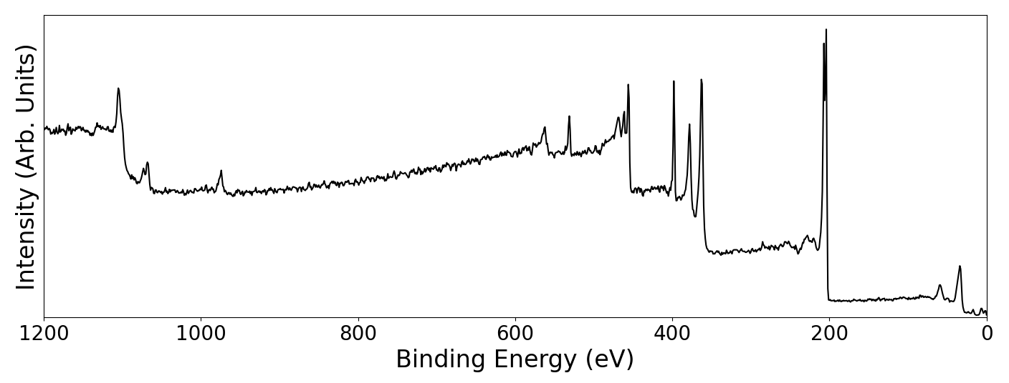
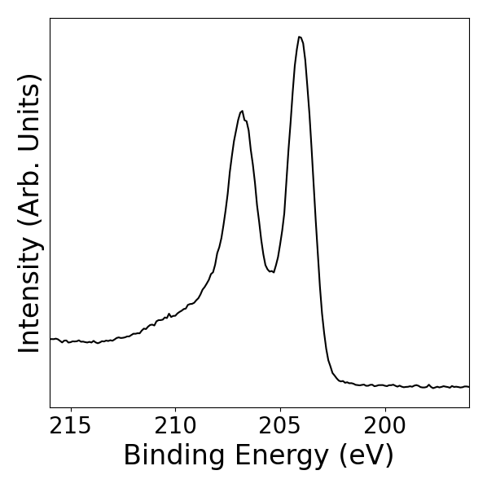
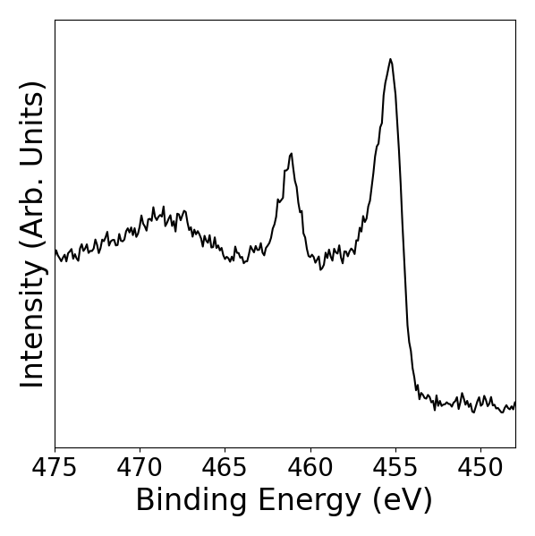
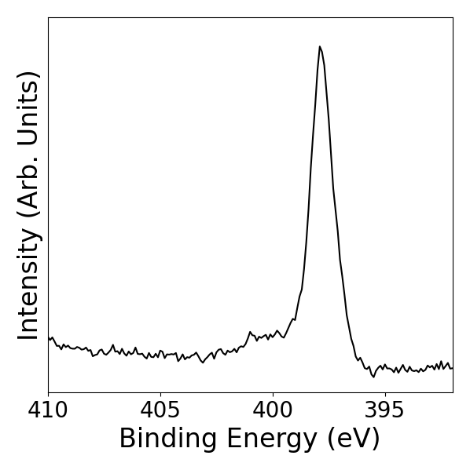
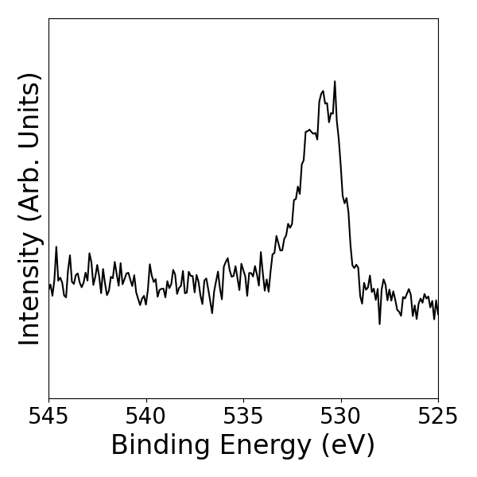
NbTiN from NbTi rod with Nb wire (He)
The X-ray photoelectron spectra indicate that the Nb, Ti, and N are in the form of a nitride.
The presence of oxygen is attributed to the sample's exposure to air and the formed oxide layer not fully removed from in situ cleaning.
204.0 eV
455.5 eV
397.8 eV
530.9 eV
Nb 3d
Ti 2p
461.1 eV
N 1s
400.3 eV
O 1s
206.8 eV
Notes:
Replace this guidance text with your own bullet pointed content.
For further guidance please see https://www.bdadyslexia.org.uk/advice/employers/creating-a-dyslexia-friendly-workplace/dyslexia-friendly-style-guide

