Slide 1




Lehrstuhl für
Oberflächen- und
Werkstofftechnologie
4th Annual IFAST meeting
15th IFAST WP9 meeting
Dr. Aleksandr Zubtsovskii, Bharath Reddy Lakki Reddy Venkata,
Prof. Dr. Xin Jiang
LOT, Institut für Werkstofftechnik, Universität Siegen
08.04.2025, Krakow

Slide 2
Lehrstuhl für
Oberflächen- und
Werkstofftechnologie
Tasks at Uni Siegen
Deposition studies:
- NbTiN in CC800: DCMS and HiPIMS
- Nb₃Sn in BoxCoater: RFMS, “test” the material, SIS structures
- MgB₂ in PVD/SEY chamber: co-sputtering with RFMS
on metal (Cu, Nb…) as well as insulating (AlN, TiO₂, Al₂O₃) substrates
Substrate preparation: mechanical and electropolishing of Cu
Sample characterization: film morphology, microstructure +
PALS experiments (HZDR Germany, Sebastian Klug, Oskar Liedke) +
SC and RF properties (INFN-LNL Italy, Dorothea, Davide, Giovanni; IEE Slovakia, Eugen)

Slide 3
Lehrstuhl für
Oberflächen- und
Werkstofftechnologie
Tasks Troubles at Uni Siegen
The SEM cathode is out of order

Slide 4
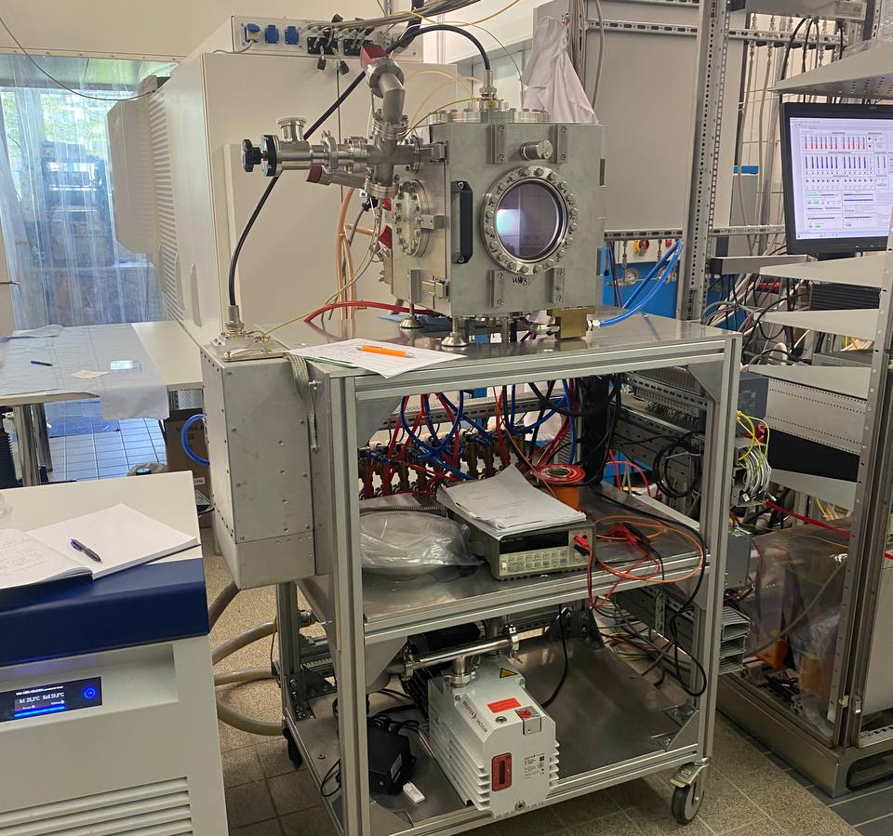
Lehrstuhl für
Oberflächen- und
Werkstofftechnologie
Tasks Troubles at Uni Siegen
The SEM cathode is out of order
Problems with ”BoxCoater” system
Software issues
Roughing pump leakage
Heater and thermocouples
→ no Nb₃Sn studies…
3. Low T_{c} for NbTiN

Slide 5
Lehrstuhl für
Oberflächen- und
Werkstofftechnologie
Tasks at Uni Siegen
The SEM cathode is out of order
Problems with ”BoxCoater” system
Software issues
Roughing pump leakage
Heater and thermocouples
→ no Nb₃Sn studies…
Attempts with RF-MgB₂ co-sputtering
HiPIMS-NbTiN deposition studies

Slide 6
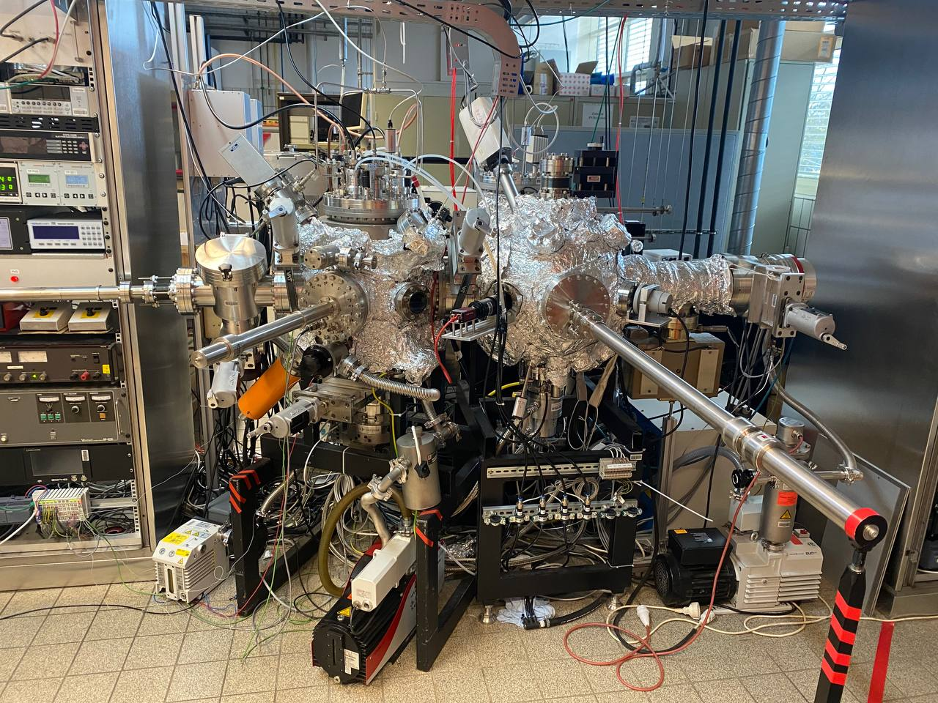
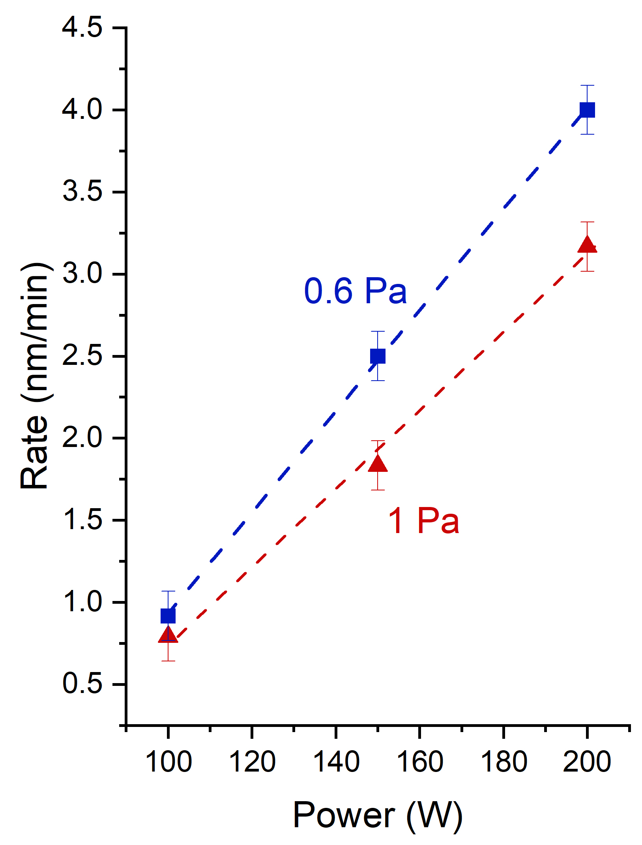
Lehrstuhl für
Oberflächen- und
Werkstofftechnologie
co-MgB₂: RF sputtering
MgB₂ in PVD/SEY chamber
Adjustment of Mg and B deposition rates R (nm/min):
Variation of the cathode power and deposition pressure
R_{Mg} : R_{B} = 3 : 2 to get MgB₂
Substrate temperature: 300°C – 600°C ?
Ar pressure: 0.5 – 1 Pa
Deposition at RT and annealing?
PVD chamber
Load lock chamber
RFMS co-sputtering of MgB₂
Mg, 0.6 Pa at 20 W (0.97 W/cm²)

Slide 7
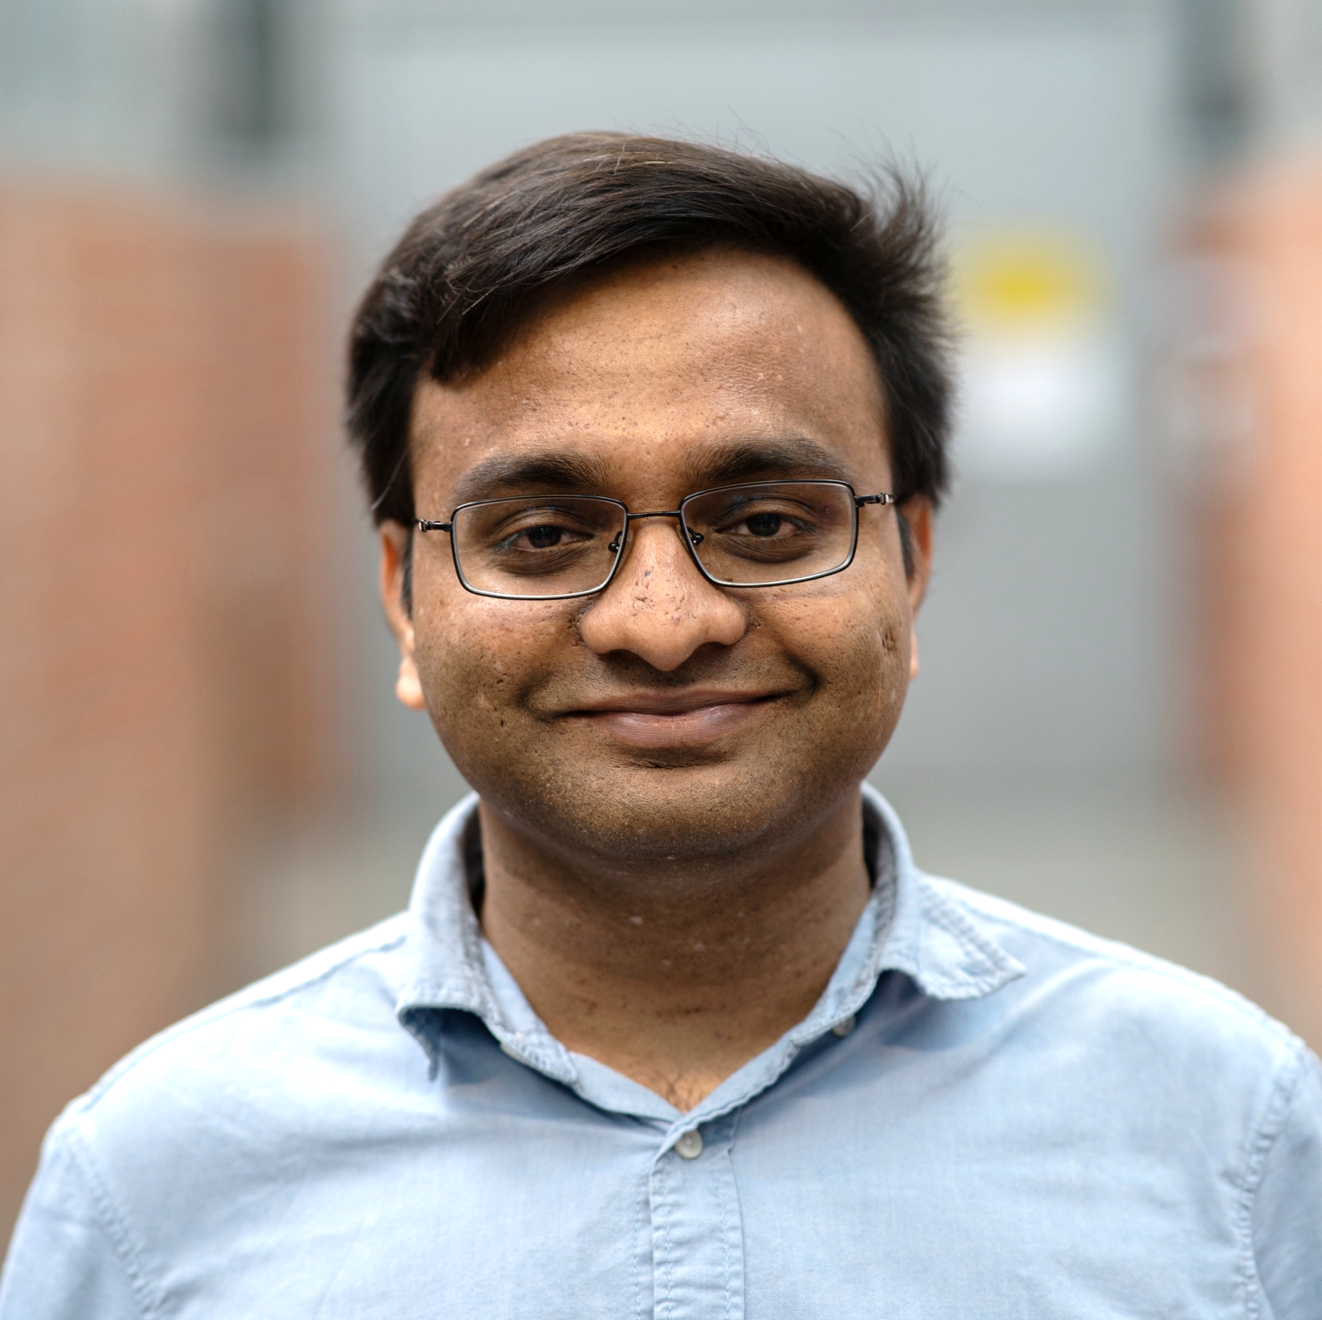

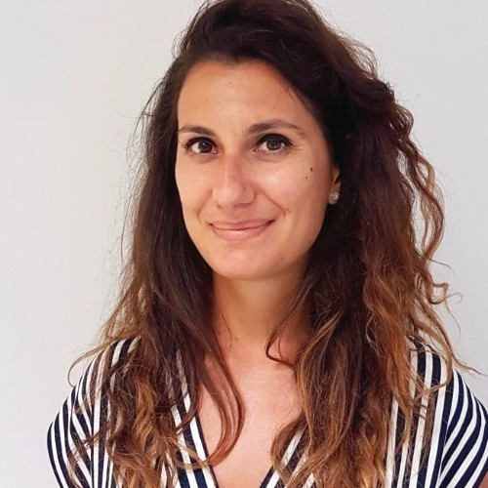
Lehrstuhl für
Oberflächen- und
Werkstofftechnologie
Experimental plan
HiPIMS-NbTiN
Deposition parameters
N₂ concentration
Deposition pressure
Cathode power
Substrate Bias
Substrate temperature
Bharath Reddy
Lakki Reddy Venkata
Critical temperature T_{c}
LNL-INFN Team:
Christian Pira
Dorothea Fonnesu
Davide Ford
Giovanni Marconato
Enrico Cremonesi

Slide 8
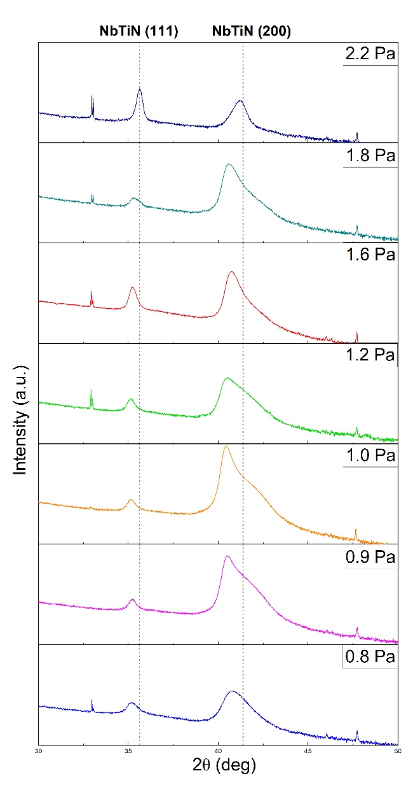
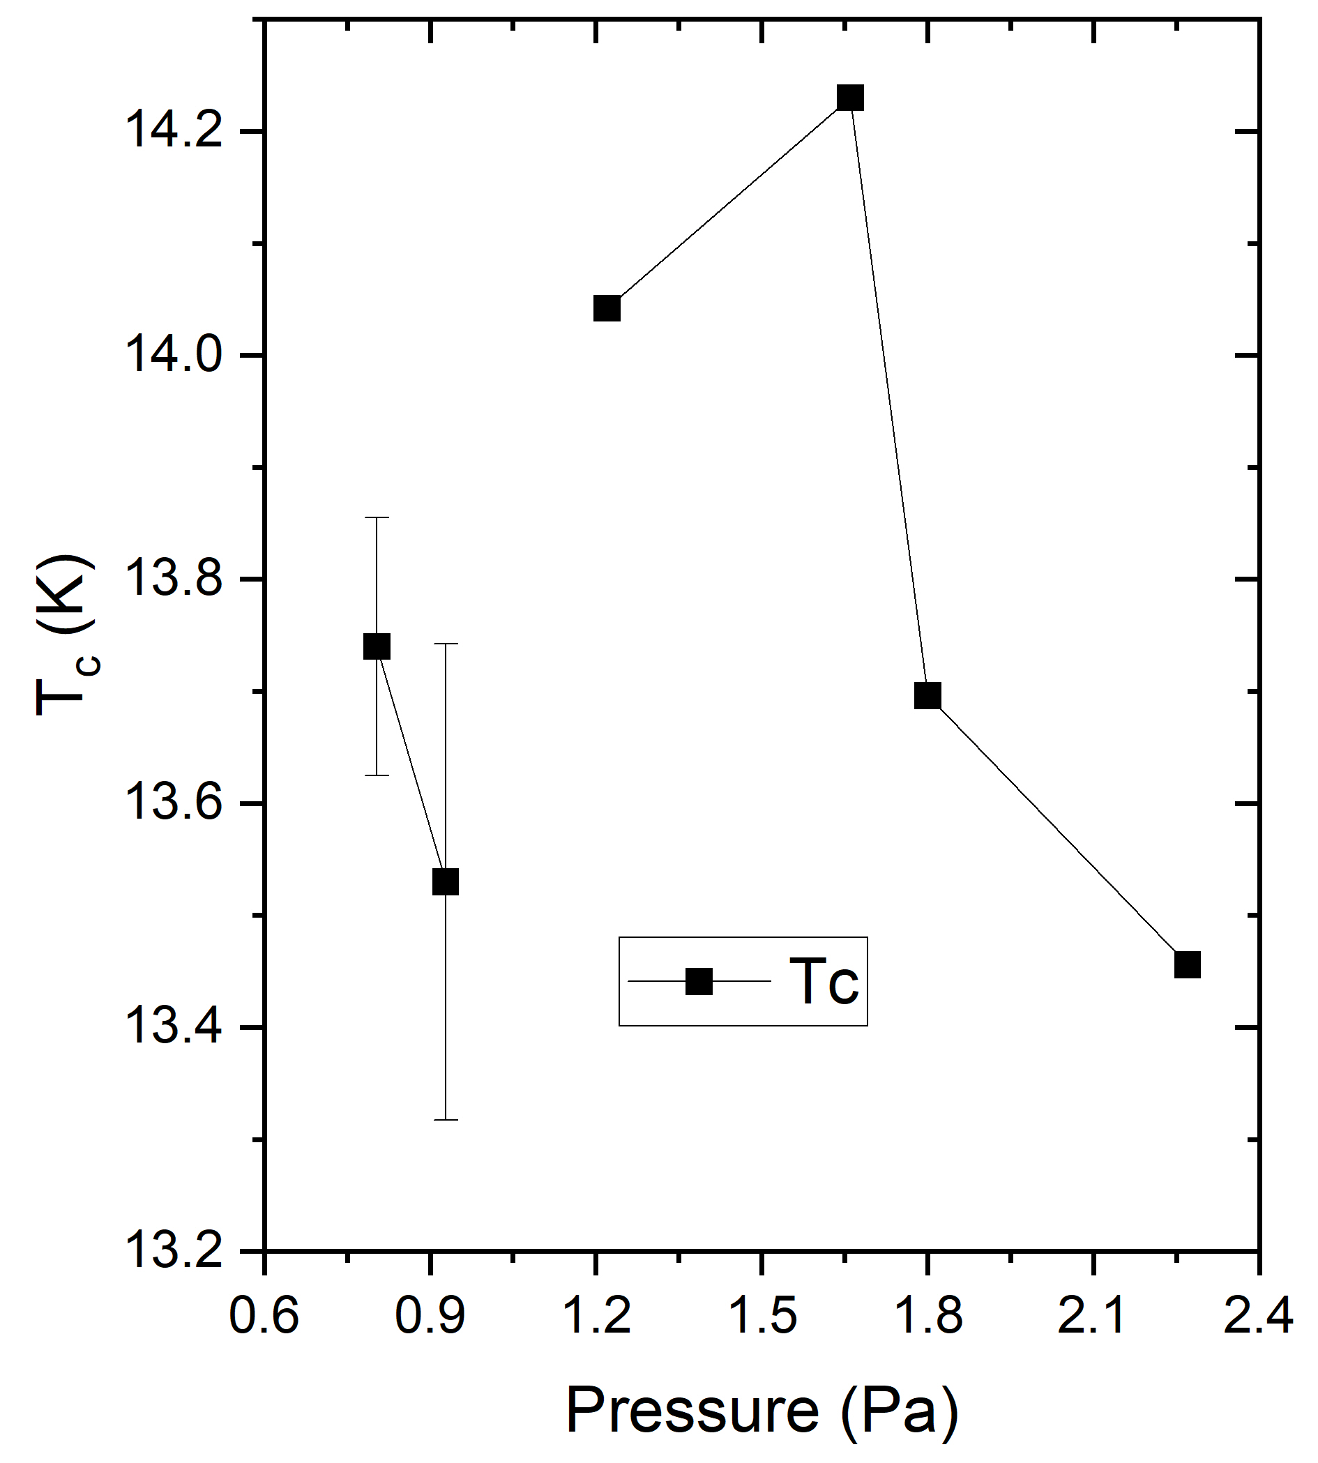
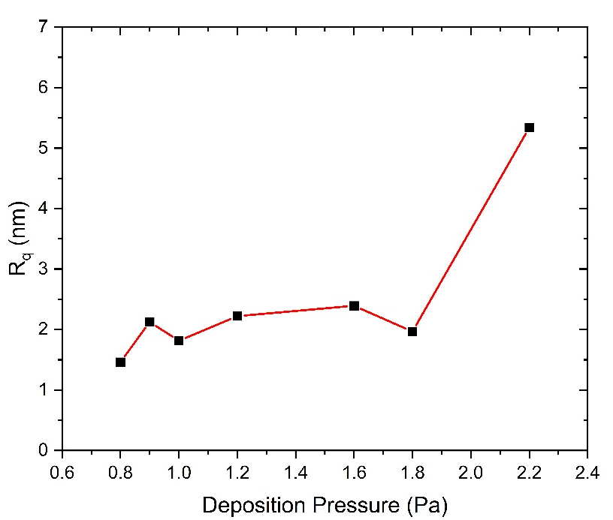
Lehrstuhl für
Oberflächen- und
Werkstofftechnologie
HiPIMS-NbTiN
Effect of deposition pressure
Deposition conditions:
P_{target} = 400 W, N₂ = 9%,
T = 170°C
Bias = -50V, d.c. = 10%
2.2 Pa
1.2 Pa
PALS experiments were conducted
Data are being analysed
AFM
1.8 Pa
0.9 Pa
1.6 Pa
0.8 Pa
@ INFN-LNL, Dorothea, Davide

Slide 9
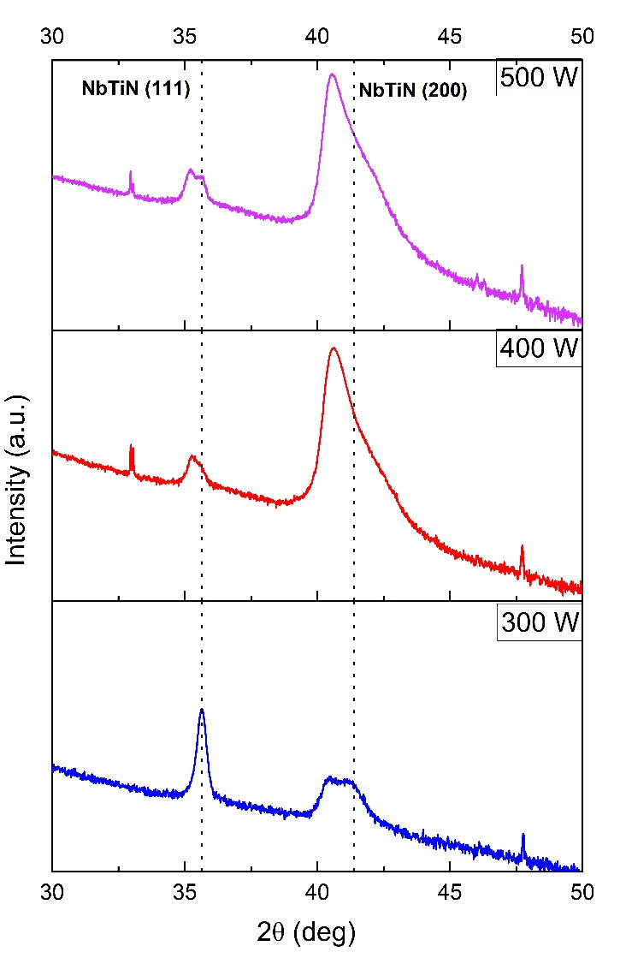
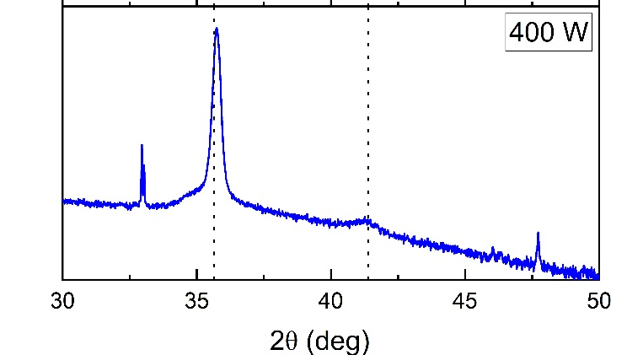
Lehrstuhl für
Oberflächen- und
Werkstofftechnologie
HiPIMS-NbTiN
Effect of cathode power
Deposition conditions:
N₂ = 9%, Bias = -50V, p_{dep} = 1.8 Pa, d.c. = 10%
500 W
T_{c}= 13.96 K
d.c. = 20%
400 W
T_{c}= 13.69 K
400 W
T_{c}= 12.96 K
300 W
T_{c}= 12.76 K

Slide 10
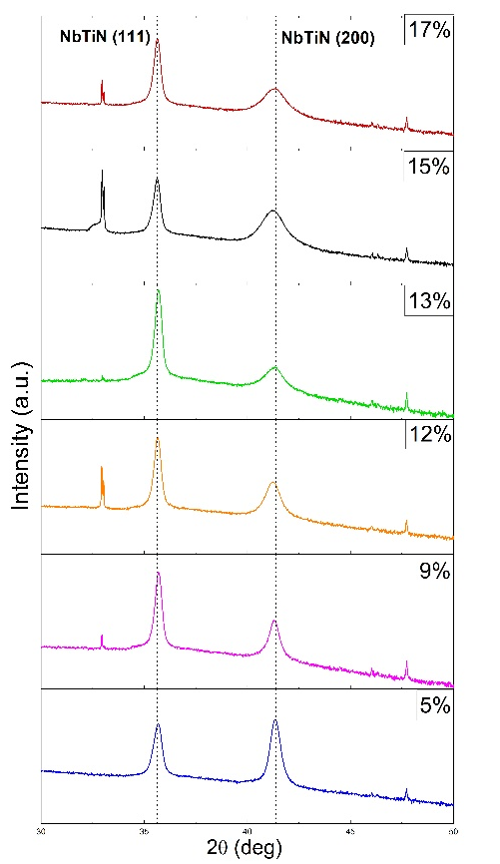
Lehrstuhl für
Oberflächen- und
Werkstofftechnologie
HiPIMS-NbTiN
Effect of N₂ concentration
Deposition conditions:
P_{target} = 400 W, p_{dep} = 1.6 Pa, Bias = -50V, d.c. = 20%
17 %
T_{c}= 12.63 K
13 %
T_{c}= 13.21 K
9 %
T_{c}= 14.03 K
15 %
T_{c}= ? K
12 %
T_{c}= ? K
5 %
T_{c}= 15.10 K (14.80 K)

Slide 11
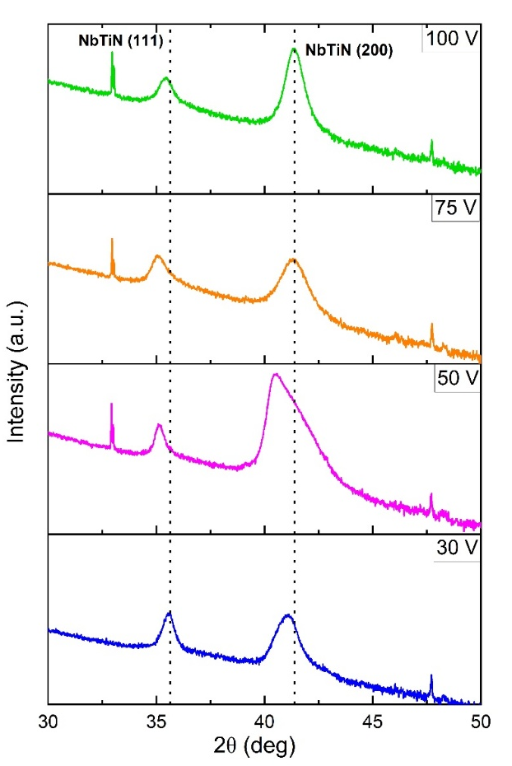
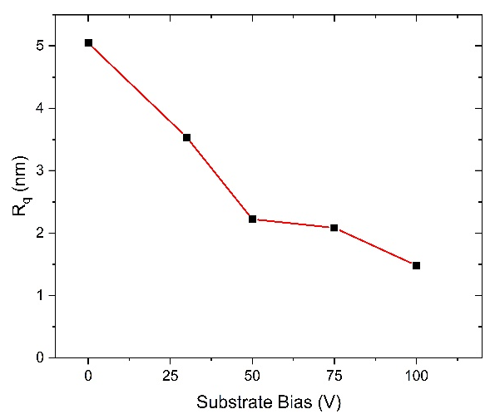
Lehrstuhl für
Oberflächen- und
Werkstofftechnologie
HiPIMS-NbTiN
Effect of substate bias
Deposition conditions:
P_{target} = 400 W, p_{dep} = 1.2 Pa, N₂ = 9%, d.c. = 10%
100 V
T_{c}= 15.26 K (14.95)
50 V
0 V
T_{c}= 13.66 K
75 V
T_{c}= 14.51 K
30 V
T_{c}= 13.88 K
AFM

Slide 12
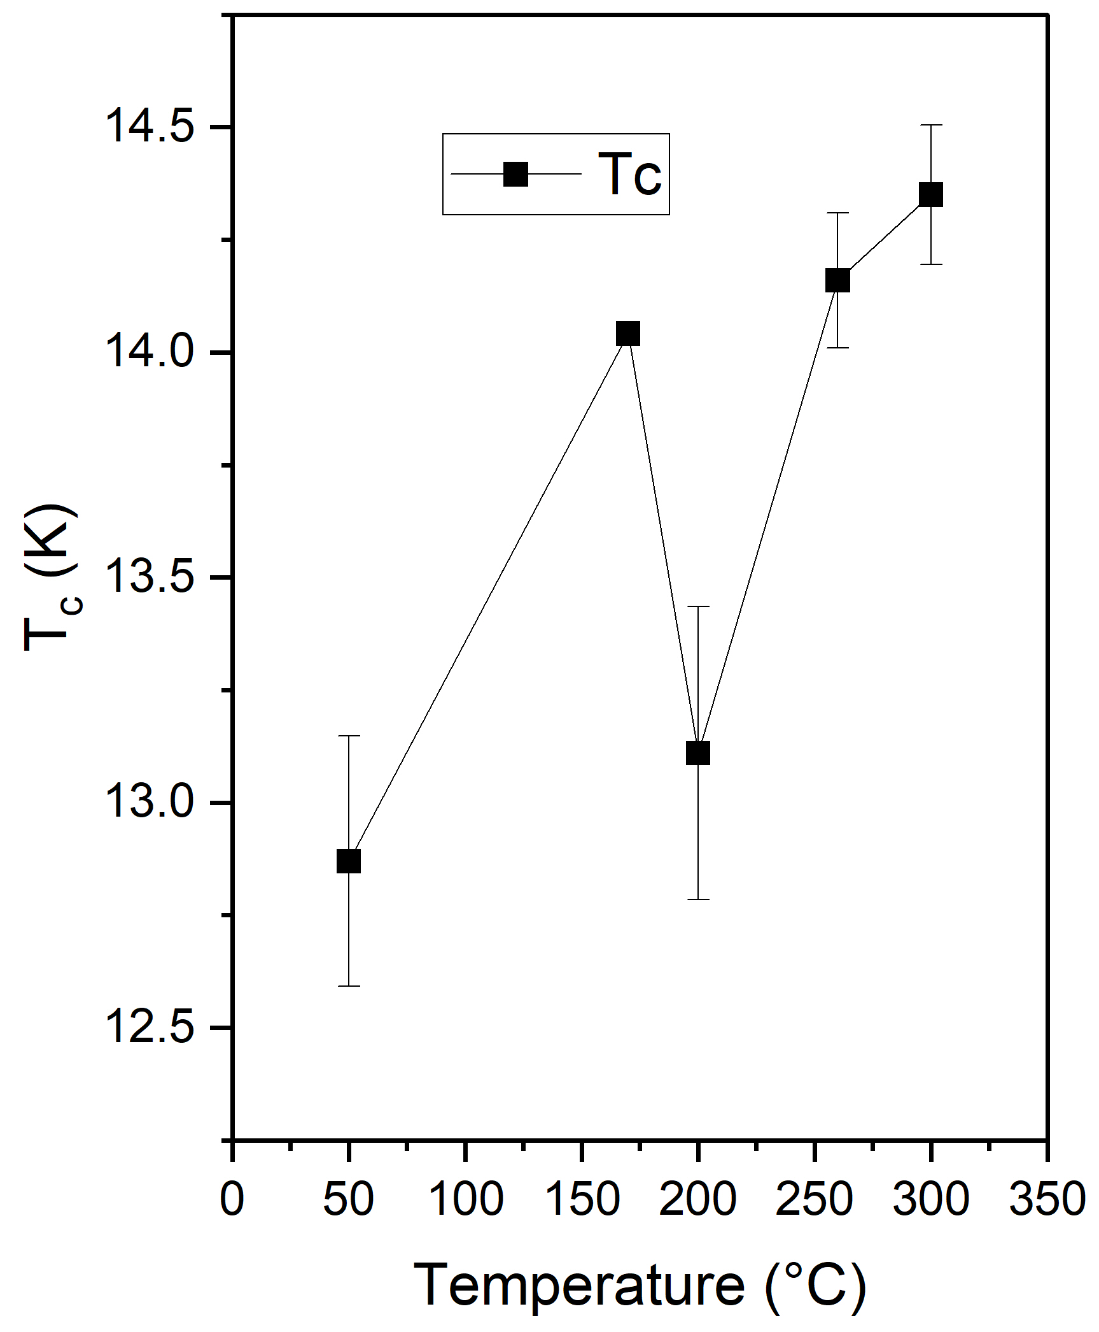
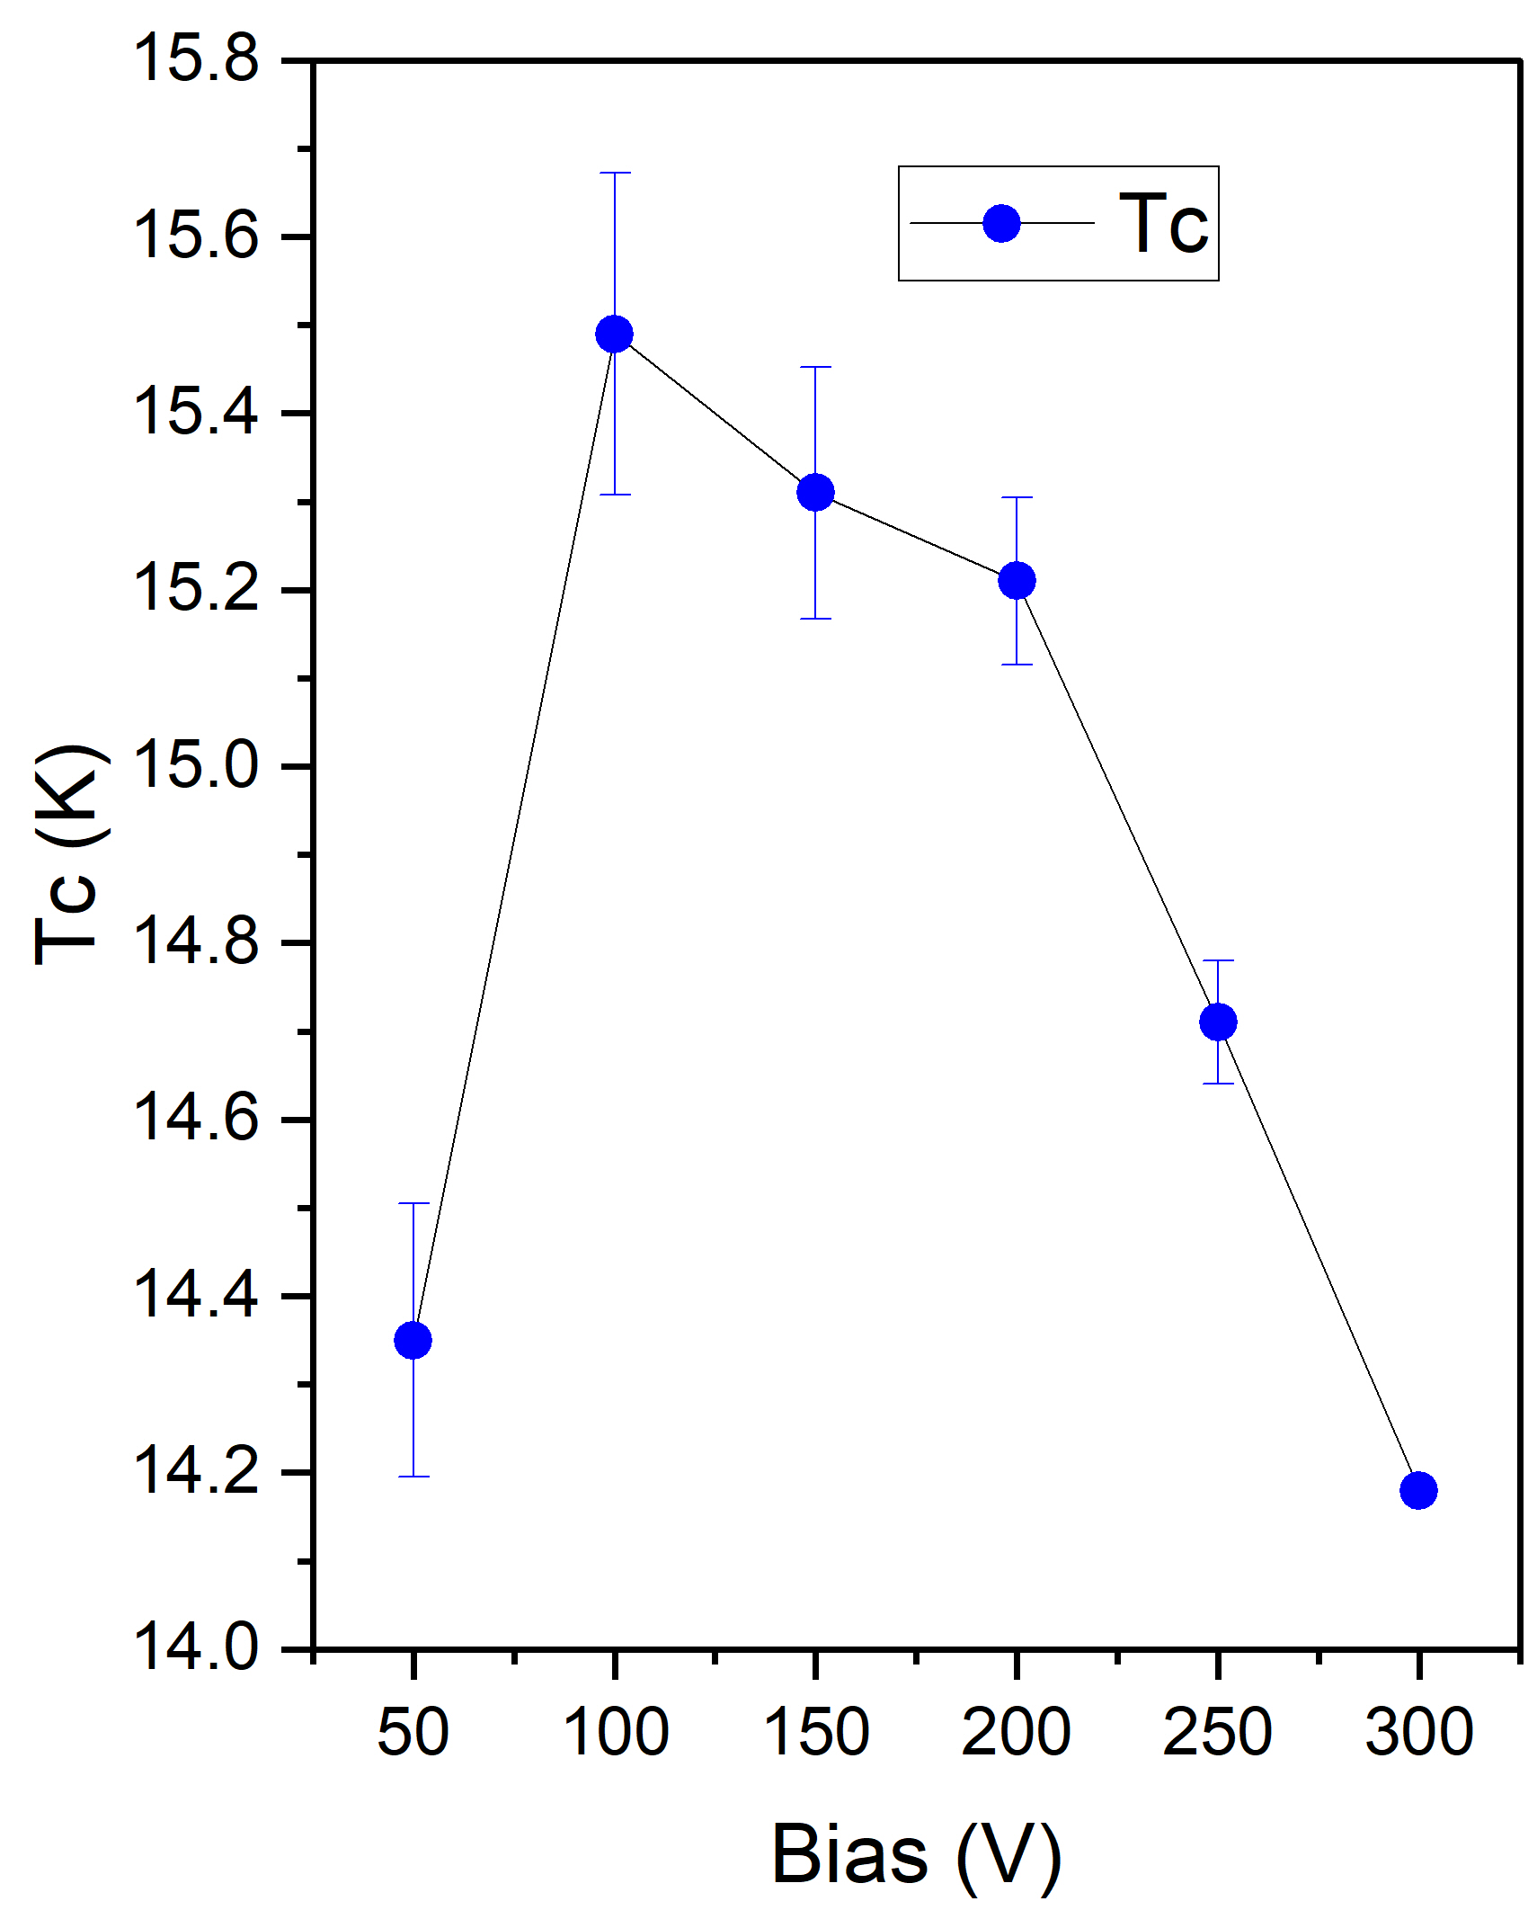
Lehrstuhl für
Oberflächen- und
Werkstofftechnologie
HiPIMS-NbTiN
Effect of substate temperature
Effect of substate temperature
Deposition conditions:
P_{target} = 400 W, p_{dep} = 1.6 Pa, N₂ = 9%, d.c. = 10% Bias = -50V
Deposition conditions:
P_{target} = 400 W, p_{dep} = 1.6 Pa, N₂ = 9%, d.c. = 10%
T = 300°C
PALS experiments conducted
Data are being analysed
@ INFN-LNL, Dorothea, Davide
@ INFN-LNL, Dorothea, Davide

Slide 13
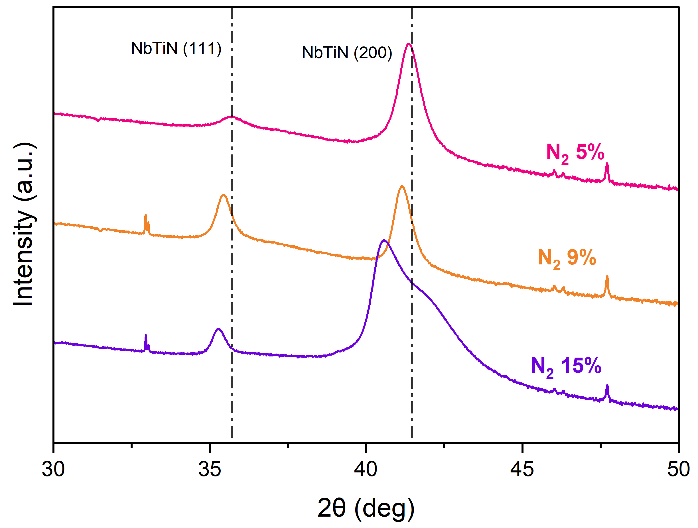
Lehrstuhl für
Oberflächen- und
Werkstofftechnologie
DCMS-NbTiN
Pressure-power-N₂ flow
400 W | 5% N₂ | 9% N₂ | 15% N₂
0.9 Pa | 14.3K-14.4K | 13.2K-13.6K | 12.9K
0.7 Pa | ? | 13.97 K | ?
0.5 Pa | 13.8 K | 14.42 K | ?
600 W | 5% N₂ | 9% N₂ | 15% N₂
0.9 Pa | 14.2K | 14.5K-14.7K | 13.7K
0.7 Pa | ? | 14.1K | ?
0.5 Pa | ? | 14.6K | 13.3K
Deposition conditions:
P_{target} = 600 W, p_{dep} = 0.5 Pa, T = 260°C, Bias = -50V

Slide 14
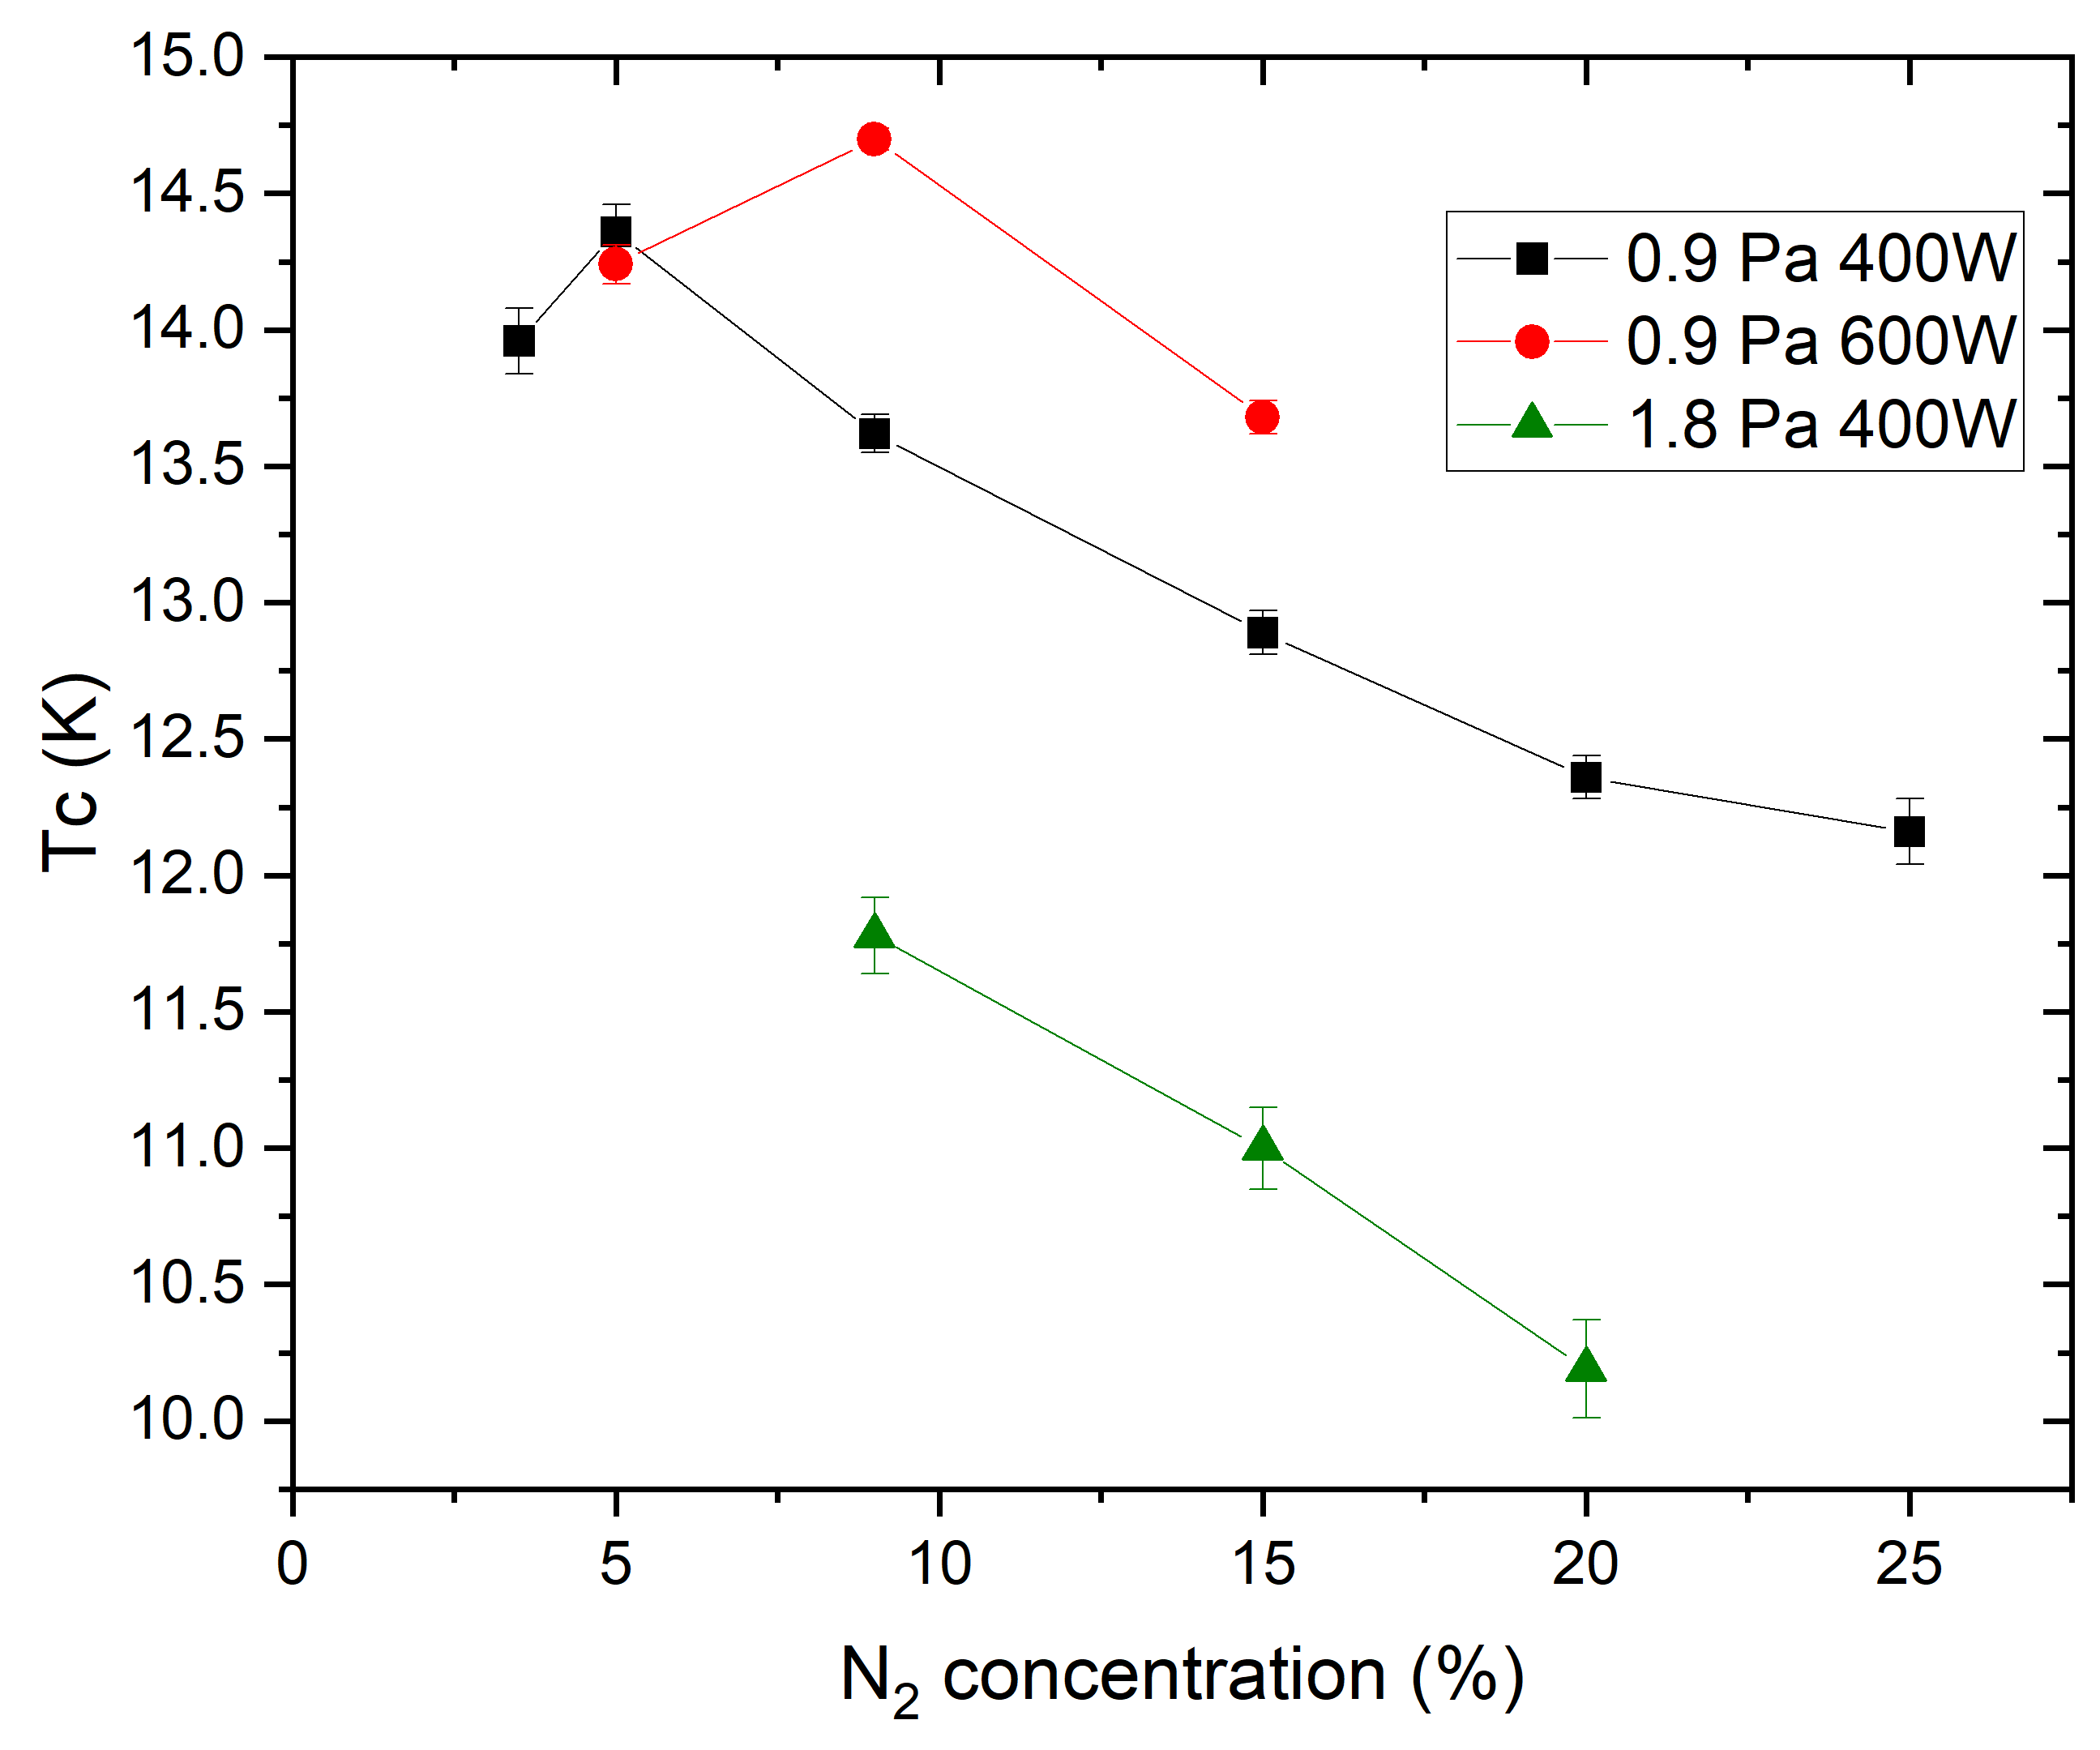
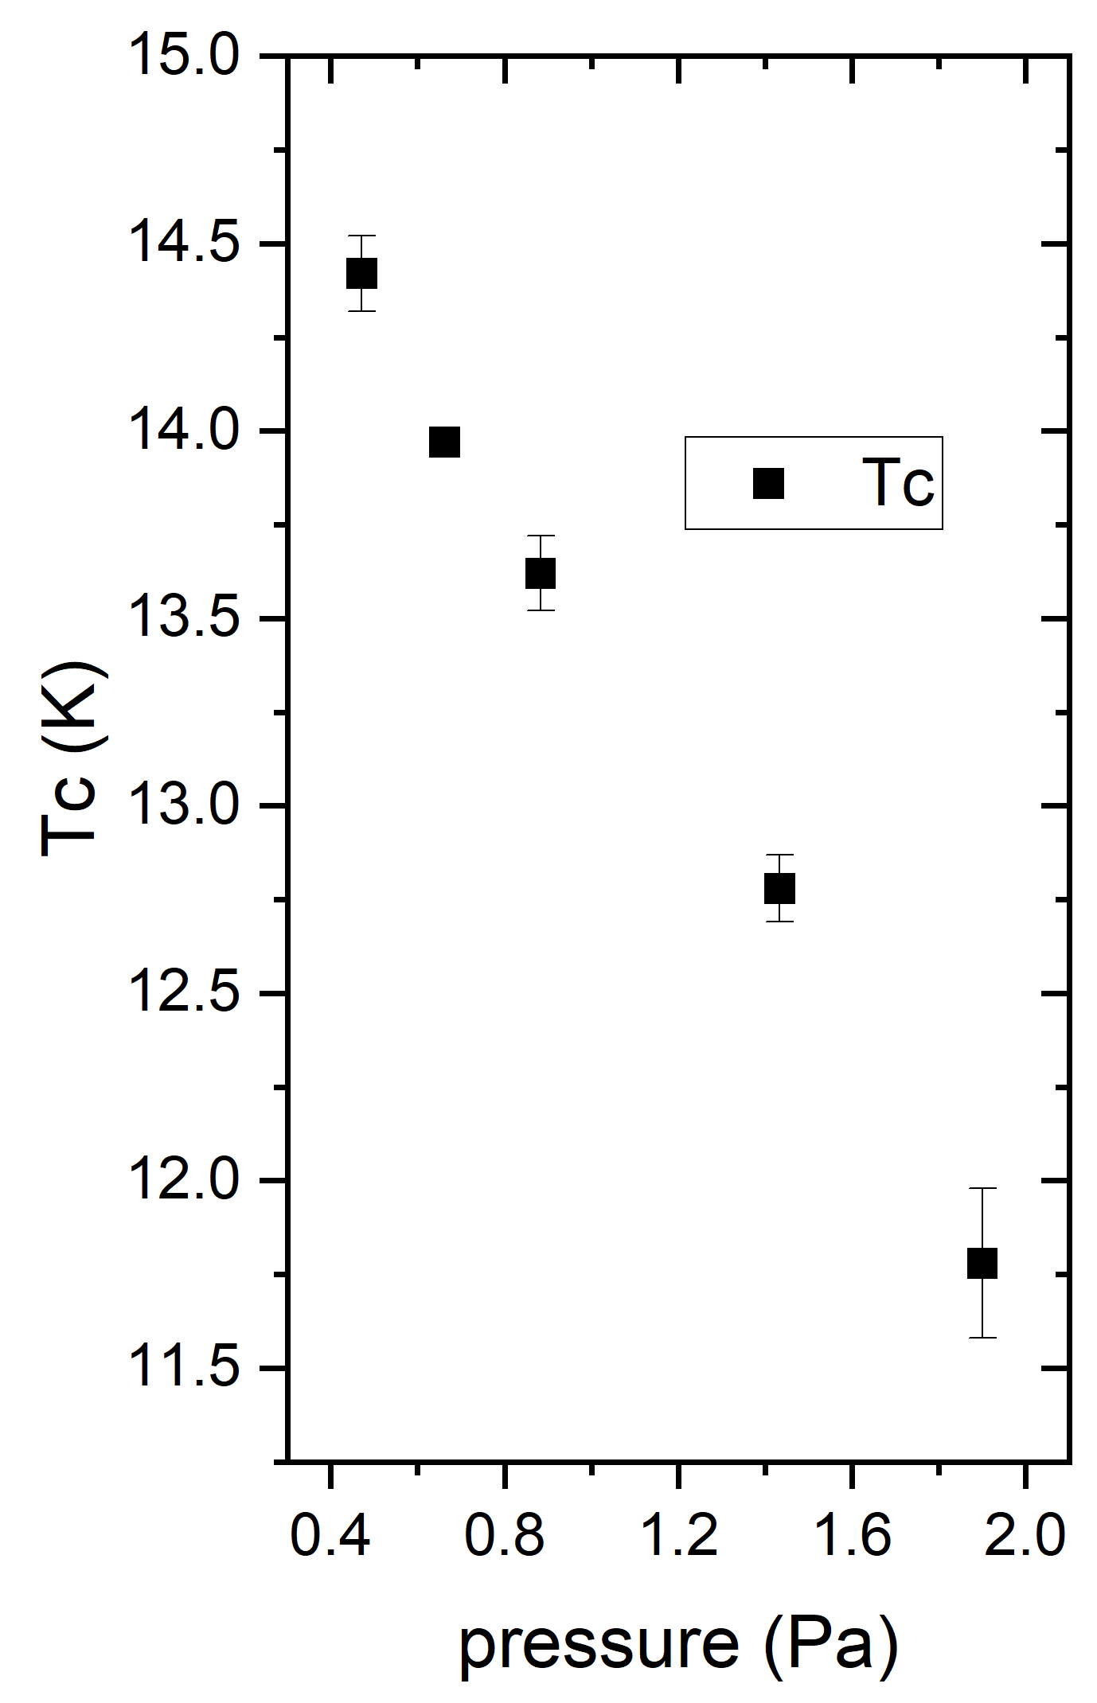
Lehrstuhl für
Oberflächen- und
Werkstofftechnologie
DCMS-NbTiN
High T_{c} – where?
Low deposition pressure:
0.5-0.7 Pa
High cathode power:
600W (6.8 W/cm²)
Low N₂ flow: <9%,
related to the cathode power
Deposition temperature:
“250°C” ???
@ INFN-LNL, Dorothea, Davide
@ INFN-LNL, Dorothea, Davide

Slide 15
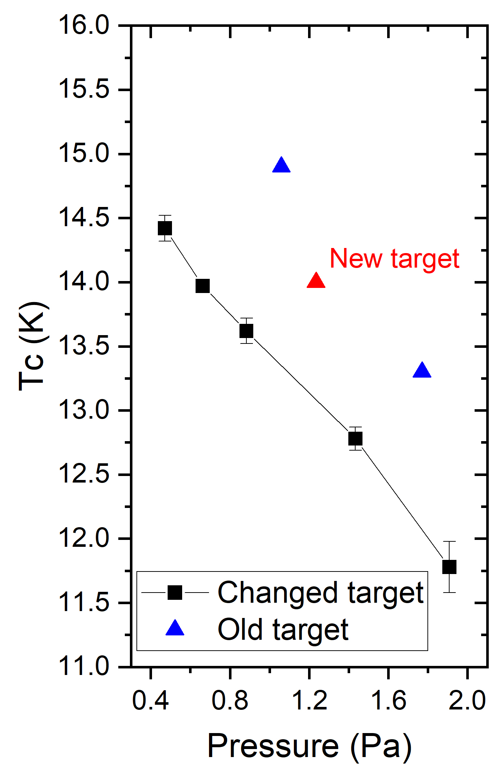
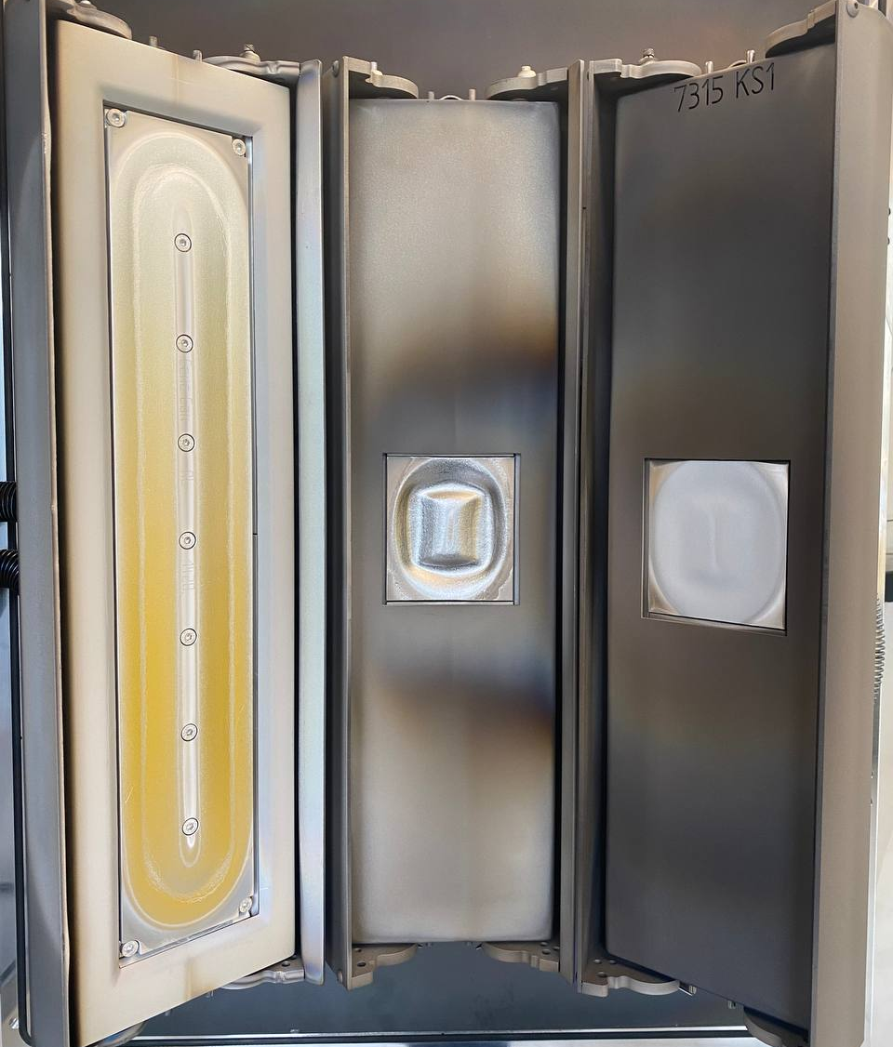
Lehrstuhl für
Oberflächen- und
Werkstofftechnologie
DCMS-NbTiN
Commercial coating system CC800/9
DC
cathode
HiPIMS
cathode
DC
cathode
@ INFN-LNL, Dorothea, Davide
NbTi
alloy
target
Deposition conditions:
P_{target} = 400 W, p_{dep} = 0.9 Pa, N₂ = 9%,
Bias = -50V, T = 260°C

Slide 16
Lehrstuhl für
Oberflächen- und
Werkstofftechnologie
DCMS-NbTiN
Commercial coating system CC800/9
DC
cathode
HiPIMS
cathode
DC
cathode
@ INFN-LNL, Dorothea, Davide
NbTi
alloy
target
Deposition conditions:
P_{target} = 400 W, p_{dep} = 0.9 Pa, N₂ = 9%,
Bias = -50V, T = 260°C

Slide 17
Lehrstuhl für
Oberflächen- und
Werkstofftechnologie
DCMS-NbTiN
Commercial coating system CC800/9
DC
cathode
HiPIMS
cathode
DC
cathode
@ INFN-LNL, Dorothea, Davide
@ INFN-LNL, Dorothea, Davide
NbTi
alloy
target
Deposition conditions:
P_{target} = 400 W, p_{dep} = 0.9 Pa, N₂ = 9%,
Bias = -50V, T = 260°C

Slide 18
Lehrstuhl für
Oberflächen- und
Werkstofftechnologie
Plans and outlook
Optimization of DC-NbTiN deposition: the problem in the target!!!
Results of T_{c} for HiPIMS-NbTiN: better, fine tunning of the parameters
PALS experiments for HiPIMS-NbTiN: influence of the substarte bias and deposition temperature
Deposition of multilayer (SS or SIS) is ongoing
Deposition of MgB₂ in PVD/SEY chamber by RF co-sputtering
Deposition of Nb₃Sn in BoxCoater: repair of the BoxCoater

Slide 19
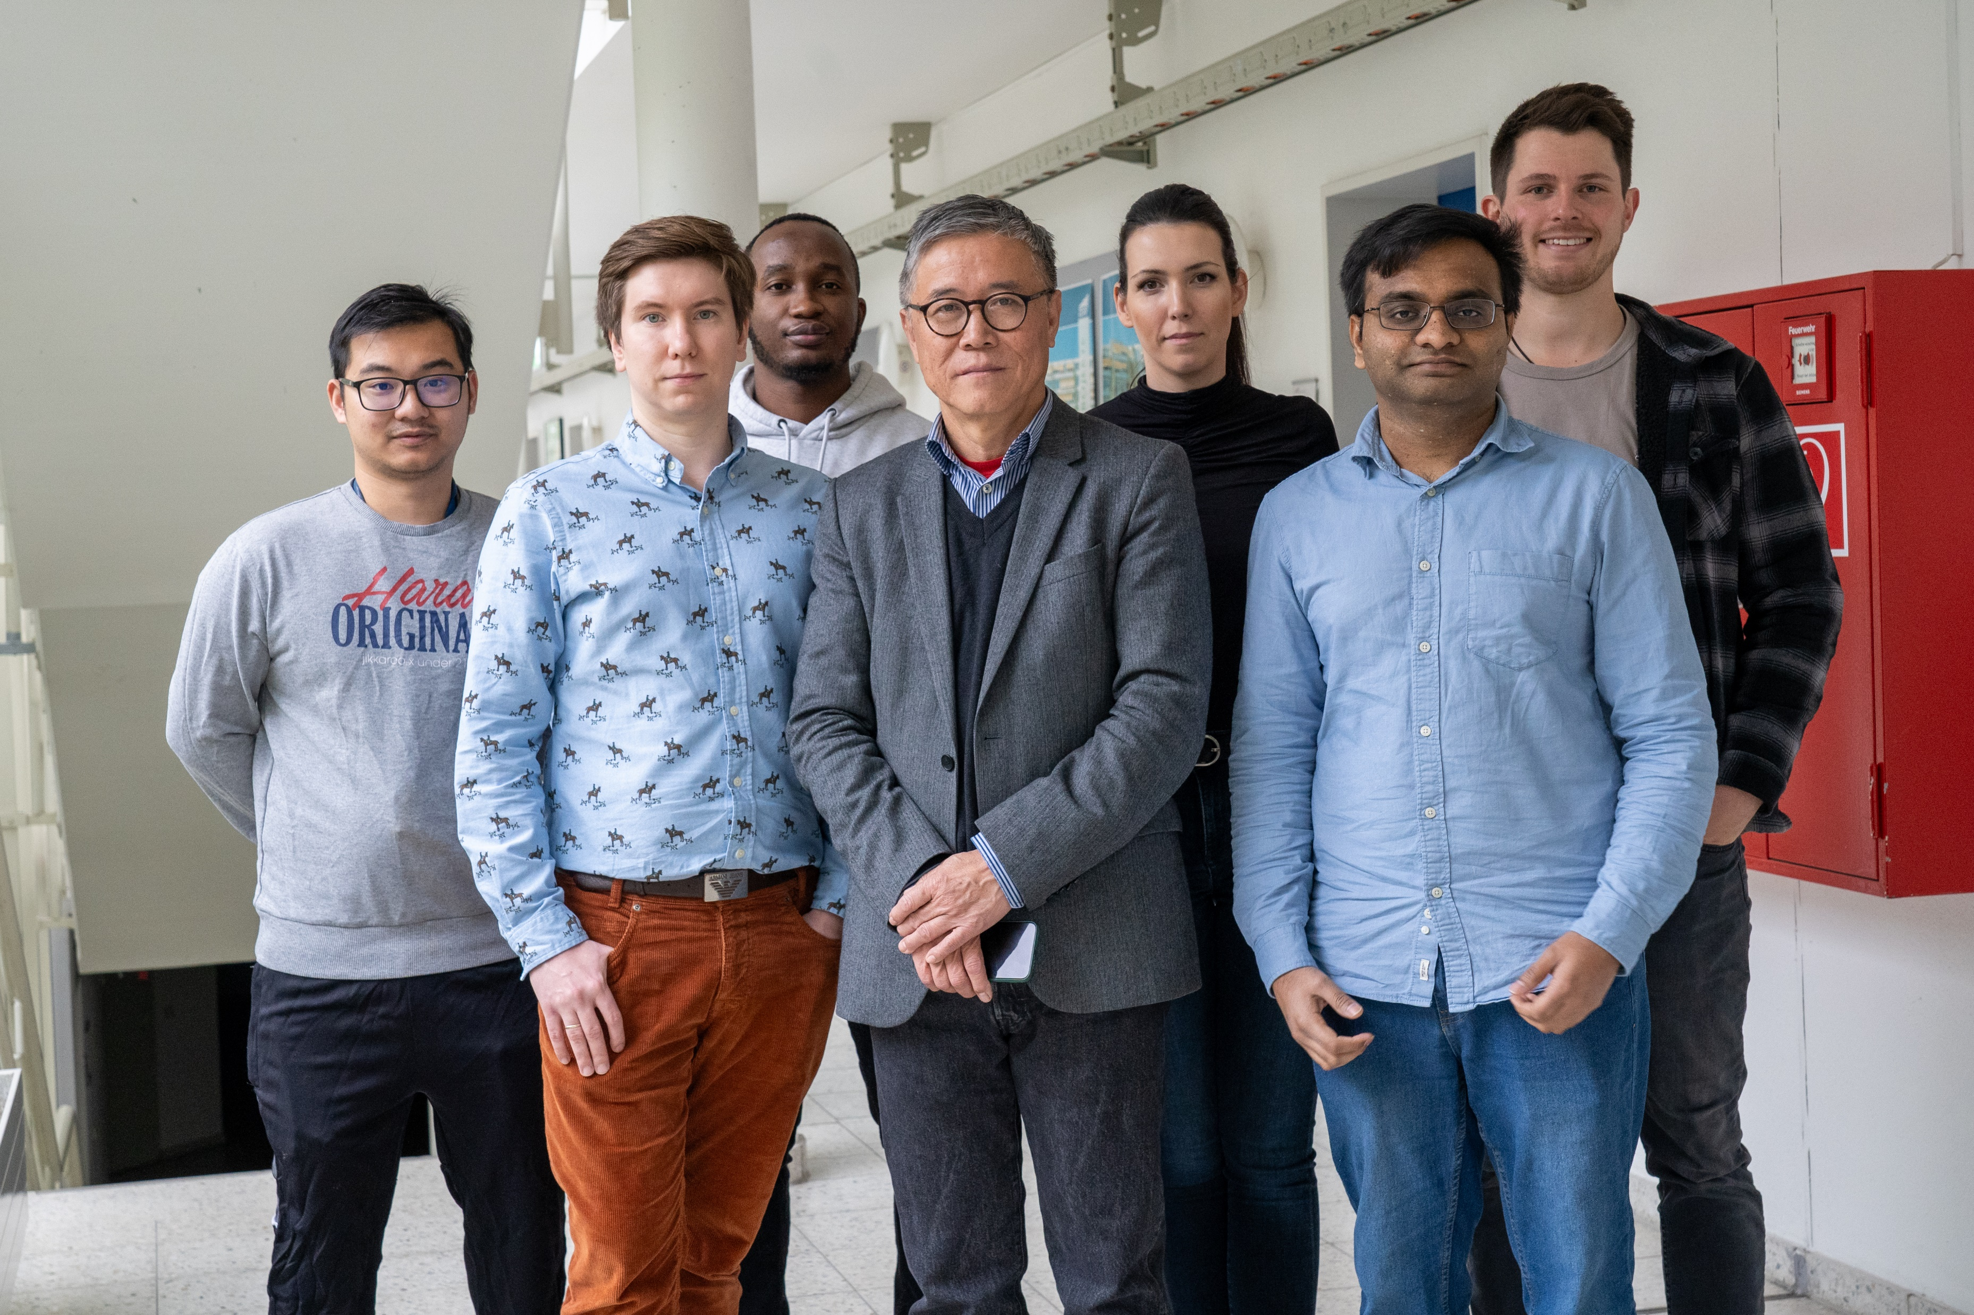
Lehrstuhl für
Oberflächen- und
Werkstofftechnologie
THANK YOU FOR YOUR ATTENTION!

Slide 20
Lehrstuhl für
Oberflächen- und
Werkstofftechnologie

