Slide 1
Cavity testing at HZB
(plan to test single cell Nb3Sn cavity from STFC at HZB)

Slide 2
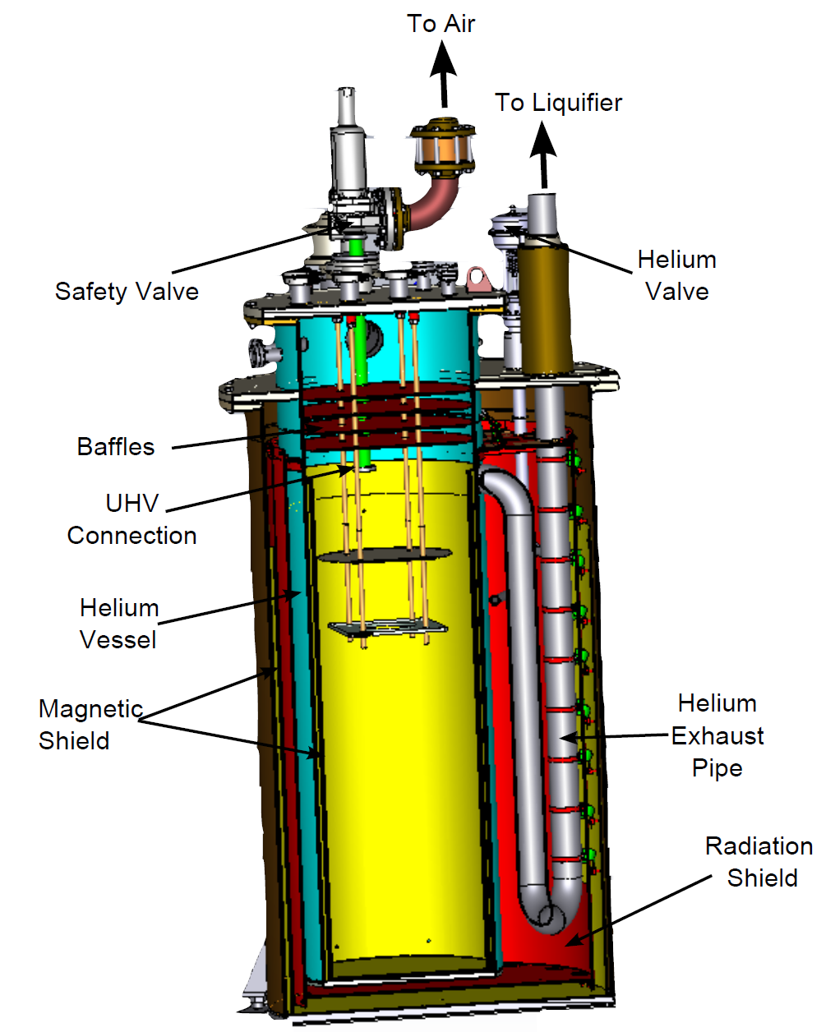
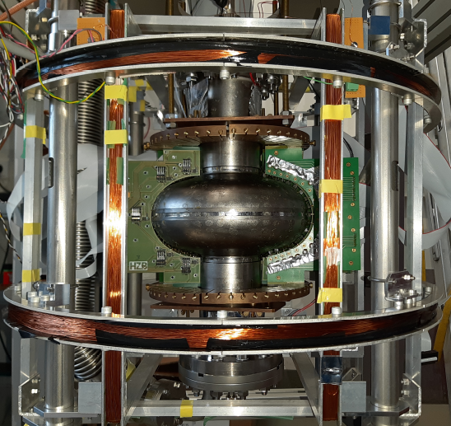
Test infrastructure SVTS at Supralab at HZB:
Vertical bath cryostat
temperatures = 1.5 K … 4 K
N2 free – pre-cooling by LHe
PLL for 400 MHz – 1.5 GHz
300 W broadband amp
Particle-free venting
Double magnetic shielding
Possible B-mapping and T-mapping
Interfacing with Nb3Sn cavity from STFC solved
Test scheduled for June 2025

Slide 3
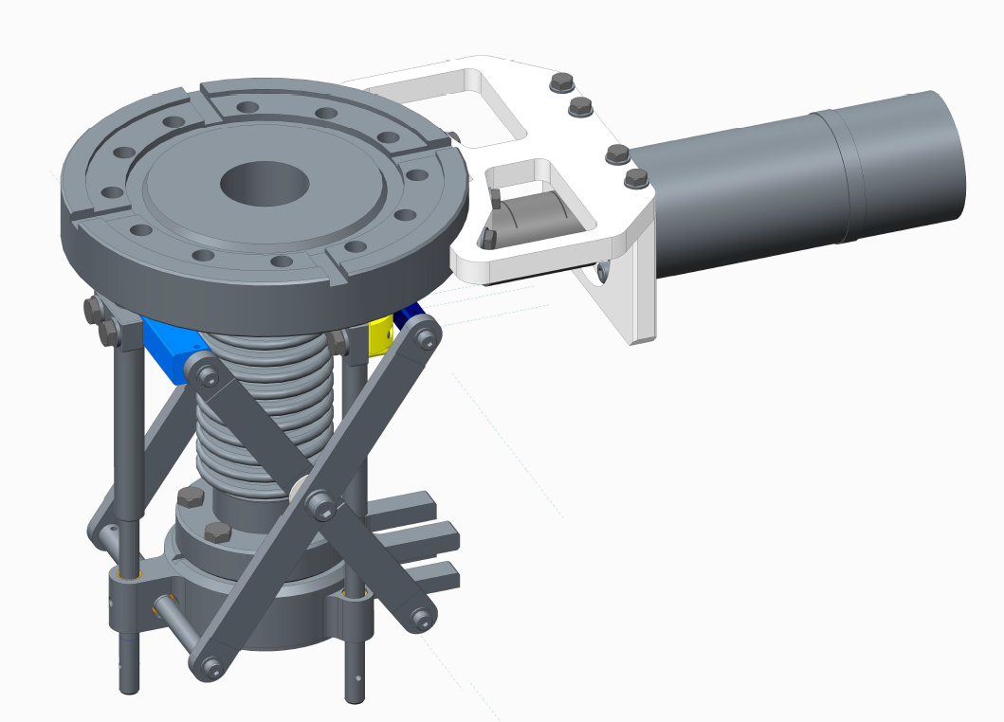
Variable coupling
Variable coupler HRD allows for
movement of input antenna into cavity
Adjustment of Q_{ext} by two orders of magnitude possible

