Slide 1
QPR measurements at HZB
Report on Deliverable 9.6

Slide 2
4 SRF samples tested in HZB QPR
Nb3Sn on Nb manufactured by DC-MS at INFN Legnaro
Nb3Sn on Nb manufactured by DC-MS at STFC Daresbury
Nb on Cu fabricated at Siegen University
Nb3Sn on Nb on Cu manufactured via Bronze route at HZB

Slide 3
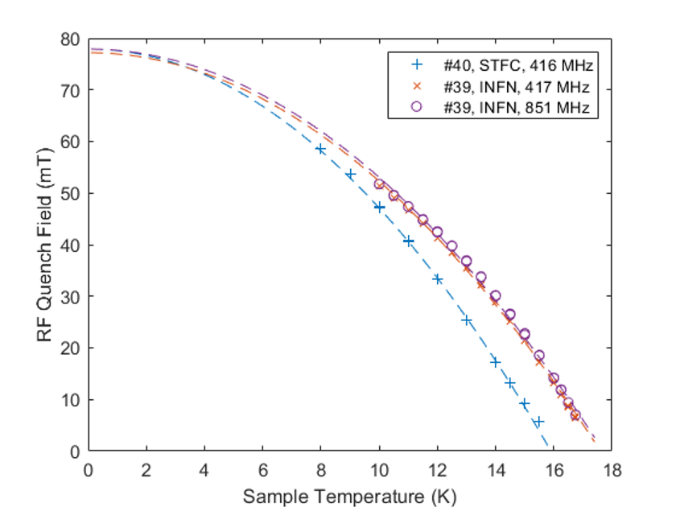
Comparison of MS samples from INFN and STFC
Quench field
(obtained from temperature dependent measurements)
Quench field vs temperature behavior different for both samples
INFN: Tc = 17.7 K
STFC: Tc = 15.9 K
Interestingly: Extrapolated quench fields Hsh(0) almost identical
H_{sh}(T = 0 K) = 77.2 – 77.9

Slide 4
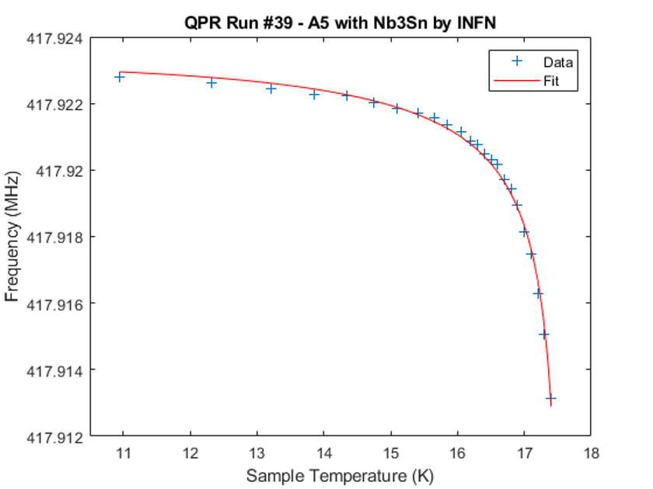
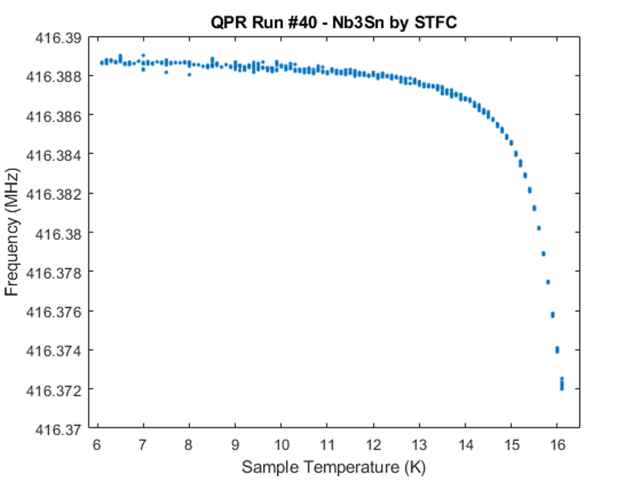
Frequency shift measurement
(measuring frequency change vs sample temperature)
Tc can be extracted from extrapolation:
INFN Tc = 17.6-17.7 K STFC: 16.4 K
London penetration depth can be extracted using Slater theorem:
INFN: λ = 315 ± 24 nm STFC: fit does not converge

Slide 5
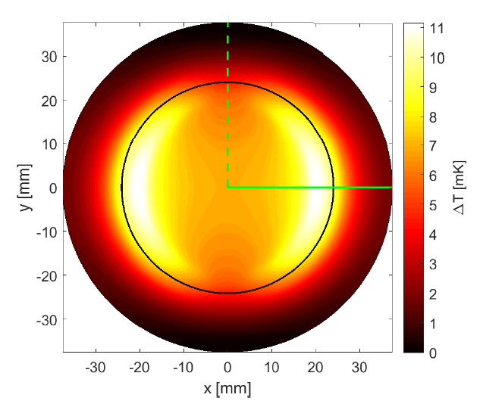
Interpretation of discrepancy in Tc values
STFC sample:
Measured significant difference in Tc with the two methods:
16.4 K by frequency change VS 15.9 K by quench field
Tc measurement gives
average value
A discrepancy between the measurements indicates a local
imhomogeneity of the coating
QPR pole shoes
Tc measurement by quench field gives worst value over entire illuminated area
QPR sample surface
QPR RF exposure

Slide 6
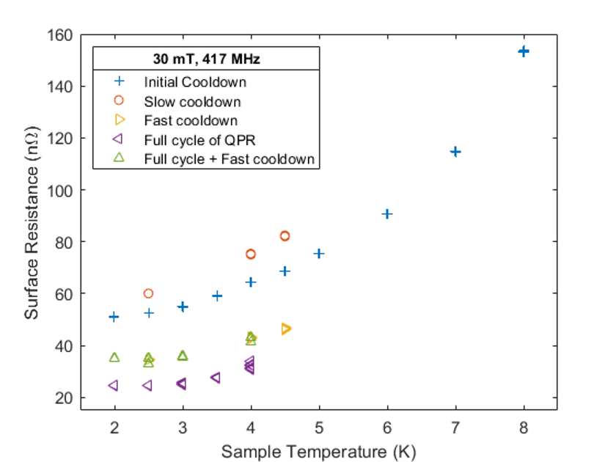
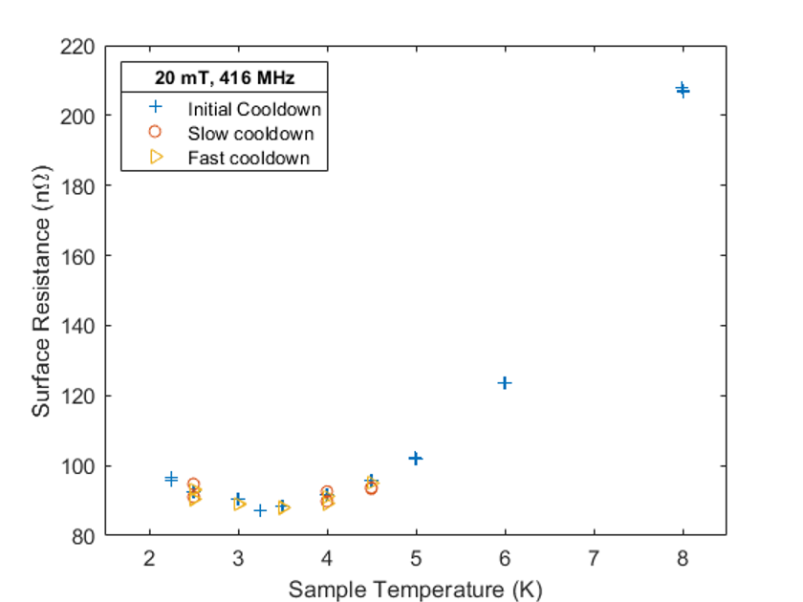
Surface resistance vs temperature
INFN
surface resistance 30 nOhm
monotoneous increase
no significant increase towards 4.1 K
flux expulsion improves surface resistance
STFC
surface resistance 90 nOhm
local minimum at 3.5 K (reason unclear, possibly poor adhesion)
no expulsion upon thermal cycling achieved
much flux pinning
surface resistance dominated by residual resistance
high point at 8K possibly due to incomplete coverage and Nb exposure
-> new test with improved sputtering chamber

Slide 7
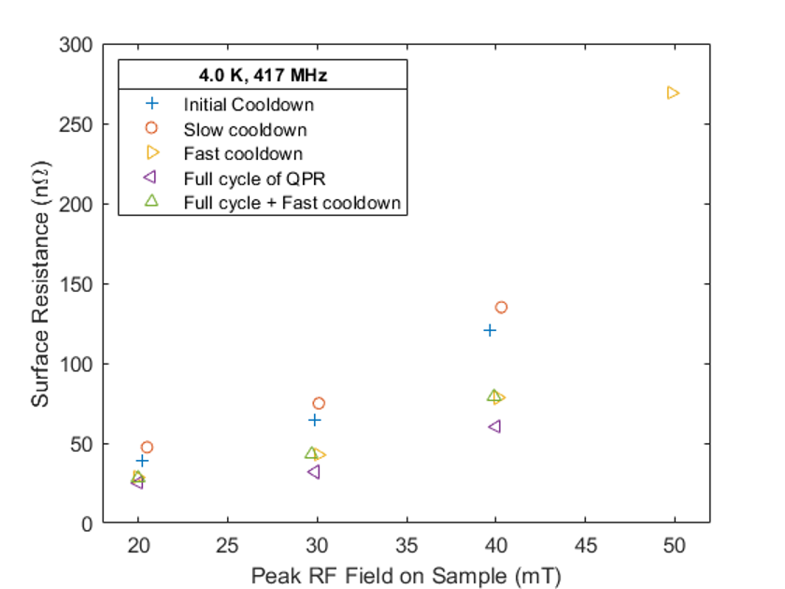
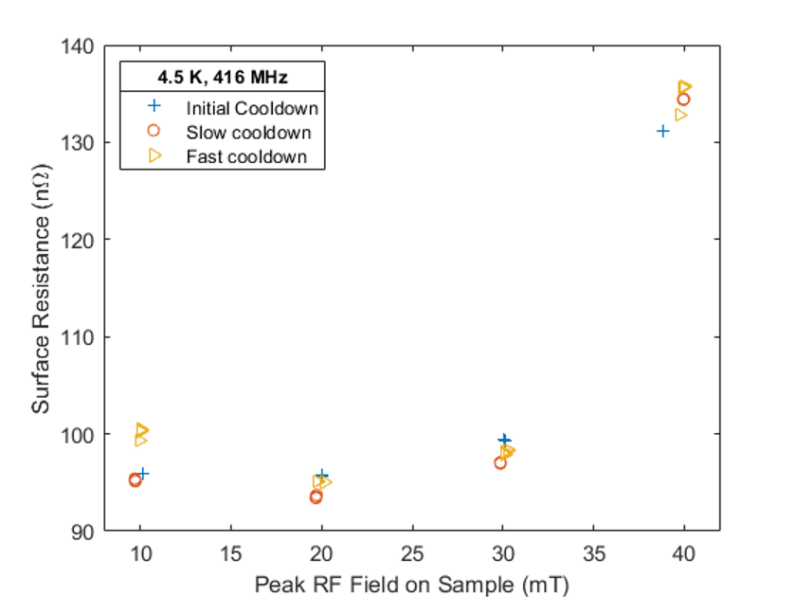
Surface resistance vs peak magnetic field
INFN sample STFC sample
Monotoneus increase of surface resistance with field
Low field Q-drop below 20 mT
High field Q-drop above 40 mT
Both possibly stemming from contaminations

Slide 8
Summary and Outlook
QPR measurements yielded information on the RF performance of Nb3Sn samples fabricated within the I.FAST collaboration
Measurements yielded feedback on the fabrication process that are have been implemented
Final QPR measurement on STFC sample scheduled
I.FAST Nb3Sn cavity prototype coated in Daresbury scheduled to be measured at HZB Supralab in June 2025

