Slide 1

Permanent Magnet Projects at STFC
Alex Hinton, STFC Daresbury Laboratory
iFast WP11 Meeting, Krakow, 9th April 2025

Slide 2
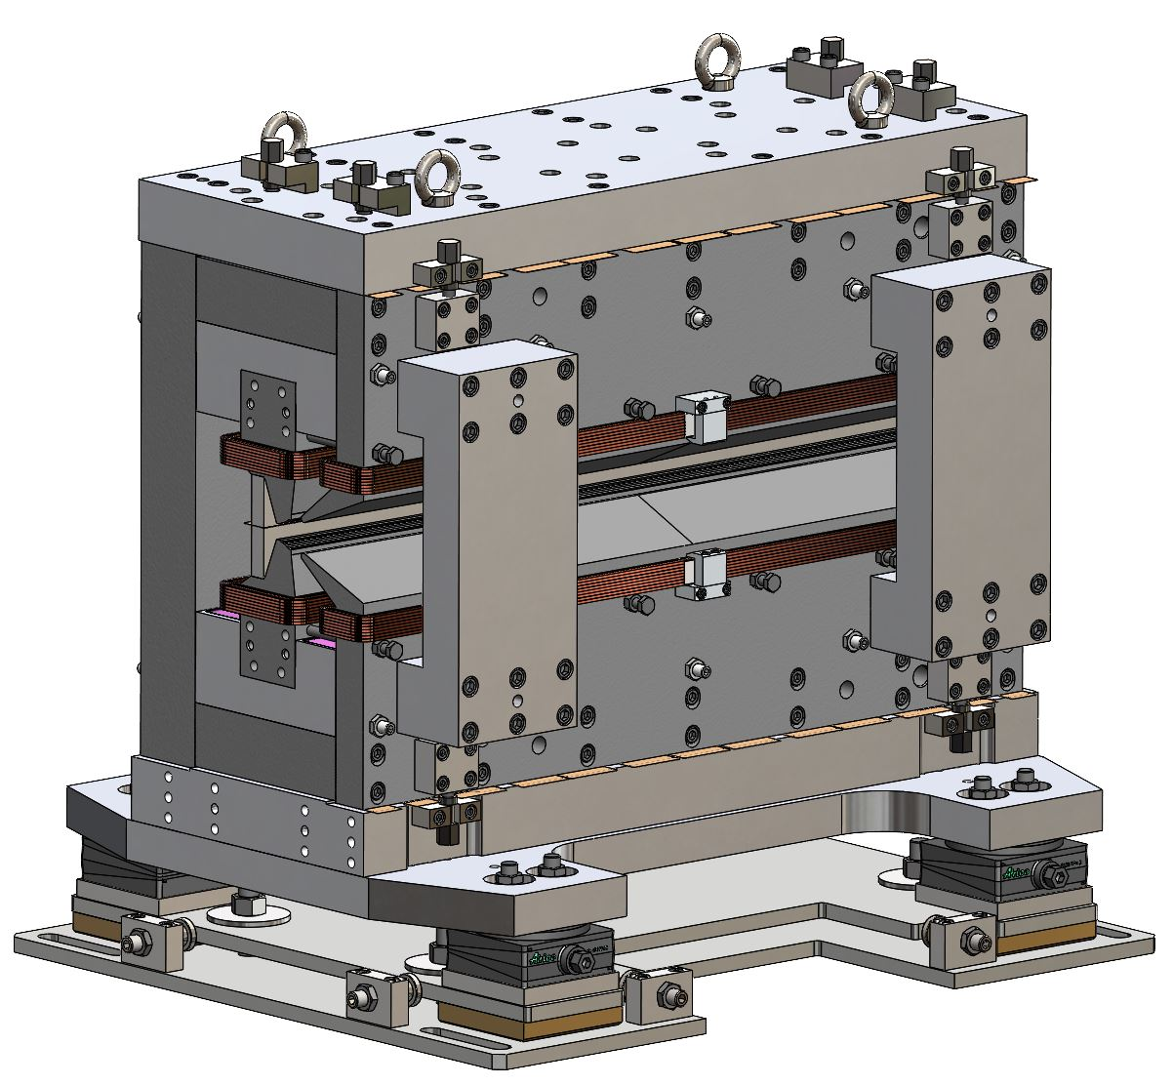
Contents
iFast – HEPTO
ZEPTO
ECRIS
Cusp-field magnets
EPAC
PoPLaR
FEBE Spectrometer
Image © STFC John Dawson
Notes:
PLEASE DELETE/REPLACE PHOTO CREDIT IF CHANGING THE IMAGE.

Slide 3


iFast WP11.3: HEPTO
Re-purposed undulator blocks.
Permanent magnet based dipole-quadrupole.
Equivalent field / space requirements as electromagnet design for Diamond-II.
Hybrid Electromagnet-Permanent Magnet Tuneable Optics (HEPTO).
Dipole = 0.7 T, Gradient = 33 T/m.
Effective length = 0.870 m.
Main source of field = NdFeB permanent magnet blocks
Dipole and gradient fields require independent tuning of ±2.5% for commissioning purposes.
Field tuning achieved by air-cooled trim coils.
Yoke and poles made from low-carbon steel.
Main coil peak power = 31 W
Auxiliary coil peak power = 16 W
Spare thermal shunt material.
EM DQ nominal power = 2.3 kW + water
Notes:
Design is for improved sustainability – replace Ems with PMs to reduce power consumption.
Design of this prototype is sustainable – recycled/re-used PM and thermal shunt material – no need to produce new material / buy in large volume.
Some tuning is necessary, over small range. Achieved through air-cooled coils, > 2kW power saved compared to EM.

Slide 4
Current Status
MS56 – Magnets Constructed and Tested.
Estimated completion June 2025.
Delays due to several difficulties:
  Re-design to incorporate re-purposed undulator PM blocks.
  Difficulties acquiring low-carbon steel.
  Difficulties acquiring thermal shunt material.
  Time required to cut and de-burr thermal shunts.
  Staff availability.
Construction is now nearing completion.
Magnetic measurements at DL will verify performance.
Write final report on testing results.

Slide 5
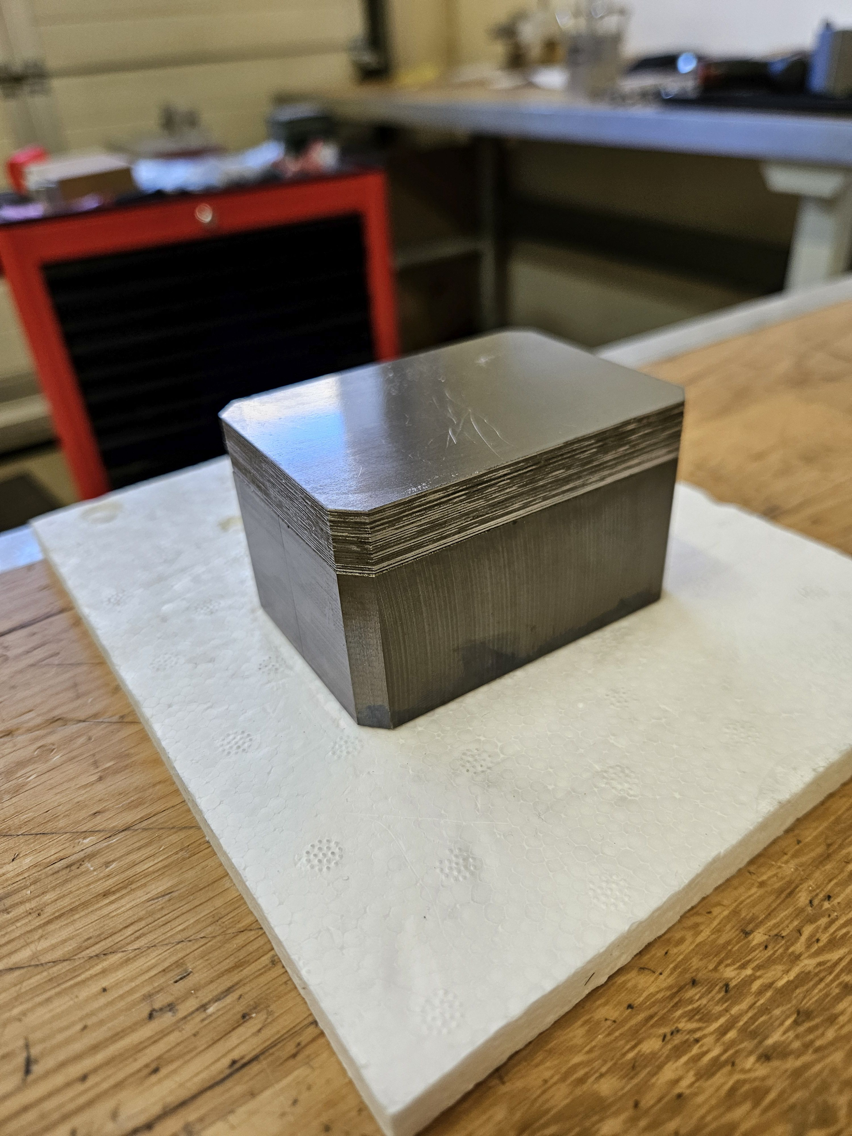
Assembly
Thermal shunt sheets glued to magnet blocks.
Notes:
Assembly is ongoing.
First step is to glue thermal shunts to PM blocks.
26 shunt sheets per side PM block x42 blocks – very slow process!

Slide 6
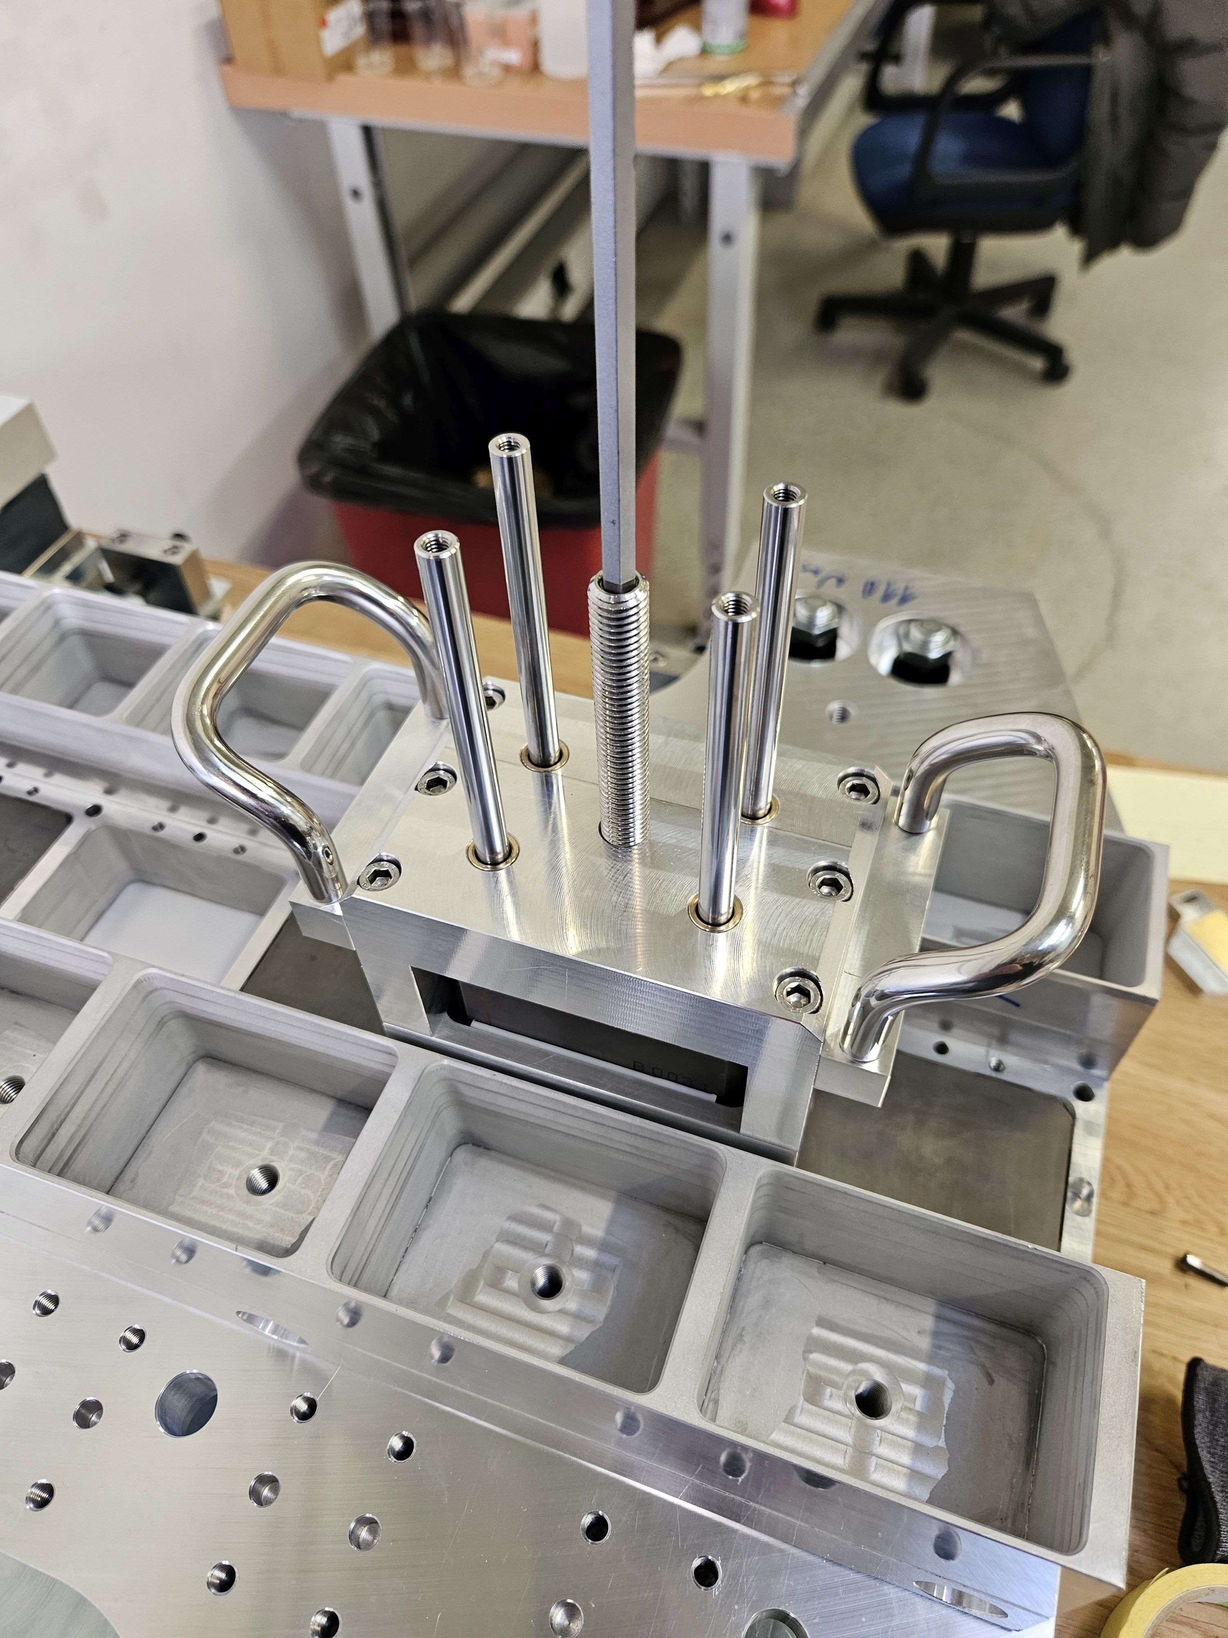
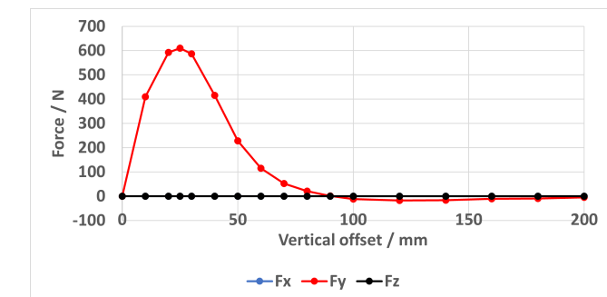
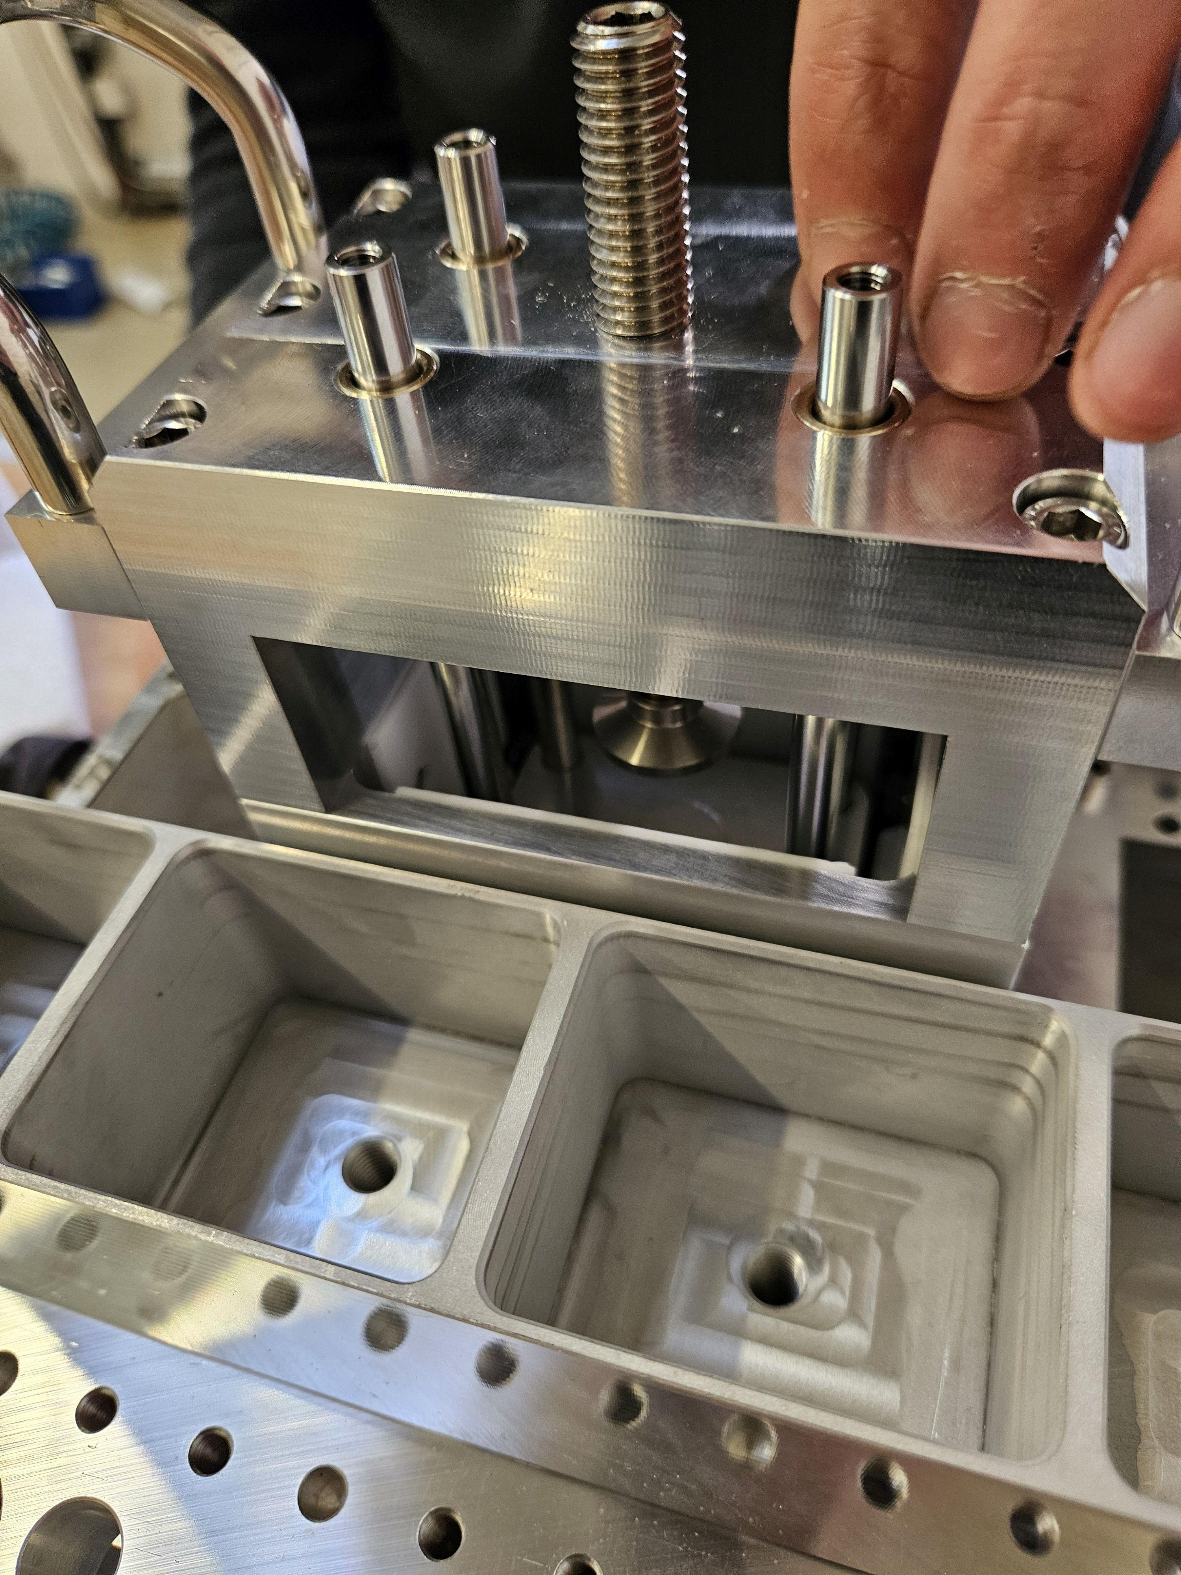
Assembly
Thermal shunt sheets glued to magnet blocks.
Middle magnets glued into tray.
Notes:
Middle magnets glued into non-magnetic tray.
Custom assembly tooling designed and built in-house at Kyma.
Tool slide along and use threaded rods to push magnets into slots.
Required because of large forces on magnets during assembly! Repulsive forces need to be overcome to push middle magnet in between two neighbours. Up to ~60 kg force to be overcome.

Slide 7
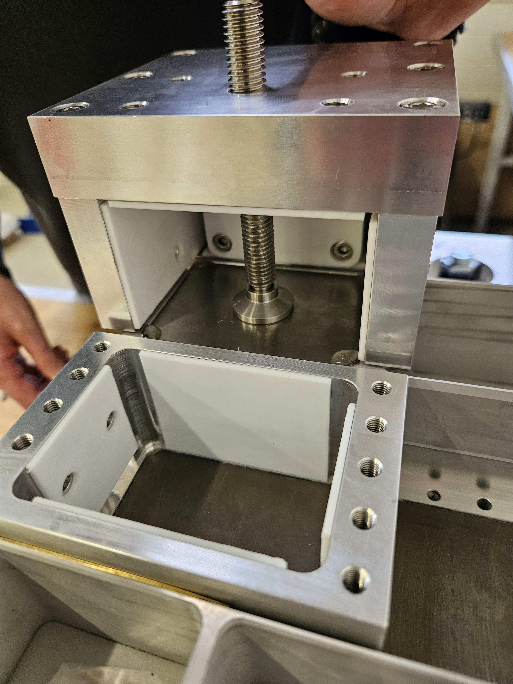
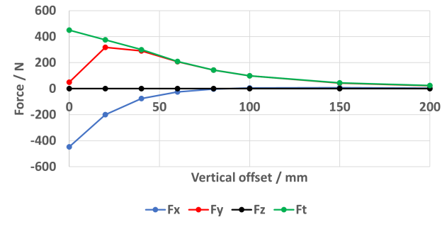
Assembly
Thermal shunt sheets glued to magnet blocks.
Middle magnets glued into tray.
Side magnets glued into tray.
Notes:
Next side magnets inserted.
Assembly tooling again used to overcome forces
Forces more complicated for side magnets – including horizontal forces to be overcome
Different tooling needed for different magnets due to different shapes. In a series production all magnets would be bespoke and same dimensions to simplify tooling.

Slide 8
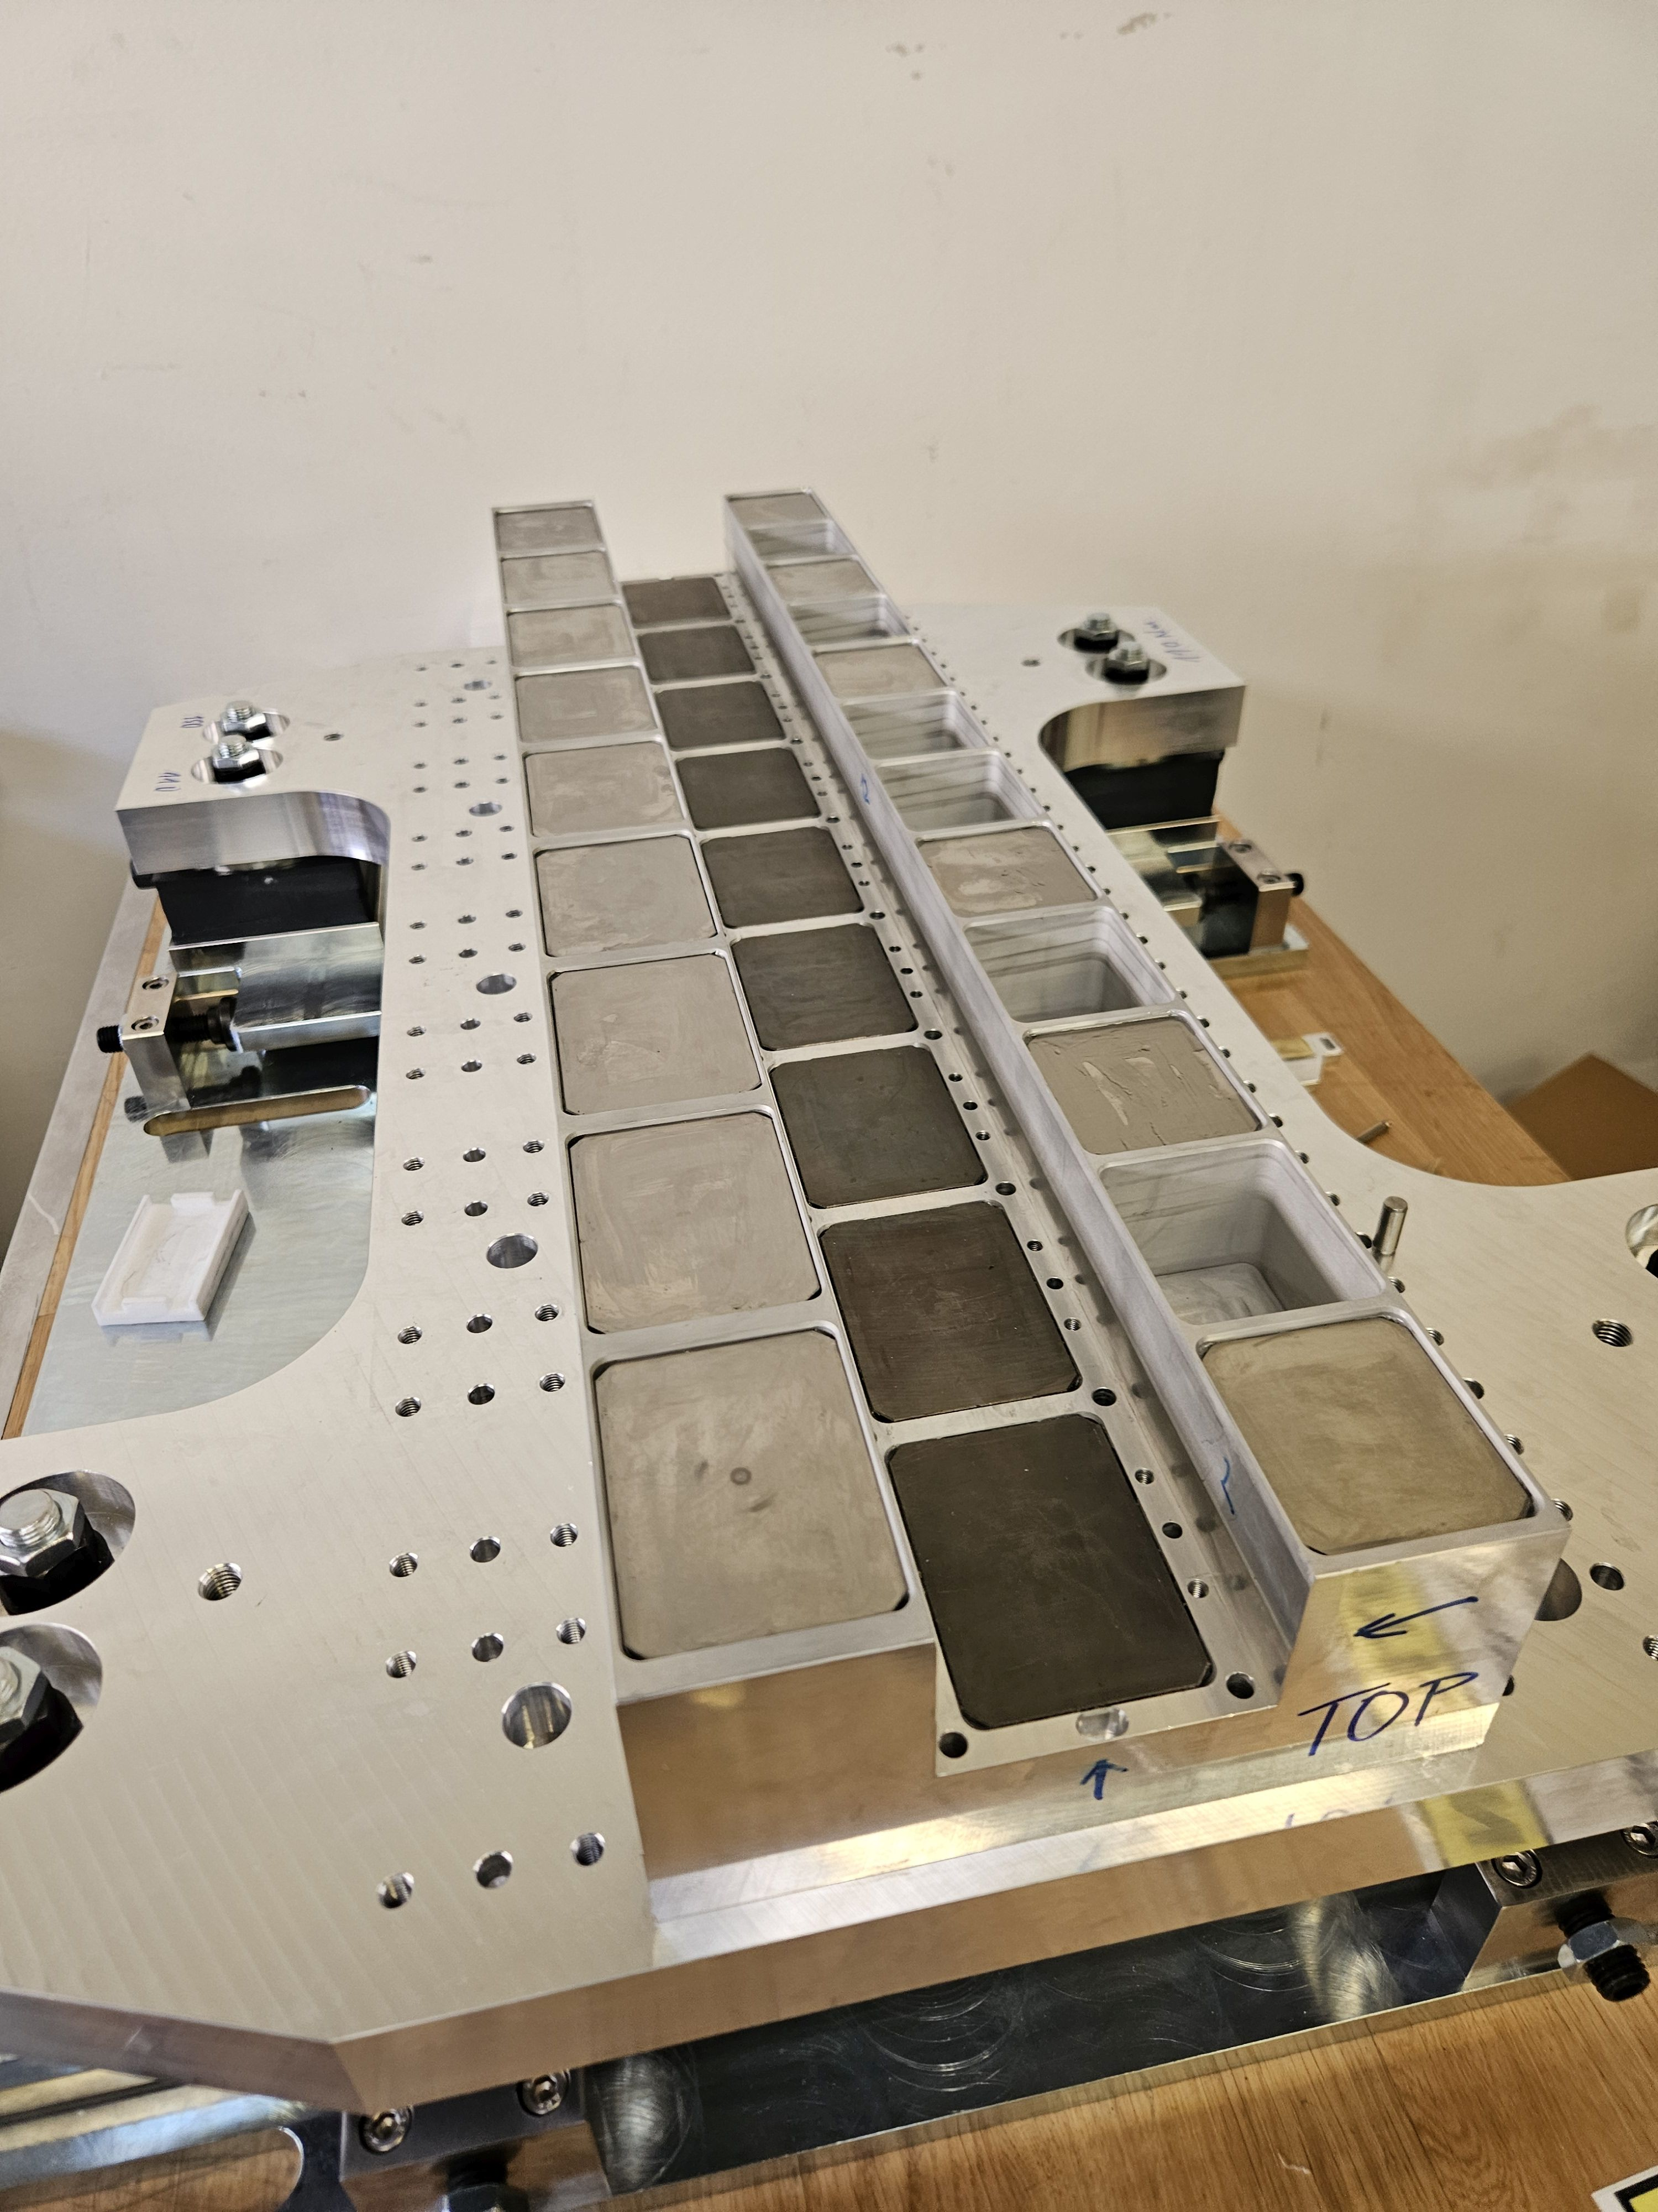
Assembly
Thermal shunt sheets glued to magnet blocks.
Middle magnets glued into tray.
Side magnets glued into tray.
Notes:
Magnets installed in set order to minimise forces on them

Slide 9
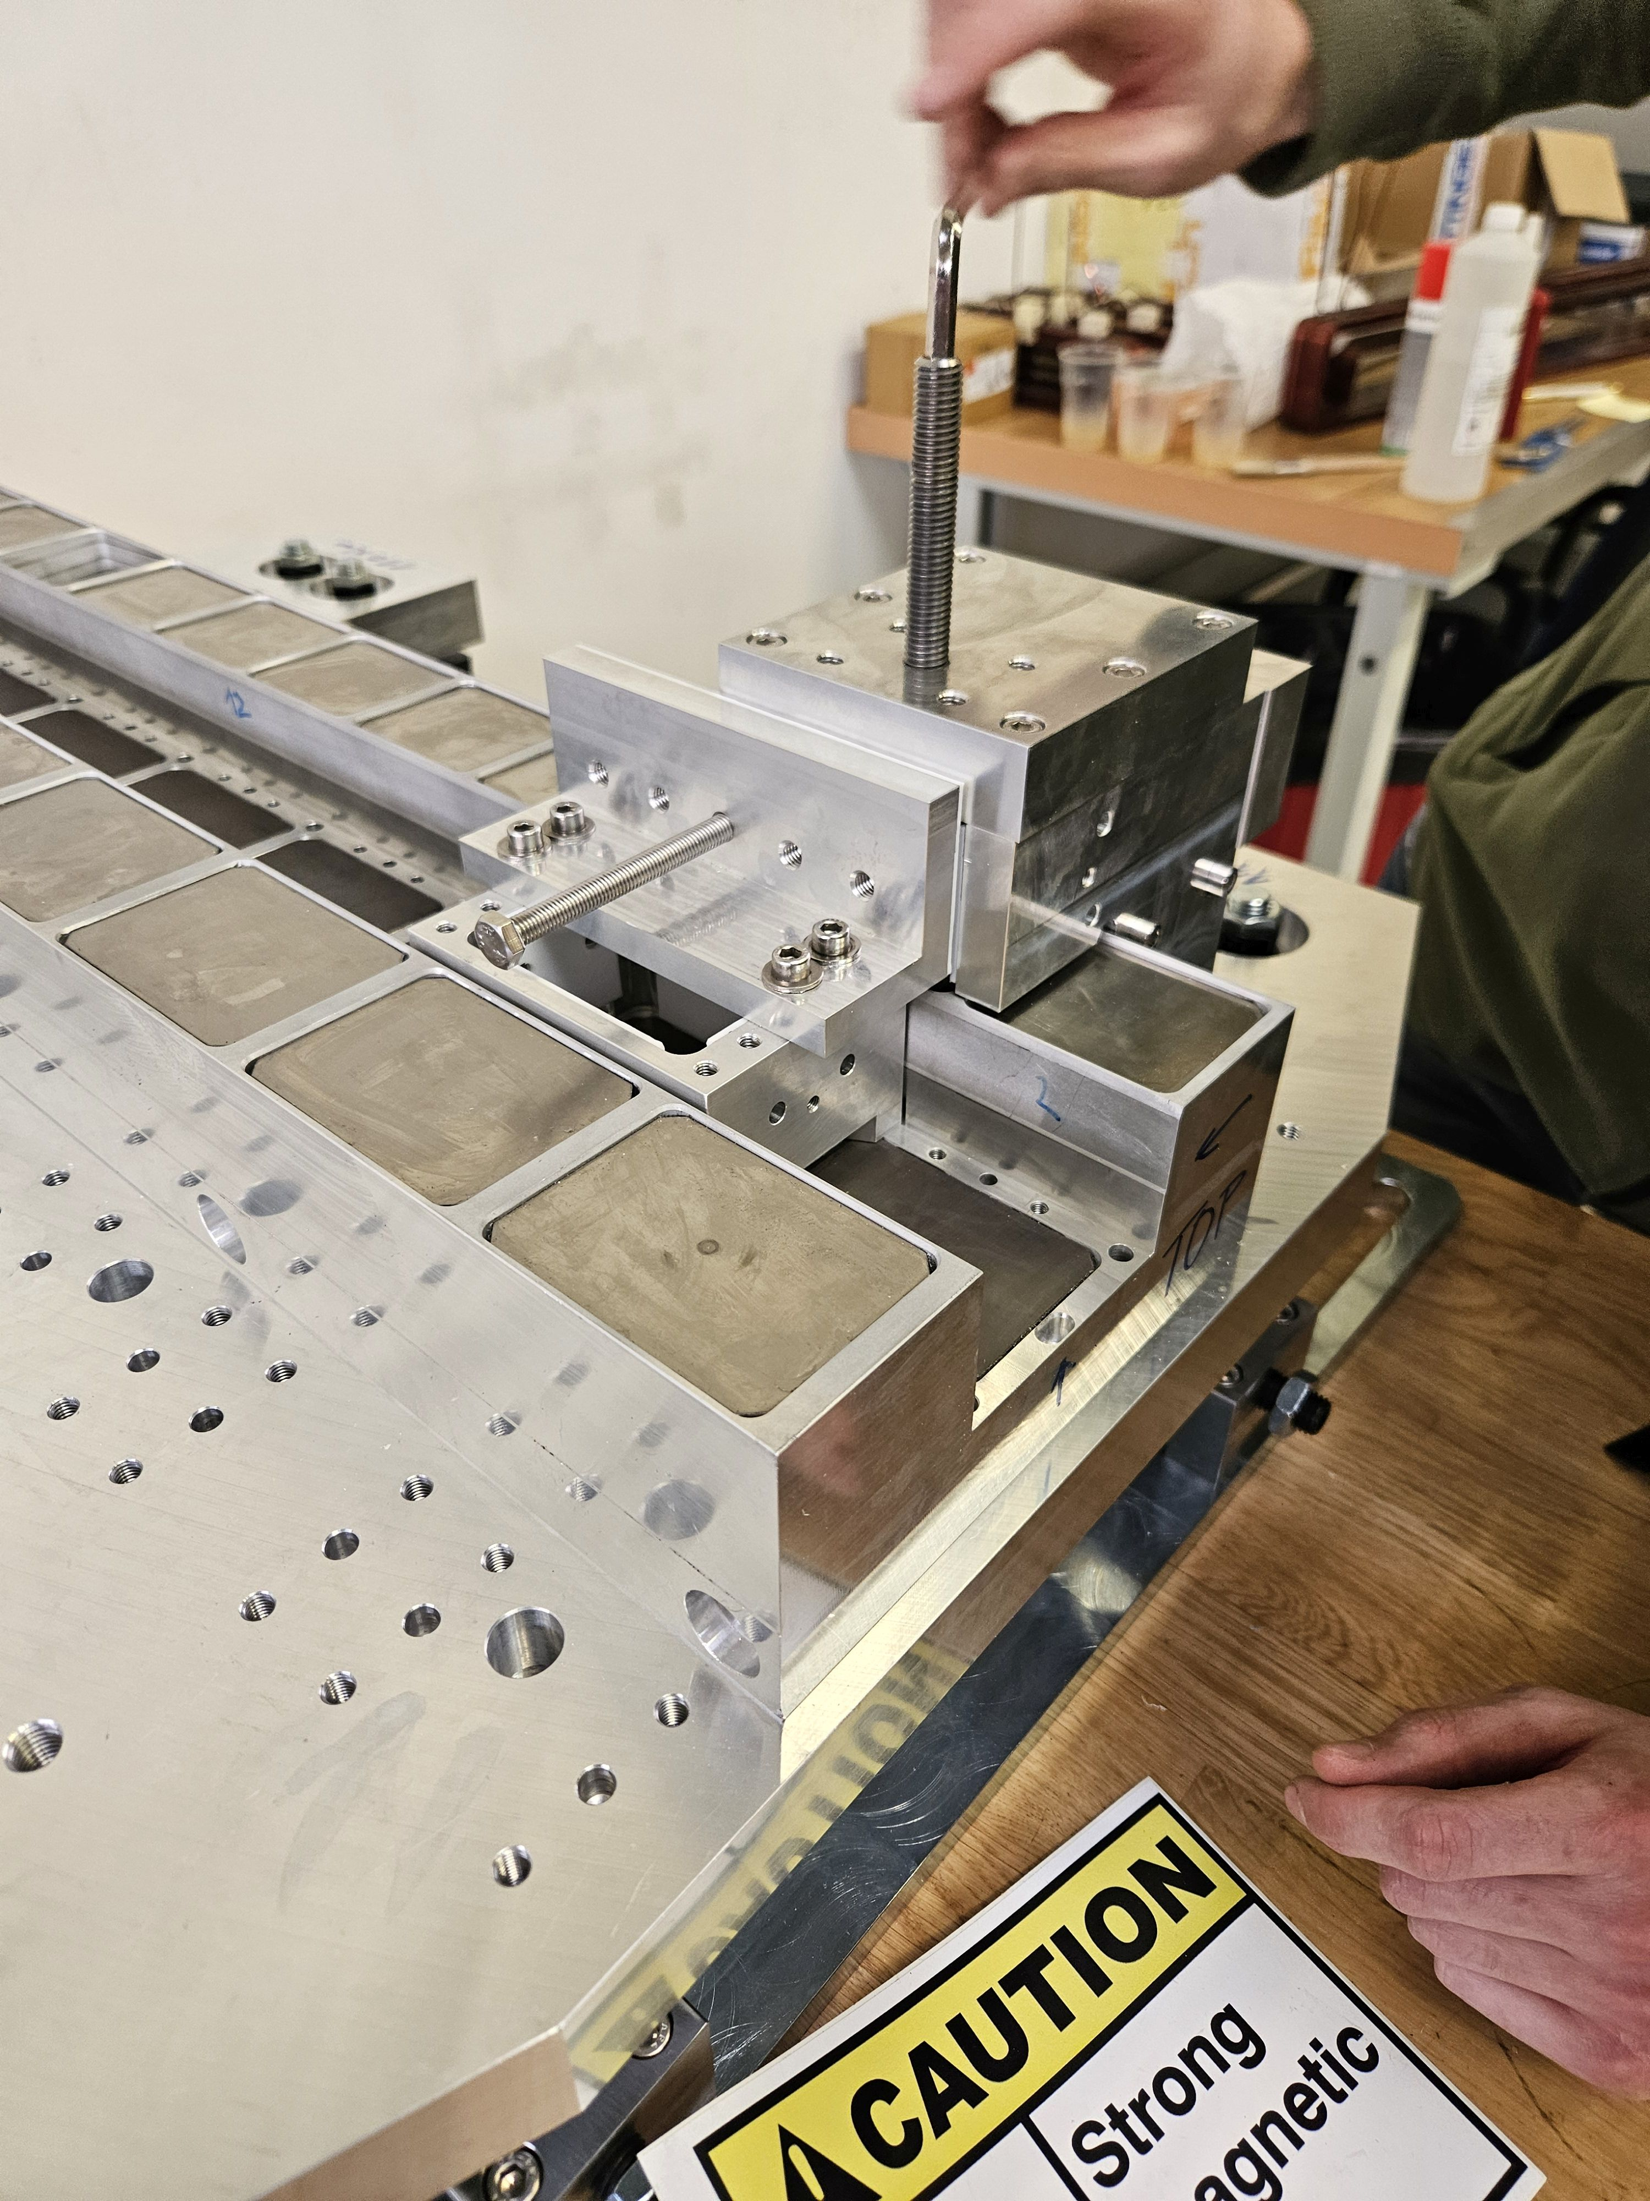
Assembly
Thermal shunt sheets glued to magnet blocks.
Middle magnets glued into tray.
Side magnets glued into tray.
Notes:
Final magnet being inserted

Slide 10
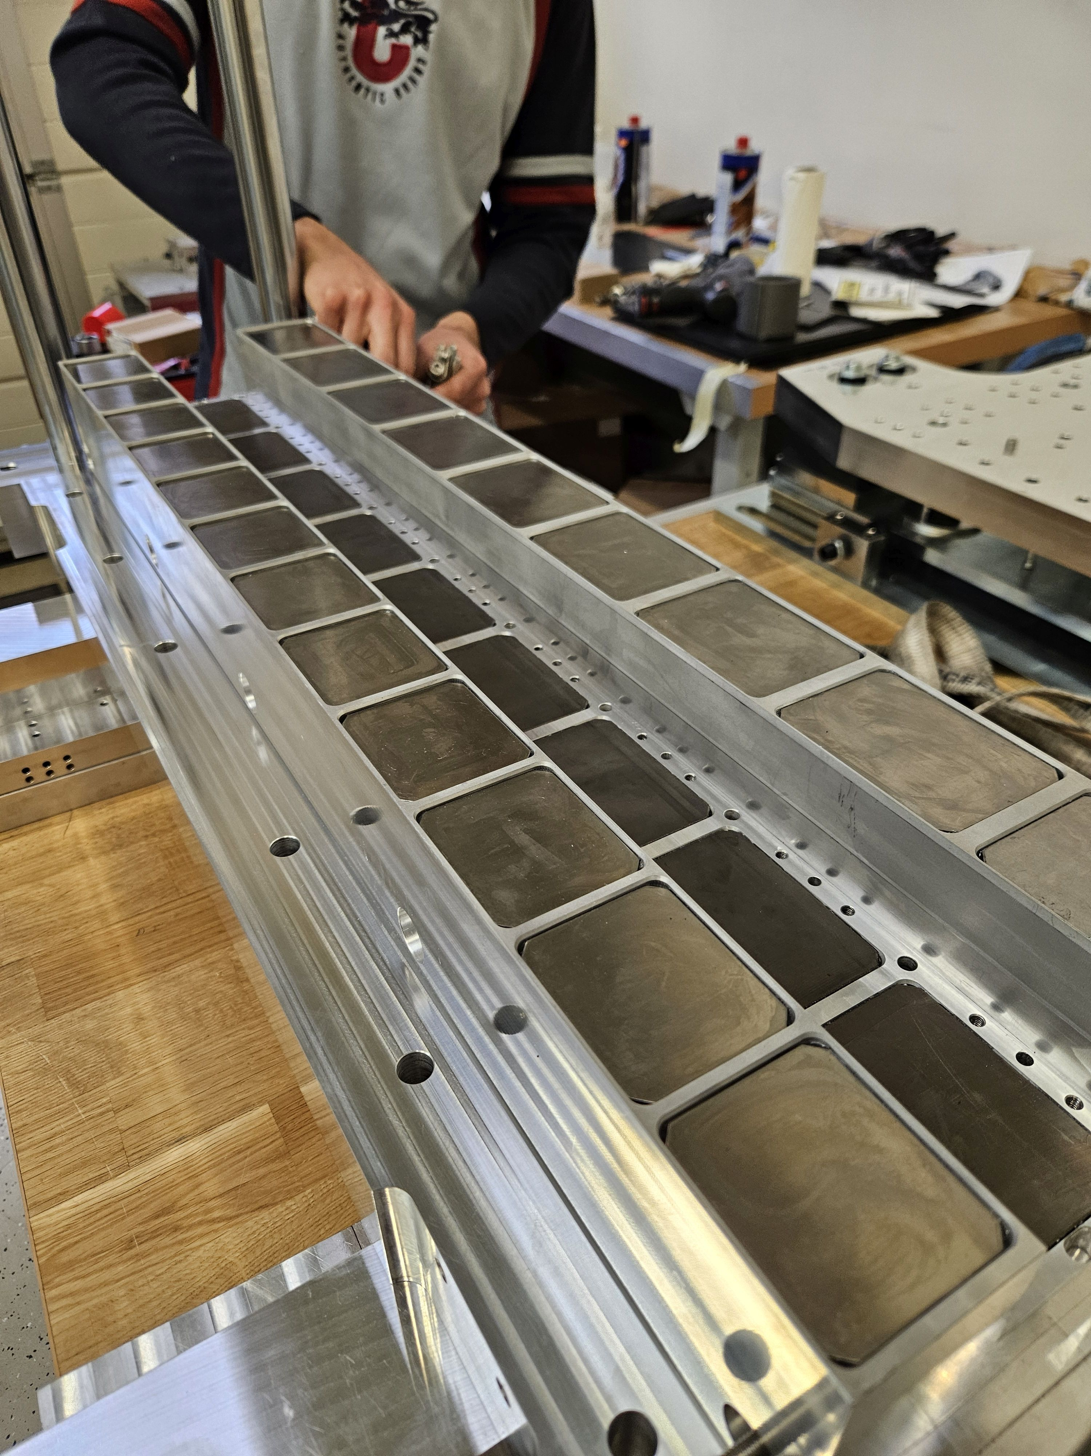
Assembly
Thermal shunt sheets glued to magnet blocks.
Middle magnets glued into tray.
Side magnets glued into tray.
Notes:
Fully filled PM carriage

Slide 11
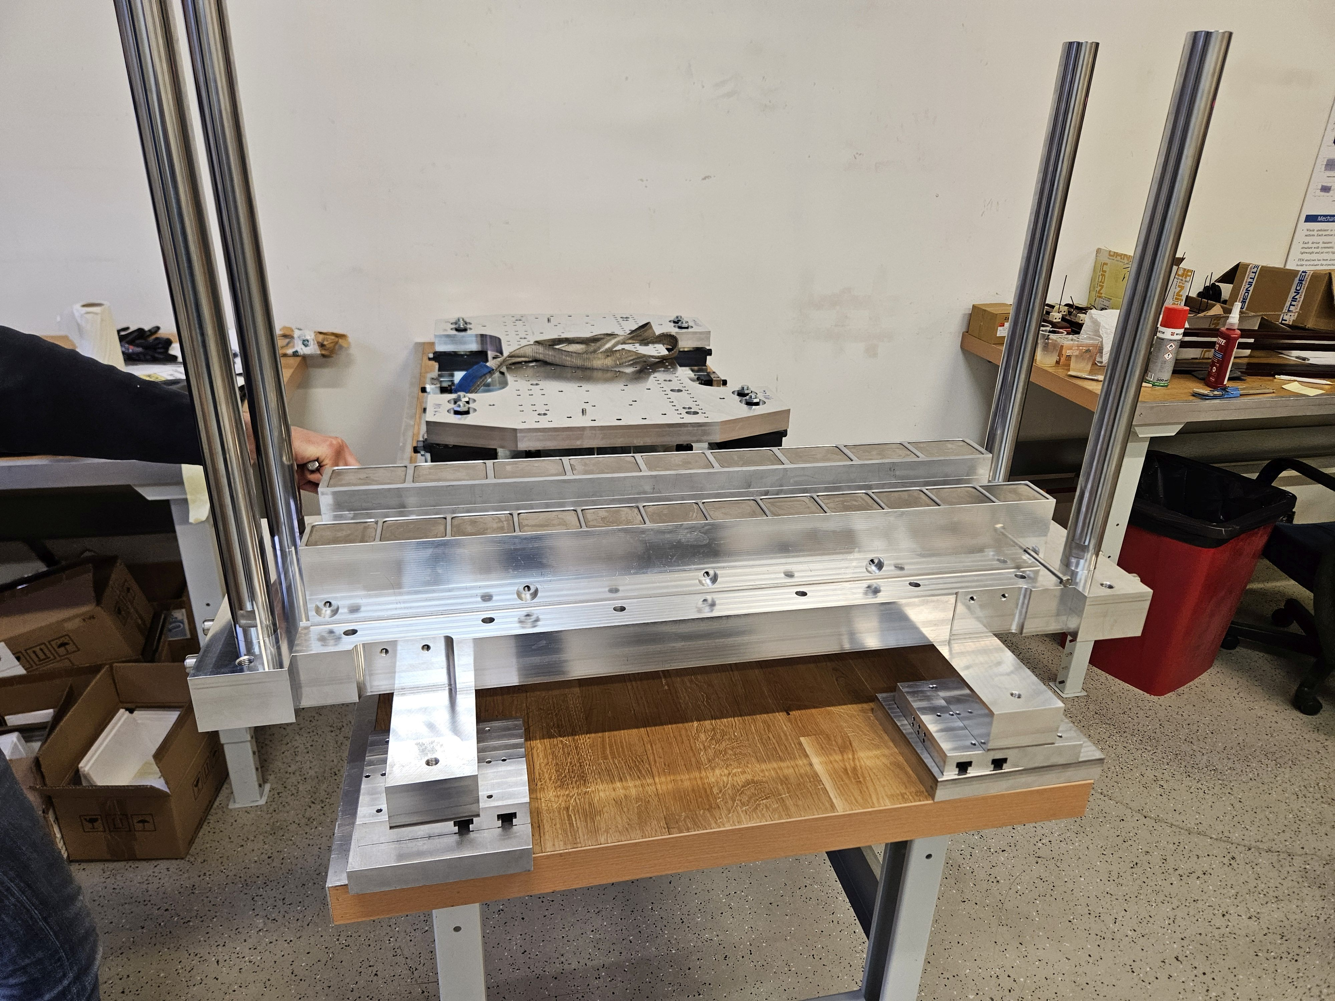
Assembly
Thermal shunt sheets glued to magnet blocks.
Middle magnets glued into tray.
Side magnets glued into tray.
Main pole inserted.
Notes:
Next the main pole is inserted into the magnet carriage.
4 poles act to guide the pole and manage movement in a controlled and safe way

Slide 12
Assembly
Thermal shunt sheets glued to magnet blocks.
Middle magnets glued into tray.
Side magnets glued into tray.
Main pole inserted.
Notes:
Next the main pole is inserted into the magnet carriage.
4 poles act to guide the pole and manage movement in a controlled and safe way

Slide 13
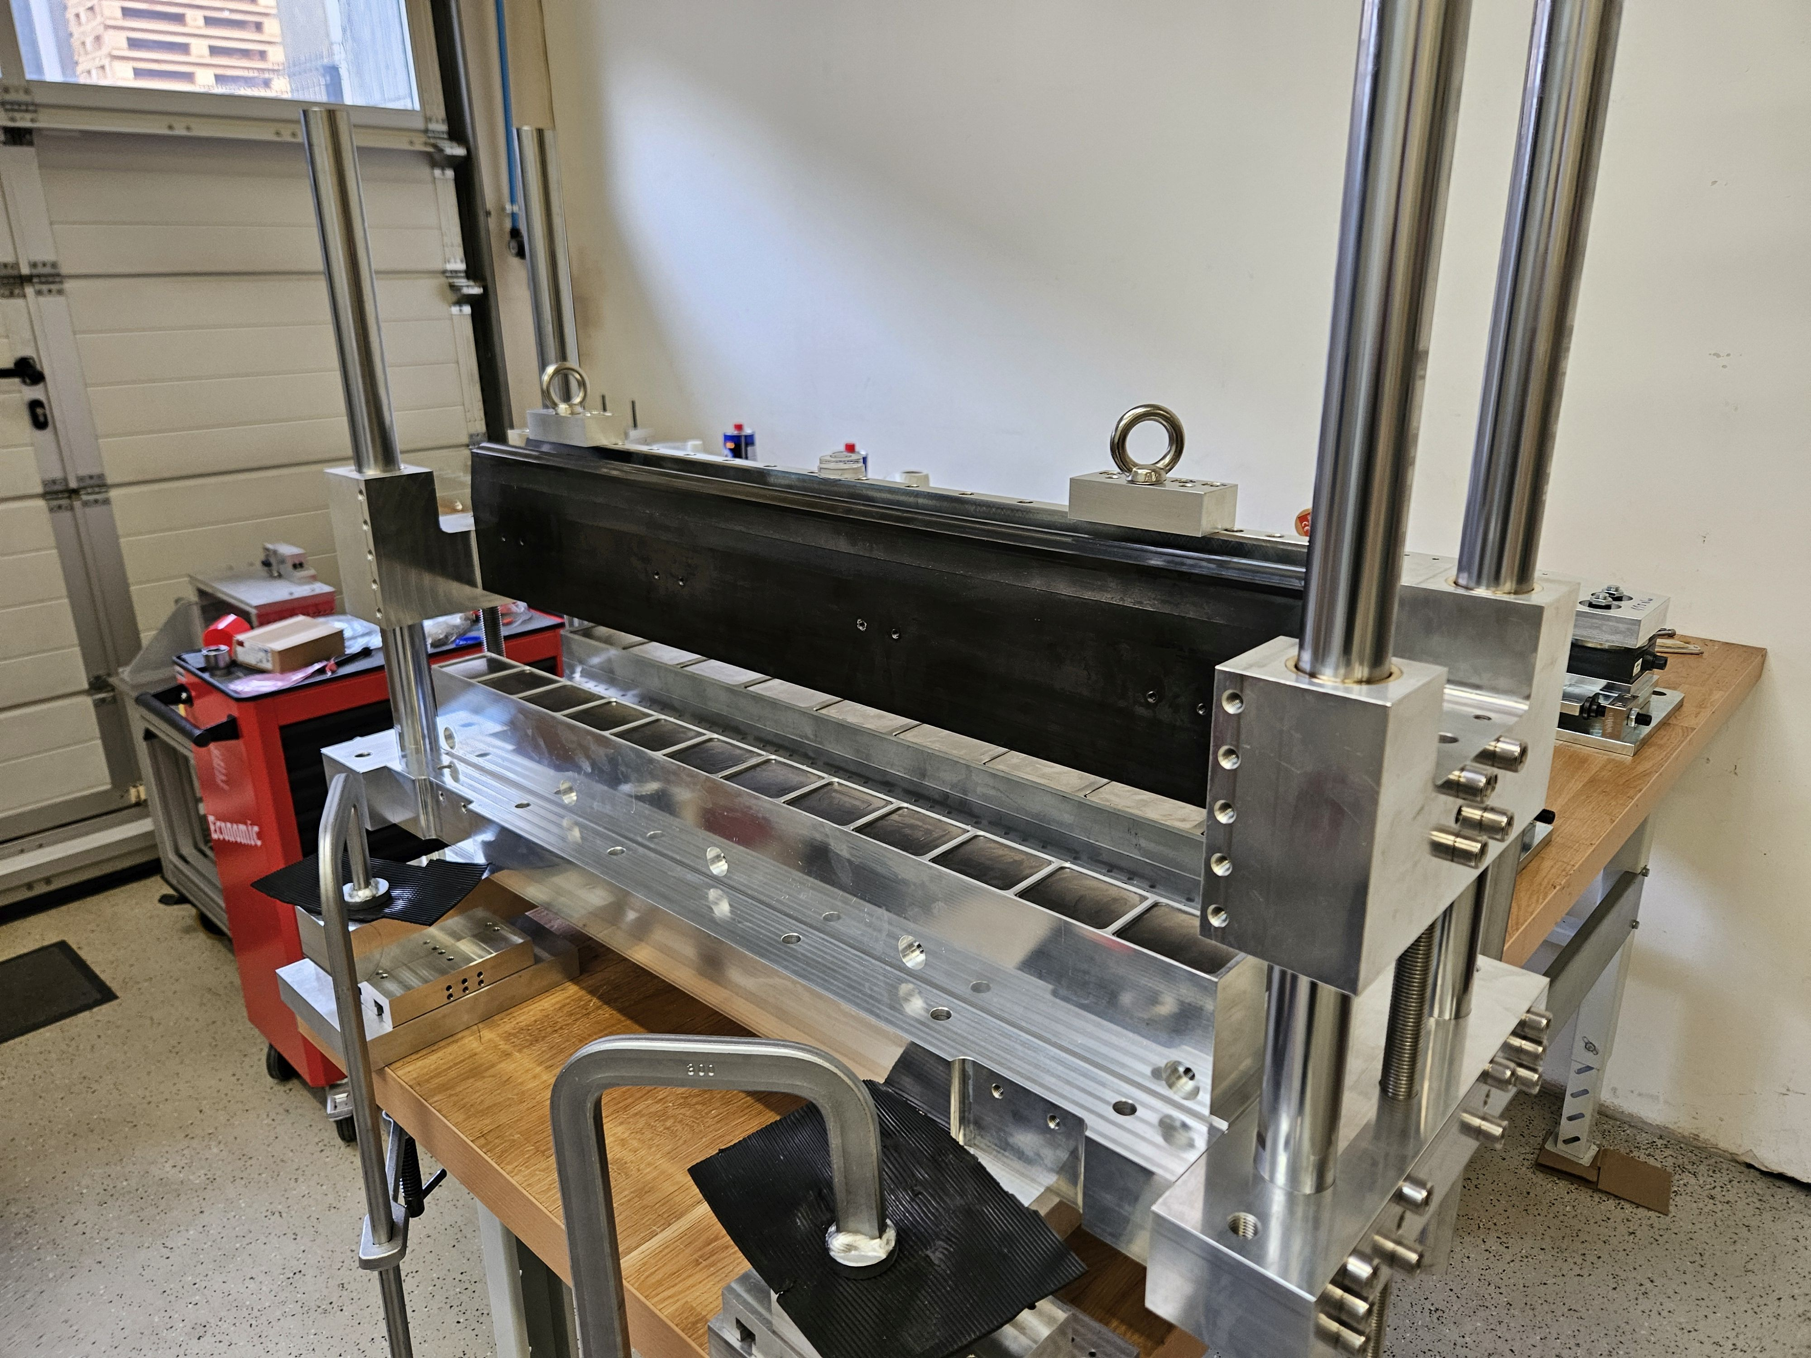
Assembly
Thermal shunt sheets glued to magnet blocks.
Middle magnets glued into tray.
Side magnets glued into tray.
Main pole inserted.
Notes:
Image of pole inserted in magnet carriage

Slide 14
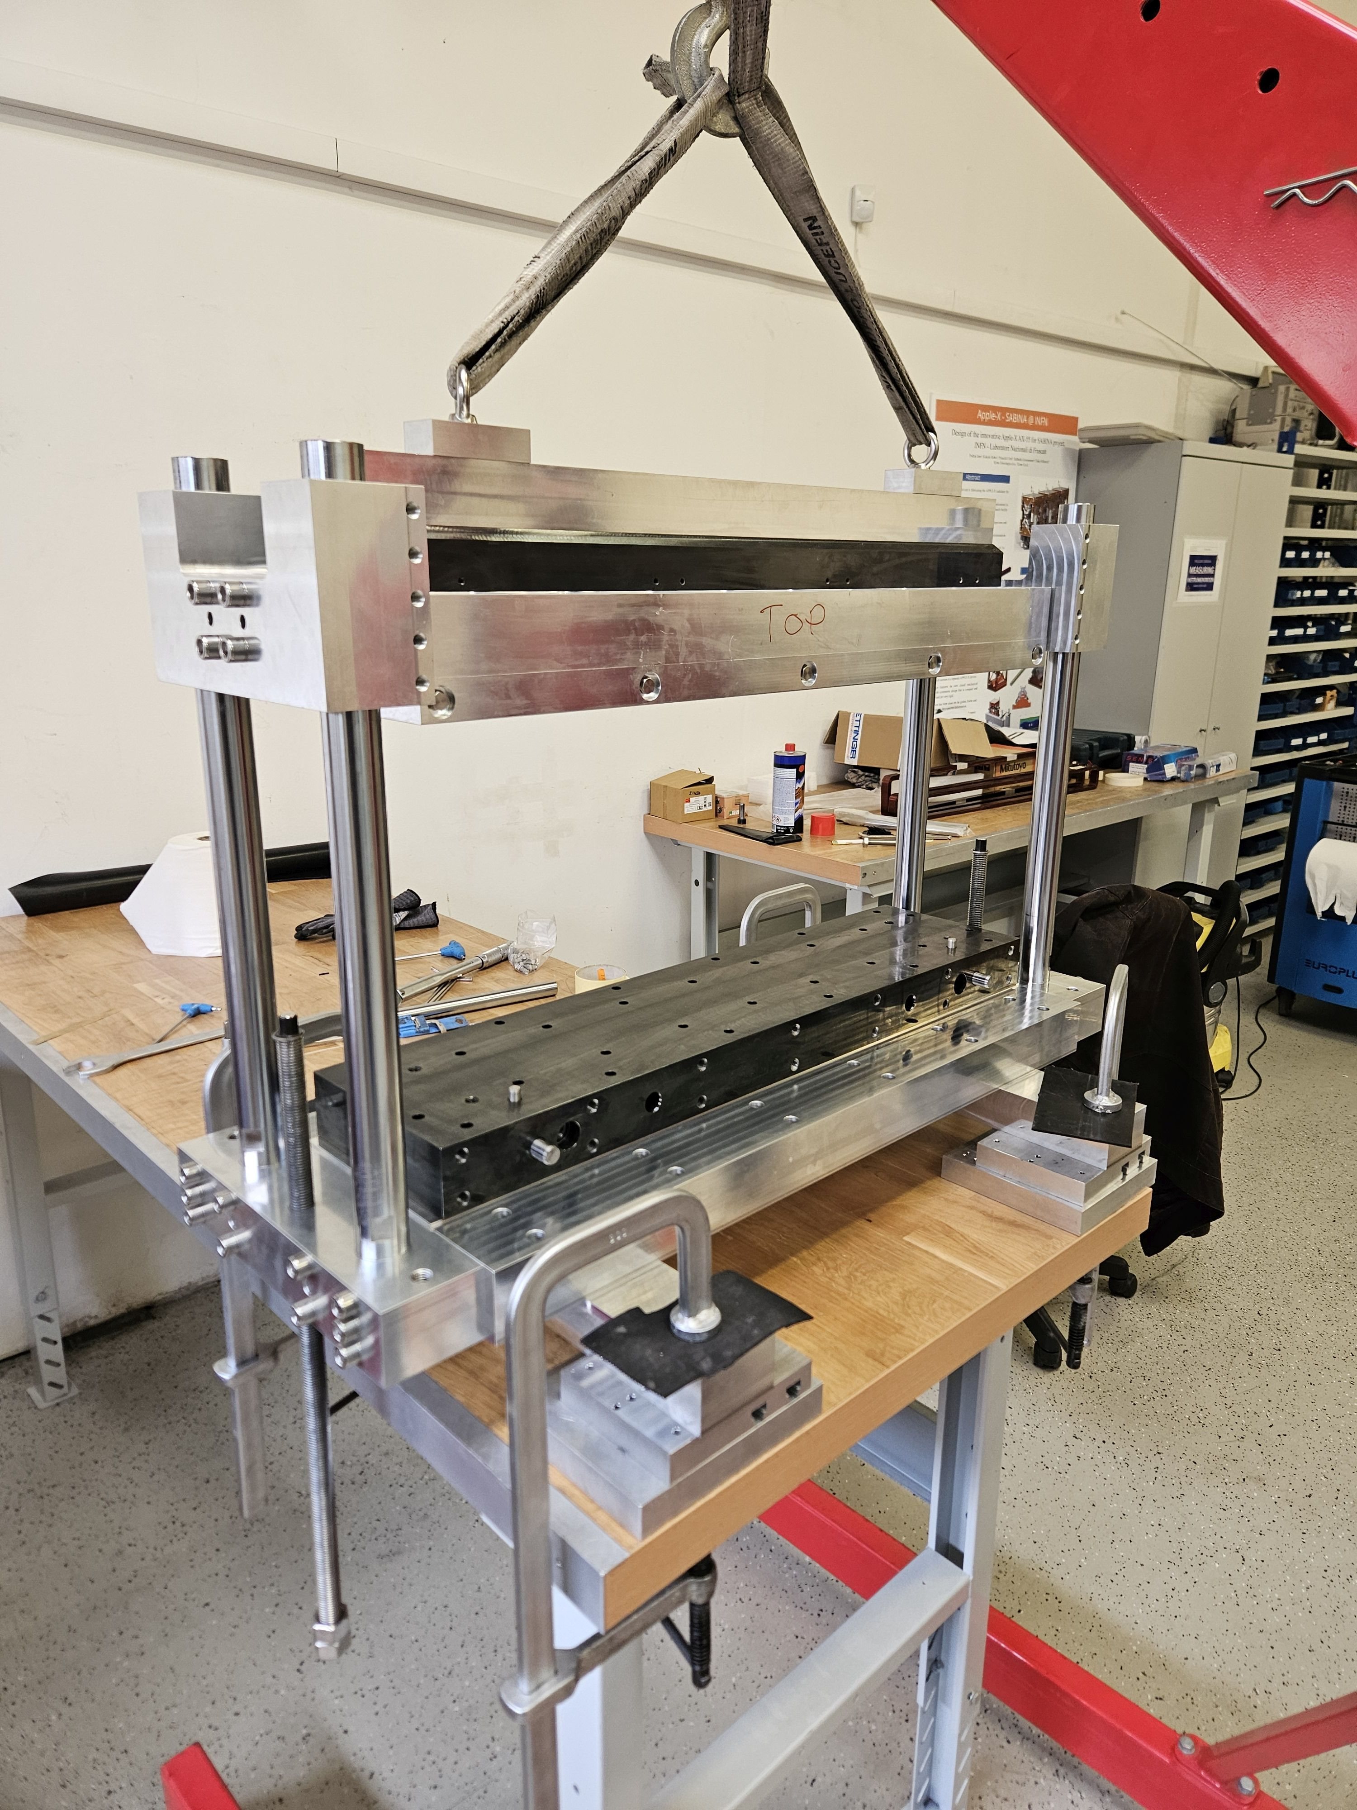
Assembly
Thermal shunt sheets glued to magnet blocks.
Middle magnets glued into tray.
Side magnets glued into tray.
Main pole inserted.
Main pole and magnet carriage bolted to top plate.
Notes:
Assembly of main pole and carriage is lowered using same frame onto the top plate.
Poles guide movement, crane used to lower carriage

Slide 15
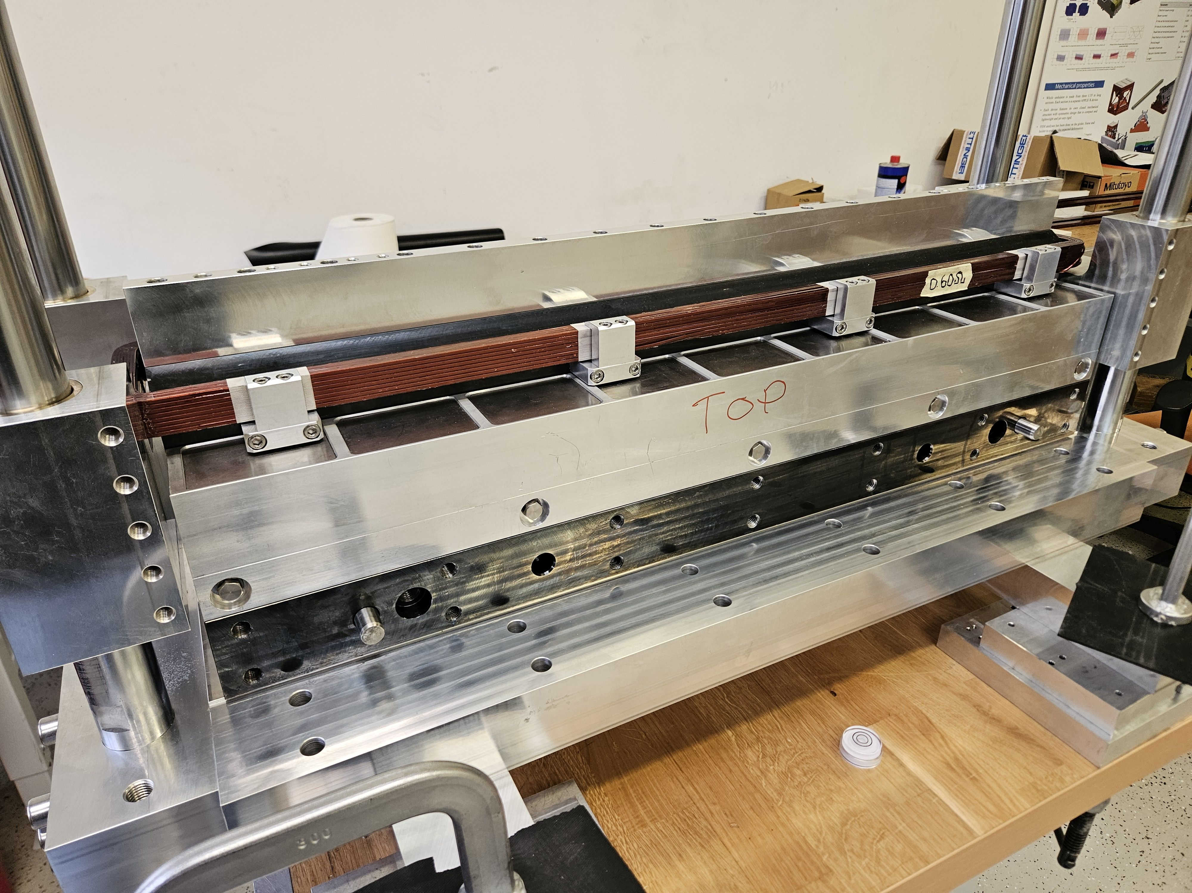
Assembly
Thermal shunt sheets glued to magnet blocks.
Middle magnets glued into tray.
Side magnets glued into tray.
Main pole inserted.
Main pole and magnet carriage bolted to top plate.
Mount trim coil on main pole.
Repeat for second girder.
Mount both girders to backplate.
Mount auxiliary poles.
Notes:
Finally, the coil is mounted around the main pole.
That’s one girder completed, have to do the same for the other girder!
Both girders have now been built.
Next steps are to mount the girders to the backplate, then mount the auxiliary coils.

Slide 16
Assembly
Thermal shunt sheets glued to magnet blocks.
Middle magnets glued into tray.
Side magnets glued into tray.
Main pole inserted.
Main pole and magnet carriage bolted to top plate.
Mount trim coil on main pole.
Repeat for second girder.
Mount both girders to backplate.
Mount auxiliary poles.
Final magnet assembled and ready for magnetic measurements.
Notes:
Final assembled magnet will look like this – ready for testing.

Slide 17
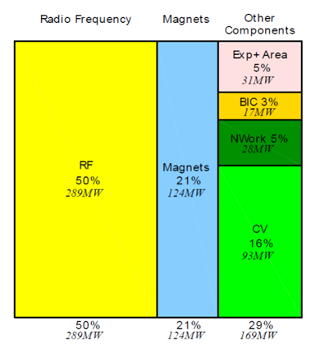
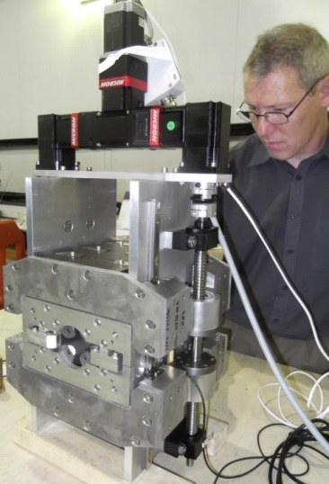
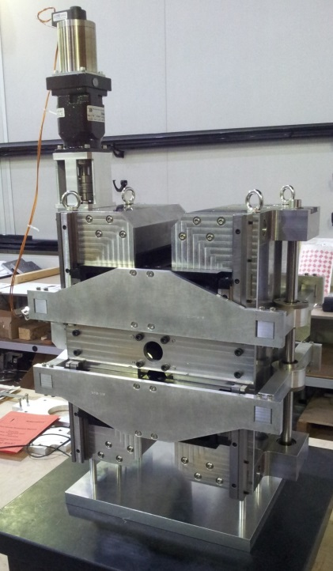
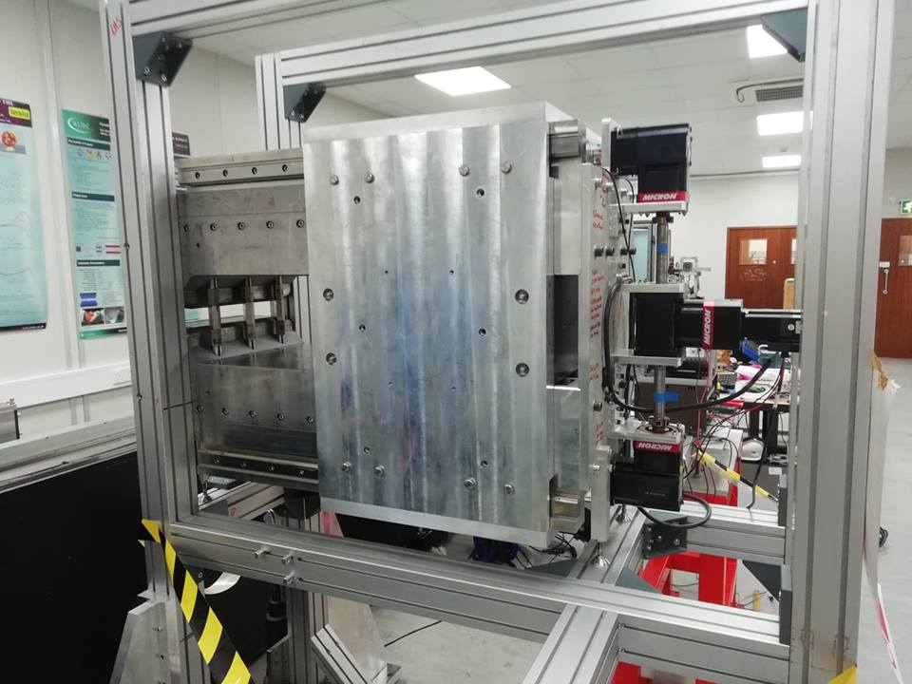
Zero Power Tuneable Optics (ZEPTO)
Project 1: High strength quad
B gradient from 60 – 15 T/m
Shepherd et al, Journal of Instrumentation, Vol 9, T11006, 2014
Project 2: Low strength quad
B gradient from 43 – 3.5 T/m
Shepherd et al, IPAC’14, Dresden, Germany, paper TUPRO113.
The ZEPTO project created 3 prototypes for CLIC (42000 quadrupoles!).
All were designed, constructed and measured at STFC Daresbury Laboratory.
All use NdFeB magnet blocks attached to a motion system, with fixed steel poles defining the field shape.
Project 3: Wide range dipole
B adjustable from 1.1 T to 0.45 T
Bainbridge et al., IPAC’17, Copenhagen, Denmark,, paper THPIK105.
2012 - 2014
2017-2019

Slide 18
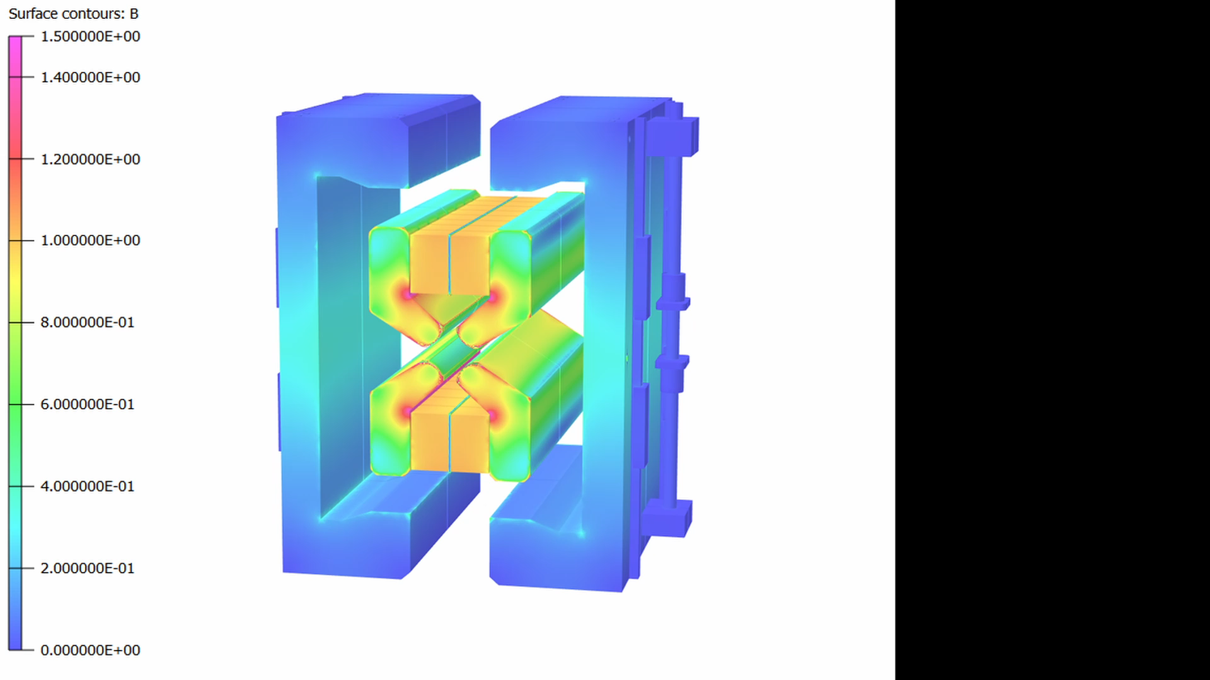
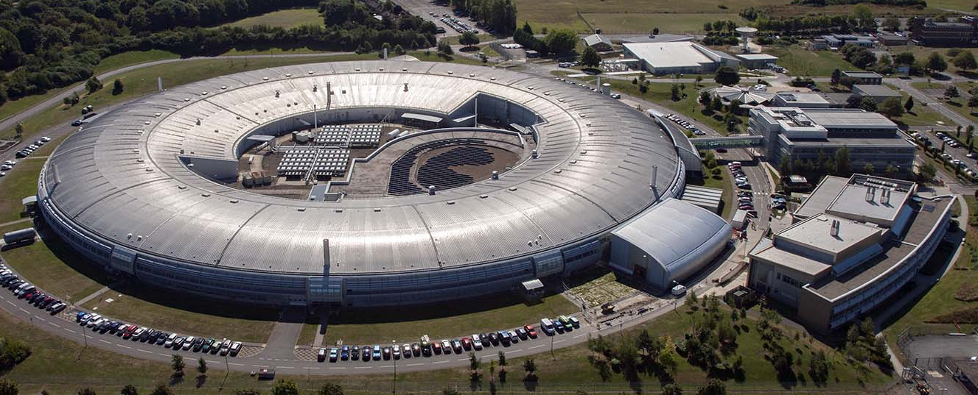
New technology demonstrator
We want to show that the benefits of ZEPTO technology are not limited to CLIC, and can be used as an energy saving `drop-in' replacement for electromagnets on accelerators such as existing light sources.
We have developed a new ZEPTO quadrupole for the booster-to-storage ring section of Diamond Light Source.
Contours B (T)
1.4
1.4
1.2
1.2
1.0
1.0
0.8
0.8
0.6
0.6
0.4
0.4
0.2
0.2
0
Bainbridge et al., IPAC’22, Bangkok, Thailand, paper THOYSP1.
Fielder et al., IPAC’23, Venice, Italy, paper WEPM129.

Slide 19
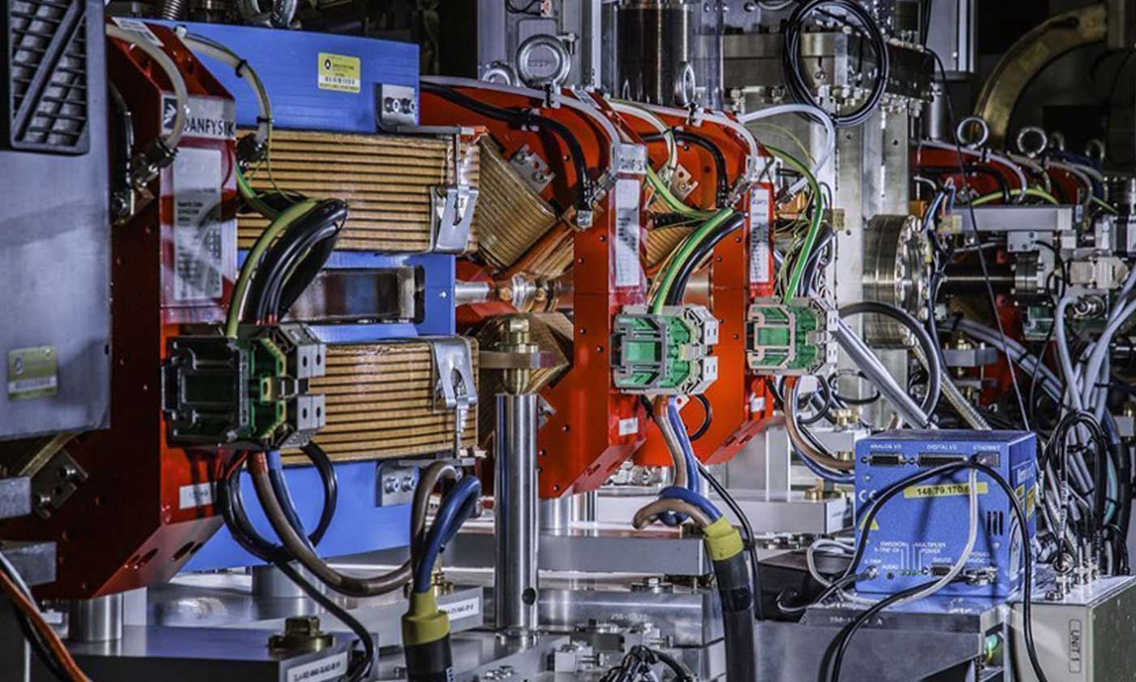
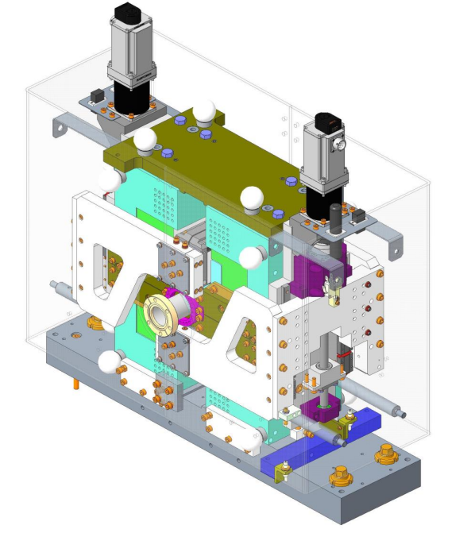
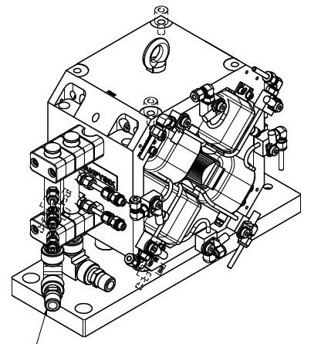
ZEPTO-CLARA
Aims of this project:
  Resolve issues with previous devices.
  Demonstrate ZEPTO working on CLARA.
  Explore commercialisation opportunities.
CLARA- Compact Linear Accelerator for Research and Applications.
Replace one electromagnet quadrupole with ZEPTO-Q4.
Design complete.
Construction over summer 2025.
Plan to install Winter 2025.

Slide 20
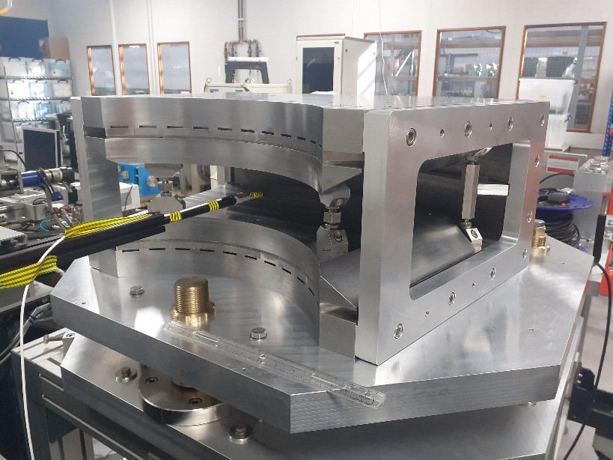
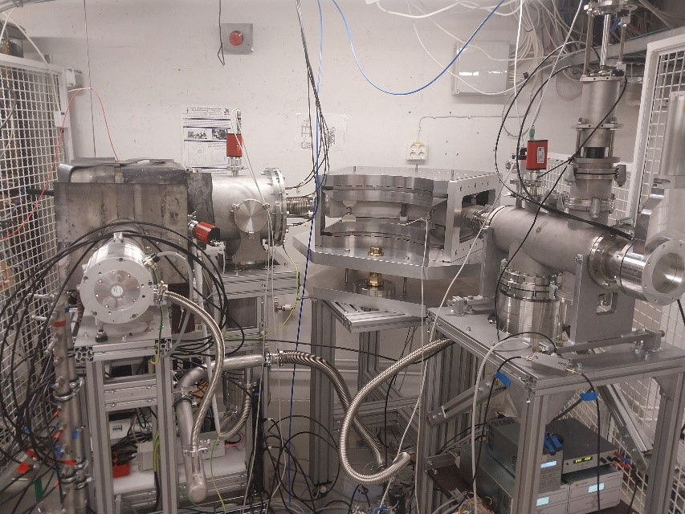
ECRIS Dipole
Tuneable permanent magnet dipole designed for use on an Electron Cyclotron Resonance Ion Source (ECRIS).
Tuneable strength for charge state selection.
Novel carbon free accelerator for Ion Beam Analysis.
Built and measured at Daresbury Laboratory.
Magnet integrated into low energy beam line of a prototype PM ion source at University of Jyväskylä.
First experiments in May 2024 with argon ion beams showed production of IBA-relevant charge states and beam currents.

Slide 21
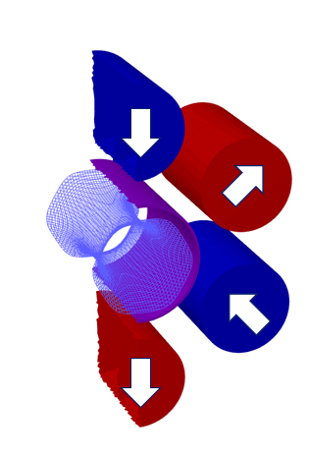
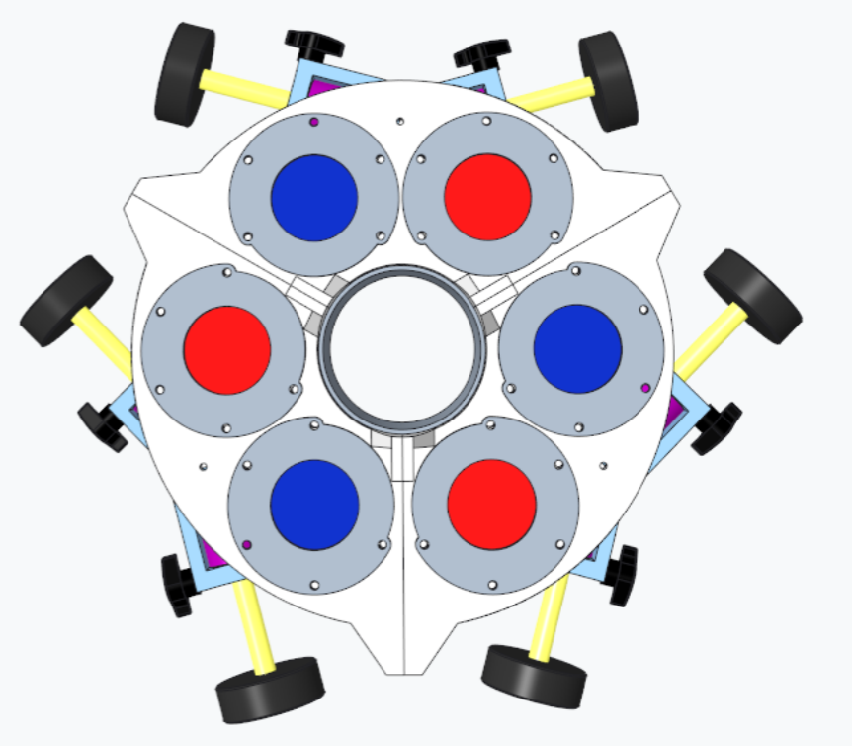
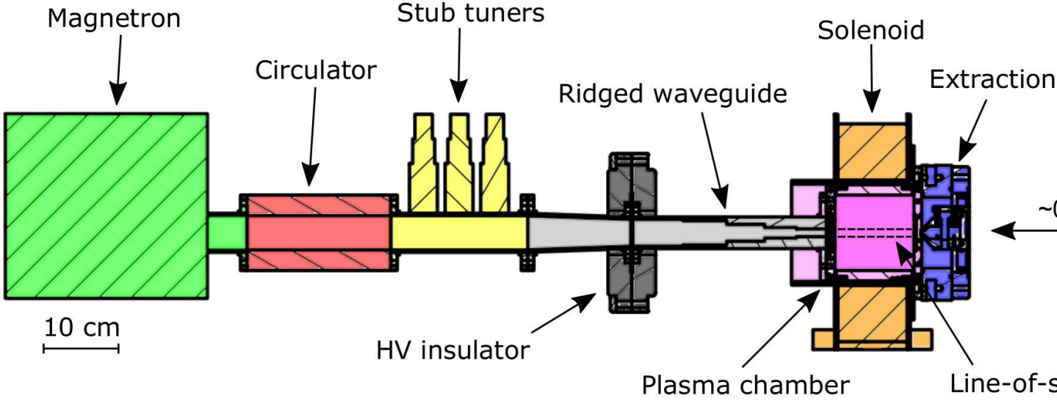
Cusp field magnets
Working with Indian Department of Atomic Energy (DAE) to develop tuneable permanent magnet multicusp magnets for ion beam sourcs.
Design to reduce energy consumption and reduce beam emittance relative to typical electromagnets.
Prototype to be built and tested at Bhaba Atomic Research Centre.

Slide 22
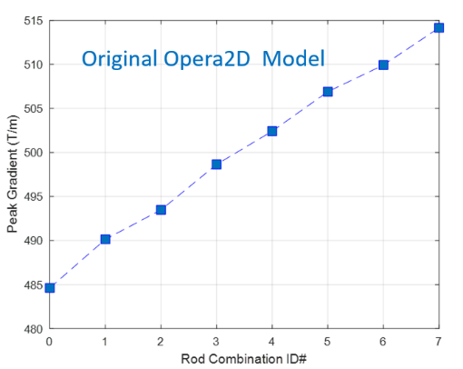
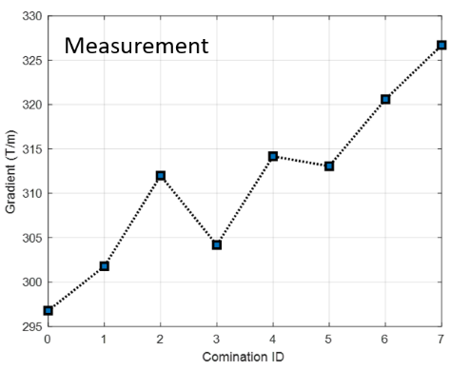
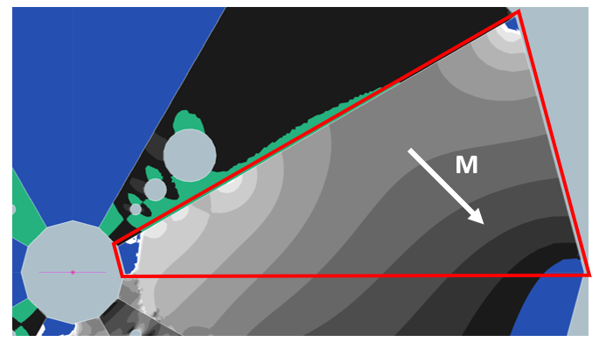
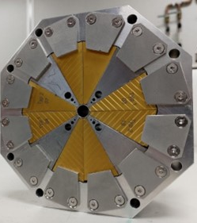
EPAC Quadrupoles
Halbach-style quadrupoles for use in plasma-wakefield acceleration experiments at Extreme Photonics Application Centre (EPAC).
Novel design allows ~10% gradient tuning.
Some issues with demagnetisation, worked with Opera support for
demag modelling.

Slide 23
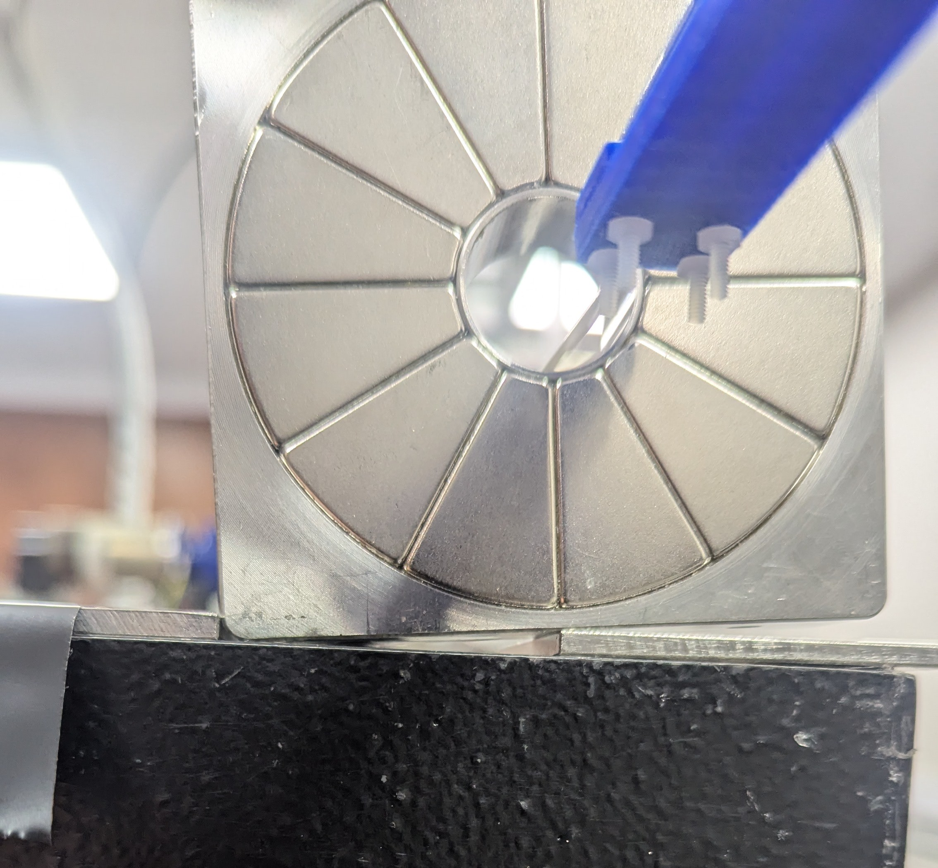
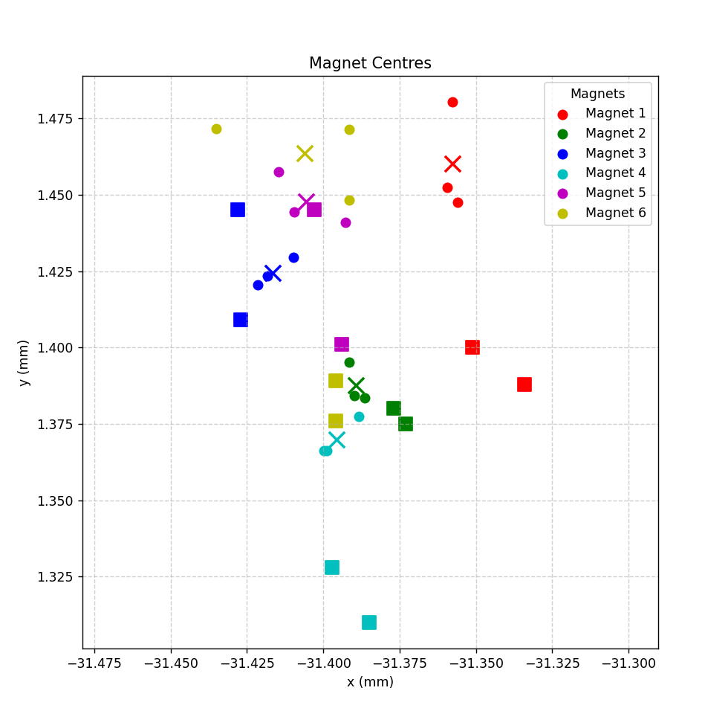
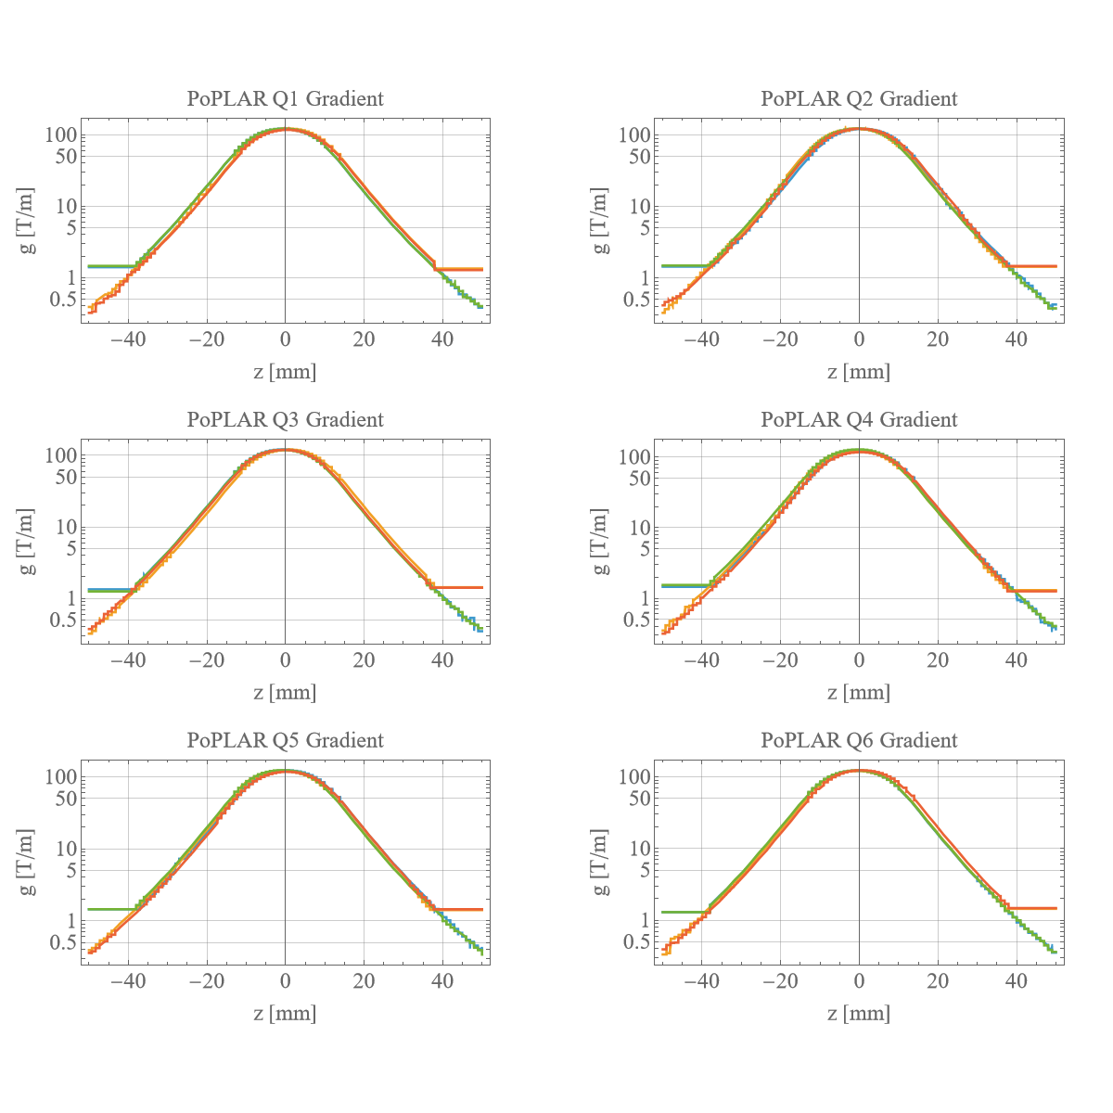
PoPLaR
Halbach quadrupoles for Proof of Principle LhARA Radiobiology experiment.
LHARA – Laser-hybrid Accelerator for Radiobiological Applications.
Gradient and magnetic centre measurements.

Slide 24
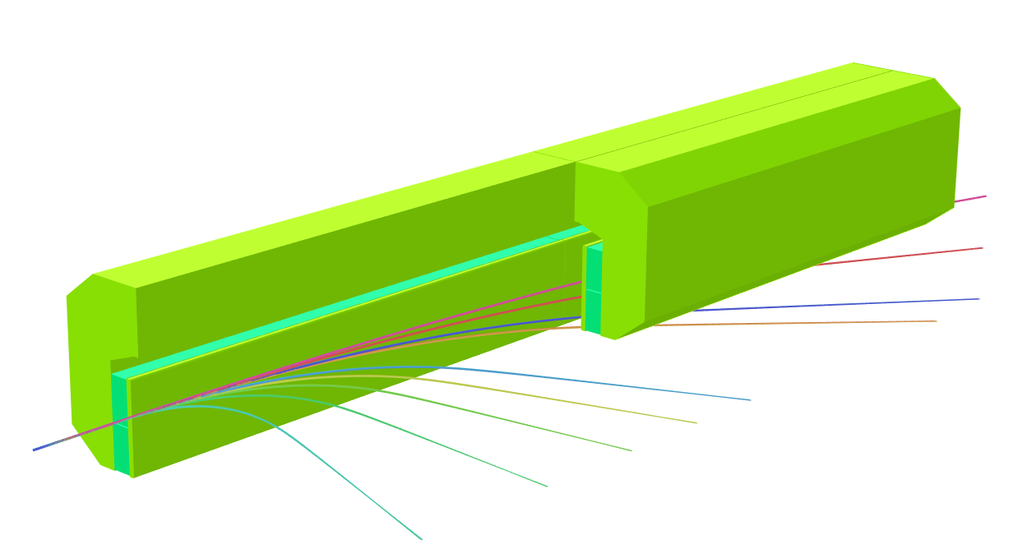
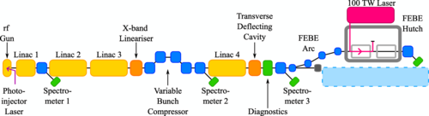
FEBE Spectrometer Dipole
FEBE – Full Energy Beam Exploitation are part of CLARA.
Broadband spectrometer up to 600 MeV needed for plasma and laser wakefield experiments.
Modular PM spectrometer dipole –
split longitudinally to vary integrated field.

Slide 25
Thank you
Acknowledgements:
Ben Shepherd, Alex Bainbridge, Neil Thompson, Tom Smith, Clive Hill, Peter O’Donnell, Mitchell Kane, Kareem Elahee Doomun, Ross Healey, Olli Tarvainen (STFC)
Dušan Topalović, Jure Počkar, Tadej Milharcic and Mirko Kokole (Kyma)
Alfie Shahveh (Diamond Light Source)
Jose Matthew, Monika Phogat, Hitesh Kewlani (Bhabha Atomic Research Centre)
Ben Pine (Opera Support)
Facebook: Science and Technology Facilities Council
Twitter:@STFC_matters
YouTube: Science and Technology Facilities Council

