Slide 1

LHC-BWS Impedance Study Update
SY-RF-BR
07/10/2024
H. Bursali on behalf of Impedance Team
hikmet.bursali@cern.ch
*BWS -> Beam Wire Scanner

Slide 2
Outline
Studied Models
  Classic Chamber
  Short Chamber
  Winged Chamber
First Results
Tried Modifications
  Classic Chamber
  Short Chamber
  Winged Chamber
Conclusion
1

Slide 3
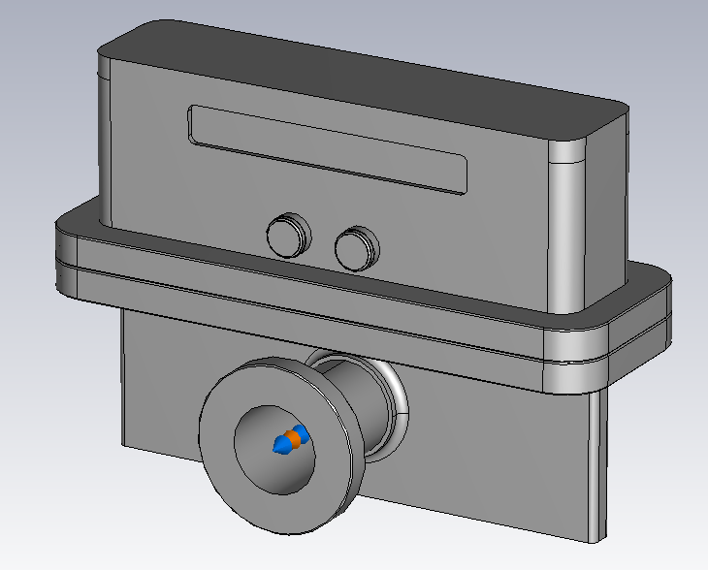
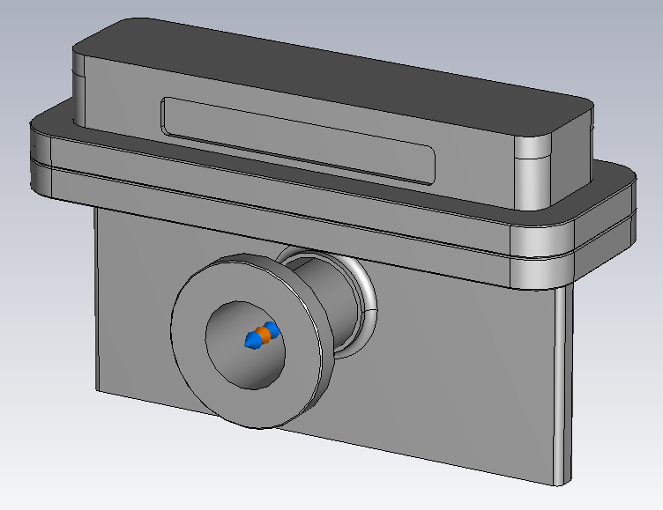
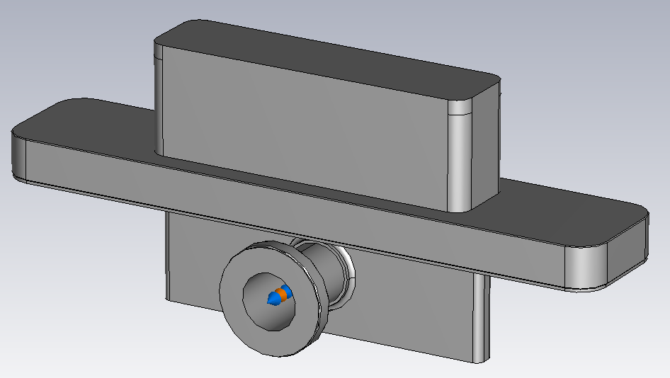
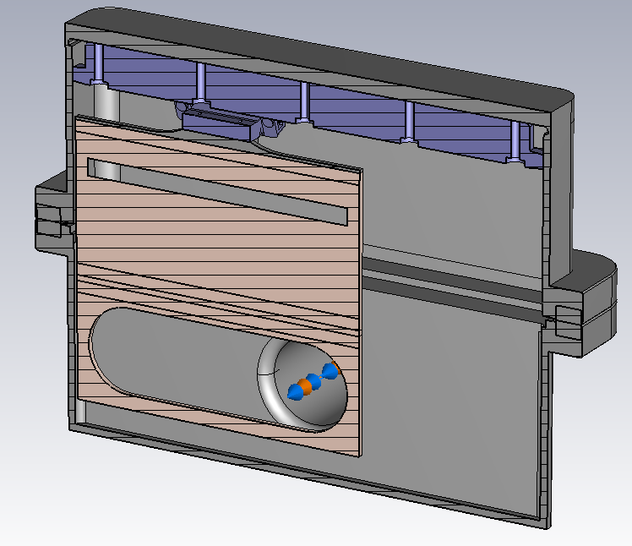
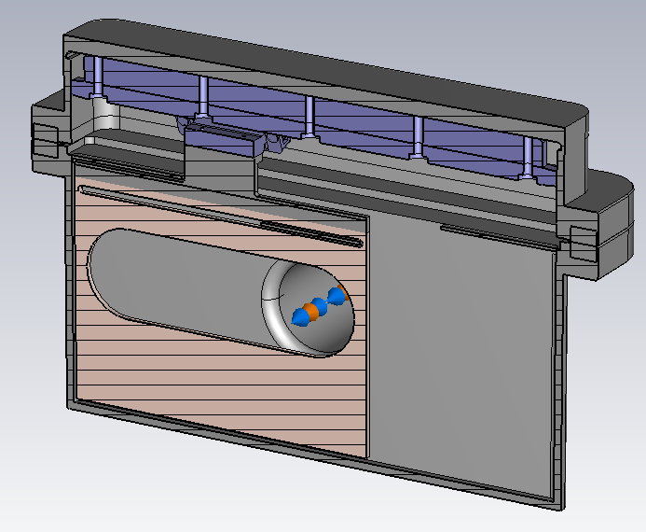
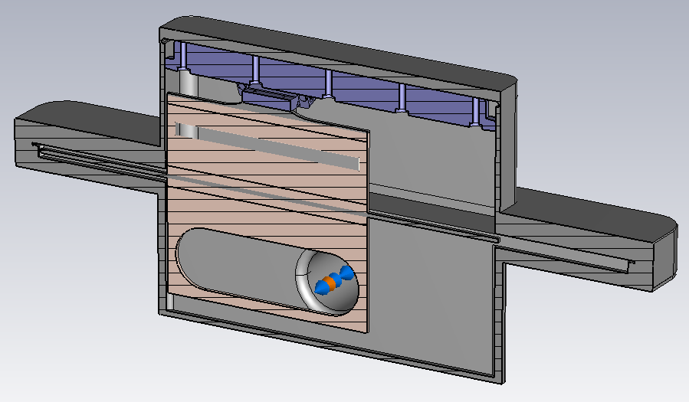
Studied Models
Classic Chamber
Short Chamber
Winged Chamber
Full models
Cross-sectional views
In the first run, models were simulated without modification. -> No additional RF contact.
2

Slide 4
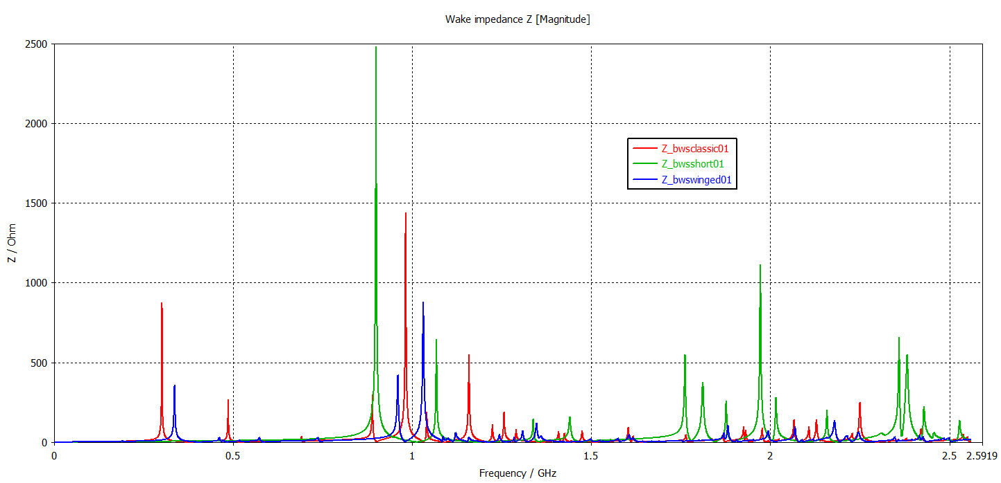
First Results
Classic Chamber
Short Model
Winged Model
3

Slide 5
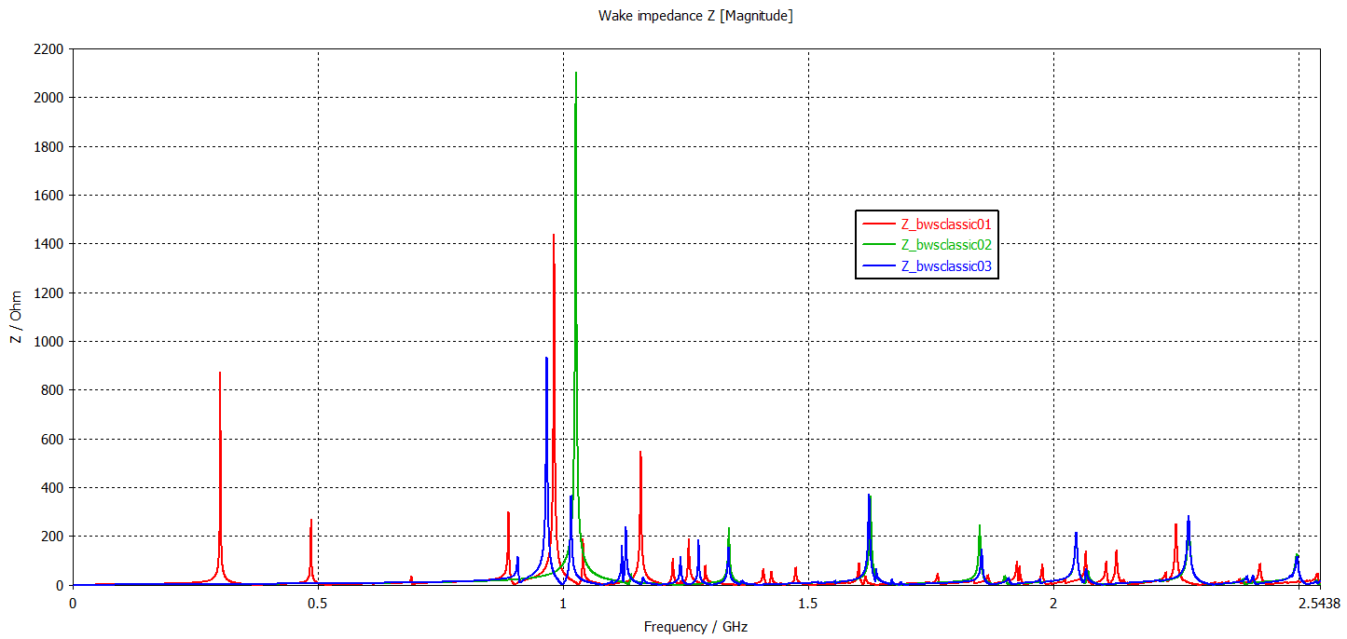
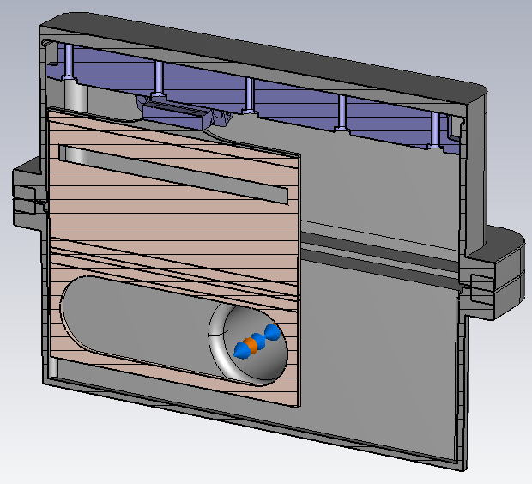
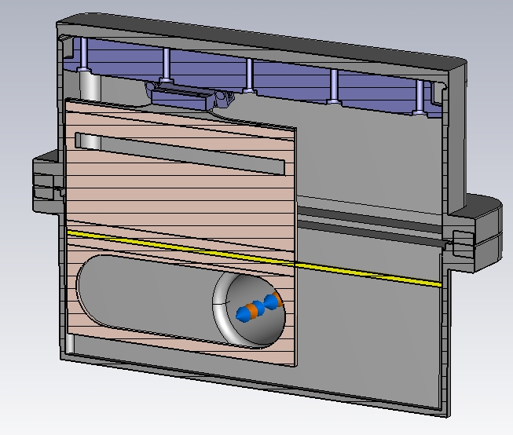
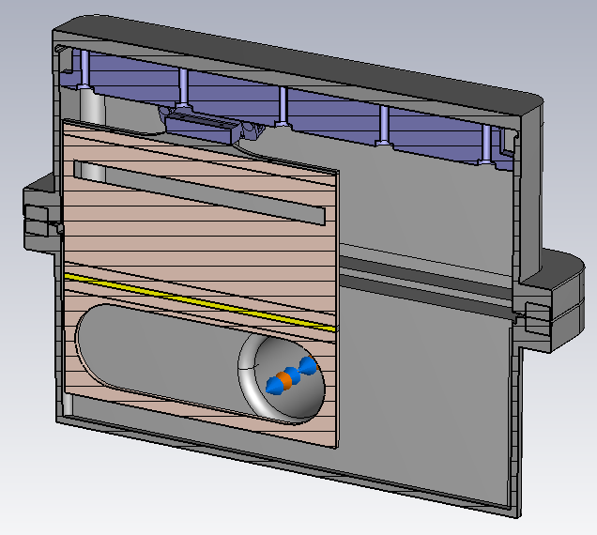
Tried Modifications – Classic Chamber
Classic Chamber
No RF contact
Full RF contact
RF contact on card
4

Slide 6
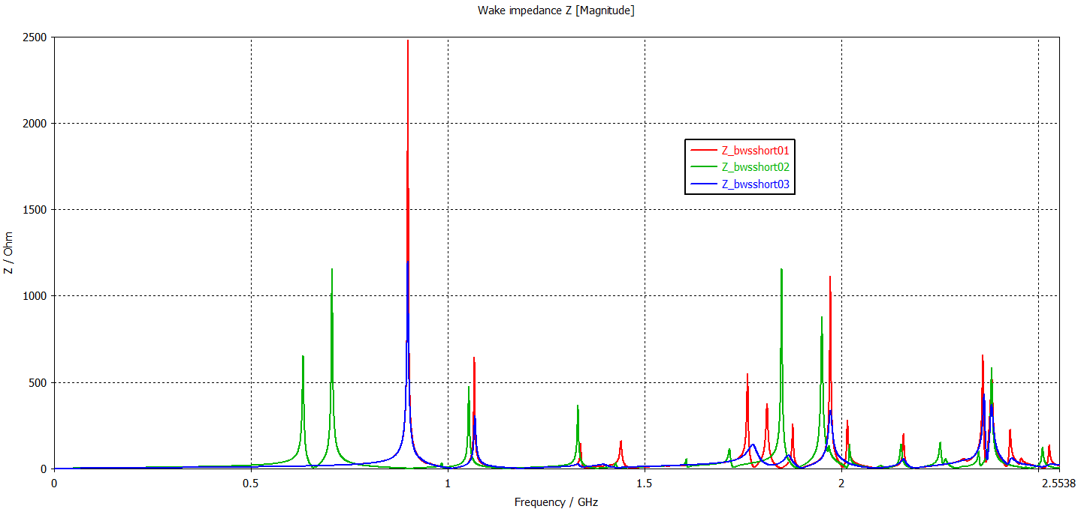
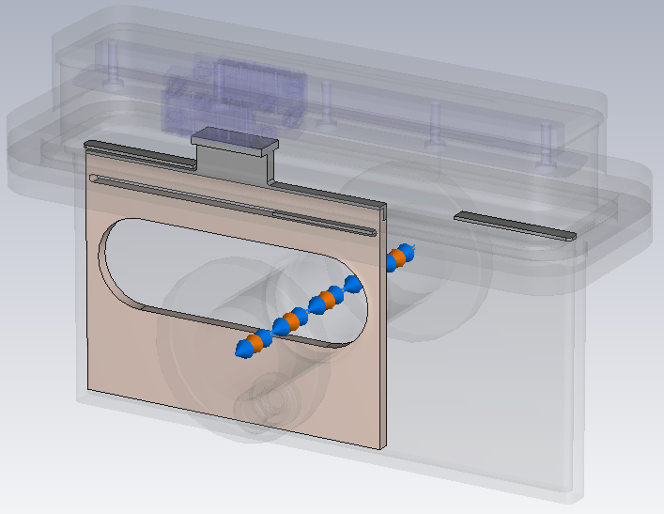
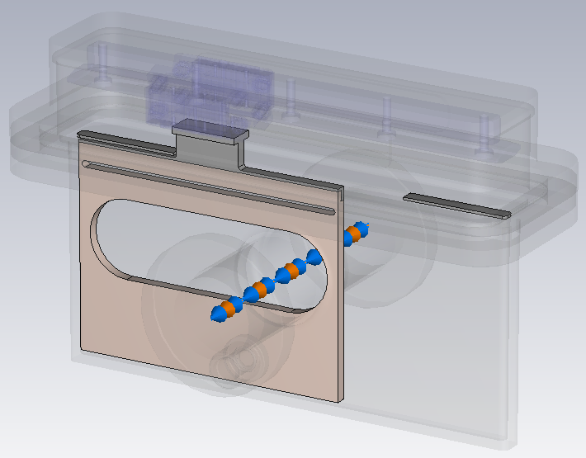
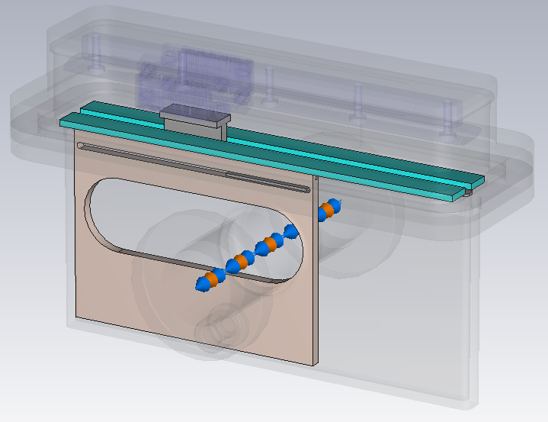
Tried Modifications – Short Chamber (1)
Short Chamber
3 panels
2 panels
3 panels + absorbers
5

Slide 7
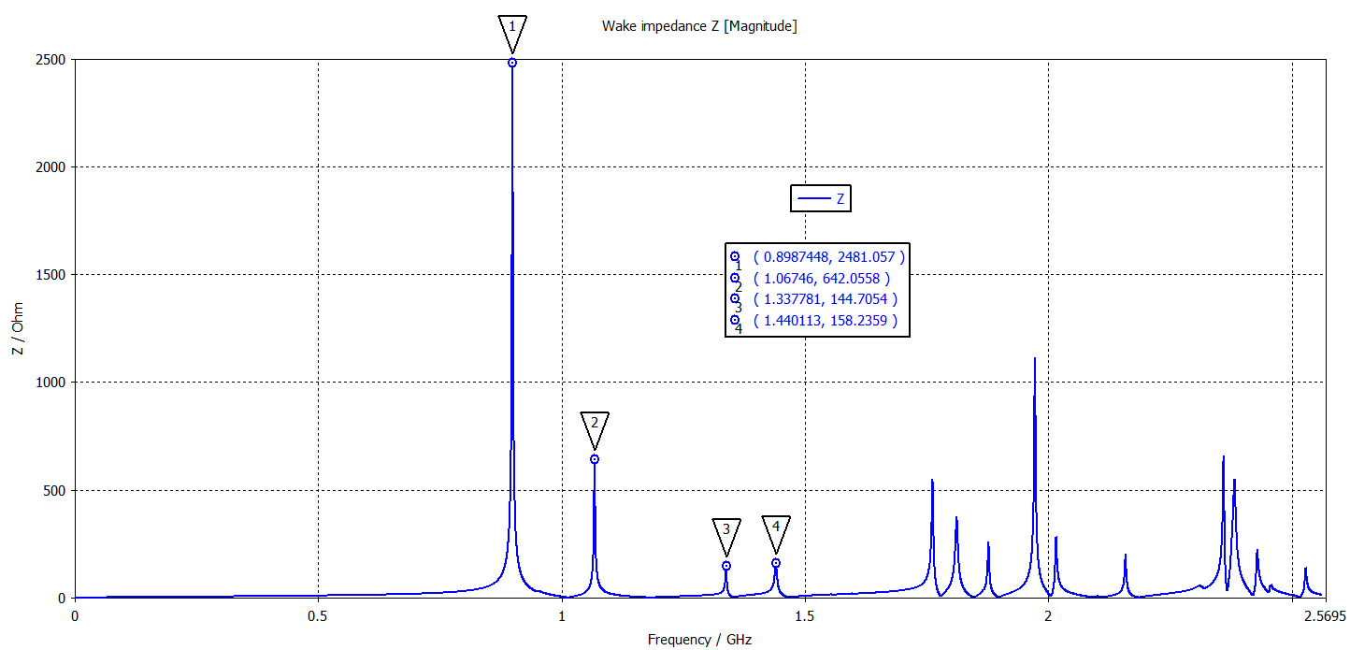
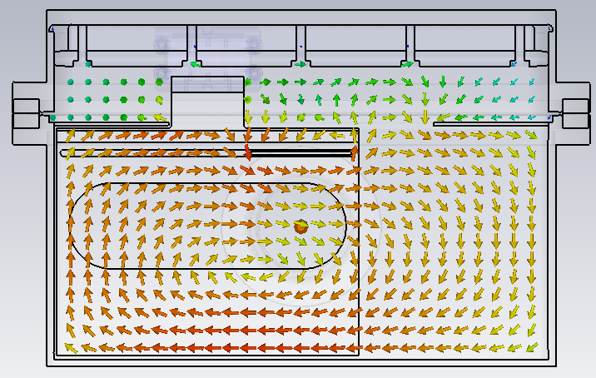
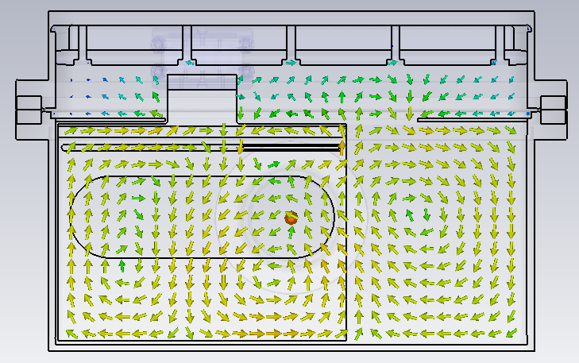
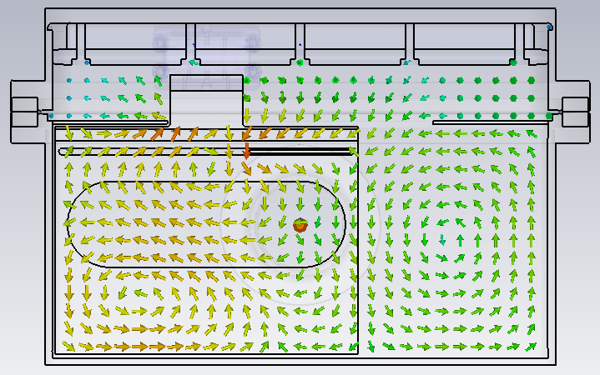
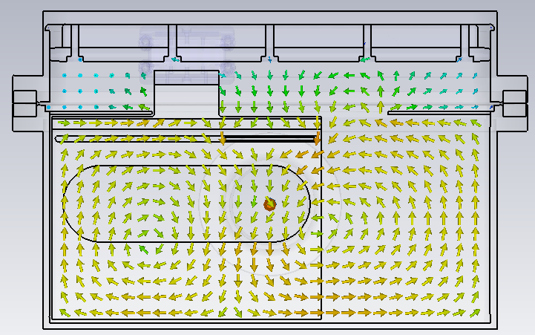
Remark on Short Chamber
H-field @ 898 MHz
H-field @ 1.33 GHz
H-field @ 1.44 GHz
H-field @ 1.06 GHz
6

Slide 8
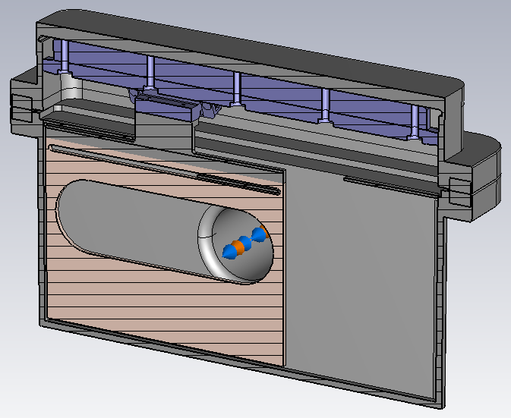
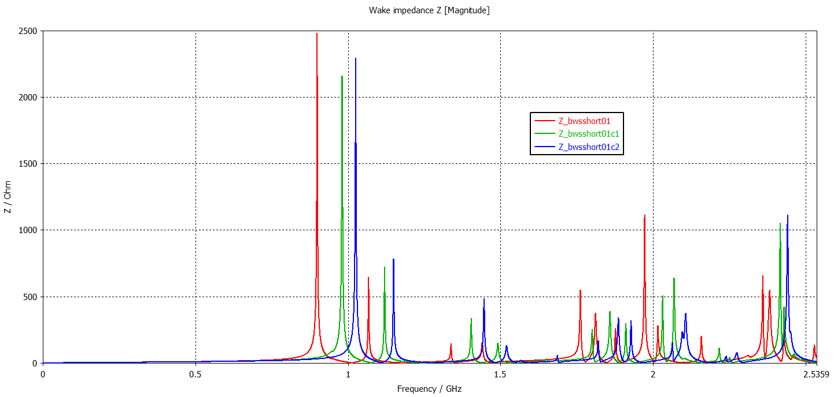
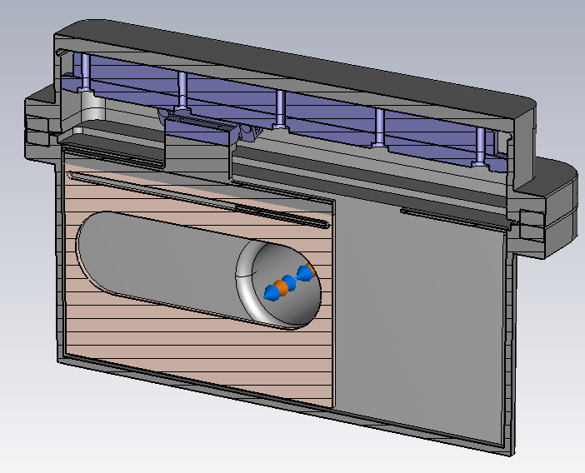
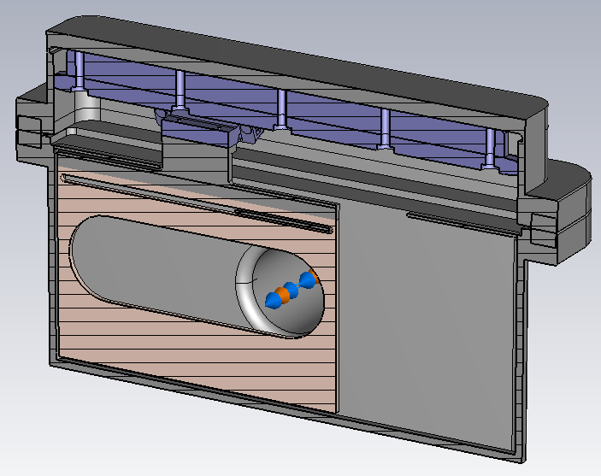
Tried Modifications – Short Chamber (2)
154 mm
Short Chamber
Below chamber -> 154 mm
Below chamber -> 144 mm
Below chamber -> 139 mm
144 mm
139 mm
7

Slide 9
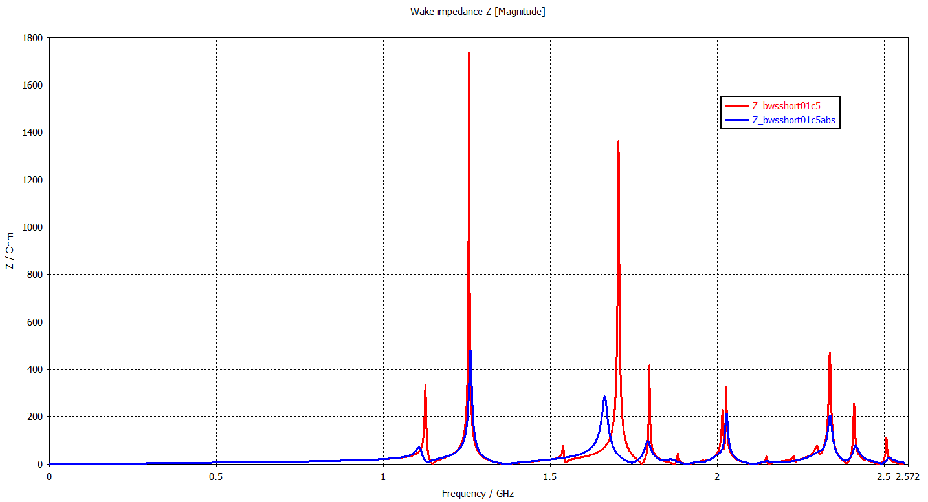
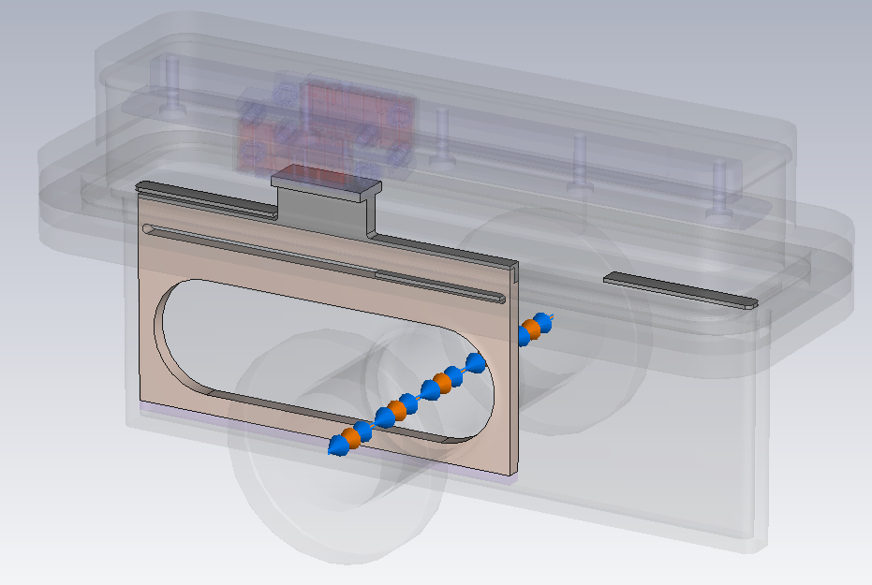
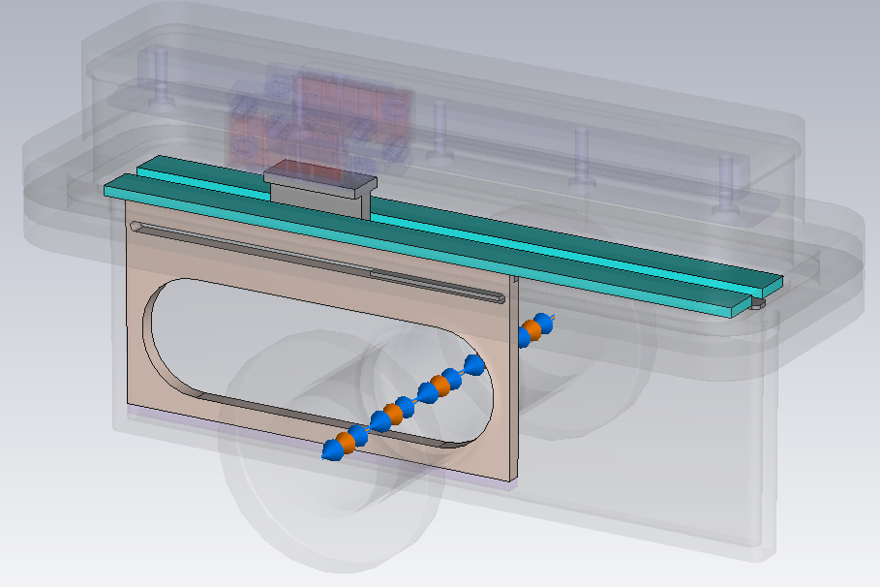
Tried Modifications – Short Chamber (3)
Short Chamber
No absorber
With absorber
8

Slide 10
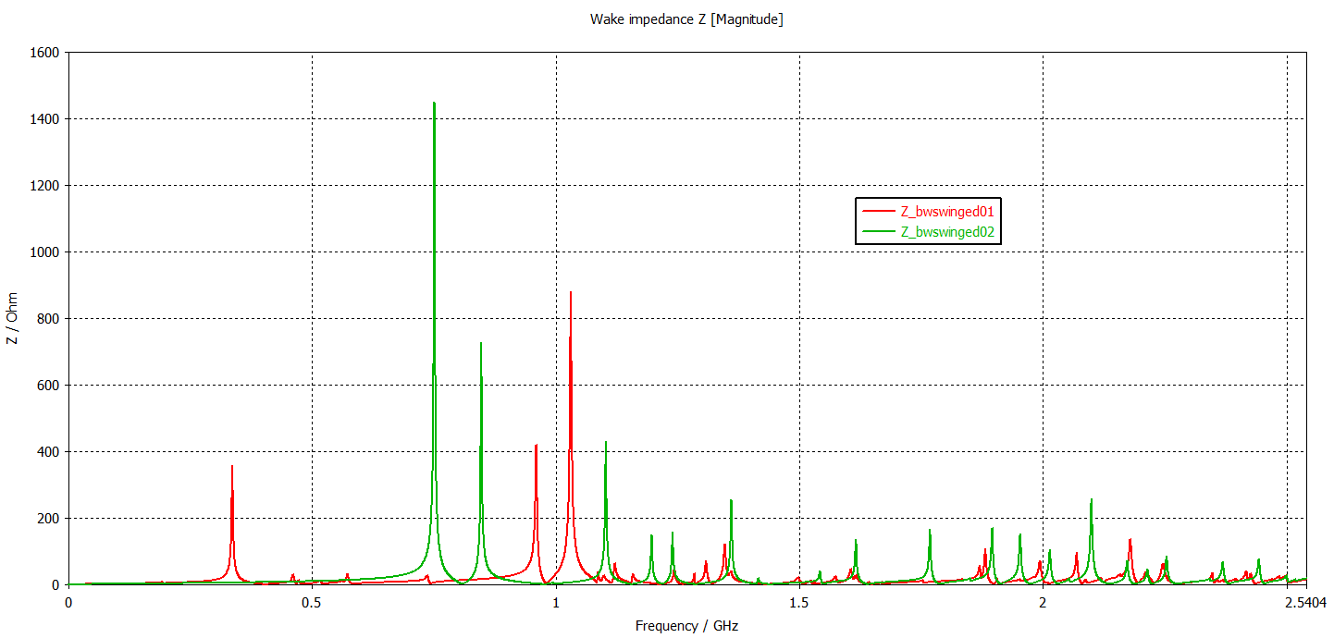
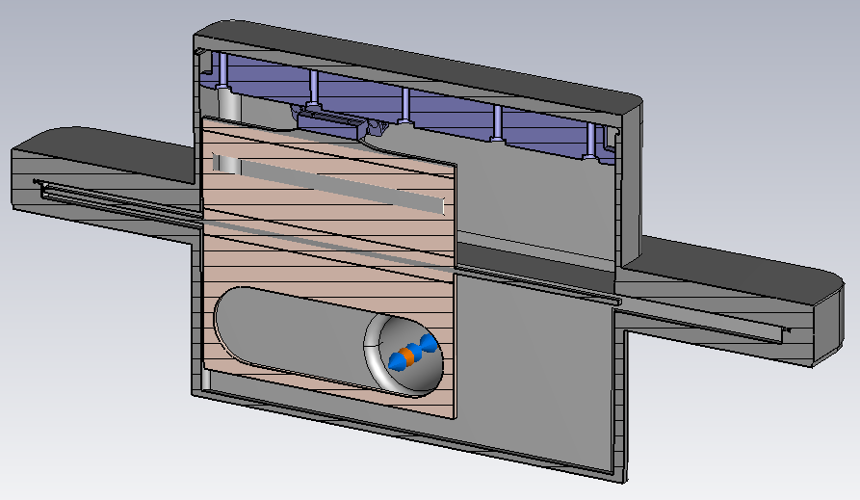
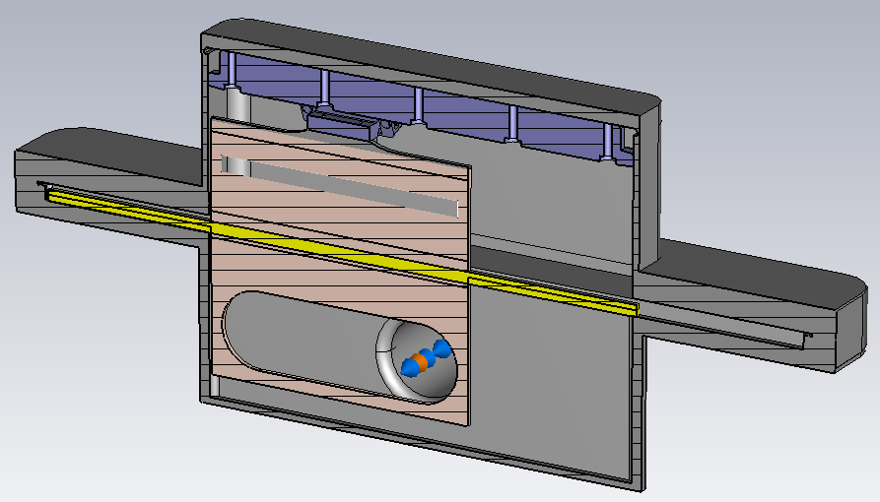
Tried Modifications – Winged Chamber
Winged Chamber
No RF contact
With RF contact
9

Slide 11
Conclusion
The smaller chambers have better impedance response. Even they couple each other.
The best model till now is the short chamber.
  No additional RF contact for sliding area!
  Resonances are above 1 GHz!
Mechanical design point of view?
10

Slide 12
Backup Slides

Slide 13
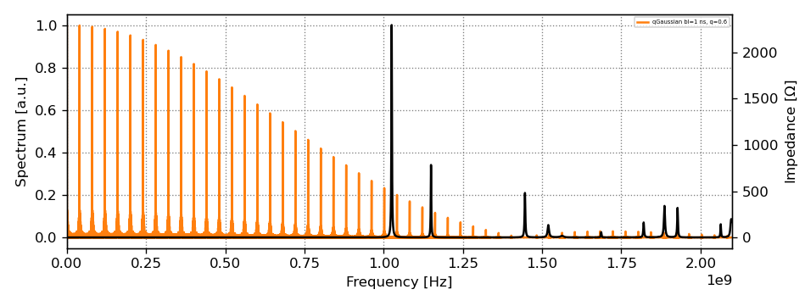
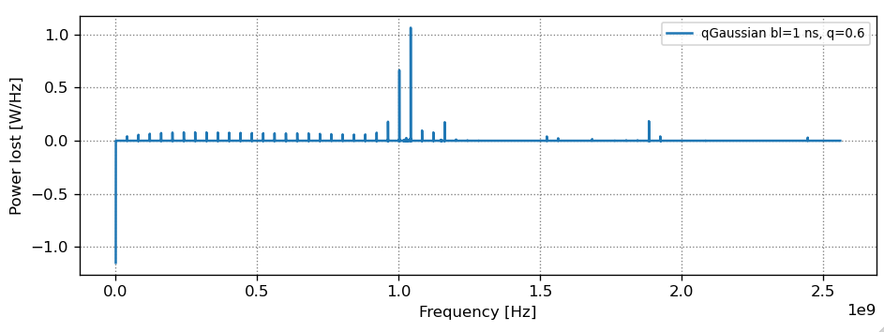
Short Chamber (Below chamber -> 139 mm)
4.6 W

Slide 14
Tried Modifications – Short Chamber
3 panels
2 panels
3 panels + absorbers
50 Ω/sq NEG coated alumina blocks

Slide 15
Tried Modifications – Short Chamber (2)
Below chamber -> 154 mm
Below chamber -> 144 mm
Below chamber -> 139 mm
154 mm
144 mm
139 mm

Slide 16
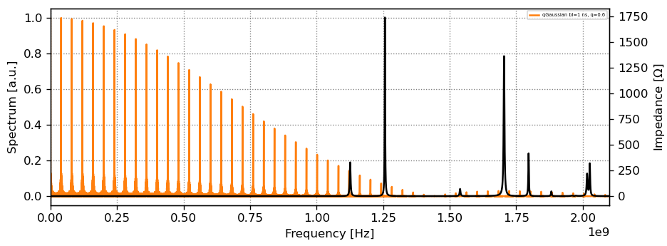
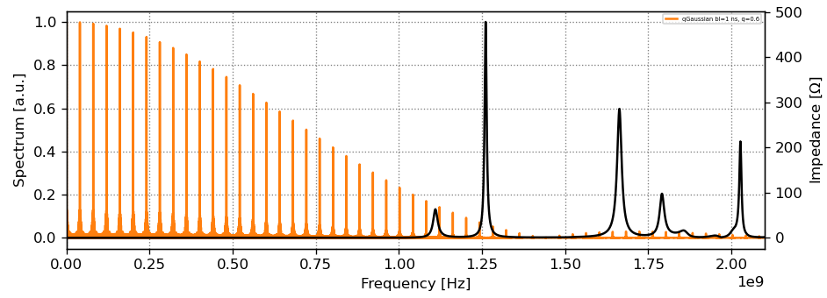
Beam-induced RF Power Loss
Short Chamber (No absorber)
5.61 W
Short Chamber (With absorber)
5.84 W

Slide 17
Tried Modifications – Winged Chamber
No RF contact
With RF contact

