Slide 1

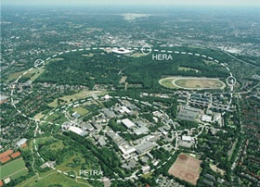




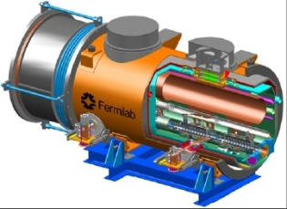
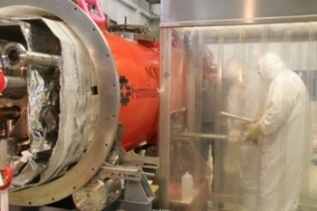

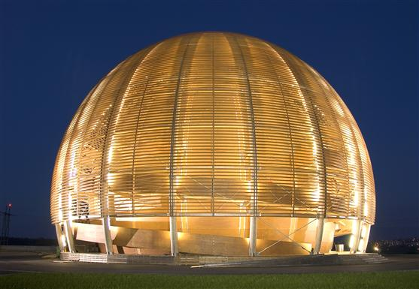
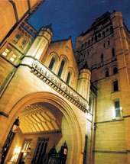

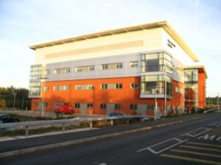

HOM DIAGNOSTICS IN
THIRD HARMONIC CAVITIES AT FLASH/XFEL
Roger M. Jones
University of Manchester/ Cockcroft Inst.

Slide 2
Task 10.5 HOM Diagnostic in 3rd Harmonic Cavities at FLASH
TASK 10.5 | HOM Distribution | R.M. Jones
Sub-Task | Name | Coordinating Institute/Univ.
10.5.1 | HOMBPM | DESY
10.5.2 | HOMCD | Cockcroft/Univ. Manchester
10.5.3 | HOMGD | Univ. Rostock
TASK 10.5 | HOM Distribution | R.M. Jones
10.5.1 HOM based Beam Position Monitors (HOMBPM)
10.5.2 HOM based Cavity Diagnostics (HOMCD)
10.5.3 HOM based Geometrical Dependancy (HOMGD)

Slide 3
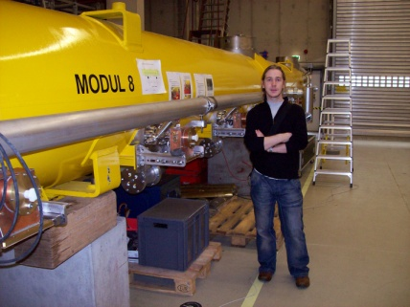
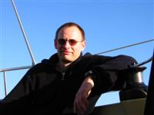
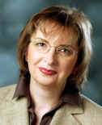
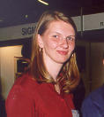


HOM Diagnostic in 3rd Harmonic Cavities at FLASH -Staff
Sub-task leaders: Nicoleta Baboi (DESY), Ursula van Rienen (Univ. Rostock), Roger M. Jones (CI/Univ. Manchester).
PDRAs: Hans-Walter Glock (Univ. Rostock), Ian Shinton (CI/Univ. of Manchester)
Ph.Ds: Nawin Juntong (CI/Univ. Manchester), Pei Zhang (DESY/Univ. Manchester/CI), Thomas Flisgen (Univ. Rostock)
WP 10.5.2
WP 10.5.3
WP 10.5.1
H-W Glock, Univ. of Rostock, PDRA
C. Glasman, CI/Univ. of Manchester PhD student
(PT on FP7)
U. Van Rienen,
Univ. of Rostock
N. Baboi, DESY
I. Shinton, CI/Univ. of Manchester PDRA
N. Juntong, CI/Univ. of Manchester PhD student
(PT on FP7)
T. Flisgen ,Univ. of Rostock
P. Zhang, DESY/Univ. Of Manchester

Slide 4
HOM Diagnostic in 1st and 3rd Harmonic Cavities at XFEL -Staff
Sub-task leaders: Nicoleta Baboi (DESY), Ursula van Rienen (Univ. Rostock), Roger M. Jones (CI/Univ. Manchester).
PDRAs: Hans-Walter Glock (Univ. Rostock), Ian Shinton (CI/Univ. of Manchester)
Ph.Ds: Pei Zhang (DESY/Univ. Manchester/CI), Thomas Flisgen (Univ. Rostock)
H-W Glock, Univ. of Rostock, PDRA
U. Van Rienen,
Univ. of Rostock
N. Baboi, DESY
I. Shinton, CI/Univ. of Manchester PDRA
T. Flisgen ,Univ. of Rostock
P. Zhang, DESY/Univ. Of Manchester
All pool together to ensure success of instrumentation of diagnostics for XFEL/FLASH cavities.

Slide 5
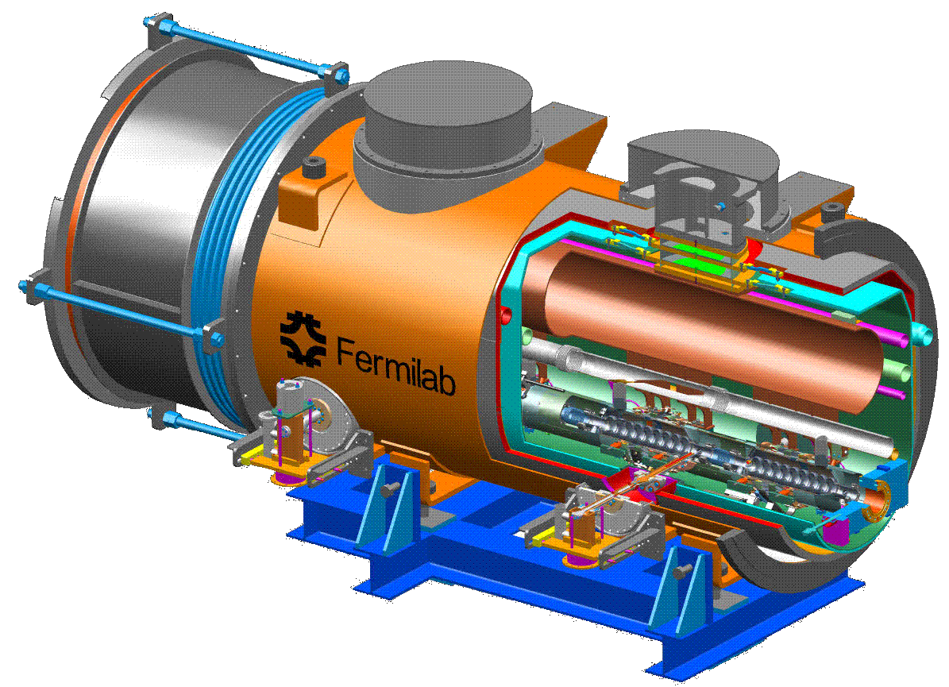
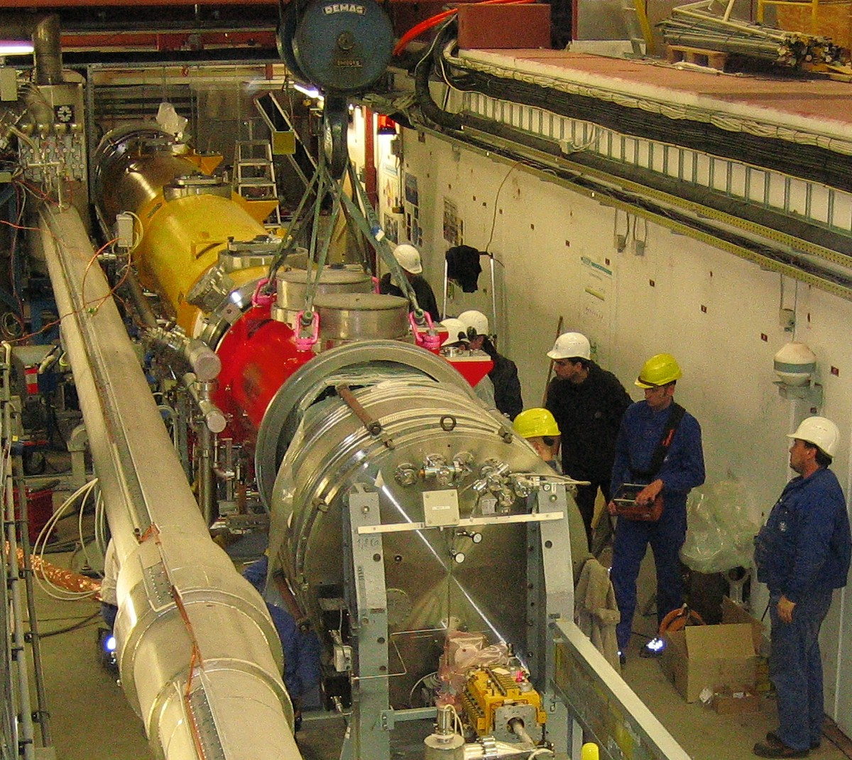
3.9 GHz Module Installed at FLASH
TESLA Cryo-Module (ACC1)
8 x 9-Cell 1.3 GHz Cavities
photo &
drawing
courtesy
E. Vogel &
FNAL
ACC39 FNAL Cryo-Module
4 x 9-Cell 3.9 GHz Cavities

Slide 6
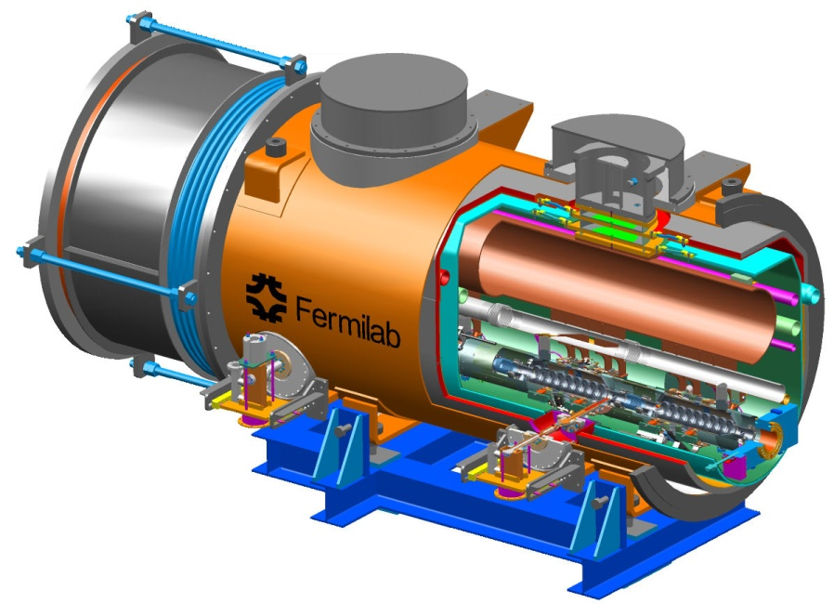
HOM Diagnostic in 3rd Harmonic Cavities at FLASH
Fermilab has constructed a third harmonic accelerating (3.9GHz) superconducting module and cryostat for a new generation high brightness photo-injector.
This system compensates the nonlinear distortion of the longitudinal phase space due to the RF curvature of the 1.3 GHz TESLA cavities prior to bunch compression.
The cryomodule, consisting of four 3.9GHz cavities, have been installed in the FLASH photoinjector downstream, of the first 1.3 GHz cryomodule (consisting of 8 cavities).
Four 3.9 GHz cavities provide the energy modulation, ~20 MV, needed for compensation.

Slide 7
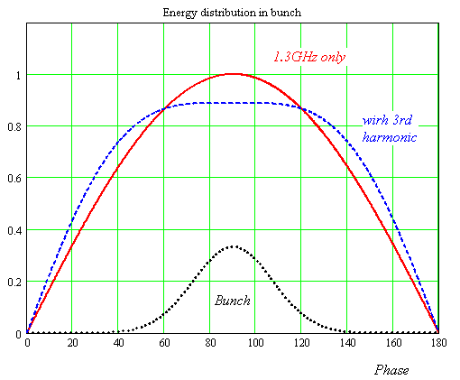
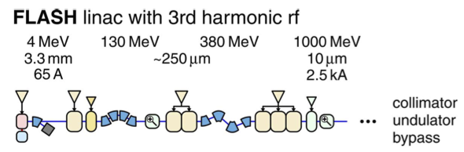

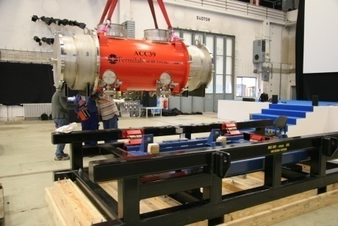
Third Harmonic (3.9 GHz) Parameters
Illustrative energy (not to scale)
Number of Cavities | 4
Active Length | 0.346 meter
Gradient | 14 MV/m
Phase | -179º
R/Q [=U²/(wW)] | 750 Ω
E_{peak}/E_{acc} | 2.26
B_{peak} (E_{acc} = 14 MV/m) | 68 mT
Q_{ext} | 1.3 X 10⁶
BBU Limit for HOM, Q | <1 X 10⁵
Total Energy | 20 MeV
Beam Current | 9 mA
Forward Power, per cavity | 9 kW
Coupler Power, per coupler | 45 kW
Adding harmonic ensures the 2nd derivative at the max is zero for total field (could use any of the harmonics in the expansion, but using the lowest freq. ensures the transverse wakefields ~ ω³ are minimised).
The third harmonic system (3.9GHz) will compensate the nonlinear distortion of the longitudinal phase space due to cosine-like voltage curvature of 1.3 GHz cavities.
It linearises the energy distribution upstream of the bunch compressor thus facilitating a small normalized emittance ~1.10⁻⁶ m*rad.

Slide 8
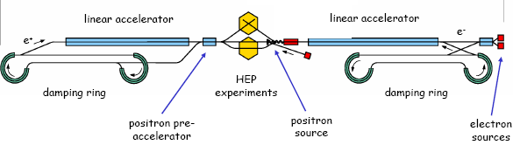
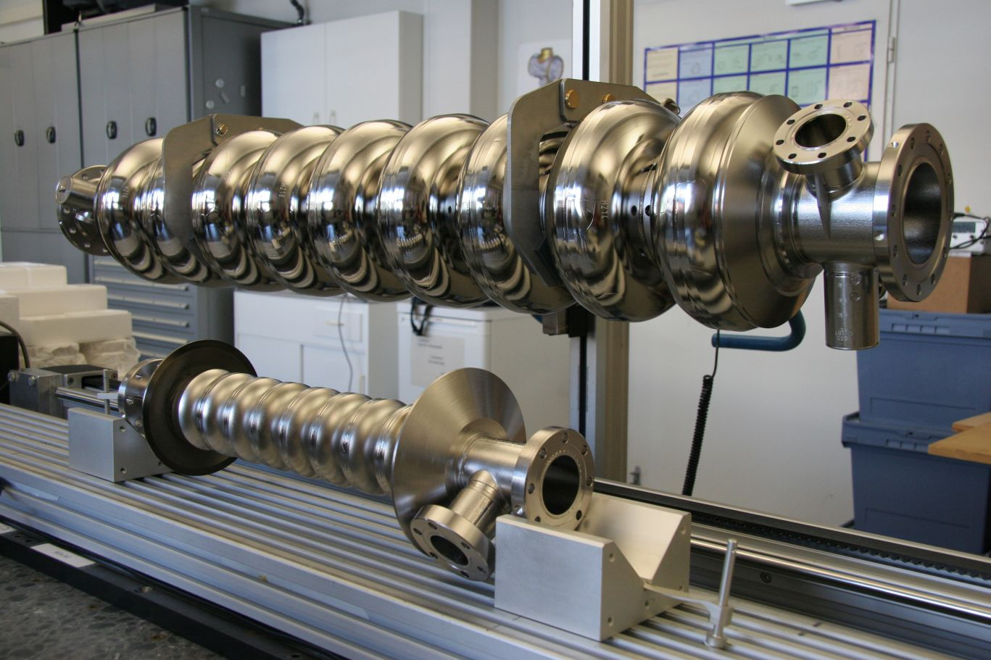
HOMs in SCRF Cavities
Schematic of International Linear Collider (ILC)
~11km
~11km
http://www.linearcollider.org
Used at XFEL and FLASH. Baseline design for main accelerators in ILC.
TESLA cavity (1.3 GHz)
FPC Coupler
~1m
Used at XFEL and FLASH in order to flatten the field profile and reduce energy spread.
HOM Coupler
3rd harmonic cavity (3.9 GHz)

Slide 9
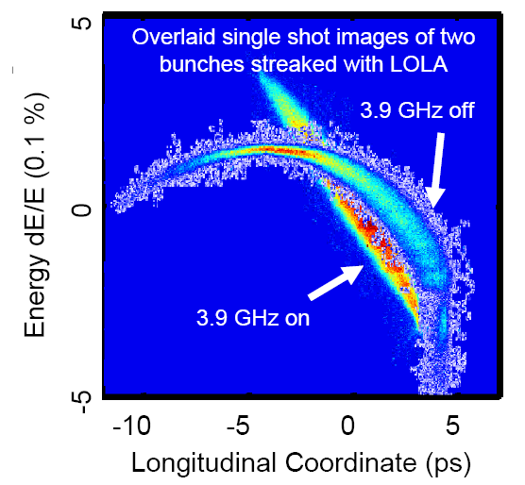
Bunch Compression Using 3rd
Harmonic Cavities
Measured with LOLA
Beam energy 700 MeV
Slight compression with first module
Linearisation with and without 3.9 GHz evident!

Slide 10
Minimising Emittance Dilution and HOMBPMs
Source of Emittance Dilution
W_{t} , transverse wakefields (W_{t} ~ a⁻³ –a iris aperture)
Much stronger in 3.9 GHz than in 1.3 GHz cavities (each iris is r ~ 15 mm compared to 35 mm for TESLA).
Utilise Wakefields as Diagnostic
Sample HOMs to ascertain beam position (HOMBPM).
Move beam to minimise impact on itself and to align to electrical axis.
  Can also be used for measuring beam charge, phase etc.

Slide 11
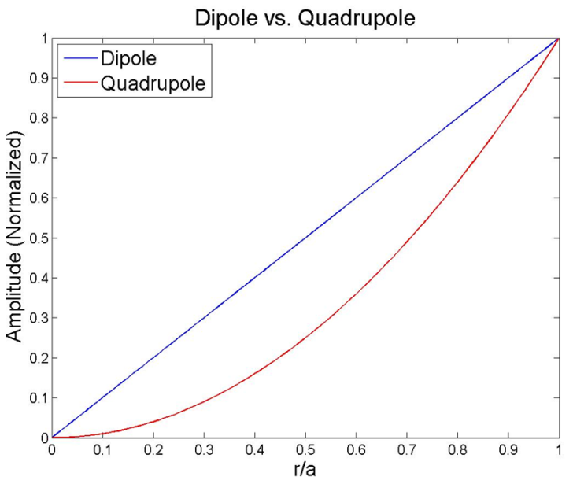
HOMs in SCRF Cavities
Higher order modes (HOMs) are excited by charge particles in cavity
‐ influence the beam both longitudinally and transversely
‐ non‐monopole modes excited by off‐axis particles effect bunch itself (intra) and subsequent (inter) bunches
Dipole modes dominate transverse wake potentials
Use HOMs (non‐monopole modes) to
‐ align the beam to the electric center
‐ monitor beam position (HOM‐BPM)
r: beam offset
a: iris radius
m=1, dipole; m=2, quadrupole
Region of
interest
Earlier work on 1.3 GHz demonstrated the principle
[1] G. Devanz et al., EPAC2002, WEAGB003
[2] N. Baboi et al., LINAC2004, MOP3

Slide 12
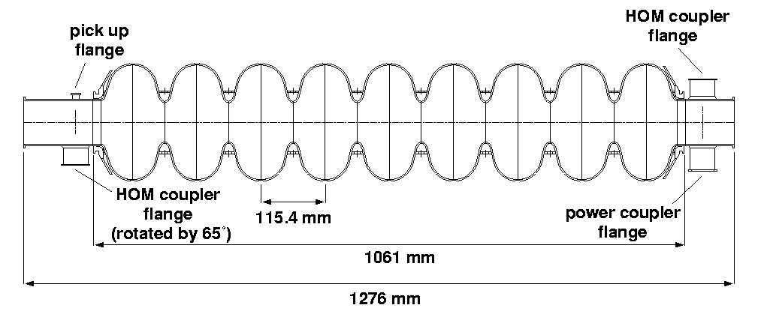
HOMs in SCRF Cavities
Task:
  Develop, build, test electronics for 3.9 GHz cavities
  Interpret signals and integrate in control system
  Measure cavity alignment
HOM-couplers
  At end of each cavity
  Enable monitoring the
  HOMs excited by beam
HOM-couplers (pick-ups)
TESLA cavity Illustrated
(similar features present in 3.9 GHz cavity)

Slide 13
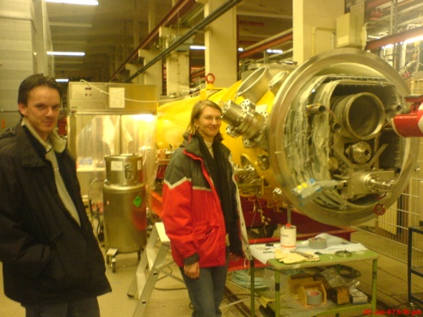
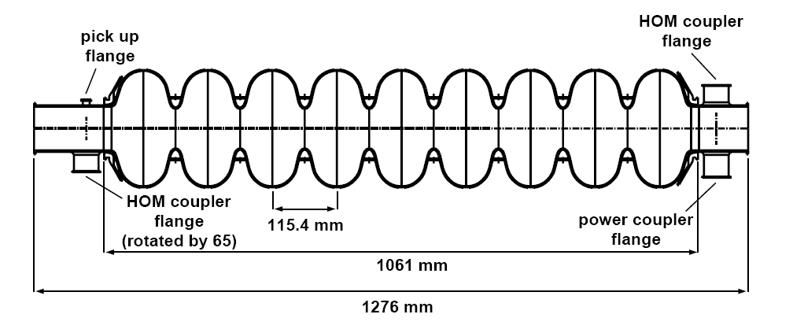
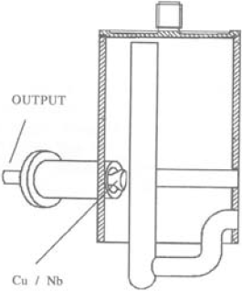
bunch compressors
bypass line
gun
undulators
FEL beam
ACC39
4 cavities within
3.9GHz Module
collimator section
dump
5 accelerating modules
with 8 cavities each
1.3GHz SC, typically 450-700MeV, 1 nC charge for FLASH/XFEL
HOMs generated in accelerating cavities must be damped.
Monitored HOMs facilitate beam/cavity info
Forty cavities exist at FLASH.
-Couplers/cables already exist.
-Electronics enable monitoring of HOMs (wideband and narrowband response).
Based on 1.3 GHz (CEA/SLAC/FNAL/DESY) Diagnostics –redesigned for ACC39 as part of EuCARD

Slide 14
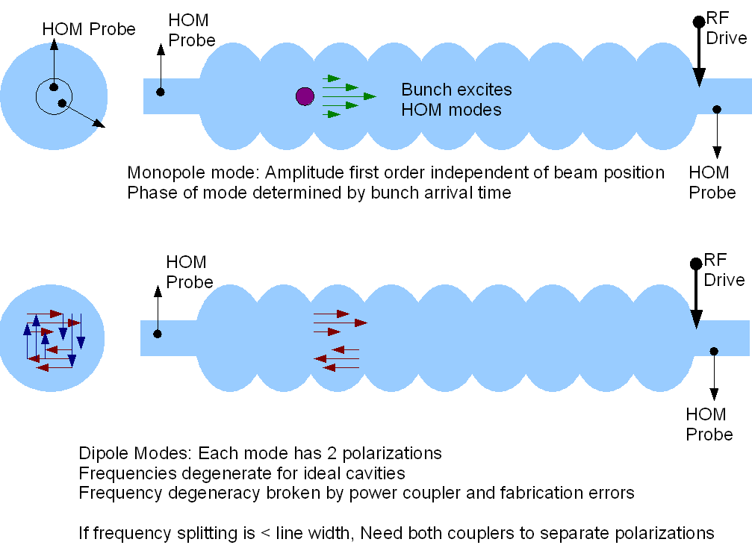
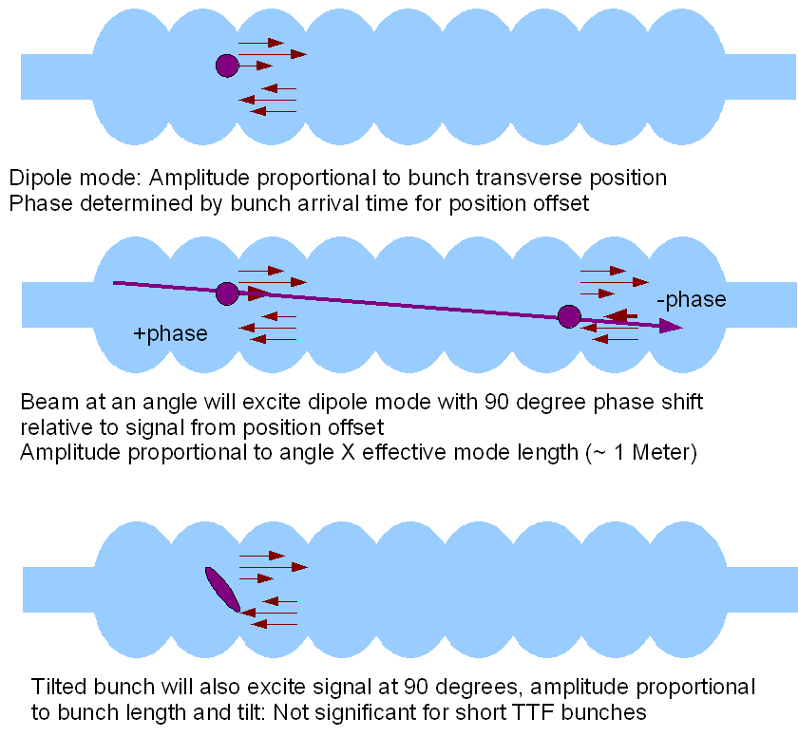
Response of HOM Modes to Beam

Slide 15
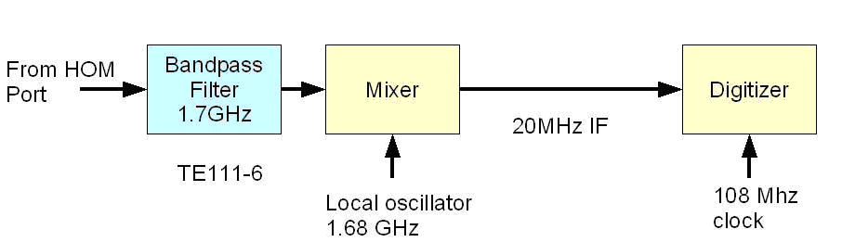
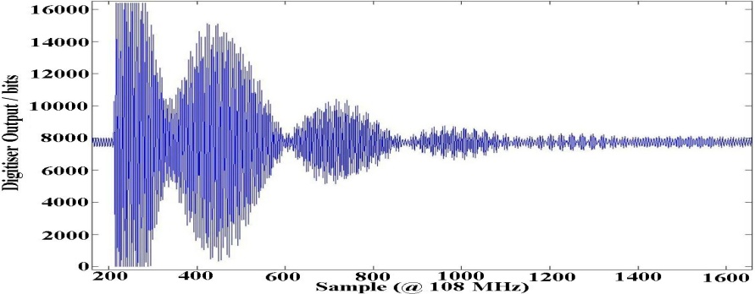
Extant Work at 1.3 GHz:
HOM-BPMs in TESLA Cavities
HOM-BPMs at 1.3GHz cavities
  Use dipole mode at 1.7 GHz
  Installed in 5 accelerating
  modules (40 cavities)
  Calibration: with SVD technique
    problem: unstable in time
Beam Alignment in Modules
  Now routinely used in FLASH
Other studies
  Cavity alignment in cryo-module
  Beam phase measurement with monopole modes at ~2.4GHz
XFEL Plans:
  Install in some 1.3 GHz and in all 3.9 GHz cavities

Slide 16
Analysis of Narrowband Signals –
Beam Position (Previous 1.3 GHz Study)
Resolution of position measurement.
  Predict the position at cavity 5 from the measurements at cavities 4 and 6.
  Compare with the measured value.
X resolution
  ~9 μm
Y resolution
  ~4 μm

Slide 17
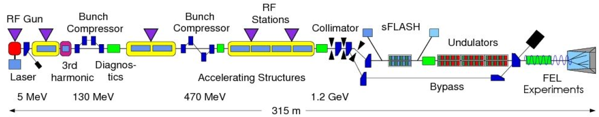
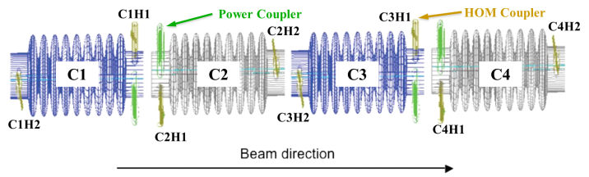
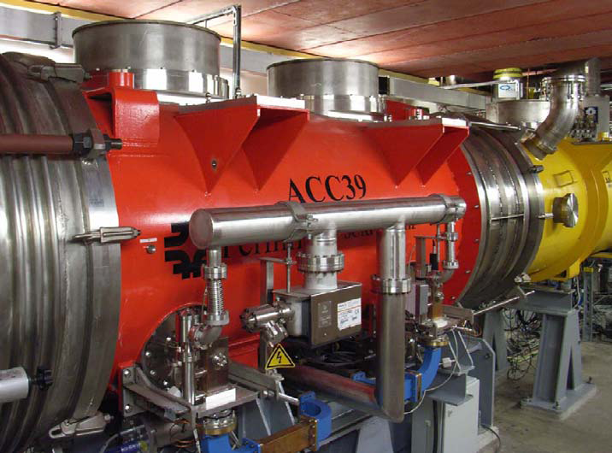
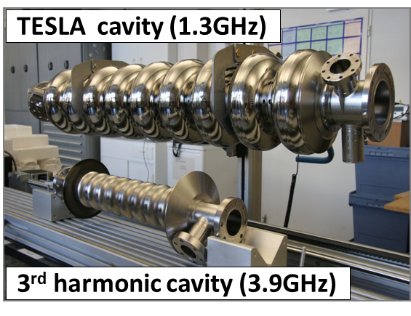
FLASH and ACC39
Free-electron LASer in Hamburg (FLASH)
Photo courtesy E. Vogel & DESY
Page 17

Slide 18
Selected Highlights
S-matrix measurements and comparison with simulations.
Transmission measurements.
Multi-cavity modes.
Beam-based mode characterisation.
HOM pickup vs beam offset for trapped/isolated modes
Comparison of analysis of data
Direct Linear Regression (DLR) vs Singular Value Decomposition (SVD)

Slide 19
Measurement Programme
(since last SRF WP10 review meeting)
Data | Measurement info | Beam info
Apr. 2010 | Transmission measurement | w/o beam
Jul. 2010 | 1st parasitic measurement | w/ beam
Nov. 2010 | 2nd parasitic measurement | w/ beam
Jan. 2011 | 1st dedicated measurement | w/ beam
Feb. 2011 | Multi-bunch measurement | w/ beam
Mar. 2011 | 2nd dedicated measurement | w/ beam
Apr. 2011 | Transmission measurement | w/o beam
May 2011 | Mini measurement | w/ beam

Slide 20
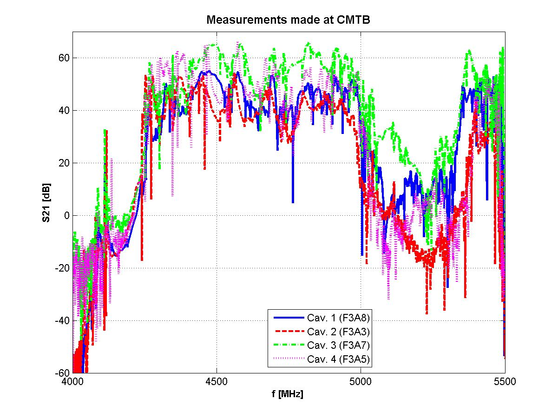
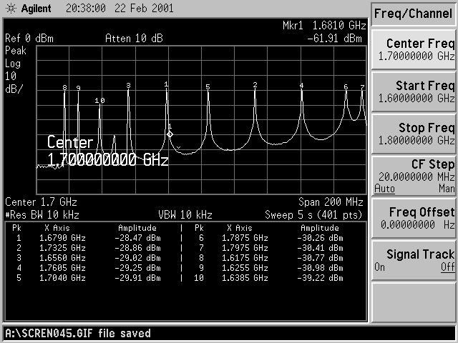
ACC39 Spectra Measured in CMTB:
Focused on Dipole and Other Bands
For comparison: dipole band in TESLA cavity
Transmission matrix measurements made on all 4 cavities within ACC39.

Slide 21
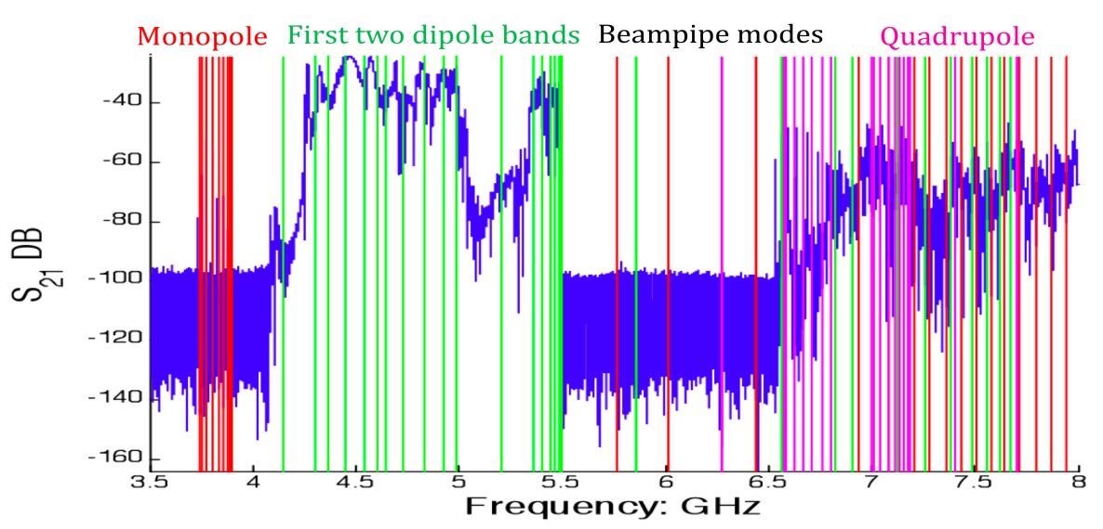
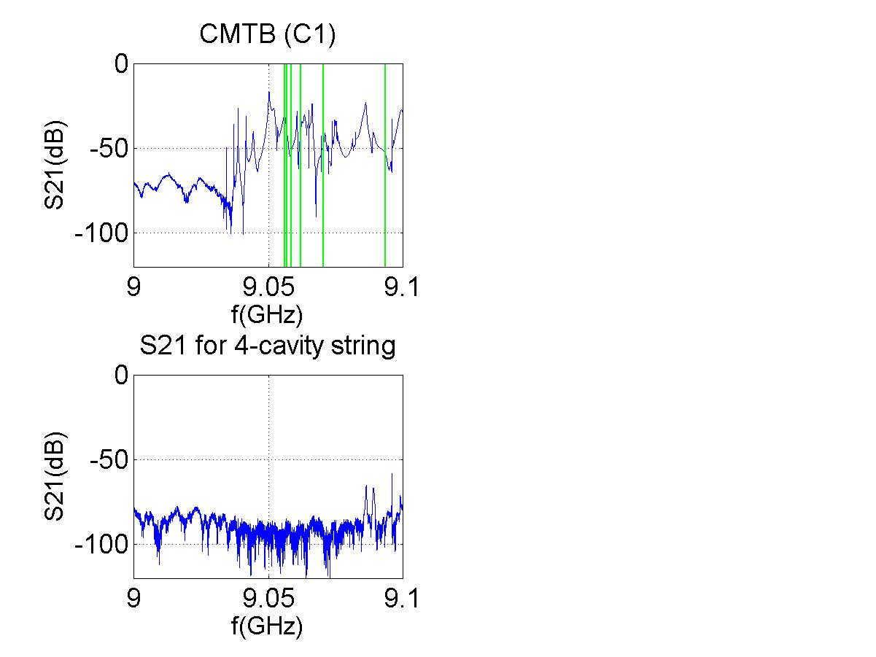
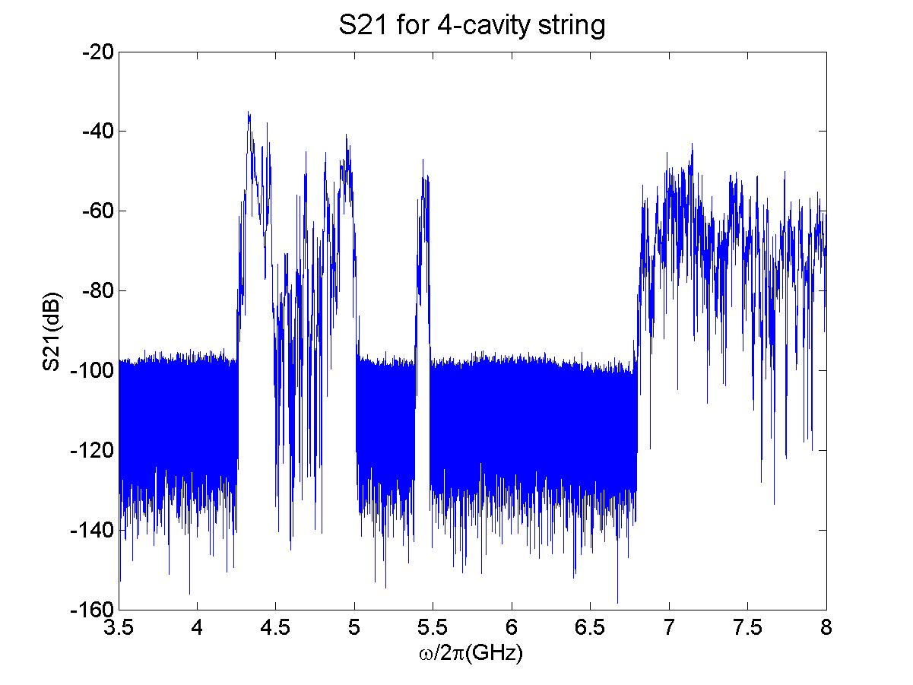
Band Structure
5th dipole band
Potential HOM Diagnostic Candidates
From transmission measurement done in CMTB
Page 21

Slide 22
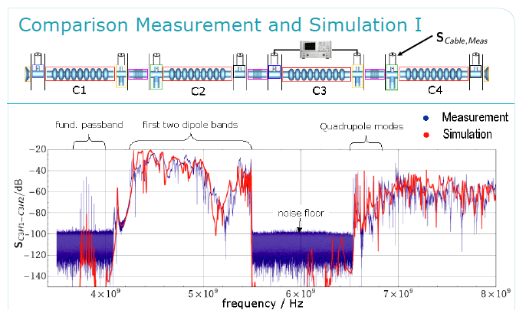
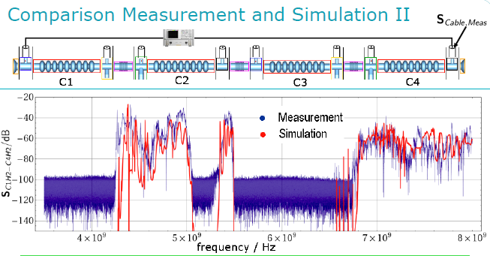
S₂₁ Exp vs Simulations
Transmission through single cavity in chain.
Transmission through complete chain.

Slide 23
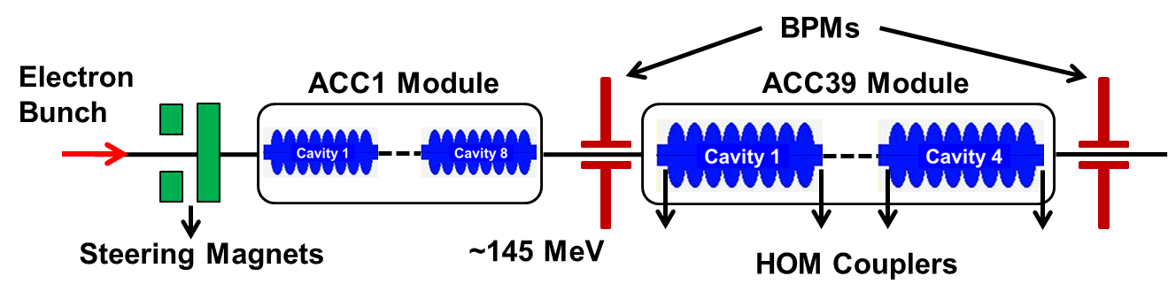
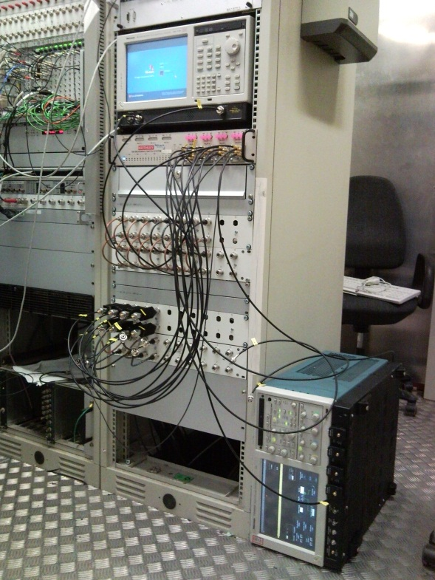
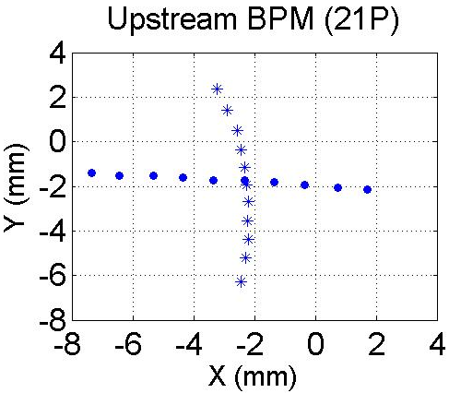
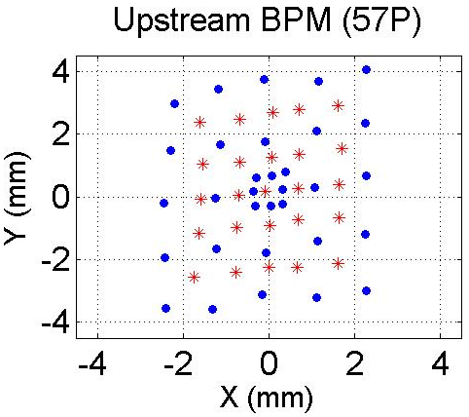
Beam-Based HOM Measurements
*Not to scale
Steer the beam in various ways

Slide 24
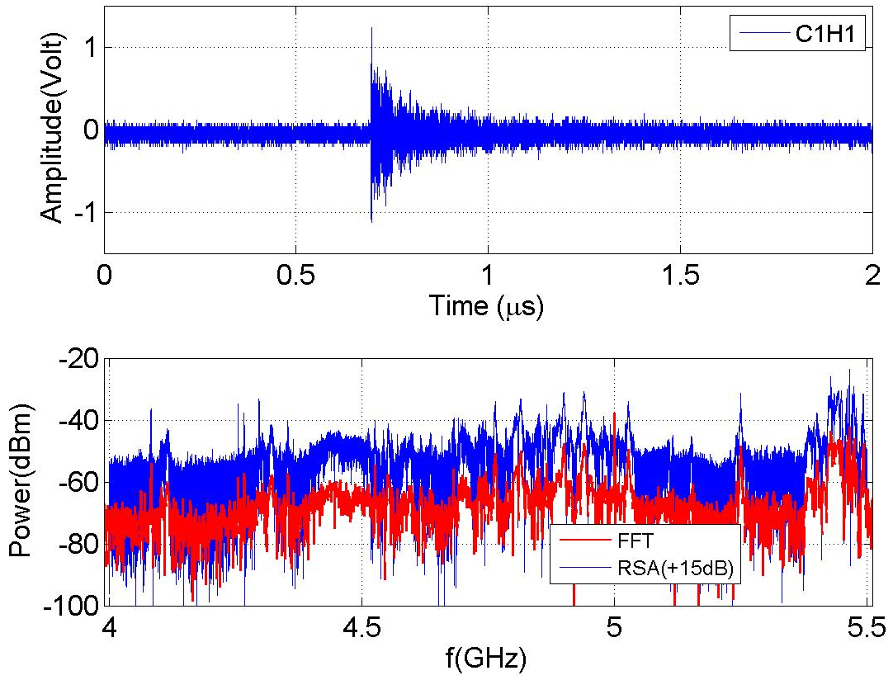
HOM Signal (1st and 2nd Dipole Bands)
HOM Signal (1st Two Dipole Bands)
Time Domain HOM pickup
Comparison of FFT of HOM pickup vs RSA

Slide 25
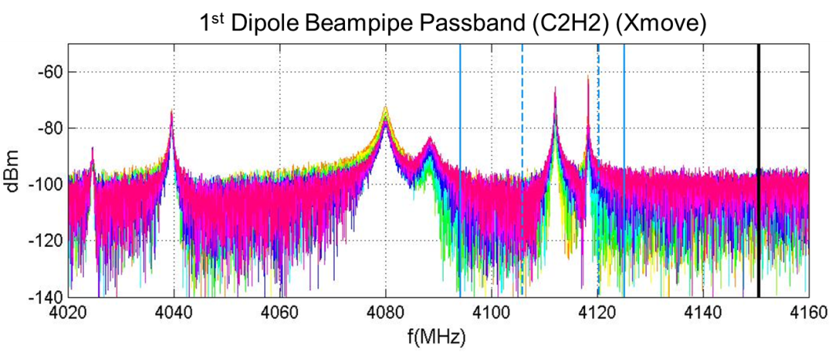
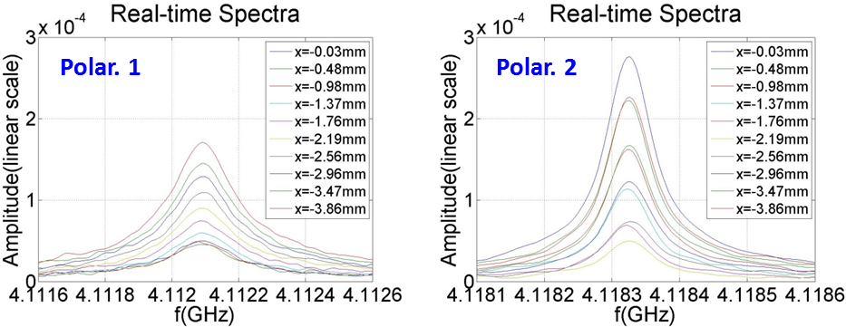
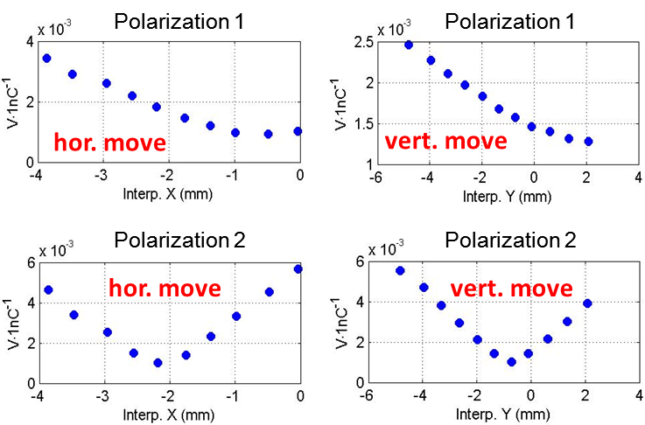
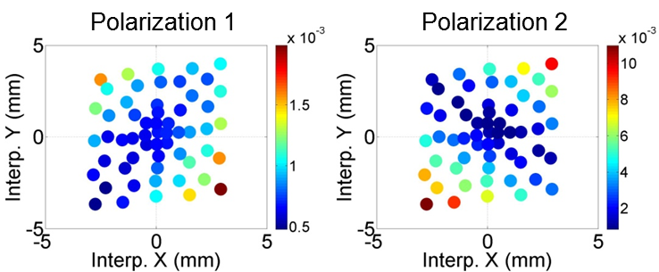
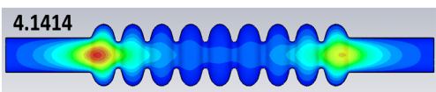
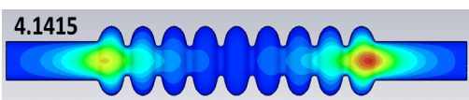

1st Dipole Beampipe Modes
Lorentzian fit to get mode amplitude

Slide 26






5th Dipole Cavity Band
5th Dipole Cavity Band
localized!
hor. move
hor. move
vert. move
vert. move
† I.R.R. Shinton, et al., “Mode Distribution …”, CI Internal Note

Slide 27
Concluding Remarks on HOM Third Harmonic Cavities for FLASH
ACC39, has been received by DESY, characterised at the CMTF, and subsequently installed at FLASH –beam well linearised.
Beam tubes connecting cavities are above cut-off and allows for strong coupling between all 4 cavities –suite of simulations being used to characterise the coupling and sensitivity to geometrical perturbations.
Experiments indicate trapped modes in 5th band (~ 9 GHz) and expected linear dependence. Mode candidate for diagnostics? (other candidates are based on modes which exist in the beampipe and stretch over the complete module)
Anticipate HOM electronics testing of 3.9 GHZ cavities in 2012.
Good overall progress

Slide 28
Remarks on HOM Beam Diagnostics
for SC Cavities for XFEL
Two cryo-modules will be installed in the E-XFEL injector, before the first bunch compressor
  8 × 1.3 GHz (TESLA) cavities
  8 × 3.9 GHz (3rd harmonic) cavities (4 cavities in FLASH)
Coupling of HOMs from one cavity to the next will need careful analysis.
Have to understand both modules as an entity
  proposal is to instrument both the accelerating module and third harmonic module with HOM-based diagnostics
In addition to the EU members (DESY, University of Rostock, University of Manchester/CI), FNAL, SLAC have also expressed an interest in participation –value added.
Ref: Pierini et al, Third harmonic superconducting cavity prototypes for XFEL, LINAC08

Slide 29
Descoping Options
Original
 | Task | UMAN |  | DESY |  | UROS |  |  | TOTAL
 |  | MP | Invest | MP | Invest | MP | Invest |  | MP | Invest
 | 3rd Harmonic HOM diagnostics | 3.75 |  | 3.75 |  | 3.33 |  |  | 10.83333 | 0
 | Consumables |  | 30000 |  | 80000 |  | 60000 |  | 0 | 170000
 | Travel |  | 25000 |  | 10000 |  | 25000 |  |  | 60000
 | Individual sums | 449169.6 | 55000 | 426228 | 90000 | 378869.3 | 85000 |  | 10.83333 | 230000
 |  | 504,169.60 € |  | 516,228.00 € |  | 463,869.33 €
 | Sum total | 1,484,266.93 €
 | Country | UK |  | Germany |  | Germany
 | Calculation basis €/year | 119778.56 |  | 113660.8 |  | 113660.8

Slide 30
Descoping Options
75%
 | Task | UMAN |  | DESY |  | UROS |  |  | TOTAL
 |  | MP | Invest | MP | Invest | MP | Invest |  | MP | Invest
 | 3rd Harmonic HOM diagnostics | 2.8125 |  | 2.8125 |  | 2.50 |  |  | 8.125 | 0
 | Consumables |  | 22500 |  | 60000 |  | 45000 |  | 0 | 127500
 | Travel |  | 18750 |  | 7500 |  | 18750 |  |  | 45000
 | Individual sums | 336877.2 | 41250 | 319671 | 67500 | 284152 | 63750 |  | 8.125 | 172500
 |  | 378,127.20 € |  | 387,171.00 € |  | 347,902.00 €
 | Sum total | 1,113,200.20 €
 | Country | UK |  | Germany |  | Germany
 | Calculation basis €/year | 119778.56 |  | 113660.8 |  | 113660.8
75% cut: The electronics required for the deliverables will be adversely affected. Software licences will be cut and travel curtailed. The major focus of this effort will entail taking part in shifts as part of the experimental programme. Partners from the University of Rostock and University of Manchester necessarily need a commensurate travel budget to travel to DESY lab.
50% cut: This would essentially make the project untenable.

Slide 31
Impact –demonstrates the potential for HOM diagnostics for future light sources. New work is also involved on remotely determining the cell offsets from the HOM radiation.
Survivability –Univ. Rostock/Manchester will drop out of the programme at 50% level. Meaning DESY will not follow it either and the overall programme is lost.

Slide 32

Thank you for your attention!

Slide 33
Acknowledgements
I acknowledge materials supplied, and/or many useful discussions with: N. Baboi, E. Vogel (DESY), P. Zhang (University of Manchester/Cockcroft Inst./DESY) , I.R.R. Shinton (University of Manchester/Cockcroft Inst.), U. Van Rienen, H.-W. Glock, T. Flisgen (University of Rostock), S. Molloy (RHUL/ESS), N. Eddy, T.N. Khabiboulline (FNAL).
Publications
Higher Order Modes In Third Harmonic Cavities at FLASH, I.R.R. Shinton, N. Baboi, T. Flisgen, H.W. Glock, R.M. Jones, U van Rienen, P. Zhang, Proc. Of Linac 2010
First Beam Spectra of SC Third Harmonic Cavity at FLASH, P. Zhang, N. Baboi, T. Flisgen, H.W. Glock, R.M. Jones, B. Lorbeer, U van Rienen, I.R.R. Shinton, Proc. Of Linac 2010.
SCRF Third Harmonic Cavity HOM Diagnostics and the Quest for High Gradient Cavities for XFEL and ILC,
By MEW Collaboration (R.M. Jones for the collaboration). 2010. 4pp.
Published in ICFA Beam Dyn.Newslett.51:182-185,2010
Higher Order Modes in Third Harmonic Cavities for XFEL/FLASH, I.R.R. Shinton, N. Baboi, N. Eddy, T. Flisgen, H.W. Glock, R.M. Jones, N. Juntong, T.N. Khabiboulline, U van Rienen, P. Zhang, FERMILAB-CONF-10-302-TD.
Third Harmonic Cavity Modal Analysis, B. Szczesny, I.R.R. Shinton, R.M. Jones, Proc. Of SRF 2009.

