Slide 1
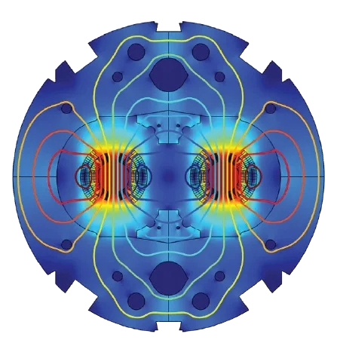

Quench Protection Systems at LHC (Large Hardon Collider)
Presented by Vasja Pirc
TE-MPE-MP

Slide 2

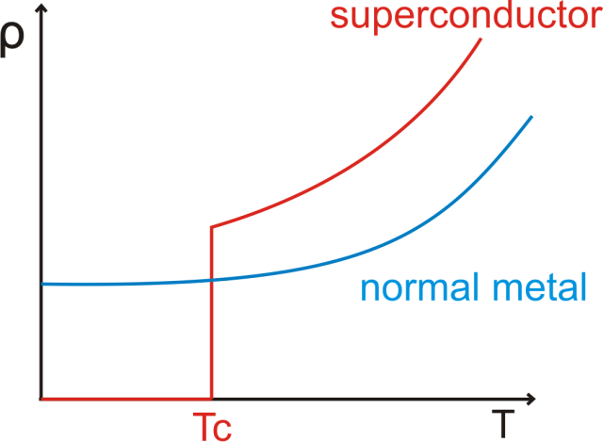
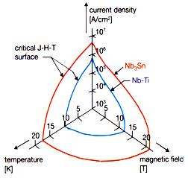
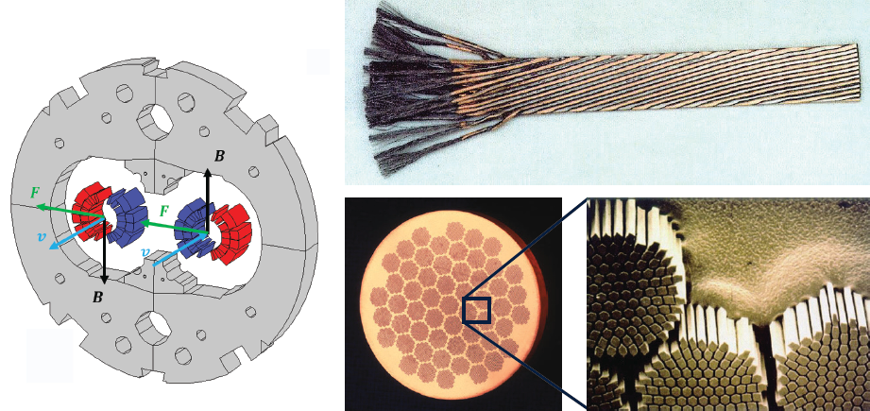
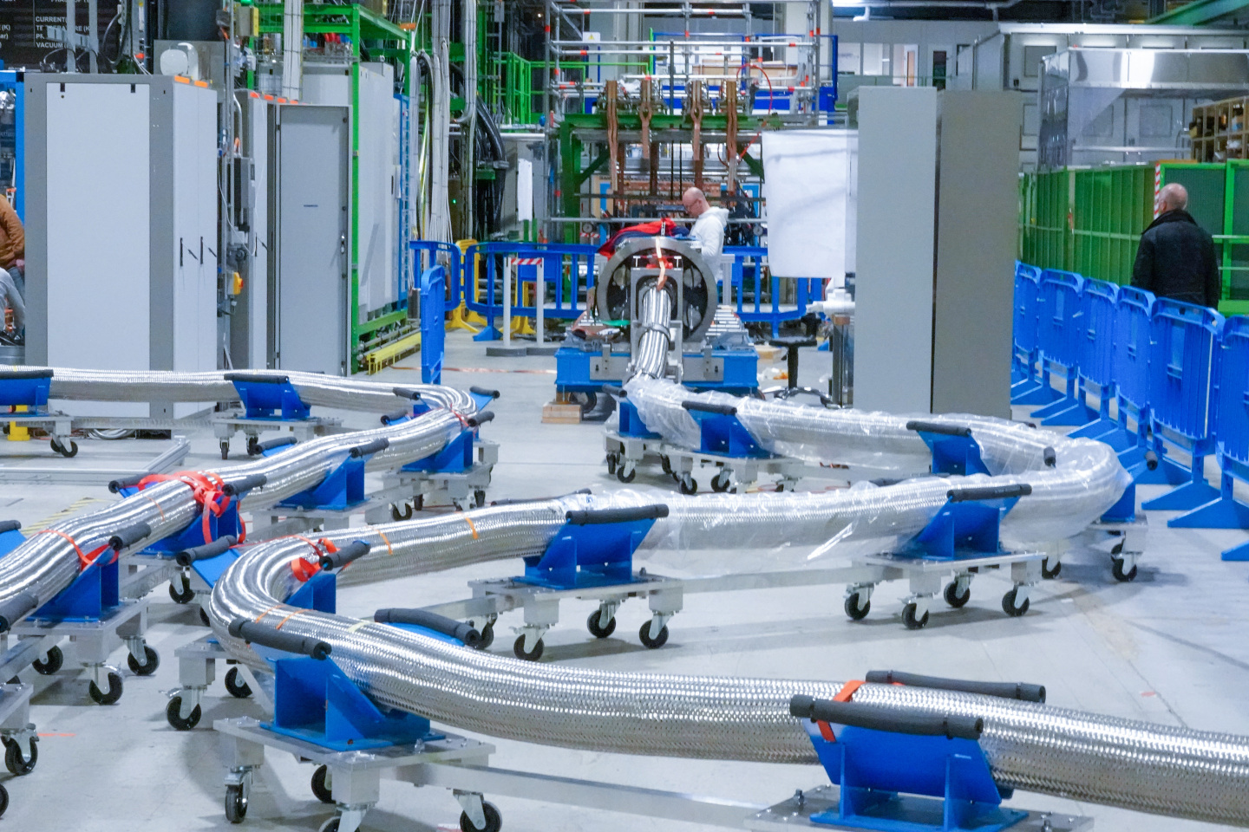
Superconductors Quench
Superconductive materials are NbTi , Nb₃Sn and MgB₂ .
Critical point in temperature, current density and magnetic field.
Combining the functions we obtain a critical surface.
What does it mean to train the magnet?
A. Osama, A. Kamel, Abdelrahman Hesham, Z. Elbouriny, Z. Amr, and M. Ahmed, “A Review On Superconducting Materials and Their Applications,” 2022, doi: 10.13140/RG.2.2.13919.27040.
“Taking a closer look at LHC - Superconductivity in short.” Accessed: Sept. 09, 2025. [Online]. Available: https://www.lhc-closer.es/taking_a_closer_look_at_lhc/0.superconductivity_in_short

Slide 3
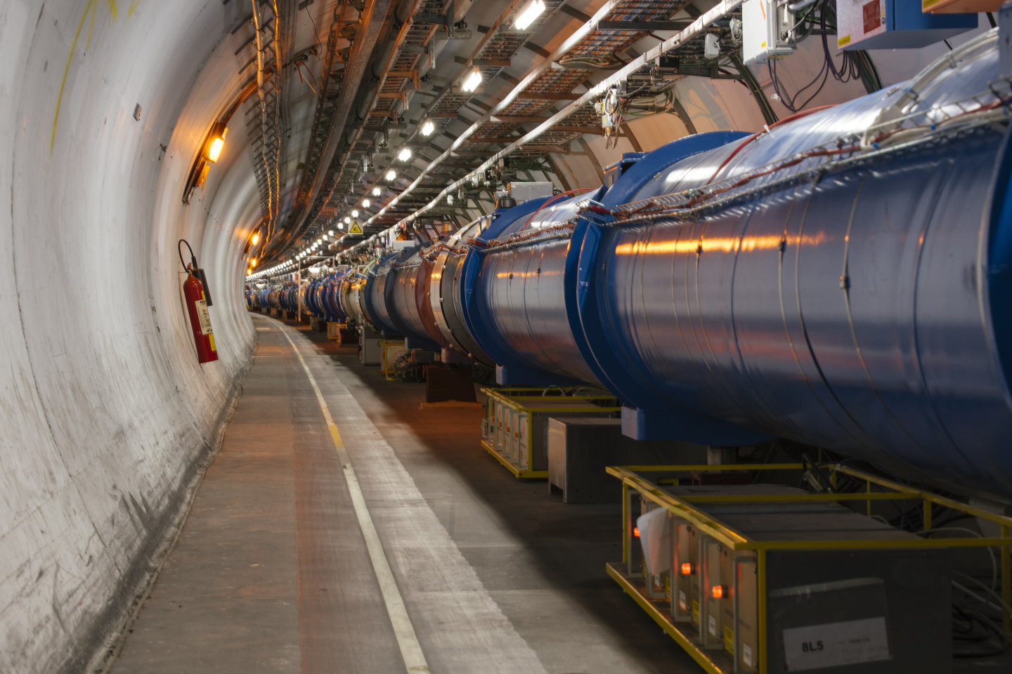
How to protect the magnet?
Detect a quench in the magnet.
Uniformly heat up the magnet.
Bypass majority of electrical current.
Decrease the energy stored in the magnetic field of the inductor.
Spread the energy losses across the whole superconductor.
React fast.
Protection Techniques
Energy Extraction
Energy Injection

Slide 4
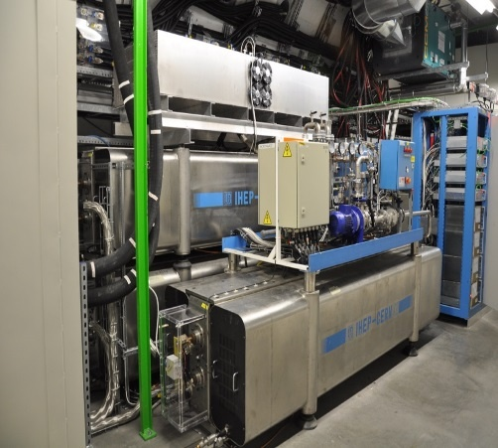
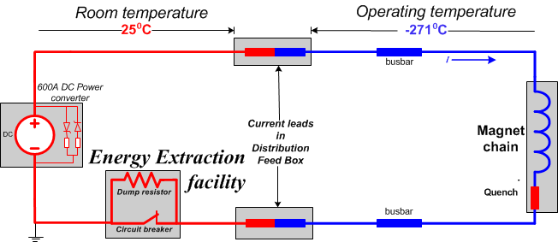
Energy Extraction Basics
Superconducting magnet circuits store energy in their magnetic field.
Energy extraction system extracts the energy from the inductor into the dump resistor.

Slide 5
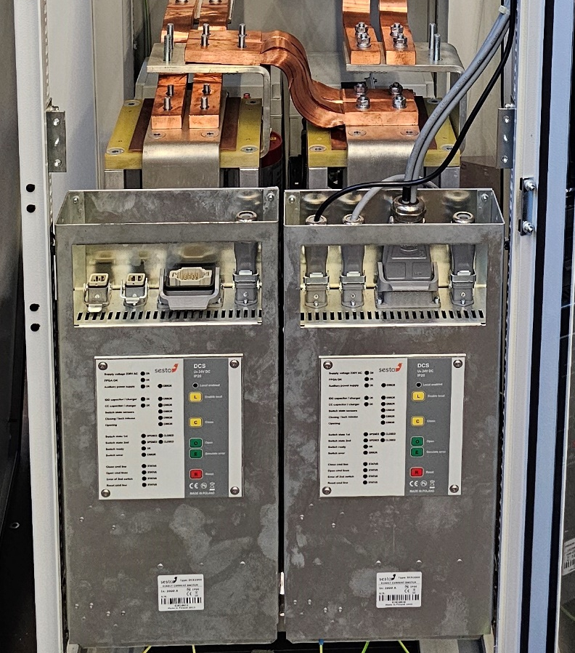
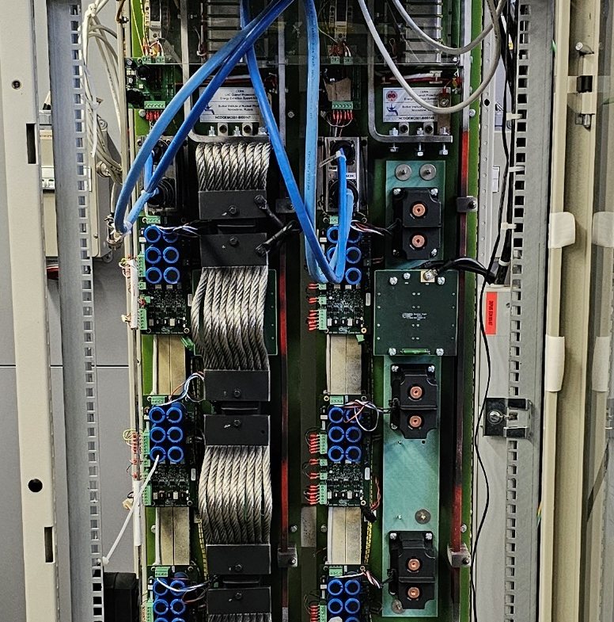
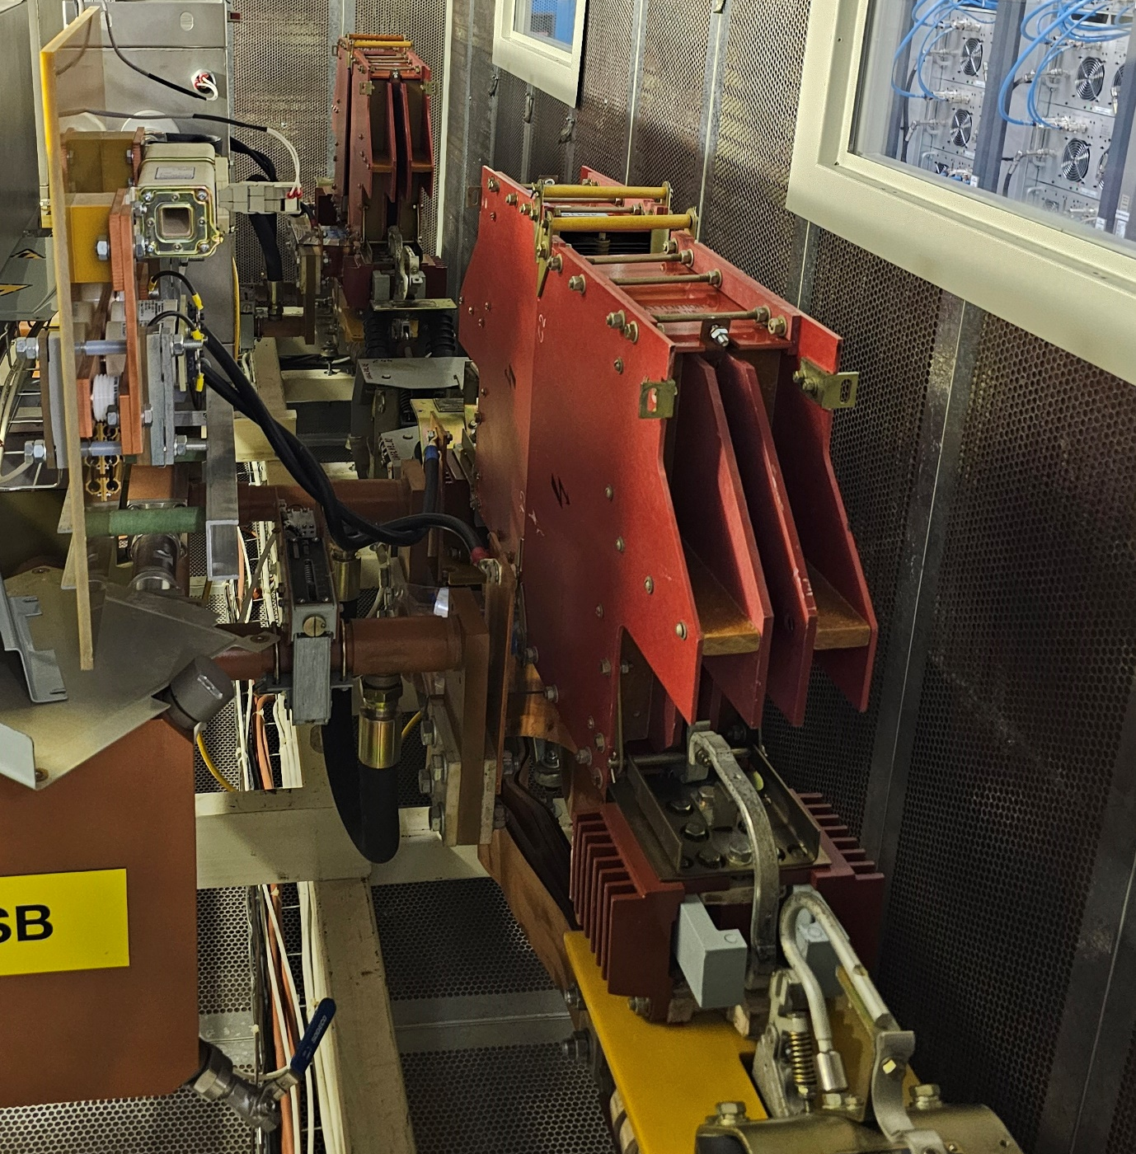
Energy Extraction Systems
Vacuum 2kA/600A
Contactors 600 A
13kA Electro-Mechanical Circuit Breakers.

Slide 6
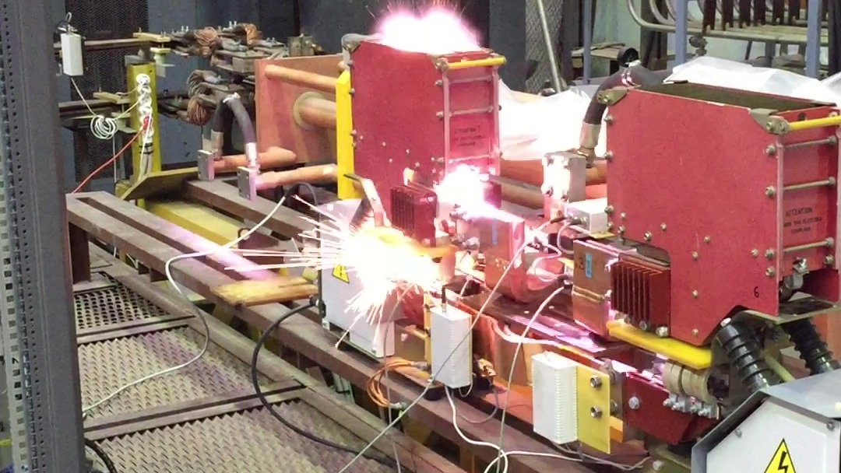
Opening of the 13 kA Circuit Breaker

Slide 7
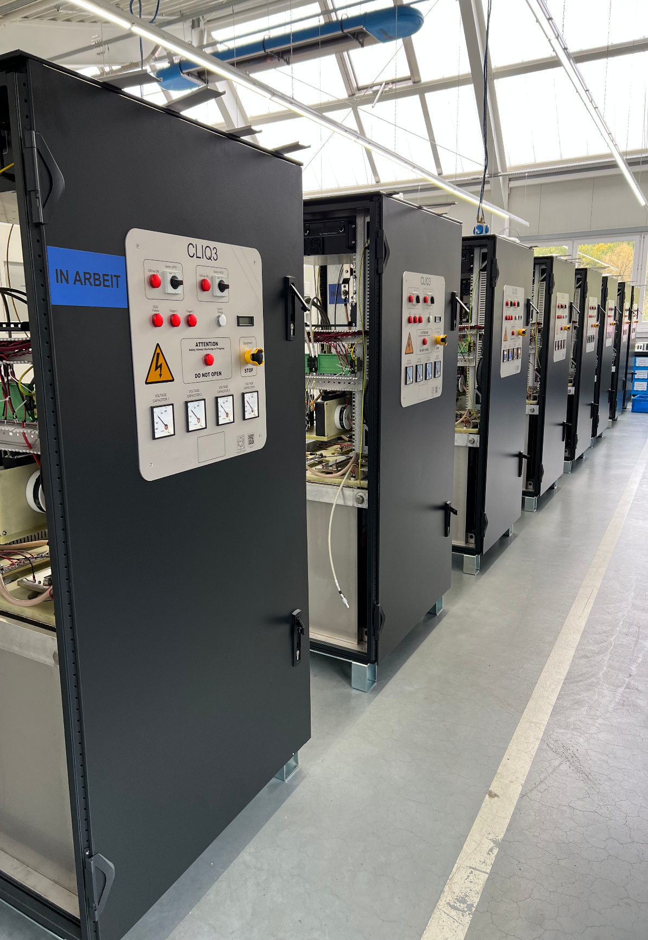
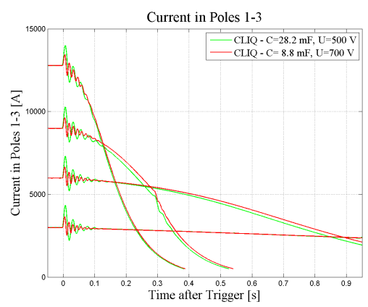
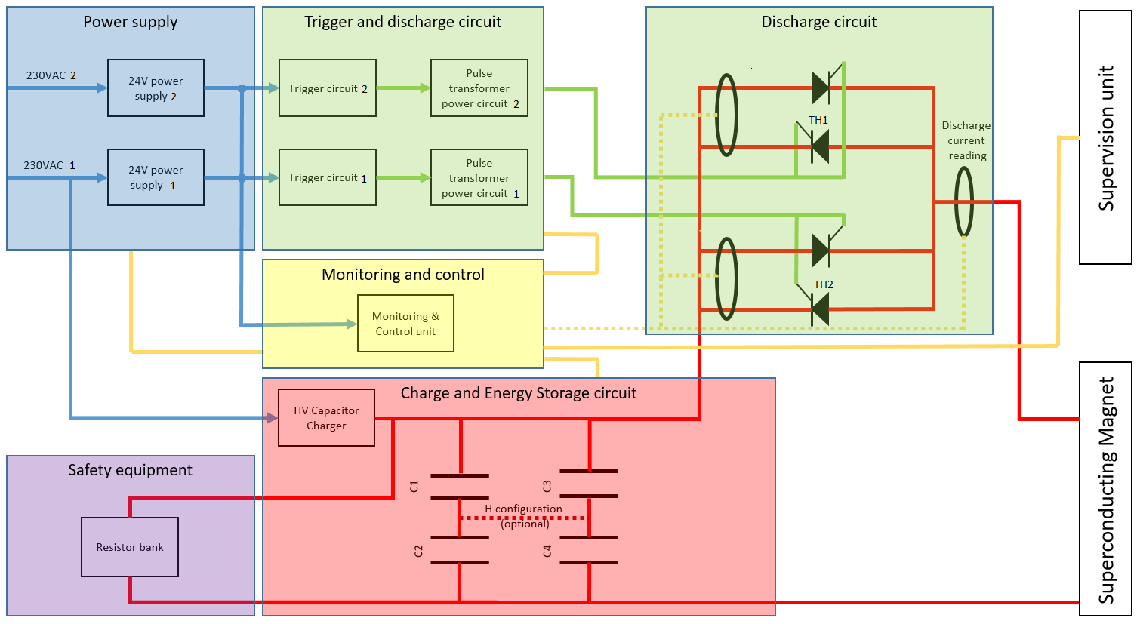
Energy Injection Basics
“CLIQ – Coupling-Loss Induced Quench System for Protecting Superconducting Magnets - CERN Document Server.” Accessed: Sept. 10, 2025. [Online]. Available: https://cds.cern.ch/record/1695142?ln=en
Quench Heaters
CLIQ (Coupling Loss Induced Quench)
Injection has an effect when used Cold Bypass Diodes.

Slide 8
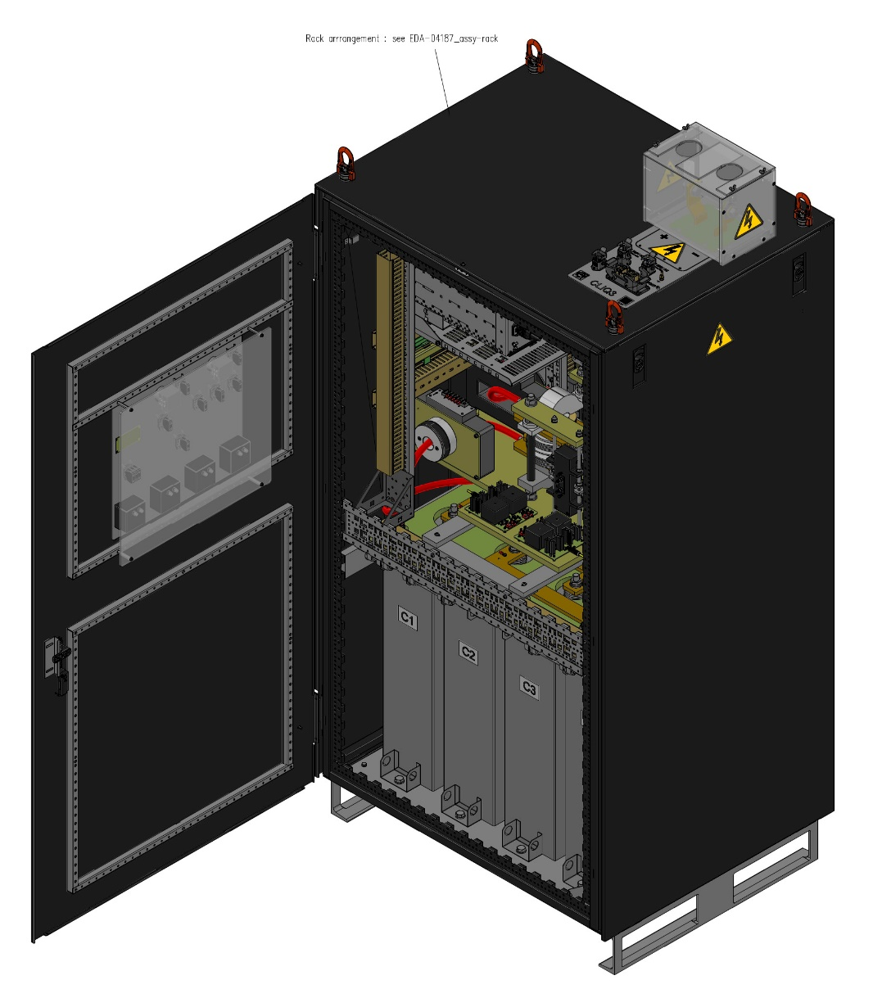
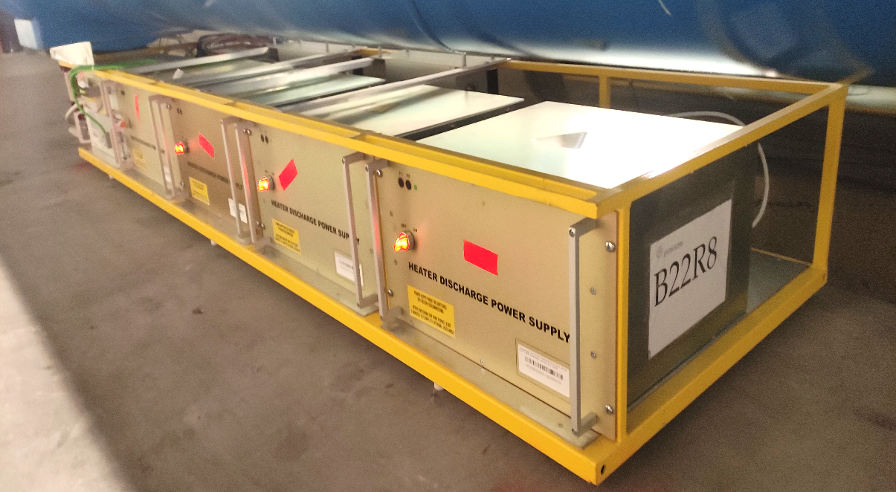
Energy Injection Systems
CLIQ (Coupling Loss Induced Quench)
Quench Heaters

Slide 9
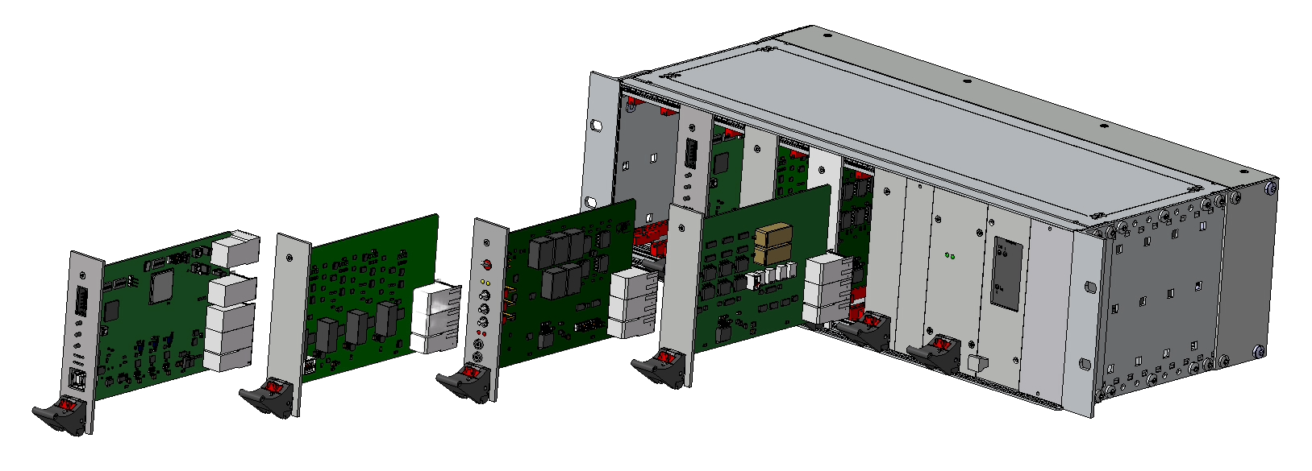
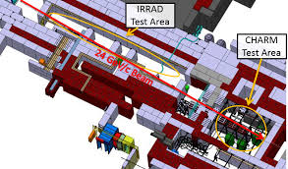
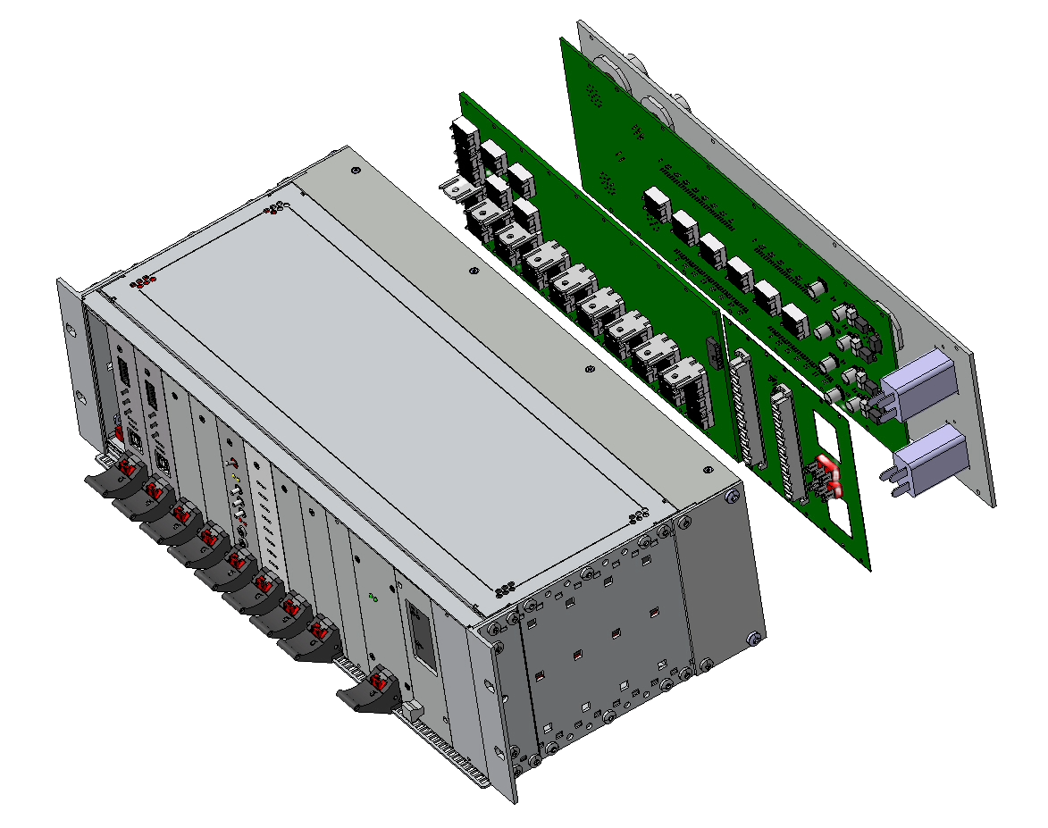
Universal Control Electronics (HL-LHC Upgrade)
Universal to control all Energy Extraction Systems
Extreme Reliability for a Safety Critical System.
Annual Dose Rate 25 Gy/year.
Radiation Tolerant up to 500 Gy.
Commissioning starts in 2026.
CHARM Radiation Test Facility
Proton beam from PS (Proton Synhrotron)
Copper Target for Protons
Mixed Field (Protons, Neutrons, Muons, etc.)
Dose rate cca. 500 Gy per week.

Slide 10
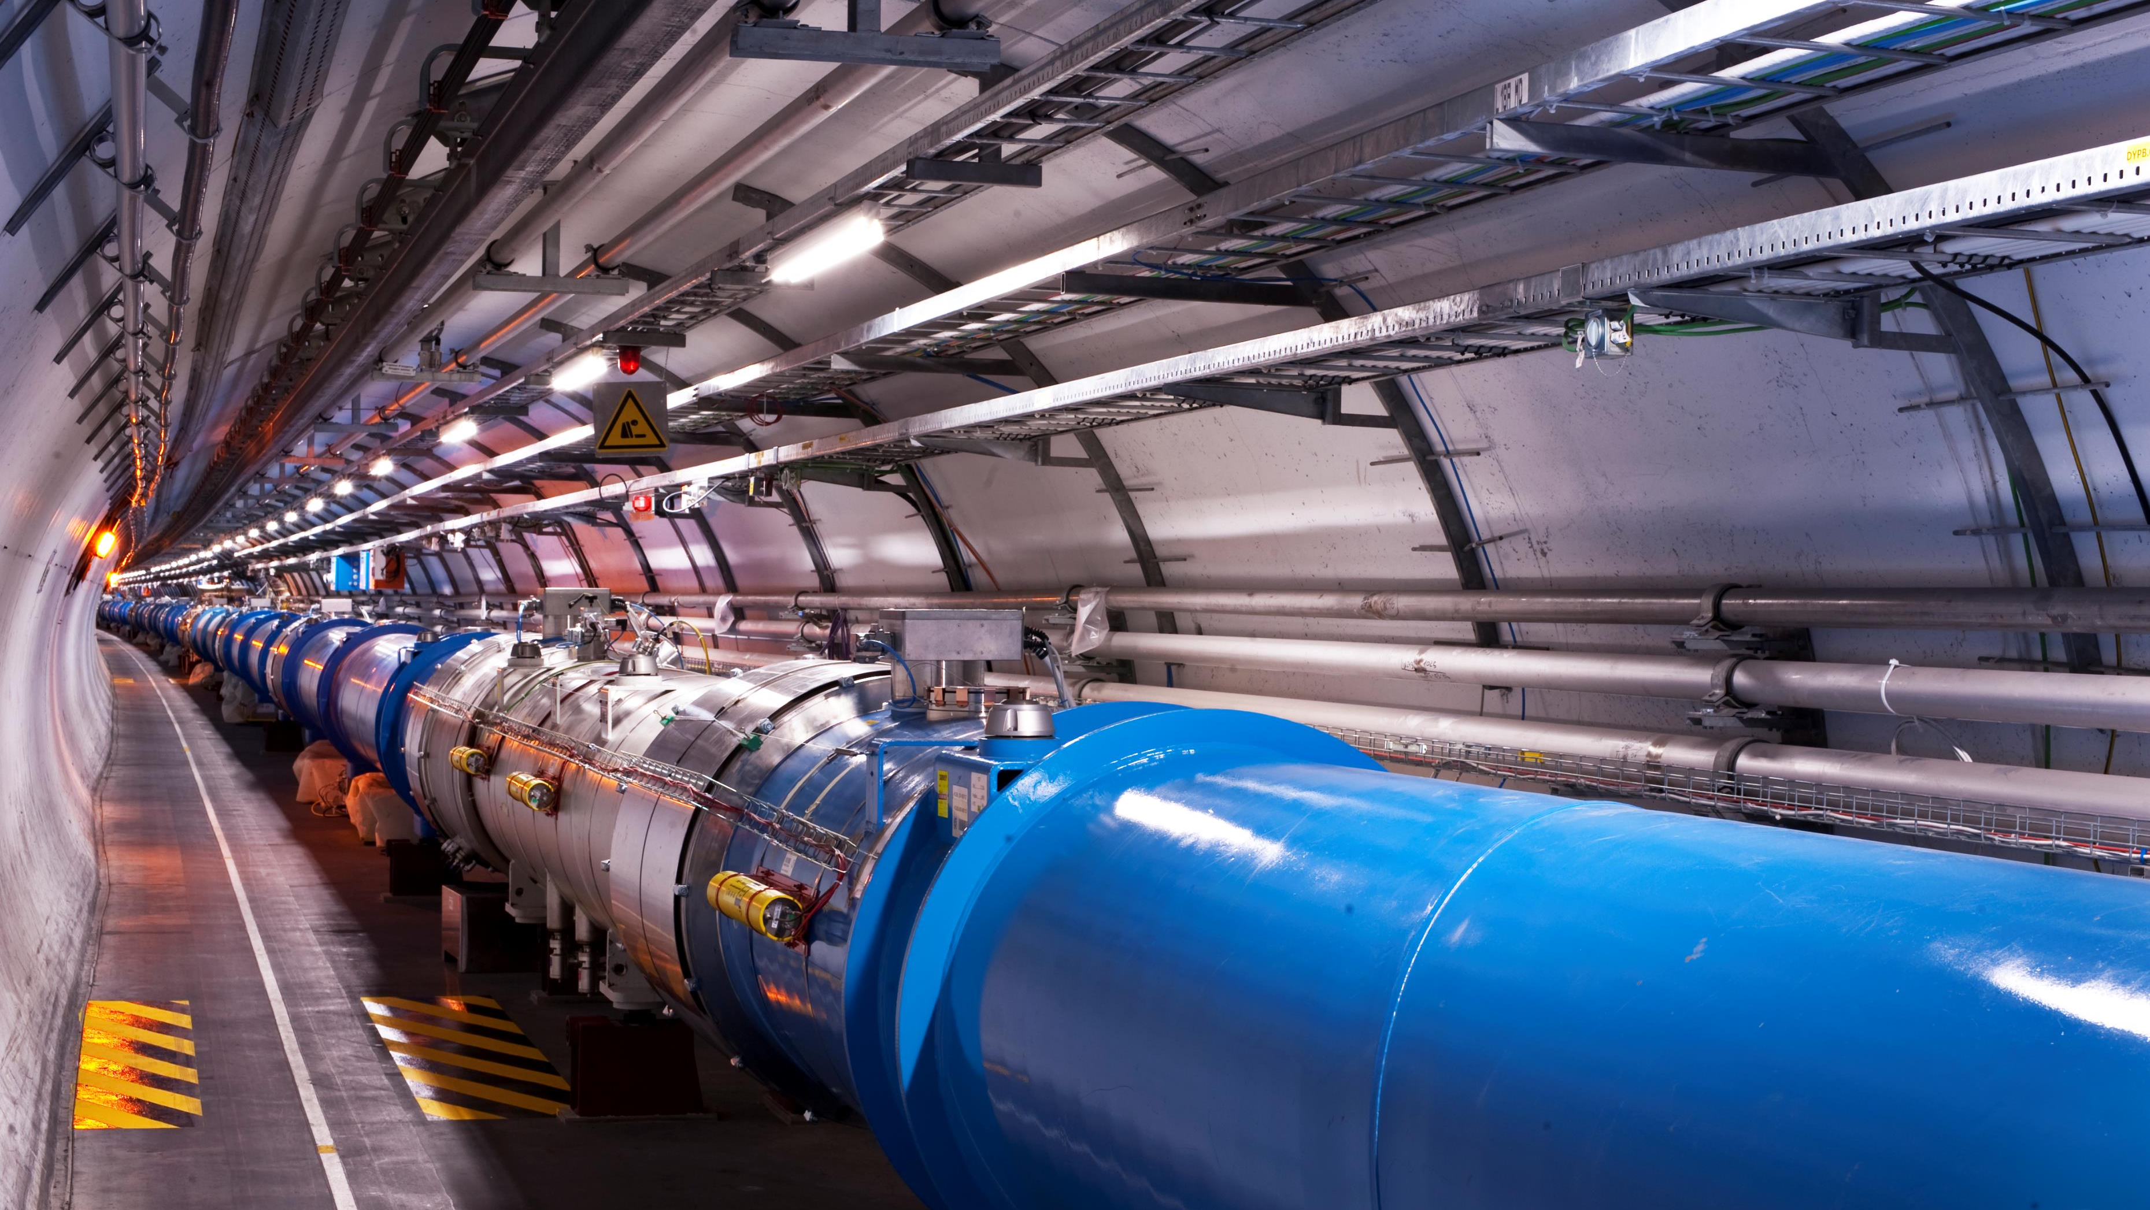
Thank you for your attention!

