Slide 2



FALCOND collaboration INFN ASG CERN meeting
FALCON-D CERN 12T dipole status (HFM RD3 WP3.1)
ASG, Genova, October September 11st 2024
MSC-SMT Arnaud Foussat, Nicola Sala, Sachin Gowrishankar.

Slide 3
Outline
Introduction
FALCON-D 12T dipole WP3.1 project
Procurement status of WP3.2 components
Key milestones in CERN & INFN collaboration
Deliverables, development plan, 2024-2026 Schedule
Summary
Notes:
As an outline, I will start with a brief introduction of the context of this work and give an update of the Wp3.1 technical scope related to the development of Cos theta 12T dipole . Then I will summarize the related achievements, agreements within the INFN – CERN collaboration with the updated deliverables of WP3.1. In the end I will present the deliverables and development plan focusing over 2024 2026 and summarise.

Slide 4
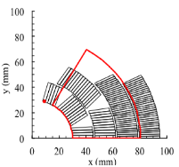
Introduction
HFM program entrusted CERN WP3.1 to developed a 12T Nb₃Sn Cos-theta dipole based on models (< 2 m) by 2028, as potential technology for further prototype ( ∼ 5 m long), 14T dipole magnet design by horizon 2030. (indico/1430998/)
Strategic knowledge for future High energy collider in mastering the cos ϴ technology for HF dipoles.
Uniformized HFM design parameters applied in update design :
  Around 80%.Iss loadline operation at 1.9K
  Mid plane stress @RT < 120 Mpa, 150 Mpa @ 4K,
  Current design J_{c} ( 16T @4.2K) = 1200 A/mm²
  50 mm aperture, 50 mm equivalent 60° sector width
From mid 2024, HFM steering board decided to enhance the alignment between FalconD INFN (WP3.2) and Falcon D CERN (WP3.1) adopting similar coils design so to gather efforts, development synergy and favor technical exchanges.

Slide 5
FALCOND WP3.1 dipole
Scope of HFM WP3.1 12T Cos-theta Nb₃Sn dipole follows following key guidelines:
    FalconD 12T dipole coils manufacture at B927-CERN with common key design features as the INFN-ASG coils
    Objective to design a magnet models assembly (1-in-1, 2-in-1) based on optimized B&K structure baseline, scaling up design features, cold tested at CERN SM18
    larger cable 40 x 1.0 mm RRP 162/169 strands Rutherford, Cu:nCu 0.9 as proposed placeholder. Common evaluation with INFN /ASG of the cable windability, need for coils heads optimisation.
      In case of winding issue (narrow bending radii, instability) back up of 0.85 mm QXF cable RRP 108/127 Cu:nCu 1.2.
      Further cable development back up under discussion RRP160/169, 1 mm, cu/ncu 1.2
      for 14T 2-in-1 dipole design possible available strands RRP 162/169 - Φ1.1 mm, RRP 60/91 - Φ 0.7 mm
    The structures variants are designed for 13.5 T e.m loads level including the 2-in-1 model at CERN.
CERN FalconD dipole development plan includes early investigation of cos-theta magnet structure candidates (B&K, alu bars + SS shells) on mechanical mockups.
Notes:
Following HFM steering board, main guidelines of update 12T cos theta renamed as Falcon D program

Slide 6


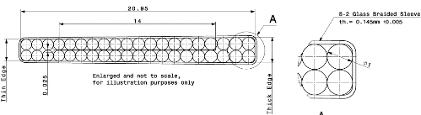

Nb₃Sn RRP wire for FALCON D WP3.1
Cable | Units | Past WP3.1 12T cos theta | 2024 baseline WP3.1 & WP3.2 12T FALCON D (1-in-1)
Material |  | Nb₃Sn (RRP 108/127) | Nb₃Sn (RRP 162/169)
Strand type name |  | MQXF | DEM 1 (ERMC-1)
No. strand |  | 40 | 40
Strand diam. | [mm] | 0.850 ± 0.003 | 1.000 ± 0.003
Cu/NonCu |  | 1.2 ± 0.1 | 0.9 ± 0.2
Keystone | [º] | 0.4 | 0.5
Jc (@4.2K, 16T) | [A/mm⁻²] | 1200 | 1200
Heat treat. |  | 665 °C 50 h | 650 °C 50 h
Ic (A) | 4.22 K, 12.0 T | > 590
 | 4.22 K, 15.0 T | > 331 | > 508
Bare cable th. (R) | [mm] | 1.59 | 1.893
Bare cable wd. (R) | [mm] | 18.500 | 21.420
RRR | Round | > 150 | > 150
Insulation th. | [mm] | 0.150 | 0.150
Filling factor |  | 0.29 | 0.35
Reference S Hopkins et al. : doi: 10.1109/TASC.2023.3254497
Notes:
New strand 162/160 with 1 m diameter and 0.9 cu ncu ratio offering a design at 76 %ISS

Slide 7
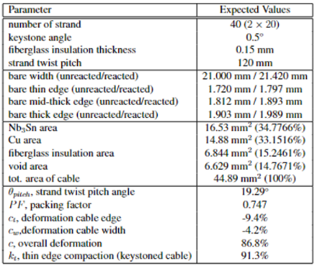
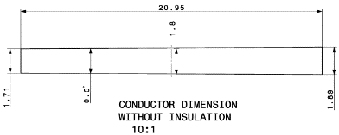

FalconD cable features
Non reacted conductor dimensions
Table 1: FalconD DEM-1 conductor type parameters

Slide 8
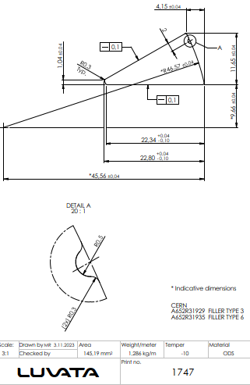
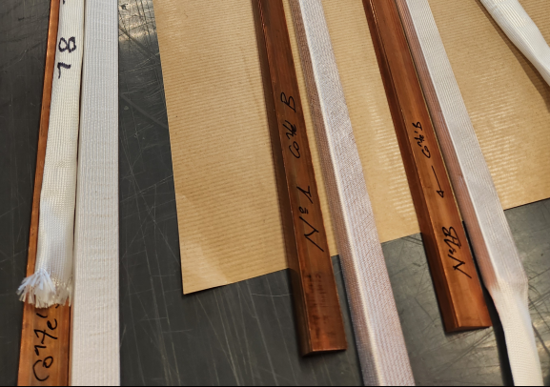
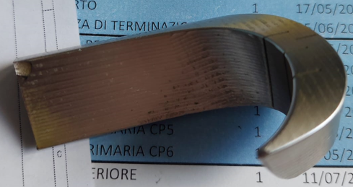
WP3.2 FalconD INFN procurement status
Glidcop Cu Wedges by Luvata
  1st batch: 3 x 6 sets delivered, slight deviation accepted,
    All being insulated with FG sleeves at CERN, delivery to ASG by Nov.
  Order of 12 sets by CERN workshop, delivery by end 2024
  One wedge end to insulated at ASG after trimming
Prototype SS end spacers machined
  Several iterations on first order of 5 pieces (OLE), contract extension with 15 pieces
    Open points to be checked during assembly ( effective sliting, stiffness, insulation design)
  Priority on next IL series 10 pieces
  Q1: To decide when is introduced the hold point on optimisation, re-design, fabrication of next end spacers
Delivery of 3ULs cables to ASG this week, traceability of leftover cable to be kept.
  CRMHFD_003-CR00466A (46 m)
  CRMHFD_003-CR00466B (145 m)
  CRMHFD_003-CR00466E (145 m)
  Q2: discussion on scope of test to be carried out on first number of cable samples
    HT cycle confirmation and Jc(B) measurement
    Winding cable trials
    First dummy coil winding

Slide 9
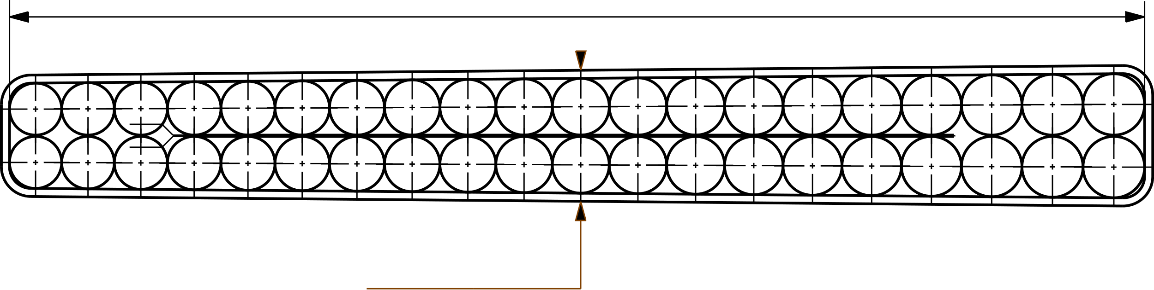
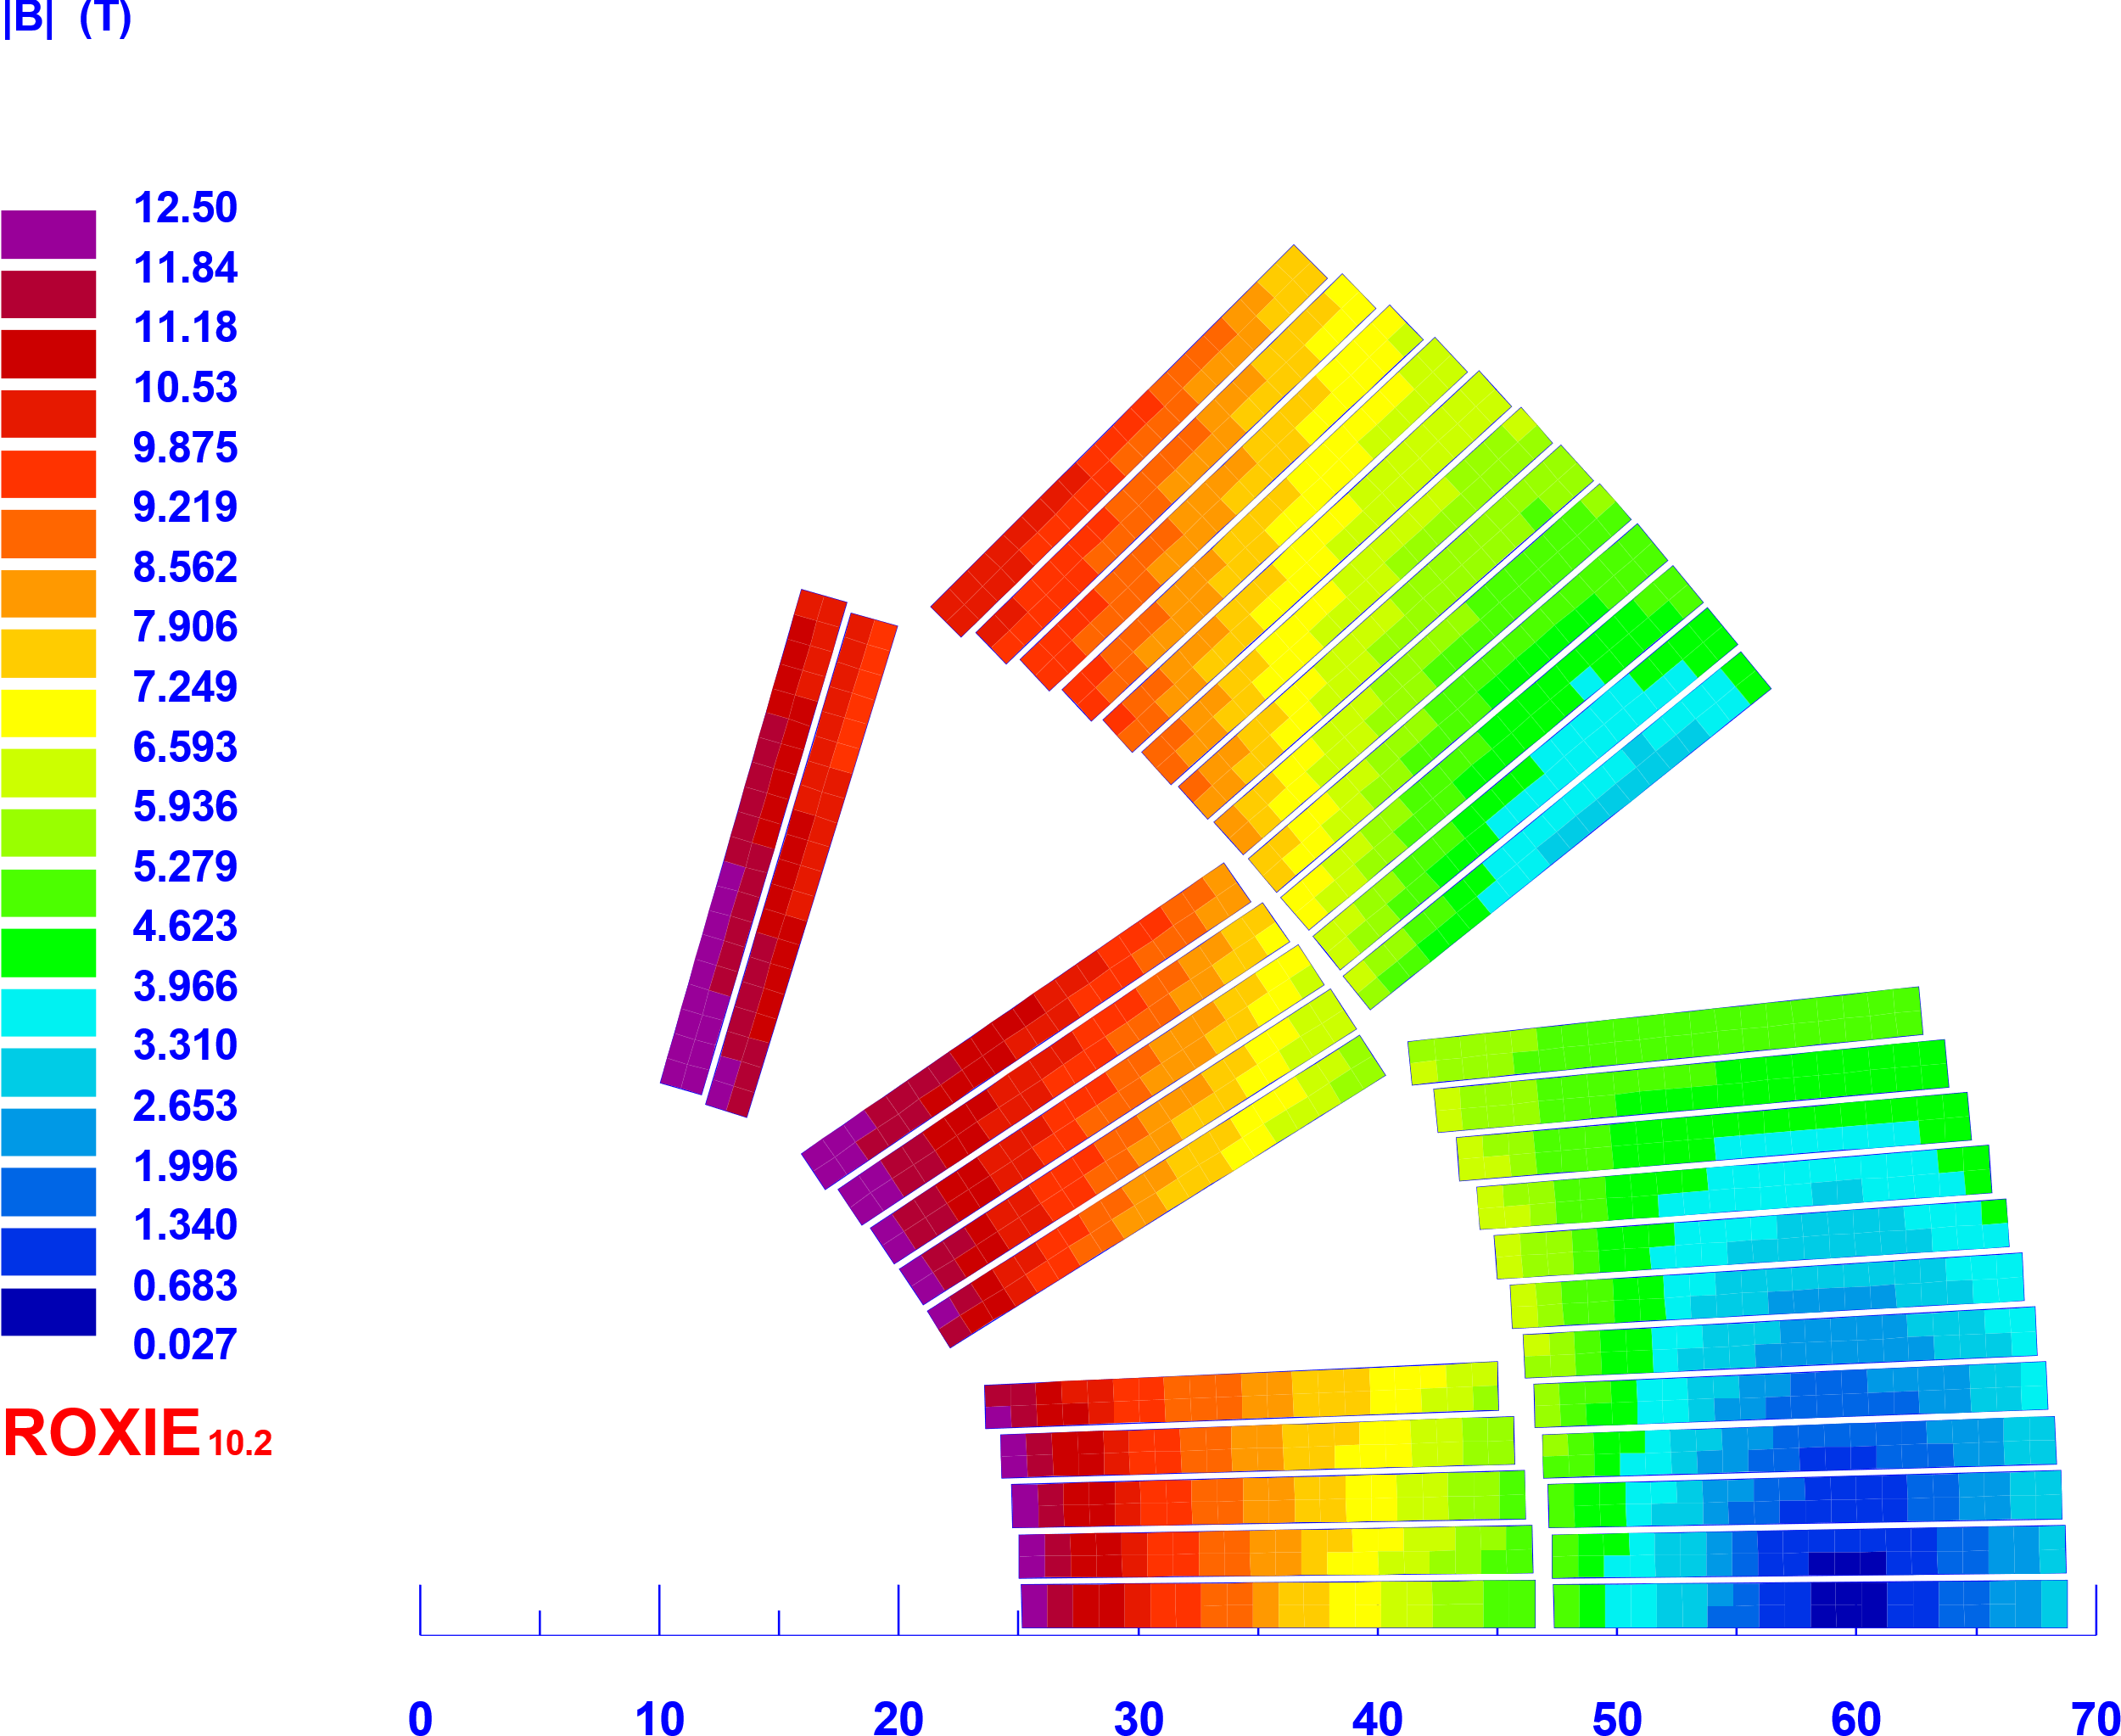



FALCOND WP3.1 12T design parameters
Coil |  | 12T cos | Falcon D 1-in-1
No. of turns per pole |  | 15+22 = 37 | 12+24 = 36
No. Blocks |  | 6 | 5
Insulated cable surface | [mm²] | 5259 | 6859
Equivalent coil width | [mm] | 31.0 | 37.5
Physical length | [m] | 1.5 | 1.5
Coil efficiency | [T.mm/A] | 0.00078 | 0.00071
21.42 mm
1.89 mm
Fig.1 Reacted DEM1 conductor size
Magnet |  | 12T collar. (2023) | Falcon 12T b&k (2024) | 1-in-1 Falcon 12T collar. (option) | 1-in-1 Falcon Ult. 14T b&k | 2-in1 Falcon D 12T
Aperture / interbeam | [mm] | 50 | 50 | 50 | 50 | 50 / 204
Operating temperature | [K] | 1.9 | 1.9 | 1.9 | 1.9 | 1.9
Outer diameter | [mm] | 620 | 640 | 640 | 640 | 640
Nominal current | [kA] | 17.750 | 20.991 | 20.400 | 24.906 | 20.400
Strand eng. Je | [A/mm²] | 782 | 668 | 650 | 793 | 650
Overall Je | [A/mm²] | 489 | 454 | 454 | 554 | 454
Nominal field | [T] | 12.01 | 12.00 | 12.00 | 14.00 | 12.3
Peak field | [T] | 12.42 | 12.53 | 12.55 | 14.63 | 12.56
Ap. to peak field ratio | [%] | 3.4 | 4.4 | 4.5 | 4.5 | 4.5
Load line fraction | [%] | 83.2 | 77 | 76 | 91 | 76.1
Temperature margin | [K] | 4.3 | 5.11 | 5.17 | 2.72 | 5.14
Inductance | [mH/m] | 2.64 | 2.24 | 2.23 | 2.19
Stored energy | [MJ/m] | 0.451 | 0.543 | 0.52 | 0.741 | 1.04
Hot spot temp. adia. | [K] |  | < 150 K | < 150 K | < 150 K | < 150 K
Horizontal force (per quadr) | [MN/m] | 3.32 | 3.57 | 3.75 | 4.920 | 3.88
Vertical force (per quadr) | [MN/m] | -2.40 | -1.78 | -1.76 | -2.580 | -1.77
Fig. 2 5 blocks Falcon D coil section
Fig.3 LR and LE end, Roxie API models
Fig.4 Falcon D 3D machined spacer vs R&D 3D printed development
Notes:
The magnet operation point at 12T in the bore must be less than 80% on the loadline at 1.9 K, which means around 5 K of temperature margin. The dipole must have an aperture of 50 mm in diameter and considering the strain sensitive characteristic of the Nb3Sn rutherford cables, the maximum stress on coil should be lower than 150 MPa, which is considered a threshold for critical current degradation.

Slide 10
Cos-ϴ dipole development plan
CERN-MSC and INFN-Ge, LASA proposed from 2024 the synergetic plan below towards a twin-aperture 12 T, 1.5 m long Nb₃Sn dipole design by 2028.
Date | Description | Length | Remarks | Goals | Institute
Q2-2026 | 1-in-1 demonstrator magnet (WP3.2) | 1.5 m | Construction at INFN LASA, test at INFN, CERN | Cable technology Coil technology Quench performance New b&k structure design | INFN WP3.2
Q3-Q4 2025 | Long mechanical mock ups | < 0.5 m | CERN B&K & collars coils section mock up assembly ( use 11T coils) | Benchmarked concepts of mechanical cross section structures at RT and cold. Measurement of residual stress | CERN WP3.1
Q3- 2026 | 1-in-1 demonstrator magnet M1 | 1.5 m | CERN B&K coils magnet assembly | Novel dipole b&k structure design | CERN WP3.1
Q2-Q4 2027 | 1-in-1 demonstrator magnet M2a – (option M2b) | 1.5 m | CERN B&K coils magnet assembly (CERN collared coils magnet assembly optional) | Optimization of b&k structure design Reproducibility Structure pro’s & con’s vs scale up | CERN WP3.1
Q2-2028 | 2-in-1 demonstrator magnet M3 | 1.5 m | CERN B&K coils 2-in-1 magnet assembly, structure around 12T coils | New 2-in-1 structure, Field optimization, fabrication process, scale-up design inputs for 14T design | CERN WP3.1

Slide 11
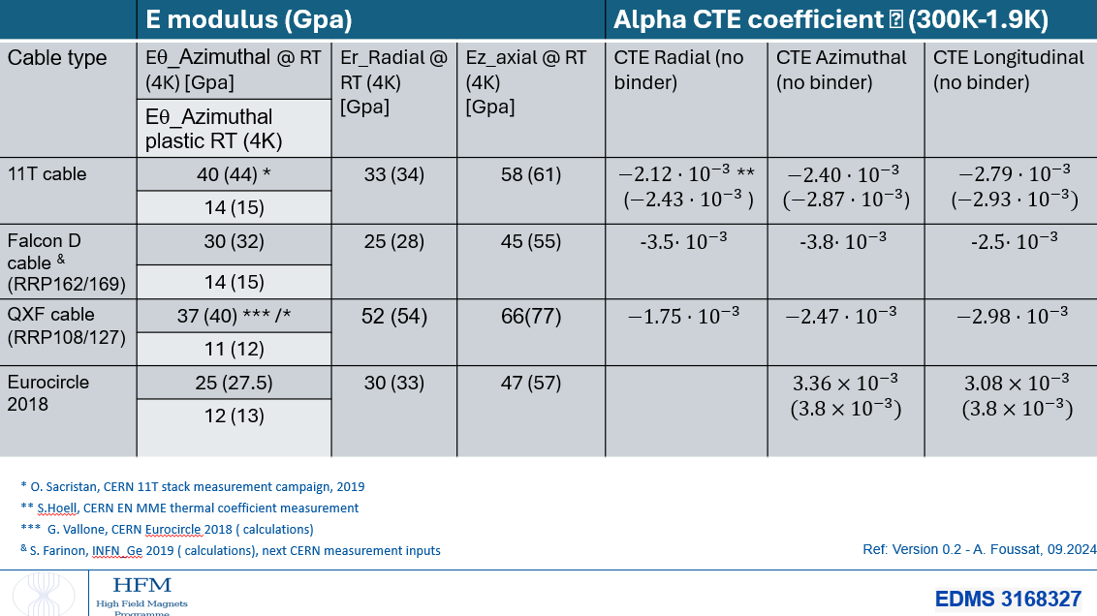
Cable material properties update
Unified Falcon D material properties based on measurement campaign used for FE inputs and 3D smeared calculation
Coming Falcon D cable ten stack measurement ( E, CTE)

Slide 12

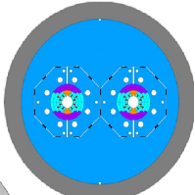
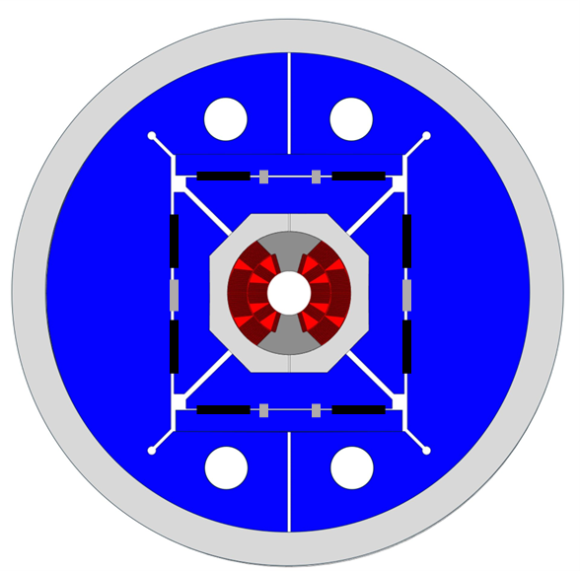
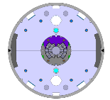
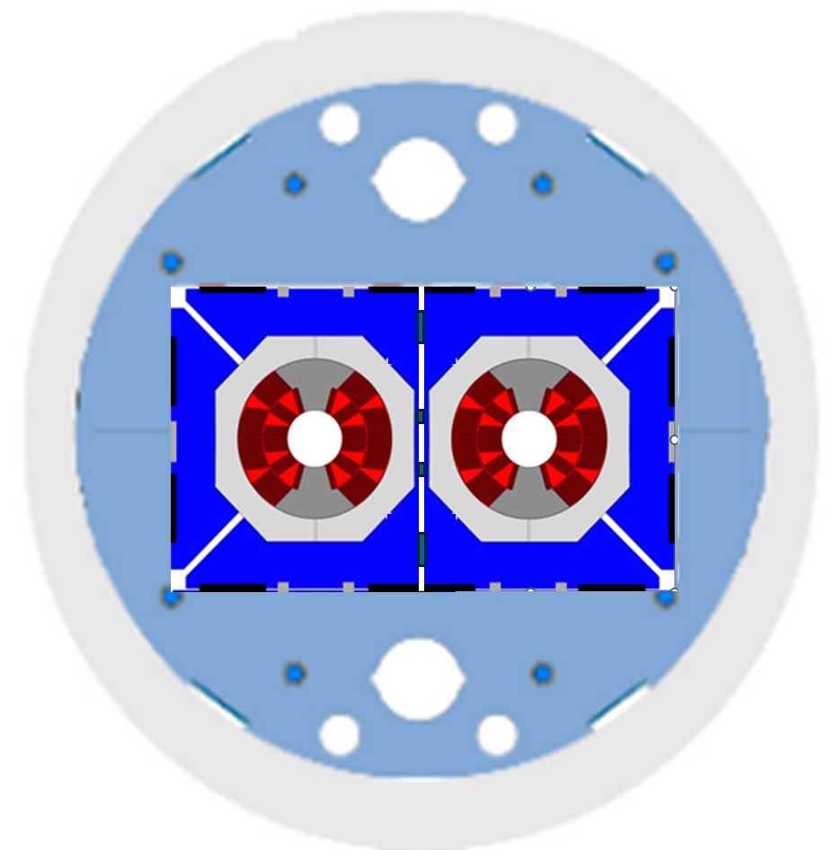
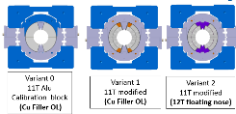
WP3.1 FalconD 12T dipole roadmap
Baseline B&K structure with Alu ring tested on mechanical mockups (ex: QXF, US-MDP concepts) versus collars with SS shell + Alu bars
Future optimization on single magnet design of 1-in-1 models towards 2-in-1 dipole
Single Aperture
B&K magnet models
Double aperture B&K 12T dipole magnet
Long mechanical mock ups
LMK1,2
M1,2
M3
Short mechanical mock up
Conceptual cross sections views
( H yoke split vs V)
2-in-1 magnet models b&k options
SMKs
Notes:
Gradual approach

Slide 13


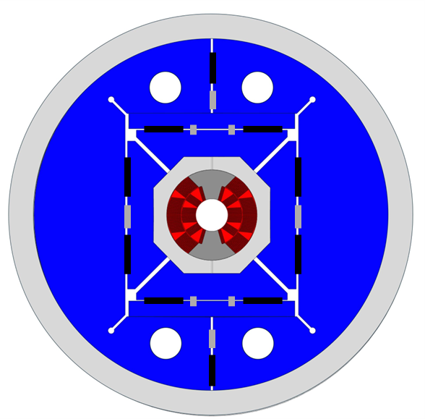
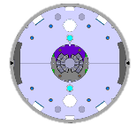
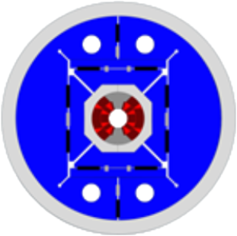
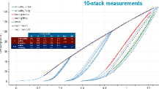


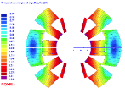


FALCON D at CERN
Focus on 2024-2026
Winding trials
on optimised end-spacers
3D printed end-spacers development
Dummy Coil
Winding trial
2 Practise Coils
2 +3 Series Coils
10-stacks
moulds fabrication
Q3_2024
Q4_2024
Q1_2025
Q2_2025
Q3_2025
Q4_2025
Q1_2026
Q2_2026
Q3_2026
Today
Long Mechanical mock-ups
Magnet model M1
10-stacks assembly
Short Mechanical mock-ups
Tooling coil, assembly Production
Notes:
Development plan along time span 2024 to 2026
Dummy winding trials start from mid 2025, followed by practice coils in end 2025 and the series coils from Q1 2026

Slide 14
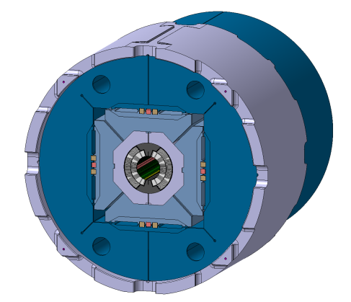
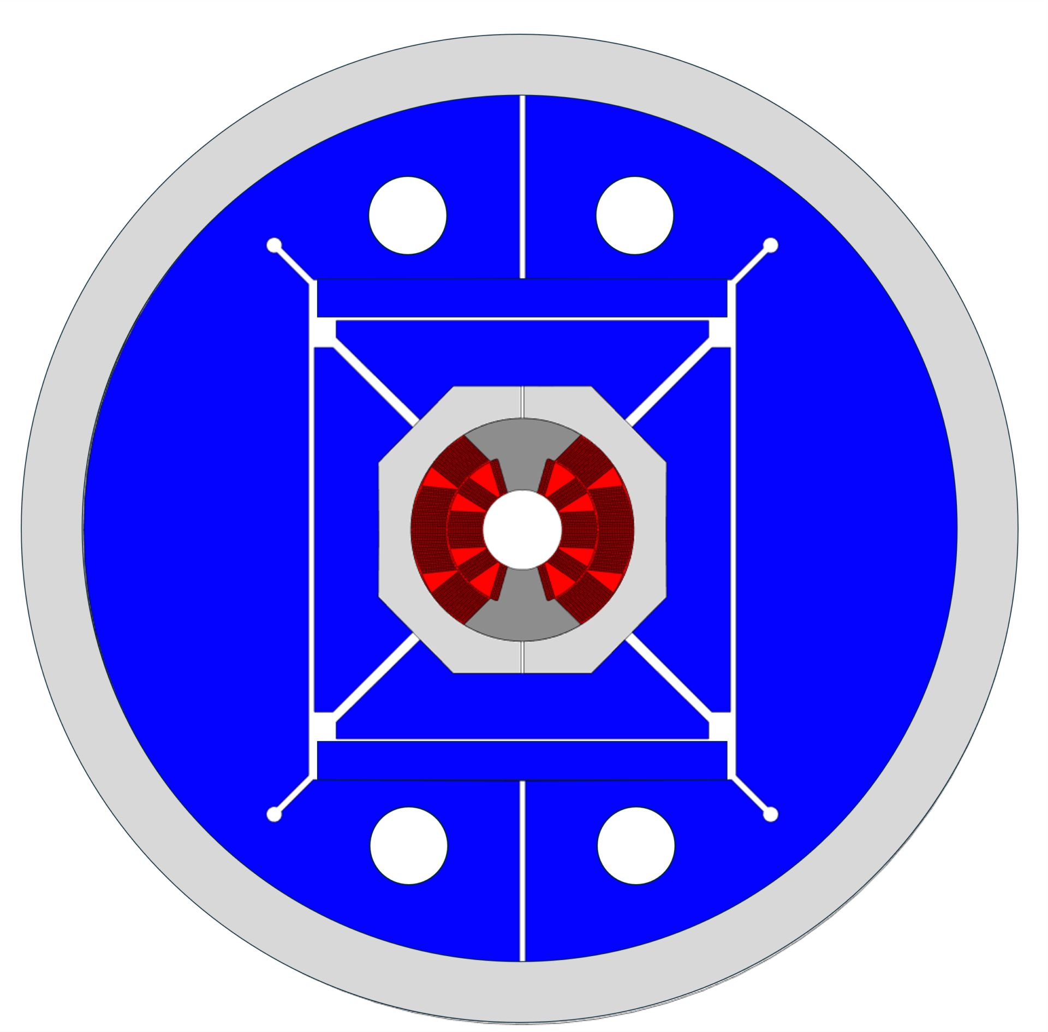
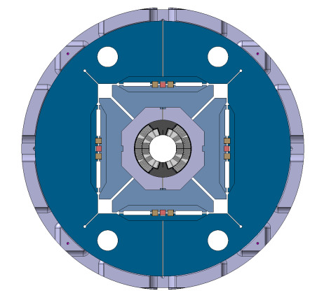
WP3.1 CERN FalconD structure variants
  Study of Horizonthal and Vertical key interferences level and sequence to minimize coil peak stress at RT, and provide low detachment of pole at cold within stress limits
                Alu collar, pads and iron master.
                Mid plane pad supported, collar shoe
                Separated nose ( similar QXF)
                B&K technology
                Vertical iron yoke slit with/wo 45 deg or 0 deg slits to tune iron stiffness
                Assessment of yoke pre-loading impact on coil peak stress across the full slits
                Alternative V&H iron slit
                Al6081 outer ring
                Length max 600 mm
M1 dipole design variant 1 (b&k)
Candidate structure design to be tested on first LMK1 mechanical model
MSC-SMT N.Sala, A.Foussat

Slide 15
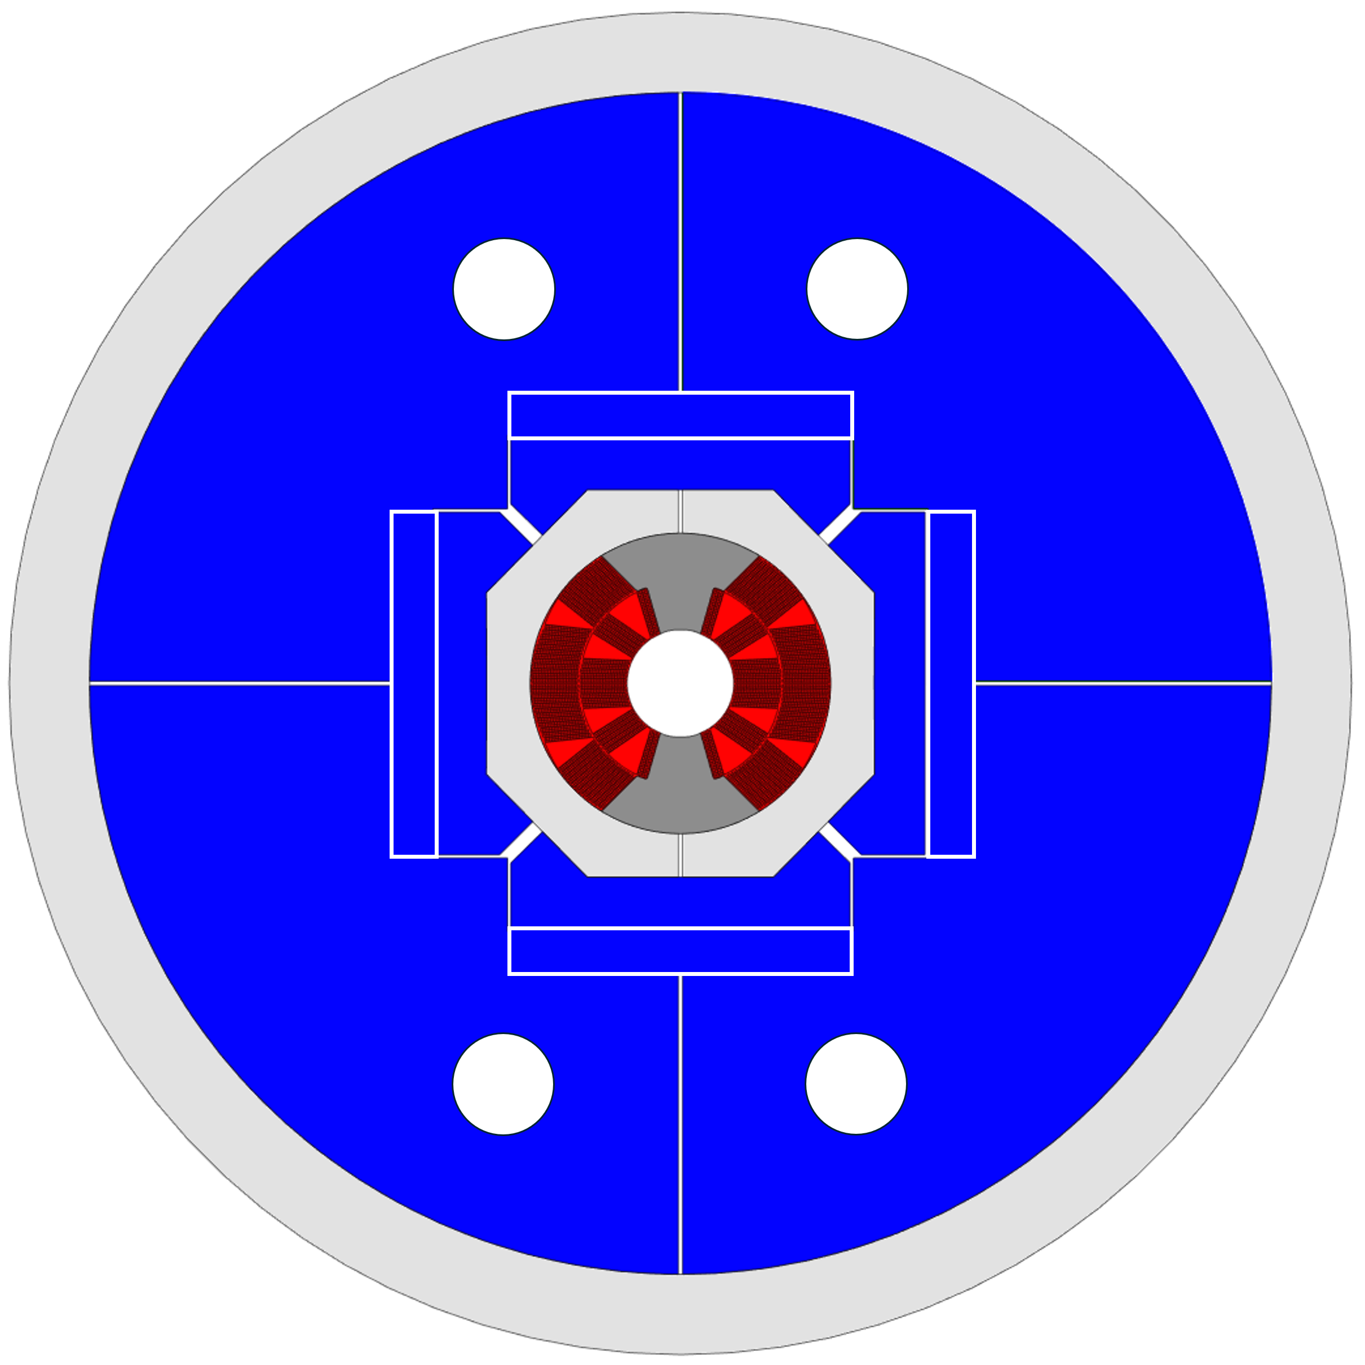
M1 dipole design variant 2
Second variant with 0-90 deg split in case of lower structure requirement
Assessment of iron preloading step onto coil stress state

Slide 16
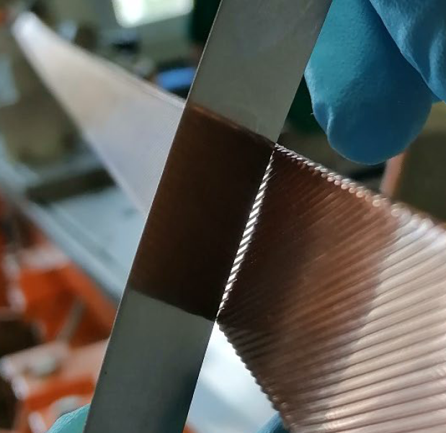
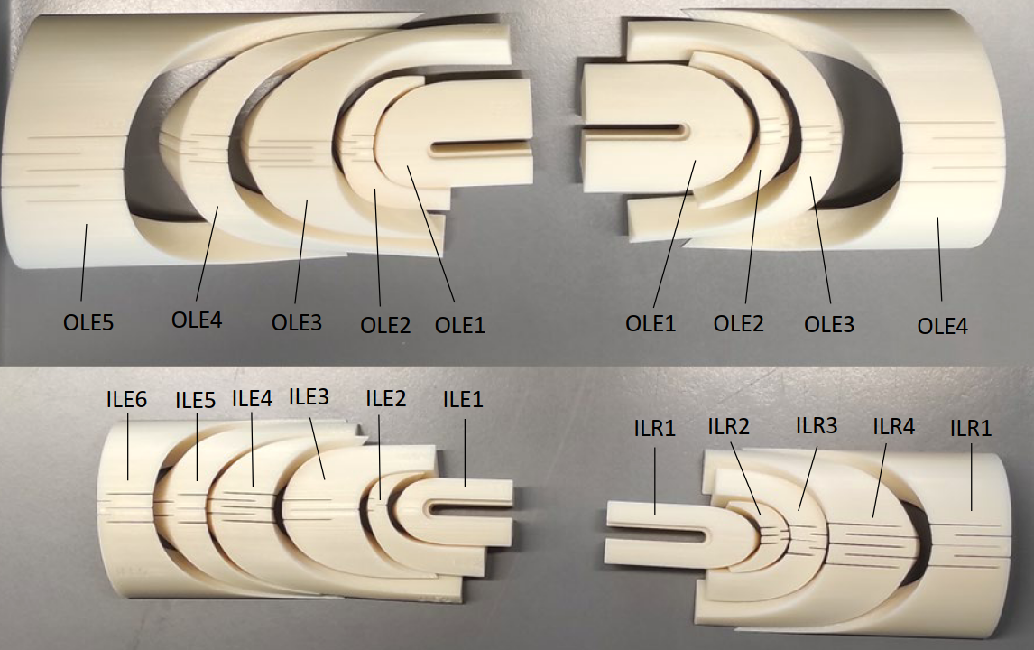
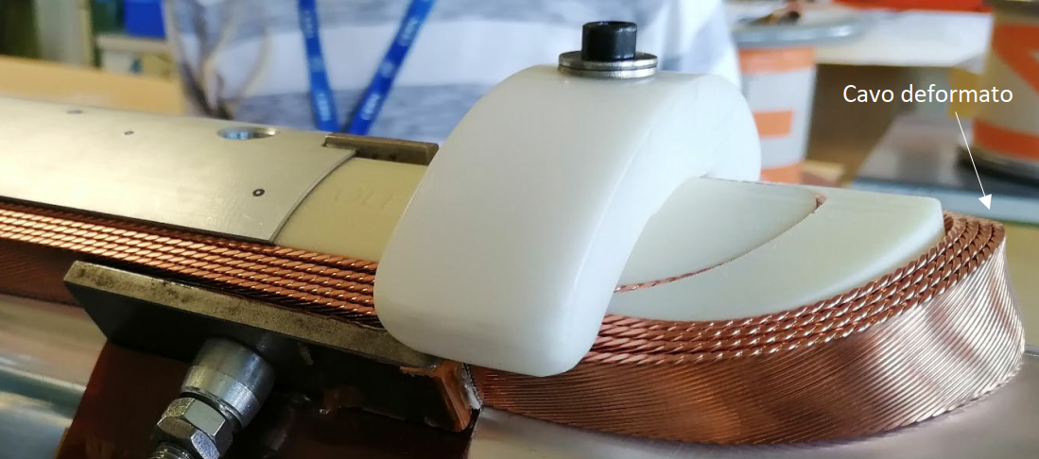
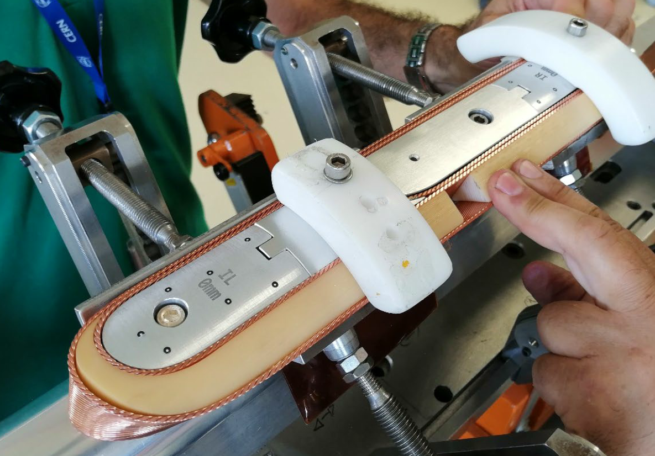
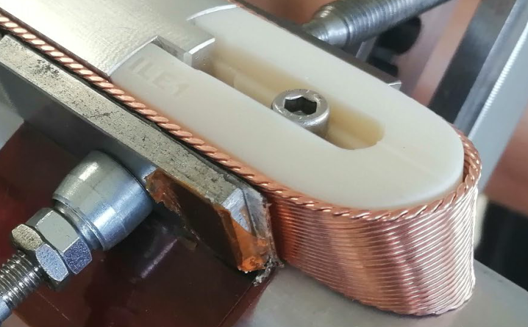
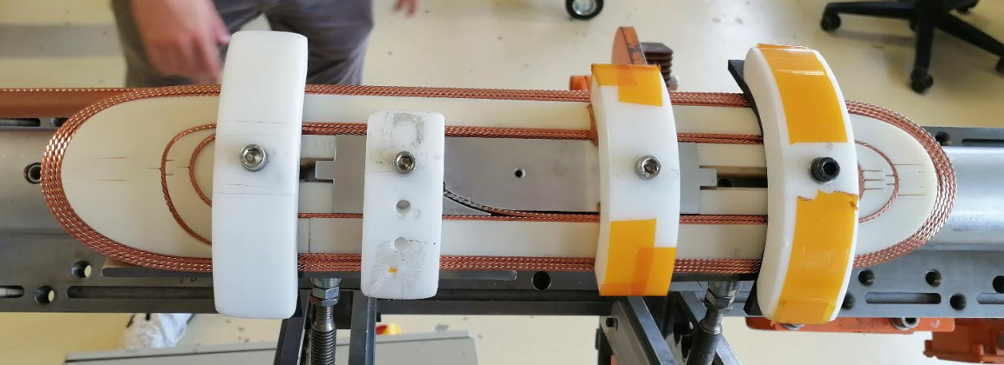
Winding trials at ASG, CERN
Dummy winding trial should focus on check of pop outs, gaps ( to mandrel, to spacers) cumulative alignment of conductors in blocks to improve last observed results by INFN. CERN will perform Cu dummy trial on same end spacers. Important share of experience.
Set of 20 Falcon D spacers
Top view of inner layer INFN dummy trial (2022)

Slide 17
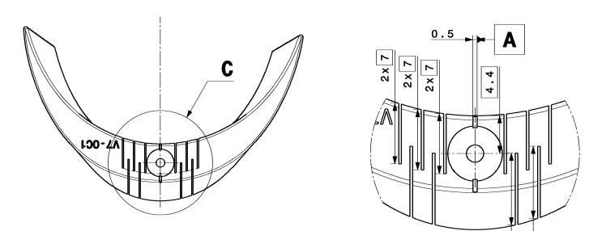
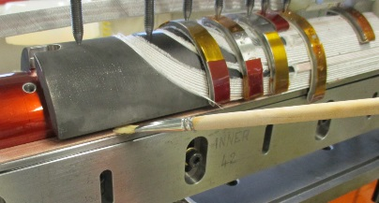
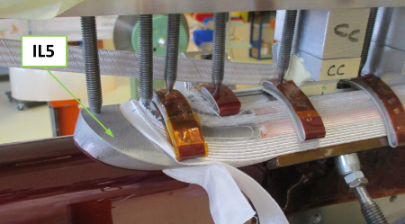
winding tool interface to spacers
Following spacers trials at ASG, to confirm slits, any feedback on improvement
Interface cones on spacers for pusher tooling, to be confirmed
Example of 11T, QXF spacer interface surface

Slide 18
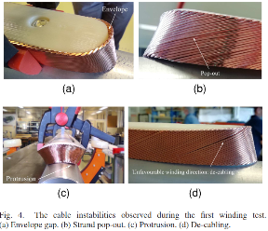
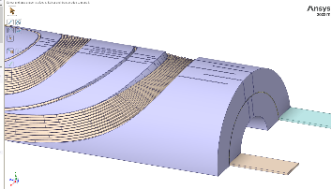
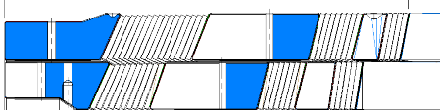
Open winding items
Well known instabilities observed on Falcon D cable and cumulative offset during first Cu dummy cable trial by INFN at CERN, to be further characterized.
Further winding parameters need optimisation per winding machine, ( ex: at ASG use rolling but not the yaw, with the spool rotating around the winding bench)
Expected radial envelop deviation of 4-5 mm of conductor block tip in coil heads wrt. envelop to be confirmed, filled for mechanical preload.
FalconD-I 3D coil view
QXF coil cut view, DWG M0223, maximum gap of 2 mm

Slide 19
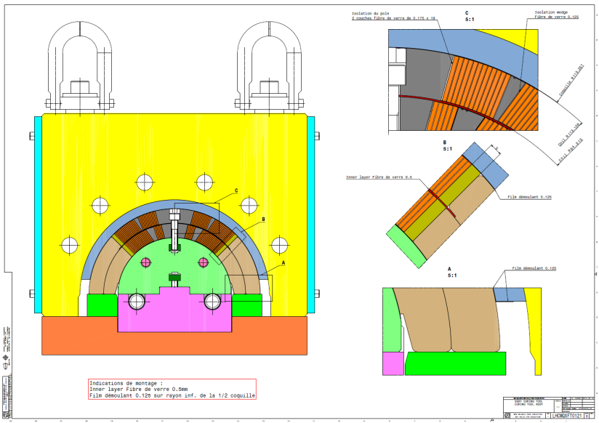
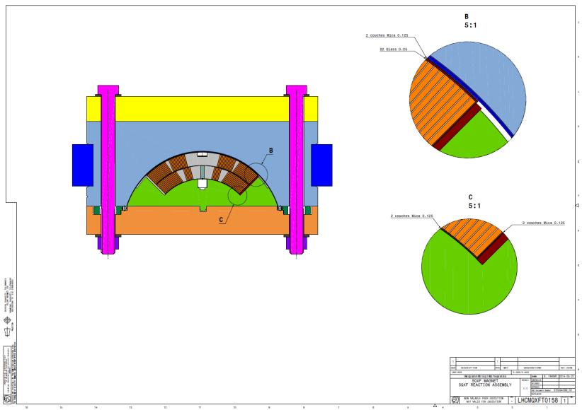
Tooling design
Cable dimension after reaction and 150 μm thick insulation
Coil cured in larger cavity ( see QXF example)
  Mica layer , S2 glass on outer radius
Coil closed in reaction fixture in larger cavity
Coil after reaction and during impregnation in nominal cavity
  Theoretical pressure ~5 MPa

Slide 20
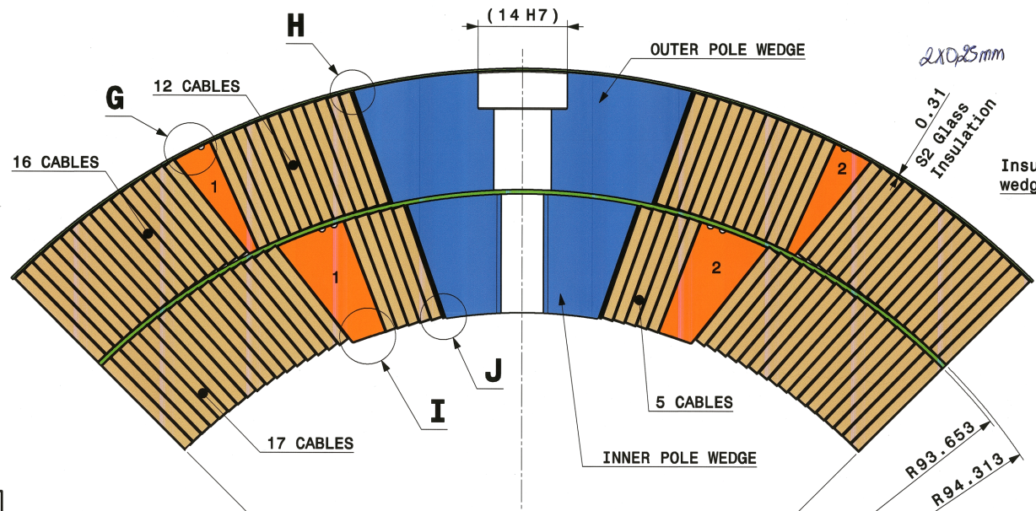
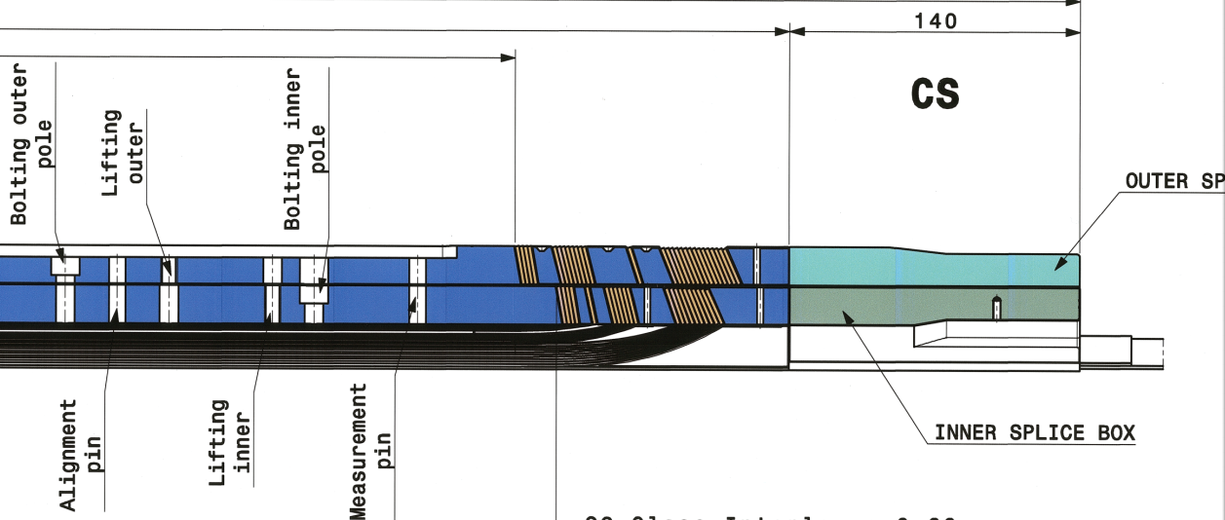
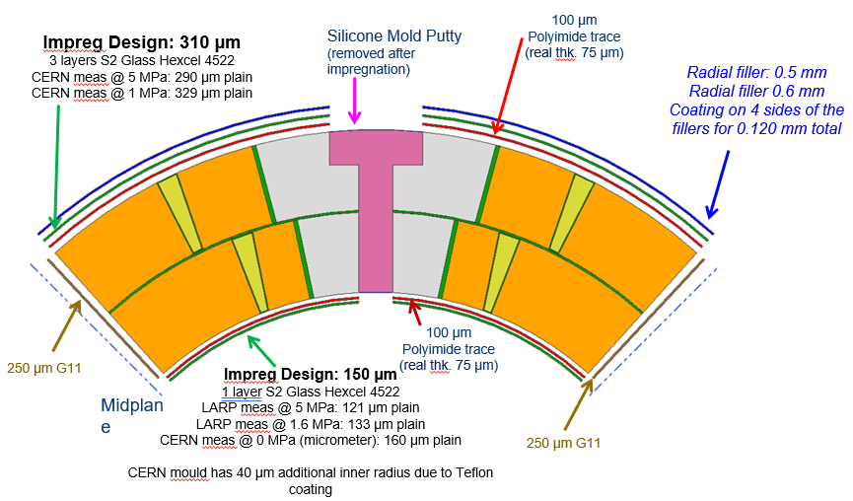
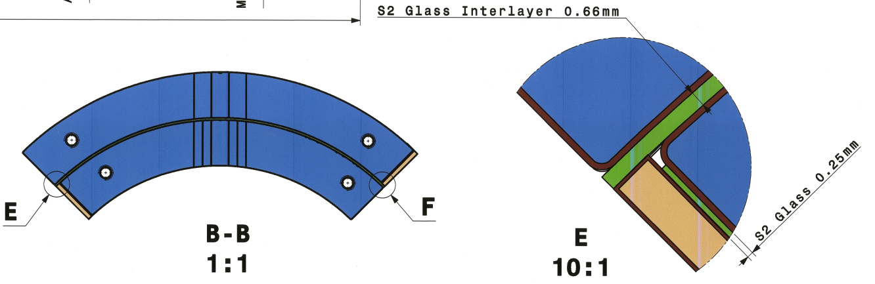
Detail coil geometry drawing ( QXFMO223)

Slide 21
11T Coil vs impregnation cavity – Impregnated QH
Outside radius of the coil = 60.899 mm / 60.787 mm (target of 60.800 mm on drawing)
Radius of the impregnation cavity (form block) = 60.845 mm / 60.945 mm
Radius of the impregnation mandrel = 29.885 mm / 29.823 mm
Radial compression of 0.054 mm / looseness of -0.158 mm
“Long coils vs short coils”
Coil as per drawing LHCMBH_C00005 (long)
Long / Short | I. Radius [mm] | I. Wrap Glass fiber tissue [mm] | Cable insul. @ 5 MPa [mm] | Reacted cable height [mm] | Cable insul. @ 5 MPa [mm] | Interlayer [mm] | Cable insul. @ 5 MPa [mm] | Reacted cable height [mm] | Cable insul. @ 5 MPa [mm] | Quenchheater [mm] | O. Wrap Glass fiber tissue [mm] | O. Radius [mm]
Long | 29.885 | 0.150 | 0.105 | 14.847 | 0.105 | 0.500 | 0.105 | 14.847 | 0.105 | 0.100 | 0.150 | 60.899
Short | 29.823 | 0.150 | 0.105 | 14.847 | 0.105 | 0.500 | 0.105 | 14.847 | 0.105 | 0.100 | 0.100 | 60.787
11st October 2024
FalconD collaboration meeting TE-MSC-SMT - AFoussat

Slide 22
11T Coil vs impregnation cavity – External QH
Outside radius of the coil = 60.709 mm / 60.647 mm
Radius of the impregnation cavity = 60.845 mm / 60.945 mm
Radius of the impregnation mandrel = 29.885 mm / 28.823 mm
The above implies a radial looseness of -0.136 mm / -0.298 mm
We can reduce the radial size of the cavity. This can be done by adding a thin metallic strip of 0.150 mm thickness (0.150 to 0.300 mm for the short coils to be discussed) between the seal
foil and the form blocks >>> 60.695 mm (60.795 mm if 0.150 mm
is used)
Long / Short | I. Radius [mm] | I. Wrap Glass fiber tissue [mm] | Cable insul. @ 5 MPa [mm] | Reacted cable height [mm] | Cable insul. @ 5 MPa [mm] | Interlayer [mm] | Cable insul. @ 5 MPa [mm] | Reacted cable height [mm] | Cable insul. @ 5 MPa [mm] | Quenchheater [mm] | O. Wrap Glass fiber tissue [mm] | O. Radius [mm]
Long | 29.885 | 0.150 | 0.105 | 14.847 | 0.105 | 0.500 | 0.105 | 14.847 | 0.105 | 0 | 0.060 | 60.709
Short | 29.823 | 0.150 | 0.105 | 14.847 | 0.105 | 0.500 | 0.105 | 14.847 | 0.105 | 0 | 0.060 | 60.647
11st October 2024
FalconD collaboration meeting TE-MSC-SMT - AFoussat

Slide 23
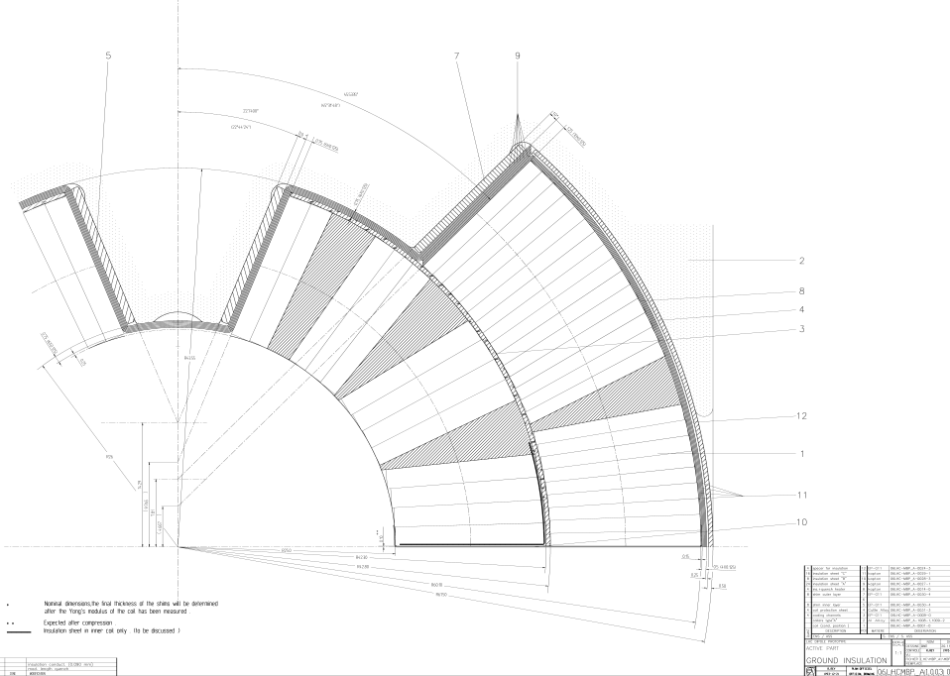
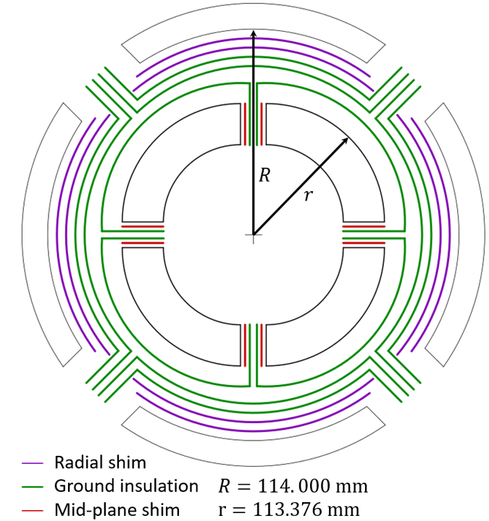
Ground insulation schemes
The off-set Falcon D pole layers is similar to LHC dipole
  If detachable poles option ( impregnated or not), possibly on Falcon D CERN coils the GI sheet could be following QXF layout design
  If non-detachable poles option like Falcon INFN, the GI sheet could be following LHC layout design, with impregnated load plate (11T type)
Detachable 11T pole,impregnated load plates on coil side
Attached LHC pole GI layer individual, load plates on collar side
QXF detachable pole GI layer individual

Slide 24
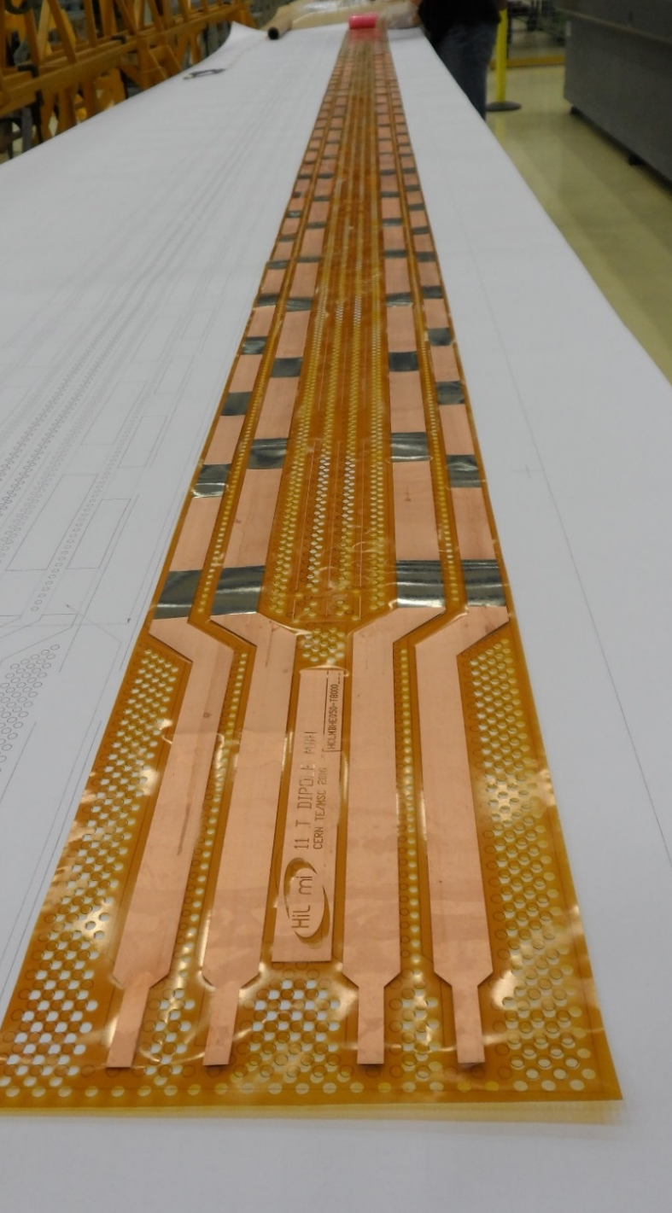
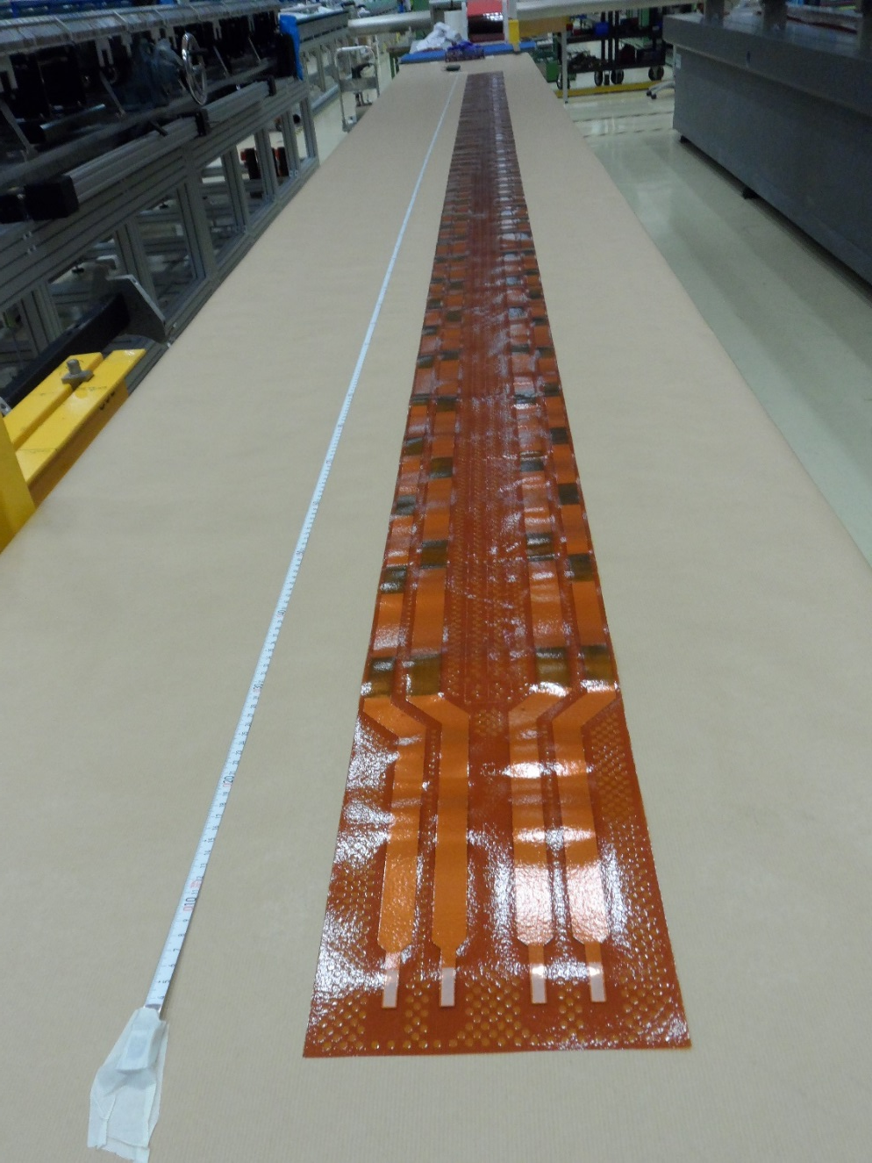
Dipole quench heaters on PCBs integration
Although Falcon D short model do not require quench protection heaters, the design integration should consider it, at least as placeholder in drawing of impregnated coil or assembly aperture insulation drawing.
- The question of instrumentation through impregnated trace to be decided.
- Management of exit soldered connections in end saddles
QH Information note:
Flexible heater circuits are commonly encapsulated with a polyimide coverlay (like for instance the LHC quench heaters).
In last 11 T dipole quench heaters, a coverlay (Krempel AKAFLEX KDF 0 50 25 - 50 µm polyimide + 25 µm) glue is systematically applied at CERN PCB lab with a static laminator.
11 T dipole heater without coverlay
11 T dipole heater with coverlay
11st October 2024
FalconD collaboration meeting TE-MSC-SMT - AFoussat

Slide 25
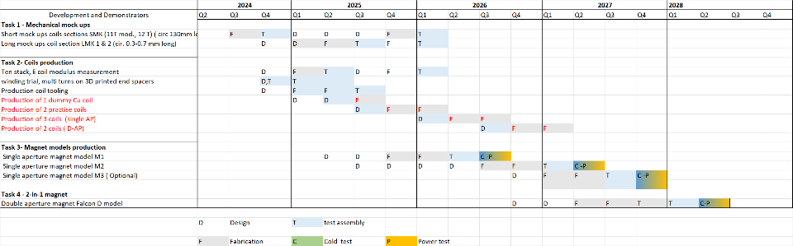
Overview schedule
Update schedule of CERN WP3.1 FALCOND-C subtasks on coils and dipole models production
Notes:
Gantt chart of the overall Falcon D project which foresees the 3 models from end 2026 to mid 2028. readiness of tooling is on critical path which should be anticipated thanks to strong collaboration with INFN ASG partners who developed and procured from initial CERN tooling concepts most fhe fabrication tools.

Slide 26
WP3.1 cable production need
 |  | Delivery dates
 |  | Bare conductor for insulation | Insulated cable to CERN
1 Dummy Cu cable |  | March 2025 | May 2025
2 units ( practise) |  | Sept-25 | Oct-25
3 units |  | Janv-26 | Mars-26
2 units |  | Jun 2026 | Sept-26
    Note: Start of first dummy coil WP3.2 winding at ASG on FALCON D-I from Oct.24

Slide 27
WP3.1 CERN coils production schedule
Start of production equipment procurement | Nov’ 2024 – June 25
Dummy winding trial tests | Oct’ 24 - Mar 25
1st dummy pole * | June 2025
2 practice coils | Nov 25 - Mar’ 26
2 aperture coils | Apr’ 26 - Aug’ 26
3 aperture coils | Nov’26 - Mar’27
    * Start of first dummy pole WP3.2 winding at ASG from 10.24

Slide 28
Drawings CDD equipment code
FALCON-D equipment codes CRNMHFD_ create for bot CERN and INFN manufacture drawings management’
Equipment code | CAD topic
CRNMHFDA | CERN Coil components & Assembly for High Field 12T Dipole Short model (HFM - Falcon D).
CRNMHFDB | INFN Coil components & Assembly for High Field 12T Dipole Short model (HFM - Falcon D).
CRNMHFDAM | CERN Magnet components & Assembly for High Field 12T Dipole Short model (HFM - Falcon D).
CRNMHFDBM | INFN Magnet components & Assembly for High Field 12T Dipole Short model (HFM - Falcon D).
CRNMHFDMK | Mock-ups for High Field 12T Dipole Short model (HFM - Falcon D).
CRNMHFDTA | CERN Tooling for High Field 12T Dipole Short model (HFM - Falcon D).
CRNMHFDTB | INFN Tooling for High Field 12T Dipole Short model (HFM - Falcon D).

Slide 29
Summary
Mutualization of WP3.1 (CERN) and WP3.2 (INFN) FalconD 12T dipole coils designs following last HFM steering board,
Falcon D WP3.1 investigates few structure variants, to provide benchmarked inputs for single design optimization towards 2-in-1 magnet.
  Start of mechanical design of structure mock ups variants and specific parameters impacts structural study.
  Falcon D structure baseline based on B&K from proven QXF technology
Next winding trials at ASG and CERN shall provide key outcome to confirm cable behavior and need for some optimization
Updated schedule with procurement plan from 2025 for 12T coils Falcon D WP3.1 manufacture scope (dummy, 2p + 5 coils) with structure.
Active collaboration on FALCOND coil tooling CAD models exchange, commissioning and troubleshooting.

Slide 30
References
2023 TE-MSC Strategy & Implementation Update for High Field Magnet (HFM) Part 1: LTS, EDMS 2816918 3-0
12 T VE Preliminary Design Review report , July 5, 2023, CERN : https://indico.cern.ch/event/1294868/
12-14T cos theta HFM WP3.1 Working indico directory: //indico.cern.ch/category/15243/
Technical Design Report of the FalconD Nb3Sn Cos-Theta Dipole Model for the FCC-hh at CERN, INFN/Code-19/001, Indico1086175
2024 update HFM program structure. https://hfm.web.cern.ch/
INFN CERN collaboration ADDENDUM FCC-GOV-CC-CC-0004/17.10.2014 (KE4102/FCC) : Design and manufacturing of a single-aperture, 12 T short model superconducting Nb3Sn dipole magnet, designed and assembled according to the bladder-and-key technology
Publications:
R. Valente et al., Status on the Development of the NbSn 12 T Falcon Dipole for the FCC-hh, IEEE trans. Appl. Supercond., 34 (3), 2024
R. Valente et al., Optimization of Electromagnetic Design After Winding Tests for the Nb3Sn Cos-Theta Dipole Model for FCC-hh, IEEE trans. Appl. Supercond., 33 (5), 2023
F. Levi et al., Updates on the Mechanical Design of FalconD, a Nb3Sn Cosθ Short Model Dipole for FCC-hh, IEEE trans. Appl. Supercond., 33 (5), 2023
A. Pampaloni et al., Mechanical Design of FalconD, a Nb3Sn Cosθ Short Model Dipole for the FCC, IEEE trans. Appl. Supercond., 32 (6), 2022
A. Pampaloni et al., Preliminary Design of the Nb3Sn cosθ Short Model for the FCC, IEEE trans. Appl. Supercond., 31 (5), 2021

Slide 31
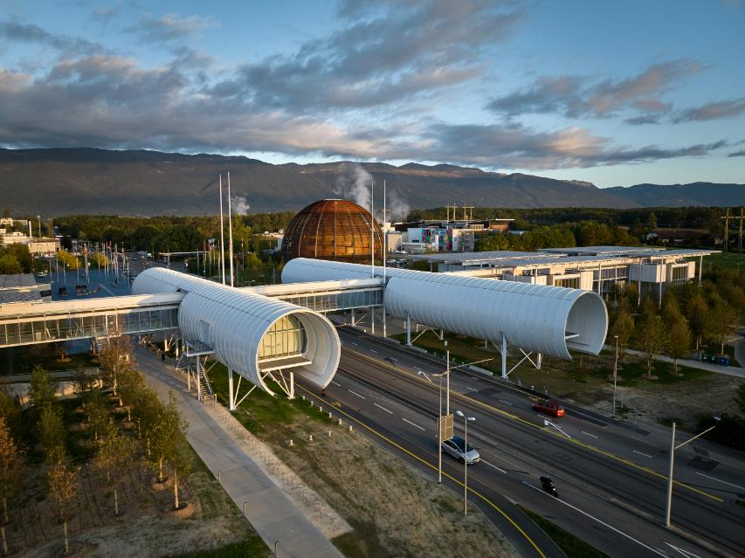


Thank you for your attention

Slide 32
Detail of 11T ground insulation

