Slide 1

FALCOND_C MAGNET
WINDING, REACTION and IMPREGNATION TOOLING
PRELIMINARY DESIGN
ASG visit
Luca Gentini, Arnaud Foussat, Paul Schneider
2024-10-11

Slide 2

Base line changes
Today, CERN has just a concept based on the MQXF (Nb3Sn) cable.
It must be adapted to the FALCOND coil design.
OLD BASE LINE (2023)
MQXF Nb3Sn cable
Layers impregnated independently.
Same tool for both layers, changing as few parts as possible.
  Internal splice between the layers.
L= 1 m.
Poles can be impregnated with the coil or not.
NEW BASE LINE
FALCOND Nb3Sn cable.
Inner and outer layers impregnated at the same time.
  No internal splice between the layers.
L= 1.5 m.
Poles can be impregnated with the coil or not.

Slide 3
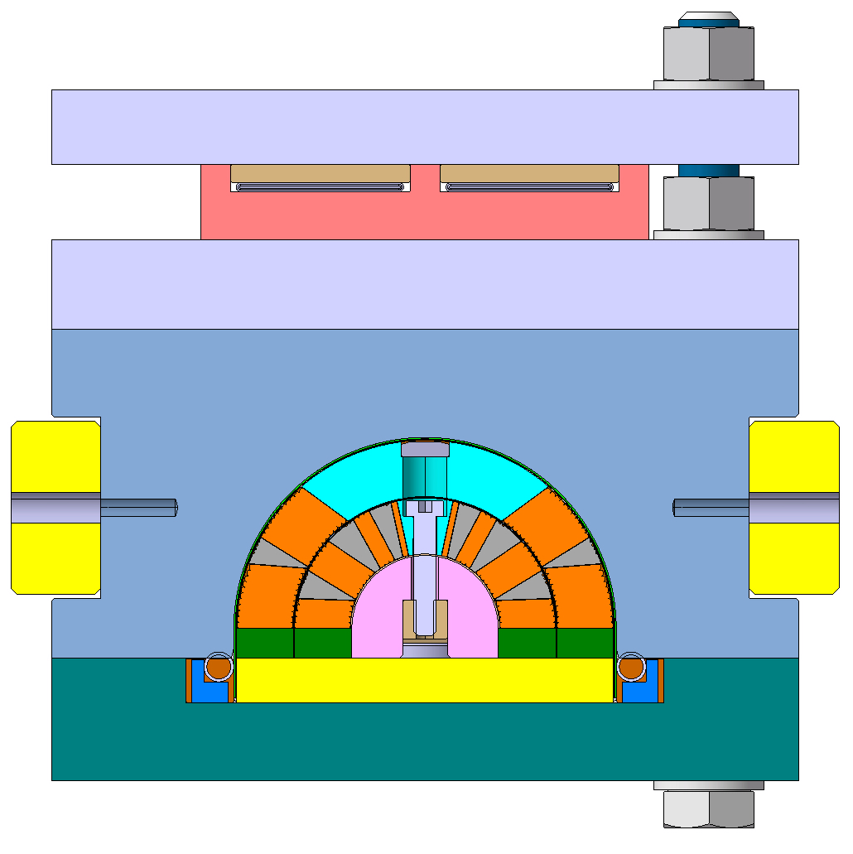
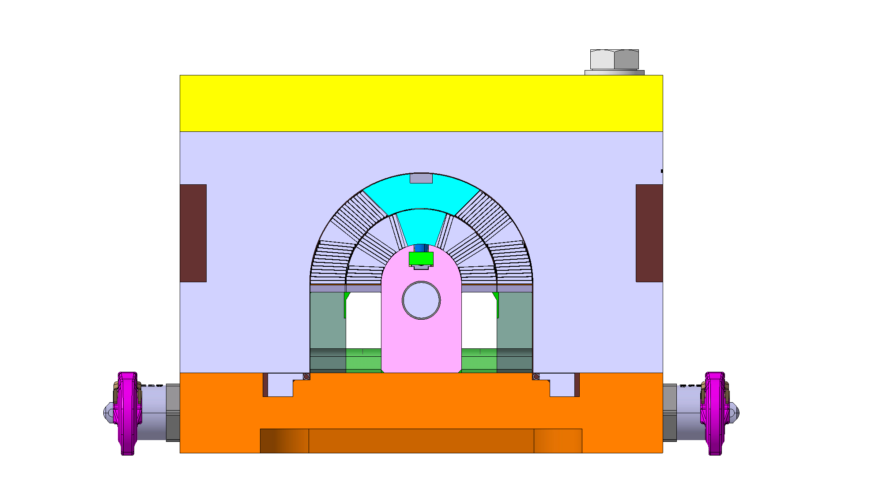
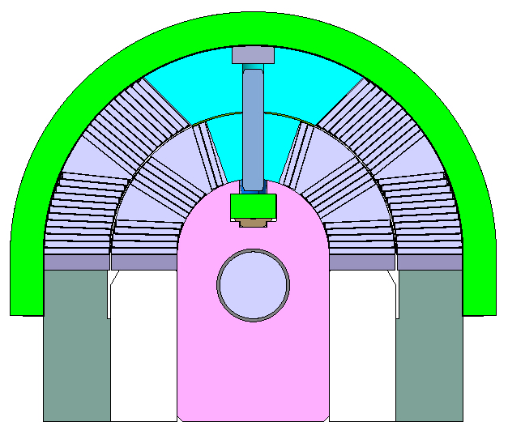
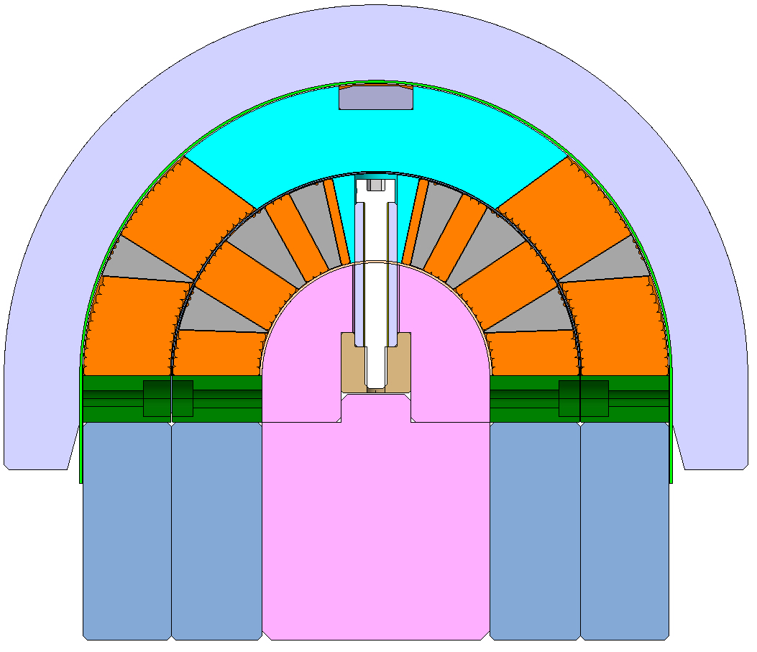
Differences between falcond and cern designs
FALCOND tooling (2022)
CERN tooling design
Link: CERN Internal review of the 11T reaction fixture and impregnation mould
Blocks
Intermediate plate
The winding mandrel is split in two parts.
Reduction of the weigh of the blocks.
Possibility to change just the upper part of the mandrel to do the outer layer independently.
Intermediate plate
Possibility to change just the plate to fix inner and outer mandrel.
Interfaces for internal splice
Integration of all cable supports during the process.
Integration of covers during the impregnation.
Integration of tooling for tinning and brazing.

Slide 4
Changes current concept
CERN new design will be adapted to the new base line, using the INFN design as reference.
Remove the intermediate plate.
  No necessary to impregnate the inner layer independently.
No more supports needed for the inner splice.
  Base plate and blocks easier.
Same mandrel
  Reduce the mass of the blocks
Intermediate plate

Slide 5
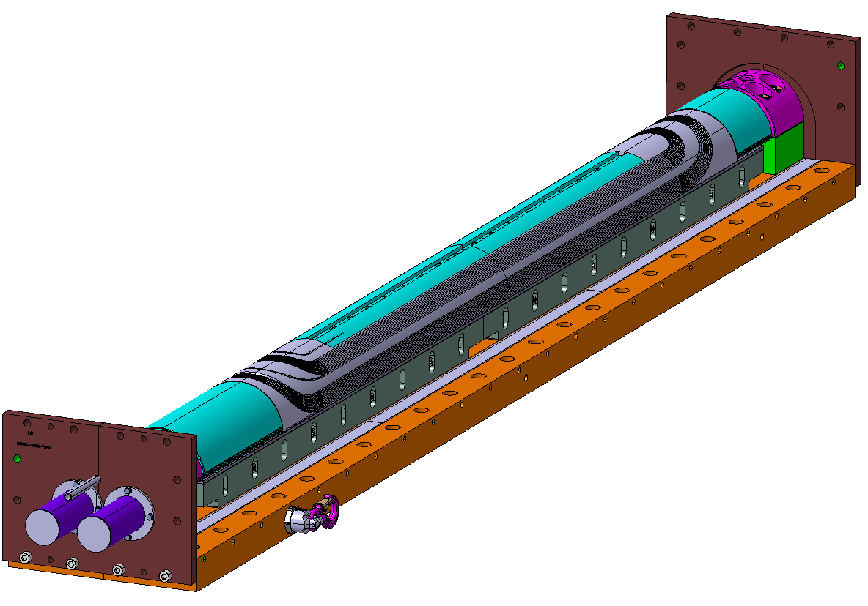
Current cern’s activities
CERN’s DO is available to start the design of the common tool for winding, reaction and impregnation.
Before starting, a conceptual internal review of the INFN tooling should be done.
Models from INFN / ASG (Native Catia, or STEP)
Drawings (PDF)

Slide 6
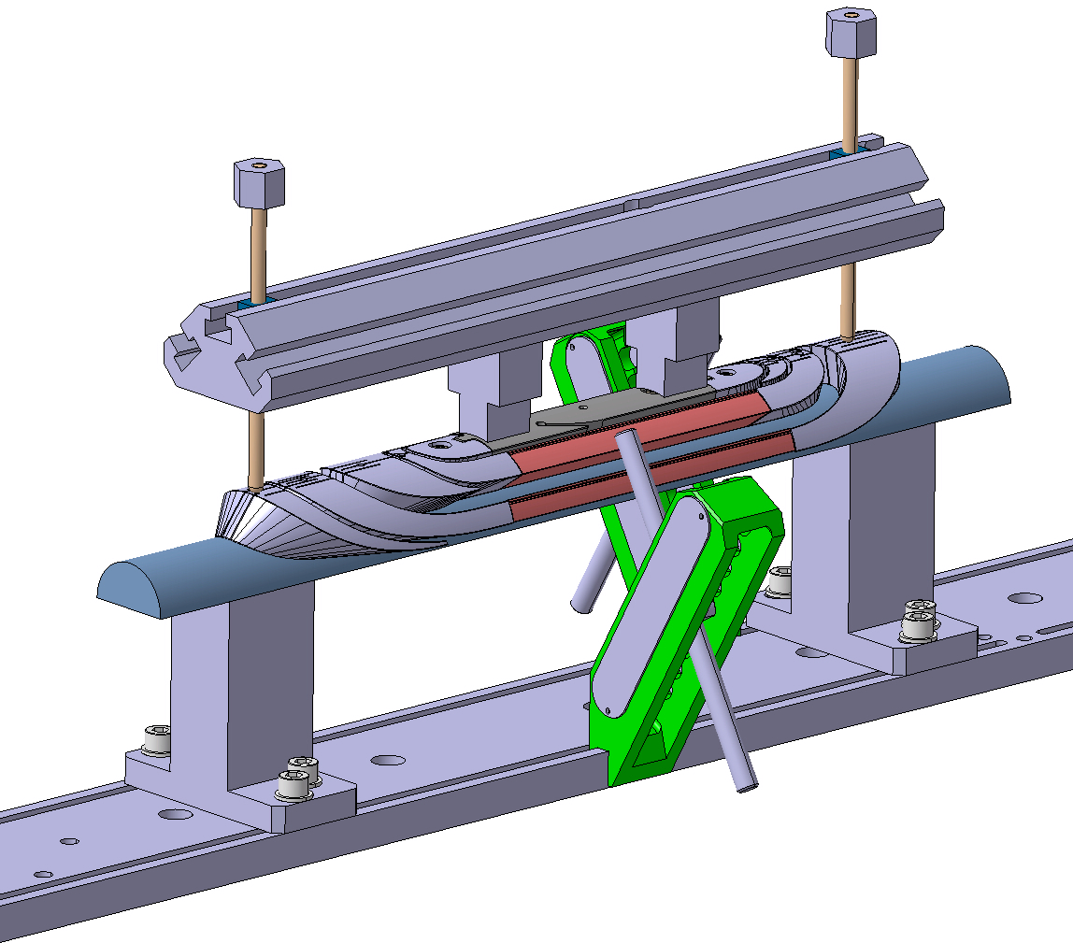
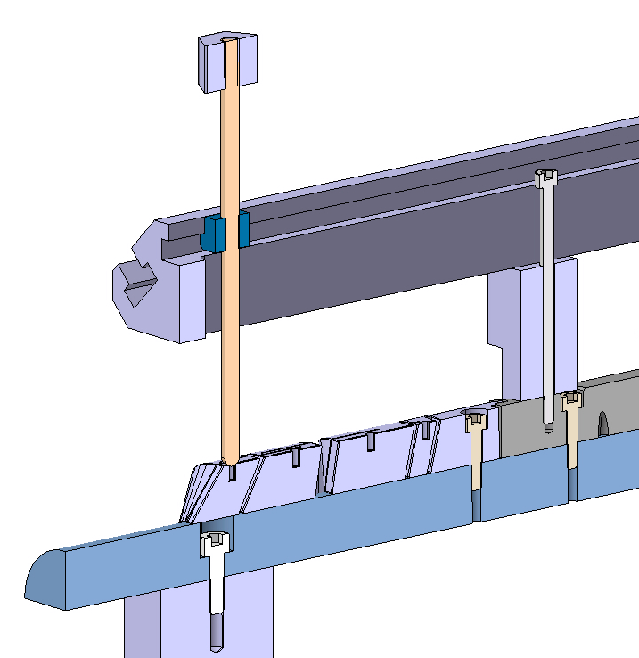
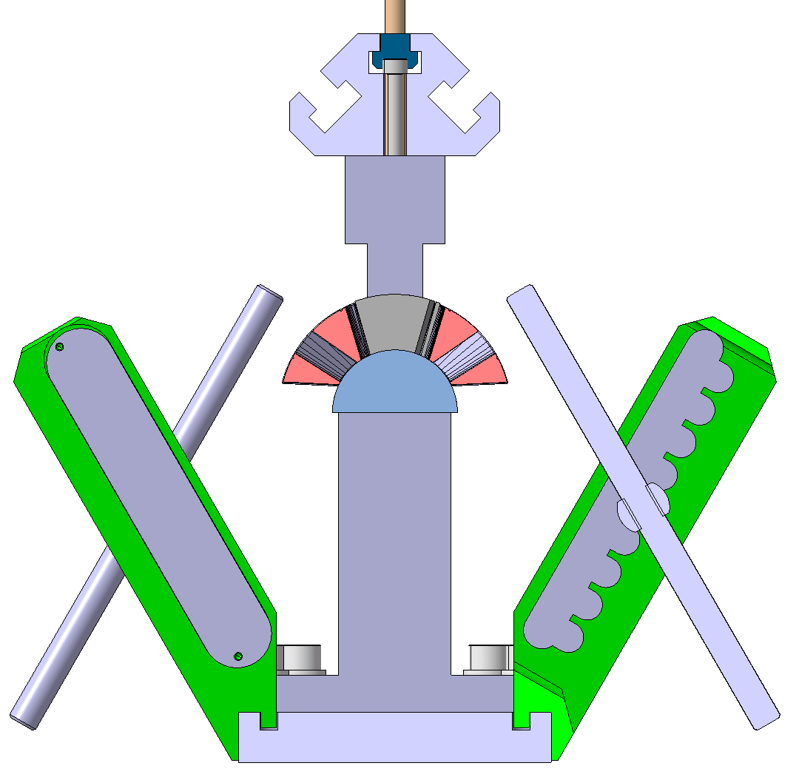
Winding test tooling
This equipment is used to perform bending tests on the FALCOND cable across all layers.
The head spacers and the short wedges are realised in additive manufacturing (ACURA, etc…)
Lateral pushers are used layer by layer to keep the cable under pressure and keep in position the wedges.
The head spacers can slide on the mandrel, and they are kept in the final position with some vertical roads.
Vertical road
3DP Head spacers
Mandrel
3DP wedges
Lateral pushers

Slide 7
Thank you for your attention

Slide 8
Planning overview
The detailed design can start immediately.
INFN should provide to CERN models (step) and drawings (pdf) of the FALCOND tooling to use the same concept which will be update to cope with the existing winding machine.
 |  | 2024 |  |  |  | 2025 |  |  |  |  |  |  |  |  |  |  |  | 2026
 |  | 9 | 10 | 11 | 12 | 1 | 2 | 3 | 4 | 5 | 6 | 7 | 8 | 9 | 10 | 11 | 12 | 1 | 2 | 3 | 4 | 5
COIL TOOLING: Winding, curing, reaction, impregnation | Design
 | Market survey
 | Procurement
 | Delivery
MAGNET TOOLING: Assembly tooling aperture, pads, yoking, … | Design
 | Market survey
 | Procurement
 | Delivery

