Slide 1

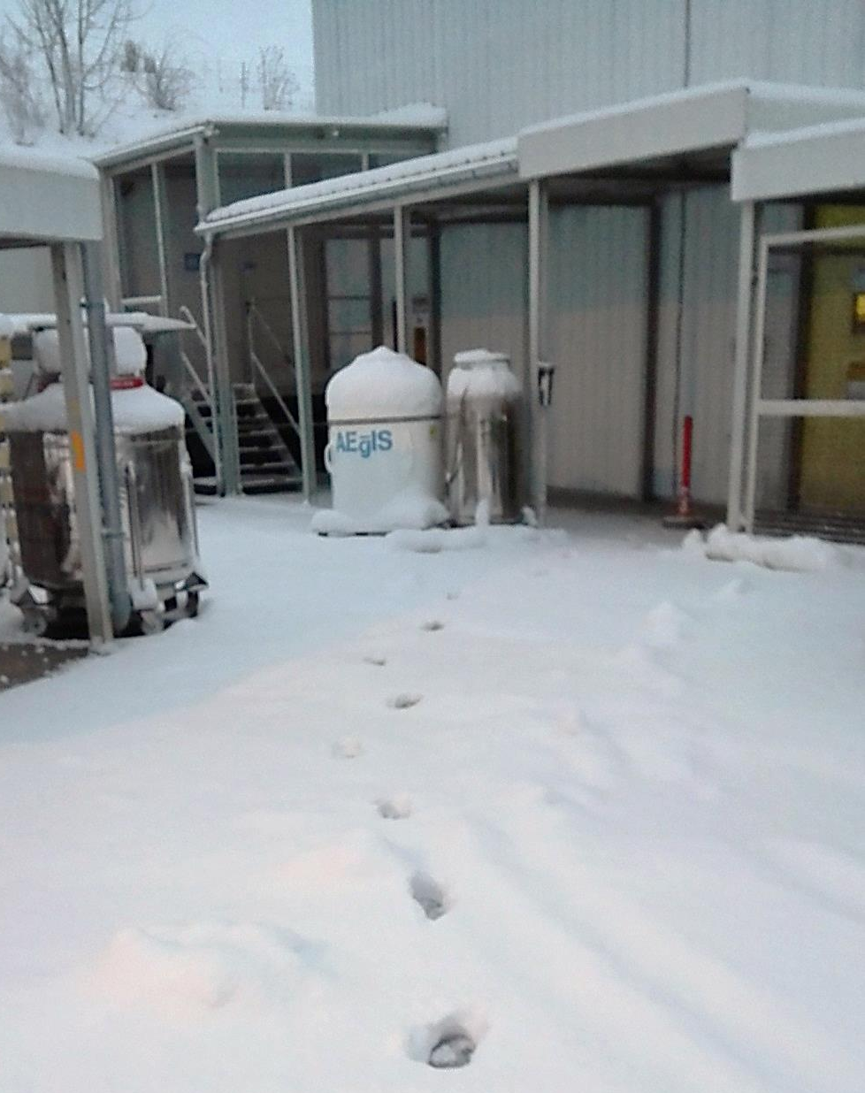

Welcome and Introduction
R. Caravita*
*INFN – TIFPA, Trento (IT)

Slide 2
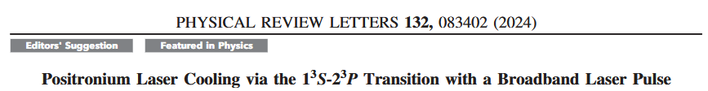
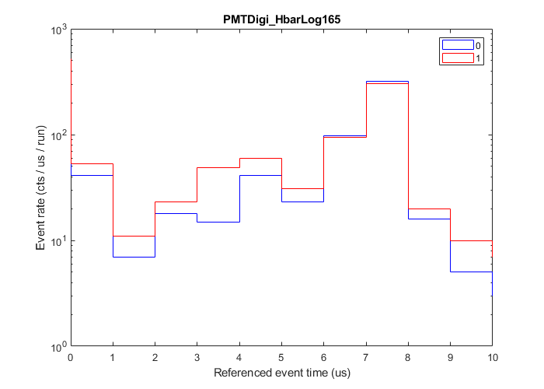
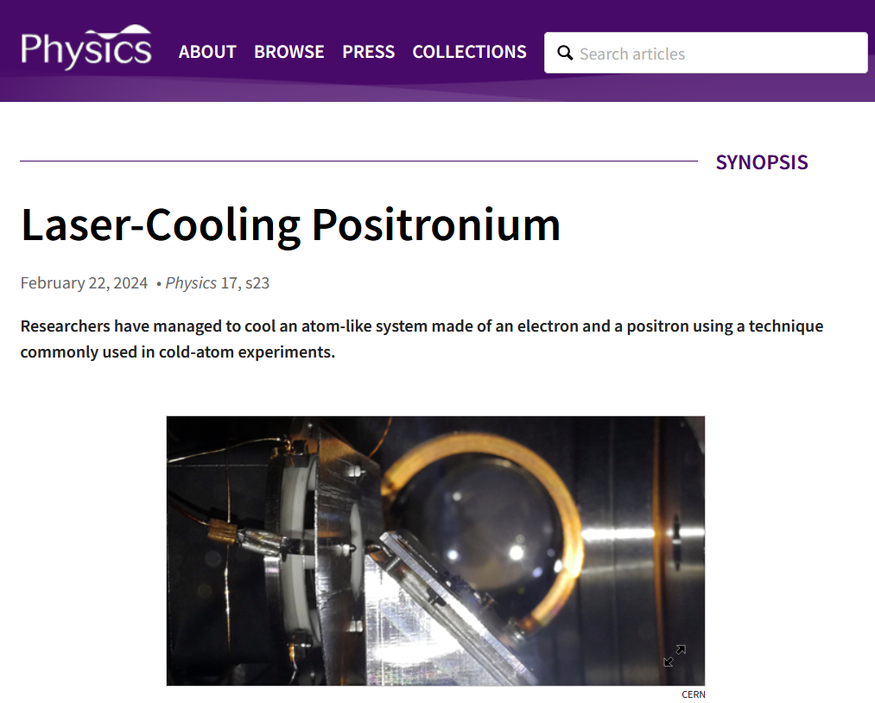

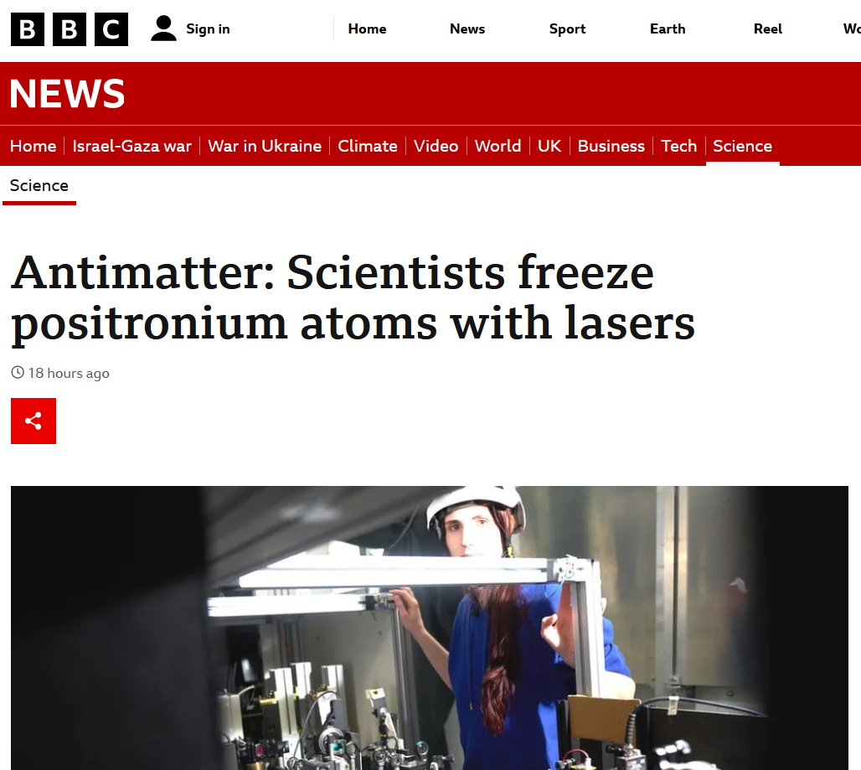

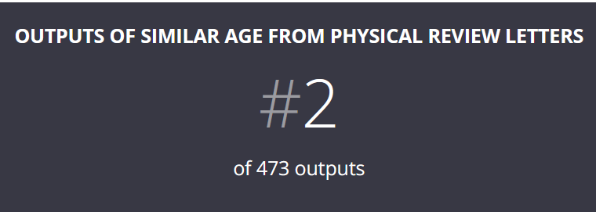
The most rewarding year so far

Slide 3
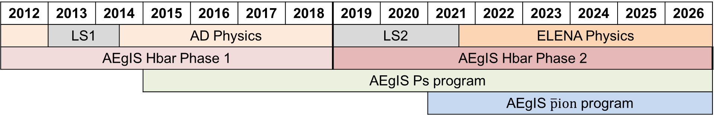
Status of the physics programs as of today
CERN ☺
AEgIS Physics timeline
2012 | 2013 | 2014 |  | 2015 | 2016 | 2017 | 2018 | 2019 | 2020 | 2021 |  | 2022 | 2023 | 2024 | 2025 | 2026
 | LS1 |  | AD Physics |  |  |  |  | LS2 |  |  | ELENA Physics
AEgIS Hbar Phase 1 |  |  |  |  |  |  |  | AEgIS Hbar Phase 2
 |  |  |  | AEgIS Ps program
 |  |  |  |  |  |  |  |  |  | AEgIS $\overline{p}ion$ program
Talks on the status of the experiment: control system, positrons and lasers, analysis
External boundary conditions
Experiment is approved until LS3: mid-2026
Call for proposals to the SPSC to extend after-LS3 is due by 1° of May
Input to the European Strategy Group for the upcoming European Strategy by 31° of January

Slide 4
Collaboration meeting agenda
Goals for this collaboration meeting
Present and discuss results obtained up to now and structure publication strategy
Discuss and organize the preparation of the SPSC review, ESG input and Proposal
Identify the weakest points in the different areas of the program
Discuss the experimental schedule for 2025/2026
Discuss resources availability: manpower at CERN, schedule, financial boundaries
Agenda for this collaboration meeting
Status session (3, 5) today
Updates and results of the ongoing physics programs (1, 4) tomorrow all day
Experiments in preparation session (4) wednesday morning
Discussion session (main goal: converge on 2, 4) wednesday afternoon
Planning and decision session (main goal: converge on 4 and 5) thursday morning

