Slide 1
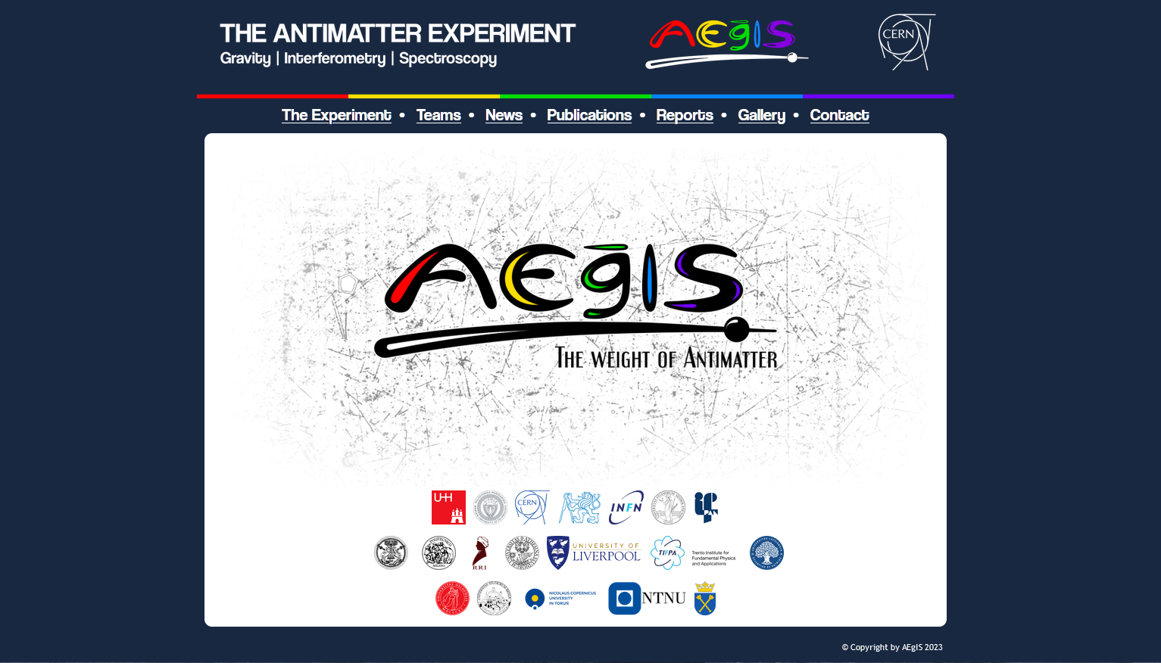
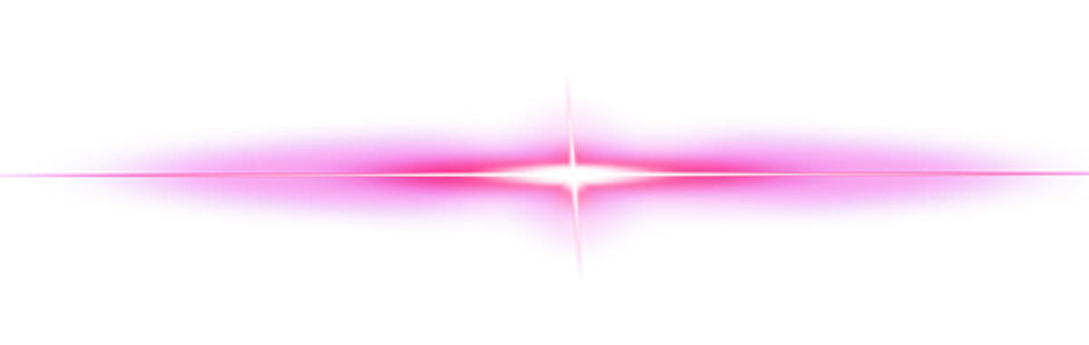
5 laser beams
100 million antiprotons
1 billion positrons
50 collaborators

Slide 2
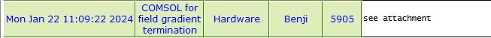
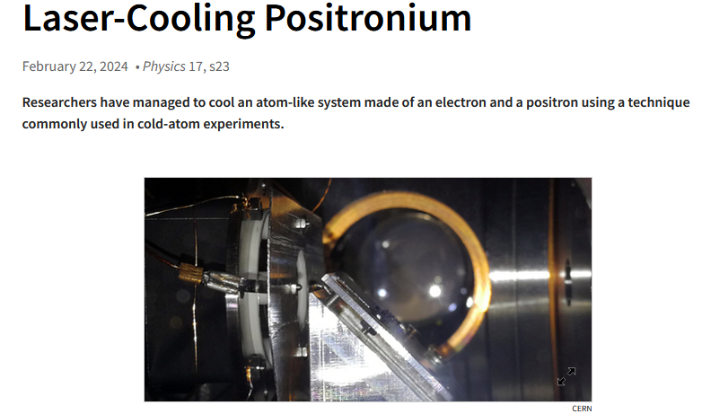
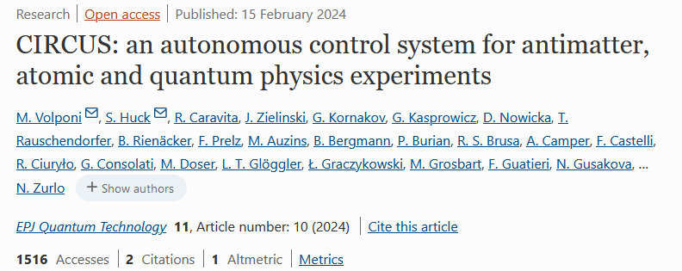
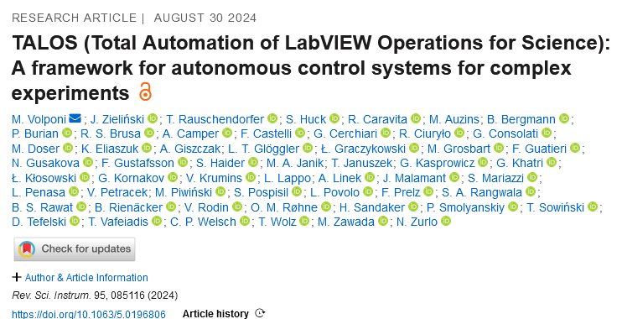
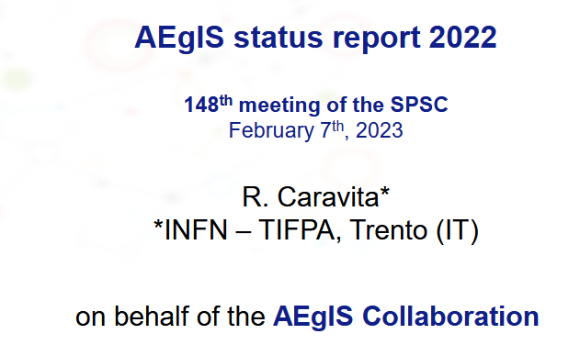
AEgIS 2024 – exciting beyond Rydberg levels
Jan-Feb: “Paper work”

Slide 3
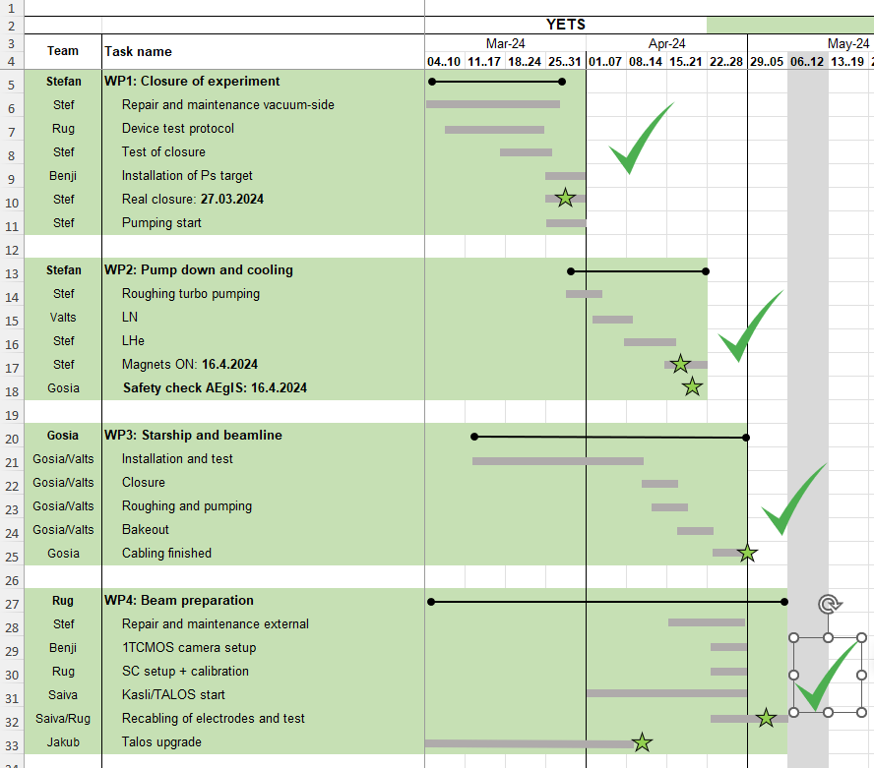
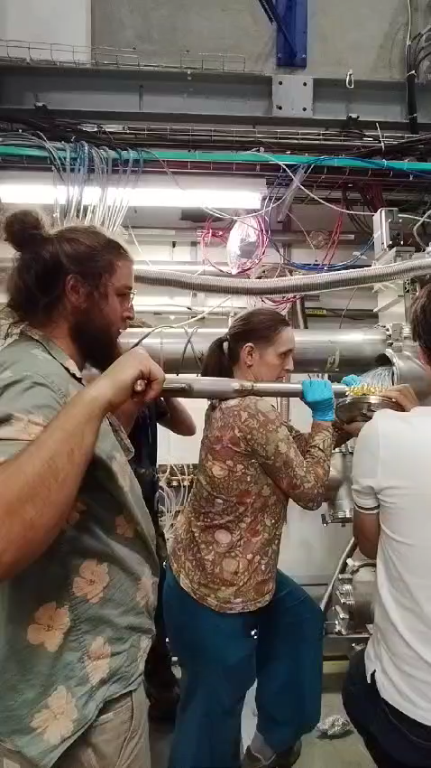
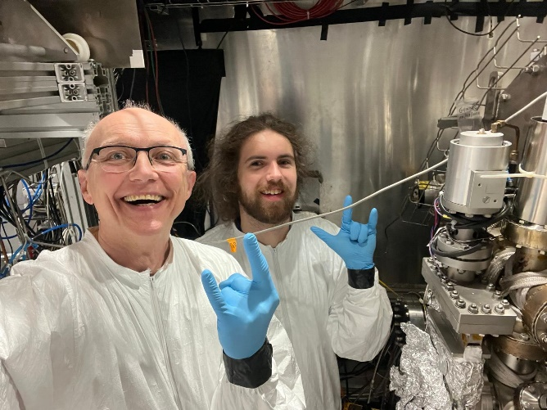
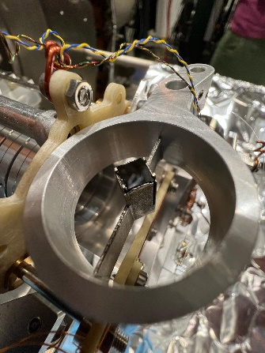
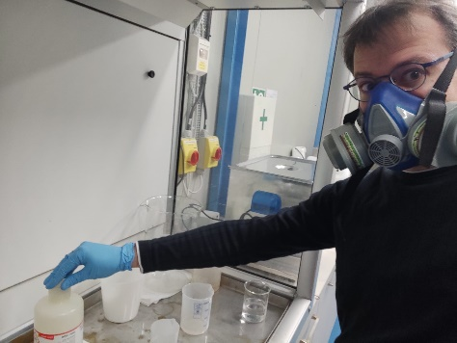
AEgIS 2024 – exciting beyond Rydberg levels
Mar-Apr: “Start-up”

Slide 4
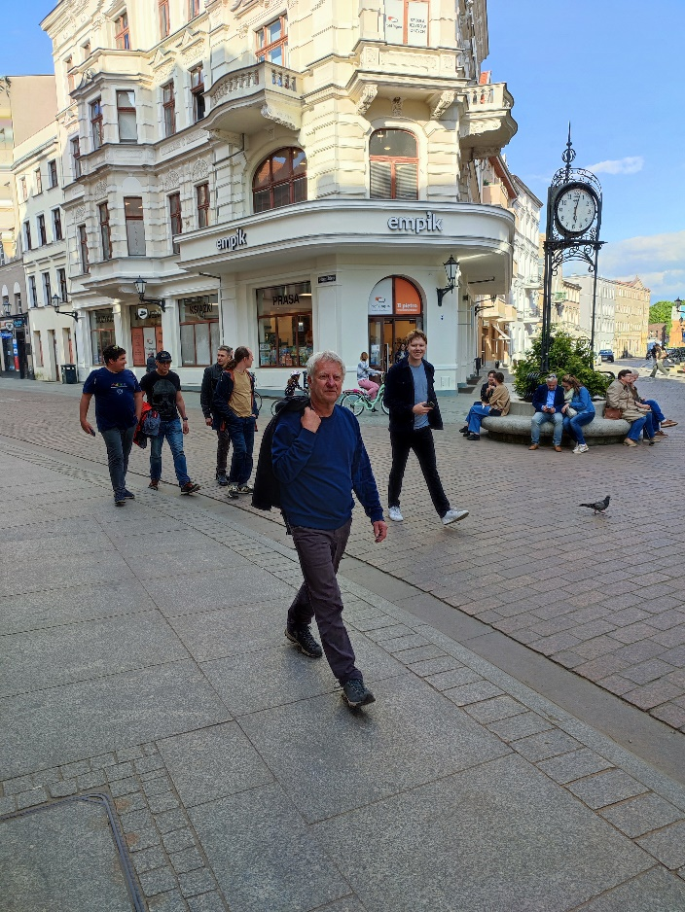
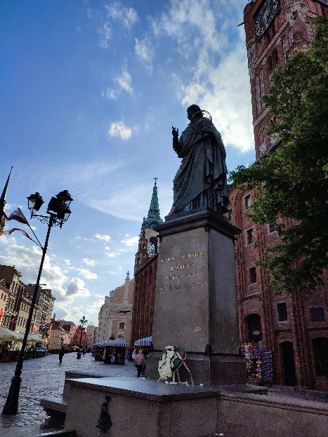
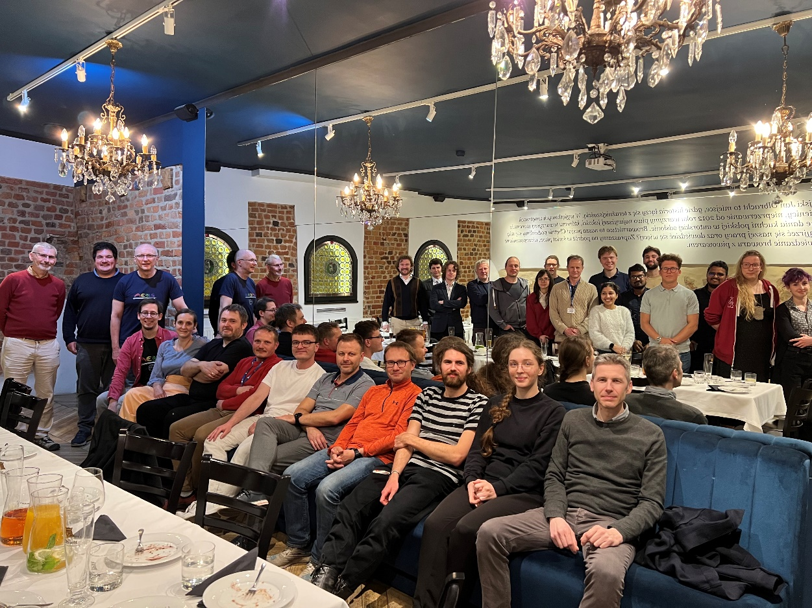
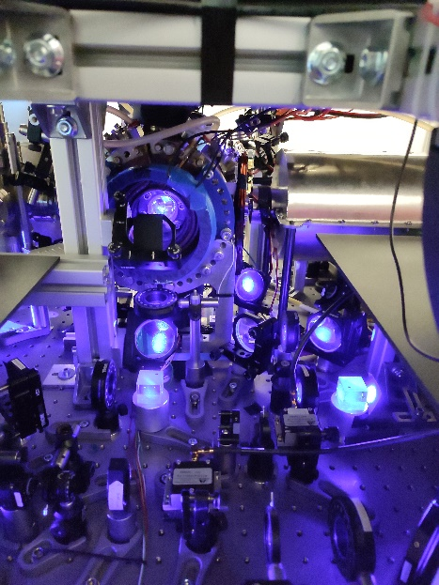
AEgIS 2024 – exciting beyond Rydberg levels
May: Torun Collaboration Meeting

Slide 5
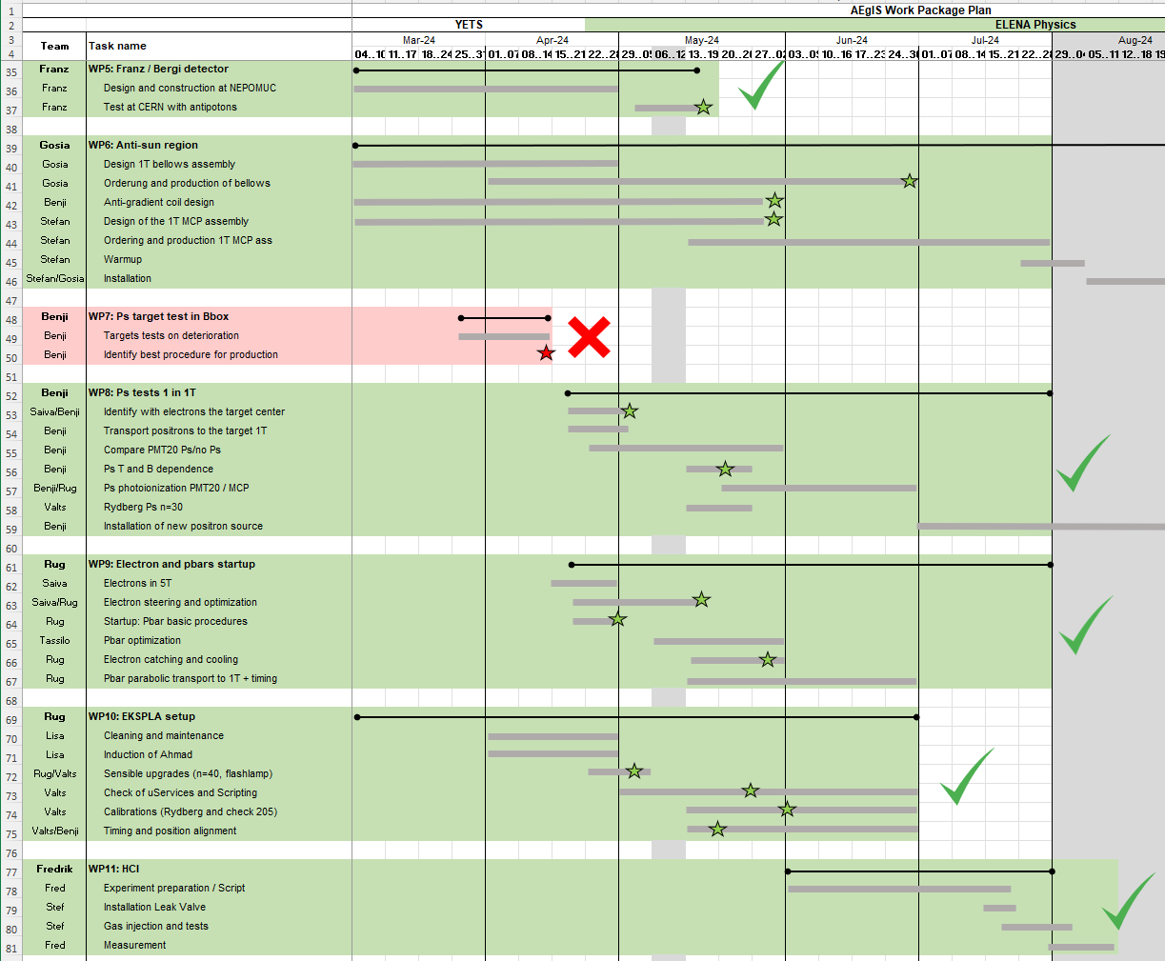
AEgIS 2024 – exciting beyond Rydberg levels
May-Aug: Block I
OPHANIM tests
Production of anti-sun region
Test Ps in the BBox
Test Ps in the 1T (0.2T)
Test Rydberg Ps
New positron source
Electron steering and tests
Laser calibration and tests
Pbar manipulations
Develop and test Hbar script
Highly-charged ion runs

Slide 6
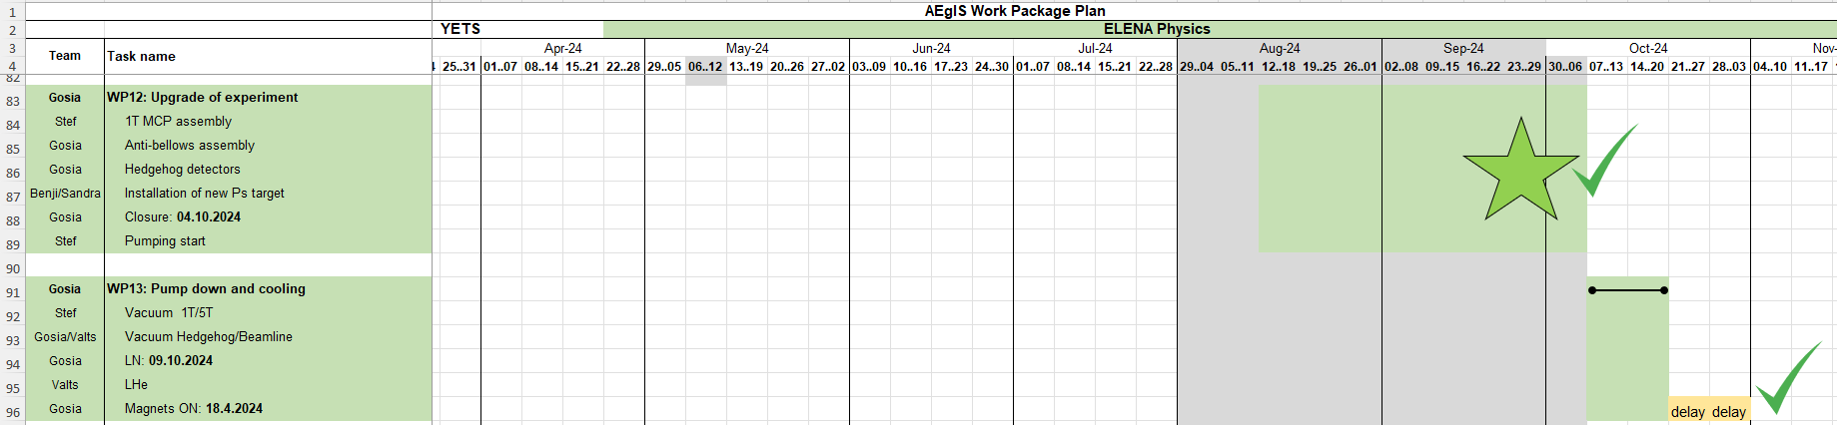
AEgIS 2024 – exciting beyond Rydberg levels
Aug-Oct: Upgrade
(Big thanks to all!!)
Installation of new 1T MCP
New anti-bellows assembly
New thermalization
New bake-out equipment
Hedgehog detectors
Starship setup for extraction
New Ps target
Fixing of minor problems
…

Slide 7
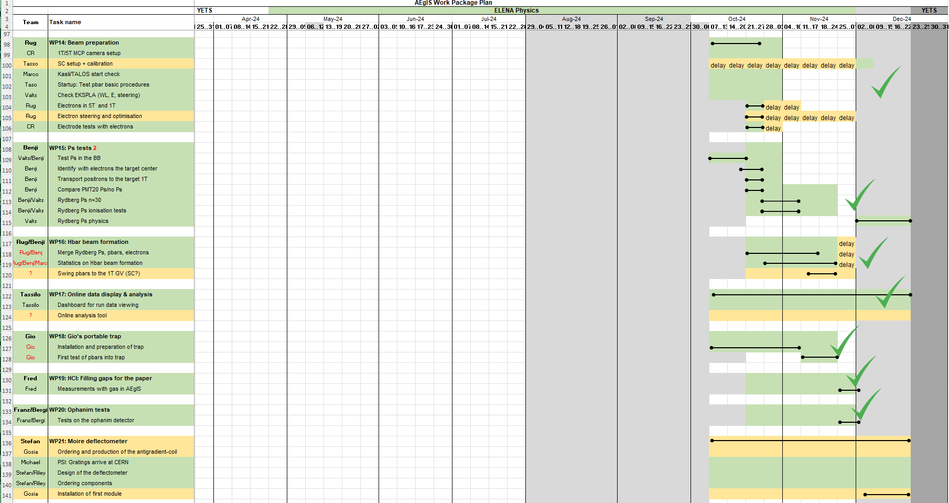
AEgIS 2024 – exciting beyond Rydberg levels
Oct-Dec: Block II
Rapid beam preparation
Fixing of 1000 little problems
(1T CMOS, electron steering …)
Ps tests in the BBox: 20% Ps!
Ps tests in 1T: 10% Ps
Rydberg Ps excitation & diagnostic
Antihydrogen production (Beam?)
Backwards extraction of pbars
HCI: improve understanding for paper
OPHANIM tests
Ps* spectroscopy for Valts PhD
Ps Doppler & Timing Scan in 1T
Laser and detector calibrations
Bonus: Ps tests at 0.2T

