Slide 1
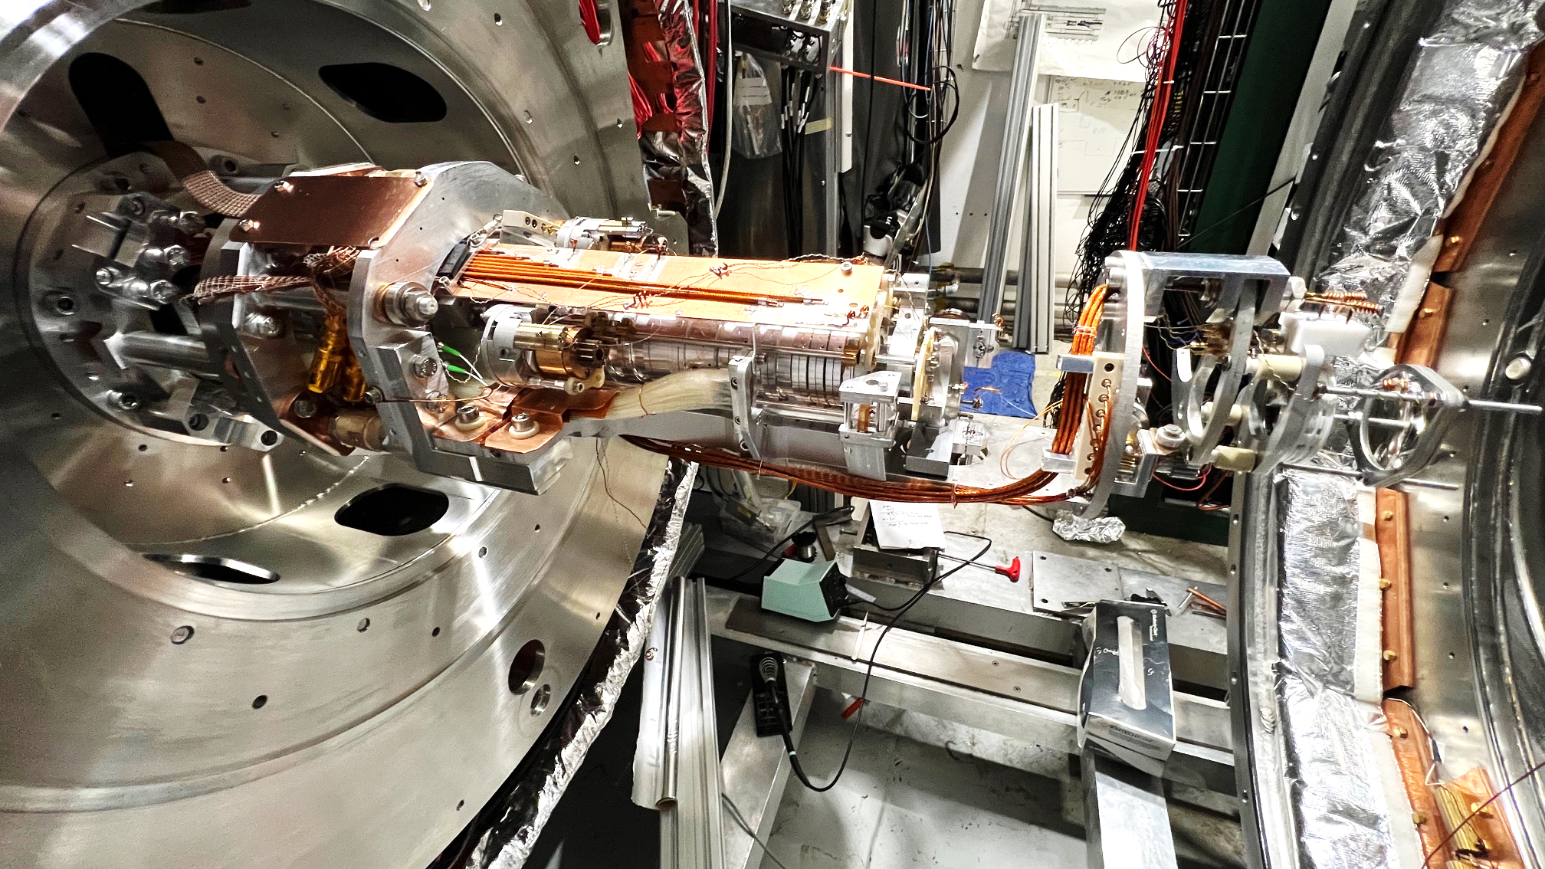
The great opening of 2024
Duration: mid-August to end of October

Slide 2
Content
1T bellows installation
Hedgehog detector system installation
New 1T MCP installation

Slide 3
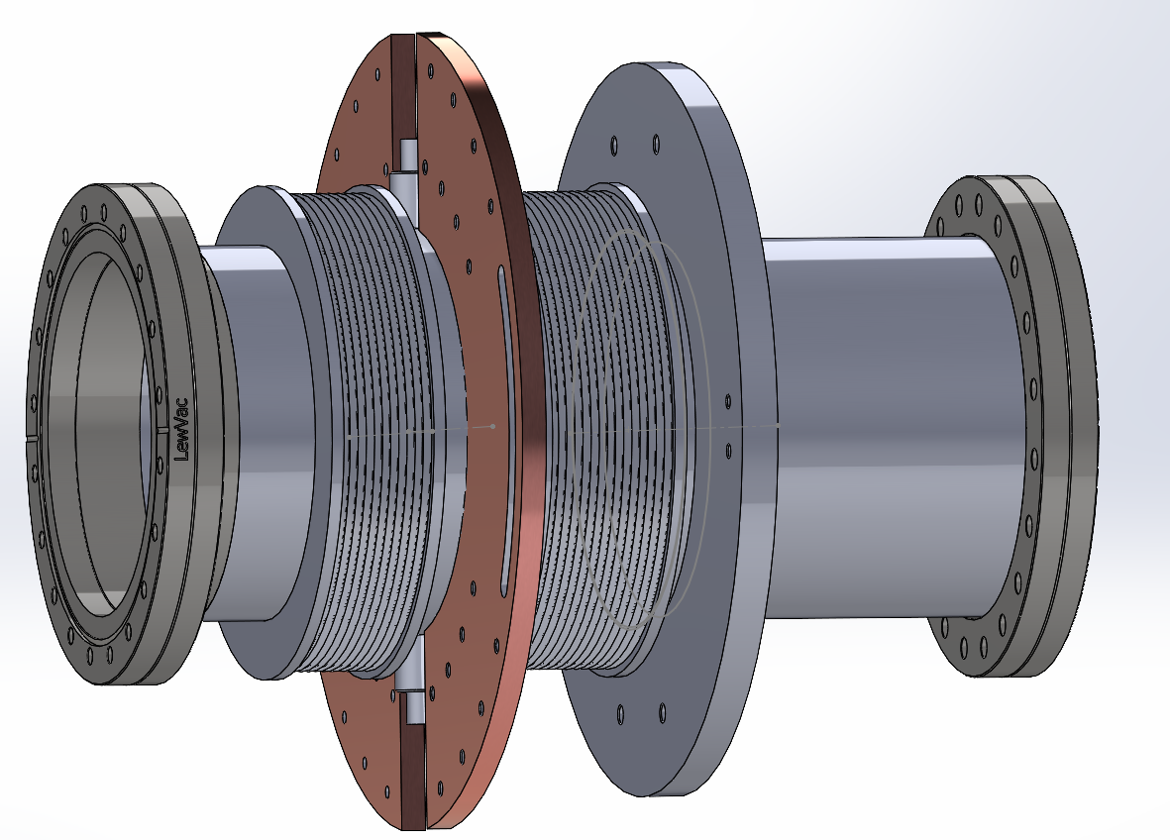
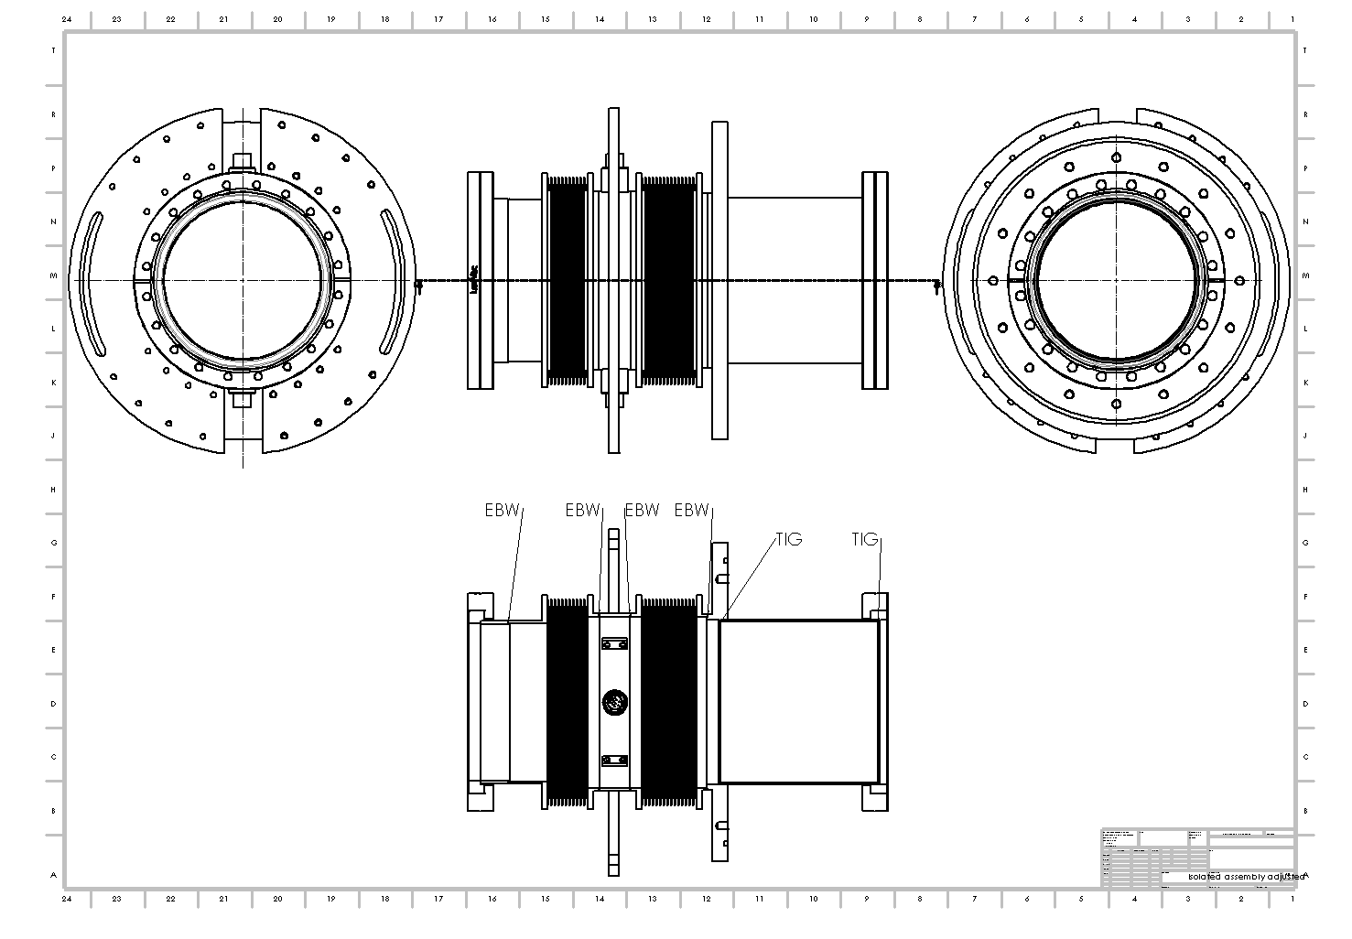
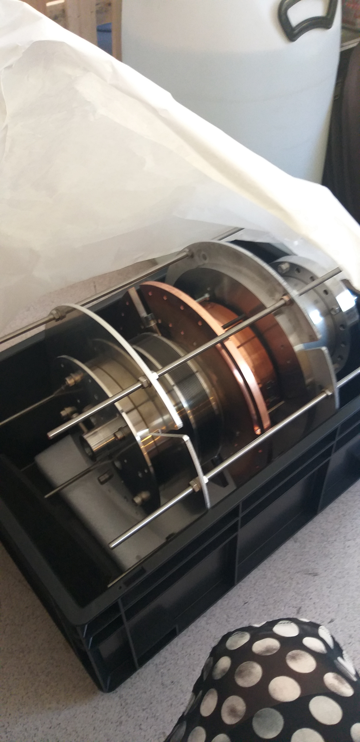
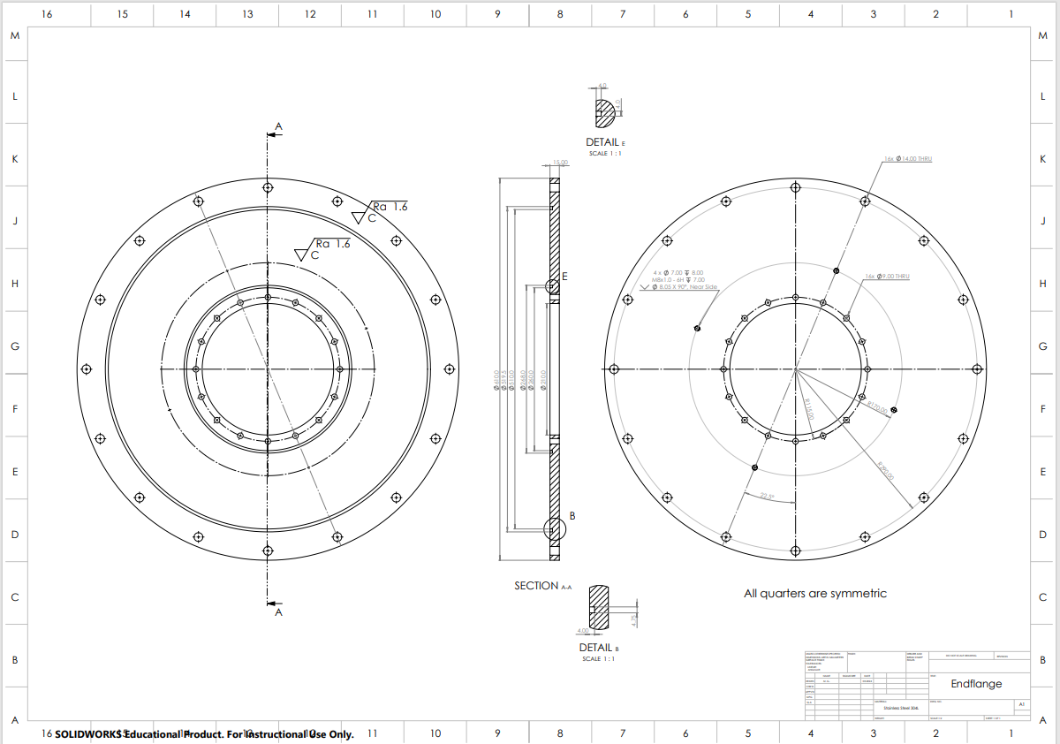
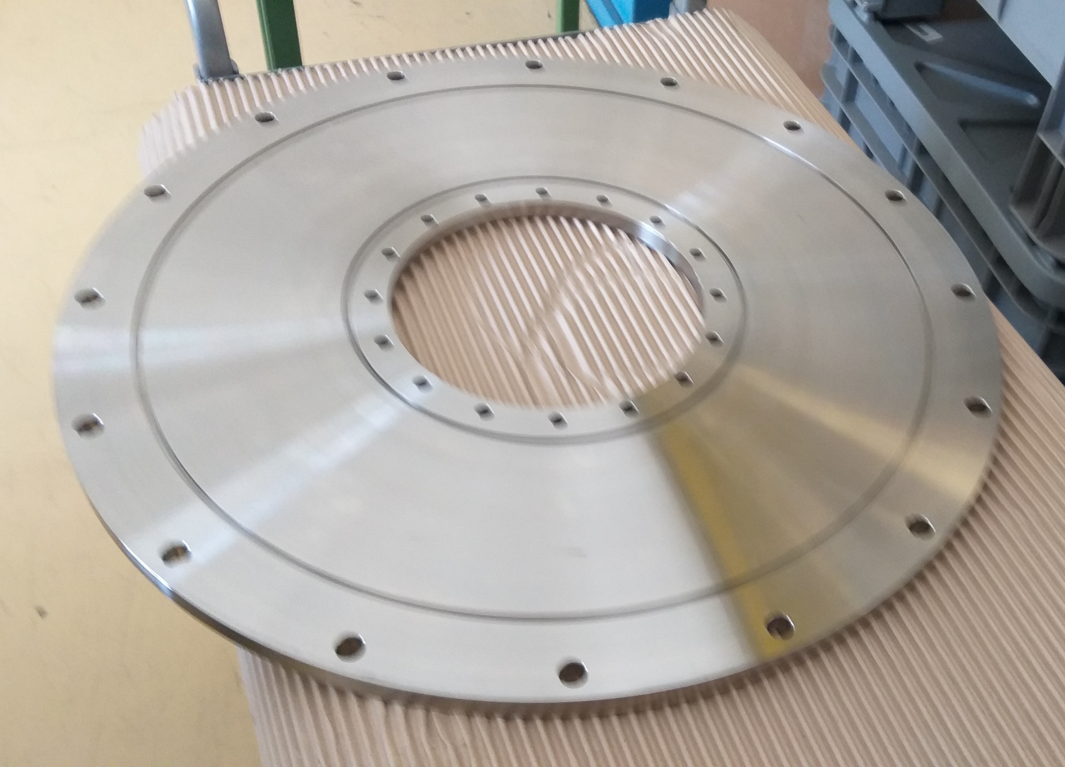
1T bellows assembly installation
Bellows to facilitate Hbar extraction beamline
Cost: ~20K
2 major pieces: bellows assembly
and a new OVC closing flange
Production finalized in August

Slide 4
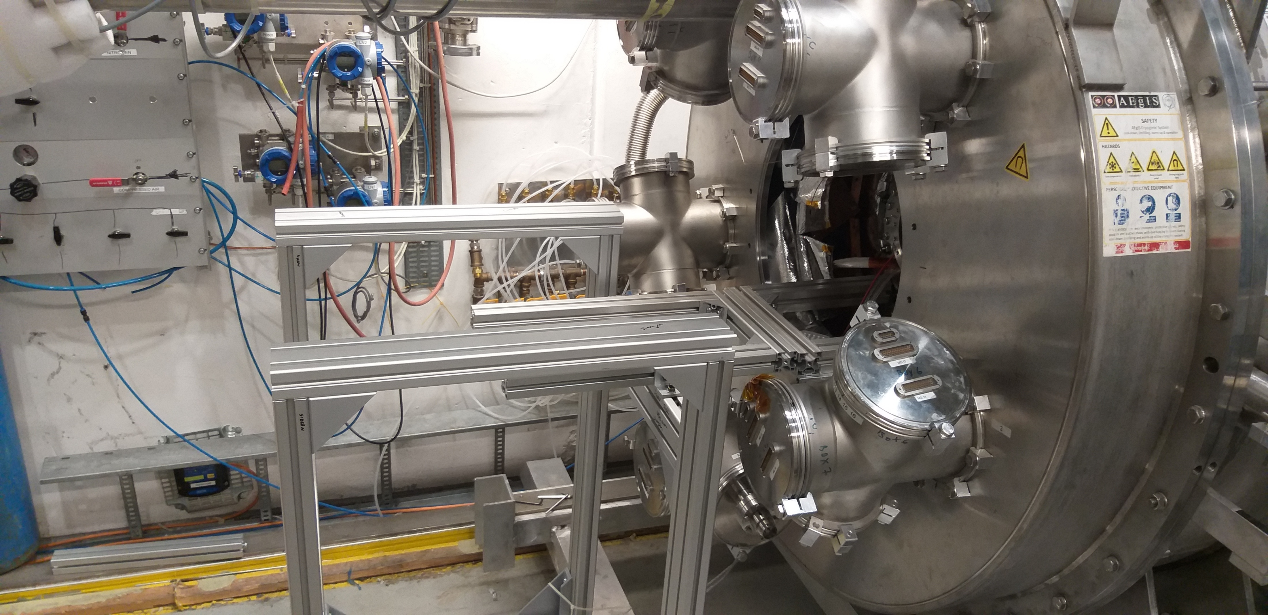
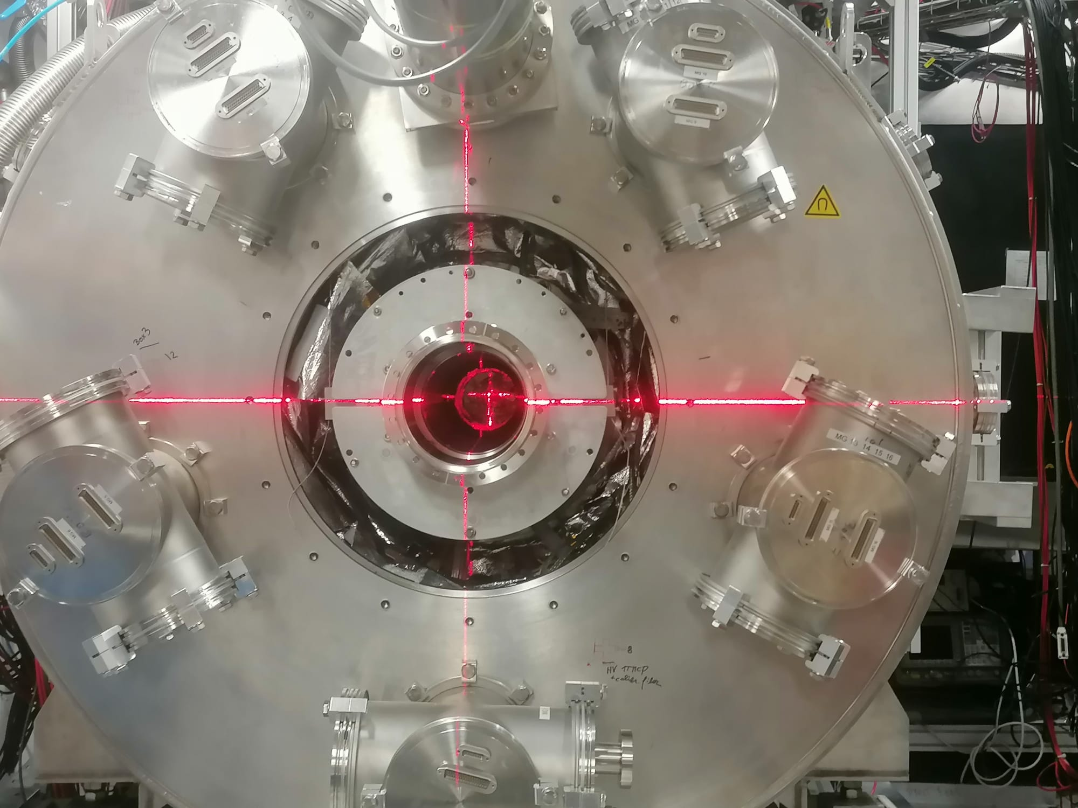
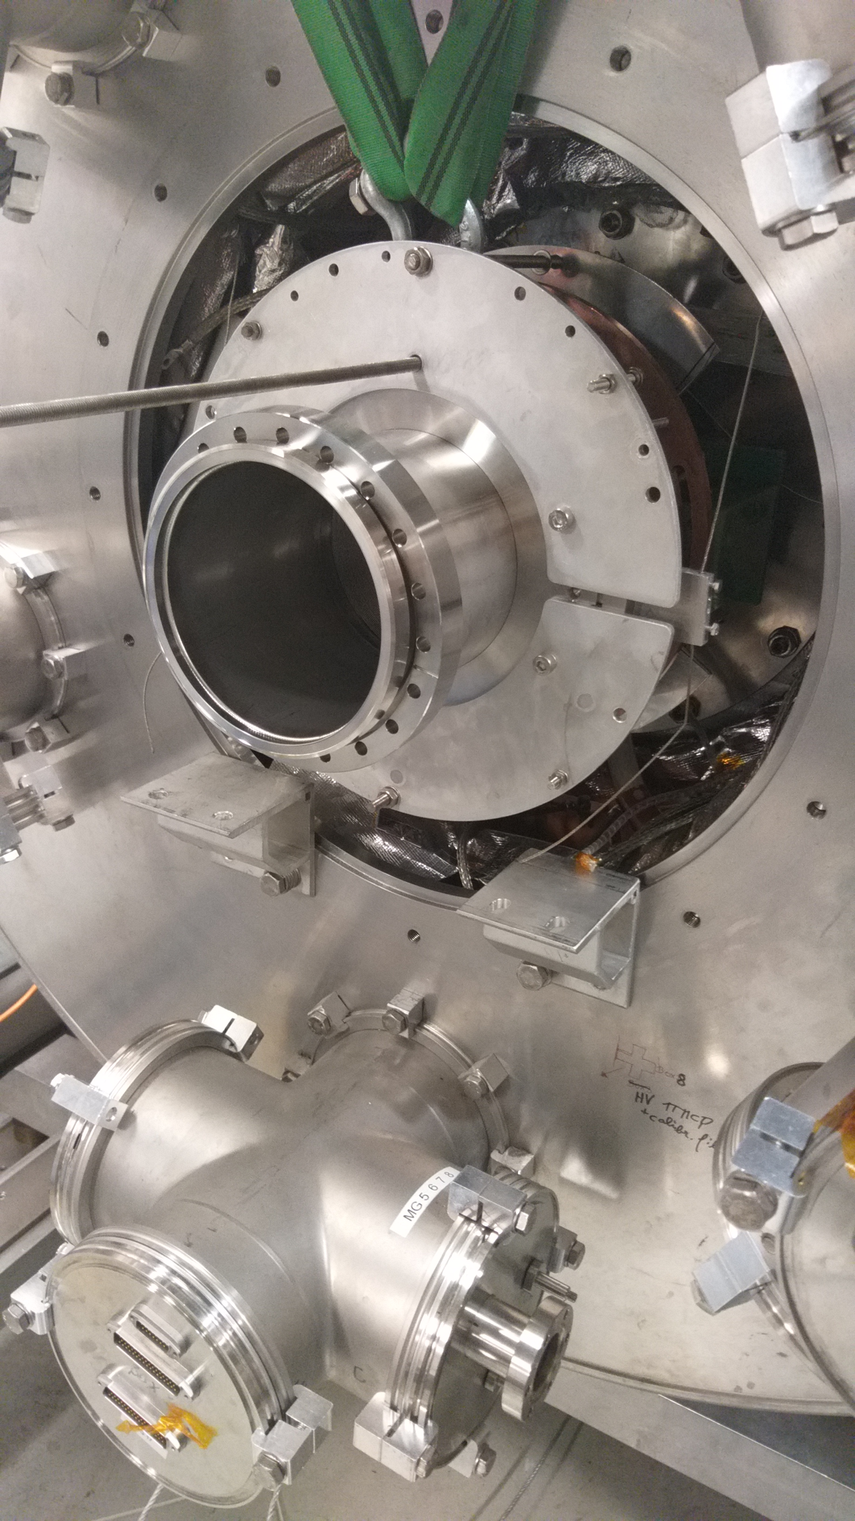
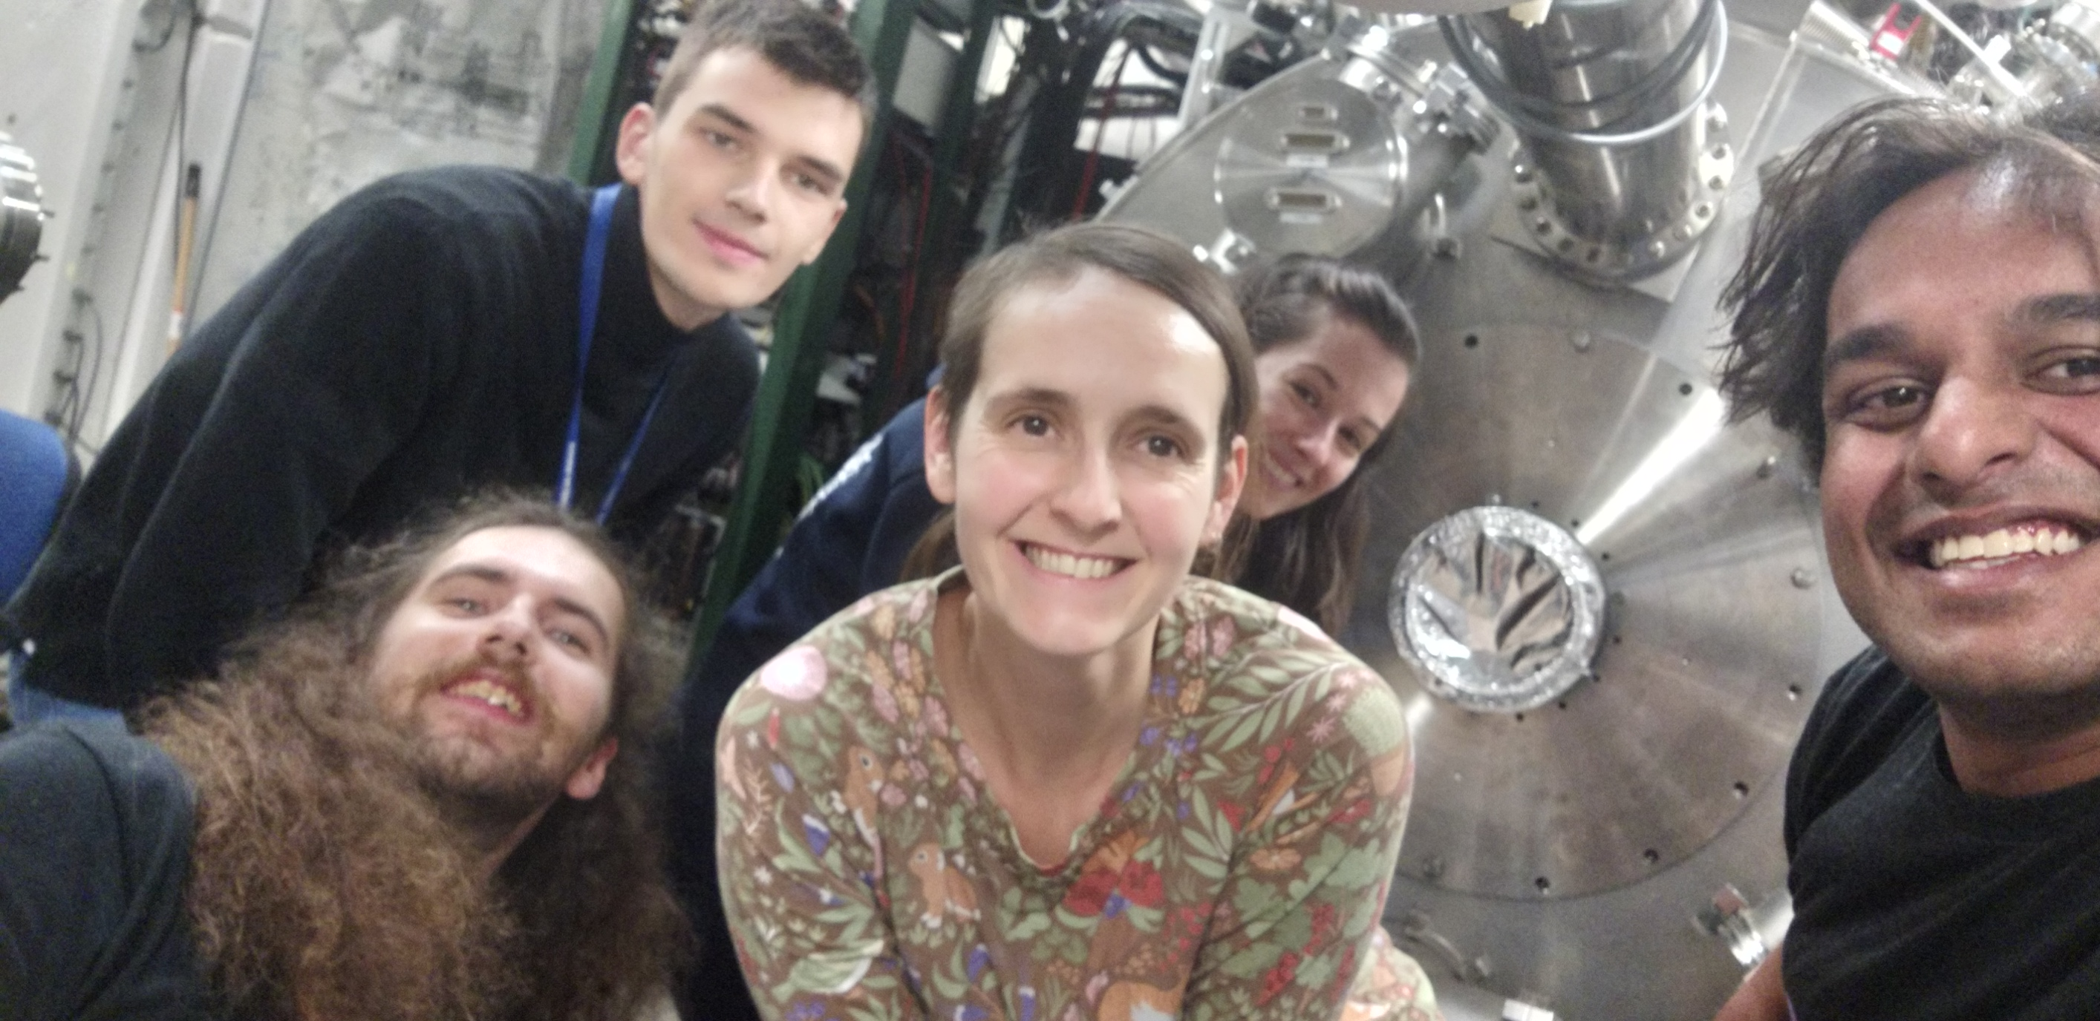
1T bellows assembly installation

Slide 5
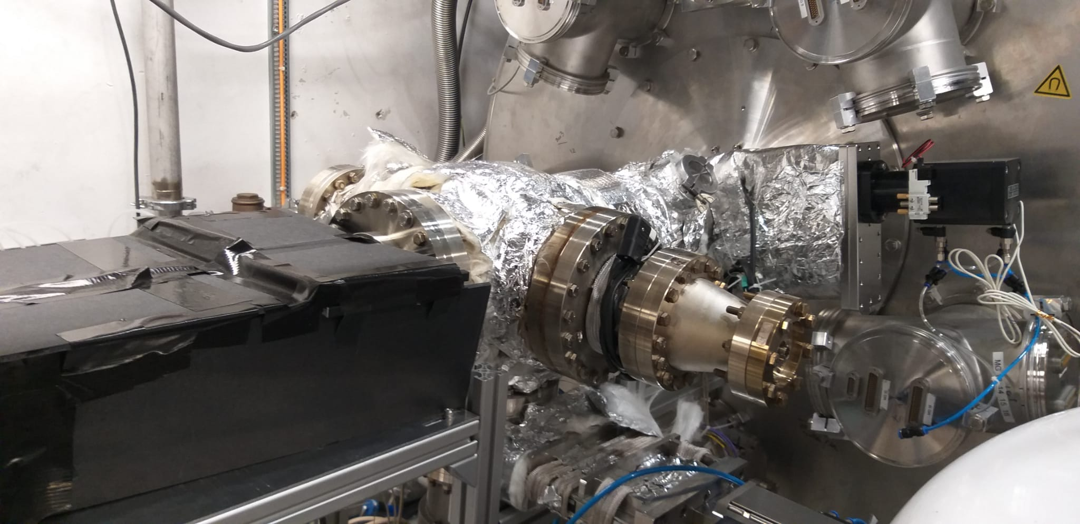
1T bellows assembly installation

Slide 6
1T bellows assembly installation
Installation process was very smooth
Complete success from the mechanical point of view
Vacuum level measured at GV12: 1x10^-9
Opening of 150mm @ the 1T side without a heat shield created a large heat leak- estimated 8 Watt of (radiative) heat energy, translating to consumption of 4 extra dewars of LHe per week
Precise damage assessment and design of a heat shield ongoing with the help of CERN cryogenic dept (More on Thursday’s talk)

Slide 7
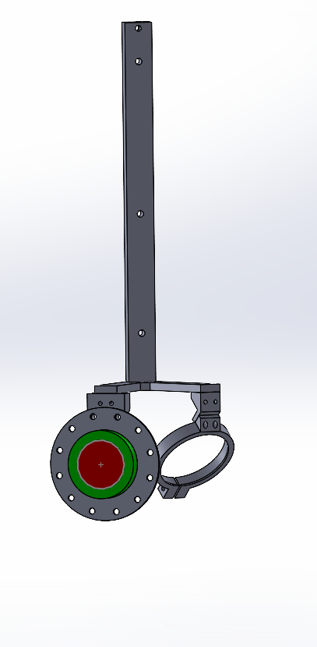
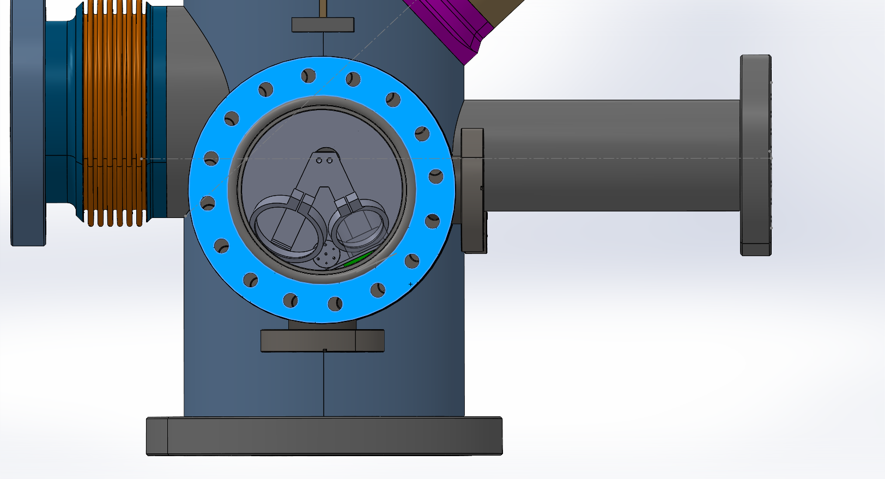
Hedgehog detector assembly

Slide 8
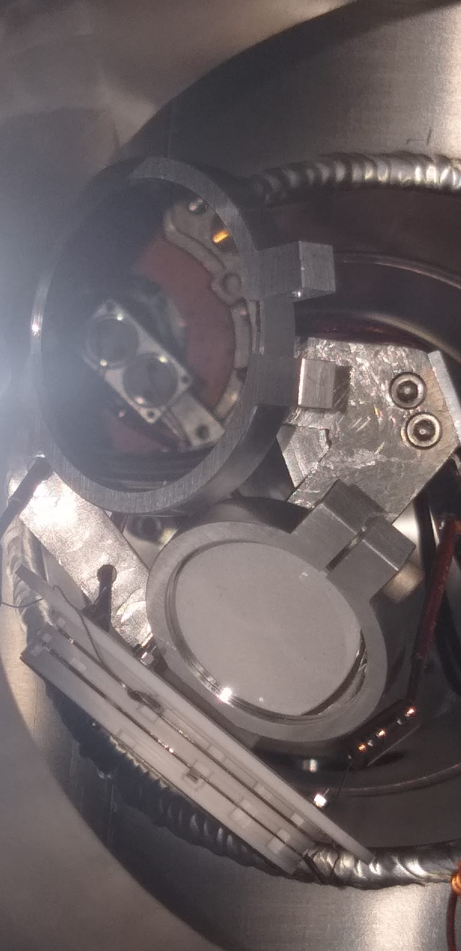
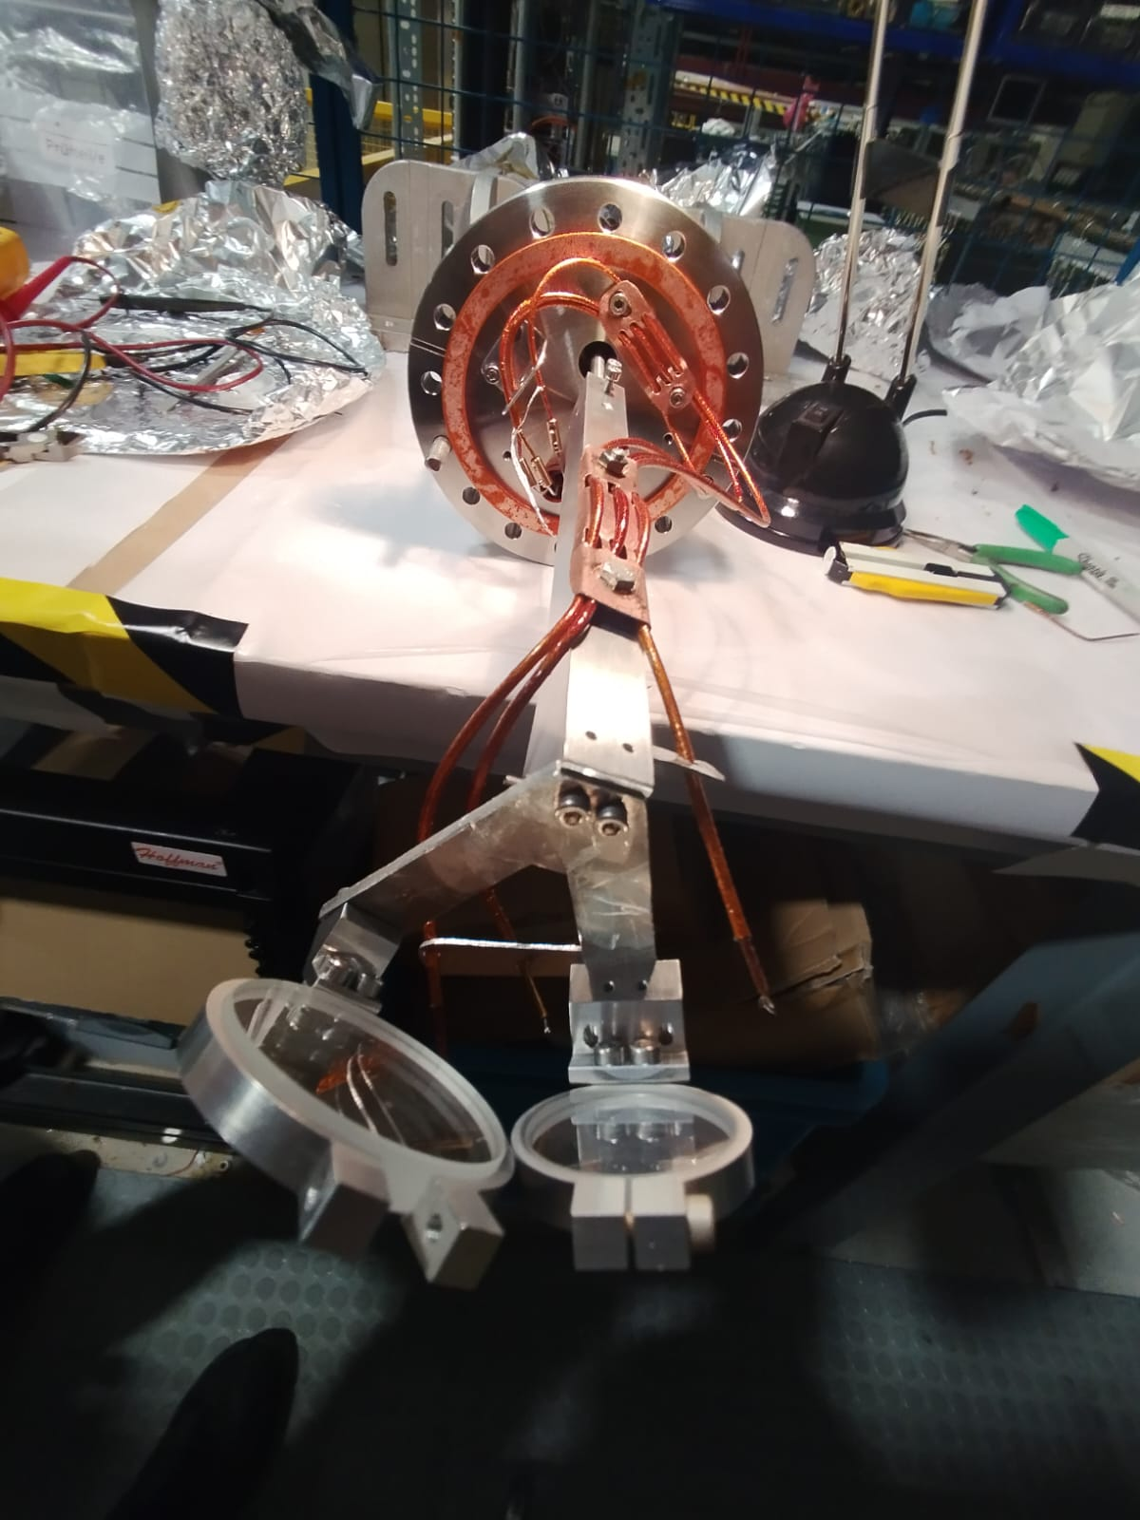
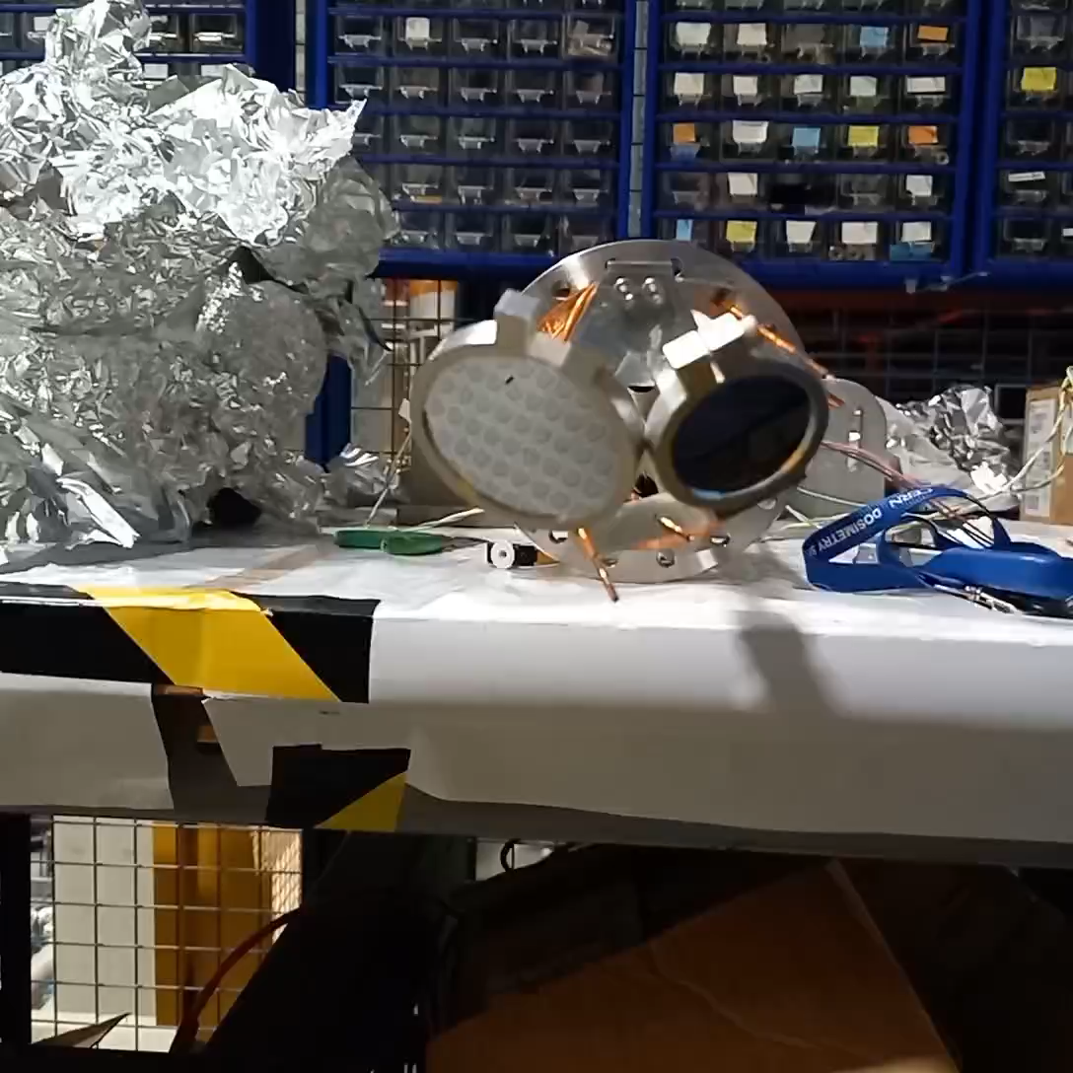
Hedgehog detector assembly

Slide 9
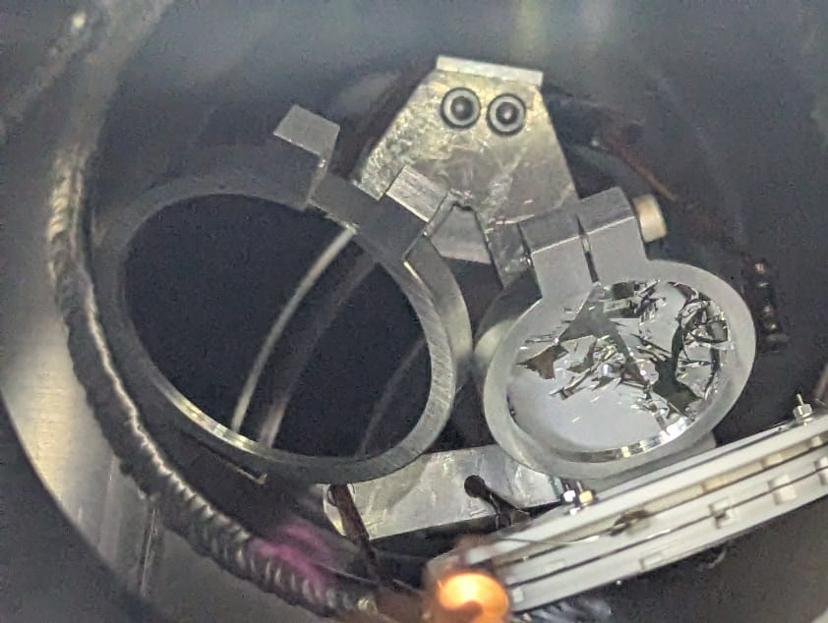
Hedgehog detector assembly
The MCP mirror shattered after baking (not enough spring effect?) and will have to be replaced
The MCP did not work properly, the cabling has to be investigated
We loose 10% of the beam…
The project has to be redesigned (More on Thursday’s talk)

