Slide 1

1T MCP status
Stefan

Slide 2

Agenda
Design parameters
3D drawings
Implementation
Tests

Slide 3
Design parameters
The 1T MCP is one of the most important analysis devices in AEgIS. For plasma diagnostics, beam steering, timing, charge collection, etc…
But sending H-bar to the Moire deflectometer is impossible, because the MCP is in the flight path
Hence:
  - for diagnostic, keep it on the beam line
  - remove it from the beam line for H-bar/Moire runs
  Actuation with another cryo motor envisaged
  Infrastructure as usual for MCPs: heater, temperature sensor, LED for camera focus

Slide 4
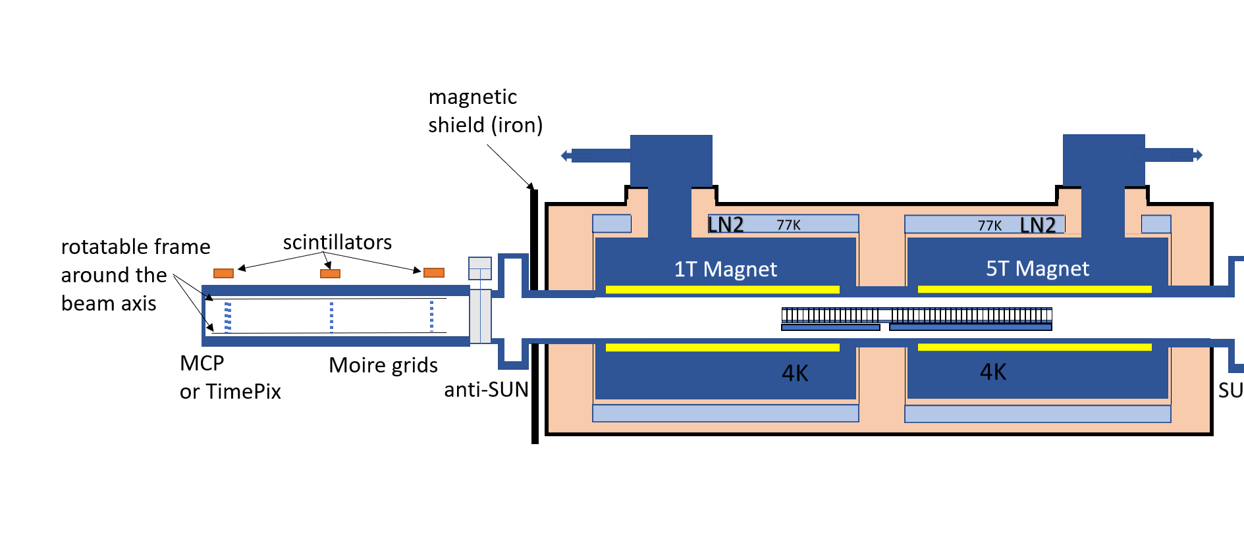
Cross section of AEgIS
Old 1T MCP
Supported by the 1T magnet
(<Sep 2024)
New 1T MCP
Supported by the 1T trap
(>Oct 2024)

Slide 5
1T Trap <Sep 2024
Short base plate

Slide 6
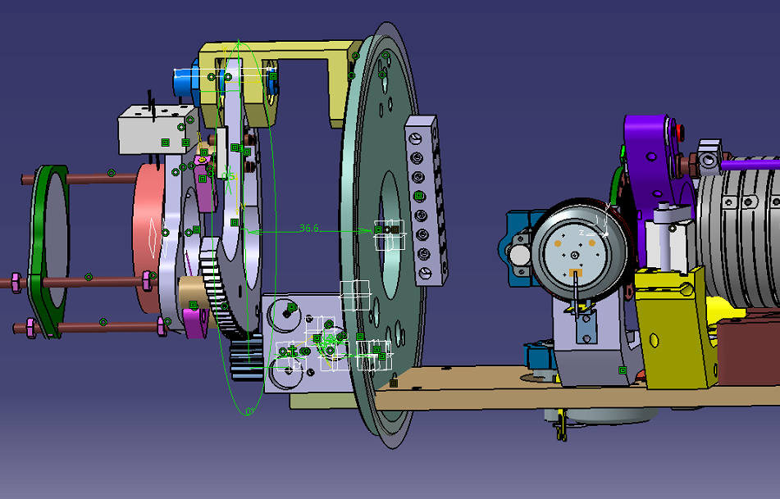
Distance MCP-IN to
Target surface:
160mm
Long base plate for new MCP support

Slide 7
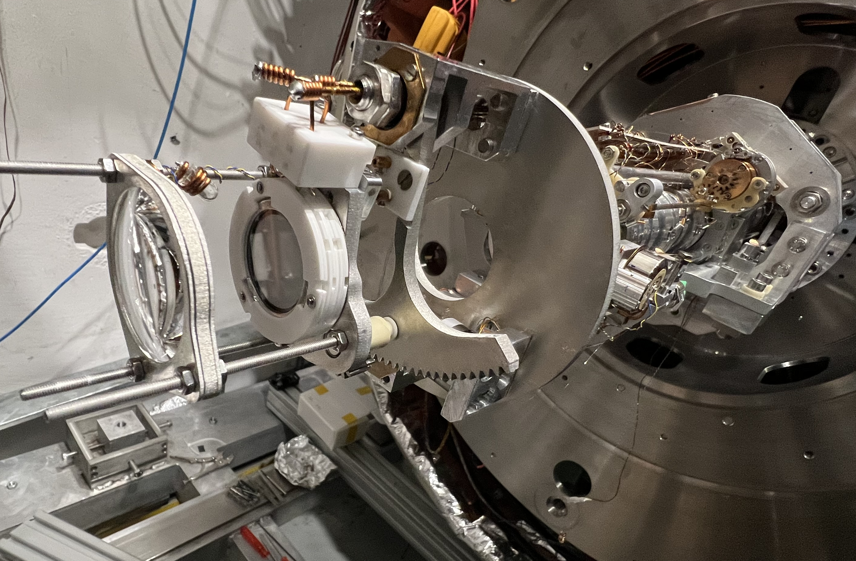
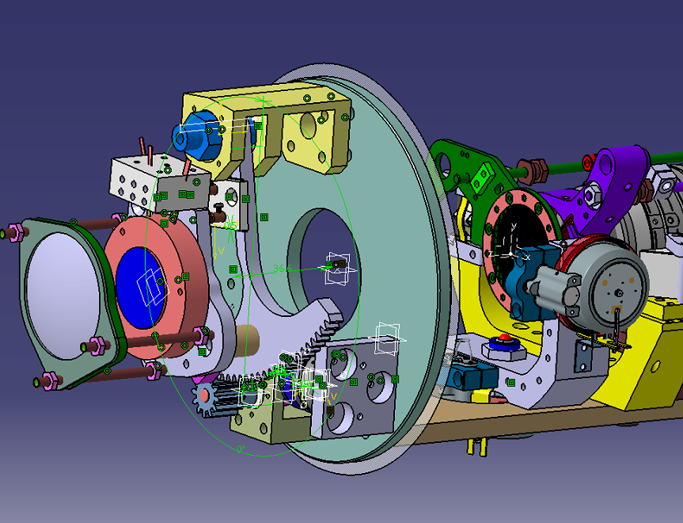
MCP base with large gear
For moving it out of beam line
1T MCP
Lense
Long base plate

Slide 8
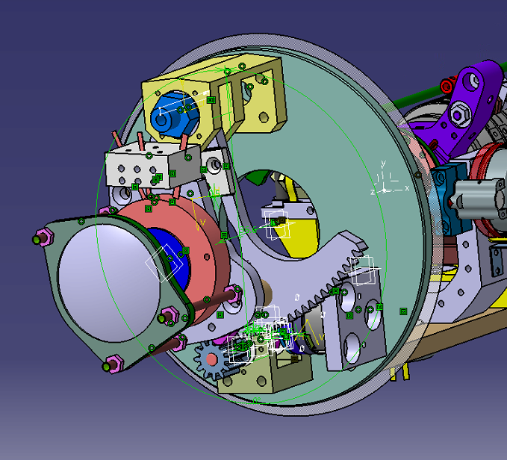

Slide 9
10kV cables
Come through the
Pivot axis!

Slide 10
Cryogenic motor
With worm gear-box
Due to the weak nature of this
Cryo motor, a worm-gear with a
10:1 gear ratio is used.
Result: to move the MCP out
Of beam axis takes 7 minutes!!

Slide 11
MCP IN plate. This is the
“view” of the particles

Slide 12
MCP in park position
(away from the beam line)
Free line of flight for H-bar
Toward the Moire deflectometer !!

Slide 13
No obstruction what so ever:
Target, Grid and 1T MCP
Are out in park position.
“P-bars to Moire” – mode…

Slide 14
Seen from the back of
the experiment
MCP in beam position
FACT tube

