Slide 1
Status of the anion source
CERN, 17 Dec 2024
Łukasz Kłosowski
Nicolaus Copernicus University in Toruń

Slide 2
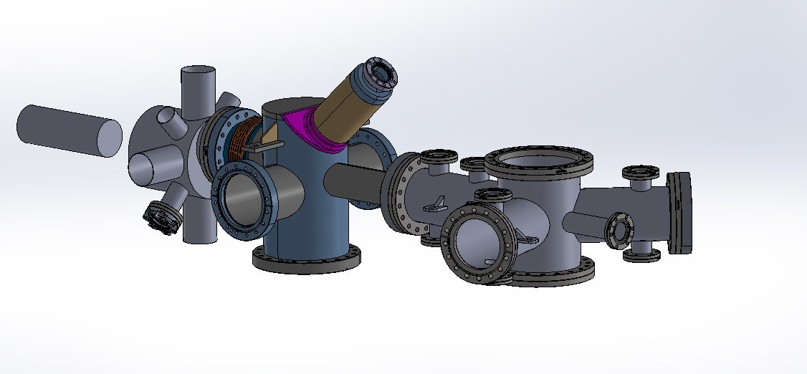
Our goal
A source of negatively charged ions
  Controlled composition of the ion ensemble
  Controlled energy, time characteristics, and geometry of the pulse
  Long-lasting source
  Compatible with the AEgIS main apparatus
  compact
The ions can be co-trapped with antiprotons (the same sign of the electric charge), and later be used for production of antiprotonic atoms

Slide 3
The device works!
We can produce pulses of about 60 000 iodine anions in several-minute intervals
We still can do better!
Stable, long lasting source
Repeatable results

Slide 4
Positive vs negative ions
cation
anion
Relatively easy to produce:
May be cooled optically, for example in a Doppler scheme
Attachment of an electron forbidden by the Energy and momentum conservation
Only one bound state – optical cooling impossible
3-body interactions improbable due to vacuum conditions
Electron dissociative attachment may be used:

Slide 5
A brief summary of the technique used
Electron dissociative attachment inside a multi-segment linear Paul trap
Iodine:
  Mass 127 a.m.u. (only one natural isotope)
  Electron affinity 3.06 eV
  The heaviest 2-atomic, homonuclear molecule
  Solid at room temperature
D. Frost and C. McDowell, CANADIAN JOURNAL OF CHEMISTRY. VOL. 38. 1960, 407-420 THE IONIZATION AND DISSOCIATION OF SOME HALOGEN MOLECULES BY ELECTRON IMPACT

Slide 6
Expected cross sections and final kinetic energies

Slide 7
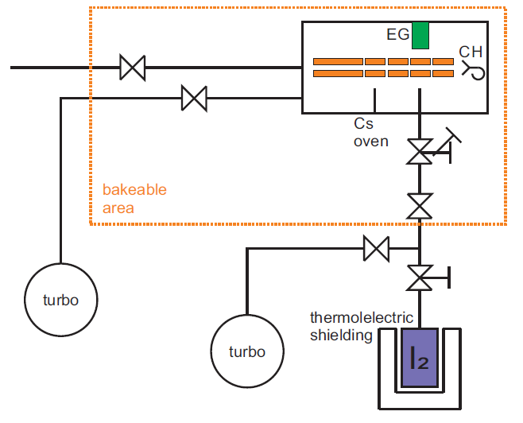
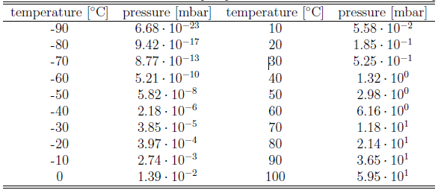
The first idea of the source (2021)

Slide 8
Further idea: iodoform instead of iodine for safety reasons

Slide 9
Design of the device
Picture prepared by Gosia Grosbart

Slide 10
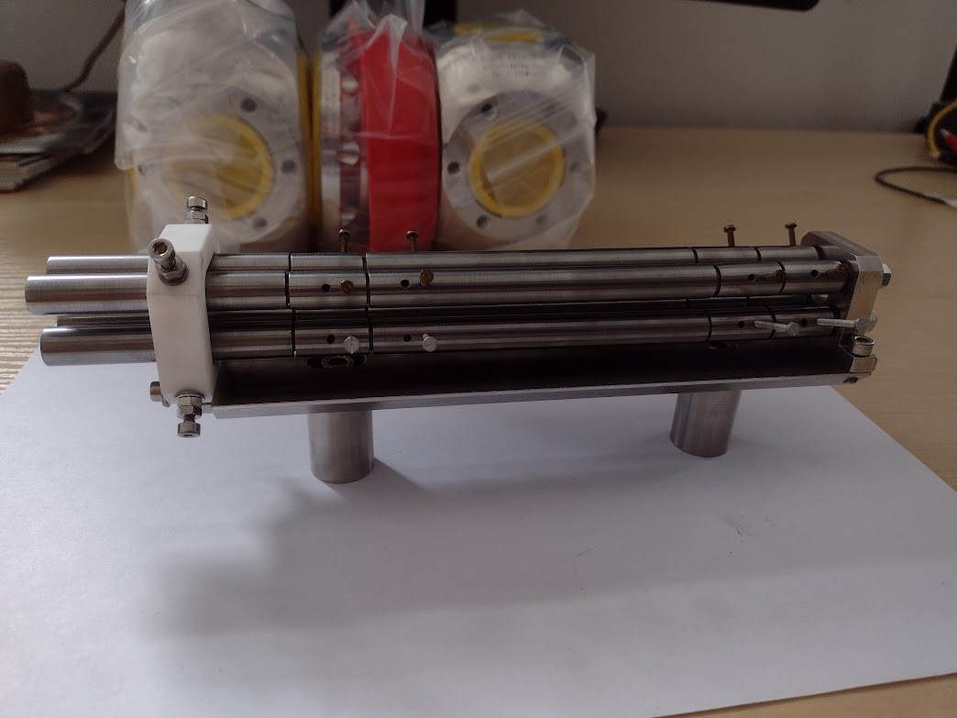
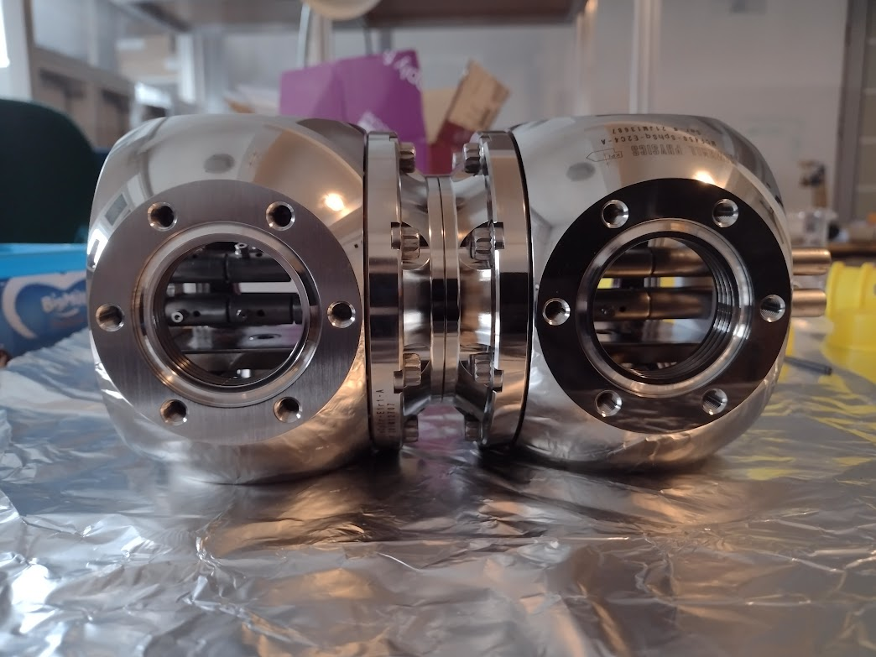
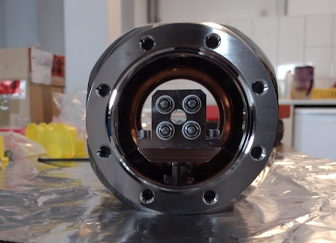
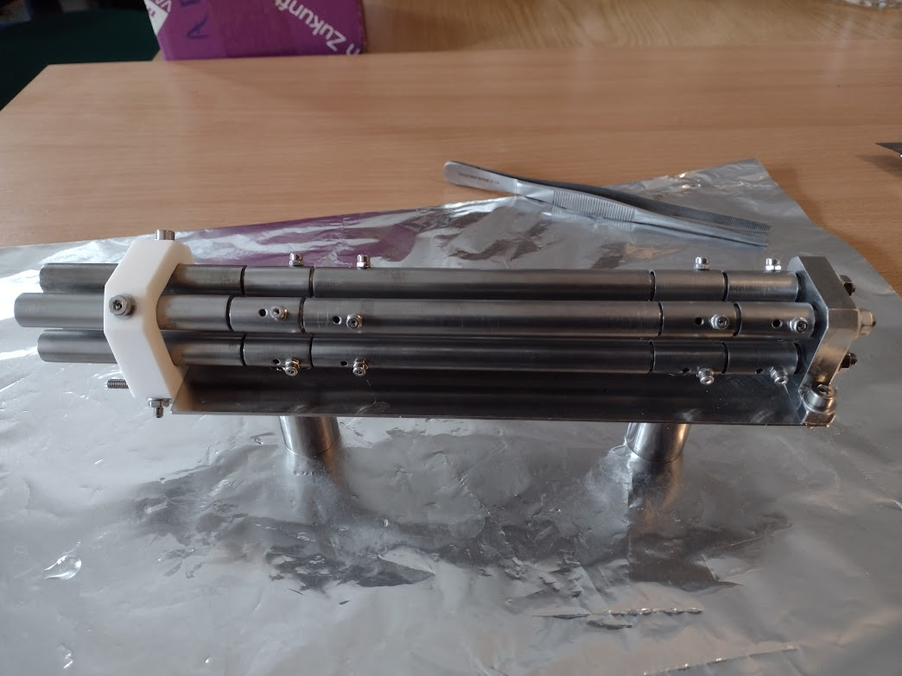
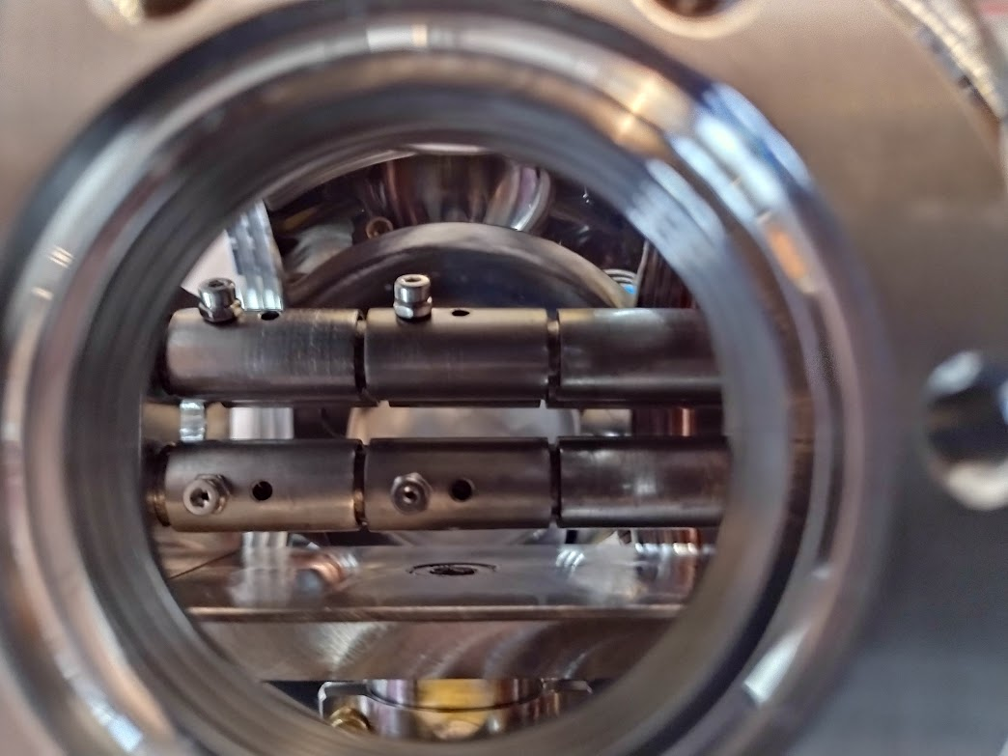
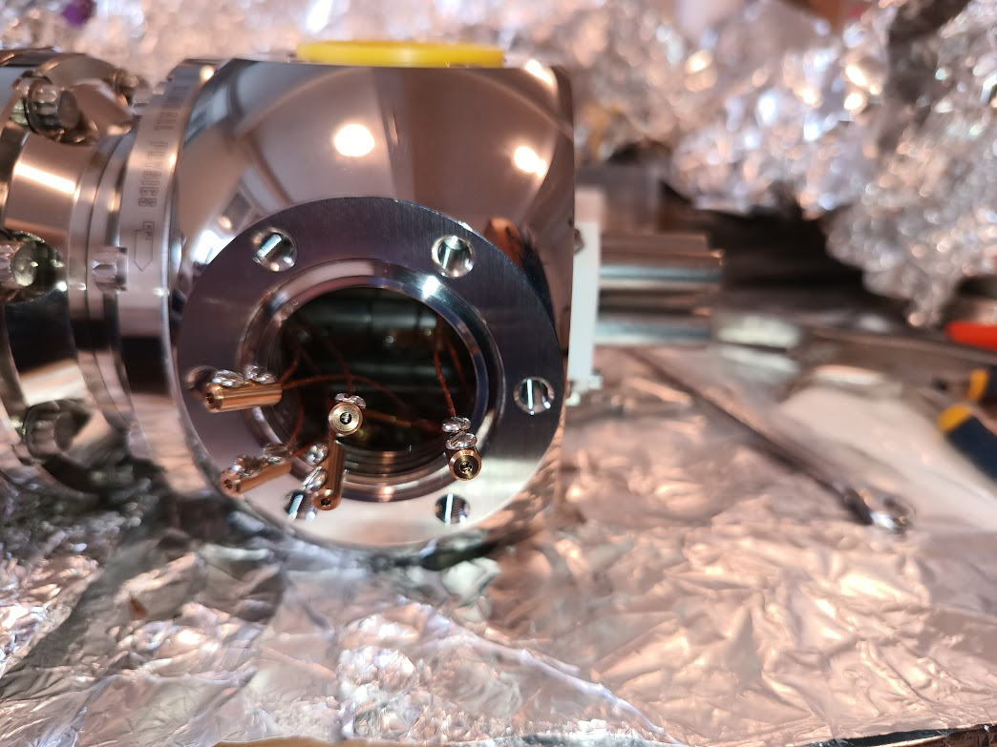
The linear Paul trap

Slide 11
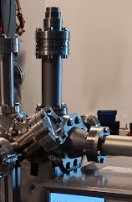
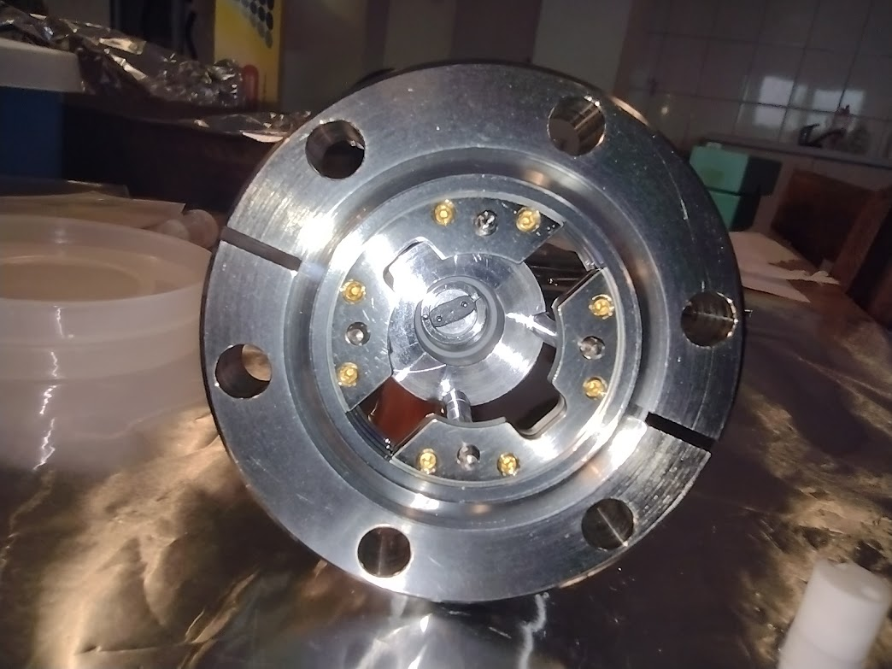
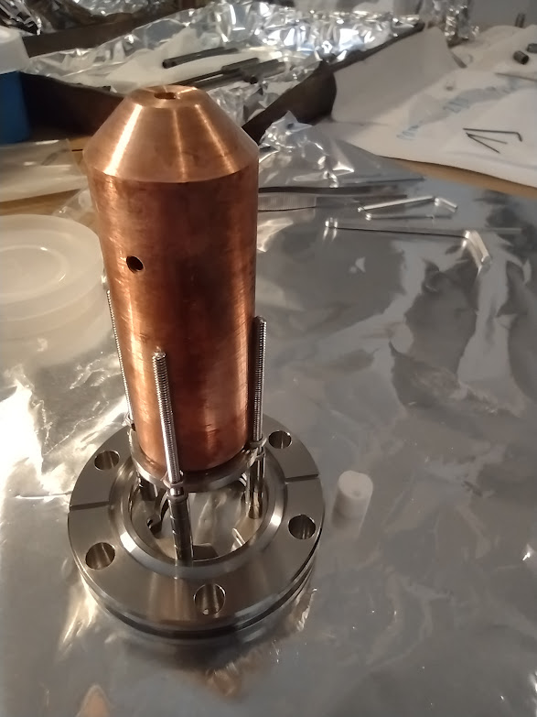
Electron gun

Slide 12
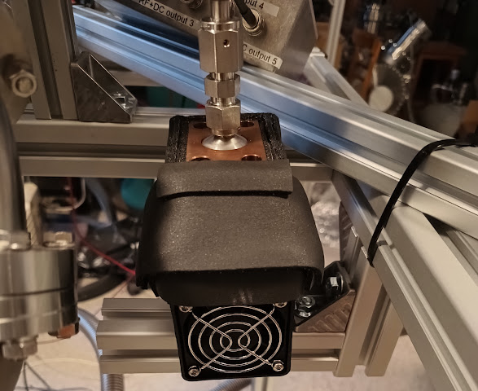
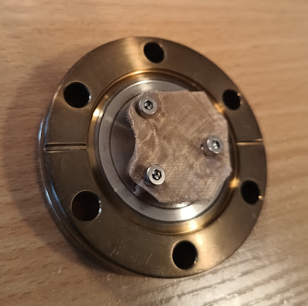
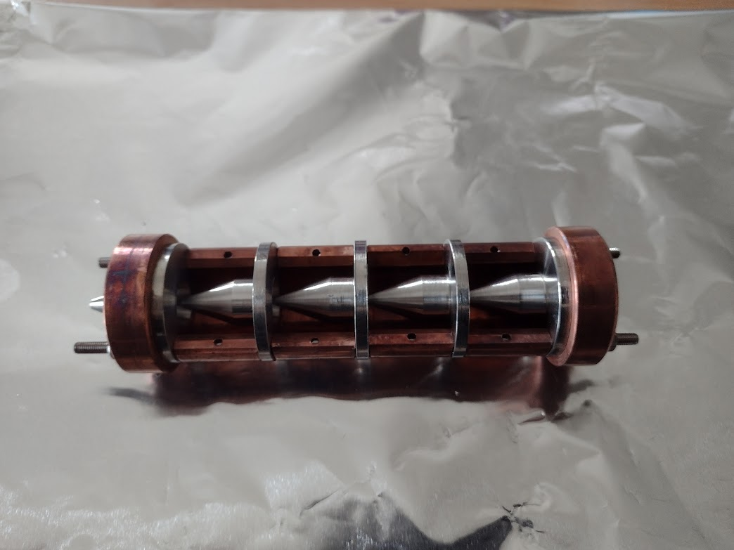
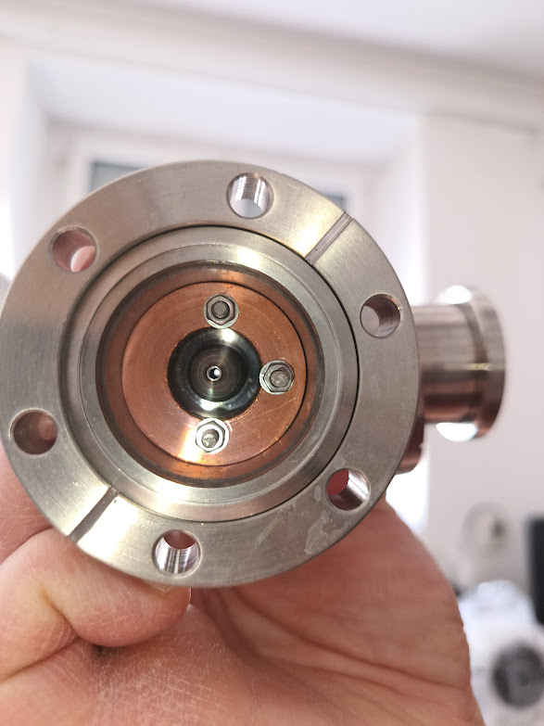
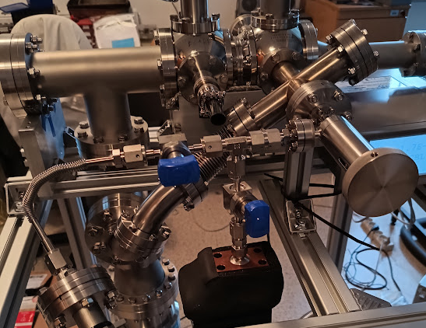
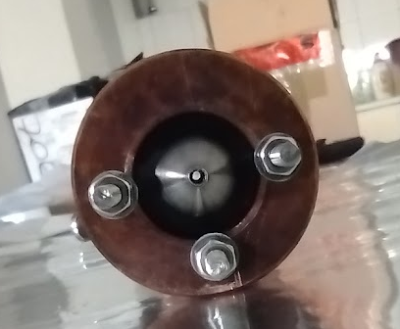
Molecular beam source
Silver mesh absorber of the iodine
Thermal shielding for the reservoir designed and built by Adam Linek
(the driver not presented in the picture)

Slide 13
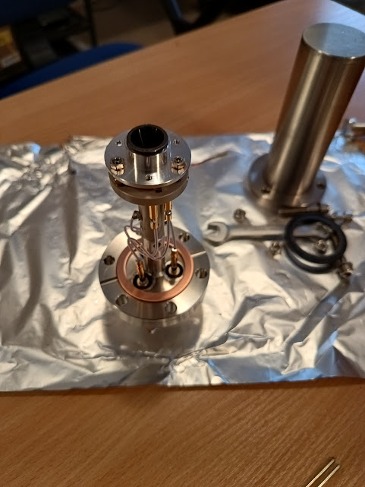
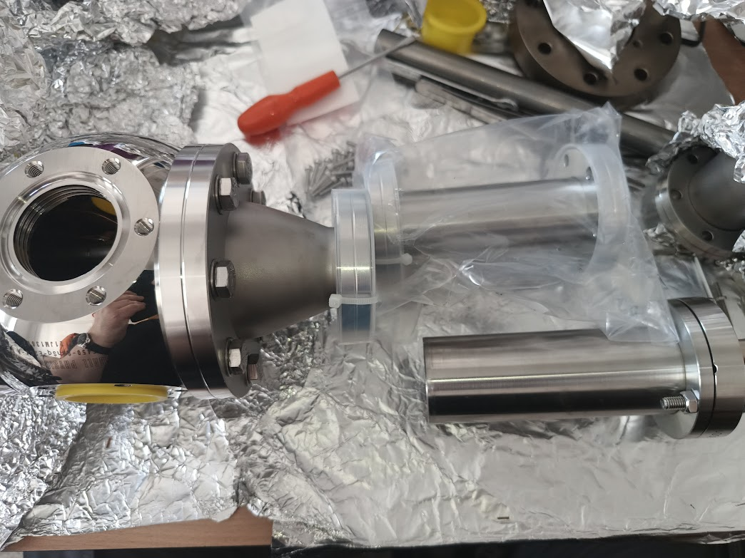
Anion detector (spiraltron)

Slide 14
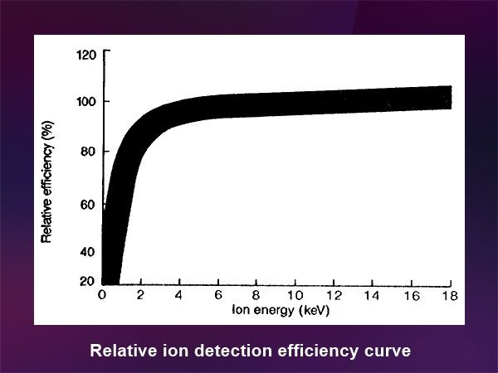
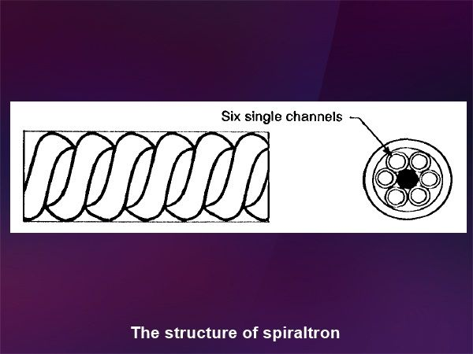
Anion detector (spiraltron)

Slide 15
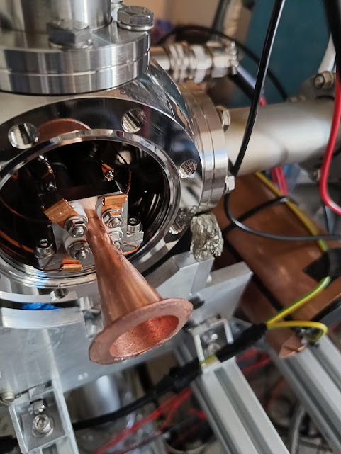
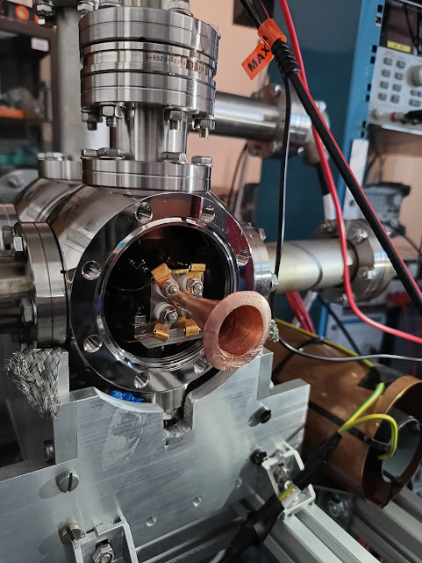
Modifications: stray electron shielding

Slide 16
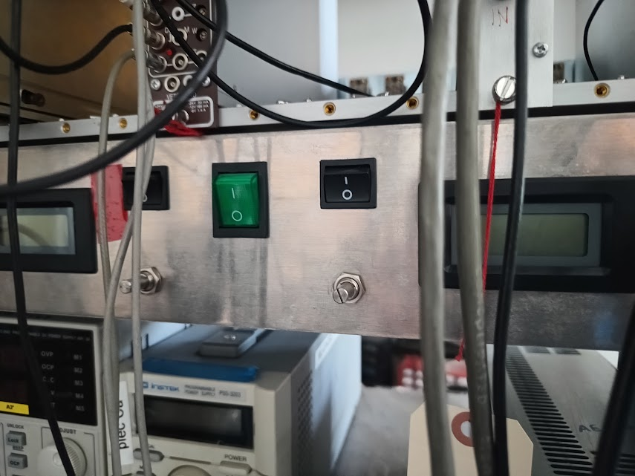
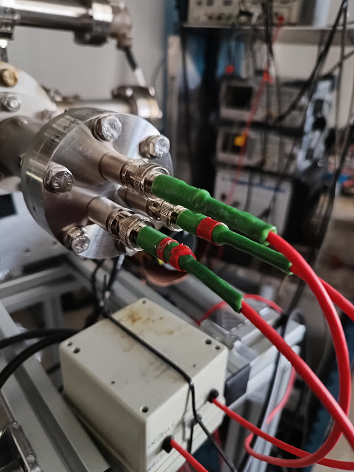
Custom-made HV power supplies

Slide 17
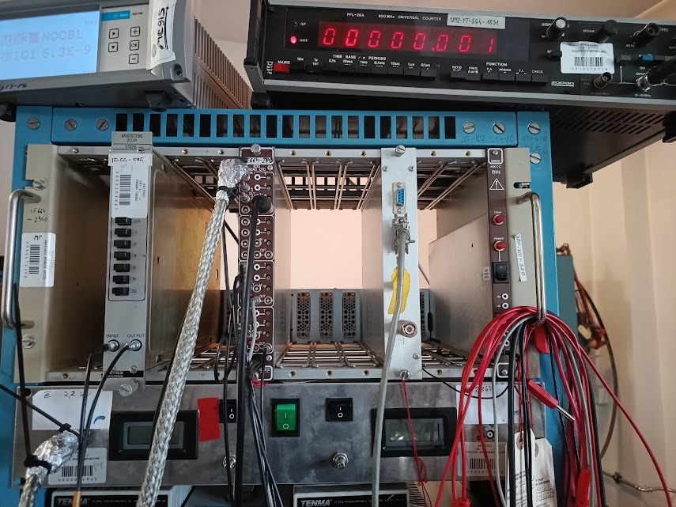
Pulsed electronics (Ortec) – borrowed from another experimental setup

Slide 18
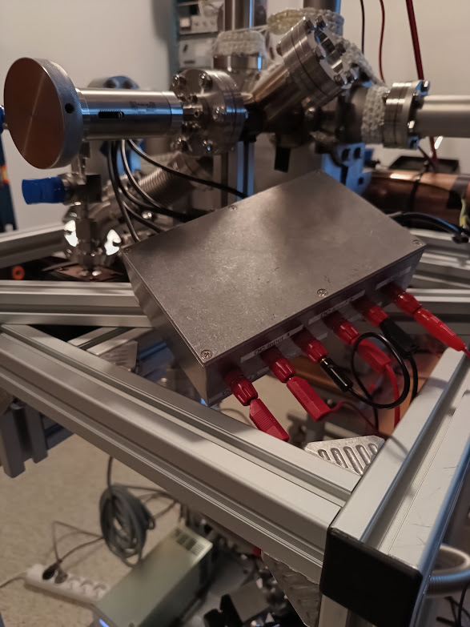
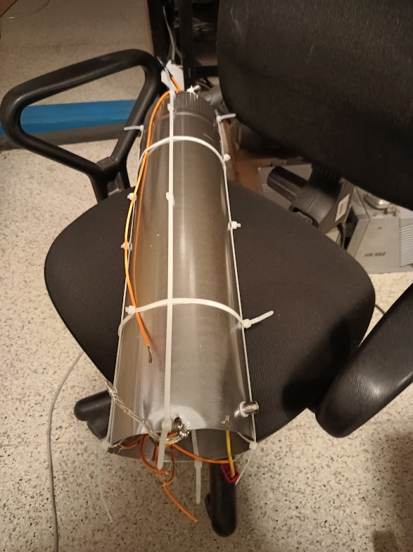
Temporary voltage supply system
At this frequency, the amplitude of about 280 V is necessary. At Q=7, we need to provide 40 V from the function generator.

Slide 19
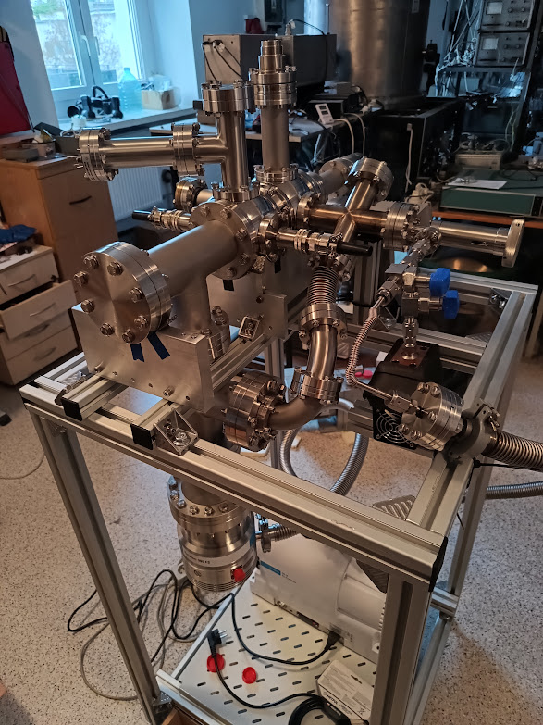
The device assembled together
Electron gun
channeltron
Silver absorber
Feedthrouhs of the trap
To the diagnostic cross and further to the AEgIS main apparatus
skimmers
Leak valve
Iodine reservoir
Turbo pump

Slide 20
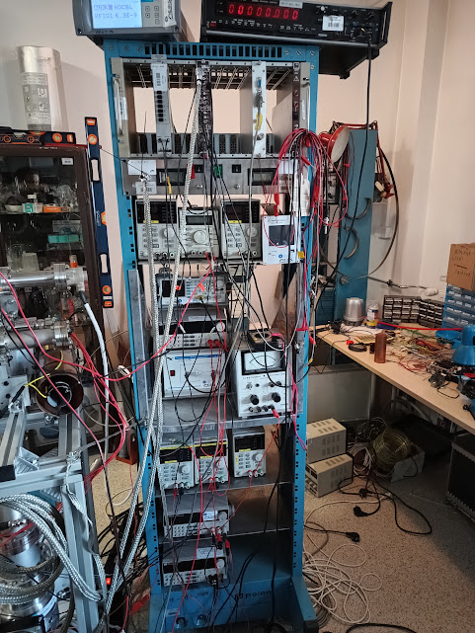

Slide 21
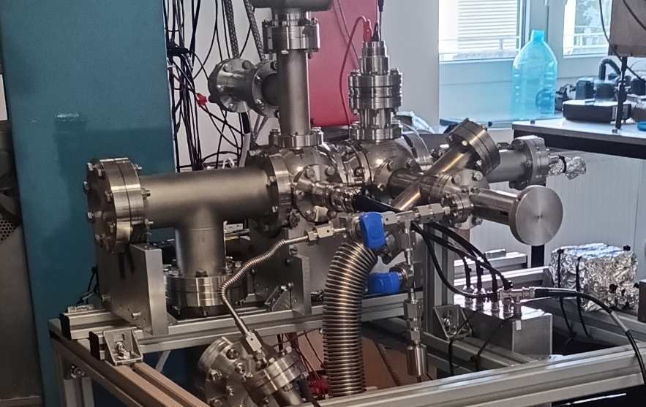

Slide 22
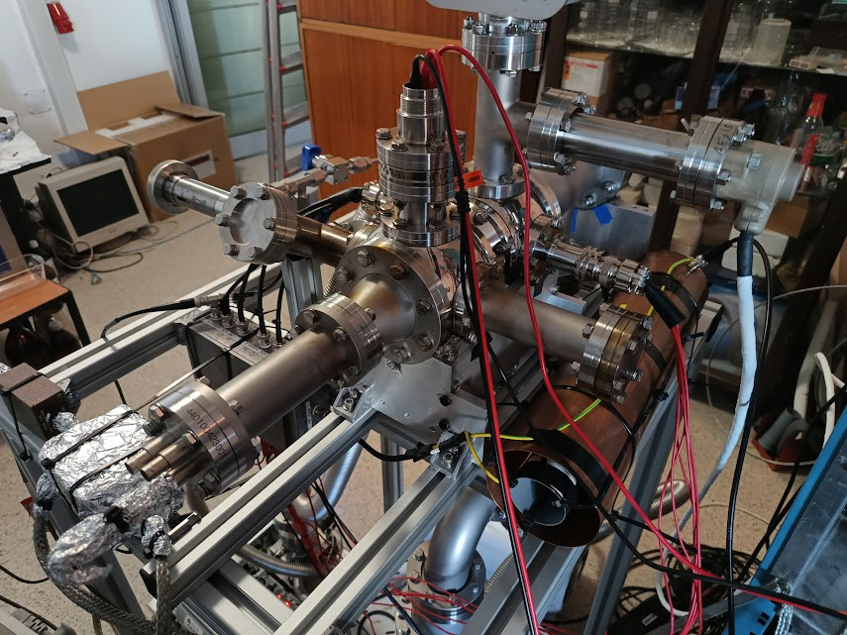
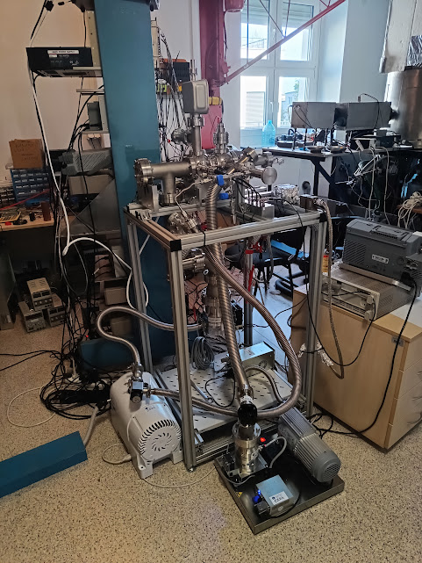

Slide 23
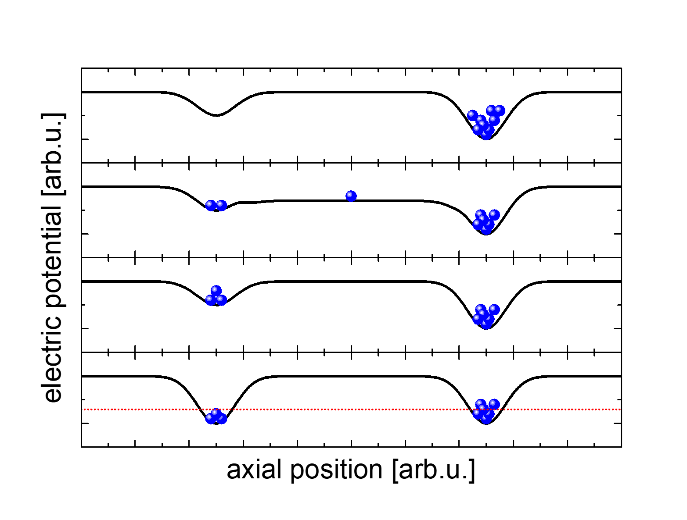
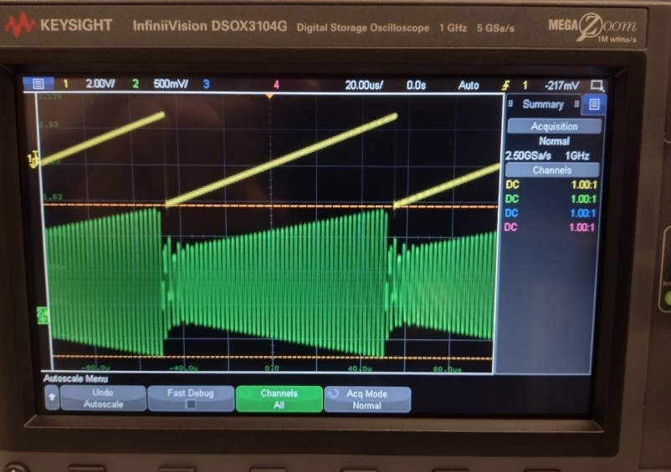
Cooling problem (no optical access to the anion)

Slide 24
Solution for the cooling problem

Slide 25
The procedure of the ion source testing

Slide 28
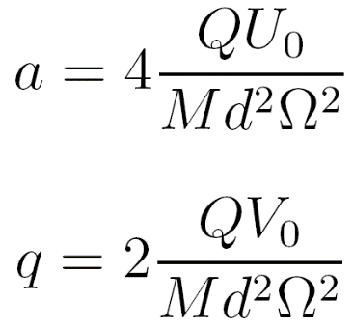
The pulses counted come from an object, which has:
Negative electric charge
Mass to charge ratio above 72 amu/e

Slide 29
Loading and unloading the trap

Slide 30
Trap settings
At 6V from the generator, we have 270 V at the trap’s electrodes.
For iodine ions it translates to the „q” stability parameter equal 0.3, which is the cue that I⁻ are the dominating component in the ion ensemble.

Slide 31
Electron gun efficiency

Slide 32
Molecular beam intensity

Slide 33
Time resolution of the detection system
Conclusion:
Our ion ensemble is squeezed to approximately 10 microseconds.
This leads to estimation of our ions’ temperature at at 6000 K (0.5 eV).
This is not very exact estimation, but the order of magnitude should be correct.

Slide 34
Summary
The device works
By now, iodoform is used instead of iodine
Temporary voltage supply system is used – to be replaced by SINARA
Transport to CERN: anytime we find it conveneient

