Slide 1
Rydberg positronium spectroscopy
Valts Krumins
Benjamin Rienacker

Slide 2
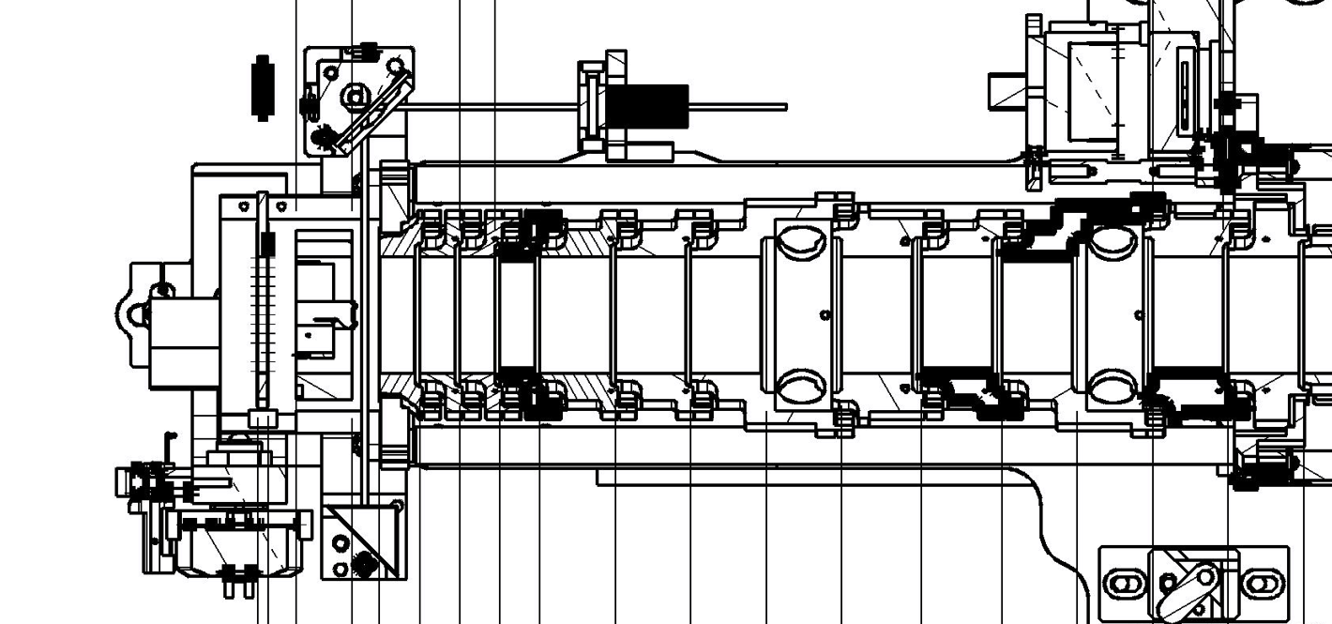
How is positronium made?
Positronium target
Positrons
205 + IR

Slide 3
How is positronium made?
Positrons
205 + IR

Slide 4
How is positronium made?
Positrons
205 + IR

Slide 5
How we see what we made?
HV6

Slide 6
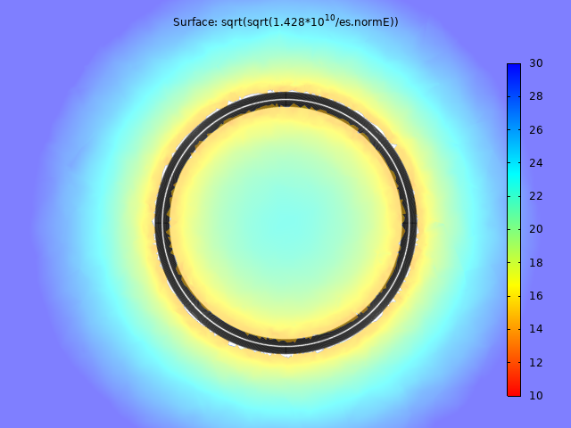

How we see what we made?
Maximum n level that can be ionized with the field from 1600V on HV6
HV6

Slide 7
How we see what we made?
To MCP
HV6

Slide 8
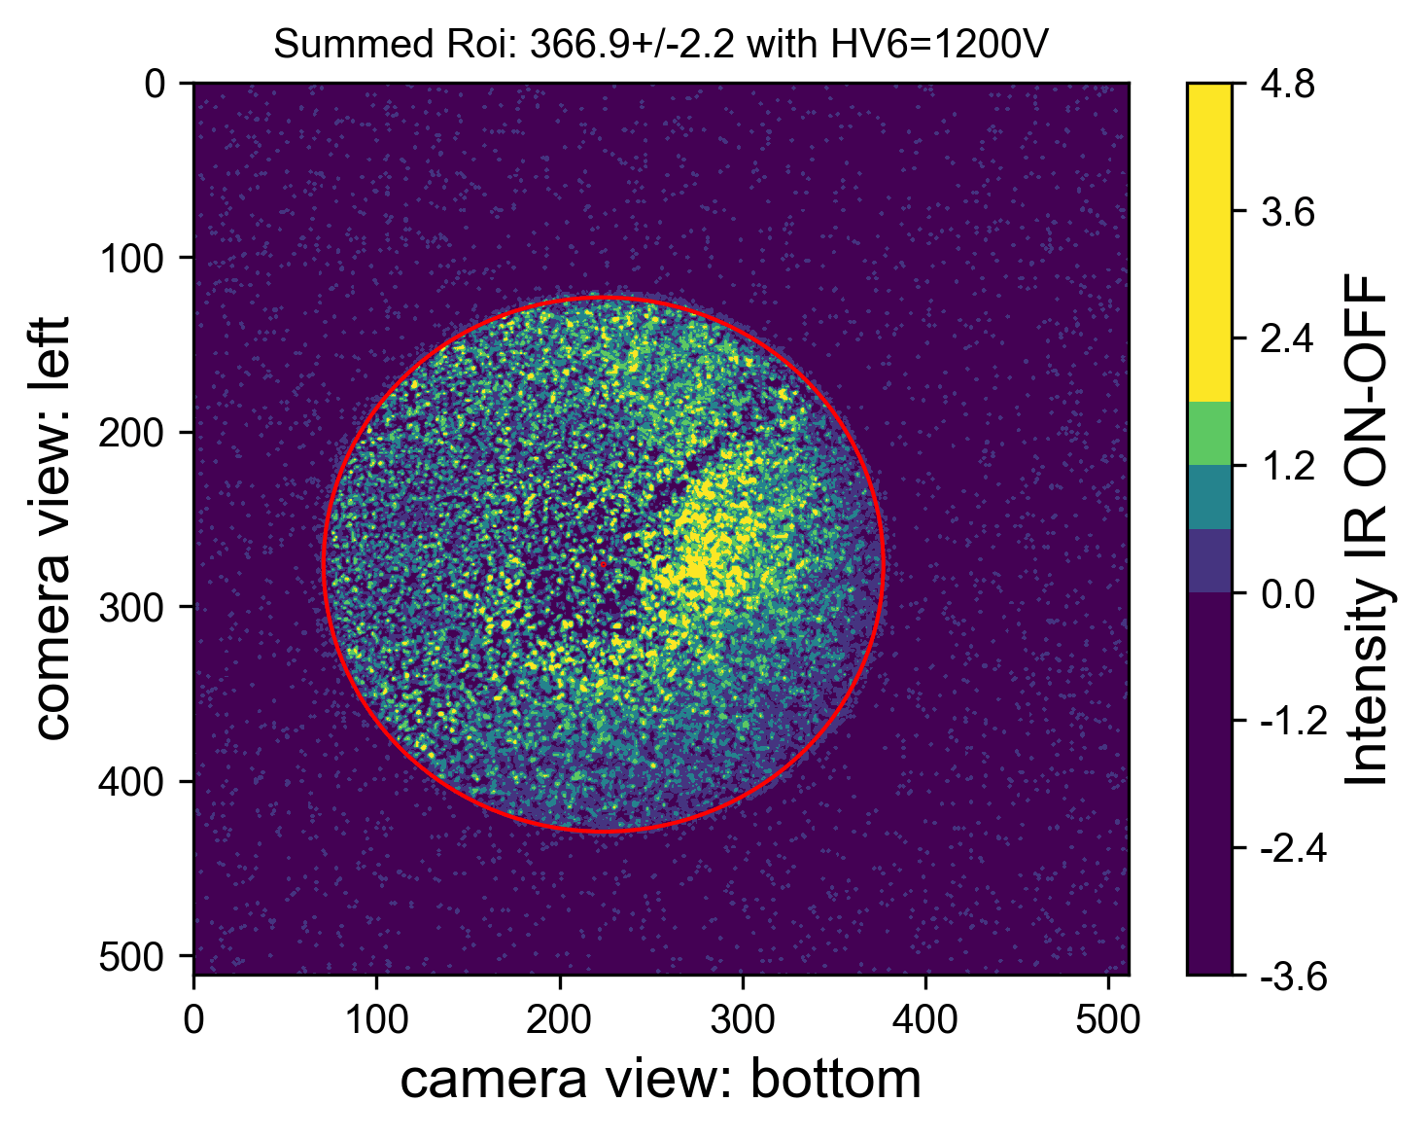
What did we see?
1660nm

Slide 9
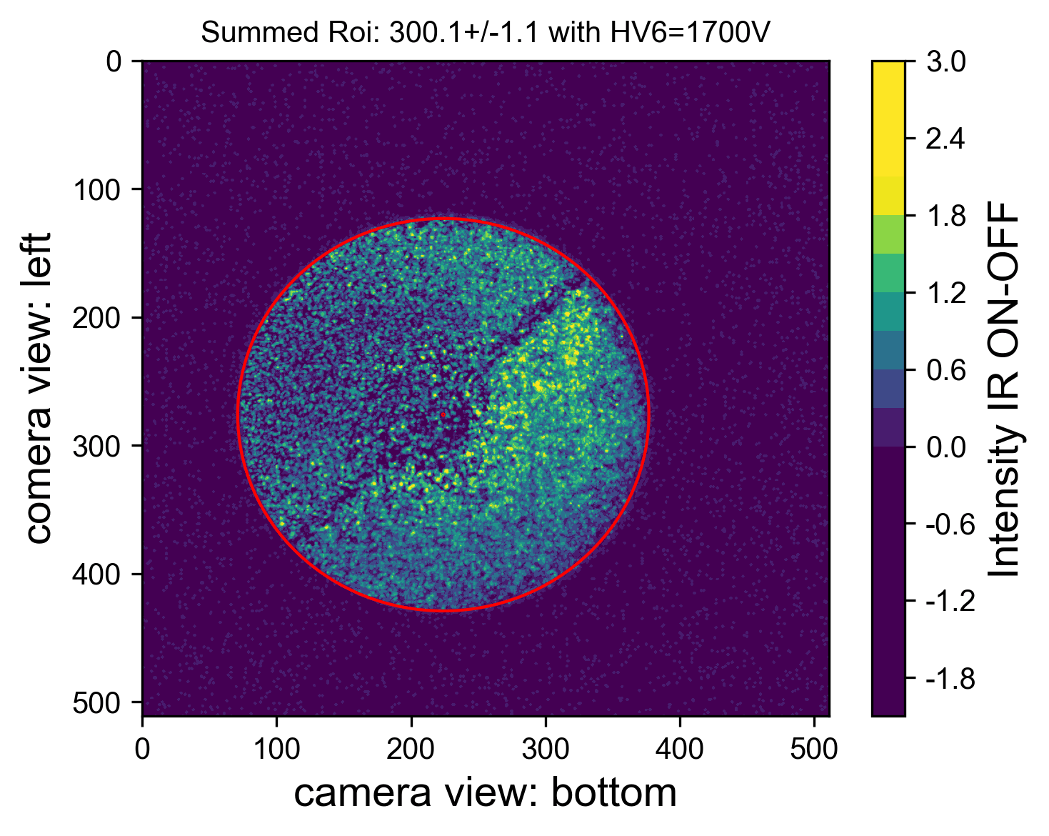
What did we see?
1665nm

Slide 10
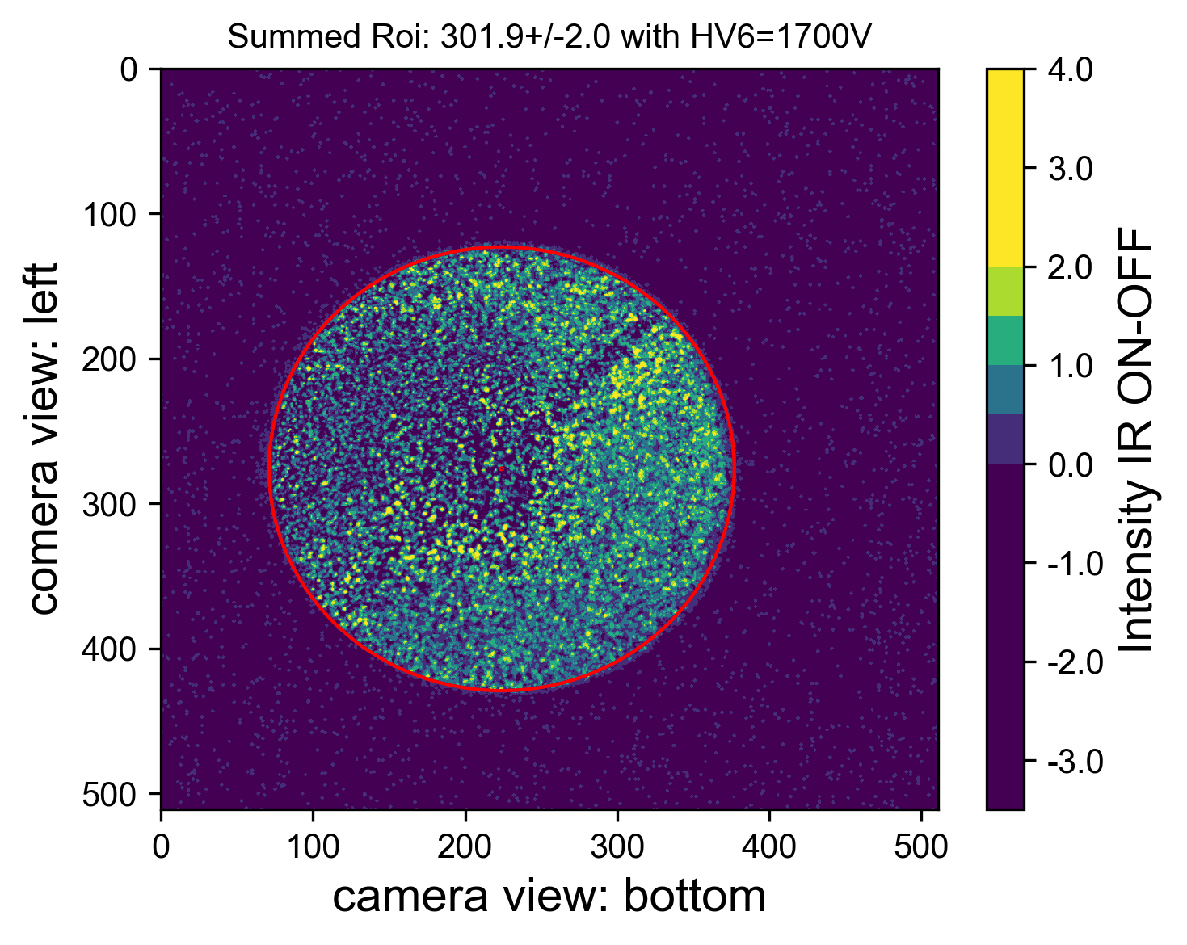
What did we see?
1670nm

