Slide 1

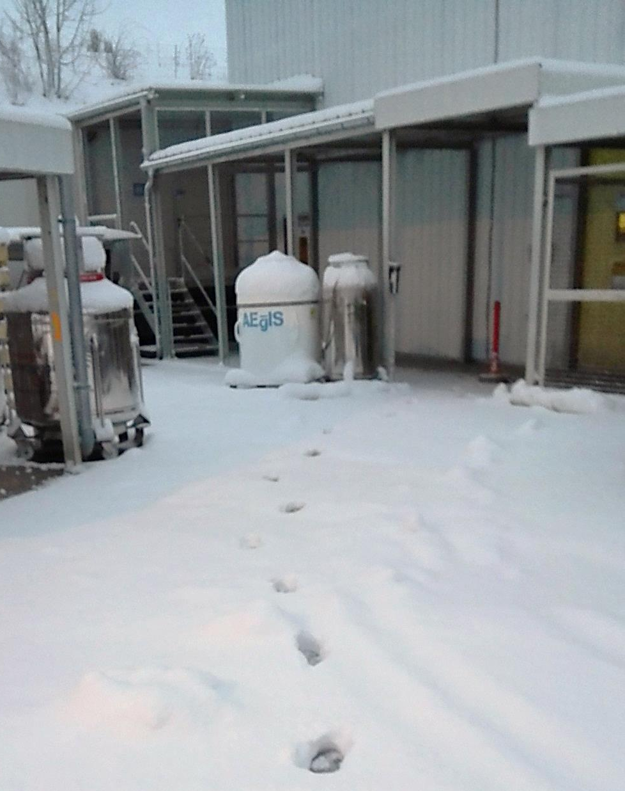

Formation of a forward beam of antihydrogen

Slide 2
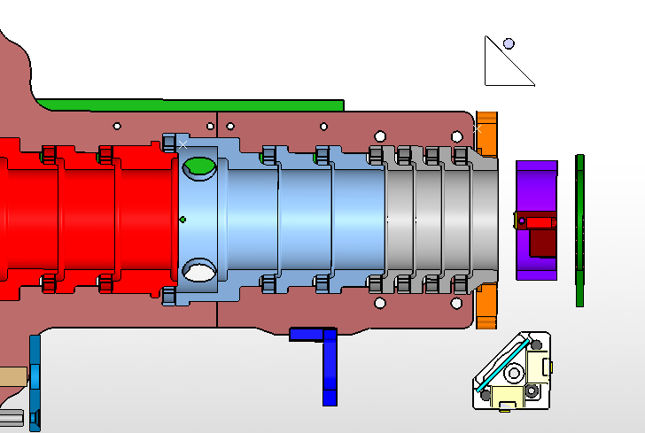
AEgIS-2 antihydrogen production scheme
External Scintillation Detector Array (ESDA)
π±
Fast Annihilation Cryogenic Tracker (FACT)
Excitation lasers
Field ionizing grid
2.5 keV e⁺
Ps*
H*
Removable MCP
B
Field ionizing
electrodes
e⁺/Ps converter
1 cm
Antiproton plasma
Fast Annihilation Cryogenic Tracker (FACT)
π±
External Scintillation Detector Array (ESDA)
π±

Slide 3
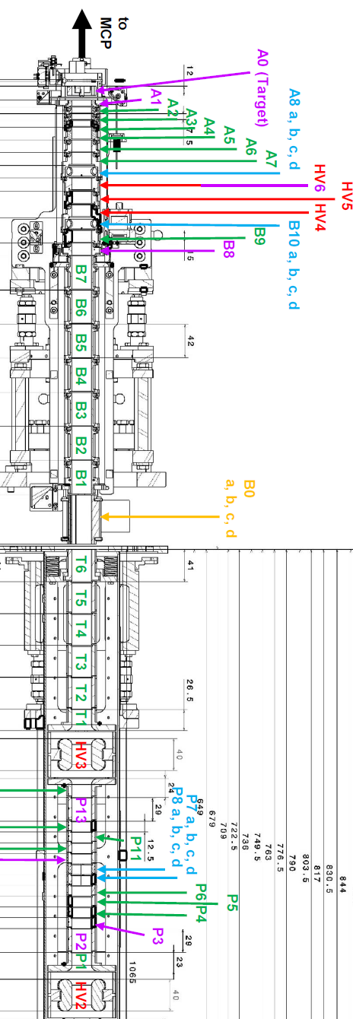
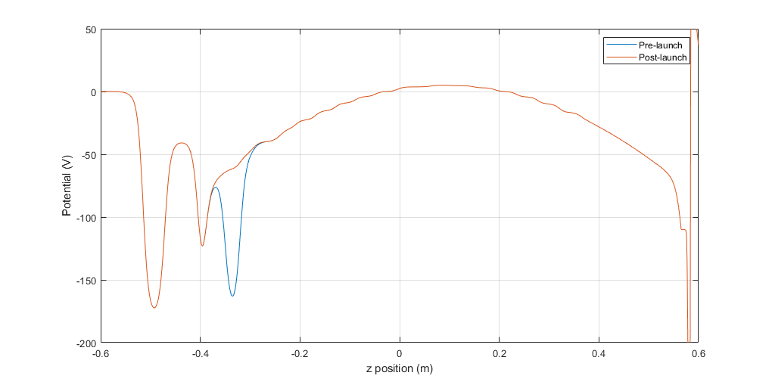
The parabolic transfer potential
A0
P13
G1

Slide 4
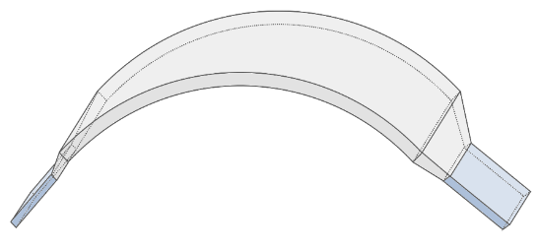
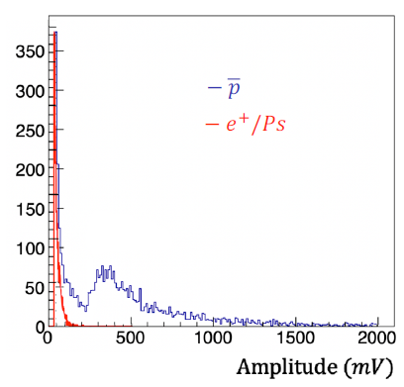
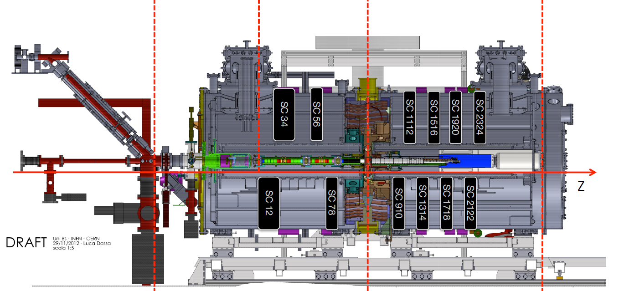
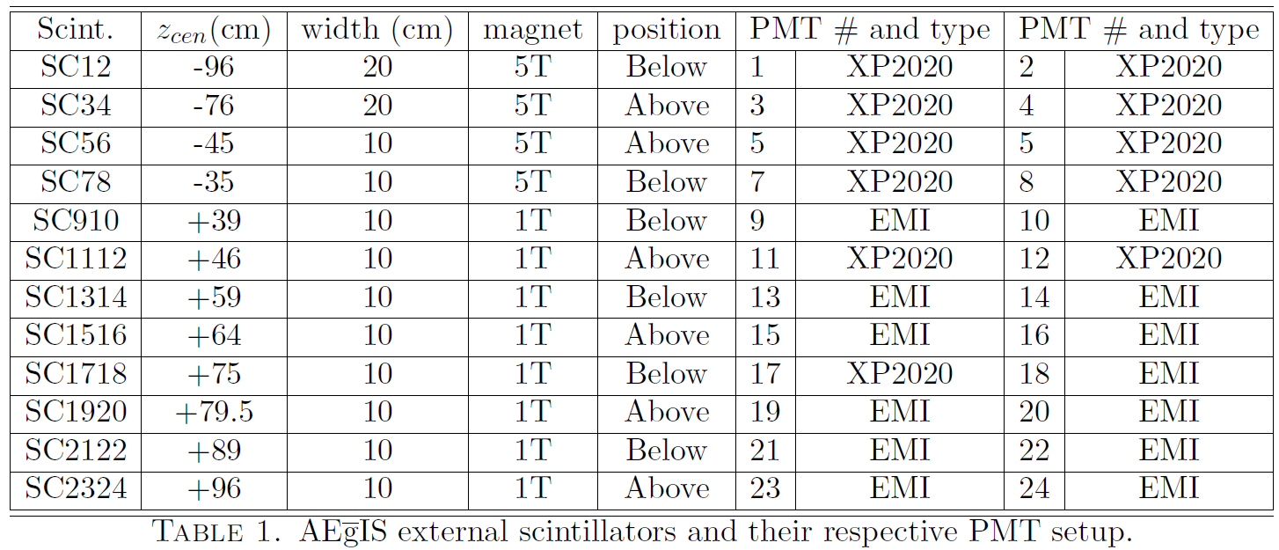
Antihydrogen detector: digitized ESDA
SC12
Need to repeat it!
EJ-200
PMT1
PMT2
MIP threshold
MIP threshold
Scintillator array for MIP detection
4+8 x EJ-200 scintillator slabs
PMT reading on both ends for coincidences
Each PMT digitized at 250 Ms, 12 bit
Software coincidence to reject PMT noise
Amplitude cut to reject gamma background

Slide 5
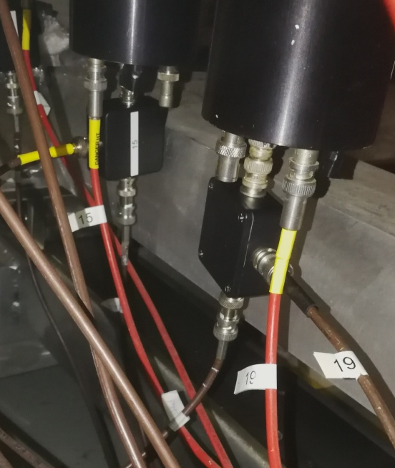
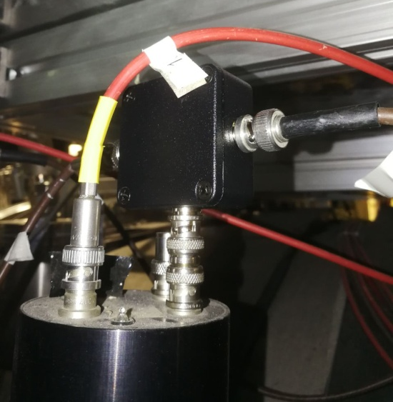
The ESDA digitized acquisition chain in 2023
ESDA single slab, 2024 config
Standard setup
  A 50/50 splitter for each 24 PMT (8 PMT @5Tesla, 16 PMT @1Tesla)
  Splitter connected directly to PMTs output to minimize ringing due to impedence mismatch
  CAEN-digitized r/o: Other end acquired with 20 dB attenuation and CAEN 1720 250 Ms 12 bit digitizer
  SIS-discriminated r/o: two PMTs of the same slab connected to 50ns coincidence unit + SIS counter
SC1920 exception
  Standard splitter at both PMTs
  CAEN-digitized r/o as above
  No SIS-discriminated r/o on PMT20
  LeCroy-digitized r/o on PMT20: the second end of the splitter is acquired with 50/50 splitter by LeCroy 2.5 Gs 12 bit oscilloscope ‘Captorius1’
PMT1
PMT2
SPL
SPL
20 dB
CAEN V1720
20 dB
50 ns coincidence
SIS COUNTER

Slide 6
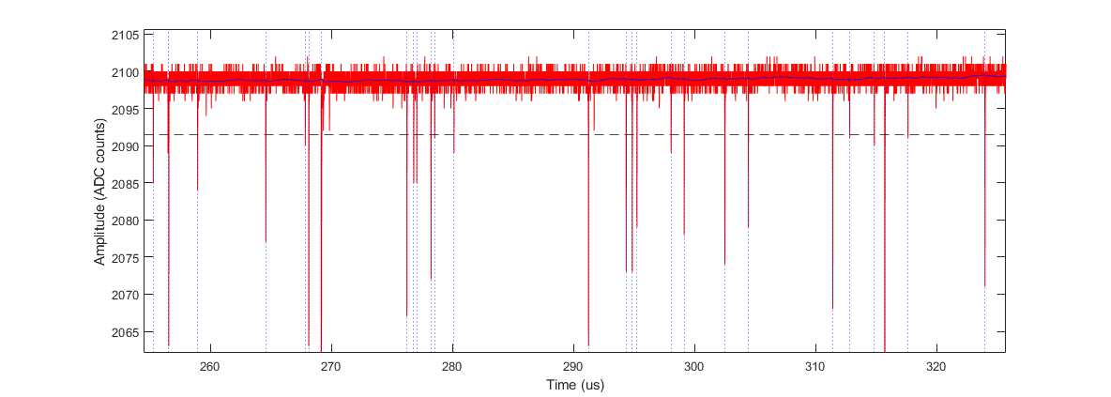
Software trigger and event discrimination
T_{stop}
T_{start}
Baseline follower
Removes HV fluctuations
Threshold discriminator
with hysteresis and hold-off
Robust to noise fluctuat.
Avoids re-triggersd
Assemble event list
Compute event charge
Start time with linear interp.
baseline_val = 0.005 .* A(i)
(1.0 – 0.005) * baseline_val
T_{start} = 10 adc, T_{stop} = 1 adc
hold-off = 0.1 us
Event: pmt, t_start, t_end, A_peak, charge

Slide 7
Coincidence formation within the same slab
PMT_{n}
Coincidences formation
AND on the single PMT events
50 ns coincidence window
PMT_{n+1}
List of coincident events
Average time-of-arrival
Time difference between PMTs
Average deposited charge
Average amplitude

Slide 8
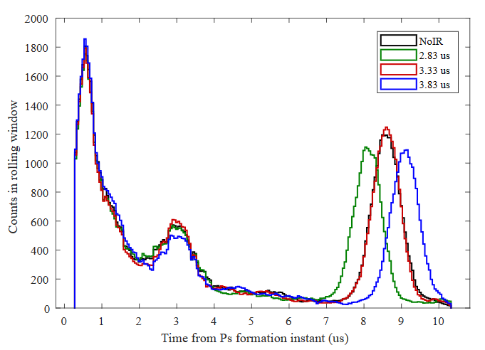
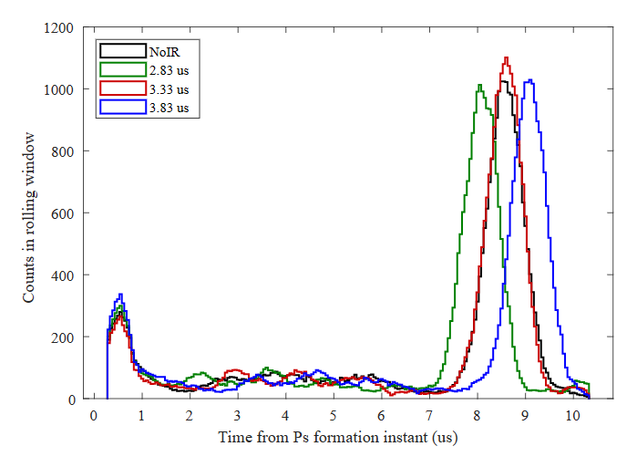
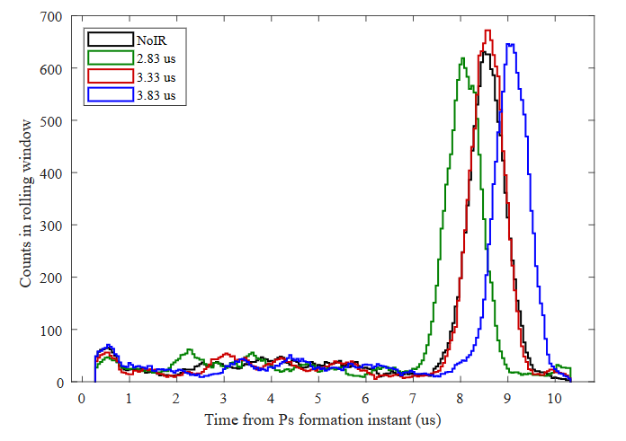
Example: effect of coincidence formation and amplitude/charge cutting
Cancelling of PMT afterpulses
No efficiency loss to
pbar/Hbar detection
No coincidence, no charge cut
Coincidence, no charge cut
Coincidence, charge cut
Reduction in gamma ray background

Slide 9
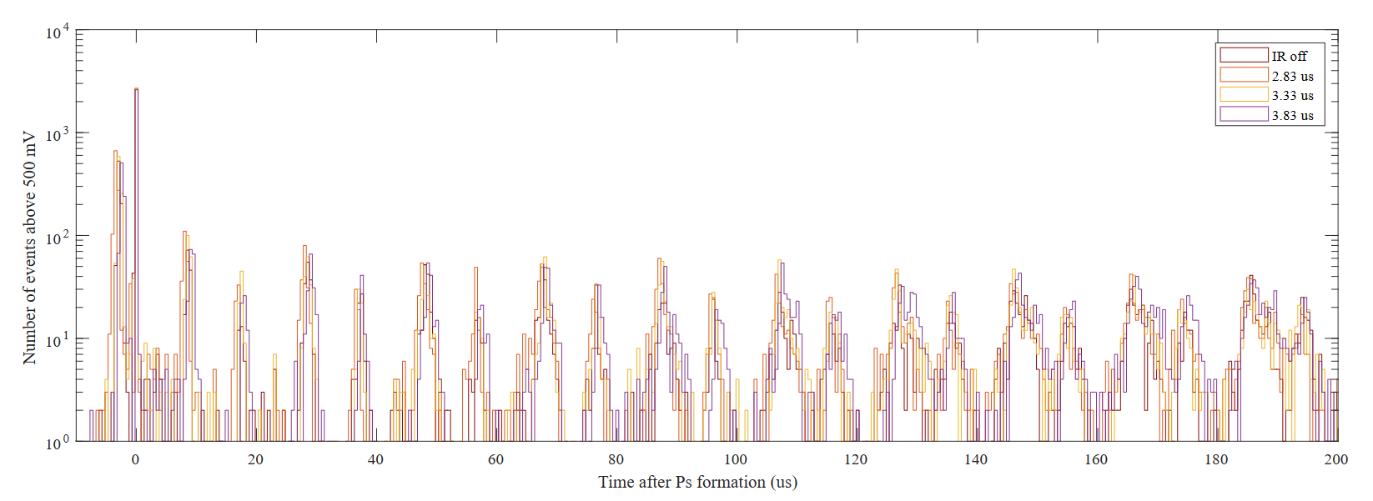
Example signal: a beautiful observation of antiprotons swinging
e⁺ peak at Ps* formation
Hbar search region
Antiproton losses in oscillations

Slide 10
Antiproton/positron sync

Slide 11
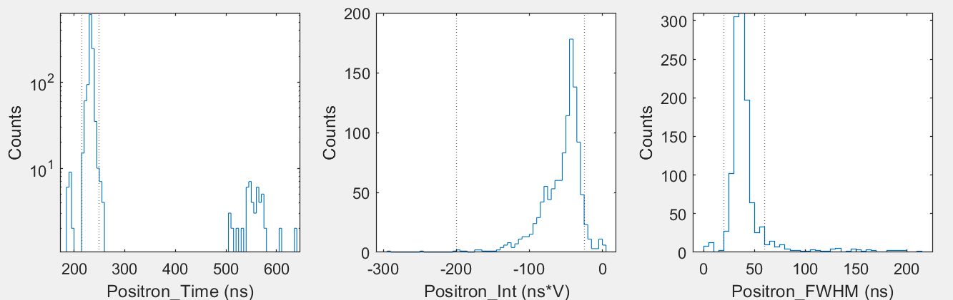
Step 0: positron impact on target
The timing on the PMTDigi is stably 70.7 us
Checked manually for sure more than 10/20 runs over the entire dataset
Captorius1 statistics on positron stability says it’s stable for all the runs with buncher on
Stability analysis of the positron arrival on the target on PMTDigi
Buncher OK
Buncher bad

Slide 12
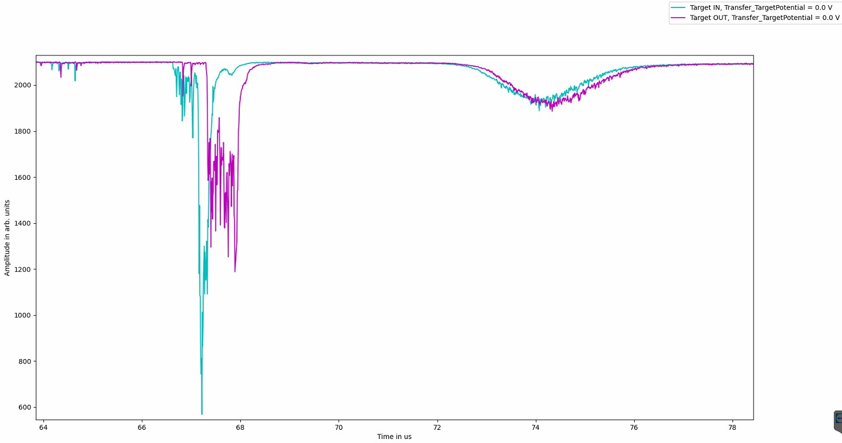
Coarse localization in time of the antiproton peak

Slide 13
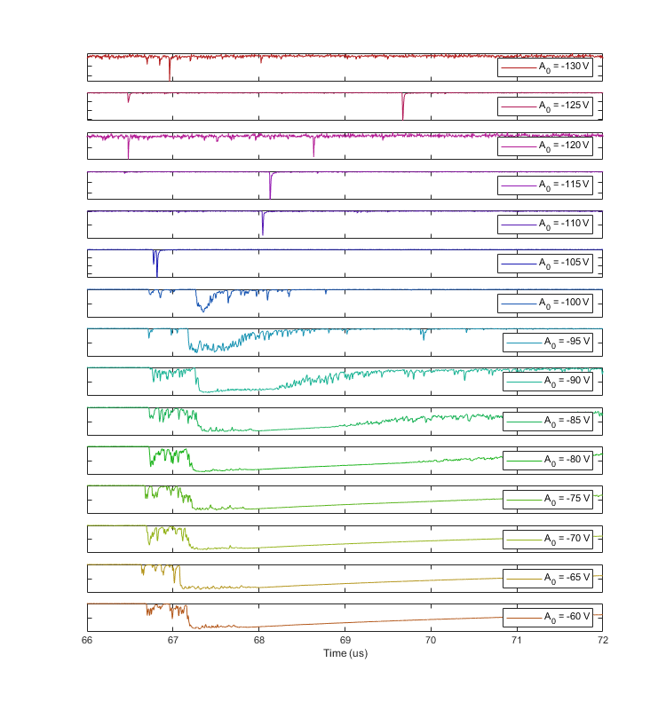
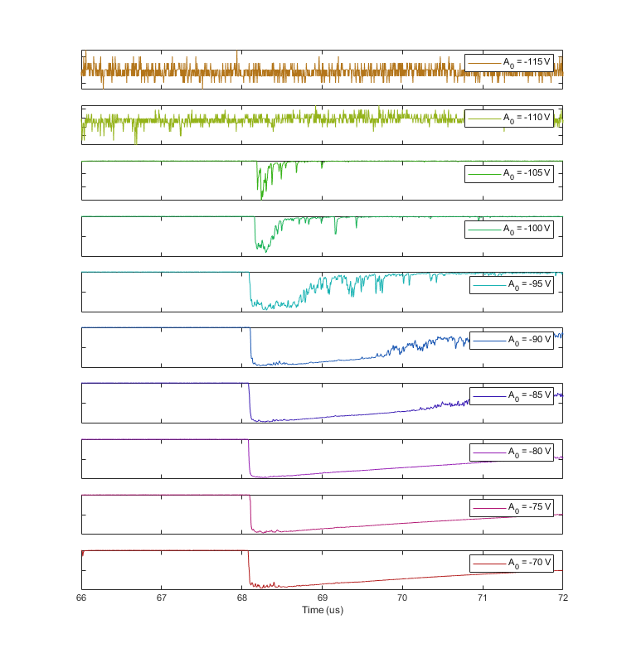
Calibration of antiproton timing
2023
2024
Calibration of antiproton hitting the target by measuring the Raising edge timing: Temptative uncertainty around 100 ns

Slide 14
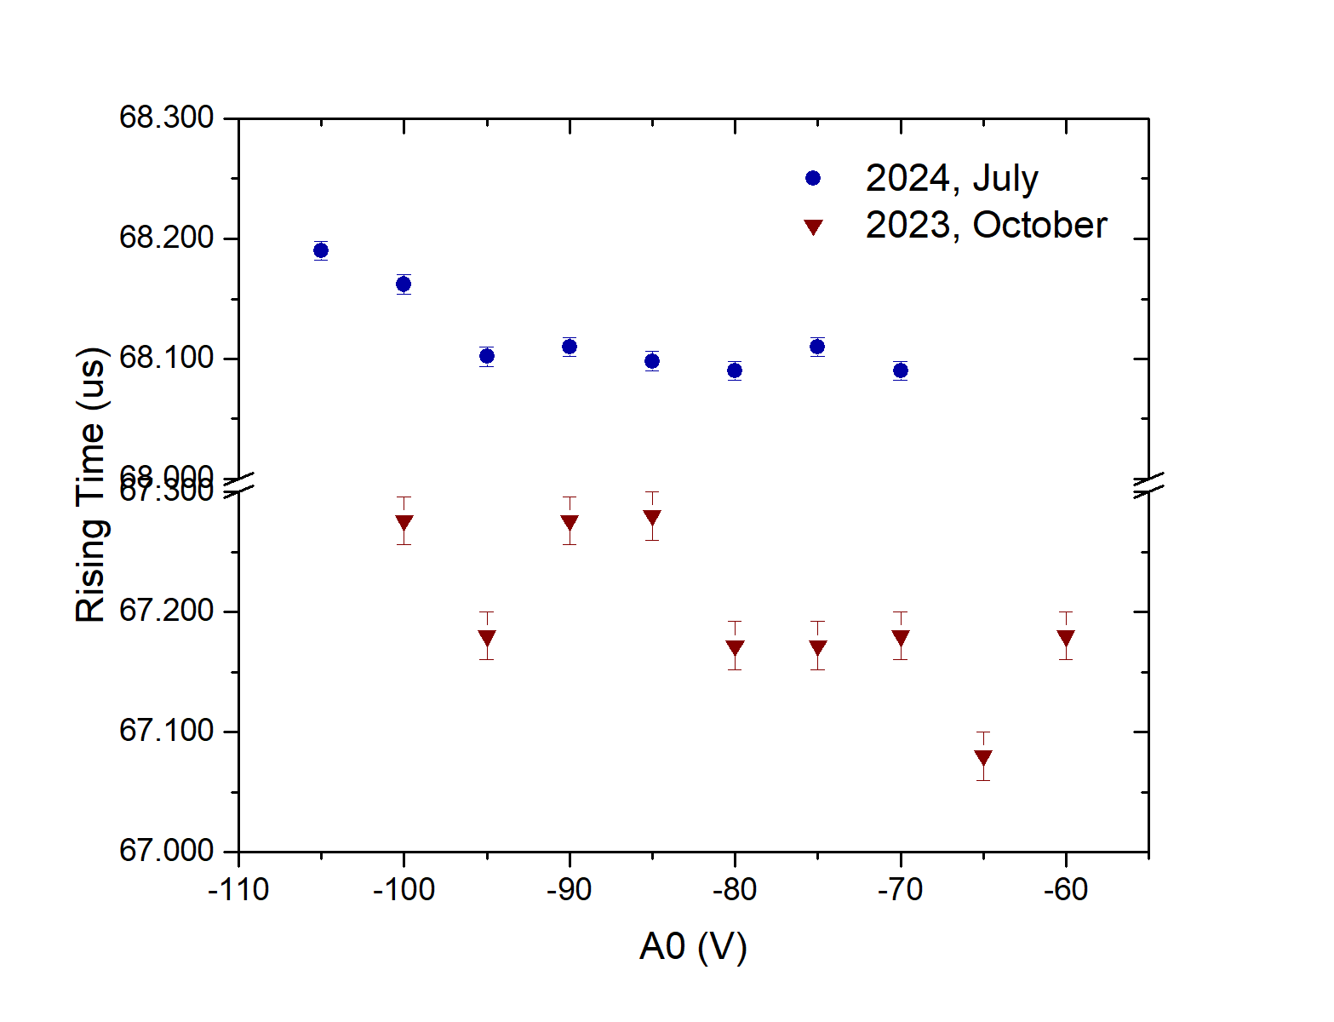
Calibration of antiproton timing, method 1
Observed variation of the absolute arrival time by 1 us: where does it come from?
Between the two measurement pbar recatching developments in early 2024 took place
Sinara is usually very stable: most likely it is a procedural difference (recatching dev.)
A third measurement is needed to establish a minority report
Can this method be “more wrong” than a few 100 ns in the determination of pbar arrival?

Slide 15
Antiproton/positron sync step 2: oscillation losses

Slide 16
A beautiful observation of antiprotons swinging
From 5T to 1T?
Midpoints?
From 1T to 5T?

Slide 17
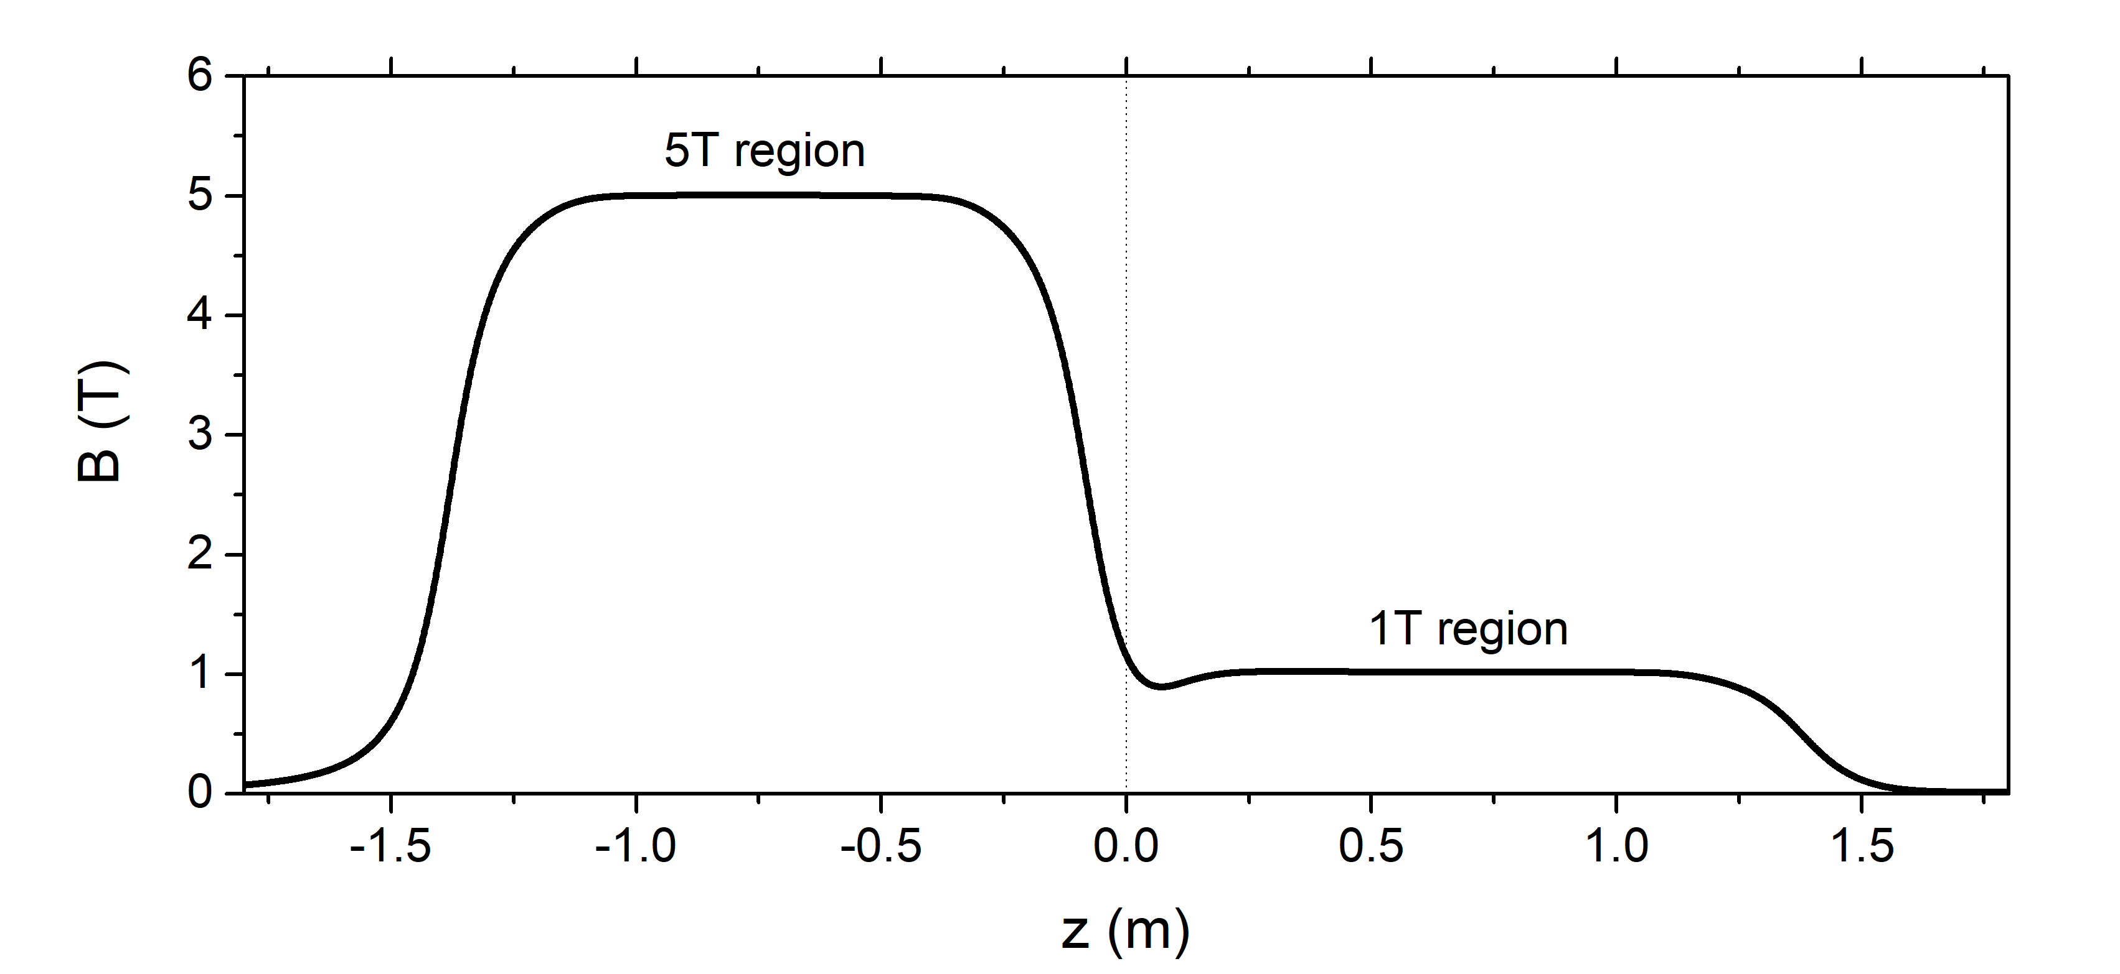
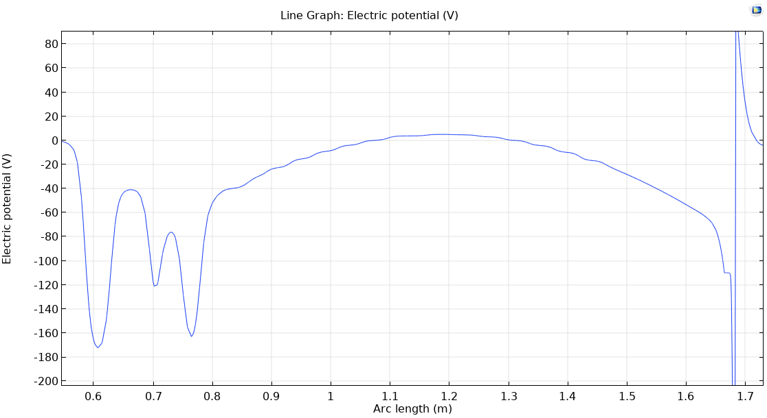
Where are losses occurring?
Here the plasma is largest
Not so sure about this is the correct interpretation
Catching trap
Hbar trap

Slide 18
A beautiful observation of antiprotons swinging
Expected oscillation period in ideal 350 V/m² harmonic trap
From 5T to 1T?
Midpoints?
Observed a staggered double pattern; oscillation periods are roughly 80% of that expected from an ideal harmonic trap.
Is the trap somehow anharmonic?
From 1T to 5T?

Slide 19
Understanding the swing period: anharmonicities
A0
P9
Answer: yes, because of the plasma space charge & potential used
We should expect a mild dependence of the oscillation frequency by the antiproton energy

Slide 20
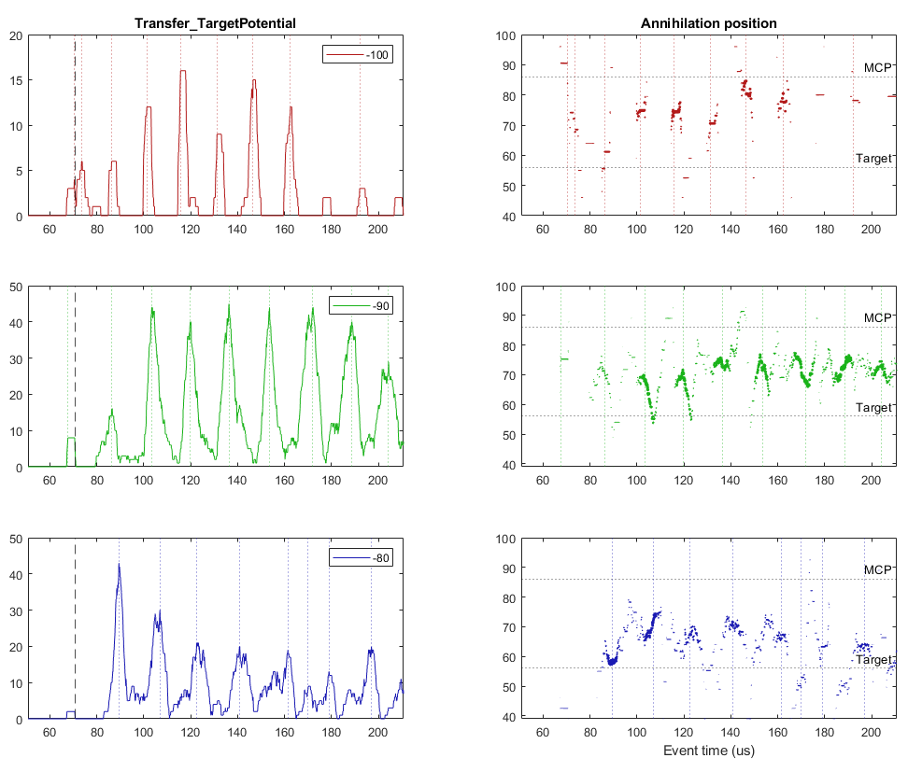
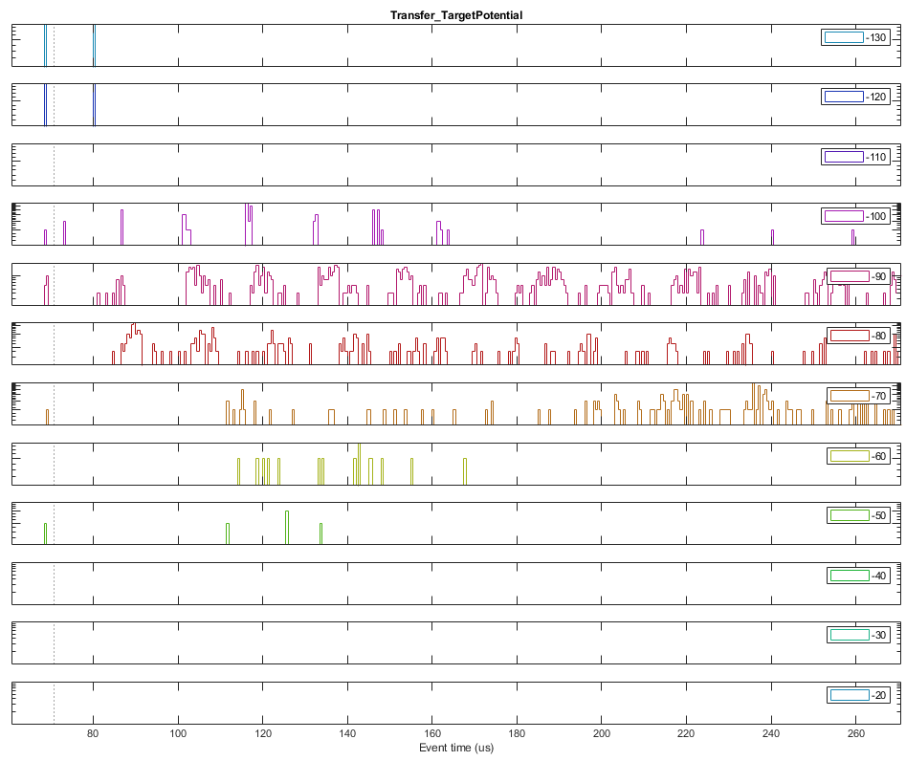
Swinging pbars while scanning the A0 potential
72.5 us
69.5 us
Measurement of the plasma space charge
Measurement of the oscillation period wrt the energy
Measurement of the annihilation position
Annihilations z consistent with target; staggered pattern not present with monoenergetic pbars coming from the trap axis

Slide 21
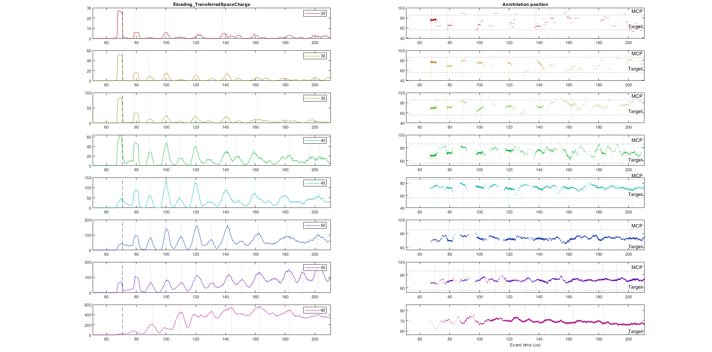
Swinging pbars while increasing the electron space charge
Also here annihilations seem to come from the target
Onset of the staggering as the space charge increases
More modeling is needed

Slide 22
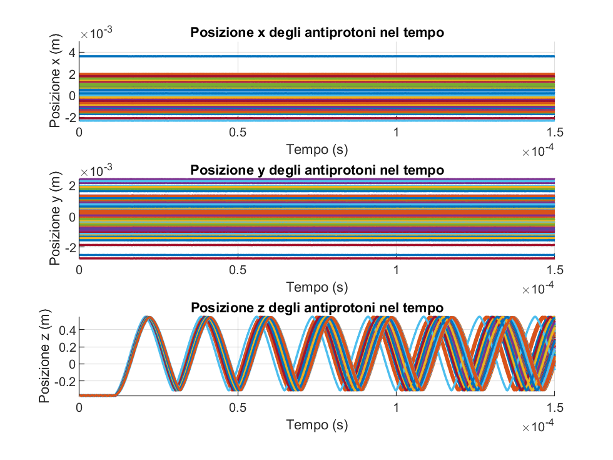
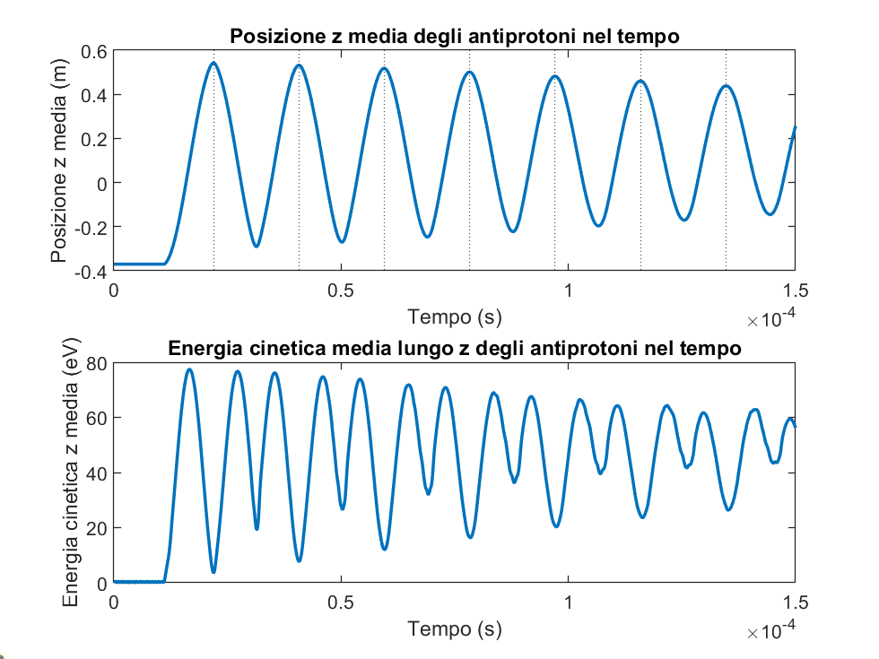
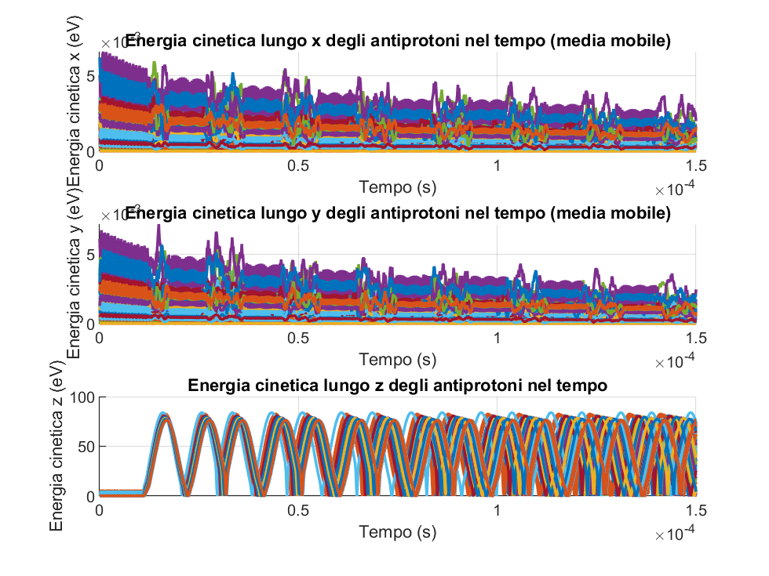
Initial approximated modeling of antiproton swings

Slide 23
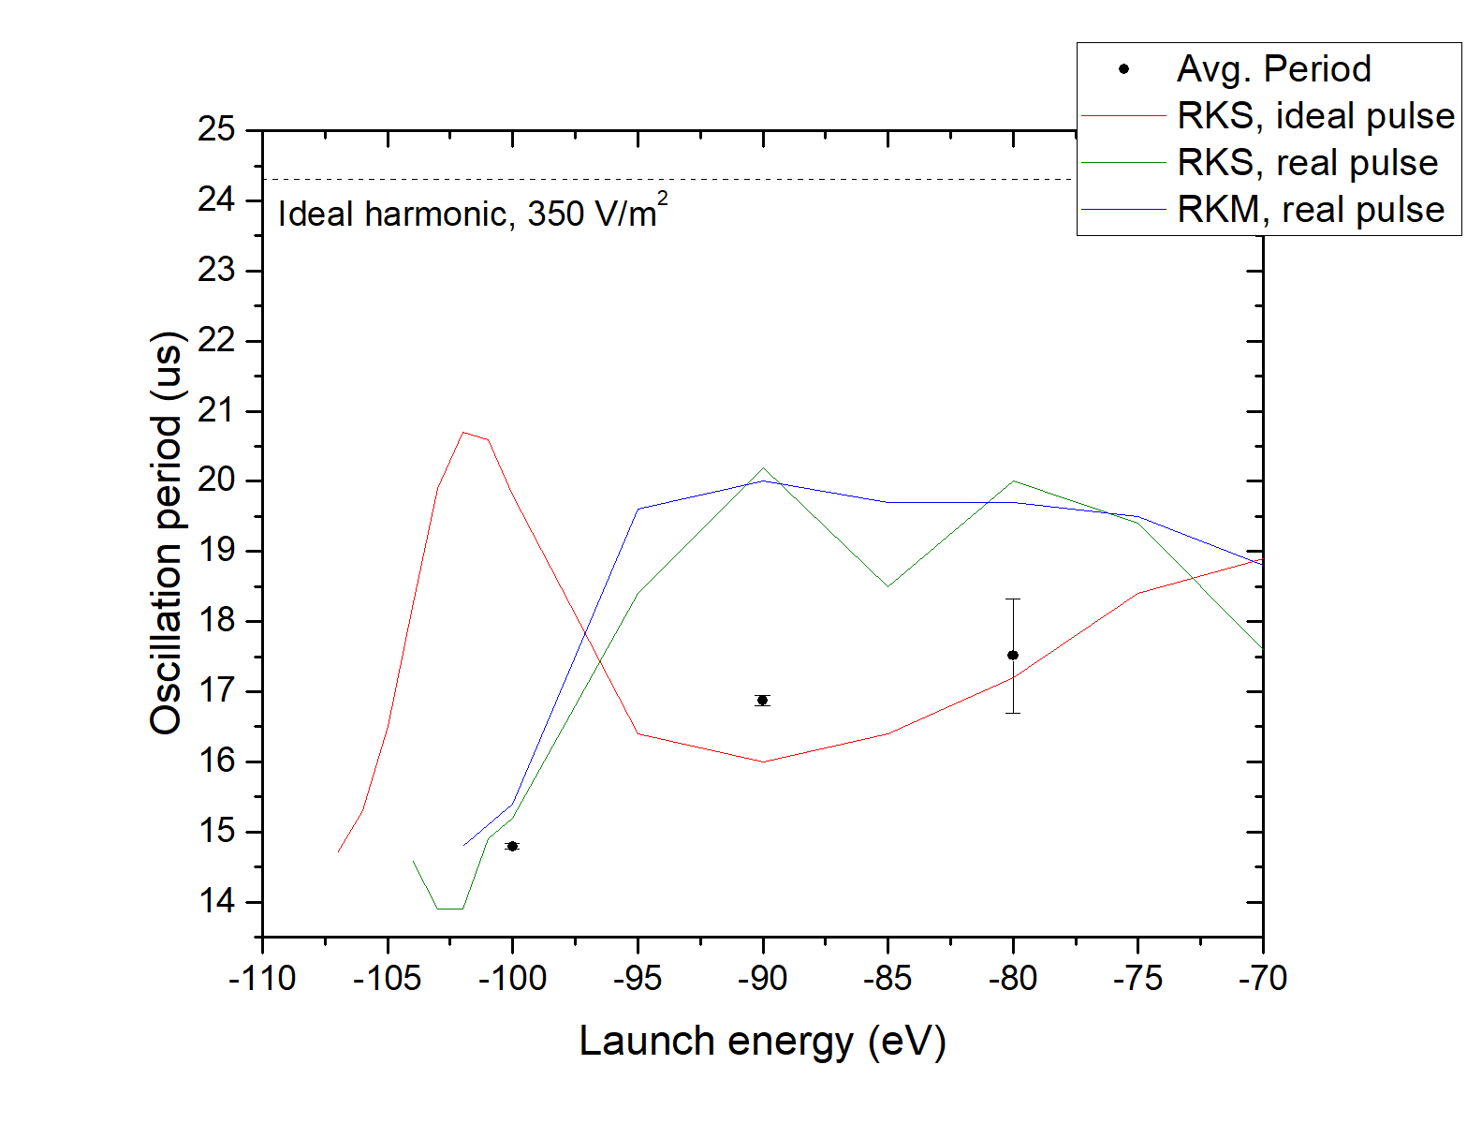
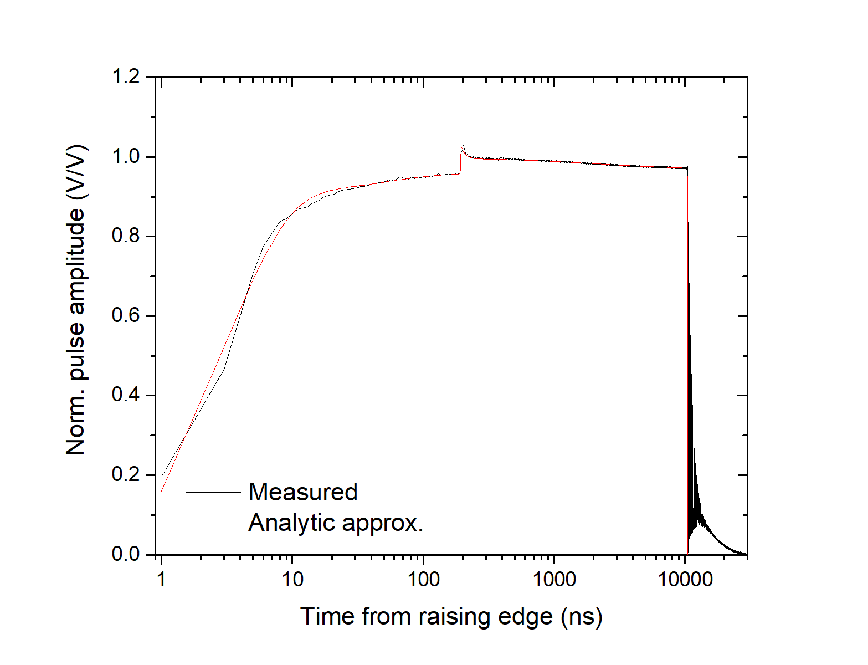
A beautiful observation of antiprotons swinging
Unphysical
Anharmonic trap + imperfect pulse
Accurate knowledge of the P13 extraction pulse is crucial for modeling

Slide 24
Looking for antihydrogen
2023

Slide 25
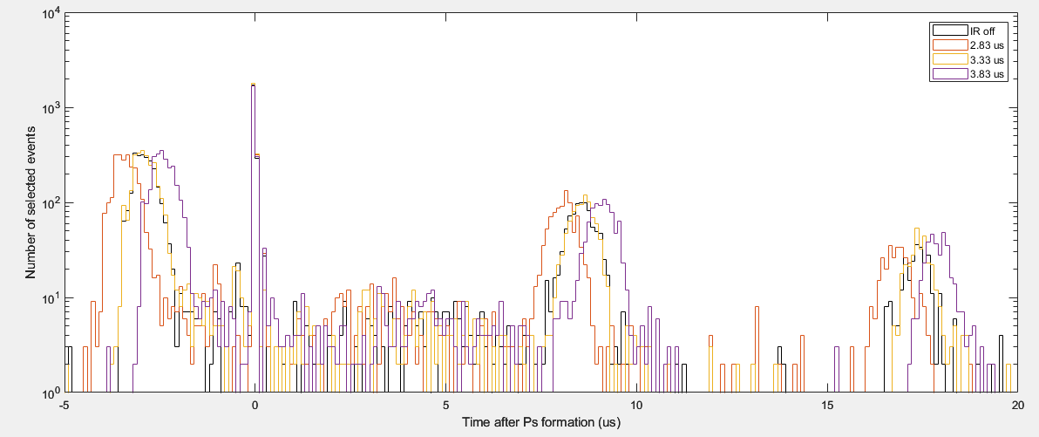
A beautiful observation of antiprotons swinging
From 5T to 1T
Midpoints
From 1T to 5T
Hypothetical conclusion: time calibration procedure was off by us
we were always sending positrons too early, i.e. with a forward boost

Slide 26
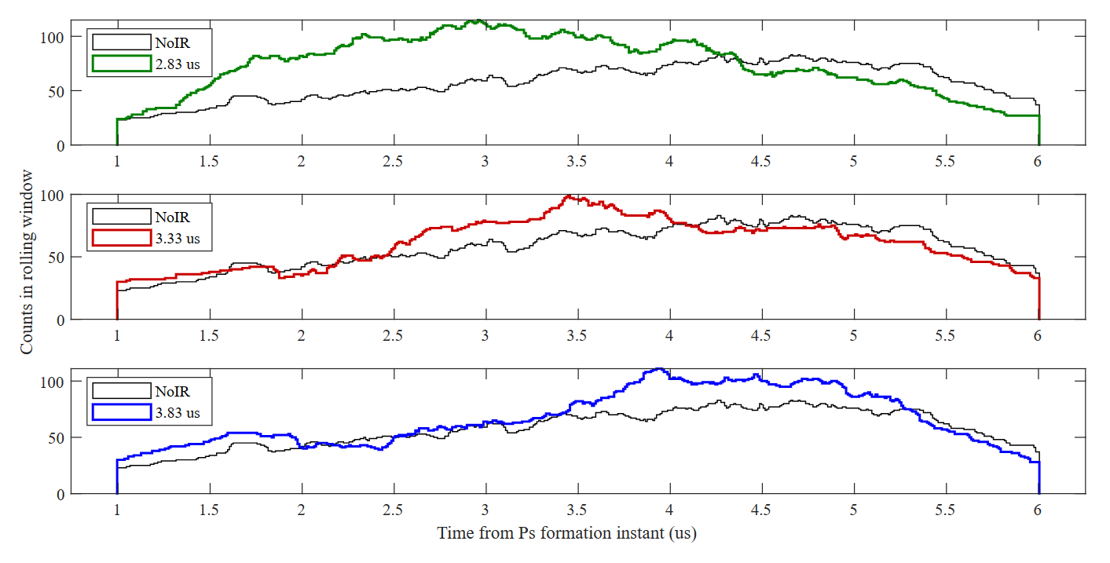
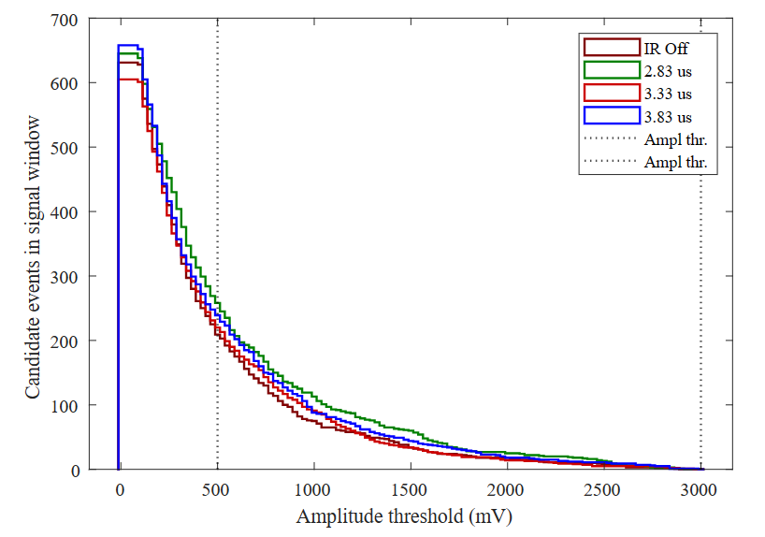
Evidence of some antihydrogen produced in 2023
500 ns
500 ns
All antihydrogen was hitting obstacles in the production region

Slide 27
Antihydrogen 2024 dataset summary
Analysis ToDo
PMTDigi
  Discriminated events
  Analog excess
PCOEdge
  Search for tracks
  Analog excess
Captorius 1
  1TMCP search for events
  1TMCP analog excess
Captorius 3
  UV amplitude & timing
  Amount of e⁺ and Ps
  SSPALS laser excit.
Avantes
  Calibration & IR bandwidth
SIS
  Antiprotons at Catch
  Antiprotons at HD
  Antiprotons in Swing
  Hbar search?
Dataset | IonGrid | Setting | Comment
HbarLog154 | OUT |  | No Ps
HbarLog155 | OUT |  | No Ps
HbarLog156 | OUT |  | No Ps
HbarLog157 | OUT | 2/3/4 | No Ps
HbarLog158 | OUT |  | No Ps
HbarLog159 | YES |  | No Ps
HbarLog161 | YES |  | No pbars
HbarLog163 | YES | 0 us
HbarLog164 | YES | -1 us
HbarLog165 | YES | -2 us
HbarLog166 | YES | -3 us
 |  | -4 us
HbarLog167 | YES |  | Centr. sep.
HbarLog168 | YES |  | Centr. sep.
HbarLog170 | YES |  | Centr. sep.

Slide 28
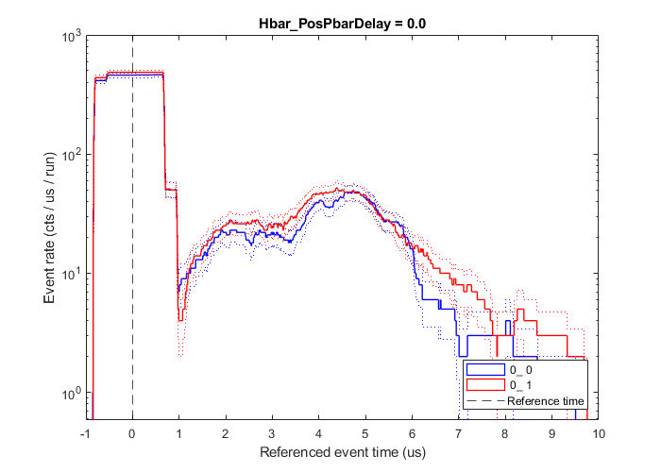
RunLog161 – background (no pbars)

Slide 29
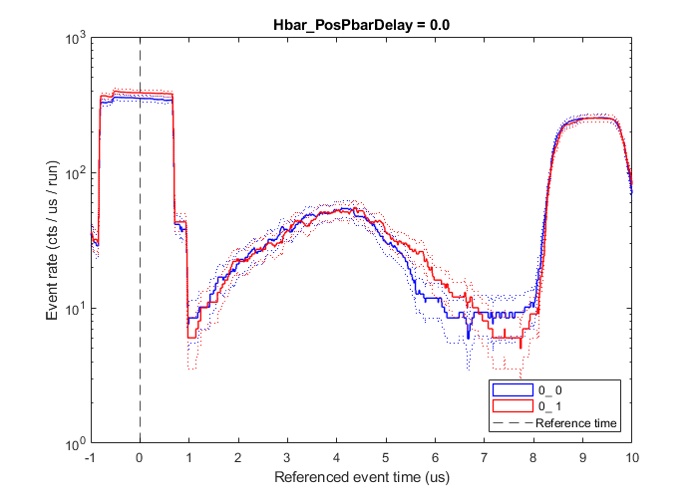
RunLog163 – very late antiprotons

Slide 30
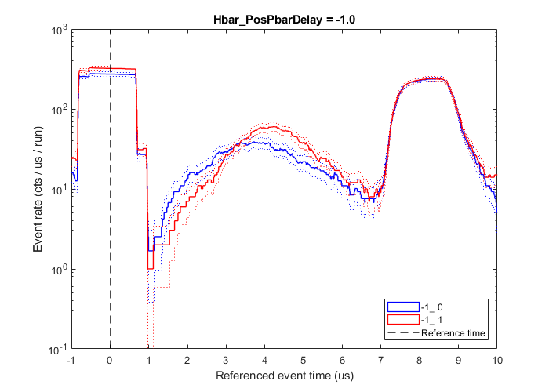
RunLog164 – late antiprotons

Slide 31
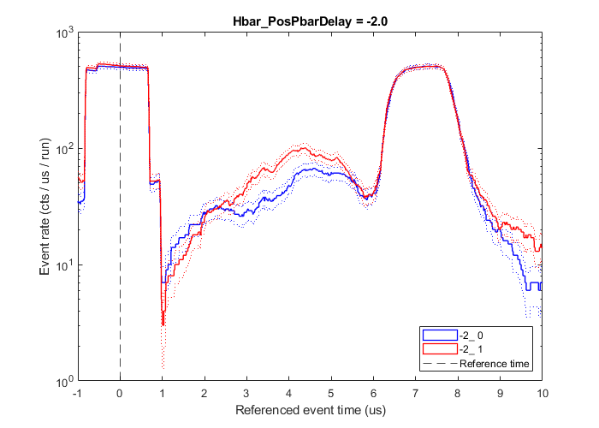
RunLog165 – early antiprotons

Slide 32
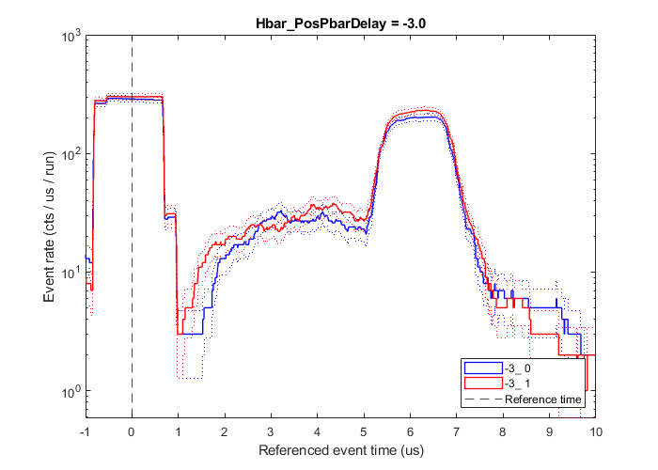
RunLog166a – very early antiprotons

Slide 33
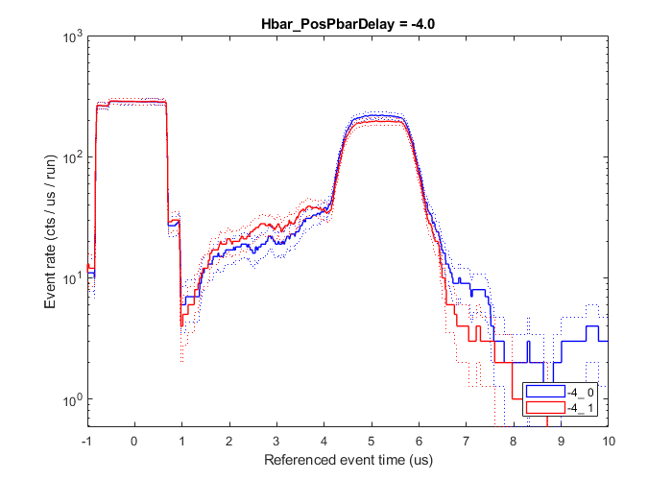
RunLog166b – even earlier antiprotons

Slide 34
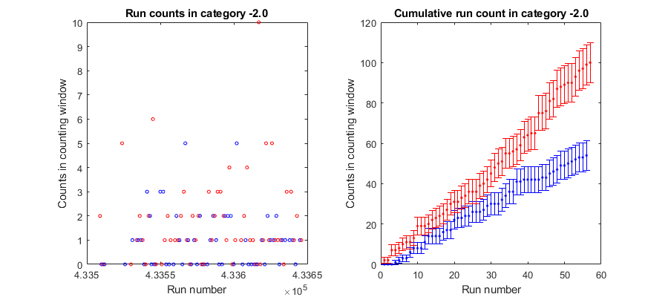
Sanity checking

Slide 35
RunLog164 – late antiprotons
65 positives vs 44 negatives
Signific. (Poiss.) = 2.9 sigma
Signific. (o1) = 3.1 sigma
21 events in 36 runs
0.6 events per run
40% det. Efficiency
.: 1.5 Hbar produced per run :.

Slide 36
RunLog165 – early antiprotons
96 positives vs 51 negatives
Signific. (Poiss.) = 5.6 sigma
Signific. (o1) = 5.6 sigma
45 events in 56 runs
0.8 events per run
40% det. Efficiency
.: 2.0 Hbar produced per run :.

Slide 37
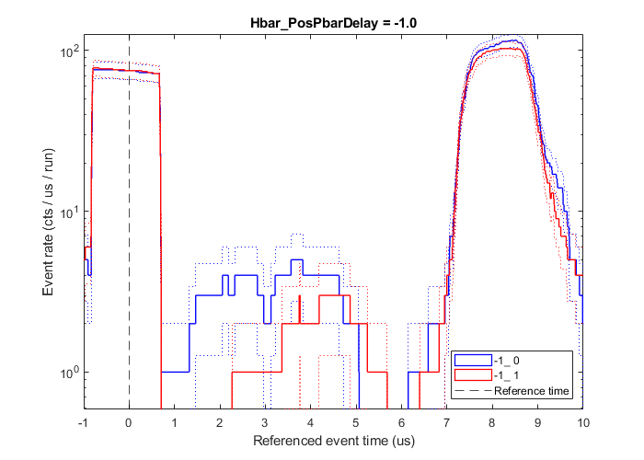
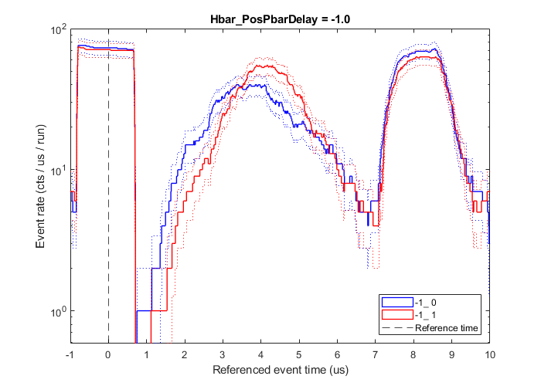
RunLog165 – late antiprotons
SC1314, SC1516
SC2122, SC2324

Slide 38
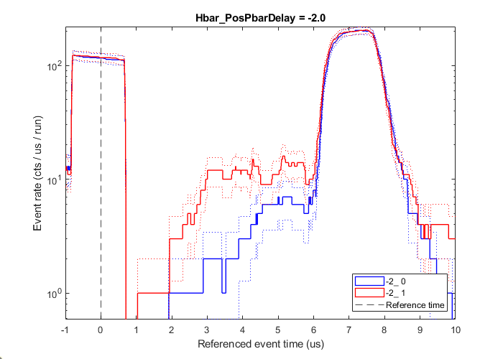
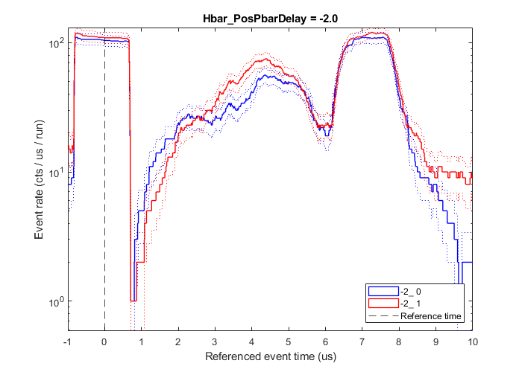
RunLog166 – early antiprotons
SC1314, SC1516
SC2122, SC2324

Slide 39
Modeling

Slide 40

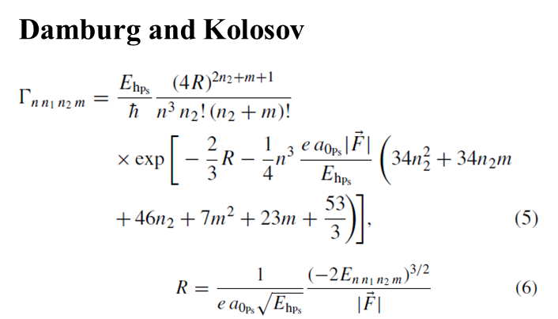




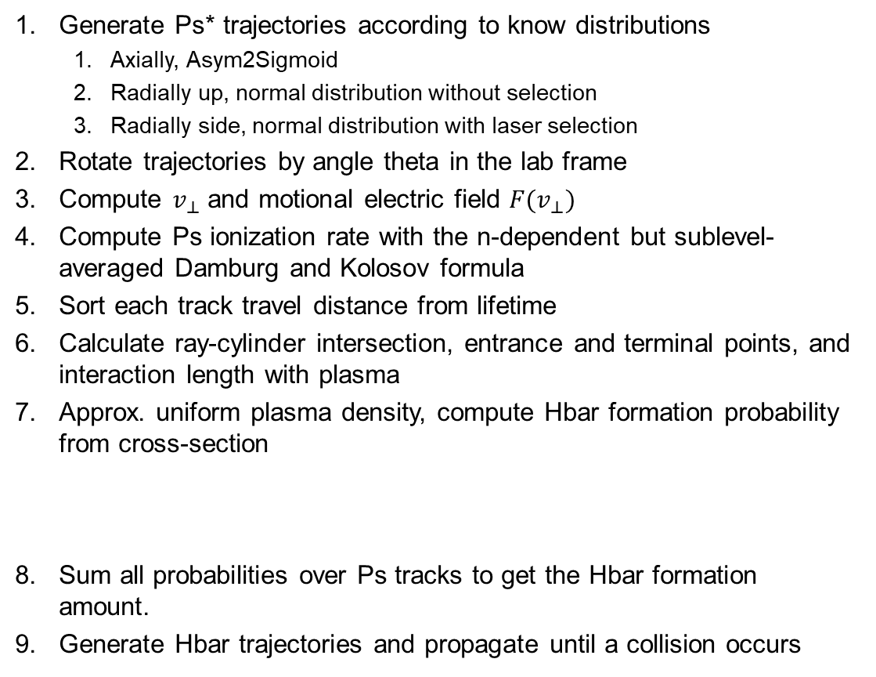


Antihydrogen formation modeling
Generate Ps* trajectories according to know distributions
  Axially, Asym2Sigmoid
  Radially up, normal distribution without selection
  Radially side, normal distribution with laser selection
Rotate trajectories by angle theta in the lab frame
Compute $v_{⊥}$ and motional electric field $F(v_{⊥})$
Compute Ps ionization rate with the n-dependent but sublevel-averaged Damburg and Kolosov formula
Sort each track travel distance from lifetime
Calculate ray-cylinder intersection, entrance and terminal points, and interaction length with plasma
Approx. uniform plasma density, compute Hbar formation probability from cross-section
Sum all probabilities over Ps tracks to get the Hbar formation amount.
Generate Hbar trajectories and propagate until a collision occurs
$$θ$$
$$h$$
$$d$$
$$L_{int}$$
N. Zurlo et al. (AEgIS collaboration), Hyperfine Interactions 240 (2019), 18

Slide 41
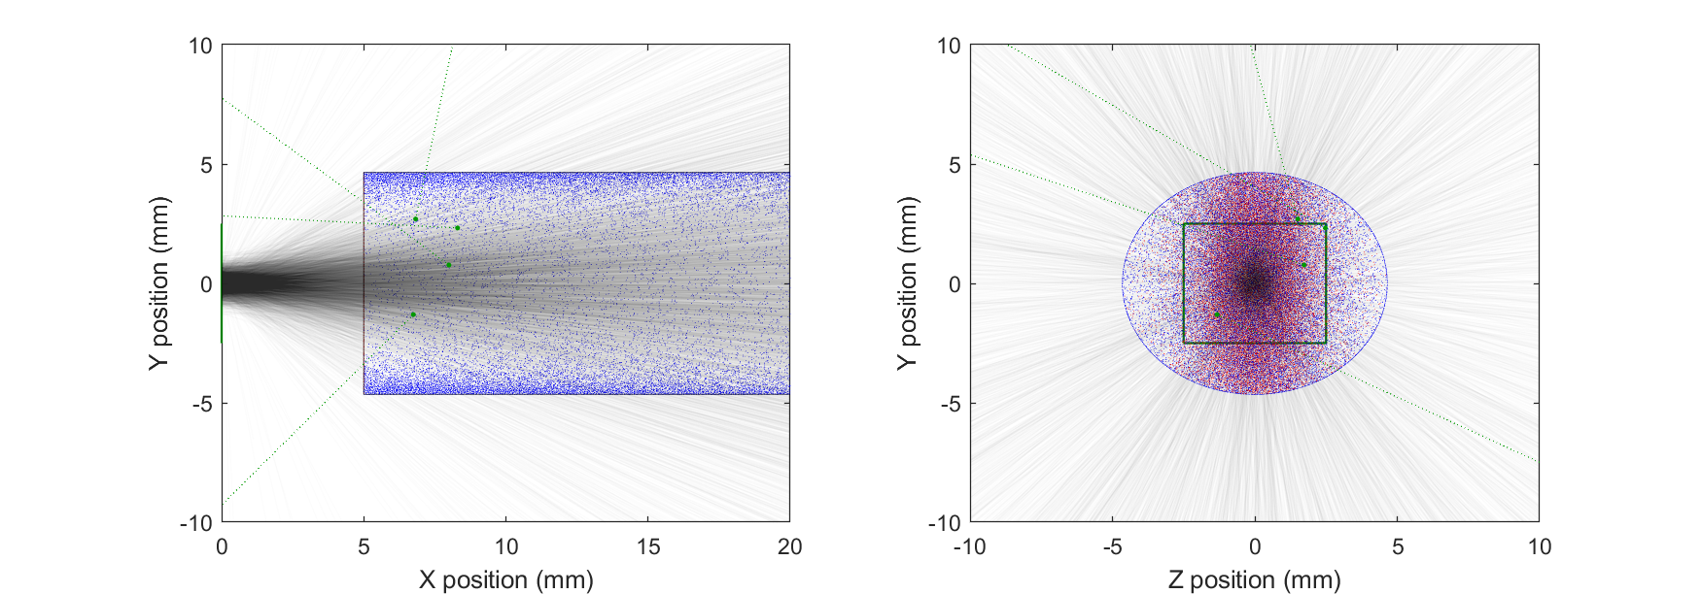
An example of simulation result: Hbar in 2024
N_{Ps*} = 0.8 · 10⁵ N_{pbar} = 2.0 · 10⁶ L_{p} = 20 mm d_{p} = 9.3 mm
Computed Hbar production rate: 2.6 per run

Slide 42
Next steps

Slide 43
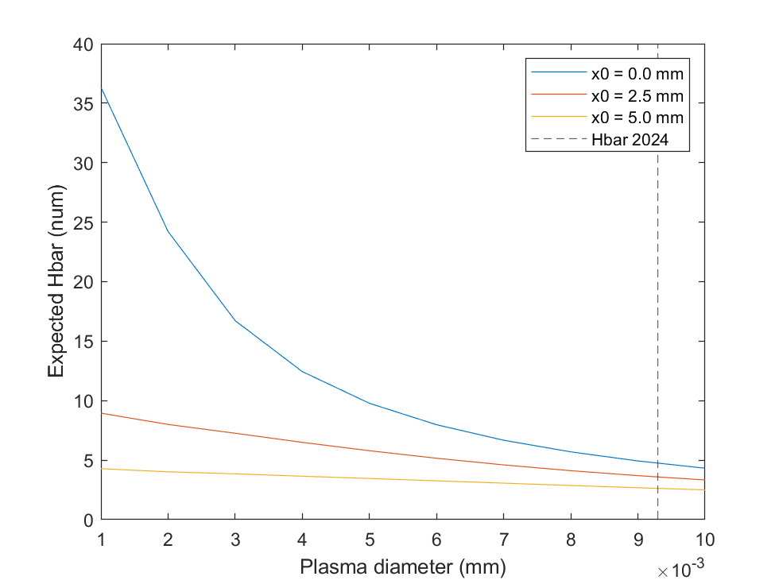
What happens if we leave all as is, and we compress the pbars?
OnAxis, study with d and x0

Slide 44
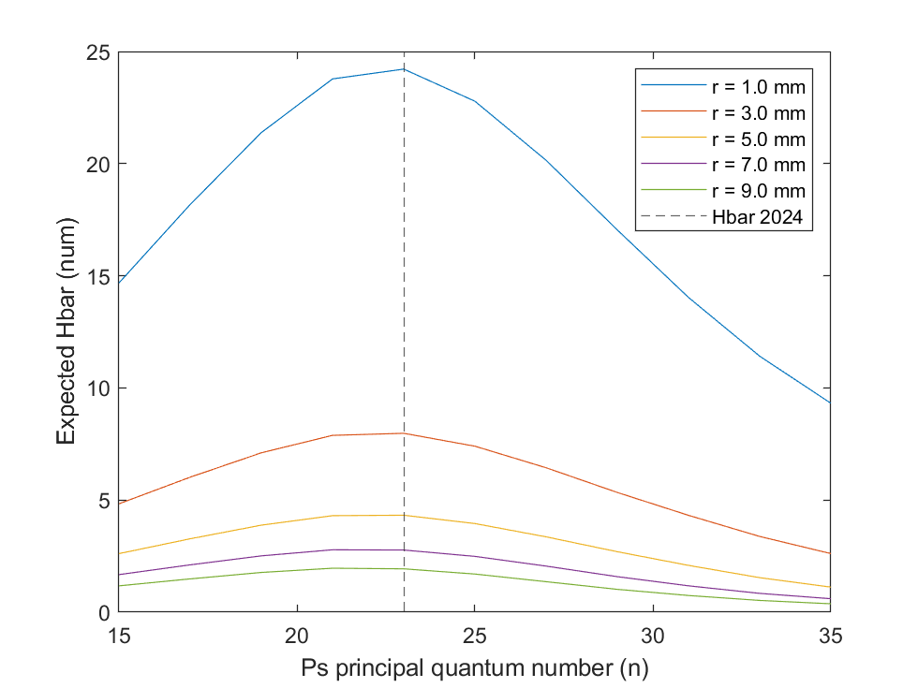
How much antihydrogen should we expect if we increase Rydberg level?
OnAxis, study with n and d

Slide 45
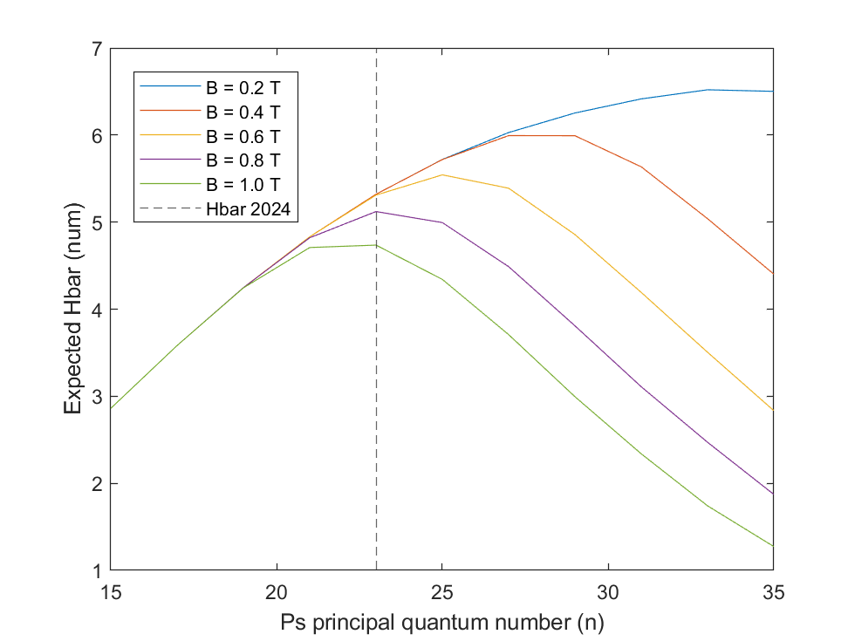
How much antihydrogen should we expect if we increase Rydberg level?
OnAxis, study with n and B

Slide 46

Estimating the forward-produced antihydrogen
Trick: oversample the number of produced antihydrogens, sorting on the same Ps* trajectories
Compute collision with the target (rotated rectangle) and with the domain (cylinder)
Define forward/backward fractions according to the traject. angle wrt the axis (10 cm / 88 cm)

Slide 47

How much antihydrogen should we expect if we go off axis?
Study with B = 1 T, h = 4 mm, d = 4 mm

Slide 48

How much antihydrogen should we expect if we go off axis?
Study with B = 0.2 T, h = 4 mm, d = 4 mm

Slide 49



Considered scenarios
Stacking
On-axis, B = 1 T, n = 22, d = 4.0 mm, N_{stack} = 4, L = 3.5 mm
  => 21.6 Hbar/shot, 0.32 forward (2.1 %)
On-axis, B = 0.2 T, n = 32, d = 4.0 mm, N_{stack} = 4, L = 3.5 mm
  => 27.7 Hbar/shot, 0.40 forward (1.4 %)
Off-axis, B = 1 T, n = 19, d = 0.8 mm, h = 1.5 mm, $θ=45°$
  => 15.0 Hbar/shot, 0.43 forward (2.9 %)
Off-axis, B = 0.2 T, n = 32, d = 2.0 mm, h = 3.2 mm, $θ=60°$
  => 10.5 Hbar/shot, 0.33 forward (3.2 %)
Pbar RW
Modeling of the plasma E x B is completely missing at the moment

