Slide 1

Overview of HCI campaigns 2024
AEGIS Collaboration meeting December 2024
Fredrik PG

Slide 2
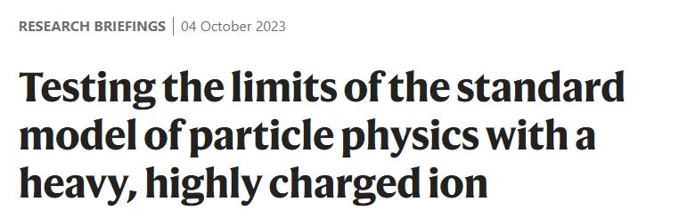

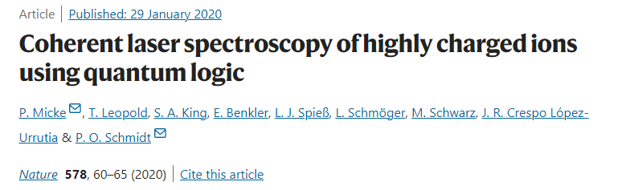
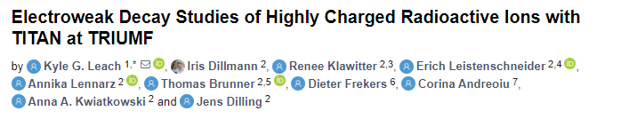
Highly Charged Ions (HCIs)
HCIs are atoms stripped of most or all their electrons.
Exhibit extreme electromagnetic properties:
  - Ideal for test of strong field QED
  - Enhanced sensitivity to nuclear structure (QCD)
Radioactive HCIs have supressed decay:
- Electron capture no longer possible (Weak interaction studies)

Slide 3
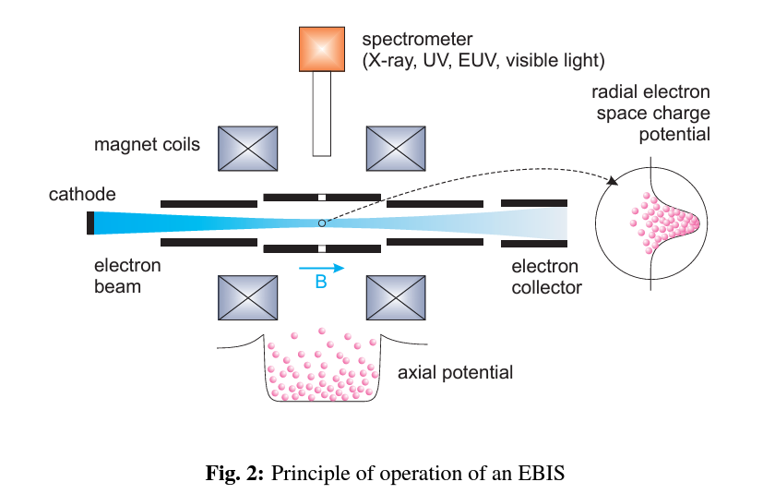
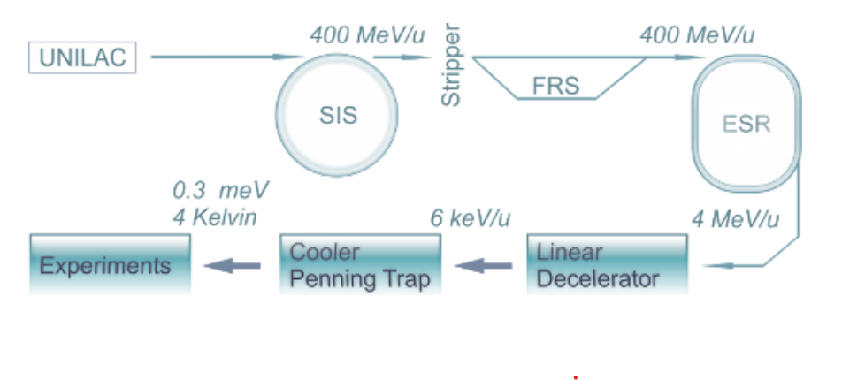
Traditional HCI formation at radioactive beam facilities:
Electron beam ionization:
High energy beam through stripper foil:
Zschornacka, G., M. Schmidt, and A. Thorn. "Electron beam ion

Slide 4
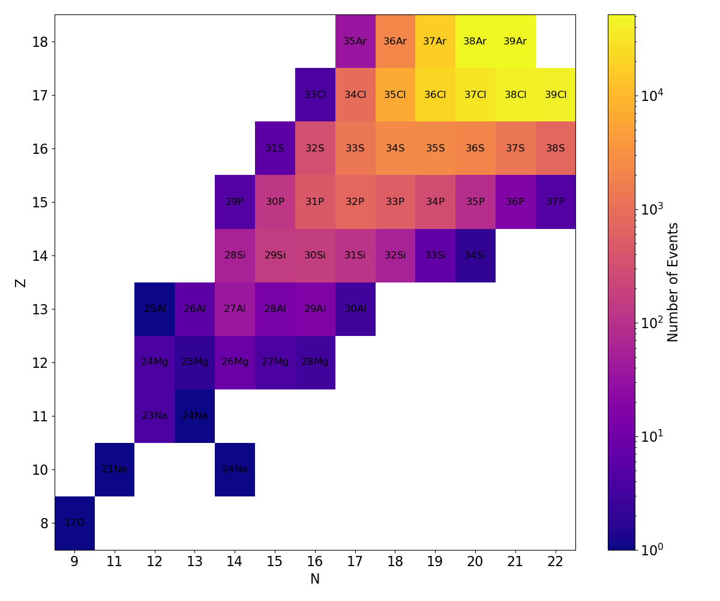





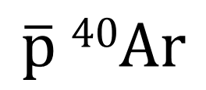



The life of an antiprotonic atom
$$e^{−}$$
$$\overline{p}$$
$$\overline{p} 40Ar$$
Capture of the antiproton in a high-n Rydberg state.
$$\overline{p}$$
$$e^{−}$$
Cascade emitting x-rays and Auger electrons.
$$e^{−}$$
Antiproton approaching stripped nucleus, strong interaction influences orbitals.
$$π$$
Annihilation on nucleus results in the formation of Highly Charged (radioactive) Ions (HCIs)
$$π$$
Notes:
The antiproton will decay through transitions, emitting auger electrons, followed by radiative emission of x-ray photons.
Energy levels shifted by strong interaction (benchmark for QCD)
Nuclear resonances resulting from antiproton decay.
Annihilation occur once the wavefunction overlap the with the nucleus.

Slide 5
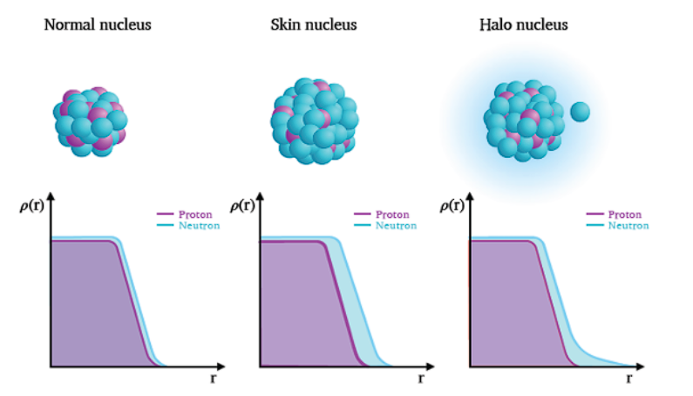
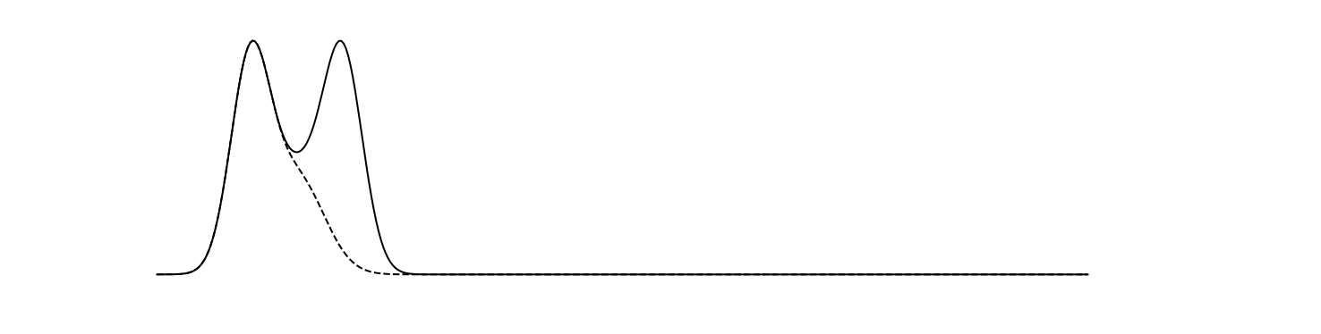
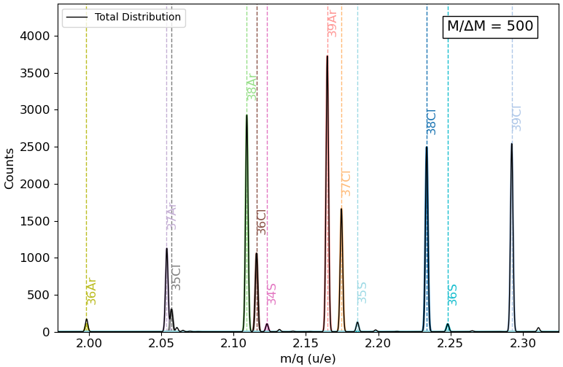



Trapping and TOF spectroscopy of fragments
Neutron skin
Trapped fragments
A+
A+
MCP
$$R_{np}=Y(N−1)/Y(Z−1)$$
$$\overline{p} 40Ar$$
$$Y(N−1)$$
$$Y(Z−1)$$

Slide 6
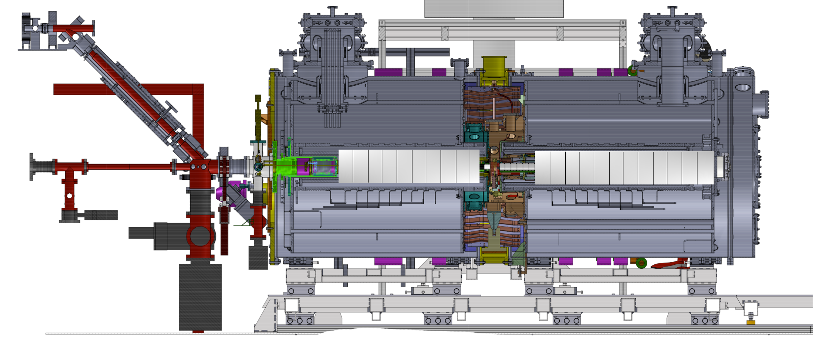
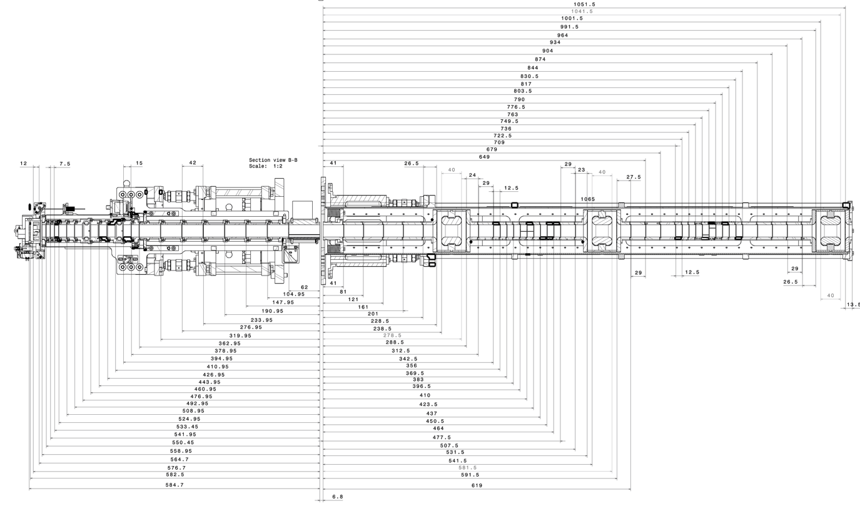
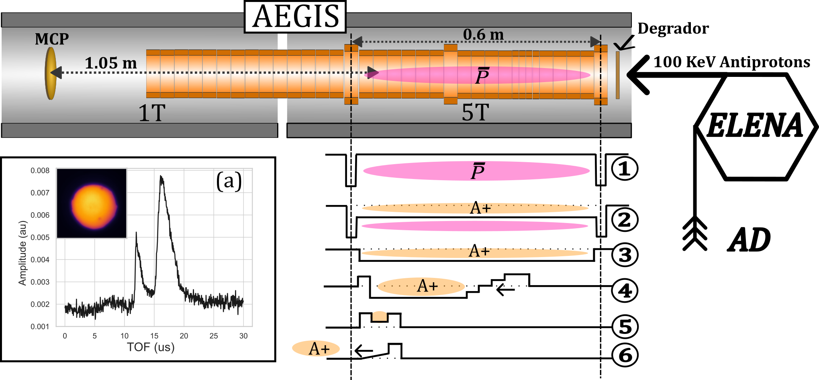


Capturing positive ions formed from antiproton annihilations
Gas valve
$\overline{p}$
Ion trajectory
Nitrogen gas injection at 1e-8 mbar
1.035m
0.545m
$\overline{p}$
ELENA
MCP
Notes:
We developed a nested trap
procedure for positive ions
Can we trap recoil fragments?

Slide 7
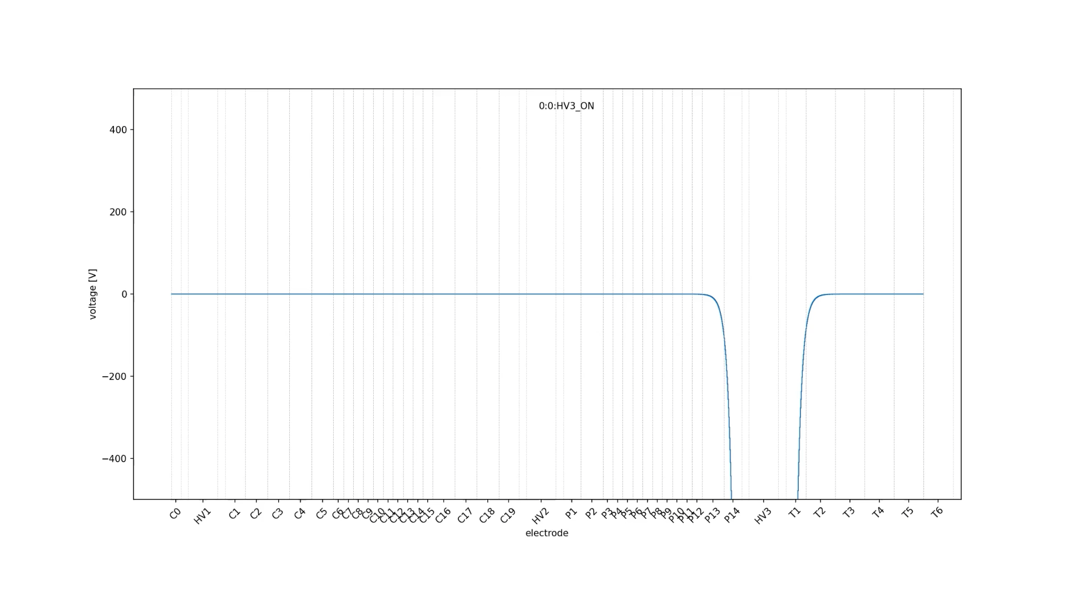
Animation by Jakub

Slide 8
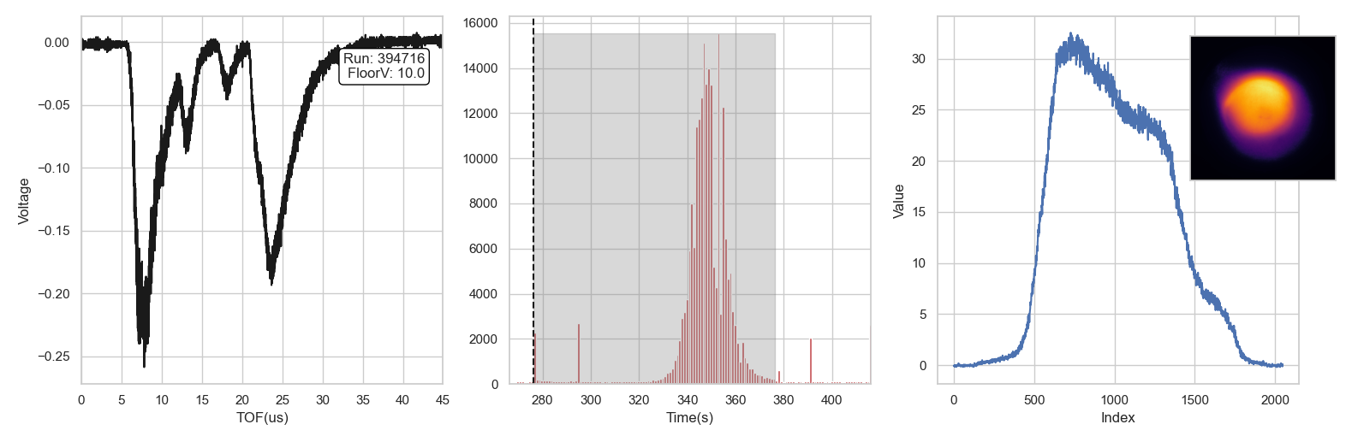
Sample data during air leak campaign
+160V
A+
Floor Voltage
A+
MCP
Scintillator signal (SC21)
MCP screen profile
MCP TOF signal

Slide 9
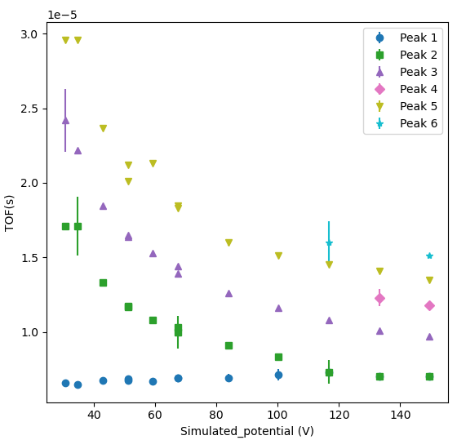
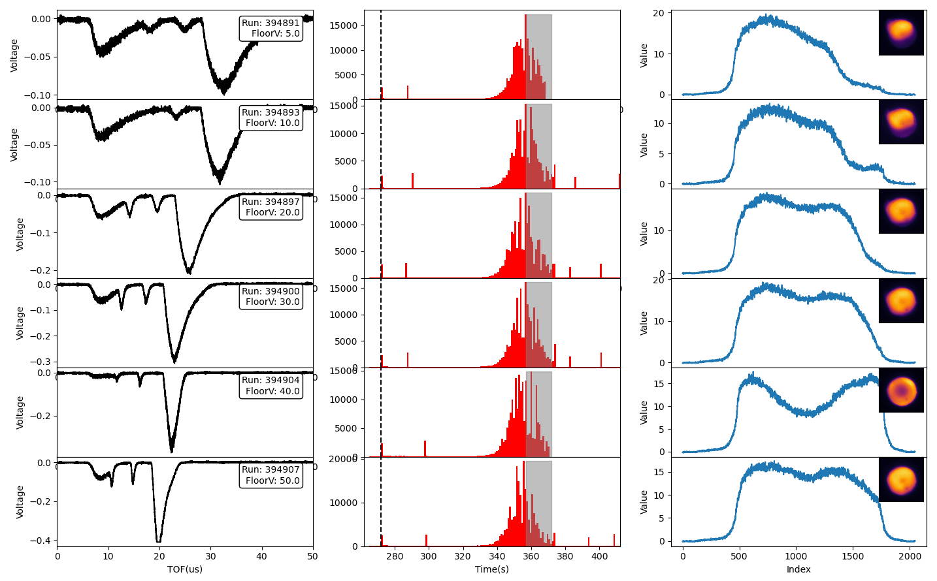
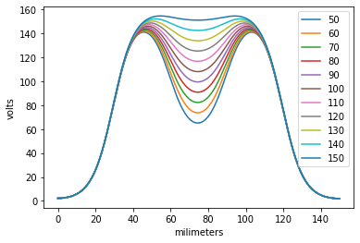
Floor voltage scan with release from MCP side
Cold ions
Constant
Hot ions

Slide 10
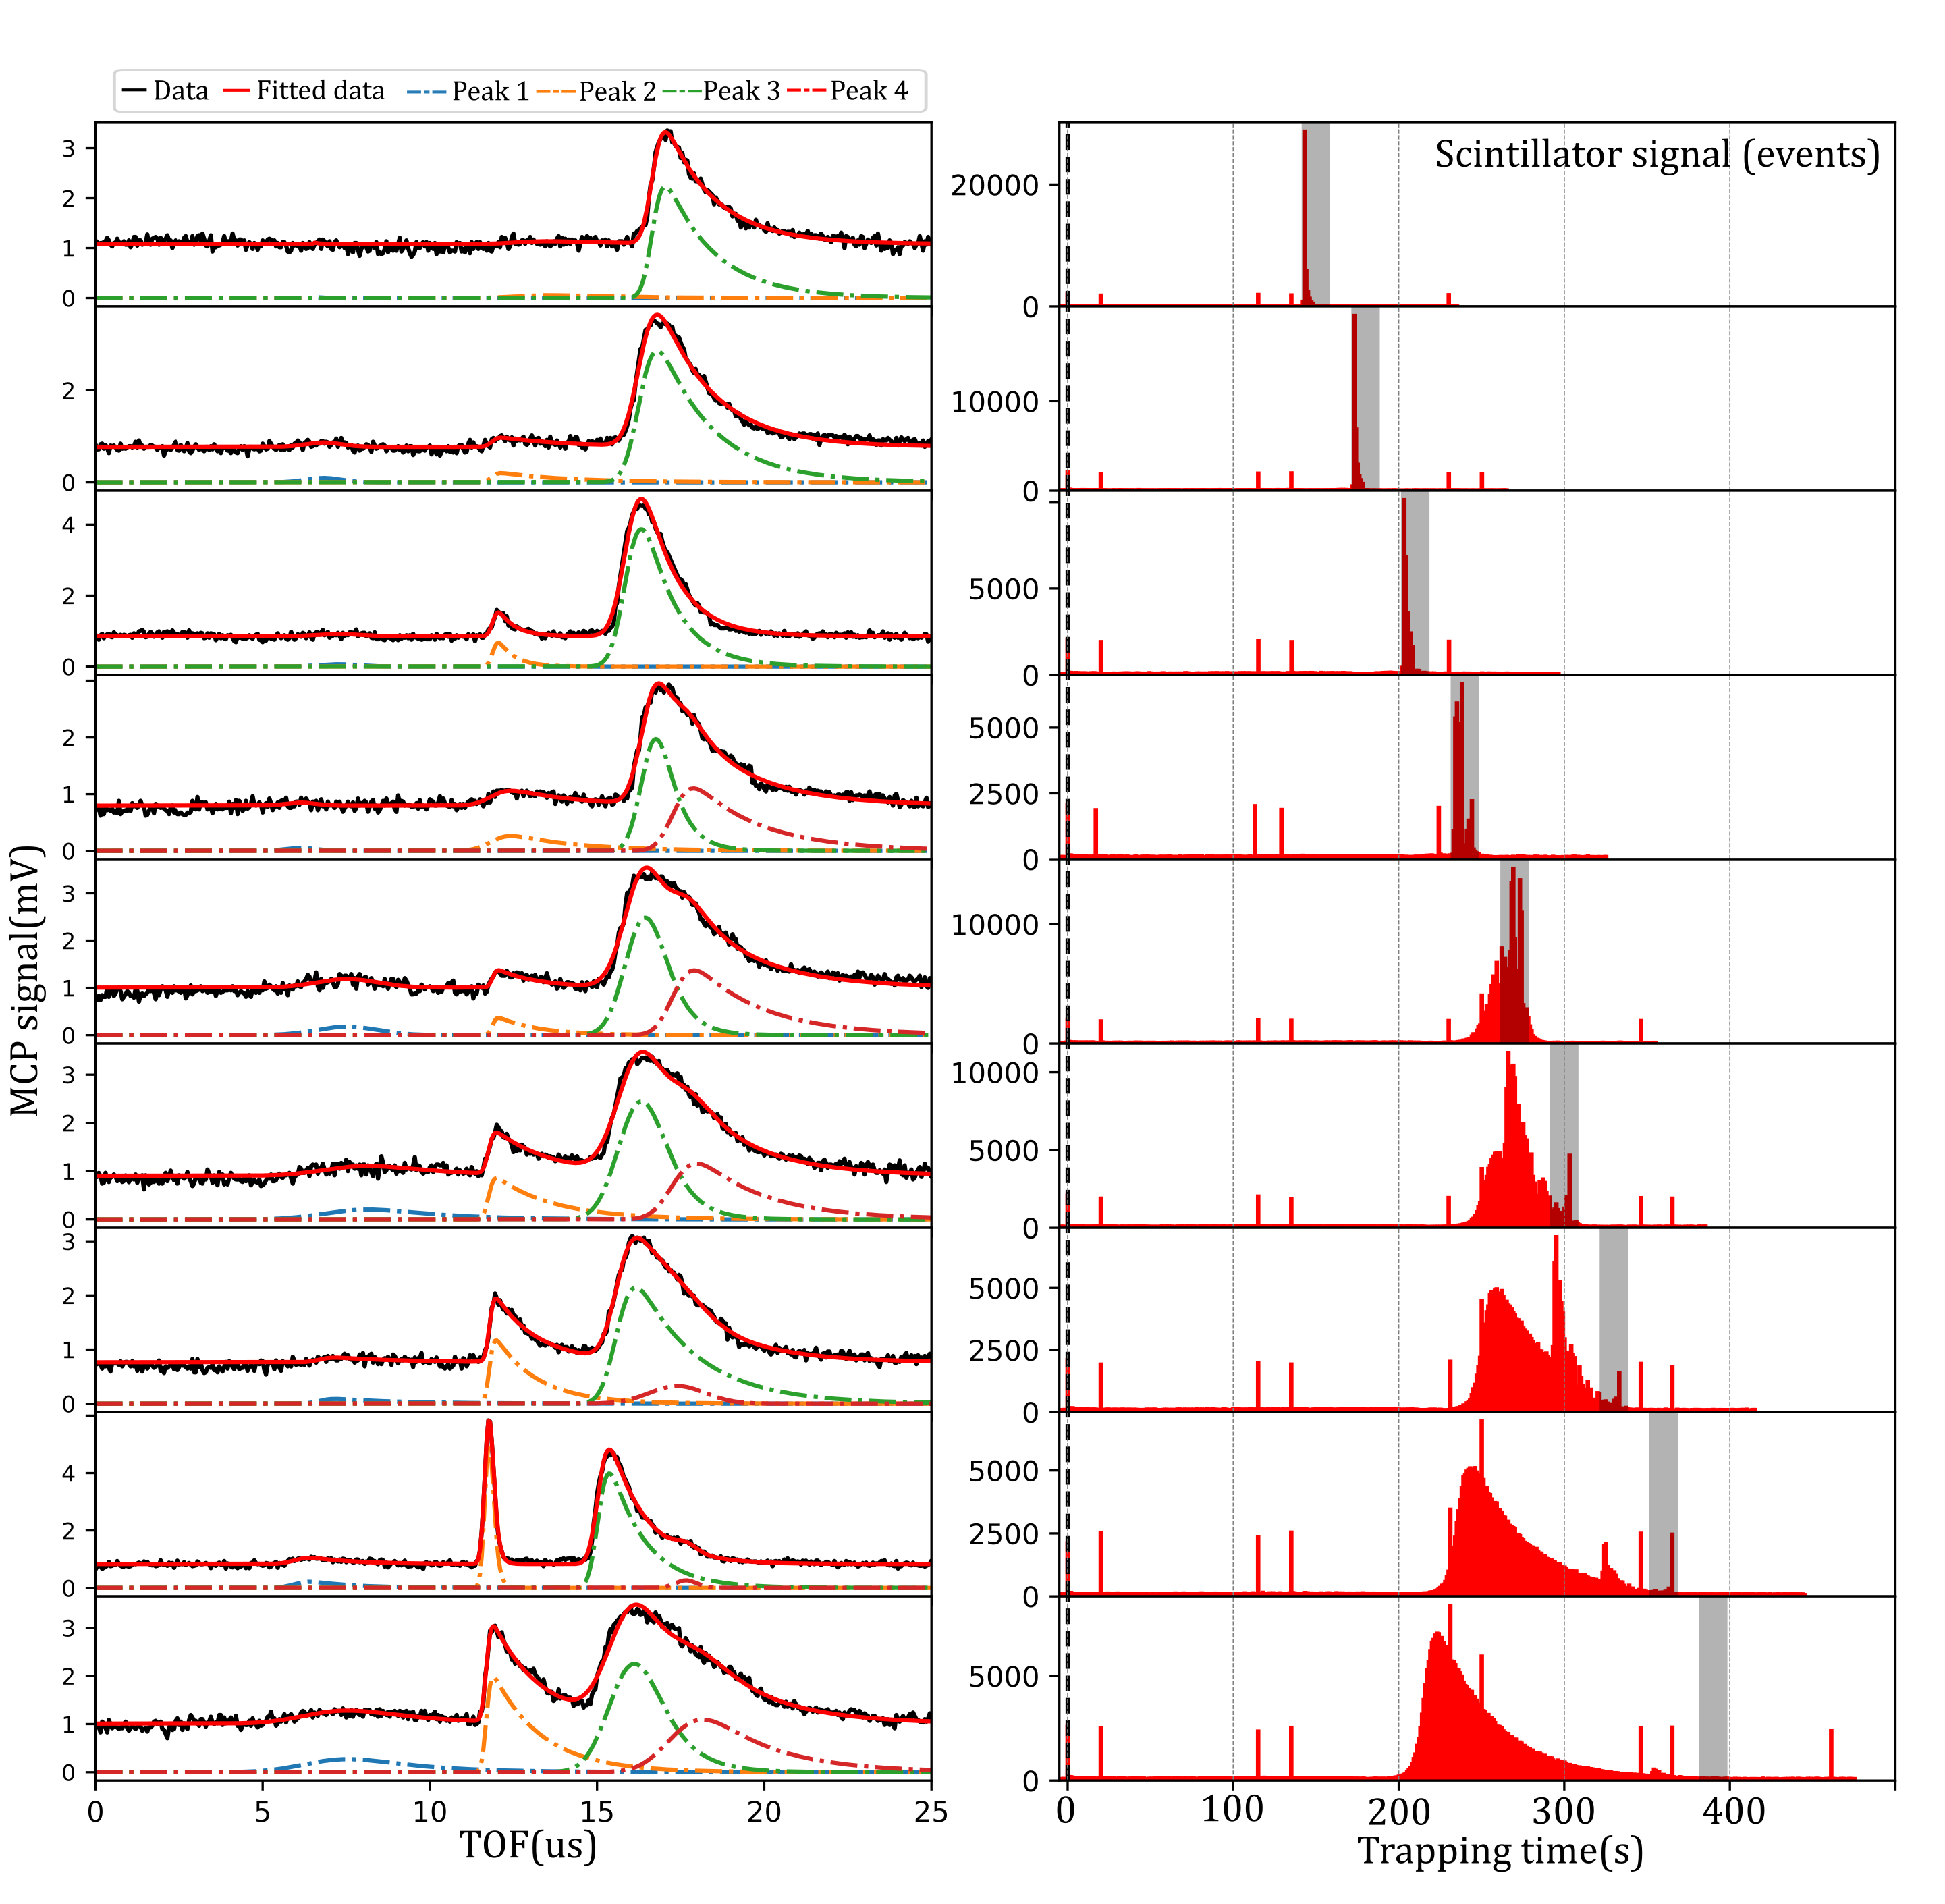
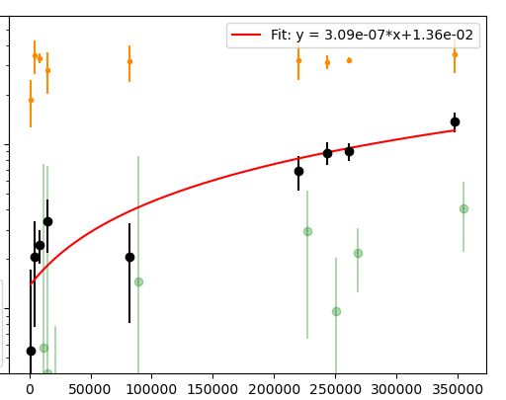
TOF spectrum vs scintillator signal
TOF spectrum
Pion events
Ions from injection?
Observation of a TOF signal vs antiproton annihilation events from nitrogen injection.
MCP peak signal (Log(au))
Scintillator events

Slide 11
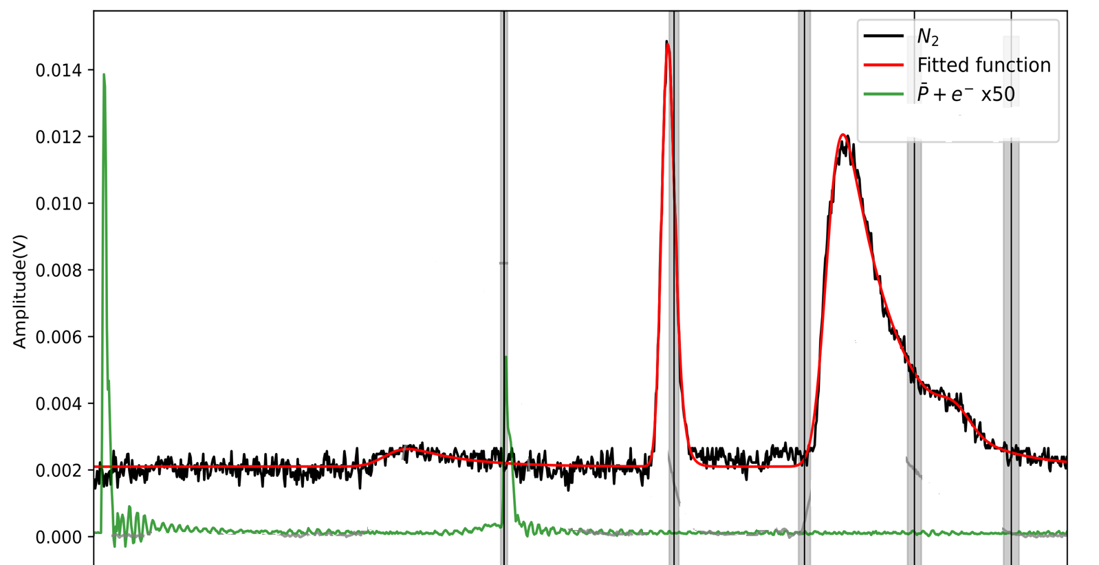
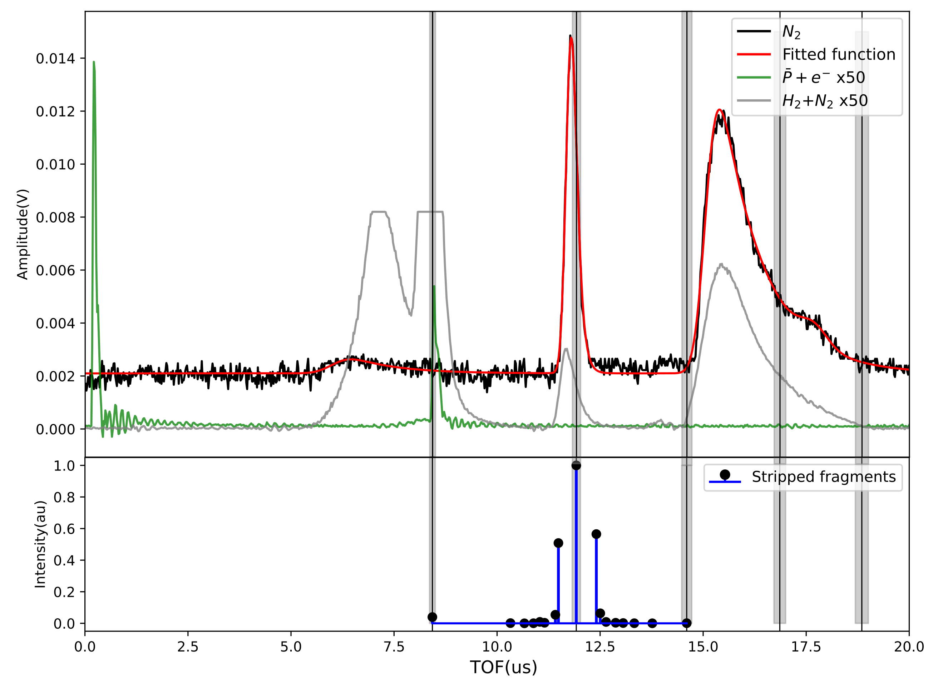
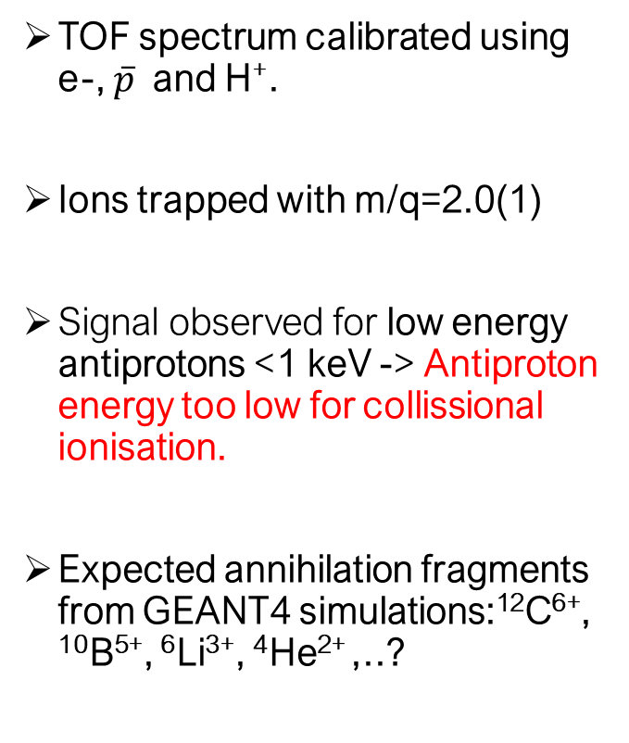
Identification of trapped ions formed from antiproton annihilation
m/q=1
2
e-
TOF spectrum calibrated using e-, $\overline{p}$ and H⁺.
Ions trapped with m/q=2.0(1)
Signal observed for low energy antiprotons <1 keV -> Antiproton energy too low for collissional ionisation.
Expected annihilation fragments from GEANT4 simulations:¹²C⁶⁺, ¹⁰B⁵⁺, ⁶Li³⁺, ⁴He²⁺ ,..?
_
P
Expected annihilation
fragments:

Slide 12
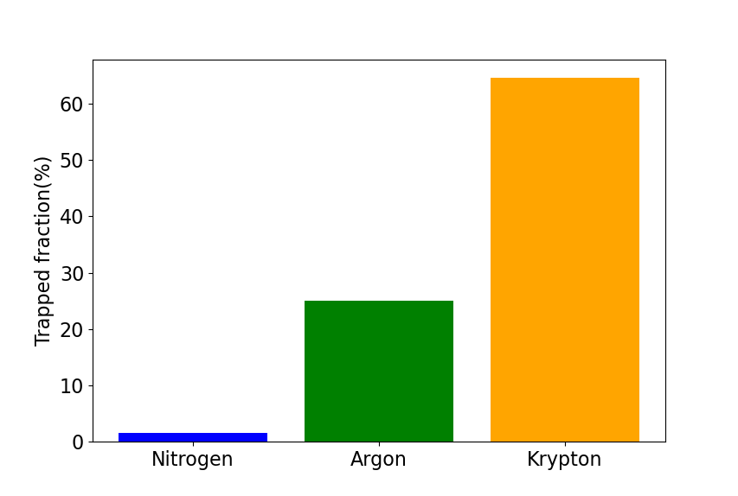
Argon campaigns 2024:
18 electrons -> 15000 eV required for full stripping.
Mass = 40 amu
Well studied in literature, confirmed full stripping from antiprotonic atom cascade.
Nobel gas, no positively charged molecules.
Greater trapping fragments

Slide 13
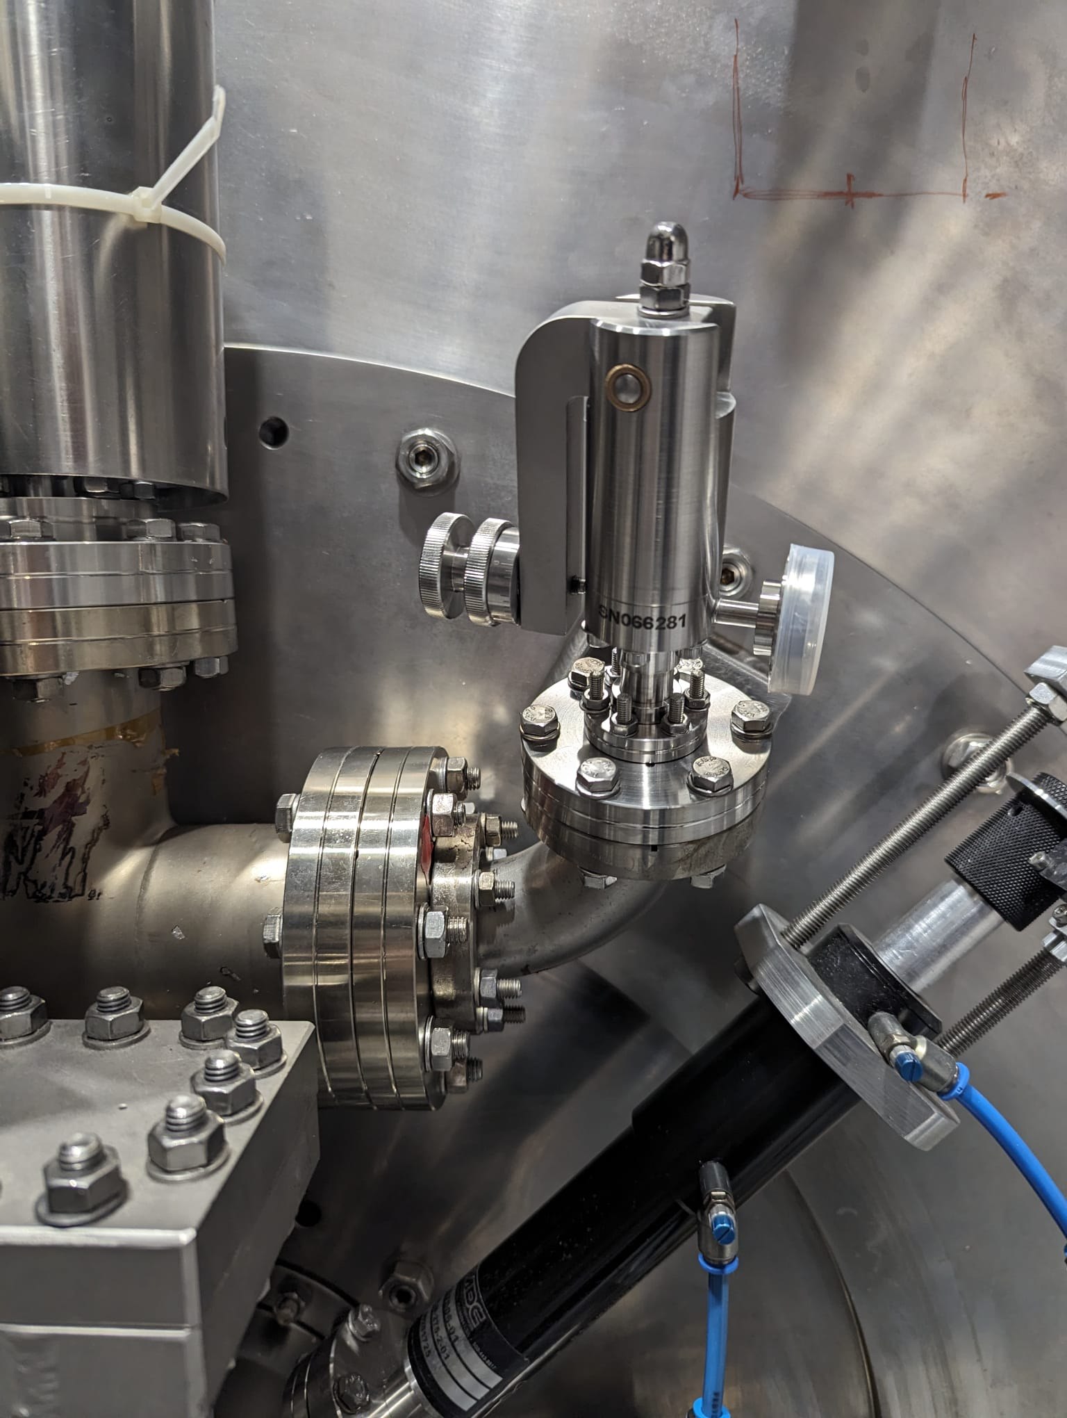
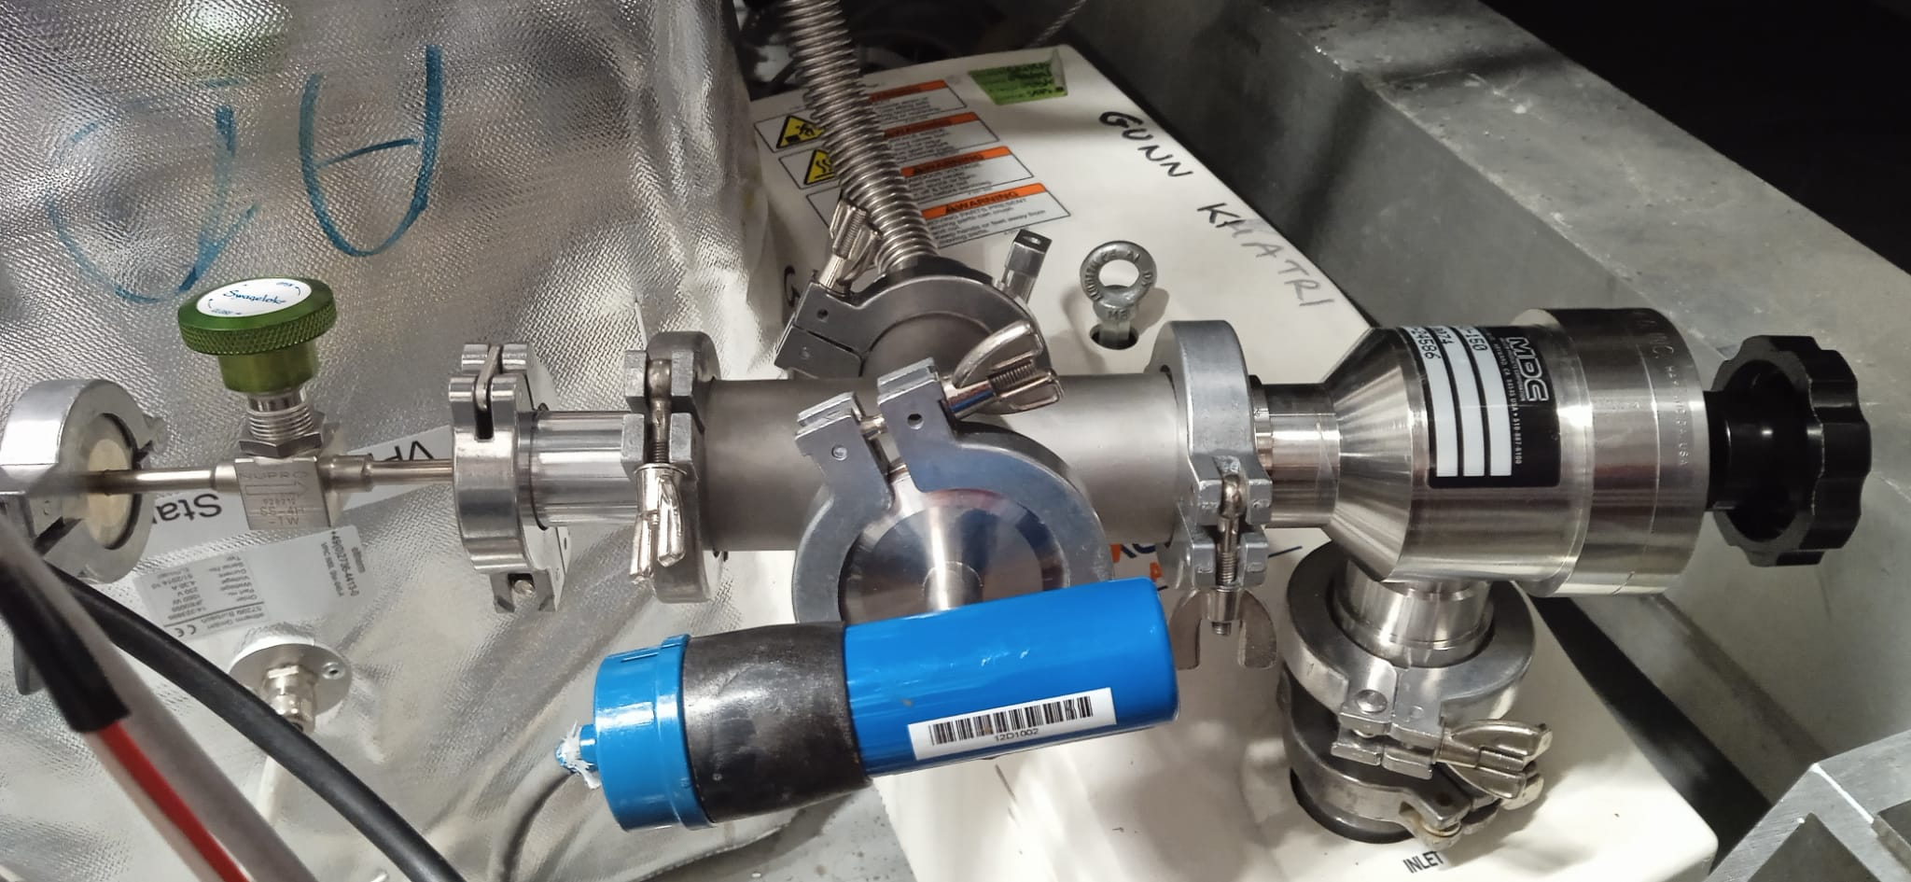
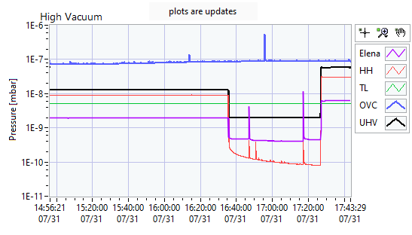
Gas injection procedure
Valve
Reservoir
Gauge
Scroll Pump
Ar

Slide 14
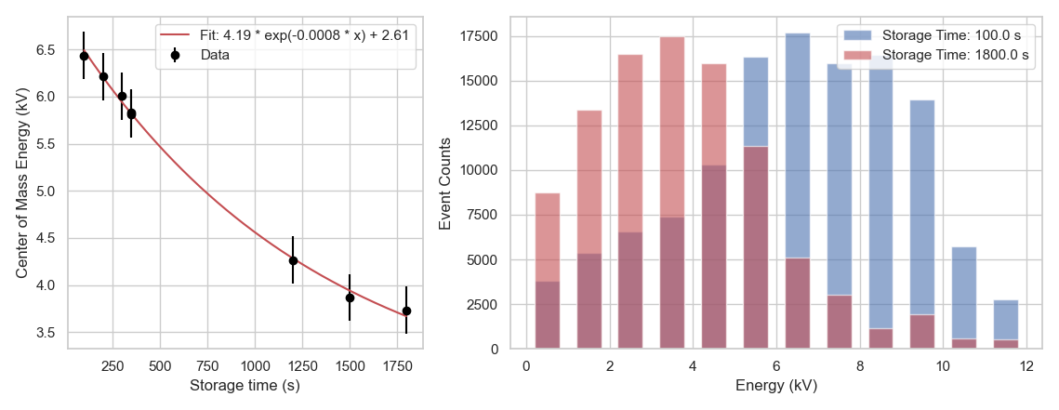
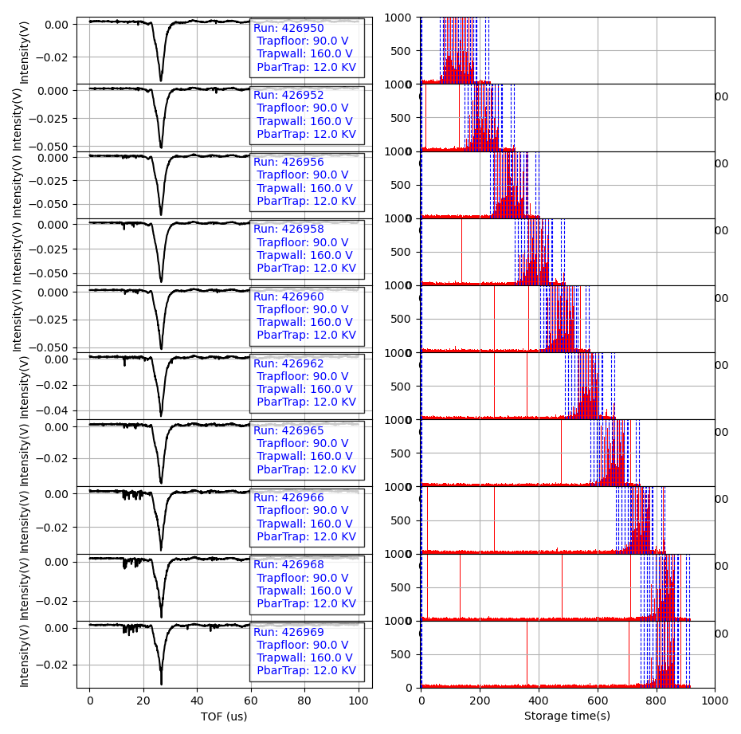
Scan over antiproton storage time

Slide 15
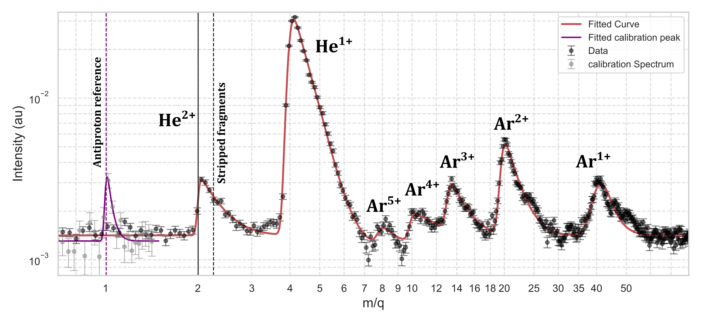
Argon TOF spectrum:
Helium contamination?
Ionization resulting from annihilation

Slide 16
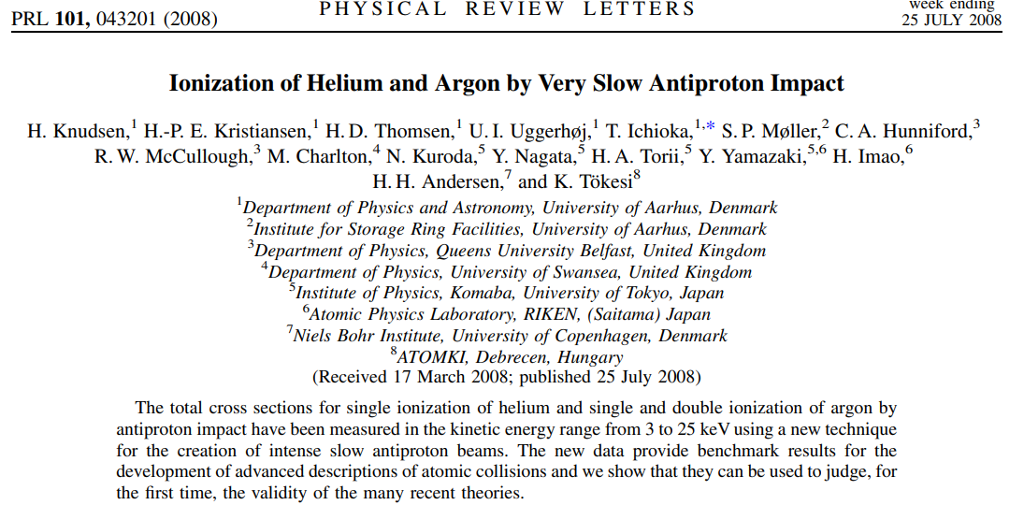
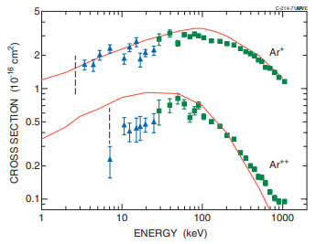
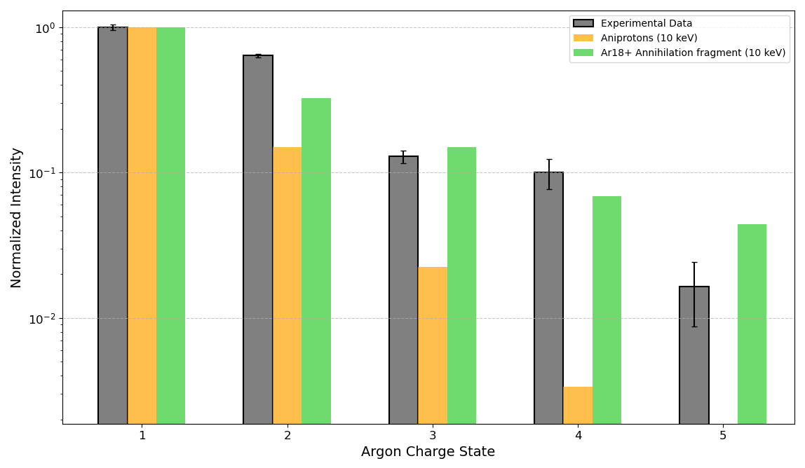
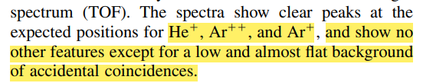

Ar¹⁺ : 2 e -16 cm2
Ar²⁺ : 3 e -17 cm2
Classical Over-Barrier Model (COBM)
Observed ionization is a result of highly charged nuclear fragments in the trap.
Paper draft in circulation

Slide 17
November 2024 Argon campaign
1T MCP replaced -> Characterising new MCP signal, TOF calibration, reduced ringing?
Refining technique, symmetric trap for removing microwells.
Gathering statistics with Argon injection, refining spectrum for paper.
Study pressure influence on signal.
Vacuum recovery test and helium injection.
Vacuum
Gas injection

Slide 18
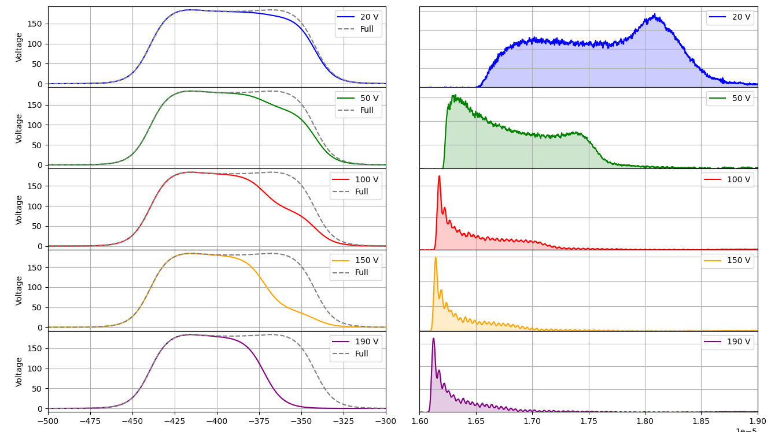
Trap potential study using antiprotons

Slide 19
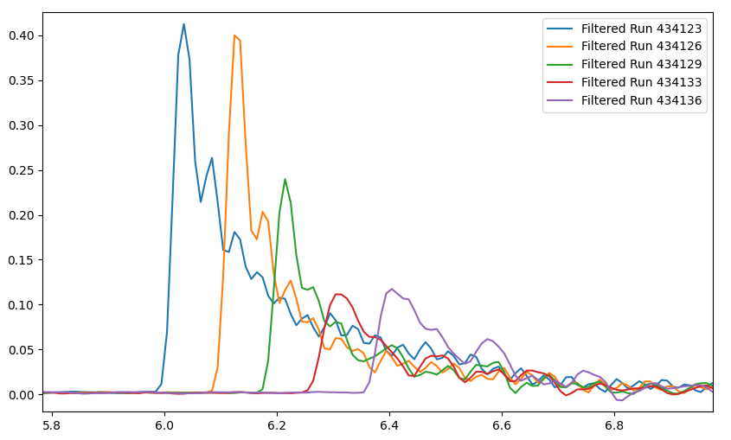
Antiproton TOF calibration
Ringing could not be reduced in new MCP..

Slide 20
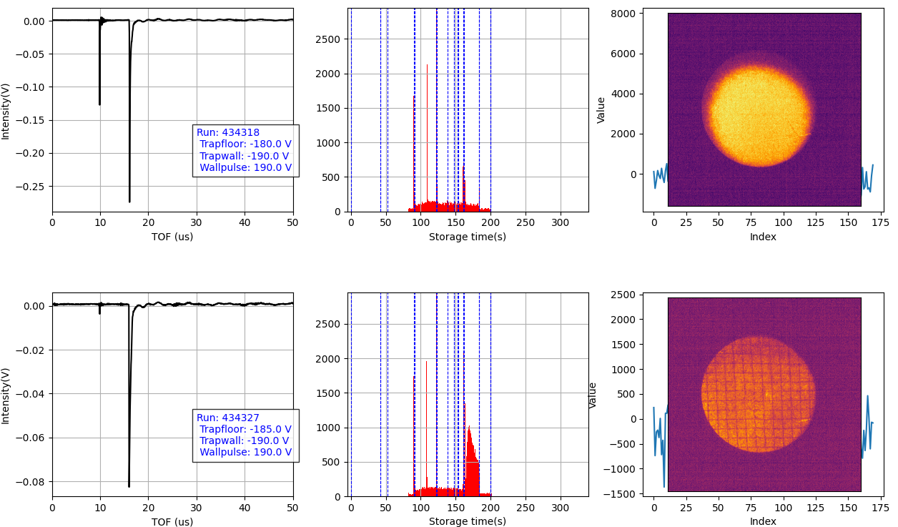
Could the antiproton calibration script have damaged the MCP?

Slide 21
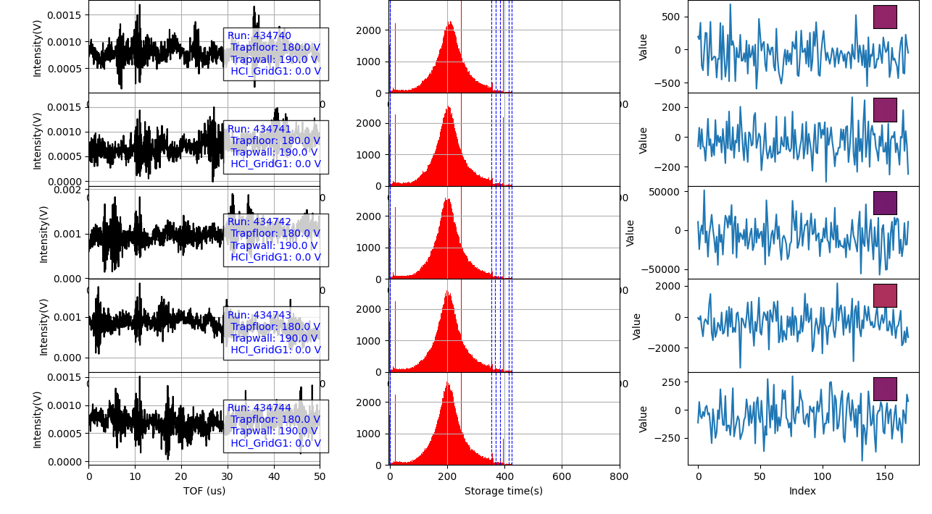
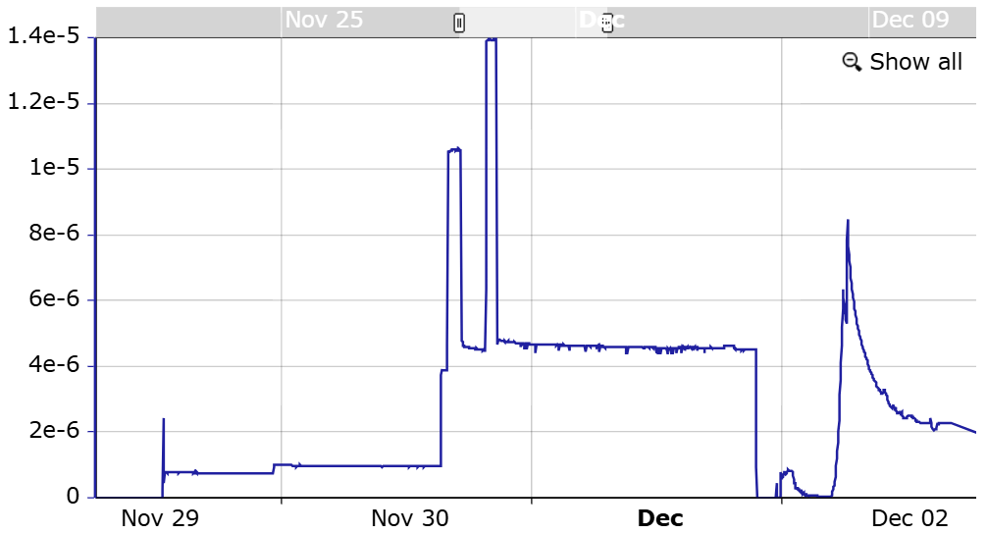
Gas injection timeline
Valve closed for filling surfaces
PS down 2.30am monday
Argon vented
Argon injection
(valve leaking)
Helium injected

Slide 22
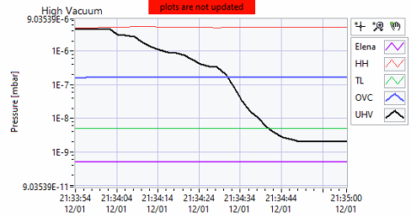
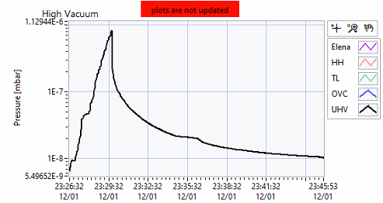
Vacuum recovery time
Argon
immediate recovery
Helium
5s
1000s

Slide 23
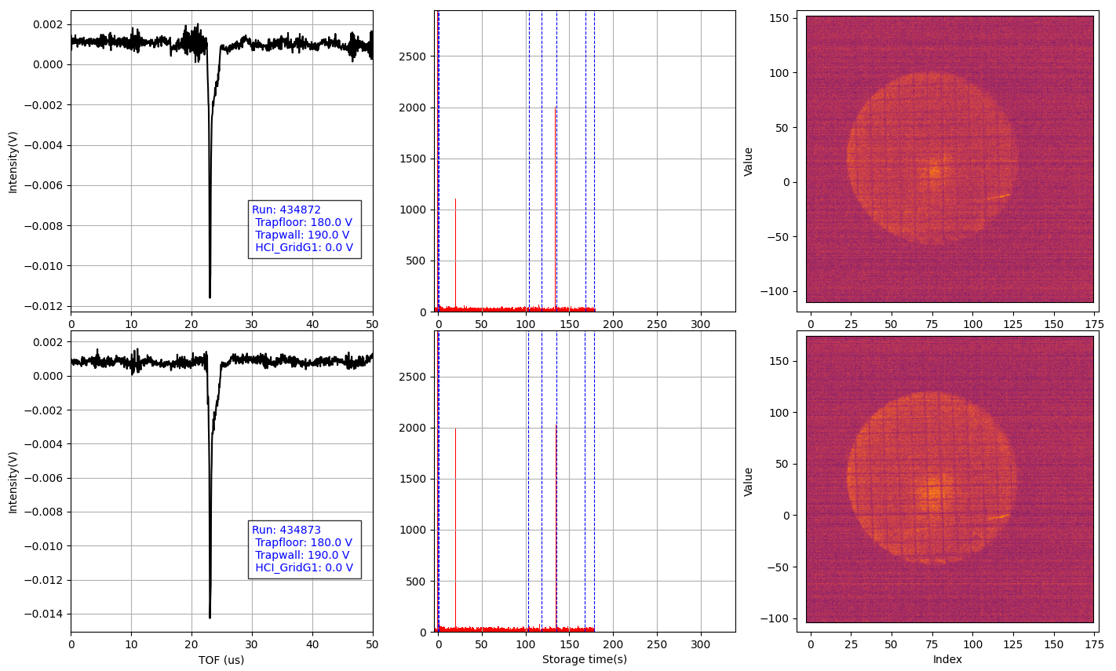
Helium collissional ionization signal

Slide 24
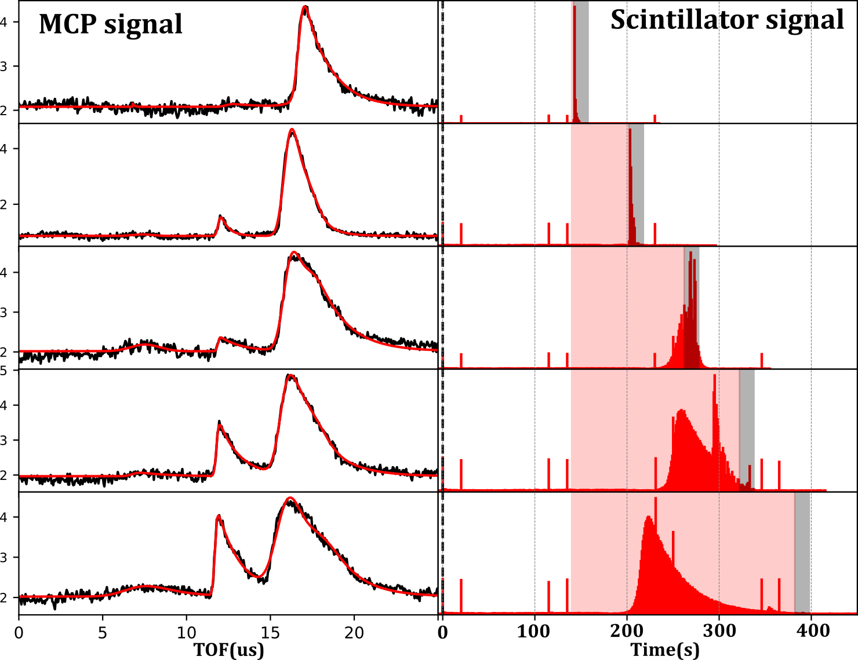
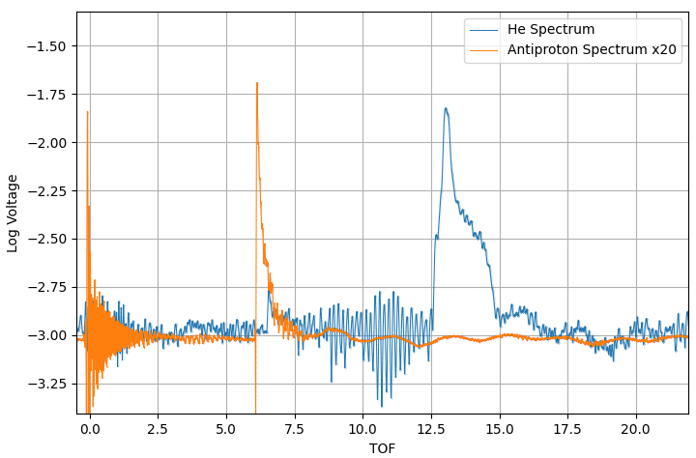
Helium signal identified
He¹⁺
Antiproton
He¹⁺
Helium Injection

Slide 25
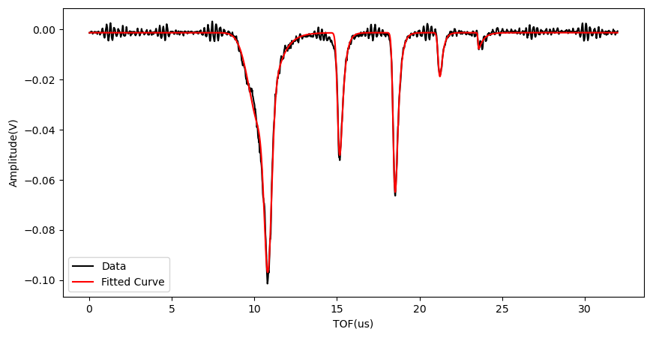
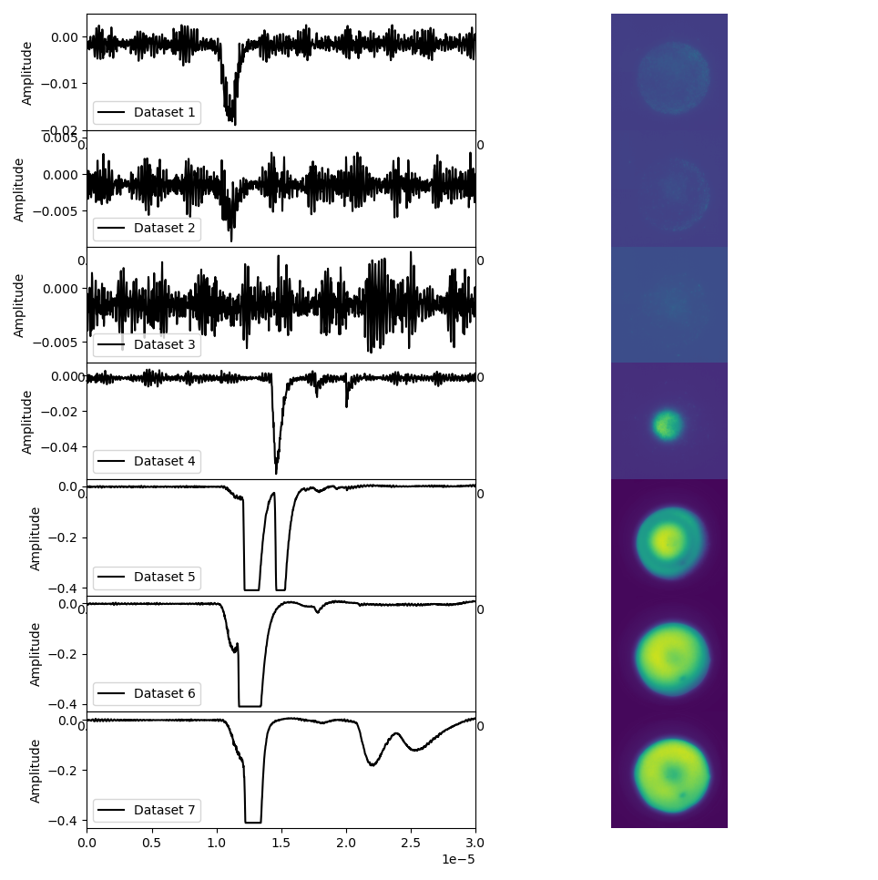
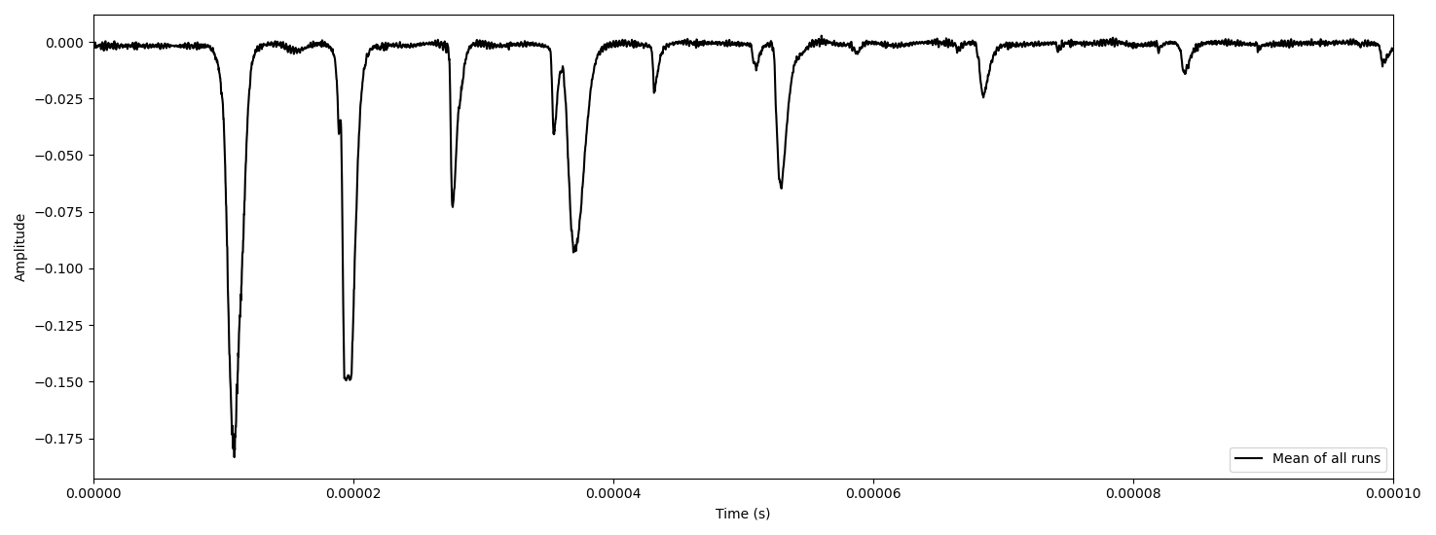
Helium signal seen in data from 2023
Hot component
?
He¹⁺
He²⁺
?
H⁺
Old data can now be better understood
He²⁺
He¹⁺
He²⁺
Cool component

Slide 26
Overview of HCI campaigns
2023
2024
Air leak campaign: (3 weeks)
- First postive ion signal.
- Techniques developed for manipulating trapped ions.
- Barrier scan, Multi-step, MR-TOF procedure.
- Identifying the energy of the TOF components.
Nitrogen campaign: (36h):
- Nitrogen injection.
- Confirming HCI formation from nitrogen.
Argon campaign: (2w):
- Needle valve installed for controlled injection
- Argon injected, antiproton energy loss measurements
- Electron cooling of antiprotons with gas.
- HCI Argon ions identified
Argon/Helium campaign: (3d):
- Trap configuration better understood.
- Collissional ionization origin of helium signal confirmed.
End of the dirty injection...

Slide 27
So what is next?

Slide 28
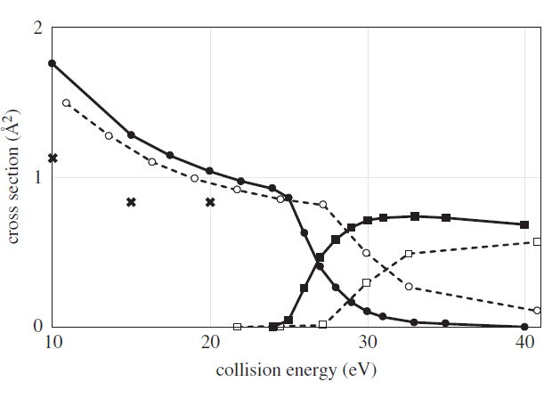
Antiproton-Helium capture cross-section
>2 . 10⁻¹⁶ cm2 below 10 eV
Antiproton capture
Ionization
Jonsell, Svante. "Collisions involving antiprotons and antihydrogen: an overview." Philosophical Transactions of the Royal Society A: Mathematical, Physical and Engineering Sciences 376.2116 (2018): 20170271.

Slide 29
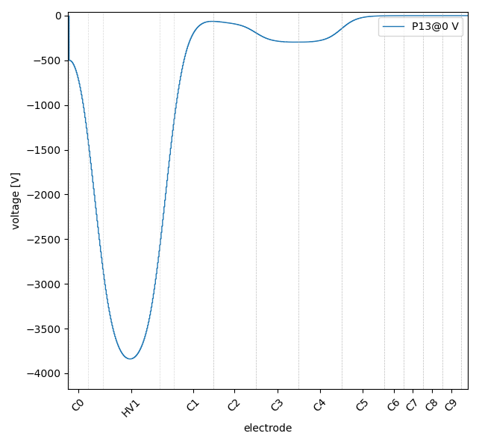
Step 1: Capture and cool antiprotons near HV1
AEGIS 5T trap
Cold antiprotons

Slide 30
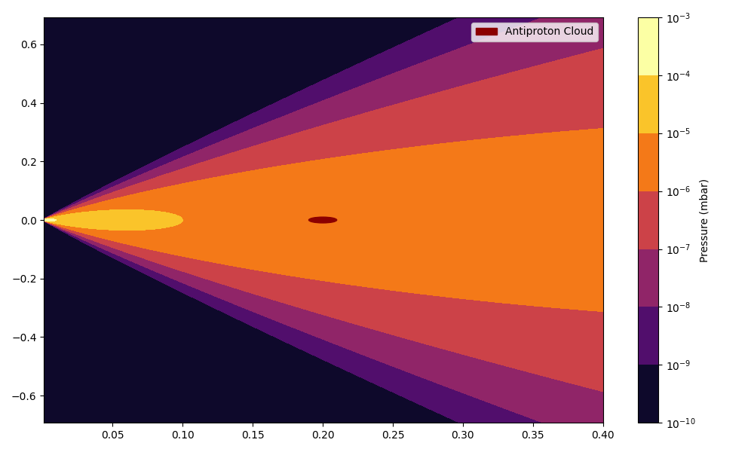
Step 2: Exposing antiprotons to gas jet
Gas reservoir
Pulse valve
1e-3 mbar
1 mm gas jet nossle
10⁻⁷
10⁻⁶
Cold antiprotons
10⁻⁵
HCIs
Interactions occuring at thermal (meV) energies

Slide 31


How much gas is needed?
Assuming capture CS of 5e-16 cm² at T=300K
20 ng/s
Antiproton capture in 1s at a pressure of 2e-6 mbar
>10000 times less gas injected compared to ’dirty’ injection

Slide 32


Step 3: Cooling of HCIs in trap
Gas reservoir
Pulse valve
electrons
HCIs
positrons
Laser
cooled ions
Recently from GSI:
electron
positrons
HCIs

Slide 33

Step 4: Moving cold HCIs from HV1 to C-electrodes
Gas reservoir
Pulse valve
HCIs
HCIs
HCIs

Slide 34

Step 3: Transport and ejection for TOF spectroscopy
Gas reservoir
Pulse valve
HCIs
HCIs

Slide 35


Laser ablation
’Laser triggered formation of antiprotonic atoms.’
Indium target
Antiprotons
532nm ablation laser
1T trap

Slide 36
Cold gas/ablation injection
Capture of HCIs in trap
Physics with nuclear fragments:
TOF spectroscopy
Annihilation process
Nuclear periphery
Mass spectroscopy
Decay spectroscopy of HCIs
Laser spectroscopy of H-like ions
Neutral atom injection
Cooling of HCIs
Positrons/laser cooling/electrons
Anion-antiproton mixing
Antiprotonic atom spectroscopy
Physics with antiprotonic bound states: (QED/QCD/BSM)
Exotic bound states
Super antiprotonic Rydberg states
Antiprotonic molecules etc.
Anions
injection
Charge-exchange antiproton capture
Anion trapping/laser cooling
Laser photodetachment
Rydberg excitation

Slide 37

Outlook: Towards the laser triggered synthesis
Nested trap is created.
(3)
(1)
Cotrapping of anions and antiprotons cooled using electrons.
Laser photodetachment and excitation/ionization.
Spectroscopy of ‘long-lived’ Rydberg antiprotonic atoms
(2)
Mixing anions with antiprotons.
Capture of HCI fragments from annihilation.
(4)
HCIs can be further cooled and studied in trap
$$A^{∗}+\overline{p}→\overline{p}A^{∗}+e^{−}$$

Slide 39
Benefits: No laser needed
Neutral gas – no need to worry about overlapping plasmas
Orders of magnitude cleaner, 0.1ng/ antiproton shot.
CS can be enhanced by exciting atoms to rydberg states,
Limitation, only works with gases
Laser Ablation? Local pressure after ablation?

Slide 40
Clean injection approaches
Anion source
Alternative?
Pulsed gas injection
Laser ablation

Slide 41
Summary and outlook:
X-ray spectroscopy on target
Resonance effects
Strong interaction shift
Antiprotonic atom
spectroscopy
Laser/microwave spectroscopy
(QED/QCD/BSM)
Exotic bound states
Dark matter search
Laser triggered synthesis of antiprotonic atoms
Nuclear structure studies:
TOF spectroscopy of captured HCI fragments
Mass spectroscopy
using MR-TOF/RF
Annihilation process
Nuclear periphery
Mass spectroscopy
Decay spectroscopy of HCIs
Laser spectroscopy of H-like ions
Novel synthesis of radioactive HCIs
Cooling of HCIs
Multi-step antiproton annihilation
(Formation of highly exotic HCIs)

Slide 42
Collissonal cooling on buffer gas 2e-12 mbar in sun region:

Slide 43



Electron cooling script working
Many antiprotons trapped in microwells
$$\overline{P}$$
Antiprotons are cooled within 10s

Slide 44


Capture cross-section

Slide 45

Study of new trap

Slide 46

Cold antiprotons observed
Direct capture of annihilation fragment?

Slide 47


Slide 48


Low energy antiproton interactions
<1 keV trapped pbars
2kV
Signal of m/q=2 peak vs annihilation event:
What could result in the formation of m/q=2 from nitrogen?

Slide 49

Overview of the fragment capture procedure
(b)

Slide 50


Helium interaction with antiprotons
He²⁺

Slide 51

RGA measurment

Slide 52



Slide 53

Ar1+ : 2 e -16 cm2
Ar2+ : 3 e -17 cm2

Slide 54


He1+ : 4.0 e -17 cm2
He2+ : 1.8 e -18 cm2

Slide 55


Slide 56


Slide 57
Outlook

Slide 58

Suggested measurements for 2024
Argon (A=40):
- 10x capture yield fragment yield expected
- Formation of 18+ very difficult with collissions.
Helium (A=4):
- Reference where we expect minimal fragments trapped.
Krypton (A=83):
- Heaviest gas available, largest trappable fraction of HCI.
Nitrogen (A=14):
- For continued technical development, refine resolution and stability.
Antiprotonic atom spectroscopy at AEGIS
- Continuing LEAR era measurments: Plenty of physics cases!
- Teaching us the procedure for antiprotonic atom x-ray spectroscopy.

Slide 59
Summary of outlook:
Continued development of trapping procedure and identification of HCI fragments from antiproton-atom interaction using gas injection (the dirty method).
First x-ray spectroscopy of antiprotonic atoms at AEGIS (initially on target). Characterizing background for spectroscopy inside the trap. Many ’simple’physics cases.
(Triggered formation of antiprotonic atoms through target ablation near trapped cold antiprotons?)
Purchase of laser systems for photodetachment and Rydberg excititatation: Triggered formation of antiprotonic atoms with cotrapped anions.
Goal: Laser triggered formation of antiprotonic atoms (laser/x-ray/auger spectroscopy) and trapping and cooling of resulting HCI fragments.

Slide 60


Noise filtering

Slide 61


Pbar trapping voltage vs MCP signal

Slide 62



Fast TOF component?
Isolating peak with 250 ns gate:
$$?$$

Slide 63



Ion time changes the 7+ population
40s
20s
5s
5s
20s
40s
The other peaks do not change significantly with time

Slide 64


Slide 65






Time-of-flight calibration using Pbars
1.035 m (MCP side)
$$\overline{P}$$
$$\overline{P}$$
-160V
$L_{eff}=$1.049(5) m
$$U\left(t\right)=\frac{L_{eff}^{2}}{2e}∙\frac{m}{t^{2}}$$
Time-of-flight (s*1e-5 )

Slide 66





Peak at m/q=2
Fully stripped nitrogen identified?
$$H_{2}^{1+}$$
$$N^{7+}$$
$$O^{8+}$$

Slide 67




Collissional ionization with antiprotons?
3000 eV is required to form N⁷⁺ from the N₂ molecule
20 eV
$$\overline{P}$$
e-
10 KeV
Could electrons accelerated by HV electrodes strip nitrogen?
Simulation by Bharat using CST in progress...

