Slide 1

The double target holder
Benji, Rug, Stef

Slide 2
Design criteria for the new target holder
Targets need to be much smaller
Reflection target necessary to continue the present tests
but the reflection target should be installed under an angle to the direction of flight,- like the 2018 target
Transmission target for starting the tests of Ps formation in forward direction
Minimize the steering of pbars, positrons and Laser as much as possible ie, by moving the A0 target electrode we should shift form reflection to transmission target.
It should be thermally isolated to keep the heat load to the magnets minimal
apply bias voltages of a few 100V
Facilitate maintenance, and easy changes of targets

Slide 3
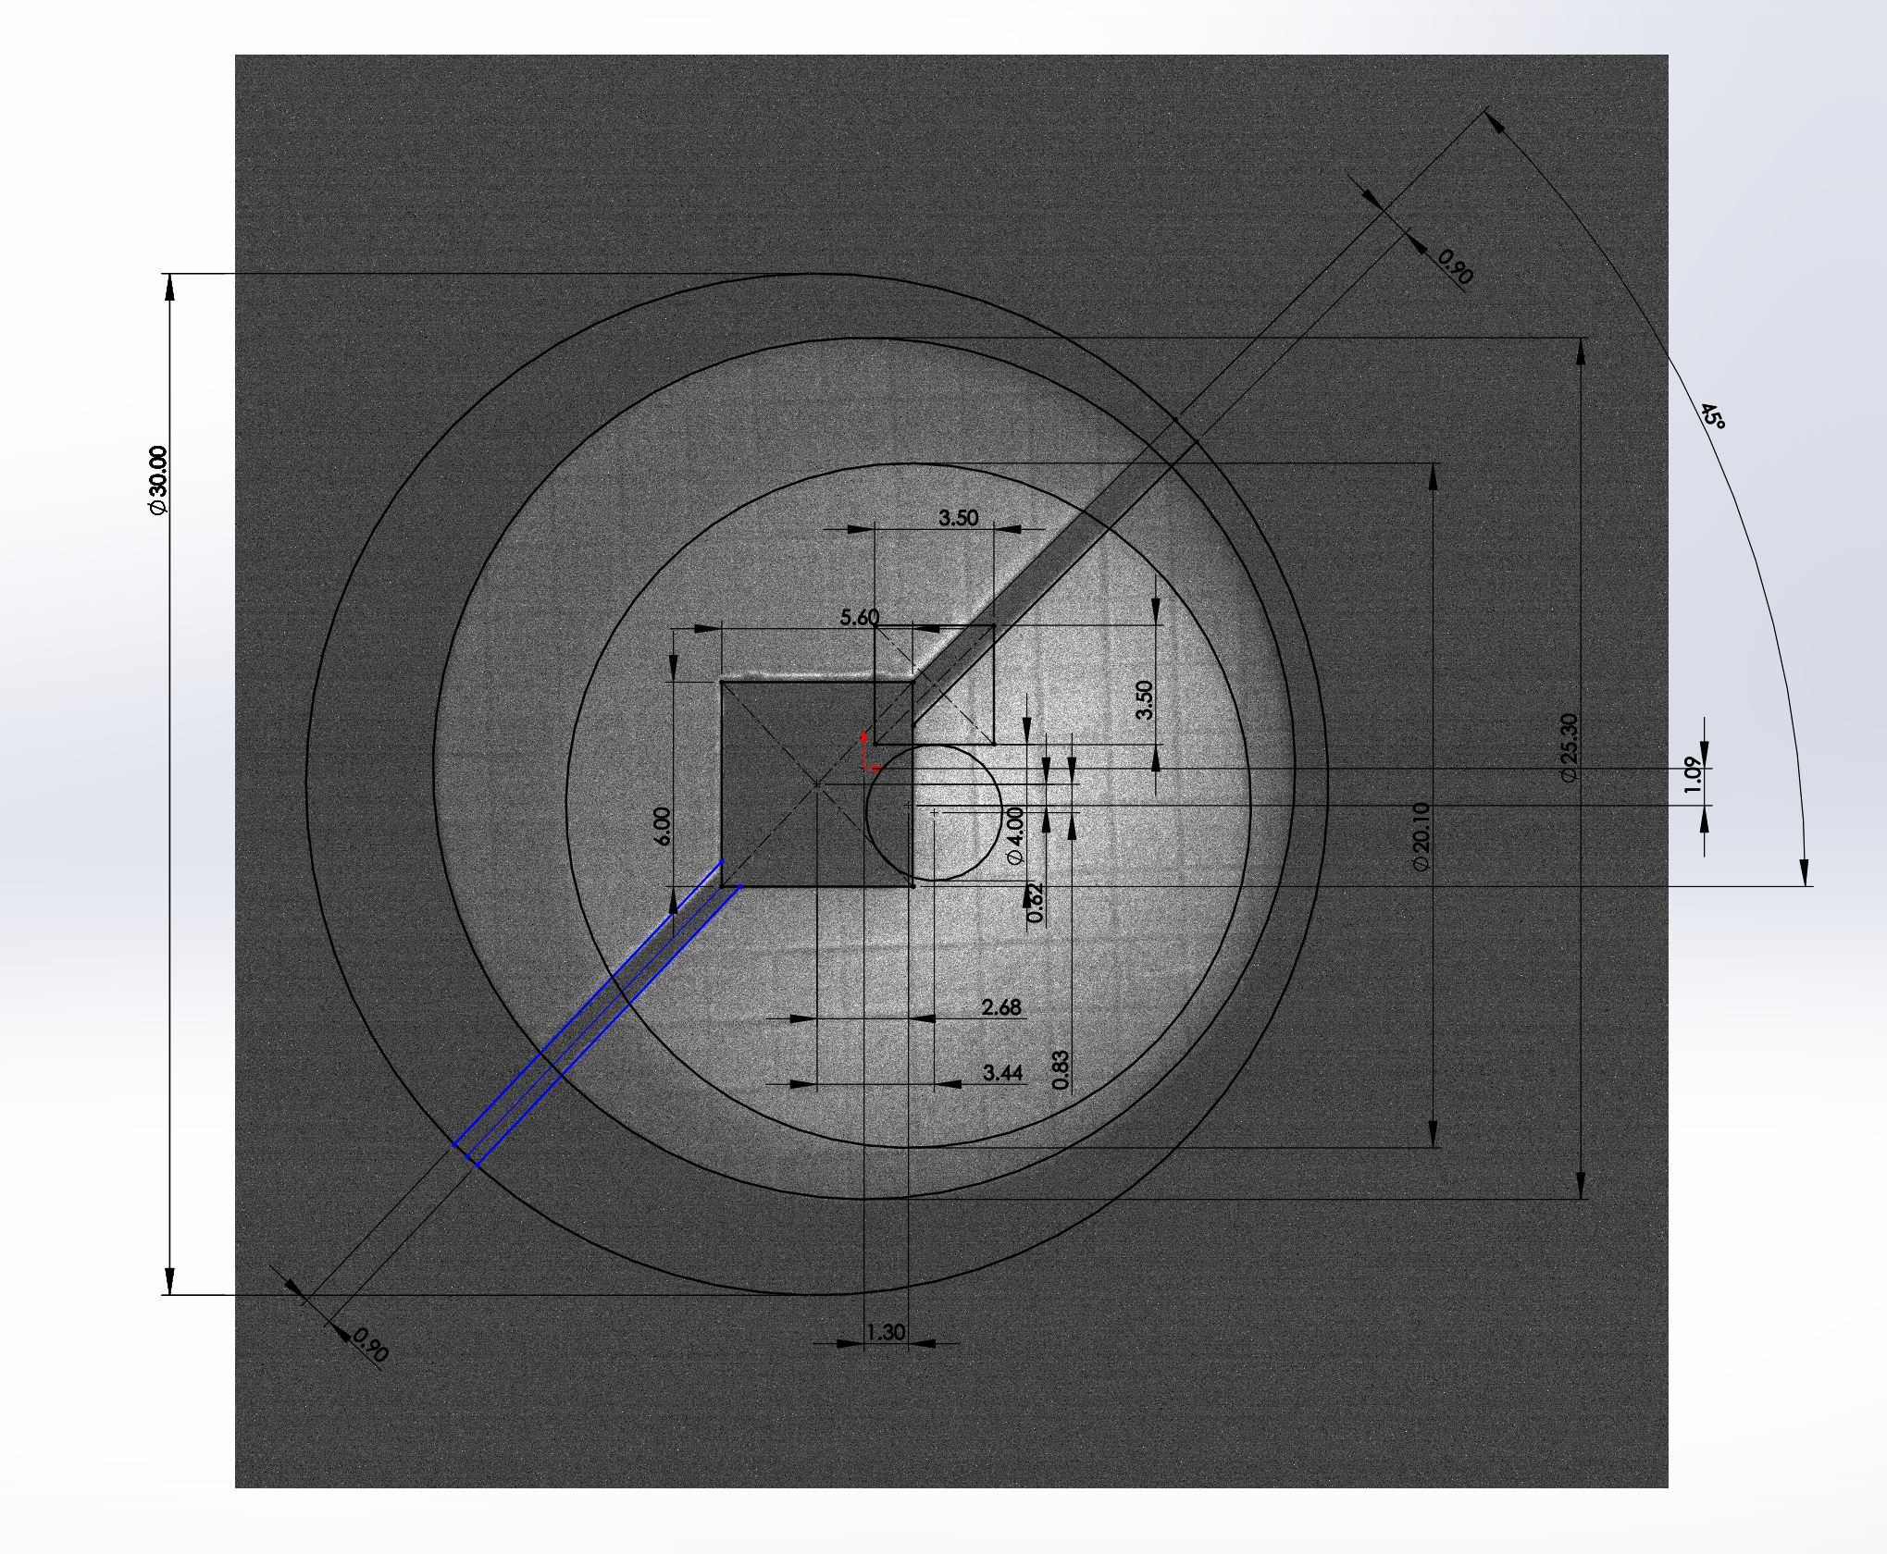
Present target
Electrons from the 5T
Active area of the 1T MCP
(25mm)
Inferred size of the
1T electrodes (30mm)

Slide 4
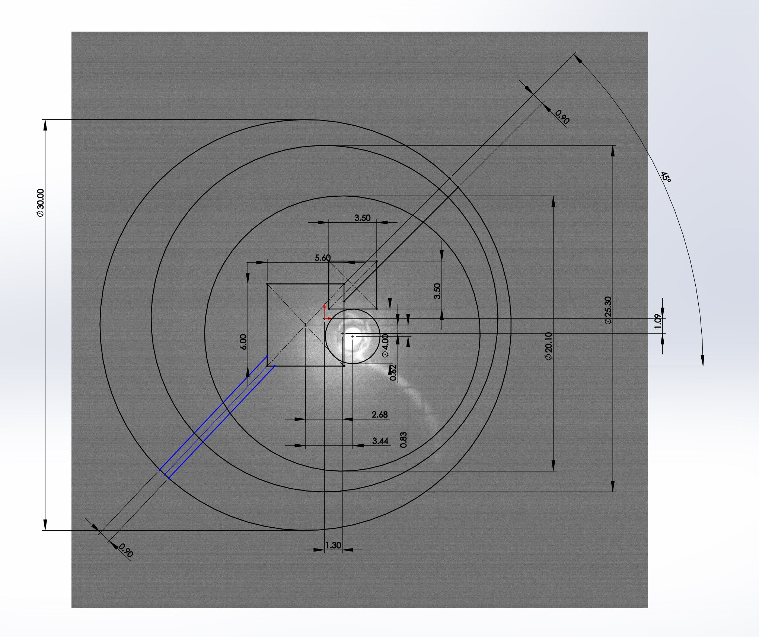
Position of the new target
P-bars from the 5T

Slide 5
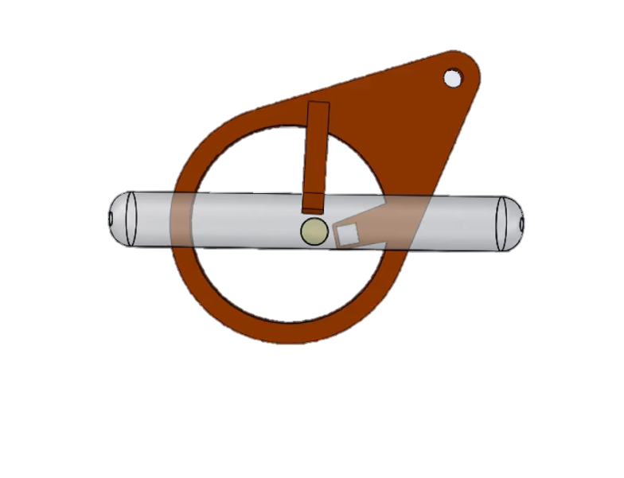
Position of the new target
P-bars from the 5T

Slide 6
The double target holder
New target holder ring
3D printed copper
Laser ~8mm diameter at the target
Reflection target 3x4.5mm
P-bars 4mm diameter
Transmission target 3x3 mm

Slide 7
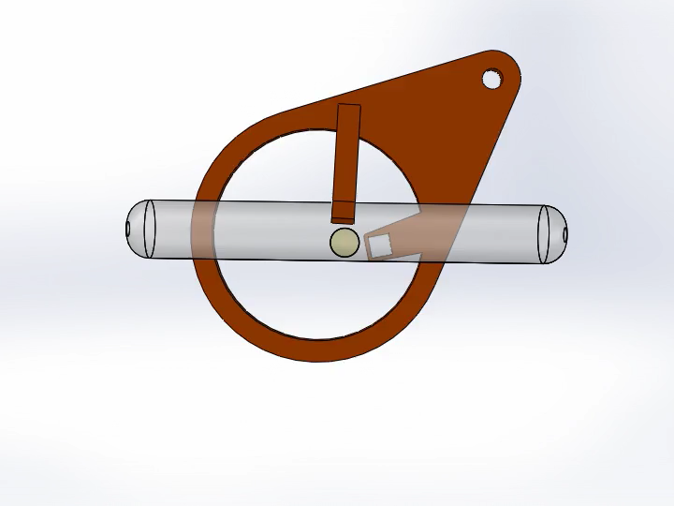
The double target holder
Reflection target
Positrons,
Pbars and
Laser
do not move when
Switching targets
Transmission target

Slide 8
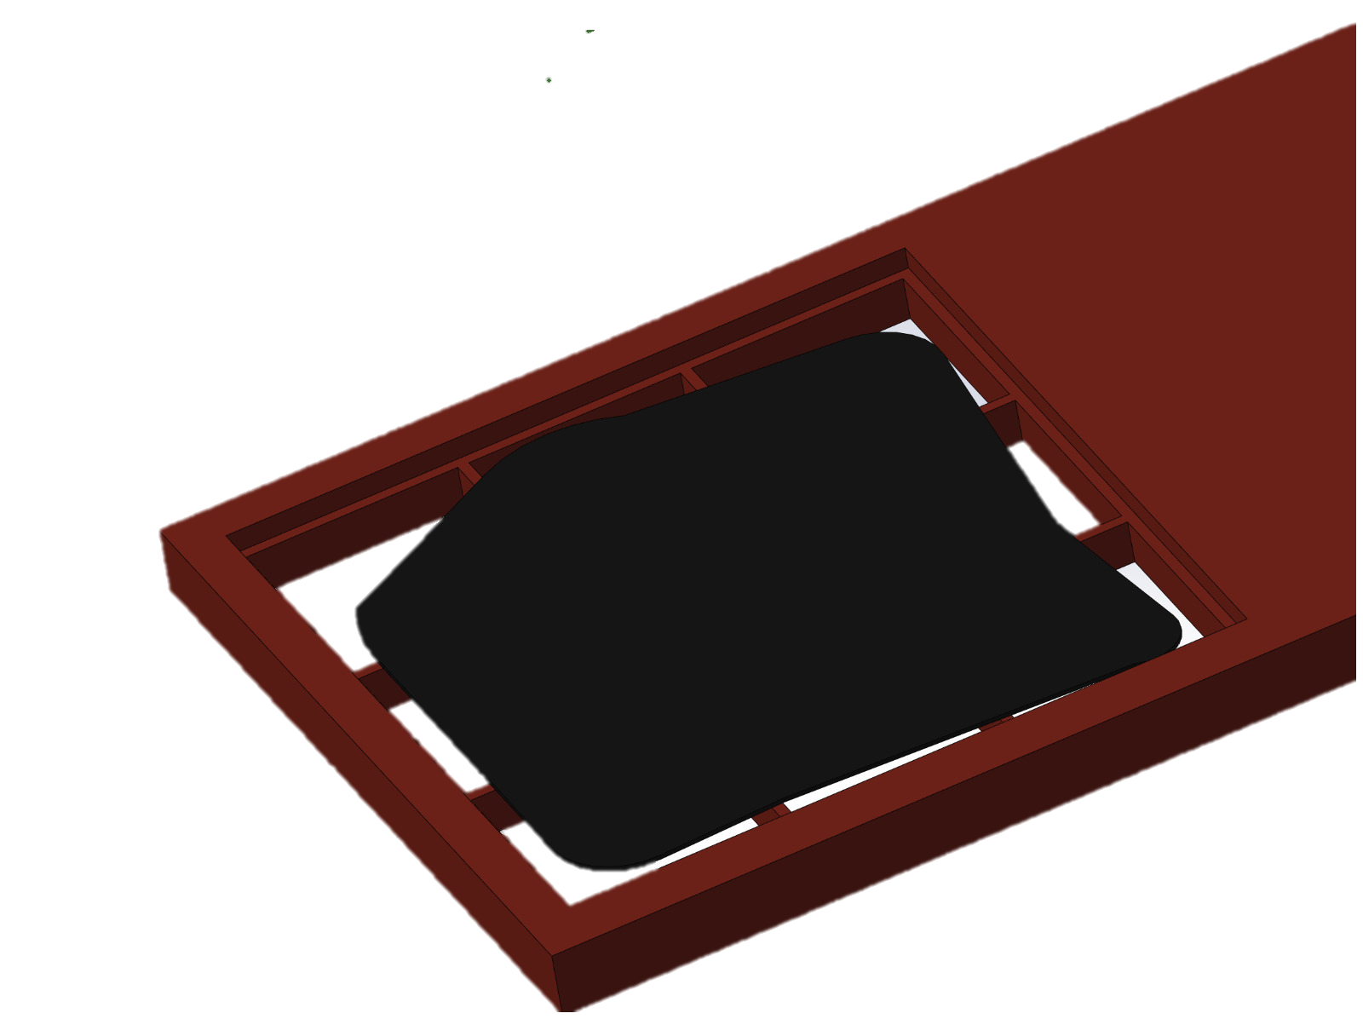
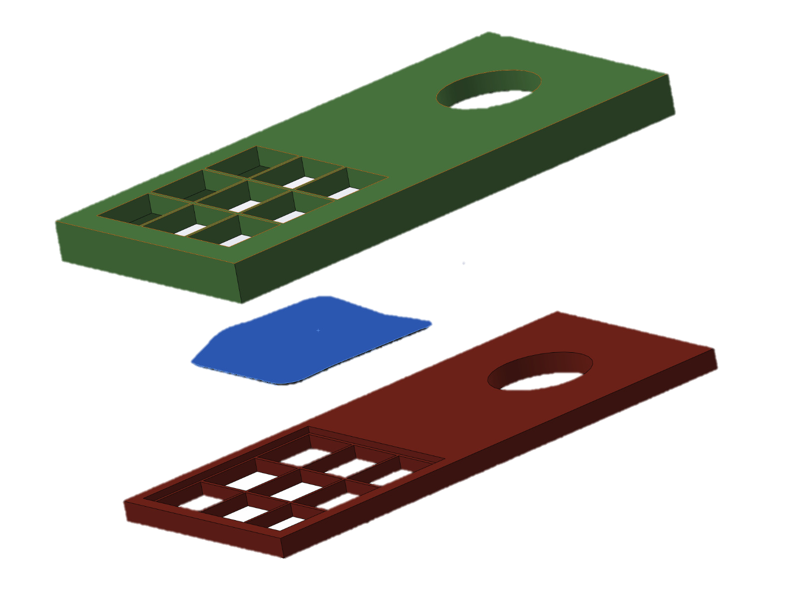
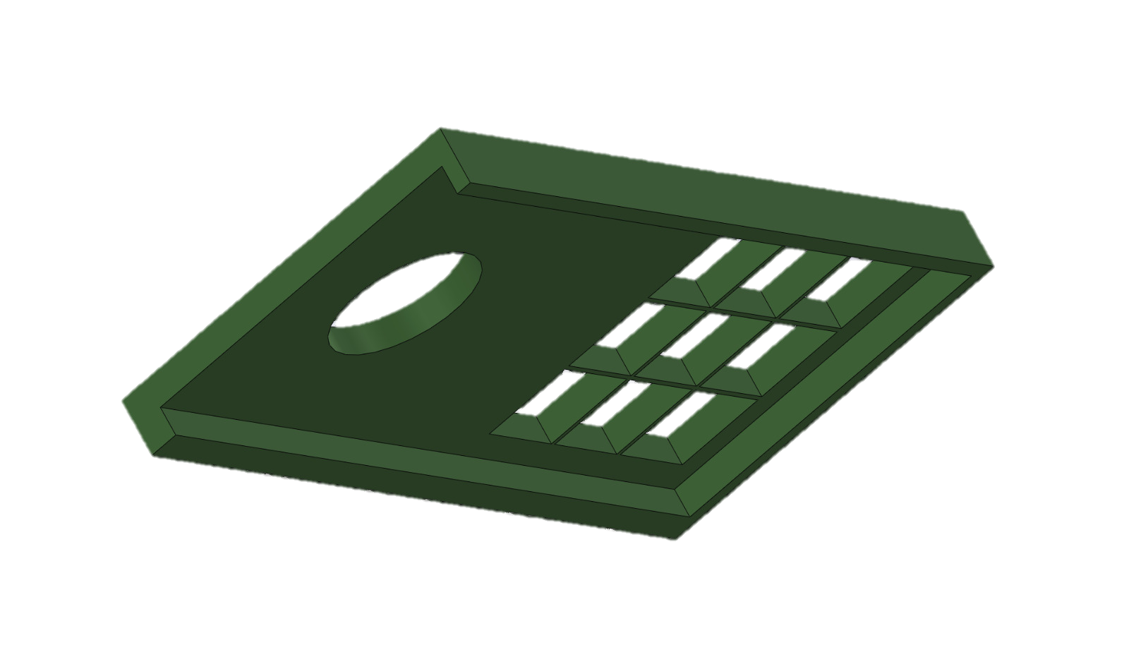
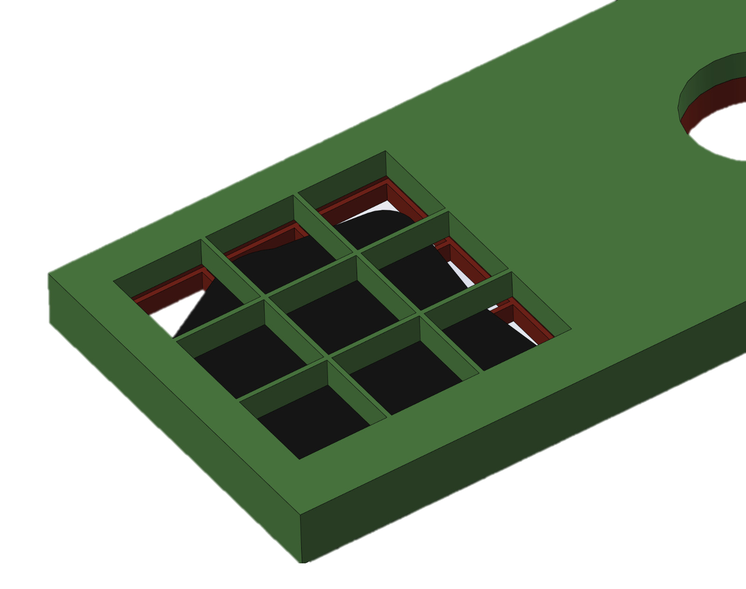
A possible technical solution from the PCB lab in CERN:
(they also made our Cupper-Beryllium double-grid on the Grid-Cryo-Motor)
Cupper Beryllium foil 0.4mm
Transmission Target ~ 3 um
Cupper Beryllium foil 0.2mm

Slide 9
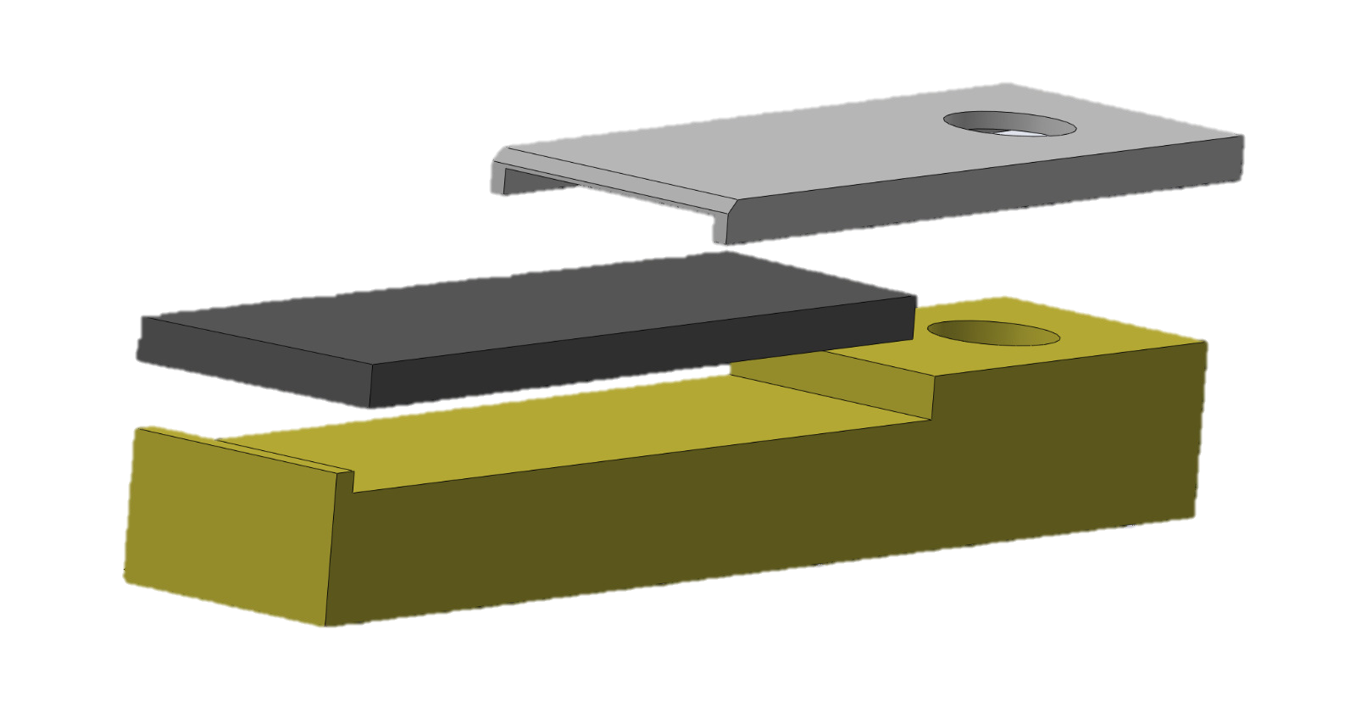
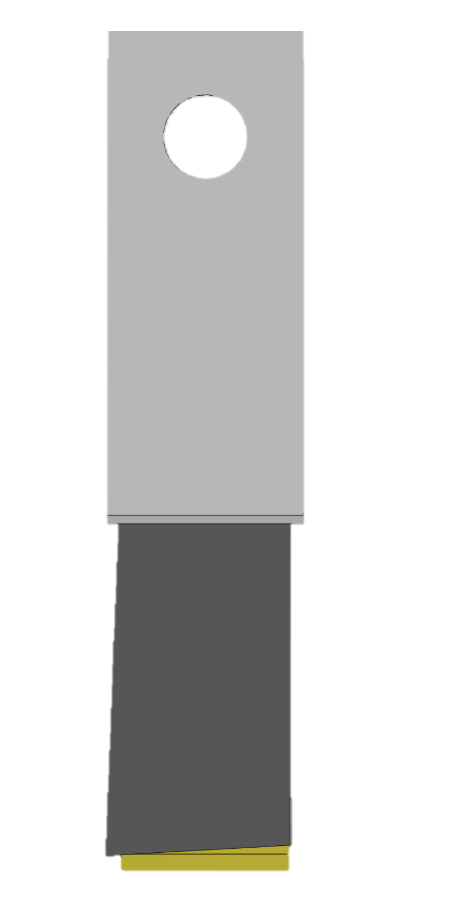
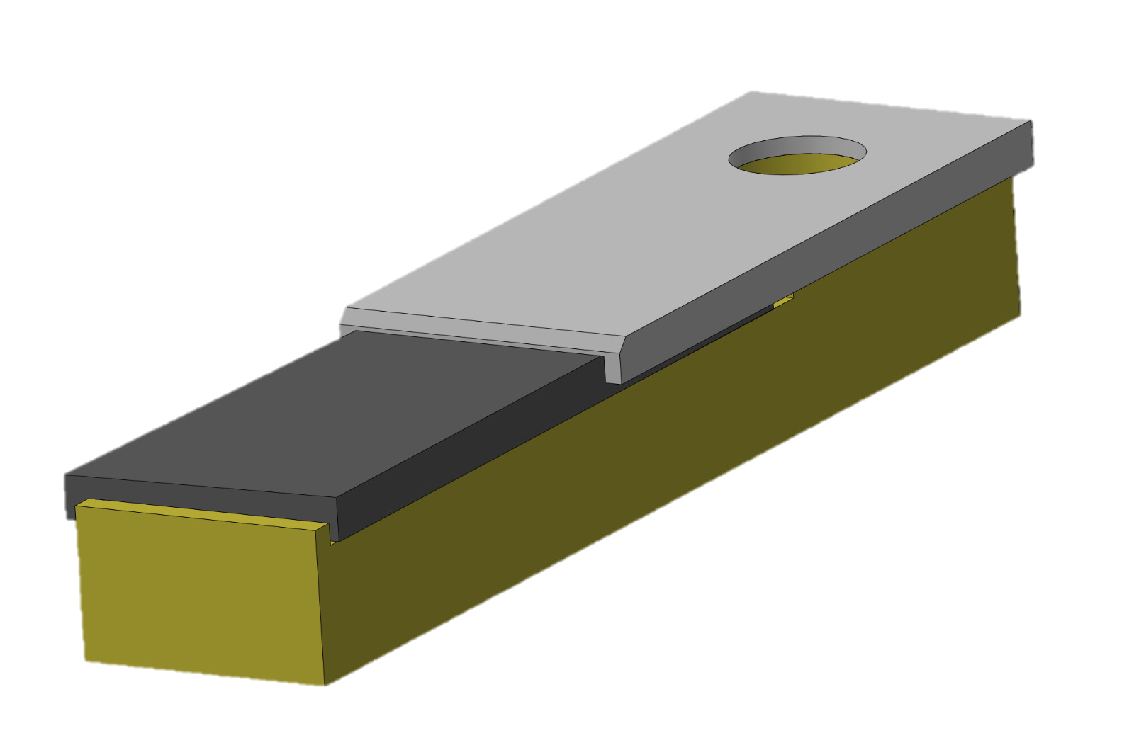
Reflection target holder:
Cupper Beryllium foil 0.3mm
Reflection target 0.5 mm
Cupper base 2.0mm
The target does not have to
perfectly cut

Slide 10
Still to be done
add adequate mechanical clamps to hold the targets securely in place
  test the transmission target holder under cryogenic conditions
add heater and temperature sensor to the ring
add thermal insulation in order to keep it at RT without heating the environment too much
integrate to the existing trap infrastructure:
  new cable management with new connectors for easier maintenance
  shift the optical elements for the laser a few mm further downstream
3D print / or micro water jet cut the elements
test the heating of the targets with an infra red camera in a vacuum setup

Slide 11
The modular design of the trap extension:
Alignment motor unit
Optical unit
Short support plate
(fixed with 4 screws to the trap support plate)

Slide 12
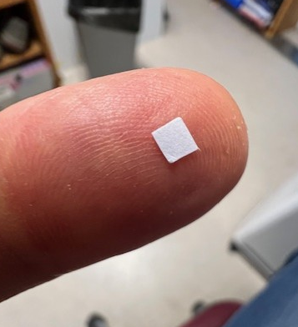
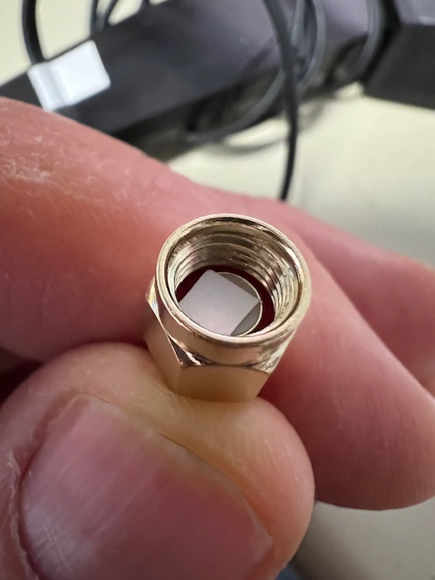
Target size 3x3mm in comparison
SMA HF connector

