Slide 1
Plans for YETS 2024

Slide 2
Contents
Summary of Cryo Shift situation of 2024 and outlook for 2025
Fixing the heat leak on the 1T bellows
Repairing the new 1T MCP assembly
Ion sources at AEgIS
Installing the anti-sun
Repair and redesign of the Hedgehog diagnostics
Rearrangement of the Enviro rack
New HV Ps for the beamline electrodes
Maintenance of beamline equipment

Slide 3
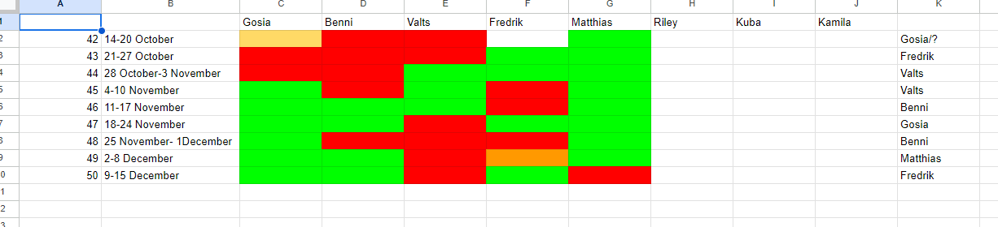
Cryo shift situation 2024 vs 2025
Stefan and Valts leaving in 2025
Kuba will be stationed at CERN on a permanent basis
Studetns (Lidka, Kamila, Ahmad, Bharat…) should be intermittently present to aid the cryo efforts
We are very low on Crane Operators- only 3 people with a license remaining!
If you can, please inscribe for both cryo and craning courses via CERN’s learning hub

Slide 4
Heat leak on the 1T bellows
With installation of 1T bellows assembly we introduced a heat leak that increased our LHe consumption from 6 to 10 dewars/week
The new demand could not be met by the Central Liquefier and forced us to operate in diminished capacity (5-6 days/week)
With a lot of effort and help from the community we managed to run continuously over the last 4 weeks, but with crippling workload for the cryo shifts
The situation has to be resolved (LHe consumption needs to go down) ASAP

Slide 5
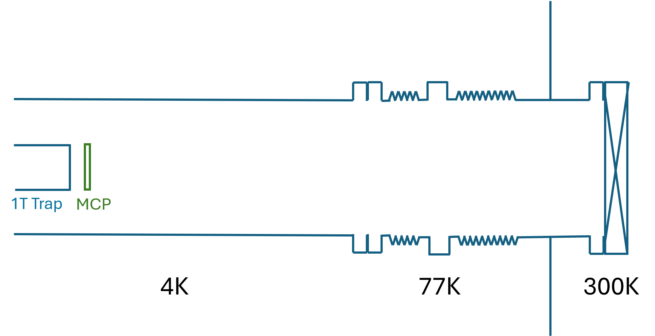
Heat leak on the 1T bellows
Origin of the leak:
We created an unshielded opening of 150 mm- radiative heating directly onto the 4K parts of the experiment
The thermalization elements that we’ve foreseen for the 77K parts of the assembly failed
Combination of both- we estimate 8 Watt going into the experiment, while our preliminary calculations account for 3-4 Watt
CERN’s cryo dept is preforming calculations for us that will help estimate and pinpoint the failure

Slide 6
Heat leak on the 1T bellows
Technical solution: improve on 1T bellows thermalization elements
Exchange the 1.5mm cs, M6 attached copper braids with 40mm copper braids soldered to a copper plate
Double check contact of the thermalization shield with the LN2 vessel

Slide 7
Heat leak on the 1T bellows
Technical solution: heat collector- a thermalized barrier absorbing the radiative heat
Heat absorption has x^2 correlation to the surface
The barrier will be best in form of a disc with an iris
We better make sure that the iris is positioned in a place/has diameter big enough to not obstruct the particle beam!

Slide 8
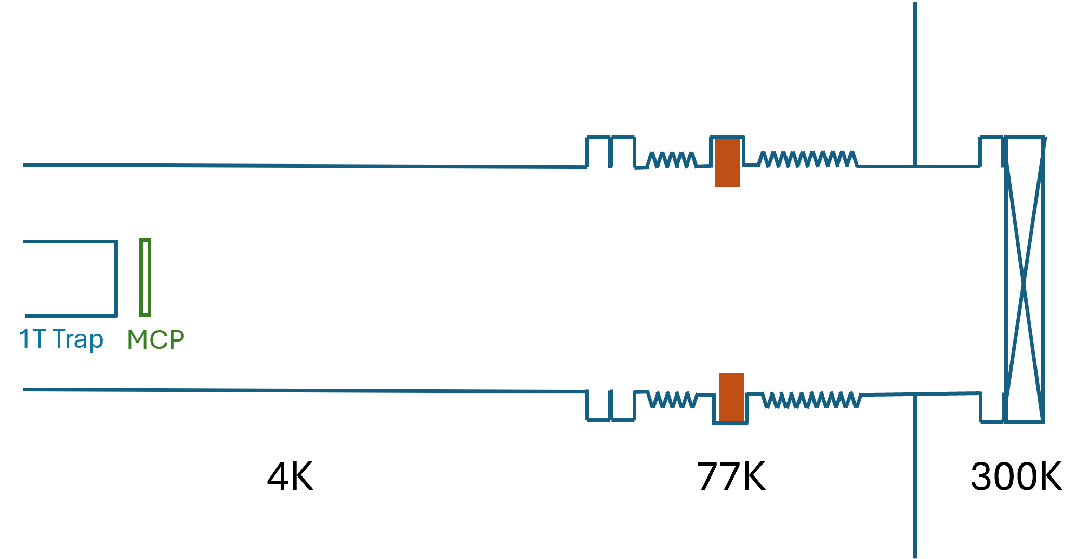
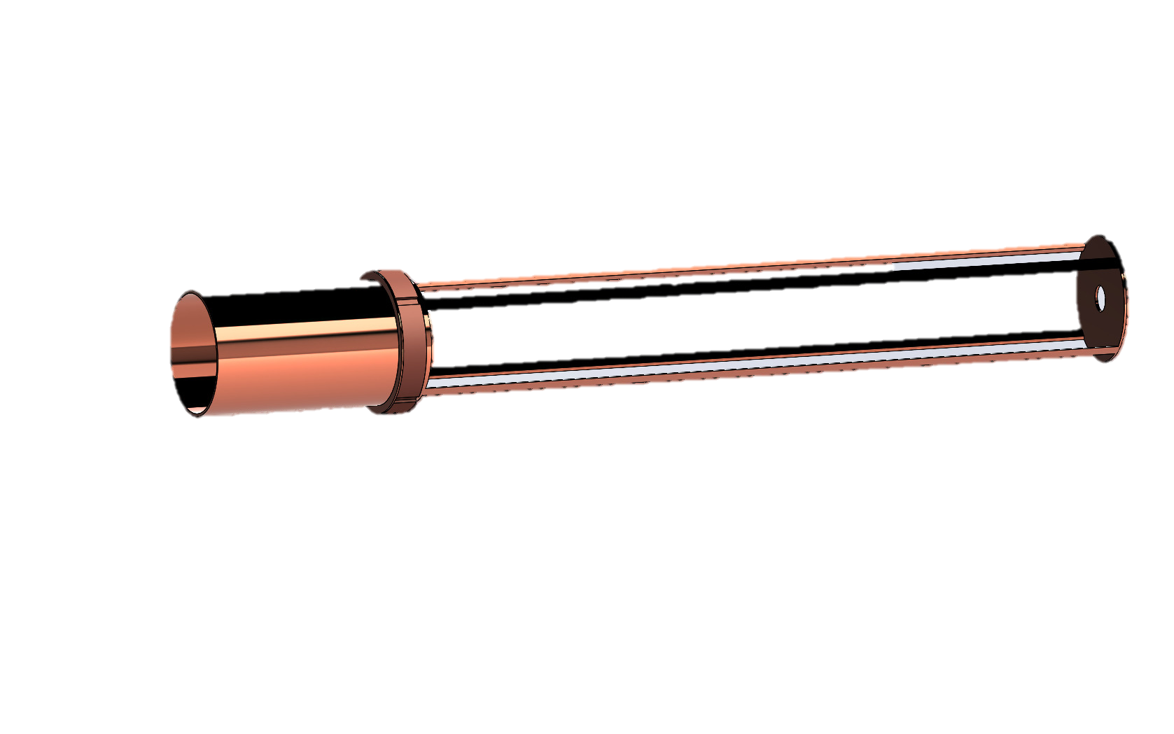
Heat leak on the 1T bellows
Technical solution: heat collector- a thermalized barrier absorbing the radiative heat

Slide 9
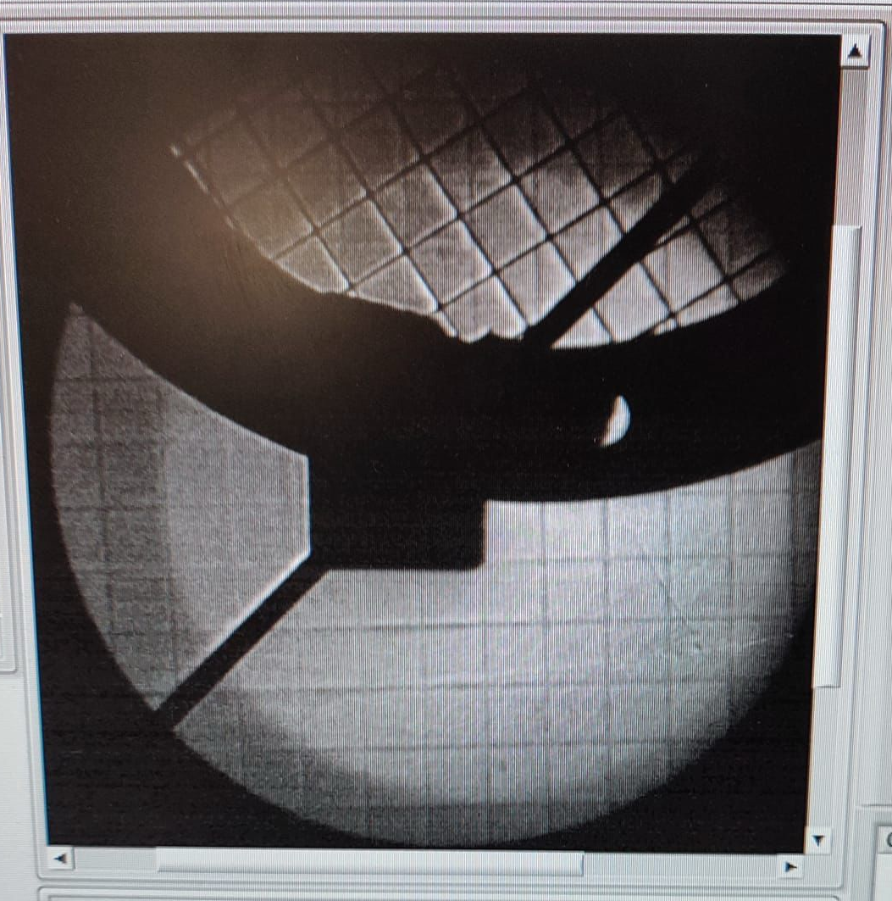
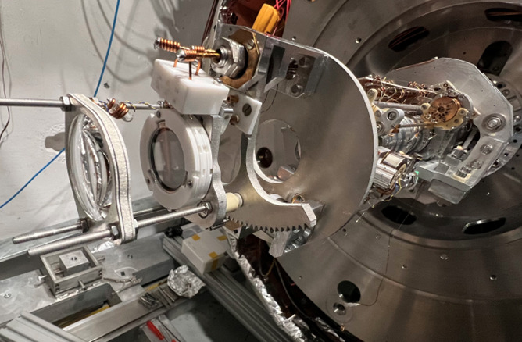
Repairs of the 1T MCP assembly
1T MCP is supposed to move in and out of the beamline to facilitate Hbar extraction
During installation, the mechanism got damaged (probably the ceramic ball bearings) and the MCP will not fully move out of the beamline
Towards the end of the run the MCP front plate has been damaged
The whole detector will have to be replaced
Needs to be done as soon as possible, will take 2-3 weeks

Slide 10
Anion source at AEgIS
We want to temporarily install the Borealis C2⁻ source at one of the Starship ports to test low- energy ion beam transport into the AEgIS experiment
We are expecting I⁻ source from Toruń
Installation is not dependent on the state of the main apparatus, we should start as soon as possible
An intervention of 2 weeks

Slide 11
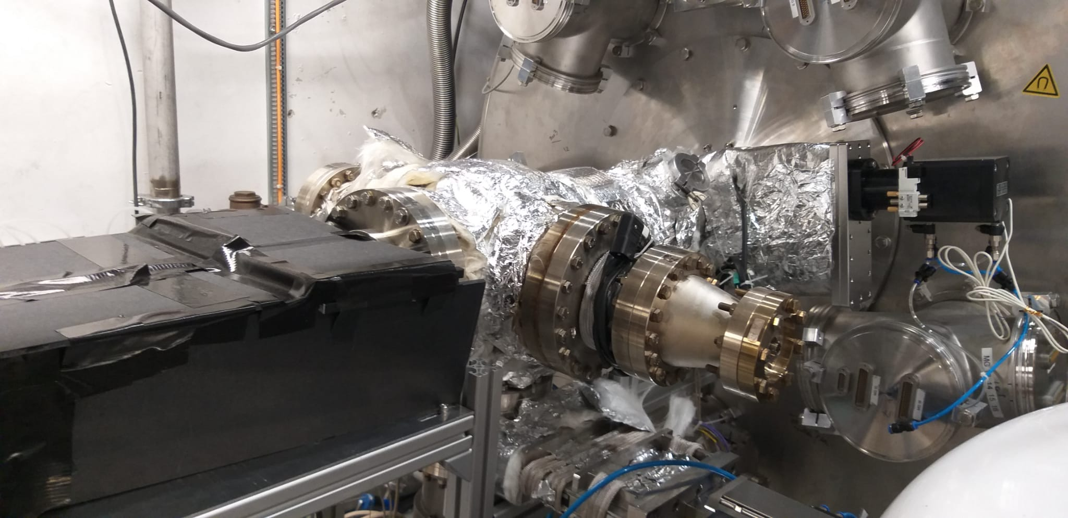
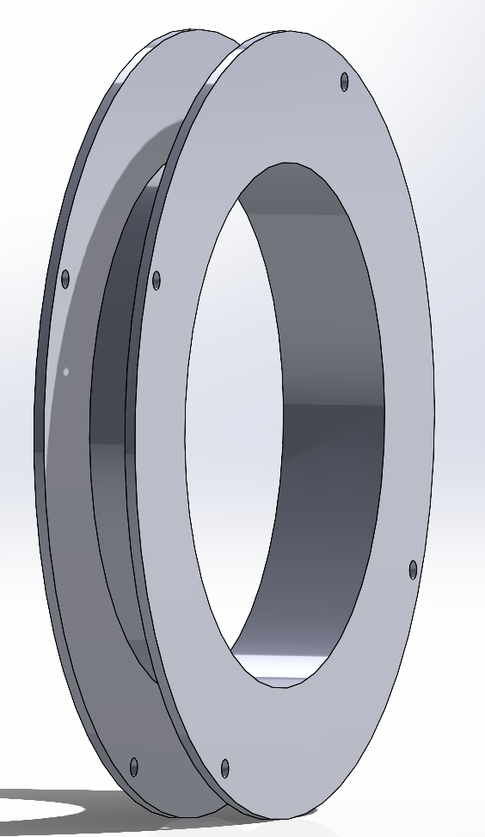
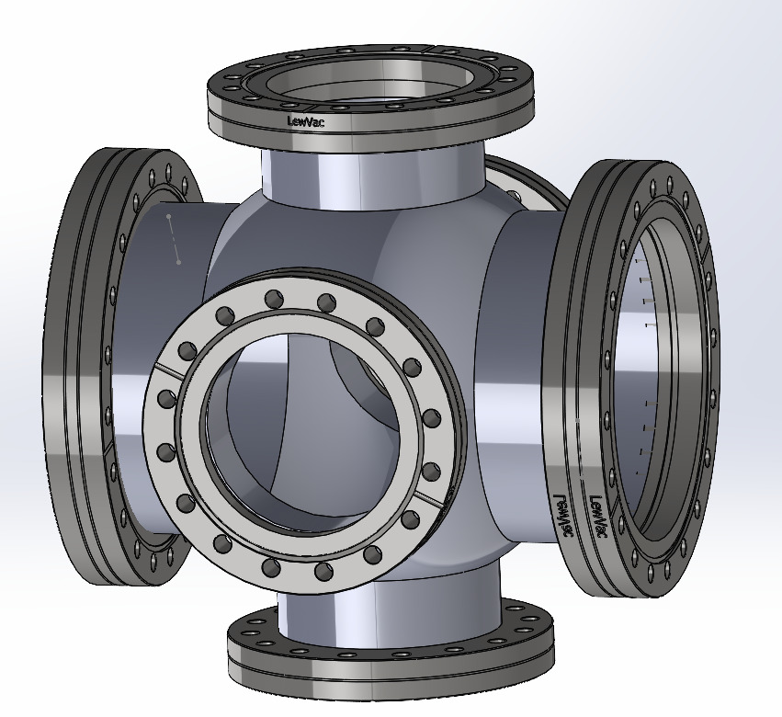
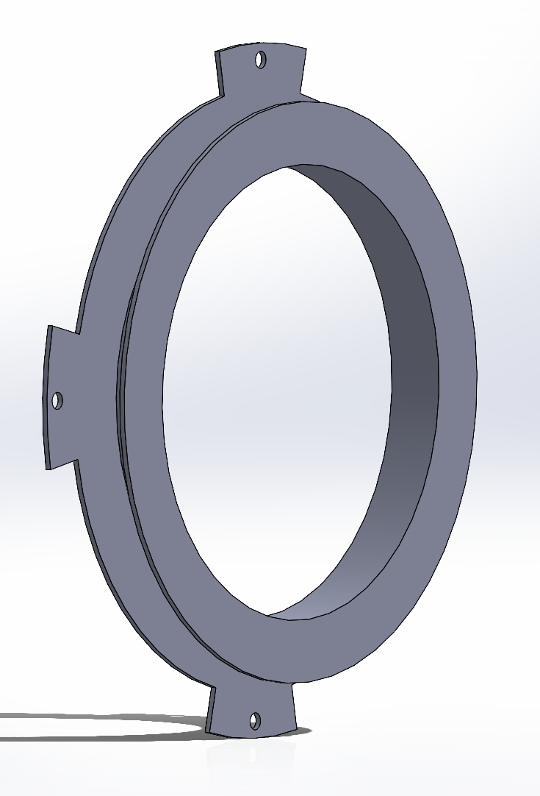
Installation of the Anti-Sun
A chamber on the 1T beamline that has a primary function to take out the 1T MCP signal
We will need to manufacture and assemble the parts of the retractable mirror holder
Can technically happen at any time, but since it involves setting up the camera better do it before the beamtime

Slide 12
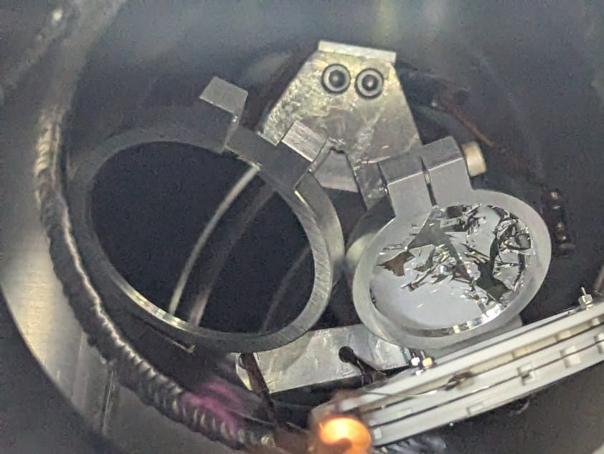
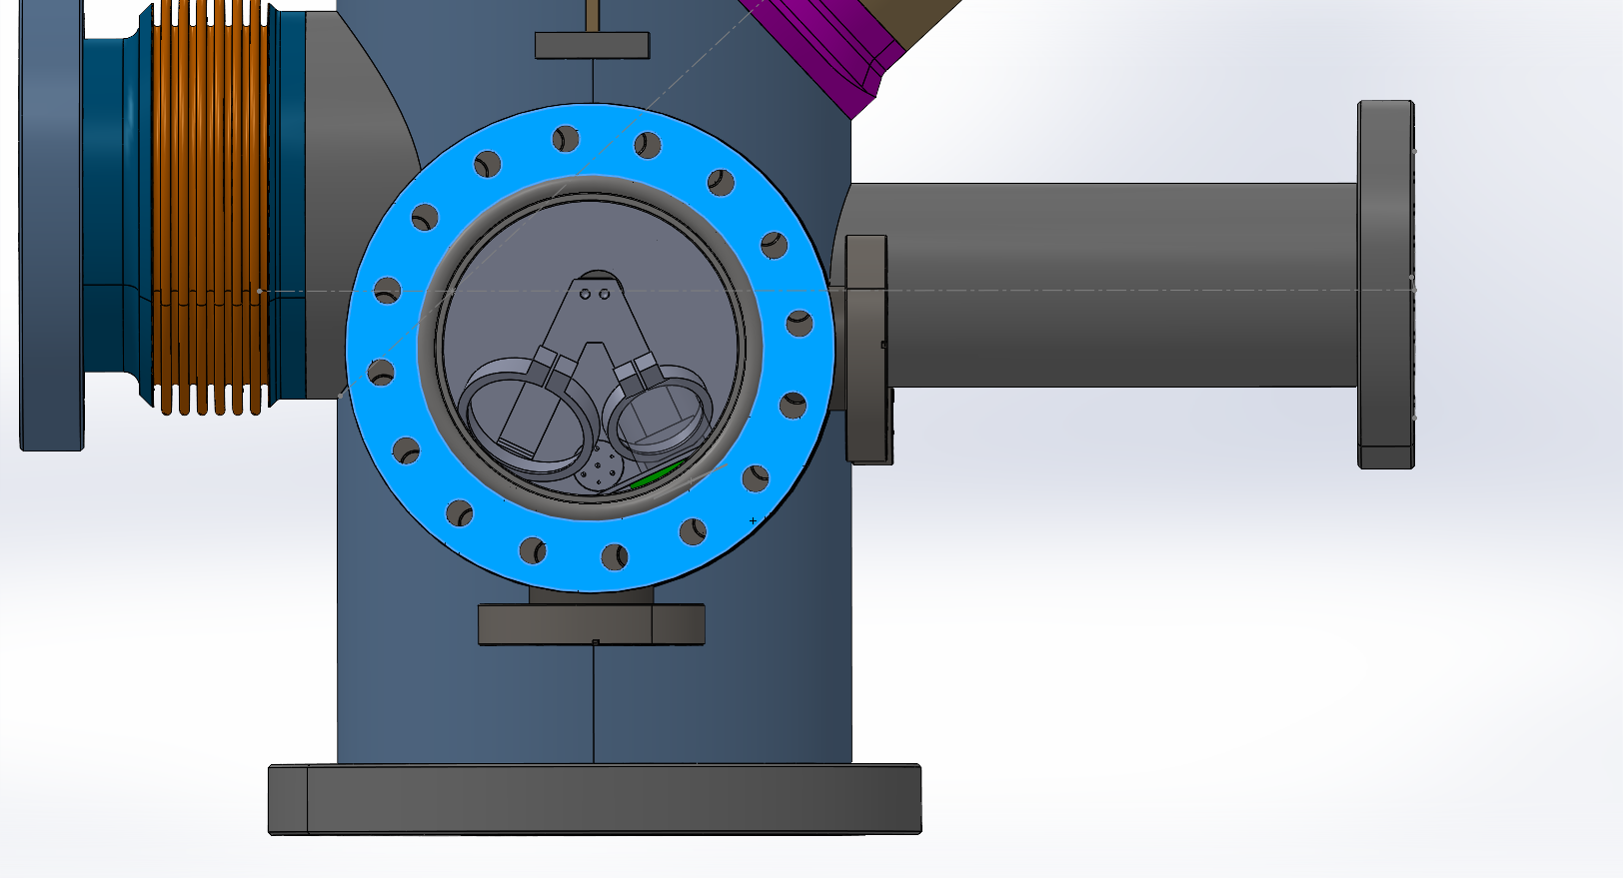
Rethinking of the Hedgehog diagnostics
Replace the broken mirror and change the mirror holder
Check the cabling on the MCP
Since we loose beam via collision with the mirror holders, the whole concept needs to be reconsidered
Conceptually easiest solution is to change geometry of the chamber

Slide 13
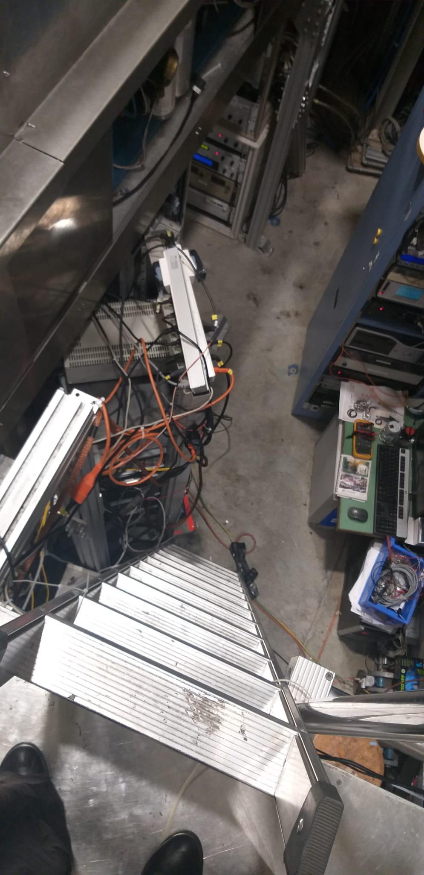
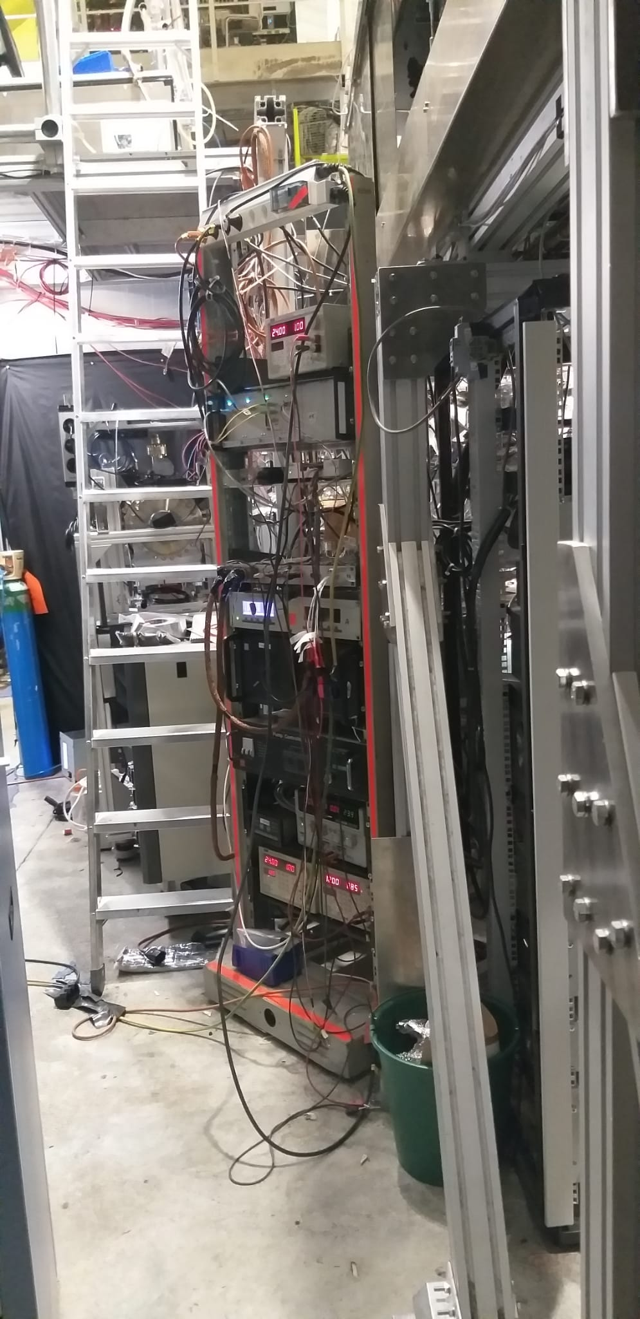
New place for the Enviro electronics rack
Moving the rack was necessary for facilitating Giovanni’s extraction experiments
Has been adopted as a temporary solution
We will not get beam clearance if it won’t change
Safety Unit promised to help and co-finance more optimal distribution of the Enviro electronics

Slide 14
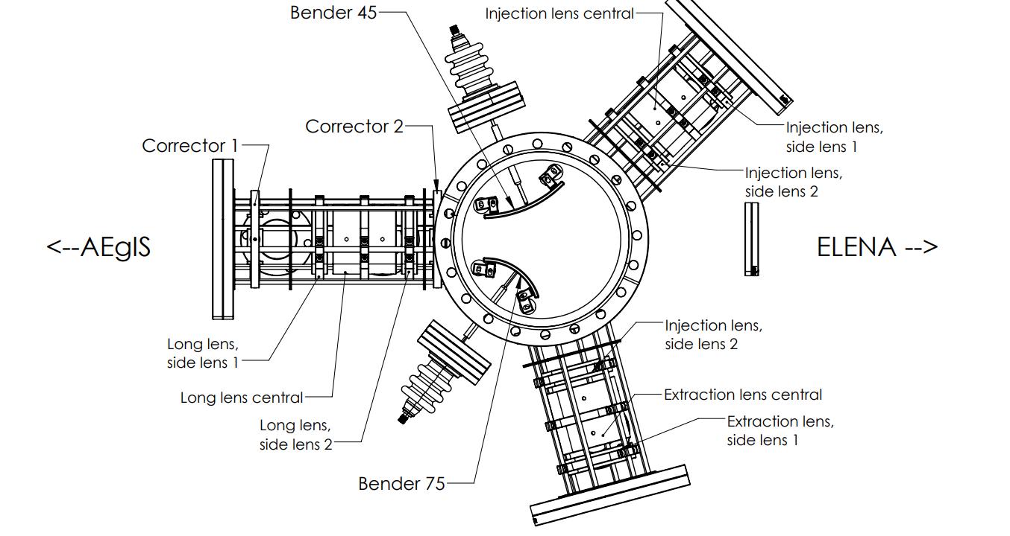
New HV Ps for the injection/extraction line
We are currently renting an EPool CAEN crate and 4 HV modules that allow us to power up Starship electrodes up to 6kV
New standard CAEN crate and 15 kV modules (POS and NEG) are being purchased
We should think about investing 12K in bi-polar remotely switchable modules for the corrector electrodes
New crate should be installed on the electronics island with the magnet power supplies
Starship needs to be re-cabled
Intervention of 1-2 days

Slide 15
Maintenance of the beamline equipment
We had a near failure of TP3 (next to the ELENA GV) in the last week of beam. Its our only active TP during data taking, it needs to be serviced!
TP2 (Sun) won’t start any more, controller throws out an error. We have an identical pump with the same behavior- we could use it to pump the Anti-Sun.
Borealis Backing Pump needs to be refurbished
Vacuum gauge on the Hedgehog is not working any more (despite being brand new…)
It would be good to repair/replace the stubborn GV at the Starship extraction port…

