Slide 1
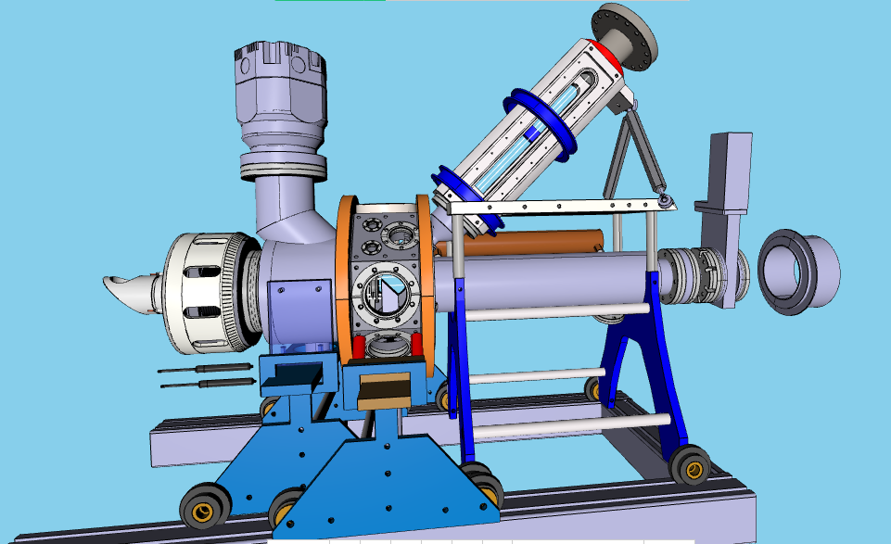

Slide 2
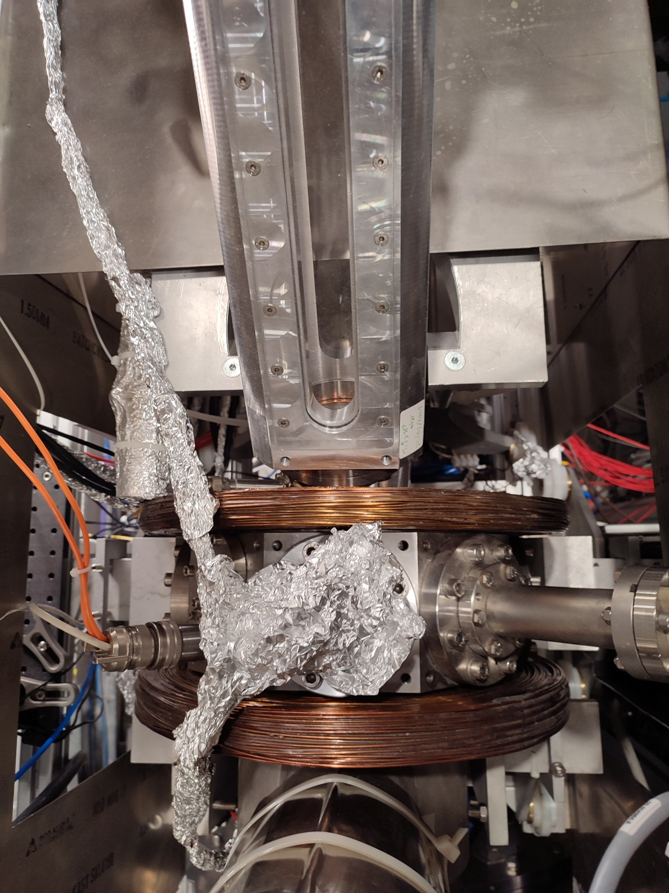
Top view
Beam tube
Laser viewports
PbWO4
Feedthrough
Pressure Gauge

Slide 3
Gauge
PbWO4
Block
Block

Slide 4
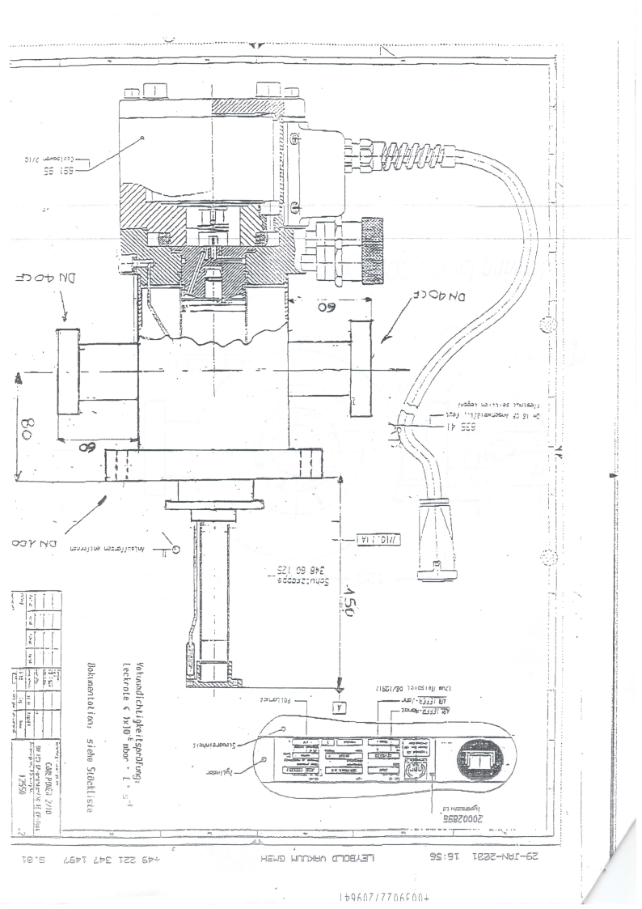
Cryostat
Cables
PbWO4

