Slide 1
Requirements for AEgIS laser system
Fredrik Parnefjord Gustafsson
19/12/2024

Slide 2
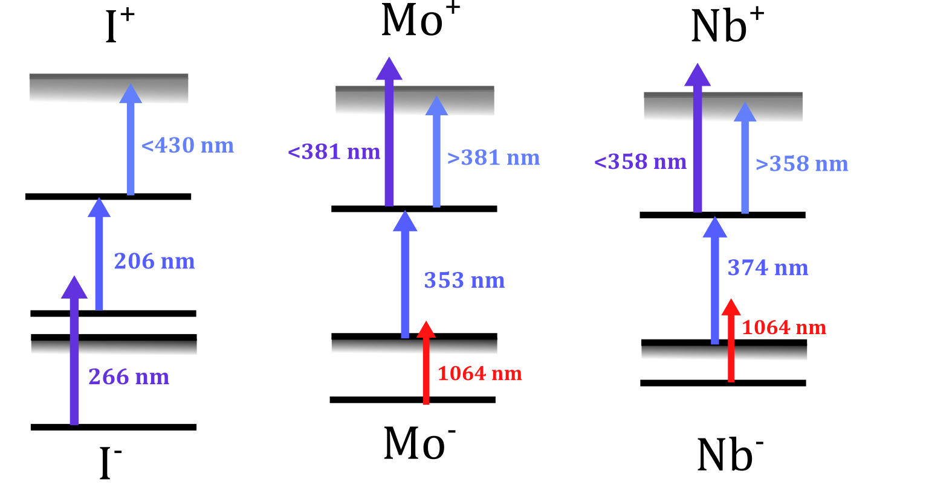
Ion program:

Slide 3
Saturation Intensity calculations for Iodine 1/3
~100 uJ/cm2
Sadiq Nawaz
Mohammed Waseem
C. J. Foot, Atomic Physics

Slide 4
Line Width @ 206 nm
The line width is equal to the Einstein “A” coefficient Γ=A,
Line Width @ 206 nm= 3E6 /s = 3 MHz
Mass of Atomic Iodine =2.1072903E-25 Kg
Doppler Broadening @ Room Temp ~ 1.6 GHz
Sadiq Nawaz
Mohammed Waseem

Slide 5
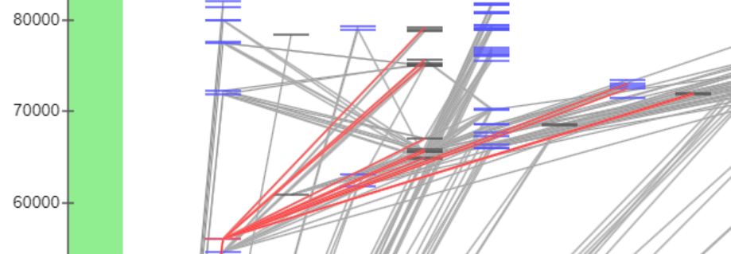

Saturation Intensity calculations for Iodine 3/3
Sadiq Nawaz
Mohammed Waseem
https://www.osti.gov/servlets/purl/1688760

Slide 6
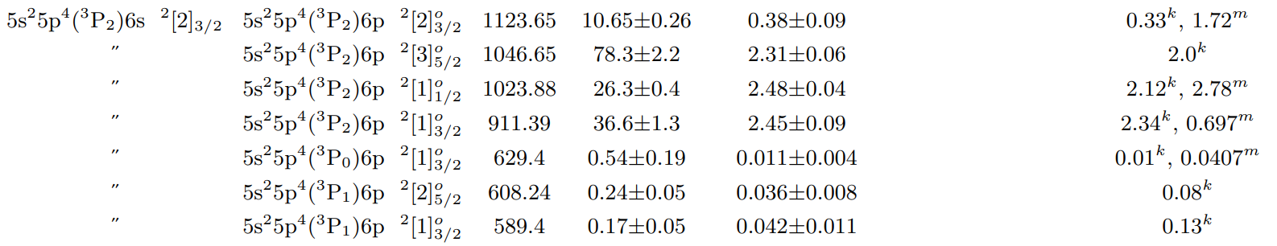
Saturation Intensity calculations for Iodine 3/3
Saturation intensity @ 589.4 nm, Einstein Coefficient=0.42E6 is 0.0427 mW/cm^2,
Fluence @ 10 Hz=4.27 uJ/cm^2
Literature not available for 511-354 nm Transitions
Sadiq Nawaz
Mohammed Waseem
https://www.osti.gov/servlets/purl/1688760

Slide 7
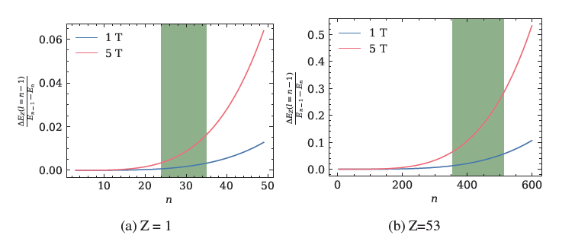
B-field splitting of antiprotonic states
Laser accessible range
Laser accessible range
Simulated by Antons

Slide 8
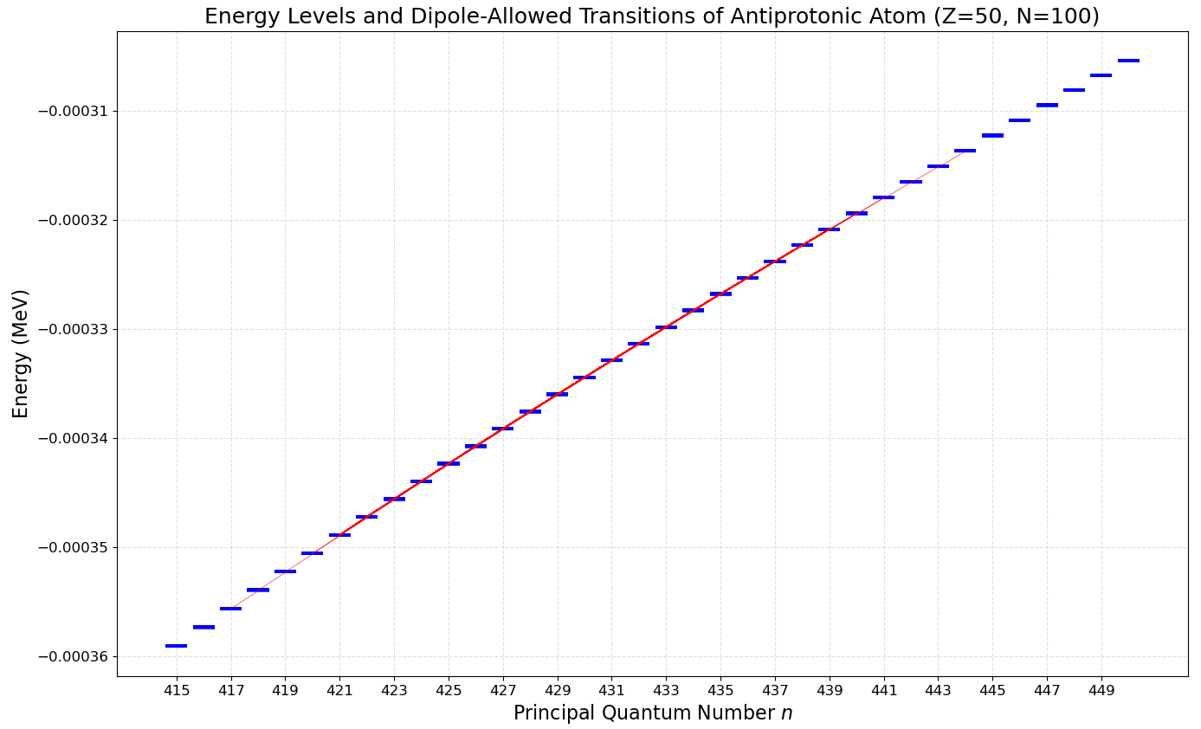
Ti:Sa range:
750 nm to 850 nm

Slide 9
Fluence for Anti-protonic Helium
^{(a)} Fluence Anti-protonic Helium @417 nm and 372 nm [-6 GHz detuning] = 1-2 mJ/cm^2 for n=34 to n=36
^{(b)} Pulse Energy Anti-protonic Helium @blue = 2-4 mJ Dye laser (Pump laser @ 531 nm has 180 mJ energy) and UV = 15-40 mJ before frequency doubling/tripling with LBO/BBO crystals (Ti:Si laser with multi-pass amplifier) for n=36 n=37, n=38 Beam Diameter 3 cm at both wavelengths
Two-photon laser spectroscopy of antiprotonic helium and the antiproton-to-electron mass ratio
Buffer-gas cooling of antiprotonic helium to 1.5 to 1.7 K, and antiproton-to–electron mass ratio

Slide 10
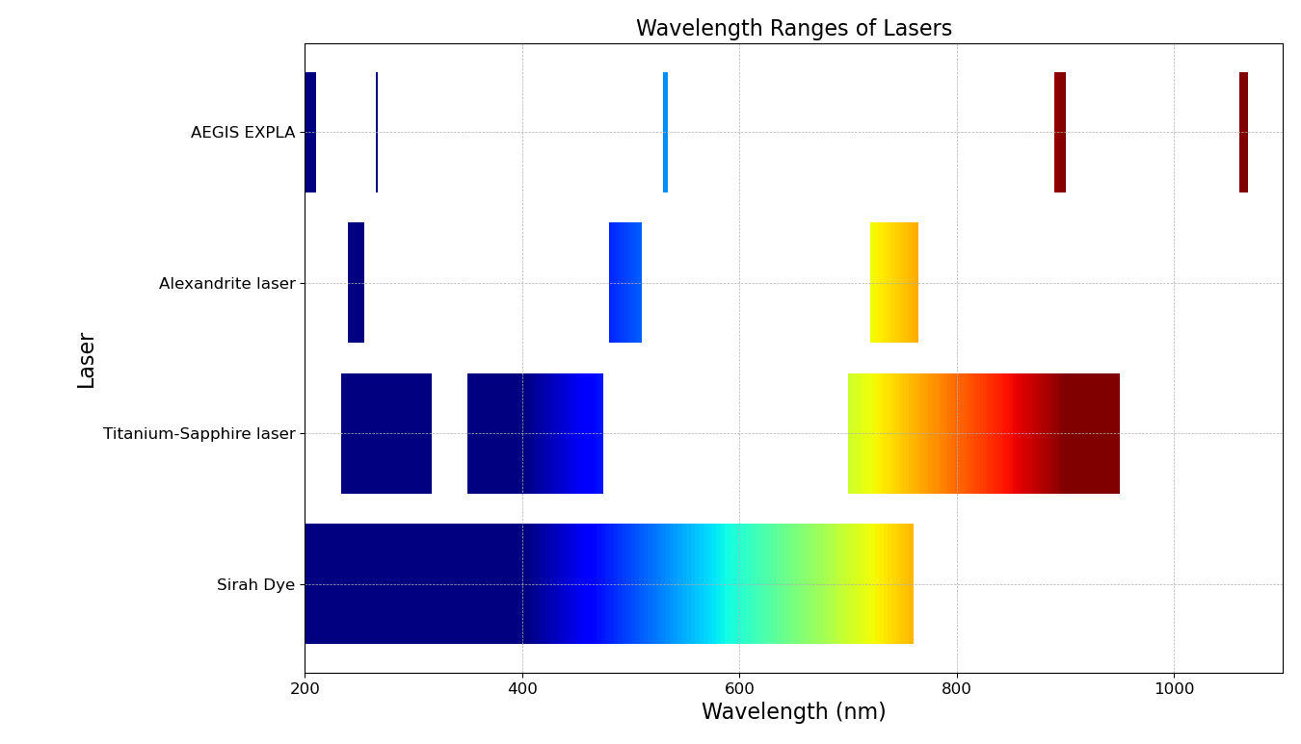
Antiprotonic atom needs:
206 nm
266 nm
430 nm
353 nm

Slide 11
Positronium needs:
205 nm
243 nm
350 nm?
410 nm

Slide 12
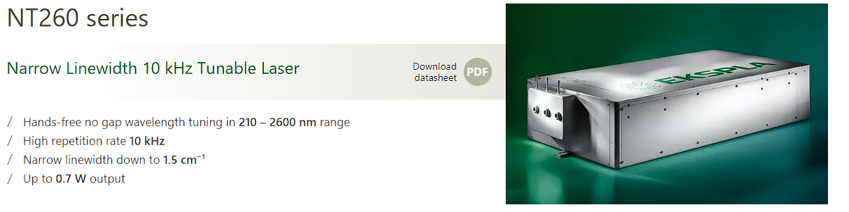
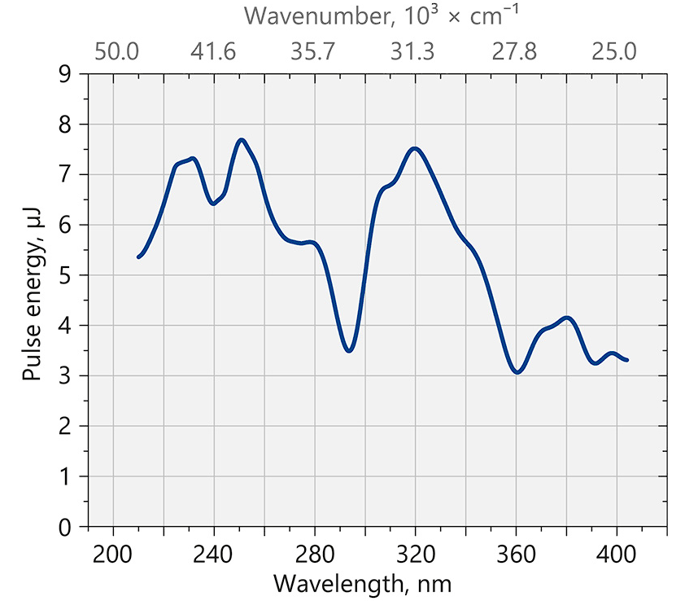
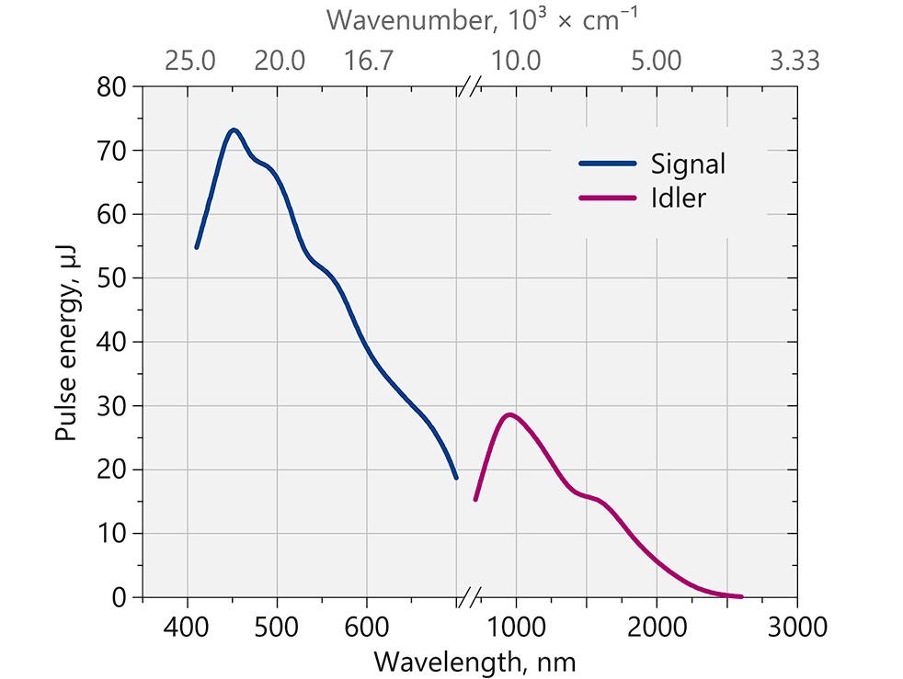

Slide 13
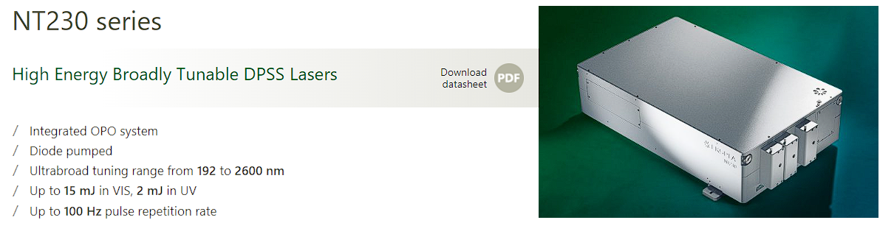
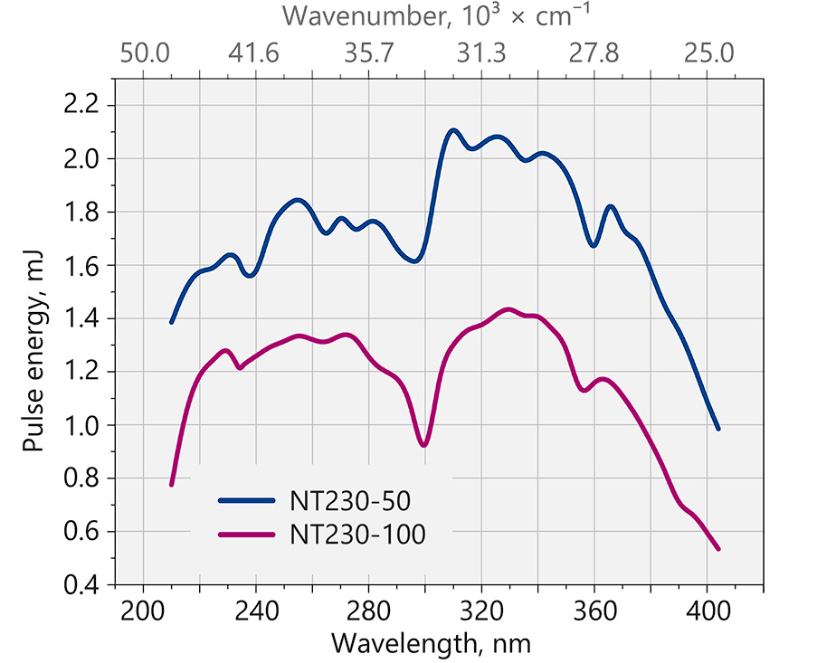
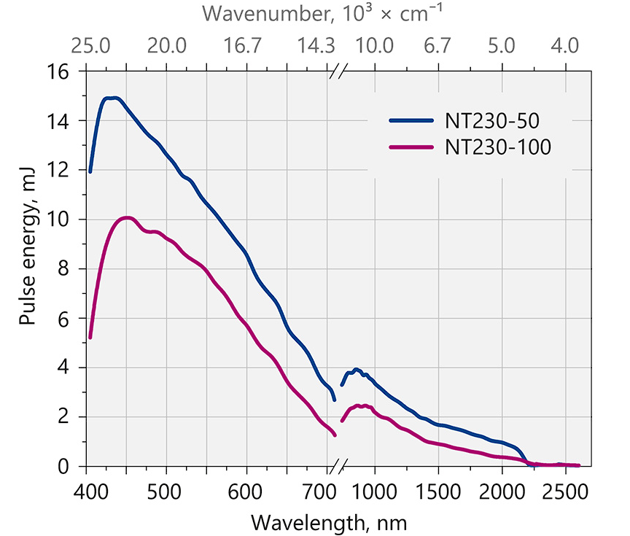
Linewidth <5 cm⁻¹
150GHz
Linewidth is <8 cm⁻¹ for 210 – 405 nm range.
<240GHz

Slide 14
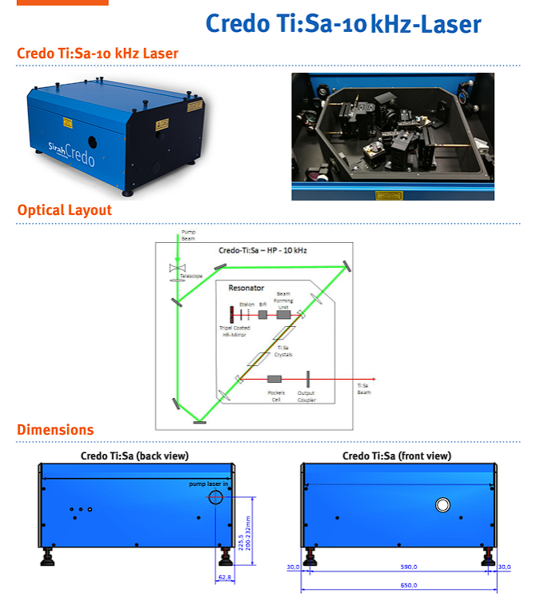
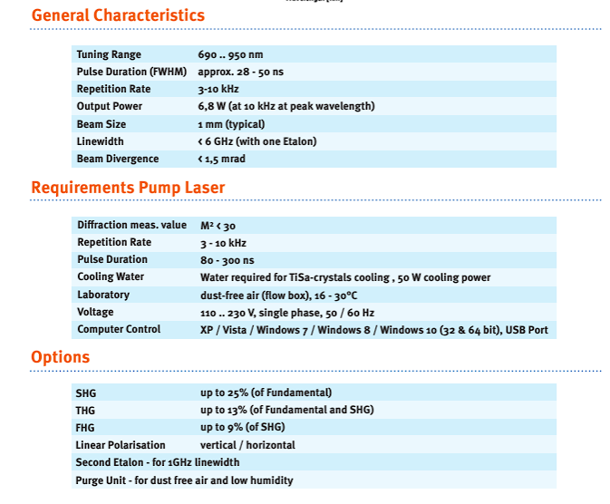
Ti:Sa system

Slide 15
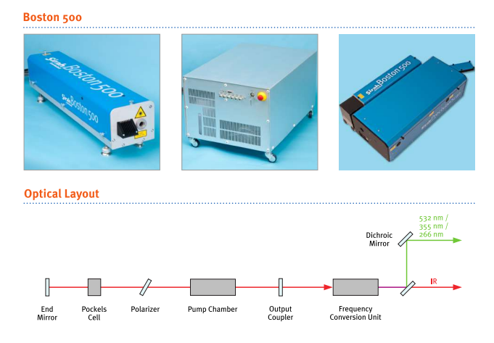
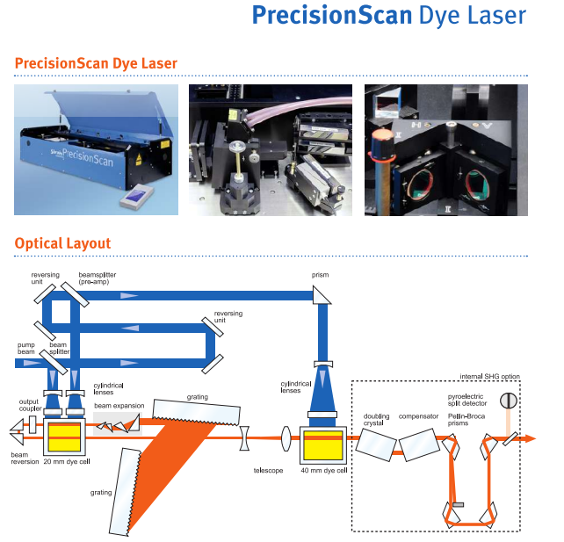
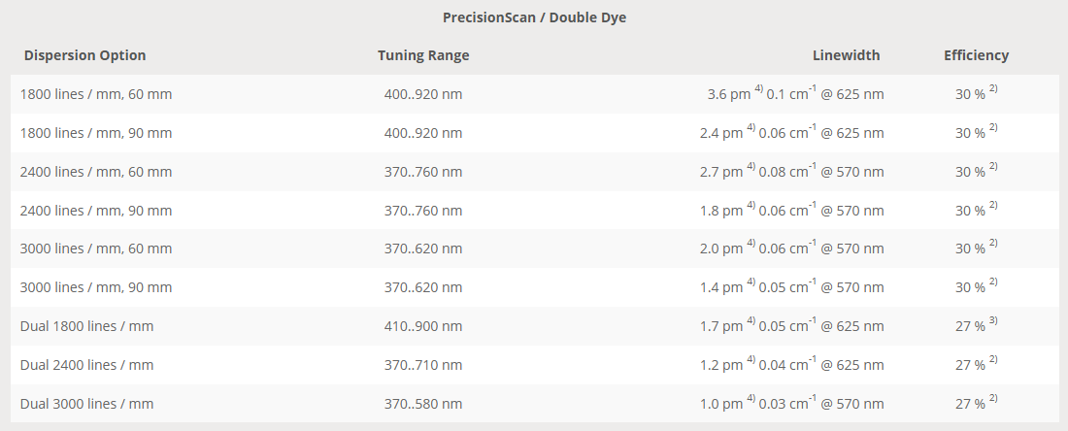

Slide 16
Price?
Component | Description | Price
Boston Nd:YAG | 500mJ@1064nm, 270mJ@532nm | €35.000
CREDO Ti:Sa Laser | Titanium:Sapphire laser system for ultrafast pulsed operations. Tunable wavelengths for precision applications. | €43.000
FCU+Cristals | 350-470nm (for Ti:Sa) | €12.000
Presicion scan Dye laser | Titanium:Sapphire laser system for ultrafast pulsed operations. Tunable wavelengths for precision applications. | €40.000
FCU+Cristals | 206-380nm (for Dye laser) | €14.000

Slide 18
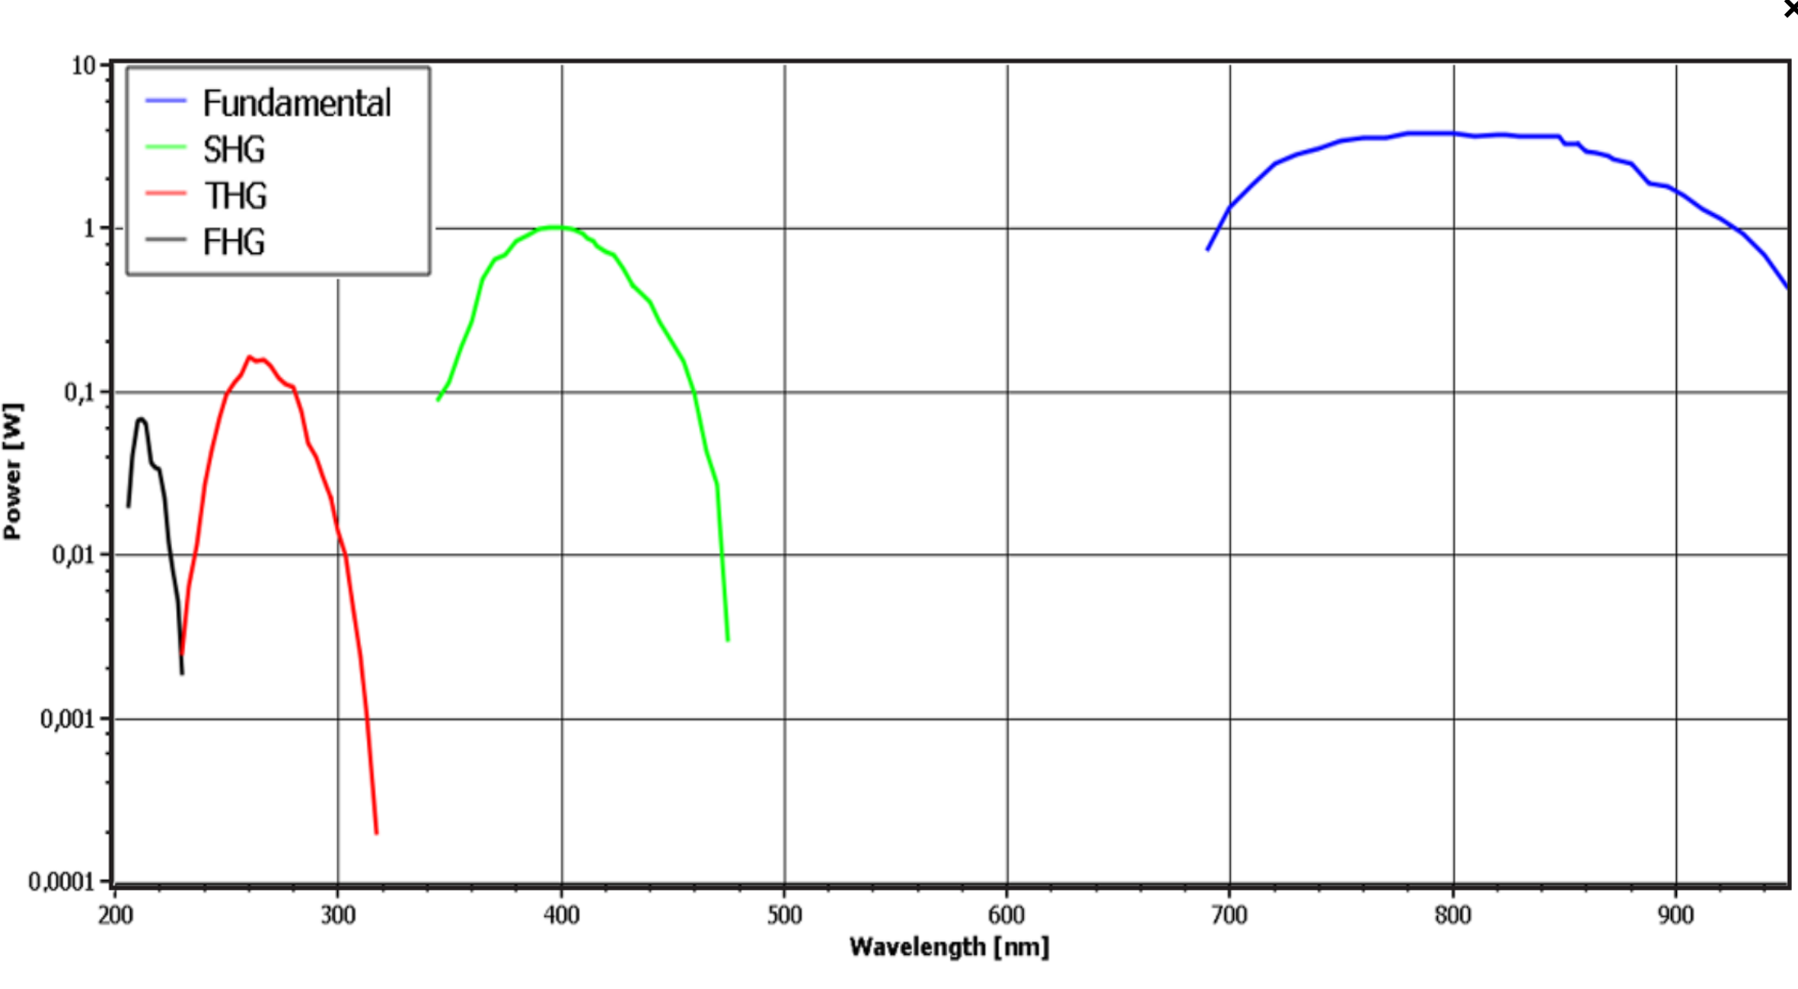

Slide 19
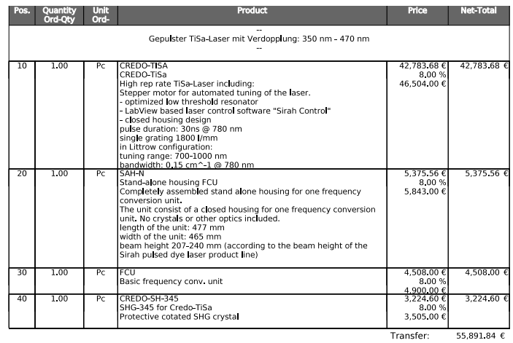
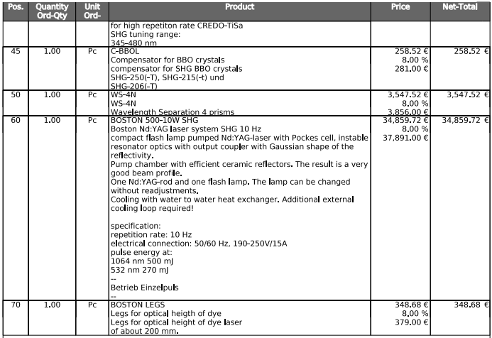
CREDO

Slide 20
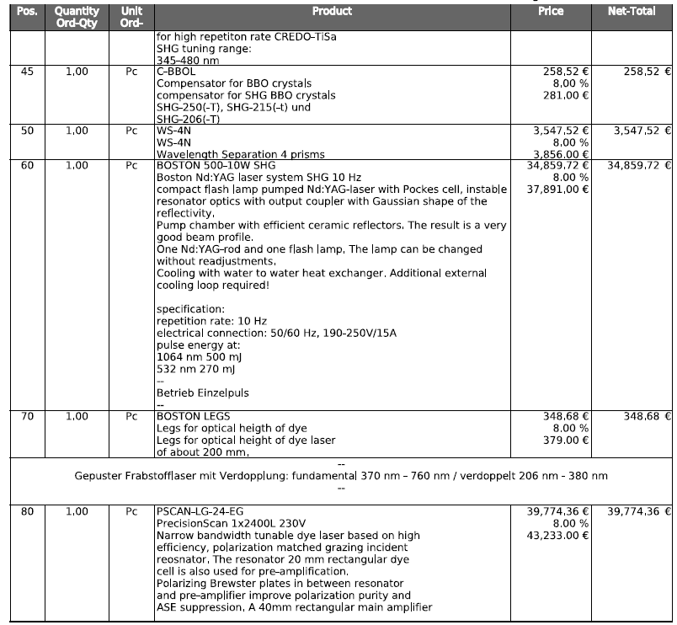
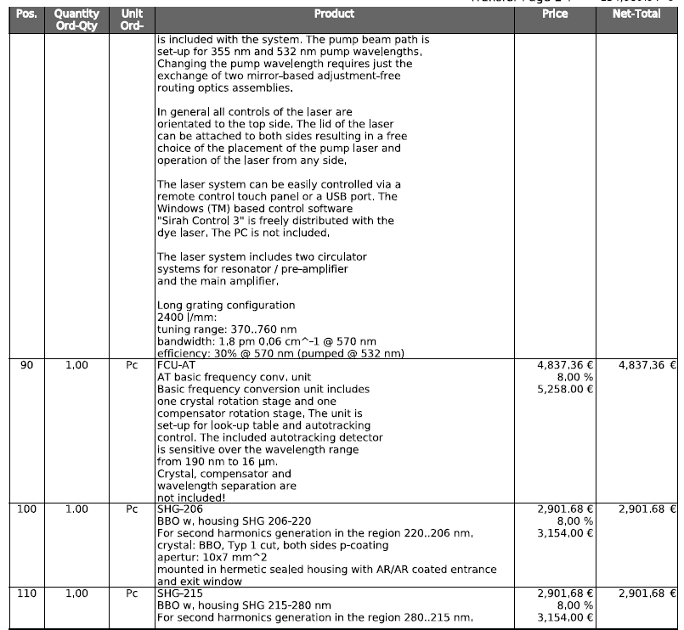

Slide 21
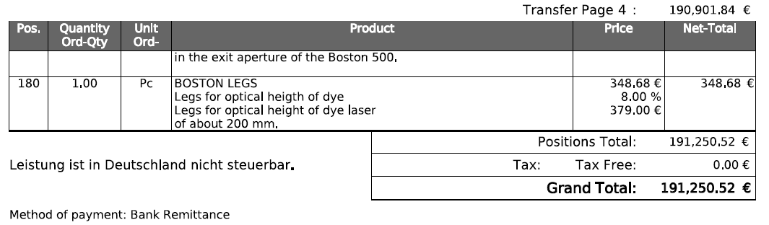

Slide 22
Step 2: Exciting neutral Iodine
I+
1064nm
Lower level:
7602.970 cm-1
5s²5p⁵ ²P_{1/2}
206.16 nm
Upper level:
56092.881
5s²5p⁴(³P₂)6s
A, s⁻¹: | 3.0e+06
4xx nm
I*
Laser:
Tripled light from Alexandrite laser system available at AEGIS. Generating 2 to 3 mJ/pulse at 206 nm.
206nm
I-
266nm

Slide 23
Step 3: Exciting neutral Iodine to a Rydberg state
I+
1064nm
Lower level:
56092.881 cm-1
5s²5p⁴(³P₂)6s
511 nm to 354 nm
Upper level:
From 74897 cm⁻¹
To
IP at 84295 cm-1
4xx nm
I*
Suggested lasers:
366 nm from BBO doubled Ti:Sa laser (same as Rydberg excitation laser.. Daniel Comparat)
Do we have enough Nd:YAG systems available for the 1064nm light?
206nm
I-
266nm

Slide 24
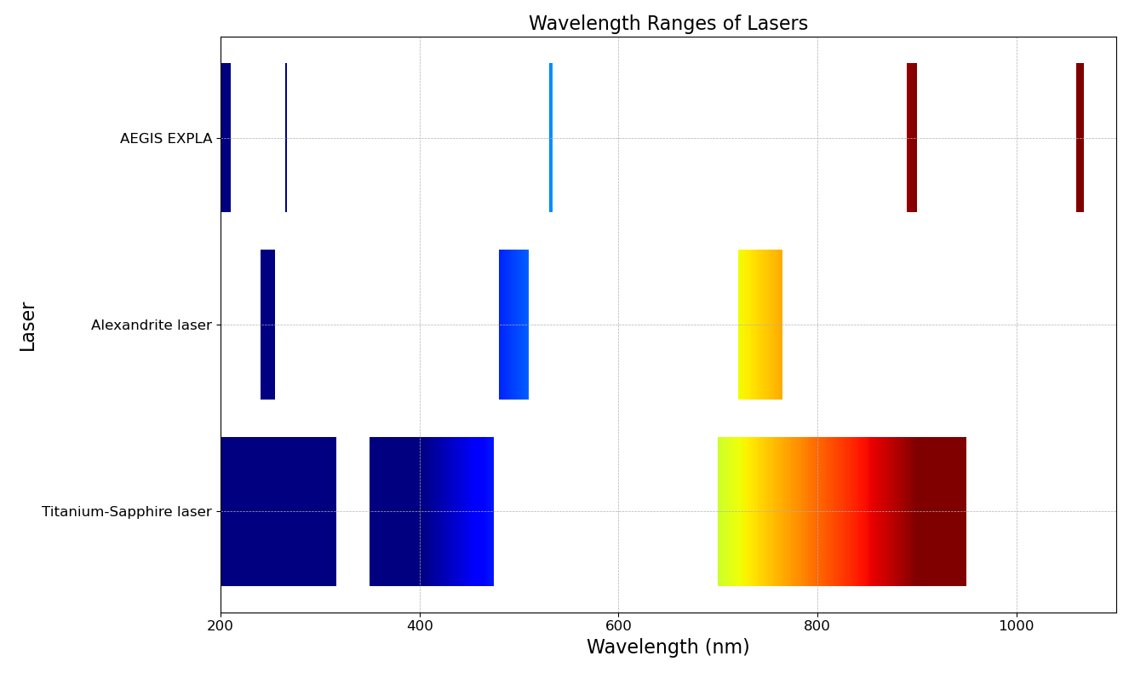
Antiprotonic atom needs:
206 nm
266 nm
430 nm
353 nm

Slide 25
Positronium needs:
205 nm
243 nm
350 nm
410 nm

Slide 26
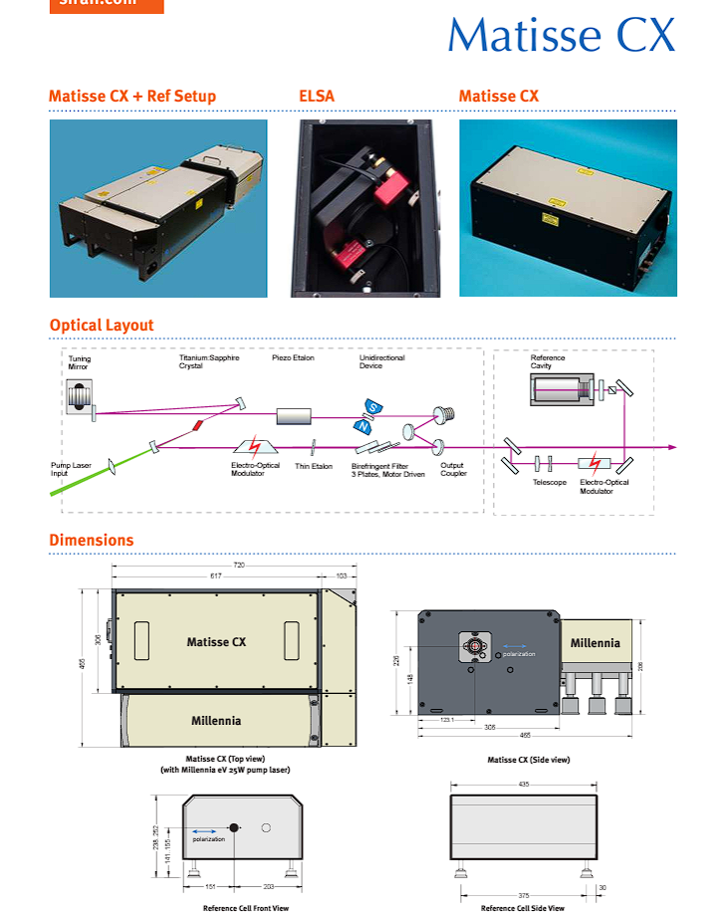
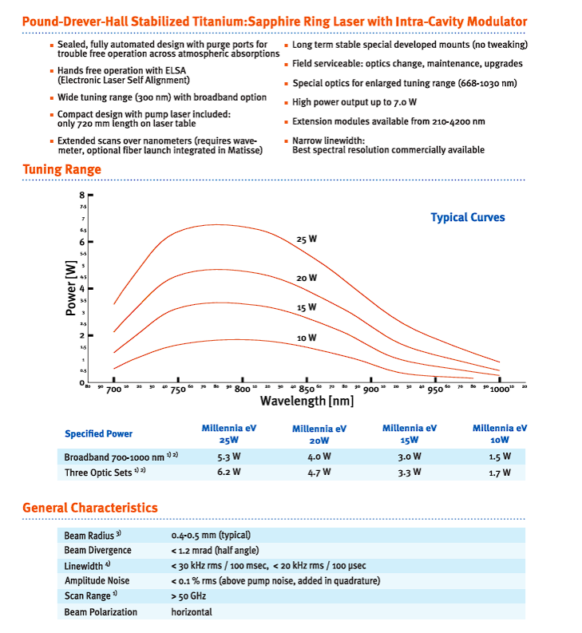
CW systems

Slide 27
