Slide 1


ExaTePP WP2: Training
Wendy Winnard
Training Officer, Hartree Centre
hartreetraining@stfc.ac.uk
Notes:
Audience 2 communities Exalat and HEP crossover
Aiming to redesign high priority simulation codes and algorithms to fully harness the power of future supercomputers, keeping UK research and development at the forefront of high-performance simulation science
PowerPoint Presentation (stfc.ac.uk)
Schools (May and October) and Prior Self Directed Learning (flipped untilising Explain)
Each concern is addressed by distinct parts of the software. Maths of problem separated from computer science of implementation
Many RSE self taught programmers and work in a system that only incentivises gaining the skills to solve the task in front of them. They may not be aware of the resources available to improve their software’s maintainability and reproducibility. Even then, most researchers have to find their own ways of establishing these practices within a workflow and introducing them to a wider workgroup.

Slide 2
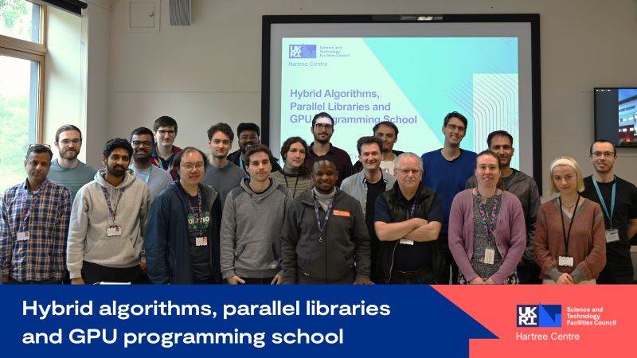
Training Events Hosted by Hartree Centre
Hybrid Algorithms, Parallel Libraries and GPU programming
22-24 May ‘24
Further mathematical concepts on communication avoiding and hybrid algorithms
Learned key characteristics of communication-avoiding algorithms and how these affect scalability.
Introduced to UQ approaches and the latest advances in parallel libraries development.
Introduction to GPU programming
Gained knowledge and hands-on experience in developing software applications for processors with massively parallel computing resources.

Slide 3

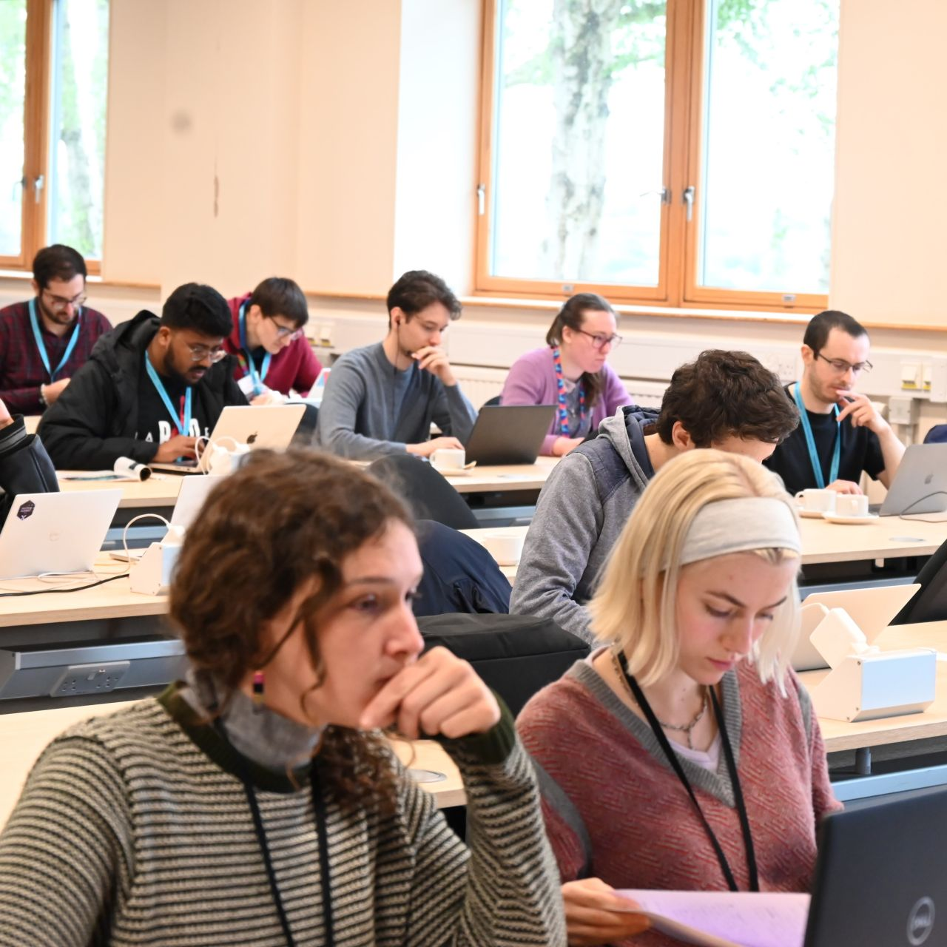
Training Events Hosted by Hartree Centre
Advanced HPC, Multi GPU Programming and Exascale School - 8-11 Oct ‘24
Parallel Programming with MPI
Parallelised codes to enable massively parallel computation, exploiting modern HPC architectures..
Multi-GPU programming
Scaled CUDA C++ applications to multiple nodes
Portable alternatives to CUDA: Parallel Programming
Gained practical experience with novel portable programming models for heterogeneous computer architectures, SYCL and Kokkos.
Notes:
Parallel

Slide 4
Learning into practice
“I’m currently working on developing an exascale fusion energy code to incorporate more comprehensive physics models. The knowledge and skills I’ve gained from these technical workshops are incredibly valuable in ensuring that the new physics I introduce enhances the accuracy of the simulations without compromising performance—and may even improve it.” Alex (Nuclear Fusion Physicist)
“My work involves applying topological data analysis……
Generating lattice configurations involves highly intensive Monte Carlo simulation. For this to scale appropriately, such that the project remains computationally feasible, the use of distributed computing and accelerated hardware is a necessity.
At the school, I have learnt highly applicable techniques such as MPI, multi-GPU programming and both in combination. These should be directly applicable in my research” Xavier (PhD student in Applied Mathematics and Theoretical Physics)
. …I have been working on Optimization of multi-physics coupling library MUI for exascale implementations. Thanks to SYCL training, implementation of the RBF filter in MUI can now be further refined. SYCL provides an exciting option for portable GPU implementation of OpenFOAM.” Mayank (Computational Scientist/Research Software Engineer)

Slide 5
“I've learnt a lot about leveraging state-of-the-art hardware which I hope to apply to my research. Many thanks to the tutors and organisers!”
“ SYCL (and Kokkos) lectures: appropriate, well-structured exercises.”
“CUDA lectures: well covered and nice tutorial.”
What attendees said
“The school was great, material on point and instructors awesome. The traveling logistics with the bus from Warrington to Daresbury was a problem but that something out of organizers control.”
“ Thank you for putting in the effort to organise and run these training workshops, I think it is great!.”
“ It was great. Really friendly atmosphere. Good to collaborate with other participants.”
Notes:
Post | Feed | LinkedIn

Slide 6
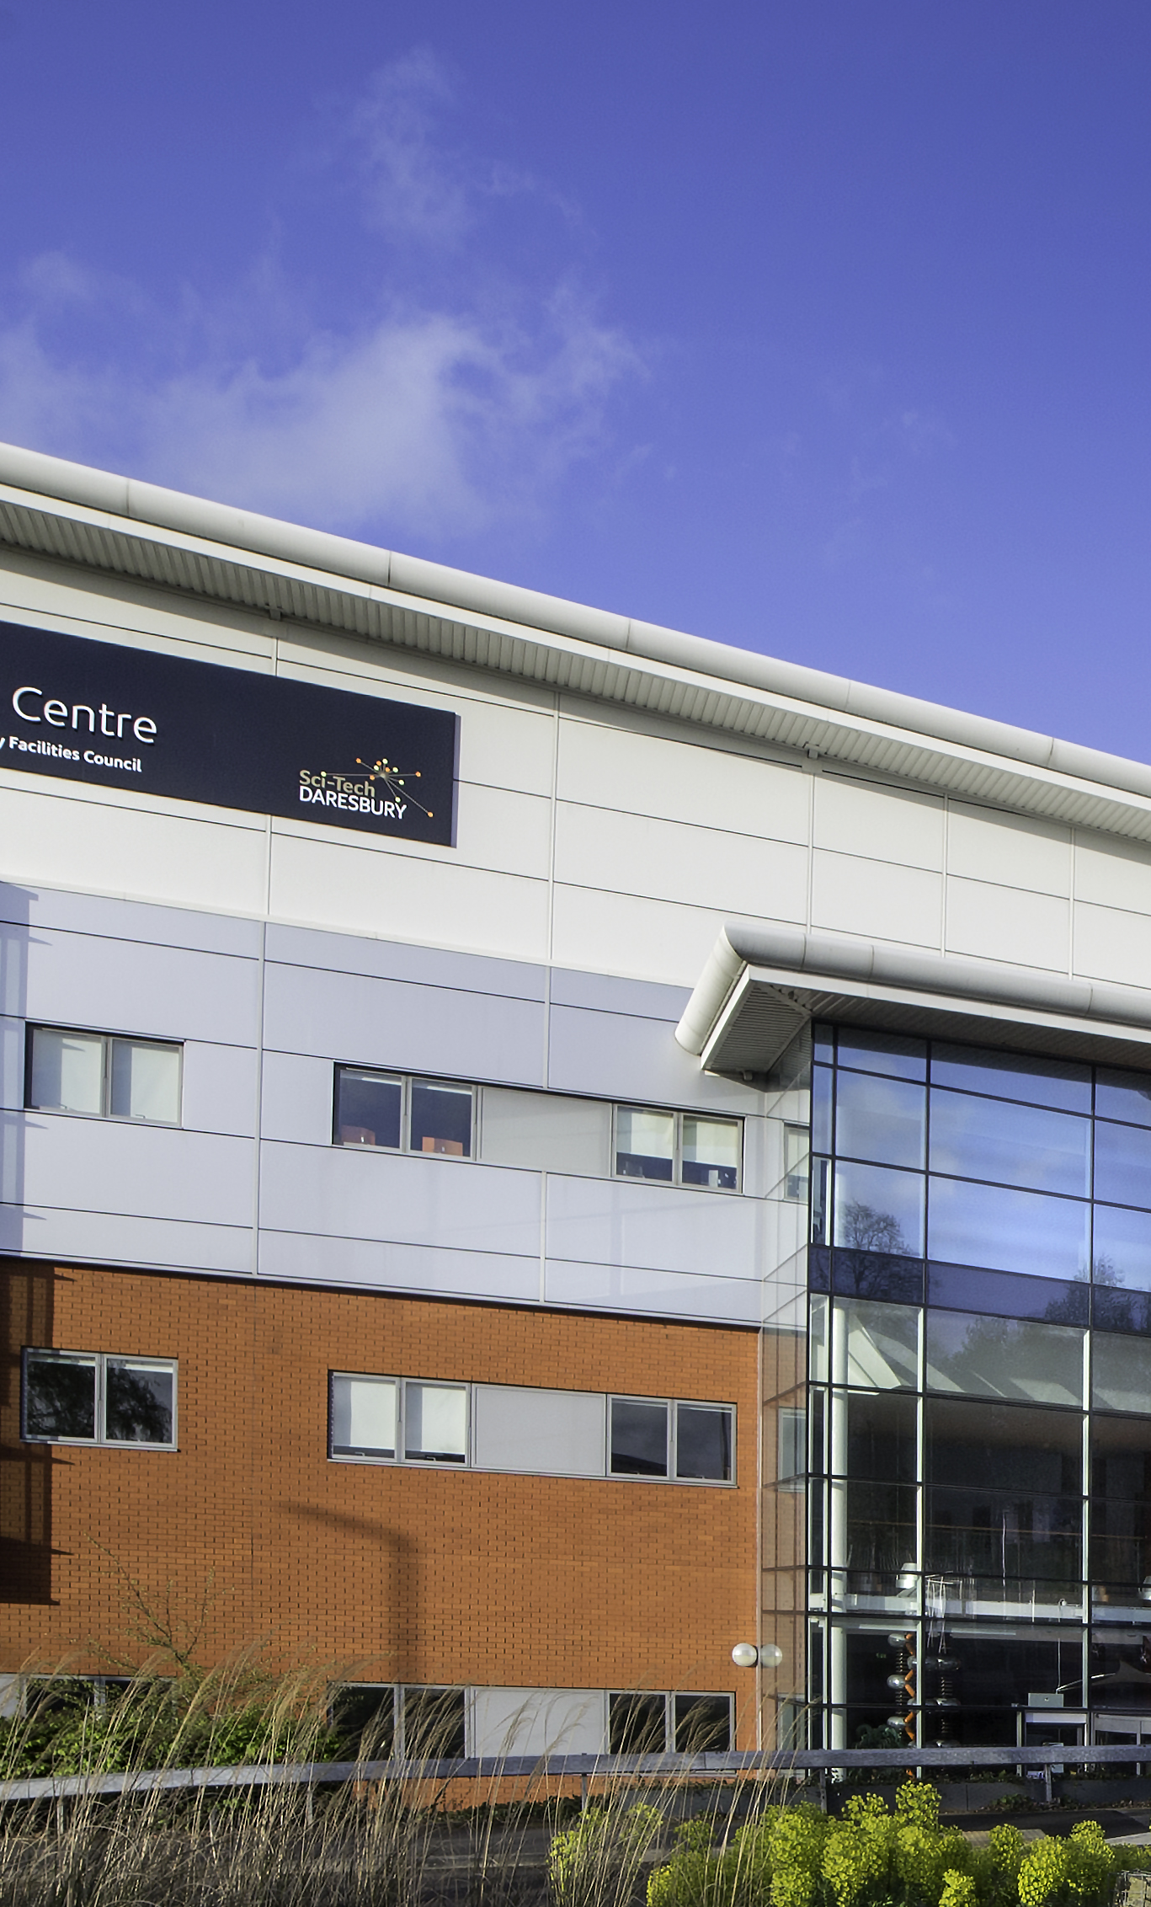
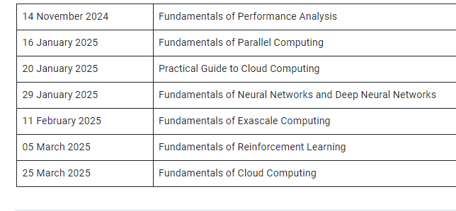
Dates for your diary
Self-paced and live practical training
Workshops:
16-17 June 2025 Exascale and Scalable AI
Notes:
Contacted May attendees to let them know of future live sessions

Slide 7

The Hartree Centre Training Portal
Home Page (stfc.ac.uk)
https://hartreetraining.stfc.ac.uk/moodle/local/hartree/index.php

Slide 8



If we cannot provide immediate answers, we will make these available with the mentimeter feedback.
Notes:
The abstract pattern can be removed or repositioned if required. Be careful to ‘Send to Back’ so that it does not obscure any important information.

Slide 9





hartree.stfc.ac.uk
@HartreeCentre
STFC Hartree Centre
hartree@stfc.ac.uk

