Slide 1



SWIFT-HEP
WP5 Analysis Systems
WP1 Data Management
Sam Eriksen & Timothy Noble
12th November 2024

Slide 2
Overview
WP5 (Analysis Systems)
  overview + roadmap
  Current progress in WP5
  Future for WP5
WP1 (Data + workflow management)
  overview
  Current progress in WP1
  Future for WP1
Previous updates
March 2024
November 2023
September 2023
May 2023
March 2023
February 2023

Slide 3
WP5: Analysis Systems

Slide 4
WP5: Analysis Systems
Run analysis workloads optimally on distributed resources

Slide 5


Analysis Anatomy
data
New idea/extension of existing work
One cycle as short as a day or as long as a month
Task
Task
Task
create/modify code
data
New ideas for improvement,
mistakes identified, or updates
Run analysis on laptop/cluster/grid
Task
Task
Understand results
data
Publication
Task
data
See talk by Luke Kreczko for some BIG Picture

Slide 6
Analysis Anatomy
data
WP5
WP1
Task
Task
Task
Analysis step
output
data
caching
DIRAC
Data lake
Task
Task
data
WP5 in a nutshell:
Run analysis workloads optimally** on distributed (GridPP) resources
** balanced between user-experience and computing efficiency
Task
data

Slide 7
WP5: Roadmap
WP1
WP1
Data lake to DIRAC (via Rucio)
Data lake to DIRAC (via Rucio)
Virtual analysis facility
Virtual analysis facility
Via tags (slide 26)
DIRAC workflow manager
Via tags (slide 26)
DIRAC workflow manager
Specify resource requirements per analysis component (portability)
Specify resource requirements per analysis component (portability)
REST API
REST API
4
FileCatalog?
4
FileCatalog?
Dask to DIRAC interface
(dask-dirac)
Dask to DIRAC interface
(dask-dirac)
Connect to data lake (caching)
Connect to data lake (caching)
Caching at analysis step level
Caching at analysis step level
WP5
WP5
2
1
2
1
3
3
More detailed slides

Slide 8
WP5: Roadmap
Dask to DIRAC interface
(dask-dirac)
Add extension to dask
Dask is able to parallelize any python code
1
1
Connect to data lake (caching)
Add the ability to save output after dask instance has closed
2
Caching at analysis step level
3
Avoid having to re-run analysis steps
Persistent caching
Specify resource requirements per analysis component (portability)
4
E.g. Let some stages run on GPUs
See talk by Luke Kreczko for some future planning

Slide 9
Where did we leave things at the last workshop

Slide 10
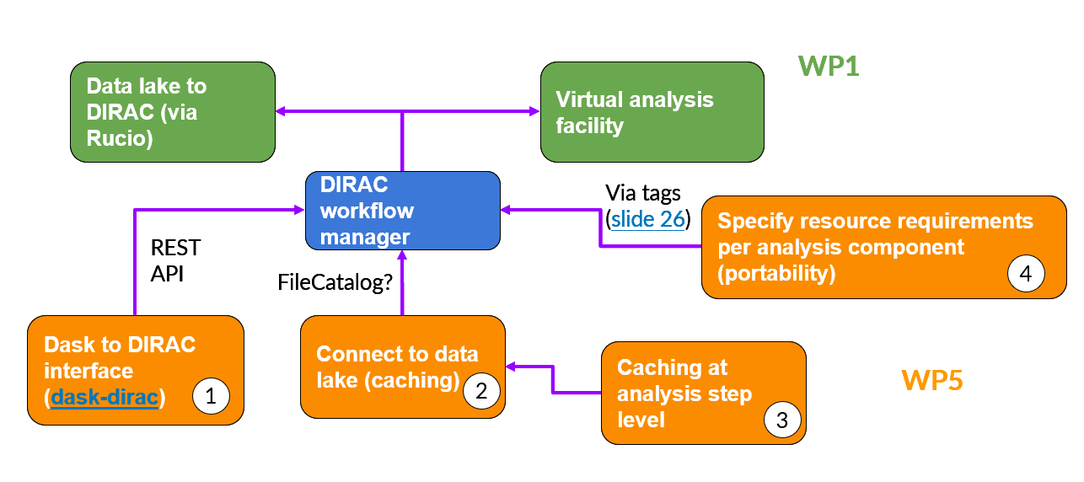
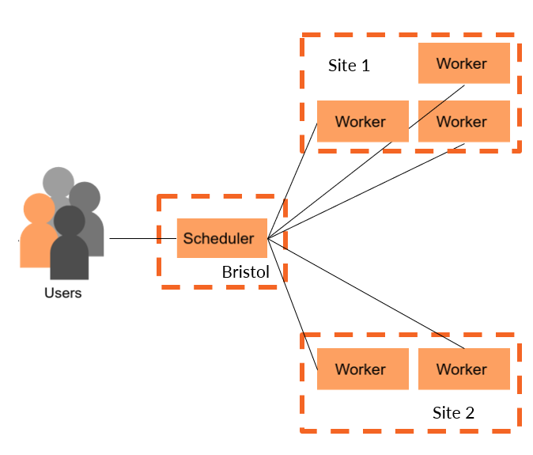

Where we left things last time
Dask to DIRAC interface (dask-dirac)
Reliable dask-DIRAC interface
Multi-site submission / fine control possible on distribution of workers
Integrated with CMS AGC
# Local workers
cluster = LocalCluster()
# PBS
cluster = PBSCluster()
# Dirac workers
cluster = DiracCluster()

Slide 11

Where we left things last time
Caching at analysis step level
Began looking at intermediate result caching using scheduler plugins
Allows for tasks to be run when a worker connects/disconnects or transitions (e.g. from running to memory) a job
Idea: perform check (ideally via RUCIO) if result exists before a task starts
Connect to data lake
Interact with diracdev StorageElement via HTTP + x509
gfal underneath
Painful and wanted to move away from
RUCIO via tokens was ideal

Slide 12
What’s happened since the last workshop

Slide 13
What have we been focusing on
Connect to data lake
Wanted to communicate with RUCIO via REST-API with tokens
  Able to interact with RUCIO, but only with x509
  Tokens generated from the OIDC-Agent and Rucio at least with the IRIS-IAM varied, to the point where Rucio would not accept the OIDC-Agent tokens. Investigation underway in association with James Walder from SKAO (Full token stack Rucio instance)
  Token Authentication in Rucio is being redesigned by a token auth SIG
We’ve parked progress on this until Tim has investigated further

Slide 14
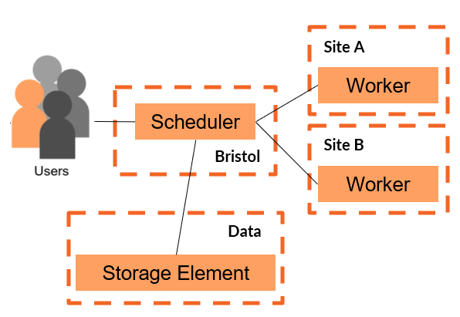
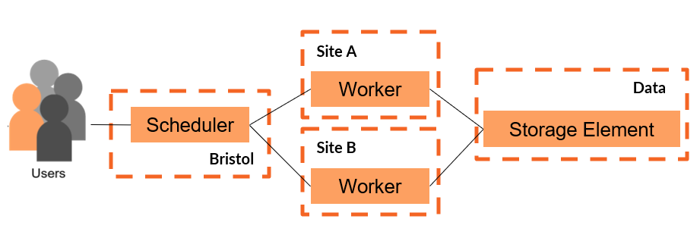
What have we been focusing on
Caching at analysis step level
Initial idea; dask plugins
Scheduler Plugins
Allows you to run custom Python code on scheduler when certain things happen
Example;
  Scheduler checks if output exists; if exists, load and don’t run job, else, run job as normal
  Workers send all data back to Scheduler which then perform ‘saves’
  Essentially intercepts result before it’s passed to the user
Worker Plugin
Allows you to run custom Python code on all workers at certain event in the worker’s lifecycle (such as when a process finishes)
Example;
  Workers check if output exists; if exists, load and don’t run job, else run job as normal
  In this case, workers interact with storage
Note
Dask already does caching which does similar to the above, but we want persistency between dask sessions
There’s also the option for scheduler and worker plugins together

Slide 15
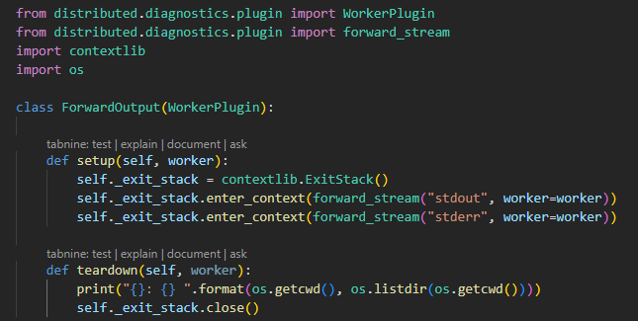
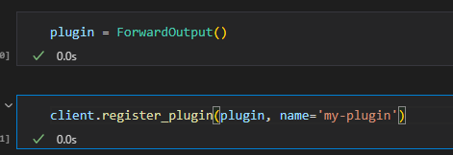

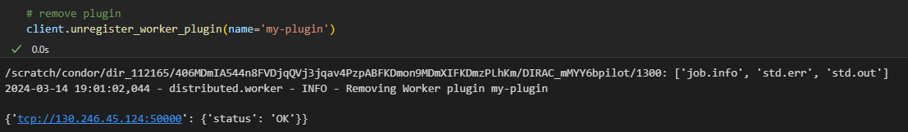
What have we been focusing on
Caching at analysis step level
Initial idea; dask plugins
Worker Plugin – where did we get to
Created examples to explore what information we can get from the worker at each stage
Created worker plugin to show what in the worker directory
Problem
This is only done when the worker is killed (or the plugin removed)
Limited by access to analysis step information / would require interrupting the processes
Very difficult to alter task graph on the fly

Slide 16
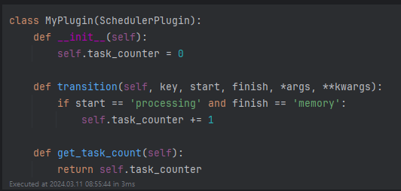
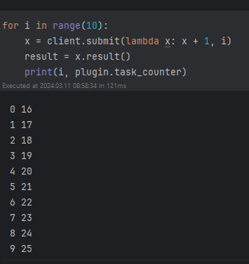
What have we been focusing on
Caching at analysis step level
Initial idea; dask plugins
Scheduler Plugin – where did we get to
Created examples to explore what information we can get from the scheduler at each stage
Created example to check if a task (via hash) had already been run (in backup)
Workflow would be;
Some kind of combination of scheduler and worker plugin
Access task hash, check if it exists, and then replace with loading or saving data

Slide 17
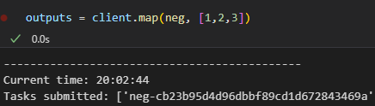
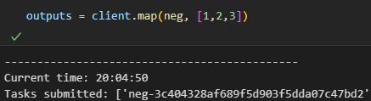
What have we been focusing on
Caching at analysis step level
deterministic hash test
Initial idea; dask plugins
Problems with this approach
Very hard to manipulate task graphs in this approach; hashes associated with tasks are only semi-deterministic -> change between dask sessions for the same code
Very difficult to access individual steps in a task graph. Very coarse; approach was more limited to final task.
Solution
Work on calculating hash that is independent of scheduler state and without plugins

Slide 18
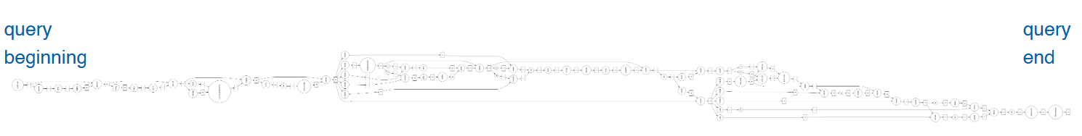

What have we been focusing on
Caching at analysis step level
Ways to interact with dask submission
  client.get
  client.map (this is what CMS AGC uses)
  client.submit
  client.compute
Find a common area where we can intercept the task graph and manipulate it
Found _graph_to_futures* where we have access to the full graph
Taken from L.Gray PyHEP.dev 2023
*Actually, started with collections_to_dsk which only works with client.compute and developed a lot of this there before changing to _graph_to_futures

Slide 19
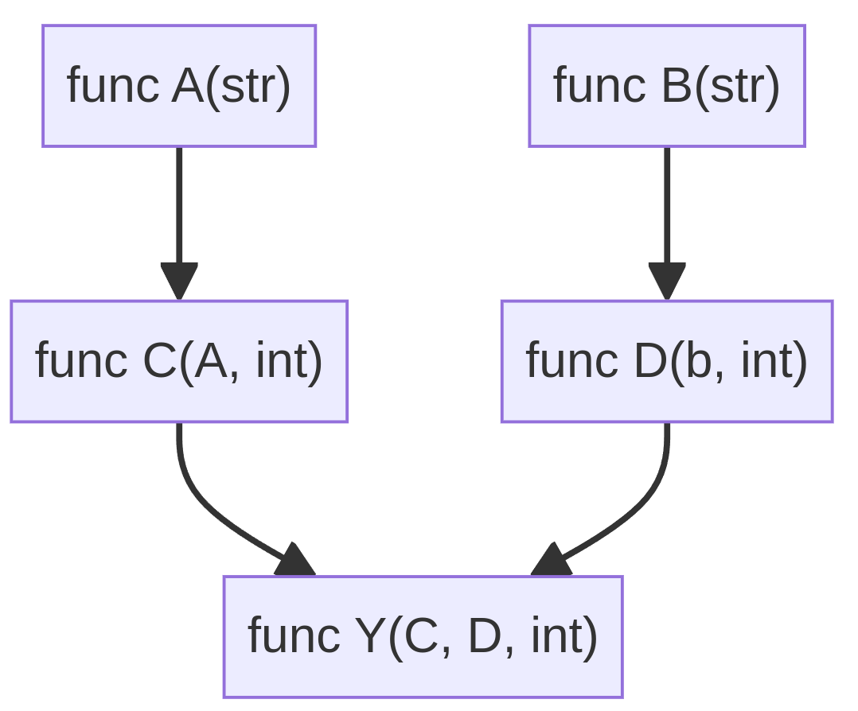
What have we been focusing on
Caching at analysis step level
Scenarios to take into account for a demonstrator
Nothing changes -> read & return Cache(Y)
A changes -> read Cache(D), calculate the rest
D changes -> read Cache(C, B), calculate the rest
Y changes -> read Cache(C, D), calculate Y
Requires
Probing task graph to work out output / input
Checking storage area for if it exists
Insert loading / saving stages into graph

Slide 20
What have we been focusing on
Caching at analysis step level
func load()
Case 3
Case 2
func load()
func load()
Scenarios to take into account for a demonstrator
Nothing changes -> read & return Cache(Y)
A changes -> read Cache(D), calculate the rest
D changes -> read Cache(C, B), calculate the rest
Y changes -> read Cache(C, D), calculate Y

Slide 21
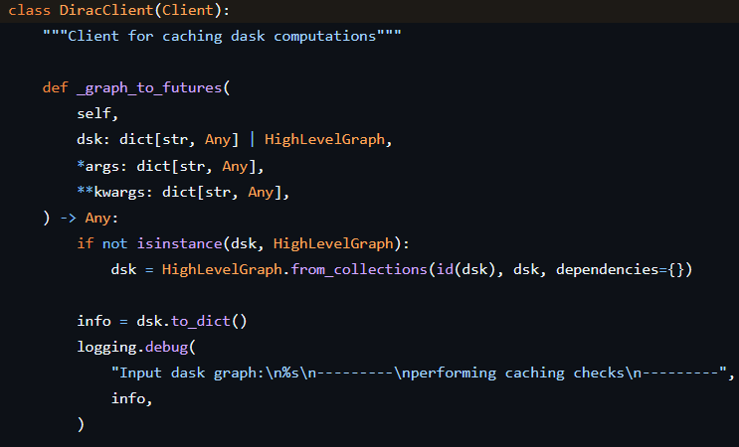
What have we been focusing on
Caching at analysis step level
Development State
We’ve created a new dask client (DiracClient) which adds persistent caching functionality
Additional functionality in the works/what needs more thought;
Changeable location of Persistent Cache; want RUCIO and local options at the very least
More work is needed to be compatible with CMS ACG; should wait for coffea-2024
Default is to cache everything, good option to have but likely no ideal
For task in Tasks:
hash = calculate_task_hash(task)
hash_found = check_storage(hash)
if hash_found:
task = load_from_storage(hash)
else:
task = task + write_to_storage(hash)

Slide 22
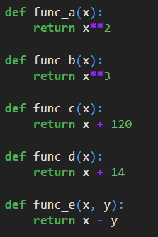
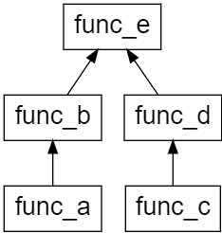
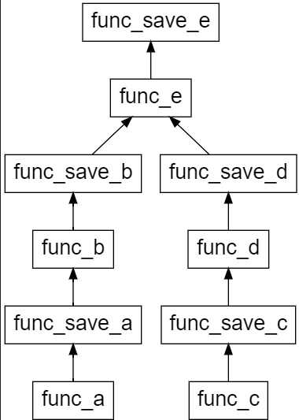
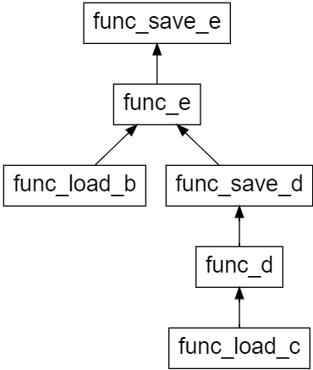
What have we been focusing on
Caching at analysis step level
Path 2
Path 1
Case if no cache entries have been found
Case if cache b and cache c are found
Example of what the output is from simple 5-function graph
Path 1
first time running
Path 2
second run, but function d has been edited

Slide 23
Summary and plan going forward
We have a dask-dirac interface
  Workers are split across sites
  Effectively splits up work across these sites
We have been looking at task graph manipulation
  Found entry point giving fine-grain access to a graph
  Implemented caching that persists between dask sessions
  Avoid rerunning tasks where result exists
Where are we going
  Awaiting tokens
  Awaiting ACG update -> coffea.2024
WP1
Data lake to DIRAC (via Rucio)
Virtual analysis facility
DIRAC workflow manager
Via tags (slide 26)
Specify resource requirements per analysis component (portability)
REST API
FileCatalog?
4
Dask to DIRAC interface
(dask-dirac)
Connect to data lake (caching)
Caching at analysis step level
WP5
1
2
3

Slide 24
WP1: Data Management

Slide 25
WP1: Data Management
Optimise the heterogeneous storage infrastructure across the UK

Slide 26

WP1: Data Management Overview
Deploy a UK based prototype data lake
  Core sites
  S3 sites
  State-less storage
Generate metrics for comparison of current to improvements made
Implement Quality of Service behaviour and information in Rucio
  Develop Rucio to expand the levels of service it provides
  Create new behaviours in Rucio to enable improved data access
Produce site recommendations on how to optimise data access and stateless storage
Setup and test SSD storage endpoints to test and develop fast storage endpoints
Rucio
Monitoring
WP5
QoS Behavior
Sites

Slide 27
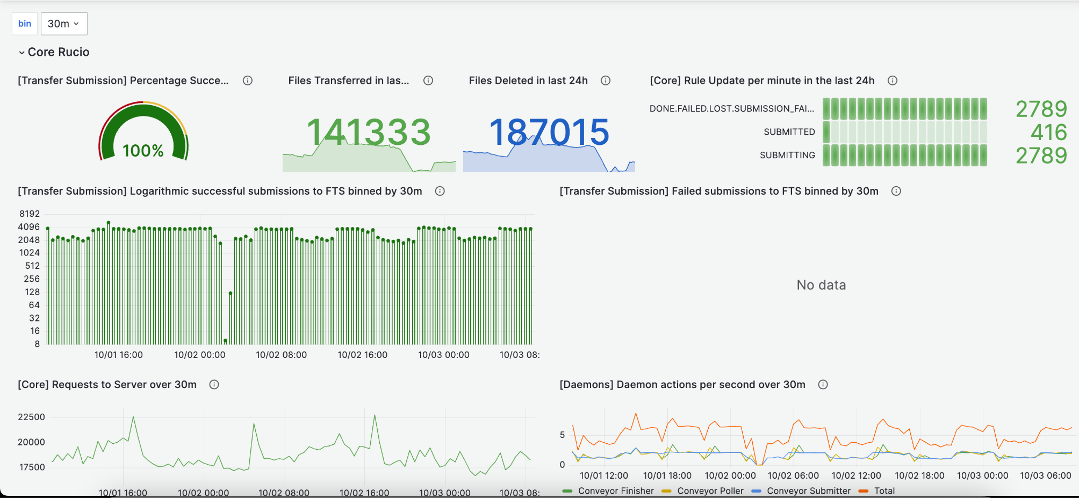
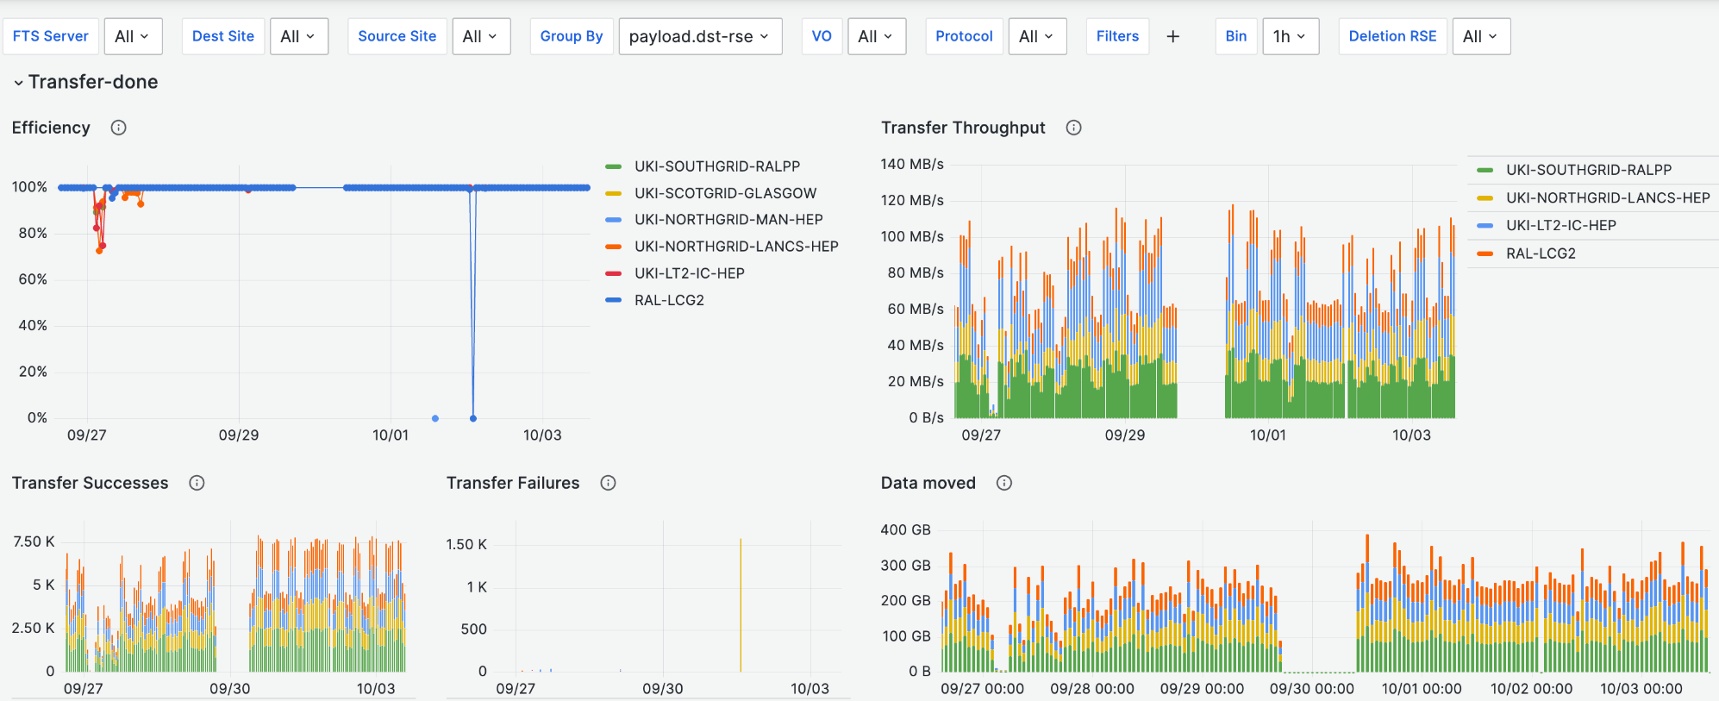
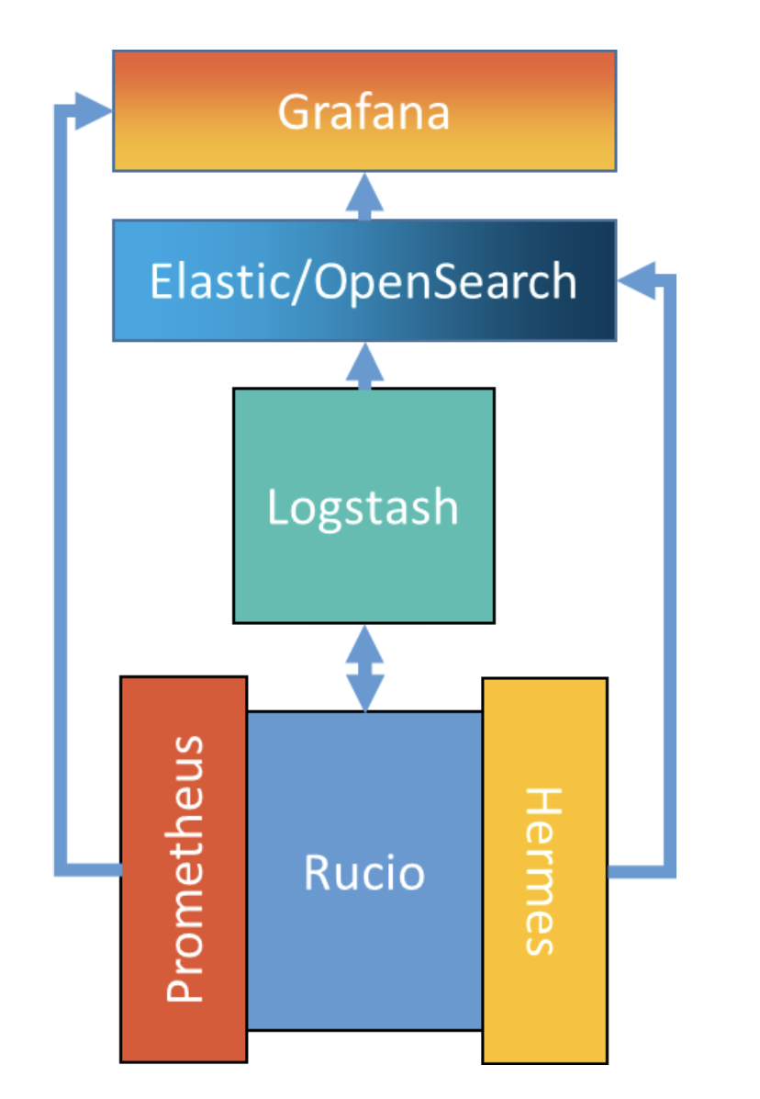
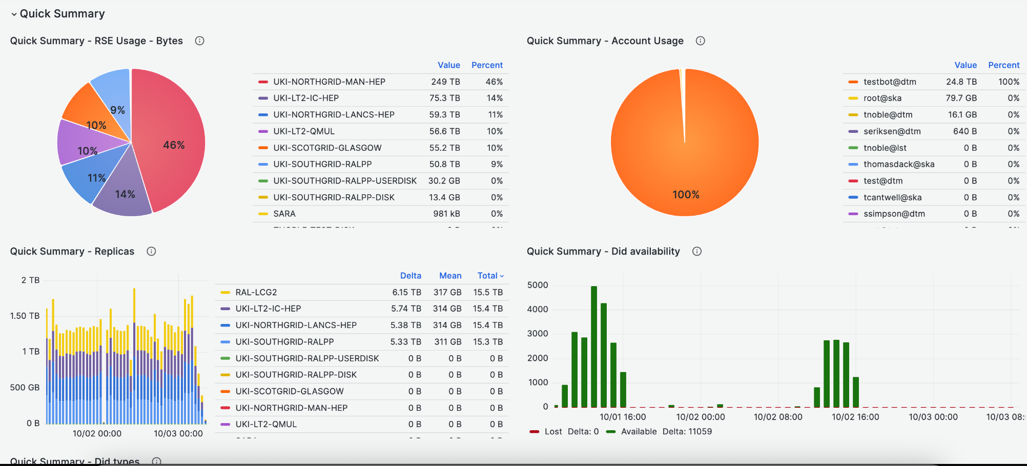
Data Management developments
Tim has redesigned and expanded upon previously shown monitoring solution to be production-ready (Deployed for astronomy experiment LSST), deployed with OpenSearch.
  made these tools available to other communities by contributing deployment back to Rucio repositories (Rucio workshop talk)
Takes 3 different data streams
from Rucio, to be visualised
in Grafana.
Minimal design to ensure
easy to maintain and deploy
Allows for quantification of
future developments

Slide 28

Data Management development plans
Investigation of ServiceX (or other tools to optimise data access for analysis)
  Developed by IRIS-HEP
  Software that sits between the Storage and Analysis Facility (close to storage), and extracts a subset of data columns from whole files – rather than moving the whole file
  Reduces the networking needs from storage to analysis
    User requests a subset of data from file(s)
    ServiceX queries Rucio for files
    Job started in Kubernetes cluster to extract needed files and create a new one
    Publish the file for full analysis job to use
User
ServiceX REST
Kubernetes
Publish

Slide 29
Data Management development plans
Fast Storage
  Sites provision Storage by Capacity, but not throughput or access rates
    Issues will arise with larger data files and increased required data rates where storage endpoints provision more storage, but throughput does not scale at the same rate
  Further coordination with Core Rucio team to develop Quality of Service to better serve Fast storage
  Using file popularity to move data between Fast and Disk storage endpoints to ensure read/write needed for analysis
FTS
Site A
Fast
Site A
HDD
Site B
Site A
Analysis

Slide 30
Data management summary and future plan
Deployed Robust monitoring at RAL for SWIFT-HEP and at Stanford for LSST (improvements to one feed into the other)
Approaching data management from Software and Hardware utilisation
Further integrations with the Analysis facility to enable better data access
Will develop Rucio to investigate the prioritization of fast storage as more fast storage pools are available in the UK now
Will work with CERN liaisons to test deployment ServiceX at RAL to test data access improvements
Robust Monitoring
Sites with FAST QoS
ServiceX
WP5
Analysis facility

Slide 31
Questions?

Slide 32
BACKUP

Slide 33
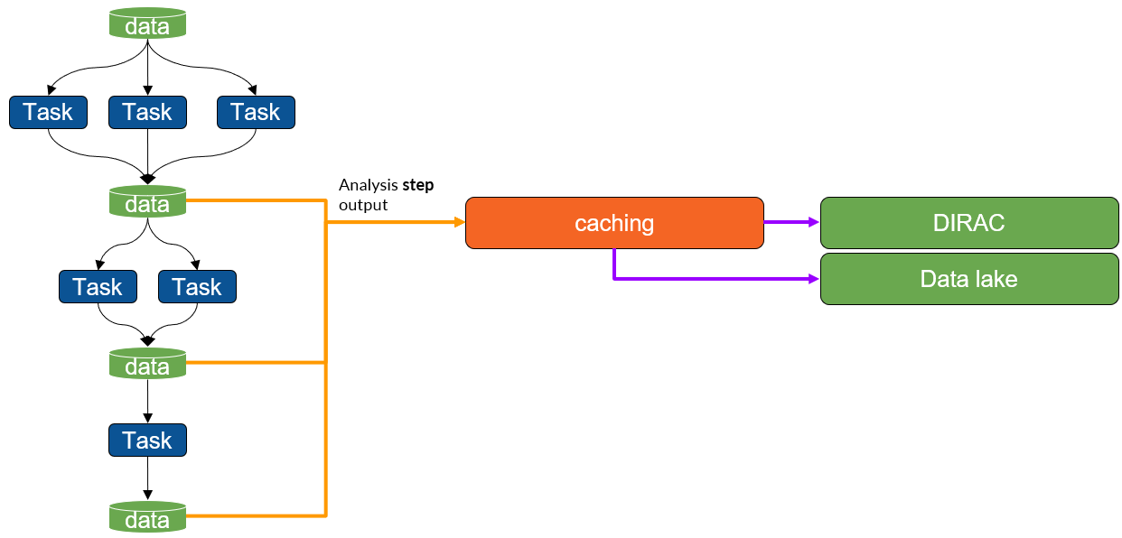
What have we been focusing on
Caching at analysis step level
What do we want to demonstrate
Imagine a complex task that you want to run.
If you know you are going to have to run this multiple times, but are only modifying one of the functions, you can think of a few ways to reduce the reprocessing;
Most obvious would be to break up the graph and submit each task separately and save the outputs, and if you are rerunning, load the bits you haven’t changed.
We want that to automatically happen when you submit something.

Slide 34
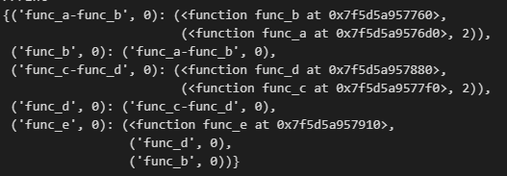
Modifying a task graph: Practical example
Caching at analysis step level
This is what we have to play with;
Task is;
Calculate hash
Check if hash exists somewhere
If exists; replace with load
If doesn’t; add save
hash(‘func_b’, hash(‘func_a’, 2))
Same as above
hash(‘func_d’, hash(‘func_c’, 2))
Same as above
hash(‘func_e’, hash(‘func_d’, hash(‘hash_c’, 2)), hash(‘func_b’, hash(‘func_a’, 2)))

Slide 35
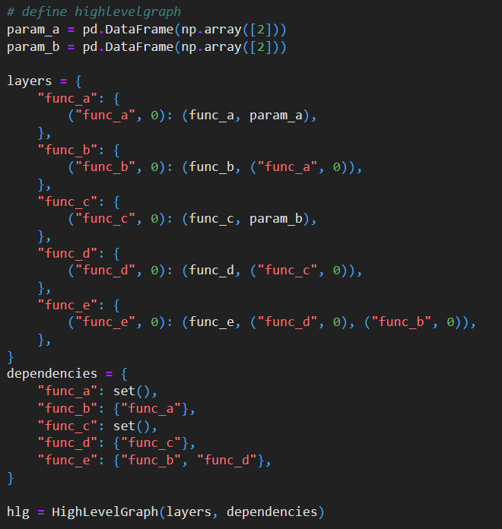
Modifying a task graph: Practical Example
Caching at analysis step level

Slide 36
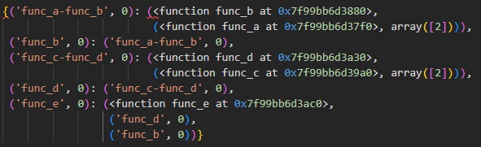
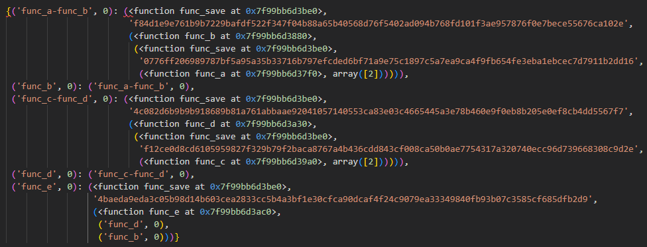
Practical Example
Caching at analysis step level

Slide 37

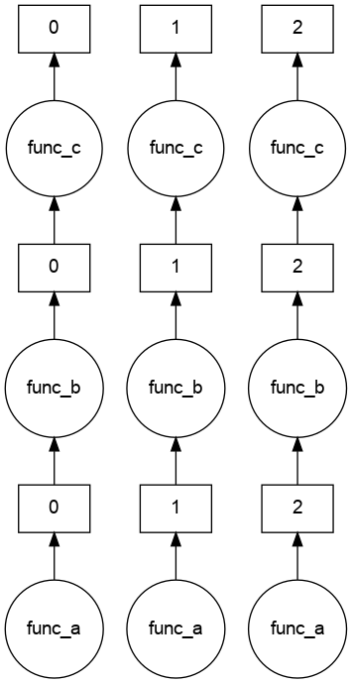
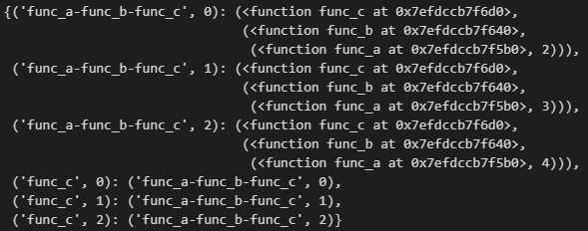
Practical Example
Caching at analysis step level

Slide 38
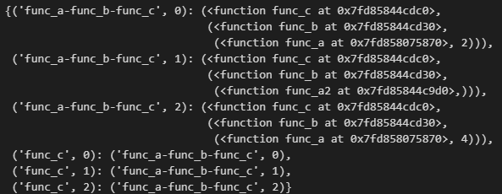
Practical Example
Caching at analysis step level

Slide 39
Worker Plugin example
Caching at analysis step level
Description
When worker is shutdown/killed or the plugin is disconnected, the directory path and contents are displayed

Slide 40
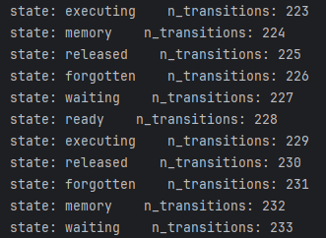
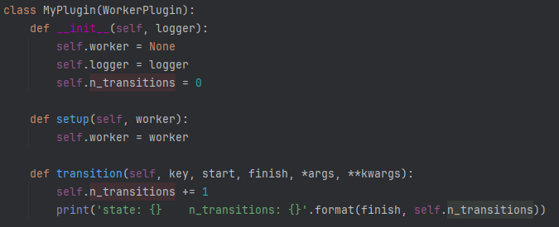
Worker Plugin example
Caching at analysis step level
Description
When worker is transitioning between states, the state is printed and the number of transitions are counted

Slide 41
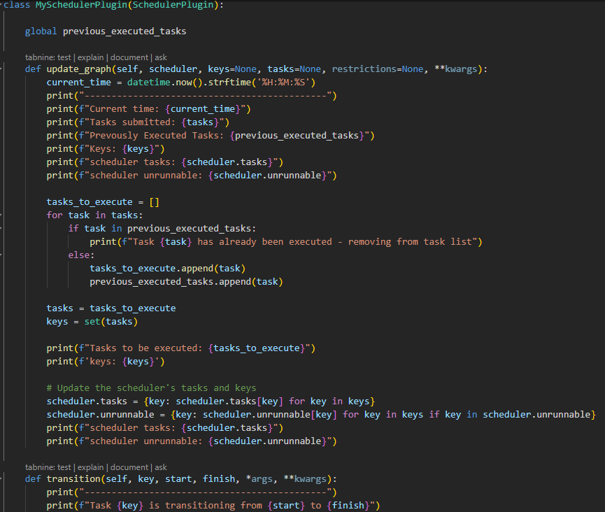
Scheduler Plugin example
Caching at analysis step level
Description
Remove a task from the graph if it has already been executed

Slide 42
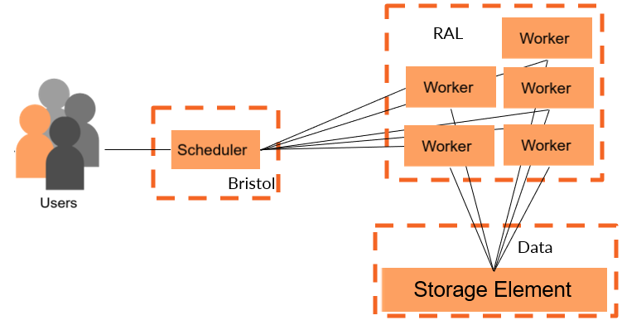
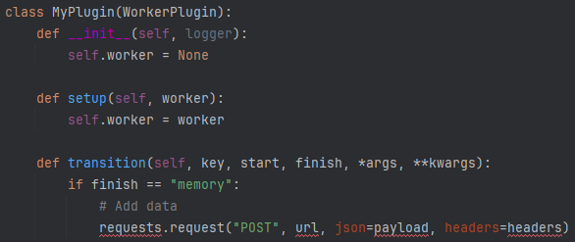
Where we left things last time
Caching at analysis step level
Began looking at intermediate result caching using scheduler plugins
Allows for tasks to be run when a worker connects/disconnects or transitions (e.g. from running to memory) a job
Idea: perform check (ideally via RUCIO) if result exists before a task starts

