Slide 1



New Higgses at the Electroweak Scale and the Multi-Lepton Anomalies
Andreas Crivellin
University of Zurich
CERN, reinterpretation forum, 28.02.2025

Slide 2
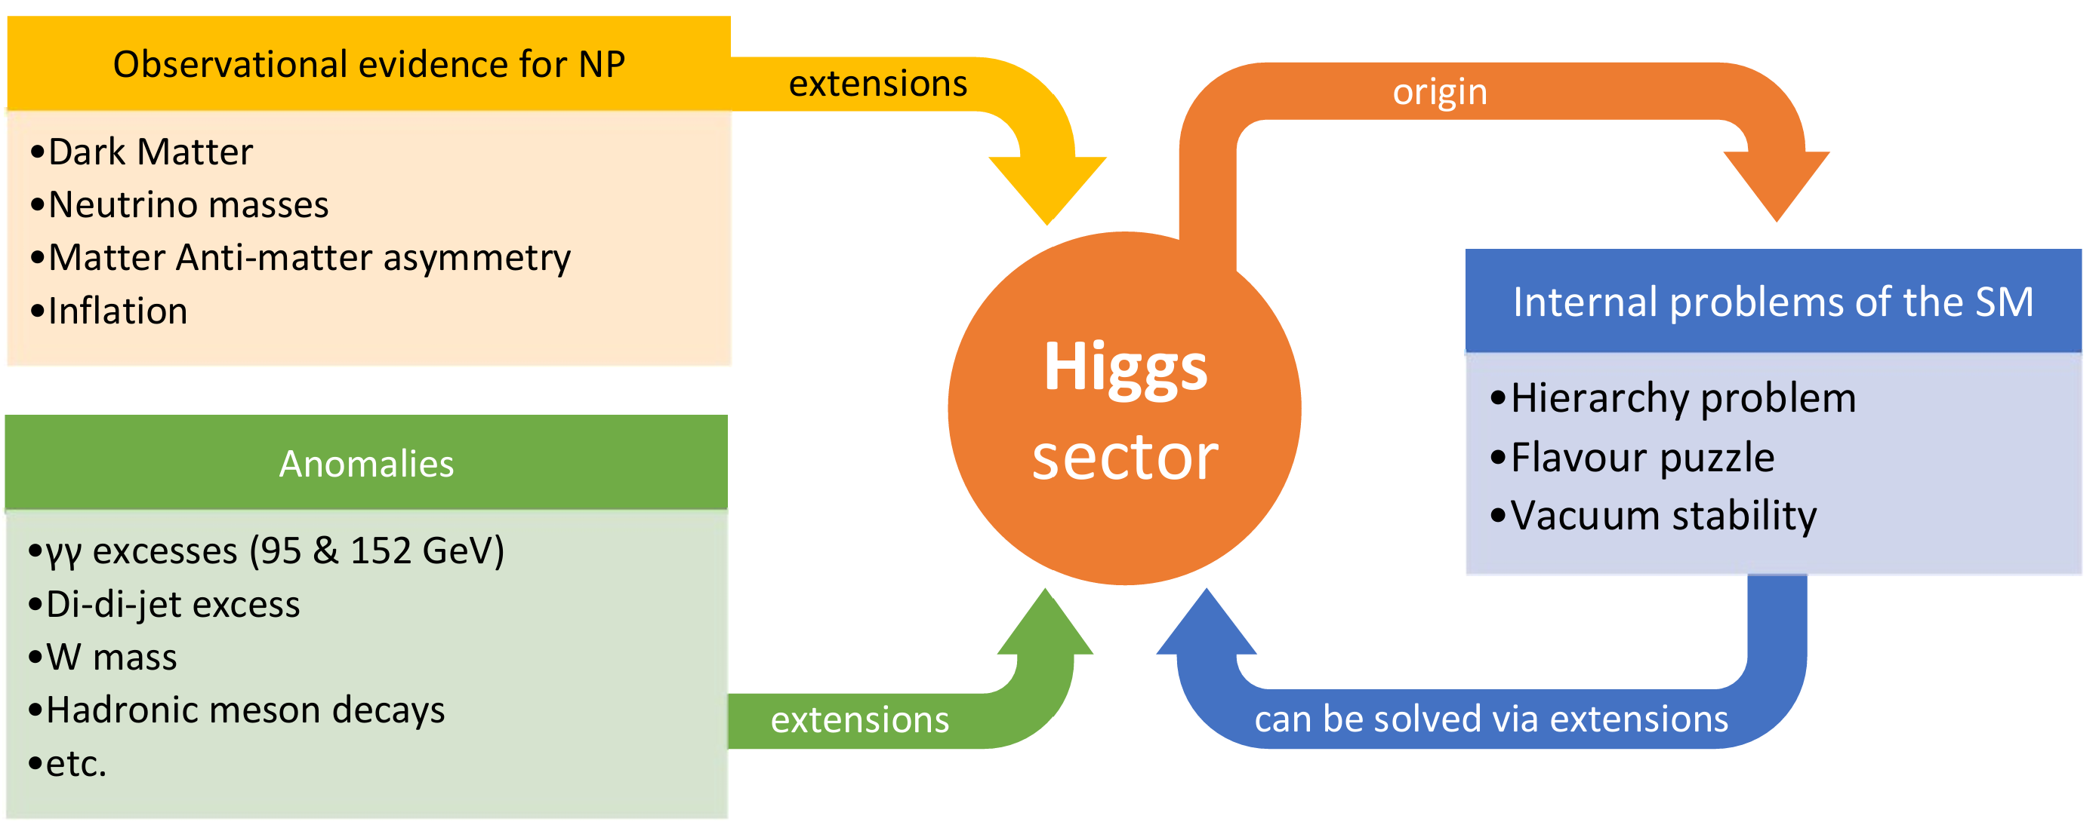
Why new Higgses
No theoretical principle forbids new Higgses
Nearly all top-down approached have new scalars
Higgs sector very promising place to expect NP
Andreas Crivellin
B Meson Decays and Lepton Flavour Universality Violation

Slide 3
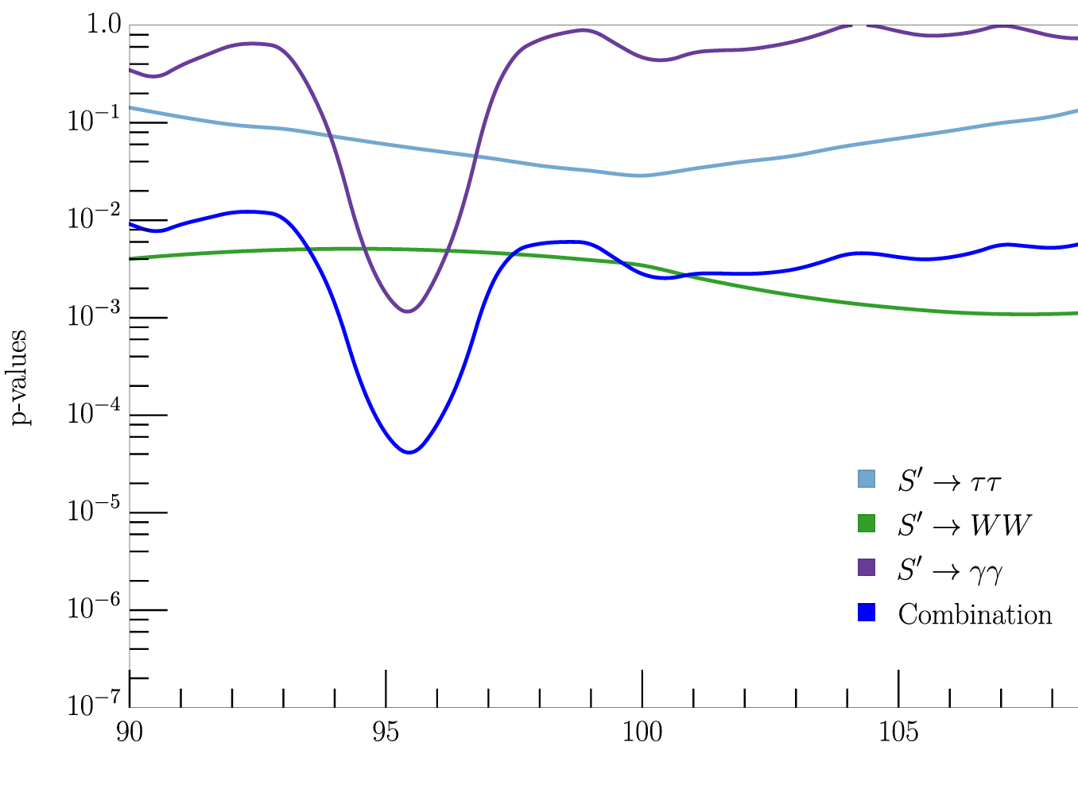
95 GeV C0mbination
S. Bhattacharya, G. Coloretti, A. Crivellin, et al. arXiv:2306.17209
LEP used to reduce the LLE
No ATLAS signal in ττ; reduced significance
3.4σ global significance

Slide 4
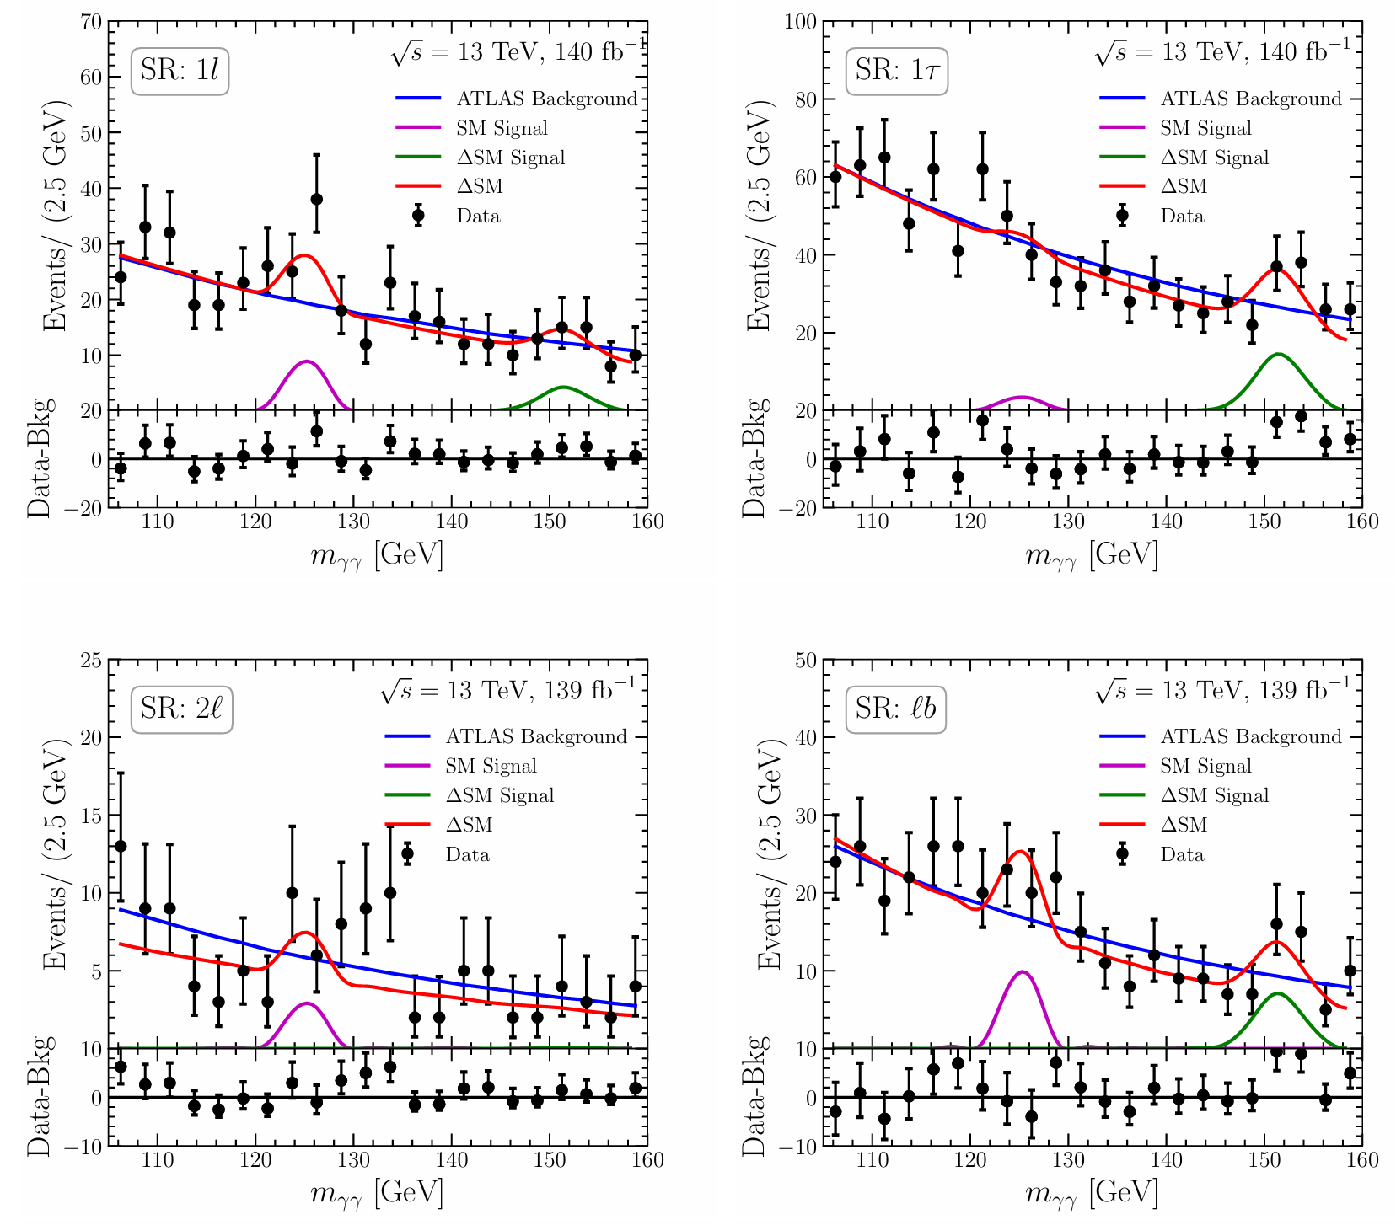
Hints for a 152 GeV scalar
JHEP 07 (2023) 176
ATLAS-CONF-2024-005
Hints for a
resonance
decaying to
photons
in association
with leptons
missing energy
and b-jets
ATLAS: 2301.10486
Dominant channels are γγ+X

Slide 5
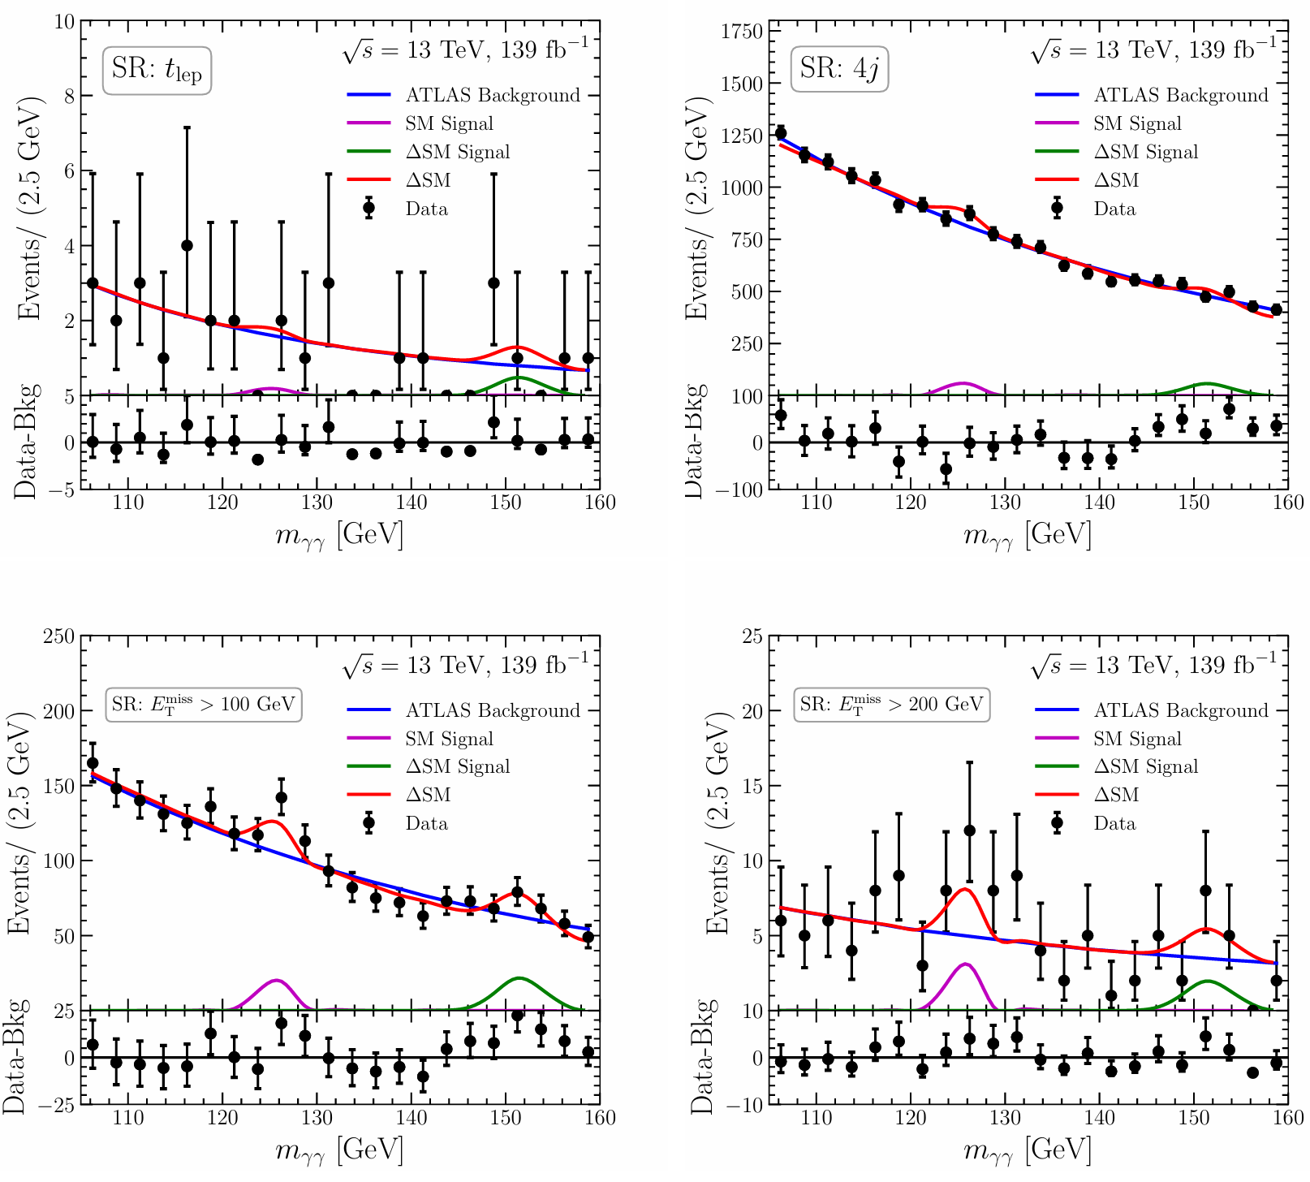
Hints for a 152 GeV scalar
Hints for a
resonance
decaying to
photons
in association
with leptons
missing energy
and b-jets
ATLAS: 2301.10486
Dominant channels are γγ+X

Slide 6
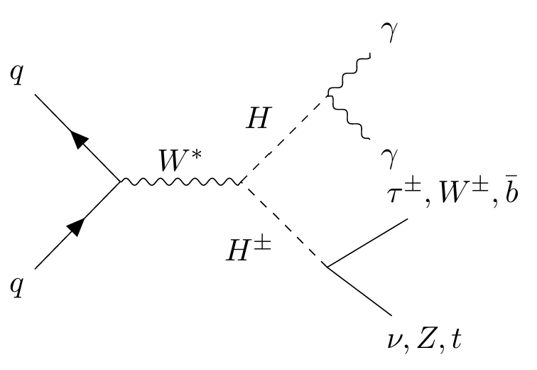
Drell-Yan Production
One leptons, but not two leptons
One tau but not two taus
lb but not t_{lep}
Moderate MET
DY production of
charged and
neutral Higgs
New Scalar with non-trivial SU(2) representation

Slide 7
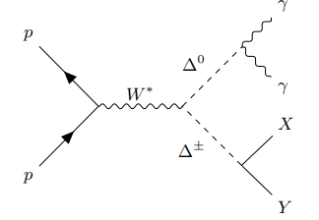
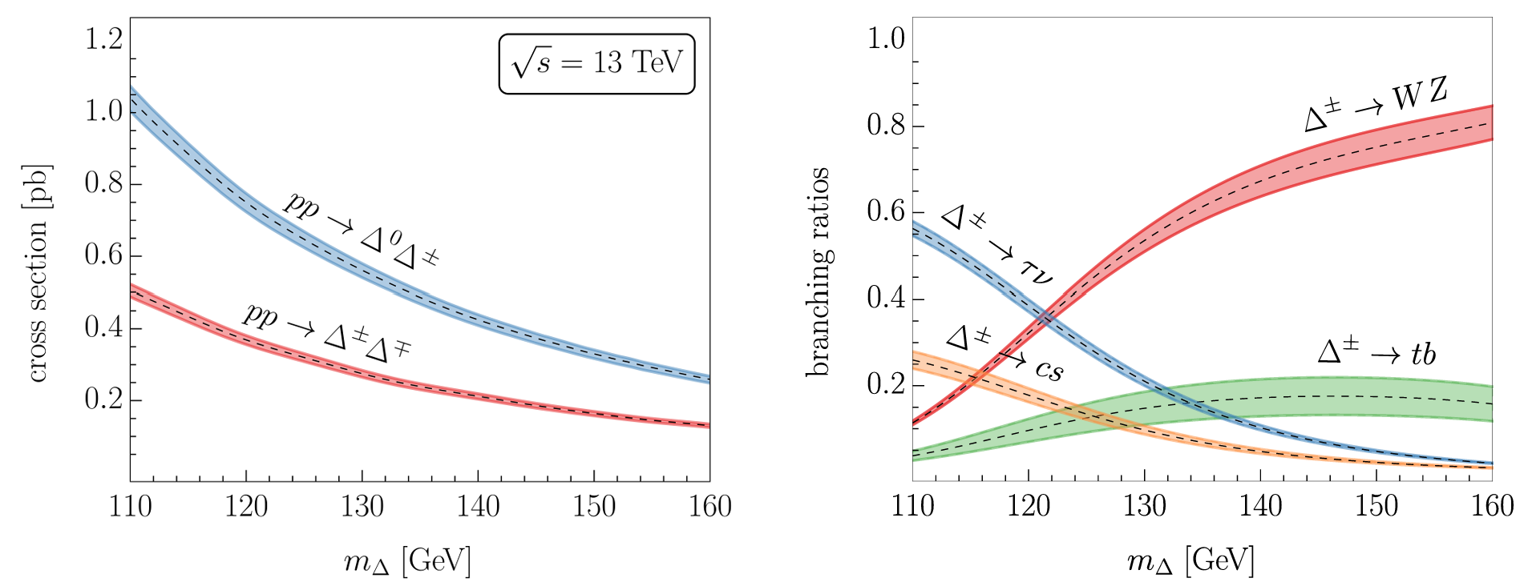
Is the 152 GeV Higgs a Triplet (Δ)?
Δ⁰ decays dominantly to WW
Positive shift in the W mass
as preferred by the EW fit
Quasi degenerate in mass
Drell-Yan production at the LHC

Slide 8
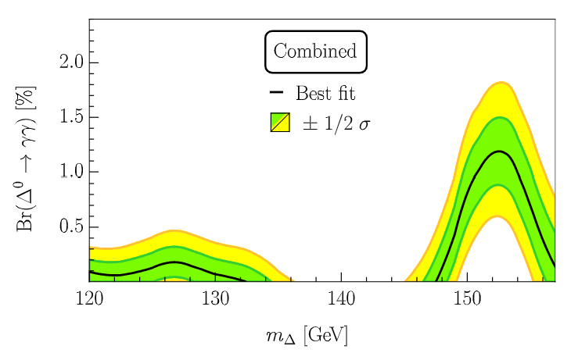
Combination
S. Ashanujjaman, S. Banik, G. Coloretti, A.C. S. P. Maharathy,
B. Mellado, 2404.14492
NEW
≈4σ excess at 152GeV

Slide 9
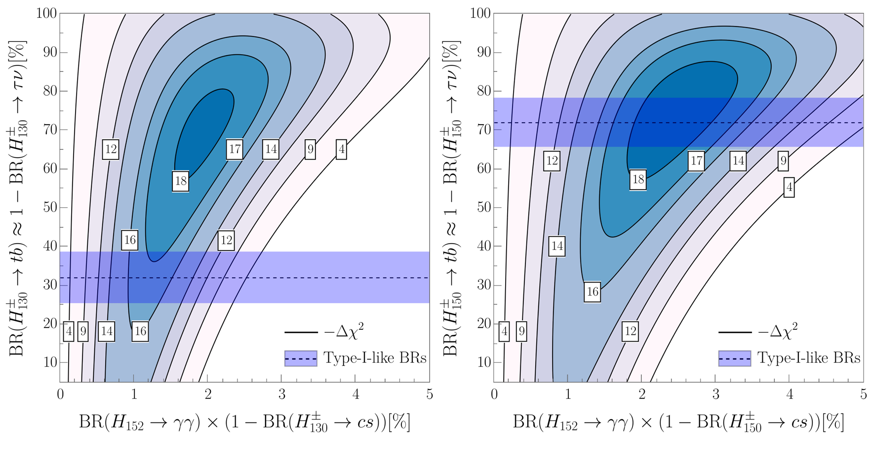
Two-Higgs Doublet Model type-I
(at tree-level)
Above 4σ, large Br needed

Slide 10
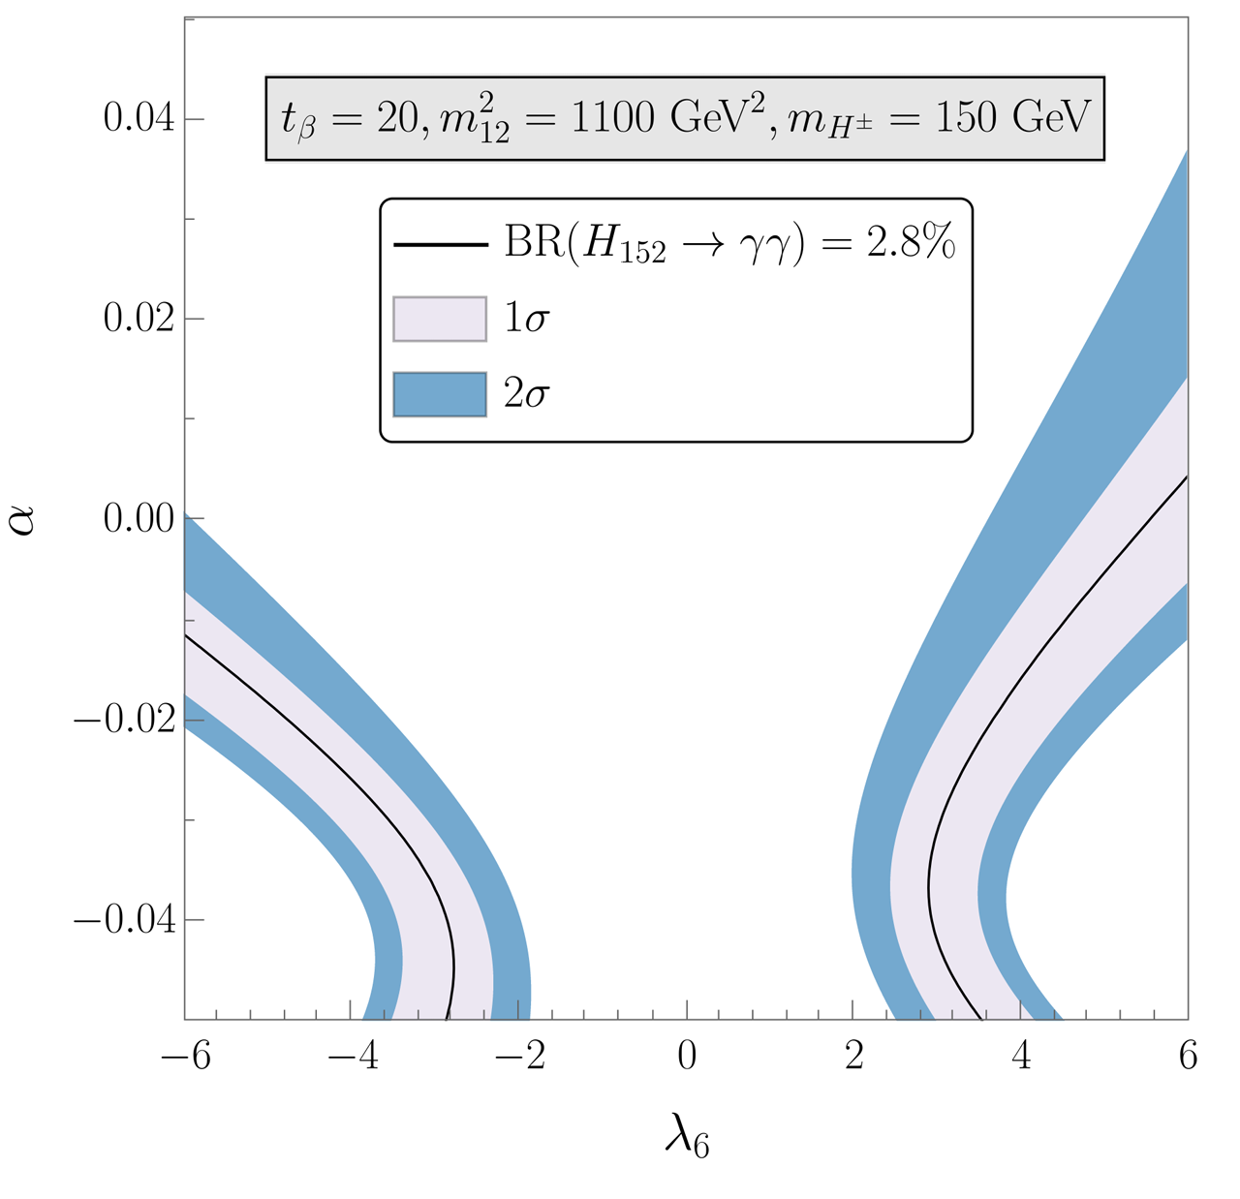
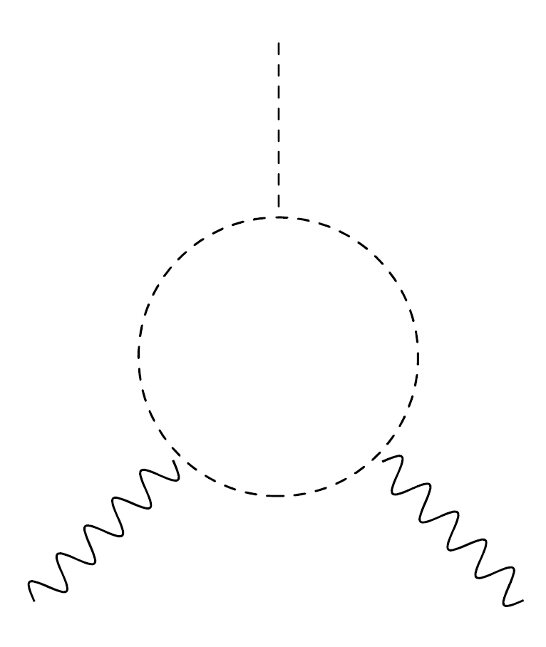
Large Br(H₁₅₂→γγ) via Z₂ breaking in 2HDMs
Dominant effect in
but suppressed in
Consistent with vacuum stability, perturbativity

Slide 11
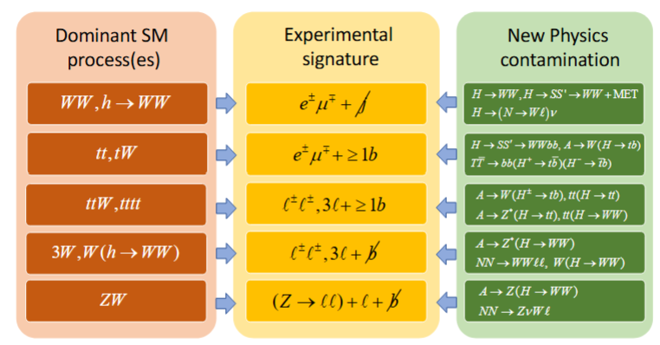
Multi-lepton anomalies
Andreas Crivellin
B Meson Decays and Lepton Flavour Universality Violation

Slide 12
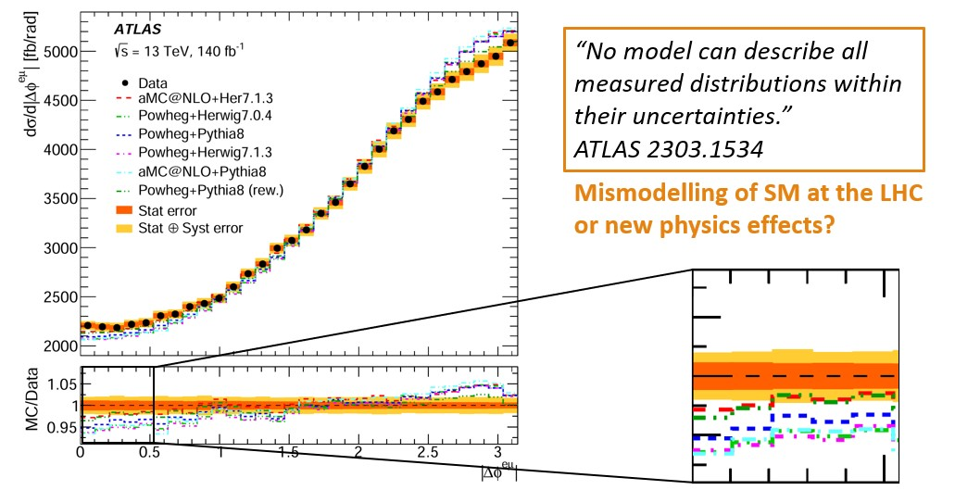
Differential Top-Quark Distributions
ATLAS:
“No model can
describe all measured
distributions within
their uncertainties.”
JHEP 07 (2023) 141
2303.15340
angle between the leptons from the W decays
New Physics pollution of this SM measurement?

Slide 13
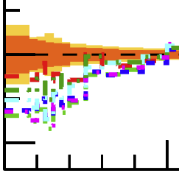
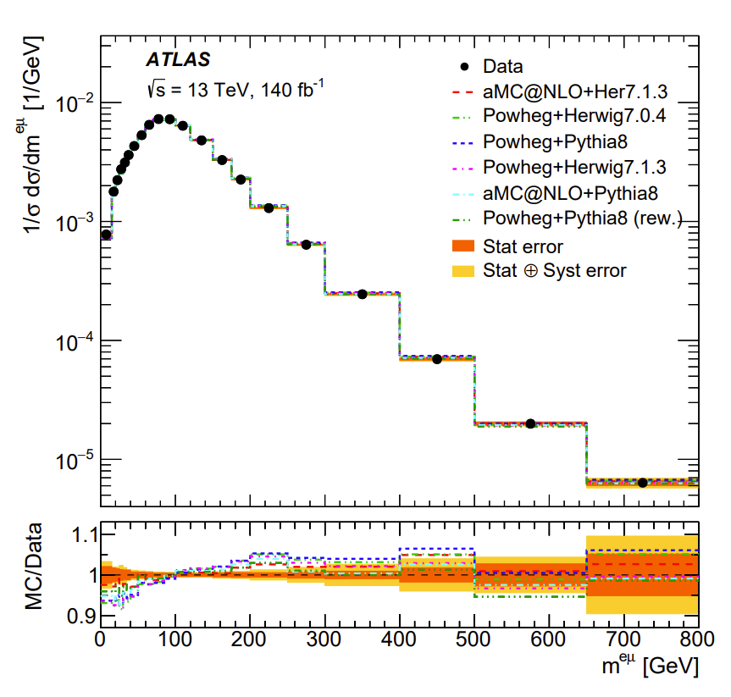
Differential Top-Quark Distributions
2303.15340
ATLAS:
“No model can
describe all measured
distributions within their uncertainties.”
New Physics pollution of this SM measurement?

Slide 14
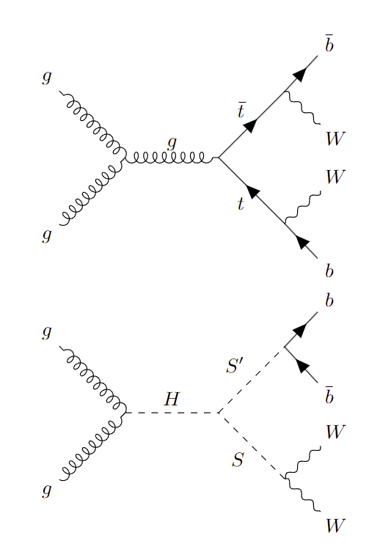
New Physics in Top-Quark Distributions
ATLAS analysis normalized to the total cross section
  only sensitive to the shape
  of NP
  NP at small angels can explain deficit at large angles
Associated production of new scalars decaying
to WW and bb has a
top-like signature
Related to the 95 GeV and 151.5 GeV hints?

Slide 15
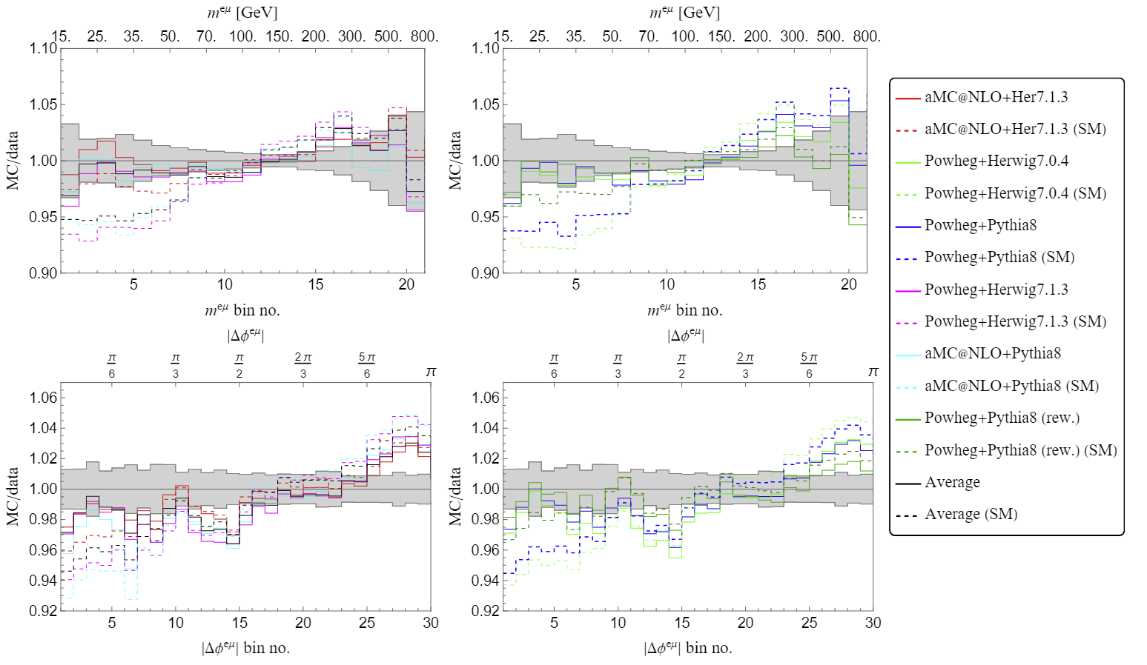
Simplified Model: H→SS’→WWbb
2308.07953
Fix m_{S}=151.5GeV and m_{S’}=95GeV by the hints for narrow resonances. Weak m_{H} (270GeV) dependence.
Deficit at large Δφ^{eµ} & m^{eµ} explained as well

Slide 16
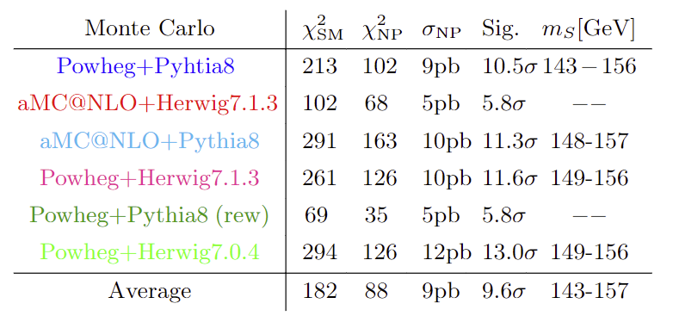
Simplified Model: H→SS’→WWbb
2308.07953
Improvement of SM prediction imperative!
Agreement with data significantly improved (>5σ)

Slide 17
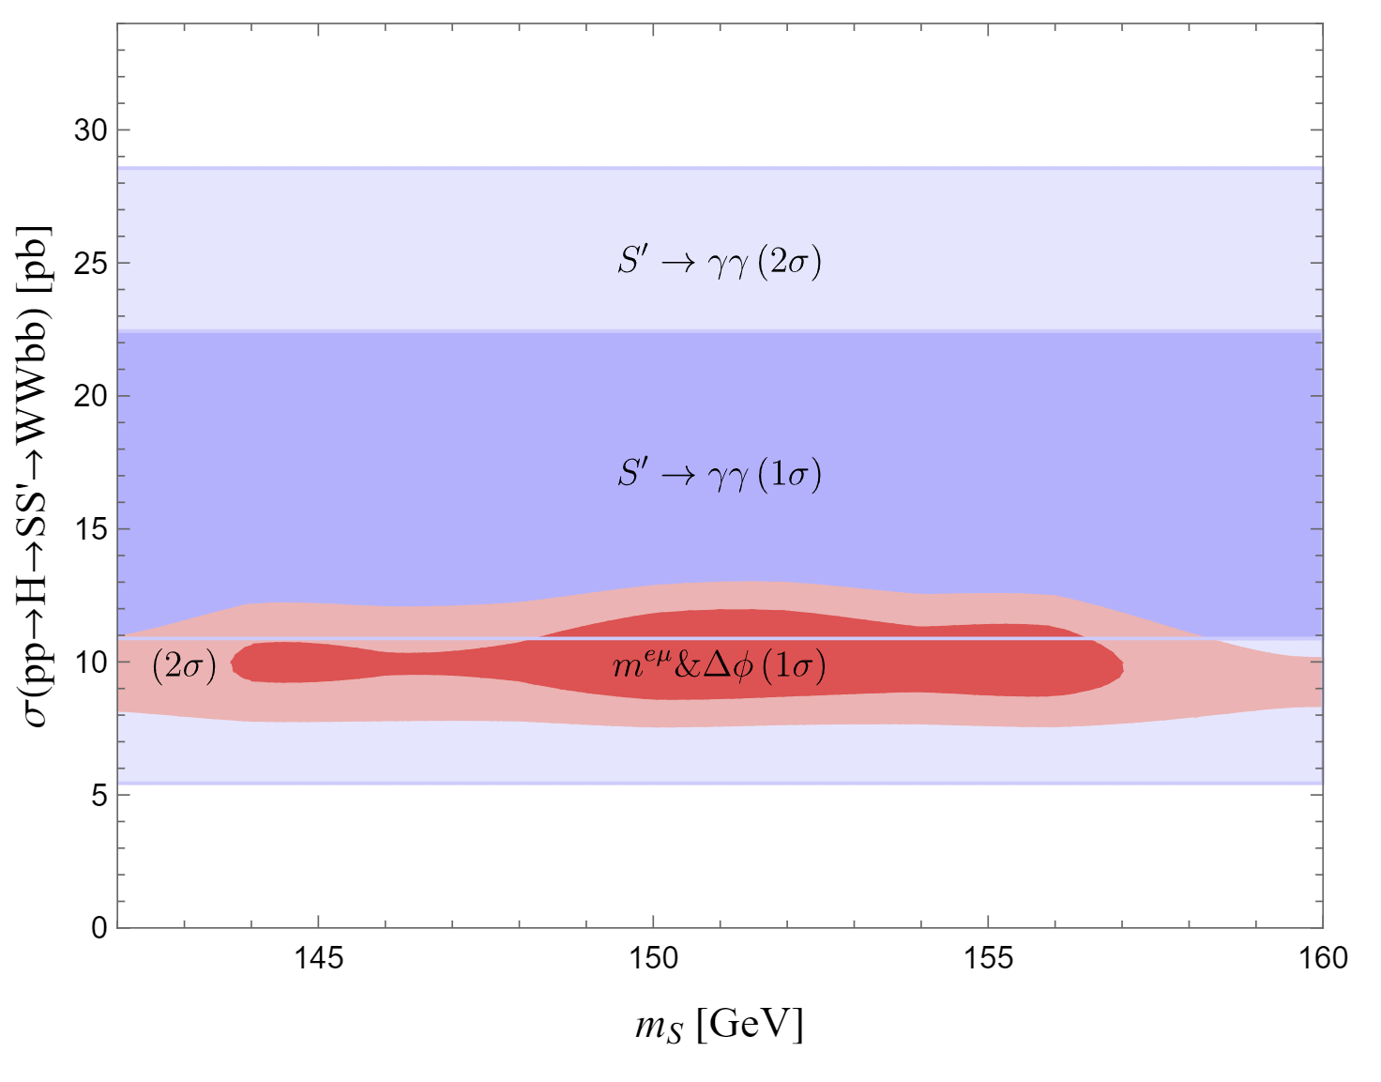
Is 95 GeV a singlet? Relation to 151.5 GeV?
S’(95): Singlet
decays
dominantly
to bb
S(152):
decays
dominantly
to WW
Consistent with 95 GeV γγ signal strength &
a mass of S with 151.5 GeV

Slide 18
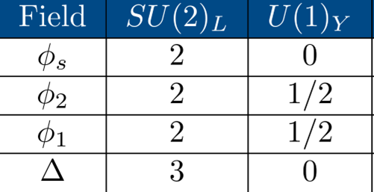
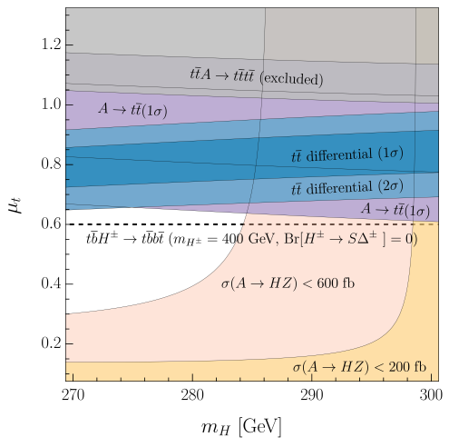
Δ2HDMS and top-quark production
G. Coloretti, A.C. and B. Mellado, 2312.17314
1
Explains:
Top-quark differential
distributions
Di-photon excesses
Resonant top-quark
production Elevated
4-top cross section
Combined explanation possible

Slide 19
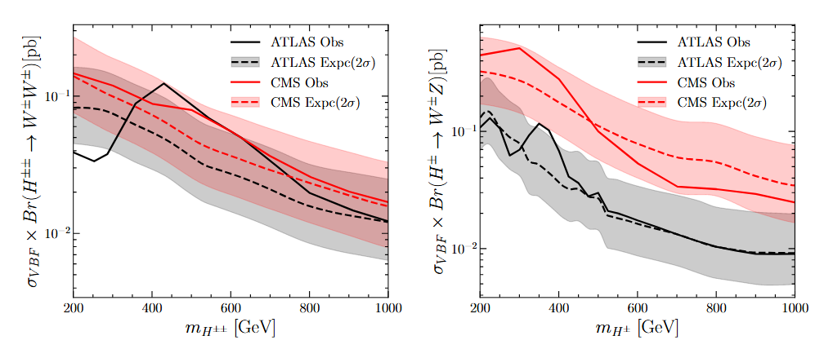
Generic Georgi-Machacek Model
SM extend
SM extended by a Y=0 and a Y=1 triplet
Vevs of the triplet can be sizable due to cancellation in the W mass -> sizable vector-boson fusion
Excesses in same-sign WW and ZW

Slide 20
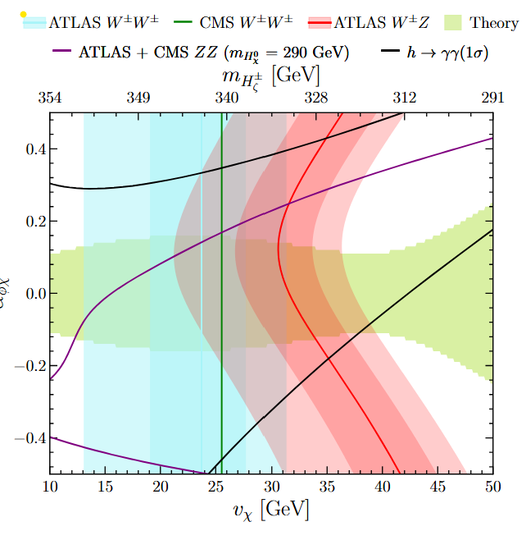
Generic Georgi-Machacek Model
Can explain WW, ZW and γγ

Slide 21
Conclusions
Hints for narrow resonances at 95 GeV & 152 GeV
Significant tensions in top quark differential distributions (>5σ)
Can be explained by EW scale Higgses
Model independent searches are useful
Provide as large sidebands as possible
Minimum: Give cut-based results
Best case: Provide PDT
Most significant hints for new particles at the LHC

Slide 22
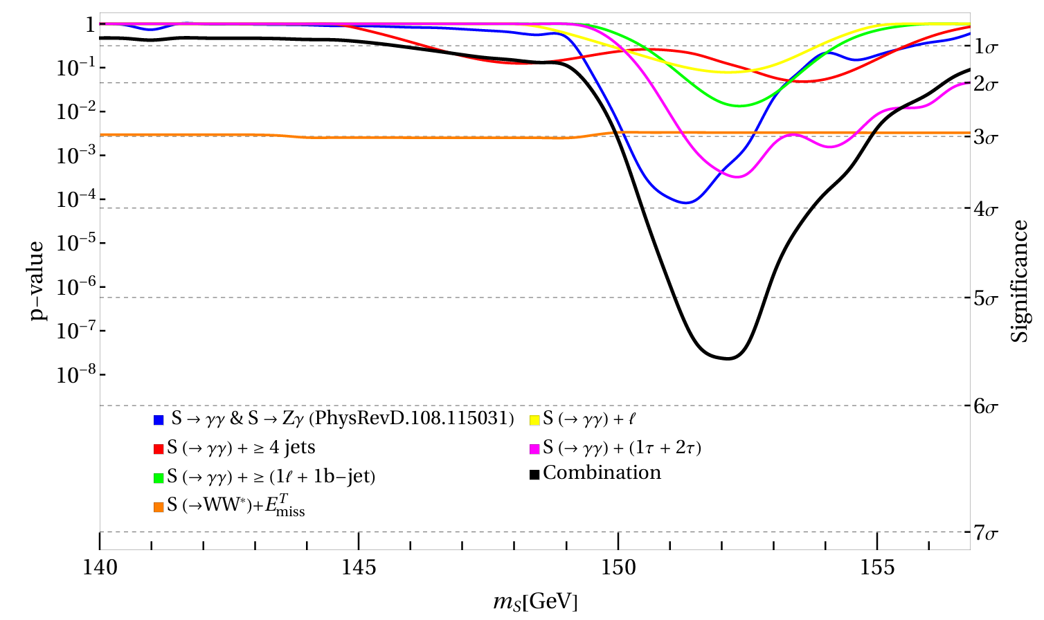
Hints for new Scalars at 152 GeV
Combination within the simplified model
H→SS* with S→WW, MET, γγ
preliminary
>5σ global significance for simplified model

Slide 23
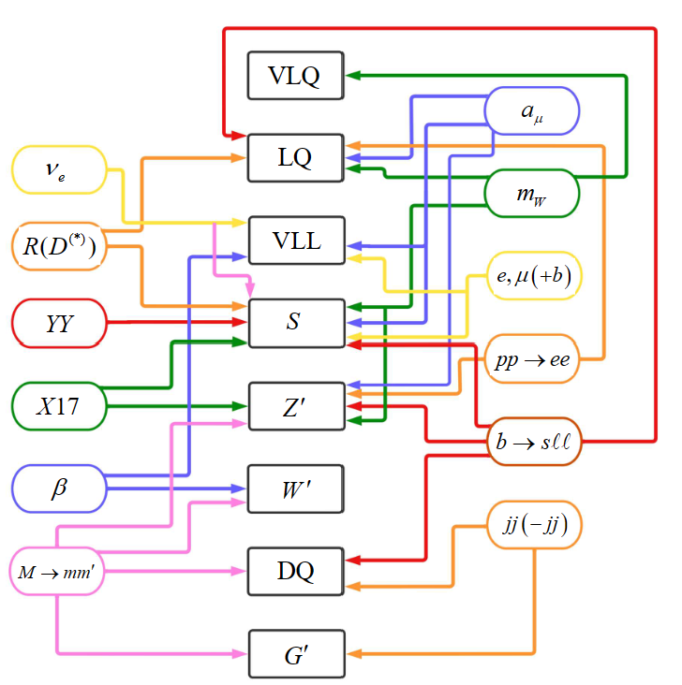
Outlook
Intriguing
anomalies
emerged in
the last years
which point
towards
new
particles
The Standard Model is crumbling

Slide 24
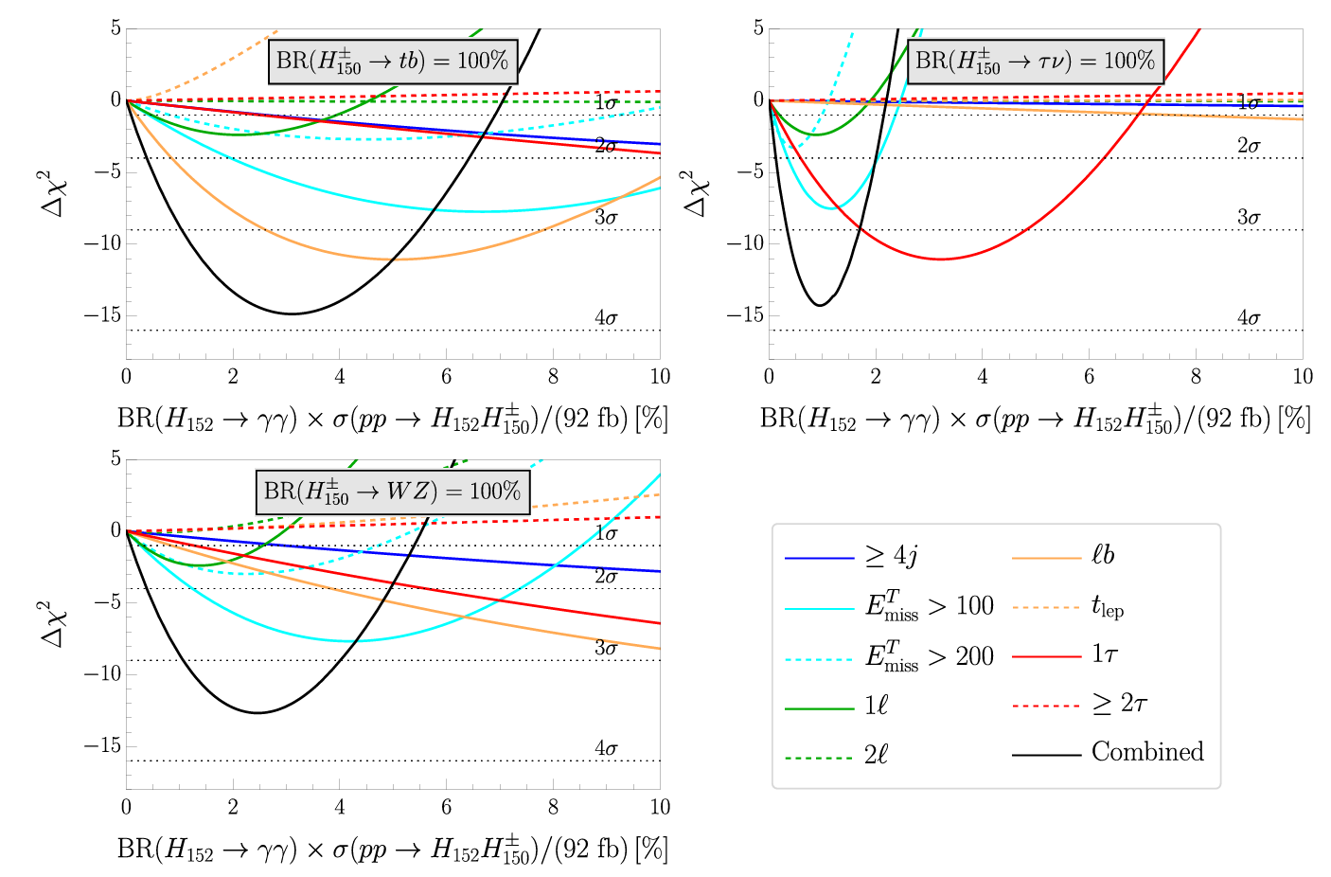
Simplifed Model Analysis
S. Banik, AC, 2407.06267
Triplet or Doublet?

Slide 25
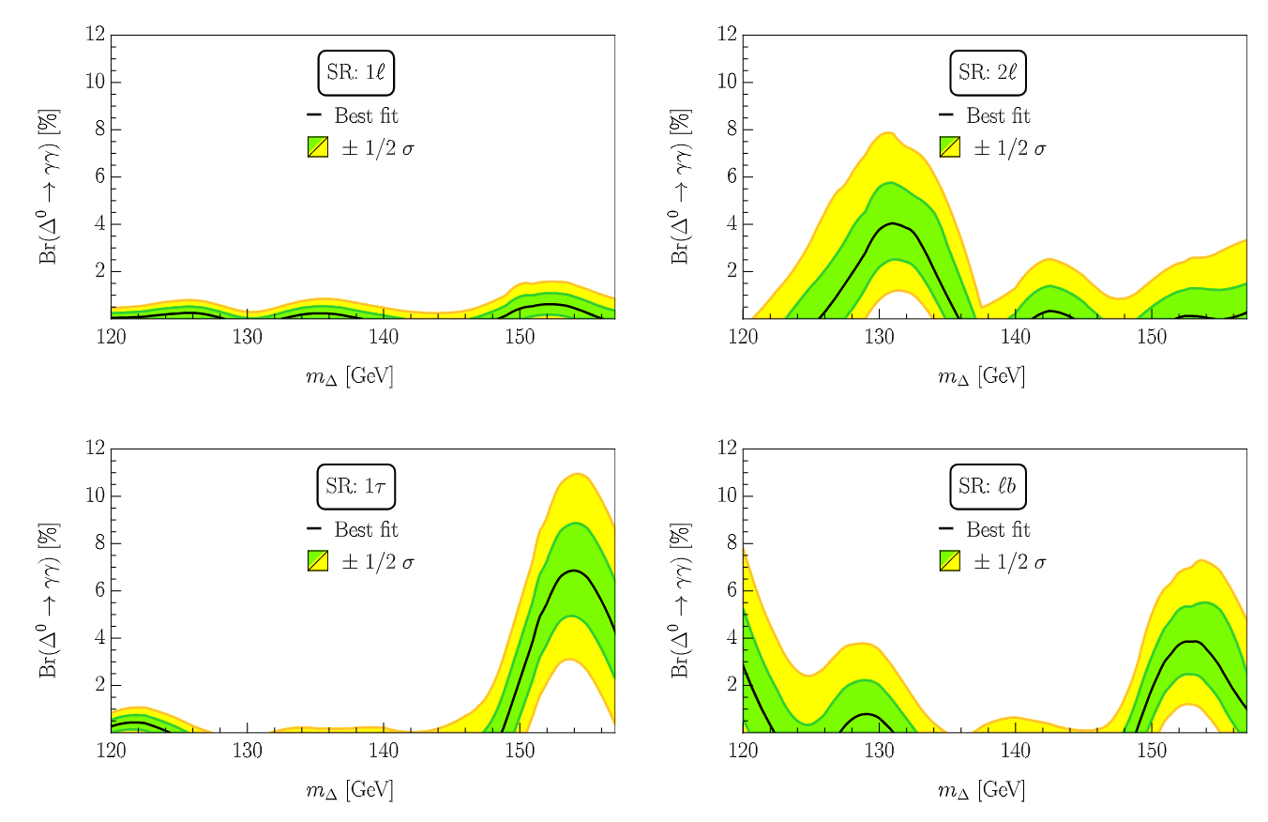
h→γγ+X from ATLAS
S. Ashanujjaman, S. Banik, G. Coloretti, A.C. S. P. Maharathy,
B. Mellado, 2404.14492
Triplet consistently explains h→γγ+X excesses

Slide 26
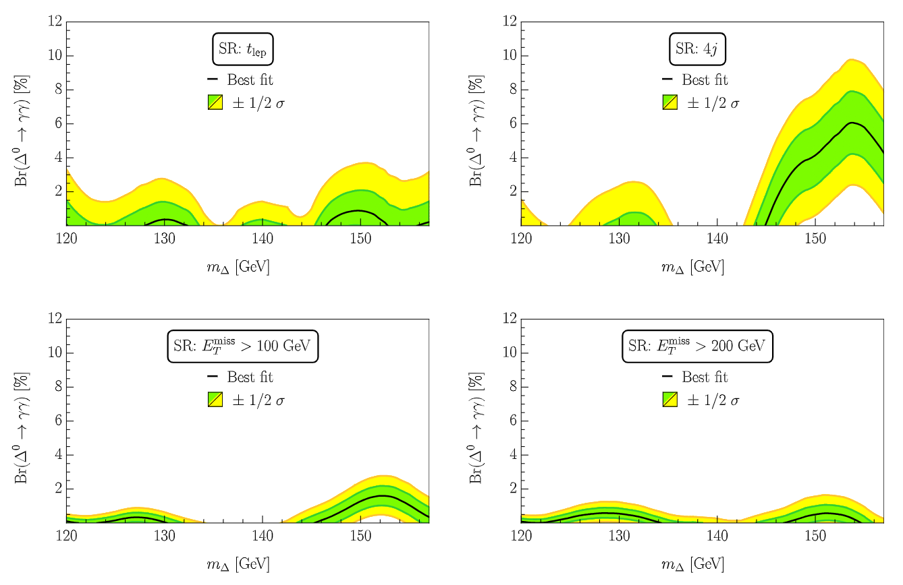
h→γγ+X Channels
S. Ashanujjaman, S. Banik, G. Coloretti, A.C. S. P. Maharathy,
B. Mellado, 2404.14492
Triplet consistently explains h→γγ+X excesses

Slide 27
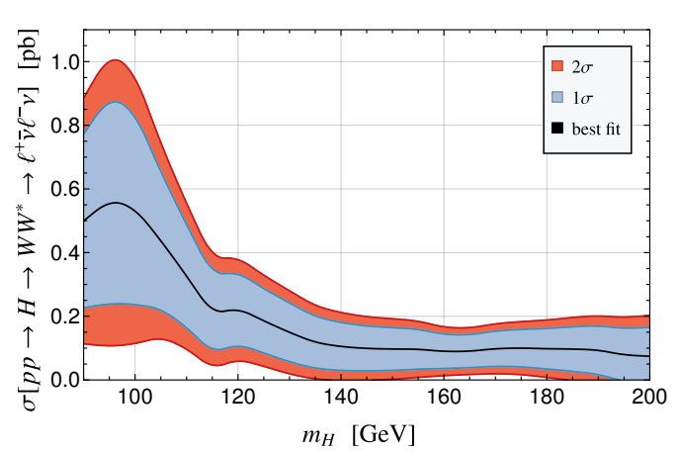
Low mass WW resonances searches
ATLAS and CMS combination
New physics effect preferred over the whole range
G. Coloretti, AC, S. Bhattacharya,
B. Mellado, 2302.07276
Transverse mass
sensitive to
additional
missing energy
from associated
production
Related to 95GeV and 151GeV?

