Slide 1
HEP/HPC Strategy Meeting
All Regions
Maria Girone, Tommaso Boccali
30 January 2025

Slide 2
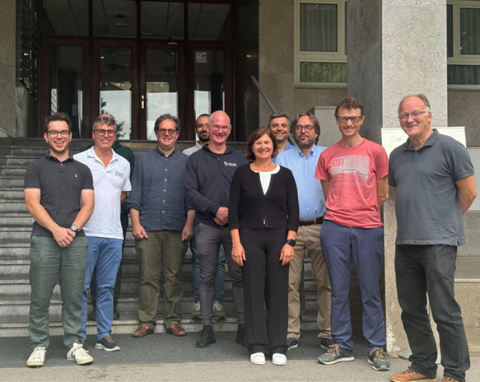
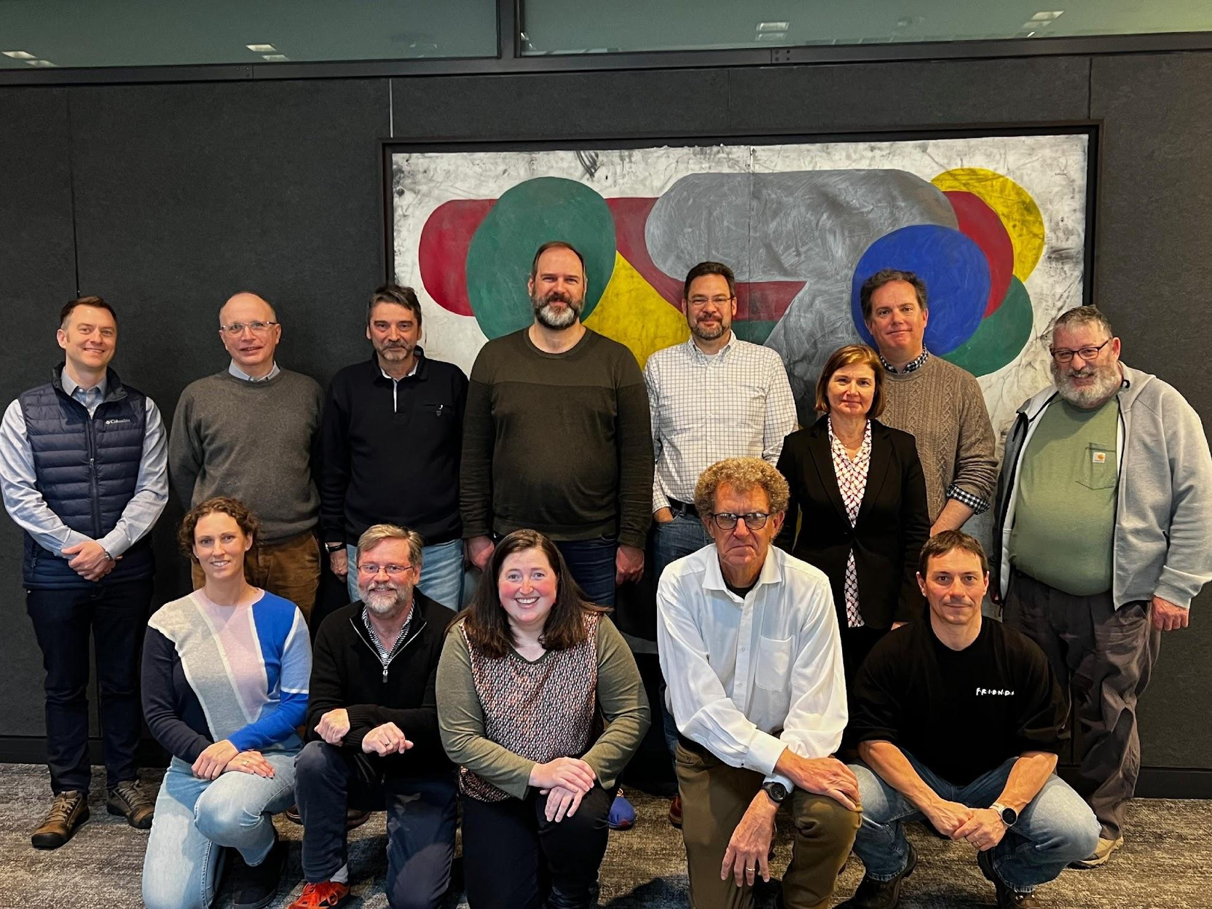
Welcome and Goals of the meeting
Welcome to this HEP/HPC Strategy meeting
  This initiative has as primary goal to bring together HEP and HPC sites experts to discuss technical challenges on HPC integration and related initiatives
    We aim at writing a white-paper
It started with small group of people (HPC experts from HEP and resource providers) starting a dialogue on HPC integration
  USA-region, January 2024, New York
  EU-region, September 20024, Ljubljana
The interest and engagement has grown (80 registrants)
This part edit by "Insert > Header and Footer”

Slide 3
Motivations
High-Performance Computing (HPC) presents a transformative opportunity for HEP
  Modern HPC systems, with exascale capabilities and advanced hardware like GPUs and AI accelerators, offer computational power that could help supporting future HEP activities besides WLCG
  To make use of this opportunity we must Strengthen HPC Partnerships and enhance collaboration:: Deepen collaboration with EuroHPC-JU, national HPC providers (EU, US, Asia), and align with evolving AI-focused and exascale plans. Secure long-term resource allocations and harmonize strategic priorities.
Fully harnessing this power requires significant adjustments to current computing workflows
  Applications & Software: Redesign HEP software for accelerated architectures (e.g., GPUs) and develop compatibility libraries, unified programming models, and access to heterogeneous processors.
  Software Distribution: Maintain effective distribution of HEP software (via CVMFS) with sufficient connectivity at HPC nodes or edge services.
  Data Management & Access: Ensure robust data and metadata handling (Rucio/Dirac/FTS) for large-scale processing and AI workloads, identity federation and trust
  Security & Federated Infrastructure: Develop interoperable, federated solutions to connect HPC resources with major HTC/Cloud/Storage environments, supported by standardized AAI (e.g., eduGAIN).
Industry’s focus on AI algorithms and lower-precision calculations poses challenges for HEP’s classic high-precision calculations
  strategic collaboration between HEP, industry and HPC communities is needed to ensure HEP needs are met

Slide 4
Objectives
Strengthen HPC Partnerships
Deepen collaboration with EuroHPC-JU and National HPC resource providers (from EU to USA and Asia)
  EuroHPC is focussing on AI Factories besides two Exascale systems
  EU post-exascale plan being revisited to to the AI-factories re-prioritization ?
Align strategic priorities with HPC and AI facilities providers
Secure long-term resource allocations
Enhance Collaboration
Foster communication among WLCG, CERN experiments, groups, and initiatives
Ensure effective utilization of HPC resources through shared goals and alignment
Actively participate in HPC user groups, coordination boards, and steering committees, to influence decisions and stay informed about the latest advancements and opportunities
Respond to (Euro)HPC and national HPC access opportunities——while building internal expertise to position HEP as a key candidate for "strategic access."
Support CERN experiments, groups and departments by deploying testbed resources, both on-premises, hosted at HPC centers, cloud-based, enabling the development and testing of accelerated architectures

Slide 5
Initiatives
EuroHPC JU - EuroHPC JU is a joint initiative between the EU, European countries and private partners to develop a World Class Supercomputing Ecosystem in Europe.
  Explore similar initiatives in USA and Asia
EuroHPC Federation Platform - Led by CSC to develop the Federation Platform to provide users with a single access point to current EuroHPC supercomputing resources and in the future EuroHPC AI Factories and quantum computers.
EC-funded project SPECTRUM - SPECTRUM unites leading European science organisations in HEP and Radio Astronomy together with e-Infrastructure providers to formulate a Strategy for a European Compute and Data Continuum.
US initiatives on HPC, including IRI- DOE's Integrated Research Infrastructure from ASCR, NSF initiatives
Joint ECFA-NuPECC-APPEC (JENA) WG1 on HPC/HTC - addresses the need for discussions on the strategy and implementation of European federated computing at future large-scale research facilities.
Computing WG for the European Strategy for Particle Physics Update (ESPP)
More forward-looking activities:
InPEX (The International Post-EXascale project)

Slide 6
What we need to cover in two short days
WLCG and experiment perspectives
Conclusions and analysis of the first meetings
Update on HPC common initiatives
  EuroHPC JU (including Platform Federation and ARC), IRI, SPECTRUM, JENA WP1
The HPC landscape in Europe, USA and Asia
Report from HPC integration efforts
Path Forward
  including ESPP
AND WE NEED TO LEAVE TIME FOR TOMORROW’S DISCUSSIONS!

Slide 7
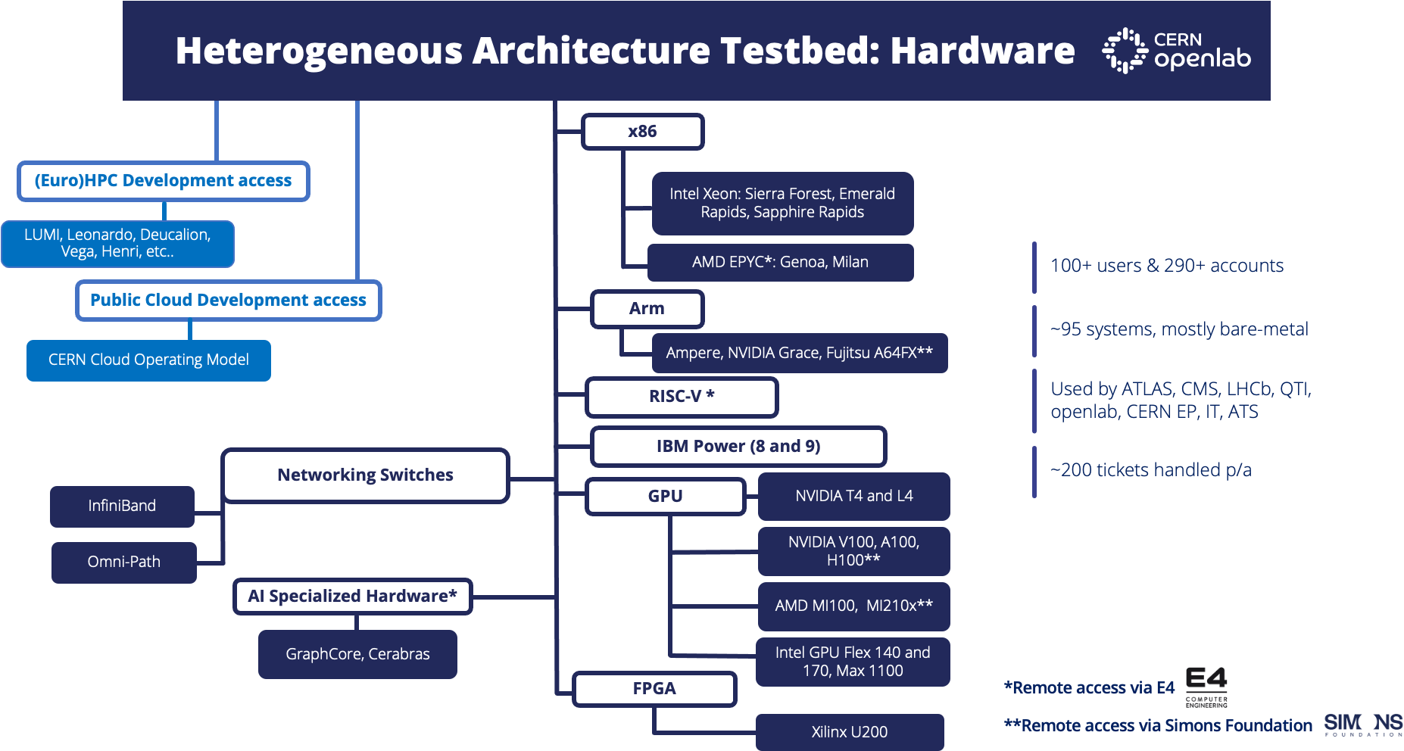

Slide 8
Housekeeping
Talks are short, discussions are needed, and there is allocated time tomorrow
respect time (it includes a few questions)
Coffee breaks, this evening social drink and tomorrow’s lunch will be located outside the cafeteria (go down the stairs near the auditorium)
We have a limited number of seats for a visit to the CMS experiment on Fri, leaving CERN ~ 4 pm and getting back 6:30 pm or so.
If you are interested, please fill the form at https://forms.gle/6ucDjFTntXBu2euF7 by today.

