Slide 1


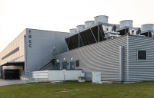



Introducing Jules Verne, toward a common European Exascale project called Alice Recoque
The acquisition and operation of the EuroHPC supercomputer is funded jointly by the EuroHPC Joint Undertaking, through the European Union’s Digital Europe program, as well as by France and the Netherlands.
The project is supported by France under the France 2030 program (Reference ANR-22-ESRE-0001).
Jan 2025

Slide 2




JULES VERNE : the french led Exascale consortium
Organization of the french application
GENCI Hosting Entity
CEA Hosting Site
SURF (NL) as member of consortium
Name of the consortium : Jules Verne
Name of the supercomputer : Alice Recoque
Full TCO over 5 years : 544 M€ (50% EuroHPC, 50% consortium)
French public contribution (MESR, France2030…)
  French research institutions (ONERA and IFPEN – under finalization)
  Industrial partners
  NL contribution

Slide 3
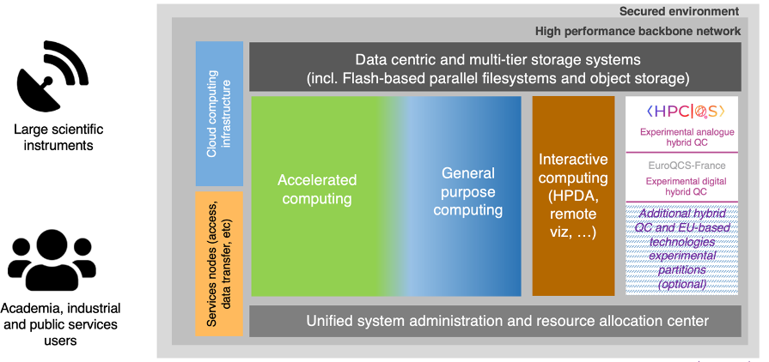
Alice recoque architecture overview
RISC-V ?
Cryo/ neuromorphic computing ?
Immersive cooling ?
Photonics ?
DNA storage ?
>1000 qubits or pre LSQ ?
HPC and AI

Slide 4

Some Challenges to face
    Power efficiency (Gflop/W) as technology target ➔ Compute power based on accelerators
    Need to port / optimise applications on GPUs
    Coupling of numerical simulations and Artificial Intelligence
    Energy to solution (EtS) taking over Time to solution (TtS)
    Need for new metrics and insights
    Energy aware algorithms
    Involvement of the scientific communities before the arrival of Alice Recoque supercomputer
    Participation in the preparation of the benchmarks
    Setup of »Contrat de progrès » for porting codes to accelerators
      joint teams between HPC vendors, user support teams from HPC centers and application developers
    Need for programming environments and tools (porting to GPUs, profiling, use of mixed precision…)
    Setting up an Application Support Team for the entire lifetime of the supercomputer
    Skills as important as the machine for the rise of Exascale

Slide 5


TIMELINE FOR ALICe recoque procurement
Selection Hosting Entities Exascale
June 2023
Exascale call for tender
Q3 2024 – Q3 2025
Exascale system in production at TGCC
2026+
Tender procedure driven by EuroHPC with Jules Verne Consortium
Delivery, installation and production for 5 years

