Slide 2
HPC / Slurm Clusters at CERN
Nils Høimyr, Ben Jones on behalf of the HPC team in IT/CD

Slide 3
High Performance Computing (HPC)
CERN local context
Motivation: Address needs of parallel MPI applications and use cases that do not fit the standard batch High Throughput Computing (HTC) model
SLURM MPI clusters as a complement to the HTCondor batch service
Theory and ATS sector main users
  Ref: workshop session 1 and session 2 in 2020 with presentations of applications and use cases
  Restricted HPC service (KB0004975) and user community
Batch HTC under HTCondor (~400k cores) is the main compute service
  Worker nodes with up to 192 cores
  A few “bigmem” nodes (1TB) for special use cases
  Some GPU capacity (T4, V100, A100, H100)
For ML use cases: k8s & Kubeflow

Slide 4
User Community
ATS | Plasma Simulations for Linac 4 Beam Simulations for LHC, CLIC, FCC… Xtrack, PyOrbit etc Picmc Gdfdl (field calculations for RF cavities) Field calculations (CST…) Engineering (Ansys and Comsol)
TH | Lattice QCD simulations
HSE | Safety/Fire simulations (FDS, OpenFOAM)
EN | CFD (Ansys-Fluent, OpenFOAM)

Slide 5
HPC MPI Clusters - Hardware
We have 4 Infiniband clusters, each on different Slurm partitions:
2x 72 nodes, with 2x Xeon® CPU E5-2630/20 cores (40HT), Infiniband FDR
(partitions “inf-short” and “inf-long”
72 nodes with 2x AMD EYPC 7302 32 cores, Infiniband EDR
(partition “photon”)
80 nodes with 2x Xeon® Gold 6442Y – 48 cores (96HT) Infiniband HDR
(partition “muon”)
All nodes with shared CephFS file system /hpcscratch

Slide 6
HPC – Software and OS
Clusters now running EL9 Linux (RHEL 9.5)
Slurm 23.02.07
MPI versions via modules
  OpenMPI 316 and 411 (4.1.6 now also available)
  Mvapich 2.3
Same software and OS packages and LxPlus and LxBatch for compatibility
  Also CVMFS mounts etc
  Try to maintain the same compute environment across these platforms to provide consistency to users

Slide 7
HPC Batch cluster – user environment
Login / submit node: “hpc-batch.cern.ch”
  Users’ home and scratch directories on the /hpcscratch file system (CephFS)
  AFS and EOS are available, similar to LxPlus
  Applications on AFS or CVMFS, (also local or EOS)
  EOS for data copy and project storage
SLURM for HPC scheduling
  Jobs typically run unauthenticated (run times up to several weeks)
  Submission with Kerberos token supported via Auks, for copy back to EOS

Slide 8
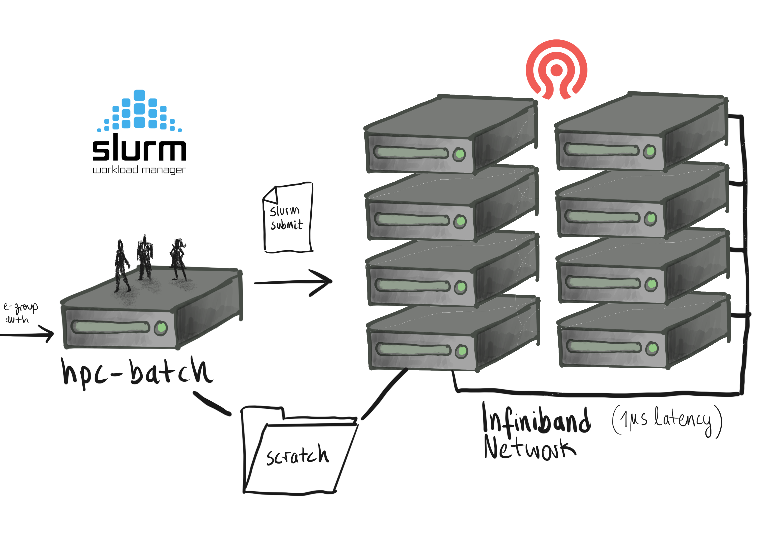
Submit node
Users compile their jobs against the MPI distribution they choose using the appropriate module ie:
module load mpi/openmpi/4.1.6
Users launch their jobs, check job status, cancel jobs…
Similar to LxPlus, but reserved for HPC
Separate system necessary due to need for shared scratch

Slide 9
HPC – Slurm partitions and queues
Partition Name | Max run time | Main users
inf-short | 5 days | ATS, HSE, engineering
inf-long | 21 days | ATS, HSE, engineering
photon | 10 days | ATS, TH
phodev | 2 hours | ATS, TH
muon | 10 days | ATS, TH
mudev | 2 hours | ATS, TH

Slide 10
CephFS Scratch File System
Home directories for users: /hpcscratch/user
Project areas: /hpcscratch/project
Slurm run-time bitmap: /hpcscratch/statesavelocation
The shared filesystem is located on the Ceph cluster “Jim” managed by the Ceph team in IT-SD
TH/QCD also have a CephFS mount: /hpcqcd
cf CephFS documentation and relevant Storage talk

Slide 11
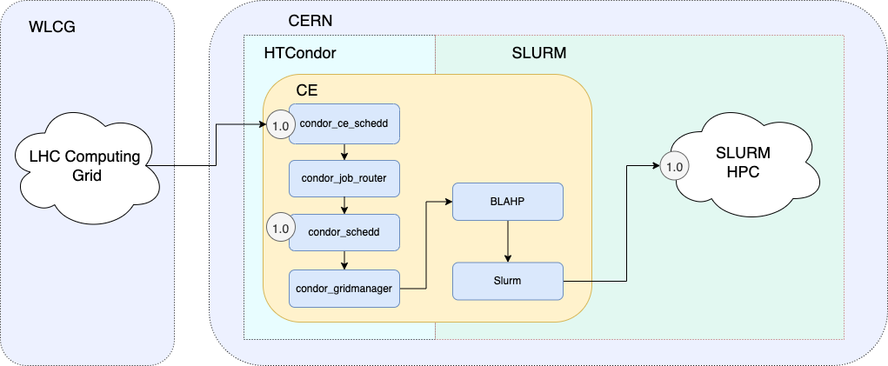
HPC Backfill
To Maximize use of HPC resources, nodes not allocated to multi-node MPI user jobs are backfilled with WLCG grid jobs
  htcondor-ce “cehpc.cern.ch”
  User HPC job will preempt backfill job (SIGCONT & SIGTERM ; 5 mins ; SIGKILL)

Slide 12
External HPC Pilots
Cloud partition (2021)
  100 workernodes on Azure added s a Slurm partition, fully integrated in the cluster (including the shared file systems)
  Implemented Express Route to Azure/Amsterdam and batch/cloud integration on the previous CERN MS Azure contract
EuroHPC VEGA:
  Benchmark/dev grant during 2021 used by a few TH and ATS users
  Procedure with ssh keys and external accounts barrier to entry for regular CERN users.
    (Should be noted that users in ATS & TH who regularly run on HPC centres are more used to these technical details)

